Slide 1
One to one conversations to Identify Self-Interest
The Essential Organizing Conversation
Notes:
liz

Slide 2

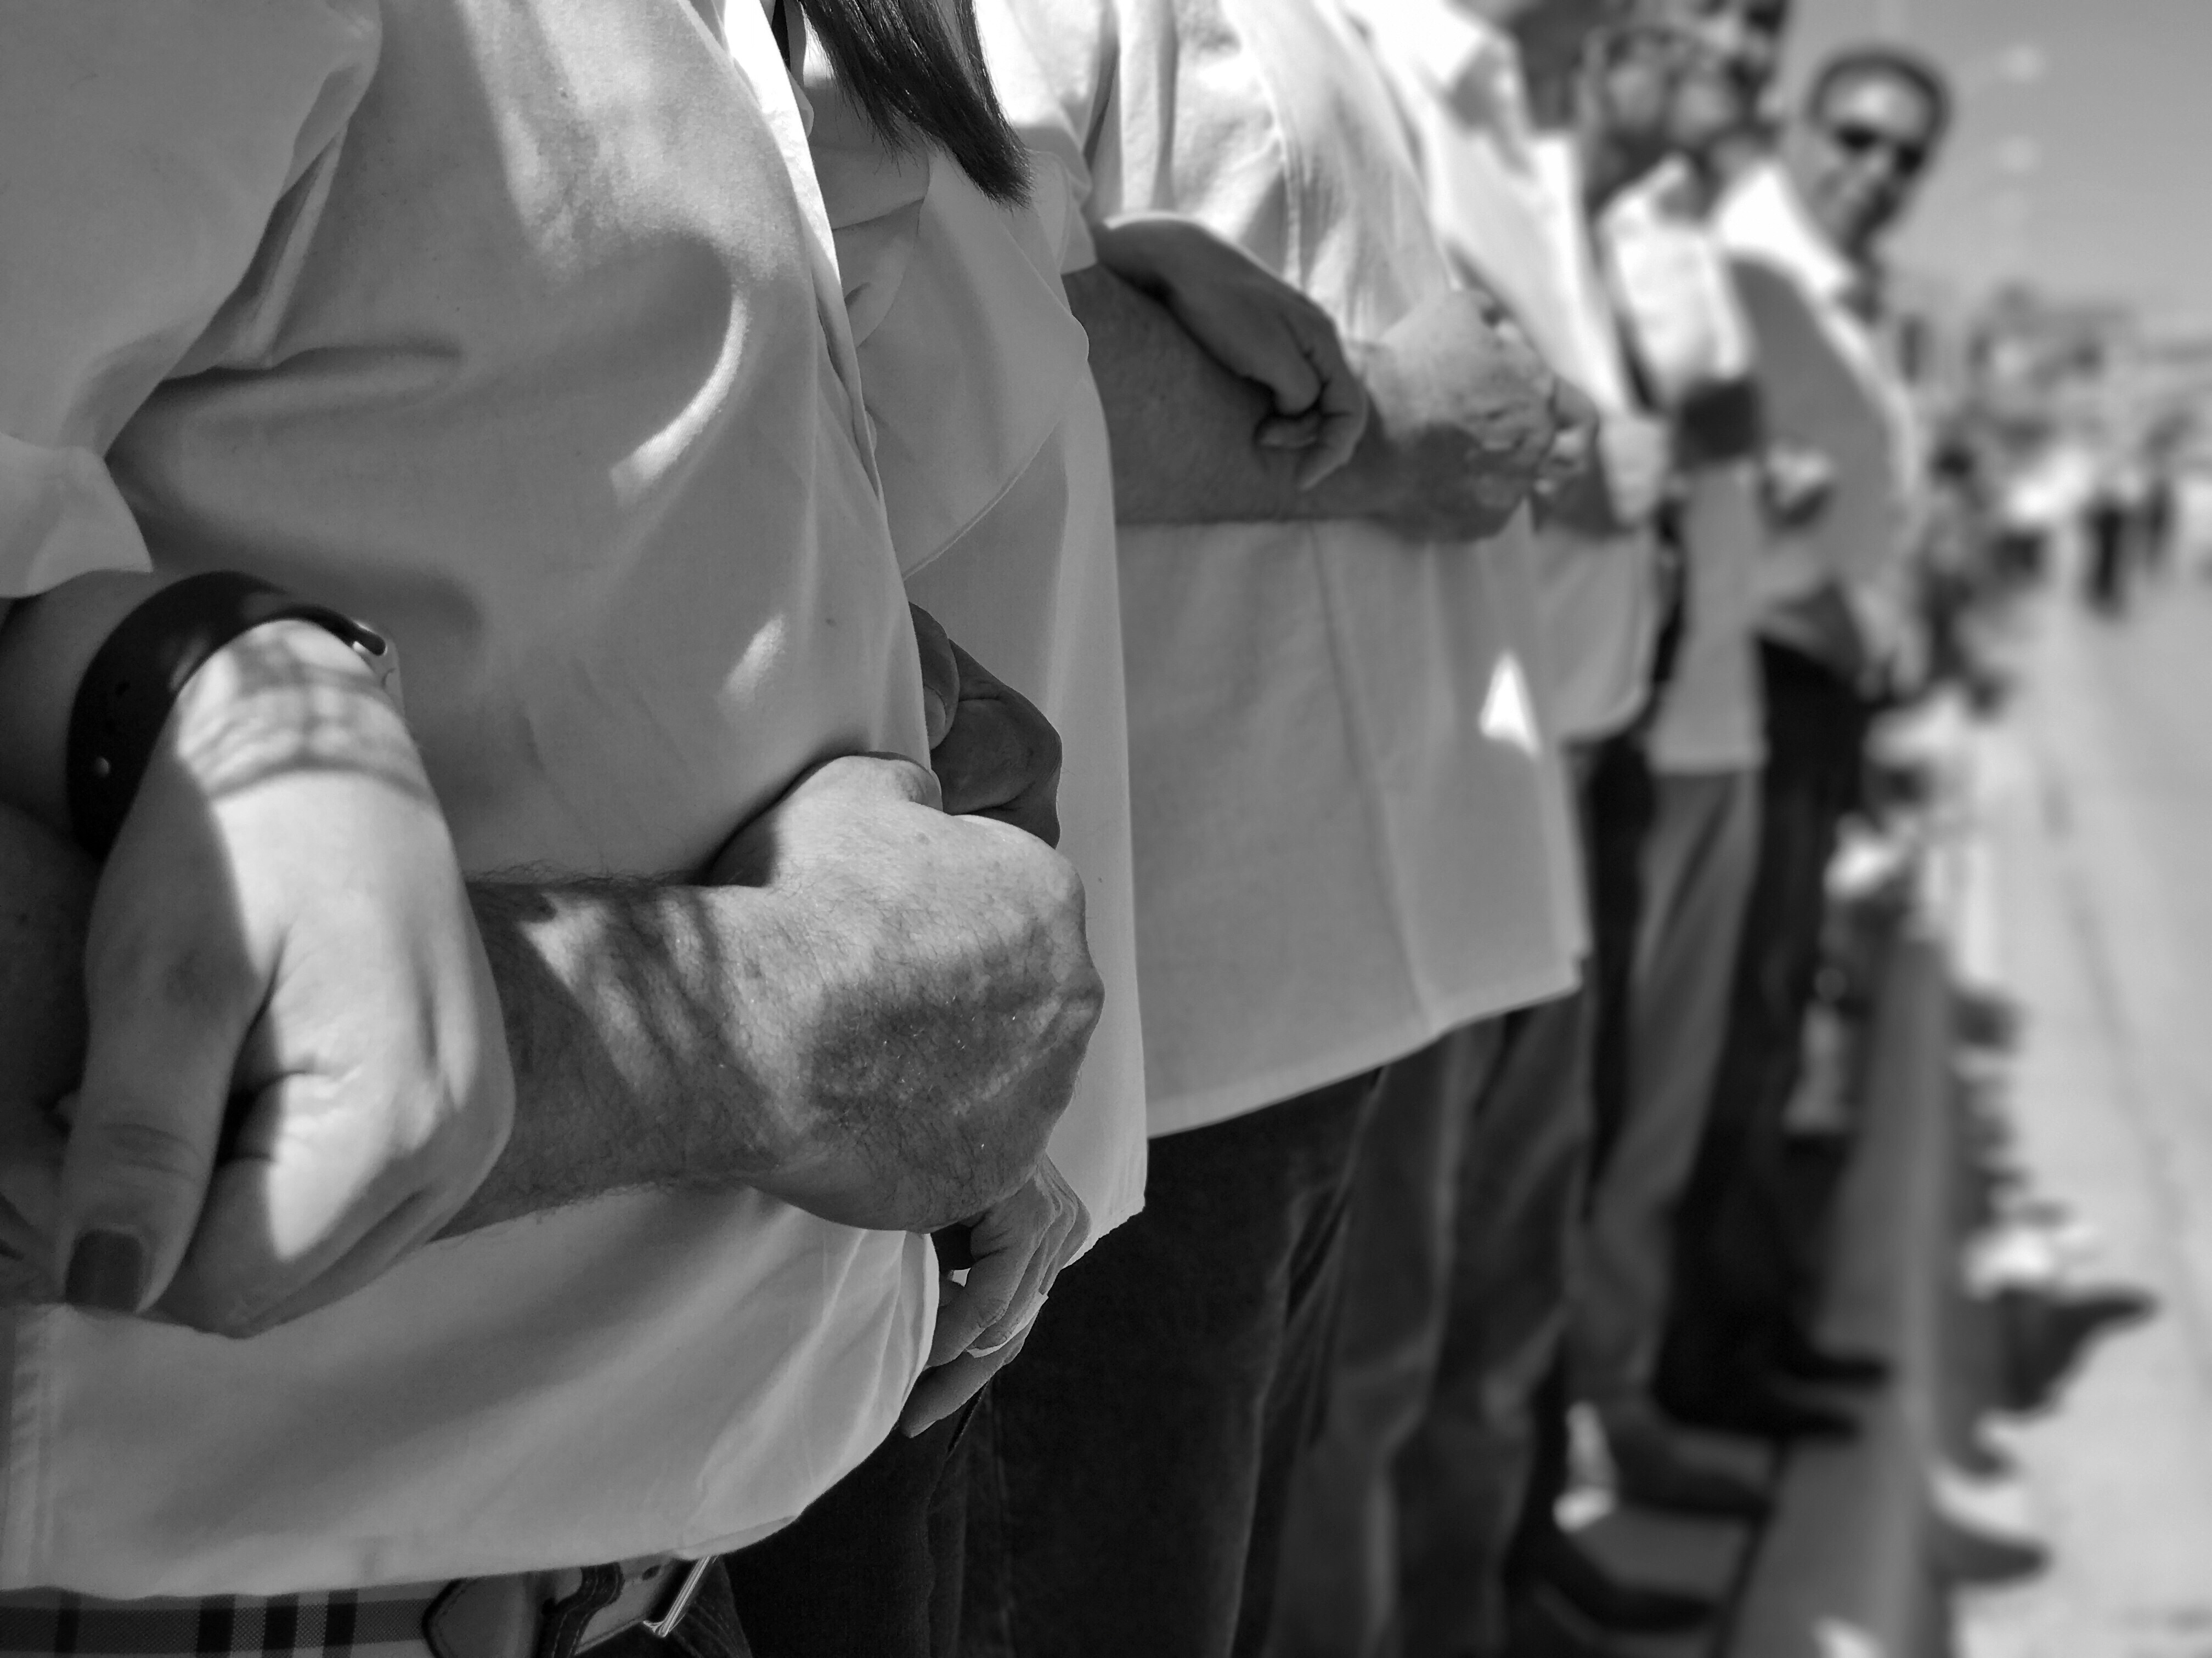

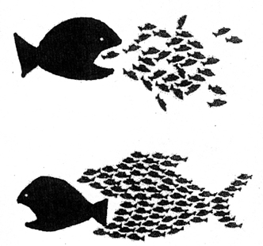
Why Do We Have 1-on-1 conversations?
Build relationships
Build power
Make change happen
Notes:
Everything in our society is built to inspire individuality. For instance, my handy-dandy iPhone. The i stands for individual. I have everything in here personalized to me…ringtone, contacts, music, apps, the case, etc. My iPhone is not the same as anyone else’s in this room. Instead of having a family desktop computer or TV where everyone has to resolve sharing the time on the device or talk about/agree on what to watch, we have our own tablets, laptops, etc, our own personalized streaming devices. This is where we are at as a society. The focus on the individual pushes farther and farther away from the power of the collective.
What is power? How does building relationships, build power?
GOLDEN RULE – Never do for others what they can do for themselves. You strip them of power when you do. When people have a charismatic leader who does all their thinking they become dependent. They become passive and lack initiative. 1:1s are about helping our colleagues get that power back and, in doing so, building power.

Slide 3






What is a 1-on-1?
Notes:
Liz--1-on-1 is an intentional conversation to build a relationship. Goes deeper than asking how your kids are.
An intentional, in-depth conversation that builds a relationship. It challenges people to examine their core values
A 1:1 conversation
Builds a relationship
Establishes transparency and trust
Is honest
Gives you information you need about where the person is now and whether they can get to where you think they can be.
Organizing is a fancy work for building relationships. If we want to organize we don’t sell an idea. What we do is find out a person’s interests and dreams. We kindle their imagination, stir the possibilities and propose some ways they can act on those values.
You need to meet the member where they are at. If you stand where you want them to be and shout for them to come over to you, it won’t work. You need to get into their space, see what world they live in, and then see whether you can help them change their perceptions in order to see things your way.
There is an art and a science to do a 1:1. We will give you the technical skills here today and you will develop your own style to reach the goal and purpose of a 1:1. No one is perfect, you only get better over time with more and more practice.

Slide 4
Who are you?
Religion / Faith
Family and Friends
Education
Hidden Talents
Experiences
Sexuality
Health
Hobbies
Politics
Race
Success and Failure
Career
Fun Facts
Interests
Role Models
Gender
Talents
Growing up / Community
Partner / Significant Other
Notes:
Butcher Paper of Stick Figure
Lots of things in common in the room, what bonds us together? Translates to what we care about, helps us identify shared values.

Slide 5
LAVA: The Organizing Conversation
Listen
Agitate
Vision
Ask
Notes:
Give folks a hand out of the six parts and have them mark each piece as facilitators model a 1:1

Slide 6
Introduction

Slide 7

Simple but important
Who are you in relation to them?
How can you be of service to them?
Why should they talk to you?
Notes:
Two different intros…
You have a relationship vs. new members or staff

Slide 8
Getting the story

Slide 9

Getting the Story
Story of Self
Finding their Story
Notes:
-Connecting shared values
Why do we do this? Why is this important? – Popcorn
Facilitate what the room defines as: Selfish/Selfless/Self interest. We are looking for MUTUAL self-interest
Self-interest is what compels individuals to engage in the work of organizing. What is it about a cause that speaks to you? What is at stake for you personally if nothing changes? That is your self-interest.
Our culture conflates self-interest, selfishness, and selfishness, but do not be fooled. If you believe that you should live only to serve others, that it is wrong to have a self-interest in your work and organizing, you are participating in your own oppression. You are denying yourself an active role in creating the world you want, and you are not being fully honest with yourself and your colleagues about your reasons for participating in an organizing movement. If you believe that you should live only for yourself, you are participating in the oppression of others. Self-interest is understanding who you are in the midst of others . . . how you relate to others and how you engage with others in a way that is life-giving and transformational.

Slide 10
Technical Skills
Be courageous and curious
Get their story
80% listen and 20% talk
Ask open-ended questions
Use active listening skills
Notes:
POPCORN AND CHART EXAMPLES OF OPEN ENDED QUESTIONS
Be courageous and curious – you have to be genuinely curious in knowing the person’s story. Have courage to ask questions that help them examine their values.
Get their story – we are all a bunch of undigested experiences – very rarely do we reflect on our experiences on a regular basis. By asking them about their experiences you are helping them to clarify their story…sometimes even find meaning in what they are doing.
80% listening and 20% talking – this is NOT an interview. It is a relational, genuine conversation. The 20% of the talking you are doing is sharing your story where its appropriate and finding common ground. Listen for concerns an issues. Need to build trust so they open up and share their story.
Open ended questions – don’t get trapped asking yes or no questions. If you do ask them, you most likely will need a follow-up questions. Let them talk and you guide the conversation.
Active listening – eye contact, body language, etc.

Slide 11
Agitation
Notes:
Liz

Slide 12
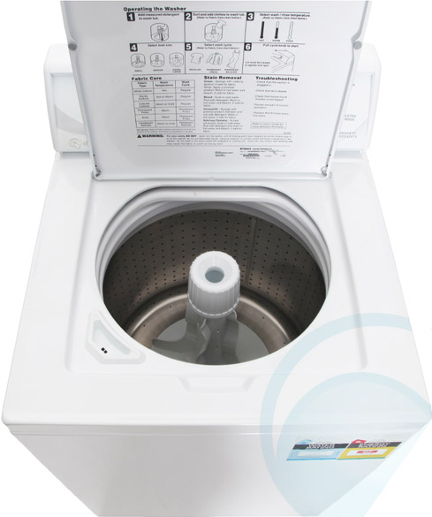
Notes:
This is an illustrative part of the training, to really get them to think of themselves as working like the center post in the washing machine. And what is the job of the center post? To get the dirt out!
We all have dirt that prevents us from doing what we are called to do
We all need agitation
It is a form of intentional investment
It is an act of love
Grounded in a relationship
Self interest based (Issues that they care about)
Series of questions: Do you think…
Followed by:
What do you need to do?

Slide 13

Connecting with anger
Anger = the appropriate response to the violation of our values
Remember to connect your own anger to the other person’s anger.
Move them from inaction to action
If that person is stuck, it’s our job to get them unstuck. Remember the job of the agitator is to get the dirt out
Notes:
rooted in relationship
Righteous Indignation
Turn anger into action

Slide 14
Union vision

Slide 15

Union Vision
A union vision should relate to a member’s issues and be specific, concise, inspiring, and about power.
Notes:
If agitation elicits anger, vision elicits hope.
what do we stand for?
We want all members in solidarity.
Plan to win

Slide 16
Inoculation education

Slide 17
What do we need to share with them?
Address fear
Prepare them for what is ahead
Notes:
Ashley
Examples
Nothing will ever change so why bother?
My supervisor will treat me differently/I’m afraid of retaliation. Solidarity is our defense. Know your rights

Slide 18
The ask
Notes:
Move them to action
Test their support

Slide 19
Test The Commitment—make the ask
We are demonstrating how united we are in this effort by signing this statement of purpose. Will you sign on?
If not, why not?

Slide 20
Assessments
1. LEADER – Signs petition, takes responsibility for getting other members involved.
2. ACTIVIST - Participates in union-sponsored mobilizations, sign petitions, and express positive beliefs about the value of unions.
3. MAYBE - fails to take part in actions, consistently raises more questions about the union than the employer
4. NO - Consistently fails to take part in actions, states that he or she is against union’s effort, “yes, buts…” are really just a nice way of saying no.
Notes:
Assess off of action
Where are they now and how to move them
Informs our where we need resources and help
Assessments are not static. Goal of assessment is to move folks

Slide 21
The Organizing Conversation RECAP
Introduction
Listening and getting the story
Agitation
Union vision
Inoculation/Education
Make the ask

Slide 22
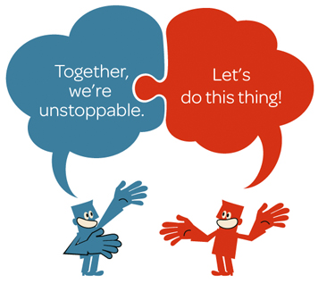
Pair Up!
Notes:
-NOT A ROLE PLAY! You are creating a relationship with someone in the room and going through the conversation.

Slide 23

Overcoming obstacles
AFFIRM
ANSWER
REDIRECT

Slide 24
aar
Affirm
Let them know you’re listening, you understand, and their feelings are valid. Your new colleagues may be scared to speak up or upset by what they’ve heard.
Answer
Give a truthful, concise answer to the question. Do not be evasive or your entire message will be lost.
Redirect
Bring the conversation back to your message.

Slide 25


brainstorm
What objections have you already faced?
What objection do you predict you will face?

Slide 26

Next Steps

