Slide 1
Why Coaching in the Campaign Lab?

Slide 2
What is organizing?
Organizing is a set of leadership practices that include: identifying leaders and coordinating them into leadership teams; building community and commitment around common goals; building power from the resources of that community; using that power strategically to make concrete change in the world.

Slide 3
Organizing is a Framework of Leadership Practices

Slide 4

Power is
  The ability to act (use agency collectively)
  The possession of control, authority, or influence over others preventing or causing action.

Slide 5

Leadership is …
Accepting responsibility(self) for enabling others (others) to achieve shared purpose in the face of uncertainty (action). Leadership requires a decision, a choice, to accept responsibility. It is a form of social interaction, of relationship. It is about achieving “shared” purpose. And its domain is the uncertain.

Slide 6
Organizing Leadership
Organizing Leadership identifies leaders and coordinates them into leadership teams; Builds community and commitment around common goals; Builds power from the resources of that community; Uses that power strategically to make concrete change in the world. Leadership is a form of social interaction, of relationship. It is about achieving “shared” purpose. And its domain is the uncertain.

Slide 7

Key Point
In Organizing, the power and authority are NOT with ONE leader – the power is at the point of individuals using their agency to risk their resources for a shared outcome.

Slide 8


Leaders move people to act.

Slide 9
If…
leadership in organizing is about enabling others to achieve purpose in the face of uncertainty. If leadership requires building teams, risking the co-commitment of resources, and acting strategically to use shared power to achieve shared purpose
- then…

Slide 10
Coaching enables others to build their own capacity to act.

Slide 11
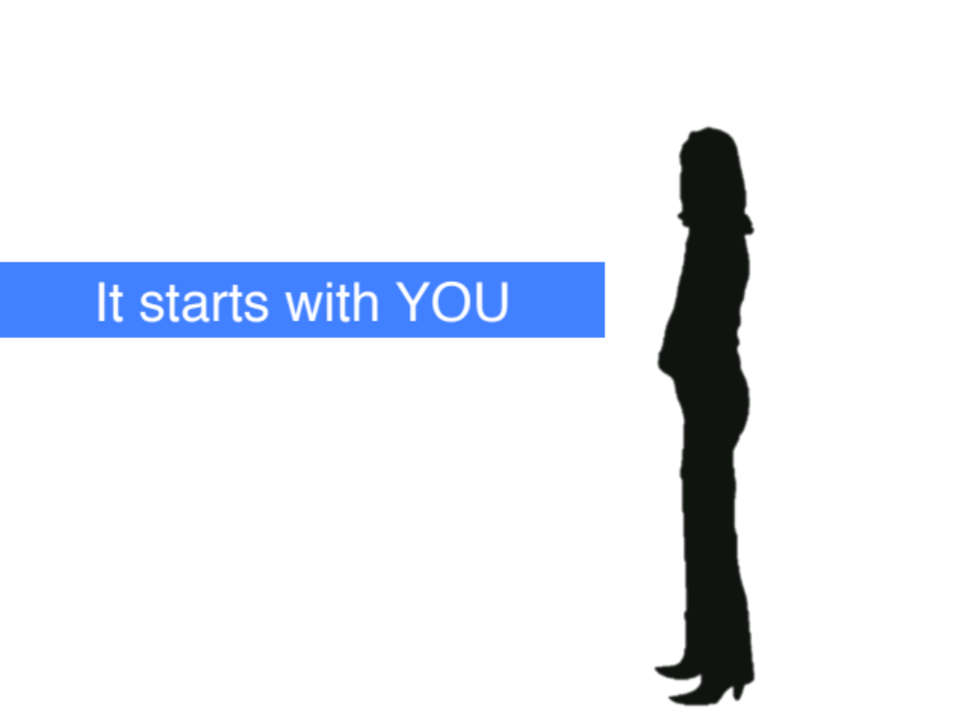
How do we enable?
Remove barriers to the other’s use of their agency- ability to choose to act. We do this by asking what they think they can do to overcome the barriers (coach)
When we direct others in action – this is OUR agency.
When someone defines their goal and uses THEIR agency to move towards it – that builds confidence, power, skills, and trust. We can support the use of agency through good coaching.

Slide 12
Power is
  The ability to act (use agency collectively)
  The possession of control, authority, or influence over others preventing or causing action.

Slide 13
We build leaders who understand power when we coach.

Slide 14
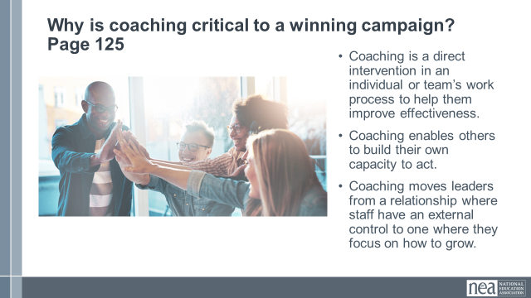
Why is coaching critical to a winning campaign?
Coaching is a direct intervention in an individual or team’s work process to help them improve effectiveness.
Coaching enables others to build their own capacity to act.
Coaching transforms leaders from a relationship where staff have an external control to one where they focus on how to grow.

Slide 15
We Have to Believe that Campaigners Can
Read a political landscape
Assess their potential allies and opponents
“Cut an issue” from a big problem to a set a of winnable (local) demands
Pick fights that will build their base and develop new leaders
Use a tactic sequence to create a crisis for our targets

Slide 16
Campaign Coaching: What It Is & Isn’t
What It Is | What It Isn’t
Helping organizers become strategists and lead powerful local campaigns | Making key strategy decisions for a local group
Supporting strong containers for collective action and shared power | “Answering questions that come up” as an external consultant
Balancing the need to learn and develop skills with running a “live” campaign | Having “catch up calls” without preparing questions to support the group through challenges

Slide 17
Key Point
Coaching is the way we change from a culture of dependence on experts and service to achieve change, to one of the leadership practices employed in organizing.

Slide 18
Basics of Coaching

Slide 19
What is coaching in Organizing?
Coaching is a direct intervention in an individual or team’s work process to help them improve effectiveness.
Coaching enables others to build their own capacity to act.
Coaching transforms leaders from a relationship where someone else has external control to one where they focus on how to grow.

Slide 20
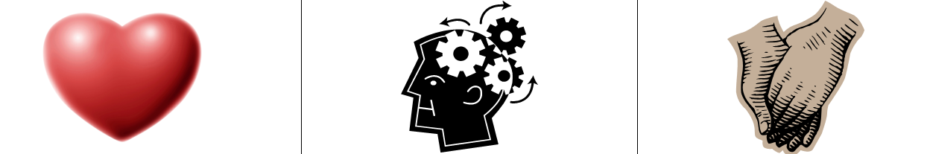
Elements of Coaching
Coaching requires learning to identify a person’s or team’s strengths and weaknesses to help them draw upon their strengths to overcome their weaknesses. People often know what they “should” do. But fresh eyes can help diagnose specific challenges they face while identifying ways to deal with them.
  ●Motivational coaching (heart) is intended to enhance effort.
  ●Strategic coaching (head) is intended to help evaluate how to use resources to achieve outcomes.
  ●Educational coaching (hands) is intended to help acquire information or skills

Slide 21
Coaching Approaches
Corrective
Some coaching is aimed at helping improve poor performance (i.e., the coachee is overall not doing the leadership practice well and needs help getting up to a basic level).
Developmental
Some coaching is aimed at helping the individual achieve mastery (i.e., the coachee does the leadership practice well and is ready to become an expert).
Basic elements of coaching are the same (i.e., motivational, strategic, and informational), but coaching strategies may differ (e.g., consult by asking reflective questions to develop mastery vs. consult by providing expert feedback to illustrate errors in how they are thinking about the task).

Slide 22
Coaching is Not
Giving advice
Since good coaching should take a coachee beyond the limitations of the, coach, leader or mentor’s knowledge it makes sense that your advice shouldn’t be the golden tip. The golden tip is the one that the coachee will realize on their on that is even better than any solution that you could come up with. It is essential to avoid giving advice as a coach.
Leading questions
Leading questions is basically hiding your advice in a question format. If good coaching is all about asking the right question, that doesn’t mean that ending with a question mark can make you get a way with an embedded advice in the question.
Examples:
●Have you tried to do xxxxxx?
●Will xxxx work in your situation?

Slide 23
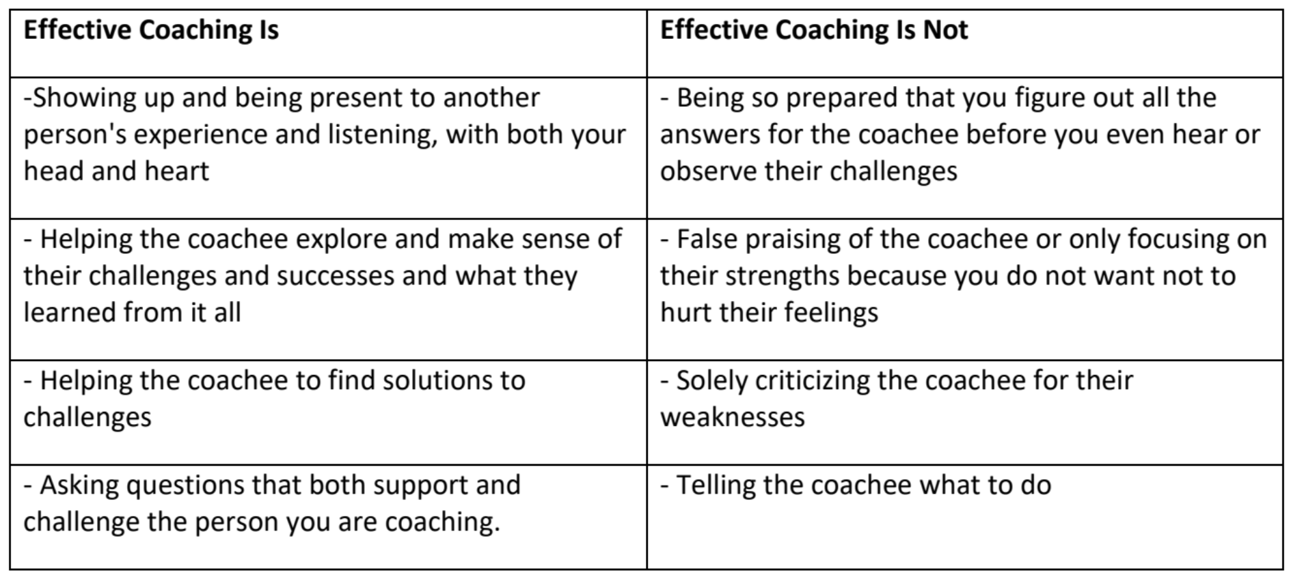

Slide 24
Key Points
Coaching is about releasing your external control and enabling the leader to grow.
Coaching is as much about you changing your behavior and growing your skill as it is about growing a leader.
We only get good at coaching by practicing it.

Slide 25
Structuring of a Coaching Meeting

Slide 26
Initial Coaching Questions to Ask
What do you need me to understand about your identity in this work?
What would you like to know about me that would help you to work with me?
Tell me a story that will help me understand a part of your identity that you feel impacts you in this work.
What might be challenging about us working together?
What can I do to support you when those challenges arise?

Slide 27
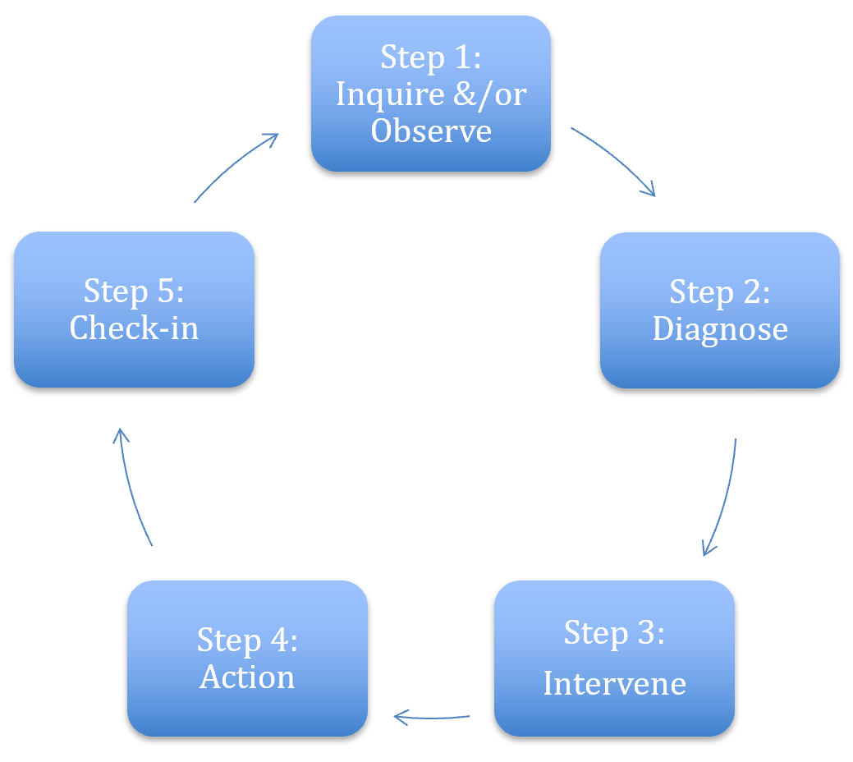
5 Phases of a Coaching Meeting
Step 1 – The Coachee is sharing what they want from their work (their goal) and then they share what is actually happening (Reality)

Slide 28
Coaching Meeting
Step 2 – You pick one of the three diagnoses
Motivational - Heart Coaching aimed at enhancing motivation
Strategic – Head Coaching aimed at helping plan, evaluate, strategize
Skills-based – Hands Coaching aimed at effective

Slide 29
Coaching Meeting
Step 3 – Your diagnosis guides your practices through the Options for Action portion of the coachee meeting.

Slide 30
Coaching Meeting
Step 4 – Support coaches’ leadership growth by letting them lead the intervention, resisting the urge to step in, and using your observations to guide towards a thoughtful commitment to an action.

Slide 31
Coaching Cycle-
The reason to apply this cycle is to stop yourself from providing THE answer.
Leaders grow from productive struggle.

Slide 32
Key Points
Coaching is about releasing your external control and enabling the leader to grow.
Coaching is as much about you changing your behavior and growing your skill as it is about growing a leader.
We only get good at coaching by practicing it.

Slide 33
Craft of Coaching

Slide 34

Craft of Coaching
Questions vs statements
Guideposting
Emotional presence
Holding authority
Soccer vs ping pong.
Strategy is also a fundamental element of the craft -- that is, choosing which content area you will dive in on.

Slide 35
Questions vs. Statements
Why are questions important?
What do questions do for the coachee that statements can’t?
How might you as a coach strategically use questions to your advantage?

Slide 36
Guideposting
Let’s the coachee know where they are going before they get there
Be explicit about what you are intervening on

Slide 37
Emotional Presence
Coach modeling vulnerability in their own campaign work
Holding tensions in a productive way so that learning can happen

Slide 38
Holding Authority
Tight leadership and focus
Your role is to challenge AND support
Keep time and Interrupt Productively
Hold coachee accountable

Slide 39
Soccer vs ping pong
Soccer = Group Facilitation: Engage the whole group to reflect, resonate, and coach one another.
Ping Pong = One-on-One Deep Dive: Use focused back-and-forth to explore vulnerability or key insights with the coachee.
Be Intentional: Use clear, purposeful questions to guide group (soccer) time effectively.
Balance Both: Strategically alternate between soccer and ping pong to maximize group learning and individual growth.

Slide 40
Within each of these Craft are Techniques
Active Listening
Mirroring – Reflecting Back
Debriefing - Summarizing and Restarting
The Art of Questions
Coaching Across Differences

Slide 41
Active Listening
Pro-actively look and listen for what someone else is trying to communicate, while trying not to project our own thoughts and expectations onto them.

Slide 42
Mirroring – Reflecting Back
Mirroring is the technique of reflecting back the EXACT WORDS that the coachee has just said and then leaving a room for silence.

Slide 43
Debriefing: Summarizing and Restating
After listening to someone we can offer them a short summary of what we’ve heard.
Boil things down into one or two short sentences.
This is essential if your summary is intended to clarify the situation and move a discussion on.

Slide 44

The Art of Questions
Open
Closed
Probing
Funnelling
Appreciative Inquiry
Reality Check
What if

Slide 45
Open Questions
Longer reasoning or answers.
TED: Tell, Explain, Describe.
Good for:
  Open conversation
  Detail
  Opinions, issues or experience

Slide 46
Closed Questions
Reduces options so as to receive a single word or very short, factual answer.
Best avoided when a conversation is in full flow.
Good for:
  Check understanding.
  Concluding i.e. a discussion.
Setting a frame i.e. Introducing an Issue

Slide 47
Probing
Two step process:
1. Limiting scope (Let’s talk about that item)
2. Asking an open question within that scope. (Why do you think …)

Slide 48
Funnelling
Refers to a sequence of specific questions that narrows down to a specific answer:
What, where, with whom, why, when (often with use if some closed questions).
Refers to more of a sequence of questions
Great for Root Cause Analysis (5 Whys)

Slide 49
Appreciative Inquiry
Ask questions based on people’s own experience like:
What have you experienced before that worked?
What successes have you experienced ?
Have you experienced a similar situation before? How was it?
If you are to give yourself an advice, what would it be?
From where do you get the courage and patience to continue?

Slide 50
Reality Check
Coaching questions that helps better evaluate the situation accurately
Questions that can put numbers on challenges and measure quantitatively and not just qualitatively.
Questions that can shed light on the half full of the cup to see the positive side not just the challenge to enable possibilities of solutions

Slide 51
What if questions
What if questions open a light of possibility

Slide 52
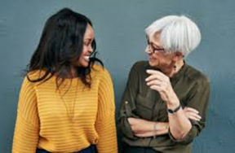
Coaching Across Differences
1. Curiosity and Compassion
Develop you Own Emotional Intelligence
Invite Conversations about Differences

Slide 53

Coaching Triads
Regroup!
You will need to get into groups of 3.
Problem of Practice
Three 20-Mnute Rounds
  5 Coachee presents Problem of Practice
  5 Coach begins inquiry and diagnosis
  5 Coach moves to debrief and monitor
  5 Observer

Slide 54
Debrief
What worked well?
What would you change the next time you coach/ are the coachee?
What is one key takeaway from this?

Slide 55
Key Points
Coaching is about releasing your external control and enabling the leader to grow.
Coaching is as much about you changing your behavior and growing your skill as it is about growing a leader.
We only get good at coaching by practicing it.

