Slide 1
Campaign Lab Structure

Slide 2
Basic Structure of Campaign Lab
250
500
Coach
Team Lead
Team Lead
Coach
Team Lead
Team Lead
Coach
Team Lead
Team Lead
Campaign Lab Coordinators
50
Tech
Logistics and Grants
Payments
Mentor Coach
7
7
Notes:
The commitment for the local team lead is that they meet twice a month with a campaign coach to discuss their progress and receive just in time problem solving, advice, and coaching towards next steps. They also agree to attend an all call meeting once month to hear from others across the country that are also doing this work. Once a coach and a mentor coach agree that the Team Lead and local have a plan, have a team, and are ready to begin taking actions according to an actual escalating plan, they receive a seed grant of $2500.
Coaches, high capacity, campaign minded, leaders can serve as coaches and will receive training and support to do this. They agree to coach locals, up to two — and receive an annual stipend of up to $1800. They commit to meet with one to two teams, twice a month and attend the monthly all call meeting.
Mentor coaches are typically staff, who have a record of leading campaigns or growing locals through organizing. They do not receive a stipend. They have no more than 5 coaches that they meet with once a month and attend the all call meetings.
The Campaign Lab Coordinators, Amanda, Carrie, and Ellen, are managed by Kyle. Kyle is primarily focused on building the alignments with our outside partners and moves the Campaign Lab strategically into other aspects of the NEA enterprise. Amanda, Carrie, and Ellen work together they keep the system connected, convene the people in the system, build capacity across the system, manage and monitor applications of teams and coaches, and develop a strategic intent for the work across the campaign lab. They are supported by Dommie, Shola, and Karla. Dommie provides technology and data support, Shola coordinates the payment of coaches, Karla pulls team applications from the grant system and provides all travel logistics.

Slide 3
Description of the Structure
The commitment for the local team lead is that they meet twice a month with a campaign coach to discuss their progress and receive just in time problem solving, advice, and coaching towards next steps. They also agree to attend an all call meeting once month to hear from others across the country that are also doing this work. Once a coach and a mentor coach agree that the Team Lead and local have a plan, have a team, and are ready to begin taking actions according to an actual escalating plan, they receive a seed grant of $2500.
Coaches, high capacity, campaign minded, leaders can serve as coaches and will receive training and support to do this. They agree to coach locals, up to two — and receive an annual stipend of up to $1800. They commit to meet with one to two teams, twice a month and attend the monthly all call meeting.
Mentor coaches are typically staff, who have a record of leading campaigns or growing locals through organizing. They do not receive a stipend. They have no more than 5 coaches that they meet with once a month and attend the all call meetings.
The Campaign Lab Coordinators, Amanda, Carrie, and Ellen, are managed by Kyle. Kyle is primarily focused on building the alignments with our outside partners and moves the Campaign Lab strategically into other aspects of the NEA enterprise. Amanda, Carrie, and Ellen work together they keep the system connected, convene the people in the system, build capacity across the system, manage and monitor applications of teams and coaches, and develop a strategic intent for the work across the campaign lab. They are supported by Dommie, Shola, and Karla. Dommie provides technology and data support, Shola coordinates the payment of coaches, Karla pulls team applications from the grant system and provides all travel logistics.

Slide 4
How to Access the SharePoint
This link will take you to a step by step tutorial about accessing SharePoint
https://scribehow.com/shared/Accessing_the_NEA_Campaign_Lab_Dashboard_and_Notes__-xq2wyWbSLmi4YhaC_h10g

Slide 5
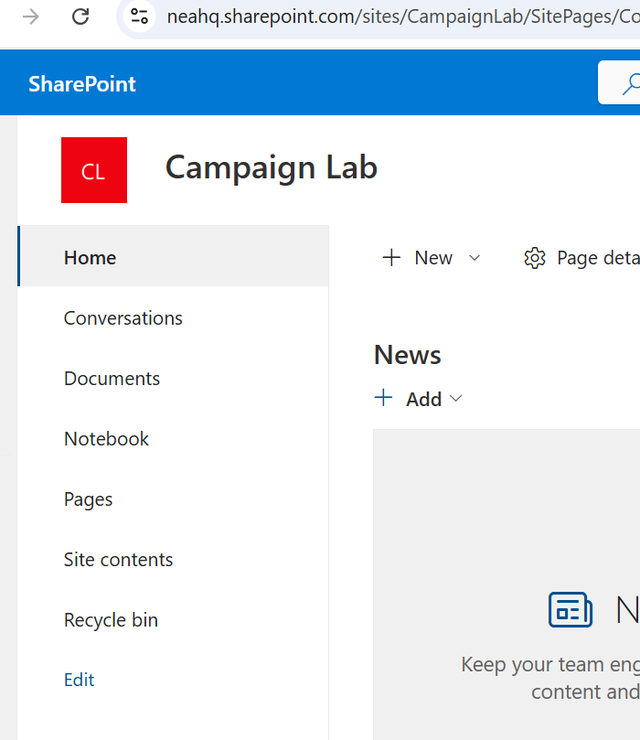
SharePoint
All Team Leads ,Coaches, Mentor Coaches are included in the Campaign Lab SharePoint site. This invitation comes from Ellen Holmes.
You will use two areas.
  Documents
    Dashboard
  Notebook

Slide 6
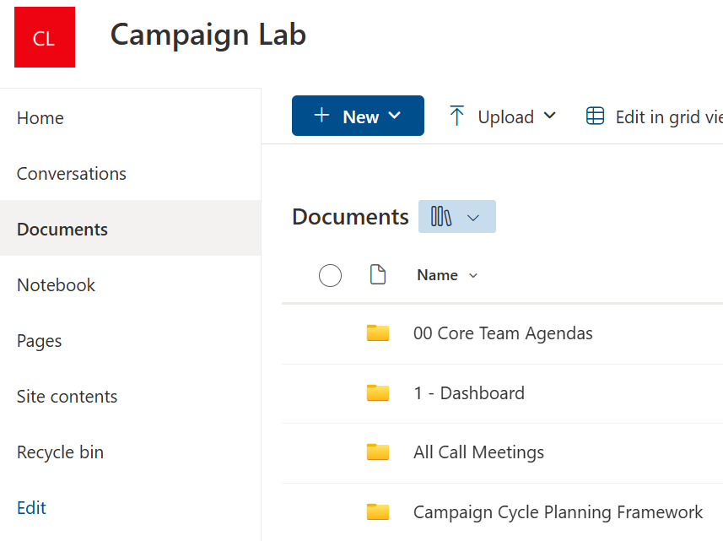
SharePoint
In the Documents folder, you will primarily use the 1- Dashboard folder, the All Call Meetings folder, and the Campaign Cycle Planning Framework folders.

Slide 7
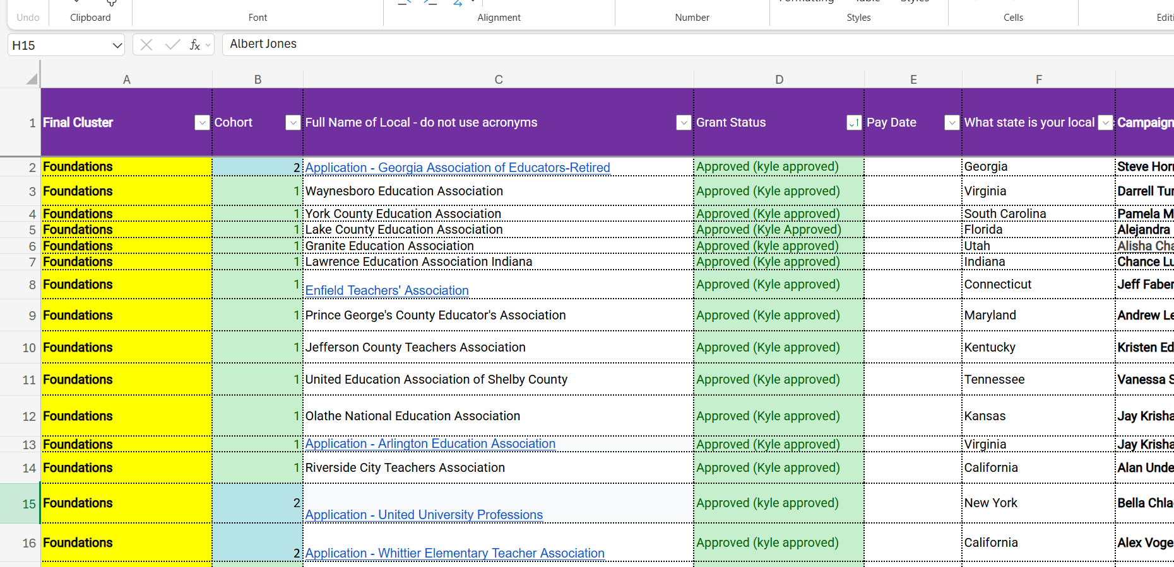
Dashboard
The dashboard is where all information about the teams in the Campaign Lab, the Leads, the Coaches and the Mentor Coaches are kept.
Tabs you will use most:
Overview
Coach Contact Info
Local Contact Info
Mentor Coach Log
Campaign Coach Log

Slide 8
Meetings and Training
Team Leads meet with their leadership teams in their locals on the implementation of their campaign.
Coaches meet twice a month with their Team Leads to help the Team Lead with the challenges of implementing a campaign.
Mentor Coaches meet with Coaches to help them with the craft and skills of coaching Team Leads
All Call Meetings are 90 minutes, once a month where Leads, Coaches, and Mentor Coaches network, learn, and share the work of their campaigns.
In person trainings – Campaign Academies and Focused Academies
On line trainings – NEA Professional Excellence Portal

