Slide 1
Campaign Academy:
Leaders and Structures for Winning Campaigns
November, 2025

Slide 2

Campaign Academy
By attending this training, you confirm that you are either an NEA affiliate staff person or NEA member in good standing. The information you receive here is only for your use in your capacity as an NEA affiliate staff person or NEA member.
This presentation and its contents are confidential and may not be further distributed or passed on to any other person or published or reproduced, in whole or in part, by any medium or in any form, for any purpose unless written consent has been provided by Ellen Holmes. Audio/video recording, copying of slides, and the use of AI note-taking tools are prohibited without the written consent from Kyle Serrette. Violation of these terms may result in legal action.

Slide 3
NEA Standards of Conduct
NEA has adopted a Standard of Conduct Policy to ensure that all of our gatherings are welcoming to and free from discriminatory, harassing, or otherwise unacceptable behavior. Discrimination or harassment based on race, color, ethnicity, religion, sex, age, national origin, sexual orientation, disability, gender identity, or expression, or any other characteristic protected by law will not be tolerated. If you have experience any discriminatory or harassing behavior, please report the incident by emailing Ron "Duff" Martin (rmartin@nea.org) and Gladys Marquez (gmarquez@nea.org). Thank you for your commitment to ensuring a positive event for all.

Slide 4
Feedback on Feedback
36 Responses !!! - Range is 4.75 -4.69 High for facilitators lowest three-way tie for materials and content
Themes:
Good Content
Meaningful Event
A LOT of Content

Slide 5
Your Words
Thank you! There are a number of strategies that I will use to assist with strengthening our union’s efforts and organization.
I would caution you with the language when you ask about sharing ideas we have heard. What I heard was “did anyone hear something so amazing that they are stealing it?” This can make some people feel like their contribution was not good enough of people don’t share what they have said.
It’s going well, just very dense and we might need more processing time.
A couple of times there was reference to teachers and classroom but not everyone in the room is a teacher or in the classroom. If we can be mindful of that, it would be appreciated
Day one was perfect! Very helpful and engaging! Just want I needed to put the fire under me (even more) to be and do better as an organizer and building rep!

Slide 6

ToDay’s Agenda
  7:30-8:30 Breakfast
  8:30-Noon
  10:15-10:30 Break
  12:00-1:00 Lunch
  1:00-4:30
  2:30-2:45 Break
  4:30-5:00 Networking and Adjourn
.

Slide 7

Community Agreements
Using Self-Awareness and Self-Knowledge
Listening for Understanding
Being Gracious
Staying Engaged
Being Open and Suspend Judgment
Saying “I”- tell your truth
Lean into Discomfort
Reaching Empathy
Expecting Non-Resolution and Non-Closure
*Adapted from “Embracing equity and inclusion”, Annie E. Casey Foundation
Notes:
Community Agreements for Our Time
Awareness and Self-Knowledge
This requires self-knowledge and self-awareness. Self-knowledge allows you to see what causes you pain and conflict and enables you to embrace your contradictions and inconsistencies. It allows the space to work on things about yourself that you are not happy with. In turn, self-knowledge helps to prevent you from projecting your negative aspects onto other people. Bringing your best self also requires that you have a positive attitude, are willing to deeply explore your perspectives and remain open to the perspectives and experiences of others.
Listening for Understanding
Be an active listener. Active listening involves paying full and careful attention to the other person, looking him or her in the eye, avoiding interruptions, reflecting your understanding, clarifying information, summarizing the other person’s perspectives and sharing your own. Remember that most people need time to open up and might not be willing to immediately share their personal stories, hopes, fears and/or concerns.
Being Gracious
Being kind is a vital way of bringing meaning to our own lives, as well as the lives of others. Kindness is about caring genuinely for others around you, wanting the best for them and recognizing in them the same wants, needs, aspirations and even fears that you may have. Being kind and generous allows us to communicate better with others, to be more self-compassionate and to be a positive force in other people’s lives. This includes following the COVID protocols that are in place to protect the health of this learning community.
Stay Engaged
Staying engaged requires you to be morally, emotionally, intellectually and socially involved in the conversation. Staying engaged means that you are listening with curiosity and willing to deepen your understanding. Staying engaged might also require you to sustain the conversation even when it gets uncomfortable or diverted. This also means a commitment to keeping your electronic communications to a minimum with folks not present in this learning community.
Be Open and Suspend Judgment
Listening with an open mind includes being receptive to the influence of others. You can suspend judgment by becoming aware of preconceived notions and listening to everything someone has to say before jumping to conclusions. Most importantly, suspending judgment also means listening to what the speaker has to say for understanding, not just to determine whether the speaker is right or wrong.
Say “I”- tell your truth
Speaking your truth in authentic and courageous conversations about race requires a willingness to take risks. It means that you will be absolutely honest and candid about your own thoughts, feelings, experiences and opinions and not just saying what you perceive others want to hear. Speaking your truth will require you to speak from the “first person” and use “I” statements.
Seek Discomfort
Leaning in to discomfort will require you to let go of racial understandings and stereotypes that you may be holding onto in order to move forward. Leaning in means that you will avoid judgment, assume positive intent and be open to the kernel of wisdom in each individual’s experiences. Leaning in to discomfort will require you to sit through moments of embarrassment, confusion, anxiety and/or fear.
Reaching Empathy
Empathy and compassion allow you to understand the other person’s point of view. When you are empathetic, you are more understanding, patient and kind. Expanding your capacity to feel empathy will also allow others to enter your circle of human concern.
Resolution and Closure
Expect and accept that there may not be closure. It is not likely that you will resolve your personal understanding about race or another person’s racial experience in a single conversation. The more you talk about race with another person, the more you learn and the more they will learn. Authentic and productive conversations about race are continuous and always evolving.
*Adapted from “Embracing equity and inclusion”, Annie E. Casey Foundation

Slide 8
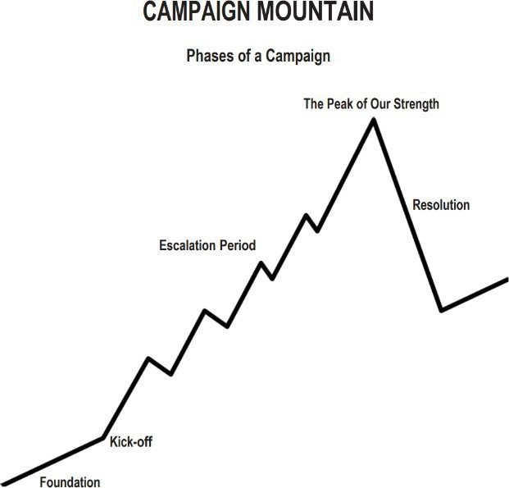
Structures and Leaders
  Centering Equity
  Leadership Team
  Problem and Issue Identification
  Target and Demand
  Power Analysis
  Allies
  Communication
  Strategy
  Tactics
  Metrics
Timeline
Tactics (in order) of escalation
Benchmarks for each tactic
Timeline
Tactics (in order) of escalation
Benchmarks for each tactic

Slide 9
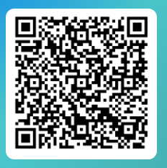
Apply to be a Campaign Lab Coach
Possess an organizing and leadership mindset
Engages in peer problem solving and coaching
Campaign Coach
Holds coaching calls, with team 2 times a month
Coaches 1–2 local teams
Attends campaign coach training
Works with a mentor coach

Slide 10
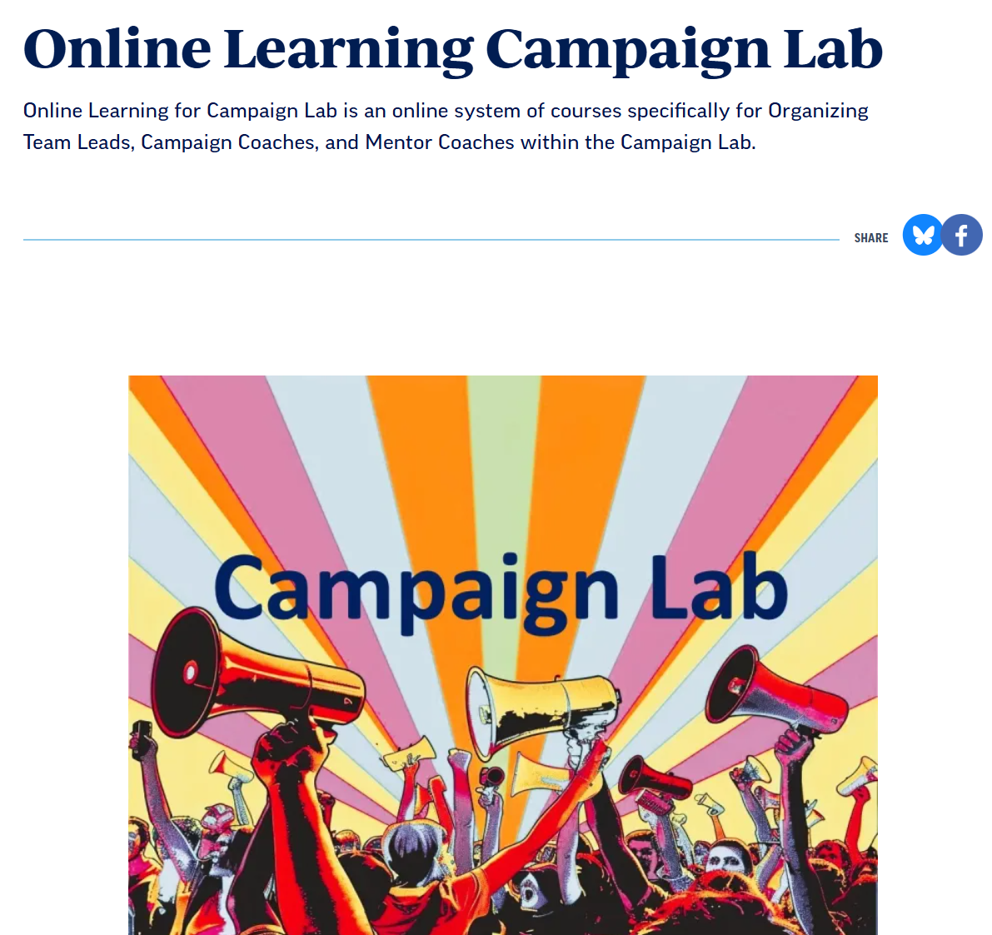
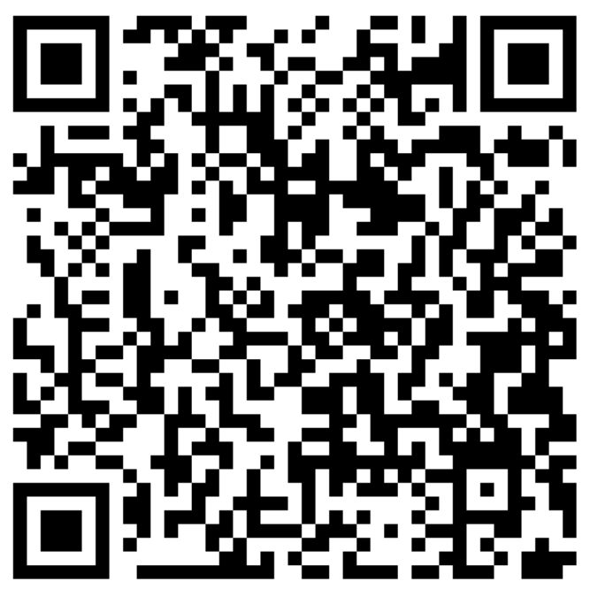
Online Learning Opportunities

Slide 11
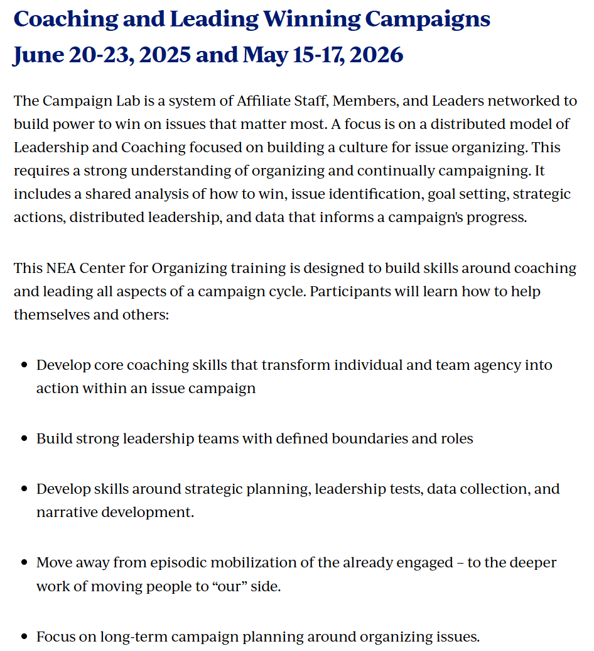
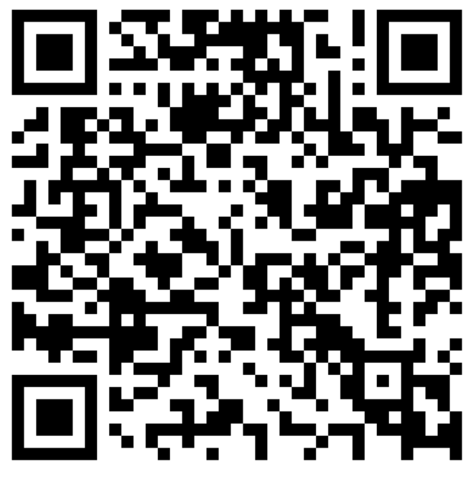


In Person Opportunities

Slide 12

An escalating campaign is held together by a set of values and shared commitment to a demand.
Escalating tactics are how we develop leaders, identify new leaders, move more people into our base.
If we are organizing, we are continually building interdependent structures as we climb campaign mountain
Key Points

Slide 13
Dreaming of 2030
Melissa

Slide 14


Dreaming about 2030

Slide 15

On Your Own First
What do you see, hear, and feel in this future?
What’s one win you’re most proud of?
What did it take to get here?
Then – Share with your Team

Slide 16
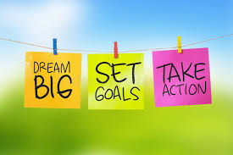
Team TIME
Making the Dream Real
2030 is not a fantasy — it’s a destination. Every organizing conversation, every contract fight, every rally gets us closer.
Finish this statement
We joined the campaign lab so that we can win _____________ by 2030.

Slide 17
Key Points
Shared dreams can be achieved with intentional and strategic actions.
Strong Leadership teams Inspire hope, deepen commitment, and align their people around a shared vision

Slide 18
Problem and Issue
Hedy

Slide 19

PROBLEMS & ISSUE
Campaigns start with issues that people have value-based solidarity around.
An issue is a slice of a workplace problem.
  Often a problem can have different issues depending on the people's perspective
It is KEY to get enough input on what the issues are that make up the problem so that YOU do not drive the solution.
Investigating the issue is necessary but not sufficient – we also need to identify workers’ SHARED values
  WHY is this an issue?
  WHY do you want to fix this?
Notes:
What are some “red flags” to look out for when identifying the issue?

Slide 20

PROBLEM vs. ISSUE
A problem is the whole pie. Problems are vast, complex, and entrenched.
When we try to tackle a problem, we reinforce the hopelessness of the situation. We are trying to take on the full pie all at once.
Issues are the pieces of the pie. It’s a small chunk of the larger problem that we can make progress on, and in turn we are slowly taking on the full problem over time.
Notes:
What are some “red flags” to look out for when identifying the issue?

Slide 21
Issue
An issue is a slice of the larger problem that is manageable and solvable.

Slide 22

PROBLEM vs. ISSUE

Slide 23
Values
Values are fundamental beliefs that dictate behavior
Ideally, Unions advance the welfare of all members.
They are based on the universal ideal of human rights, the idea of justice, progress, and betterment of self and of society.
Through shared values, members build solidarity and commit to active participation in the labor movement.
Shared values transform individual members into part of something larger than themselves.

Slide 24
Some Union Values
Fairness, honesty/integrity, responsibility, compassion/empathy, safety, health, generosity, hard work/responsibility, community, freedom, democracy, binding contracts, equality, opportunity, respect, stability/security, unity, quality work, justice, collective action, dignity/respect, charity/community service, and due process.

Slide 25
How to Link Issues and Values
Investigating member issues is necessary but not sufficient – we also need to identify workers’ SHARED values –
WHY is this an issue?
WHY do you want to fix this?

Slide 26
EXAMPLES- Problems to Issues + Values
VALUES – Public Schools should be safe, equitable, and inclusive learning and working environments for all people.
PROBLEM -Our school is hostile to LGBTQ+ staff and students
  ◦ Issue Cut – There are no gender inclusive bathrooms and/or transgender students and staff are forced to use the wrong restroom.
PROBLEM - Our school reinforces racism by silencing protestors
  ◦ Issue Cut– We need to stop law enforcement from arresting students and staff for exercising their Constitutional rights.

Slide 27
TEAM WORK – The Problems
Look back at your Villains list. List the problems that your team wants to improve – these are BIG
For each of the problems you identify – try to think what the values are that are behind WHY you see this as a problem.
Example Problem – We want quality health care for everyone
Values behind wanting to fix this – equity, fairness, dignity
List your problems and values on your charts.

Slide 28
We listen for the values as talk about these problems.
This is how we build solidarity.
Key Points

Slide 29
TEAM WORK – Problems into Issues
Example Problem – We want quality health care for everyone
Values behind wanting to fix this – equity, fairness, dignity
Possible Issues –
Not enough providers in our rural system
Values – access and equity
Drugs are not affordable
Values – fairness and access
No coverage for home health options
Values – equity and dignity
Pick ONE problem and cut into issues on your charts.

Slide 30
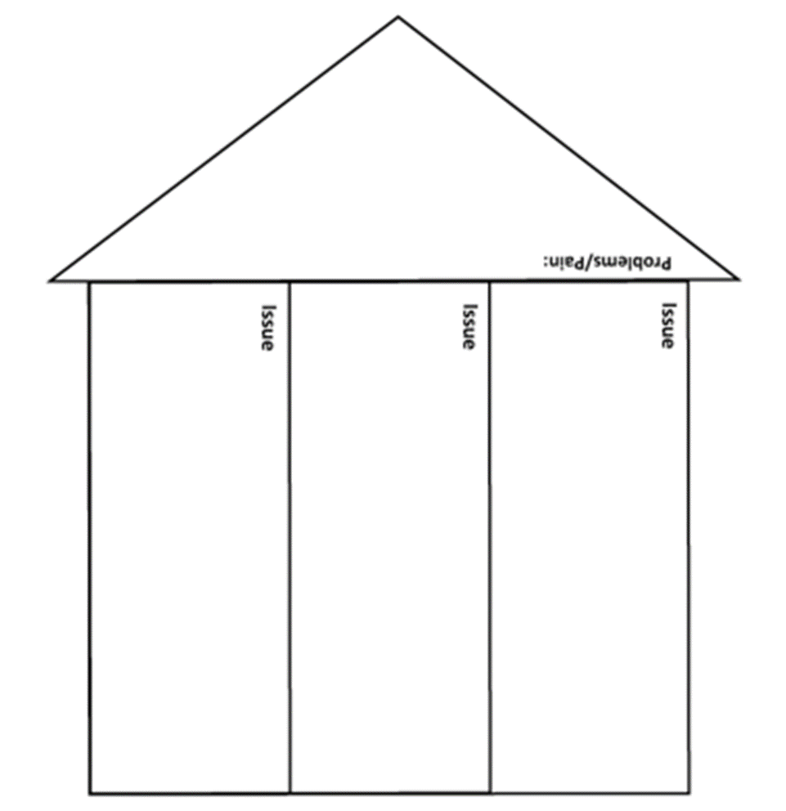
Issues are the small(er) actionable pieces that contribute to the larger problem. By asking why is this an issue you can uncover values.
(Page 19)

Slide 31
Assessing Our Issues
Widely felt and/or deeply felt.
  The pain can be felt by just one, but the injustice of that pain is shared by many.
  The pain AND the injustice of that pain is felt by many.
Winnable.
Builds the union and builds leaders.
Has a connection to students and the public.
Secrets of a Successful Organizer “A Good Organizing Issue” handout

Slide 32

Issue Criteria Checklist

Slide 33
Problems are big conditions of injustice
Issues are the smaller member identified components that makeup the problem
Issues indicate a path to action
Values build a relatable why across people experiencing the pain of the problem
We intentionally work to connect members around issues and values to build solidarity
Key Points

Slide 34

BREAK

Slide 35
Demand, Win, Target
Melissa

Slide 36

A Target is...
The person with the power to give you what you are demanding.
This person
Has a name
Has a face
Has an address

Slide 37
TEAMWORK
Return to Your Problem and Issue Charts
Who are the Potential Targets for the PROBLEM and your Issues?
Remember our Definition of Target

Slide 38
Demand
“Hey TARGET,
we demand ACTION
because HARM or IMPACT!”

Slide 39
Demand:
Hey Dean Sam: We demand gender affirming bathrooms in every building because all students and faculty need to feel safe and included in our schools. ”

Slide 40
TEAM WORK – Demand
Use your Issue and Target.
Draft at least one demand of your Target that resolves your issue and is linked to YOUR VALUES

Slide 41
Key Points
A powerful demand makes clear who has the power to make the change that’s needed
We can only build a powerful demand when we have taken the steps to accurately identify the issue and determine who has the power to create change

Slide 42
LUNCH

Slide 43
Pillars of Power
Amanda

Slide 44
Statement One
“The most common way people
give up their power is by thinking
they don’t have any.”
-Alice Walker, author of The Color Purple

Slide 45
Statement Two
Political leaders don't implement their policies, plans, and repression.
People do.

Slide 46

Pillars of Power
Tool to analyze and identify how your target maintains their power
Powerful figures are supported by institutions
Individuals within these institutions give their consent to support people in power.
Individuals within those institutions can also withdraw their support, eventually toppling the leader
Can also be used to analyze an injustice

Slide 47
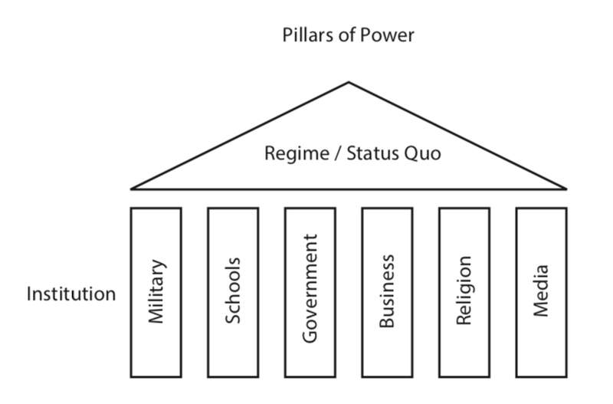

Slide 48
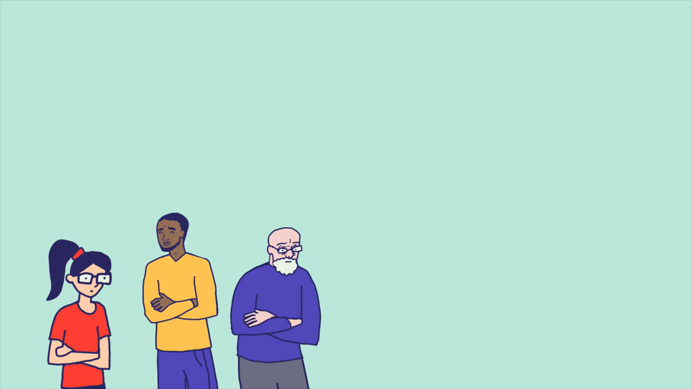

Slide 49
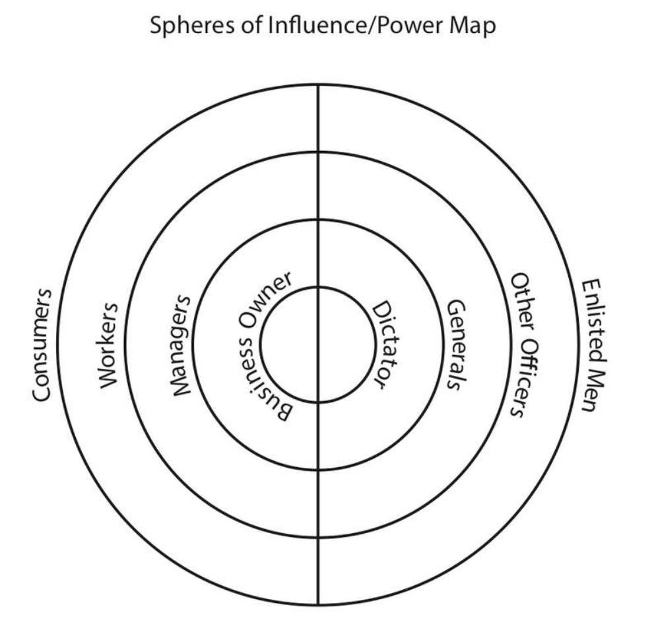
Eroding the Pillars
Who could you influence?
Who is out of your reach?

Slide 50
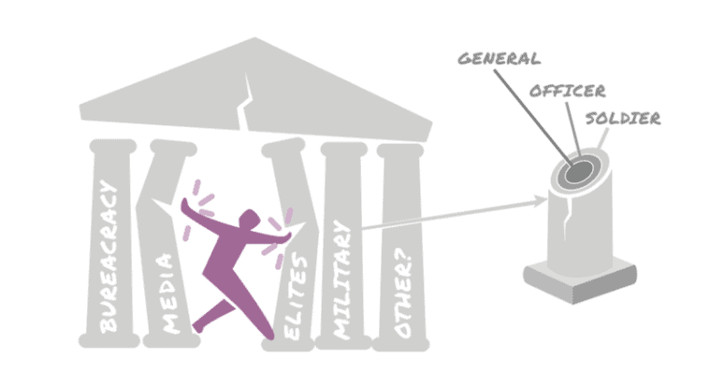
Question...
Do you have to reach ALL the people in each section?
Do you have to reach the people at the center of the pillar?

Slide 51
What Works
Forcing a Crisis- Actions that force those in power to act in ways that are in direct conflict with what most people think is acceptable
  Example: Civil Disobedience
Positive Visions
  Example: The Schools our Communities Deserve
Creating easy ways for people to join you
  Example: Regular protests

Slide 52
Key Points
Power holders in non-violent situations maintain power because the majority of the people CHOOSE to let them
A movement is successful when it convinces the majority to withhold that agreement to submit.
It does not require all the pillars to fall for those in power to feel enough pressure to change the unjust policy

Slide 53
Group Work!!
Campaign Teams
Pillars of Support Content Sheet (page 26-27)
Name the Injustice of your Issue
Name the “Power Holders” for this issue
Identify the Pillars of Support that exist to keep this Injustice going.
AND identify the pillars that you YOUR TEAM believes they can win over or neutralize.
Create one dissection of one pillar you think you can will over

Slide 54
Targeting Immigrant Families
Texas Governor and
Trump Republicans
Legislature and the 5th Circuit Court of Appeals
Immigration Customs Enforcement
Media and News Outlets
Police
Employers
School System
Healthcare

Slide 55
Neutralized Pillars- Targeting Immigrant Families
Texas Governor and
Trump Republicans
Immigration Customs Enforcement
Legislature and the Courts – Senator Menendez
Healthcare – Local Paid Sick-Leave for All Workers
Media and News Outlets – FaceBook
School System- Police Handbook
Police – Cite and Release
Employers

Slide 56
Pillars of Power Report Out
Team Reports– (3 Mins or less each)
Who are the powerholders?
What are the pillars of support?
Which pillars can you neutralize or turn – by doing what?
Debrief
What stands out to you?
Are there any questions you would like to ask a team?
Is there any idea you would like to hold up as a an awesome idea?

Slide 57
Key Points
Coalitions are a part of your structure that you should consider
We only have to neutralize the pillars of support

Slide 58
Spectrum of Allies
Ellen & Beth

Slide 59
Keep it in mind…
If campaigns put people at the center of solving the problems they are experiencing...
Then understanding the relationship people have with the win you seek is essential

Slide 60

Spectrum of Allies- page 29

Slide 61

Spectrum of Allies
  Active allies: people who agree with you & are organizing alongside you
  Passive allies: people who agree but aren't doing anything about it (yet!)
  Neutrals: people who aren't sure, or are unengaged (they might just not know about you yet)
  Passive opponents: people who disagree, but aren't trying to stop you
  Active opponents: people who have done something to prevent you from reaching your goal

Slide 62
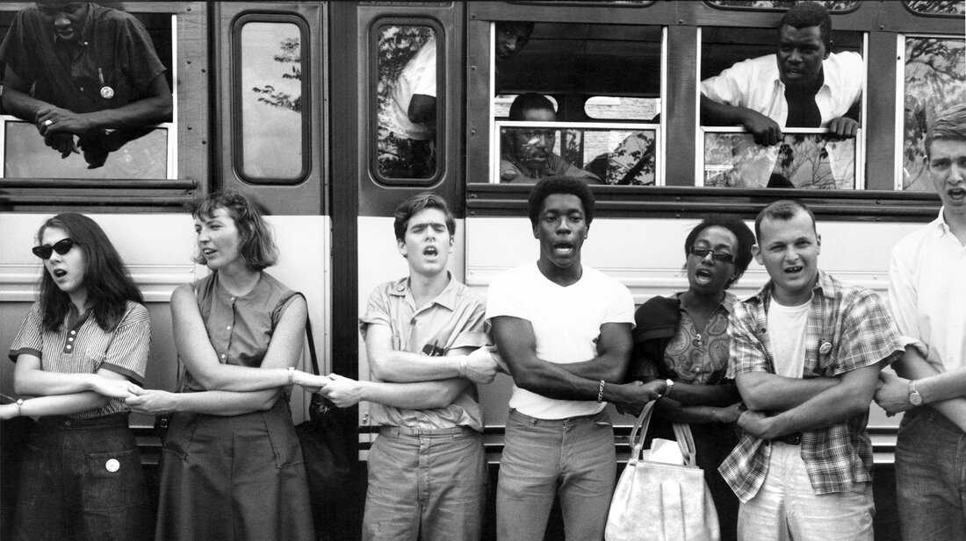
An example from history – Freedom Summer

Slide 63
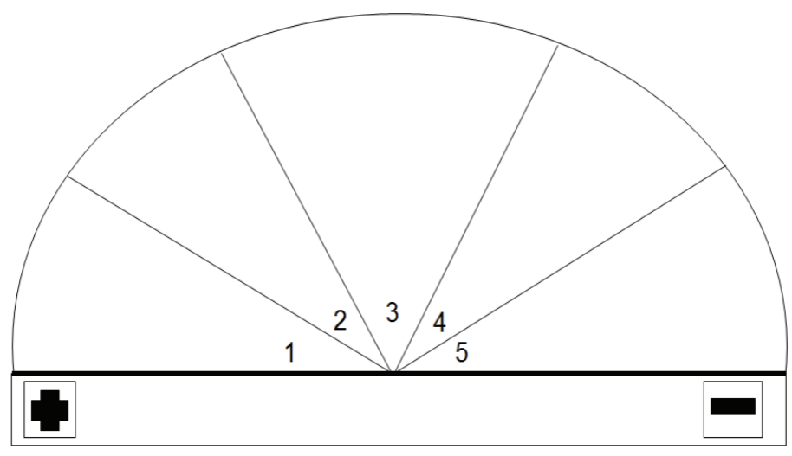
Spectrum of Allies Example
Neutrals
-Northern Parents
-Northern college students
Passive opponents
Passive Allies
-White, liberal northern college students
-Conservative lawmakers
Active Allies
Active Opponents
-SNCC Members & Allies
-White Supremacy culture

Slide 64
It is only necessary to move some or all of the pie wedges one step in your direction.
If we shift each wedge one step, we are likely to win, even if the hardliners on the opponent’s side don’t budge.
Key Points

Slide 65
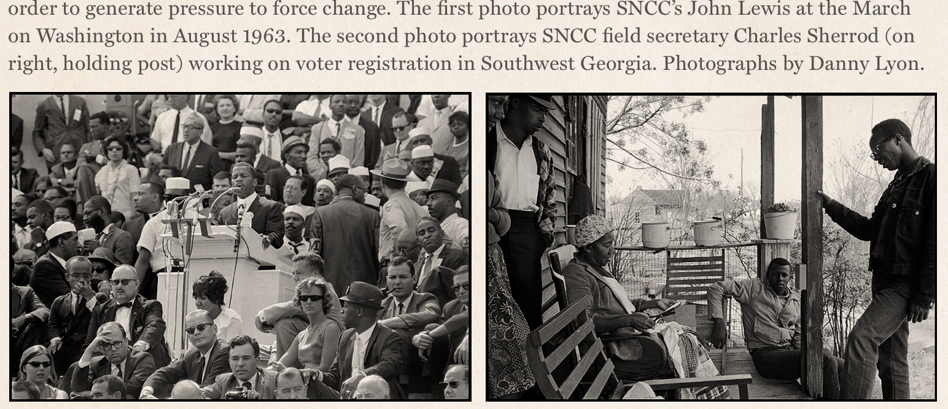
Messaging is Movement-Building
Messaging isn’t about arguing—it's about inviting.
Focus determines who gets included and who is left out.
Equity-centered messaging helps build power with, not for.

Slide 66
Who Are You Talking To?
Spectrum | Needs Messaging That...
Active Allies | Deepens commitment
Passive Allies | Invites low-risk engagement
Neutrals | Frames values alignment
Passive Opponents | De-escalates with dignity
Active Opponents | Not the focus but you gotta say something and it needs to make sense

Slide 67
Campaign Team Practice: Spectrum of Allies- p. 30

Slide 68
Key Points
Equity means naming nuance - be specific, be inclusive
Don’t center your opponent - build around your base
Good coaching = helping teams build power, not chase power

Slide 69
Dossier of Target
Hedy

Slide 70

Who is getting it, and who is getting fat?

Slide 71

Research – it's a powerful tool
It should be strategic, targeted, and relentless.
We need to know who holds the power and how they use it.
It's about finding leverage, and understanding what makes our target tick and how we can make them move

Slide 72

Strategic Research as a Tool for Organizing
Power of Strategic Research
  Strategic research is a powerful tool that helps organizers understand their opposition and plan effectively.
Understanding the Opposition
  Knowing who holds power and how they act allows campaigns to target efforts and increase chances of success.
Research as Leverage
  Research uncovers what motivates targets and reveals leverage points to influence decisions and actions.
  When we know who we are up against – we know how to win!

Slide 73

Research as Resistance
Research as Empowerment
  Research serves as a powerful tool to expose power structures and empower communities.
Building People Power
  Organizing informed by solid research strengthens collective action and campaign success.
Pathway to Justice
  Strategic research leads to effective organizing, which ultimately achieves justice and change.

Slide 74
Where should we look?
Institutional Power and Influence
Funding and Financial Ties
Policy History and Public Statements
Community Impact and Demographics
Local Institutions and Networks
Personal Background and affiliations
Local Intel and Relationships

Slide 75
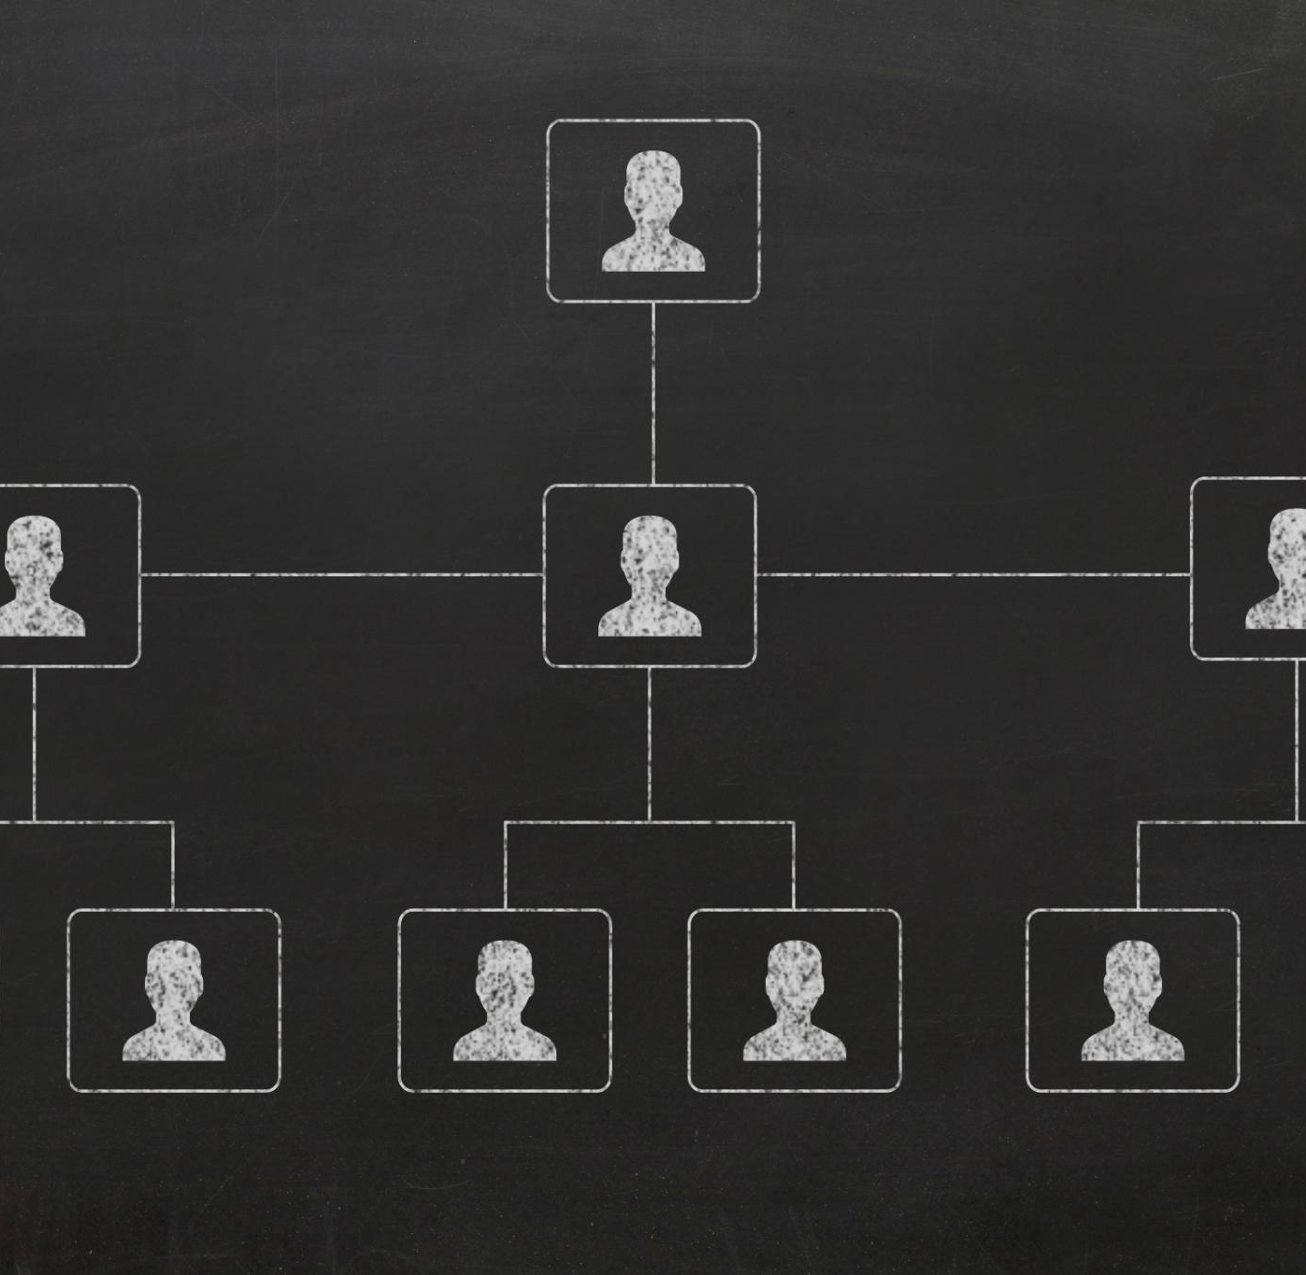
Institutional Power & Influence
Mapping Power Structures
  Identify who holds decision-making authority over staffing, budgets, curriculum, and safety within the institution.
Formal vs Informal Influence
  Recognize the difference between official authority and informal influence to locate real decision-makers effectively.
Targeting Campaign Strategies
  Use insights about power dynamics to focus campaigns on the right targets and tailor strategies accordingly.

Slide 76
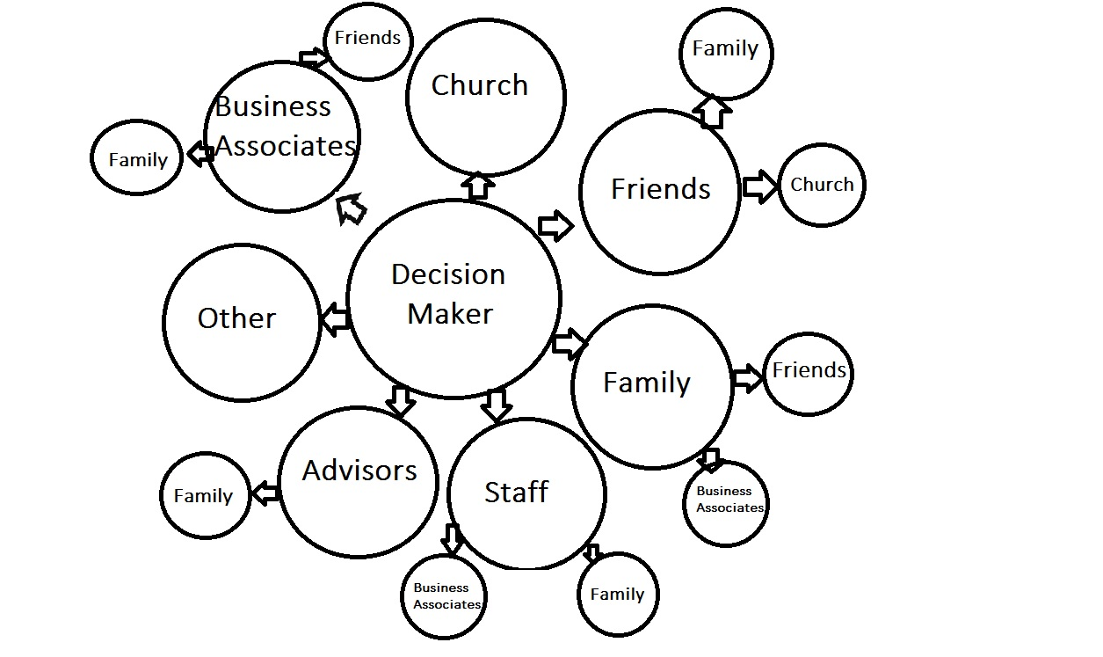
Map the power structure
Who make decisions about staffing, budgets, curriculum, or safety?
Who has formal authority?
Who has informal influence?
How are they all connected?
This helps us identify the pathways to influence the decision-maker.

Slide 77
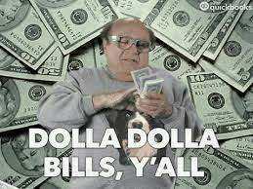
Funding & Financial Ties
Identifying Funding Sources
  Understanding who funds programs reveals priorities and potential conflicts of interest in decision-making.
Analyzing Financial Relationships
  Financial ties highlight loyalty, pressure points, and reveal hidden agendas impacting leadership.
Leveraging Financial Insights
  Organizers use funding analysis to uncover leverage points and build effective narratives for influence.

Slide 78

Policy History & Public Statements
Tracking Policy Decisions
  Analyzing policies pushed helps understand impact on educators and students and anticipate future moves.
Monitoring Public Statements
  Reviewing statements from forums and interviews reveals decision-makers’ positions and accountability.
Crafting Targeted Messaging
  Understanding history and statements enables tailored campaigns that anticipate resistance and build credibility.
Highlighting Inconsistencies
  Pointing out contradictions and failures strengthens campaign urgency and public trust.

Slide 79

Community Impact & Demographics
Affected Communities
  Understanding which communities are served or underserved guides inclusive and effective decision-making.
Demographic Factors
  Analyzing race, income, language, housing, and education levels reveals social and economic context.
Mobilizing and Outreach
  Demographic insights help identify allies and design outreach strategies to mobilize communities effectively.

Slide 80
Local Institutions & Networks
Institutions as Power Centers
Institutions like churches and schools hold significant influence and shape local power dynamics.
Identifying Allies and Opponents
Mapping which groups support or oppose decision-makers reveals strategic allies and opposition.
Strategic Coalition-Building
Understanding networks uncovers pressure points and opportunities to build coalitions for greater impact.

Slide 81
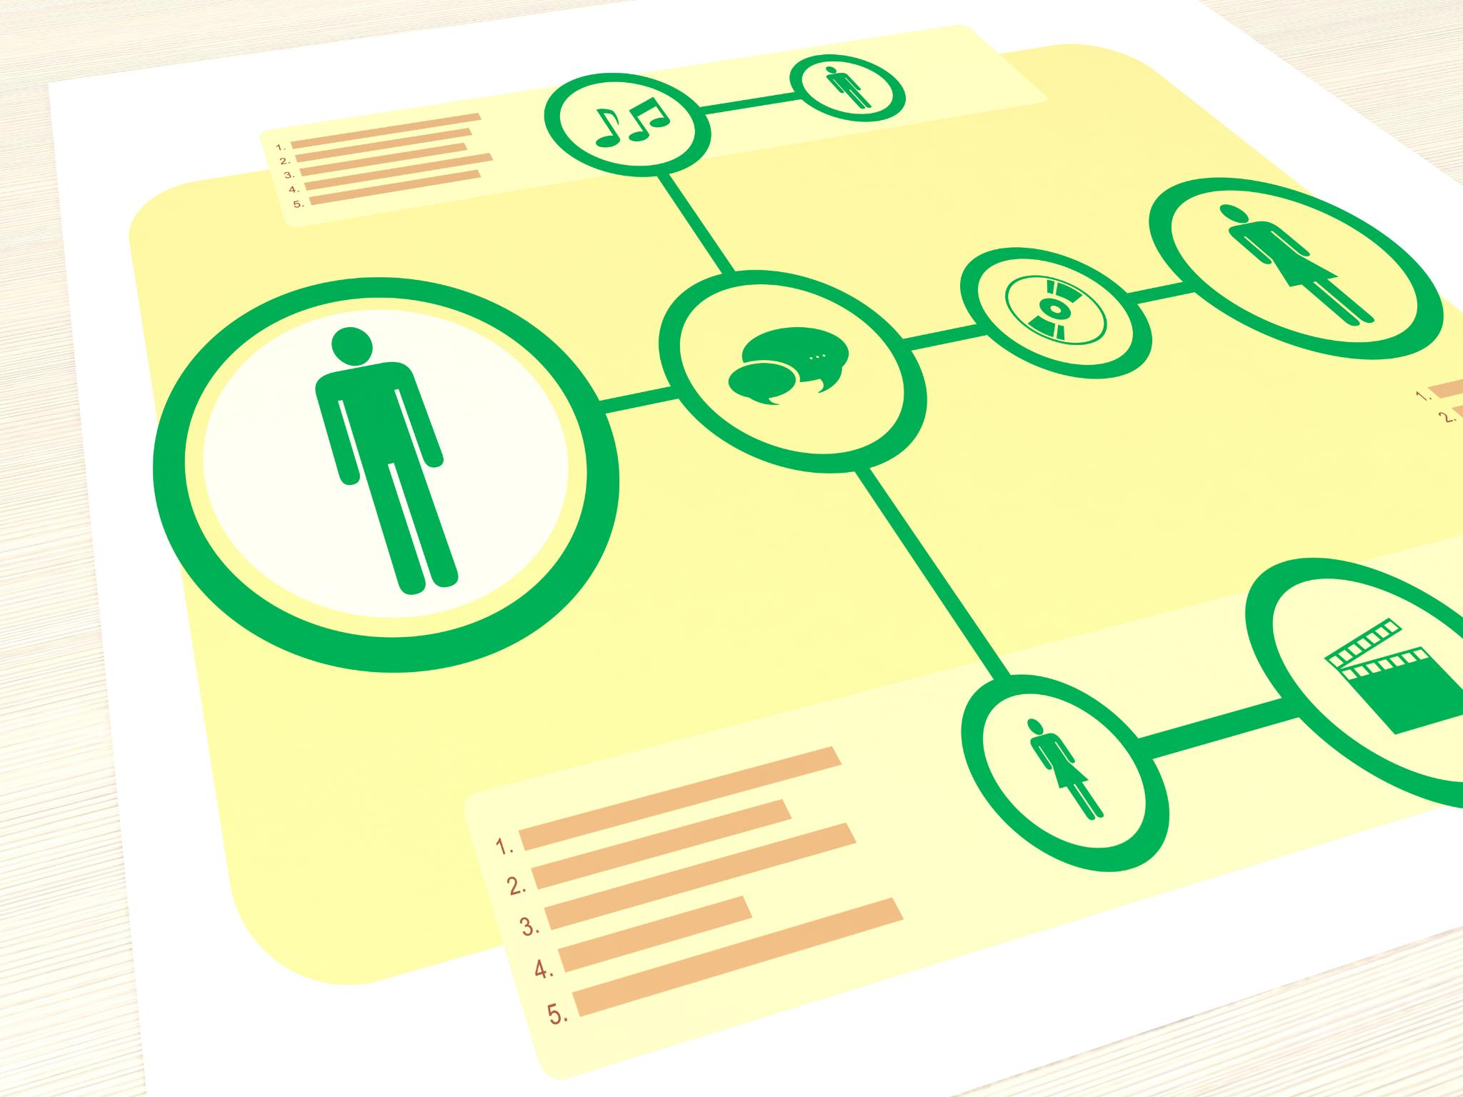
Personal Background & Affiliations
Understanding Personal Background
  Researching a person’s history reveals motivations and key factors beyond their professional role.
Exploring Affiliations
  Identifying boards and organizations linked to the person highlights their networks and influence.
Humanizing Through Research
  Personal research uncovers hidden motivations and aids storytelling to engage public opinion effectively.

Slide 82

Local Intel & Relationships
Continuous Communication
  Always talk to a variety of people to gather real stories and understand dynamics deeply.
Informal Intelligence Gathering
  Informal intel fills gaps left by formal research, providing context and actionable insights.
Building Trust
  Sustaining long-term efforts depends on building trust and maintaining relationships.

Slide 83
Team Time – pages 31 & 32
With your team review the Dossier of Your Target Document.
Be ready to discuss the following:
What surprised you most about the information you will need to research?
Which section of the handout felt most useful or revealing?
Did you discover any gaps in your current understanding of local power structures?

Slide 84
Key Points
When we know our target, we know how to organize.
And when we organize,
we win.

Slide 85
Organizer Math: Building Exponential Power
Vanessa

Slide 86

How can I make a difference?

Slide 87
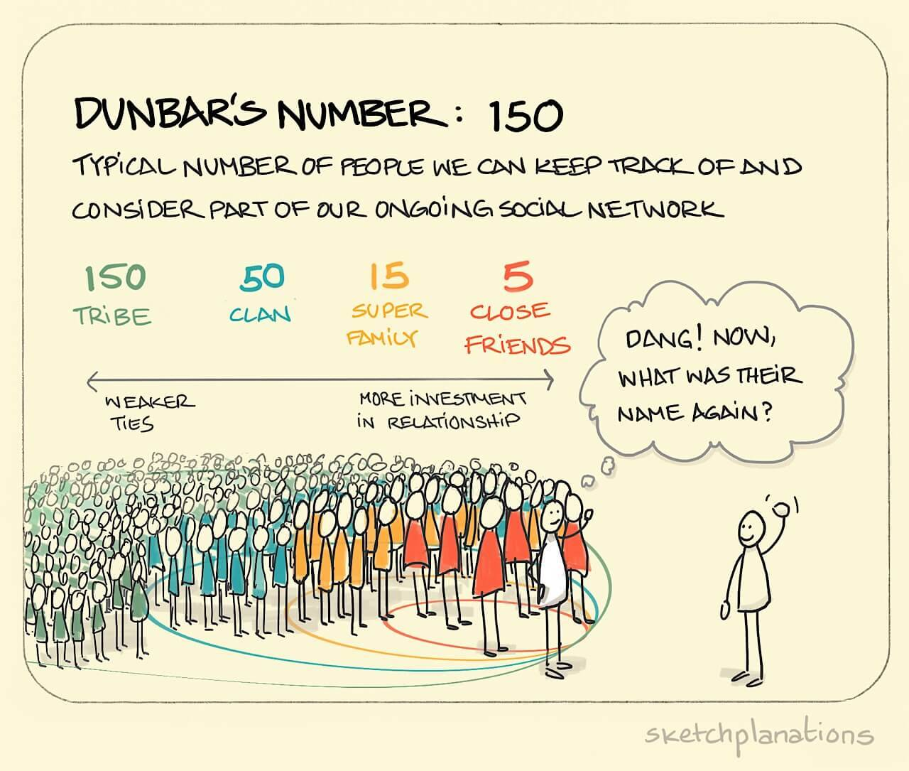

Slide 88
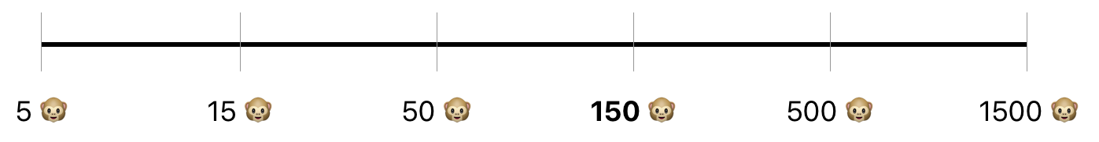
Why do we care about Dunbar’s Numbers? Pages 33-36
Stable - Relationship
Connections
Developing Leaders
Engaged Members
Aware Members
Disengaged Members - Supporters
“Driver” Leaders
Natural Leaders

Slide 89

The Schools Everyone Deserves Campaign
Page 37
Crisis: Board announced cuts (15 social workers, class size increase, salary freeze).
Union’s Shift: From service model → organizing model using Bargaining for the Common Good (BCG).
Victory Metric: 5,000 public pledges.
Notes:
Explain the strategic pivot: HPSEU reframed demands as Common Good issues, enabling coalition building and political leverage.

Slide 90
Phase 1 – Internal Unity (The Spark)- p. 40
Leadership Team 10
Organizer
Organizer
Organizer
Organizer
Organizer
Organizer
Organizer
Organizer
Organizer
Organizer
10 Core Leaders → 150 organizers (10% of union).
Internal test: 92% participation in 'Green for Harmony Day'.
Internal Unity
Victory
External Coalition
Notes:
Stress importance of structure tests and supermajority commitment before going public. This phase builds internal strength.

Slide 91
Phase 2 – External Coalition (The Multiplier)- p. 41
Internal
External
200
50 external organizers recruited (parents, students, clergy).
Rally: 1,250 attendees (60% non-union).
Internal Unity
Victory
External Coalition
Notes:
Show how Common Good framing multiplies power and builds political pressure through external allies.

Slide 92
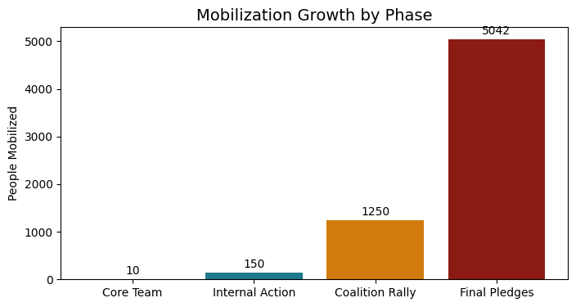
Final Phase – The Confrontation (Victory) - p.41-42
5,042 pledges + 94% strike vote.
Board rescinded cuts.
Internal Unity
Victory
External Coalition
Notes:
Emphasize measurable commitment as ultimate power metric. Translate numbers into political cost for decision-makers.

Slide 93
Team Work Time
At your table, answer the Debrief Questions in the Case Study (p. 46-47)
  How did framing demands as Common Good issues change the campaign's reach & impact?
  What were the key turning points in the campaign that shifted power toward the union?
  Why was achieving 92% internal unity before going public critical for success?
  How did the coalition with parents, students, and community groups amplify the union’s leverage?
Use all of the information included in pages 37-46 to answer the questions
Be ready to report out.

Slide 94
Action Checklist for Organizers- page 47
Identify
Identify 10% organizers.
Test
Test structure with measurable asks.
Frame
Frame demands as Common Good.
Build
Build coalition.
Track
Track power metrics.
Notes:
Provide practical steps for replication. Encourage organizers to apply these immediately in their campaigns.

Slide 95
Team Work Time
As a Team, complete the Planning Checklist for your own campaign (p. 47)
Be ready to report out

Slide 96
Key Points:
Power is not what you have, but what you can mobilize because you have working structures.
Organizing success depends on measurable commitment, not just membership size.

Slide 97
Dr. Taraja

Slide 98
Ladder of Engagement

Slide 99
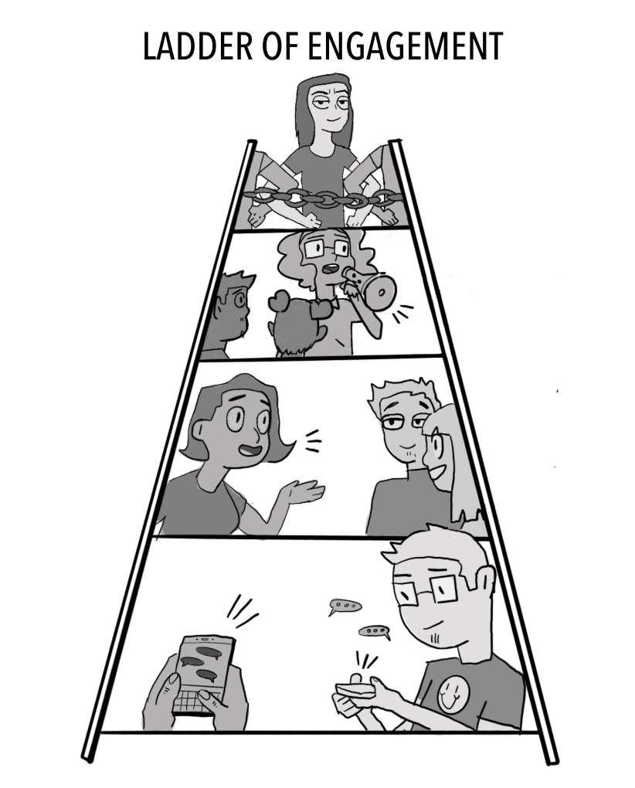
A Strategic Ladder for Union Campaigns

Slide 100
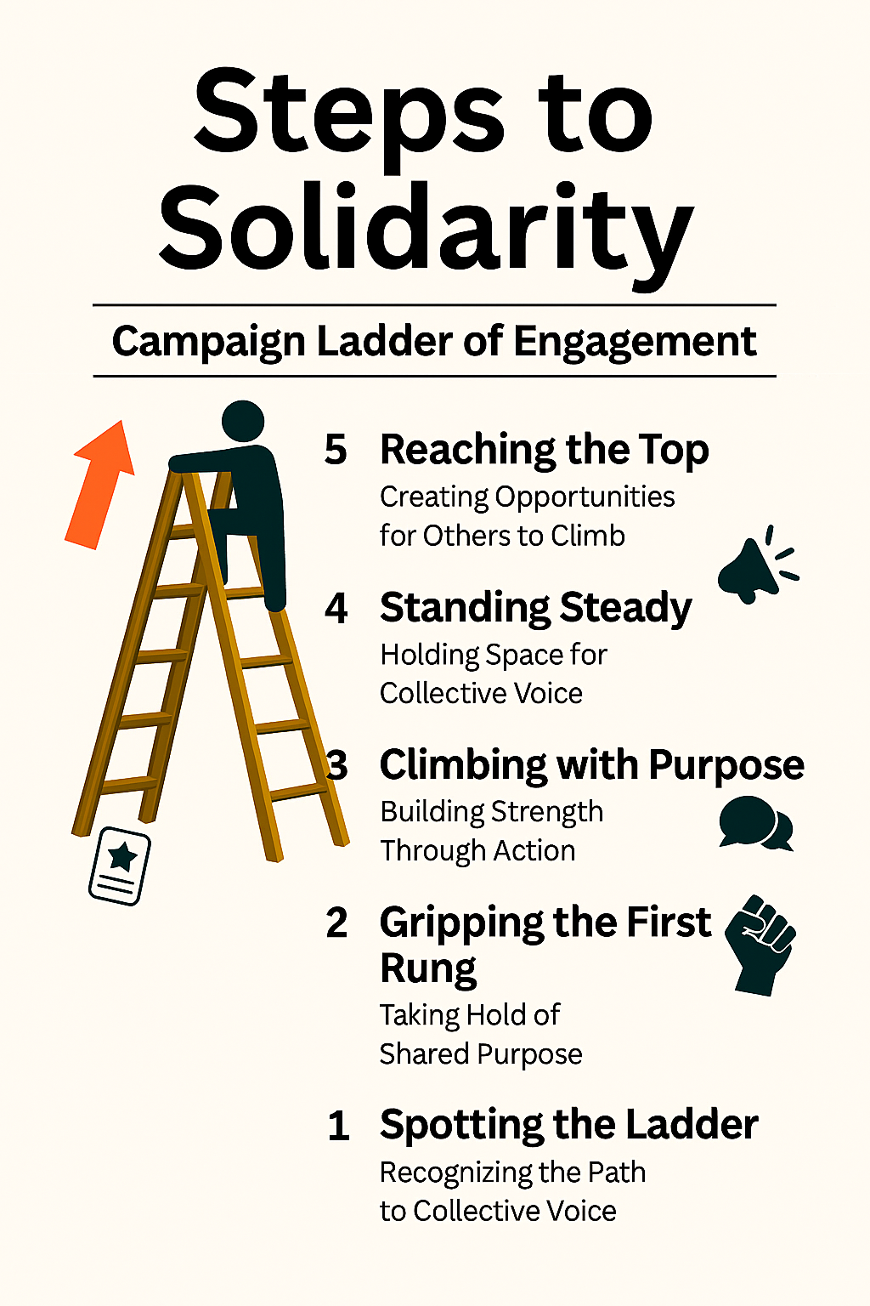
What is the Ladder of Engagement?
A framework to help union leaders activate and elevate member participation through a series of intentional steps.
Each step builds trust, capacity, and ownership—turning passive members into powerful advocates and leaders.

Slide 101

Step 1: Spotting the Ladder – Recognizing the Path to Collective Power
Objective: Introduce the campaign and spark initial interest.
Tactics:
  Send targeted emails or texts with campaign goals and relevance to educators.
  Share compelling stories or visuals on social media.
  Host informal info sessions or coffee chats at school sites.
Leadership Focus:
Equip building reps and site leaders with talking points and flyers.
Use warm, inclusive language that affirms educators’ values and concerns.

Slide 102
Step 2: Gripping the First Rung – Taking Hold of Shared Purpose
Objective: Encourage members to express curiosity and take a first step.
Tactics:
  Invite members to sign a petition or pledge of support.
  Conduct short surveys to gather input and build buy-in.
  Offer low-barrier opportunities to attend virtual briefings or town halls.
Leadership Focus:
  Track engagement and follow up personally.
  Celebrate participation publicly to build momentum.

Slide 103
Step 3: Climbing with Purpose – Building Strength Through Action
Objective: Move members from passive support to active involvement.
Tactics:
  Recruit volunteers for canvassing, phone banking, or event support.
  Form working groups around specific campaign issues (e.g., class size, funding).
  Host action nights or community forums.
Leadership Focus:
  Provide clear roles, training, and support.
  Recognize contributions and foster team spirit.

Slide 104
Step 4: Standing Steady – Holding Space for Collective Voice
Objective: Cultivate consistent, reliable contributors.
Tactics:
  Invite members to take on formal roles (e.g., site coordinator, committee lead).
  Offer leadership development workshops.
  Engage committed members in strategic planning or negotiations.
Leadership Focus:
  Build trust through transparency and shared decision-making.
  Create pathways for growth and mentorship.

Slide 105
Step 5: Reaching the Top – Creating Opportunities for Others to Climb
Objective: Empower members to lead, organize, and inspire others.
Tactics:
  Support members in organizing their own events or initiatives.
  Encourage representation at regional or statewide union gatherings.
  Develop a leadership pipeline with coaching and peer support.
Leadership Focus:
  Shift from directing to empowering.
  Celebrate leadership as a collective legacy.

Slide 106
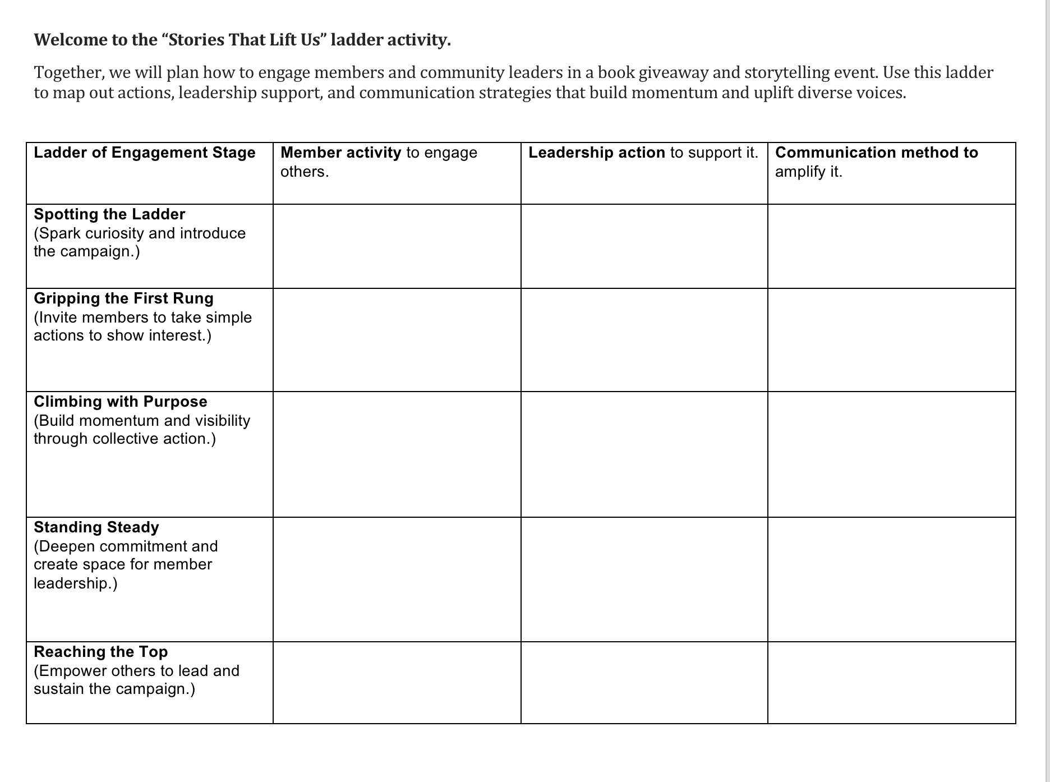
ScenarioTime! Page 22

Slide 107

Share Out!

Slide 108
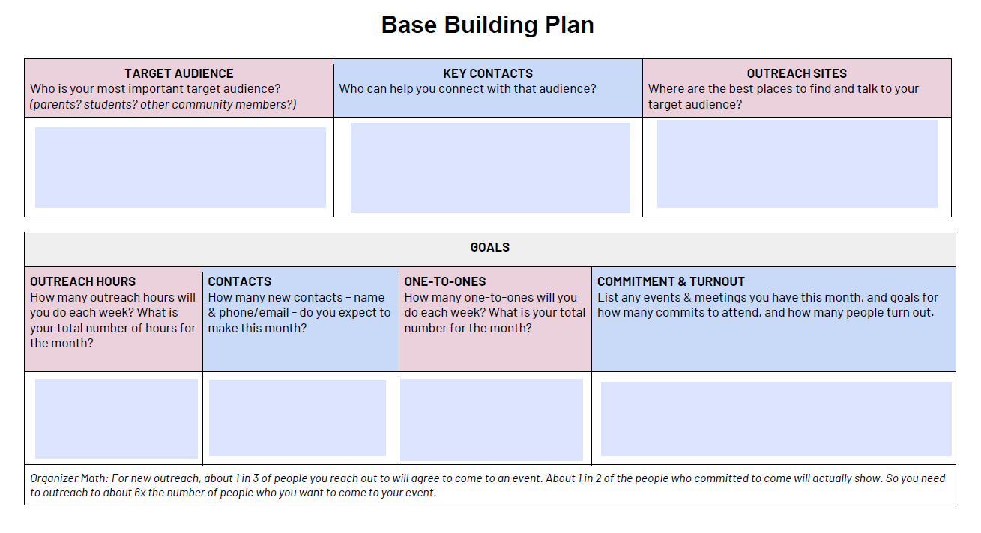
Future Application: Applying the Ladder to Your Base Building Plan

Slide 109

Journal: Open a Document and Reflect
What ideas or perspectives shifted as your group built the ladder?
Which step did you see a strong potential for big impact?
What strategies felt most effective for supporting and amplifying member voices?

Slide 110
Key Points:
Using the Ladder Strategically
Map your members: Identify where individuals currently sit on the ladder.
Design your campaign: Align tactics with each stage to meet members where they are.
Track progress: Use engagement metrics to assess movement and adjust strategy.
Build culture: Reinforce that union work is shared, valued, and visionary.

Slide 111
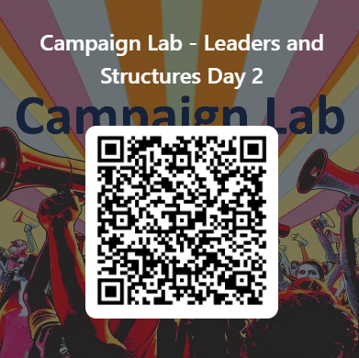
Feedback time
Goal – 100%Participation​
6 Short Questions​
We use what you give us

Slide 112
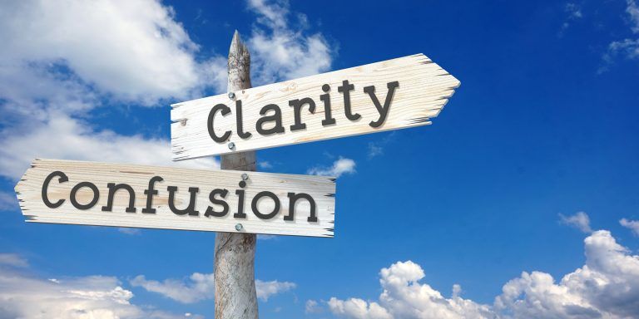
Closing the Day
What is becoming clearer?
What remains murky?
Housekeeping

