Slide 1
Constituency Organizing:
From Club to Fighting Union
Day 2

Slide 2

Community Agreements pg 2-3
Using Self-Awareness and Self-Knowledge
Listening for Understanding
Being Gracious
Staying Engaged
Being Open and Suspend Judgment
Saying “I”- tell your truth
Seeking Discomfort
Reaching Empathy
Expecting Non-Resolution and Non-Closure
*Adapted from “Embracing equity and inclusion”, Annie E. Casey Foundation
Notes:
Community Agreements for Our Time
Awareness and Self-Knowledge
This requires self-knowledge and self-awareness. Self-knowledge allows you to see what causes you pain and conflict and enables you to embrace your contradictions and inconsistencies. It allows the space to work on things about yourself that you are not happy with. In turn, self-knowledge helps to prevent you from projecting your negative aspects onto other people. Bringing your best self also requires that you have a positive attitude, are willing to deeply explore your perspectives and remain open to the perspectives and experiences of others.
Listening for Understanding
Be an active listener. Active listening involves paying full and careful attention to the other person, looking him or her in the eye, avoiding interruptions, reflecting your understanding, clarifying information, summarizing the other person’s perspectives and sharing your own. Remember that most people need time to open up and might not be willing to immediately share their personal stories, hopes, fears and/or concerns.
Being Gracious
Being kind is a vital way of bringing meaning to our own lives, as well as the lives of others. Kindness is about caring genuinely for others around you, wanting the best for them and recognizing in them the same wants, needs, aspirations and even fears that you may have. Being kind and generous allows us to communicate better with others, to be more self-compassionate and to be a positive force in other people’s lives. This includes following the COVID protocols that are in place to protect the health of this learning community.
Stay Engaged
Staying engaged requires you to be morally, emotionally, intellectually and socially involved in the conversation. Staying engaged means that you are listening with curiosity and willing to deepen your understanding. Staying engaged might also require you to sustain the conversation even when it gets uncomfortable or diverted. This also means a commitment to keeping your electronic communications to a minimum with folks not present in this learning community.
Be Open and Suspend Judgment
Listening with an open mind includes being receptive to the influence of others. You can suspend judgment by becoming aware of preconceived notions and listening to everything someone has to say before jumping to conclusions. Most importantly, suspending judgment also means listening to what the speaker has to say for understanding, not just to determine whether the speaker is right or wrong.
Say “I”- tell your truth
Speaking your truth in authentic and courageous conversations about race requires a willingness to take risks. It means that you will be absolutely honest and candid about your own thoughts, feelings, experiences and opinions and not just saying what you perceive others want to hear. Speaking your truth will require you to speak from the “first person” and use “I” statements.
Seek Discomfort
Leaning in to discomfort will require you to let go of racial understandings and stereotypes that you may be holding onto in order to move forward. Leaning in means that you will avoid judgment, assume positive intent and be open to the kernel of wisdom in each individual’s experiences. Leaning in to discomfort will require you to sit through moments of embarrassment, confusion, anxiety and/or fear.
Reaching Empathy
Empathy and compassion allow you to understand the other person’s point of view. When you are empathetic, you are more understanding, patient and kind. Expanding your capacity to feel empathy will also allow others to enter your circle of human concern.
Resolution and Closure
Expect and accept that there may not be closure. It is not likely that you will resolve your personal understanding about race or another person’s racial experience in a single conversation. The more you talk about race with another person, the more you learn and the more they will learn. Authentic and productive conversations about race are continuous and always evolving.
*Adapted from “Embracing equity and inclusion”, Annie E. Casey Foundation

Slide 3

Today’s Outcomes

Slide 4
Feedback on Feedback

Slide 5


Slide 6
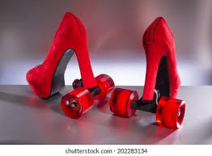
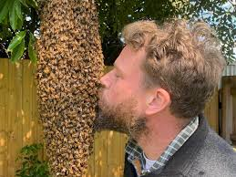
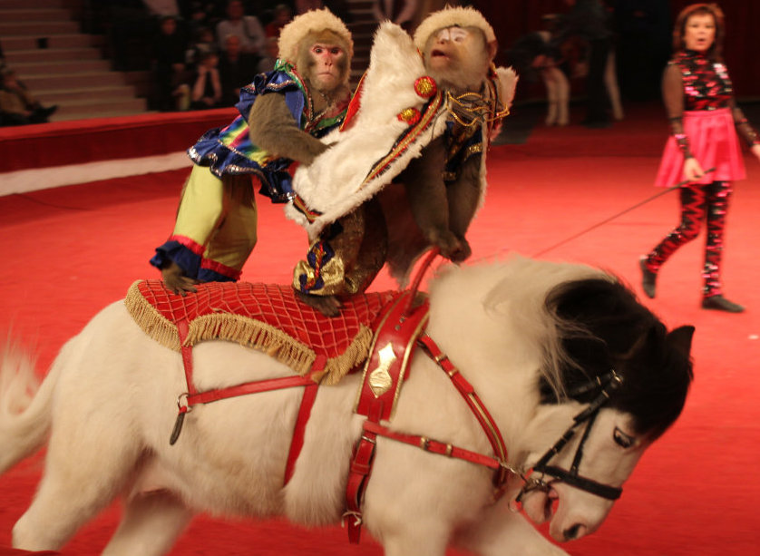
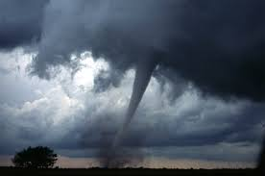
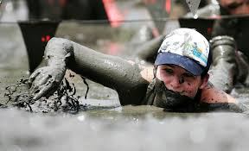
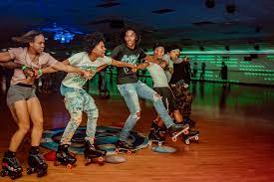
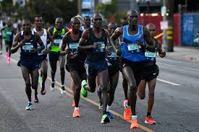
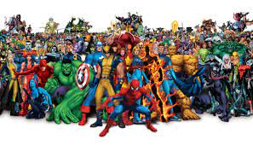
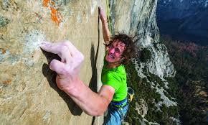
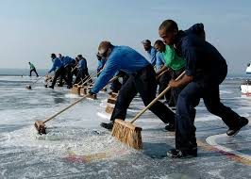
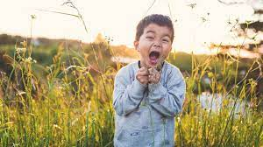
Go to the picture that best describes your work.
Gather,greet.
Share why.
One person report out.

Slide 8

Why People Join their Union – Group Work
P. 5 Member Retention Research Memo
Need BWhy People Join Their Union Handout (separate)
Use the chart to analyze the levels of expectation and connection for each reason for joining. Add others that your table might think.
Be Prepared to Discuss:
What do you notice?
Which ones were harder to analyze than others?
Were there any that you added?

Slide 9

Key Ideas
The more connection (solidarity, shared value/purpose/issue) and the more meaningful expectations there are – the more likely that members stay and are engaged.
From the Member Retention Research P. 5,
“Our research consistently finds that a member’s bond with the association (how connected a member feels to his/her local) is the best predictor of a member’s intention to remain in the union when given the opportunity to drop. Members who rate their connectedness at 10 are significantly more likely to remain in the union than those who rate their level of connection at 7, 8, or even 9. Merely connecting with our members is not enough. Instead, we must build— and maintain— strong relationships and deep connections with our members.”

Slide 11
What is your people’s most precious resource ?
Notes:
Sara

Slide 12


Slide 13
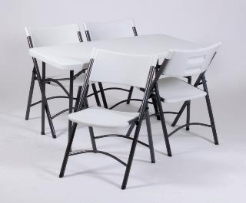
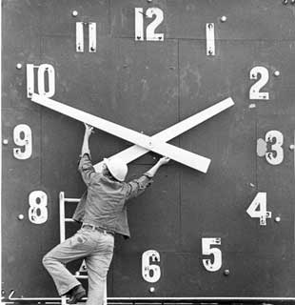

Resources that shrink as you use them.
Tangibles
Time/Energy
Money
Notes:
Sara
Resources are what your people have to help them make change. These are resources that are limited and are reduced as you use them.

Slide 14
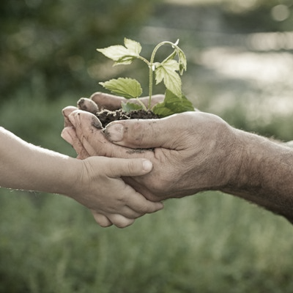
Resources that Grow as You Use Them
Relationships
Skills
Hope
Trust
Notes:
Sara
These resources are the most important. The more you use relationships, the more you trust, the more that you coach people in using their skills the more capacity they develop for action- these resources grow.

Slide 15
These resources are most precious, because they are priorities that people make decisions about.
Time
Energy
Notes:
Sara
Resources are what your people have to help them make change. These are resources that are limited and are reduced as you use them.

Slide 16

Resource Analysis P. 50-52
4 Groups, each with one of the cases found on P. 53-82
Refer to the case study notes you completed prior to on P. 50-52
Each team completes the chart on P. 49 and prepares to share what they found.

Slide 17
Report Out and then Final Reflections
Each team shares for 2-3 minutes what they discovered about their case.
Final reflections –
How do your groups think about resources at home?
How do they get them?

Slide 18
Key Ideas
For any campaign to be effective, the leadership team needs to assess the constituents’ resources and capabilities and those of the “boss” or target of the campaign.
The bigger the win, the more resource you need.
Adding new people adds new and varied resources.
Money is a vital resource, but time, connections, and relationships of a constituency’s members are the strongest resource they have.

Slide 19


Slide 21
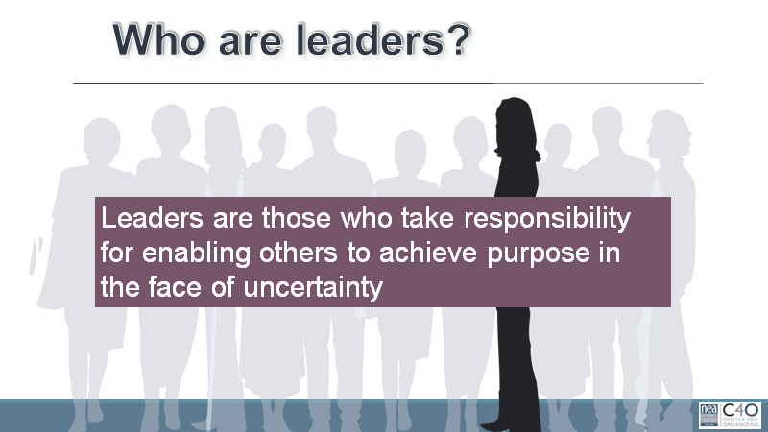

Slide 22
Leadership Cycle and Leadership Spiral
Leader Growth
Accountable
Implement
Reflect Assess
Proceed
Make Change
Stop
Recruit
Develop
Identify

Slide 23

Whole Room Discussion
How do you identify and track leaders in your state?
Resources on Leaders
Trusted and Respected, P. 87-95
He was Fired by Amazon…, P. 96-97
These are the Workers…, P. 98-120

Slide 24


Slide 25
What did you notice as you watched?

Slide 26
Why Trusted AND Respected?
Trusted:
They will have your back
Respected:
Their work or visible beliefs have value to you.
Trusted AND Respected have the resource we need most – relationship and connections between people.

Slide 27
Key Ideas
Leaders are not fixed to a certain characteristic, have been trained by the organization, or must be members of the union.
Leaders are those people who are trusted and respected by their colleagues.

Slide 28
Some Definitions for Group Work
Leaders – Trusted and respected by their colleagues in ways that cut across communities of workers- are connected by values and influential relationships with mobilizers, activists, and those not yet part of the work. Get people to move their thinking and take action.
Mobilizers – Are already convinced members, who are already willing to take action. They are connected to the other already convinced.
Activists – Supportive and willing to act if invited but not able to move others.

Slide 29
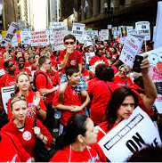


Leaders, Mobilizers, and Activists – Scenarios pg 121-122

Slide 30
Team Work Leaders, Mobilizers, and Activists
Who is a leader, a mobilizer, and an activist? How do you know?
In what order would you want to invite them into your cause and why?

Slide 31
How Recruitment Grows Your Base
Leaders bring their followers.
Mobilizers bring their loyalty to leaders and their reputation with colleagues.
Activists bring their potential.

Slide 32
Key Ideas
Title does not indicate the leader.
Leadership characteristics (think True Colors do not make natural leaders.
Our primary job is to identify leaders who can build shared power, responsibility, and authority.
We grow our constituency’s resources for action by intentionally and continually increasing the base of people.
Leaders are our greatest resource.

Slide 33


Slide 34
What did you hear that you want to highlight?

Slide 35
Key Ideas
Patient and persistent identification of the trusted and respected leaders. And it may not be someone who is with us.
Members pick their leaders, we cannot pick them for them.
We cannot grow and become a fighting union without bringing in new leaders. The identification and inclusion of new leaders is the core of a fighting union.
Then we have to figure out what matters to them.
Cannot shy away from really hard conversations- they are critical to making the change we need.
Unity is the basis of our power and without mass involvement and engagement of our constituency- we do not have the power we need to make the change we cannot alone.

Slide 37
What are some of the activities that you typically ask members to do?

Slide 38
Do you ask your members to do activities that require them to lead others in the face of uncertainty?

Slide 39
Even clubs, form around a shared sense of purpose and shared values.

Slide 40
Definition Reminder: Values P. 145
Values are fundamental beliefs that dictate behavior
Ideally, Unions advance the welfare of all workers.
They are based on the universal ideal of human rights, the idea of justice, progress, and betterment of self and of society.
Through shared values, workers build solidarity and commit to active participation in the labor movement.
Shared values transform individual members into part of something larger than themselves.

Slide 41
Some Union Values
Fairness, honesty/integrity, responsibility, compassion/empathy, safety, health, generosity, hard work/responsibility, community, freedom, democracy, binding contracts, equality, opportunity, respect, stability/security, unity, quality work, justice, collective action, dignity/respect, charity/community service, and due process.

Slide 42
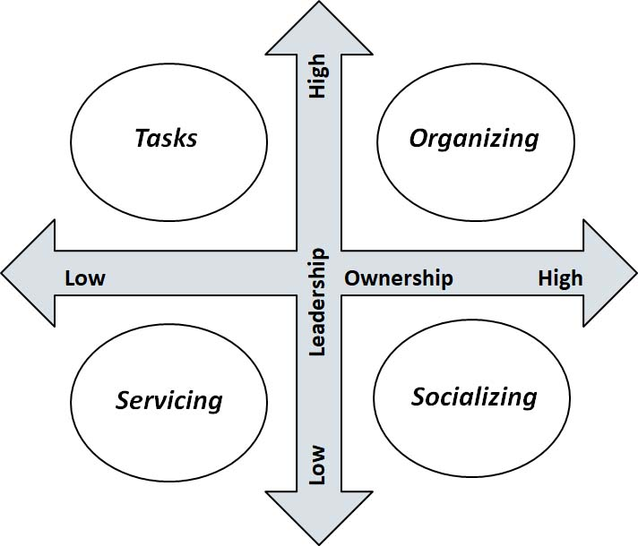
Engagement Grid pg. 124
What are typical things that members and leaders do in a union?
…Let’s sort it out

Slide 43
Bringing it back to our Work
What aspects of the activity do you change to move it through the quadrants? How do you help move them into quadrants with more leadership and ownership?

Slide 44
Key Ideas
People grow when they have to stretch. When the union staff step back, members can step forward.
Tasks have to be meaningful and members need to own them.
Our job is to look for opportunities to coach people towards taking risks and raising expectations for what they can do with their union.

Slide 45
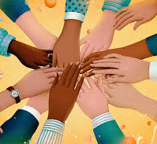
Constituency Teams
Early Career Educators
Retirees
LGBTQ group
ESP’s
Aspiring Educators
Members of Color / Social Justice
Professional Issues

Slide 46

Constituency Teams
Step 1 - What is the usual purpose of your assigned group? What are the typical values or issues that bind this group together? (Keep this secret for now)
Step 2 Brainstorm list of “tasks” or “asks” that your assigned group performs and sort them into each quadrant- (socialize, tasks, service, organize) be specific about the activities they would do. (chart with quadrants and list of activities)
Step 3 - Choose 3 of the tasks from step 2 to turn them into something that would be considered as living in the “organizing Quadrant”

Slide 47
Constituency Teams Report Out
Early Career Educators
Retirees
LGBTQ group
ESP’s
Aspiring Educators
Members of Color / Social Justice
Professional Issues

Slide 48
Key Ideas
How and what we invite members to do, sets the tone for the relationship and the expectations of what is possible in their union.
If we never move on from BBQ’s and info-meetings, we get stuck in a non growth, risk averse culture.
Once a culture is set, it requires disciplined, intentional, methods for changing the levels of engagement.

Slide 49


Slide 51
“Organizing is a fancy word for relationship-building.”

Slide 52
Definition Review
Organizing is shared leadership that enables people to turn the resources they have into the power they need to make the change they want.
Power comes from the shared commitment of that community to risk their resources in order to achieve a common purpose.
Commitment is developed through visible, public relationships.

Slide 53
What is a public relationship?
Public Relationships are visible and build shared understanding through a focus on:
  Shared Work
  Shared Values
  Shared Interests

Slide 54

Group work
Review P. 135
Where is most of your work completed?
Recruitment, Maintenance, or Mobilizing?

Slide 55

Organizing Conversation Review P. 140
Introduce
Exchange
Educate, Agitate
Seek Commitment
Who here is trusted and respected?

Slide 56
Leadership Conversations
What do we actually do with all that leadership ID data?
How do we authentically follow up?
Who follows up?

Slide 57
What do you hear that you think is important to share?

Slide 58
Organizing Conversation Report Out
What did you notice?

Slide 59
Key Ideas
Listen and ignore the qualities that you think people have to check.
Organizing is selective, and must be if we are to build the structures that move people forward. But you must be able to check your own bias in this work, or you will continue to pick people that you like.
Relational meetings for those you want to dig deeper with, the wide net is 2-3 minutes with other people.
You also need to share in these conversations, reflect a little on your own story and what you share as part of your public life.
Tension is not a negative, it is energy. Where does energy come from?

Slide 60
Communication Shut Downs P. 143
Generate at least one effective direct/redirect to the communication shutdown.
If you get stuck move on.
Your goal is for your group to get at least one redirect for each shut down.
15 minutes

Slide 61
Communications Shut Down Report Out
Did any team get a response for all?
Who has a one that they had to skip?
Who has a way to respond?

Slide 62
SHOULD WE INCLUDE THESE Next Slides Here?

Slide 63
Handling Objections: AAR
Acknowledge/Affirm
– Affirm their feeling without legitimizing the excuse
Answer
– Answer the question and address the issue they’ve raised concisely
Redirect
– ASK a question that takes them back to THEIR issues

Slide 64

“Nothing will ever change”
Acknowledge/Affirm
– “I understand you feel that way right now, especially since the boss never talks to any of us about the changes they are making before they make them…”

Slide 65
“Nothing will ever change”
Answer
– While things don’t change overnight, the reality is if teachers choose to do nothing then nothing will ever change.
When we come together as a union we have a chance to make improvements to these types of things because we have more power as a group than we do on our own.

Slide 66

“Nothing will ever change”
Redirect
– If you and the other teachers at your school had a say in the evaluations, what would be the first thing you’d improve?”

Slide 67
Best Practices on Objections
If they say “no” or “maybe” when you call the question,
ask, “What’s holding you back?”
Don’t spend a lot of time on the objection
Don’t let them off the hook
Don’t ignore the objection
Come back to their issues

Slide 68
Organizing Conversation Fish Bowl Tag Team
One trainer will be the leader that is the target of an organizing conversation.
Another trainer will be the facilitator who moves participants into and out of the “bowl” to serve as the organizer in the middle.
The “leader” will put up three objections each round. After the ”organizer” gives a response to the objection- the facilitator will say stop, thank the current participant, and have another “organizer” jump in where the other person left off. (This will mean the member/trainer will have to respond to the previous person- but it allows the person to pivot and have to practice).
After three objections and responses- stop and reset. Ask the group what went well and what did not.
Total of 3 Rounds

Slide 69
Background for the Leader
You are a leader who has not been very involved in the union but you are very involved in your worksite. You are 9 years into your profession. You have thought about being a union member, but time has passed and you have not see a reason to join at this point. You do not particularly care about professional issues, and are worried about your pay and being able to afford to stay in the profession. Maybe a few years ago you would have been interested in professional issues.

Slide 70
Background for the Organizers
You have done the 1-1's in the building and this person was ID-ed as the most respected person. You got this person to to agree to another meeting with you. You want them to join your professional issues leadership team. The team wants to demand that they have the professional autonomy to design and run a peer mentoring and support program that helps new and struggling classroom educators.
You have done the 1-1's in the building and this person was ID-ed as the most respected person. You got them to agree to another meeting. You want them to join your professional issues team.

Slide 71
Key Ideas
Relational Meetings are not just ‘get to know you’. They are intentional, targeted to specific people.
The goal is to walk away with the foundation of a public relationship and commitment to keep working together.
We have to pivot and focus on what members care about ignoring our personal agendas and biases.
If we keep agitating on our interests and not theirs we lose the chance to learn more and go deeper.

Slide 74
Stand up Masterpiece
Make three columns

Slide 75

Gallery Walk

Slide 76

Whole group discussion:

Slide 77
Key Ideas
Risk is required to move from club to fighting union and from advocacy to organizing.

Slide 78
TeamWork
Pg 163, 164
Some of you are Organizers
Some of you are one of the Characters
Your task is to get a commitment.

Slide 81
Debrief

Slide 82
Key Ideas
How we speak about the work either centers worker agency or it does not.
We have to be able to TEACH MEMBERS TO DO THIS WORK
We need a continuous plan for working with the folks not already part of our base.

Slide 83
Renita

Slide 84
Values
Values are fundamental beliefs that dictate behavior
Ideally, Unions advance the welfare of all workers.
They are based on the universal ideal of human rights, the idea of justice, progress, and betterment of self and of society.
Through shared values, workers build solidarity and commit to active participation in the labor movement.
Shared values transform individual members into part of something larger than themselves.

Slide 85
Some Union Values
Fairness, honesty/integrity, responsibility, compassion/empathy, safety, health, generosity, hard work/responsibility, community, freedom, democracy, binding contracts, equality, opportunity, respect, stability/security, unity, quality work, justice, collective action, dignity/respect, charity/community service, and due process.

Slide 86
Power is a function of Courage and Unity
Our Ultimate Power
Amount of Effort or Courage to Persist and Act
Unity - Number of People Sharing the Values, Pain, and Actions

Slide 87
Low level of courage and high number of actors…
Amount of Effort or Courage to Persist and Act
Sign an online Petition
Unity - Number of People Sharing the Values, Pain, and Actions

Slide 88
High level of courage and low number of actors…
Storm the Superintendent’s Office
Amount of Effort or Courage to Persist and Act
Unity - Number of People Sharing the Values, Pain, and Actions

Slide 89
High Participation Is a Prerequisite to Power - Super Majority of Workers Engaged

Slide 90
But Also Need…
Unity (against division) TIGHT STRUCTURE Demonstrable & Sustainable Super-Majorities

Slide 91
It’s your turn –
Our Ultimate Power
Where is each scenario on this graph (p.16)?
Do they have the power to achieve their demand? Why?
What would you do to increase the power needed to achieve their demand?

Slide 92
Ellen

Slide 93
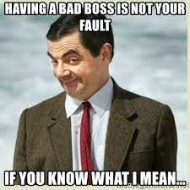
Make a list
What are some objectionable things that bosses have done to the workers of your at-home campaign?

Slide 94
How do you identify a worker issue?
As a group – put a check next to each of the issues you think would be great for collective action.
How did you decide?

Slide 95
How do you identify a worker issue? Round 2
Now, use the Assessment Tool on Page 6 of your handouts, identify which of these issues is ready for collective action.
Were there differences?

Slide 96
Key Ideas
If you don’t know the issue – ask the people.
Issues should meet the criteria of
  Widely and Deeply Felt by the people
  Is Winnable – the demand needs to make sense given the amount of power your base has
  Brings more people to the cause
  Is connected to students and the public
You can’t care about winning the issue more than the people.

Slide 97

We are coaching towards the Interdependent Structure – Leadership and Ownership Rich

Slide 98
Renita and Ellen

Slide 99

Ending it Right
Choice Networking
Housekeeping
Feedback via email

Slide 100

Choice Network Time

