Slide 1
Constituency Organizing
From Club to Fighting Union

Slide 2
Honoring This Space
We begin by acknowledging that through a history of colonization and brutality, we are currently on the traditional lands stewarded by generations of the XXXXXXXXXXXXX
We honor these indigenous people, all elders, past, present, and emerging. We are called to learn and share these learnings about this tribal history, culture, and contributions that have been suppressed in the telling of the story of what we now call the United States of America.

Slide 3
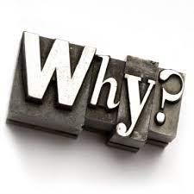
Why are we Here?
NEA has an enterprise wide emphasis on organizing.
Our UniServ focused events don’t always meet the needs of organizers.

Slide 4

Logistics to Remember
Questions to Ask
Bathroom
Materials
Food
Room Temperature
Jasmine as a Resource
Travel
Vouchers

Slide 5

3 Day Agenda
Days 1 and 2
7:30-8:30 Breakfast
8:30 Convene
10:15-10:30 Break
12:00- 1:00 LUNCH
2:15-2:30 Break
4:30-5:00 Choice Networking
5:00 Adjourn
Day 3
7:30-8:30 Breakfast
8:30 Convene
11:00-11:15 Break
1:00 Boxed Lunch
1:00-2:00 Choice Networking
2:00 Adjourn

Slide 6

Today’s Outcomes

Slide 7

Community Agreements pg 2-3
Using Self-Awareness and Self-Knowledge
Listening for Understanding
Being Gracious
Staying Engaged
Being Open and Suspend Judgment
Saying “I”- tell your truth
Seeking Discomfort
Reaching Empathy
Expecting Non-Resolution and Non-Closure
*Adapted from “Embracing equity and inclusion”, Annie E. Casey Foundation
Notes:
Community Agreements for Our Time
Awareness and Self-Knowledge
This requires self-knowledge and self-awareness. Self-knowledge allows you to see what causes you pain and conflict and enables you to embrace your contradictions and inconsistencies. It allows the space to work on things about yourself that you are not happy with. In turn, self-knowledge helps to prevent you from projecting your negative aspects onto other people. Bringing your best self also requires that you have a positive attitude, are willing to deeply explore your perspectives and remain open to the perspectives and experiences of others.
Listening for Understanding
Be an active listener. Active listening involves paying full and careful attention to the other person, looking him or her in the eye, avoiding interruptions, reflecting your understanding, clarifying information, summarizing the other person’s perspectives and sharing your own. Remember that most people need time to open up and might not be willing to immediately share their personal stories, hopes, fears and/or concerns.
Being Gracious
Being kind is a vital way of bringing meaning to our own lives, as well as the lives of others. Kindness is about caring genuinely for others around you, wanting the best for them and recognizing in them the same wants, needs, aspirations and even fears that you may have. Being kind and generous allows us to communicate better with others, to be more self-compassionate and to be a positive force in other people’s lives. This includes following the COVID protocols that are in place to protect the health of this learning community.
Stay Engaged
Staying engaged requires you to be morally, emotionally, intellectually and socially involved in the conversation. Staying engaged means that you are listening with curiosity and willing to deepen your understanding. Staying engaged might also require you to sustain the conversation even when it gets uncomfortable or diverted. This also means a commitment to keeping your electronic communications to a minimum with folks not present in this learning community.
Be Open and Suspend Judgment
Listening with an open mind includes being receptive to the influence of others. You can suspend judgment by becoming aware of preconceived notions and listening to everything someone has to say before jumping to conclusions. Most importantly, suspending judgment also means listening to what the speaker has to say for understanding, not just to determine whether the speaker is right or wrong.
Say “I”- tell your truth
Speaking your truth in authentic and courageous conversations about race requires a willingness to take risks. It means that you will be absolutely honest and candid about your own thoughts, feelings, experiences and opinions and not just saying what you perceive others want to hear. Speaking your truth will require you to speak from the “first person” and use “I” statements.
Seek Discomfort
Leaning in to discomfort will require you to let go of racial understandings and stereotypes that you may be holding onto in order to move forward. Leaning in means that you will avoid judgment, assume positive intent and be open to the kernel of wisdom in each individual’s experiences. Leaning in to discomfort will require you to sit through moments of embarrassment, confusion, anxiety and/or fear.
Reaching Empathy
Empathy and compassion allow you to understand the other person’s point of view. When you are empathetic, you are more understanding, patient and kind. Expanding your capacity to feel empathy will also allow others to enter your circle of human concern.
Resolution and Closure
Expect and accept that there may not be closure. It is not likely that you will resolve your personal understanding about race or another person’s racial experience in a single conversation. The more you talk about race with another person, the more you learn and the more they will learn. Authentic and productive conversations about race are continuous and always evolving.
*Adapted from “Embracing equity and inclusion”, Annie E. Casey Foundation

Slide 8
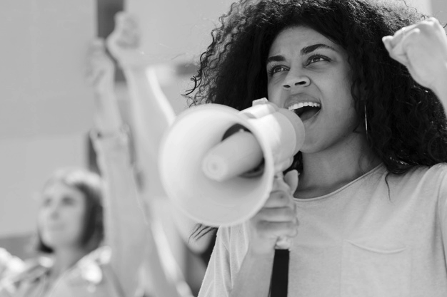
One Revolution Around the Room
Name
Required Pronoun
State

Slide 9


Slide 10

Picturing Power
At Your Tables – Each Person Picks 3 Pics
Each person shares Name, Pronouns, Location, and uses all three of Pics they Picked to define power.
Round 2 – Stand and form triads – share Name Pronouns, Location and Definition of Power with 3 Pics
Round 3 – Repeat Round 2

Slide 11
Whole Room Report
What are some common themes you heard?
What really surprised you OR left you wondering?

Slide 13

Power in Our Work p. 8-12
Move into quads (someone you are not currently sitting with and don’t know well)
Each Person in the group develops a statement about how their employer defines power.
HOW does your employer want that power exressed? AKA what does power look like in action?
Each Team Creates a Poster
  Each person draws their state and puts their name and statement about power in the state outline.

Slide 14
Power in Our Work Closing Thoughts
For our time together we will use this definition:
Organizing and leadership are about accepting responsibility for enabling others to achieve shared purpose in the face of uncertainty.

Slide 15
Power in Our Work Closing Thoughts
When we remove enabling -
Organizing and leadership are about accepting responsibility for others to achieve shared purpose in the face of uncertainty.
We lose agency, structures, teams, and shared accountability.

Slide 16
Power in Our Work Closing Thoughts
When we take out “to achieve purpose”
Organizing and leadership are about accepting responsibility for enabling others in the face of uncertainty.
We lose our “why,” the issues, and the problems that matter.

Slide 17
Power in Our Work Closing Thoughts
When we take out uncertainty
Organizing and leadership are about accepting responsibility for enabling others to achieve shared purpose.
It simply becomes socializing with a predictable outcome.

Slide 18

Key Ideas
A number of examples you had were about power over, or using power.
Our final definition is about BUILDING
power together in order to USE it to make change
Organizing is about shared risk and accountability in the face of uncertainty
Unity is the basis of our power.

Slide 19
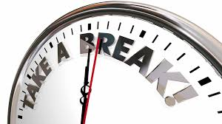

Slide 21

Community and Constituency P. 13-17
Quick Table Talk and Article Review
What are the differences between community and constituency?

Slide 22
Defining Communities
A community shares values or interests.
Remember organizing? Enabling, achieve shared purpose, uncertainty

Slide 23
Defining Constituency
Constituencies are communities, people who share common values or interests, organized to use its resources to act in their interests. Constituents are the heart of an organization, they have voice. If we treat people like customers (service model), they can only exit to make influence.

Slide 24
Pause to think:
Is the concept of power different in a community vs. a constituency?

Slide 25

Constituencies: Their Values and Interests
Group Wall Charts
In one column brainstorm all the constituencies you are aware of in your work settings
In the second column, write the special core values, interests, or issues that each constituency has.
Look for what might be common in the second column

Slide 26
Community and Constituency Whole Room
What did your discover by listing these constituencies and their values, interests, and issues?

Slide 27
Key Ideas
Constituencies are distinct from communities.
Organizing identifies their common values and interests builds structure to act. Building power.
When we treat constituents like customers, their only avenue is to exit. They relied on us to have power.
Only organizing small groups within the larger community limits power and gives us fewer resources to leverage for change.

Slide 29

Frames of Teacher Unionism
Using your brainstormed list of constituencies, work to identify which frame of teach unionism they are operating from.
Read the “key components” and if you think that represents a particular constituency, write its name there.
A single constituency may be in any of the columns, depending on the topic.
More than one constituency may be in the same place.

Slide 30
Frames of Teacher Unionism Report Out
What are you noticing in working to identify where your constituencies lie within the three frames?
If we had asked you to assess which frame your employers say they are working in – or your locals – do you think they would be different?
If the whole organization is the community – how then do these constituencies contribute to the overall picture of power?

Slide 31
Key Ideas
Without consistent and intentional organizing, constituencies become separate entities from the larger union community.
Without intentional and consistent organizing, unions become separate entities from larger social movements (labor, class, race, gender)

Slide 32
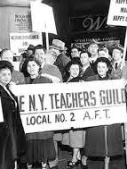
Visions of Justice P. 22-32
Review article and answer:
Across the history, as outlined in this article, when were the teachers most powerful? Least powerful? How did unity or the lack of it contribute to this?

Slide 33


Slide 34
Visions of Justice P. 22-32
Groups of 3
How do the tensions of self-interest (industrial, and professionalism) and broader social justice concerns(social justice) make it difficult to move a community to constituency?
How do you see these tensions in your own work with members?

Slide 35
Key Ideas
Without consistent and intentional organizing, constituencies become separate entities from the larger union community.
Without intentional and consistent organizing, unions become separate entities from larger social movements (labor, class, race, gender)
Long lasting Unity within teacher unions requires BOTH a focus on self-interests and public interest.

Slide 37

Organizer Discourse
A conversation of professionals, not specifically led by any one person. These professionals share a particular way of working, values, language, and issues.
What are the challenges you are currently facing that you hoped this training would address?
In response you can
  Question
  Provide suggestion
  Add to the story (me too, and…)

Slide 40

How can I plan for my next steps?

Slide 41
Club or Union? Pg 47 Table Talk
Which of these columns best describes the constituency you’re focusing on?
What indicators stand out to you?
Unorganized
Club
Union
Fighting Union

Slide 42
Levels of Organizing P. 33-35
Advanced
Members Lead
Basic
Member and Staff Partners
Staff Coach and Build Leader Capacity
Beginning
Staff Lead
Staff Focus on Engagement and Leader ID
Survival
Staff Lead
Staff Advise and Coach
Focus on Recruitment and Engagement

Slide 43

Peer to Peer Planning
Advanced and Basic on the Right
Survival and Beginning on the Left
Form groups of 3 to 4, with at least one person from each side of the room on each team

Slide 44
Planning to Move Up Levels of Organizing P. 36-38
Advanced
Basic
Beginning
Survival
Using the planning sheets, think through explicit ways you can make changes in your work that move you up a level.

Slide 45
Whole Room Idea Sharing
Advanced
Basic
Beginning
Survival
What are some ideas you have for moving your work to a new level?
Unorganized
Club
Union
Fighting Union

Slide 47
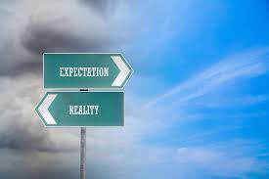
Levels of Commitment and Raising Expectations
LAE and NYSUT – Why Join Webpages p. 39-40
On the Club to Fighting Union grid, p. 47 – where would you place them?
What are the expectations set up by these two webpages?
Who has the responsibility for committing to make these expectations happen?

Slide 48

Group Charts – What do you want to do?
What are the kind of actions and level of commitment you want to recruit/invite people to do back home?
We are going to use these ideas tomorrow in our one on one clinic, so please capture them on the charts.

Slide 49
Key Ideas
Having low expectations for members or offering services does not set any expectation for involvement.
It is critical that we invite members in and set the expectation that involvement is key to power.

Slide 50
Ellen

Slide 51

Ending it Right
Choice Networking
Housekeeping
Feedback via email

Slide 52

Choice Network Time

