Slide 1
Constituency Organizing:
From Club to Fighting Union
Day 2- Correct PP

Slide 2

Community Agreements pg 2-3
Using Self-Awareness and Self-Knowledge
Listening for Understanding
Being Gracious
Staying Engaged
Being Open and Suspend Judgment
Saying “I”- tell your truth
Seeking Discomfort
Reaching Empathy
Expecting Non-Resolution and Non-Closure
*Adapted from “Embracing equity and inclusion”, Annie E. Casey Foundation
Notes:
Community Agreements for Our Time
Awareness and Self-Knowledge
This requires self-knowledge and self-awareness. Self-knowledge allows you to see what causes you pain and conflict and enables you to embrace your contradictions and inconsistencies. It allows the space to work on things about yourself that you are not happy with. In turn, self-knowledge helps to prevent you from projecting your negative aspects onto other people. Bringing your best self also requires that you have a positive attitude, are willing to deeply explore your perspectives and remain open to the perspectives and experiences of others.
Listening for Understanding
Be an active listener. Active listening involves paying full and careful attention to the other person, looking him or her in the eye, avoiding interruptions, reflecting your understanding, clarifying information, summarizing the other person’s perspectives and sharing your own. Remember that most people need time to open up and might not be willing to immediately share their personal stories, hopes, fears and/or concerns.
Being Gracious
Being kind is a vital way of bringing meaning to our own lives, as well as the lives of others. Kindness is about caring genuinely for others around you, wanting the best for them and recognizing in them the same wants, needs, aspirations and even fears that you may have. Being kind and generous allows us to communicate better with others, to be more self-compassionate and to be a positive force in other people’s lives. This includes following the COVID protocols that are in place to protect the health of this learning community.
Stay Engaged
Staying engaged requires you to be morally, emotionally, intellectually and socially involved in the conversation. Staying engaged means that you are listening with curiosity and willing to deepen your understanding. Staying engaged might also require you to sustain the conversation even when it gets uncomfortable or diverted. This also means a commitment to keeping your electronic communications to a minimum with folks not present in this learning community.
Be Open and Suspend Judgment
Listening with an open mind includes being receptive to the influence of others. You can suspend judgment by becoming aware of preconceived notions and listening to everything someone has to say before jumping to conclusions. Most importantly, suspending judgment also means listening to what the speaker has to say for understanding, not just to determine whether the speaker is right or wrong.
Say “I”- tell your truth
Speaking your truth in authentic and courageous conversations about race requires a willingness to take risks. It means that you will be absolutely honest and candid about your own thoughts, feelings, experiences and opinions and not just saying what you perceive others want to hear. Speaking your truth will require you to speak from the “first person” and use “I” statements.
Seek Discomfort
Leaning in to discomfort will require you to let go of racial understandings and stereotypes that you may be holding onto in order to move forward. Leaning in means that you will avoid judgment, assume positive intent and be open to the kernel of wisdom in each individual’s experiences. Leaning in to discomfort will require you to sit through moments of embarrassment, confusion, anxiety and/or fear.
Reaching Empathy
Empathy and compassion allow you to understand the other person’s point of view. When you are empathetic, you are more understanding, patient and kind. Expanding your capacity to feel empathy will also allow others to enter your circle of human concern.
Resolution and Closure
Expect and accept that there may not be closure. It is not likely that you will resolve your personal understanding about race or another person’s racial experience in a single conversation. The more you talk about race with another person, the more you learn and the more they will learn. Authentic and productive conversations about race are continuous and always evolving.
*Adapted from “Embracing equity and inclusion”, Annie E. Casey Foundation

Slide 3
Outcomes for The Day
Understanding how the frames of unionism apply to consituency groups.
Assess our own work
Why people belong to unions
Resources, what they are and are not
How we identify and engage leaders
How we build our base for power

Slide 4
Breaks for Today
Start 8:55 am
Break 10:00am- 10:15am
Lunch 12pm-1pm
Break 2:15pm-2:30pm
Closing 4:00pm
National Civil Rights Museum

Slide 5
Melissa Dan
Power Conversation Conclusion

Slide 6

Power in Our Work Closing Thoughts
Organizing and leadership are about accepting responsibility for others to achieve shared purpose in the face of uncertainty.

Slide 7
Power in Our Work Closing Thoughts
When we remove enabling -
Organizing and leadership are about accepting responsibility for others to achieve shared purpose in the face of uncertainty.
We lose agency, structures, teams, and shared accountability.

Slide 8
Power in Our Work Closing Thoughts
When we take out “to achieve purpose”
Organizing and leadership are about accepting responsibility for enabling others in the face of uncertainty.
We lose our “why,” the issues, and the problems that matter.

Slide 9
Power in Our Work Closing Thoughts
When we take out uncertainty
Organizing and leadership are about accepting responsibility for enabling others to achieve shared purpose.
It simply becomes socializing with a predictable outcome.

Slide 10

Key Ideas
A number of examples you had were about power over, or using power.
Our final definition is about BUILDING
power together in order to USE it to make change
Organizing is about shared risk and accountability in the face of uncertainty
Unity is the basis of our power.

Slide 11

Zac Johnson
Northern Colorado Uniserv Unit
He/Him/His

Slide 12

Community and Constituency P. 13-17
Quick Table Talk and Article Review
What are the differences between community and constituency?

Slide 13
Defining Communities
A community shares values or interests.
Remember organizing? Enabling, achieve shared purpose, uncertainty

Slide 14
Defining Constituency
Constituencies are communities, people who share common values or interests, organized to use its resources to act in their interests. Constituents are the heart of an organization, they have voice. If we treat people like customers (service model), they can only exit to make influence.

Slide 15
Pause to think:
Is the concept of power different in a community vs. a constituency?

Slide 16

Constituencies: Their Values and Interests
Group Wall Charts
In one column brainstorm all the constituencies you are aware of in your work settings
In the second column, write the special core values, interests, or issues that each constituency has.
Look for what might be common in the second column

Slide 17
Community and Constituency Whole Room
What did your discover by listing these constituencies and their values, interests, and issues?

Slide 18
Key Ideas
Constituencies are distinct from communities.
Organizing identifies their common values and interests builds structure to act. Building power.
When we treat constituents like customers, their only avenue is to exit. They relied on us to have power.
Small organized groups within the larger community have limited power and can access fewer resources for change.

Slide 19
Jeny Gardner
Wyoming EA
She/He/They

Slide 20

Frames of Teacher Unionism
Using your brainstormed list of constituencies, work to identify which frame of teach unionism they are operating from.
Read the “key components” and if you think that represents a particular constituency, write its name there.
A single constituency may be in any of the columns, depending on the topic.
More than one constituency may be in the same place.

Slide 21
Frames of Teacher Unionism Report Out
What are you noticing in working to identify where your constituencies lie within the three frames?
If we had asked you to assess which frame your employers say they are working in – or your locals – do you think they would be different?
If the whole organization is the community – how then do these constituencies contribute to the overall picture of power?

Slide 22
Key Ideas
Without consistent and intentional organizing, constituencies become separate entities from the larger union community.
Without intentional and consistent organizing, unions become separate entities from larger social movements (labor, class, race, gender)

Slide 23
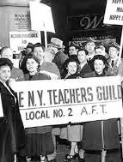
Visions of Justice P. 22-32
Groups of 3
How do the tensions of self-interest (industrial, and professionalism) and broader social justice concerns(social justice) make it difficult to move a community to constituency?
Across the history, as outlined in this article, when were the teachers most powerful? Least powerful? How did unity or the lack of it contribute to this?
How do you see these tensions in your own work with members?

Slide 24
Key Ideas
Long lasting Unity within teacher unions requires BOTH a focus on self-interests and public interest.

Slide 25
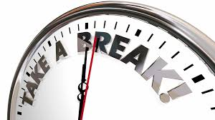

Slide 26
Melissa Dan
Palm Beach Classroom Teachers
Association
She/her/hers

Slide 27
Organizing is about...
Turning our community into a constituency that can pool its resources, we need to have a good handle on how they are currently operating so what we (staff) can adjust our work with them to growth their capacity.

Slide 28
Club or Union? Table Talk
Which of these columns best describes the constituency you’re focusing on?
What indicators stand out to you?
In your handbook, page 47 and page 33-38
Unorganized
Club
Union
Fighting Union

Slide 29
Levels of Organizing P. 33-35
Advanced
Members Lead
Basic
Member and Staff Partners
Staff Coach and Build Leader Capacity
Beginning
Staff Lead
Staff Focus on Engagement and Leader ID
Survival
Staff Lead
Staff Advise and Coach
Focus on Recruitment and Engagement

Slide 30

Peer to Peer Planning
Advanced and Basic on the Right
Survival and Beginning on the Left
Form groups of 3 to 4, with at least one person from each side of the room on each team

Slide 31
Planning to Move Up Levels of Organizing P. 36-38
Advanced
Basic
Beginning
Survival
Using the planning sheets, think through explicit ways you can make changes in your work that move you up a level.

Slide 32
Whole Room Idea Sharing
Advanced
Basic
Beginning
Survival
What are some ideas you have for moving your work to a new level?
Unorganized
Club
Union
Fighting Union

Slide 33
Key Ideas
Clubs are fixed, are not growing, and do not have enough resources to achieve the wins they want or to move the community to act.
The best way to transform a community into a constituency is to listen for the shared issues and values in order to invite people to act for a shared purpose.
When WE (staff) do the work, lead the work, make the change happen- we take the opportunity for growth away from a leader and a constituency.

Slide 34
Ellen Holmes
NEA Uniserv Programs
She/Her/Hers

Slide 35
What is your people’s most precious resource ?
Notes:
Sara

Slide 36


Slide 37
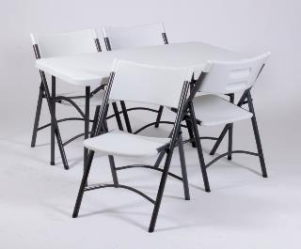
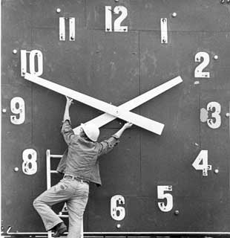

Resources that shrink as you use them.
Tangibles
Time/Energy
Money
Notes:
Sara
Resources are what your people have to help them make change. These are resources that are limited and are reduced as you use them.

Slide 38
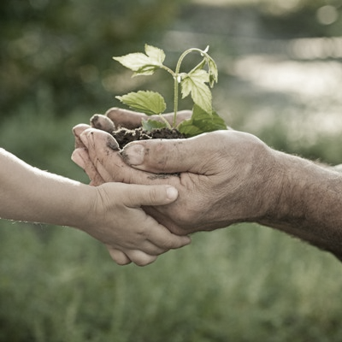
Resources that Grow as You Use Them
Relationships
Skills
Hope
Trust
Notes:
Sara
These resources are the most important. The more you use relationships, the more you trust, the more that you coach people in using their skills the more capacity they develop for action- these resources grow.

Slide 39
These resources are most precious, because they are priorities that people make decisions about.
Time
Energy
Notes:
Sara
Resources are what your people have to help them make change. These are resources that are limited and are reduced as you use them.

Slide 40

Resource Analysis P. 50-52
4 Groups, each with one of the cases found on P. 53-82
Refer to the case study notes you completed prior to on P. 50-52
Each team completes the chart on P. 49 and prepares to share what they found.

Slide 41
Report Out and then Final Reflections
Each team shares for 2-3 minutes what they discovered about their case.
Final reflections –
How do your groups think about resources at home?
How do they get them?

Slide 42
Key Ideas
For any campaign to be effective, the leadership team needs to assess the constituents’ resources and capabilities and those of the “boss” or target of the campaign.
The bigger the win, the more resource you need.
Adding new people adds new and varied resources.
Money is a vital resource, but time, connections, and relationships of a constituency’s members are the strongest resource they have.

Slide 43


Slide 44
Ellen Holmes
She/Her/Hers

Slide 45

Organizer Discourse
A conversation of professionals, not specifically led by any one person. These professionals share a particular way of working, values, language, and issues.
What are the challenges you are currently facing that you hoped this training would address?
In response you can
  Question
  Provide suggestion
  Add to the story (me too, and…)

Slide 46
Katie Bishop
WEA Sammamish
She/Her/Hers

Slide 47

Whole Room Discussion
How do you identify and track leaders in your state?
Systemic Process on page 89-91
What is the difference?

Slide 48
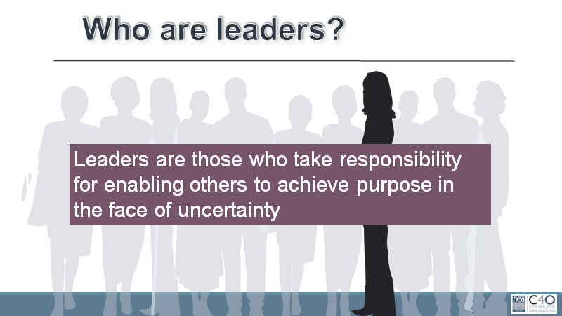

Slide 49
Leadership Cycle and Leadership Spiral
Leader Growth
Accountable
Implement
Reflect Assess
Proceed
Make Change
Stop
Recruit
Develop
Identify

Slide 50


Slide 51
What did you notice as you watched?

Slide 52
Why Trusted AND Respected?
Trusted:
They will have your back
Respected:
Their work or visible beliefs have value to you.
Trusted AND Respected have the resource we need most – relationship and connections between people.

Slide 53
Warning about any leader ID system

Slide 54
Key Ideas
Leaders are not fixed to a certain characteristic, have been trained by the organization, or must be members of the union.
Leaders are those people who are trusted and respected by their colleagues.
Leaders have followers.

Slide 55
Some Definitions for Group Work
Leaders – Trusted and respected by their colleagues in ways that cut across communities of workers- are connected by values and influential relationships with mobilizers, activists, and those not yet part of the work. Get people to move their thinking and take action.
Mobilizers – Are already convinced members, who are already willing to take action. They are connected to the other already convinced.
Activists – Supportive and willing to act if invited but not able to move others.

Slide 56
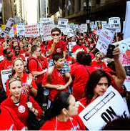


Leaders, Mobilizers, and Activists – Scenarios pg 121-122

Slide 57
Team Work Leaders, Mobilizers, and Activists
Who is a leader, a mobilizer, and an activist? How do you know?
In what order would you want to invite them into your cause and why?

Slide 58
How Recruitment Grows Your Base
Leaders bring their followers.
Mobilizers bring their loyalty to leaders and their reputation with colleagues.
Activists bring their potential.

Slide 59
Key Ideas
Title does not indicate the leader.
Leadership characteristics (think True Colors do not make natural leaders.
Our primary job is to identify leaders who can build shared power, responsibility, and authority.
We grow our constituency’s resources for action by intentionally and continually increasing the base of people.
Leaders are our greatest resource.

Slide 60


Slide 61
What did you hear that you want to highlight?

Slide 62
Key Ideas
Patient and persistent identification of the trusted and respected leaders. And it may not be someone who is with us.
Members pick their leaders, we cannot pick them for them.
We cannot grow and become a fighting union without bringing in new leaders. The identification and inclusion of new leaders is the core of a fighting union.
Then we have to figure out what matters to them.
Cannot shy away from really hard conversations- they are critical to making the change we need.
Unity is the basis of our power and without mass involvement and engagement of our constituency- we do not have the power we need to make the change we cannot alone.

Slide 64
Zac Johnson
Northern Colorado Uniserv Unit
He/him/his

Slide 65
What are some of the activities that you typically ask members to do?

Slide 66
Do you ask your members to do activities that require them to lead others in the face of uncertainty?

Slide 67
Even clubs, form around a shared sense of purpose and shared values.

Slide 68
Definition Reminder: Values P. 145
Values are fundamental beliefs that dictate behavior
Ideally, Unions advance the welfare of all workers.
They are based on the universal ideal of human rights, the idea of justice, progress, and betterment of self and of society.
Through shared values, workers build solidarity and commit to active participation in the labor movement.
Shared values transform individual members into part of something larger than themselves.

Slide 69
Some Union Values
Fairness, honesty/integrity, responsibility, compassion/empathy, safety, health, generosity, hard work/responsibility, community, freedom, democracy, binding contracts, equality, opportunity, respect, stability/security, unity, quality work, justice, collective action, dignity/respect, charity/community service, and due process.

Slide 70
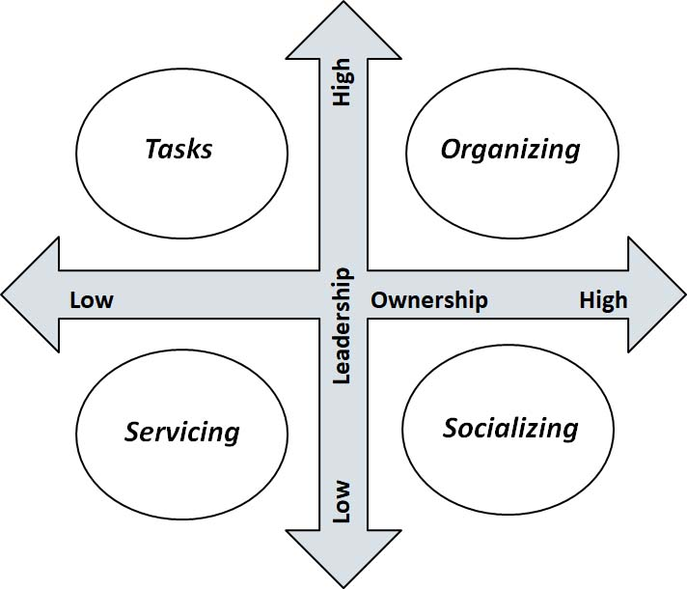
Engagement Grid pg. 124
What are typical things that members and leaders do in a union?
…Let’s sort it out

Slide 71
Bringing it back to our Work
What aspects of the activity do you change to move it through the quadrants? How do you help move them into quadrants with more leadership and ownership?

Slide 72
Scenario
There is a constituency group that is focused on professional issues organizing.
Staff writing the training and present the training and invite members to it.

Slide 73
Key Ideas
People grow when they have to stretch. When the union staff move back, members can move forward.
Tasks have to be meaningful and members need to own them.
Our job is to look for opportunities to coach people towards taking risks and raising expectations for what they can do with their union.

Slide 74
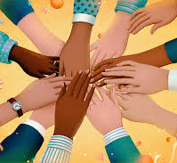
Constituency Teams
Early Career Educators
Retirees
LGBTQ group
ESP’s
Aspiring Educators
Members of Color / Social Justice
Professional Issues

Slide 75

Constituency Teams
Step 1 - What is the usual purpose of your assigned group? What are the typical values or issues that bind this group together? (Keep this secret for now)
Step 2 Brainstorm list of “tasks” or “asks” that your assigned group performs and sort them into each quadrant- (socialize, tasks, service, organize) be specific about the activities they would do. (chart with quadrants and list of activities)
Step 3 - Choose 3 of the tasks from step 2 to turn them into something that would be considered as living in the “organizing Quadrant”

Slide 76
Constituency Teams Report Out
Early Career Educators
Retirees
LGBTQ group
ESP’s
Aspiring Educators
Members of Color / Social Justice
Professional Issues

Slide 77
Key Ideas
How and what we invite members to do, sets the tone for the relationship and the expectations of what is possible in their union.
If we never move on from BBQ’s and info-meetings, we get stuck in a non growth, risk averse culture.
Once a culture is set, it requires disciplined, intentional, methods for changing the levels of engagement.

Slide 78
Jeny Gardner
WEA- Wyoming
She/He/They

Slide 79
Stay In Your Groups:
Review three activities (that we brainstormed earlier).
As a group strategically think about which of the other groups may share your values or issues. (Make sure your group is very clear what your interests are).
Consider the groups around the room you will target.
2. Move about and start to have 1-1s to seek commitment for your ask.
(If needed pages 136 Hard asks and Types of NO)
Your goal is to secure as many commitments as possible and build coalitions with other groups.

Slide 80
Debrief!
Who really asked you great questions?
Who genuinely made you move your thinking? How?
Who really challenged your skills in asking? Why?
What is something that you will take away from this?

Slide 81
Key Ideas
It is critical that our constituency continue to grow their base by connecting with other groups in the union.
Base building allows our constituency groups the ability to leverage more resources to achieve the things they cannot alone.
Assuming the answer without the ask will generally hurt your group more than the ask, when the ask is done correctly.

Slide 82
Breakfast at 7:30am at the Sheraton
- Start as a Whole Group tomorrow morning
- Feedback Form
Ending it Right

Slide 83

Choice Network Time

Slide 84
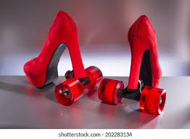
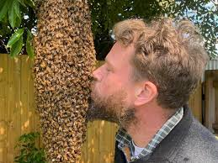
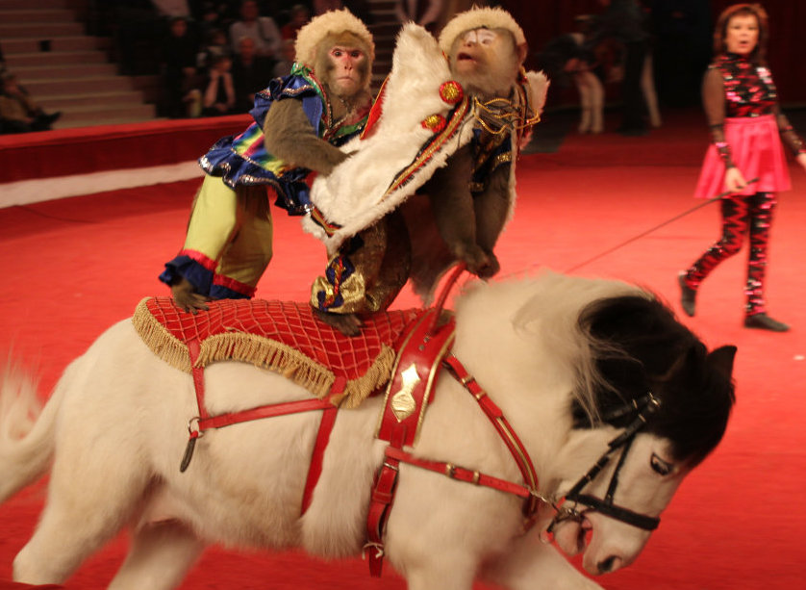
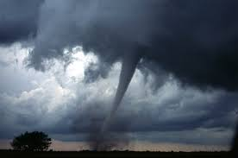
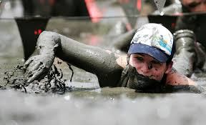
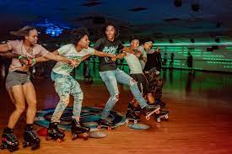
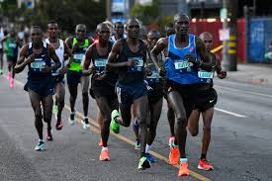
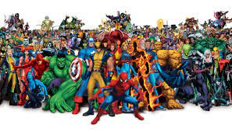
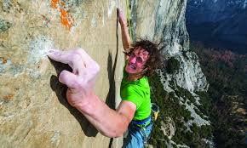
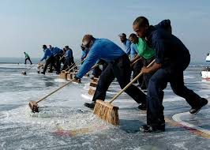
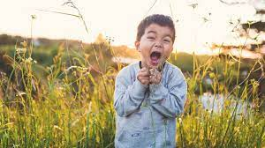
Go to the picture that best describes your work.
Gather,greet.
Share why.
One person report out.

