Slide 1

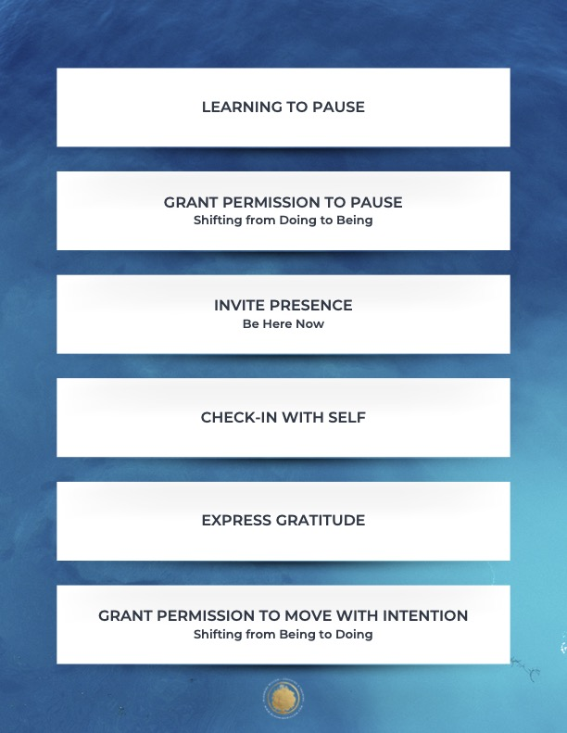

Slide 2

Awareness-based systems thinking is a transformative approach that combines understanding complex system interconnections with shifting the inner awareness, consciousness, or mindset of the people within that system. It focuses on addressing root causes rather than just symptoms.
Notes:
Examples of systems thinking in a school and union context.

Slide 3

A " Change Maker" is
a activist who believes the systems patterns, structures, values, and beliefs that we live in are not getting us the results we need to thrive, and acts to make CHANGE.
Notes:
Examples of systems thinking in a school and union context.

Slide 4
Why we use "Awareness-Based Systems Thinking"
Move beyond an individual/organizational perspectives into sensing the broader system.
Notice recurring patterns and our own role in creating them.
Move away from "reacting to the past" towards "sensing the future" and what is emerging.
Help leaders test new ways of acting, learning quickly from failures rather than fearing them.
Build new structures that support and sustain the change.

Slide 5

Notes:
Examples of systems thinking in a school and union context.

Slide 6
“We cannot solve our problems with the same thinking we used when we created them.”
Albert Einstein

Slide 7

Awareness-Based Systems Thinking Theory -
You cannot understand a system unless you can change it
You cannot change a system until you transform the MINDSET of the people enacting the system.
You cannot change the MINDSET of the people until you can make them SEE THEMSELVES, SEE THEMSELVES IN THE SYSTEM, MAKE THE SYSTEM SEE ITSELF and INVERT ITSELF.
You cannot change the system until you an SENSE the possible future.
Notes:
Examples of systems thinking in a school and union context.

Slide 8
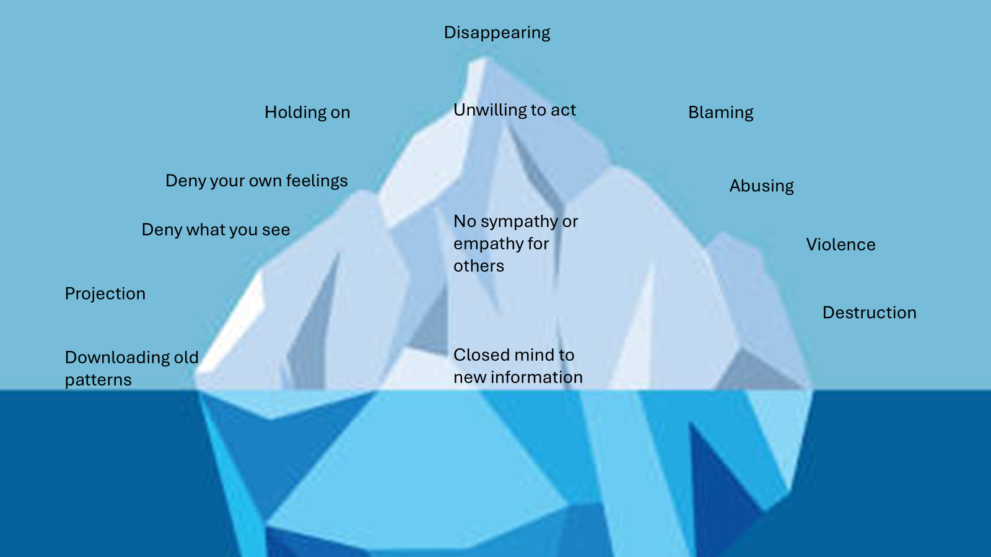

Slide 9
Co-Create: Take initiative to invite in others to co-create with you
Open Mind
Open Heart
Open Will
Suspend old patterns
How do you feel NOW? Can you move or shape your body to meet your new reality?
See with Fresh Eyes
Redirect the energy to return to old patterns.
Prototyping: What can you CREATE NOW as a symbol?
What can you do NOW to capture your inspiration?
Notice how you are feeling
Crystalizing: What could this look like in the real world? With who?
What do you need to LET GO of?
What are the ideas, possible relationships and works that you are LETTING IN?
What is Emerging? What must be done?

Slide 10
Puzzle Activity

Slide 11
Small Group ACTIVITY. 20 Minutes.
Count off by 6 and create a group. Take notes on large paper.
Pick one problem. It can be big to medium sized, for example, affecting the whole world, the nation, your state, your school division or your local union.
Define the people that are affected by or connected to this problem. List each group and how they are affected by the problem.
Label each group for +, neutral =, or against – the problem.
Download: What are some patterns of thought or beliefs that each group needs to download in order to have their position?
What are the patterns that surround each group as this problem persists?

Slide 12
ReCap: Coaching Campaign Leaders
Concepts
Competencies
Core Skills
CG TO ADD SLIDES

Slide 13
Reflection
How do you want to grow as a coach or when coaching others?
How might developing coaching skills help you grow on a deeper level?

