Slide 1

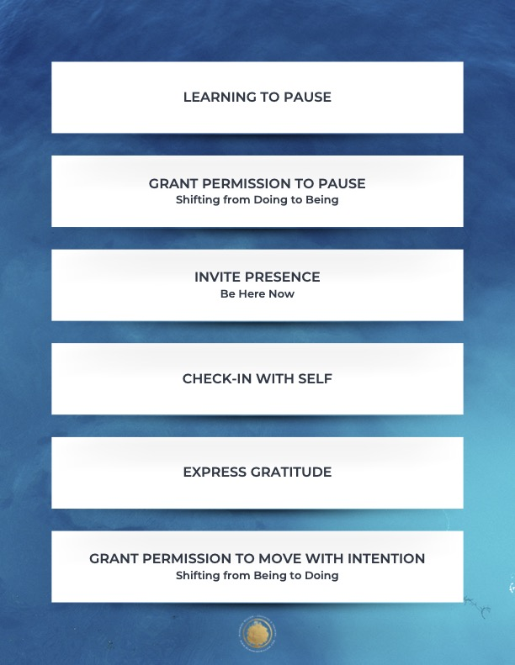

Slide 2

Notes:
Examples of systems thinking in a school and union context.

Slide 3
Notes:
Examples of systems thinking in a school and union context.

Slide 4
A " Change Maker" is a person who believes the systems patterns, structures, values, and beliefs that we live in are not getting us the results we need to thrive.
Notes:
Examples of systems thinking in a school and union context.

Slide 5
RULES OF AWARENESS-BASED SYSTEMS THINKING
You cannot understand a system unless you can change it
You cannot change a system until you transform the MINDSET of the people enacting the system.
You cannot change the MINDSET of the people until you can make them SEE THEMSELVES, SEE THEMSELVES IN THE SYSTEM, MAKE THE SYSTEM SEE ITSELF and INVERT ITSELF.
You cannot change the system until you can SENSE the POSSIBLE future.
Notes:
Examples of systems thinking in a school and union context.

Slide 6
Small Group ACTIVITY. 20 Minutes.
Count off by 6 and create a group. Take notes on large paper.
Pick one problem. It can be big to medium sized, for example, affecting the whole world, the nation, your state, your school division or your local union.
Define the people that are affected by or connected to this problem. List each group and how they are affected by the problem.
Label each group for +, neutral =, or against – the problem.
Download: What are some patterns of thought or beliefs that each group needs to download in order to have their position?
What are the patterns that surround each group as this problem persists?

Slide 7
ReCap: Coaching Campaign Leaders
Concepts
Competencies
Core Skills
CG TO ADD SLIDES

Slide 8
Reflection
How do you want to grow as a coach or when coaching others?
How might developing coaching skills help you grow on a deeper level?

