Slide 2
Centering Equity

Slide 3
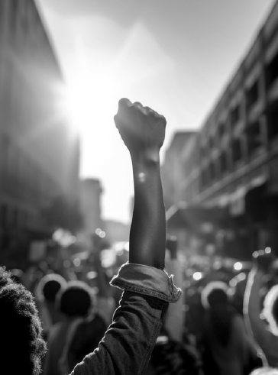
You shared pictures that embodied a loving school and leaned into why Campaign Lab exists.
Who is needed to solve these problems?
Name PEOPLE, not organizations

Slide 4
What type of union builds power?
Campaigns
Public Action and Demands
Strategic and Ongoing
Continues to Add
  Base – Mobilizers - Leaders
  Allies – Partners - Coalitions
  Requires Risk
  Supported by Staff
  Leaders Build and Use Power
Programs
Build Presence
Episodic
Member Recruitment
Committee/Program Leaders
Low Risk
Often Staff Led
Power in Policy

Slide 5
Centering Race, Class, and Gender Justice
Race, class, and gender justice is the systematic fair treatment of people resulting in equitable opportunities and outcomes for all.
It is not just the absence of discrimination and inequities, but also the presence of deliberate systems and supports to achieve and sustain race, class, and gender equity through proactive and preventative measures.

Slide 6

Centering Equity in your Campaigns Tool
What they do:
Proactively seek to both eliminate systemic barriers and advance equity
Identify clear goals, objectives and measurable outcomes
Develop mechanisms for successful implementation
What they are:
A set of questions used to anticipate, assess, and prevent potential adverse consequences of proposed actions on different race, class, or gender groups.

Slide 7
Would the campaign(s) your coaching have answers to these questions or be able to say most components of these tools are a part of their campaign?
What is something you noticed that could support your coaching?

Slide 8
Factors that Support the Centering Equity in your Campaigns Tool
Buy in from the organization and its leaders
Routine and ongoing use of the RET
Data- driven assessment
A commitment to making changes
Tenacity – A commitment to overcoming obstacles to making changes
WE HAVE TO DECIDE TO DO THINGS DIFFERENTLY AND STICK WITH IT

Slide 9

Key
Points
Intentional campaigns, not programs build power.
Centering race, class, and gender justice in our campaigns increases the people engaged, the number of leaders involved, and the amount of resources we have to win the change we want.
Power is only built through people with a shared vision, making public commitments to act, to risk their collective resources, for the meaningful change they want.

