Slide 1
Centering Equity

Slide 2
Centering Race, Class, and Gender Justice
Race, class, and gender justice is the systematic fair treatment of people resulting in equitable opportunities and outcomes for all.
It is not just the absence of discrimination and inequities, but also the presence of deliberate systems and supports to achieve and sustain race, class, and gender equity through proactive and preventative measures.

Slide 3

Centering Equity in your Campaigns Tool
What they do:
Proactively seek to both eliminate systemic barriers and advance equity
Identify clear goals, objectives and measurable outcomes
Develop mechanisms for successful implementation
What they are:
A set of questions used to anticipate, assess, and prevent potential adverse consequences of proposed actions on different race, class, or gender groups.

Slide 4
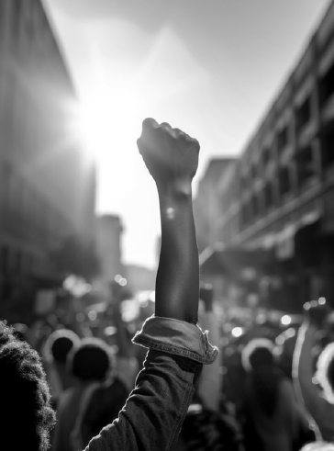
Would the campaign(s) your coaching have answers to these questions or be able to say most components of these tools are a part of their campaign?
What is something you noticed that could support your coaching?

Slide 5
Factors that Support the Centering Equity in your Campaigns Tool
Buy in from the organization and its leaders
Routine and ongoing use of the RET
Data- driven assessment
A commitment to making changes
Tenacity – A commitment to overcoming obstacles to making changes
WE HAVE TO DECIDE TO DO THINGS DIFFERENTLY AND STICK WITH IT

Slide 6
Coaching Equity—Tabletop Discussion
How can we coach leaders to center equity?
How can the tool assist?
What are some coaching questions you could ask?
What might come up for the leader as they explore issues of race, gender, culture, etc?
How can this be used to discuss not just a campaign but also the functioning of the union?

Slide 7

15 minute break

Slide 8
Coaching Practice (groups of 3)
Coach, leader, observer/timekeeper
12 minutes coaching, 3 minute debrief.
Switch roles.
Possible scenarios:
Union participation is all white, despite 15% of members being people of color.
Students are missing school due to fears of ICE.
Teachers of color report that parents complain about them frequently.

Slide 9
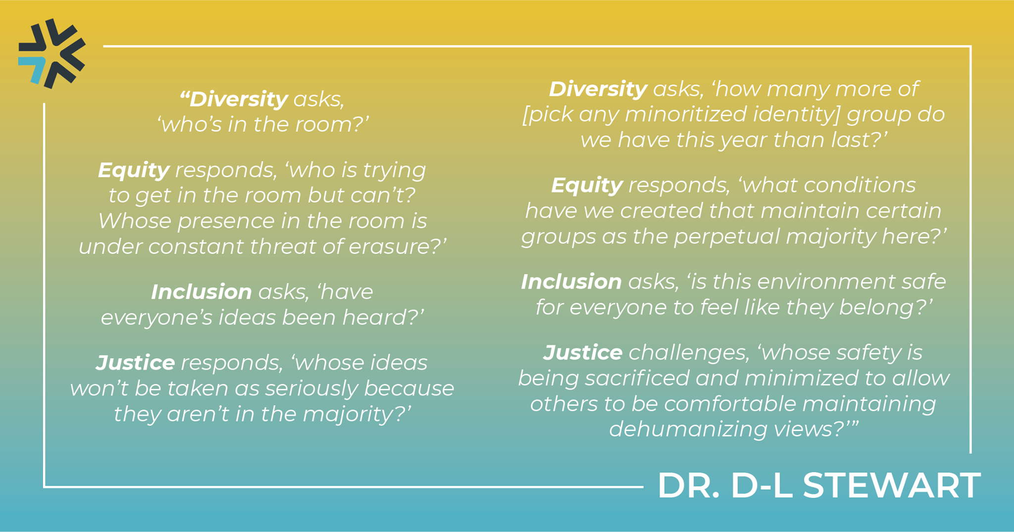

Slide 10

Key
Points
Centering race, class, and gender justice in our campaigns increases the people engaged, the number of leaders involved, and the amount of resources we have to win the change we want.
Power is only built through people with a shared vision, making public commitments to act, to risk their collective resources, for the meaningful change they want.
Centering equity requires changes in the work we do and in how we do the work we do.

