Slide 1
Campaign Academy:
Building a Team to Win
New Orleans, 2026
Notes:
6

Slide 2

Campaign Academy
By attending this training, you confirm that you are either an NEA affiliate staff person or NEA member in good standing. The information you receive here is only for your use in your capacity as an NEA affiliate staff person or NEA member.
This presentation and its contents are confidential and may not be further distributed or passed on to any other person or published or reproduced, in whole or in part, by any medium or in any form, for any purpose unless written consent has been provided by Ellen Holmes. Audio/video recording, copying of slides, and the use of AI note-taking tools are prohibited without the written consent from Kyle Serrette. Violation of these terms may result in legal action.

Slide 3
NEA Standards of Conduct
NEA has adopted a Standard of Conduct Policy to ensure that all of our gatherings are welcoming to and free from discriminatory, harassing, or otherwise unacceptable behavior. Discrimination or harassment based on race, color, ethnicity, religion, sex, age, national origin, sexual orientation, disability, gender identity, or expression, or any other characteristic protected by law will not be tolerated. If you have experience any discriminatory or harassing behavior, please report the incident by emailing Ron "Duff" Martin (rmartin@nea.org) and Gladys Marquez (gmarquez@nea.org). Thank you for your commitment to ensuring a positive event for all.

Slide 4
Honoring This Space
We begin by acknowledging that through a history of colonization and brutality, we are currently on the traditional lands stewarded by generations of indigenous people.
We honor these indigenous people, all elders, past, present, and emerging. We are called to learn and share these learnings about this tribal history, culture, and contributions that have been suppressed in the telling of the story of what we now call the United States of America.

Slide 5

Key Outcomes
Participants will: Analyze their current situation in the context of a broader political landscape Build a vision based on shared values and analyze that vision through an equity lens Articulate solidarity as a strategic choice as well as a union value Understand why a team is vital to a campaign Learn the strategy of base-building Learn key skills to build a team: 1:1 organizing conversation, worksite mapping and charting, and leader identification Learn about examples of how to troubleshoot common problems with organizing teams. Create a plan to build the strongest, tightest, most resilient organizing committee possible

Slide 6
Overall Agenda
General Conference Schedule:
  Friday: 8:30am-4:30pm
  Saturday: 8:30am-4:30pm
  Sunday: 8:30am-1:00pm
General Conference Meal Breaks
  Breakfast: 7:30am-8:30am
  Lunch: 12:00pm -1:00pm
    Sunday Boxed Lunch To Go
  Adult Choice Networking: 4:30pm-5:00pm

Slide 7
Friday, May 17
8:30-9:00 Introduction and Overview
9:00-9:15 Values Mixer
9:15-10:30 Building a Shared Vision
10:30-10:45 Break
10:45-12:00 Centering Equity
12:00-1:00 Lunch
1:00-2:00 Solidarity as a Core Value & Strategy
2:00-2:30 Putting it All Together
2:30-2:45 Break
2:45-3:00 Energizer Activity
3:00-4:00 Base-Building Strategy
4:00-4:30 Ending it Right
4:30-5:00 Networking
AGENDA

Slide 8
Logistics to Remember
PEPs Portal
  Materials
Food
  Allergies
  Special Meals
Bathrooms
Room Temperature
Solidarity Captain

Slide 9

Who is in the room?
Share Your
Name
Pronouns
Location

Slide 10

Community Agreements (p. 2)
Using Self-Awareness and Self-Knowledge
Listening for Understanding
Being Gracious
Staying Engaged
Being Open and Suspend Judgment
Saying “I”- tell your truth
Leaning into Discomfort
Reaching Empathy
Expecting Non-Resolution and Non-Closure
Adapted from “Embracing equity and inclusion”, Annie E. Casey Foundation
Notes:
Community Agreements for Our Time
Awareness and Self-Knowledge
This requires self-knowledge and self-awareness. Self-knowledge allows you to see what causes you pain and conflict and enables you to embrace your contradictions and inconsistencies. It allows the space to work on things about yourself that you are not happy with. In turn, self-knowledge helps to prevent you from projecting your negative aspects onto other people. Bringing your best self also requires that you have a positive attitude, are willing to deeply explore your perspectives and remain open to the perspectives and experiences of others.
Listening for Understanding
Be an active listener. Active listening involves paying full and careful attention to the other person, looking him or her in the eye, avoiding interruptions, reflecting your understanding, clarifying information, summarizing the other person’s perspectives and sharing your own. Remember that most people need time to open up and might not be willing to immediately share their personal stories, hopes, fears and/or concerns.
Being Gracious
Being kind is a vital way of bringing meaning to our own lives, as well as the lives of others. Kindness is about caring genuinely for others around you, wanting the best for them and recognizing in them the same wants, needs, aspirations and even fears that you may have. Being kind and generous allows us to communicate better with others, to be more self-compassionate and to be a positive force in other people’s lives. This includes following the COVID protocols that are in place to protect the health of this learning community.
Stay Engaged
Staying engaged requires you to be morally, emotionally, intellectually and socially involved in the conversation. Staying engaged means that you are listening with curiosity and willing to deepen your understanding. Staying engaged might also require you to sustain the conversation even when it gets uncomfortable or diverted. This also means a commitment to keeping your electronic communications to a minimum with folks not present in this learning community.
Be Open and Suspend Judgment
Listening with an open mind includes being receptive to the influence of others. You can suspend judgment by becoming aware of preconceived notions and listening to everything someone has to say before jumping to conclusions. Most importantly, suspending judgment also means listening to what the speaker has to say for understanding, not just to determine whether the speaker is right or wrong.
Say “I”- tell your truth
Speaking your truth in authentic and courageous conversations about race requires a willingness to take risks. It means that you will be absolutely honest and candid about your own thoughts, feelings, experiences and opinions and not just saying what you perceive others want to hear. Speaking your truth will require you to speak from the “first person” and use “I” statements.
Seek Discomfort
Leaning in to discomfort will require you to let go of racial understandings and stereotypes that you may be holding onto in order to move forward. Leaning in means that you will avoid judgment, assume positive intent and be open to the kernel of wisdom in each individual’s experiences. Leaning in to discomfort will require you to sit through moments of embarrassment, confusion, anxiety and/or fear.
Reaching Empathy
Empathy and compassion allow you to understand the other person’s point of view. When you are empathetic, you are more understanding, patient and kind. Expanding your capacity to feel empathy will also allow others to enter your circle of human concern.
Resolution and Closure
Expect and accept that there may not be closure. It is not likely that you will resolve your personal understanding about race or another person’s racial experience in a single conversation. The more you talk about race with another person, the more you learn and the more they will learn. Authentic and productive conversations about race are continuous and always evolving.
*Adapted from “Embracing equity and inclusion”, Annie E. Casey Foundation

Slide 11
Core Values
Matt Fargen

Slide 12

What are core values? (p.4)
Core Values are the things that guide us when things are getting difficult or challenging.
Core Values are important to discuss with your core leadership team so that you understand, and they know what will motivate them and what will motivate you in times of difficulty. It is why you are willing to do this work-
Examples: teamwork, compassion, curiosity, integrity, courage, faith, sustainability, competition, loyalty, kindness...

Slide 13
Values Mixer
List 3-5 of your core values on your own.
Use the chart paper near your table to list the core values from your table.
We will be referring back to this throughout the day.

Slide 14
Personal Vision
Amanda Kail

Slide 15

What’s your vision?
In 10 years, the world is governed by your values….
How will you be living?
What will it be like to arrive at work?
What will your workday feel like?
What will your students’ lives be like?
What will your coworkers’ lives be like?
What will you be doing in your free time?
How will you be interacting with family and friends? With neighbors?
What will your community be like?
What will you see when you are out and about in your community?

Slide 16

Share Your Vision with a Partner
What resonates ?
Where do you hear your partner’s values most strongly?
What new understanding did you gain by listening?

Slide 17

Key Points
Shared values is a foundation for building trust and campaign participation.
Building a shared vision helps others find their self-interest in your goals.
A shared vision helps others see where you are going with your campaign.

Slide 18
Shared Vision
Kristin Lytie

Slide 19

Why does a shared vision matter?

Slide 20
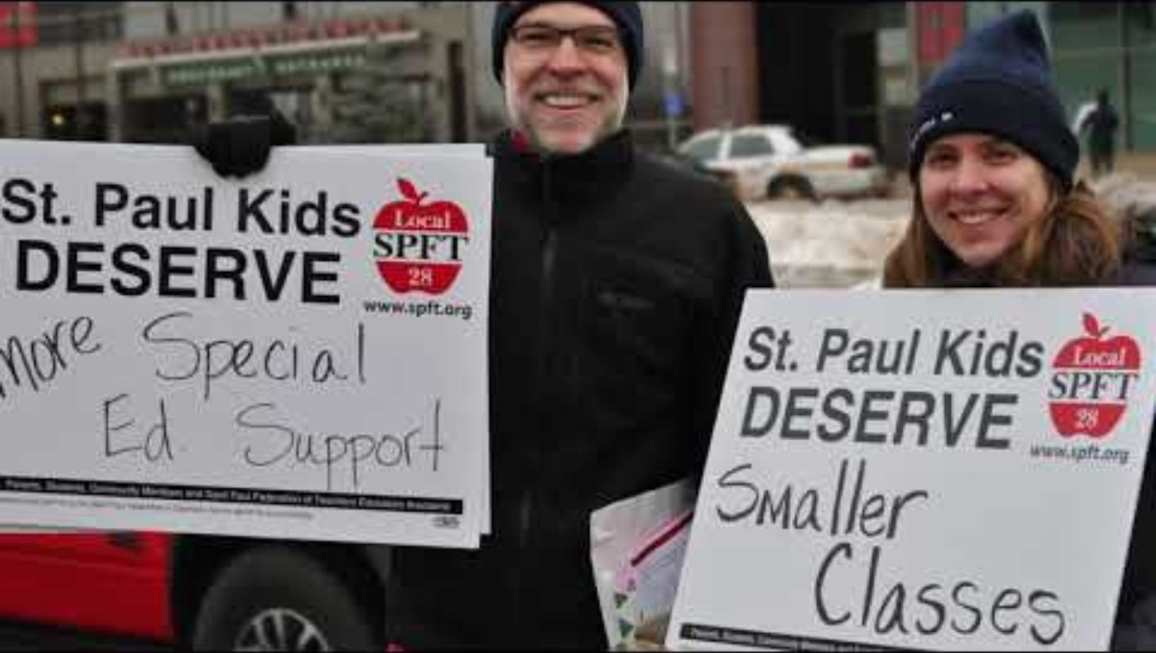
SPFE- A Vision Rooted in Shared Values

Slide 21

Power
Our targets have money and titles, and the power to give us what our members want
Unions have people with a shared vision of a just and equitable future
Unions have power when they activate members by reflecting their values

Slide 22

Another world is possible...
But no person can do it alone.

Slide 23

Creating a Shared Vision
Share one or two things from your vision with the group.
On your chart paper, write or draw a collective vision for the future in 10 years.

Slide 24

Gallery Walk
Where are the commonalities?
What stands out?
What is something new for you?

Slide 25
Debrief
What did it feel like to do this exercise?
What is the power of sharing a vision like this, as opposed to a list of policy changes or political agenda?
How could you use this exercise in your local?

Slide 26
Key Points
Shared values are a foundation for building trust and campaign participation.
A shared vision creates understanding of the goal but also:
  How the work will be done
  Roles members can have and the self interest to choose them.
Remember to listen to the values of others.
People do not value what they do not build.

Slide 27
Break
10:30-10:45

Slide 28
Centering Equity
Dr. Taraja Shephard Allen

Slide 29
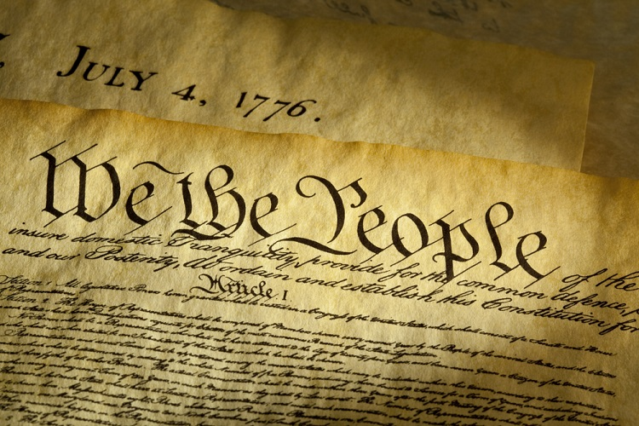
An Unfinished Promise. An Incomplete Vision.
Every vision is shaped by who was present when it was written and who was not yet imagined.
A vision meant to guide us all. Written with certainty. Declared complete.
Yet:
  power decided what mattered
  access determined who contributed
  silence was mistaken for agreement
What we inherit is not neutral. What we build next is a choice.
Campaigns are no different.

Slide 30
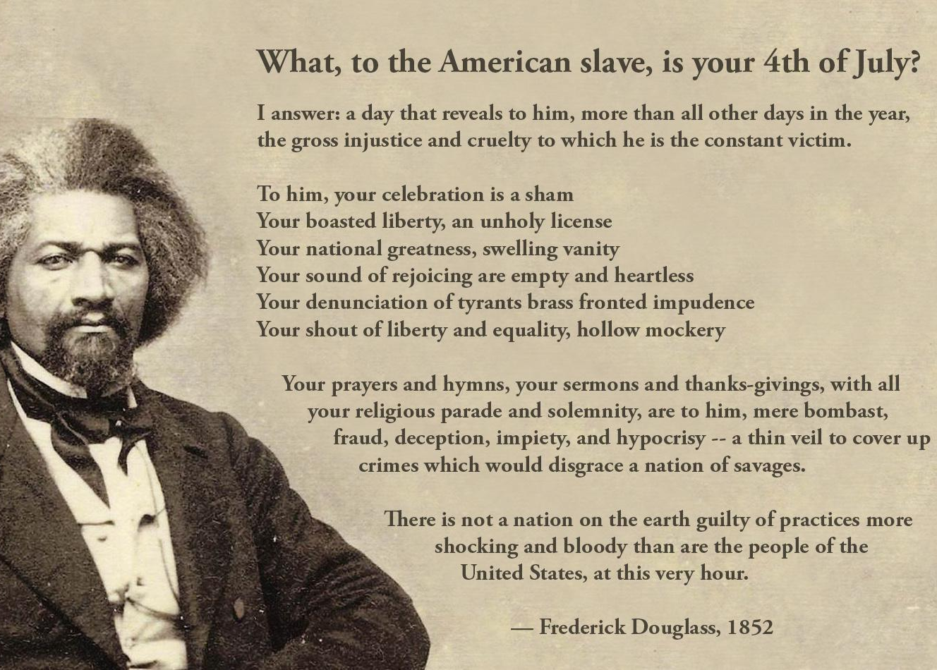
Centering Equity:
Race, Class and Gender
Equity is:
  deliberate and intentional
  rooted in history and systems
  measured by outcomes, not promises
It is the work of designing so everyone belongs — not just those already inside.

Slide 31
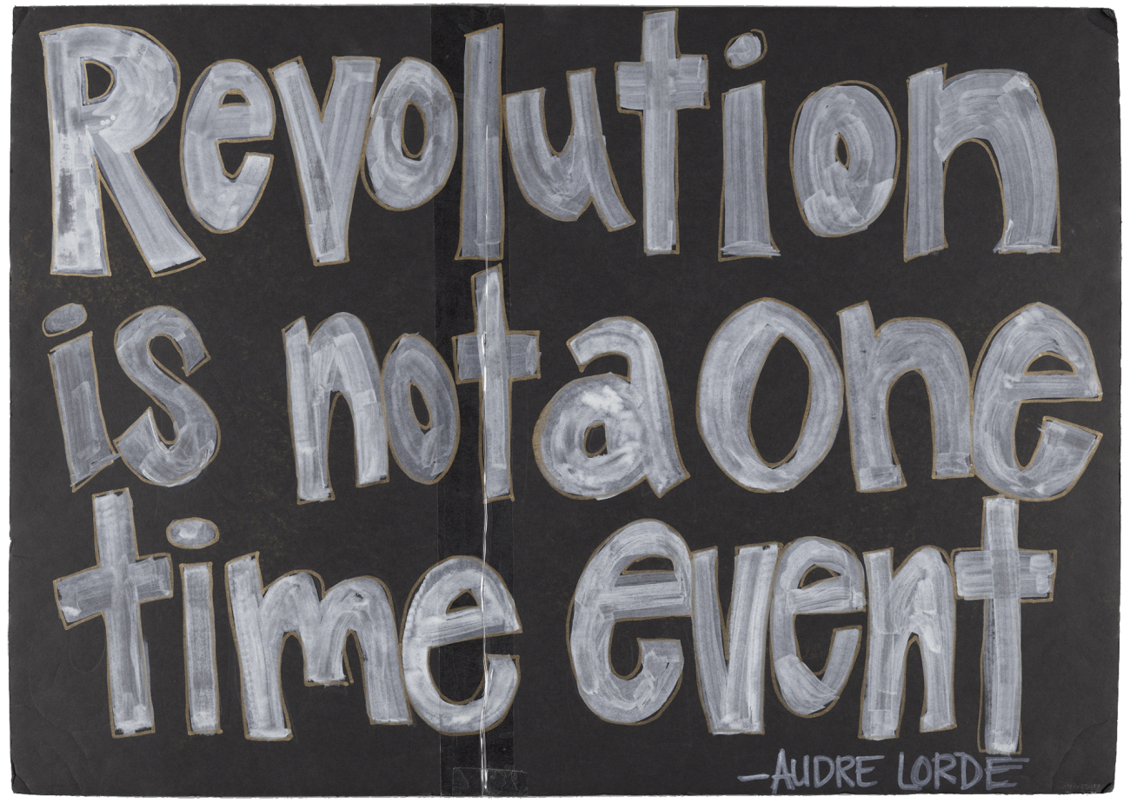
Why Centering Equity Matters
What happens when:
  a vision doesn’t include everyone?
  decisions are made far from lived experience?
  absence is treated as neutral?
Equity analysis helps us see:
  whose interests were prioritized
  whose experiences were ignored
  who absorbs harm when systems fail
Equity is not about intent. It is about design, access, and impact.

Slide 32
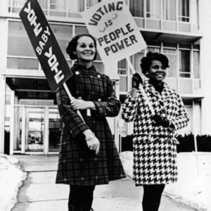
Equity and Power
Equity is not a value statement — it is a campaign discipline.
Campaigns without equity analysis often reproduce existing power structures.
Consider:
  Who defines the problem determines whose needs are centered?
  Who names the solution shapes who benefits?
  Who leads the work determines how power moves — or if it does at all?

Slide 33
Programs vs. Campaigns —Through an Equity Lens
Programs
Campaigns
Often designed for people
Participation is optional, often low‑risk
Leadership is frequently predefined
Can unintentionally prioritize access for those already resourced
May ease harm without changing conditions
Built with those most impacted
Leadership emerges from lived experience
Risk is shared and supported
Power is intentionally shifted, not managed
Demands are shaped by those closest to the harm
Success is measured by who gained voice, agency, and power

Slide 34

The Four Essential Organizing Questions
Every Organizer Asks
  Who are my people? What are their issues?
  What do they demand?
  Who has the power to meet that demand?
  What are people willing to risk to win?
The Missing 5th Question: Who is missing — and why?
Asked once, it’s reflection. Asked always, it’s equity.

Slide 35
What are some of the challenges that come with intentionally centering equity?

Slide 36
Common Myths When Centering Equity
Myths we hear
What equity analysis reveals
  Absence signals barriers, not apathy.
  “Small” issues often reflect systemic harm.
  Tradition can mask normalized inequity.
  Harm is often carried quietly by the same people.
  “They don’t come to meetings.”
  “This issue isn’t big enough or doesn’t exist.”
  “That’s just the way it’s always been.”
  “It only impacts a few people.”
Equity‑centered responses remove barriers, prioritize lived experience, challenge what’s been normalized, and address root causes rather than symptoms.

Slide 37
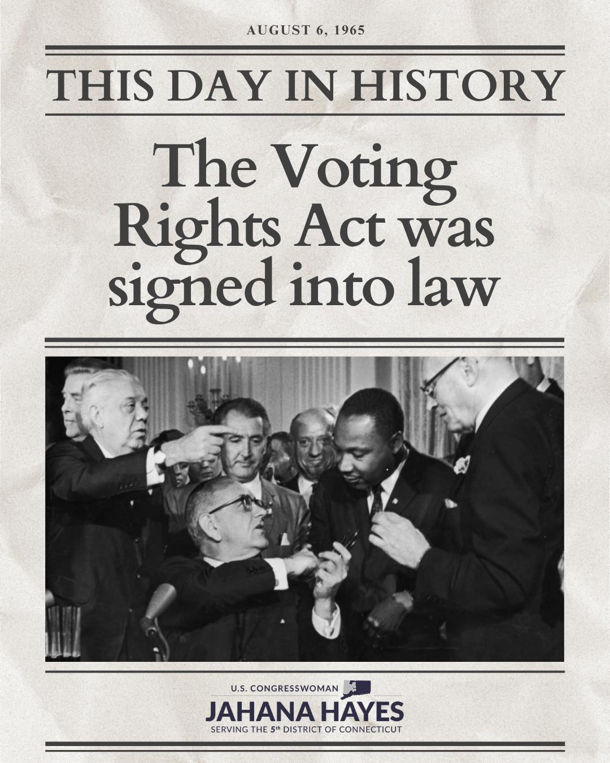
Who is in the Room Where It Happens?
Decisions are made
by those who are present.
Absence is not accidental.
- It is produced.
- It is predictable.

Slide 38
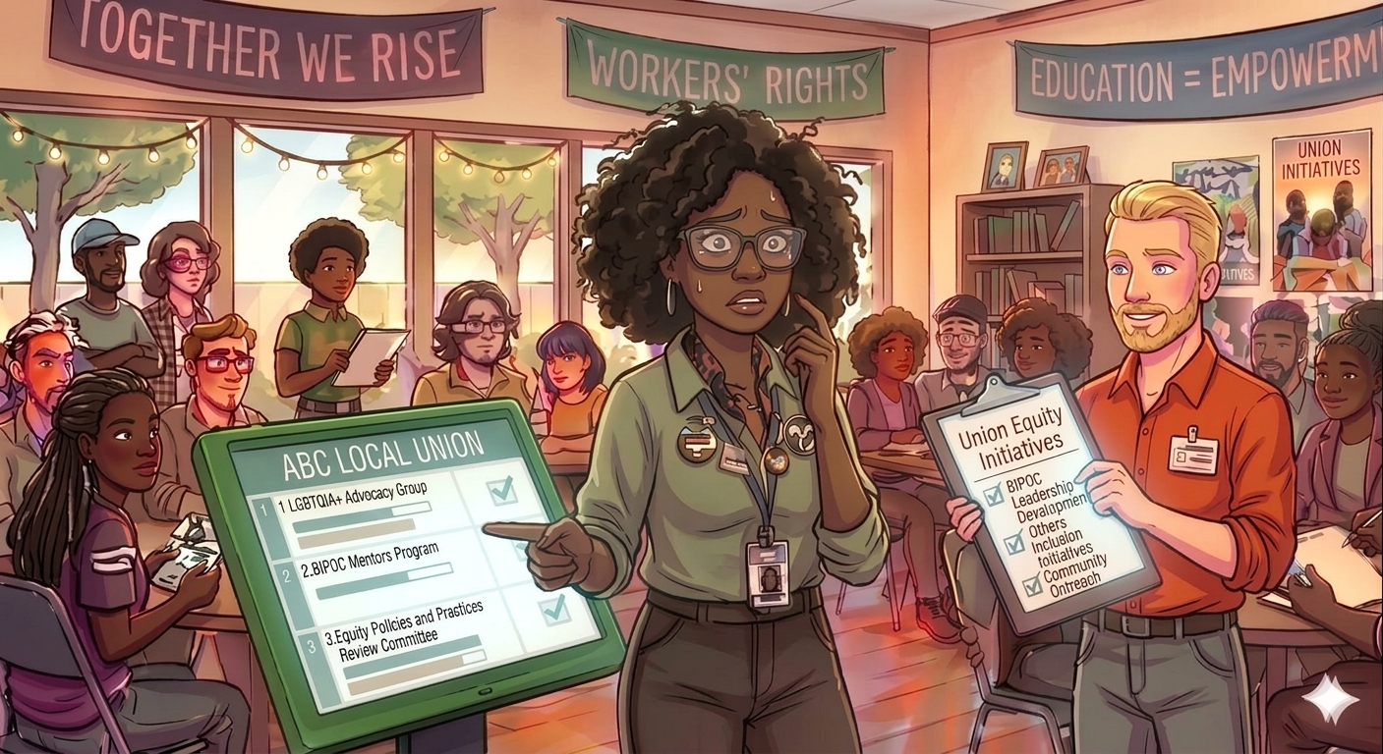
Who Leads Equity Work (And at What Cost):
A Necessary Note on Leadership and Care
  Equity work should not rest solely on marginalized people.
  Those most impacted must be centered — not burdened.
  Responsibility for equity belongs to those with power, access, and influence.
Equity work should never:
  cost someone their health
  erode their sense of belonging
  require reliving harm to be believed
Centering equity means shared leadership, collective care, and real accountability

Slide 39
Centering Equity: A Tool and How to Use It (p.5)
What is the Centering Equity Tool?
  A set of questions used to identify inequities across race, class, and gender; examine root causes and systems; assess impacts on different groups; shape equitable solutions and strategies; and elevate leadership of those most impacted.
Remember… Equity is layered through every stage of a campaign, not added at the end.
  If those most impacted are not in the room, power is not centered.
  If leadership does not reflect lived experience, equity is incomplete.
  If demands benefit some while harming others, the analysis is unfinished.
  If success is not measured by who gained voice, agency, and power, the campaign must be redesigned.

Slide 40
Problems
Causes
Solutions
History
Strategies
Leadership
What race, class, or gender inequities are you noticing or experiencing? What are the impacts on different racial groups? Who benefits most and who is hurt most?
What institutions, policies, or practices are causing or contributing to the inequities? What social norms, popular myths, or cultural biases may be contributing?
How did things get this way and are things worsening or improving?
What solutions could address the root causes and eliminate the inequities? How would different racial groups be impacted by the proposed solutions?
What strategies and actions could be used to advance the solutions?
Who are the stakeholders most affected by the inequities? Are they involved in naming the issues and solutions? What kinds of active leadership roles could they take to advance the proposed solution?

Slide 41
Teamwork: Applying the Equity Analysis
Use the Equity Analysis questions. Work with YOUR campaign or campaign idea.
As you work, keep these three prompts in view:
  Who is most directly impacted and are they shaping the decisions being made?
  Who is missing from the process, and what barriers keep them out of the room?
  What would need to change for this campaign to truly shift power, not just manage harm?
Notice where your campaign is strong and where it needs to be redesigned.

Slide 42
Team Equity Analysis Share Out:
Where your campaign is strong or where does it need to be redesigned?

Slide 43
Key Points: Centering Equity in Campaigns
Centering equity means equity shapes the vision, not just the outcome.
Equity analysis is essential to avoid reinforcing harm.
Centering equity shifts campaigns from:
  participation → leadership
  representation → shared power
  fixes → systemic change
A campaign is equitable only if those most impacted help define the problem, shape the demands, lead the work, and gain power through it.

Slide 44
Lunch
12:00-1:00

Slide 45
Solidarity as a Core Value and Strategy
Katie Bishop

Slide 46
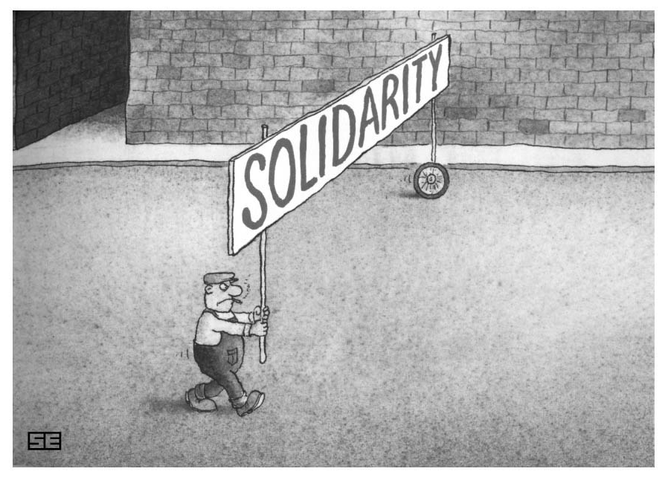
How would you describe solidarity?

Slide 47
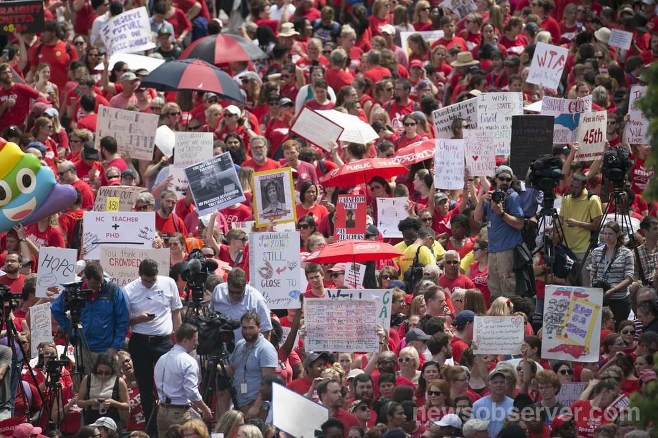
Solidarity
“Unity or agreement of feeling or action, especially among individuals with a common interest; mutual support within a group.”
https://www.newsobserver.com/news/local/education/article315575311.html

Slide 48

New Groups
Mix it up!
Count off by 8…

Slide 49
Record your answers on the chart paper.
How are working people divided against each other?
How and why do the people with the most power create the division?

Slide 50
Gallery Walk
Put a dot next to every example you see happening in your own local.

Slide 51
Talk at your table
What tactics to divide working people stood out to you? Why?
Which ones did you see repeated often? Why do you think that is?
Who is using these tactics? Why?
What is the impact of these tactics in your own locals?
What is the impact across local and state lines?

Slide 52
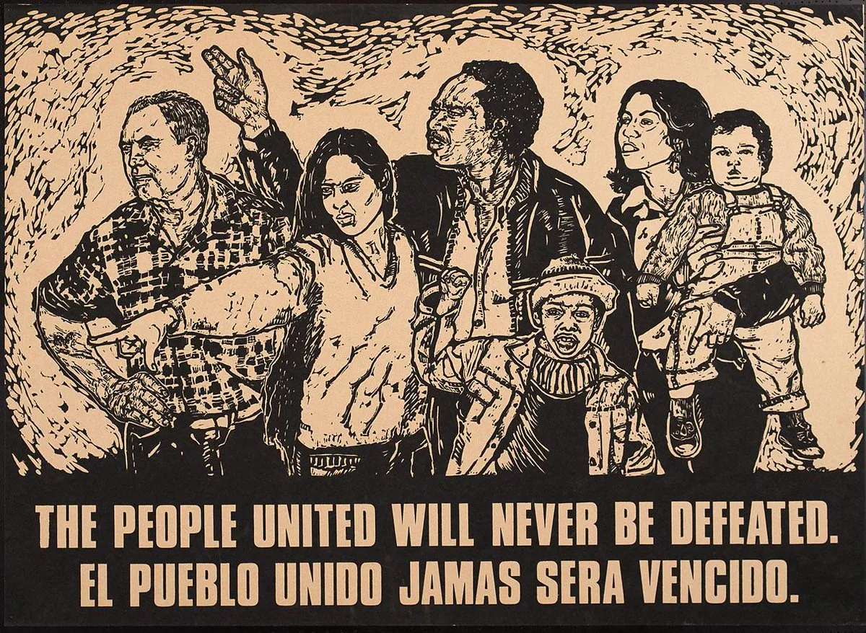
Why solidarity?
Why is solidarity a strategy as well as a value?
How do we overcome the tactics of division?

Slide 53
Key Points
Solidarity is standing together and using our resources in support of another.
Division, based on race/gender/sexuality, can be overcome with intentional thoughtful work.
Solidarity does not mean abandoning your own values- but partnering with those that align with your values.
All we have is each other.

Slide 54
Putting It All Together
Alan Underwood

Slide 55

Problem vs Issue Reminder...
Problem: "Our students receiving services don't have enough support."
Issue: Paraprofessionals start at $13.00/hour.
Issue: School Psychologists do not have a caseload limit.
Page 55.

Slide 56
Using what you have learned, describe a local issue and a vision for what it would look like if the person in power delivered on your demand.

Slide 57
Break
2:30-2:45

Slide 58

ENERGIZER BREAK!
Marker madness
Who can pick up the most markers in 60 seconds?
2 volunteers
Follow the directions on the slip of paper.
Don't start until I say GO!

Slide 59
Marker Madness Debrief
Who got the most markers? Why?
Who got no markers?
At your tables…
  What do the markers represent?
  What takeaways are there for why and how you need to build your team?

Slide 60
Key Points
Review your team through the lens of equity:
  How is the work being distributed?
  Is everyone represented?
Remember, they have money we have people. They have money we have people.
Our relationships represent the power we have to move an issue.
Team building and sharing work creates buy in and pride.

Slide 61
Base-Building
Pete Clancy

Slide 62
What is ”Strategy"?
"Using the resources you have to make the power you need to get what you want.”- Marshall Ganz
"Strategy involves identifying your group's form of power and then finding ways to concentrate it to achieve your goals." - Deepak Bhargava and Stephanie Luce
"...strategies are not just action plans and operational purposes. Strategies are the 'ways and means' to get closer to our intended horizon.”- Norma Kaweloku Wong,

Slide 63
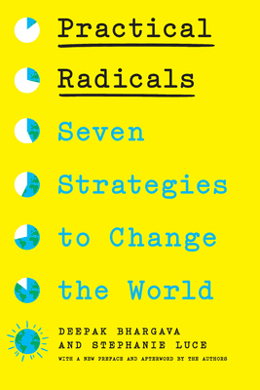

Some Examples of Strategies
Disruption
Narrative Shift
Electoral Change
Rapid Acceleration
Collective Care
Inside/Outside

Slide 64

Strategy: Base-Building
Recruiting new members
Expanding participation
Deepening relationships
Developing leaders
Moving people into action
Majority Actions of Members
Notes:
3 minutes
Right now, I am going to ask you to close your eyes….Think of…
“Think of an experience you’ve had of effective coaching, or being supported by someone – this could have been an athletic coach, a teacher mentor, or anyone else in your life who supported you to learn and grow in some way. What’s a moment you remember them providing a kind of support that exemplifies the role of a coach?...(continue closed eye in your own style)”
What were you feeling as you came into coaching? How did you feel leaving the coaching session?
What did they say? And if you can’t remember - what has stuck with you now that this is the moment you’re recalling?
You can open your eyes….

Slide 65

Strategy: Base-Building
Who is your "base"?
Why do you need to build your base?
How do you "build" your base?
Notes:
3 minutes
Right now, I am going to ask you to close your eyes….Think of…
“Think of an experience you’ve had of effective coaching, or being supported by someone – this could have been an athletic coach, a teacher mentor, or anyone else in your life who supported you to learn and grow in some way. What’s a moment you remember them providing a kind of support that exemplifies the role of a coach?...(continue closed eye in your own style)”
What were you feeling as you came into coaching? How did you feel leaving the coaching session?
What did they say? And if you can’t remember - what has stuck with you now that this is the moment you’re recalling?
You can open your eyes….

Slide 66
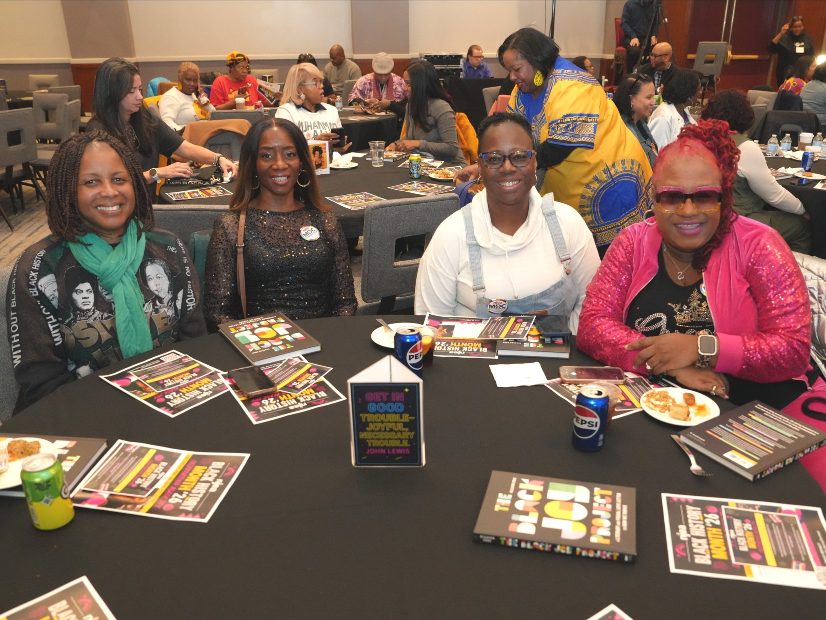

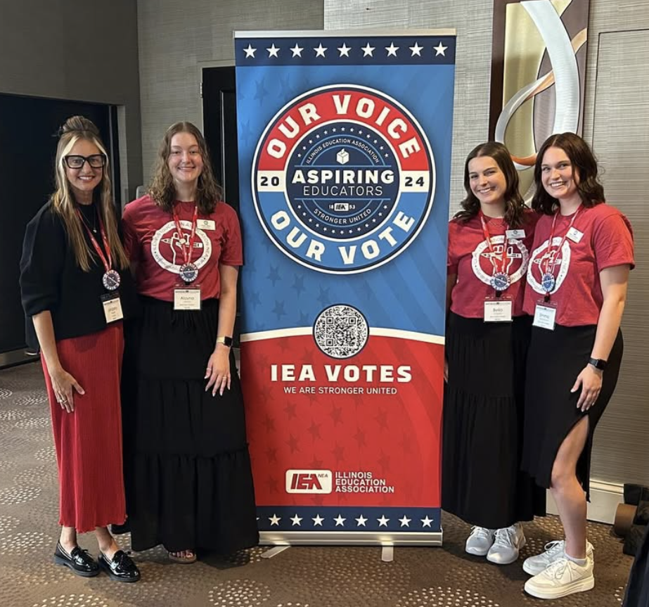
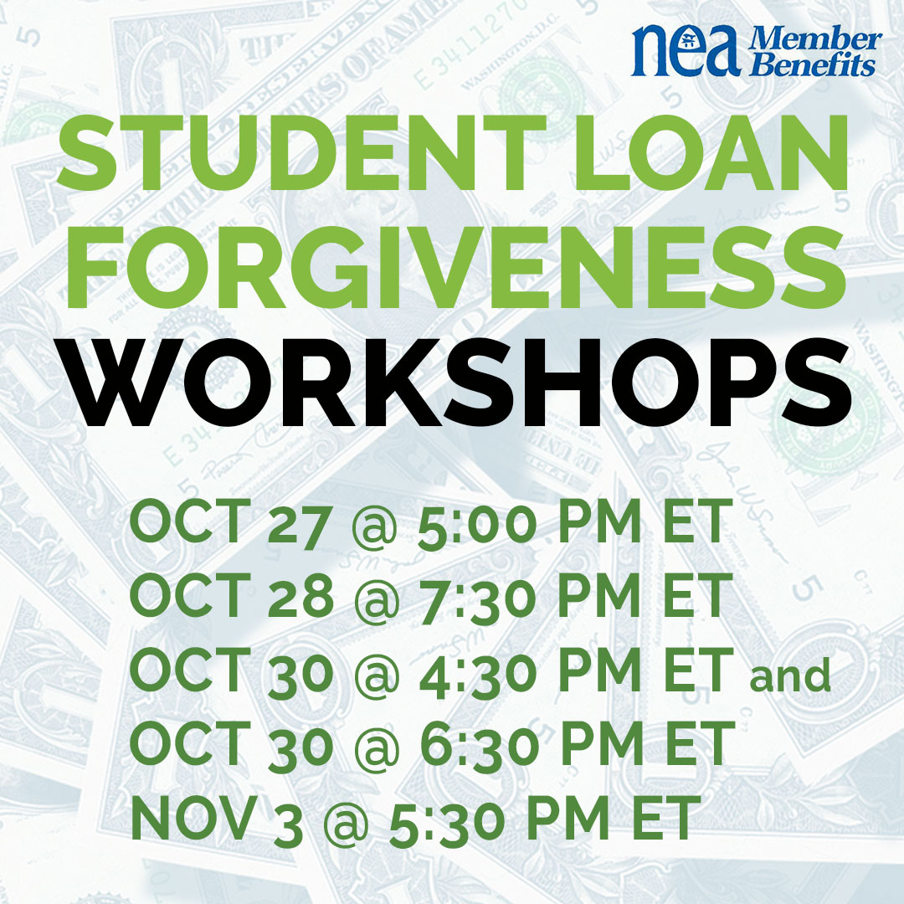
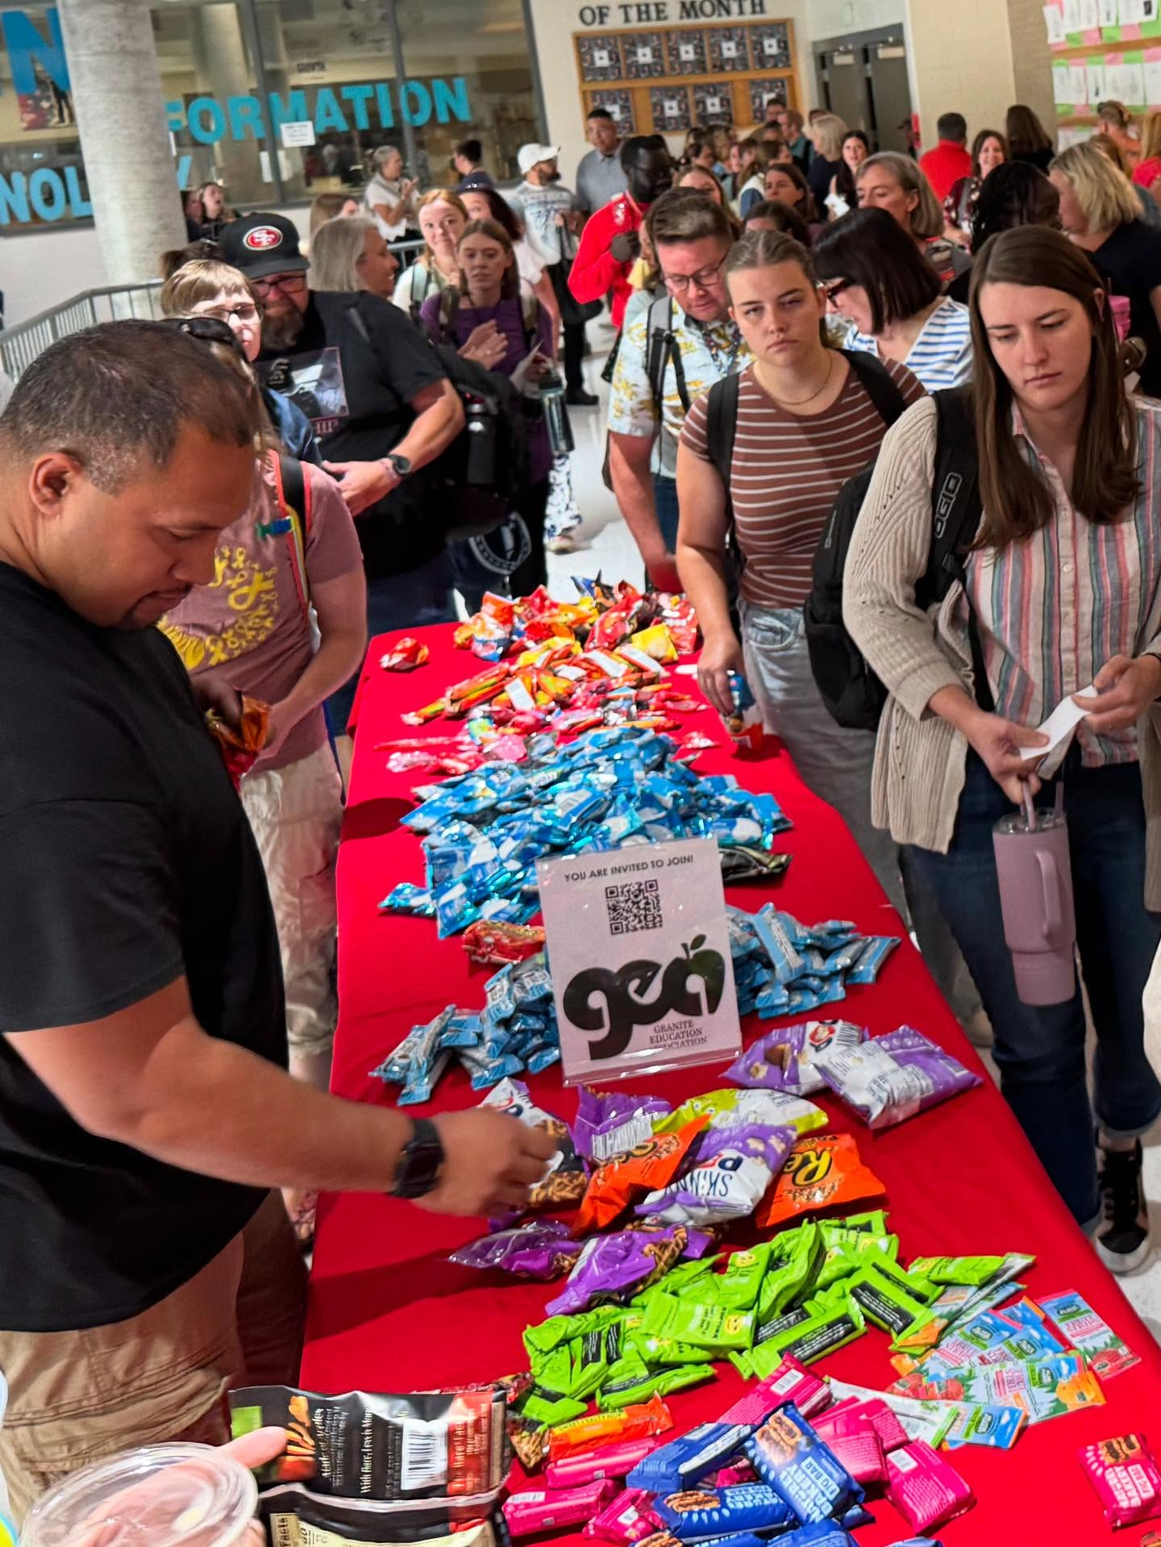
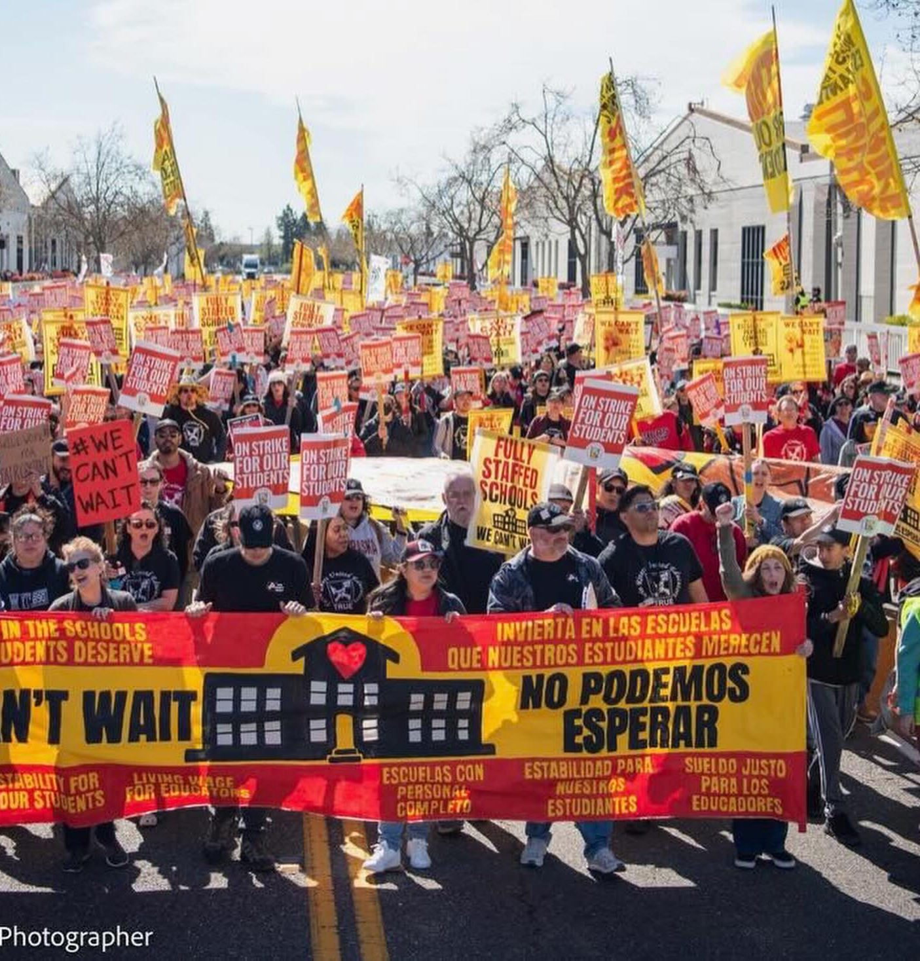
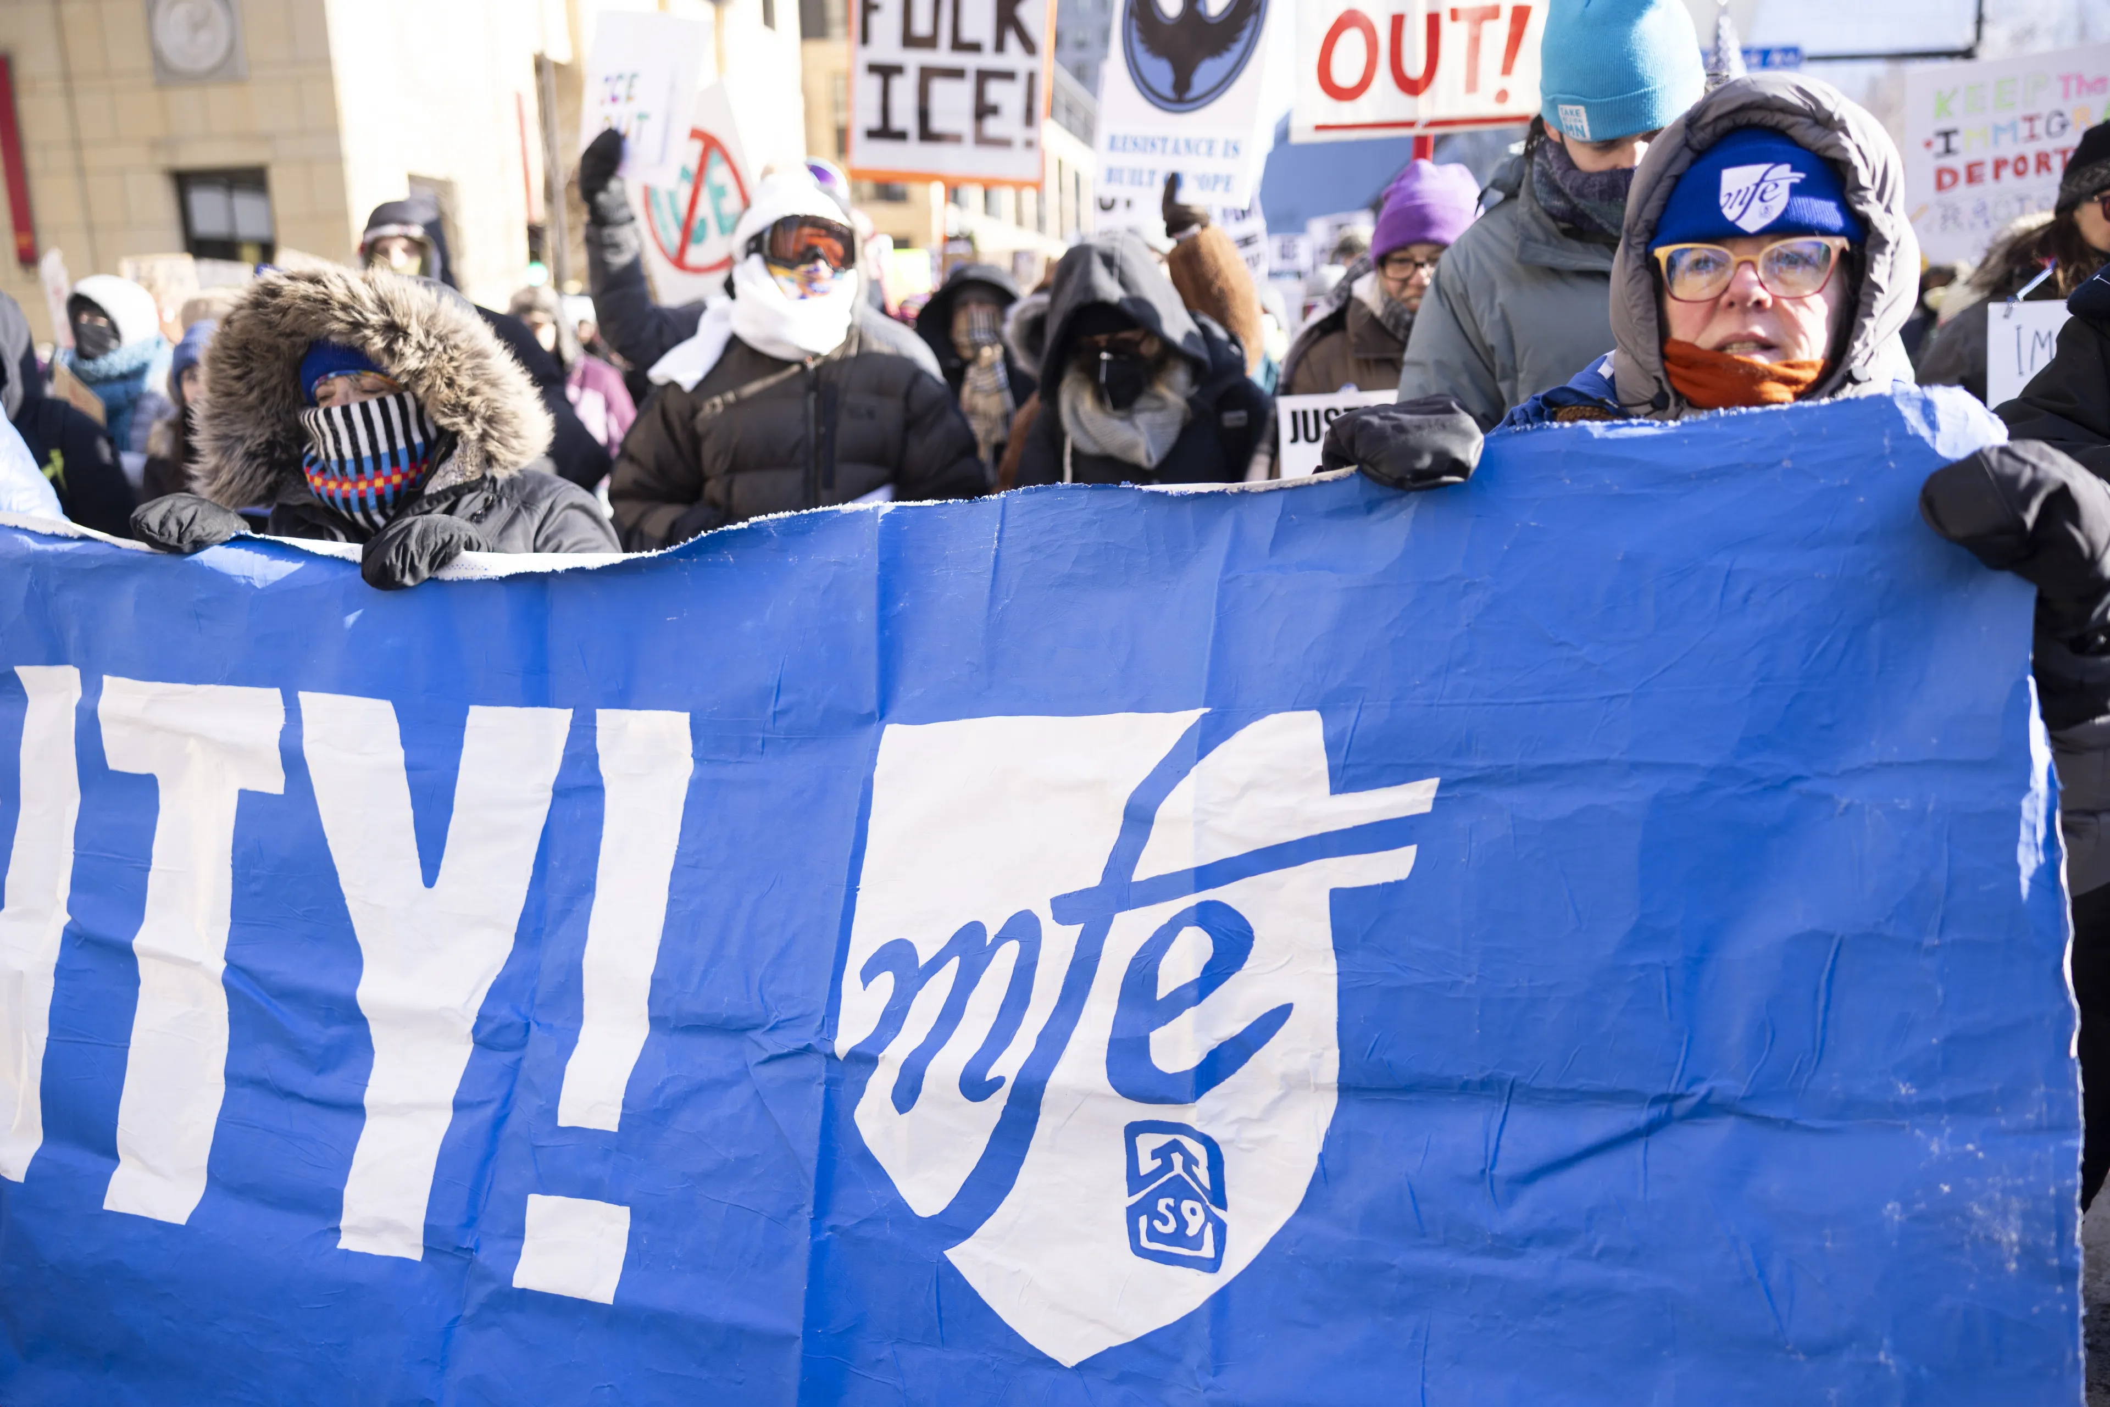
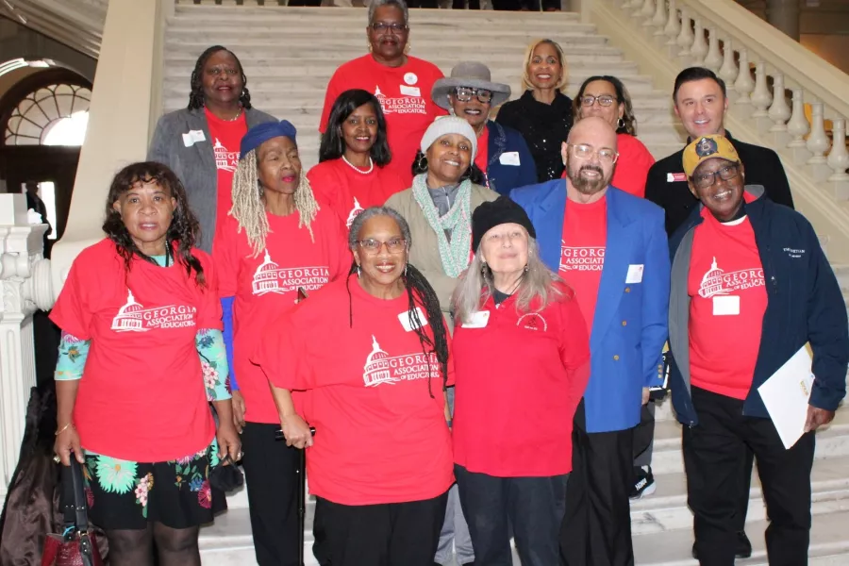
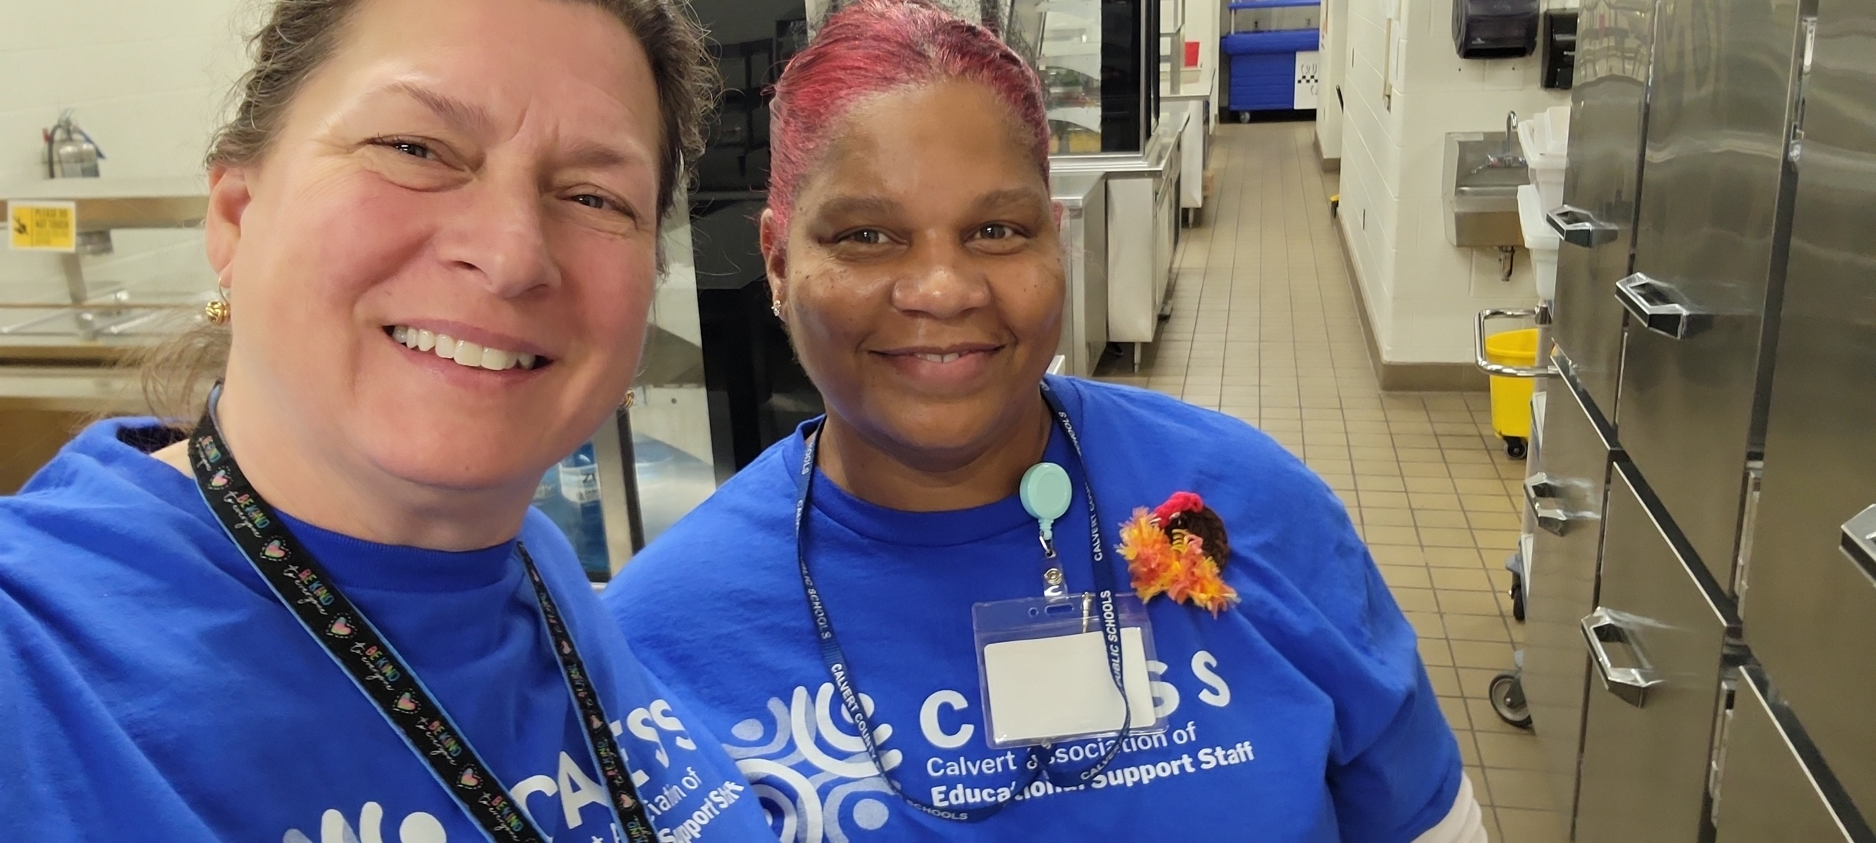
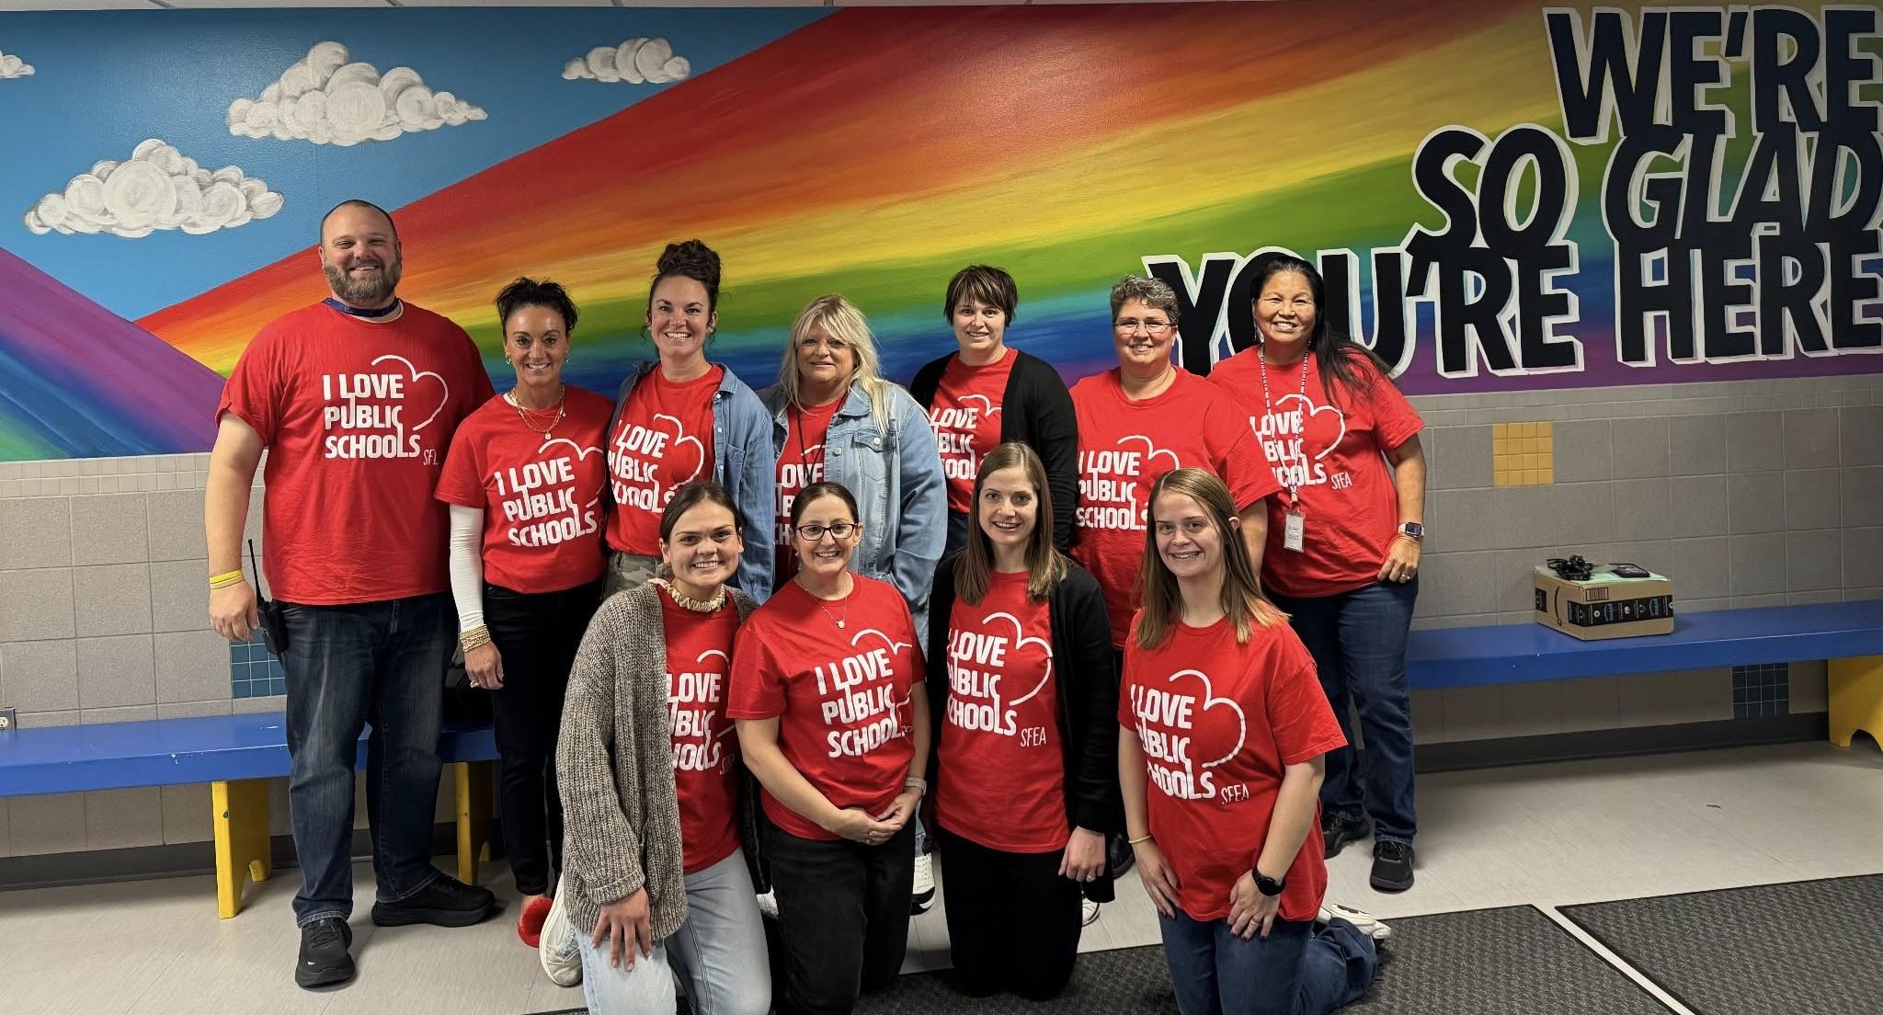

Slide 67
Assess your Local (Page 6 of handouts)
Complete the self-assessment on pages 6-11. If you're here with a team, it may be interesting to complete the assessment independently and then compare answers. (15 minutes)
Once you've discussed the assessment, switch your focus to the reflection questions on pages 11 and 12

Slide 68
Key Points
Union power is member power.
Unions get their power from a majority of workers who act together in solidarity as members.
Building and engaging your membership is how you build your base.
Members! Members are the base of our support.

Slide 69

Closing the Day
What is becoming clearer?
What remains murky?
Housekeeping

Slide 70
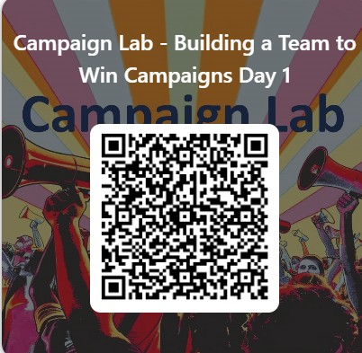
Please let us know how we are doing.

