Slide 1
Campaign Academy:
Building a Team to Win
New Orleans, 2026
Notes:
6

Slide 2

Campaign Academy
By attending this training, you confirm that you are either an NEA affiliate staff person or NEA member in good standing. The information you receive here is only for your use in your capacity as an NEA affiliate staff person or NEA member.
This presentation and its contents are confidential and may not be further distributed or passed on to any other person or published or reproduced, in whole or in part, by any medium or in any form, for any purpose unless written consent has been provided by Ellen Holmes. Audio/video recording, copying of slides, and the use of AI note-taking tools are prohibited without the written consent from Kyle Serrette. Violation of these terms may result in legal action.

Slide 3
NEA Standards of Conduct
NEA has adopted a Standard of Conduct Policy to ensure that all of our gatherings are welcoming to and free from discriminatory, harassing, or otherwise unacceptable behavior. Discrimination or harassment based on race, color, ethnicity, religion, sex, age, national origin, sexual orientation, disability, gender identity, or expression, or any other characteristic protected by law will not be tolerated. If you have experience any discriminatory or harassing behavior, please report the incident by emailing Ron "Duff" Martin (rmartin@nea.org) and Gladys Marquez (gmarquez@nea.org). Thank you for your commitment to ensuring a positive event for all.

Slide 4
Feedback on Feedback – 36 Responses
The first half of Day 1 focused on creating a vision based on shared values and learning how to center equity. -4.28
The second half of Day 1 focused on understanding solidarity as strategy as well as a value and bringing everything together to describe your campaigns using these new understandings.- 4.39
Careful consideration has been taken in the selection of materials, the flow of the content, and the development of the online course support- 4.28
The facilitators have worked to design adult learning experiences that allow for both individual and group development. They have planned for an experience that builds in networking, movement, and multiple ways to apply learning. They have worked on the basics of giving directions, practicing strong questioning, and planning their responses.- 4.67

Slide 5
Feedback on Feedback
"We enjoyed the hands-on activities and the get up and move balance. "
"I LOVED the sensory activity of “what does it sound/feel/taste like” incredibly powerful"
"I love the engaging pieces. They were intentional with helping us to identify issues, importance of solidarity, equity, etc within our locals. It also allowed us to connect with others that may be similar to us or be able to brainstorm with those that needed help."
"The pacing works well - chunks of time are manageable"
"Differentiated instruction may have been necessary as some groups were coming into this lab for the first time while others were coming into for the second time and had already had some of the content prior. There was an expectation from our group that this lab, for second timers, was more about building out the plan."
"Have a QR Code with paperwork."
"Change the steps because as educators we work from the objective and build from that perspective"
"Clearer expectations and directions."

Slide 6
Feedback on Feedback- Suggestions for Improvement
"Need time for our group to plan together"
"Please include campaigns that are larger than a local."
"This was a strong session overall. However, it is important to remember that the historical foundation of collective bargaining is deeply rooted in the struggles, sacrifices, and resistance of Black and Brown communities in this country. Campaigning, organizing, and labor advocacy were often forged through the blood, courage, and lives of those who fought for equity and dignity. Just as we honored the Indigenous peoples and native lands at the beginning of the session, we must also honor the historical realities and contributions of those whose labor, advocacy, and sacrifice shaped collective bargaining movements. We must be careful not to sanitize, dilute, or gentrify that history, but instead honor it with the depth and context it deserves."
"Facilitators should avoid reprimanding participants for side conversations and distractions. There are more effective ways to regain the attention of a room."

Slide 7

Saturday’s Agenda
8:30-9:00 Introduction and Overview
9:00-10:30 Visions, Goals, and Case Studies
10:30-10:45 Break
10:45- 11:30 Leader ID
11:30-12:00 Semantics for Recruiting Leaders
12:00-1:00 Lunch
1:00-2:00 Structured Organizing Conversations
2:00-2:15 Break
2:15-3:15 Mapping & Charting
3:15- 3:30 Energizer Activity
3:30-4:00 What could go wrong?
4:00-4:30 Ending it Right
4:30-5:00 Networking Time

Slide 8
Saturday’s Outcomes
Analyze their current situation in the context of a broader political landscape
Build a vision based on shared values and analyze that vision through an equity lens
Articulate solidarity as a strategic choice as well as a union value
Understand why a team is vital to a campaign
Learn the strategy of base-building
Learn key skills to build a team: 1:1 organizing conversation, worksite mapping and charting, and leader identification
Learn about examples of how to troubleshoot common problems with organizing teams.
Create a plan to build the strongest, tightest, most resilient organizing committee possible

Slide 9

Community Agreements (p. 2)
Using Self-Awareness and Self-Knowledge
Listening for Understanding
Being Gracious
Staying Engaged
Being Open and Suspending Judgment
Saying “I”- tell your truth
Leaning into Discomfort
Reaching Empathy
Expecting Non-Resolution and Non-Closure
Adapted from “Embracing equity and inclusion”, Annie E. Casey Foundation
Notes:
Community Agreements for Our Time
Awareness and Self-Knowledge
This requires self-knowledge and self-awareness. Self-knowledge allows you to see what causes you pain and conflict and enables you to embrace your contradictions and inconsistencies. It allows the space to work on things about yourself that you are not happy with. In turn, self-knowledge helps to prevent you from projecting your negative aspects onto other people. Bringing your best self also requires that you have a positive attitude, are willing to deeply explore your perspectives and remain open to the perspectives and experiences of others.
Listening for Understanding
Be an active listener. Active listening involves paying full and careful attention to the other person, looking him or her in the eye, avoiding interruptions, reflecting your understanding, clarifying information, summarizing the other person’s perspectives and sharing your own. Remember that most people need time to open up and might not be willing to immediately share their personal stories, hopes, fears and/or concerns.
Being Gracious
Being kind is a vital way of bringing meaning to our own lives, as well as the lives of others. Kindness is about caring genuinely for others around you, wanting the best for them and recognizing in them the same wants, needs, aspirations and even fears that you may have. Being kind and generous allows us to communicate better with others, to be more self-compassionate and to be a positive force in other people’s lives. This includes following the COVID protocols that are in place to protect the health of this learning community.
Stay Engaged
Staying engaged requires you to be morally, emotionally, intellectually and socially involved in the conversation. Staying engaged means that you are listening with curiosity and willing to deepen your understanding. Staying engaged might also require you to sustain the conversation even when it gets uncomfortable or diverted. This also means a commitment to keeping your electronic communications to a minimum with folks not present in this learning community.
Be Open and Suspend Judgment
Listening with an open mind includes being receptive to the influence of others. You can suspend judgment by becoming aware of preconceived notions and listening to everything someone has to say before jumping to conclusions. Most importantly, suspending judgment also means listening to what the speaker has to say for understanding, not just to determine whether the speaker is right or wrong.
Say “I”- tell your truth
Speaking your truth in authentic and courageous conversations about race requires a willingness to take risks. It means that you will be absolutely honest and candid about your own thoughts, feelings, experiences and opinions and not just saying what you perceive others want to hear. Speaking your truth will require you to speak from the “first person” and use “I” statements.
Seek Discomfort
Leaning in to discomfort will require you to let go of racial understandings and stereotypes that you may be holding onto in order to move forward. Leaning in means that you will avoid judgment, assume positive intent and be open to the kernel of wisdom in each individual’s experiences. Leaning in to discomfort will require you to sit through moments of embarrassment, confusion, anxiety and/or fear.
Reaching Empathy
Empathy and compassion allow you to understand the other person’s point of view. When you are empathetic, you are more understanding, patient and kind. Expanding your capacity to feel empathy will also allow others to enter your circle of human concern.
Resolution and Closure
Expect and accept that there may not be closure. It is not likely that you will resolve your personal understanding about race or another person’s racial experience in a single conversation. The more you talk about race with another person, the more you learn and the more they will learn. Authentic and productive conversations about race are continuous and always evolving.
*Adapted from “Embracing equity and inclusion”, Annie E. Casey Foundation

Slide 10
Goal or Vision?
How is a goal different than a vision?
Katie Bishop

Slide 11
Distinct and Both Necessary
Goal
Vision
Goal is specific and definable with a target and a timeframe. There are established ways to achieve the goal, like a school board vote or ballot initiative. It is a measurable step within or towards a larger vision..
A vision is more broad and less easy to define. It is not clear how to achieve the vision. It could take a lifetime or several lifetimes to achieve. However- a vision is compelling and vivid enough to move people to act.

Slide 12
Activity Time!
Count off by 8.
  Half will get a vision statement and the other half will take a goal statement.
  Something is wrong with all of these. Your job is to “fix” your statements.
PAGE 26

Slide 13
Debrief
What patterns did you notice in what makes a good goal and a strong vision?
Where do you see confusion between vision and goals in our union’s work?

Slide 14

Key Points
Goals are specific and definable with a target and a timeframe.
There are established ways to achieve the goal, like a school board vote or ballot initiative.
A vision is broad and less easy to define.
It is not clear how to achieve the vision.
It could take a lifetime or several lifetimes to achieve.

Slide 15
Strategy: Base-Building
Union power is member power.
  Expanding participation (getting more members involved)
  Deepening relationships (trust, shared identity, leadership)
  Developing leaders (so the work isn’t dependent on a few people)
  Moving people into action (meetings, campaigns, collective actions)
  Majority Actions of Members (Joining, Acting together to pressure decision makers, admin, politicians, applying pressure to achieve change.)
Notes:
3 minutes
Right now, I am going to ask you to close your eyes….Think of…
“Think of an experience you’ve had of effective coaching, or being supported by someone – this could have been an athletic coach, a teacher mentor, or anyone else in your life who supported you to learn and grow in some way. What’s a moment you remember them providing a kind of support that exemplifies the role of a coach?...(continue closed eye in your own style)”
What were you feeling as you came into coaching? How did you feel leaving the coaching session?
What did they say? And if you can’t remember - what has stuck with you now that this is the moment you’re recalling?
You can open your eyes….

Slide 16

How to Build your base
Building a common long-term vision
Engaging workers in achieving goals that solve deeply and widely felt issues and move you closer to your shared vision.

Slide 17
New Groups!
Count off by 8
Groups 1, 3, 5 , and 7
  Identify pros & cons of building your base using goals. When would you use goals?
Groups 2, 4, 6, and 8
  Identify pros & cons of base building with a shared vision. When would you use vision?
Write each answer on a post it note.

Slide 18
Debrief - Vision
Pros
Cons
Brings more people in because it “helps everyone get free”.
More people means more power.
Holistic-it is about more than just your working conditions; it is about the world you want to live in.
Easy to understand and relate to.
Can guide your short-term goals.
Not specific- no clearly defined goal and process to achieve the goal.
Can take lifetimes.
Can be seen as unrealistic.
Hard to keep people engaged over the time it takes.
Notes:
r

Slide 19
Debrief - Goals
Pros
Cons
Short term goal is easy to define.
You know what you want and who to ask to get it.
You know when you have won.
Achieving your goal doesn’t help everyone and so not everyone gets involved.
Because fewer people are involved, goals build less power.
Goals are often based in policy and can be hard to explain to potential supporters because of technical language.
Goals are usually smaller wins and smaller wins can be chipped away by your opposition. You must build enough power to defend your wins.
Notes:
r

Slide 20
Review yesterday's vision for the future
(Clarify If needed)
Who are the people who will help you achieve that goal?
How do you bring them in?
Be specific!
Write down 1 goal for Your Local…
Notes:
3 minutes
We know that the word ‘coaching’ gets used a lot these days. There’s life coaching, there’s athletic coaching, some of us might work with a personal trainer who coaches, and you can find a ton of coaching books written for corporate executives.
And some of you might have practiced or experienced the kind of coaching we are talking about – as mentor teachers or schools staff just learning your roles
But just to be clear, when we say ‘campaign coaching’, we believe any time groups take collective action to change their material conditions, there are some people playing a coach role, intentionally trying to develop the insights and skills of their peers, mentees and even top leaders to help empower and grow people to become independent to lead their own campaigns
We’re especially inspired by US social movements that made widespread use of volunteer-based leadership development networks
“As unionists, we are constantly… building agency, scaling movements, whereas with directive coaching you’re teaching dependence…”
As a mentor coach, you are task to ask questions and provide supports that will lead to locals building agency, engaging a variety of people, and creating campaigns that they can own and execute

Slide 21
Key Points
Visions are broad and less easily defined, but they create obvious ways for people to connect.
Goals are specific and measurable, but others may not join you if they don't relate to your goal.
Strategic planning is about achieving goals that move the campaign toward your vision.
We need both goals and vision to have a strategic plan to win.
Winning is not possible if we do not have large majorities of members acting together.

Slide 22
Analyzing Vision and Goals in Campaign Lab Locals
Alan Underwood

Slide 23
Vision + Goals = Strategic Planning
Create a shared vision that engages your base.
Chip away at the vision by achieving goals that build your base enough to win BIG
Notes:
r

Slide 24
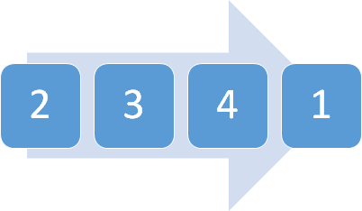
Vision + Goals = Strategic Planning
Goal that fundamentally shifts money and power (achieves part of the vision)
Current campaign goal
3-4. Goals on the horizon that bring in coalitions and community support
Notes:
r

Slide 25
Base Building- Case Studies (p. 17)
Discuss at your table…
How is the strategy of base building being used? How did they combine their goals and vision?
Are the locals using a narrow or more expanded vision, or both, to carry out building their base?
What suggestions could you make to improve the local’s use of base-building strategy?
Who is included and who is not?

Slide 26
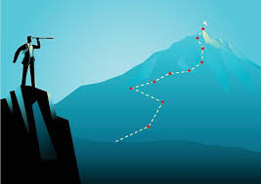
Share Outs

Slide 27
Key Points
Strategic planning sets goals along the path to reach your shared vision.
Organizers can use goals and visions strategically to build support for their campaigns depending on their circumstances.
This is a wonderful time to use your equity analysis tools to ask yourself who is included and who is not.

Slide 28
Break
10:30-10:45

Slide 29
Leadership ID
Skills for Building Your Team
Pete Clancy

Slide 30
Thinking Back…
What were the qualities of the WORST BOSS you've ever worked for? This could be a bad organization leader as well?
What were the qualities of the BEST BOSS you've ever worked for?

Slide 31
From our Reading... Ella Baker on Leadership
“Baker represented a different leadership tradition altogether. She combined the generic concept of leadership... and a confidence in the wisdom of ordinary people to define their problems and imagine solutions. Baker helped everyday people channel and congeal their collective power to resist oppression and fight for sustainable, transformative change…
That collective effort required leaders who were accountable to one another and were not singular...group-centered leaders... strengthen the group, forge consensus and negotiate a way forward. That kind of leadership is impactful, democratic, and, I would argue, more radical and sustainable, than the alternatives.”

Slide 32
From our Reading... Ella Baker on Leadership
“Baker represented a different leadership tradition altogether. She combined the generic concept of leadership...and a confidence in the wisdom of ordinary people to define their problems and imagine solutions. Baker helped everyday people channel and congeal their collective power to resist oppression and fight for sustainable, transformative change…
That collective effort required leaders who were accountable to one another and were not singular... group-centered leaders are at the center of many concentric circles. They strengthen the group, forge consensus and negotiate a way forward. That kind of leadership is impactful, democratic, and, I would argue, more radical and sustainable, than the alternatives.”

Slide 33

Leaders Across these Three Theories

Slide 34
Leader ID Activity, Reflection Questions
Take 5 minutes to quietly read pages 18 and 19, then take 5 minutes to answer these questions as a group at your table:
Based on the scenario only, who would you identify as the Leader who has moved people the most? Why?
List the specific order of who you want to meet with and why.
What else do you want to know about these employees? Why?
Write the answers to these questions on the chart paper.
We will do a gallery walk hunting for the correct answers later.

Slide 35

Key Points
Intentional campaigns that center equity, not programs, build power.
The power to win is only built through people with a shared vision, making public commitments to act, to risk their collective resources, for the big meaningful changes they want.
The kind of power we needs depends a distributed and interdependent leadership structure.

Slide 36
Semantics for Recruiting and Building Power
Amanda Kail

Slide 37

Question....
Who is "the Union"?

Slide 38
Who does the work in "the union"?
Just you
All the members are regularly and actively involved

Slide 39
How many do you have? What do you ask them to do?
State Union Staff
Union Officers/Executive Board
Building Representatives/Association Representatives
Rank and File Members

Slide 40
The $1,000,000,000 Question...
How do you go from a few people doing all the work to a majority of members being actively involved?
It starts with how you talk to them.

Slide 41
Consider different responses...
Scenario: You are trying to recruit new members.
"Joining your union means you will always have someone to call if you ever get in trouble."
"You have some great ideas on what needs to change around here. Who else do you think feels that way? Do you think you could get a few folks together this week to talk about it? I'd love to hear more about how I could support you!"
What's the difference?

Slide 42
Consider different responses...
Scenario: a group of members has gathered for an action
  "Thanks so much to all of you for showing up tonight!"
  "I'm so excited to see you all here! Your numbers show our power!"

Slide 43

Do Not 3rd Party Your Union!
"We are working on ..."
"The union is fighting for..."
When you talk like this, who do your members think will do the work?

Slide 44
Avoid Being Transactional
What expectations about participation are you communicating to members?
How are you building solidarity?
"Your dues cost less than your daily Starbucks and you can offset the cost with member benefits"
"You have car insurance so why don't you have job insurance?"

Slide 45
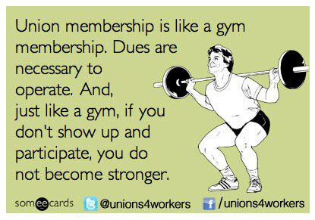
Your Turn!
Let’s practice rephrasing as many of the sentences as you can in ways that build participation and solidarity.

Slide 46
Try not to use the following words:
The union (or union at all), organization, we, us, our, or I.
"Thank you.”
“Union membership is like insurance; don’t you want someone to protect you in case something bad happens?”
“Let me explain what the union/organization does for you.”
“The union usually gets us more in pay raises and benefits than we pay in dues so if you do the math it’s definitely a good investment!”
“You say you have a good principal now, but sometimes managers change, you never know. What if you end up with a bad principal tomorrow and need the union to stand up for you?”
“We need all the members (or all of you) to call your elected representative to oppose this legislation.”
“That’s not actually a grievance so there’s nothing we can do for you.”
“The union leadership believes strikes are an absolute last resort, we do our best to prevent them on your behalf, since no one wants to strike ever.

Slide 47
Key Points
If you want members to participate, you have to tell them that.
Your language should match your intent.
"The union" doesn't work unless the members do.
Base building starts at the beginning of the project. It means including them from the get-go.
Participation= more power.

Slide 48
Lunch
12:00-1:00

Slide 49
Organizing Conversations
Matt Fargen

Slide 50

Why do you think we need to talk about doing one-on-one, worker-to-worker conversations in a training about building a team to win?
Talk at your table and be ready to talk as a room.
Question???
Notes:
Why do you think we need to talk about...
Take some time – about 5 mins – and be ready to talk as a room
What did you come up with?

Slide 51
Basics of One-on-Ones
Notes:
Quick content set

Slide 52
One-on-Ones can be...
Recruitment
  Values and Commitment
Escalation
  Member to Activist to Mobilizer to Leader
Maintenance
  Relationship, Leadership, Strategic
Notes:
When one person talks to another person
And its primarly to get to know each other, but can be used for
Recruitment, Escalation, Maintenance

Slide 53

Who Are They? — Shared Definition
Leaders
  Trusted and respected across the worksite
  Influence thinking and action
  Bring their people with them
Mobilizers
  Already committed and active
  Activate participation and follow‑through
  Bring loyalty and credibility with coworkers
Activists
  Supportive and willing to act when invited
  Participate but do not yet move others
  Bring growth potential
Not Yet Engaged
  Not currently participating or connected
  Essential to building the base
  Require an intentional outreach plan
Titles do not equal leadership
Every role matters

Slide 54
We listen to relate to our people
Listen 80%; talk 20%
Use open ended questions-
  "Why haven't you become a leader?" Or "How would you fix the problem?"
Not about winning an argument with workers or interrogating workers
Learning where our stories connect and where their story connects to the campaign
Shared values, commitments, and risks of the campaign
Notes:
What do we do when we have one on ones
Listen 80%; talk 20%
Use open ended questions (Not will you become a member as opposed to
Not about winning an argument or interrogating even is they are wrong
Learning where our stories connect
Shared values, commitments, risks

Slide 55
We listen to identify their issues and values
Use open-ended questions
    What is not right here?
    What would you change?
    Why is this an issue for you?
    Why do you care about this?
    Why does that frustrate you?
Notes:
As Organizers we are listening to identiry their issues and values, not TELL them what the issues are
We use probing questions such as:
Use probing questions
What’s not right here?
What would you change?
Why is this an issue for you?
Why do you care about this?

Slide 56
We ask for commitment when we recruit workers to step up
Use direct and specific language
Stress the shared values you have exchanged
  "You said that... was important to you"
Frame it so the person IS the solution to the ask
  "Your colleagues need you to... in order to..."
Move them toward the next level of action
  Non-Member to Member to Activist to Mobilizer to Leader
Notes:
Use direct and specific language – Are you ready to sign this pledge cards, will you bring 5 people with you
Stress the shared values you have exchanged - Like you, I have been a low paid person that has felt disrespected by my managers
Frame it so that the person IS the solution to the ask – We cant win this if you do not show up, You are critical to the success of this action
Move them towards the next level of action – You joined us last month at Happy Hour, can you bring 5 people

Slide 57
We ask questions to identify leaders when we escalate campaigns
Who is trusted and respected?
  Why? How do you know?
To objectively identify leaders, we must ask our people who they trust and who they respect in their workplaces
Notes:
We do not organize worksites, worksites are already organized by natural leaders
We have to ask who is trusted and respected
Even if they are not a member, we need to be in contact
We cannot idently leaders based on our own observations and bias' - They wear the swag, they have been here 20 years but no one talks to them
We have to ask our people who they trust.
The attendance at the most recent ESP Conference

Slide 58
We cannot build our base beyond our usual suspects, the people who always show up at everything, without using intentional one-on-one conversations to bring new workers into our campaign and participate in building the power we need to achieve our vision.
We ask questions to build our base of power.

Slide 59

Responding with AAR

Slide 60
Responding with AAR
Affirm: Let them know you validate their feelings.
Answer: Give them an answer to the question. (Or get back to them.)
Redirect: Bring the conversation back to the ask.

Slide 61
Practice as a Group
Give me a reason you often hear about why people won't join the union?
How would you?
  Affirm
  Answer
  Redirect

Slide 62
Practicing AAR (Affirm, Answer, and Redirect)
Find a Partner who you have not yet worked with.
One will be the Organizer, one will be the Potential Leader.
After the first round you will switch roles for the second round.
We will then find a new partner and repeat for rounds three and four.

Slide 63
Practicing AAR (Affirm, Answer, and Redirect)
Organizer: "Will you help lead a team to address ongoing violence in classrooms?"
Potential leader: respond with one of the following:
"My principal likes me"
"I'm afraid I'll get targeted"
"I've got a busy schedule already"
"I don’t think I am a leader"
"I don’t' have violence in my classroom, I know how to manage a classroom"
"I will have to ask my husband first"

Slide 64
Debrief
What part(s), if any, were most challenging?

Slide 65
Key Points
Organizers listen and ask questions:
  Organizers prepare to respond to difficult questions
  Organizers work to understand a person's values that drive their concerns
We want our workers to realize:
  They care about a problem (issue)
  There is a person with a name who has the power to fix this problem
  The decision-maker won’t fix it until we push them to do the right thing
  To solve the problem, they need to join their colleagues, combine resources, and act together

Slide 66
Break
2:00-2:15

Slide 67
Worksite Mapping: People in the Campaign
Dr. Taraja Shephard Allen
and Alan Underwood

Slide 68

Purpose of a Worksite Mapping Tool
Visualizing Workplace Structure
  Worksite mapping helps leaders see who works where and when, revealing workplace structure and communication flow.
Identifying Influence and Opportunities
  Mapping uncovers key areas of influence and potential organizing opportunities within the workforce.
Strategic Resource Allocation
  Worksite mapping enables targeted outreach and efficient resource use, enhancing organizing effectiveness.

Slide 69

Building Capacity with Mapping
Setting Goals and Measuring Success
  Leaders use maps to set goals, measure progress, and coordinate organizing efforts effectively.
Identifying Key Leaders
  Mapping helps spot natural leaders and activists to play pivotal roles in campaigns.
Fostering Engagement and Confidence
  Engaging in mapping encourages ownership, enhancing leader confidence and commitment.

Slide 70

Engaging Teams with Mapping
Evolving Living Document
  Maps should be updated regularly to reflect staffing changes and workplace shifts for accuracy.
Fostering Collaboration and Alignment
  Sharing maps ensures team alignment and collaboration, enhancing campaign cohesiveness.
Guiding Activities and Tracking Milestones
  Actionable maps guide daily activities, track milestones, and adapt to changing needs.

Slide 71

Who Are We Mapping — Campaign Roles
Leaders
  Trusted and respected across the worksite
  Influence thinking and action
  Bring their people with them
Mobilizers
  Already committed and active
  Activate participation and follow‑through
  Bring loyalty and credibility with coworkers
Activists
  Supportive and willing to act when invited
  Participate but do not yet move others
  Bring growth potential
Not Yet Engaged
  Not currently participating or connected
  Essential to building the base
  Require an intentional outreach plan
Titles do not equal leadership
Every role matters — strategy depends on alignment

Slide 72
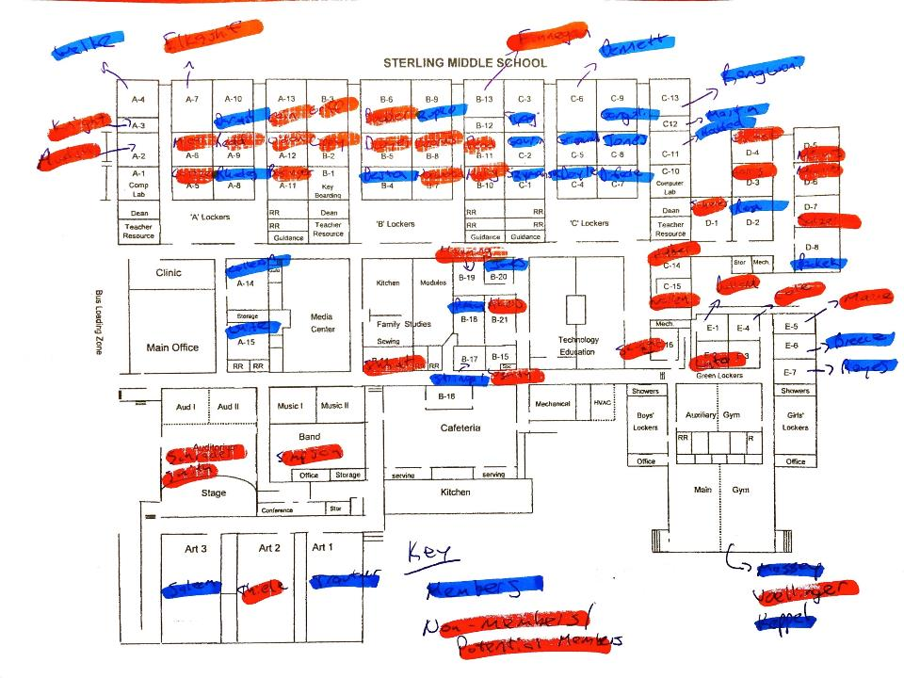
Example: K-12 Worksite Map
What does this map tell us?
What does this map not tell us?

Slide 73
Example- K-12 Spreadsheet
Name | Role | CEA Member? | ABC Member? | Works Well With | Union Support Rank | Attended Board Mtg | Joined Rally | Displayed Union Poster | Personal Contact Updated | Concerns
Alex Johnson | Math Teacher | Yes | Yes | Leo Martinez, Morgan Taylor | Leader | Yes | Yes | Yes | Yes | Class size concerns
Jamie Patel | School Nurse | Yes | No | Riley Brooks, Samira Ali | Supporter | No | Yes | No | Yes | Safety protocol clarity
Morgan Taylor | English Teacher | Yes | Yes | Alex Johnson, Taylor Green | Leader | Yes | Yes | Yes | Yes | Grievance process delays
Riley Brooks | Counselor | Yes | No | Jamie Patel, Samira Ali | Ally | No | No | No | No | Caseload limits
Samira Ali | SPED Teacher | Yes | No | Riley Brooks, Jamie Patel | Undecided | No | No | No | No | Planning time
Leo Martinez | Science Teacher | Yes | Yes | Alex Johnson, Drew Santiago | Leader | Yes | Yes | Yes | Yes | Lab safety resources
Taylor Green | Librarian | Yes | No | Morgan Taylor, Jordan Kim | Supporter | No | No | No | Yes | Access to materials
Jordan Kim | Art Teacher | No | No | Taylor Green | Undecided | No | No | No | No | Supply budget
Quinn Harper | Kindergarten Teacher | Yes | No | Drew Santiago, Samira Ali | Supporter | Yes | No | No | Yes | Evaluation support
Drew Santiago | PE Teacher | Yes | No | Leo Martinez, Quinn Harper | Leader | Yes | Yes | Yes | Yes | Assault protocol
Potential Building Chart

Slide 74
How to Assess Your Building/Department
Union Power
Category | Value | Count
Union Support Rank | Leader | 4
Union Support Rank | Supporter | 3
Union Support Rank | Undecided | 2
Union Support Rank | Ally | 1
Personal Contact Updated | Yes | 7
Personal Contact Updated | No | 3
Attended Board Mtg | Yes | 5
Attended Board Mtg | No | 5
Joined Rally | Yes | 5
Joined Rally | No | 5
Displayed Union Poster | No | 6
Displayed Union Poster | Yes | 4

Slide 75
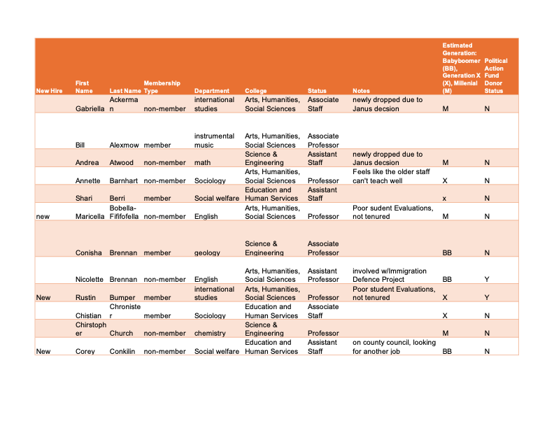
Example- Campus Spreadsheet
Potential Campus Chart

Slide 76
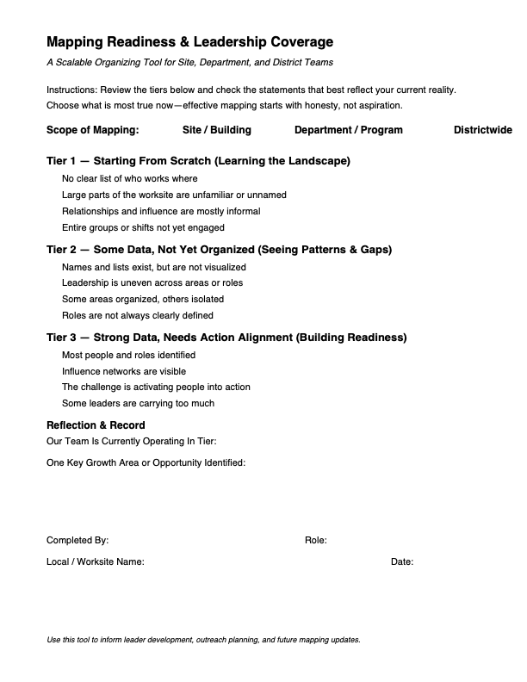
Mapping Readiness and Leadership Coverage Activity
Take the Self-Assessment on Page 30. Choose the tier that matches your reality:
  Tier 1: Starting from scratch
  Tier 2: Some data, not organized
  Tier 3: Strong data, needs action alignment

Slide 77

Next Steps: Tier 1 — Starting From Scratch
You’re in Tier 1 if…
  You don’t have reliable lists
  You’re working mostly from memory
  Entire areas of the worksite feel unknown
What To Do
  Sketch the structure of your building, department, or site
  Add names only where you are confident
  Use placeholders where people exist but names are missing
Examples
  “3rd floor — custodial staff — names unknown”
  “Bus drivers — afternoon shift — not yet engaged”
  “New hires — unsure who they are yet”
Focus
  Learning the landscape
  Identifying who and what you don’t yet know

Slide 78

Next Steps: Tier 2 —
Some Data, Not Yet Organized
You’re in Tier 2 if…
  You have lists or access to data
  You know many names but haven’t visualized coverage
  Leadership is uneven across areas
What To Do
  Place names on the map by location or unit. Label each person’s role. Use color, symbols, or notes to show roles: Leader, Mobilizer, Activist, Not Yet Engaged
Examples
  “Strong leaders in Special Ed, none in electives”
  “Several activists clustered in one department”
  “Mobilizers without clear leaders”
Focus
  Seeing gaps, clusters, and imbalance
  Identifying leadership development needs

Slide 79
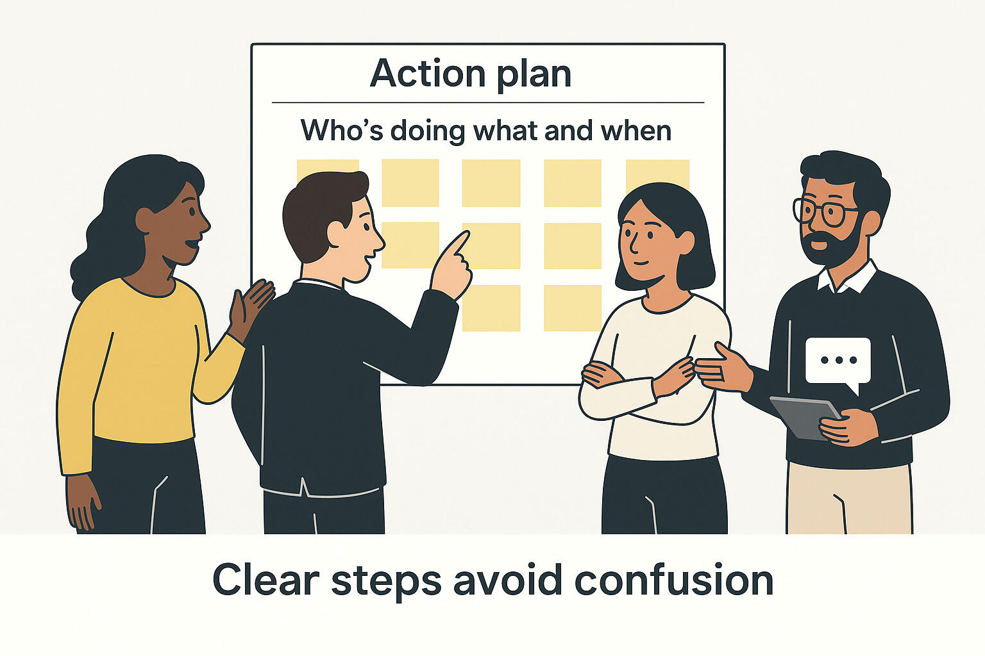
Tier 3 — Strong Data, Needs Action Alignment
You’re in Tier 3 if…
  Most names and roles are known
  You understand who influences whom
  The challenge is moving people into action
What To Do
  Confirm leadership roles and influence
  Map relationships and followership
  Align people to campaign roles
Examples
  “Leader with many followers but no shared responsibility”
  “Area ready for turnout but no assigned lead”
  “Overloaded leaders who need support”
Focus
  Readiness for action
  Preventing burnout
  Expanding leadership depth

Slide 80
Things to Consider When Assessing Your Worksites
Who are the people in your workplace that many coworkers trust and respect?
  (Identifying leaders who anchor influence and structure)
Who is actively supporting the union and able to move a small group of coworkers?
  (Identifying mobilizers who drive turnout and participation)
Who is ready and willing to take visible pro‑union action?
  (Identifying activists who participate in collective action)
Who is missing, under‑represented, not yet a member, not yet engaged, or not yet activated—and what might be the barriers?
  (Identifying equity gaps across shifts, roles, and demographics)

Slide 81
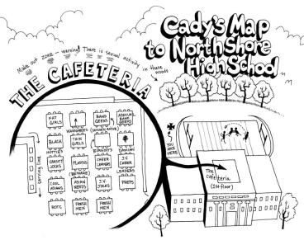
Worksite Mapping — Instructions
Choose the tier that matches your reality
  Tier 1: Starting from scratch
  Tier 2: Some data, not organized
  Tier 3: Strong data, needs action alignment
Map your worksite
  Location (building, department, unit, shift)
  People (names or placeholders)
  Roles:
    Leader, Mobilizer, Activist, Not Yet Engaged
As you work
  Map what you know today
  Use placeholders where information is missing
  Focus on coverage and leadership, not neatness

Slide 82

Leadership Coverage Scan: Scan Your Map
Mark each area you map:
  ✅ Leader present
  ⚠️ Activity but no leader
  ❗ No one mapped
Consider these questions:
  Where is leadership strong?
  Where is it fragile or missing?
  Where is the base thinnest?
“Anywhere you marked ⚠️ or ❗ — that’s not a failure. That’s base‑building work.”

Slide 83
Pause & Reflect
Take a moment to review your map.
Did your self‑assessment phase match what your map revealed?
What surprised you once everything was on the map?
Where do you see your strongest opportunity for growth or focus?
No discussion yet — just notice what you see.

Slide 84

Peer Share‑Out (Shake‑Out): Tips From the Room
In groups of 3–4:
  Share your campaign phase
  Share one practical tip you learned
Prompts:
  Something that worked
  A gap you didn’t expect
  A tool or mindset shift

Slide 85
Key Ideas
Mapping is an analysis tool leaders can use
Titles do not equal leadership
Maps are living documents
Work with what you got.
Growing the base grows our power
Our people are our greatest resource

Slide 86

Energizer!
EPIC Rock, Paper, Scissors
Katie Bishop

Slide 87
EPIC Rock, Paper, Scissors. Instructions!
Get into Pairs!
It is Rock, Paper, Scissors, shoot!
If you lose, you join the winner and cheer them on.
If you on a losing team, you become cheerleaders of the winning team. (You are always following the winner)
Every time you win, you gain more followers.

Slide 88
Real Talk
What could go wrong?
Kristin Lytie

Slide 89
On Your Own:
Write down some examples of what might go wrong with your team, either in building your team or what might happen once you have a team.

Slide 90
Partner Up!- 20 MINUTES
Find someone you haven’t been a partner with yet. Take turns sharing your worries.
Resist the urge to give each other advice! Instead, help your partner figure out what is the most urgent problem to consider.
  Identify the root of the problem by asking a lot of “why” questions.
The goal at the end of this exercise is to have a better understanding of the problem you most need to tackle in order to have the strongest, most bad-ass, tightest team possible.

Slide 91
WRITE IT UP- 5 MINUTES
Write your problem on a post it
Include your name
Bring it to the front of the room

Slide 92
Key Ideas
Don't internalize problems
We are stronger when we solve them together
Opens space for reflection-
  Are we doing something that creates a barrier?
  Do people need to be inoculated?

Slide 93

Closing the Day
What is becoming clearer?
What remains murky?
Housekeeping

Slide 94
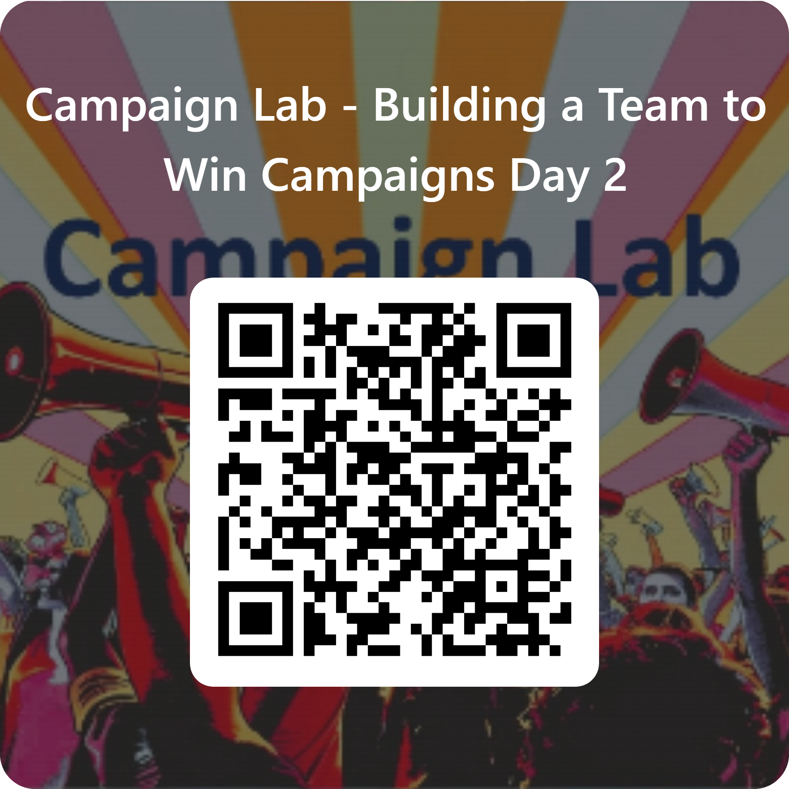
Please let us know how we are doing.

