Slide 1
Coaching Academy
Salt Lake City 2026
Notes:
6

Slide 2

Coaching Academy
By attending this training, you confirm that you are either an NEA affiliate staff person or NEA member in good standing. The information you receive here is only for your use in your capacity as an NEA affiliate staff person or NEA member.
This presentation and its contents are confidential and may not be further distributed or passed on to any other person or published or reproduced, in whole or in part, by any medium or in any form, for any purpose unless written consent has been provided by Ellen Holmes. Audio/video recording, copying of slides, and the use of AI note-taking tools are prohibited without the written consent from Kyle Serrette. Violation of these terms may result in legal action.

Slide 3
NEA Standards of Conduct
NEA has adopted a Standard of Conduct Policy to ensure that all of our gatherings are welcoming to and free from discriminatory, harassing, or otherwise unacceptable behavior. Discrimination or harassment based on race, color, ethnicity, religion, sex, age, national origin, sexual orientation, disability, gender identity, or expression, or any other characteristic protected by law will not be tolerated. If you have experience any discriminatory or harassing behavior, please report the incident by emailing Ron "Duff" Martin (rmartin@nea.org) and Gladys Marquez (gmarquez@nea.org). Thank you for your commitment to ensuring a positive event for all.

Slide 4
Honoring This Space
We begin by acknowledging that through a history of colonization and brutality, we are currently on the traditional lands stewarded by generations of indigenous people. We also stand on ground within a system that was built with free labor of black and brown people.
We honor these people, all elders, past, present, and emerging. We are called to learn and share these learnings about this tribal history, culture, and contributions that have been suppressed in the telling of the story of what we now call the United States of America.

Slide 5
Key Outcomes
Participants will Understand and apply the coaching cycle, the diagnosis framework, and the spectrum of interventions campaign coaches use Develop core coaching skills including asking powerful questions, learning to self-manage and centering the agenda of those being coached. Learn how to coach common challenges in leadership, centering equity and shifting from a service to organizing model of unionism. Assess and coach team leads and locals along the high-participation local continuum

Slide 6

Overall Agenda
Overall Schedule:
  Day 1: 8:30am - 5:00pm
  Day 2: 8:30am - 5:00pm
  Day 3: 8:30am -2:00pm
Overall Meal Breaks:
  Breakfast: 7:30am - 8:30am
  Morning Break – 15 Mins
  Lunch: 12:00 -1:00pm
    Day 3 Box Lunch
  Afternoon Break – 15 Minutes
  Adult Choice Networking: 4:30pm-5:00pm

Slide 7
Day 1
8:30-9:00am Introduction and Overview
9:00- 10:25am Content
10:25-10:40am Break
10:40-12:00pm Content
12:00-1:00pm Lunch
1:00-2:30pm Content
2:30-2:45pm Break
2:45-4:20pm Content
4:20-4:30pm Ending it Right
4:30-5:00pm Networking
AGENDA

Slide 8
Logistics to Remember
PEPs Portal
  Materials and Slides
Food
  Allergies
  Special Meals
Bathrooms
Room Temperature
Gratuity Hero
Microphones

Slide 9
Why we are here
The Campaign Lab is a strategy to build the power we need to get the wins we want.
A core element of the lab is the coaching structure.
Learning to be an effective Campaign Coach is critical to the success of the Campaign Lab.
We believe in building leadership.

Slide 10

Who is in the room
Name
Location
Your Pronouns
Notes:
Ellen

Slide 11

Community Agreements (page )
Using Self-Awareness and Self-Knowledge
Listening for Understanding
Being Gracious
Staying Engaged
Being Open and Suspend Judgment
Saying “I”- tell your truth
Leaning into Discomfort
Reaching Empathy
Expecting Non-Resolution and Non-Closure
Adapted from “Embracing equity and inclusion”, Annie E. Casey Foundation
Notes:
Community Agreements for Our Time
Awareness and Self-Knowledge
This requires self-knowledge and self-awareness. Self-knowledge allows you to see what causes you pain and conflict and enables you to embrace your contradictions and inconsistencies. It allows the space to work on things about yourself that you are not happy with. In turn, self-knowledge helps to prevent you from projecting your negative aspects onto other people. Bringing your best self also requires that you have a positive attitude, are willing to deeply explore your perspectives and remain open to the perspectives and experiences of others.
Listening for Understanding
Be an active listener. Active listening involves paying full and careful attention to the other person, looking him or her in the eye, avoiding interruptions, reflecting your understanding, clarifying information, summarizing the other person’s perspectives and sharing your own. Remember that most people need time to open up and might not be willing to immediately share their personal stories, hopes, fears and/or concerns.
Being Gracious
Being kind is a vital way of bringing meaning to our own lives, as well as the lives of others. Kindness is about caring genuinely for others around you, wanting the best for them and recognizing in them the same wants, needs, aspirations and even fears that you may have. Being kind and generous allows us to communicate better with others, to be more self-compassionate and to be a positive force in other people’s lives. This includes following the COVID protocols that are in place to protect the health of this learning community.
Stay Engaged
Staying engaged requires you to be morally, emotionally, intellectually and socially involved in the conversation. Staying engaged means that you are listening with curiosity and willing to deepen your understanding. Staying engaged might also require you to sustain the conversation even when it gets uncomfortable or diverted. This also means a commitment to keeping your electronic communications to a minimum with folks not present in this learning community.
Be Open and Suspend Judgment
Listening with an open mind includes being receptive to the influence of others. You can suspend judgment by becoming aware of preconceived notions and listening to everything someone has to say before jumping to conclusions. Most importantly, suspending judgment also means listening to what the speaker has to say for understanding, not just to determine whether the speaker is right or wrong.
Say “I”- tell your truth
Speaking your truth in authentic and courageous conversations about race requires a willingness to take risks. It means that you will be absolutely honest and candid about your own thoughts, feelings, experiences and opinions and not just saying what you perceive others want to hear. Speaking your truth will require you to speak from the “first person” and use “I” statements.
Seek Discomfort
Leaning in to discomfort will require you to let go of racial understandings and stereotypes that you may be holding onto in order to move forward. Leaning in means that you will avoid judgment, assume positive intent and be open to the kernel of wisdom in each individual’s experiences. Leaning in to discomfort will require you to sit through moments of embarrassment, confusion, anxiety and/or fear.
Reaching Empathy
Empathy and compassion allow you to understand the other person’s point of view. When you are empathetic, you are more understanding, patient and kind. Expanding your capacity to feel empathy will also allow others to enter your circle of human concern.
Resolution and Closure
Expect and accept that there may not be closure. It is not likely that you will resolve your personal understanding about race or another person’s racial experience in a single conversation. The more you talk about race with another person, the more you learn and the more they will learn. Authentic and productive conversations about race are continuous and always evolving.
*Adapted from “Embracing equity and inclusion”, Annie E. Casey Foundation

Slide 12
Yvie
Community Building

Slide 13
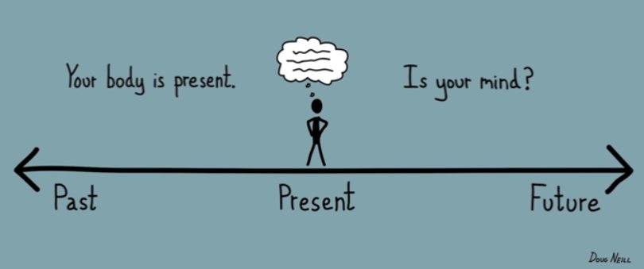
Present in this Moment …
What is the work of being a Campaign Lab Coach?
Why are you called to volunteer for this work as a unionist?
What are your goals in this work?
What are all the experiences about you bring to this room that will help our community of coaches achieve our goals?

Slide 14
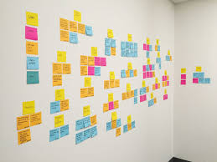
Cloud of Experience Wall
Brainstorm the types of campaign experiences you have had.
*Write one experience per Post-it*
Notes:
Step 1 brainstorm challenges/issues ESP members have - work, life, union, etc. one challenge per post-it.
Step 2 Place post-its to a wall and begin to move them into clusters that are similar
Step 3 Name the clusters – ex. “Fair Pair”
Remember - people at the front to move back and those at the back to move up – keep churning and engaging.
An affinity wall is a collaborative brainstorming and analysis tool used to organize large amounts of unstructured data, ideas, or user feedback into natural, thematic clusters.

Slide 15
Cloud Wall of Experiences in 3 Acts
1. Put all post its on the wall
2. Move post its
  - (yours and others into similar clouds)
3. Name the clouds and outliers
Notes:
Step 1 brainstorm challenges/issues ESP members have - work, life, union, etc. one challenge per post-it.
Step 2 Place post-its to a wall and begin to move them into clusters that are similar
Step 3 Name the clusters – ex. “Fair Pair”
Remember - people at the front to move back and those at the back to move up – keep churning and engaging.
An affinity wall is a collaborative brainstorming and analysis tool used to organize large amounts of unstructured data, ideas, or user feedback into natural, thematic clusters.

Slide 16
Cloud Wall Debrief
What do you notice?
What do you feel as you look at these clouds of experiences?

Slide 17
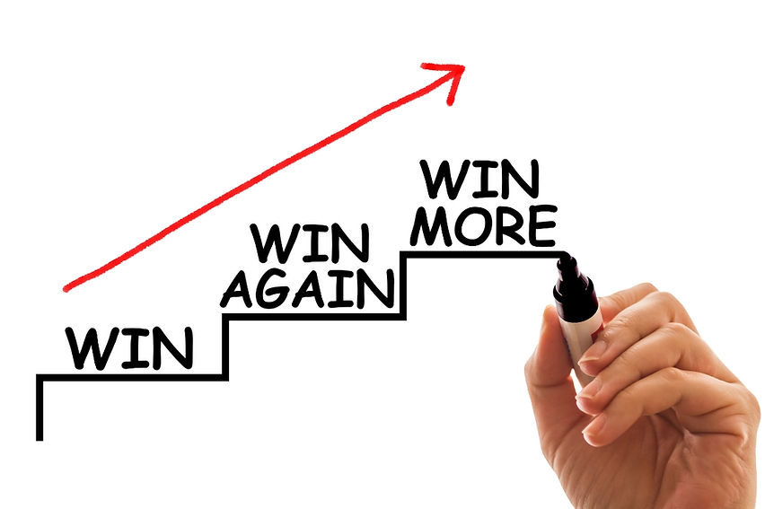
How do we know if we are winning?

Slide 18
When We Win Resource Wall
Brainstorm the types of resources you will need in order to get that BIG win.
*write one resource per Post-it*
Notes:
Step 1 brainstorm challenges/issues ESP members have - work, life, union, etc. one challenge per post-it.
Step 2 Place post-its to a wall and begin to move them into clusters that are similar
Step 3 Name the clusters – ex. “Fair Pair”
Remember - people at the front to move back and those at the back to move up – keep churning and engaging.
An affinity wall is a collaborative brainstorming and analysis tool used to organize large amounts of unstructured data, ideas, or user feedback into natural, thematic clusters.

Slide 19
Cloud Wall of Resources in 3 Acts
1. Put all post its on the wall
2. Move post its
  - (yours and others into similar clouds)
3. Name the clouds and outliers
Notes:
Step 1 brainstorm challenges/issues ESP members have - work, life, union, etc. one challenge per post-it.
Step 2 Place post-its to a wall and begin to move them into clusters that are similar
Step 3 Name the clusters – ex. “Fair Pair”
Remember - people at the front to move back and those at the back to move up – keep churning and engaging.
An affinity wall is a collaborative brainstorming and analysis tool used to organize large amounts of unstructured data, ideas, or user feedback into natural, thematic clusters.

Slide 20
Cloud Wall Debrief
What do you notice?
What do you feel as you look at these clouds of experiences?

Slide 21

Key Points
Collectively we know a lot about campaigns
We will need many campaigns and a lot of resources to achieve the wins we visioned in our minds.

Slide 22
Amanda & Melissa
Intro to Campaign Lab

Slide 23
Why the Campaign Lab?
The old strategies of every local and state working independently are not building the leadership, participation, power, or resources we need.

Slide 24




Those who are attacking us are better organized and control our government.
Notes:
Advocates, Mobilizers, Organizers Scenario

Slide 25
What is Campaign Lab?
This is an intentionally created and networked leadership structure focused on building and using power within and across issue campaigns.

Slide 26
What the Campaign Lab Offers
Free Training: Expert-led sessions by the NEA and partners, including AROS, the UC Berkeley Labor Center and the Midwest Academy.
Peer Coaching: Direct support from an experienced, rank-and-file peer coach focused on leadership growth.
Collaborative Community: A supportive network of locals driving member participation through active campaigns.
Campaign Grants: Grant funding to power your local campaigns.
Notes:
WHAT IS CAMPAIGN LAB?
Context on this moment and what’s needed from our union. Helpful narrative context for us internally:
"Almost all strategic narratives demand change from the organization and/or the broader world. Establishing a sense of urgency for the change required, by authentically setting out the current reality of where the organization is and the challenges it faces. This current reality also provides the dramatic tension the narrative needs in order to capture its audience’s attention. Don’t restrict the narrative to just good news,
A good strategic narrative should link together why the organization is – or needs to go – on a journey, what the direction and destination of that journey is, and how it is going to get there.

Slide 27
Key Points
Campaign Lab is a Strategy for creating high-participation locals who are leadership rich, networked with other leadership rich locals, and working towards winning the conditions required for the schools, communities, and future we want.

Slide 28
Why Coaching

Slide 29

Leadership in organizing is …
accepting responsibility(self) for enabling others (others) to achieve shared purpose in the face of uncertainty (action). Leadership requires a decision, a choice, to accept responsibility. It is a form of social interaction, of relationship. It is about achieving “shared” purpose. And its domain is the uncertain.

Slide 30
Coaching enables others to understand their own agency and make decisions about how to act in the face of uncertain outcomes.

Slide 31
Coaching is:
A direct intervention
Centered on the lead or team’s processes
Focused to help the team lead make strategic decisions and is the ultimate leadership development practice

Slide 32
From our Reading... Ella Baker on Leadership (p.5)
“Baker represented a different leadership tradition altogether. She combined the generic concept of leadership— “a process of social influence in which a person can enlist the aid and support of others in the accomplishment of a common task”—and a confidence in the wisdom of ordinary people to define their problems and imagine solutions. Baker helped everyday people channel and congeal their collective power to resist oppression and fight for sustainable, transformative change…
That collective effort required leaders who were accountable to one another and were not singular. There were many organizers in groups such as SNCC who modeled Baker’s brand of what sociologist Charles Payne has called “group-centered leadership.” Rather than someone with a fancy title standing at a podium speaking for or to the people, group-centered leaders are at the center of many concentric circles. They strengthen the group, forge consensus and negotiate a way forward. That kind of leadership is impactful, democratic, and, I would argue, more radical and sustainable, than the alternatives.”
In Ella’s own words, “Strong people don’t need strong leaders.”

Slide 33

Time to Talk
What stands out as important to you?
What does this mean to you in your role as Campaign Lab Coach?

Slide 34
When we coach, we build leaders who understand they are interdependent in both responsibility and accountability.

Slide 35

Key Points
NEA needs more leaders who are committed to the work of building campaigns.
Like Ella Baker said, we need a group of folks who are committed to finding and developing the leaders we need. That’s where you come in.
Coaching is about helping members develop their leadership skills. You are building the leaders we need for this moment.

Slide 36
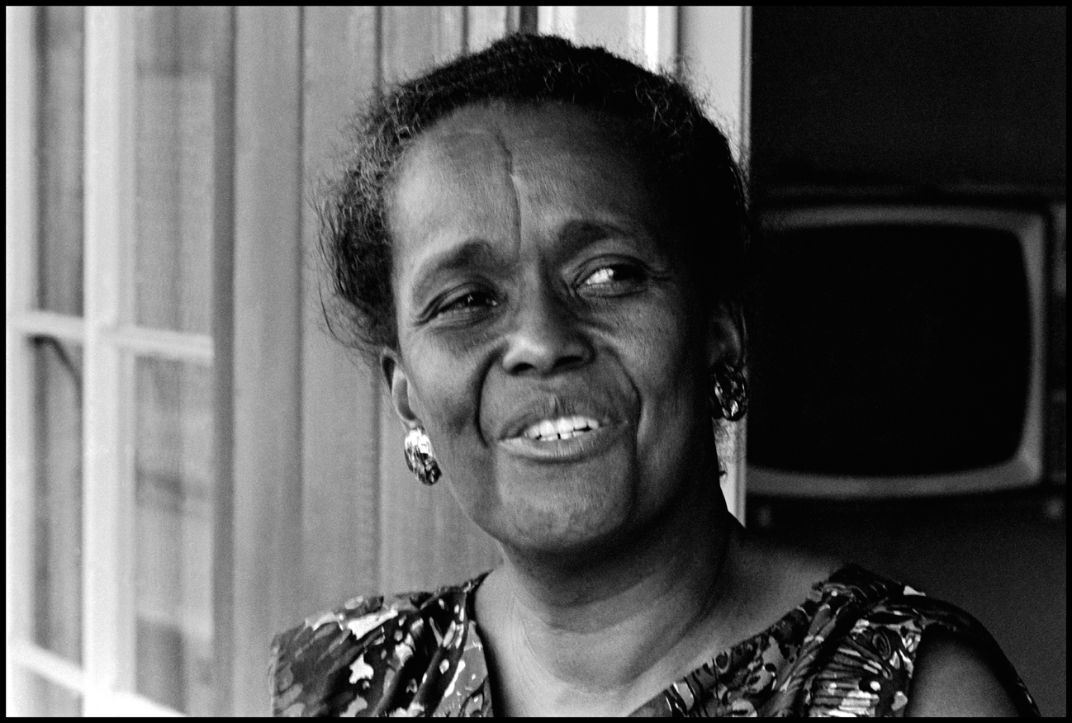
Coaching in the Campaign Lab
You are a thought partner for the campaign lead.
You don’t have to be an expert.
You do need to be able to be curious, be a good listener, and be a learner.

Slide 37
Campaign Coaching: What It Is & Isn’t (p.7)
What It Is | What It Isn’t
Using mostly questions observations, personal stories, and sometimes advice to help campaign leads clarify their thoughts and figure out next steps to achieving their goals | Being the technical expert that does all the talking. Always giving advice and telling stories.
Helping campaign leads understand what is going on beneath the surface of their problems so that they can find a way forward. | Being a lead organizer. You are not responsible for the work of the campaign, including meetings or campaign plans (although you should help the lead think through being successful at those things)
Holding the campaign lead accountable for meeting their goals but also holding space for them to struggle productively in the work. | Acting as a therapist. Make space for the lead to voice their fears and frustrations but make sure to pivot at a certain point to figuring out what they can do to change their situation.
Encouraging campaign leads to keep going by reminding them of the good work they have done so far and the difference that their work is making. | Only listening to the campaign lead. Coaching sessions should have an agenda and outcomes that the coach has an active role in helping the lead achieve.

Slide 38
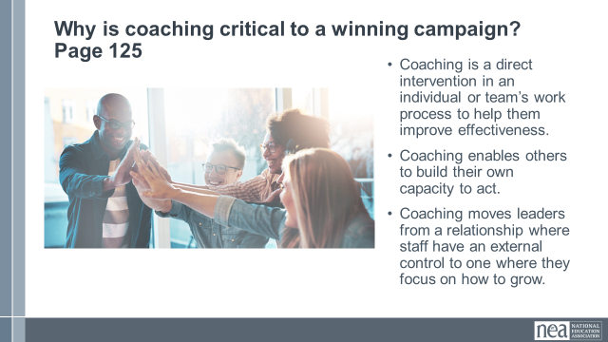
Small Group Discussion
What on this chart stands out to you?
(refer to page 7)

Slide 39
Key Points
Coaching is a direct intervention
Coaching is the ultimate form of leadership development

Slide 40
Scott
Effective Coaching

Slide 41
Remember a time…
Notes:
3 minutes
Right now, I am going to ask you to close your eyes….Think of…
“Think of an experience you’ve had of effective coaching, or being supported by someone – this could have been an athletic coach, a teacher mentor, or anyone else in your life who supported you to learn and grow in some way. What’s a moment you remember them providing a kind of support that exemplifies the role of a coach?...(continue closed eye in your own style)”
What were you feeling as you came into coaching? How did you feel leaving the coaching session?
What did they say? And if you can’t remember - what has stuck with you now that this is the moment you’re recalling?
You can open your eyes….

Slide 42

5 Minute Quick Draw of your Coach
Represent your coach in pictures.
How did they talk to you?
What was their disposition?
What sorts of questions did they ask?
Other attributes…

Slide 43
At your tables:
Think about your experience:
  What did the coach (or other person) do?
  What qualities did they demonstrate?
Notes:
10 minutes total -
We are now going to go to breakout rooms to break into pairs.
First, introduce yourself, briefly. Then, share with your partner a little about your experience: What did the coach, or other person, do? What qualities did they demonstrate? You will have 8 minutes, 4 minutes each.”
Cofacilitator paste in chat:
=========
Introduce yourself, briefly. Share a little about your experience: What did the coach (or other person) do? What qualities did they demonstrate?

Slide 44

Sharing Stories and Commonalities
Share your picture and the story of your coach.
Create a chart that captures 3 to 5 commonalities you each shared in your stories.

Slide 45
Whole Group Reflection
What themes did you notice?
What surprised you?
What might you aspire to include in your own coaching practice?

Slide 46
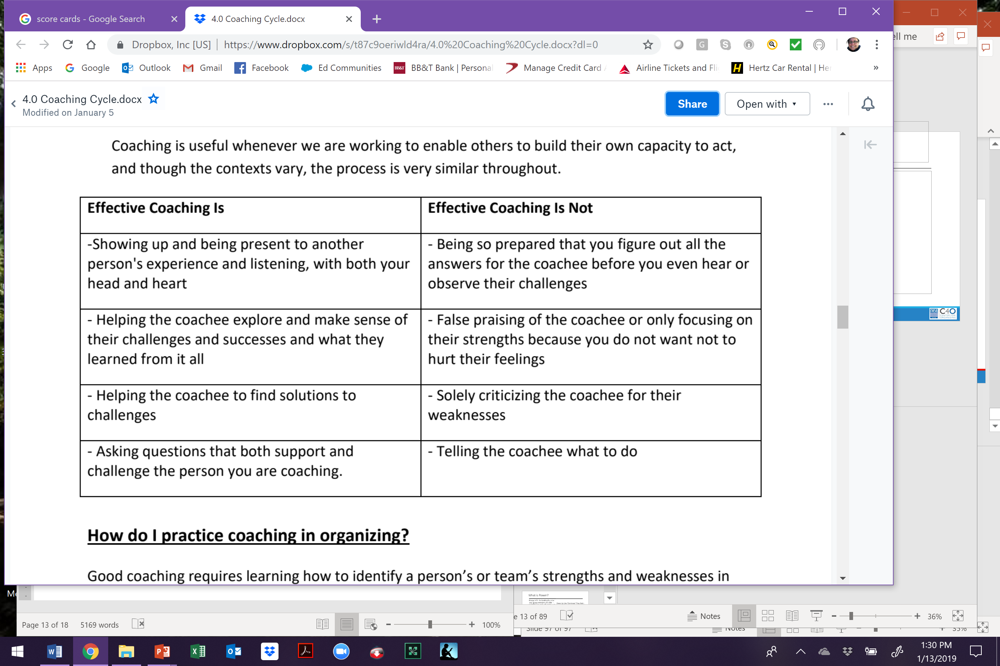
Effective Coaching

Slide 47
Key Points
Coaching is an intentional set of skills and practices that helps leads identify shared goals, define strategic plans, build activated communities of people willing to share resources towards their common goal, and assess progress towards those goals.
This is about leadership development at every level.

Slide 48
Break

Slide 49
Dr. Taraja & Katie B.
Centering Equity in Coaching

Slide 50
Framing what we mean on Centering Equity…
Race, class, and gender dynamics, disparities, and divisions permeate our society, communities, schools, and classrooms. Systemic oppression is so deeply rooted in our history, culture, and institutions that there is no escaping it.
Visible or not, the impacts are ever-present. Race, class, and gender justice is the systematic fair treatment of all people resulting in equitable opportunities and outcomes for all. Justice, or equity goes beyond being against the systematic use of oppressions like misogyny, racism, and classism. It is not just the absence of discrimination and inequities, but also the presence of deliberate systems and supports to achieve and sustain equity through proactive and preventative measures.

Slide 51

An Unfinished Promise. An Incomplete Vision.
Every vision is shaped by who was present when it was written and who was not yet imagined.
A vision meant to guide us all. Written with certainty. Declared complete.
Yet:
  power decided what mattered
  access determined who contributed
  silence was mistaken for agreement
What we inherit is not neutral. What we build next is a choice.
Campaigns are no different.

Slide 52
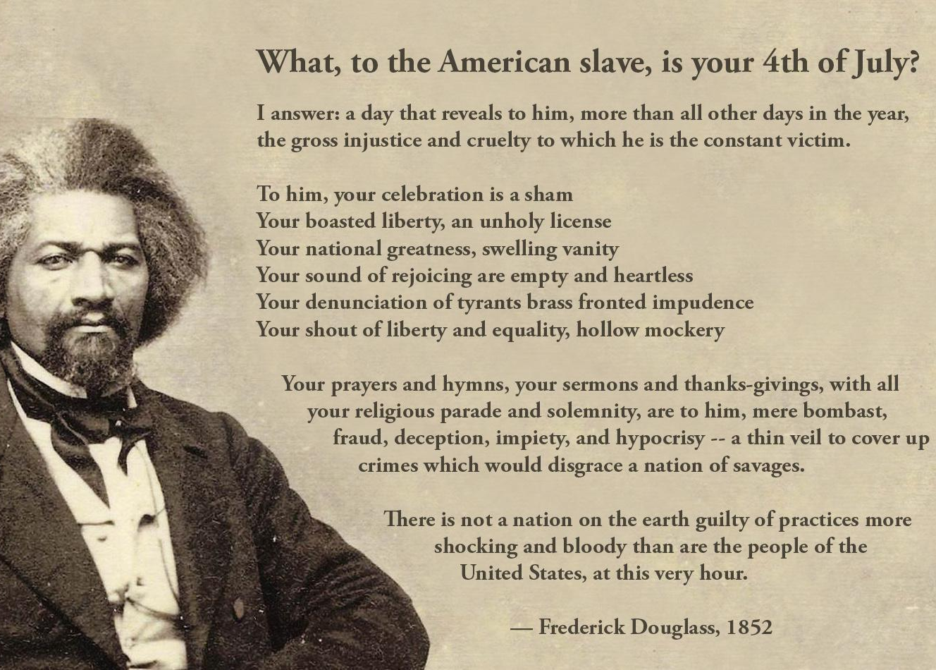
Centering Equity:
Race, Class and Gender
Equity is:
  deliberate and intentional
  rooted in history and systems
  measured by outcomes, not promises
It is the work of designing so everyone belongs — not just those already inside.

Slide 53
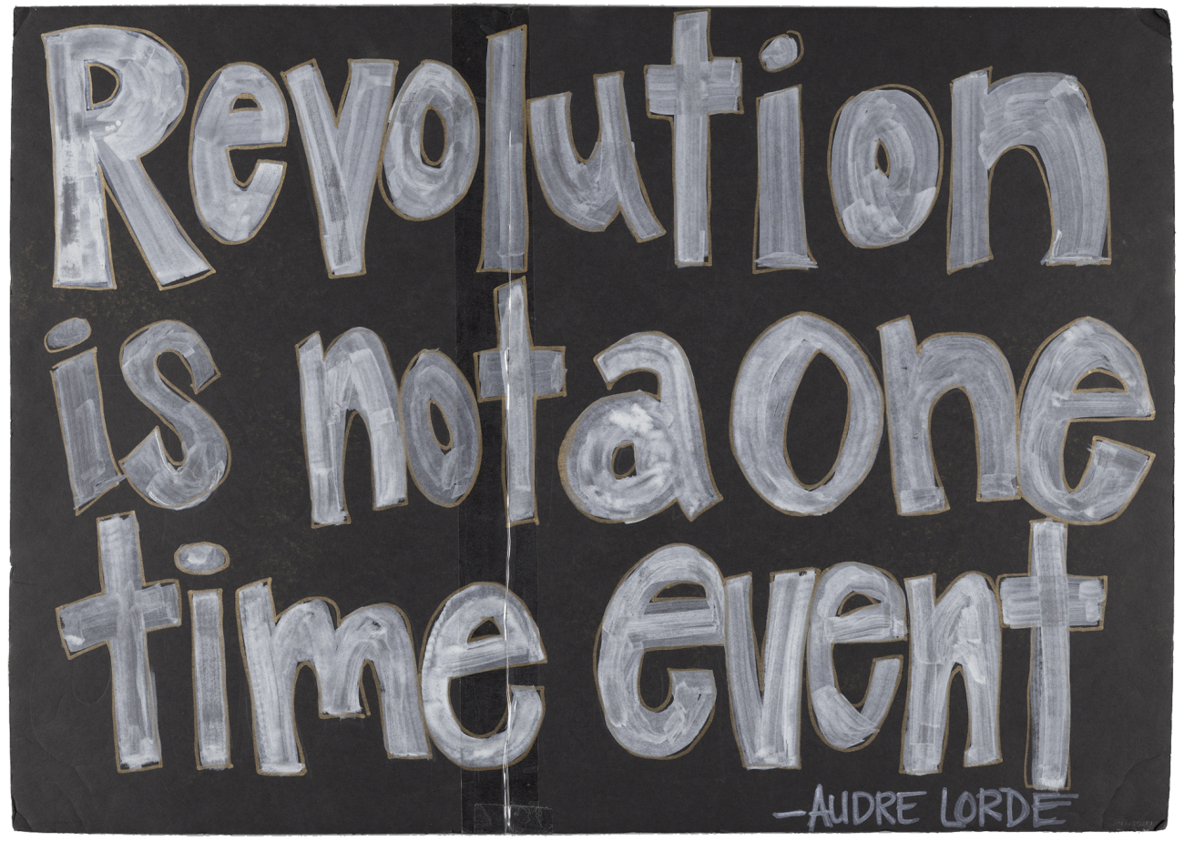
Why Centering Equity Matters
What happens when:
  a vision doesn’t include everyone?
  decisions are made far from lived experience?
  absence is treated as neutral?
Equity analysis helps us see:
  whose interests were prioritized
  whose experiences were ignored
  who absorbs harm when systems fail
Equity is not about intent. It is about design, access, and impact.

Slide 54
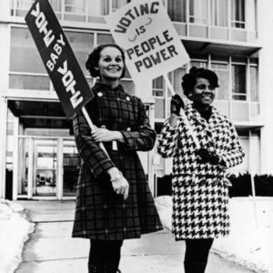
Equity and Power
Equity is not a value statement — it is a campaign discipline.
Campaigns without equity analysis often reproduce existing power structures.
Consider:
  Who defines the problem determines whose needs are centered?
  Who names the solution shapes who benefits?
  Who leads the work determines how power moves — or if it does at all?

Slide 55

The Four Essential Organizing Questions
Every Organizer Asks
  Who are my people? What are their issues?
  What do they demand?
  Who has the power to meet that demand?
  What are people willing to risk to win?
The Missing 5th Question: Who is missing — and why?
Asked once, it’s reflection. Asked always, it’s equity.

Slide 56
What are some of the challenges that come with intentionally centering equity?

Slide 57
Common Myths When Centering Equity
Myths we hear
What equity analysis reveals
  Absence signals barriers, not apathy.
  “Small” issues often reflect systemic harm.
  Tradition can mask normalized inequity.
  Harm is often carried quietly by the same people.
  “They don’t come to meetings.”
  “This issue isn’t big enough or doesn’t exist.”
  “That’s just the way it’s always been.”
  “It only impacts a few people.”
Equity‑centered responses remove barriers, prioritize lived experience, challenge what’s been normalized, and address root causes rather than symptoms.

Slide 58

Who is in the Room Where It Happens?
Decisions are made
by those who are present.
Absence is not accidental.
- It is produced.
- It is predictable.

Slide 59

Who Leads Equity Work (And at What Cost):
A Necessary Note on Leadership and Care
  Equity work should not rest solely on marginalized people.
  Those most impacted must be centered — not burdened.
  Responsibility for equity belongs to those with power, access, and influence.
Equity work should never:
  cost someone their health
  erode their sense of belonging
  require reliving harm to be believed
Centering equity means shared leadership, collective care, and real accountability

Slide 60
Centering Equity: A Tool and How to Use It
What is the Centering Equity Tool?
  A set of questions used to identify inequities across race, class, and gender; examine root causes and systems; assess impacts on different groups; shape equitable solutions and strategies; and elevate leadership of those most impacted.
Remember… Equity is layered through every stage of a campaign, not added at the end.
  If those most impacted are not in the room, power is not centered.
  If leadership does not reflect lived experience, equity is incomplete.
  If demands benefit some while harming others, the analysis is unfinished.
  If success is not measured by who gained voice, agency, and power, the campaign must be redesigned.

Slide 61
Teamwork: Applying the Equity Analysis
Review the Scenario (RCEA) on page 8.
Use the Equity Analysis questions. Review this through the lens of a Coach.
As you read, keep these three prompts in view:
  Who is most directly impacted and are they shaping the decisions being made?
  Who is missing from the process, and what barriers keep them out of the room?
  What would need to change for this campaign to truly shift power, not just manage harm?
Notice where the campaign is strong and where it needs to be redesigned.

Slide 62
Problems (1)
Causes (2)
Solutions (4)
History (3)
Strategies (5)
Leadership (6)
What race, class, or gender inequities are you noticing or experiencing? What are the impacts on different racial groups? Who benefits most and who is hurt most?
What institutions, policies, or practices are causing or contributing to the inequities? What social norms, popular myths, or cultural biases may be contributing?
How did things get this way and are things worsening or improving?
What solutions could address the root causes and eliminate the inequities? How would different racial groups be impacted by the proposed solutions?
What strategies and actions could be used to advance the solutions?
Who are the stakeholders most affected by the inequities? Are they involved in naming the issues and solutions? What kinds of active leadership roles could they take to advance the proposed solution?
Tool, P. 10

Slide 63
As a table, on a chart paper list:
An equity gap
An assumption of your group that shifted
A design question that emerged

Slide 64
Key Points: Centering Equity in Campaigns
Centering equity means equity shapes the vision, not just the outcome.
Equity analysis is essential to avoid reinforcing harm.
Centering equity shifts campaigns from:
  participation → leadership
  representation → shared power
  fixes → systemic change
A campaign is equitable only if those most impacted help define the problem, shape the demands, lead the work, and gain power through it.

Slide 65
Joshua & Serafina
Diagnosis Framework

Slide 66
What is coaching?
Campaign Coaches are Thought Partners
Coaches remain curious and listen deeply
Coaching enables others to build their own capacity to act and solve their problems
Coaching transforms leaders from a relationship where someone else has external control to one where they focus on how to grow.

Slide 67
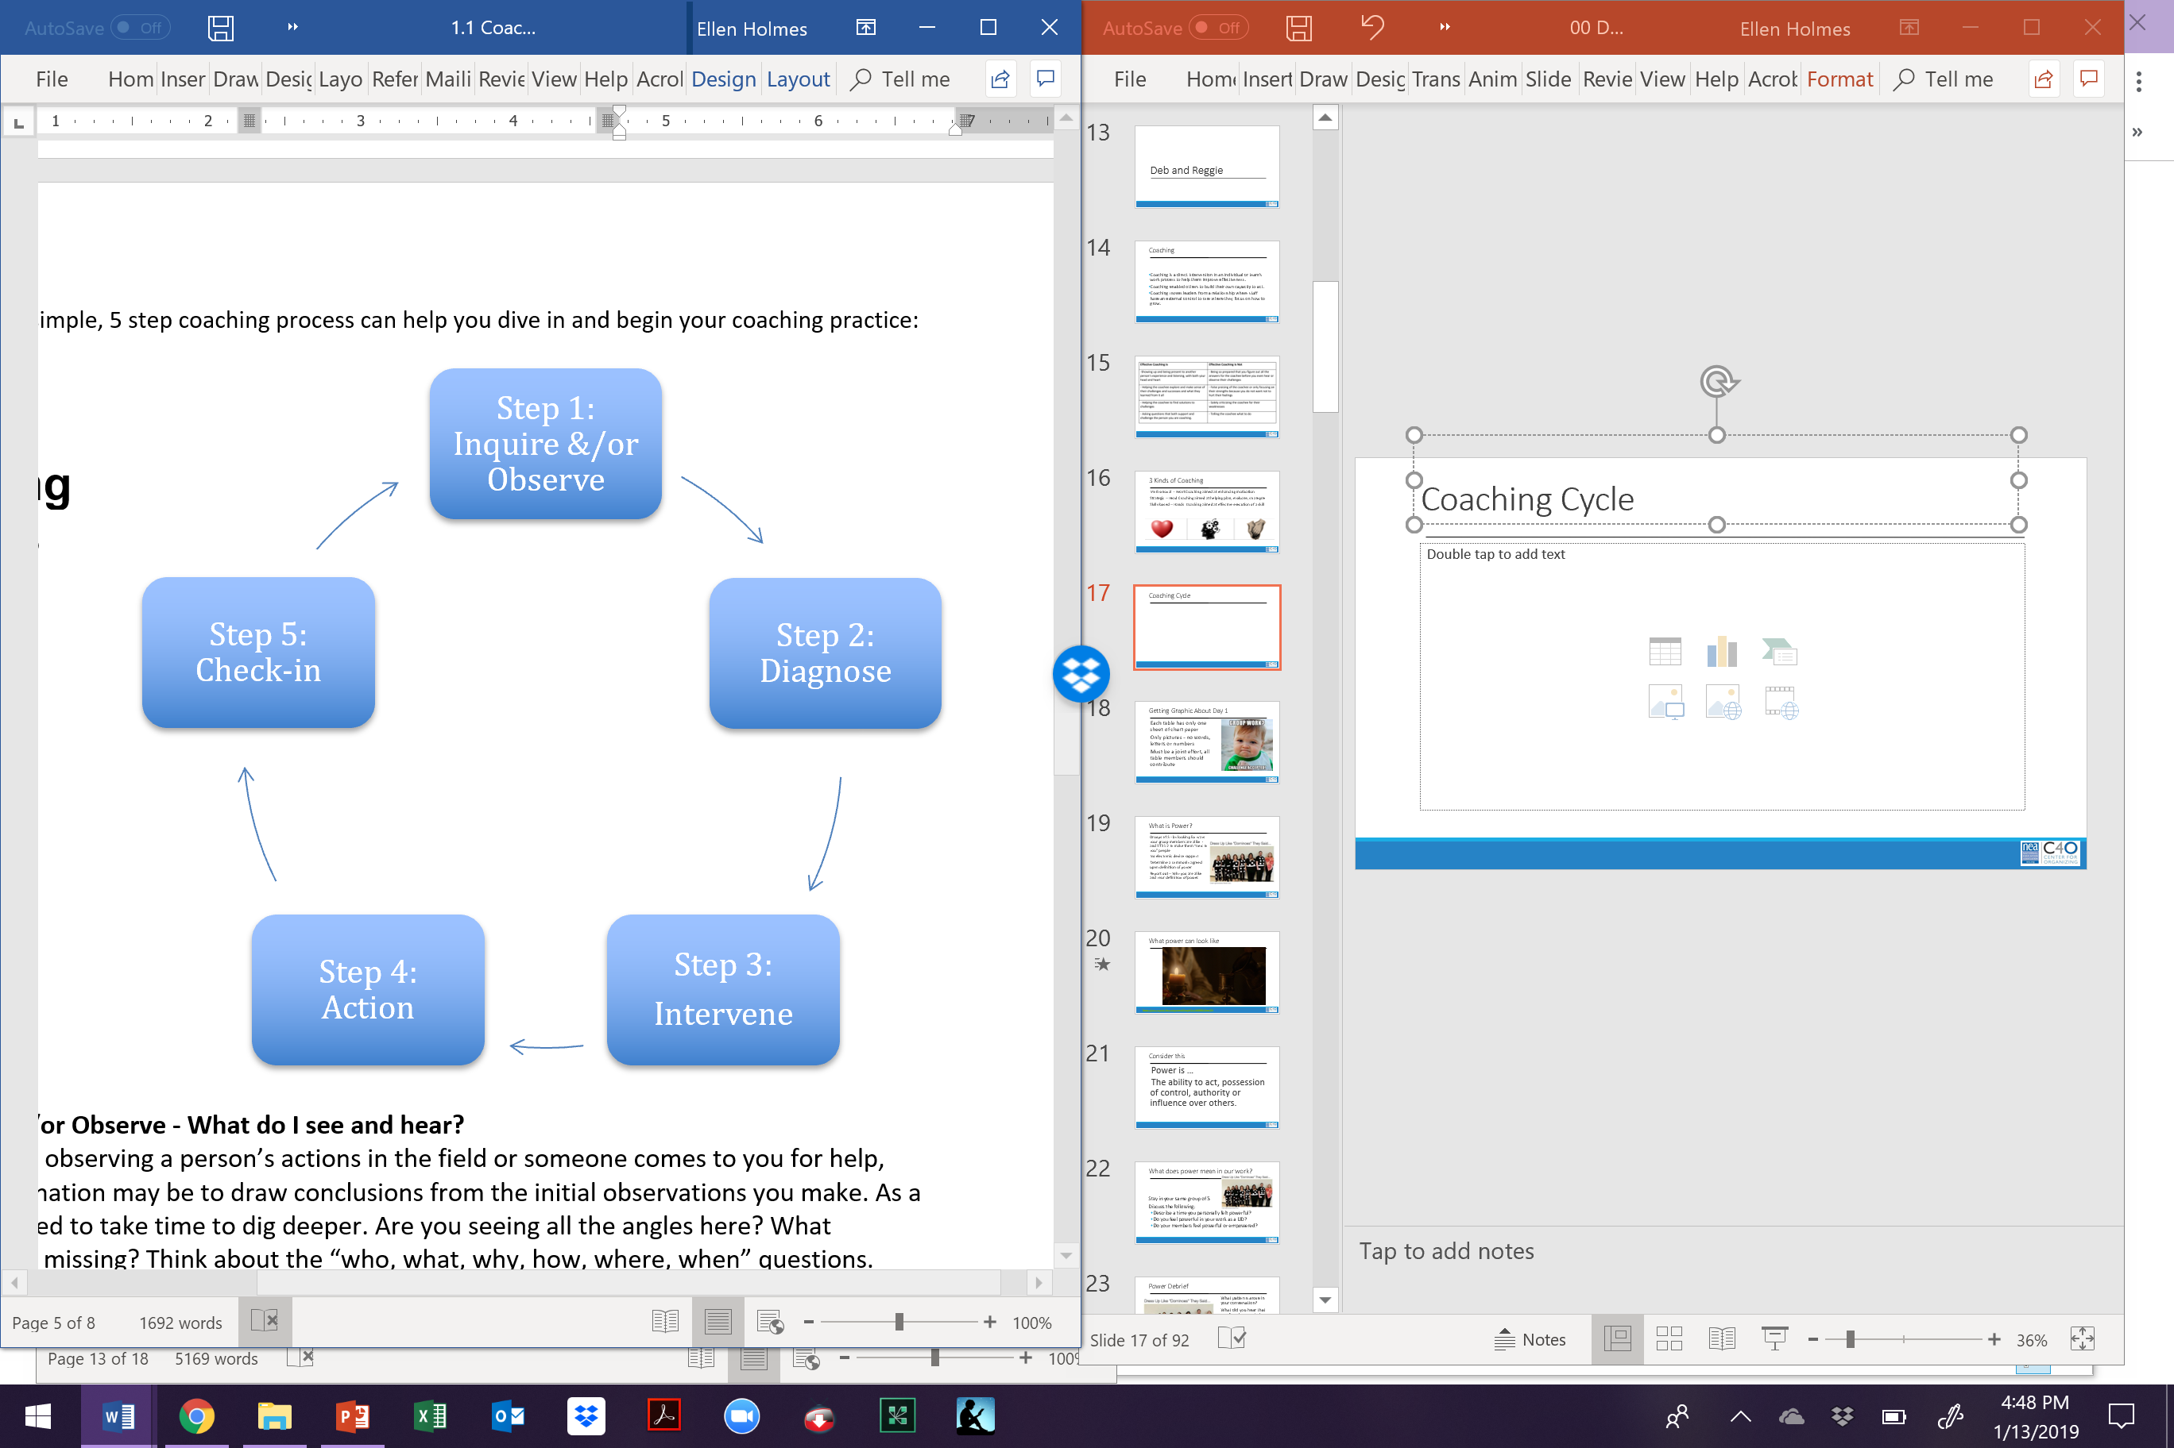
Coaching Cycle
Step 1: Inquire or Observe
Your role is to build a relationship with the lead or team, learn their context, listen to what they want to achieve, and listening to what they believe are their challenges.

Slide 68
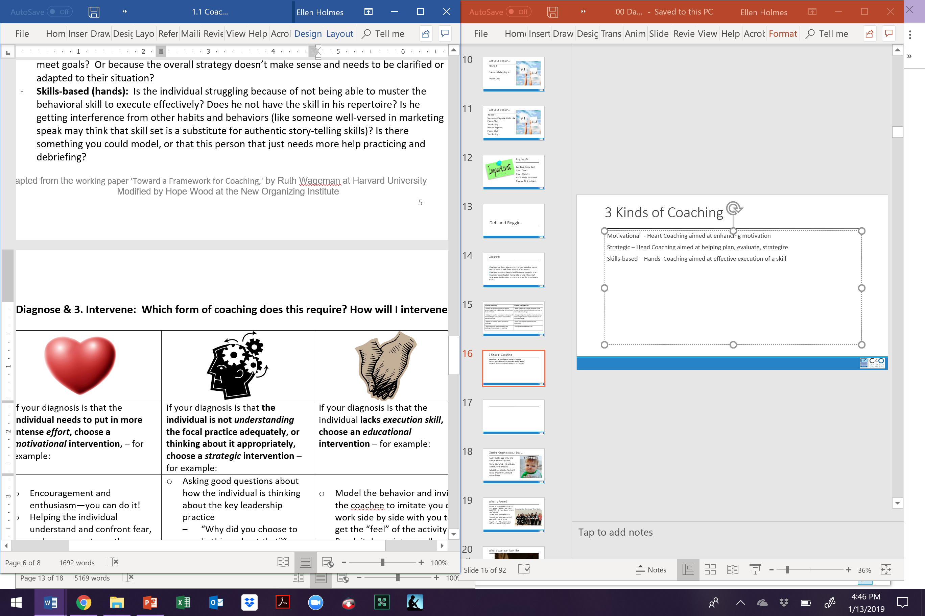
Coaching Cycle
Step 2 : Diagnose
You formulate a theory about the type of challenge they are having.

Slide 69
Coaching Cycle
Step 3: Intervention
These are the ways that you interrupt the lead or team and in a way that centers what they think they can do to solve their challenges

Slide 70
Coaching Cycle
Step 4: Action
Your role is to set up how you will check in with them accountability.
Ask questions of How, When, Who, etc?

Slide 71
Coaching Cycle
Step 5 : Check-in
How did it go?
Why do you think it went that way?
What have you learned?

Slide 72
Key Points
We use these steps to prevent us from jumping right into intervention and action.
We use these steps to remind us to center the lead and the team as much as possible

Slide 73
Step 2- Diagnosis

Slide 74
3 Kinds of Diagnoses – Your Theory on the Case
Motivational - Heart Coaching aimed at enhancing motivation
Strategic – Head Coaching aimed at helping plan, evaluate, strategize
Skills-based – Hands Coaching aimed at effective execution of a skill

Slide 75
Strategic (Head):
Is the individual struggling because the goals are not achievable?
Or because they’re not thinking creatively enough about how to use the resources they have to meet goals?
Or because the overall strategy doesn’t make sense and needs to be clarified or adapted to their situation?

Slide 76
Motivational (Heart):
Is the individual struggling because they are not putting forth enough effort?
Are they not trying hard enough because they are embarrassed?
Are they quitting too soon because of frustration or fear?

Slide 77
Skills-Based (Hands):
Is the individual struggling because of not being able to muster the behavioral skill to execute effectively?
Do they not have the skill in their repertoire?
Is the person getting interference from other habits and behaviors (like someone well-versed in marketing speak may think that skill set is a substitute for authentic story-telling skills)?
Is there something you could model, or that this person that just needs more help practicing and debriefing?

Slide 78
What’s next in the cycle -
Pick an Intervention

Slide 79
Key Points
Without being able to identify which "type" of challenge the person is having, a coach is not able to formulate the sorts of questions that will lead the person to a helpful intervention.

Slide 80
Diagnosis Activity
Come up with a team name and be ready to make a chart
  Include the Scenario Number and Name of Scenario Leader
  Identify the appropriate diagnosis for the scenario (head/heart/hands)
  What questions might you ask to help determine your diagnosis
  What questions might you ask to help them identify a specific action they are willing to commit to that they believe would improve their challenge?

Slide 81
Report Out
Who is challenged by the "answers" we revealed, why?
What is the big learning you took from doing this scenario work?
What happens if you misdiagnose?

Slide 82
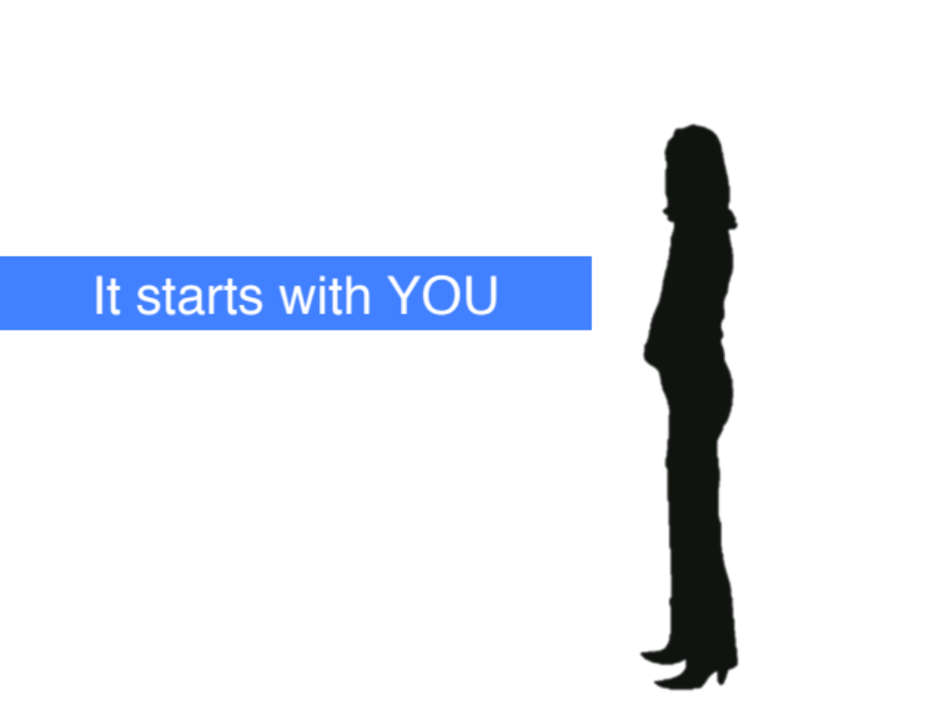
When the Coaching Gets Tough
If we keep pushing someone with a effort intervention who is already trying a lot- that leads to burn out. “Just try harder”
If we push someone who has the skills with a skills intervention- they feel like they are a failure. “Nothing works”
If we push some to just reinforcing an existing strategy- the work then feels impossible. “It is impossible”

Slide 83
Key Points
Coaches need to craft questions that allow them to make an accurate diagnosis early in the coaching cycle.
Coaches need to listen carefully to what the leader believes is an action they could take to improve their challenge.
Debriefing and regular check ins are critically important because they allow the space and time to do these interventions and assess their effectiveness

Slide 84
Rita
Team Lead Centered Interventions

Slide 85
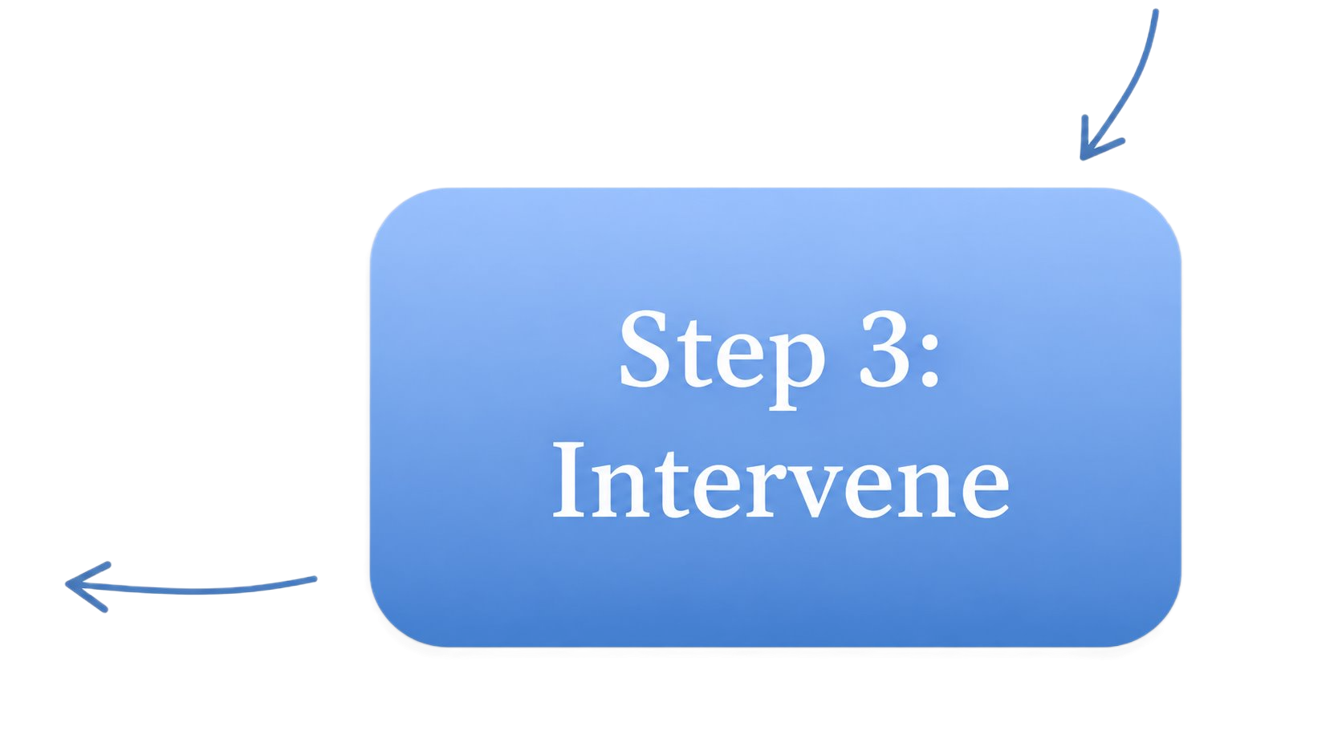
Step 3 of the Cycle
Picking an Intervention

Slide 86
Possible Interventions
Coach Centered
Team Lead Centered
Suggestions/Advice
Feedback
Stories
Observations
Questions

Slide 87

Observations and Questions
Questions and observations center the team lead by creating space for them to examine their situation, think strategically, and reach their own conclusions.

Slide 88

Sharing Stories
Sharing stories from your own experience can provide a valuable model and help the team lead see new options. However, too much storytelling can turn into a monologue that the team lead tunes out.

Slide 89

Feedback, Suggestions and Advice
Feedback, suggestions, and advice center the coach. These options are sometimes necessary and even desired by the team lead. But coaches should use them sparingly, because our goal is to grow new leaders.

Slide 90
Intervention Practice Scenarios (p.21)
Imagine you are coaching a lead who has committed to recruiting a few people to their organizing team, but the conversations keep not happening.
Your handout includes three possible coach responses.
As a group:
Identify the coach’s diagnosis: Head, Heart, or Hands
Identify the intervention(s) used: Questions, Observations, Stories, Feedback, Suggestions, or Advice
Be prepared to explain why the intervention fits the diagnosis

Slide 91

Report Out
Reflect
What is the biggest idea you are wrestling with right now?
How will you apply this in your own coaching?

Slide 92
Key Point
The most important part of coaching is helping your team lead think strategically, build confidence, and navigate the campaign with increasing independence.

Slide 93
Katie B.
Crafting Questions

Slide 94
Coaching conversations at their core are about getting another person to see what their goals are, identify what is in the way or enabling them to reach those goals, and commit to actions that they will take to achieve that goal.
Curiosity
Inquiry
Questions

Slide 95
Steps to Crafting Questions
Listen with curiosity and observe
Assess your gut reaction
Determine your curiosity underneath
Formulate a question you could ask

Slide 96
Good Questions…
Are open-ended (not a ‘yes-no’ answer)
Are answerable (not too complex or theoretical)
Generate options, ideas, or insights
Avoid giving advice with a question mark attached
  “You should do this tactic next, don’t you think?”

Slide 97
Small Group Scenario Practice
Using the worksheet (p.22) and your elbow buddy at your table work through each column
What questions would you suggest our coach could use to address these challenges in this scenario?
My Observations ➡️ | My “Gut Response” ➡️ | My Curiosity Underneath ➡️ | A Question I Could Ask 💬
The officers have a goal but aren’t sure how to win it. | “They just need to organize.” | “What will it take for them to activate their members? | “What feels most important right now to move towards your goal?”

Slide 98
Rebuilding the union and winning raises in a suburban district (p. 22)
Sarais is a newly elected President in a district in a small city. She and the other newly elected officers decided to run because they wanted a stronger union. Winning higher raises is a widely felt issue, but the officers aren’t sure how to get there. Sarah wants to start the campaign right away because she just attended a campaign training. Another officer Paul is worried about low member participation. And another officer Marie thinks that they don’t need a campaign and just should deal with it when bargaining comes up. Sarah is feeling frustrated but is determined to figure out a solution. The union currently has only 30% dues paying members. Many of those members believe the union needs to win salary increases. They aren’t aware of the role members can play, or how they can be involved in their union. They think of the union as a third party- someone else doing the work. These members can’t imagine what is possible or how the union could campaign for better pay. Just a small group of members goes to the union meetings.

Slide 99
Share Out
Who has a great question that they heard at their table?

Slide 100
Key Point
Effective coaching starts with inquiry and curiosity.
Coaches actively listen to understand the deeper issues, motivations, or emotions behind what someone is saying.
Strong coaching questions are open-ended, encourage reflection, and help people generate their own ideas and solutions.
Avoid giving advice disguised as a question; instead, ask questions that help leaders explore options, align around goals, and identify next steps.

Slide 101
Jeny
Coaching Cycle and Agenda Structure

Slide 102

What drives to coaching cycle?
Genuine Curiosity

Slide 103
Agenda Structure and Coaching Cycle
Getting the Meeting Started ( Step 1)
Pause : Take a moment to come into presence with the team lead
Ground: Establish the agenda of the leader. What would you like coaching on today? What would success look like?
Inquire and Observe: How are things going?

Slide 104
Agenda Structure and Coaching Cycle
Centering their Agenda around a Diagnosis (Step 2) and Intervention (Step 3)
Ask questions- to support THEIR greater clarity and for you to formulate a theory about how they may be “stuck”
Use interventions- that allow them to identify what they are willing to commit to and need to solve their problem.

Slide 105
Agenda Structure and Coaching Cycle
Plan to Act (Step 4)
Create an accountability plan with your team lead. Consider these questions.
What have they decided they are willing to do (and by when)?
When will you check in?
What sort of accountability checks will there be?
Acknowledge the intention the lead has brought to their coaching session.

Slide 106
Agenda Structure and Coaching Cycle
Check-in (Step 5)
Set up and have the next check-in:
  It could be the next coaching session
  It could be a quick, agreed upon accountability check (email, text, call)
Determine what the lead wants out of this step.

Slide 107
Sample Agenda
Ground yourself and your Team Lead for the Check in. “How are you?” (Inquire and Observe)
Review agenda and decide on outcomes for the meeting. (Inquire and Observe)
  “Here’s what I have in my notes to discuss today. Is there anything you want to add or change?
  What do you want to have figured out by the end of this meeting so I can make sure we focus our time there?”
Important campaign updates.
  “The last time we spoke, you told me the campaign was at the (__) stage. Has anything big changed since then?” (Diagnosis)
Discuss key questions that will land the agreed upon outcomes. *Majority of your time is spent here.
  See sample coaching questions on page 11 for ideas on possible questions to ask during this segment. (Diagnosis and Intervention)
Secondary topics/challenges. “What else feels urgent?” (Diagnosis and Intervention)
Next steps: “Ok, what’s landed for you in this conversation? What next steps will you take to address the challenges we discussed today? And just confirming that our next meeting is ___.” (Action and Check -in)
Closing reflection. “How is this going? What was most helpful about today?” (Check-In)

Slide 108
Small Group Work
On chart paper, create a draft agenda for a lead that wants to meet with you.
Include:
  Your questions or process at each stage
  What you would actually say to move through each cycle?

Slide 109
Debrief
What was tough about developing this agenda?
What do you think might be challenges you will need to work through when making agendas with your Lead?
How will you incorporate this into your coaching?

Slide 110
Key Points
Coaching meetings are intentional and built on the team lead’s needs
The Cycle of Coaching keeps you centered on the team lead

Slide 111
Scott & Yvie
Self-management and Centering Around Leaders Agenda

Slide 112
What do you think this represents?
90:10

Slide 113
Remember these Possible Interventions?
Team Lead Centered
Coach Centered
Suggestions/Advice
Feedback
Stories
Observations
Questions

Slide 114
How Observations and Questions Helps
Questions – What’s the insight you want to tell someone? You can almost always reverse engineer a question that might lead them to discover it for themselves.
Observations – Sometimes drawing attention and inviting curiosity to a key dynamic you’re noticing is enough to generate learning.
Observations
Questions

Slide 115
How Sharing Stories Helps
Stories – “We don’t know what we don’t know,”
Your stories about having traveled similar paths will help your team leads sidestep common stumbles, identify options available to them, and your stories of unexpected victory will inspire their confidence and motivate them to keep moving forward
Stories

Slide 116
How Feedback, Suggestions and Advice Helps
Feedback – Sometimes your honest assessments, paired with an empathetic suggestion, are what will most help you are coaching move forward.
Suggestions/Advice – Advice is the least likely to develop our team leads into strategists, capable of making the many assessment-driven decisions needed in the “heat” of any campaign. But there are moments when our suggestions are what’s needed.
Suggestions/Advice
Feedback

Slide 117
Whole Group Discussion
Why might some of the interventions that are more towards centering the coach be considered pitfalls?
Suggestions and Advice giving
Focusing on solutions
Sharing personal experiences
Storytelling

Slide 118

How Using Self-Management Helps
As a coach, self-management is the coach's ability to control their own emotions, biases, and impulses to fully support the campaign lead. It involves setting aside personal opinions, letting go of the need to give advice, and focusing on the goals the lead would like to achieve.
Tactics for Self-Management
Pause.
Notice the urge to share, give advice, and fix it.
Take a deep breath.
Ask a good question that brings the leader into deeper insight or clarity.

Slide 119
Whole Group Discussion
Why is your self-management as a coach important to the team lead?
Why is self-management important in centering equity?

Slide 120
Key Points
Coaching at its essence is “about asking rather than telling.” Our role as a coach is to center the agenda, the process of the leader.
Self-management is a foundational skill for campaign coaches and it is a practice many of use across different parts of our lives

Slide 121
Scott
Centering the Team Lead’s Agenda

Slide 122

Turn and Talk
What do you think it means to center the Team Lead’s Agenda?

Slide 123
Three Agendas
TRANSACTIONAL – What they name as their agenda
DEEPER -What is beneath the surface of our leader's coaching agenda. It's all their conscious and subconscious feelings, values and beliefs that influence their actions and behaviors. We get to this by asking powerful questions.
FUTURE - There is also the Future Agenda. In coaching, we encourage people to come into presence into order to gain clarity and tap into their own agency to grow and to act. The coach typically opens the future agenda by inviting the leader to get curious about what's possible, who they want to become, and the bigger picture.

Slide 124

Small Group Practice
Craft two to three questions that a coach could use to get the lead to thinking about all three of those agendas.
Be ready to share your best one.

Slide 125
Key Points
Coaches build Leadership Capacity by Strengthening Decision Making and Agency in the Lead
Coaches use inquiry and observation to find all three agendas – transactional, deeper, and future.

Slide 126
Small Group Task: Make a List
What do you think are some signs that we are not centering the leader’s coaching agenda?

Slide 127
Signs You’re Not Centering the Lead’s Agenda
The topic dramatically changes and the coach doesn't confirm that’s the direction the leader wants to take
Speaking more than the leader
Interrupting insight moments
Over-explaining or using jargon
Rescuing the leader from feelings
Helping someone avoid being held accountable for racism

Slide 128
Small Group Task: Make a List
What is the potential impact of some of these “signs” on the leader and your coaching conversation?

Slide 129
Key Points
When you speak too much, it centers the coach not the leader. Coaching is 90/10 ratio of listening to talking.
The coach should let the leader lead the session.
Use awareness to recognize the signs that the center is shifting to you.
Use Self-Management to interrupt that shift and recenter on the team lead.

Slide 130
Melissa & Amanda
Day 1 Closing

Slide 131

Closing the Day
We are going to take a moment for reflection. We encourage you to write down your reflection. Explore these two questions:
  Which skill do you feel will be challenging for you?
  What makes this skill or practice challenging for you?

Slide 132

Housekeeping:
Survey: Goal is 100% Participation. We really use this
Gratity Collection Reminder
Begin tomorrow at 8:30 a.m.
Breakfast is from 7:30am-8am.

Slide 133


