Slide 1
Coaching Academy:
September 26, 2026

Slide 2

Coaching Academy
By attending this training, you confirm that you are either an NEA affiliate staff person or NEA member in good standing. The information you receive here is only for your use in your capacity as an NEA affiliate staff person or NEA member.
This presentation and its contents are confidential and may not be further distributed or passed on to any other person or published or reproduced, in whole or in part, by any medium or in any form, for any purpose unless written consent has been provided by Ellen Holmes. Audio/video recording, copying of slides, and the use of AI note-taking tools are prohibited without the written consent from Kyle Serrette. Violation of these terms may result in legal action.

Slide 3
NEA Standards of Conduct
NEA has adopted a Standard of Conduct Policy to ensure that all of our gatherings are welcoming to and free from discriminatory, harassing, or otherwise unacceptable behavior. Discrimination or harassment based on race, color, ethnicity, religion, sex, age, national origin, sexual orientation, disability, gender identity, or expression, or any other characteristic protected by law will not be tolerated. If you have experience any discriminatory or harassing behavior, please report the incident by emailing Ron "Duff" Martin (rmartin@nea.org) and Gladys Marquez (gmarquez@nea.org). Thank you for your commitment to ensuring a positive event for all.

Slide 4
Feedback on Feedback – 34 responses
The morning of Day 1 focused on a foundational understanding of what coaching is and what the campaign lab is. These activities were meaningful to my work in coaching campaigns. - 4.65
The second half of the morning focused on Centering Equity in your Coaching and the Diagnosis Framework. These were concepts and practices that I can immediately apply as a campaign coach. 1 not at all applicable to 5 immediately applicable. - 4.68
After lunch we continued to explore the coaching cycle with a focus on the Head, Heart, Hand diagnosis focus. These were concepts and practices that I can immediately apply as a campaign coach. - 4.47
We ended the day by learning the skill of crafting questions and how to hold curiosity and inquiry in our coaching practice. - 4.65
Careful consideration has been taken in the selection of materials, the flow of the content, and the development of the online course support. - 4.65
The facilitators have worked to design adult learning experiences that allow for both individual and group development. - 4.62

Slide 5
Your Words
"The timing is phenomenal. I love how you all work together."
"More than I expected. Awesome presentations."
"The training was great nothing needs to be changed. Have the leader do Brainstorming of ideas when developing the Leader Centered Agenda. This would help the leader create a vision, a goal, a plan, activities, evaluation, a script, and talking points. This would help with the head, heart, and hand. It would help the leader have something to say in the example scenarios. The training was Excellent; it promoted critical thinking skills. Awesome Training!"
"It would be powerful to hear other campaigns in the room. Maybe that will happen tomorrow?"
"A bit more time on some of the work when did in groups would have been helpful."
"Have inside the modules which pages of the pre packet should be done with that module. Also, when I finished the module on community agreements, it ended the course and said I completed even though I hadn’t."
"Need clearer directions with forming different groups. A lot of movement"
"I need more quiet time to process answers to longer questions, to read, and locate info between several different packets etc.."

Slide 6

ToDay’s Agenda
8:30-9:00am Introduction and Overview ​
9:00- 10:30am Content​
10:30-10:45am Break ​
10:30-12:00pm Content​
12:00-1:00pm Lunch ​
1:00-2:15pm Content​
2:15-2:30pm Break ​
2:30-4:15pm Content​
4:15-4:30pm Ending it Right​
4:30-5:00pm Networking​

Slide 7

Community Agreements
Using Self-Awareness and Self-Knowledge
Listening for Understanding
Being Gracious
Staying Engaged
Being Open and Suspend Judgment
Saying “I”- tell your truth
Lean into Discomfort
Reaching Empathy
Expecting Non-Resolution and Non-Closure
*Adapted from “Embracing equity and inclusion”, Annie E. Casey Foundation
Notes:
Community Agreements for Our Time
Awareness and Self-Knowledge
This requires self-knowledge and self-awareness. Self-knowledge allows you to see what causes you pain and conflict and enables you to embrace your contradictions and inconsistencies. It allows the space to work on things about yourself that you are not happy with. In turn, self-knowledge helps to prevent you from projecting your negative aspects onto other people. Bringing your best self also requires that you have a positive attitude, are willing to deeply explore your perspectives and remain open to the perspectives and experiences of others.
Listening for Understanding
Be an active listener. Active listening involves paying full and careful attention to the other person, looking him or her in the eye, avoiding interruptions, reflecting your understanding, clarifying information, summarizing the other person’s perspectives and sharing your own. Remember that most people need time to open up and might not be willing to immediately share their personal stories, hopes, fears and/or concerns.
Being Gracious
Being kind is a vital way of bringing meaning to our own lives, as well as the lives of others. Kindness is about caring genuinely for others around you, wanting the best for them and recognizing in them the same wants, needs, aspirations and even fears that you may have. Being kind and generous allows us to communicate better with others, to be more self-compassionate and to be a positive force in other people’s lives. This includes following the COVID protocols that are in place to protect the health of this learning community.
Stay Engaged
Staying engaged requires you to be morally, emotionally, intellectually and socially involved in the conversation. Staying engaged means that you are listening with curiosity and willing to deepen your understanding. Staying engaged might also require you to sustain the conversation even when it gets uncomfortable or diverted. This also means a commitment to keeping your electronic communications to a minimum with folks not present in this learning community.
Be Open and Suspend Judgment
Listening with an open mind includes being receptive to the influence of others. You can suspend judgment by becoming aware of preconceived notions and listening to everything someone has to say before jumping to conclusions. Most importantly, suspending judgment also means listening to what the speaker has to say for understanding, not just to determine whether the speaker is right or wrong.
Say “I”- tell your truth
Speaking your truth in authentic and courageous conversations about race requires a willingness to take risks. It means that you will be absolutely honest and candid about your own thoughts, feelings, experiences and opinions and not just saying what you perceive others want to hear. Speaking your truth will require you to speak from the “first person” and use “I” statements.
Seek Discomfort
Leaning in to discomfort will require you to let go of racial understandings and stereotypes that you may be holding onto in order to move forward. Leaning in means that you will avoid judgment, assume positive intent and be open to the kernel of wisdom in each individual’s experiences. Leaning in to discomfort will require you to sit through moments of embarrassment, confusion, anxiety and/or fear.
Reaching Empathy
Empathy and compassion allow you to understand the other person’s point of view. When you are empathetic, you are more understanding, patient and kind. Expanding your capacity to feel empathy will also allow others to enter your circle of human concern.
Resolution and Closure
Expect and accept that there may not be closure. It is not likely that you will resolve your personal understanding about race or another person’s racial experience in a single conversation. The more you talk about race with another person, the more you learn and the more they will learn. Authentic and productive conversations about race are continuous and always evolving.
*Adapted from “Embracing equity and inclusion”, Annie E. Casey Foundation

Slide 8

Quick Check-in
What resonated with you?
What questions still exist?
What is becoming clearer?

Slide 9
Prepping for Coaching Session
Ellen and Dr. Taraja

Slide 10
Jeny & Dr. Taraja
Coaching Practice

Slide 11
Campaign Coaching
What It Is | What It Isn’t
Helping organizers become strategists that lead powerful campaigns | Making key strategy decisions for a group
Supports a growth mindset that includes reflection and thinking through challenges | “Answering questions that come up” as an external consultant
Balancing the need to learn and develop skills with running a “live” campaign | Having “catch up calls” without preparing questions to support the group through challenges

Slide 12
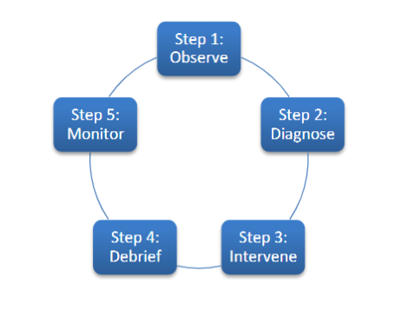
Cycle of Coaching

Slide 13

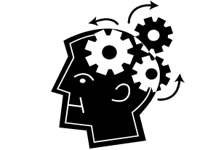

Our Diagnosis Framework
Notes:
Is the challenge motivational (effort/heart)?Is the individual struggling because s/he is not putting forth enough effort? Is she not trying hard enough because she’s embarrassed? Is he quitting too soon because of frustration or fear? Is s/he getting interference from other habits (e.g., someone well-versed in marketing speak may not know how to tell an authentic story)?
Is the challenge educational (information/skills/hands)?Is the individual struggling because he lacks the skill to execute effectively? Does he not know how to do it? Is she getting interference from older habits or behaviors (like someone who is so used to selling things confusing this with telling a story of self)? Is it something you could model or role-play with them?
Is the challenge strategic (strategy/head)?Is the individual struggling because s/he doesn’t know how to use the information or skills that she does have. Does he understand the concepts or underlying principles clearly? Has he not

Slide 14
Possible Interventions
Coach Centered
Team Lead Centered
Suggestions/Advice
Feedback
Stories
Observations
Questions

Slide 15
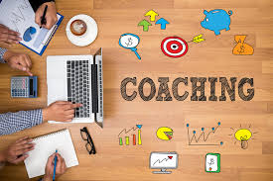
The Coaching Conversation in a Nutshell
Supports campaign leaders.
Centers curiosity and inquires how they can improve effectiveness.
Builds their capacity to act.
Focuses on how to grow and keep a growth mindset.
Addresses challenges and identifies new possibilities.
Notes:
Salina

Slide 16
Coaching Practice

Slide 17
Prepping for Our Coaching Session
You will be in triads: coach, lead, and observer
Lead – you need a campaign (real or made up) and a problem that you are experiencing that you want help solving.
Coach – you are going to apply the practices of coaching we covered yesterday – with a focus on
  Centering equity
  Diagnosis and intervention
Observer- Using the guide on page 71 (print 90), observe, make notes, and be prepared to give feedback

Slide 18

Coaching Practice
Count off – Get into groups of three
Roles: Coach, Lead, Observer
You will have 3 rounds, 15 minutes each
  10 minutes of coaching the lead
  4 minutes of observer feedback
  1 Minute to reset
Each person will play each role

Slide 19

Personal Reflection
Grab a piece of paper or open a document up. Take 4 minutes to free write about that experience.
How did it feel to coach?
What did you learn by coaching?
What did you learn by being coached?
What did you learn by observing coaching?

Slide 20
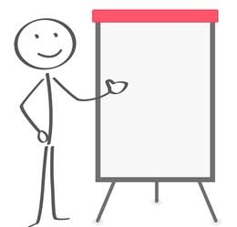
Debrief
Table Talk
3 to 5 reflections about the learning your table believes is important for everyone to hear
Be ready to share

Slide 21
Katie B. & Serafina
Service to High Participation Model

Slide 22
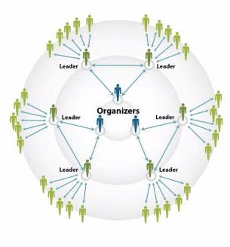

Service to High Participation
Notes:
We spend a lot of time talking about the need to shift from service to organizing. However, the reality is- members have expectations of their union. They want services and help. Which is reasonable and will always be a core of our unions' work. However- how we respond to or structure supporting members with their concerns/requests can help transform our unions. Let's start by examining the hall marks of a service culture and an organizing culture.

Slide 23
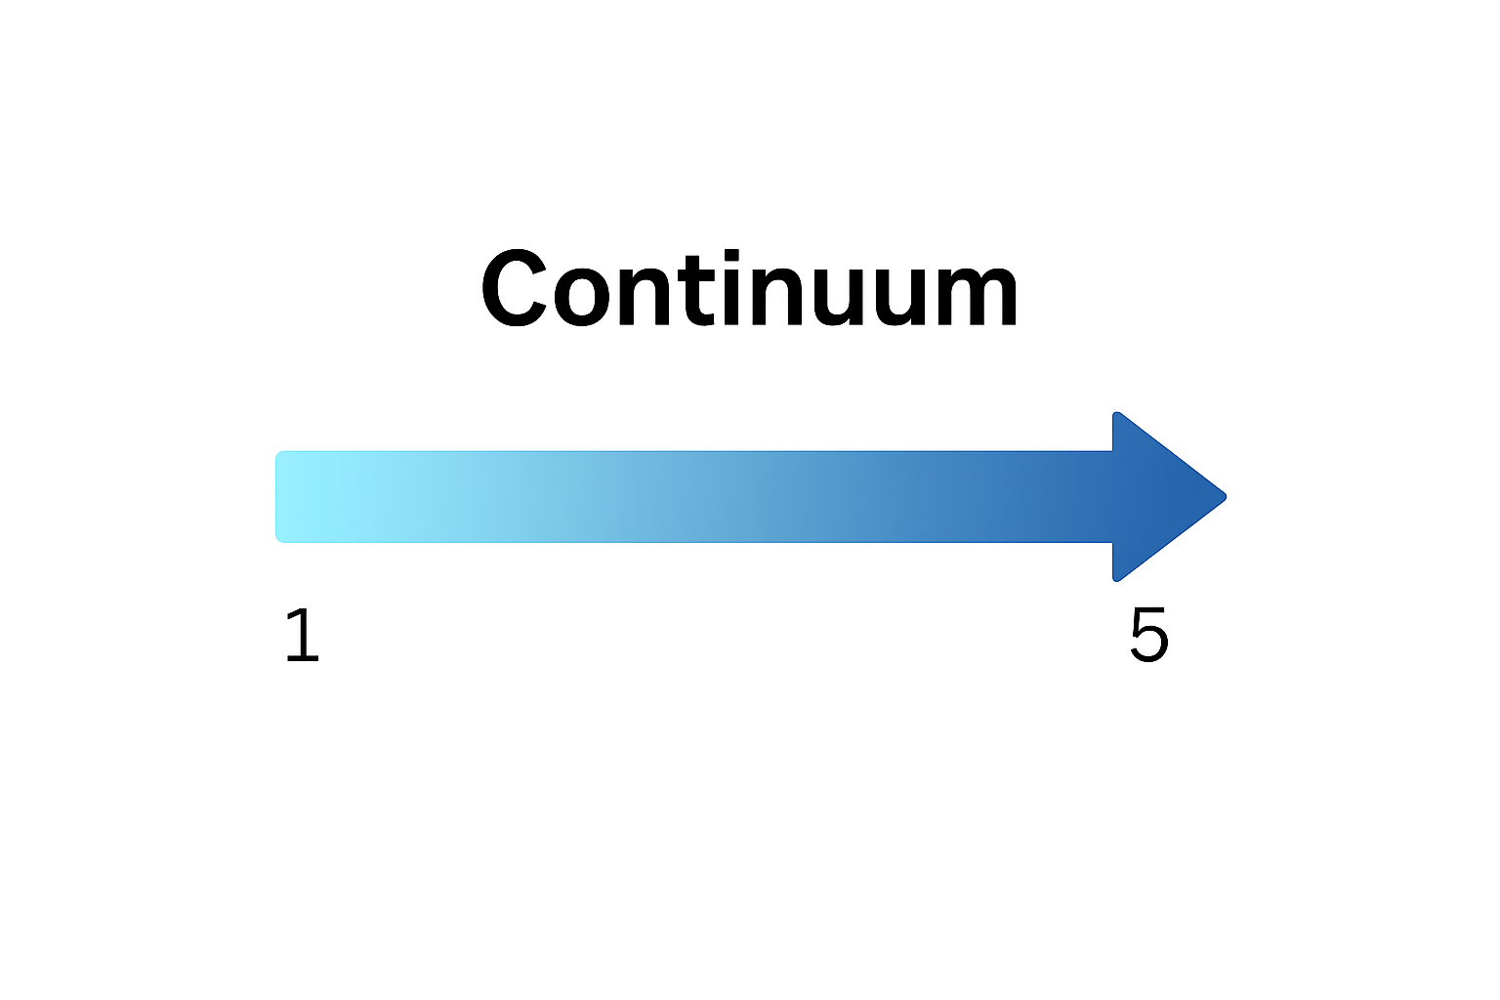
Service ---------------------- High Participation
Episodically and transactionally.
The union is primarily seen as a provider of services: filing grievances, negotiating contracts, enforcing board policy, and resolving individual member issues.
Success is measured by outputs such as the number of grievances filed or resolved, contract settlements reached, and membership totals maintained.
Participation is concentrated in formal roles — officers, staff, bargaining teams — while most members engage only when they need assistance.
The culture reinforces the idea that “the union handles it” on behalf of members.
Leadership, responsibility, organizing skills, and decision-making are broadly distributed throughout the membership.
Members are active participants in building and exercising collective power. Worksites,
Intentionally centers equity by identifying and removing barriers to participation, developing diverse leadership, and ensuring that all members can see themselves reflected in the union's priorities, leadership, and decision-making.
The culture reinforces worksite structures, effective communication networks, leadership development, data use, and the capacity to organize and win
Notes:
Service Model Union Culture
A service model union culture operates episodically and transactionally. The union is primarily seen as a provider of services: filing grievances, negotiating contracts, enforcing board policy, and resolving individual member issues. Success is measured by outputs such as the number of grievances filed or resolved, contract settlements reached, and membership totals maintained. Participation is concentrated in formal roles — officers, staff, bargaining teams — while most members engage only when they need assistance. Information flows vertically through a small number of designated leaders, and decision-making is centralized. Bargaining is typically led by staff and a limited group of member representatives. The culture reinforces the idea that “the union handles it” on behalf of members.
Organizing Model Union Culture
An organizing model union culture is continual and power-building. The union is understood not as a service provider, but as a collective vehicle for members to build power together. Success is measured not just by contract wins, but by the number of members actively involved in identifying issues, leading campaigns, and solving problems. Leadership is intentionally expanded — new leaders are consistently invited into roles such as building reps, issue organizers, and bargaining team members. Information flows broadly across networks of members rather than through a few gatekeepers. Bargaining is led by large member committees, with visible participation and engagement across worksites. The culture reinforces the belief that “we are the union,” and that meaningful change comes from collective action, not just representation.
Quick Assessment- where would you place your local.
Quick fist of 5. 1 being total organizing model and 5 being complete service model.
Quick Share out- why did you rate yourself this way? What function of your union highlights your personal rating.

Slide 24
High Participation Local Assessment
Hold up the number of fingers that reflects where your local is.
4 being a high-participation local
1 being a complete service local
Service ---------------------- High Participation

Slide 25

Small Talk to Whole Room Talk
Share at your table- Why did you rate yourself this way?
Whole Group Share-Out - Share out one indicator that you believe best supports your personal rating.

Slide 26
Chart it Out
Keep the groups to 5-6, go to second choice if need be
Bargaining
Membership
Building Worksite Teams
Grievances/Arbitration
Answering Member Questions
Budgeting
Finding Members for Committees
Communication and Information Sharing

Slide 27
Pick a Topic
TOPIC
Bargaining
Membership
Building Worksite Teams
Grievances/Arbitration
Answering Member Questions
Budgeting
Finding Members for Committees
Communication and Information Sharing

Slide 28
Chart it Out
TOPIC
Service High Participation
What current behaviors, mindsets, or practices about the task are service oriented ( Left Side)
What could you change about this task that makes it closer to a high participation culture (right side)?

Slide 29
Share Out
Each group shares out what marks these for service and what they could change about them to shift to a high participation culture.

Slide 30

Turn and Talk
What do you say to a member that wants YOUR time and energy RIGHT NOW?
Turn and Talk -
What is so hard about this moment?
How could we change this moment to reflect a high participation culture?
How might we coach a leader navigating this culture shift?

Slide 31
Coaching a Building Rep
Scenario for Triad Activity:
A building rep calls the office looking to get help with a member who is facing a bad evaluation. The building reps want the local president/staff member to step in.
How do you coach the building rep to take on this situation and support their colleague. Note they like the admin and think the colleague may need help, but the admin is being overly harsh.
Person A – Building Rep
Person B – Coach
Person C – Observer

Slide 32
Share Out
What was something you heard that resonated/changed your mindset?

Slide 33

Key Points
Helping build member agency is how we shift a service culture.
Engagement is the best way to retain members.
Larger engagement of the members leads to more creative and not typically considered outcomes. Increases capacity of union to act and do more!
More people involved = harder to burn out and harder for the boss to come down on people.
Engagement and moving towards high participation model is how we shift towards a more inclusive union culture, away from “the union” to “our union”.
Any plan that does not include engage members, cannot be a part of our plan.

Slide 34
Rita
Overview of Campaign Cycle

Slide 35
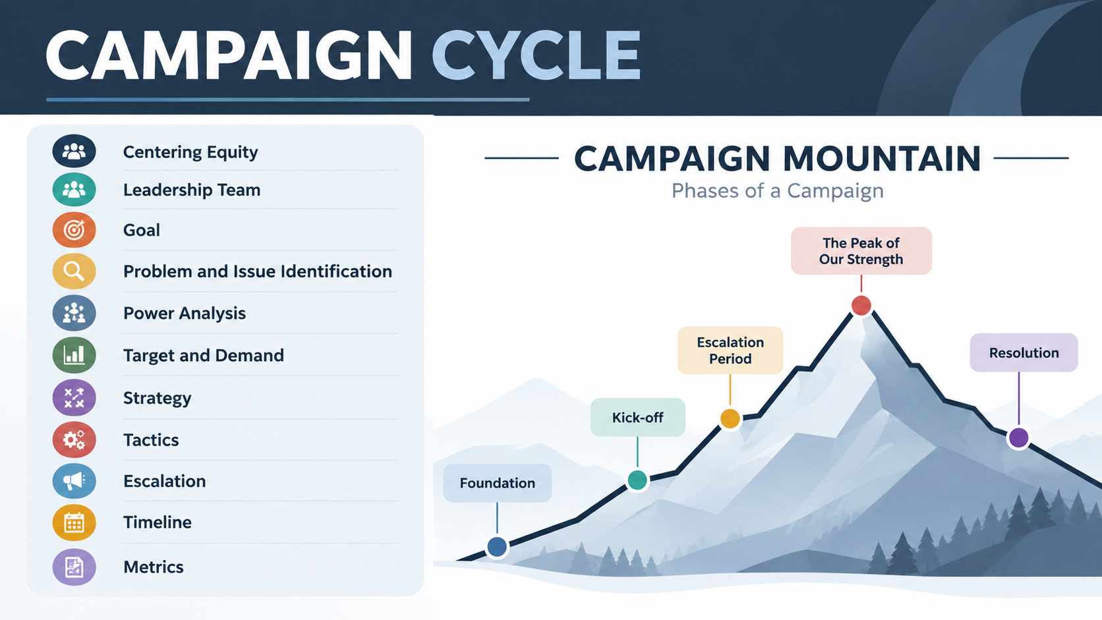

Slide 36
Campaign Plans
A clear action plan with a beginning, middle, and end
Escalating tactics tied to a specific issue and demand
Pressure on the decision-maker who can make the change
Power-building through engagement, leadership, and capacity
Milestones that show when we are ready to go bigger and move closer to winning

Slide 37
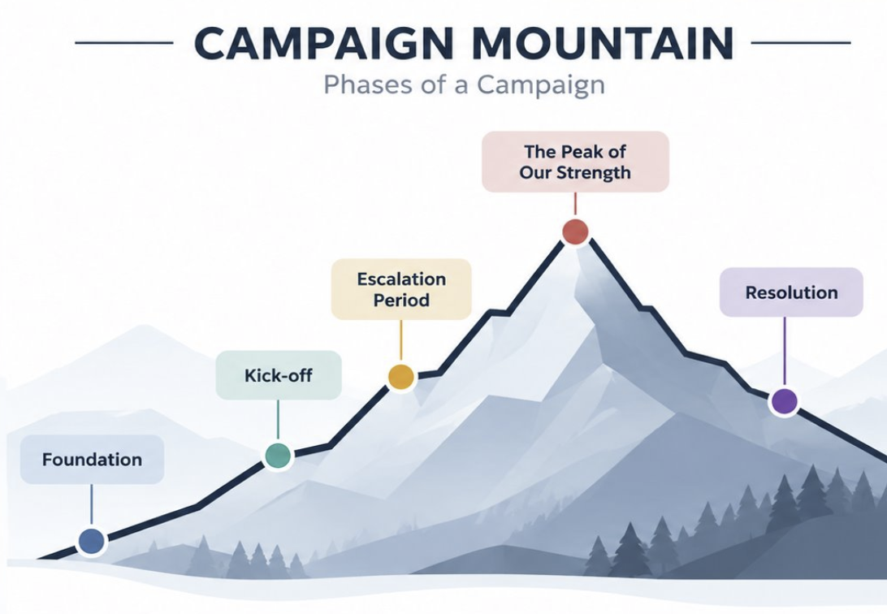
Are We Winning?
Benchmark Example:
55 members attended the public meeting and left feeling confident and ready for the next action.
As the coach, ask:
What was the benchmark?
Did we meet it?
Does the lead know what progress looks like?
What tells us we are building power?

Slide 38
Key Points
A campaign plan turns strategy into action.
Escalating tactics grow leaders, expand the base, and build power.
Benchmarks show whether we are making progress toward winning.

Slide 39
Campaign Stories
Choose one campaign that you have participated in or know about.
It does not have to be a successful campaign.
Use the Campaign Cycle Checklist on Page 26 of the participant handouts
Capture what you remember: what happened, what worked, what did not, and what may have been missing.
Be honest. You will use this reflection to guide your conversation after lunch.

Slide 40
Lunch

Slide 41
Joshua & Rita
Practicing Curiosity in the Campaign Cycle

Slide 42
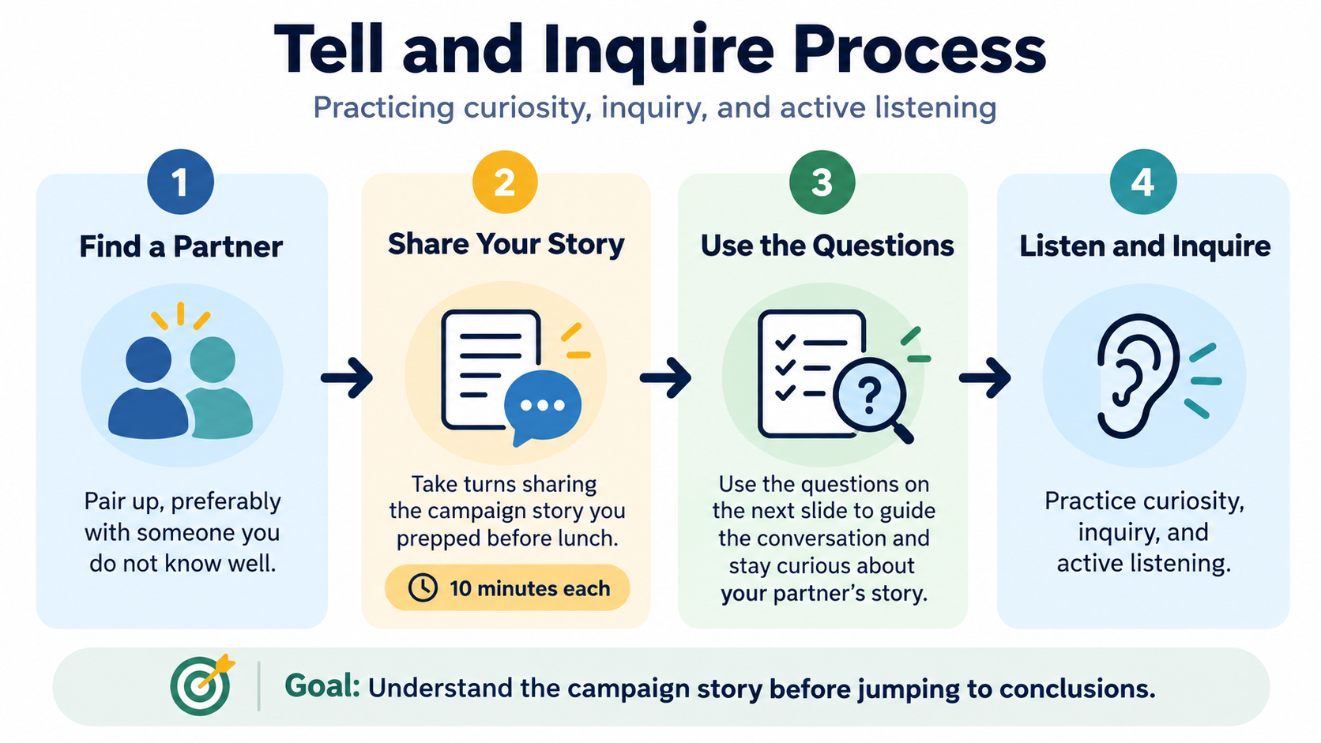
Campaign Cycle Story Process

Slide 43
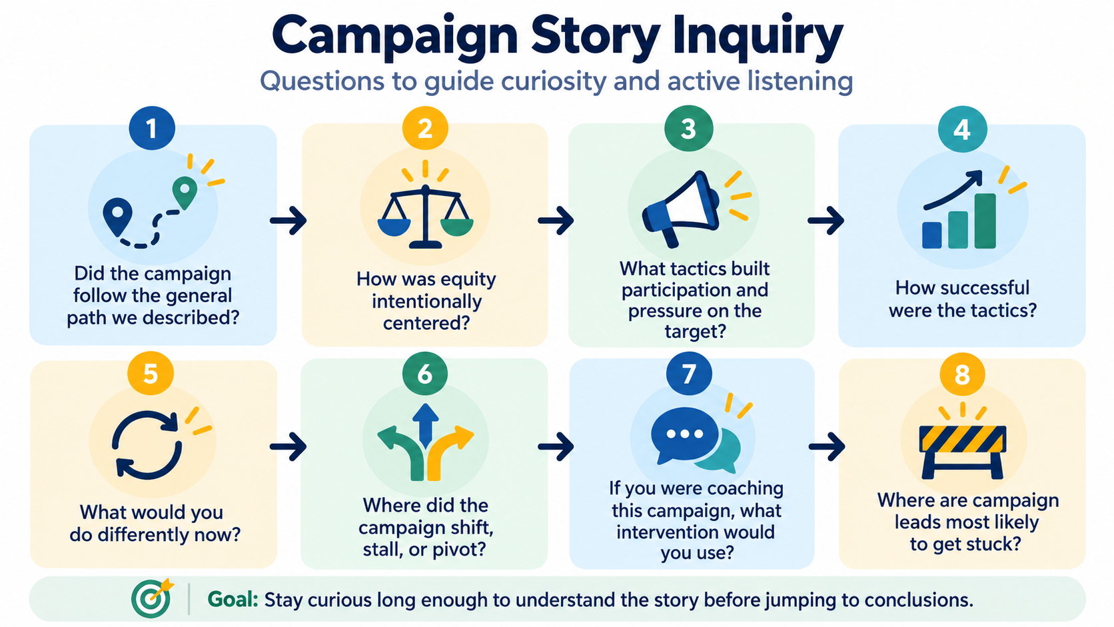

Slide 44
Share Out
What is something your partner talked about as an answer to any of the partner discussion questions that stood out to you?

Slide 45
Key Points
Coaches begin their cycle with observation and “data gathering”
Sustained curiosity is a practiced skill
A campaign plan is an action plan and your role as coach is to understand from the lead what they think that plan is, how they think they will achieve it, and how they will know that they are winning.

Slide 46
Yvie
Stages of a Campaign Leadership Team

Slide 47
Campaign Leadership Team Stages
The Iterative Practice of Centering Equity p.27
Forming a Team p.28
Issue Cut and Target Identification p.29-32
Making a Plan p.37- 38
Tactics p. 37, 41
Debriefing/Pivoting/Building Cycle p.44
Notes:
Salina

Slide 48
Team Coaching Activity
Discuss:
What are some indicators that a team is stuck at a particular stage?
What are some indicators that a team has skipped a stage?
How will you coach for this?
What are questions you would use?
Notes:
Salina

Slide 49
Group Reflection
What do you think will be your most challenging stages to coach leads and teams through?
Why do you think this?

Slide 50
Campaign Leadership Teams move through these key stages
  The iterative practice of centering equity
  Forming a team
  Issue Cut and Target Identification
  Making a plan
  Tactics
  Debriefing/Pivoting/Building Cycle
Campaign Coaches help them assess if they have skipped a stage or a stuck in a stage
Key Points

Slide 51
Katie B.
Coaching High Participation

Slide 52
Remember
You are not the organizer of the campaign
Campaign Lab is about building the conditions that lead to High Participation Locals
Locate the High Participation Local Self-Assessment Tool (p.58)

Slide 53
Groups
Group 1/6: River Valley EA at a Crossroads (p.50)
Group 2/7: Higher Education Workers Alliance (p.52)
Group3/8: Building a Union Beyond Bargaining (p.53)
Group 4/9: Building Visibility, Trust, and Collective Action in Challenging Times (p.54)
Group 5/10: Vision to Action? Assessing River City Educators Association (p.55)

Slide 54
Coaching Practice – High Participation
In your groups:
Come to a near consensus on the rating for each of the 13 indicators – the goal here is to get clear on why you rated it that way.
On your chart you will identify
  Your key observations
  Your diagnosis
  Key Questions you will ask to help the leader in key areas for improving

Slide 55
Share Out
Observations
Diagnosis
Key Questions

Slide 56
Key Points
You are not the campaign lead
You are the coach
High participation locals have a culture for campaigning

Slide 57
Scott
Coaching Self-Assessment

Slide 58

What is the Self-Assessment? (p.65-70 print 84-89)
Coaching is a continuous, connected, complicated set of interpersonal skills and you only get better by doing it, reflecting on your doing, and identifying what you need to grow into.
It helps you identify professional development goals aligned with the NEA Campaign Lab Coaching Model.

Slide 59
Discussing Your Self-Assessment
Get into groups of 3:
Use these three questions as you reflect upon your self-assessment
  What are your greatest coaching strengths?
  What are some areas that you would like to develop?
  What are your coaching goals?

Slide 60
Key Points
Self-assessment is designed to help reflect on coaching practice, identify strengths, and create professional development goals
A key mindset to hold as a coach is that this is a continuous set of skills that require attention and growth.
A routine self-assessment keeps us growing

Slide 61
Amanda & Melissa

Slide 62

Closing the Day
Feedback
Travel Updates
Homework
Questions?

Slide 63
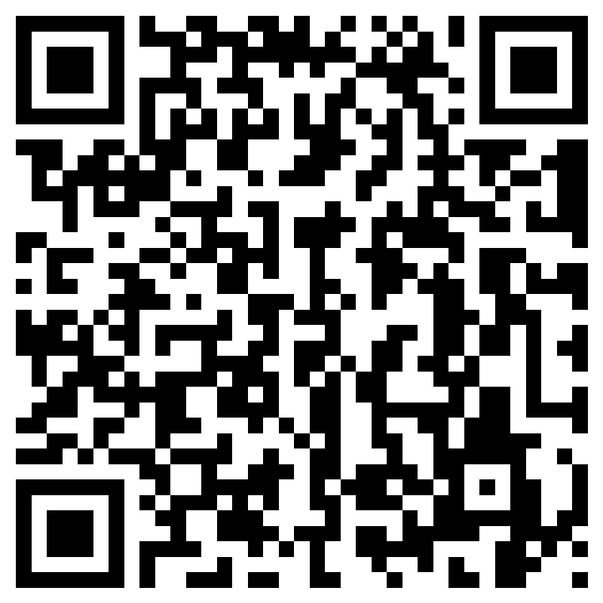
Feedback time
Goal – 100%Participation​
We use what you give us

Slide 64
Travel Prep and After
IF you are leaving tomorrow, please ensure that you have CHECKED OUT at the hotel and received a copy of your bill. Make sure you ask for it. Bring you luggage to this room and place it along the outer walls for safety.
IF you are not leaving tomorrow – enjoy your day once you are finished with us, but please when you check out with the hotel, get a printed copy of your bill.
Any travel disruptions must be handled via AmTrav.
A stipend will be processed and sent to you (members) or your employer (Affiliate Staff). Make sure you have completed your W-9 (link in original registration notice).

Slide 65
Homework
Review the list of locals spreadsheet in PEPs.
Scan the QR Code to enter your top three preferences for a campaign you would like to coach.
  You could use your Networking Time to accomplish these tasks ☺
After this training is over, you will receive an email confirming which campaign(s) you have been assigned to coach.

Slide 66


Slide 67


