Slide 1
Did you do your homework?
Application List and Three Choices QR Codes

Slide 2
Coaching Academy
September 2026

Slide 3

Campaign Academy
By attending this training, you confirm that you are either an NEA affiliate staff person or NEA member in good standing. The information you receive here is only for your use in your capacity as an NEA affiliate staff person or NEA member.
This presentation and its contents are confidential and may not be further distributed or passed on to any other person or published or reproduced, in whole or in part, by any medium or in any form, for any purpose unless written consent has been provided by Ellen Holmes. Audio/video recording, copying of slides, and the use of AI note-taking tools are prohibited without the written consent from Kyle Serrette. Violation of these terms may result in legal action.

Slide 4
NEA Standards of Conduct
NEA has adopted a Standard of Conduct Policy to ensure that all of our gatherings are welcoming to and free from discriminatory, harassing, or otherwise unacceptable behavior. Discrimination or harassment based on race, color, ethnicity, religion, sex, age, national origin, sexual orientation, disability, gender identity, or expression, or any other characteristic protected by law will not be tolerated. If you have experience any discriminatory or harassing behavior, please report the incident by emailing Ron "Duff" Martin (rmartin@nea.org) and Gladys Marquez (gmarquez@nea.org). Thank you for your commitment to ensuring a positive event for all.

Slide 5
Did you do your homework?
Application List and Three Choices QR Codes

Slide 6

Community Agreements
Using Self-Awareness and Self-Knowledge
Listening for Understanding
Being Gracious
Staying Engaged
Being Open and Suspend Judgment
Saying “I”- tell your truth
Lean into Discomfort
Reaching Empathy
Expecting Non-Resolution and Non-Closure
Adapted from “Embracing equity and inclusion”, Annie E. Casey Foundation
Notes:
Community Agreements for Our Time
Awareness and Self-Knowledge
This requires self-knowledge and self-awareness. Self-knowledge allows you to see what causes you pain and conflict and enables you to embrace your contradictions and inconsistencies. It allows the space to work on things about yourself that you are not happy with. In turn, self-knowledge helps to prevent you from projecting your negative aspects onto other people. Bringing your best self also requires that you have a positive attitude, are willing to deeply explore your perspectives and remain open to the perspectives and experiences of others.
Listening for Understanding
Be an active listener. Active listening involves paying full and careful attention to the other person, looking him or her in the eye, avoiding interruptions, reflecting your understanding, clarifying information, summarizing the other person’s perspectives and sharing your own. Remember that most people need time to open up and might not be willing to immediately share their personal stories, hopes, fears and/or concerns.
Being Gracious
Being kind is a vital way of bringing meaning to our own lives, as well as the lives of others. Kindness is about caring genuinely for others around you, wanting the best for them and recognizing in them the same wants, needs, aspirations and even fears that you may have. Being kind and generous allows us to communicate better with others, to be more self-compassionate and to be a positive force in other people’s lives. This includes following the COVID protocols that are in place to protect the health of this learning community.
Stay Engaged
Staying engaged requires you to be morally, emotionally, intellectually and socially involved in the conversation. Staying engaged means that you are listening with curiosity and willing to deepen your understanding. Staying engaged might also require you to sustain the conversation even when it gets uncomfortable or diverted. This also means a commitment to keeping your electronic communications to a minimum with folks not present in this learning community.
Be Open and Suspend Judgment
Listening with an open mind includes being receptive to the influence of others. You can suspend judgment by becoming aware of preconceived notions and listening to everything someone has to say before jumping to conclusions. Most importantly, suspending judgment also means listening to what the speaker has to say for understanding, not just to determine whether the speaker is right or wrong.
Say “I”- tell your truth
Speaking your truth in authentic and courageous conversations about race requires a willingness to take risks. It means that you will be absolutely honest and candid about your own thoughts, feelings, experiences and opinions and not just saying what you perceive others want to hear. Speaking your truth will require you to speak from the “first person” and use “I” statements.
Seek Discomfort
Leaning in to discomfort will require you to let go of racial understandings and stereotypes that you may be holding onto in order to move forward. Leaning in means that you will avoid judgment, assume positive intent and be open to the kernel of wisdom in each individual’s experiences. Leaning in to discomfort will require you to sit through moments of embarrassment, confusion, anxiety and/or fear.
Reaching Empathy
Empathy and compassion allow you to understand the other person’s point of view. When you are empathetic, you are more understanding, patient and kind. Expanding your capacity to feel empathy will also allow others to enter your circle of human concern.
Resolution and Closure
Expect and accept that there may not be closure. It is not likely that you will resolve your personal understanding about race or another person’s racial experience in a single conversation. The more you talk about race with another person, the more you learn and the more they will learn. Authentic and productive conversations about race are continuous and always evolving.
*Adapted from “Embracing equity and inclusion”, Annie E. Casey Foundation

Slide 7
Feedback on Feedback
Include the Number of Repsonsise – a percentage
Include the Highest rating and for what question
Include the lowest rating and for want question
Themes
Plus
Deltas

Slide 8
Your Words
Include responses that indicate the themes

Slide 9

ToDay’s Agenda
.

Slide 10
Travel Prep and After
IF you are leaving today – you should be all checked out of your room with a printed receipt in your possession AND you luggage should be here, stowed safely away from our tables.
IF you are not leaving tomorrow – enjoy your day once you are finished with us, but please when you check out with the hotel, get a printed copy of your bill.
Any travel disruptions must be handled via AmTrav.
A stipend will be processed and sent to you (members) or your employer (Affiliate Staff). Make sure you have completed your W-9 (link in original registration notice). This can take up to 60 days

Slide 11
Campaign Assignments

Slide 12
Guidelines for Campaign Assignment
Skill
Experience
Level of comfort
Geographic location/time zone
We will finalize the pairings and email you very shortly

Slide 13
Scott & Dr. Taraja

Slide 14

Who are we and who are we coaching?

Slide 15
Coaching Across Differences
Campaign Lab coaches build high participation locals through equity-centered coaching.
To coach for equity and with equity you have to be able to fully do the following:
See the person, see the system, and see the interaction between the two.

Slide 16

Three Coaching Commitments
Curiosity over Assumption
Impact over Intent
Awareness over Neutrality

Slide 17

As a coach what do you think this looks like in your practice?

Slide 18

Defining Intersectionality
Intersectionality is a framework for understanding a person, group of people, or social problem as affected by a number of discriminations and disadvantages. It takes into account people's overlapping identities and experiences in order to understand the complexity of prejudices they face.

Slide 19
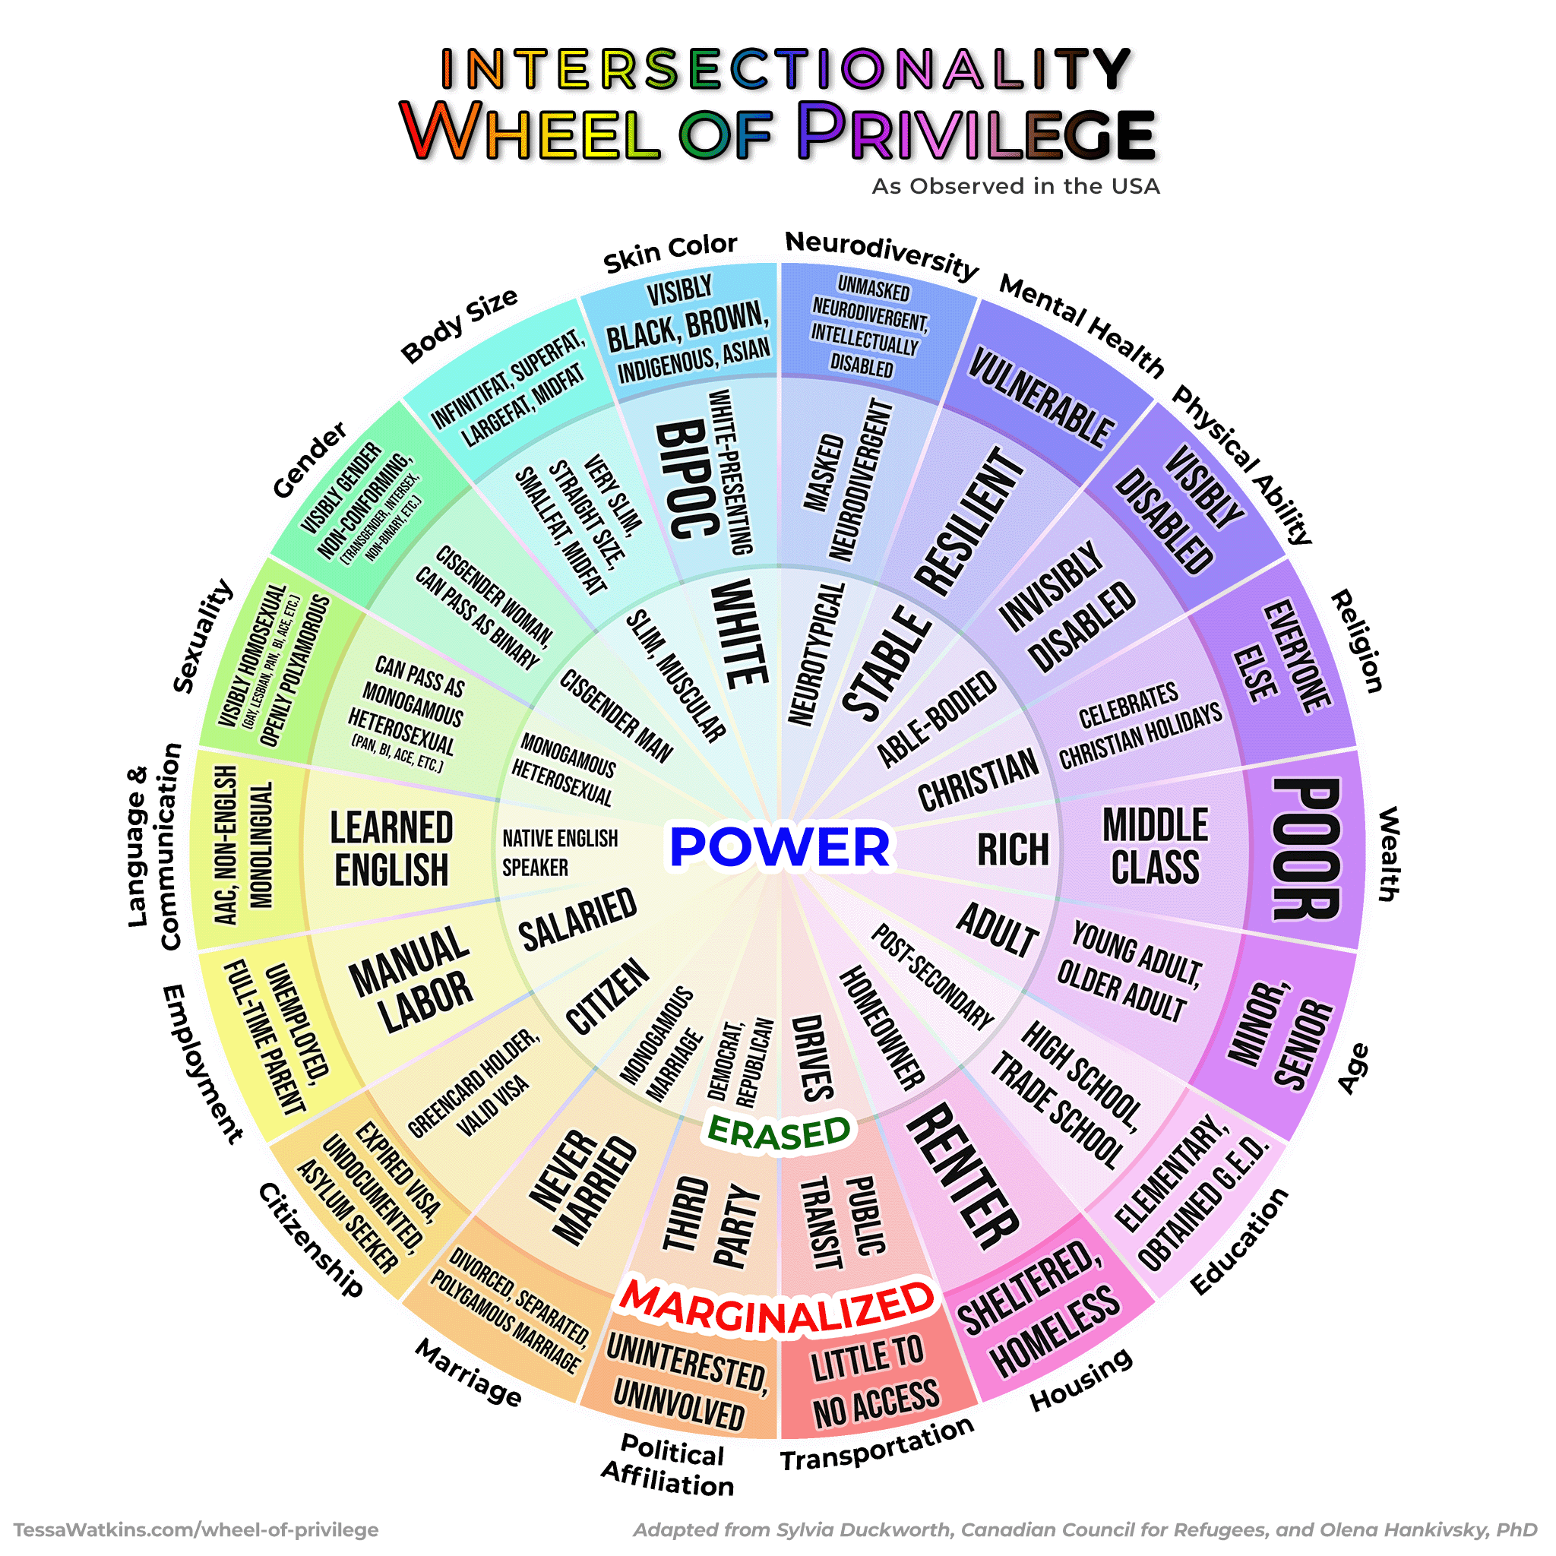
Intersectionality
Power:
People who exist in this ring the are the most powerful and usually hold the most privileged in any room ( their voice, ideas, and opinions matter).
Notes:
Taraja - Pass out paper- It is important to see all the different pieces of intersectionality when thinking about equity. If we are only looking at one or two pieces on the wheel then you still leaving inequities unaddressed. Focus on class to help address inequities in school but that still leaves other inequities that disproportionately affect other groups i.e. students of color, LGBTQIA students, students with a disability . This is where allyship is important. If you’re a privileged and/or powerful person and you’re in the room with someone that isn’t, your job as an ally is to make space for them, amplify their voice, and listen. If they aren’t in the conversation, that is the only time when it is appropriate for you to speak on their behalf. Also, ask yourself why they’re not part of the discussion and look for ways to invite them to it.
https://just1voice.com/advocacy/wheel-of-privilege/

Slide 20
Intersectionality
Erased:
People who exist in this ring the are often the forgotten ring or have their identities erased or are marginalized in unique ways. Some these people can “pass” and “choose” to be marginalized or privileged when it benefits them.

Slide 21
Intersectionality
Marginalized:
People who exist in this ring experience more overt discrimination and are most impacted by systemic discrimination. Underrepresented in media unless they serve negative purpose:
the subject of jokes in comedy
villains in media
children are taught to avoid them or not talk about them
behavior or appearance is criminalized
children dress up as them for costumes
used as school mascots
and so much more…

Slide 22
Key Reminders about this Tool and Process
The rings describe how identities are valued by systems, not the worth of individuals.
Power is contextual and fluid—identities may move across rings depending on space and setting.
Focus on self‑reflection, not labeling or analyzing others.
Most people hold identities across multiple rings, including both power and marginalization.
“Passing” often relates to safety and survival, not ease or advantage.
Identities influence who speaks, who is heard, and who takes up space.
Privilege is about impact and responsibility, not intent or guilt.
Be aware of how unexamined power can silence, erase, or marginalize others unintentionally.
This guided reflection is not a space to compare oppression, disclose others’ identities, or justify harm.

Slide 23
Considering Differences When Coaching

Slide 24
Coaching is Never Separate from Power
The relationship is not just Coach ↔ Team Leader.
It is also:
  Race ↔ Race
  Gender ↔ Gender
  Staff ↔ Member
  Manager ↔ Employee
  HQ ↔ Field
  Older ↔ Younger
  Credentialed ↔ Non-credentialed
People enter coaching conversations carrying their lived experiences with power.

Slide 25
Assume Differences Matter – Don’t Assume that You Know How
Common coaching mistakes is:
  Minimizing Difference
  "We're all the same."
  Overgeneralizing Difference
  "Because you're a woman/person of color/support professional, you must experience X."
Instead:
  Stay curious
  Ask rather than assume
  Let the leader define their experience

Slide 26
Separate Behavior From Identity
Strong coaches avoid two traps:
Trap A
  Explaining everything through identity.
Trap B
  Ignoring identity completely.
Good coaching asks:
What happened?
What behavior occurred?
What systemic dynamics may also be present?

Slide 27
Credibility and Prove It Dynamics
Leaders from historically marginalized groups often carry additional burdens:
Needing to demonstrate competence repeatedly
Being scrutinized more closely
Having expertise questioned
Being interrupted or overlooked
A coach should help the leader:
  See the pattern clearly
  Avoid internalizing systemic problems as personal failures
  Identify what is within their control
  Develop strategies while also naming inequitable dynamics

Slide 28
Be Alert to Common Misreads
Several predictable misinterpretations show up repeatedly:
Directness becomes "aggressive."
Emotion becomes "unstable."
Reserved behavior becomes "disengaged."
Informal communication becomes "unprofessional."
Relational leadership becomes "soft."

Slide 29
Listen for Adaptations
Sometimes what looks like a weakness is actually an adaptation.
Examples:
  Over-preparation
  Being hyper-careful
  Avoiding conflict
  Excessive deference
  Controlling details
Before coaching someone to change the behavior, ask:
"What has this behavior helped you survive, navigate, or accomplish?"

Slide 30
Create Psychological and Identity Safety
A leader should not have to choose between:
  Being authentic
  Being successful
  Coaches build safety by:
    Listening before advising
    Being willing to hear difficult truths
    Acknowledging mistakes
    Inviting correction
    Naming uncertainty
One of the most powerful coaching moves is:
"I may be missing something because of my own experience. Help me understand."

Slide 31
Practice Cultural Humility over Expertise
The coach is not expected to know everything about another person's experience.
The expectation is:
  Humility
  Curiosity
  Accountability
  Learning
Rather than:
"Let me explain your experience."
Try:
"Help me understand how you're experiencing this."

Slide 32
Focus on Impact not Intent
Differences often create misunderstandings.
When they occur:
  Explore impact first.
  Explore intent second.
Questions:
  "What impact did that have on you?"
  "What impact do you think it had on others?"
  "What would repair look like?"
This keeps coaching grounded in learning and growth rather than blame.

Slide 33
Help Leaders Navigate Systems, Not Just Individual Behaviors
Coaching should not only ask:
"How could you do better?"
It should also ask:
"What is the system rewarding, discouraging, or making difficult?"
Examples:
Who gets speaking time?
Who gets stretch assignments?
Who gets second chances?
Whose expertise is trusted?

Slide 34
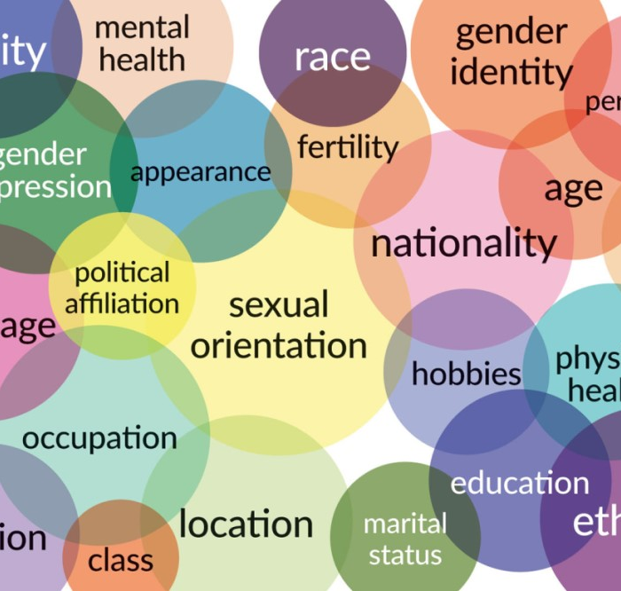
Why Coaching Across Differences Matters
Power, credibility, communication, trust and identity shape coaching relationships - your ability to do this well increases your effectiveness and builds stronger leaders who can do the same.
Inclusive, Democratic relationships build high participation and shift culture within locals.

Slide 35
How to use this as a Tool:
8-Step Guided Reflective Process
Complete wheel
Identify power
Reflect on story
Others experience you
Coaching defaults
Blind spots
Connect to practice
Equity commitments

Slide 36
Small Group Discussion
Begin your sharing about your experience with tool and guided reflection in any way that you like. However, be sure to discuss how you intend to incorporate this into you your coaching practice.

Slide 37

Key Points
Coaching is never separate from power
Assume difference matters
Create psychological and identity safety
Focus on impact not intent
The goal is not perfection—but greater awareness, so we can choose to show up in ways that reduce harm and expand belonging between our coaching community and our campaign leads

Slide 38
See the person, see the system, and see the interaction between the two.

Slide 39
Serafina & Jeny
Coaching Practice

Slide 40

Coaching Practice
Get into Triads: Coach, Lead, and Observer
You’ll have 3 rounds (18 minutes each)
  13 minutes of coaching the lead
  5 minutes of observer feed back
  Reset
Each person will play each role
Observer can access guide on p.73 (print 92)

Slide 41

Personal Reflection
Grab a piece of paper or open a document up. Take 4 minutes to free write about that experience.
How did it feel to coach?
What did you learn by coaching?
What did you learn by being coached?
What did you learn by observing coaching?

Slide 42
Break

Slide 43
Katie B. & Joshua

Slide 44
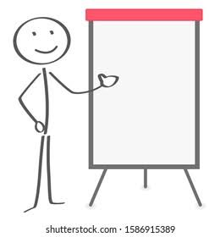
Debrief
Table Talk
Share your personal reflections:
As a table, select 3 to 5 reflections your table believes are important for everyone to hear
Elect a person to share out on behalf of your table

Slide 45
Amanda & Melissa
Coaching Academy Requirements and Practicuum

Slide 46
Team Leads
Local member leaders who act as the lead organizer for their campaigns.
Have all applied and been accepted into Campaign Lab

Slide 47
Campaign Coaches
Campaign experience a plus
Willingness to learn more
Coach 1-2 teams

Slide 48
Mentor Coaches
Staff who support campaign coaches
Oversee the practicum

Slide 49
Requirements to be a Campaign Coach
1. Attend the in-person Coaching Academy training.
2. Practicum is completed with your mentor coach
  Meeting 1 – Mentor leads, coach observes
  Meeting 2 - Mentor and coach lead meeting together
  Meeting 3 - Coach leads, mentor observes
3. Alternate to Option 1 - Attend the online Coaching Academy Series

Slide 50
What do Campaign Coaches Do?
Meet with mentor coach at least once per month.
Meet with lead twice per month
Document coaching notes
Attend monthly all call meetings

Slide 51
How do Coaches Document Their Work

Slide 52
Your Coaching Commitments
Remotely coach 1-2 participating Campaign Lab teams; coaching 1 team is a ~ 5 hour per month commitment; coaching 2 teams is a ~9 per month commitment.
Engage in the following activities: Coach local team leads; plan, reflect on, and document coaching calls; participate in virtual trainings and workshops; participate in peer-to-peer problem solving calls with other coaches; engage in follow-up check-ins with local teams between coaching sessions.
Attend monthly all-call meetings and assist with facilitation for at least one meeting.

Slide 53
Campaign Lab Commitments to You
A stipend of $1,100 for coaching 1 local team or $1,800 for coaching 2 local teams for one year, with the option to extend.
Foundational training in methods and tools for coaching campaigns.
Biweekly (twice per month) coaching from an experienced organizing coach that will work with you to sharpen your coaching skills and navigate coaching challenges in ways that build the skills, motivation, and strategic capabilities of local team leads.
The opportunity to participate in a historic national campaign committed to promoting, protecting, and strengthening public education.

Slide 54
Successful Campaign Coaches Will Have:
Demonstrated experience in foundational organizing practices associated with building organizing teams and planning campaigns. Additional experience in strategic planning and coalition-building is a plus.
A willingness to grow and develop your organizing and coaching practice through completion of the NEA Coaching Academy training and practicum.

Slide 55
Yvie
Training Opportunities

Slide 56


Online and IN Person training

Slide 58
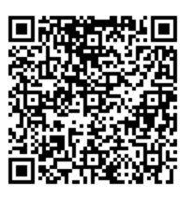

Alliance to Reclaim Our Schools Free the Future Leadership Schools

Slide 59
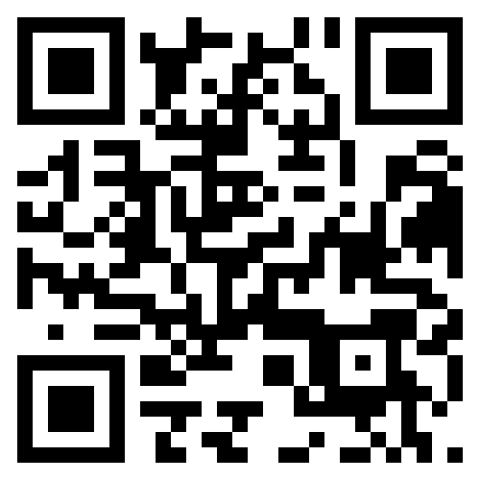
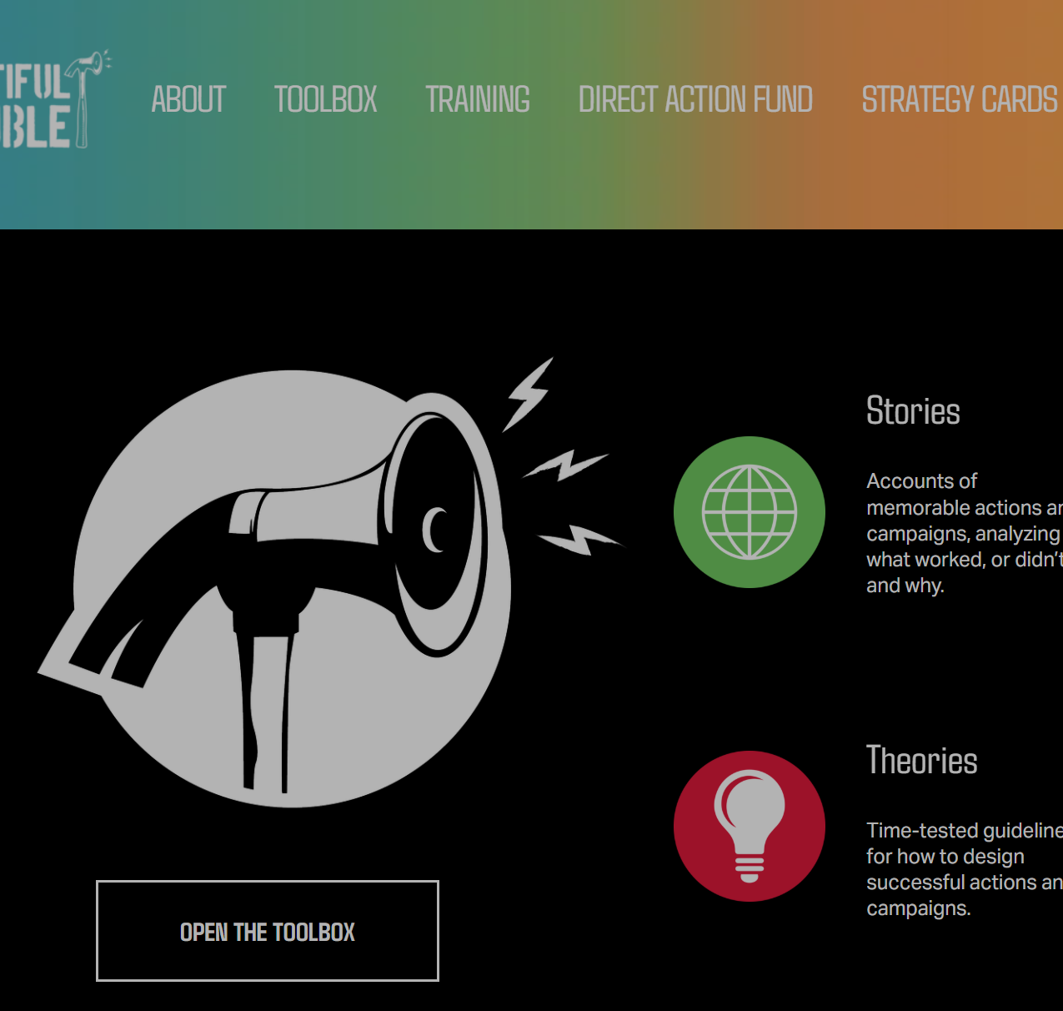
Beautiful Trouble

Slide 60
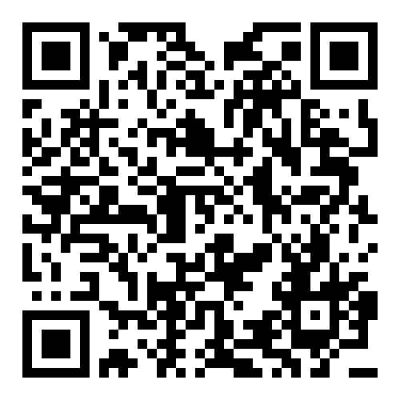

Practical Radicals

Slide 61
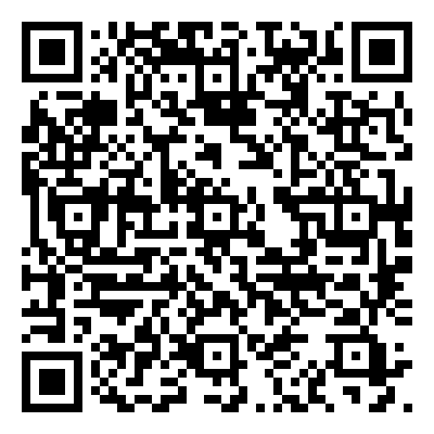
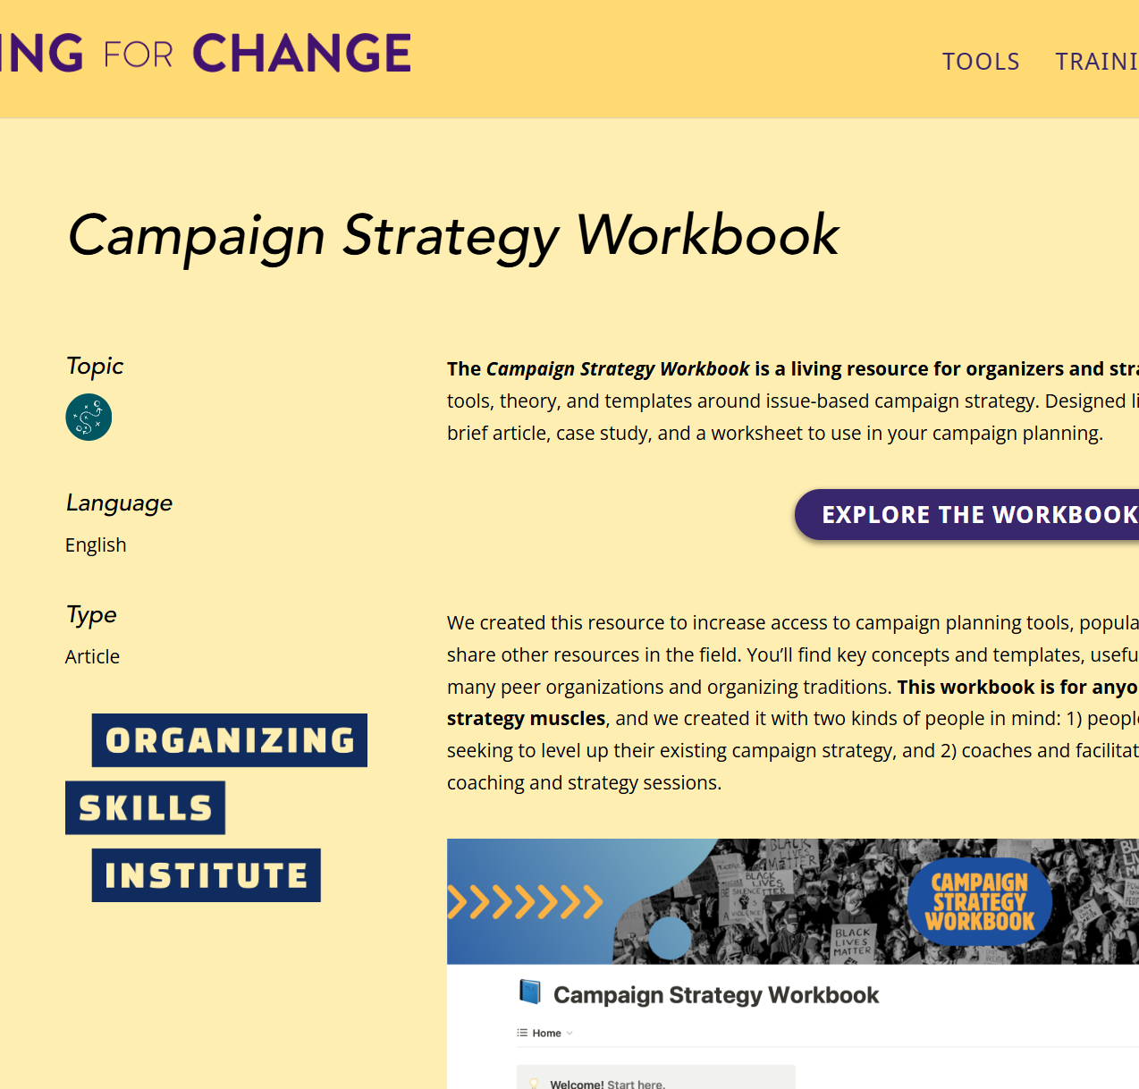
Training for Change

Slide 62
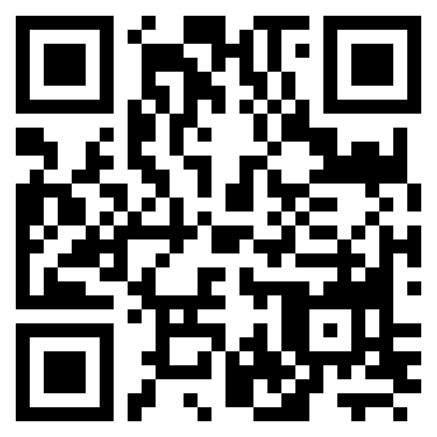
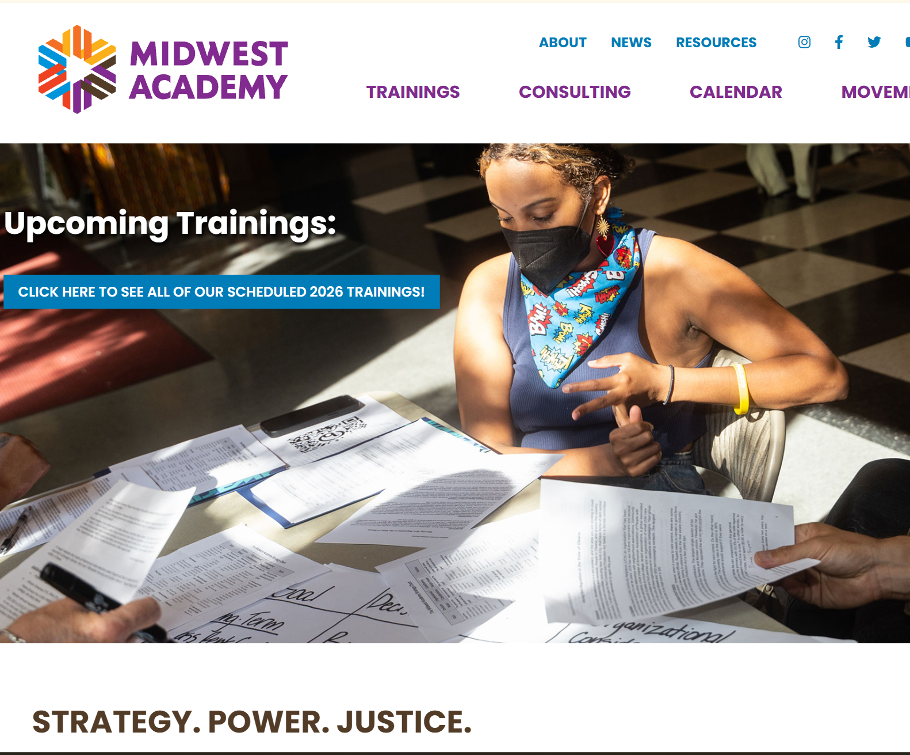
Midwest Academy

Slide 63
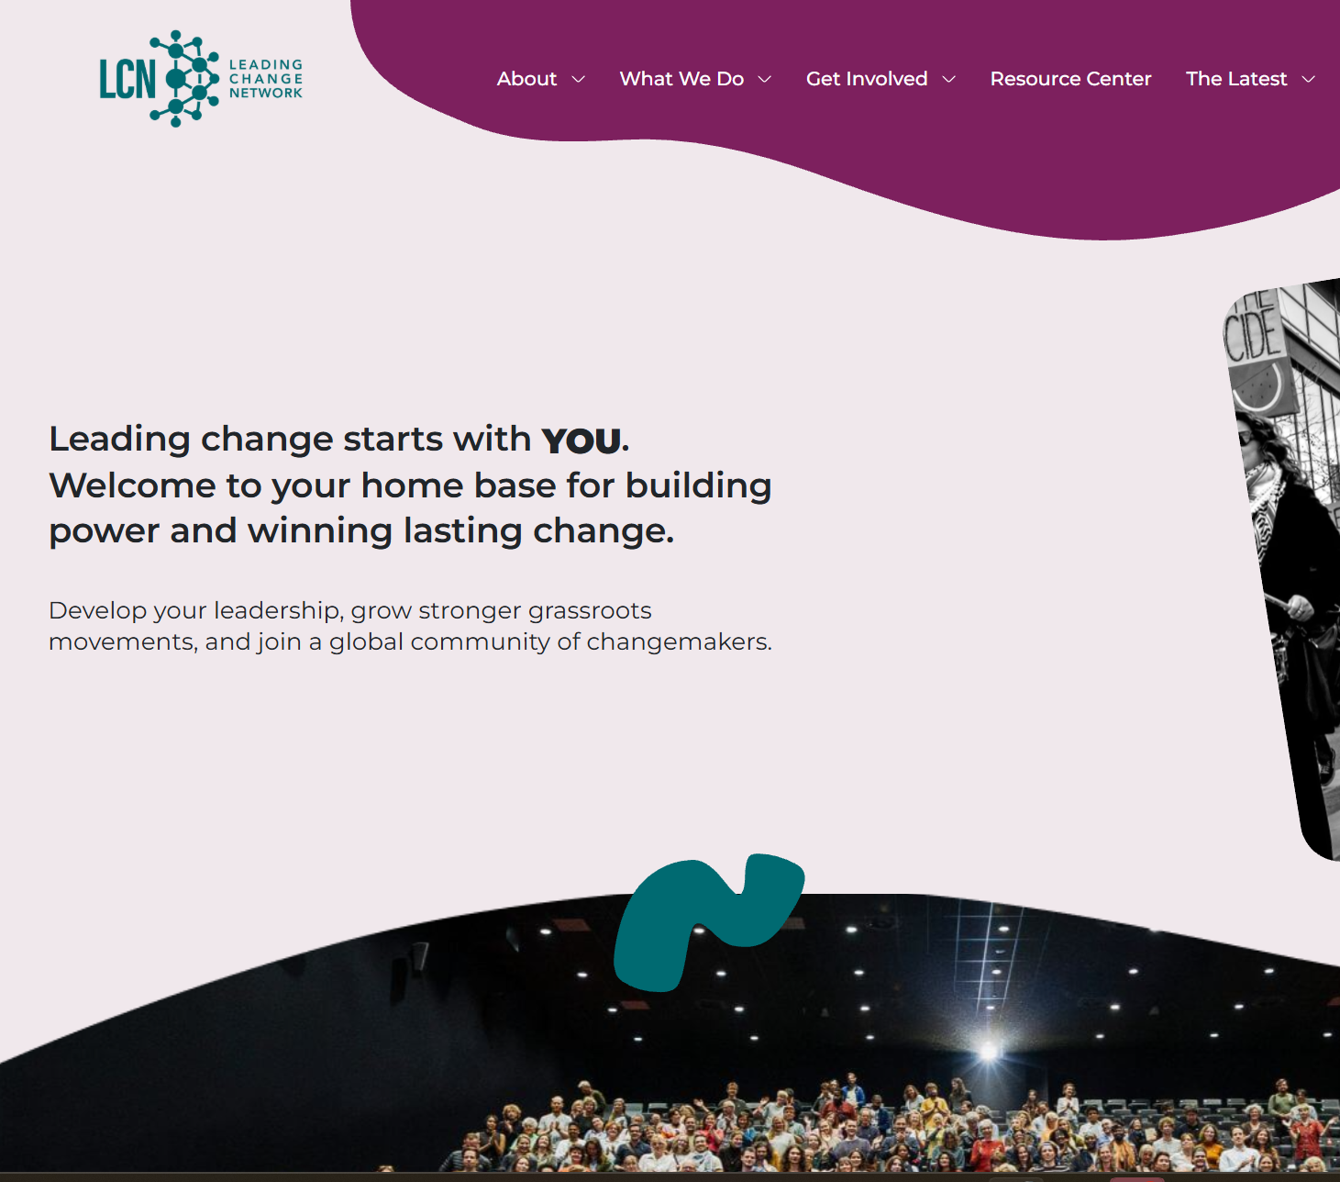
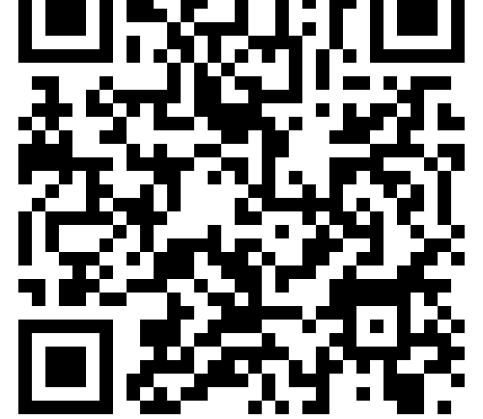
Leading Change Network

Slide 64
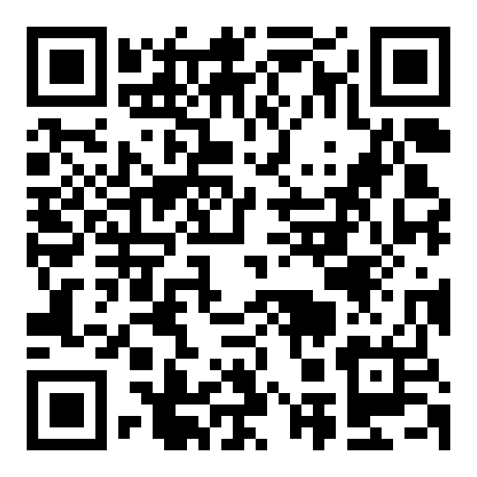
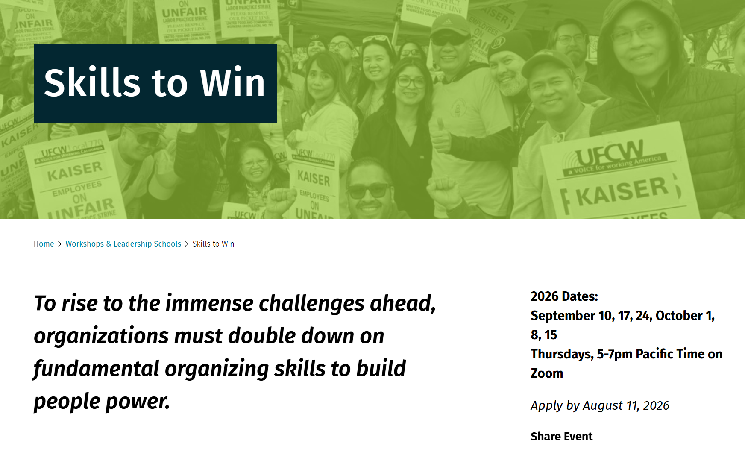
Skills to Win – Berkeley Labor Center

Slide 65
Melissa & Amanda

Slide 66

Acknowledgments
What is ONE thing your table can agree on that you are taking away from this training?

Slide 67
Feedback time
Goal – 100%Participation​
We use what you give us

Slide 68
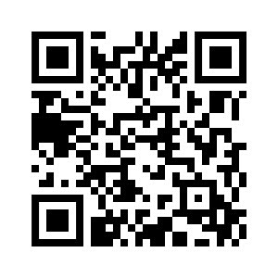

Experienced in leading campaigns?
Apply to be a Coach!
Do you want to build the power of your local?
Apply to the Campaign Lab.

Slide 69
Final Reminder Travel Prep and After
You should be all checked out of your room with a printed receipt in your possession
IF you are not leaving tomorrow – enjoy your day once you are finished with us, but please when you check out with the hotel, get a printed copy of your bill.
Any travel disruptions must be handled via AmTrav.
A stipend will be processed and sent to you (members) or your employer (Affiliate Staff). Make sure you have completed your W-9 (link in original registration notice). This can take up to 60 days

Slide 70


