Slide 1
Campaign Academy: Coaching Skills to Develop Campaign Leaders
Day 1
March 2026

Slide 2

Campaign Academy
By attending this training, you confirm that you are either an NEA affiliate staff person or NEA member in good standing. The information you receive here is only for your use in your capacity as an NEA affiliate staff person or NEA member.
This presentation and its contents are confidential and may not be further distributed or passed on to any other person or published or reproduced, in whole or in part, by any medium or in any form, for any purpose unless written consent has been provided by Ellen Holmes. Audio/video recording, copying of slides, and the use of AI note-taking tools are prohibited without the written consent from Kyle Serrette. Violation of these terms may result in legal action.

Slide 3
NEA Standards of Conduct
NEA has adopted a Standard of Conduct Policy to ensure that all of our gatherings are welcoming to and free from discriminatory, harassing, or otherwise unacceptable behavior. Discrimination or harassment based on race, color, ethnicity, religion, sex, age, national origin, sexual orientation, disability, gender identity, or expression, or any other characteristic protected by law will not be tolerated. If you have experience any discriminatory or harassing behavior, please report the incident by emailing Ron "Duff" Martin (rmartin@nea.org) and Gladys Marquez (gmarquez@nea.org). Thank you for your commitment to ensuring a positive event for all.

Slide 4
Honoring This Space
We begin by acknowledging that through a history of colonization and brutality, we are currently on the traditional lands stewarded by generations of indigenous people.
Cherokee, Chickasaw, Choctaw, Muscogee (Creek), and Seminole Nations are today the five main tribes in Oklahoma who maintain significant cultural and political presence today, with distinct governments and rich heritage. We acknowledge that the 39 sovereign Native Nations inhabiting what is now Oklahoma were forcibly relocated from all four corners of the North American continent. We acknowledge this territory once served as a hunting ground, trade exchange point, and migration route for the Apache, Comanche, Kiowa and Osage nations.
We honor these indigenous people, all elders, past, present, and emerging. We are called to learn and share these learnings about this tribal history, culture, and contributions that have been suppressed in the telling of the story of what we now call the United States of America.
Notes:
ADD Oklahoma speciific land acknowledgement

Slide 5
Training Outcomes. Participants will: Explore how coaching is a leadership development practice that expands the capacity of leaders to build organizing power and impactful campaigns. Develop core coaching skills including asking powerful questions, learning to self-manage and centering the agenda of those being coached. Learn how to coach common challenges in leadership, centering equity and shifting from a service to organizing model of unionism. Learn how to assess affiliate readiness and capacity to run effective campaigns, and how to coach a leader to define goals and priorities for growing the strength of their local union. Learn about awareness-based systems thinking as a coaching model for deeper growth.

Slide 6

Overall Schedule
Meeting Starts: 8:30am Daily
Meeting Closes:
Friday/ Saturday
Start 8:30am
Mid-Morning Break
15 minutes
Lunch 12pm-1pm
Mid-Afternoon Break:
15 minutes
Meeting End 4:30pm
Network: 4:30-5pm
Dinner: On your own
Sunday
Start 8:30am
Break: 10:15 am-10:30am
End 1pm
Lunch: Box lunches to go

Slide 7

Documents you will need today
Make sure you can access the Course
Make sure you have downloaded all files.
Pre Academy Assignments and the Participant Handout Module
Community Agreements
Be able to access your personal local-assessment.

Slide 8

Community Agreements
Using Self-Awareness and Self-Knowledge
Listening for Understanding
Being Gracious
Staying Engaged
Being Open and Suspend Judgment
Saying “I”- tell your truth
Lean into Discomfort
Reaching Empathy
Expecting Non-Resolution and Non-Closure
Adapted from “Embracing equity and inclusion”, Annie E. Casey Foundation
Notes:
Community Agreements for Our Time
Awareness and Self-Knowledge
This requires self-knowledge and self-awareness. Self-knowledge allows you to see what causes you pain and conflict and enables you to embrace your contradictions and inconsistencies. It allows the space to work on things about yourself that you are not happy with. In turn, self-knowledge helps to prevent you from projecting your negative aspects onto other people. Bringing your best self also requires that you have a positive attitude, are willing to deeply explore your perspectives and remain open to the perspectives and experiences of others.
Listening for Understanding
Be an active listener. Active listening involves paying full and careful attention to the other person, looking him or her in the eye, avoiding interruptions, reflecting your understanding, clarifying information, summarizing the other person’s perspectives and sharing your own. Remember that most people need time to open up and might not be willing to immediately share their personal stories, hopes, fears and/or concerns.
Being Gracious
Being kind is a vital way of bringing meaning to our own lives, as well as the lives of others. Kindness is about caring genuinely for others around you, wanting the best for them and recognizing in them the same wants, needs, aspirations and even fears that you may have. Being kind and generous allows us to communicate better with others, to be more self-compassionate and to be a positive force in other people’s lives. This includes following the COVID protocols that are in place to protect the health of this learning community.
Stay Engaged
Staying engaged requires you to be morally, emotionally, intellectually and socially involved in the conversation. Staying engaged means that you are listening with curiosity and willing to deepen your understanding. Staying engaged might also require you to sustain the conversation even when it gets uncomfortable or diverted. This also means a commitment to keeping your electronic communications to a minimum with folks not present in this learning community.
Be Open and Suspend Judgment
Listening with an open mind includes being receptive to the influence of others. You can suspend judgment by becoming aware of preconceived notions and listening to everything someone has to say before jumping to conclusions. Most importantly, suspending judgment also means listening to what the speaker has to say for understanding, not just to determine whether the speaker is right or wrong.
Say “I”- tell your truth
Speaking your truth in authentic and courageous conversations about race requires a willingness to take risks. It means that you will be absolutely honest and candid about your own thoughts, feelings, experiences and opinions and not just saying what you perceive others want to hear. Speaking your truth will require you to speak from the “first person” and use “I” statements.
Seek Discomfort
Leaning in to discomfort will require you to let go of racial understandings and stereotypes that you may be holding onto in order to move forward. Leaning in means that you will avoid judgment, assume positive intent and be open to the kernel of wisdom in each individual’s experiences. Leaning in to discomfort will require you to sit through moments of embarrassment, confusion, anxiety and/or fear.
Reaching Empathy
Empathy and compassion allow you to understand the other person’s point of view. When you are empathetic, you are more understanding, patient and kind. Expanding your capacity to feel empathy will also allow others to enter your circle of human concern.
Resolution and Closure
Expect and accept that there may not be closure. It is not likely that you will resolve your personal understanding about race or another person’s racial experience in a single conversation. The more you talk about race with another person, the more you learn and the more they will learn. Authentic and productive conversations about race are continuous and always evolving.
*Adapted from “Embracing equity and inclusion”, Annie E. Casey Foundation

Slide 9
Today's Agenda: Core Coaching Skills
Time | Content
8:30-9am | Opening, Agenda, Community Agreements
9-10:30am | Systems Thinking & Puzzle Activity
10:30-10:45am | Break
10:45-11:15am | Coaching Overview
11:15am-12pm | Coaching Towards Alignment
12-1pm | Lunch
1-1:40pm | Coaching Towards Alignment Activity
1:40-2:10pm | Self-Management
2:10-2:25pm | Break
2:25-2:55pm | Curiosity and Unpacking Judgement
3:25-4:20pm | Coaching Equity
4:20-4:30pm | Closing
4:30-5pm | Adult Choice Networking

Slide 10

What is Campaign Lab?
Leadership Development through Peer Coaching
Campaign and Organizing Fundamentals: Tools and Training
Assessment, Evaluation, and Centering Equity
Strategizing and Collaboration
Notes:
Carrie- Shine up the slide

Slide 11
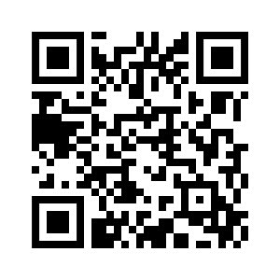

Do you want to build the power of your local?
Apply to the Campaign Lab.
Experienced in leading campaigns?
Apply to be a Coach!

Slide 12
Ice breaker: Introduce Yourself!
Name, title, location, pronouns
Years of organizing or union campaign experience
Kinds of organizing or union campaigns you have been a part of
Secret Superpower - One word share your gift, skill, or talent you bring to table (doesn't have to be campaign-related)
One person should take notes and add up the years of experience, type of experience and list of superpowers!
Notes:
Carrie
Find new people, Groups of 3-4
Note takes is person whose birthday is coming up soonest.

Slide 13

Awareness-based systems thinking:
combines understanding complex systems with shifting the our inner-awareness and the mindset of the people within that system in order to change the system. It focuses on root causes.
Notes:
Examples of systems thinking in a school and union context.

Slide 14
A " Change Maker" believes the systems, patterns, structures, values, and beliefs around us need to shift to create the change we need.

Slide 15

Awareness-based systems change
What appears...
What does not appear....
Patterns
Structures
Beliefs + Values
Root Causes
Notes:
Starts with just the title, click to see what appears, click to see what does not appear, and click to see concepts.

Slide 16
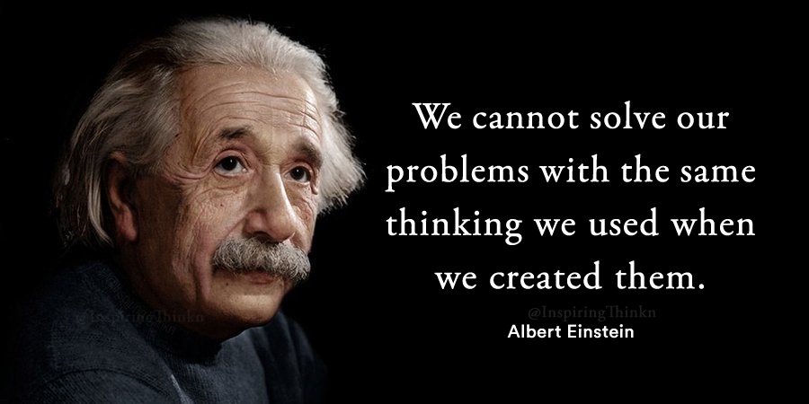

Slide 17
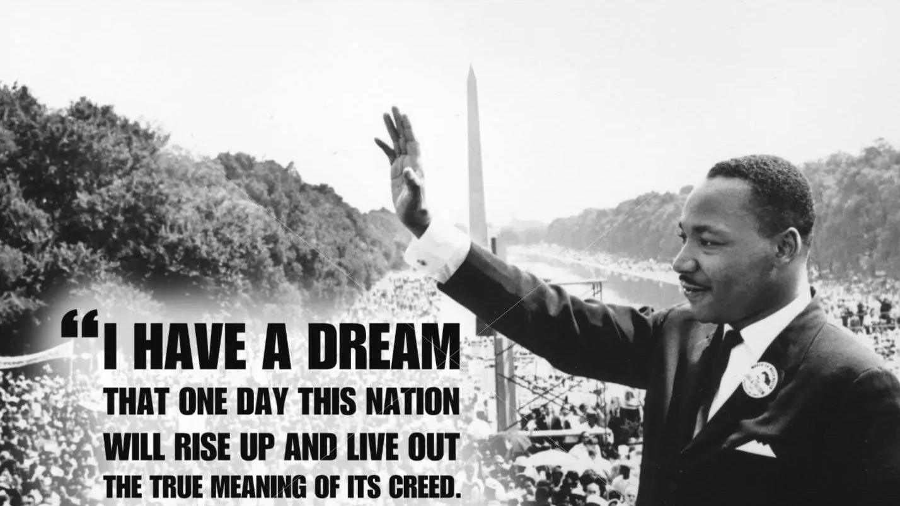

Slide 18
Awareness-based systems change
What appears...
What does not appear....
Patterns
Structures
Beliefs + Values
Root Causes
Notes:
Starts with just the title, click to see what appears, click to see what does not appear, and click to see concepts.

Slide 19
Shift
Notice
Recurring patterns and our own role in creating them.
Move away
From "reacting to the past" towards "sensing the future" and what is emerging.
Help
Leaders test new ways of acting, learning quickly from failures rather than fearing them.
Build
New structures that support and sustain the change.
Beyond an individual perspective into sensing the broader system.

Slide 20
Activity
Find a new friend and answer the two questions below:
What patterns, thoughts, habits or tendencies do you notice in your union that are preventing your union from cultivating more participation and organizing more leaders to take action?
What patterns, thoughts, habits and tendencies do you notice in yourself that are holding you back from trying to change that?

Slide 21
Share Out
If you can successfully disrupt the old patterns, what does that inspire inside of you?
With an open mind, heart and will, what change in the world becomes possible?

Slide 22

Puzzle Piece Activity
Silent Reflection:
“What does it feel like to belong to a community that is supported and shows up for everyone?”
Katie

Slide 23
Puzzle Piece
Silent Reflection:
‘What belief, value, or mindset
— within us or within the system —
would need to shift for that kind of community to become possible?

Slide 24
Outer Part of the Puzzle
On the outer edges or border of your puzzle piece, express your reflections from the first question:
‘What does it feel like to have a community that is supported and shows up for all?’”
Inner Part of the Puzzle
Now, use the inner area of your puzzle piece to express your reflections from the second question:
‘What belief, value, or mindset must change — within us or within the system — for that kind of community to be possible?’”

Slide 25
Initial Debrief: Level 1
What patterns or colors do you see?
Do you notice anything about the textures used?
Do you notice any shared themes across the pieces?

Slide 26
Level 2: Deeper Analytical Question
What does our outer‑puzzle art reveal about what we value most in a supportive community?
Looking at the inner messages, what common beliefs or values are emerging?
What common needs or experiences are reflected across our pieces?
What connections or interdependencies do we notice between our visions of community?
What does this reveal about the challenges our system is living through?

Slide 27
Level 3 Evaluating & Creating Questions
What do these puzzle pieces say about the future we’re ready to step into together?
What strengths, hopes, or sources of power become visible when all of our pieces come together?
Based on our shared artwork, what elements of a supportive community must we prioritize first as a union?
Which parts of our shared vision feel most achievable if we work together — and which require deeper system change?
What leverage points or opportunities do we see that could move us toward the community we envisioned?
How might we turn these visual themes into commitments or next steps that we take together?

Slide 28
Whole Group Debrief
Now take a few minutes to walk over to the other group’s puzzle.
Observe what stands out to you.
Notice similarities, differences, surprises, or insights.
Debrief :
Who would like to share what you noticed between the two collective pieces?What themes stood out?
What surprised you?

Slide 29

Key Takeaways
We can see that there is a shared vision and experience across our experiences.
We can find patterns across all of our individual experiences.
Achieving change requires opening up to new mindsets and disrupting old patterns.
Awareness-Based Systems Thinking allows us to develop a deeper sense and understanding of the system and identify where we might intervene for change.

Slide 30

Break Time!

Slide 31

Salina

Slide 32
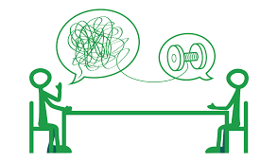
Coaching is a leadership practice. Coaching.....
Enables leaders to grow, understand their own agency and gain clarity about what is needed.
Guides leaders to explore how to overcome challenges to make their themselves, their campaigns and organizing more effective.
Notes:
Salina- Coaching can help leaders tap into their own wisdom to gain greater clarity.
Coaching helps leaders understand and move through what is getting in the way.

Slide 33
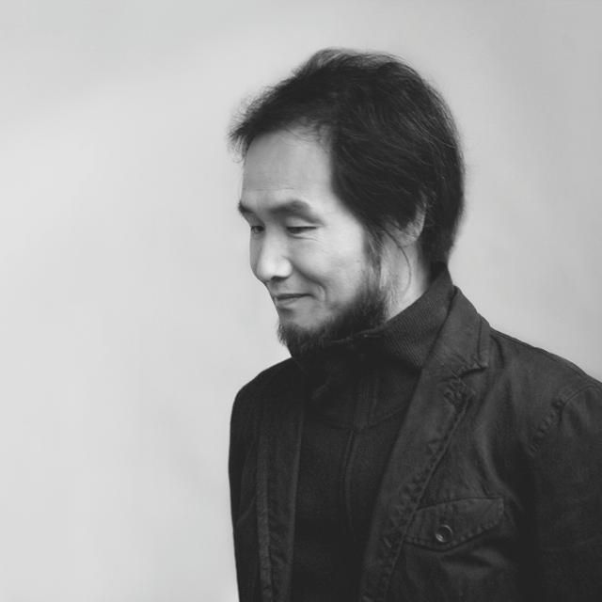
"People Are the Only Hope"​
By Park No-Hae
Translated by Helen S. Kim
People who speak of hope
Are themselves hope
People looking for a new way
Are themselves a new way
In truly good people
Is already a good world
It is within people
It begins with people
Again people are the only hope
Notes:
Jariza

Slide 34
Pair Share Activity
Where have you witnessed ordinary people becoming "hope" in your life?
What do you hope to contribute in
being a coach?

Slide 35

Engaged Listening
Open Body language
Maintain eye contact, nodding, facial expressions that show empathy or curiosity
Bring curiosity
Mirror
Paraphrase
Reflect the feelings you hear
Consider what is not being said
Notes:
Salina – Before we go in an activity, let's revisit on a foundational practice to both organizing and coaching conversations - engaged listening.
Open body language. Maintaining eye contact, Nodding. Facial expressions that show empathy or curiosity
Let’s get started. One the person is done. They can indicate by thanking the person for listening. Then the listener can just simple say thank you for sharing.
What is not being said.

Slide 36
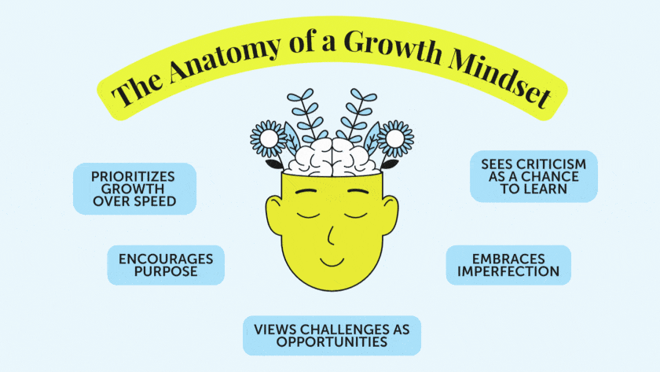
Notes:
When a leader has a growth mindset, how do they approach beingcoached?
What are some signs that you might be coaching someone with amore fixed mindset?

Slide 37

Grounded in the principles of Healing Justice. We partner with change-makers to reimagine what is possible through deep listening and transformative presence.

Slide 38
The Coaching Conversation
Center curiosity and how to improve effectiveness.
Build their own capacity to act.
Focus on how to grow and have a growth mindset.
Overcome challenges and tap new possibilities.
Notes:
Salina

Slide 39
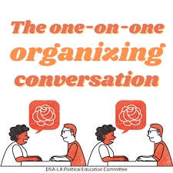
Organizing Conversation Structures
LAVA: Listen, Agitate, Vision, Ask
AHUY: Anger, Hope, Urgency, You
Feel, Felt Found
AAR: Affirm, Answer, Redirect

Slide 40

What's the difference?
Count off by 8
Get into your group
Create a T chart
  What is a coaching conversation
  What is an organizing conversation

Slide 41
Core Competencies in Coaching
Understanding the ways coaching can support growth
Centering the Leader’s Agenda
Asking Powerful Questions
Active Listening
Diagnosis
Curiosity, Interrupting and Acknowledgment
Self-Management
Notes:
Salina

Slide 42

Pause: Take a moment to come into presence and intention.
Ground: Tap into what's most important. What would you like coaching on today?
Align: What's getting in the way? What are the possibilities to move the forward?
Act: Clarity needs to act. What’s standing out for you? What might some next steps be for you?
Acknowledge: I want to acknowledge the work you did today.
The Structure of a Coaching Conversation
Notes:
Structure of a Coaching Conversation

Slide 43
Centering the Leader's Agenda
"What do you want coaching on today?"
It's what the leader is noticing that they want to pay attention to in their lives.
This the area where they would like to see move, find clarity or strategies to support them to act.
On the surface, it might seem like the only agenda.
Blooming Willow Coaching, Pause as Practice, 2021

Slide 44
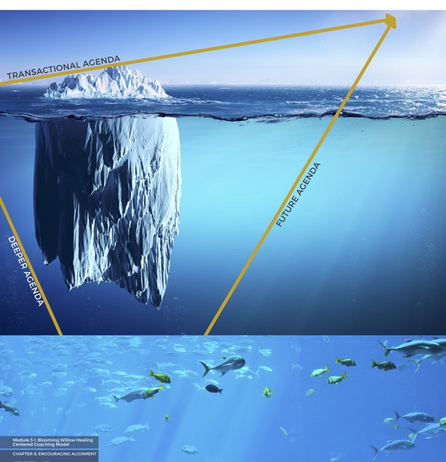
3 Agendas of the Leader
Transactional
Deeper
Future

Slide 45
Key Takeaways
Coaching....
Builds Leadership Capacity
Strengthens Decision Making and Agency
Helps leaders Navigates Challenges
Improves Campaign and Organizing Impact
Has 3 agendas: Transactional, Deeper and Future
Is Intentional.

Slide 46

Coaching Skill: Coaching towards Alignment
Kristin

Slide 47

Let's start with a moment of reflection:
  What is a deeper lesson you have learned in organizing, campaign or leadership?
  How might you connect someone with that wisdom by asking a question?
  Put sticky note with question on the wall.
Notes:
Carrie

Slide 48

Asking Questions
Why are questions important?
What do questions do that statements can’t?
Notes:
Carrie
This is how we deal with those issues- we ask questions.
Ask for volunteers to come off mute.

Slide 49
Asking Questions as a Coach
WHAT and HOW questions that are open – ended to allow the leader to be in the driver seat - problem solve and draw from their own experience.
WHO, WHEN, WHERE questions temporarily allow the coach to be in the driver seat to uncover blind spots or move through difficult conversations.
© 2026 Blooming Willow Coaching
Notes:
Amanda read
Which stands out or do you have questions about

Slide 50
Asking Building Questions
What is important about the issue? How do you wish it would be?
Identifying Barriers: What is getting in the way?
Explore Possibilities: What is needed to change that? Overcome that obstacle? What is needed from your leadership?
© 2026 Blooming Willow Coaching

Slide 51

Asking powerful questions....
What is getting in the way?
What needs more clarity for you?
How might other people help with finding a solution?
What values or beliefs might guide you right now?
What’s the lesson for you in this situation?
What do you want to be spending more time on?
How are you adapting?
What might be another way to think of this challenge?
How is this challenge impacting how you feel about the work?
© 2026 Blooming Willow Coaching
Notes:
Amanda-
What stands out or do you have questions about

Slide 52
Ask concisely. Preambles aren't needed.
Build upon where they are going.
Silence and pause can give space to a deeper insight. Wait.
Interrupt to support greater clarity.
Invite them to consider different possibilities.
Moving towards Alignment

Slide 53
Activity: Write it Out!
What are ten questions you want to incorporate into your coaching?

Slide 54
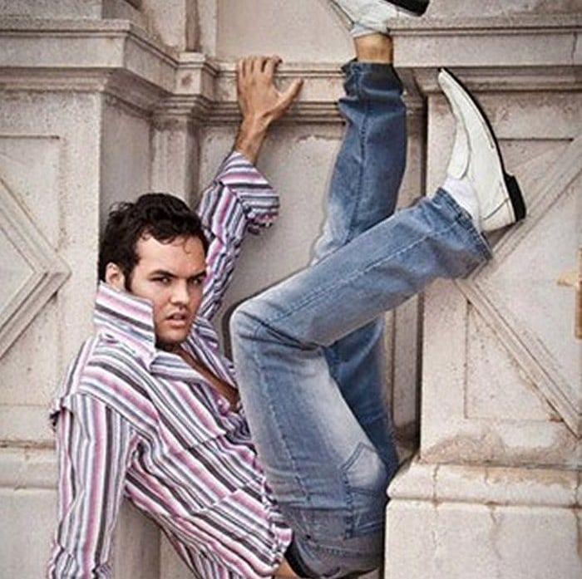
Model

Slide 55
Model Debrief

Slide 56

LUNCH
12:00 – 1:00 P.M.

Slide 57
Coaching Triads – 35 minutes
Each group will have 3 people. Find someone new!
10 minutes for each coaching conversation. Each group should have one volunteer in these different roles:
Coachee: Share a challenge you are facing in your union work and receive coaching.
Coach: Ask powerful questions to help the person explore their challenge.
Observer: Observe the coaching conversation to note what was impactful.
Debrief 2 minutes
Notes:
Carrie - 35 minutes. We will join for 10 minute sessions. Amanda will be floating, we will stay for 10 min segments

Slide 58

Debrief!
For 2 minutes share:
Observer: What did you observe in the coaching conversation? What went well? What might be something to adjust for the future?
Coachee: What was your experience being coached? What felt impactful or helpful to you?
Coach: How did it feel to be a coach? What worked well? What might you try differently next time?
Notes:
Amanda- We will put this in the chat. When they come back we will stop screen sharing and let them give feedback on experience.

Slide 59
Learn to Self-Manage
- Bekah
Notes:
BEKAH

Slide 60
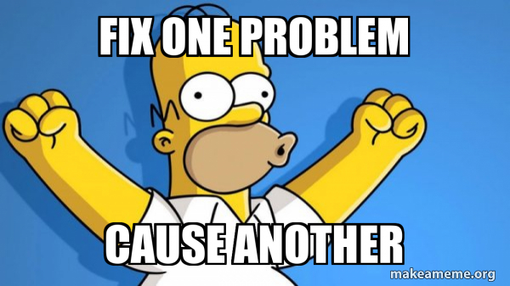
  The coach’s role is not to fix the problem or find the "solution.”

Slide 61

Coaches don’t have to be experts.
The leader is responsible for their own growth.
The coach supports them in this process.

Slide 62
Possible Interventions
Centering the Coach
Centering the Leader
Suggestions/Advice
Feedback
Stories
Observations
Questions

Slide 63
  Why might these practices be considered self-management pitfalls?
  Giving advice
  Focusing on solutions
  Sharing personal experiences
  Storytelling
Notes:
For many of us, self-management is a skill we have to practice as acoach...but also as an educator, facilitator, organizer, leader, in our relationships and more!

Slide 64
What are some signs that we are not centering the leader and their agenda?
On chart paper
Draw or Write the moment when you were not being centered in conversation you were having or you did not center someonee else.
Notes:
Group brainstorm.

Slide 65
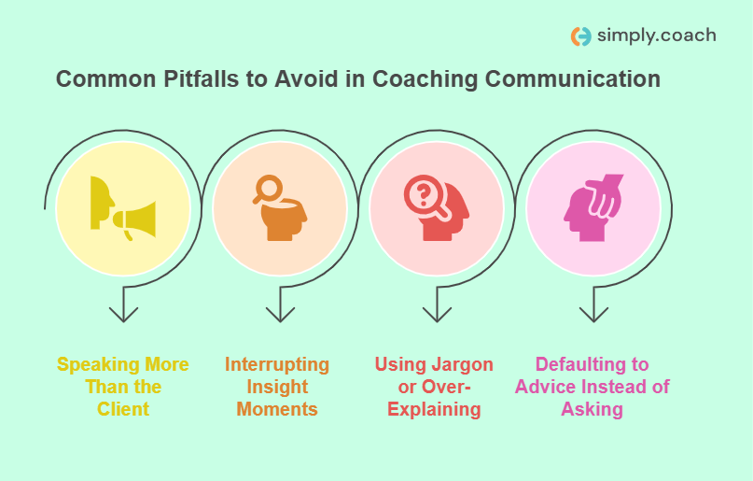

Adapted from
Speaking More than the Leader
Rescuing the Leader from Feelings

Slide 66

When coaching, manage your....
Fears
Beliefs
Judgements
Opinions
Reactions.

Slide 67
How might we self-manage as a coach?
Pause.
Notice the urge to share, give advice, and fix it.
Reflect on why you have that urge.
Take a deep breath.
Ask the leader a good question to support their deeper insight or greater clarity.
© 2026 Blooming Willow Coaching

Slide 68
Key Takeaways
Self- Manage
You cannot force your members/other leaders to want something more than you.
Organizing conversations are 10% talking, 90% listening
Guide on the side, not sage on the stage

Slide 69

15 minute break

Slide 70

Curiosity and
Unpacking Judgement
Melissa Dan

Slide 71
Curiosity....
Core competency of coaching.
A posture of openness and genuine interest in the thoughts, feelings, and experiences of another individual.
Builds the connection between the coach and the leader.
It supports exploring what's hidden beneath the surface.
Curiosity is a part of "not knowing" and being willing to explore new perspectives and a way forward.

Slide 72
Judgement
IS | IS NOT
Counterpart to curiosity Invites the leader to evaluate themself rather than be curious about themselves. Invites a feeling of assessment, problem solving, forming opinions, and decision making. | Invited into a coaching session because it creates barriers for the leader to move outside of set parameters.
It’s important to bring awareness of judgment into a coaching conversation because it will limit the exploration of deeper understanding and new possibilities.

Slide 73
Unpacking Judgement: Table Groups
10 minutes
List common judgements in our union work and identify how they might take a posture of curiosity.
Develop coaching questions that feel authentic without judgement.
Example:
The members don't want to do anything.
Vs.
What might motivate the members to get involved?

Slide 74
Share Out

Slide 75
Key Takeaways
Curiosity is about questioning. It allows you to probe deeper into understanding.
Curiosity allows people to see themselves and the challenge from different perspectives.
Prior to judgement, a question is better.
Judgement reinforces existing systems.

Slide 76

Practicing Interrupting
Melissa Dan and Kristin Lytie

Slide 77
How do we feel about Kristin interrupting Melissa?

Slide 78
What do we mean by interrupting?
  Process of stopping someone from continuing what they are saying by suddenly gently speaking to them or making a noise.

Slide 79
Intrusive Interruptions
Disagreement: Jumps in to voice a different opinion
Floor-Taking: Takes over the conversation, but stays on same subject
Topic-change: cuts in to change the topic
Summarization: Paraphrases the speaker’s point, often minimizing it

Slide 80
Collaborative Interruptions
Agreement: shows support or elaborates on the speaker's idea.
Assistance: provides a word or phrase the speaker was searching for.
Clarification: asks for an explanation about something the speaker just shared.

Slide 81
Focusing the Conversation on Intention
Interrupting a coachee by inviting them to Pause as needed to support them to move with greater intention
Interrupting may be experienced as rude, but as framed here we can see it is a skill that coaches need to develop. Our role as a coach is to maintain focus in the coaching conversation and steer the leader to focus on the coaching agenda they laid out.

Slide 82
What do we mean by a pause?
Taking a moment, taking a breath.
Pausing allows the leader to achieve deeper intention in the coaching conversation.

Slide 83
WHY might we need to interrupt when coaching someone?
Our role as a coach is to be the guide, and when someone gets them off track, bring them back into clarity so they can find their way.

Slide 84
When should we interrupt?
Background info: We just need to know the impact on the coachee, not what led to it.
Long stories: Only need to know what’s important about it, not all of it in detail.
Details about Others: Should focus on the coachee, not the people around them.
Loops: Repeating same thoughts, stories, words, phrases.
Confusion: Coachee is lost and needs a moment to reset.
Boredom: Coachee doesn’t seem interested in the direction of the conversation.

Slide 85
Coaching Tips:
A coach supports greater clarity – and helps someone tap into their own wisdom.
Help an individual discover new thoughts, beliefs, emotions that strengthen their ability to take action and achieve what’s important to them.
“Bottom-line” or understand the essence of the person’s communication and support them to get there rather than engaging in long stories.

Slide 86
Let's try it!
Count off by 5 and go to a chart paper with your group.
Write down a list potential prompts you could use to cooperatively interrupt someone.
  Examples:
    Let’s take a moment to breathe
    I don’t want what you just shared to get lost
Share out - What would you feel comfortable saying to interrupt?

Slide 87
Debrief
What did you hear that stuck out?
What will you use?

Slide 88
Key Takeaways
Interrupting can be used constructively to keep conversations focused.

Slide 89
Centering Equity and Justice
Bekah Saxon

Slide 90

The new racism: Racism without 'racists.' Today, racial segregation and division often result from habits, policies, and institutions that are not explicitly designed to discriminate. Contrary to popular belief, discrimination or segregation do not require animus. They thrive even in the absence of prejudice or ill will. It's common to have racism without racists.
Eduardo Bonilla-Silva

Slide 91
Centering Race, Class, and Gender Justice
Race, class, and gender justice is the systematic fair treatment of people resulting in equitable opportunities and outcomes for all.
It is not just the absence of discrimination and inequities, but also the presence of deliberate systems and supports to achieve and sustain race, class, and gender equity through proactive and preventative measures.

Slide 92

Centering Equity in your Campaigns Tool (pg 3 in PEPS)
What they do:
Proactively seek to both eliminate systemic barriers and advance equity
Identify clear goals, objectives and measurable outcomes
Develop mechanisms for successful implementation
What they are:
A set of questions used to anticipate, assess, and prevent potential adverse consequences of proposed actions on different race, class, or gender groups.

Slide 93
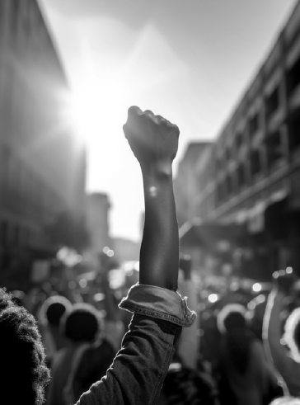
Would the campaign(s) your coaching have answers to these questions or be able to say most components of these tools are a part of their campaign?
What is something you noticed that could support your coaching?

Slide 94
Factors that Support the Centering Equity in your Campaigns Tool
Buy in from the organization and its leaders
Routine and ongoing use of the RET
Data- driven assessment
A commitment to making changes
Tenacity – A commitment to overcoming obstacles to making changes
WE HAVE TO DECIDE TO DO THINGS DIFFERENTLY AND STICK WITH IT

Slide 95
Coaching Equity—Tabletop Discussion
How can we coach leaders to center equity?
How can the tool assist?
What are some coaching questions you could ask?
What might come up for the leader as they explore issues of race, gender, culture, etc?
How can this be used to discuss not just a campaign but also the functioning of the union?

Slide 96
Coaching for Equity
Transformational coaching requires:
  Compassion
  Curiosity
  Connection
  Courage
  Purpose
  This is especially true for coaching for equity

Slide 97
Working to cultivate
Transformation
Humility
Empathy
Curiosity

Slide 98
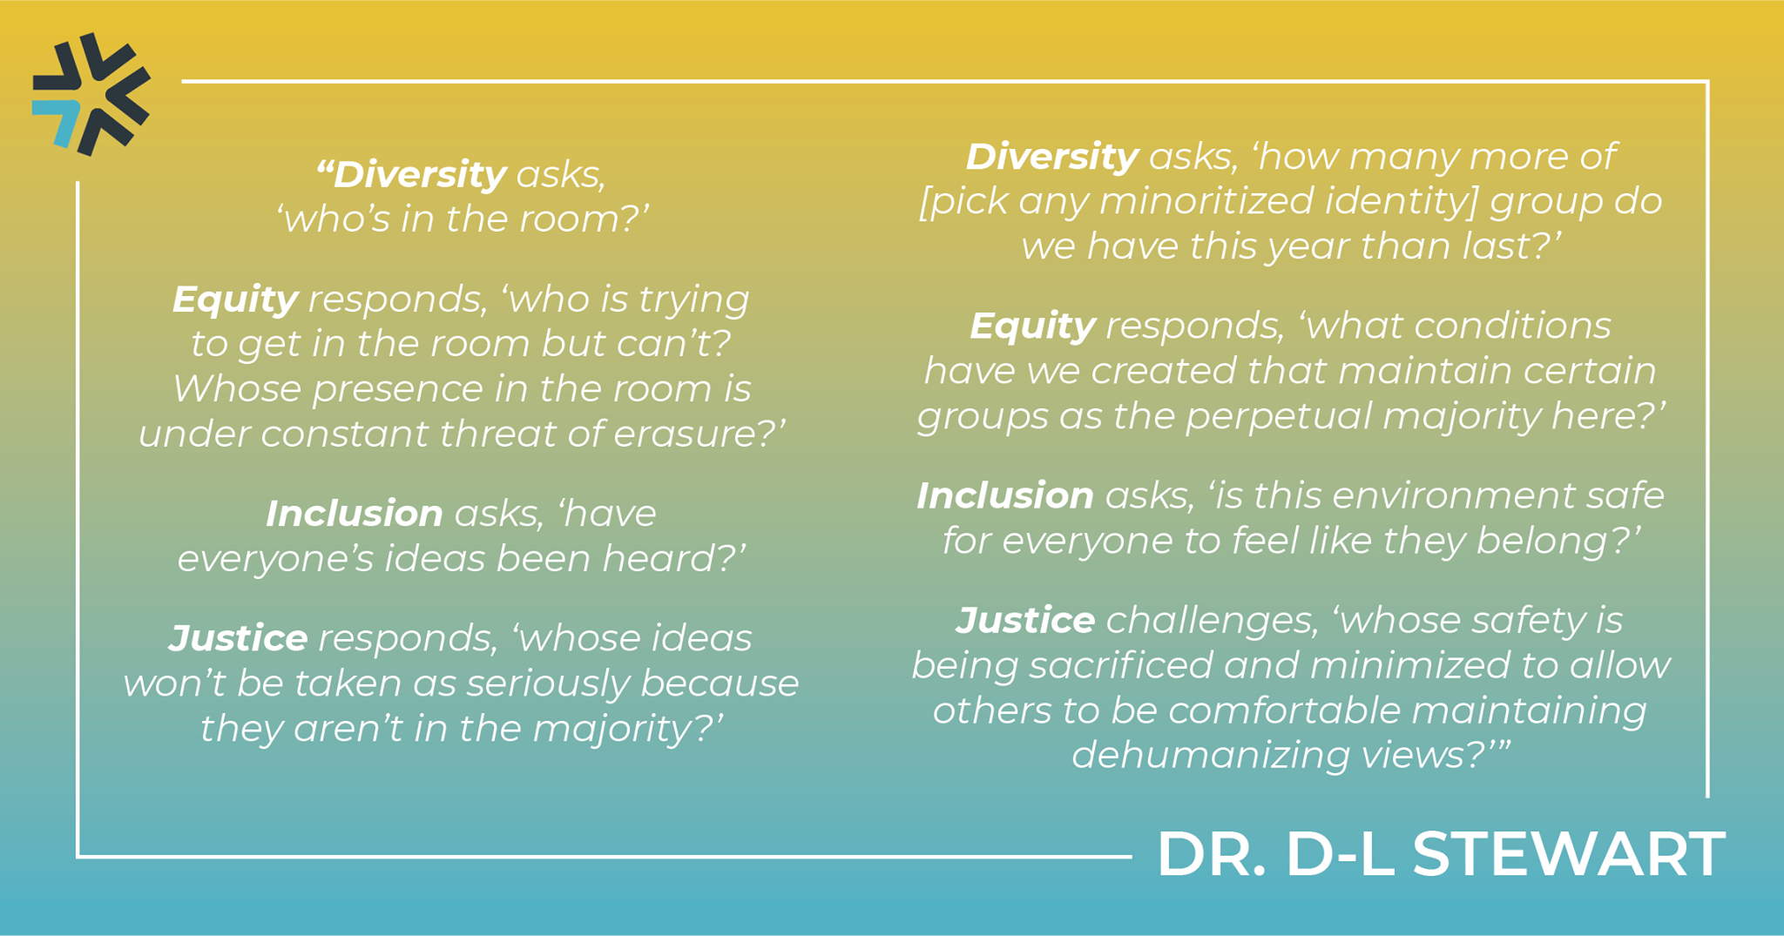

Slide 99
Coaching Practice (groups of 3)
Coach, leader, observer/timekeeper
12 minutes coaching, 3 minute debrief.
Switch roles.
Pick one of these scenarios to practice:
Union participation is all white, despite 15% of members being people of color.
Students are missing school due to fears of ICE.
Teachers of color report that parents complain about them frequently.

Slide 100

Key Points
Centering race, class, and gender justice in our campaigns increases the people engaged, the number of leaders involved, and the amount of resources we have to win the change we want.
Power is only built through people with a shared vision, making public commitments to act, to risk their collective resources, for the meaningful change they want.
Centering equity requires changes in the work we do and in how we do the work we do.

Slide 101
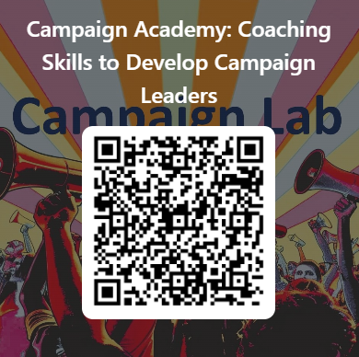
Give us Your Feedback Please

Slide 102
Closing 4:20

Slide 103
What is becoming clearer?
What is murkey?
Breakfast Tomorrow
Coaching Assessment

