Slide 1
Campaign Academy: Coaching Skills to Develop Campaign Leaders
Day 2
March 2026

Slide 2
Feedback on Feedback
High ratings for the facilitator team and collaborating with each other in group activities.
More time for debrief and feedback noted and adjustments made.
We are educators not just teachers in our union. Yes!
Pilot feedback on adapting coaching fundamentals.
Mixed reviews on puzzle activity
Coming up...
  Today coaching campaigns and implementing.
  Sunday implementing coaching in your context.

Slide 3

Community Agreements
Using Self-Awareness and Self-Knowledge
Listening for Understanding
Being Gracious
Staying Engaged
Being Open and Suspend Judgment
Saying “I”- tell your truth
Lean into Discomfort
Reaching Empathy
Expecting Non-Resolution and Non-Closure
Adapted from “Embracing equity and inclusion”, Annie E. Casey Foundation
Notes:
Community Agreements for Our Time
Awareness and Self-Knowledge
This requires self-knowledge and self-awareness. Self-knowledge allows you to see what causes you pain and conflict and enables you to embrace your contradictions and inconsistencies. It allows the space to work on things about yourself that you are not happy with. In turn, self-knowledge helps to prevent you from projecting your negative aspects onto other people. Bringing your best self also requires that you have a positive attitude, are willing to deeply explore your perspectives and remain open to the perspectives and experiences of others.
Listening for Understanding
Be an active listener. Active listening involves paying full and careful attention to the other person, looking him or her in the eye, avoiding interruptions, reflecting your understanding, clarifying information, summarizing the other person’s perspectives and sharing your own. Remember that most people need time to open up and might not be willing to immediately share their personal stories, hopes, fears and/or concerns.
Being Gracious
Being kind is a vital way of bringing meaning to our own lives, as well as the lives of others. Kindness is about caring genuinely for others around you, wanting the best for them and recognizing in them the same wants, needs, aspirations and even fears that you may have. Being kind and generous allows us to communicate better with others, to be more self-compassionate and to be a positive force in other people’s lives. This includes following the COVID protocols that are in place to protect the health of this learning community.
Stay Engaged
Staying engaged requires you to be morally, emotionally, intellectually and socially involved in the conversation. Staying engaged means that you are listening with curiosity and willing to deepen your understanding. Staying engaged might also require you to sustain the conversation even when it gets uncomfortable or diverted. This also means a commitment to keeping your electronic communications to a minimum with folks not present in this learning community.
Be Open and Suspend Judgment
Listening with an open mind includes being receptive to the influence of others. You can suspend judgment by becoming aware of preconceived notions and listening to everything someone has to say before jumping to conclusions. Most importantly, suspending judgment also means listening to what the speaker has to say for understanding, not just to determine whether the speaker is right or wrong.
Say “I”- tell your truth
Speaking your truth in authentic and courageous conversations about race requires a willingness to take risks. It means that you will be absolutely honest and candid about your own thoughts, feelings, experiences and opinions and not just saying what you perceive others want to hear. Speaking your truth will require you to speak from the “first person” and use “I” statements.
Seek Discomfort
Leaning in to discomfort will require you to let go of racial understandings and stereotypes that you may be holding onto in order to move forward. Leaning in means that you will avoid judgment, assume positive intent and be open to the kernel of wisdom in each individual’s experiences. Leaning in to discomfort will require you to sit through moments of embarrassment, confusion, anxiety and/or fear.
Reaching Empathy
Empathy and compassion allow you to understand the other person’s point of view. When you are empathetic, you are more understanding, patient and kind. Expanding your capacity to feel empathy will also allow others to enter your circle of human concern.
Resolution and Closure
Expect and accept that there may not be closure. It is not likely that you will resolve your personal understanding about race or another person’s racial experience in a single conversation. The more you talk about race with another person, the more you learn and the more they will learn. Authentic and productive conversations about race are continuous and always evolving.
*Adapted from “Embracing equity and inclusion”, Annie E. Casey Foundation

Slide 4
Today's Agenda: Coaching Campaign Leaders
Time | Content
8:30 – 9:00 A.M. | Welcome, Grounding, Feedback
9:00 – 10:00 A.M. | Heart Hand Head Diagnosis
10:00 – 10:15 A.M. | Break
10:15 – 10:50 A.M. | Practice
10:50 – 12:00 P.M. | Services to Organizing
12:00 – 1:00 P.M. | Lunch
1:00 – 1:10 P.M. | Grounding
1:10 – 1:55 P.M. | Using Assessments in Coaching
1:55 – 2:15 P.M. | Coaching a Campaign Leader
2:15 – 2:30 P.M. | Break
2:30 – 3:15 P.M. | Activity: Coaching a Campaign Leader
3:15 – 4:05 P.M. | Coaching Triads
4:05 – 4:30 P.M. | Debrief and Wrap Up
4:30 – 5:00 P.M. | Adult Choice Networking

Slide 5
Opening Activity
Carrie

Slide 6
Diagnosis: head, heart, hand
Katie

Slide 7
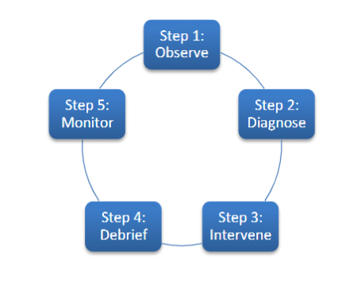
Cycle of Coaching

Slide 8
Coaching Approaches
Corrective
  Aimed at poor performance
Developmental
  Mastery
  3 elements (Head/Strategic, Heart/Motivational, Hands/Skills)

Slide 9
Effective coaching is | Effective coaching is not
Showing up and being present to another person’s experience and listening, with both your head and heart | Being so prepared that you work out all the answers for the coachee before you even hear or observe their challenges
Helping the coachee explore and make sense of their challenges and successes, and what they learned from it all | False praising of the coachee or only focusing on their strengths because you do not want to hurt their feelings
Helping the coachee to find solutions to challenges | Solely criticizing the coachee
Asking questions that both support and challenge the person you are coaching | Telling the coachee what to do

Slide 10
Coaching Is Not
Giving Advice
The gold tip is that the coachee will realize on their own that is even better than any solution that you could come up with. It is essential to avoid giving advice.
Leading Questions
Hiding advice in your question format. If good coaching is about asking the right question- that doesn't mean that ending with a question mark can make you get away with an embedded advice in the question.
  Examples:
    Have you tried to do xxx?
    Will xxx work in your situation?

Slide 11




Types of Interventions, page 33
Notes:
Is the challenge motivational (effort/heart)?Is the individual struggling because s/he is not putting forth enough effort? Is she not trying hard enough because she’s embarrassed? Is he quitting too soon because of frustration or fear? Is s/he getting interference from other habits (e.g., someone well-versed in marketing speak may not know how to tell an authentic story)?
Is the challenge educational (information/skills/hands)?Is the individual struggling because he lacks the skill to execute effectively? Does he not know how to do it? Is she getting interference from older habits or behaviors (like someone who is so used to selling things confusing this with telling a story of self)? Is it something you could model or role-play with them?
Is the challenge strategic (strategy/head)?Is the individual struggling because s/he doesn’t know how to use the information or skills that she does have. Does he understand the concepts or underlying principles clearly? Has he not

Slide 12
Motivational
Heart Coaching aimed at enhancing motivation
Is the individual struggling because they are not putting forth enough effort? Are they not trying hard enough because they are embarrassed? Are they quitting too soon because of frustration or fear? Are they getting interference from other habits (e.g., someone well-versed in marketing speak may not know how to tell an authentic story)?

Slide 13
Strategic Motivation
Head coaching aimed at helping plan, evaluate, strategize.
Is the individual struggling because they lack the skill to execute effectively? Do they not know how to do it? Are they getting interference from older habits or behaviors (like someone who is so used to selling things confusing this with telling a story of self)? Is it something you could model or role play with them?

Slide 14
Skills
Hands Coaching aimed at effective execution of a skill
Is the individual struggling because they do not know how to use the information or skills that they do have. Do they understand the concepts or underlying principles clearly? Have they not thought it through carefully? Are the goals not achievable? Does the strategy make sense?

Slide 15
Activity, on a chart paper
Come up with a team name, break into groups
In your team:
  Diagnose the people on page 45. Is it strategic/head, motivation/heart, or skills/hands?
  What questions would you ask as a coach to get to the 'right' diagnosis?
  BONUS! Once you are secure in your diagnosis, what intervention questions do you ask?

Slide 16
Share out!

Slide 17
As we wrap up...
What happens if we misdiagnose?

Slide 18
Key Points
Debriefing and check ins are critically important because they allow the space and time to do these interventions.
The correct intervention is critical to supporting a persons growth and helping them find the answers.
Asking good questions helps us find the appropriate intervention.

Slide 19
Before Break... Think on your back home campaign...
Think about an issue you are having with your campaign.
Write it on a post it note.

Slide 20
Break Time!

Slide 21
Diagnosis in Coaching

Slide 22
Model!
Two facilitators will demonstrate a coaching conversation
Notes:
Carrie and Brave participant

Slide 23
Observations
Notes:
What did you see in the coaching work? What good questions did they ask? Did they give any stories? Was this a head, heart, hands issue?

Slide 24
Find a new friend- Triad Practice
Get into groups of 3. Someone you have not worked with today or yesterday if possible
  One person will coach
  One person will be coached
  One person will observe.
10 minutes and switch to a new role.
We will get to 2 of the 3 roles in your triad.

Slide 25
Debrief: Do not move...
What was a question that you heard or had asked of you that helped bring something to light?

Slide 26
Coaching the Shift from Services to Organizing
Katie

Slide 27

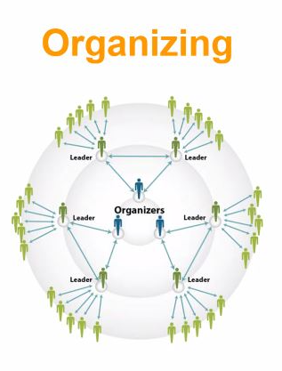
Service to Organizing
Notes:
We spend a lot of time talking about the need to shift from service to organizing. However, the reality is- members have expectations of their union. They want services and help. Which is reasonable and will always be a core of our unions' work. However- how we respond to or structure supporting members with their concerns/requests can help transform our unions. Let's start by examining the hall marks of a service culture and an organizing culture.

Slide 28
Two Models , page 107
Organizing
Service
Continual and power-building.
The union is understood as a collective vehicle for members to build power together.
Success is measured not just by contract wins, but by the number of members actively involved in identifying issues, leading campaigns, and solving problems.
Leadership is intentionally expanded — new leaders are consistently invited into roles such as building reps, issue organizers, and bargaining team members.
The culture reinforces the belief that “we are the union,” and that meaningful change comes from collective action, not just representation.
Episodically and transactionally.
The union is primarily seen as a provider of services: filing grievances, negotiating contracts, enforcing board policy, and resolving individual member issues.
Success is measured by outputs such as the number of grievances filed or resolved, contract settlements reached, and membership totals maintained.
Participation is concentrated in formal roles — officers, staff, bargaining teams — while most members engage only when they need assistance.
The culture reinforces the idea that “the union handles it” on behalf of members.
Notes:
Service Model Union Culture
A service model union culture operates episodically and transactionally. The union is primarily seen as a provider of services: filing grievances, negotiating contracts, enforcing board policy, and resolving individual member issues. Success is measured by outputs such as the number of grievances filed or resolved, contract settlements reached, and membership totals maintained. Participation is concentrated in formal roles — officers, staff, bargaining teams — while most members engage only when they need assistance. Information flows vertically through a small number of designated leaders, and decision-making is centralized. Bargaining is typically led by staff and a limited group of member representatives. The culture reinforces the idea that “the union handles it” on behalf of members.
Organizing Model Union Culture
An organizing model union culture is continual and power-building. The union is understood not as a service provider, but as a collective vehicle for members to build power together. Success is measured not just by contract wins, but by the number of members actively involved in identifying issues, leading campaigns, and solving problems. Leadership is intentionally expanded — new leaders are consistently invited into roles such as building reps, issue organizers, and bargaining team members. Information flows broadly across networks of members rather than through a few gatekeepers. Bargaining is led by large member committees, with visible participation and engagement across worksites. The culture reinforces the belief that “we are the union,” and that meaningful change comes from collective action, not just representation.
Quick Assessment- where would you place your local.
Quick fist of 5. 1 being total organizing model and 5 being complete service model.
Quick Share out- why did you rate yourself this way? What function of your union highlights your personal rating.

Slide 29
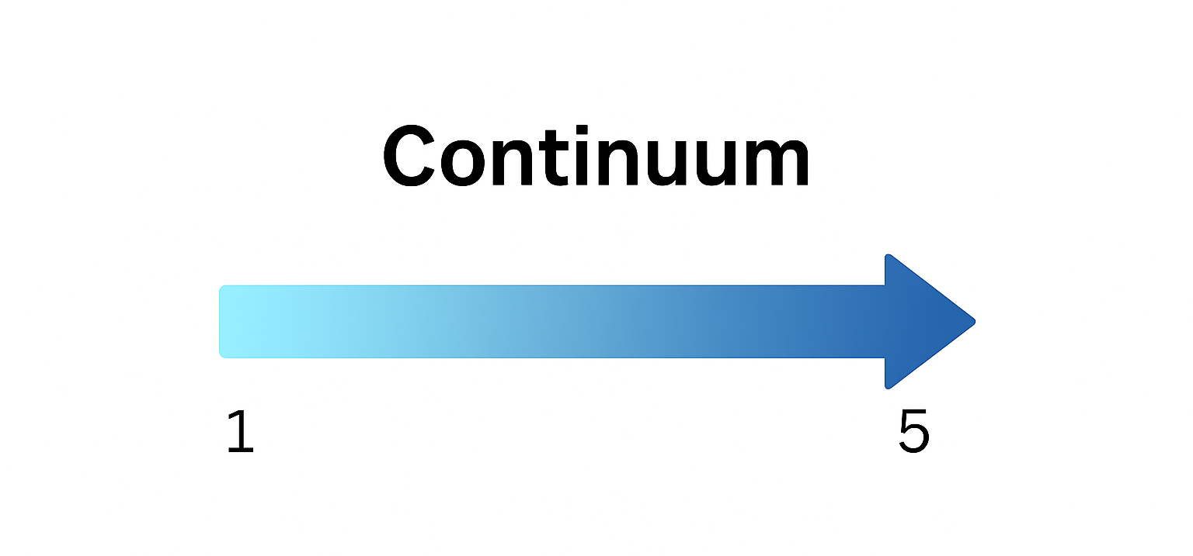
Where is your local on the continuum?

Slide 30
Activity! You choose!
Keep the groups to 5-6, go to second choice if need be
Political Action Committee Drive/Committee
Bargaining
Membership
Grievances/Arbitration
Answering Member Questions
Budgeting
Finding Members for Committees
Information Sharing

Slide 31
Create a T- Chart : Your Union Activities
What could you change about this task that makes it closer to an organizing culture (right side)?
What current behaviors, mindsets, or practices about the task are service oriented ( Left Side)

Slide 32
Changing the mindset, culture, and practices of being a service-oriented culture
Notes:
Who here as gotten the call from a member that wants their time and energy right now?
Many of us have. Quick turn and share, what is so hard about this moment? How could we change this moment to reflect an organizing culture? How might we coach a leader navigating this shift?

Slide 33
Coaching a Building Rep (page 104)
Scenario for Triad Activity:
A building rep calls the office looking to get help with a member who is facing a bad evaluation. They want the local president/staff member to step in.
How do you coach the building rep to take on this situation and support their colleague. Note they like the admin and think the colleague may need help, but the admin is being overly harsh.
Person A – Building Rep:
Person B – Coach:
Person C – Observer:

Slide 34
Share Out!

Slide 35
Key Points!
Helping build member agency is how we shift a service culture to an organzing culture.
Engagement is the best way to retain members.
Larger engagement of the members leads to more creative and not typically considered outcomes. Increases capacity of union to act and do more!
More people involved = harder to burn out and harder for the boss to come down on people.
Engagement and moving towards an organizing model is how we shift towards a more inclusive union culture, away from “the union” to “our union”.
Any plan that does not include engage members, cannot be a part of our plan.

Slide 36
LUNCH
12:00 – 1:00 P.M.

Slide 37
Using Assessments to Guide Coaching
Bekah

Slide 38
The Assessment Tool (pg 23 in PEPs)
Vision: Having a clear vision of the power the leaders, and team are building.
The Now: Understanding where you are beginning.
The How: How to support team leads in using the tool

Slide 39
Group Work (20 minutes)
Divide into groups of 3: 2 people who completed an assessment and 1 person who did not.
1. What are the union's strengths?
2. Overall, what are the largest challenges?
3. What are the main barriers?
4. What are the top 3 priorities?
10 tips for talking about race: additional resources
Coaching questions: PEPS pg. 98
Equity questions: pg. 43

Slide 40
Key Points
Helps you understand where are you so you can be intentional about where you need to go.
Helps to provide a shared objective picture
Supports Strategic Planning
Builds leadership awareness and accountability
Encourages member driven action

Slide 41
Coaching A Campaign Leader
Kristin

Slide 42
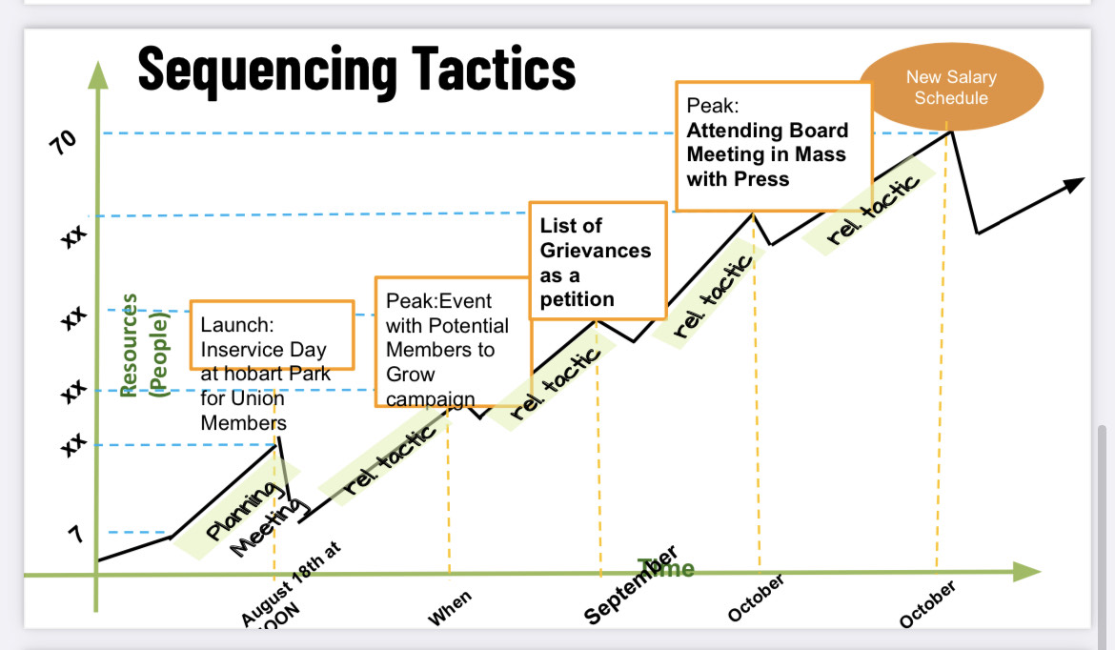
CAMPAIGN PLAN EXAMPLE
Chilton's Campaign for a
New Salary Schedule
I need a graphic of filled out campaign mountain

Slide 43
The Stages of Campaign Planning
Team Formation
1
Issue Identification
2
Goal Setting
3
Power Analysis
4
Strategy & Tactics
5
Implementation
6
Reflection
7

Slide 44
Why does having a Campaign Plan matter?
Why do we need a written plan?
What is challenging about developing a plan?

Slide 45
Campaign Coaching
What It Is | What It Isn’t
Helping organizers become strategists that lead powerful campaigns | Making key strategy decisions for a group
Supports a growth mindset that includes reflection and thinking through challenges | “Answering questions that come up” as an external consultant
Balancing the need to learn and develop skills with running a “live” campaign | Having “catch up calls” without preparing questions to support the group through challenges

Slide 46
Why is coaching critical to a winning campaign?
Coaching helps leaders.....
Center curiosity and how to improve effectiveness.
Build their own capacity to act.
Focus on how to grow and have a growth mindset.
Overcome challenges and tap new possibilities.
Notes:
Jariza

Slide 47
Designing Interventions For Coaching
Observation - What do I see and hear? What is the challenge?
Diagnosis - Why is the problem a problem?
Intervention – Questions to create space for reflection

Slide 48
Questions for Sharpening Assessments
How do you know that?
What kinds of evidence do you have?
When have you seen that happen?
What would have to happen to change that?
If you say, "Yes" to this opportunity, what will you have to say, "No" to?

Slide 49
Questions for Getting "Under the Surface"
You mentioned a challenge your group is dealing with. Let's slow down a bit. What else might be going on there?
Sounds like X has been challenging. What might the bigger pattern or challenge be?
We've covered the urgency challenges rising to the surface this week. But I want to make sure to check in about 'the bigger picture.' In the grand scheme of things, what other things are important for us to spend time on?

Slide 50
Questions for Prioritizing:
Which of these things feels most urgent for us to figure out today?
Is that what you wanted to talk about today?
How does that align with the campaign plan?

Slide 51
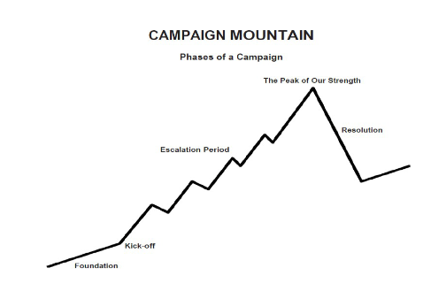
Knowing where you are will help your coaching

Slide 52
Issue Identification
Define the specific, tangible issue to address—moving from broad problems to actionable focus.
How do you know people care about this?
Is this the root cause?

Slide 53
Team Formation
Establish a core group with clear roles, shared purpose, and commitments.
Is your team made up of trusted and respected leaders?
Does your team have representation from each school/worksite?

Slide 54
Power Analysis Questions
Analyze the landscape: identify decision-makers, allies, opponents, and the systems influencing the issue.
Does this person have the power to make the change you want?
Who might be in opposition of this?
Why hasn't this been fixed already?

Slide 55
Goal Setting Questions
Set clear, measurable, and motivating goals that define what success looks like for the campaign.
How will you know you've won?
What might look like a win along the way?

Slide 56
Implementation Questions
Put the plan into action, mobilizing people and resources to execute tactics effectively.
How will you track who is doing what?
How will you be in communication with leaders from each site?

Slide 57
Evaluate outcomes, celebrate wins, and identify lessons to strengthen future campaigns.
Reflection Questions
Knowing what you know now, what would you have done differently?
How could you have pushed through that challenge?

Slide 58
Strategy and Tactics Questions
Develop creative strategies and concrete tactics to leverage resources and achieve campaign goals.
How will you know people are ready to take that step?
What will your campaign look like in the school?
Is there a slogan that relates to your goal?

Slide 59
Break Time!

Slide 60
What's the Difference?
Campaign Coach
Campaign Organizer
Holds campaigners accountable to their values and decisions
Asks good questions to get "underneath" sticky situations, shares experiences and helpful resources
Creates safe space for campaign lead to struggle and try out new ideas
Holds members accountable to campaign tasks
Creates campaign plans
Tracks participation and outcome of tactics towards goal
Builds a campaign organizing team that is accountable to winning the campaign
Notes:
What are things you would say as a coach that are different than what you would say as an organizer?

Slide 61
Campaign Diagnosis and Intervention Activity
Review Scenarios on Page 101-103
What is the Observation
What is your Diagnosis
What questions will you intervene with?
Write on chart paper

Slide 62
Key Points
A campaign plan is a commitment the team has made.
You are not directing the campaign but asking the questions that put its leaders on track for themselves.
Your intervention can create a fresh perspective and provide insight on how the leader might approach:
  Fear
  Internal disagreements
  Unseen obstacles
  How communications on a win will be carried out

Slide 63
Coaching Triads
Melissa Dan

Slide 64
Coaching Framework
Coach the person not the problem.
What are the barriers within yourself that is getting in the way of what you want or can do?
Expanding the capacity of leaders increases the capacity of the team to drive the campaign.

Slide 65

Core Competencies in Coaching
Understanding the ways coaching can support growth
Centering the Leader’s Agenda
Asking Powerful Questions
Active Listening
Diagnosis
Curiosity, Interrupting, and Acknowledgment
Self-Management
Notes:
Salina

Slide 66

The Coaching Conversation
Coaching supports campaign leaders.
Center curiosity and how to improve effectiveness.
Build their own capacity to act.
Focus on how to grow and have a growth mindset.
Overcome challenges and tap new possibilities.
Notes:
Salina

Slide 67

Pause: Take a moment to come into presence and intention.
Ground: Tap into what's most important. What would you like coaching on today?
Align: What's getting in the way? What are the possibilities to move the forward?
Act: Clarity needs to act. What’s standing out for you? What might some next steps be for you?
Acknowledge: I want to acknowledge the work you did today.
The Structure of a Coaching Conversation
Notes:
Structure of a Coaching Conversation

Slide 68
Coaching Practice - 15 minutes
Scenario 1:
You left your last coaching session with action step to have 1:1s with 5 newly identified leaders. You emailed them all but only got one response and have had one 1:1.
Practice in pairs – 10 min
Whole Group Debrief – 5 min

Slide 69
Coaching Practice – 15 minutes
Scenario 2:
You are creating an organizing team at a worksite. Two white veteran teachers signed up.
Practice in (new) pairs – 10 min
Whole Group Debrief – 5 min

Slide 70
Key Points
The structure of a coaching conversation is to guide a person or team on the steps they need to take - not solve their issue or campaign.
Coaching can help leaders get “unstuck.”

Slide 71
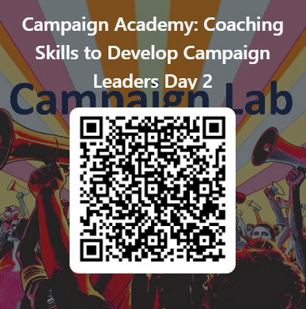
Give us Your Feedback Please

Slide 72
Ending it right
Carrie

