Slide 1
Campaign Academy: Coaching Skills to Develop Campaign Leaders
Day 3
March 2026

Slide 2
Carrie

Slide 3

Campaign Academy
By attending this training, you confirm that you are either an NEA affiliate staff person or NEA member in good standing. The information you receive here is only for your use in your capacity as an NEA affiliate staff person or NEA member.
This presentation and its contents are confidential and may not be further distributed or passed on to any other person or published or reproduced, in whole or in part, by any medium or in any form, for any purpose unless written consent has been provided by Ellen Holmes. Audio/video recording, copying of slides, and the use of AI note-taking tools are prohibited without the written consent from Kyle Serrette. Violation of these terms may result in legal action.

Slide 4
NEA Standards of Conduct
NEA has adopted a Standard of Conduct Policy to ensure that all of our gatherings are welcoming to and free from discriminatory, harassing, or otherwise unacceptable behavior. Discrimination or harassment based on race, color, ethnicity, religion, sex, age, national origin, sexual orientation, disability, gender identity, or expression, or any other characteristic protected by law will not be tolerated. If you have experience any discriminatory or harassing behavior, please report the incident by emailing Ron "Duff" Martin (rmartin@nea.org) and Gladys Marquez (gmarquez@nea.org). Thank you for your commitment to ensuring a positive event for all.

Slide 5

Community Agreements
Using Self-Awareness and Self-Knowledge
Listening for Understanding
Being Gracious
Staying Engaged
Being Open and Suspend Judgment
Saying “I”- tell your truth
Lean into Discomfort
Reaching Empathy
Expecting Non-Resolution and Non-Closure
Adapted from “Embracing equity and inclusion”, Annie E. Casey Foundation
Notes:
Community Agreements for Our Time
Awareness and Self-Knowledge
This requires self-knowledge and self-awareness. Self-knowledge allows you to see what causes you pain and conflict and enables you to embrace your contradictions and inconsistencies. It allows the space to work on things about yourself that you are not happy with. In turn, self-knowledge helps to prevent you from projecting your negative aspects onto other people. Bringing your best self also requires that you have a positive attitude, are willing to deeply explore your perspectives and remain open to the perspectives and experiences of others.
Listening for Understanding
Be an active listener. Active listening involves paying full and careful attention to the other person, looking him or her in the eye, avoiding interruptions, reflecting your understanding, clarifying information, summarizing the other person’s perspectives and sharing your own. Remember that most people need time to open up and might not be willing to immediately share their personal stories, hopes, fears and/or concerns.
Being Gracious
Being kind is a vital way of bringing meaning to our own lives, as well as the lives of others. Kindness is about caring genuinely for others around you, wanting the best for them and recognizing in them the same wants, needs, aspirations and even fears that you may have. Being kind and generous allows us to communicate better with others, to be more self-compassionate and to be a positive force in other people’s lives. This includes following the COVID protocols that are in place to protect the health of this learning community.
Stay Engaged
Staying engaged requires you to be morally, emotionally, intellectually and socially involved in the conversation. Staying engaged means that you are listening with curiosity and willing to deepen your understanding. Staying engaged might also require you to sustain the conversation even when it gets uncomfortable or diverted. This also means a commitment to keeping your electronic communications to a minimum with folks not present in this learning community.
Be Open and Suspend Judgment
Listening with an open mind includes being receptive to the influence of others. You can suspend judgment by becoming aware of preconceived notions and listening to everything someone has to say before jumping to conclusions. Most importantly, suspending judgment also means listening to what the speaker has to say for understanding, not just to determine whether the speaker is right or wrong.
Say “I”- tell your truth
Speaking your truth in authentic and courageous conversations about race requires a willingness to take risks. It means that you will be absolutely honest and candid about your own thoughts, feelings, experiences and opinions and not just saying what you perceive others want to hear. Speaking your truth will require you to speak from the “first person” and use “I” statements.
Seek Discomfort
Leaning in to discomfort will require you to let go of racial understandings and stereotypes that you may be holding onto in order to move forward. Leaning in means that you will avoid judgment, assume positive intent and be open to the kernel of wisdom in each individual’s experiences. Leaning in to discomfort will require you to sit through moments of embarrassment, confusion, anxiety and/or fear.
Reaching Empathy
Empathy and compassion allow you to understand the other person’s point of view. When you are empathetic, you are more understanding, patient and kind. Expanding your capacity to feel empathy will also allow others to enter your circle of human concern.
Resolution and Closure
Expect and accept that there may not be closure. It is not likely that you will resolve your personal understanding about race or another person’s racial experience in a single conversation. The more you talk about race with another person, the more you learn and the more they will learn. Authentic and productive conversations about race are continuous and always evolving.
*Adapted from “Embracing equity and inclusion”, Annie E. Casey Foundation

Slide 6
Feedback on Feedback

Slide 7
Reflection
How might your coaching skills help you build the capacity of your local union?
How might developing coaching skills help you grow as a person?

Slide 8

What is Campaign Lab?
Leadership Development through Peer Coaching
Campaign and Organizing Fundamentals: Tools and Training
Assessment, Evaluation, and Centering Equity
Strategizing and Collaboration
Notes:
Carrie- Shine up the slide

Slide 9
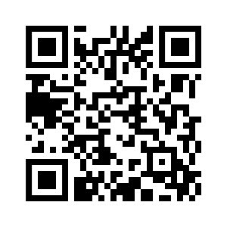
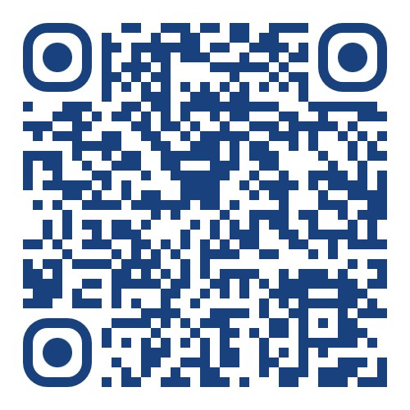
Experienced in leading campaigns?
Apply to be a Coach!
Do you want to build the power of your local?
Apply to the Campaign Lab.

Slide 10
Time | Activity
8:30am-8:50am | Welcome, Feedback, and Changing Relationships
8:50am – 10:20am | Awareness-Based Systems Change
10:20am- 10:35am | BREAK
10:35am- 11:45am | Back Home Planning: Review assessment, coaching agenda, coaching campaign, system beliefs
11:45am – 12:20pm | Presentations
12:20pm- 12:40pm | Closing

Slide 11
Awareness-Based Systems Change
Fabricio

Slide 12

Awareness-Based Systems Thinking
To change a system, you have to understand it.
To truly understand the system, you must also understand how the people inside the system think.
To change the system, you have to make people understand that they ARE a part of the system, they have to a role to play in making the change, must decide they want to change it, and act on that decision.
To make transformational change, you must be able to imagine and embody what a different, emerging, possible, future can be.

Slide 13
Can you name a system?

Slide 14
Our ability to make change in our lives, our union, our schools and the world....
is enabled and/or limited by...
the conditions inside of us, our local and our union.

Slide 15
Find a partner who you don't work with.
2 Minute Talk and Swap:
Discuss a time when you, or someone else, proposed trying something new in your union and the idea was shut down.
What was the mindset and patterns that were working in that example? How can you disrupt the pattern in the future?

Slide 16
Shift
Notice
Recurring patterns and our own role in creating them.
Move away
From "reacting to the past" towards "sensing the future" and what is emerging.
Help
Leaders test new ways of acting, learning quickly from failures rather than fearing them.
Build
New structures that support and sustain the change.
Beyond an individual perspective into sensing the broader system.

Slide 17
Systems Awareness: Group Activity
Instructions:
You all are union member leaders in an imaginary local union.
Select one scenario you want to work on.
Select one person to write the responses on the butcher paper.
Select one person to read the scenario, out loud, to the group.
Draw an iceberg on the paper and a water line.
Be sure to leave a lot of room on the paper to write the responses to the following questions.

Slide 18
3 Scenarios
A divided union in a large urban district
Rebuilding the union and winning raises in a suburban district
Building community defense with immigrant families

Slide 19
Developing Systems Awareness
Consider the different people affected by the scenario.
Write your responses down the left side of the iceberg:
STEP 1: Seeing the problem with fresh eyes and from different perspectives.
1. How is the way the union is structured impact what’s happening (behaviors + events)?
2. In a sentence, state what each group of people believes about the union and their relationship to it.

Slide 20
STEP 2: Force for and against change
3. What patterns are you seeing that keep the problem in place? By patterns we mean habits, people dynamics, union or member behaviors.
4. What incentives are there to keep the problem in place? What incentives are there to disrupt it?

Slide 21
    RIGHT SIDE OF THE ICEBERG
    STEP 3: What needs to change?
    5. Awareness: What awareness do the leaders need to cultivate to address this problem?
    6. Organizing: What can the leaders do in relation to each constituent group to achieve their goal of more powerful union?
    7. Mindset: What beliefs and mindsets in the union will support this change?
    8. Practices: What practices and behaviors do you think will support change?

Slide 22
Building Systems Awareness Debrief
What did you learn?
What are the patterns you can disrupt?
How can you use this when you go home?

Slide 23
Break!
10:20 – 10:35 A.M.

Slide 24
Back Home Planning
Kristin and Katie

Slide 25
Back Home Planning
Review your self-assessment of local union strength and growth.
  If you do not have one- look at the materials on the additional resources page to find the filled-out assessments and sections to use.
Select one section to create a coaching agenda to take back home to your local.
Organizing and Engaged Membership
  Bargaining and Worksite Advocacy
  Communications
  Politics and Policy
  Infrastructure

Slide 26
Planning a Coaching Agenda – 60 minutes
Get into your local teams or individually to work on an agenda to take back home.
On chart paper create a plan that includes:
What section is the largest challenge for your campaign?
Has your team set goals for growth and participation?
Based on these goals who are the leaders you want to coach?
What do you think are your strengths that will allow you to build an effective campaign?
What are the main barriers you face?
What is the timeline?
How are you centering equity around your campaign?

Slide 27

Presentations

Slide 28
Team Presentations
Take your chart and find another group.
20 minutes total
  5 minutes to present to one group.
  5 minutes to get coaching feedback
  (swap for a total of 20 minutes of time).

Slide 29
Gallery Walk – 10 minutes
Put your chart on the wall and complete a gallery walk to see other plans.
Leave feedback/wonderings on post it notes for each chart.

Slide 30
Closing It Out
Carrie

Slide 31
What is your commitment?
What can before you leave today to take a step toward your commitment?
What can do this month?

Slide 32
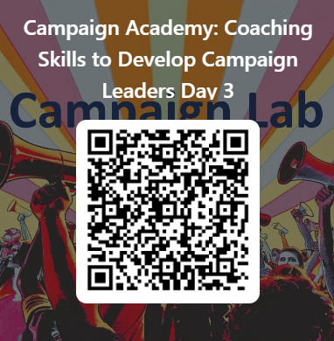
Give us Your Feedback Please

Slide 33
What is Campaign Lab?
Leadership Development through Peer Coaching
Campaign and Organizing Fundamentals: Tools and Training
Assessment, Evaluation, and Centering Equity
Strategizing and Collaboration
Notes:
Carrie- Shine up the slide

Slide 34
Experienced in leading campaigns?
Apply to be a Coach!
Do you want to build the power of your local?
Apply to the Campaign Lab.

