Slide 1
Campaign Academy:
Planning and Coalition Building
[location], 2026

Slide 2
Entry Activity

Slide 3

Campaign Academy
By attending this training, you confirm that you are either an NEA affiliate staff person or NEA member in good standing. The information you receive here is only for your use in your capacity as an NEA affiliate staff person or NEA member.
This presentation and its contents are confidential and may not be further distributed or passed on to any other person or published or reproduced, in whole or in part, by any medium or in any form, for any purpose unless written consent has been provided by Ellen Holmes. Audio/video recording, copying of slides, and the use of AI note-taking tools are prohibited without the written consent from Kyle Serrette. Violation of these terms may result in legal action.

Slide 4
Honoring This Space
We begin by acknowledging that through a history of colonization and brutality, we are currently on the traditional lands stewarded by generations of indigenous people.
We honor these indigenous people, all elders, past, present, and emerging. We are called to learn and share these learnings about this tribal history, culture, and contributions that have been suppressed in the telling of the story of what we now call the United States of America.

Slide 5

Key OUtcomes
Participants will understand: Why the Campaign Lab exists How the Campaign Lab operates to support and network local campaigns What is expected for participation in Planning and Coalition Building

Slide 6
Overall Agenda
Day 1
  7:30-8:30 Breakfast
  8:30-Noon Meeting
  12:00-1:00 Lunch
  1:00-4:30 Meeting
  4:30-5:00 Networking and Adjourn
Day 2
  7:30-8:30 Breakfast
  8:30-Noon Meeting
  12:00-1:00 Lunch
  1:00-4:30 Meeting
  4:30-5:00 Networking and Adjourn
Day 3
  7:30-8:30 Breakfast
  8:30-1:00 Meeting
  1:00 Adjourn, Lunch on your own

Slide 7
Today’s Agenda and Outcomes
  7:30-8:30 Breakfast
  8:30-9:00 Welcome
  9:00-10:15 World As It Should Be
  10:15-10:30 Break
  10:30-12:00 World As It Is
  12:00-1:00 Lunch
  1:00-2:00 Power Shield
  2:00-2:15 Break
  2:15-4:30 Power Shield, Pillars of Power
  4:30-5:00 Networking and Adjourn

Slide 8
Logistics to Remember
Questions to Ask
Bathroom
Materials
Food
Room Temperature
PEPs Portal

Slide 9

Community Agreements
Using Self-Awareness and Self-Knowledge
Listening for Understanding
Being Gracious
Staying Engaged
Being Open and Suspend Judgment
Saying “I”- tell your truth
Lean into Discomfort
Reaching Empathy
Expecting Non-Resolution and Non-Closure
*Adapted from “Embracing equity and inclusion”, Annie E. Casey Foundation
Notes:
Community Agreements for Our Time
Awareness and Self-Knowledge
This requires self-knowledge and self-awareness. Self-knowledge allows you to see what causes you pain and conflict and enables you to embrace your contradictions and inconsistencies. It allows the space to work on things about yourself that you are not happy with. In turn, self-knowledge helps to prevent you from projecting your negative aspects onto other people. Bringing your best self also requires that you have a positive attitude, are willing to deeply explore your perspectives and remain open to the perspectives and experiences of others.
Listening for Understanding
Be an active listener. Active listening involves paying full and careful attention to the other person, looking him or her in the eye, avoiding interruptions, reflecting your understanding, clarifying information, summarizing the other person’s perspectives and sharing your own. Remember that most people need time to open up and might not be willing to immediately share their personal stories, hopes, fears and/or concerns.
Being Gracious
Being kind is a vital way of bringing meaning to our own lives, as well as the lives of others. Kindness is about caring genuinely for others around you, wanting the best for them and recognizing in them the same wants, needs, aspirations and even fears that you may have. Being kind and generous allows us to communicate better with others, to be more self-compassionate and to be a positive force in other people’s lives. This includes following the COVID protocols that are in place to protect the health of this learning community.
Stay Engaged
Staying engaged requires you to be morally, emotionally, intellectually and socially involved in the conversation. Staying engaged means that you are listening with curiosity and willing to deepen your understanding. Staying engaged might also require you to sustain the conversation even when it gets uncomfortable or diverted. This also means a commitment to keeping your electronic communications to a minimum with folks not present in this learning community.
Be Open and Suspend Judgment
Listening with an open mind includes being receptive to the influence of others. You can suspend judgment by becoming aware of preconceived notions and listening to everything someone has to say before jumping to conclusions. Most importantly, suspending judgment also means listening to what the speaker has to say for understanding, not just to determine whether the speaker is right or wrong.
Say “I”- tell your truth
Speaking your truth in authentic and courageous conversations about race requires a willingness to take risks. It means that you will be absolutely honest and candid about your own thoughts, feelings, experiences and opinions and not just saying what you perceive others want to hear. Speaking your truth will require you to speak from the “first person” and use “I” statements.
Seek Discomfort
Leaning in to discomfort will require you to let go of racial understandings and stereotypes that you may be holding onto in order to move forward. Leaning in means that you will avoid judgment, assume positive intent and be open to the kernel of wisdom in each individual’s experiences. Leaning in to discomfort will require you to sit through moments of embarrassment, confusion, anxiety and/or fear.
Reaching Empathy
Empathy and compassion allow you to understand the other person’s point of view. When you are empathetic, you are more understanding, patient and kind. Expanding your capacity to feel empathy will also allow others to enter your circle of human concern.
Resolution and Closure
Expect and accept that there may not be closure. It is not likely that you will resolve your personal understanding about race or another person’s racial experience in a single conversation. The more you talk about race with another person, the more you learn and the more they will learn. Authentic and productive conversations about race are continuous and always evolving.
*Adapted from “Embracing equity and inclusion”, Annie E. Casey Foundation

Slide 11
Core Values
[Facilitators]

Slide 12
Core Values p.12
Core values are the fundamental beliefs of a person. These guiding principles dictate behavior and can help people understand the difference between right and wrong – These can often be expressed using one or two words.

Slide 13
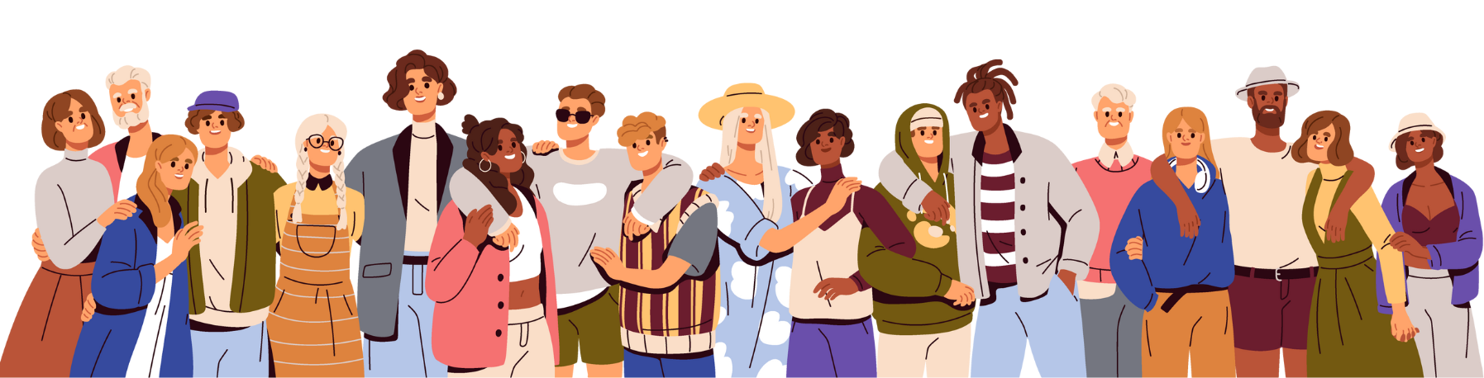
Sharing Values for Solidarity
Name
Pronouns
State or local
Core Value – One or two words that describes a fundamental belief held by you
15 Seconds Each
Core values are the fundamental beliefs of a person. These guiding principles dictate behavior and can help people understand the difference between right and wrong – These can often be expressed using one or two words.

Slide 14
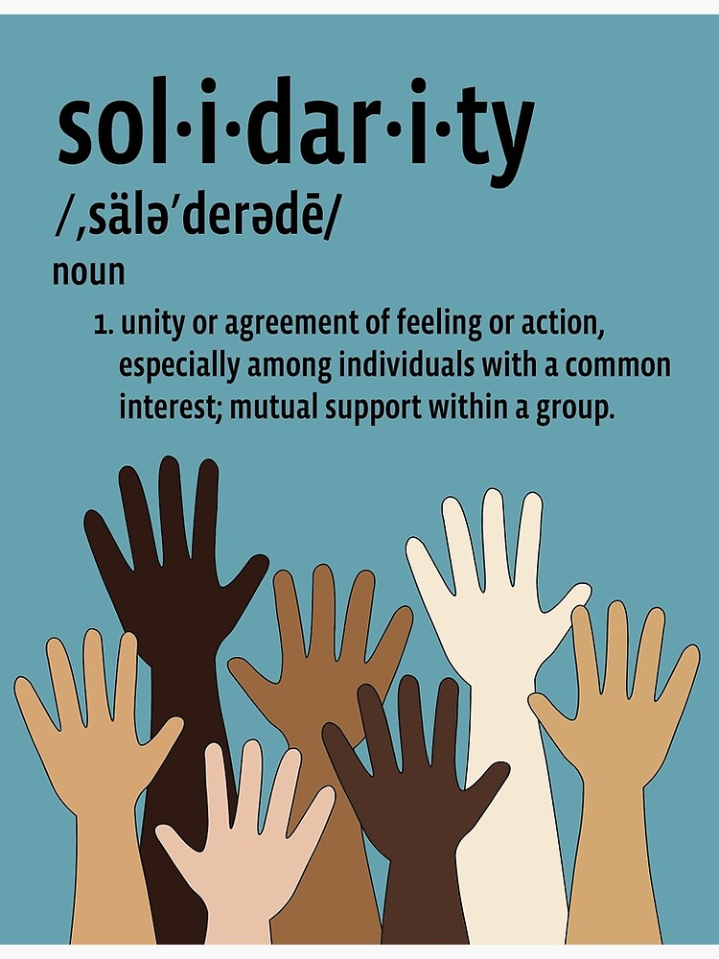
Core Values
Core Values are critical for building solidarity in our work.

Slide 15

Core Values as a Work Life Balancer p. 12
Reflecting on work and your life
  What are the core values that drive my work and life?
  How am I living and working with integrity towards these values?
  What can I do to improve that integrity?

Slide 16

Key Point
Our work can be balanced by reflecting on our values.
Values are at the core of relationships, community and solidarity.

Slide 17
The World As It Could Be
[Facilitators]

Slide 18
Let's build a school.
What does a loving school look like?

Slide 19
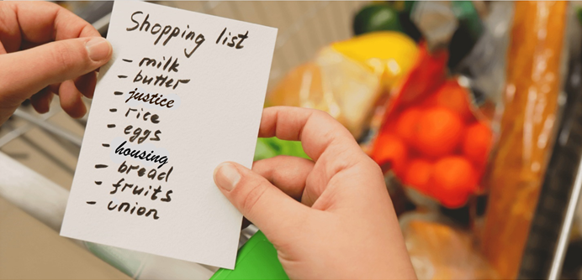
What do we need to build that school?

Slide 20
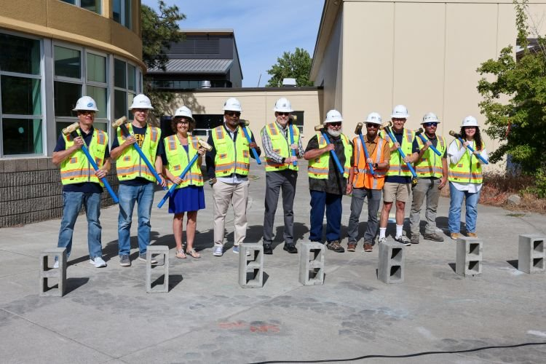
Who do we need to build that power?

Slide 21
Club to Fighting Union?
Facilitators

Slide 22

What power do we have right now?

Slide 24
Break

Slide 25
Centering Equity
[Facilitators]

Slide 26
Equity Tool

Slide 27
6 Box SWOT
[Facilitators]

Slide 28
6 Box SWOT

Slide 29
Lunch

Slide 30
Power Shield
[Facilitators

Slide 31
Definition of Privilege
A special right, advantage, or immunity granted or available only to a particular person or group

Slide 32
Race
Class
Gender
Social constructs that can weaponize privilege.

Slide 33
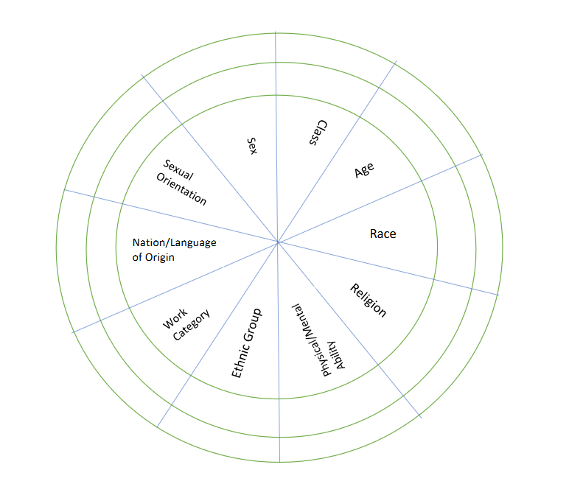
Power Shield
Power
Shield
p. 19
Sex
Sexual Orientation
Notes:
We are going to take a minute to look intentionally at our identities, and how they relate to power.
Stations around room for activity: Gender/Presentation, Race, Sexual Orientation, Ethnicity, Religion, Class, Nation/Language of Origin, Physical/Mental Ability, Age, Work Category
Challenge by choice; not meant to out someone.
Which identity do you think about the most?
…the least?
Which identity are people most surprised to learn about it?
Which identify brings you the most discomfort or confusion?

Slide 34
Power Shield Activity p.19
Activity is based on Power Flower
10 Segments:
Sex
Class
Age
Race
Religion
Physical/ Mental Ability
Ethnic Group
Work Category
Nation/ Language of Origin
Sexual Orientation

Slide 35
Power Shield Activity
Analysis of Power and Privilege as Individuals
Inner Ring – Dominant Identities
Outer Ring – Oppressed Identities
First on your own, then discuss as a group.

Slide 36
Power Shield Activity
On your own:
Mark the inner or outer ring of each trait to describe your identity.
How many of your segments are not dominant, meaning you do not share those areas of power conferred by society?
What insight does this provide on how you have been treated as a person of privilege or a marginalized person?
Which identity brings you the most discomfort or confusion?

Slide 37
Power Shield Activity
Together:
Which identity of yours do you think about the most?
Which identity of yours do you think about least?
Why don’t you have to think about it as much?
What could that mean in terms of your identity?
How can you leverage that power/privilege for marginalized people in your scope of influence?

Slide 38
Power Shield Activity
Transfer your dots to the group Power Shield.
What does the composite picture tell us about who we are as a group?
Who is missing or invisible?
How does that connect to our core values?
If one of your schools is in a neighborhood that has changed quite substantially in recent years, what kind of pattern might your “members” present, and how much would it differ from the parents and students in that school?
What implications would this pose to that school’s ability to organize in that community?
In what places are there gaps in your power, and what coalitions could you make to harness an ally’s power?
How can you flex areas of privilege to empower marginalized allies in a coalition? Who can you empower in a coalition?

Slide 39
Key Points
There are intentionally built systems that privilege some and oppress others.
We each have an identity that allows us to be privileged, and each has been oppressed due to an identity.
We have the ability to use our agency to act and unify to create and use power.

Slide 40
Break

Slide 41
Expressions of Oppression and
Pillars of Power
Facilitators

Slide 42
Quadrants of Expressions of Oppressions p.20
I n d i v i d u a l | Internalized Oppression lies within individuals. These are our private beliefs and biases about others, influenced by our culture, that reside inside our minds. | S y s t e m i c | Institutional Oppression occurs within institutions and systems of power. It is the norms, policies and practices that are structured into political, societal and economic institutions that have the net effect of imposing oppressive conditions, denying rights, opportunity, and equality to identifiable groups.
 | Interpersonal Oppression occurs between individuals. Once we bring our private beliefs into our interactions with others, we are now in the interpersonal realm. |  | Structural Oppression is bias across institutions and society. It’s the cumulative and compounded effects of an array of factors that systematically privilege some and disadvantage others.
Notes:
10:45-11:30 Ben

Slide 43
Key Points
There are no hard and fast lines between the quadrants and changing one can affect another. ​
​
​The way to effect change is by addressing institutionalized and structural oppression – this is where injustice lives.
This framework helps us think about the size of the solution we need to fight injustice at a particular quadrant.
Using an intersectional lens alongside the understanding of the quadrants of expressions of oppression helps us decide the scope of the solution we need and the power it will take to implement that solution.

Slide 44
Pillars of Power

Slide 45
Statement One
“The most common way people
give up their power is by thinking
they don’t have any.”
-Alice Walker, author of The Color Purple

Slide 46
Statement Two
Political leaders don't implement their policies, plans, and repression.
People do.

Slide 47

Pillars of Power
Tool to analyze and identify how your target maintains their power
Powerful figures are supported by institutions
Individuals within these institutions give their consent to support people in power.
Individuals within those institutions can also withdraw their support, eventually toppling the leader
Can also be used to analyze an injustice

Slide 48
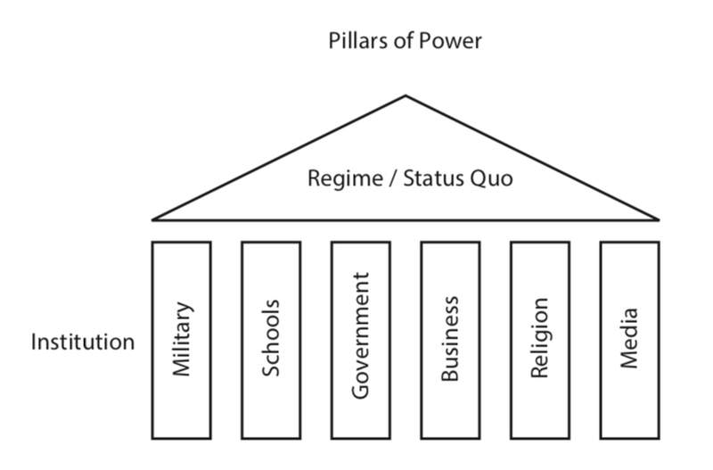

Slide 49
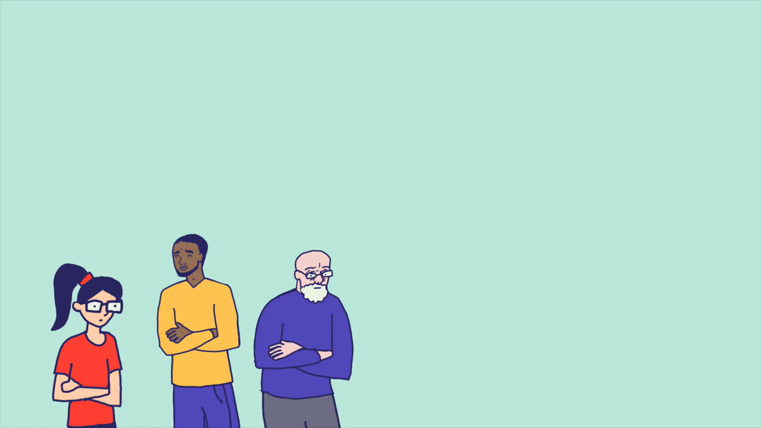

Slide 50
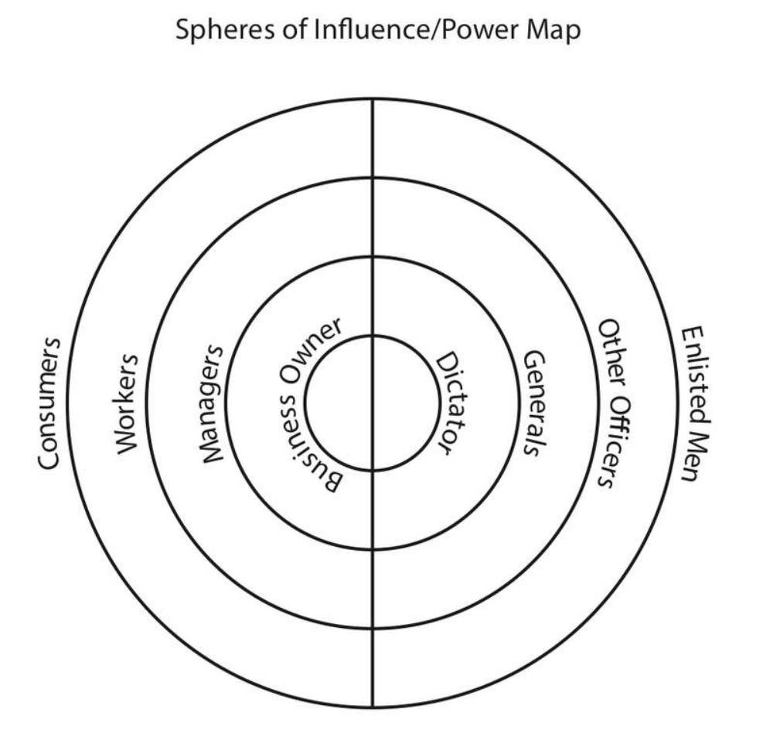
Eroding the Pillars
Who could you influence?
Who is out of your reach?

Slide 51
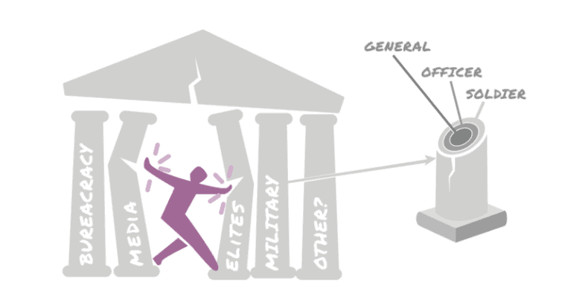
Question...
Do you have to reach ALL the people in each section?
Do you have to reach the people at the center of the pillar?

Slide 52
What Works
Forcing a Crisis- Actions that force those in power to act in ways that are in direct conflict with what most people think is acceptable
  Example: Civil Disobedience
Positive Visions
  Example: The Schools our Communities Deserve
Creating easy ways for people to join you
  Example: Regular protests

Slide 53

Key Points
Power holders in non-violent situations maintain power because the majority of the people CHOOSE to let them
A movement is successful when it convinces the majority to withhold that agreement to submit.
It does not require all the pillars to fall for those in power to feel enough pressure to change the unjust policy

Slide 54
Group Work!!
Campaign Teams
Pillars of Support Content Sheet
Name the Injustice of your Issue
Name the “Power Holders” for this issue
Identify the Pillars of Support that exist to keep this Injustice going.
AND identify the pillars that you YOUR TEAM believes they can win over or neutralize.
Create one dissection of one pillar you think you can will over

Slide 55
Example
Attacks on Immigrant Communities
Federal Law Enforcement and Military
Media and News Outlets
Governor
Local Police
Employers
School System
Healthcare

Slide 56
Example
Attacks on Immigrant Communities
Federal Law Enforcement and Military
Media and News Outlets
Governor
Local Police
Employers
School System
Healthcare

Slide 57
Neutralized Pillars- Targeting Immigrant Families
Texas Governor and
Trump Republicans
Immigration Customs Enforcement
Legislature and the Courts – Senator Menendez
Healthcare – Local Paid Sick-Leave for All Workers
Media and News Outlets – FaceBook
School System- Police Handbook
Police – Cite and Release
Employers

Slide 58
Pillars of Power Report Out
Team Reports– (3 Mins or less each)
Who are the powerholders?
What are the pillars of support?
Which pillars can you neutralize or turn – by doing what?
Debrief
What stands out to you?
Are there any questions you would like to ask a team?
Is there any idea you would like to hold up as a an awesome idea?

Slide 59
Key Points
Coalitions are a part of your structure that you should consider
We only have to neutralize the pillars of support

Slide 60
Theory of Change &
Organizing Statement
Facilitators

Slide 61
So far we have discussed:
Who our people are
Our collective resources, power, and influence
The issue we want to change
The power holders over that issue
The level of pressure needed to win our issue from those power holders
Now we draw all of that together into our goal.

Slide 62
Remember, a strong goal:
Is measurable
Is motivating
Contributes to a strategic change
Strengthens our people's capacity to act
Maximizes our strengths and oppositions' weakness

Slide 63
Once your team has a clear goal, create your theory of change like this:
Theory of Change
We are organizing [WHO: our people]... to win [WHY: the purpose, grounded in your shared values]... by demanding [WHAT: measurable, strategic outcome] From [TARGET] by [WHEN: date]

Slide 64
When your theory of change is clear, you should be able to state it simply like this:
ORGANIZING STATEMENT
Hey [Target], We demand [Strategic Outcome] by [Date] because [Purpose/Values]!

Slide 65
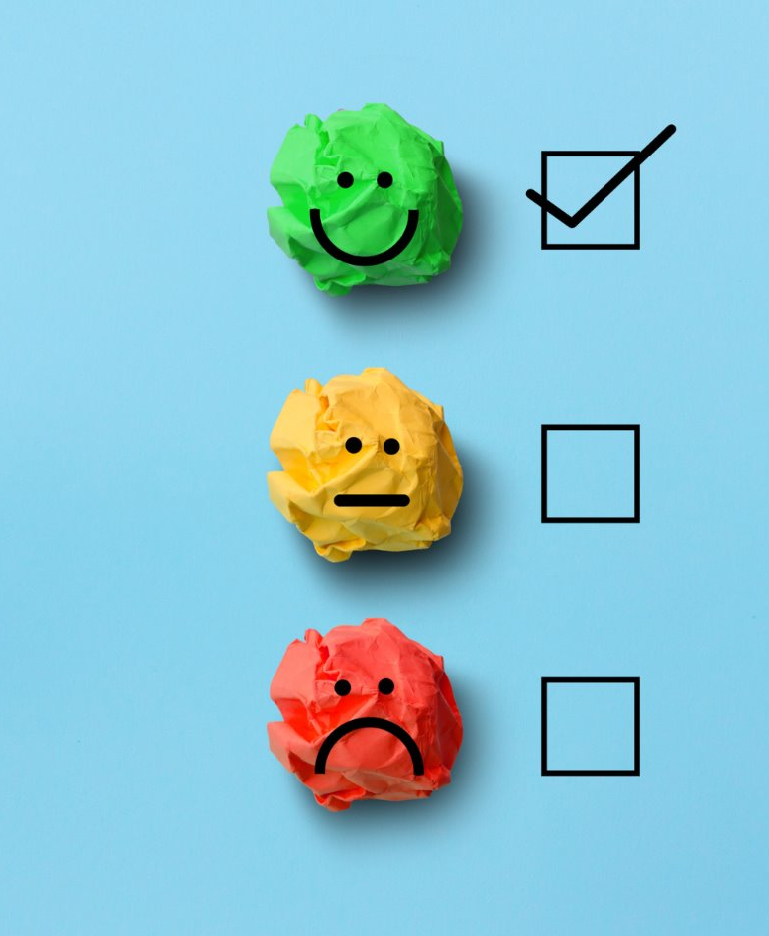
Evaluation Time and Evening Email

Slide 66

Choice Time

