Slide 1
Campaign Academy:
Planning and Coalition Building
[location], 2026

Slide 2
Feedback on Feedback

Slide 3

Today’s Agenda and Outcomes
  7:30-8:30 Breakfast
  8:30-9:00 Feedback and Review
  9:00-10:15 Spectrum of Allies
  10:15-10:30 Break
  10:30-12:00 Planning/Community Mapping
  12:00-1:00 Lunch
  1:00-2:00 Case Studies
  2:00-2:15 Break
  2:15-4:30 Personal and Public Narrative
  4:30-5:00 Networking and Adjourn

Slide 4

Community Agreements
Using Self-Awareness and Self-Knowledge
Listening for Understanding
Being Gracious
Staying Engaged
Being Open and Suspend Judgment
Saying “I”- tell your truth
Lean into Discomfort
Reaching Empathy
Expecting Non-Resolution and Non-Closure
*Adapted from “Embracing equity and inclusion”, Annie E. Casey Foundation
Notes:
Community Agreements for Our Time
Awareness and Self-Knowledge
This requires self-knowledge and self-awareness. Self-knowledge allows you to see what causes you pain and conflict and enables you to embrace your contradictions and inconsistencies. It allows the space to work on things about yourself that you are not happy with. In turn, self-knowledge helps to prevent you from projecting your negative aspects onto other people. Bringing your best self also requires that you have a positive attitude, are willing to deeply explore your perspectives and remain open to the perspectives and experiences of others.
Listening for Understanding
Be an active listener. Active listening involves paying full and careful attention to the other person, looking him or her in the eye, avoiding interruptions, reflecting your understanding, clarifying information, summarizing the other person’s perspectives and sharing your own. Remember that most people need time to open up and might not be willing to immediately share their personal stories, hopes, fears and/or concerns.
Being Gracious
Being kind is a vital way of bringing meaning to our own lives, as well as the lives of others. Kindness is about caring genuinely for others around you, wanting the best for them and recognizing in them the same wants, needs, aspirations and even fears that you may have. Being kind and generous allows us to communicate better with others, to be more self-compassionate and to be a positive force in other people’s lives. This includes following the COVID protocols that are in place to protect the health of this learning community.
Stay Engaged
Staying engaged requires you to be morally, emotionally, intellectually and socially involved in the conversation. Staying engaged means that you are listening with curiosity and willing to deepen your understanding. Staying engaged might also require you to sustain the conversation even when it gets uncomfortable or diverted. This also means a commitment to keeping your electronic communications to a minimum with folks not present in this learning community.
Be Open and Suspend Judgment
Listening with an open mind includes being receptive to the influence of others. You can suspend judgment by becoming aware of preconceived notions and listening to everything someone has to say before jumping to conclusions. Most importantly, suspending judgment also means listening to what the speaker has to say for understanding, not just to determine whether the speaker is right or wrong.
Say “I”- tell your truth
Speaking your truth in authentic and courageous conversations about race requires a willingness to take risks. It means that you will be absolutely honest and candid about your own thoughts, feelings, experiences and opinions and not just saying what you perceive others want to hear. Speaking your truth will require you to speak from the “first person” and use “I” statements.
Seek Discomfort
Leaning in to discomfort will require you to let go of racial understandings and stereotypes that you may be holding onto in order to move forward. Leaning in means that you will avoid judgment, assume positive intent and be open to the kernel of wisdom in each individual’s experiences. Leaning in to discomfort will require you to sit through moments of embarrassment, confusion, anxiety and/or fear.
Reaching Empathy
Empathy and compassion allow you to understand the other person’s point of view. When you are empathetic, you are more understanding, patient and kind. Expanding your capacity to feel empathy will also allow others to enter your circle of human concern.
Resolution and Closure
Expect and accept that there may not be closure. It is not likely that you will resolve your personal understanding about race or another person’s racial experience in a single conversation. The more you talk about race with another person, the more you learn and the more they will learn. Authentic and productive conversations about race are continuous and always evolving.
*Adapted from “Embracing equity and inclusion”, Annie E. Casey Foundation

Slide 5

Get Graphic About Day 1
Each table will have 15 minutes to create a poster that summarizes the key points learned the previous day.
There are 3 rules:
Only one sheet of chart paper can be used,
Only pictures can be used, no words, letters or numbers,
This must be a joint effort with all table members contributing.

Slide 6
Spectrum of Allies
[Facilitators]

Slide 7
Keep in Mind…
Race, class and gender dynamics, disparities, and divisions permeate our society, communities, schools, and classrooms. Systemic oppression is so deeply rooted in our history, culture, and institutions that there is no escaping it. Visible or not, the impacts are ever-present.
Race, class, and gender justice is the systematic fair treatment of people of all races, resulting in equitable opportunities and outcomes for all. It is not just the absence of discrimination and inequities, but also the presence of deliberate systems and supports to achieve and sustain race, class, and gender equity through proactive and preventative measures. To continually and systematically keep equity in your work you have to use a Race, Class, and Gender Equity tool, or lens.

Slide 8
Keep it in mind…
Despite structural oppression, non-PWIs have been some of the greatest success stories of our nation, and some of the most under-represented by our unions.
They succeed because:
    Provide internal community support
    Offer unparalleled representation and mentorship
    Close relationships
    Focused on leadership beyond school
  Successful organizing campaigns need to match their strengths

Slide 9

Spectrum of Allies

Slide 10

Spectrum of Allies Part 1
  Active allies: people who agree with you & are organizing alongside you
  Passive allies: people who agree but aren't doing anything about it (yet!)
  Neutrals: people who aren't sure, or are unengaged (they might just not know about you yet)
  Passive opponents: people who disagree, but aren't trying to stop you
  Active opponents: people who have done something to prevent you from reaching your goal

Slide 11
Share Out Spectrum of Allies

Slide 12
Focusing your tactics matters
Only the Opposition – cynicism
Only the Active Allies – stagnation
Generalizations about Slices – missed opportunities
DO FOCUS ON THE PASSIVE ALLIES
  These are folks who know or care about what you’re up to, but aren’t doing anything about it! Give them a chance to participate and build power with you.
THE GOOD NEWS
  It is only necessary to move some or all of the pie wedges one step in your direction. If we shift each wedge one step, we are likely to win, even if the hardliners on the opponent’s side don’t budge.

Slide 13
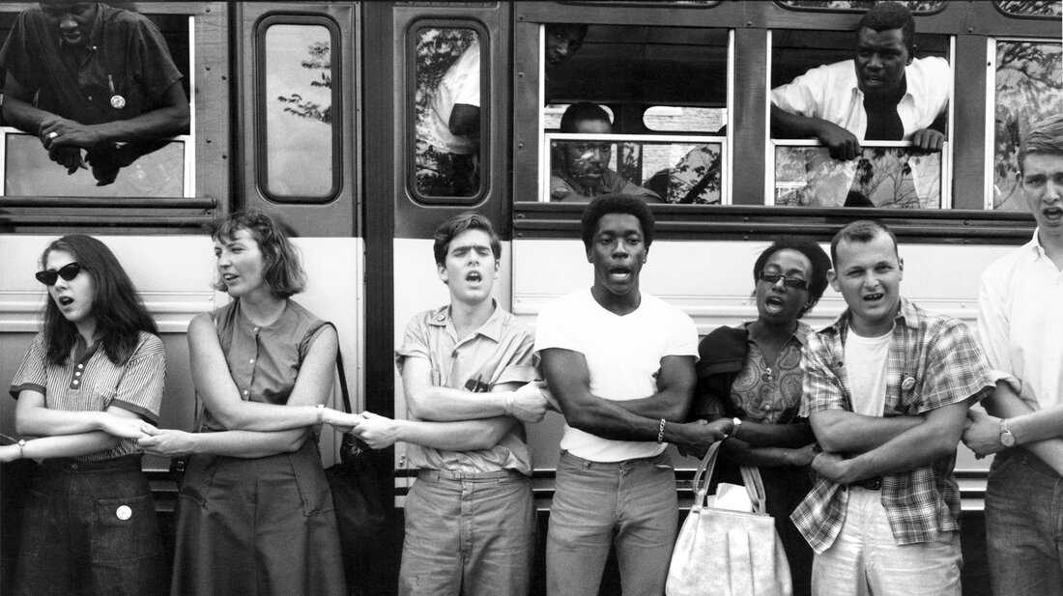
An example from history – Freedom Summer

Slide 14
Spectrum of Allies Part 2
Develop a convincing argument or values based narrative that will appeal to each wedge.
Design one tactic for each wedge that you can invite them to participate in that will move that wedge one closer to us.
Design one small achievable ask to engage one individual from that wedge to move closer to you

Slide 15
Team Pair Share of Spectrum of Allies

Slide 16
Spectrum of Allies Debrief – Whole Group
How did it feel to present your arguments for how to move your wedges?
What is something new you learned from this or from another team?
What do you think you could apply to your current work?

Slide 17
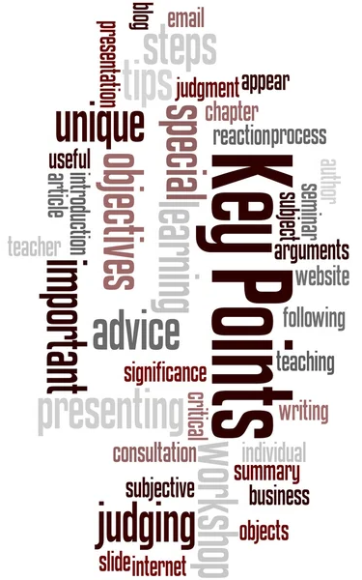
It is only necessary to move some or all of the pie wedges one step in your direction.
If we shift each wedge one step, we are likely to win, even if the hardliners on the opponent’s side don’t budge.

Slide 18
Break

Slide 19
Strategic Planning
[Facilitators]

Slide 20
Vision + Goals = Strategic Planning
Create a shared vision that engages your base.
Chip away at the vision by achieving goals that build your base enough to win BIG
Notes:
r

Slide 21
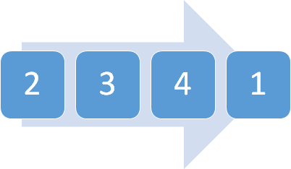
Vision + Goals = Strategic Planning
Goal that fundamentally shifts money and power (achieves part of the vision)
Current campaign goal
3-4. Goals on the horizon that bring in coalitions and community support
Notes:
r

Slide 22
Community Mapping
Facilitators

Slide 23
Lunch

Slide 24
Case Studies
Facilitators

Slide 25
Break

Slide 26
Public Narrative Strategy
Facilitators

Slide 27

WHAT DOES STORYTELLING HAVE TO DO WITH LEADERSHIP?

Slide 28
THINGS TO REMEMBER:
Everyone has a story
Your story is always a work in progress
In depth, meaningful feedback is key to developing your story (we’ll be doing this later!)
Notes:
Ali
Everyone has a story of self. Our goal today is to find them. This might come naturally to some and be more of a challenge for others. We’re here to help each other find our stories and coach each other through making them stronger.
Your story is never “finished” or “perfect.” It’s always a work in progress that you’ll constantly define as you have new experiences, get good coaching from others, and work to make the change you want to see in the world.

Slide 29

PUBLIC NARRATIVE:
WHY DO WE TELL STORIES?

Slide 30


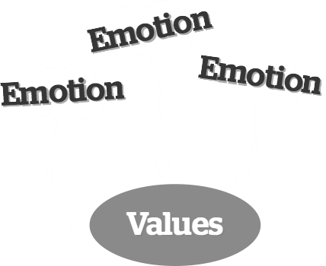
STORIES HELP US FEEL THE EMOTIONS THAT REMIND US OF OUR VALUES
Notes:
Give examples of values

Slide 31


STRATEGY
ANALYSIS
TACTICS
HOW
Notes:
The first is through your head, understanding how the world works
Things like strategy, analysis, and tactics come from our heads

Slide 32

STORY
MOTIVATION
EMOTION
VALUES
WHY
Notes:
The second is through our hearts, understanding why the world works the way that it does
Things like story, motivation, and emotion come from our hearts

Slide 33

HOW
WHY
ACTION!
Notes:
The combination of the two, head and heart, leads to action
This is what the public narrative of story of self, us, and now is about.
It’s about combining our heads and our hearts to lead towards action

Slide 34

URGENCY
ANGER
Inertia
Apathy
STAGNATION
HOPE
MOTIVATION
Fear
Isolation
SOLIDARITY
Self Doubt
YCMaD
Notes:
As human beings we feel lots of different emotions
These emotions can oftentimes be broken down into two general categories “stagnation” and “motivation”
Let’s look at the types of stagnated emotions. Show of hands, Who’s ever felt some of these?
Let’s look at motivated emotions. Who’s ever felt some of these?
Popcorn answers from the group, “What moves us from stagnation to motivation?”
Take answers from the group looking to lead them towards stories being the key
Trainer’s Note: Check out how Joy Cushman trains slides 21 – 22 at: http://neworganizing.com/toolbox/training/story-of-self/1 time marker 9:15
Trainer’s Note: YCMD stands for “You Can Make A Difference”

Slide 35
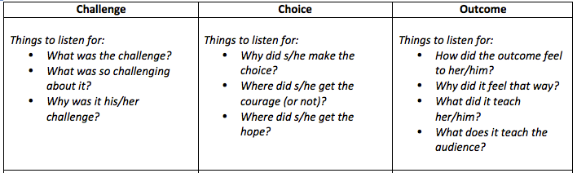
Focus: Story of Self
Notes:
There doesn’t have to be conflict light a fight but a challenge that leads to a choice and an outcome that is a result of that choice.
So now we’re going to watch that example Story of Self. Follow along and take notes on the worksheet on page 7 of your participant guide.
Trainer’s Note: Story of self example can be viewed at: http://www.youtube.com/watch?v=H0wq5VVxAFk
Trainers Note: After viewing video give participants 4 minutes to complete worksheet.
Take popcorn answers from group on following questions:
What was the challenge?
What was the choice?
What was the outcome?
What values did this story convey? How? By telling or showing?
What details or images in particular reflected those values?

Slide 36
Video: Jacquinette Brown
Link: https://leadingchangenetwork.org/wp-content/uploads/2021/08/Jacquinette-Brown-1.mp4
Notes:
How did her choice affect the outcome? What are her values

Slide 37
Planning Your Story of Self
Notes:
Ask who has taken a story of self training and have the spread out amongst people who have not taken the training
So now we’re going to watch that example Story of Self. Follow along and take notes on the worksheet on page 7 of your participant guide.
Trainer’s Note: Story of self example can be viewed at: http://www.youtube.com/watch?v=H0wq5VVxAFk
Trainers Note: After viewing video give participants 4 minutes to complete worksheet.
Take popcorn answers from group on following questions:
What was the challenge?
What was the choice?
What was the outcome?
What values did this story convey? How? By telling or showing?
What details or images in particular reflected those values?

Slide 38
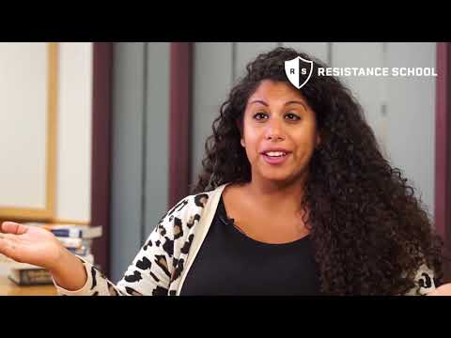
Coaching Tips
Uplift strong story moments.
Guidepost - be clear what element you will focus coaching on.
Ask “when” to surface story moments.
Pull out specific details.
Ask questions to link choice to hope.
Wrap up - reiterate main coaching points.

Slide 39
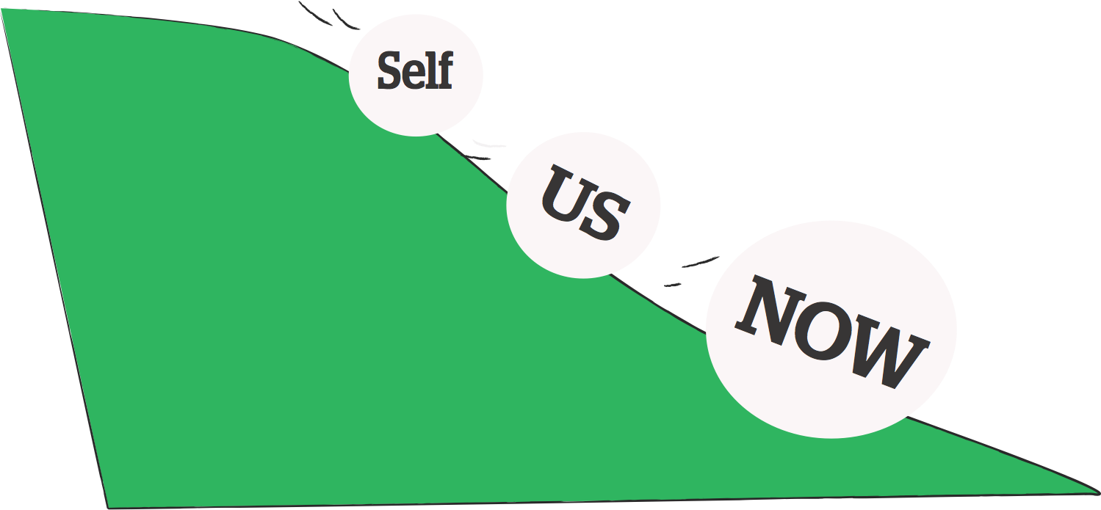
3 Parts of Public Narrative

Slide 40

Will you join him? Pg 11

Slide 41
What is a narrative?
A collection of related stories and content that are shared and shaped over time to represent a central idea or belief.
Illegal Aliens – Undocumented – Asylum Seekers - Immigrants
Notes:
Narratives are adaptable to respond to events. New characters can be added over time. They are overarching themes (e.g. “We must support educators who are demoralized, leaving the profession, and need solutions.”) that encompass our core beliefs.

Slide 42
Story of Self
Creating a Personal Narrative
Succinct, powerful statement that engages others
It sets, defines and aligns values, beliefs, goals and actions into a narrative.

Slide 43





Values
What matters to you?
What calls you to lead?
What defines you?
Story of Self Pathway
Challenges
What made it so challenging?
Why did you feel it was a challenge?
Choice
What did you decide to do?
What gave you the courage to do it?
What gave you the hope to do it?
Outcomes
What happened?
What did you learn?
What do you want us to learn?
Notes:
Ellen

Slide 44
Coaching Video

Slide 45

How to coach story of self page
Giving Feedback:
  Were each of these explicit?
    Challenge, Choice, Outcome
Could you identify with their values? Where did they come from?
  Were the details vivid in ways that helped you identify with what s/he was feeling?
Coach … don’t interview
Notes:
When it’s your turn to coach, remember some key points. People’s stories are usually fascinating, and often they make us feel emotional. If that happens, that means it’s a great story! But when our job is to coach, we have to resist the urge to interview the person, to ask them a lot of questions to give us even more understanding of their story. Because we’re all leaders, we’re also probably curious to know more about how that story lead to successes. Those are all great things to explore at the reception tonight! ☺ But as coaches, our job right now is to HELP them improve their Story of Self. We can do that by listening for these points and giving the storyteller explicit feedback along these lines.
Let’s count to 11 … that should give us 11 groups of three. Each person will have 3 minutes to tell their story, and then you’ll have 3 minutes to give feedback. So that will be 20 minutes total before we come back together. 11:08AM – 11:30AM

Slide 46

Story of Self use guide
Use your handout to develop your story of self
Share your story with your the group and get feedback

Slide 47
Values
What matters to you?
What calls you to lead?
What defines you?
Story of Self Pathway
Challenges
What made it so challenging?
Why did you feel it was a challenge?
Choice
What did you decide to do?
What gave you the courage to do it?
What gave you the hope to do it?
Outcomes
What happened?
What did you learn?
What do you want us to learn?
Notes:
Ellen

Slide 48

Story of Self Rock Stars…
Values
Challenge
Choice
Outcome
Notes:
11:30 – 11:45AM

Slide 49

Closing
I used to think….
Now I know…

Slide 50

Closing the Day
Reminders on traveling...
Housekeeping

Slide 51
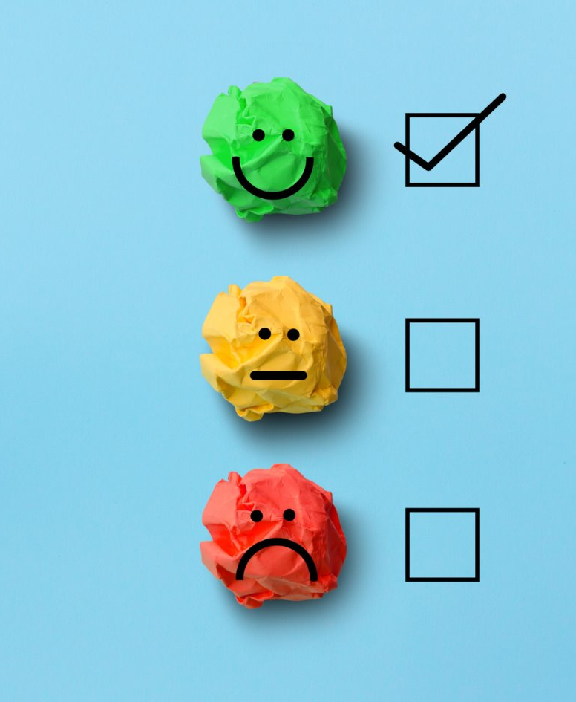
Evaluation Time and Evening Email

Slide 52

Choice Time

