Slide 1
Campaign Academy:
Planning and Coalition Building
[location], 2026

Slide 2
Feedback on Feedback

Slide 3

Today’s Agenda and Outcomes
  7:30-8:30 Breakfast
  8:30-9:00 Feedback and Review
  9:00-11:00 Building a Plan
  11:00-11:15 Break
  11:15-12:45 Sharing Plans and Feedback
  12:45-1:00 Ending It Right
  1:00 Lunch and Adjourn

Slide 4
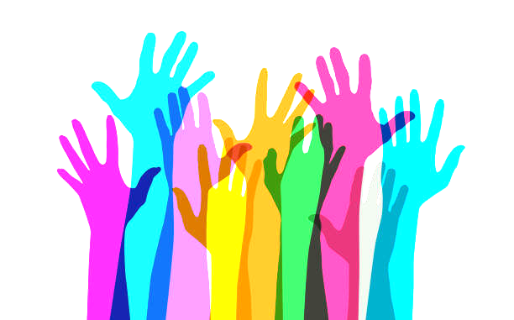
Community Agreements
Using Self-Awareness and Self-Knowledge
Listening for Understanding
Being Gracious
Staying Engaged
Being Open and Suspend Judgment
Saying “I”- tell your truth
Lean into Discomfort
Reaching Empathy
Expecting Non-Resolution and Non-Closure
*Adapted from “Embracing equity and inclusion”, Annie E. Casey Foundation
Notes:
Community Agreements for Our Time
Awareness and Self-Knowledge
This requires self-knowledge and self-awareness. Self-knowledge allows you to see what causes you pain and conflict and enables you to embrace your contradictions and inconsistencies. It allows the space to work on things about yourself that you are not happy with. In turn, self-knowledge helps to prevent you from projecting your negative aspects onto other people. Bringing your best self also requires that you have a positive attitude, are willing to deeply explore your perspectives and remain open to the perspectives and experiences of others.
Listening for Understanding
Be an active listener. Active listening involves paying full and careful attention to the other person, looking him or her in the eye, avoiding interruptions, reflecting your understanding, clarifying information, summarizing the other person’s perspectives and sharing your own. Remember that most people need time to open up and might not be willing to immediately share their personal stories, hopes, fears and/or concerns.
Being Gracious
Being kind is a vital way of bringing meaning to our own lives, as well as the lives of others. Kindness is about caring genuinely for others around you, wanting the best for them and recognizing in them the same wants, needs, aspirations and even fears that you may have. Being kind and generous allows us to communicate better with others, to be more self-compassionate and to be a positive force in other people’s lives. This includes following the COVID protocols that are in place to protect the health of this learning community.
Stay Engaged
Staying engaged requires you to be morally, emotionally, intellectually and socially involved in the conversation. Staying engaged means that you are listening with curiosity and willing to deepen your understanding. Staying engaged might also require you to sustain the conversation even when it gets uncomfortable or diverted. This also means a commitment to keeping your electronic communications to a minimum with folks not present in this learning community.
Be Open and Suspend Judgment
Listening with an open mind includes being receptive to the influence of others. You can suspend judgment by becoming aware of preconceived notions and listening to everything someone has to say before jumping to conclusions. Most importantly, suspending judgment also means listening to what the speaker has to say for understanding, not just to determine whether the speaker is right or wrong.
Say “I”- tell your truth
Speaking your truth in authentic and courageous conversations about race requires a willingness to take risks. It means that you will be absolutely honest and candid about your own thoughts, feelings, experiences and opinions and not just saying what you perceive others want to hear. Speaking your truth will require you to speak from the “first person” and use “I” statements.
Seek Discomfort
Leaning in to discomfort will require you to let go of racial understandings and stereotypes that you may be holding onto in order to move forward. Leaning in means that you will avoid judgment, assume positive intent and be open to the kernel of wisdom in each individual’s experiences. Leaning in to discomfort will require you to sit through moments of embarrassment, confusion, anxiety and/or fear.
Reaching Empathy
Empathy and compassion allow you to understand the other person’s point of view. When you are empathetic, you are more understanding, patient and kind. Expanding your capacity to feel empathy will also allow others to enter your circle of human concern.
Resolution and Closure
Expect and accept that there may not be closure. It is not likely that you will resolve your personal understanding about race or another person’s racial experience in a single conversation. The more you talk about race with another person, the more you learn and the more they will learn. Authentic and productive conversations about race are continuous and always evolving.
*Adapted from “Embracing equity and inclusion”, Annie E. Casey Foundation

Slide 5
Building a Plan: Elements and Expectations
[Facilitators]

Slide 6
Group Work Time
[Facilitators]

Slide 7
Break

Slide 8
Gallery Walk
[Facilitators]

Slide 9
Group Presentations
[Facilitators]

Slide 10
Debrief
[Facilitators]

Slide 11
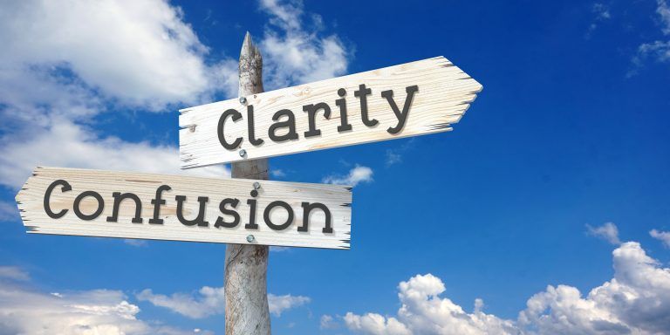
Closing the Day
Reminders on traveling...
Housekeeping

Slide 12
Evaluation and Lunch

