Slide 1
Pillars of Power
Amanda

Slide 2
Statement One
“The most common way people
give up their power is by thinking
they don’t have any.”
-Alice Walker, author of The Color Purple

Slide 3
Statement Two
Political leaders don't implement their policies, plans, and repression.
People do.

Slide 4
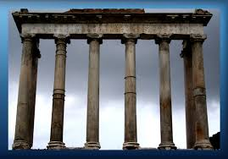
Pillars of Power
Tool to analyze and identify how your target maintains their power
Powerful figures are supported by institutions
Individuals within these institutions give their consent to support people in power.
Individuals within those institutions can also withdraw their support, eventually toppling the leader
Can also be used to analyze an injustice

Slide 5
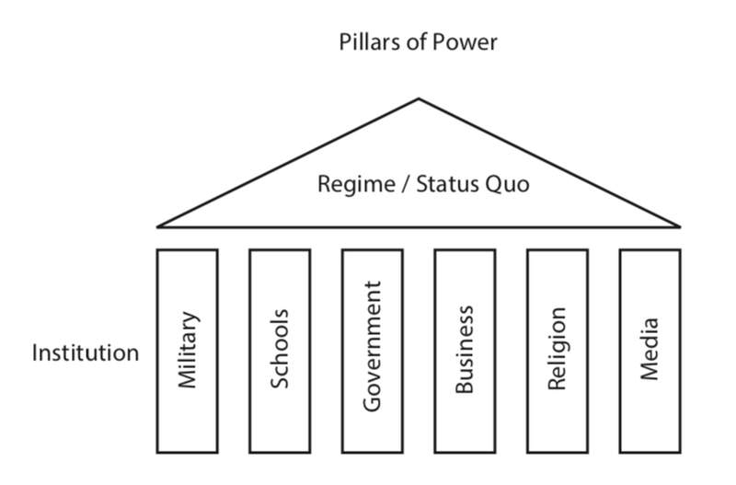

Slide 6


Slide 7
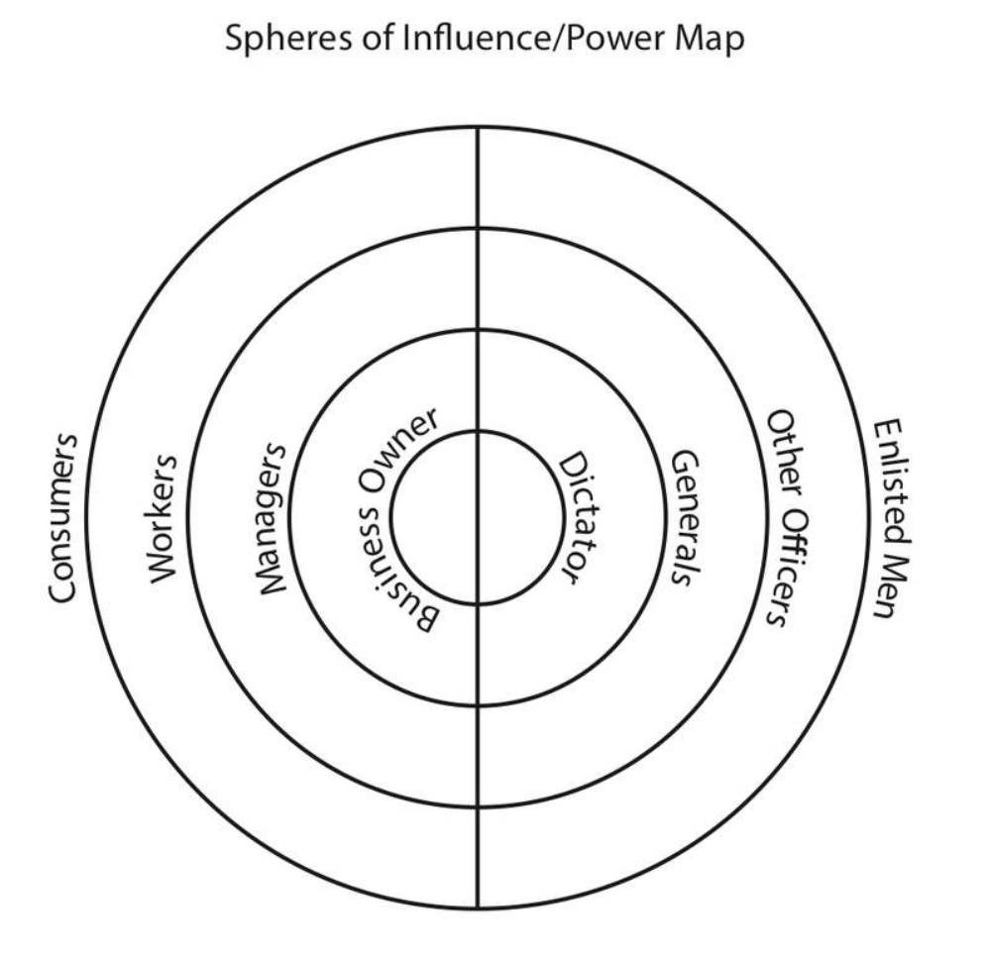
Eroding the Pillars
Who could you influence?
Who is out of your reach?

Slide 8
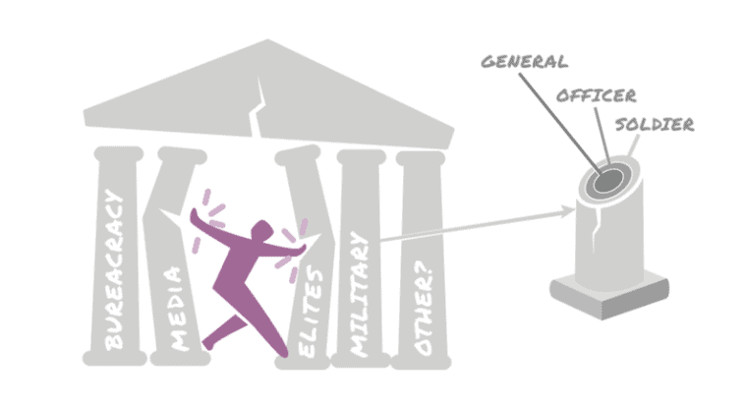
Question...
Do you have to reach ALL the people in each section?
Do you have to reach the people at the center of the pillar?

Slide 9
What Works
Forcing a Crisis- Actions that force those in power to act in ways that are in direct conflict with what most people think is acceptable
  Example: Civil Disobedience
Positive Visions
  Example: The Schools our Communities Deserve
Creating easy ways for people to join you
  Example: Regular protests

Slide 10

Key Points
Power holders in non-violent situations maintain power because the majority of the people CHOOSE to let them
A movement is successful when it convinces the majority to withhold that agreement to submit.
It does not require all the pillars to fall for those in power to feel enough pressure to change the unjust policy

Slide 11
Group Work!!
Campaign Teams
Pillars of Support Content Sheet (page 26-27)
Name the Injustice of your Issue
Name the “Power Holders” for this issue
Identify the Pillars of Support that exist to keep this Injustice going.
AND identify the pillars that you YOUR TEAM believes they can win over or neutralize.
Create one dissection of one pillar you think you can will over

Slide 12
Targeting Immigrant Families
Texas Governor and
Trump Republicans
Legislature and the 5th Circuit Court of Appeals
Immigration Customs Enforcement
Media and News Outlets
Police
Employers
School System
Healthcare

Slide 13
Neutralized Pillars- Targeting Immigrant Families
Texas Governor and
Trump Republicans
Immigration Customs Enforcement
Legislature and the Courts – Senator Menendez
Healthcare – Local Paid Sick-Leave for All Workers
Media and News Outlets – FaceBook
School System- Police Handbook
Police – Cite and Release
Employers

Slide 14
Pillars of Power Report Out
Team Reports– (3 Mins or less each)
Who are the powerholders?
What are the pillars of support?
Which pillars can you neutralize or turn – by doing what?
Debrief
What stands out to you?
Are there any questions you would like to ask a team?
Is there any idea you would like to hold up as a an awesome idea?

Slide 15
Key Points
Coalitions are a part of your structure that you should consider
We only have to neutralize the pillars of support

Slide 17
Vision + Goals = Strategic Planning
Create a shared vision that engages your base.
Chip away at the vision by achieving goals that build your base enough to win BIG
Notes:
r

Slide 18
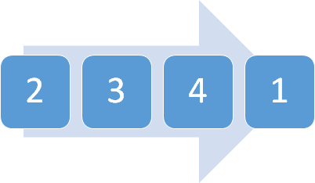
Vision + Goals = Strategic Planning
Goal that fundamentally shifts money and power (achieves part of the vision)
Current campaign goal
3-4. Goals on the horizon that bring in coalitions and community support
Notes:
r

