Slide 1
Campaign Academy:
Building a Team to Win
New Orleans, 2026
Notes:
6

Slide 2

Campaign Academy
By attending this training, you confirm that you are either an NEA affiliate staff person or NEA member in good standing. The information you receive here is only for your use in your capacity as an NEA affiliate staff person or NEA member.
This presentation and its contents are confidential and may not be further distributed or passed on to any other person or published or reproduced, in whole or in part, by any medium or in any form, for any purpose unless written consent has been provided by Ellen Holmes. Audio/video recording, copying of slides, and the use of AI note-taking tools are prohibited without the written consent from Kyle Serrette. Violation of these terms may result in legal action.

Slide 3
NEA Standards of Conduct
NEA has adopted a Standard of Conduct Policy to ensure that all of our gatherings are welcoming to and free from discriminatory, harassing, or otherwise unacceptable behavior. Discrimination or harassment based on race, color, ethnicity, religion, sex, age, national origin, sexual orientation, disability, gender identity, or expression, or any other characteristic protected by law will not be tolerated. If you have experience any discriminatory or harassing behavior, please report the incident by emailing Ron "Duff" Martin (rmartin@nea.org) and Gladys Marquez (gmarquez@nea.org). Thank you for your commitment to ensuring a positive event for all.

Slide 4

Sunday, May 17th
8:30-9:00 Introduction and Overview
9:00-10:30 Team Accountability
10:30-10:45 Break
10:45- 11:45 Creating a Plan
11:45-12:30 Group/Peer Feedback
12:30-1:00 Final Wrap Up
1:00 Box Lunch to Go

Slide 5
Sunday, May 17th
Outcomes
Analyze their current situation in the context of a broader political landscape
Build a vision based on shared values and analyze that vision through an equity lens
Articulate solidarity as a strategic choice as well as a union value
Understand why a team is vital to a campaign
Learn the strategy of base-building
Learn key skills to build a team: 1:1 organizing conversation, worksite mapping and charting, and leader identification
Learn about examples of how to troubleshoot common problems with organizing teams.
Create a plan to build the strongest, tightest, most resilient organizing committee possible

Slide 6
Feedback on Feedback
The first half of Day 2 focused on using vision and goals to build your base, leadership identification, and semantics for recruiting and building power. 4.5
The second half of Day 2 focused on organizing conversations, mapping, and charting. 4.63
Careful consideration has been taken in the selection of materials, the flow of the content, and the development of the online course support. 4.5
The facilitators have worked to design adult learning experiences that allow for both individual and group development. They have planned for an experience that builds in networking, movement, and multiple ways to apply learning. They have worked on the basics of giving directions, practicing strong questioning, and planning their responses. 4.63

Slide 7
Feedback on Feedback
“more time talking about how things relate to our campaign specifically.”
“I feel like we are toggling our learning between two lenses - now for this urgent campaign and then a greater scope of our future. Some opportunity to explore both would be great.”
“The engagement was great and I like the change in facilitators. Today gave me a more clear vision of who my potential leaders may be. The mapping was new and I found it helpful because it gave me a blueprint of everyone I need to encounter.”
"I have been so excited by this training. There are a few folks grumbling that say they want to work with their own teams more. I think they are missing the mark. This is where you come to learn from each other. Teams can then apply it back home. Great work."
"In this space everyone needs to be mindful of the space others are in with respect to spatial closeness and comfort..."

Slide 8
Feedback on Feedback
"When asked to group up or pick a partner, it would be helpful if facilitators assured in grouping participants by campaign goal. I often some with people who felt like our goals were unrelated"
"I really enjoyed learning from a variety of participants. The "turn and talk" was very informative."
"Matt's push and deeper dive into the AAR and 1:1s was amazing. It really helped push the intentionality and led beautifully into the mapping conversations. The build up in the program focuses on the what and why before the how level and I love the way it is focusing on methodology and intention over the "just do it" concept."
"An amazing day!! I loved that you highlighted we don't focus our efforts and messages on the opposition. Too many people waste their time on that. We are not going to move the actively opposed. We have to move the middle!! I am going to take this back to my local and begin applying it. Amazing day."

Slide 9

Community Agreements
Using Self-Awareness and Self-Knowledge
Listening for Understanding
Being Gracious
Staying Engaged
Being Open and Suspending Judgment
Saying “I”- tell your truth
Leaning into Discomfort
Reaching Empathy
Expecting Non-Resolution and Non-Closure
*Adapted from “Embracing equity and inclusion”, Annie E. Casey Foundation
Notes:
Community Agreements for Our Time
Awareness and Self-Knowledge
This requires self-knowledge and self-awareness. Self-knowledge allows you to see what causes you pain and conflict and enables you to embrace your contradictions and inconsistencies. It allows the space to work on things about yourself that you are not happy with. In turn, self-knowledge helps to prevent you from projecting your negative aspects onto other people. Bringing your best self also requires that you have a positive attitude, are willing to deeply explore your perspectives and remain open to the perspectives and experiences of others.
Listening for Understanding
Be an active listener. Active listening involves paying full and careful attention to the other person, looking him or her in the eye, avoiding interruptions, reflecting your understanding, clarifying information, summarizing the other person’s perspectives and sharing your own. Remember that most people need time to open up and might not be willing to immediately share their personal stories, hopes, fears and/or concerns.
Being Gracious
Being kind is a vital way of bringing meaning to our own lives, as well as the lives of others. Kindness is about caring genuinely for others around you, wanting the best for them and recognizing in them the same wants, needs, aspirations and even fears that you may have. Being kind and generous allows us to communicate better with others, to be more self-compassionate and to be a positive force in other people’s lives. This includes following the COVID protocols that are in place to protect the health of this learning community.
Stay Engaged
Staying engaged requires you to be morally, emotionally, intellectually and socially involved in the conversation. Staying engaged means that you are listening with curiosity and willing to deepen your understanding. Staying engaged might also require you to sustain the conversation even when it gets uncomfortable or diverted. This also means a commitment to keeping your electronic communications to a minimum with folks not present in this learning community.
Be Open and Suspend Judgment
Listening with an open mind includes being receptive to the influence of others. You can suspend judgment by becoming aware of preconceived notions and listening to everything someone has to say before jumping to conclusions. Most importantly, suspending judgment also means listening to what the speaker has to say for understanding, not just to determine whether the speaker is right or wrong.
Say “I”- tell your truth
Speaking your truth in authentic and courageous conversations about race requires a willingness to take risks. It means that you will be absolutely honest and candid about your own thoughts, feelings, experiences and opinions and not just saying what you perceive others want to hear. Speaking your truth will require you to speak from the “first person” and use “I” statements.
Seek Discomfort
Leaning in to discomfort will require you to let go of racial understandings and stereotypes that you may be holding onto in order to move forward. Leaning in means that you will avoid judgment, assume positive intent and be open to the kernel of wisdom in each individual’s experiences. Leaning in to discomfort will require you to sit through moments of embarrassment, confusion, anxiety and/or fear.
Reaching Empathy
Empathy and compassion allow you to understand the other person’s point of view. When you are empathetic, you are more understanding, patient and kind. Expanding your capacity to feel empathy will also allow others to enter your circle of human concern.
Resolution and Closure
Expect and accept that there may not be closure. It is not likely that you will resolve your personal understanding about race or another person’s racial experience in a single conversation. The more you talk about race with another person, the more you learn and the more they will learn. Authentic and productive conversations about race are continuous and always evolving.
*Adapted from “Embracing equity and inclusion”, Annie E. Casey Foundation

Slide 10
Team Accountability

Slide 11
Common Problems in Teams…
People don't show up to the action
Building reps aren't tracking their one on ones
Unaddressed fear
Interpersonal/Interest group conflict
Something else becomes more urgent for a teammate

Slide 12
Tracking as an Internal Structure Test
Show of hands: who among you are tracking participation at specific actions during your campaign?
What do you do when you see a tab (for a building/department) with NOTHING completed?

Slide 13
"That collective effort required leaders who were accountable to one another and were not singular..." " -Ella Baker

Slide 14
Accountability Conversations
How comfortable are you having accountability conversations with your team?
  Show us with your hand-
    0-5- show us by raising your fingers.
What do those conversations sound like, look like?
What questions are you asking of those you need to hold accountable?

Slide 15
Choose Your Own Adventure
Lack of Communication/clarity from leadership
Why aren't members involved?
Division in our union
Is Apathy real?
One leader trying to run the show
Organizing in divided territory
Organizing a far spread group

Slide 16
Scenario 1- "Don't Worry About It!"
Sal, a former president of 10 years now an exec board member, has a great relationship with the Superintendent, and he has decided he's going to have a conversation to get what everyone wants. Your union is currently launching a survey to understand what the members' priorities are for the upcoming year. Sal wants to have this conversation with the Superintendent before the survey even closes. Sal has had good conversations with the Superintendent in the past and many attribute the new flexible PTO policy to his intervention. A lot of members respect him. Sal frequently skips meetings and does not follow the agenda when he does attend. Angela and April (other exec board members) have been discussing how much this bothers them.

Slide 17
Scenario 2- "Lisa is Missing"
One of your campaign team members, Lisa has stopped coming to meetings. She is not checking in with the team. She is not responding to text/email/phone calls. Lisa initially agreed to help pass out buttons and talk to 1 potential member about joining the local. She randomly came to a meeting and volunteered. Her friend Tina, who is not a union member, told the Building Rep that she thinks Lisa is experiencing a death in the family based on her Facebook posts. She has not been at work for the last two days. Lisa's building has very few union members. The two that are there have told the team they do not want to be active and prefer just to rely on the union as insurance.

Slide 18
Scenario 3- "The Good Relationship"
Sarah, a team member from the elementary school believes we cannot go public with our demand of mold removal from our district's buildings. She knows we need clean classrooms but she believes, "They are our employer we cannot embarrass our boss and the district." Sarah is near retirement and while she has not participated in job actions, she has always held monthly building meetings and does an excellent job keeping people informed on what is happening in the legislature, NEA initiatives, and upcoming events. Sarah has been mentoring an early career educator to become the new Building Rep. She believes the team should focus on the good relationship the union has with the district and ask a local politician to speak for them with the board quietly. Sarah has many followers and they have been talking loudly to others about the union's campaign being a bad idea.

Slide 19
Scenario 4 – “Is Apathy Real?”
Marcus Reed, vice president of their local union, struggles with keeping leadership organized and focused as constant workplace issues pull attention away from the local’s long-term vision. Members increasingly complain that “the union does nothing,” while many remain disengaged and uninvolved, creating low trust across the local. At the same time, the leadership team feels frustrated and overwhelmed because only a small group consistently steps up to help. They struggle to recruit people they know are trusted and respected to "do" union work.

Slide 20
Scenario 5- "Puts on the Cape"
Jane is a part of everything. She talks over people in meetings, constantly cutting them off. Some people have left the team out of frustration and no one attends her building meetings. Jane has planned the kickoff for the campaign without confirming the date, time, location, and agenda with the team. When Sam, another member of the team asked to change the proposed date because half of the team cannot attend Jane said, "Don't worry it's taken care of," and with a huge smile adds, "I can't wait to get everyone jazzed about our campaign!" Jane has said she will also make the buttons, food, as well as bringing a keg of beer and sound equipment for the kick-off. Many members have expressed that they don't want alcohol at the functions but Jane just laughed and said, "If they don't like it, they don't have to come."

Slide 21
Scenario 6- "Organizing in Divided Territory"
The right-wing school board is planning to institute a book ban. The local media's coverage of more liberal groups has blown up and the conflict is now national news- firing up the more conservative parent groups. Union leaders are afraid of losing community support, but have started a community petition to prevent "The Bluest Eye", "Beloved", "Anne Frank", "The Kite Runner", "The Hate You Give", "Catcher in the Rye," "Fahrenheit 451" and others from being banned. Susan, a building rep has been vocal about not wanting to circulate the petition and the tracking sheet from her building is emty.

Slide 22
Report Out! (5 minutes)
Tell us about your scenario
Identify the Issue
How would you intervene
  What questions would you ask?
  How would you approach them?
  Coach them toward the team vision/goals/agreements?

Slide 23
Feedback for each scenario:
Have you experienced something like this with your team?
How did your team find a path through the challenge?
What was a positive action the group took to address the problem?
What might you do differently in the future?

Slide 24

Key Points
When an issue arises turn to your teammates and have conversations because fear and apathy grow in isolation.
Issues engage people with the union; they find community in a union that is addressing their issues.
People do not value what they have not built.
Your team's vision and your team's shared values move people through fear and apathy.
Tracking conversations with members can help alert the team that attention is needed in a department or building.
Reflection on how will you bring these ideas back home.

Slide 25
Break
10:30-10:45

Slide 26
Create: Plans for the Future

Slide 27
Create or Modify Your Campaign: Plan for Recruitment and Engagement
What’s your specific ask for recruitment and engagement?
  How will you pivot when people do not readily engage?
Who are you looking to recruit on your team? (individual people, coalitions, parent groups, other stakeholders, etc.)
  What role will they play?
  What additional information do you need about your recruitment list?
  What are ideas that you have about centering equity and removing barriers for connecting with individuals?
Who will connect with those individuals?
  What training or information will they need to have those conversations?
What other resources will you need?

Slide 28
Recruitment Planning and Presentations

Slide 29
Peer Review of Team Campaign Recruitment Plans
Get in to groups of no more than 3 Teams/Campaigns
    You will have 10 minutes for a campaign presentation.
    Share your campaign recruitment and engagement plans.
Other teams will have five minutes to give feedback
    Do you have a sense of who they will recruit to their team?
    Are their asks clear?
Offer questions and ideas to help them better craft their plan.

Slide 30
Key Points
Campaigns are more powerful when we tap into our people as a resource.
Equity is centered at every level, at every stage.
Teams can make progress even when all the pieces are not there.
We continue to learn from each other.

Slide 31


Slide 32
Closing It Out
Amanda Kail

Slide 33

What is Campaign Lab?
Leadership Development through Peer Coaching
Campaign and Organizing Fundamentals: Tools and Training
Assessment, Evaluation, and Centering Equity
Strategizing and Collaboration
Notes:
Carrie- Shine up the slide

Slide 34
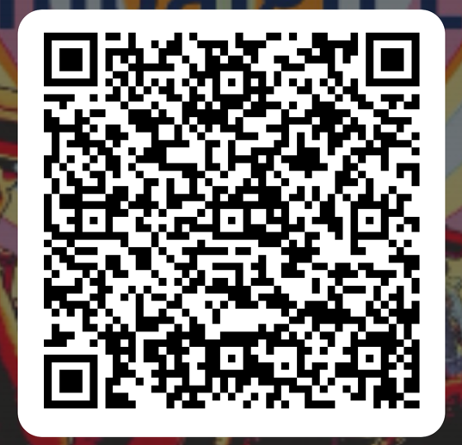
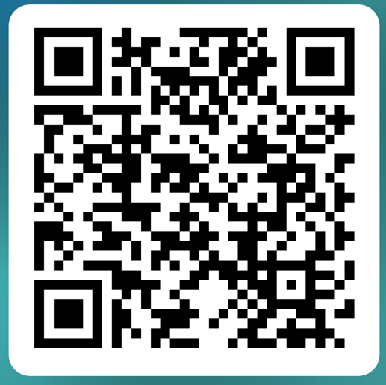
Do you want to build the power of your local?
Apply to the Campaign Lab.
Experienced in leading campaigns?
Apply to be a Coach!

Slide 35

Closing the Day
Reminders on traveling...
Housekeeping

Slide 36
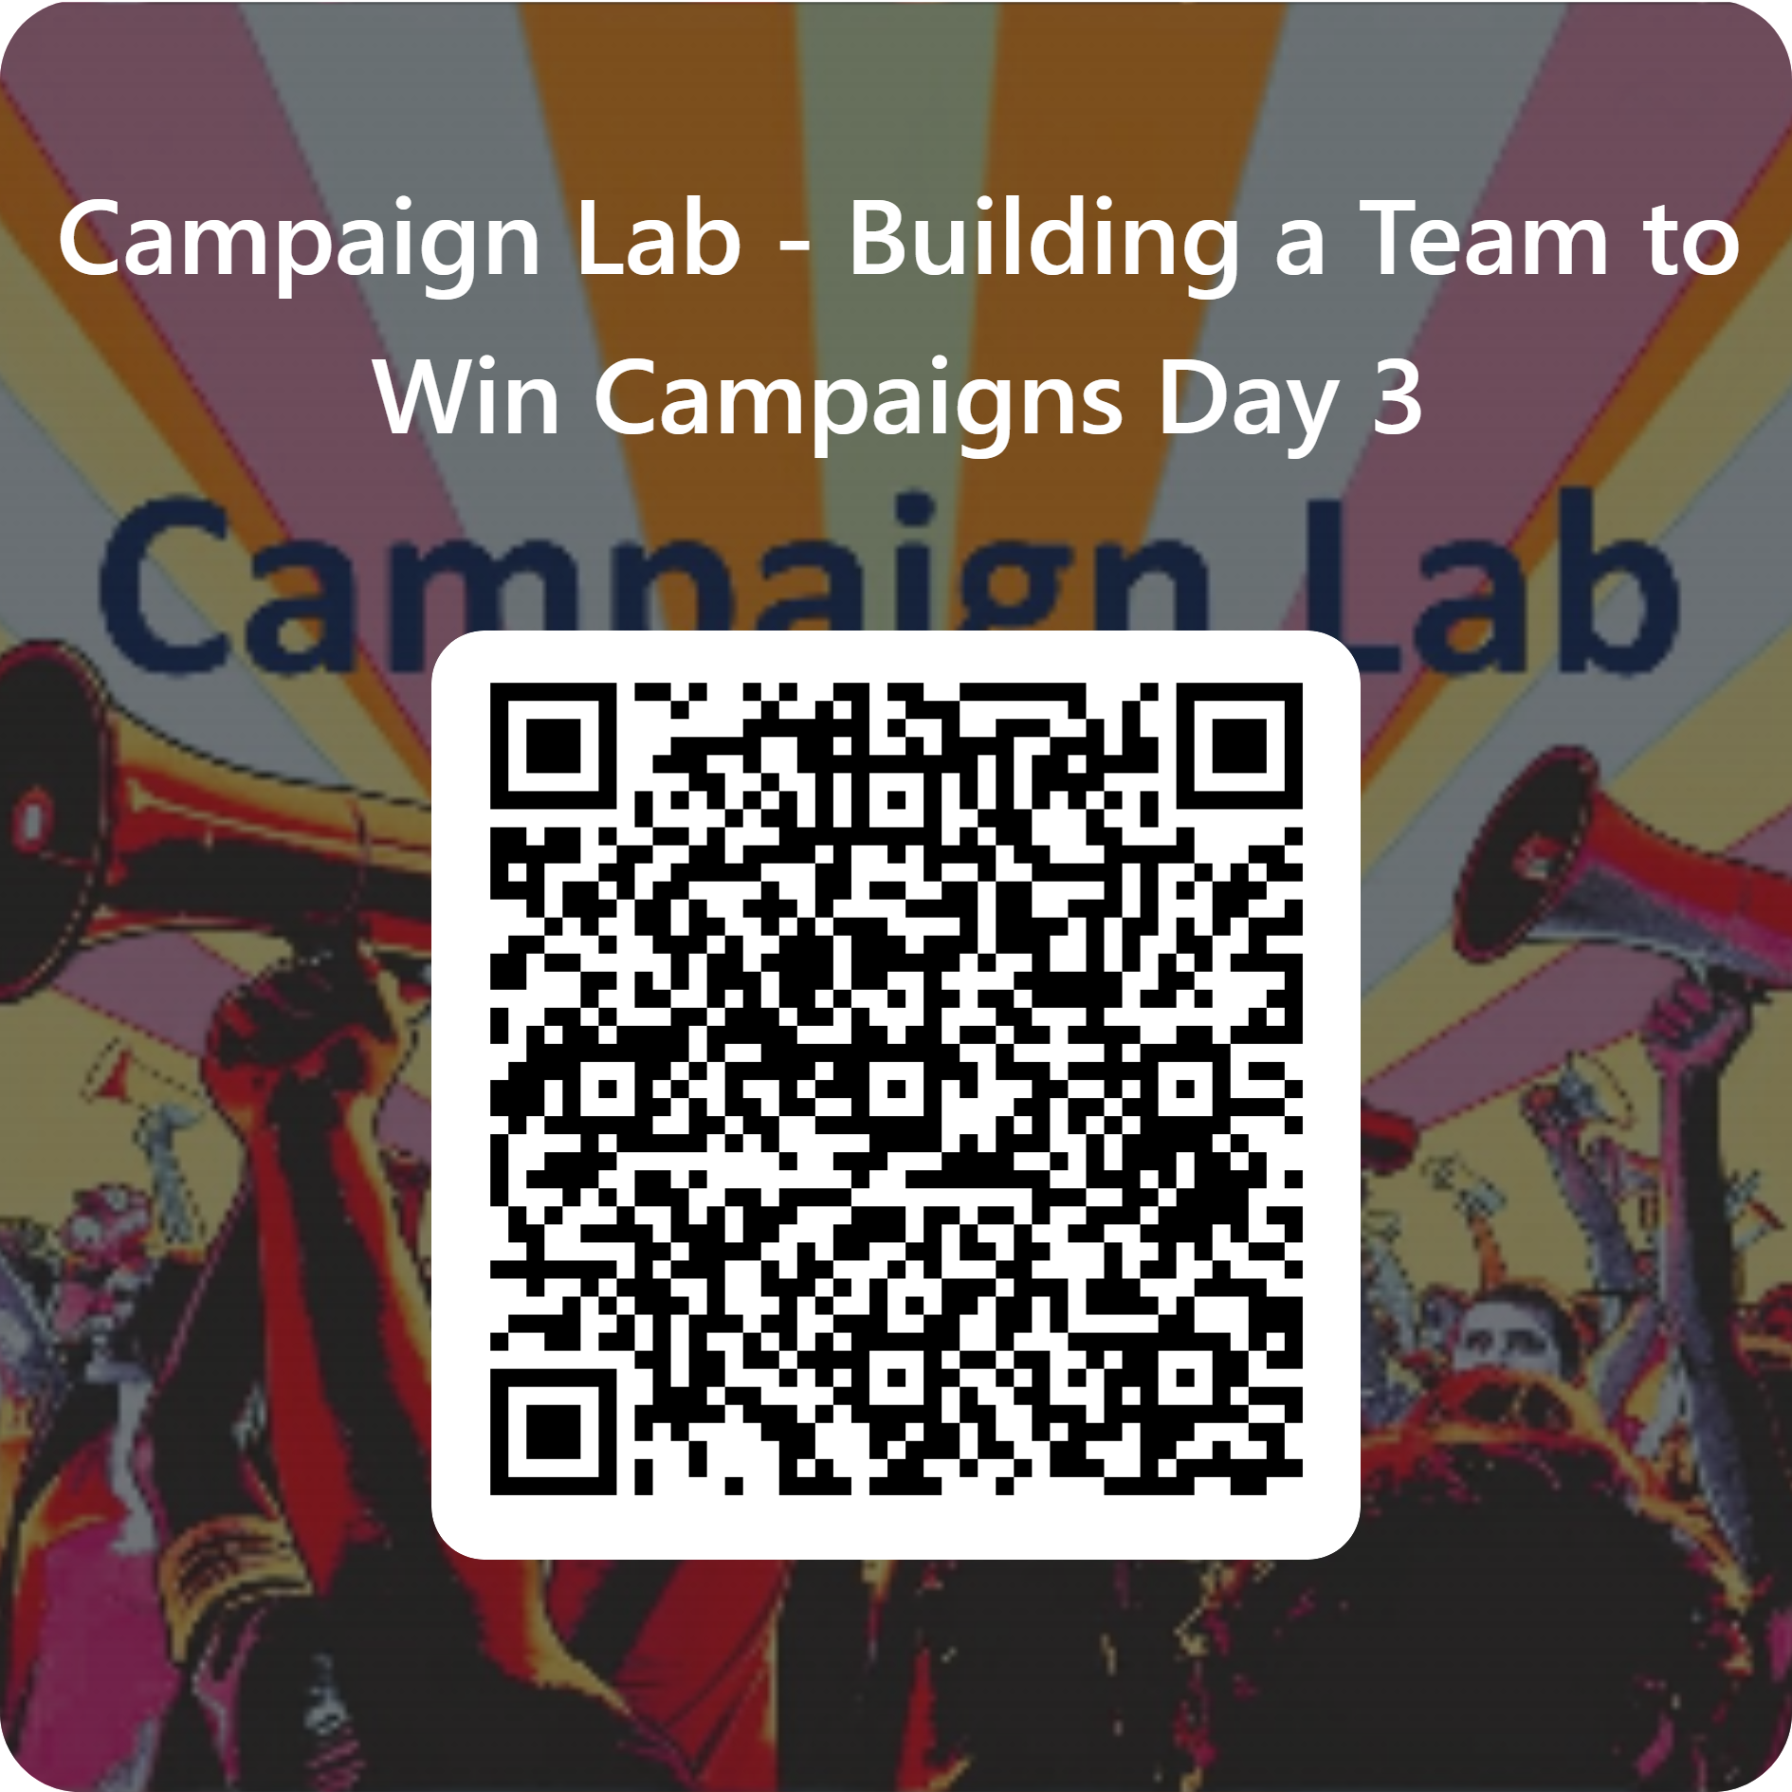
Please let us know how we are doing.

Slide 37


