Slide 2

Izaak pg 32
Established Executive Leadership
2,700 Members
Triad Affiliation
Moved from Industrial Frame of Unionism to Social Justice
Historic Hub of Latinx and Chicano Civil Rights Movement

Slide 3
House of Injustice - Loss of Sanctuary Cities
Texas Governor Greg Abbott
Trump Republicans
Immigration Customs Enforcement
Legislature and the 5th Circuit Court of Appeals
Media and News Outlets
Police
Employers
School System
Healthcare

Slide 4
Neutralized Pillars- Loss of Sanctuary Cities
Texas Governor Greg Abbott
Trump Republicans
Immigration Customs Enforcement
Healthcare – Local Paid Sick-Leave for All Workers
School System- Police Handbook
Legislature and the Courts – Senator Menendez
Police – Cite and Release
Media and News Outlets – FaceBook
Employers

Slide 5
Allies
Community Coalition –
  San Antonio Stands
  ACLU People Power
  Texas Organizing Project
  Move Texas
  Immigrant Legal Resource Center
  and Others
School System
San Antonio Social Justice Caucasus - PODER

Slide 6

“There is no path to equity without directly challenging and confronting inequities”
- Paul Gorski

Slide 7
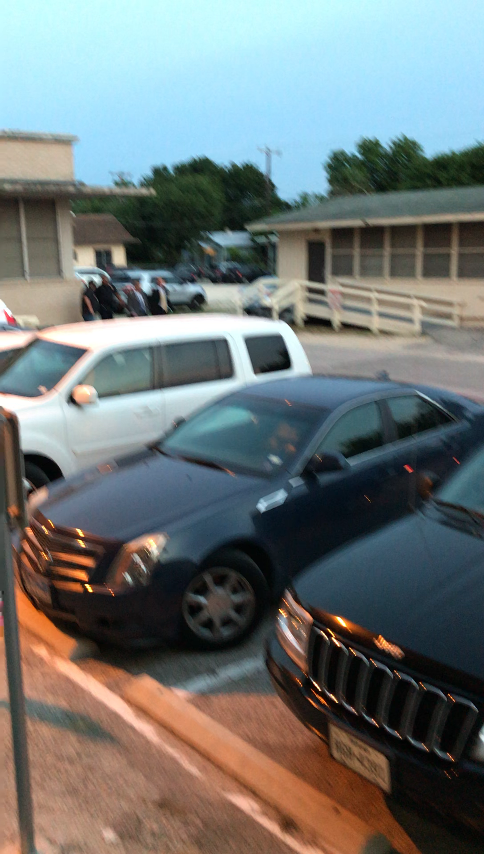

Slide 8

Key Points
Coalitions are a part of your structure that you should consider
We only have to neutralize the pillars of support

Slide 9

BREAK

Slide 10
Izaak and Ellen

Slide 11
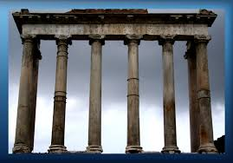
Supports for Powerholders
Powerholders are able to maintain their unjust policies because of the support they receive from supportive pillars “organizations and institutions” when we can win over these pillars or at the least, neutralize them, then we erode the power holders grip.

Slide 12
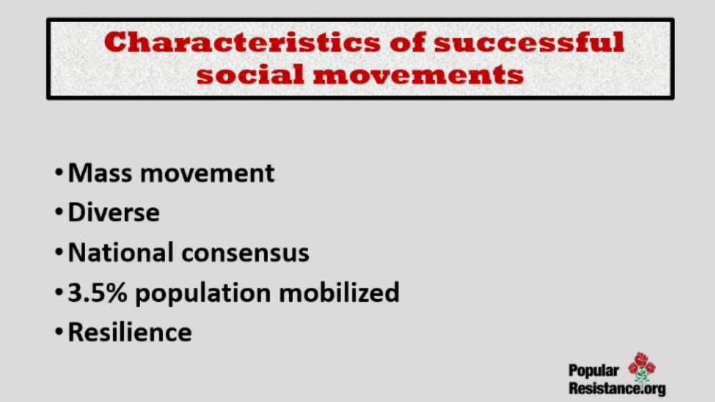

Slide 13
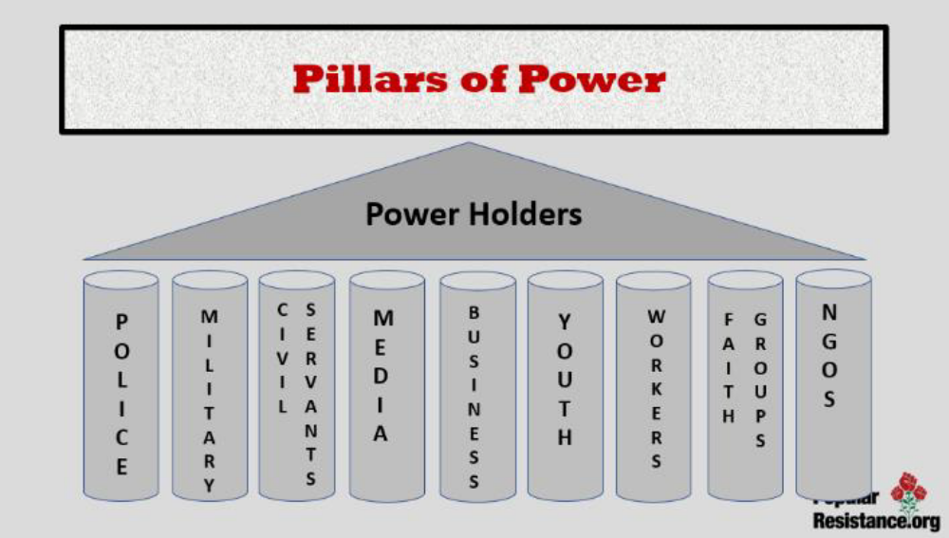

Slide 14
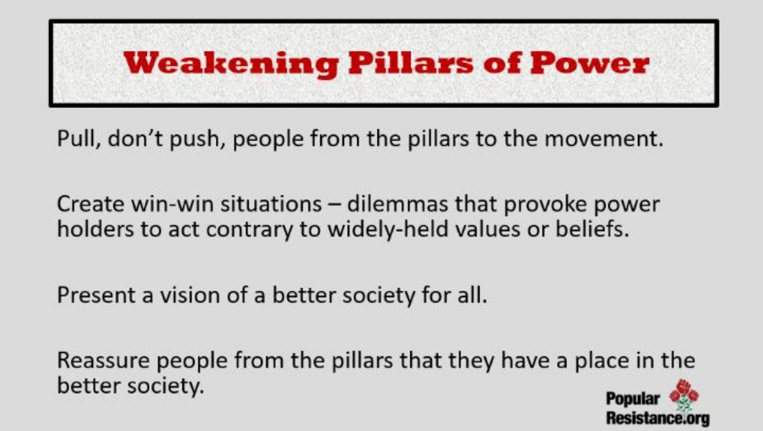

Slide 15
Group Posters!!
Teams of 5ish - Pg. 33 - 45
Pillars of Support Content Sheet
Worksheet and
“Mapping the Privatization of Public Schools”
House of Injustice Poster
Name the “Power Holders” for this issue
Identify the Pillars of Support that exist to keep this Injustice going.
AND identify the pillars that you YOUR TEAM believes they can win over or neutralize.

Slide 16
House of Injustice Report Out
Team Reports– (3 Mins or less each)
Who are the powerholders?
What are the pillars of support?
Which pillars can you neutralize or turn – by doing what?
Debrief
What stands out to you?
Are there any questions you would like to ask a team?
Is there any idea you would like to hold up as a an awesome idea?

Slide 17
Key Points
Power holders in non-violent situations maintain power because the majority of the people CHOOSE to let them
A movement is successful when it convinces the majority to withhold that agreement to submit.
It does not require all the pillars to fall for those in power to feel enough pressure to change the unjust policy

Slide 18
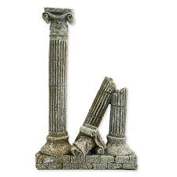
It only takes …
3.5 %

