Slide 1
Campaign Academy:
Leaders and Structures for Winning Campaigns
November, 2025

Slide 2

Campaign Academy
By attending this training, you confirm that you are either an NEA affiliate staff person or NEA member in good standing. The information you receive here is only for your use in your capacity as an NEA affiliate staff person or NEA member.
This presentation and its contents are confidential and may not be further distributed or passed on to any other person or published or reproduced, in whole or in part, by any medium or in any form, for any purpose unless written consent has been provided by Ellen Holmes. Audio/video recording, copying of slides, and the use of AI note-taking tools are prohibited without the written consent from Kyle Serrette. Violation of these terms may result in legal action.

Slide 3
NEA Standards of Conduct
NEA has adopted a Standard of Conduct Policy to ensure that all of our gatherings are welcoming to and free from discriminatory, harassing, or otherwise unacceptable behavior. Discrimination or harassment based on race, color, ethnicity, religion, sex, age, national origin, sexual orientation, disability, gender identity, or expression, or any other characteristic protected by law will not be tolerated. If you have experience any discriminatory or harassing behavior, please report the incident by emailing Ron "Duff" Martin (rmartin@nea.org) and Gladys Marquez (gmarquez@nea.org). Thank you for your commitment to ensuring a positive event for all.

Slide 4
Honoring This Space
We begin by acknowledging that through a history of colonization and brutality, we are currently on the traditional lands stewarded by generations of indigenous people.
We honor these indigenous people, all elders, past, present, and emerging. We are called to learn and share these learnings about this tribal history, culture, and contributions that have been suppressed in the telling of the story of what we now call the United States of America.

Slide 5

Key OUtcomes
Participants will: Understand a high-level overview of the purpose of the Campaign Lab Understand that Leads, Coaches, and Campaign Coaches have different roles in the Campaign Lab Learn key concepts of power building through the development of Leaders and Structures Use their stated campaign description to move into a number of possible networking groups Use lists of members and partners to begin mapping possible leaders Use an assessment tool to help understand the internal structure of their local Identify the internal and external parts of their campaign

Slide 6
Overall Agenda
Friday
  7:30-8:30 Breakfast
  10:15-10:30 Coffee and Tea
  8:30-Noon Meeting
  12:00-1:00 Lunch
  1:00-4:30 Meeting
  2:30-2:45 Break with Snacks
  4:30-5:00 Networking and Adjourn
Saturday
  7:30-8:30 Breakfast
  8:30-Noon Meeting
  10:15-10:30 Coffee and Tea
  12:00-1:00 Lunch
  1:00-4:30 Meeting
  2:30-2:45 Break with Snacks
  4:30-5:00 Networking and Adjourn
Sunday
  7:30-8:30 Breakfast
  10:15am-10:30amMeeting
  1:00 Adjourn, Boxed Lunch Provided

Slide 7

Documents you Will Need Today
Make sure you can access the Course
Make sure you have downloaded all files.
Pre Academy Assignments and the Participant Handout Module
Community Agreements
Make sure you can access the data about members you were asked to bring
Be able to access your personal self-assessment.

Slide 8
Logistics to Remember
Questions to Ask
Bathroom
Materials
PEPs Portal
Food
Room Temperature

Slide 9

Shout Out from Your Team and Around the Room
Name
Pronouns
Work Location

Slide 10

Community Agreements in Pre Academy Assignments, Page 2 of Handouts
Using Self-Awareness and Self-Knowledge
Listening for Understanding
Being Gracious
Staying Engaged
Being Open and Suspend Judgment
Saying “I”- tell your truth
Lean into Discomfort
Reaching Empathy
Expecting Non-Resolution and Non-Closure
*Adapted from “Embracing equity and inclusion”, Annie E. Casey Foundation
Notes:
Community Agreements for Our Time
Awareness and Self-Knowledge
This requires self-knowledge and self-awareness. Self-knowledge allows you to see what causes you pain and conflict and enables you to embrace your contradictions and inconsistencies. It allows the space to work on things about yourself that you are not happy with. In turn, self-knowledge helps to prevent you from projecting your negative aspects onto other people. Bringing your best self also requires that you have a positive attitude, are willing to deeply explore your perspectives and remain open to the perspectives and experiences of others.
Listening for Understanding
Be an active listener. Active listening involves paying full and careful attention to the other person, looking him or her in the eye, avoiding interruptions, reflecting your understanding, clarifying information, summarizing the other person’s perspectives and sharing your own. Remember that most people need time to open up and might not be willing to immediately share their personal stories, hopes, fears and/or concerns.
Being Gracious
Being kind is a vital way of bringing meaning to our own lives, as well as the lives of others. Kindness is about caring genuinely for others around you, wanting the best for them and recognizing in them the same wants, needs, aspirations and even fears that you may have. Being kind and generous allows us to communicate better with others, to be more self-compassionate and to be a positive force in other people’s lives. This includes following the COVID protocols that are in place to protect the health of this learning community.
Stay Engaged
Staying engaged requires you to be morally, emotionally, intellectually and socially involved in the conversation. Staying engaged means that you are listening with curiosity and willing to deepen your understanding. Staying engaged might also require you to sustain the conversation even when it gets uncomfortable or diverted. This also means a commitment to keeping your electronic communications to a minimum with folks not present in this learning community.
Be Open and Suspend Judgment
Listening with an open mind includes being receptive to the influence of others. You can suspend judgment by becoming aware of preconceived notions and listening to everything someone has to say before jumping to conclusions. Most importantly, suspending judgment also means listening to what the speaker has to say for understanding, not just to determine whether the speaker is right or wrong.
Say “I”- tell your truth
Speaking your truth in authentic and courageous conversations about race requires a willingness to take risks. It means that you will be absolutely honest and candid about your own thoughts, feelings, experiences and opinions and not just saying what you perceive others want to hear. Speaking your truth will require you to speak from the “first person” and use “I” statements.
Seek Discomfort
Leaning in to discomfort will require you to let go of racial understandings and stereotypes that you may be holding onto in order to move forward. Leaning in means that you will avoid judgment, assume positive intent and be open to the kernel of wisdom in each individual’s experiences. Leaning in to discomfort will require you to sit through moments of embarrassment, confusion, anxiety and/or fear.
Reaching Empathy
Empathy and compassion allow you to understand the other person’s point of view. When you are empathetic, you are more understanding, patient and kind. Expanding your capacity to feel empathy will also allow others to enter your circle of human concern.
Resolution and Closure
Expect and accept that there may not be closure. It is not likely that you will resolve your personal understanding about race or another person’s racial experience in a single conversation. The more you talk about race with another person, the more you learn and the more they will learn. Authentic and productive conversations about race are continuous and always evolving.
*Adapted from “Embracing equity and inclusion”, Annie E. Casey Foundation

Slide 11

Why are you here?

Slide 12

Picturing Our Purpose
Open a picture that represents why you choose to be part of Campaign Lab.
Three 3 Minute Rounds
Triads – People you don’t typically talk to or are new to you.
Share your name, your picture, and your purpose.
Notes:
Participants will line up in order of nearest to farthest from Baton Rouge – They will then fold the line in half so that those on the nearest end of the line end up talking to the farthest end of the line

Slide 13

Discussion
How did you feel when you were presenting or listening ?
What are some common themes that you heard across the introductions?
Did you notice any patterns?

Slide 14
Dreams and Challenges
Melissa

Slide 15

If you had all the power you could dream of, what is the biggest win your team could hope for?

Slide 16
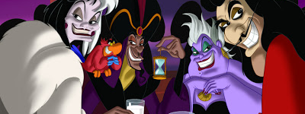
Who is the villain preventing you from achieving this win?
Notes:
Advocates, Mobilizers, Organizers Scenario

Slide 17

Why?
Who is benefiting from what's happening ?
What is the villain's vision for our public schools and higher education?
Notes:
12 min. Let's take a moment. How have the attacks impacted our schools and our communities? 6 min. Find someone to pair with to share. 6 min Group discussion
15 min. By small groups: Each table discusses one of these questions. (Facilitators can pop in for guidance as needed.)
Shared analysis -

Slide 18

6 Core Concepts We will Propose Here in Designing Winning Campaigns
1. Pick a Fight NOT Plan a win
2. Begin with Equity NOT Add Equity
3. Structure NOT Self-Selecting
4. Leaders vs. Activists
5. Majorities NOT Minorities
6. Organizing vs. Mobilizing/Activism

Slide 19
Relationships and Roles
Melissa

Slide 20
Role Clarity
For this work to be equitable, we must have intentional structure, not guesswork
Misalignment leads to burnout, duplication, or dropped tasks
Clear roles help teams build power and leadership at every level

Slide 21
Basic Structure of Campaign Lab
Team Lead
Team Lead
Coach
Coach
Coach
Tech
Logistics and Grants
Payments
Campaign Lab Coordinators
Team Lead
Team Lead
Mentor Coach
Team Lead
Team Lead
7
Notes:
The commitment for the local team lead is that they meet twice a month with a campaign coach to discuss their progress and receive just in time problem solving, advice, and coaching towards next steps. They also agree to attend an all call meeting once month to hear from others across the country that are also doing this work. Once a coach and a mentor coach agree that the Team Lead and local have a plan, have a team, and are ready to begin taking actions according to an actual escalating plan, they receive a seed grant of $2500.
Coaches, high capacity, campaign minded, leaders can serve as coaches and will receive training and support to do this. They agree to coach locals, up to two — and receive an annual stipend of up to $1800. They commit to meet with one to two teams, twice a month and attend the monthly all call meeting.
Mentor coaches are typically staff, who have a record of leading campaigns or growing locals through organizing. They do not receive a stipend. They have no more than 5 coaches that they meet with once a month and attend the all call meetings.
The Campaign Lab Coordinators, Amanda, Carrie, and Ellen, are managed by Kyle. Kyle is primarily focused on building the alignments with our outside partners and moves the Campaign Lab strategically into other aspects of the NEA enterprise. Amanda, Carrie, and Ellen work together they keep the system connected, convene the people in the system, build capacity across the system, manage and monitor applications of teams and coaches, and develop a strategic intent for the work across the campaign lab. They are supported by Dommie, Shola, and Karla. Dommie provides technology and data support, Shola coordinates the payment of coaches, Karla pulls team applications from the grant system and provides all travel logistics.

Slide 22
Mentor Coach
Mostly staff-based
Monthly meetings with assigned Campaign Coaches and whole network
Campaign Coach
Holds coaching calls, documents progress
Team Lead
Coordinates team operations, meetings, and roles
Support Campaign Coaches problem solving and thought partnership
Coaches 1–2 local teams
Engages in peer problem solving and coaching
Upholds team norms and shared commitments
Focus on output, capacity building, and leadership development
Clarifies team membership and purpose
Team Members
Implements the plan
Assists in developing added structures
Attends regular meetings
Critical in building the base, increasing engagement, and gathering information

Slide 23
Reflection at Tables
Within your teams, what are 1–2 actions you can take to clarify your roles?

Slide 24

Role clarity enables power-building and sustainability
Each role supports equity through intentionality and reflection
You don’t have to do everything, just your piece well
Key Points

Slide 25
Amanda

Slide 26
Network Building

Slide 27

What makes Campaign Lab Unique?
Focus is on connecting:
Campaigns
Organizers
Leaders
Core Belief:
Those in the struggle have the best answers to solving the struggle.

Slide 28

Raise Your Hand When You Hear Your Role
Mentor Coaches = Support for Coaches
Campaign Coaches = Support for Local Teams
Team Leads = Support and Coordinate the Team
Team Members= Implement the Plan and Primary contact with Rank and File

Slide 29

Small Group Networking Activity
3 Rounds of 10 Minutes Each
Grouped by Role
Grouped by Campaign Lab Coordinator
Grouped by NEA Region
Final 10 Minutes
Your Choice

Slide 30
Small Group Networking Activity 10 Minutes Per Round
All Share
Name, job title, local, state
One Sentence about either your campaign, your own expertise, or an expertise you are looking for
Group decides the focus of the conversation for the remainder of the time.

Slide 31
Round 1 – Mix by Role
Mentor Coach
Mostly staff-based
Monthly meetings with assigned Campaign Coaches and whole network
Campaign Coach
Holds coaching calls, documents progress
Team Lead
Coordinates team operations, meetings, and roles
Support Campaign Coaches problem solving and thought partnership
Coaches 1–2 local teams
Engages in peer problem solving and coaching
Upholds team norms and shared commitments
Focus on output, capacity building, and leadership development
Clarifies team membership and purpose
Team Members
Implements the plan
Assists in developing added structures
Attends regular meetings
Critical in building the base, increasing engagement, and gathering information

Slide 32
Small Group Networking Activity 10 Minutes Per Round
All Share
Name, job title, local, state
One Sentence about either your campaign, your own expertise, or an expertise you are looking for
Group decides the focus of the conversation for the remainder of the time.

Slide 33
Round 2 – Campaign Lab Coordinator Choice
  GA Retired, NEA-AK, York
  Lawrence (KS), Classified Staff Union (MA), NC Aspiring Ed
  Riverside, Celina
  Olathe, Des Moines, United EA Shelby CO

Slide 34
Small Group Networking Activity 10 Minutes Per Round
All Share
Name, job title, local, state
One Sentence about either your campaign, your own expertise, or an expertise you are looking for
Group decides the focus of the conversation for the remainder of the time.

Slide 35
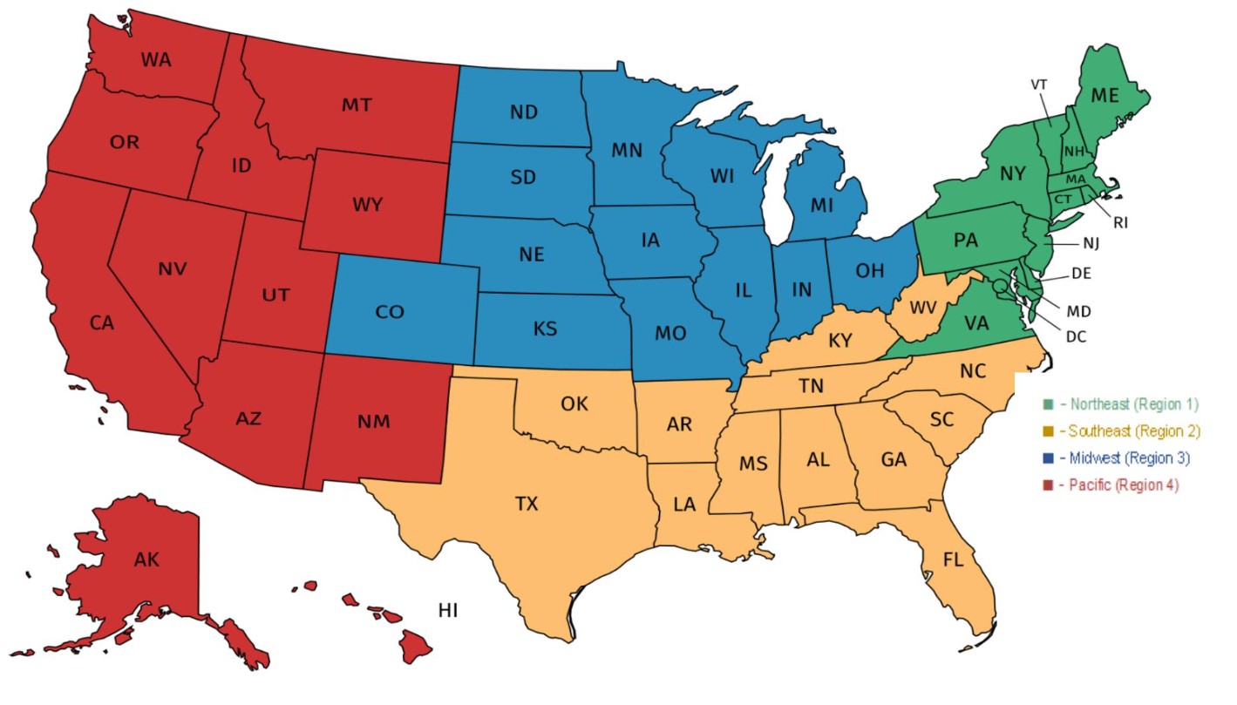
Mix by NEA Region

Slide 36
Small Group Networking Activity 10 Minutes Per Round
All Share
Name, job title, local, state
One Sentence about either your campaign, your own expertise, or an expertise you are looking for
Group decides the focus of the conversation for the remainder of the time.

Slide 37

Your Choice

Slide 38
Small Group Networking Activity 10 Minutes Per Round
All Share
Name, job title, local, state
One Sentence about either your campaign, your own expertise, or an expertise you are looking for
Group decides the focus of the conversation for the remainder of the time.

Slide 39
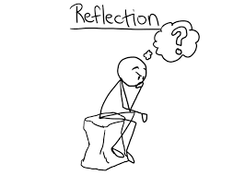
Reflection
What have you learned?
What are you still wanting?

Slide 40

Key
Points
The goal of the Campaign Lab is to be an intentional network to support organizing nationwide

Slide 41
Beth and Vanessa

Slide 42
Centering Equity

Slide 43
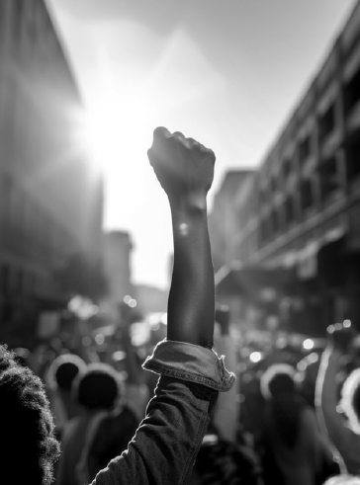
What will it take to achieve equity in the “Big Dreams” you have for your campaigns, your schools, and your communities?

Slide 44
What type of union builds power?
Campaigns
Public Action and Demands
Strategic and Ongoing
Continues to Add
  Base – Mobilizers - Leaders
  Allies – Partners - Coalitions
  Requires Risk
  Supported by Staff
  Leaders Build and Use Power
Programs
Build Presence
Episodic
Member Recruitment
Committee/Program Leaders
Low Risk
Often Staff Led
Power in Policy

Slide 45
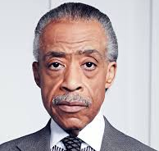
Al Sharpton
“There are those in the Democratic Party who have driven the party further and further to the right in the name of a winning strategy,” Sharpton said. “And it seems that it is their presumption that the only way to be electable is that progressive forces and people of color must voluntarily turn into invisible people.”

Slide 46
What about Social Justice?
Many of us value justice and equity, so we must start by examining Race, Class, Gender, and Ability in our work
This lens involves both personal and institutional commitment to advancing equity
It means proactively eliminating systemic barriers and setting clear, measurable equity goals
Use it to develop equity-focused campaigns and anticipate harm across race, class, and gender lines
It’s more than avoiding discrimination, it’s about creating systems that sustain equity

Slide 47
Team Time - Centering Equity page 5
Causes: What institutions, policies, or practices are causing or contributing to the inequities? What social norms, popular myths, or cultural biases may be contributing?
History: How did things get this way and are things worsening or improving?
Strategies: What strategies and actions could be used to advance the solutions?
Problems: What inequities are you noticing or experiencing? What are the impacts on different racial groups? Who benefits most and who is hurt most?
Solutions: What solutions could address the root causes and eliminate the inequities? How would different racial groups be impacted by the proposed solutions?
Leadership: Who are the stakeholders most affected by the inequities? Are they involved in naming the issues and solutions? What kinds of active leadership roles could they take to advance the proposed solution?
Additional Equity Tools: Who is most directly impacted? Who has been left out? How can they be directly engaged? How do our demands center race, class, and gender justice?

Slide 48
Debrief
What did you learn about using this analysis tool?
What did your group struggle with?
How do you think you could use this in your own work?

Slide 49
Key
Points
Intentional campaigns, not programs, build power.
Centering race, class, and gender justice in our campaigns increases the number of people engaged, the number of leaders involved, and the amount of resources we have to win the change we want.
Power is only built through people with a shared vision, making public commitments to act, to risk their collective resources, for the meaningful change they want

Slide 50
Hedy

Slide 51
Defining Leaders and Structures

Slide 52

Who are leaders?

Slide 53

Structures are groups of people who choose to use their agency to achieve a common goal.
Organizers identify, recruit, and develop leadership within and across structures.

Slide 54
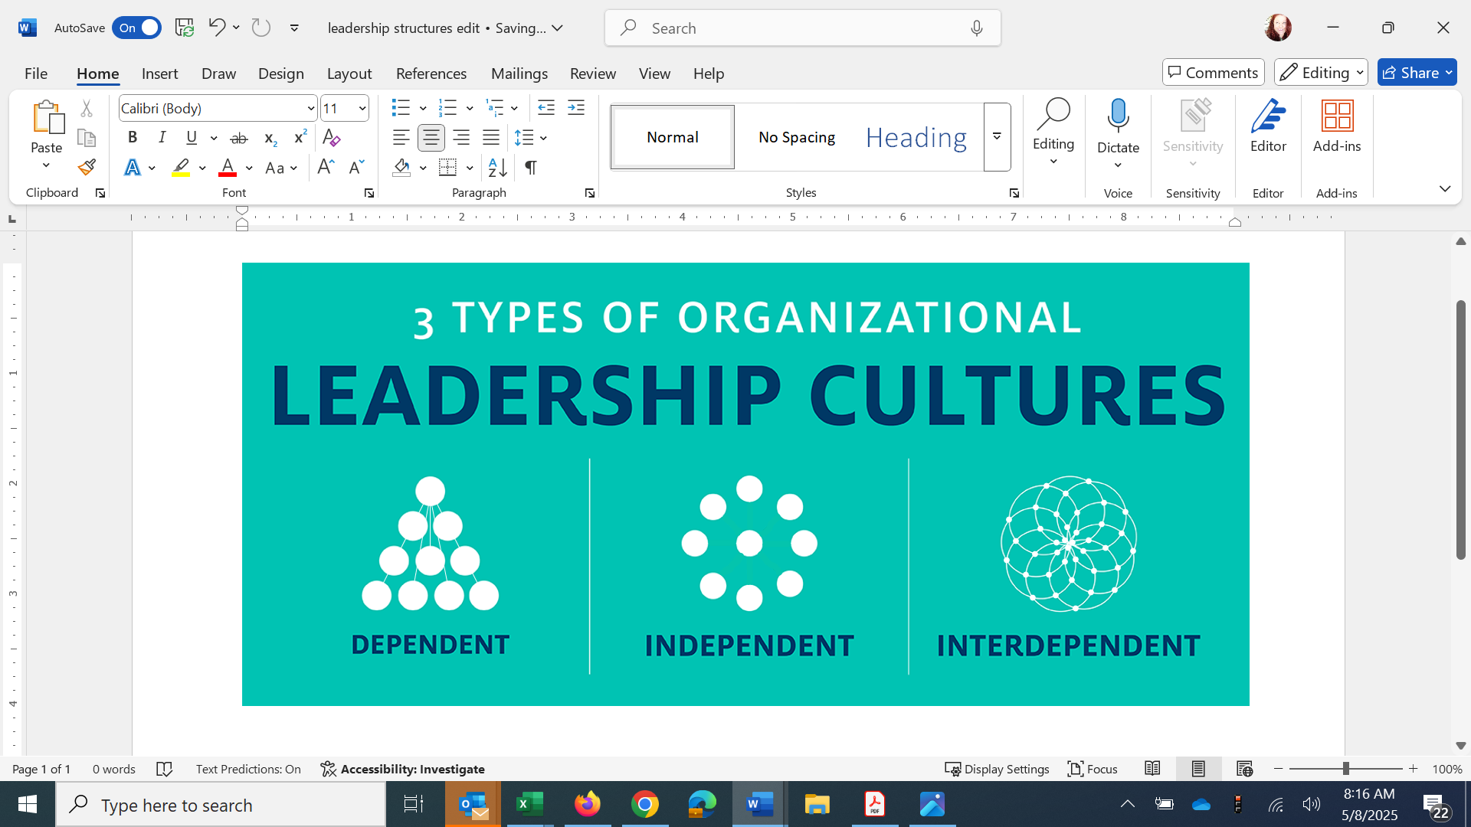
3 Types of Leadership Structures

Slide 55

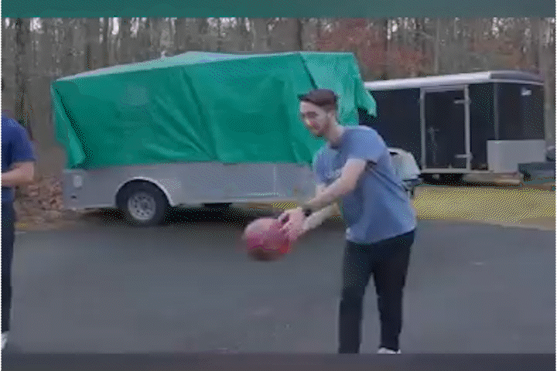
If you are the only leader…

Slide 56
Where is the power?
Is this a powerful or sustainable model?
Where are the resources? Who benfits?
What happens if the kingpin is knocked out?

Slide 57

If we are all leaders…

Slide 58

If we are all leaders…

Slide 59
Where is the power?
Is this a powerful or sustainable model?
Who benefits from the resources?
What happens to the resources?

Slide 60
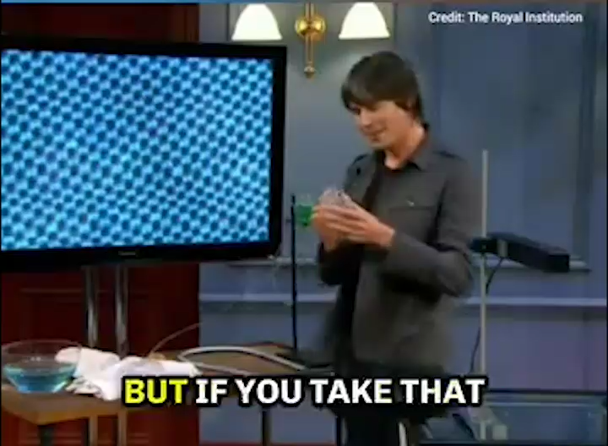

Slide 61
    In this model – where is the weight?
    Where is the power?
    Is this a powerful or sustainable model – Who benefits from the resources?

Slide 62
  How are they different from the dependent model?
  What are the qualities of a diamond that we get from this structure?

Slide 63
Interdependent Structures
Allow for the distribution of power
Allow for responsibility
Prioritize leadership development
Organizing is a leadership practice that organizes the resources you have to build the power you want

Slide 64
Table Talk
How close to or far away is your local from interdependent leadership?
How does your work shift across these leadership models?

Slide 65

Who are leaders?
Leaders are those who take responsibility for enabling others to achieve shared purpose in the face of uncertainty

Slide 66

If leadership is…
Taking responsibility for enabling others to achieve shared purpose in the face of uncertainty
Notes:
For the purpose of our working together today, let’s use this definition, “Leadership is taking responsibility for enabling others to achieve purpose, in the face of uncertainty”

Slide 67

Then leaders…
Have followers who trust and respect them.

Slide 68
Leaders...
Are TRUSTED and RESPECTED
Have followers

Slide 69
Key Points
Campaigns allow for the identification of leaders who can share power, responsibility and authority.
Well planned campaigns intentionally build structures that distribute power, responsibility, and authority.

Slide 70
Dr. Taraja

Slide 71
Worksite Mapping: People in the Campaign
Notes:
Why Worksite Mapping Matters, Building Leader Capacity Through Mapping

Slide 72
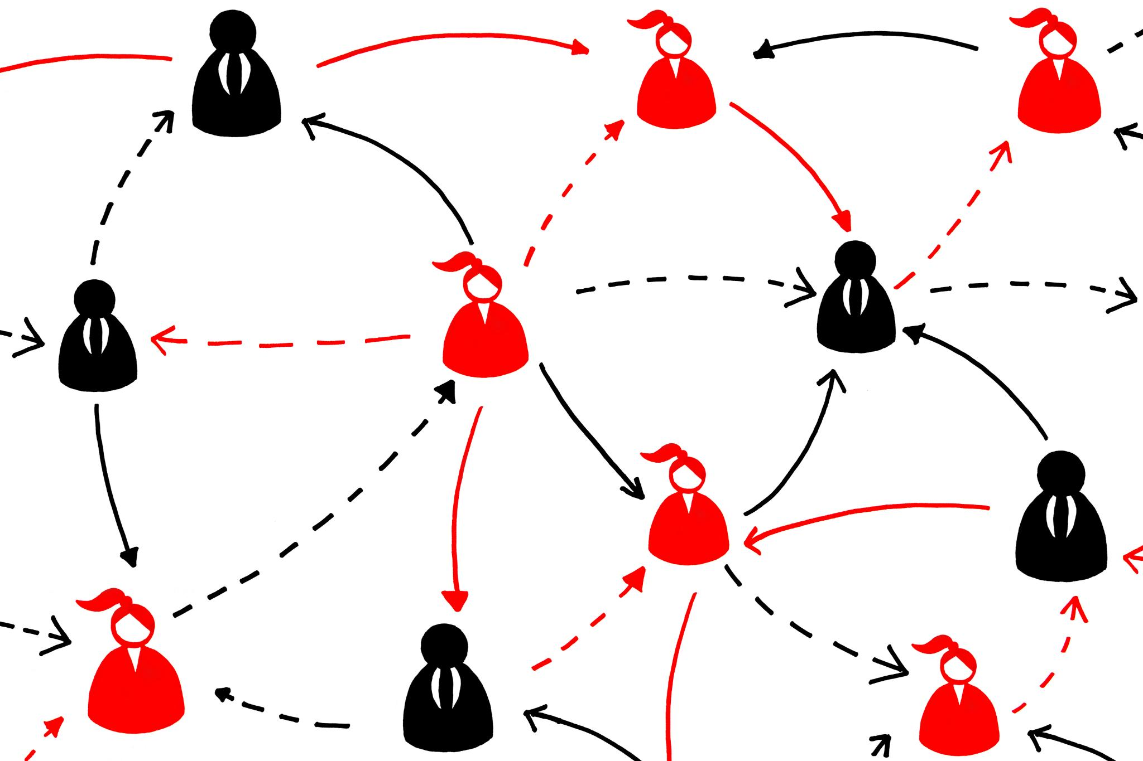
Why Worksite Mapping Matters
Visualizing Workplace Structure
  Worksite mapping helps leaders see who works where and when, revealing workplace structure and communication flow.
Identifying Influence and Opportunities
  Mapping uncovers key areas of influence and potential organizing opportunities within the workforce.
Strategic Resource Allocation
  Worksite mapping enables targeted outreach and efficient resource use, enhancing organizing effectiveness.
Turning Goals into Action
  Mapping transforms abstract goals into clear, actionable plans by depicting workplace dynamics visually.

Slide 73
How do we know who our people are?
How do we know where our people are?
How do we know who they are connected to?
Organizers Ask

Slide 74
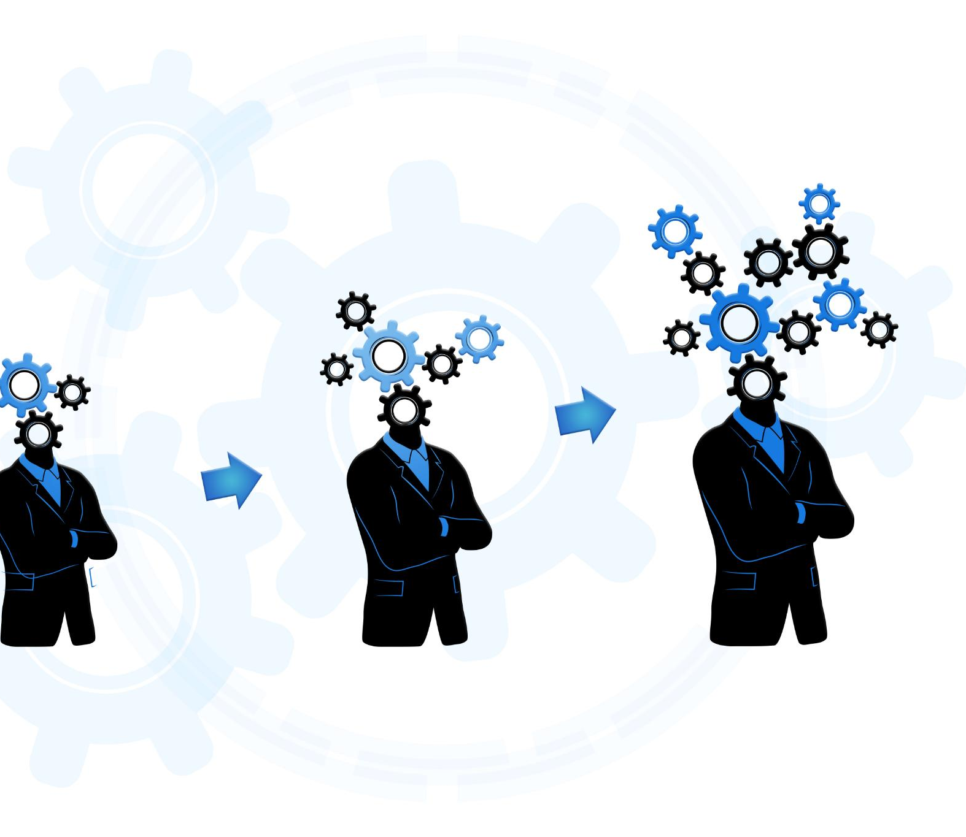
Building Leader Capacity Through Mapping
Mapping as Leadership Tool
  Mapping transforms workplace views, helping leaders identify influencers and relationship strengths clearly.
Strategic Clarity and Mobilization
  Mapping provides clarity on workplace layout, enabling leaders to strategize and mobilize effectively.
Identifying Key Leaders
  Mapping helps spot natural leaders and activists to play pivotal roles in campaigns.
Fostering Engagement and Confidence
  Engaging in mapping encourages ownership, enhancing leader confidence and commitment.

Slide 75
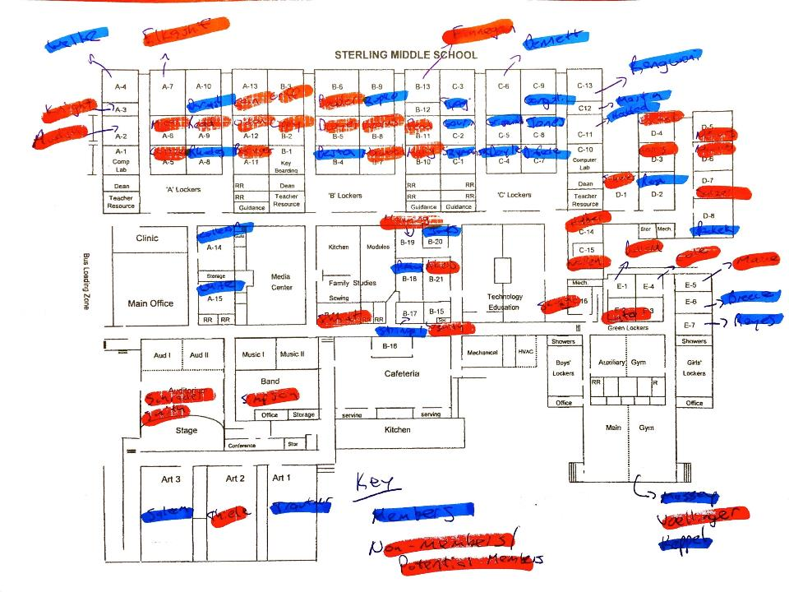
Strategic Organizing with Worksite Maps
Identifying Communication Gaps
  Worksite maps help leaders identify communication and representation gaps in the workplace to ensure full coverage.
Supporting Planning and Outreach
  Maps support planning meetings, actions, and visibility events by showing where support is strong or requires improvement.
Tracking Progress Dynamically
  Leaders track contact, attendance, and commitments on the map, enabling data-driven adjustments in organizing tactics.

Slide 76
Name | Role | CEA Member? | ABC Member? | Works Well With | Union Support Rank | Attended Board Mtg | Joined Rally | Displayed Union Poster | Personal Contact Updated | Concerns
Alex Johnson | Math Teacher | Yes | Yes | Leo Martinez, Morgan Taylor | Leader | Yes | Yes | Yes | Yes | Class size concerns
Jamie Patel | School Nurse | Yes | No | Riley Brooks, Samira Ali | Supporter | No | Yes | No | Yes | Safety protocol clarity
Morgan Taylor | English Teacher | Yes | Yes | Alex Johnson, Taylor Green | Leader | Yes | Yes | Yes | Yes | Grievance process delays
Riley Brooks | Counselor | Yes | No | Jamie Patel, Samira Ali | Ally | No | No | No | No | Caseload limits
Samira Ali | SPED Teacher | Yes | No | Riley Brooks, Jamie Patel | Undecided | No | No | No | No | Planning time
Leo Martinez | Science Teacher | Yes | Yes | Alex Johnson, Drew Santiago | Leader | Yes | Yes | Yes | Yes | Lab safety resources
Taylor Green | Librarian | Yes | No | Morgan Taylor, Jordan Kim | Supporter | No | No | No | Yes | Access to materials
Jordan Kim | Art Teacher | No | No | Taylor Green | Undecided | No | No | No | No | Supply budget
Quinn Harper | Kindergarten Teacher | Yes | No | Drew Santiago, Samira Ali | Supporter | Yes | No | No | Yes | Evaluation support
Drew Santiago | PE Teacher | Yes | No | Leo Martinez, Quinn Harper | Leader | Yes | Yes | Yes | Yes | Assault protocol
Potential Building Chart

Slide 77
How to Assess Your Building/Department
Union Power
Category | Value | Count
Union Support Rank | Leader | 4
Union Support Rank | Supporter | 3
Union Support Rank | Undecided | 2
Union Support Rank | Ally | 1
Personal Contact Updated | Yes | 7
Personal Contact Updated | No | 3
Attended Board Mtg | Yes | 5
Attended Board Mtg | No | 5
Joined Rally | Yes | 5
Joined Rally | No | 5
Displayed Union Poster | No | 6
Displayed Union Poster | Yes | 4

Slide 78

Making Mapping Actionable
Evolving Living Document
  Maps should be updated regularly to reflect staffing changes and workplace shifts for accuracy.
Setting Goals and Measuring Success
  Leaders use maps to set goals, measure progress, and coordinate organizing efforts effectively.
Fostering Collaboration and Alignment
  Sharing maps ensures team alignment and collaboration, enhancing campaign cohesiveness.
Guiding Activities and Tracking Milestones
  Actionable maps guide daily activities, track milestones, and adapt to changing needs.

Slide 79

LUNCH

Slide 80
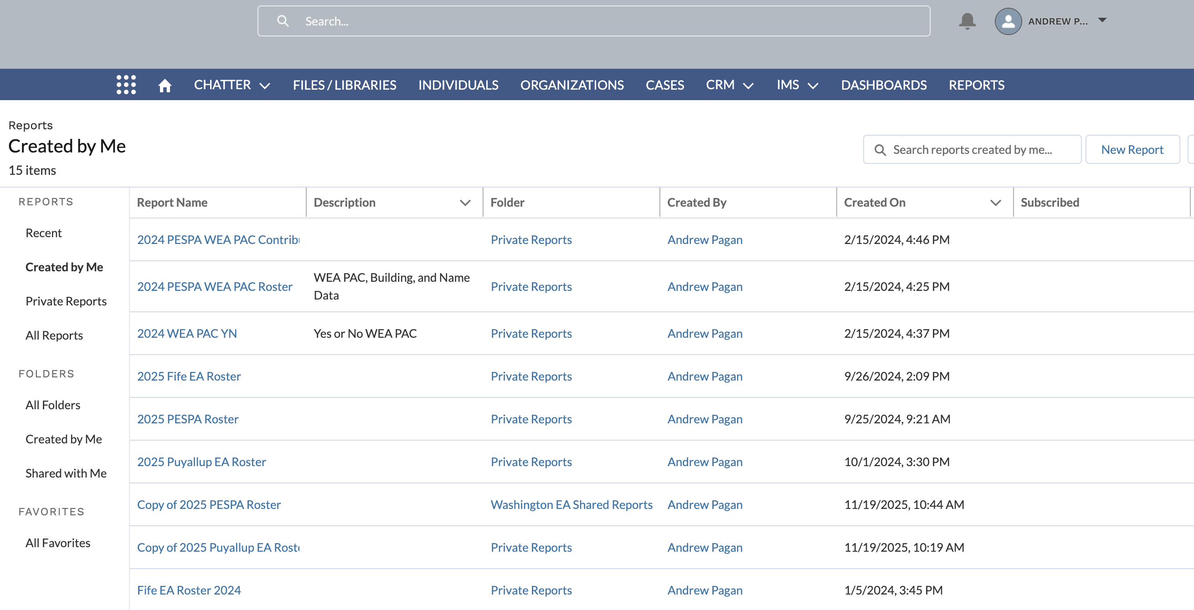
Mapping and Data(bases)
Consider digital tools for worksite and local mapping
  Portability
  Security
  Collaboration
You can use Excel, NEA360, VAN, etc.
Data you can track
  Membership/PAC status
  Participation in collective actions or committees
  Meeting or event attendance

Slide 81
Who are we mapping?
Leaders – Trusted and respected by their colleagues in ways that cut across communities of workers- are connected by values and influential relationships with mobilizers, activists, and those not yet part of the work. Get people to move their thinking and take action.
Mobilizers – Are already convinced members, who are already willing to take action. They are connected to the other already convinced.
Activists – Supportive and willing to act if invited but not able to move others.

Slide 82




Roles of People Within Your Campaign
Leaders bring their followers.
Mobilizers bring their loyalty to leaders and their reputation with colleagues.
Activists bring their potential.
Not yet engaged – What is your plan?

Slide 83
Things to Consider When Assessing Your Worksites
1. How many people have been identified as trusted and respected by a number of people in the worksite/local? (Leaders connect mobilizers into structures)
2. How many people are actively working in support of the union and have a group of folks that they influence? (Mobilizers get activists to show up and act)
3. How many people are ready to take pro-union action? (Activists see their relationship with the union as a participatory one)

Slide 84
Key Points
Mapping is an analysis tool for members to use.
Helps organizers think about their people differently.
Use your local tools, such as NEA 360, to gather data.

Slide 85
Things to Consider When Assessing Your Worksites
1. How many people have been identified as trusted and respected by a number of people in the worksite/local? (Leaders connect mobilizers into structures)
2. How many people are actively working in support of the union and have a group of folks that they influence? (Mobilizers get activists to show up and act)
3. How many people are ready to take pro-union action? (Activists see their relationship with the union as a participatory one)

Slide 86
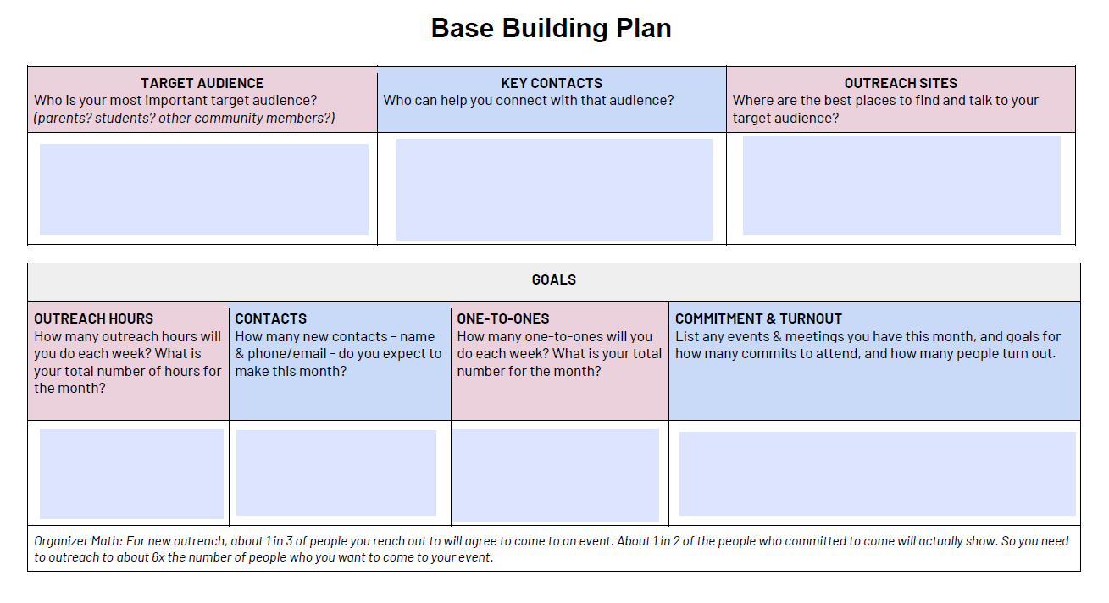
Page 23 Base Building Plan

Slide 87
Group Work
How do you Map your organization to find your leaders?
What tools, resources, supports do you need? What do you have access to at this moment?
Name, Role, Location, Work Schedule, Etc
What roles do you need them to play in a particular campaign?
A list of what you do not yet have

Slide 88
Key Ideas
Title does not indicate a leader.
Leadership characteristics (think True Colors do not make natural leaders.
Our primary job is to identify leaders who can build shared power, responsibility, and authority.
We grow our campaign’s resources for action by intentionally and continually increasing the base of people.
Our people are our greatest resource.

Slide 89
Pete

Slide 90
Building Power

Slide 91
Campaign Lab is a Structure to Build Power
It is an intentionally created and networked leadership structure focused on building and using power within and across issue campaigns.

Slide 92


Slide 93
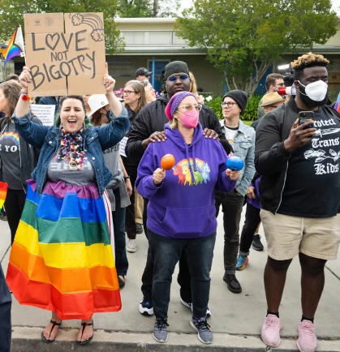

DEFINING POWER
Power is the ability to control, create, and prevent change.
Power is organized people and organized resources (money).
Power is not static, it is either waning or growing.

Slide 94

UNDERSTANDING POWER
Power is neutral
Our values affect the way we use power

Slide 95

TRUTHS ABOUT BUILDING POWER
Power has to be consistently built or it is waning
Not everyone wants us to have power and actively work to take our power away
Public actions through shared vision, shared purpose, shared resources, shared risk, and unity is how we build power
The bigger the win you want– the more power you need
Building power requires leadership

Slide 96

Discussion
Think about your Dreams and Villains chart
What kind of power will you need to achieve the dreams you want?
Think in terms of structures and leaders
    Structures and Teams of people

Slide 97
Key
Points
Intentional campaigns, not programs, build power.
The power to win is only built through people with a shared vision, making public commitments to act, to risk their collective resources, for the big meaningful changes they want.
The kind of power we needs depends a distributed and interdependent leadership structure.

Slide 98
Hedy and Beth

Slide 99
Self- Assessment

Slide 100
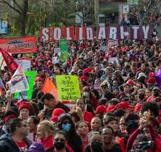
Strength and Growth Page 6
Strength is the ability to use power to win.
Growth is a focus on building the base of members, leaders, structures, and partners.
Think about the base building plan you just worked on.

Slide 101
Self-Assessment Cycle
Assess
Self assessment Tool
Prioritize
Which can we take on?
Plan
What ACTION can we put in place, by when
Review
What are the outcomes
Current Status
Which might build into other categories?
Who is responsible
What is our schedule for revisiting

Slide 102
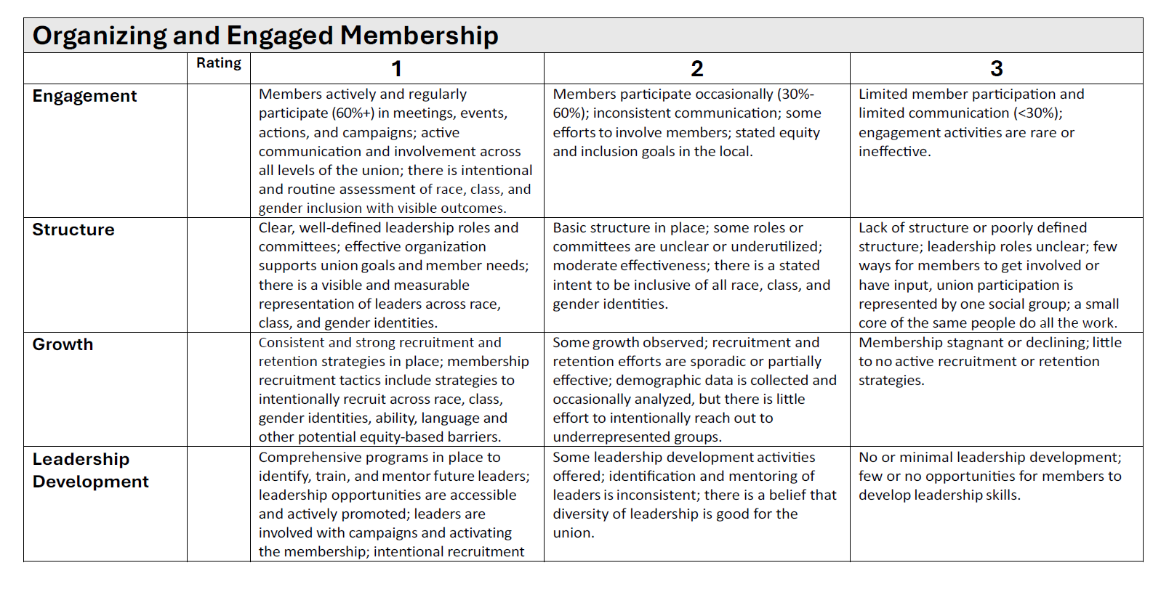
Tool Tour Page 6
Five broad categories with rows of descriptors
Rate each row then record a total for each category
Low Score is strength; High Score is growth focus

Slide 103

Report Out and Discuss
What did you notice?
Are these “internal” issues?
How can external campaigns help address your internal issues?

Slide 104

If there was a crisis, how prepared is your local?

Slide 105
Five Questions for Consideration- page 11
Has your local set goals for membership growth and participation? If yes, what are they?
2. What do you think are your organization’s main strengths that will allow you to build a strong union and effective campaign?
3. Overall, which of the areas above do you think are the largest challenges for your local?
4. In the areas that you’ve identified as your biggest challenges, what are the main barriers your local faces?
5. Which of the above areas do you think should be the top three priorities for your local to address?

Slide 106
Self-Assessment Cycle
Assess
Self assessment Tool
Prioritize
Which can we take on?
Plan
What ACTION can we put in place, by when
Review
What are the outcomes
Current Status
Which might build into other categories?
Who is responsible
What is our schedule for revisiting

Slide 107
Key
Points
Weaker locals are fixed, are leader sparse, are not focused on winning fights, are limited in capacity beyond single issues, and do not have enough resources to achieve the wins they want. Focus is on Growth.
Stronger locals are nimble, leader dense, have the ability to focus on a number of campaigns, are a series of interconnected structures, with the resources to achieve the wins they want. Focus is on Strength.

Slide 108
Amanda

Slide 109
Internal or External

Slide 110

What is the difference between and internal and external campaign?

Slide 111

Internal Campaign - Growth
Goal: To increase member engagement, leadership development, structural capacity, and activist participation.
Focus: Member-to-member communication, empowering members to address issues together, and breaking down the perception of the union as a distant service provider.
Activities: Training existing members to become leaders and activists, conducting member education, and building strong committees to ensure member involvement in union activities.

Slide 112

External Campaigns - Strength
Goal: To win specific demands for members and partners.
Focus: Active participation of rank and file members and partners, building towards broader and bigger coalitions
Activities: Issue identification, escalating and public actions, strategic pressuring

Slide 113

Internal or External?

Slide 114

How do we actually get eggs in your basket?
Email blast, or?
Survey blast, or?
Social Media, or ?
Hustle, or ?
Stuff a mailbox, or ?
That is why 1:10

Slide 115

Guided Group activity
Write one metric that would indicate you are achieving the goal for your campaign.

Slide 116

Guided Group activity
2. Given your current rep structure, how many worksites do you think would be able to get more than 50% of their workers to take a small action such as signing an online petition or wearing a sticker? If yes, you are ready for an external campaign.

Slide 117

Guided Group activity
3. For the rest of us, how do we get there? Where do you even start? Make a list of worksites or groups (for example by job category or department) that starts with your most committed and ends with your “best worst”- groups or worksites at least have some sign of being active.

Slide 118

Guided Group activity
4. Take some time to brainstorm how you might build those teams; refer to page 15 to help you with ideas. Put your ideas on your chart paper, and add questions you need to answer to put your plan in place.

Slide 119
Has you answer to this changed?
If there was a crisis, how prepared is your local?

Slide 120
Key Points
Internal campaigns build the power to win external campaigns.
External campaigns engage your constituents and bring in potential members and community support.
Internal and external organizing feed each other and are how locals build power.
Strategic campaigns combine multiple cycles of internal and external organizing to win on multiple issues towards long term strategic goals, such as achieving your vision for public schools.

Slide 121
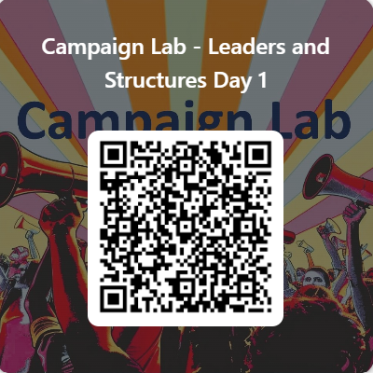
Feedback time
Goal – 100% Participation
6 Short Questions
We use what you give us

Slide 122

Closing the Day
What is becoming clearer?
What remains murky?
Housekeeping

