Slide 1

Coaching Fundamentals
Coaching Fundamentals
Notes:
Campaign Lab is a growing peer network of local NEA affiliates are

Slide 2







What symbol of a coach type resonates with you?

Slide 3
Our goals for this workshop
By the end of the session, you will…
Understand a capacity-building and leadership development approach to campaign coaching.
Understand core coaching skills including asking effective questions and centering the agenda of the person.
Gain awareness of yourself as a coach.

Slide 4
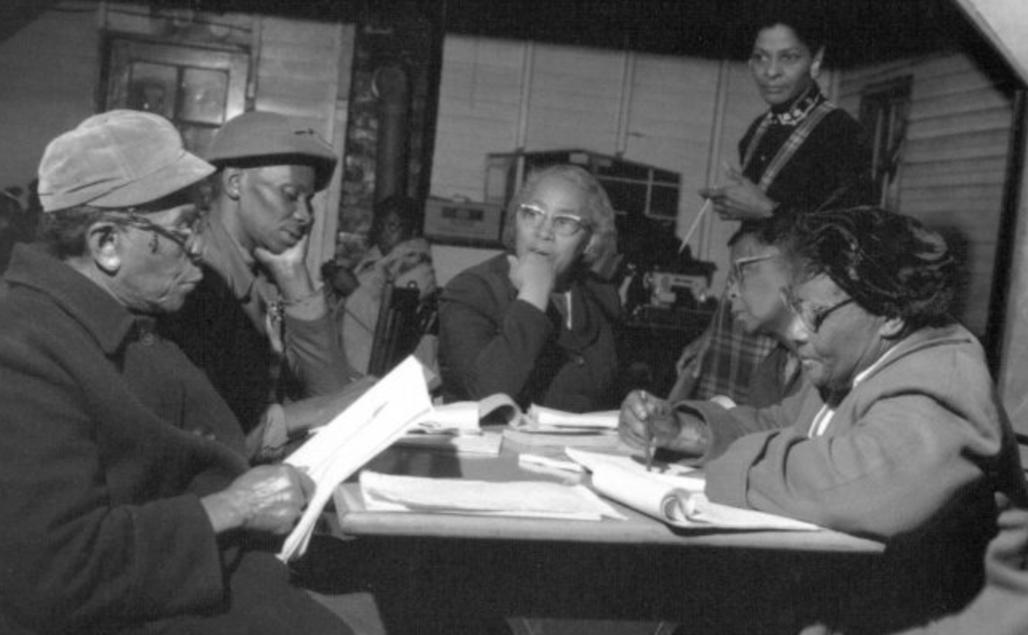
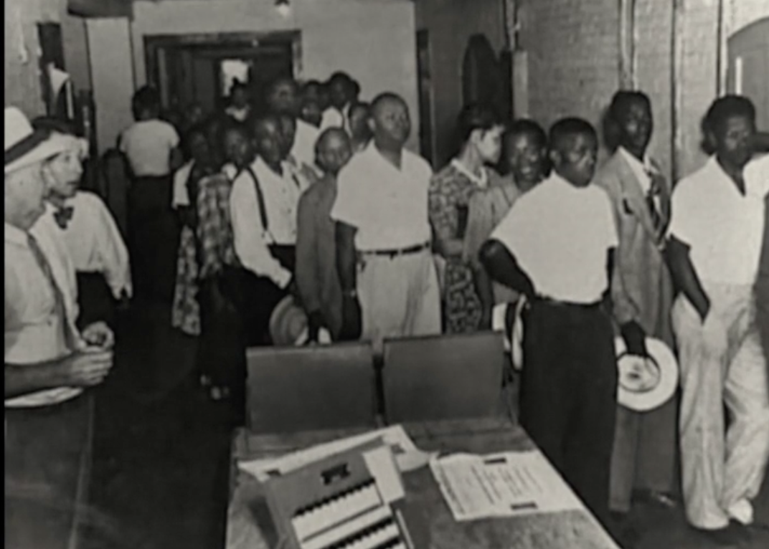
Our Coaching Lineage

Slide 5
Remember a time…
What’s a moment you remember someone providing the kind of support to you that exemplifies the role of a coach?
What were you feeling at the start of the conversation?
How did you feel leaving the coaching conversation? ​​
What did they say?
Notes:
Diagram on slide is the Box Step

Slide 6
In pairs:
Introduce yourself, briefly.
Share a little about your experience:
What did the coach (or other person) do?
What qualities did they demonstrate?
Notes:
START SCREEN SHARE

Slide 7
Qualities Effective Coach? Let's brainstorm
Notes:
START SCREEN SHARE

Slide 8
Coaching campaigns
Notes:
Diagram on slide is the Box Step

Slide 9
Key ingredients of a campaign...
An engaged leadership team
An active membership
A campaign theory of change
One to three specific demands for one to three targets
Power mapping
A tactic sequence of at least three public actions
Building parent and community support

Slide 10
What is Campaign Coaching?
What is Campaign Coaching not?
Notes:
START SCREEN SHARE

Slide 11
Campaign Coaches...
Support the leader as a whole person to deepen their vision, determination and capacity to lead.
Help leaders understand their own agency and gain clarity about what is needed.
Guide the leader to make their campaign and organizing more effective.
Explore how to overcome challenges and consider different possible paths.

Slide 12
Core Coaching Interventions
Most directive
Most elicitive
Suggestions + Advice
Feedback
Stories
Observations
Questions

Slide 13
Asking Questions
Why are questions important?
What do questions do that statements can’t?
Notes:
START SCREEN SHARE

Slide 14
Campaign Coaches ask questions to support the leader to:
Define their goals
Connect with their own agency
Understand what’s underneath the surface
Sharpen assessments
Explore different paths
Work through challenges
Prioritize

Slide 15
Coaching questions are like organizing questions...
WHAT and HOW questions that are open – ended to allow the leader tobe in the driver seat - problem solve and draw from their own experience.
WHO, WHEN, WHERE questions temporarily allow the coach to be inthe driver seat to uncover blind spots or move through difficultconversations.

Slide 16
Scenario:
Rebuilding the union and winning raises in a suburban district
Sarah is a newly elected President in a district in a small city. She and the other newly elected officers decided to run because they wanted a stronger union. Winning higher raises is a widely felt issue, but the officers aren’t sure how to get there. Sarah wants to start the campaign right away because she just attended a campaign training. Another officer Paul is worried about low member participation. And another officer Marie thinks that they don’t need a campaign and just should deal with it when bargaining comes up. Sarah is feeling frustrated but determined to figure it out.
The union currently has only 30% dues paying members. Many of those members believe the union needs to win salary increases. They aren’t aware of the role members can play, or how they can be involved in their union. They think of the union as a third party- someone else doing the work. These members can’t imagine what is possible or how the union could campaign for better pay. Just a small group of members goes to the union meetings.

Slide 17
Small Groups: 20 minutes
My Observations ➡️ | My “Gut Response” ➡️ | My Curiosity Underneath ➡️ | A Question I Could Ask 💬

Slide 18




Diagnosis
HEAD HEART HANDS
Strategic Motivational Skills
Notes:
Is the challenge motivational (effort/heart)?Is the individual struggling because s/he is not putting forth enough effort? Is she not trying hard enough because she’s embarrassed? Is he quitting too soon because of frustration or fear? Is s/he getting interference from other habits (e.g., someone well-versed in marketing speak may not know how to tell an authentic story)?
Is the challenge educational (information/skills/hands)?Is the individual struggling because he lacks the skill to execute effectively? Does he not know how to do it? Is she getting interference from older habits or behaviors (like someone who is so used to selling things confusing this with telling a story of self)? Is it something you could model or role-play with them?
Is the challenge strategic (strategy/head)?Is the individual struggling because s/he doesn’t know how to use the information or skills that she does have. Does he understand the concepts or underlying principles clearly? Has he not

Slide 19
Designing Interventions For Coaching
Observation - What do I see and hear? What is the challenge?
Diagnosis - Why is the problem a problem?
Intervention – Questions to create space for reflection

Slide 20
Small Group Activity: Asking Questions as a Coach
25 minutes
Break into groups of 6.
Come up with a team name
Diagnose the appropriate intervention (head/heart/hands)
What questions might you ask to help determine your diagnosis?
What questions might you ask to help with the intervention?
Notes:
Amanda read
Which stands out or do you have questions about

Slide 21
Share out!
Notes:
START SCREEN SHARE

Slide 22
Key Points
Debriefing and check ins are critically important because they allow the space and time to do these interventions.
The correct intervention is critical to supporting a persons growth and helping them find the answers.
Asking good questions helps us find the appropriate intervention.

Slide 23

Pause: Take a moment to come into presence and intention.
Ground: Tap into what's most important. What would you like coaching on today?
Align: What's getting in the way? What are the possibilities to move the forward?
Act: Clarity needs to act. What’s standing out for you? What might some next steps be for you?
Acknowledge: I want to acknowledge the work you did today.
The Structure of a Coaching Conversation
Notes:
Structure of a Coaching Conversation

Slide 24
Practice Coaching Pairs
Everyone will coach and be coached.
Take a moment for you to think about your problem that you would like coaching on.
Pair up with another person.
Coach using the structure of the coaching conversation.
Debrief: Spend 5 min to debrief after the coaching conversation

Slide 25
Debrief Questions – 5 minutes
What did you feel successful with as a coach or leader?
Did the coach support the leader’s growth such as deeper insight, clarity, skill or motivation?
What intervention did the coach use?
What would you change the next time you coach/are the leader?
What is a key takeaway from this for the next time you are coaching?

Slide 26
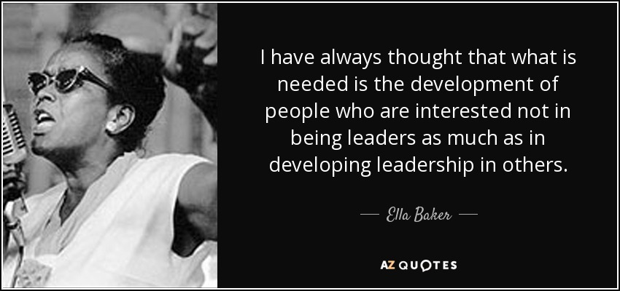

Slide 27
Who might be a good coach?

Slide 28
What style of coaching resonates with you?
Curious Co-Conspirator
Expert Campaigner
Cheerleader
Head Coach
Supportive Peer

Slide 29
Break into pairs
What style of coaching resonates with your approach?
How do you imagine yourself going forward using coaching skills?

Slide 30
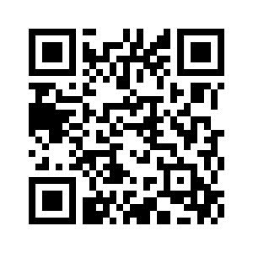
Apply to become a Campaign Coach
Participate in a historic national campaign committed to promoting, protecting, and strengthening public education.
The Commitment
Remotely coach 1-2 participating Campaign Lab leaders which is about a 5-7 hours monthly commitment.
Coach a campaign leader and plan, reflect on, and document coaching calls
Participate in virtual trainings and workshops
An initial 12 month commitment, with the possibility of extend.
The Opportunity
One year stipend: $1,100 for coaching 1 local team OR $1,800 for coaching 2 local teams
Training in methods and tools for coaching campaigns.
Mentor coaching from an experienced organizing coach.

