Slide 1


2026 COACH Kick Off!
Notes:
Campaign Lab is a growing peer network of local NEA affiliates are

Slide 2
NEA Members and Supporters
By attending this webinar, you confirm that you are a NEA member or staff person. The information you receive here is only for your use in your capacity as an NEA member or supporter.
This presentation and its contents are confidential and may not be further distributed or passed on to any other person or published or reproduced, in whole or in part, by any medium or in any form, for any purpose. Audio/video recording, copying of slides, and the use of AI note-taking tools are prohibited without the written consent. Violation of these terms may result in legal action.
Notes:
This slide should be inserted at the beginning, middle, and end of the presentation to provide notice to those who join after the introduction.
Amanda

Slide 3

NEA Standards of Conduct
NEA has adopted a Standard of Conduct Policy to ensure that all of our gatherings are welcoming to and free from discriminatory, harassing, or otherwise unacceptable behavior. Discrimination or harassment based on race, color, ethnicity, religion, sex, age, national origin, sexual orientation, disability, gender identity, or expression, or any other characteristic protected by law will not be tolerated. If you have experience any discriminatory or harassing behavior, please report the incident by emailing Ron "Duff" Martin (rmartin@nea.org) and Gladys Marquez (gmarquez@nea.org). Thank you for your commitment to ensuring a positive event for all.
Notes:
Amanda

Slide 4
Honoring This Space
We begin by acknowledging that through a history of colonization and brutality, we are currently on the traditional lands stewarded by generations of indigenous people.
We honor these indigenous people, all elders, past, present, and emerging. We are called to learn and share these learnings about this tribal history, culture, and contributions that have been suppressed in the telling of the story of what we now call the United States of America.
Notes:
Amanda

Slide 5

Agenda
Welcome , Introductions, and Overview (35 minutes)
Your Role as a Coach (5 minutes)
Focus Core Coaching Skill: Asking Questions (30 minutes)
Training: Coaching Skills + Practice (35 minutes)
Campaign Lab Nuts and Bolts (10 minutes)
Wrap Up: Q & A (10 minutes)
Notes:
Amanda

Slide 6


Our Thoughts as Coaches & Campaigners
Notes:
Share where we both learned coaching and how to organize a campaign.
In designing this coaching training, we realized part of what we have been struggling with is our own orientations on how we approach coaching. Are we coaching campaigns, or are we coaching individuals? Coaching and campaigning skills are different, so what is our focus? These questions matter and how we (Carrie and Amanda) come to our own understanding of the skills and tools needed for the training matters. We don't have a definitive answer to those questions, but we do think it's important that you understand where we are both coming from so you have a context for what we will share tonight.
Amanda and Carrie each briefly share how we learned campaigning and coaching.

Slide 7

Introduce Yourself!
Name, title, location
Years of campaign experience
Kinds of campaigns you have been a part of
Secret Superpower- gift, skill, or talent you bring to table (doesn't have to be campaign-related)
Notes:
Carrie
Groups of 3-4
Note takes is person whose birthday is coming up soonest.

Slide 8

How Campaign Lab Supports Local Campaigns
Leadership Development through Coaching
Campaign and Organizing Fundamentals: Tools and Training
Assessment, Evaluation, and Centering Equity
Strategizing and Collaboration
Notes:
Carrie
5 minutes

Slide 9

How we are thinking of the year ahead
Local assessment as a baseline.
Define clear goals and priorities for the work in Campaign Lab.
Deepen coaching as a practice through skills building.
Greater structure to the process of building a campaign.
Notes:
Carrie
5 minutes
These are some of the changes we have created based on your feedback. This are the main changes we are focusing on this year.

Slide 10
Your Role as a Coach
  Developing Leaders- Hold the Team Lead as a whole person to deepen their vision, determination and capacity to lead.
  Serving as a Campaign Guide - Guide the Team Lead to be rigorous about the process of building a strong union and campaign.
  What skills or capabilities do you have already for these two roles?
  What skills or capabilities do you still need to develop?
Notes:
Amanda
10 minutes
There are two prongs to being a coach in campaign lab.
Campaign: Support them through the Campaign Lab process. Hold them accountability to building a team and leading a campaign. We are asking this question honestly so we can develop our monthly sessions accordingly. Reflect and write your answers down. Put answers in the chat. Amanda will call on people who put in compelling answers to share more.

Slide 11

Why Coaching?
Enable leaders to grow, understand their own agency and gain clarity about what is needed.
Guide leaders to explore how to overcome challenges to make their campaigns and organizing more effective.
Notes:
Amanda- Coaching can help the Team Lead tap into their own wisdom to gain greater clarity.
Coaching can help the Team Lead understand and move through what is getting in the way.

Slide 12

Stickiness (or complexity) in leadership
What are some sticky themes in leadership?
Limiting Beliefs
A Team of One
Setting Boundaries
Learning from Fear
Ideas into Action
Addressing Bias
Bridging Difference
Navigating Conflict
Building Trust
Notes:
Carrie-
Brainstorm answers in the chat, and then show list to crystalize some core themes.
What are the common challenges that leaders experience

Slide 13

Asking Questions
Why are questions important?
What do questions do that statements can’t?
Notes:
Carrie
This is how we deal with those issues- we ask questions.
Ask for volunteers to come off mute.

Slide 14
Asking Questions as a Coach
WHAT and HOW questions that are open – ended to allow the Team Lead to be in the driver seat - problem solve and draw from their own experience.
WHO, WHEN, WHERE questions temporarily allow the coach to be in the driver seat to uncover blind spots or move through difficult conversations.
Ask concisely. Preambles aren't needed.
Build upon where they are going.
Silence and pause can give space to a deeper insight. Wait.
Interrupt to support greater clarity.
Invite them to consider different possibilities.
Notes:
Amanda read
Which stands out or do you have questions about

Slide 15

Asking powerful questions....
What is getting in the way?
What are might be another way to think of this challenge?
How is this challenge impacting how you feel about the work?​
What needs more clarity for you?
How might other people help with finding a solution?
What values or beliefs might guide you right now?
What’s the lesson for you in this situation?
What do you want to be spending more time on?
How are you adapting?
​
​
​
​
Notes:
Amanda-
What stands out or do you have questions about

Slide 16
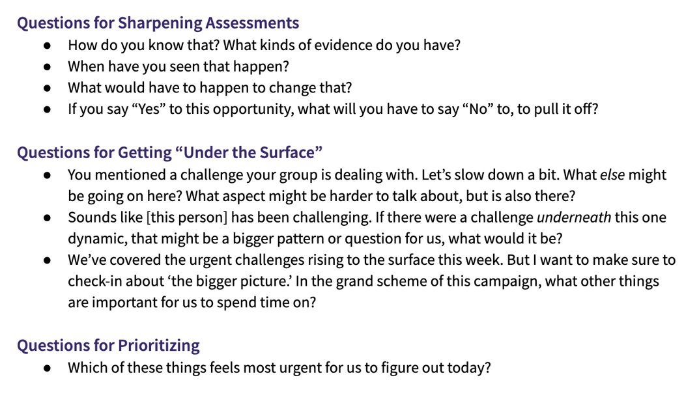
Training for Change
Notes:
Amanda-
I used these questions to train myself to not immediately jump to advice or diagnosis. You can start to use them for specific purposes.

Slide 17

Engaged Listening
Bring curiosity
What is not being said?
Mirror
Paraphrase
Reflect the feelings you hear
Maintain eye contact and open body language
Notes:
Carrie

Slide 18

Pause: Take a moment to come into presence and intention.
Ground: What would you like coaching on today?
Align: What's getting in the way? What are the possibilities to move the forward?
Act: I want to acknowledge the work you did today. What’s standing out for you? What might some next steps be for you?
Notes:
Carrie-
There is a framework you can use. If you use this, you are being a coach.

Slide 19
Coaching Triads – 35 minutes
Each group will have 3 people. 8 minutes for each coaching conversation. Each group should have one volunteer in these different roles:
Coachee: Share a challenge you are facing in your union work and receive coaching.
Coach: Ask powerful questions to help the person explore their challenge.
Observer: Observe the coaching conversation to note what was impactful.
Notes:
Carrie - 35 minutes. We will join for 10 minute sessions. Amanda will be floating, we will stay for 10 min segments

Slide 20

Debrief!
For 2 minutes share:
Observer: What did you observe in the coaching conversation? What went well? What might be something to adjust for the future?
Coachee: What was your experience being coached? What felt impactful or helpful to you?
Coach: How did it feel to be a coach? What worked well? What might you try differently next time?
Notes:
Amanda- We will put this in the chat. When they come back we will stop screen sharing and let them give feedback on experience.

Slide 21

Getting started with a new Team Lead
First Session
Coach shares what to expect with coaching
Team Leads share more about their goals for coaching
Get to Know the Team Lead
What might be helpful questions to ask in a first session with a Team Lead?
Who are you and how would you describe yourself?
What is helpful for me to know as we start coaching?
What might your goals in coaching be?
Notes:
Amanda- Who are you and how would youdescribe yourself?
What is helpful for me to know as westart coaching?
What might your goals in coaching be?

Slide 22
Campaign Coaches are local leaders with experience in campaigns and organizing. Campaign coaches are assigned to coach 1 or 2 local leaders who participants in Campaign Lab and serve as Team Leads.
Mentor Coaches are NEA or state affiliate staff. Mentor Coaches meet once a month with 1-2 campaign coaches to support them in their development as coaches and offer guidance in how they can support the local leaders.

Slide 23

Nuts and Bolts for Coaches
Campaign Coaches:
Meet twice a month with their Team Lead
Submit brief notes of coaching calls.
Mentor Coaches:
Meet at least once a month with the Campaign Coach.
Contact Campaign Lab staff as needed for guidance.
Monthly Calls: Both Campaign and Mentor Coaches:
Attend the All Calls: 3rd Tuesdays:1/20 7pm ET/ 6pm CT/ 5pm MT/ 4pm PT / 3pm AK
Attend monthly Coach Meeting: Take a Poll!
Let us know if you can't make the group meetings.
In Person Training: All coaches are encouraged to attend at least one in-person training: March 13-15 Coaching a Campaign Lead

Slide 24
Nuts and Bolts
Campaign Coach Notes: Campaign Coach Notes – Fill out form
Campaign Coach Stipend: $1100 for one Team Lead, $1800 for two Team Leads
Campaign Grant: How to Apply
Campaign Lab Seed Grant Request – Fill out form
Assessment: How to Access
Online Portal and Resources: How to Access

Slide 25


