Slide 1
Campaign
Coaching 101

Slide 2
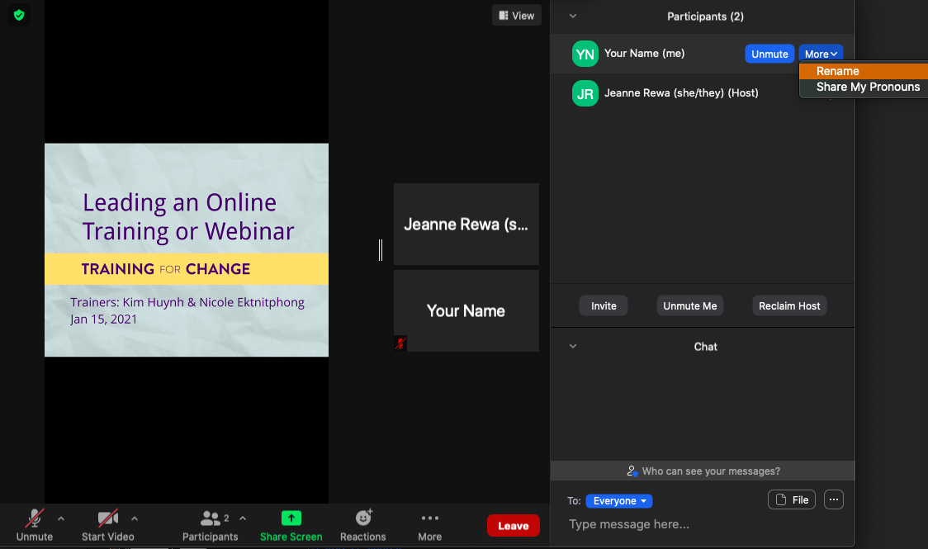
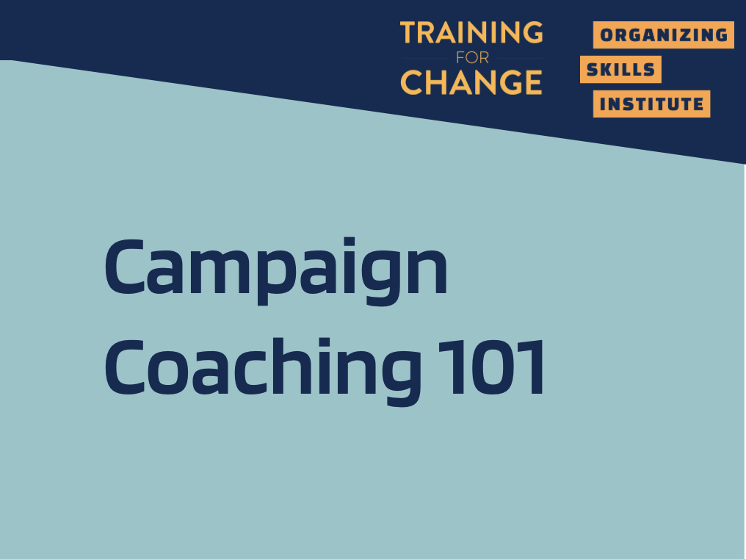
Rename yourself: Find your name at the top of the Participants list, click More then Rename. Add your name & location.
Notes:
Template by Training for Change • www.trainingforchange.org

Slide 3
Be present
Choose how you want to be in this space to support your learning
Remove distractions
Get drink/food
Get note-taking stuff
Notes:
Template by Training for Change • www.trainingforchange.org
Diagram on the slide is Swing

Slide 4

Share in chat:
Your name, pronoun & which picture represents the approach you want to bring as a coach?
1
2
3
4
5
6
7
Notes:
5 minutes

Slide 5
Why
We’re Here

Slide 6
Our goals for this workshop
By the end of the session, you will…
Understand a capacity-building approach to campaign coaching
Anticipate challenges unique to campaign coaching and add tools to your coach toolbox
Practice prepping for a coaching session
Gain awareness of self as a coach

Slide 7
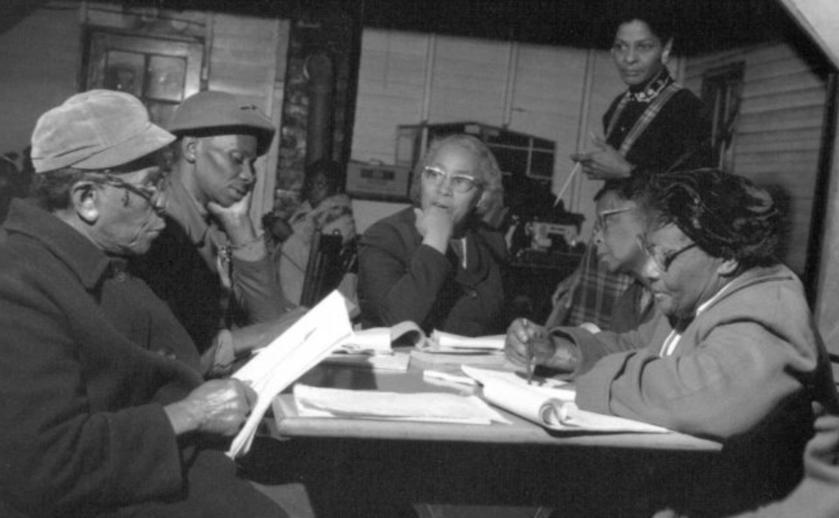
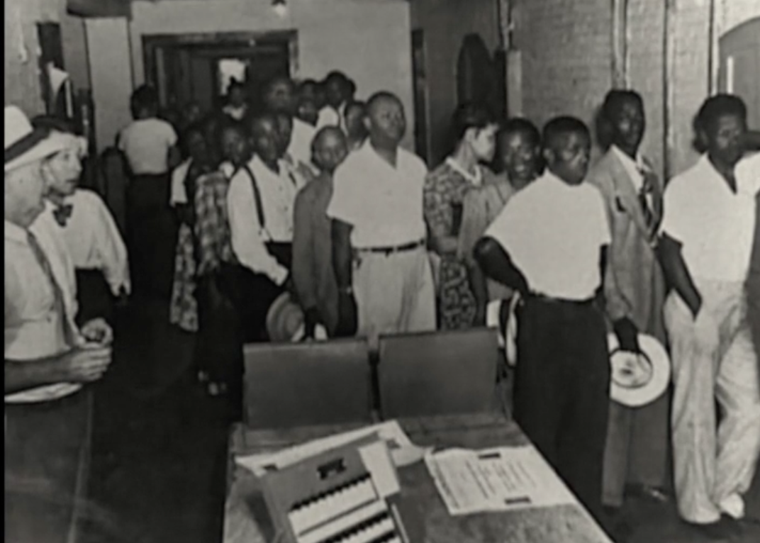
Our Coaching Lineage

Slide 8
Remember a time…
Notes:
Diagram on slide is the Box Step

Slide 9
In pairs:
Introduce yourself, briefly.
Share a little about your experience: What did the coach (or other person) do? What qualities did they demonstrate?
Notes:
START SCREEN SHARE
Breakout room - 10 minutes

Slide 10
Qualities of an Effective Coach
Notes:
START SCREEN SHARE
Melissa will scribe

Slide 11
Core Coaching Interventions
Most directive
Most elicitive
Advice
Feedback
Stories
Observations
Questions

Slide 12
Crafting Coaching Questions
Scenario: I’m starting to coach a local that is organizing a campaign to bargain their first contract after gaining union recognition. A challenge the local faces is being new to bargaining and running campaigns. The local has the drive and desire to organize around this issue but is reluctant to ideas that involve engaging members. How do I be supportive and move the campaign forward but also look for openings to reconsider strategy? How do I explore what decisions are set in stone and what can be reexamined? How do I navigate the reality that it's often other staff (both national and state) that laid this problematic groundwork to begin with?
Notes:
START SCREEN SHARE

Slide 13
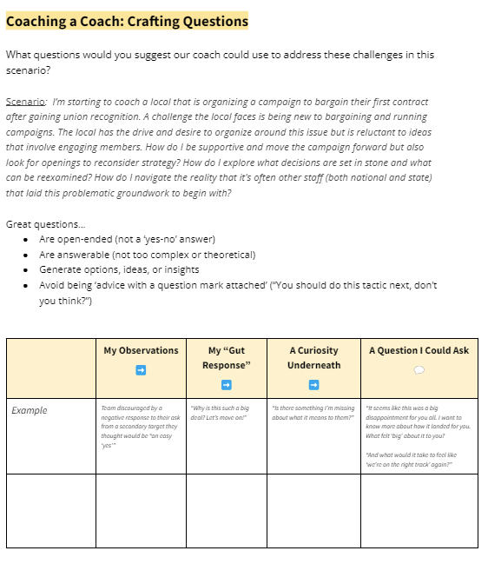
Notes:
START SCREEN SHARE

Slide 14

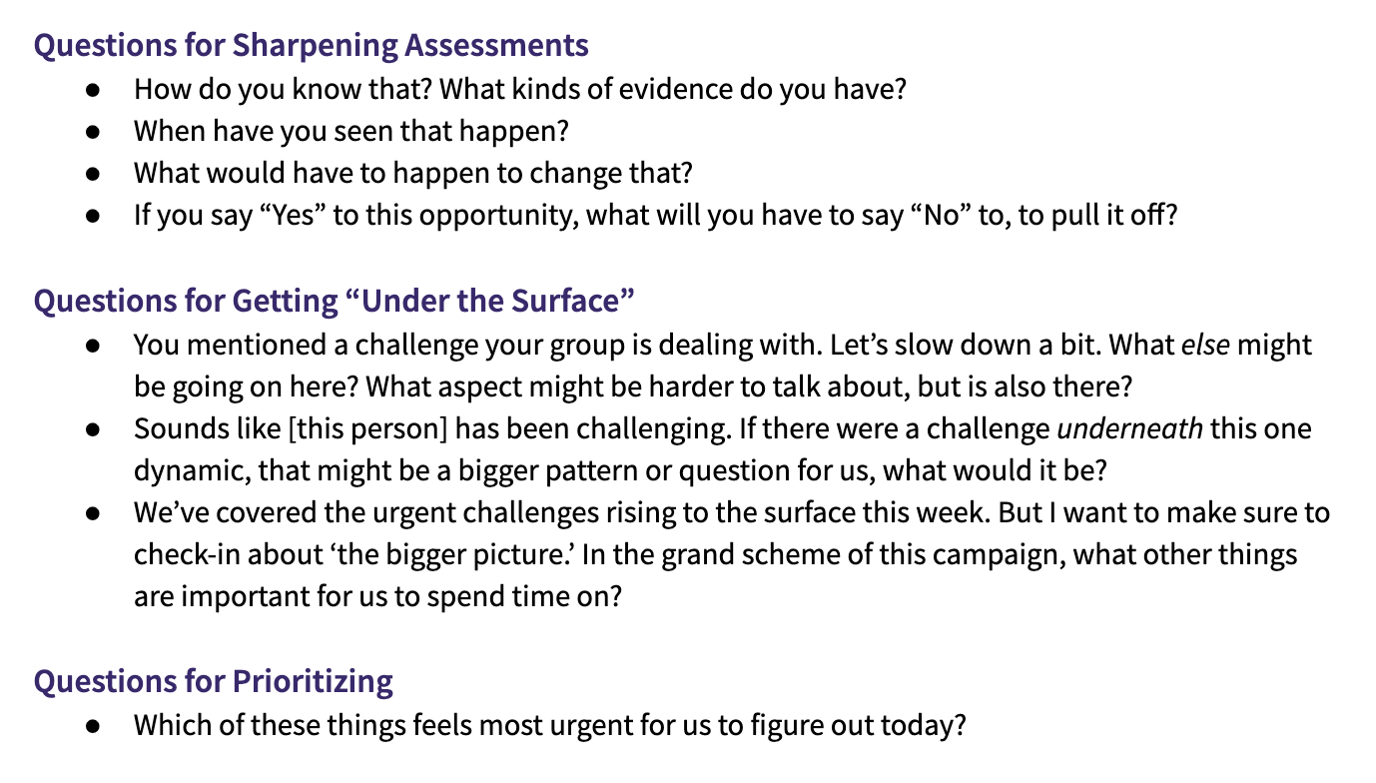
Notes:
START SCREEN SHARE

Slide 15
Coaching campaigns
Notes:
Diagram on slide is the Box Step

Slide 16
Campaigners can…
Read a political landscape
Assess their potential allies and opponents
“Cut an issue” from a big problem to a set a of winnable (local) demands
Pick fights that will build our base and develop new leaders
Use a tactic sequence to create a crisis for our targets

Slide 17
Campaign Coaching
What It Is | What It Isn’t
Helping organizers become strategists and lead powerful local campaigns | Making key strategy decisions for a local group
Supporting strong containers for collective action and shared power | “Answering questions that come up” as an external consultant
Balancing the need to learn and develop skills with running a “live” campaign | Having “catch up calls” without preparing questions to support the group through challenges

Slide 18
A Campaign Story

Slide 19
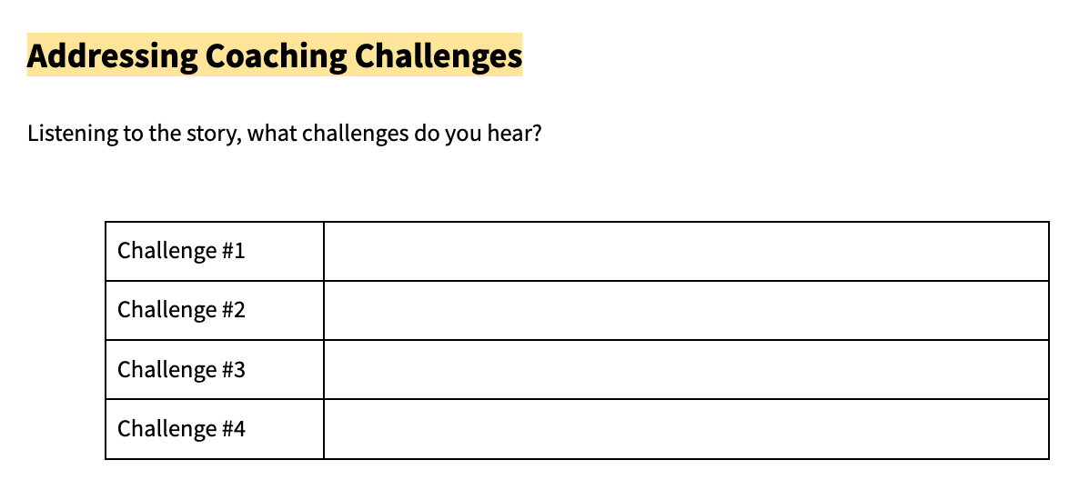
Listening for Challenges
Notes:
START SCREEN SHARE

Slide 20
Challenges in the Story
Challenge #1
Challenge #2
Challenge #3
Challenge #4

Slide 21
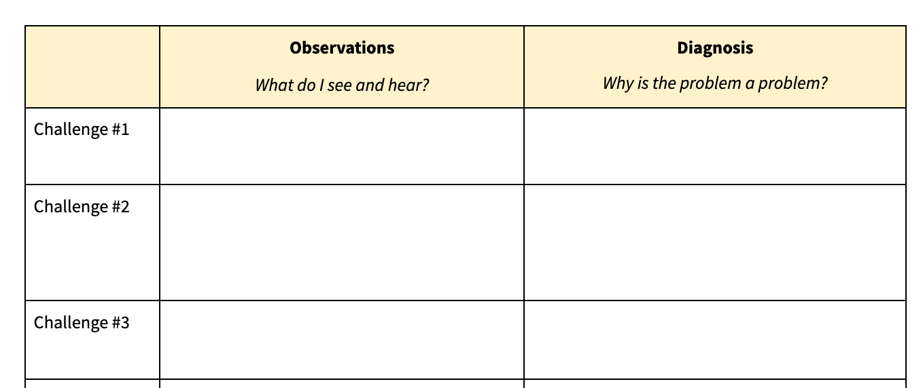
Breakouts:
Practice Designing Interventions
Political makeup of board
How to keep momentum going
Not having a lot of experience
Notes:
START SCREEN SHARE

Slide 22
Getting to “Our Story of the Problem”
 | Observations | Diagnosis
Challenge #1 School Board
Challenge #2: Keeping momentum going
Challenge #3: Team not having a lot of experience
Challenge #4

Slide 23
Break time!
Return by :XX

Slide 24
Practice time!

Slide 25
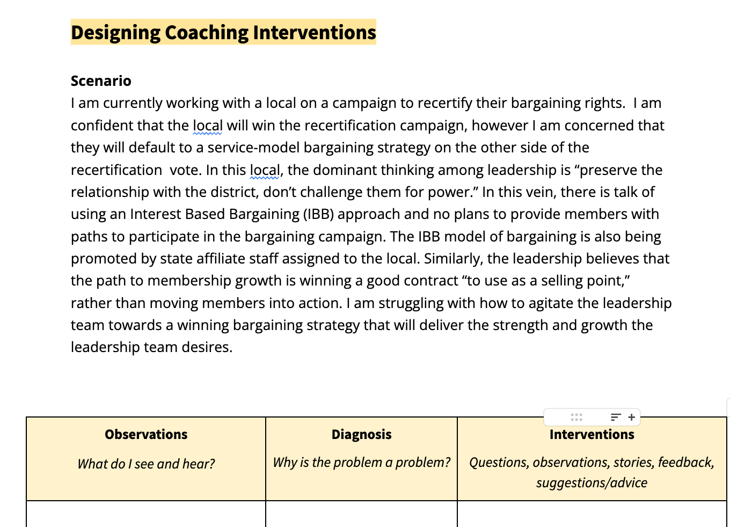
Breakouts: Practice Time
Notes:
START SCREEN SHARE

Slide 26
Journal: What would you do?
Imagine you are the coach for this group. How might you prepare for your next coaching session with them? What coaching response might you go for and what tools would you prepare? What will you say, what you will ask, etc.
Use the previous slides to prepare. You have 5 minutes, and then we will share in breakouts.

Slide 27
Practice Partners
You’ll have 10 minutes in pairs to share how you prepared to be a coach in this scenario.
For example, what questions are you planning to ask? What tools will you use? What are your goals for the session?

Slide 28
Practice
Debrief
Notes:
Return to a large group and debrief.
“How was that? What came up in pairs? How are you feeling right now? How would it feel to walk into that next coaching session? What did you try? Say more about what you prepped? How did it go to try prepping that?...”
Unpack for options, use of tools, use of responses to challenges, toward mini successes or risks, and to surface the range of effective styles and approaches to coaching.
GENERALIZATION (12)
Invite in chat or out loud: “Given our discussion, what’s one lesson you’re learning about being an effective campaign coach?” and/or “What do you notice about the different ways people prepped? What meaning do you make of that?”
Elicit generalizations, a-ha moments, and lessons from the group
Affirm the range of styles and ways to approach coaching challenges.
Opportunity for trainer to name patterns or gaps in how participants prepped, and stick up for a style, option, or tool that’s on the margin.
7 minutes - Fishbowl

Slide 29
Designing Interventions
 | Observations | Diagnosis | Interventions
Challenge #1
Challenge #2
Challenge #3
Challenge #4

Slide 30
What’s next?
We’ll be sending you:
The slides from today
Handouts

Slide 31


Check out:
Campaign Resources
PODCAST: Craft of Campaigns
WORKBOOK: Strategy Workbook
COACHING: Campaign Strategy Fellowship
More from Organizing Skills Institute
Other OSI workshops
Tools on organizing, action, and strategy

