Slide 1
Campaign
Coaching 101

Slide 2
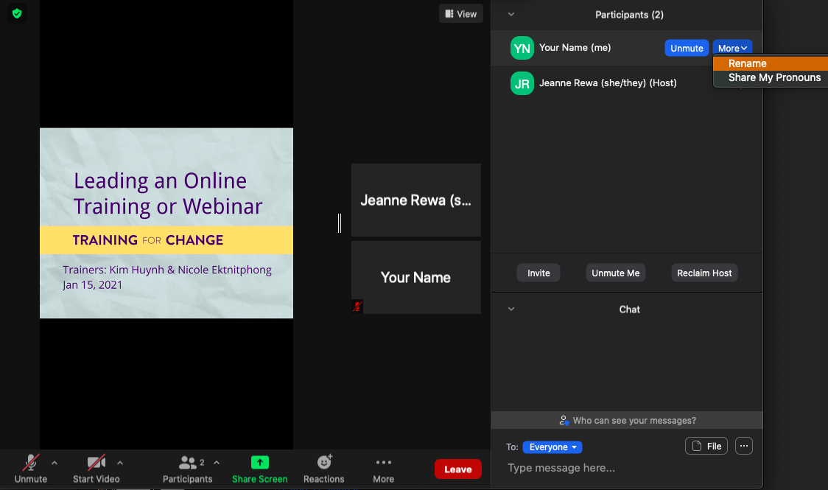

Rename yourself: Find your name at the top of the Participants list, click More then Rename. Add your name & location.
Notes:
Template by Training for Change • www.trainingforchange.org

Slide 3
Be present
Choose how you want to be in this space to support your learning
Remove distractions
Get drink/food
Get note-taking stuff
Notes:
Template by Training for Change • www.trainingforchange.org
Diagram on the slide is Swing

Slide 4
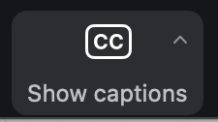
Closed Captioning
Click Show Captions in the toolbar
(if you don’t see it, look under More)
Notes:
Template by Training for Change • www.trainingforchange.org
Visual guide for how to turn on closed captioning is very important when you have a live captioner in your online meeting. It is recommended to also paste in chat:
==========
Live closed captioning available. Click “Closed Caption” in the toolbar and “Show Subtitle” to view the captions. Click “Subtitle Settings…” for more options.
==========

Slide 5
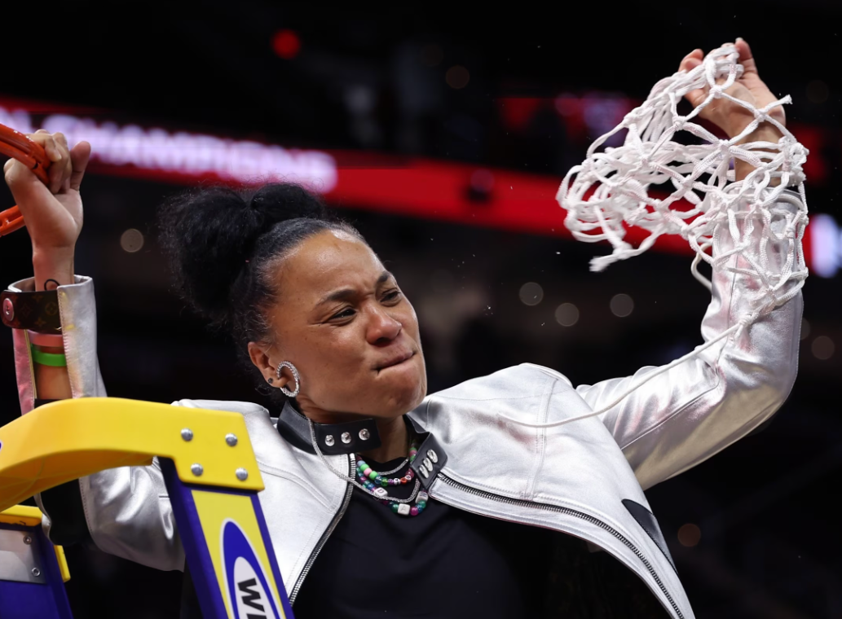
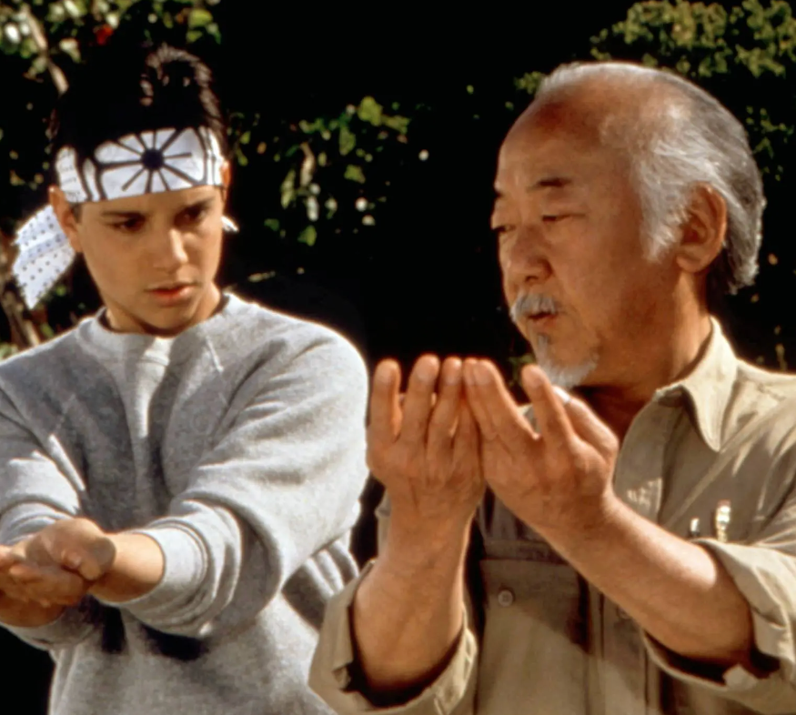

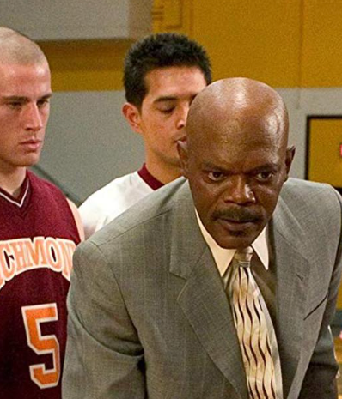
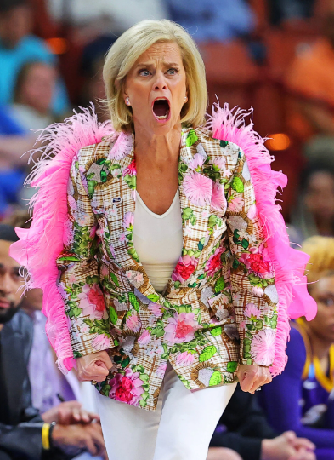
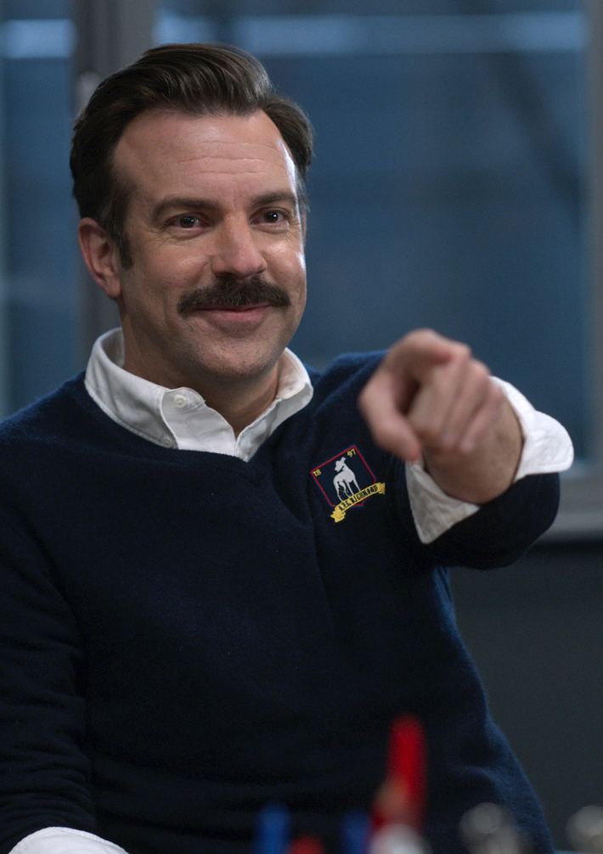
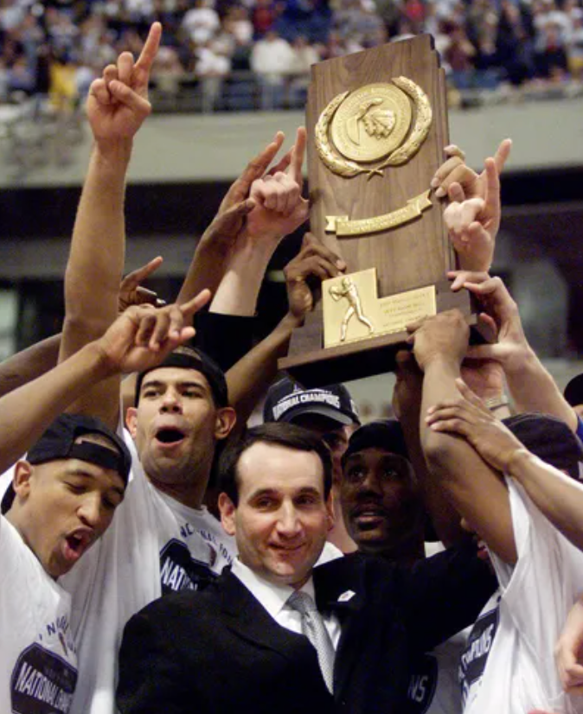
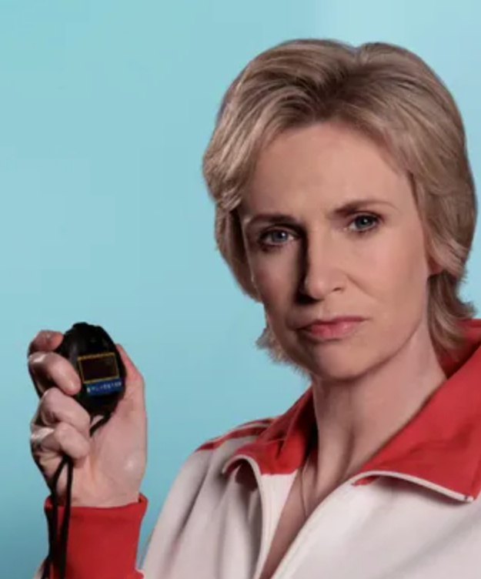
Share in chat:
Which best represents what you want to bring as a coach? Share the number and a bit about why in chat.
1
2
3
4
5
6
7
8

Slide 6
Why
We’re Here

Slide 7
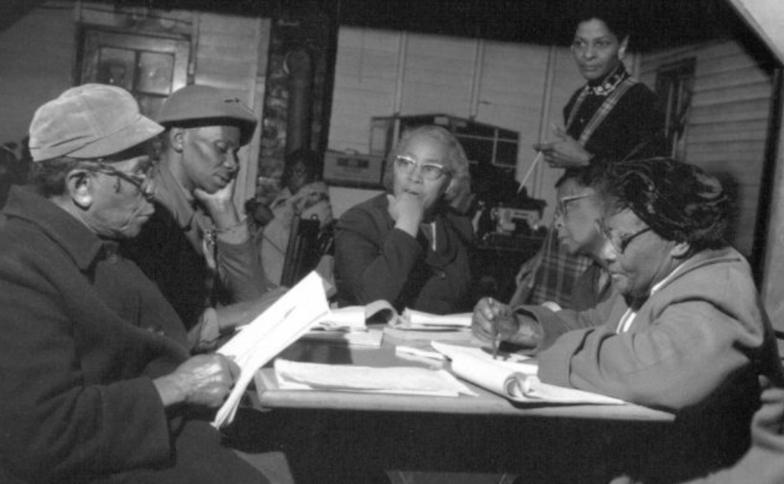
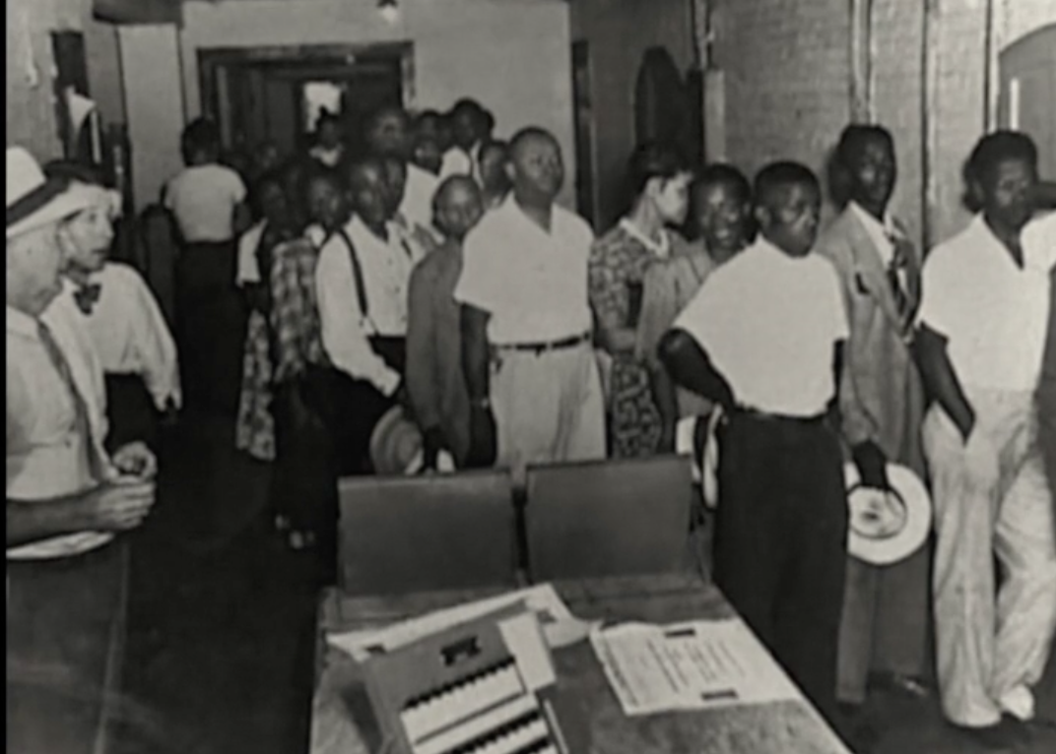
Our Coaching Lineage

Slide 8
Our goals for this workshop
By the end of the session, you will…
Understand a capacity-building approach to campaign coaching
Anticipate challenges unique to campaign coaching and add tools to your coach toolbox
Practice prepping for a coaching session
Gain awareness of self as a coach

Slide 9
Remember a time…
Notes:
Diagram on slide is the Box Step

Slide 10
In pairs:
Introduce yourself, briefly.
Share a little about your experience: What did the coach (or other person) do? What qualities did they demonstrate?
Notes:
START SCREEN SHARE

Slide 11
Qualities of an Effective Coach
Empathy
Nonjudgmental observations
Expresses excitement about the thing we’re doing (including for the learning process)
ID resources someone needs to learn
Helps learner ID what’s working, not working
“Sounding board” vibe
Recognizing an obstacle (like frustration or overthinking) + designing an intervention / question / suggestion around it
Offers “empowering” interventions
Notes:
START SCREEN SHARE

Slide 12
Core Coaching
Skills
Questions
Observations
Stories
Feedback
Suggestions/Advice

Slide 13
Core Coaching
Skills
Drag and drop a + on those you are more comfortable using and a - on those you are less comfortable with.

Slide 14
Scenario
Notes:
START SCREEN SHARE

Slide 15
Coaching campaigns
Notes:
Diagram on slide is the Box Step

Slide 16
Organizing is…
Campaigns are…
people coming together for collective action toward shared purpose; it involves building and wielding power to create change.
Organizers recruit new people, develop their skills and leadership, and create opportunities for them to take action toward shared interests.
Organizers take the responsibility of building the structures and strategies needed to achieve collective goals.
Organizers cultivate and leverage their own strength and skills toward organizing others.
strategic sequences of actions toward achievable demands;
they activate community leaders and engage key constituencies to pressure clear targets to make change.

Slide 17
Campaigners can…
Read a political landscape
Assess their potential allies and opponents
“Cut an issue” from a big problem to a set a of winnable (local) demands
Pick fights that will build our base and develop new leaders
Use a tactic sequence to create a crisis for our targets

Slide 18
Campaign Coaching
What It Is | What It Isn’t
Helping organizers become strategists and lead powerful local campaigns | Making key strategy decisions for a local group
Supporting strong containers for collective action and shared power | “Answering questions that come up” as an external consultant
Balancing the need to learn and develop skills with running a “live” campaign | Having “catch up calls” without preparing questions to support the group through challenges

Slide 19
A Campaign Story

Slide 20
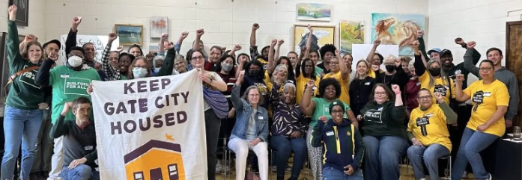
Keep Gate City Housed

Slide 21
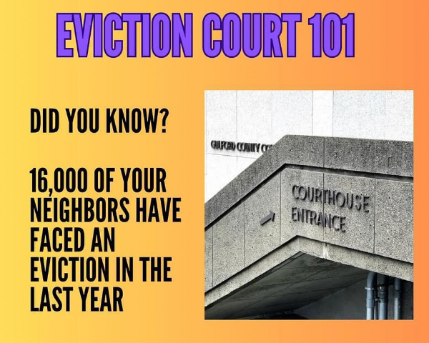
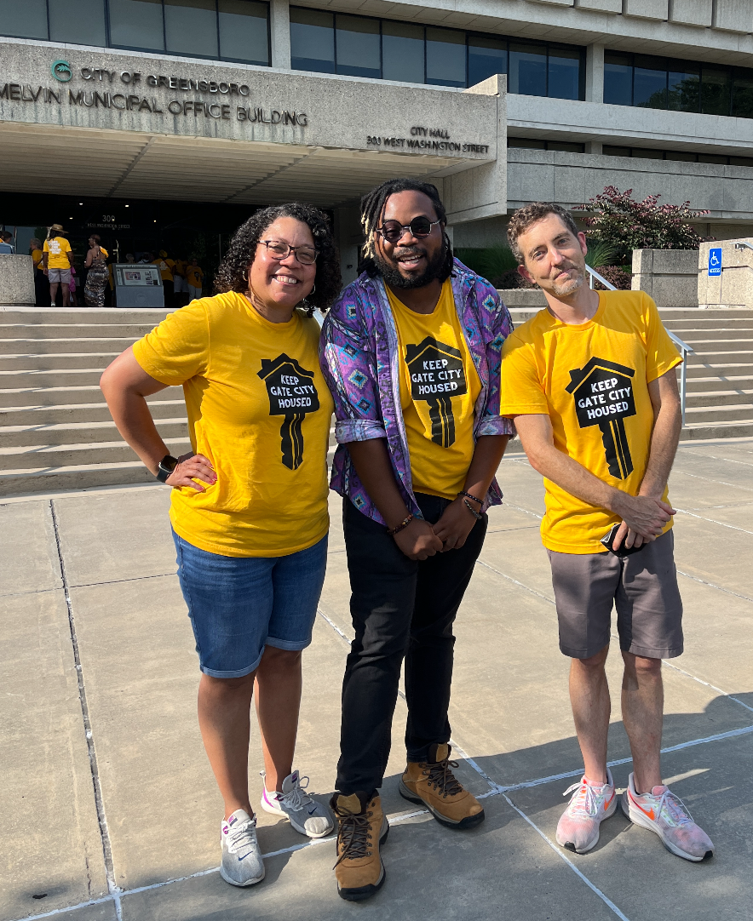

Slide 22
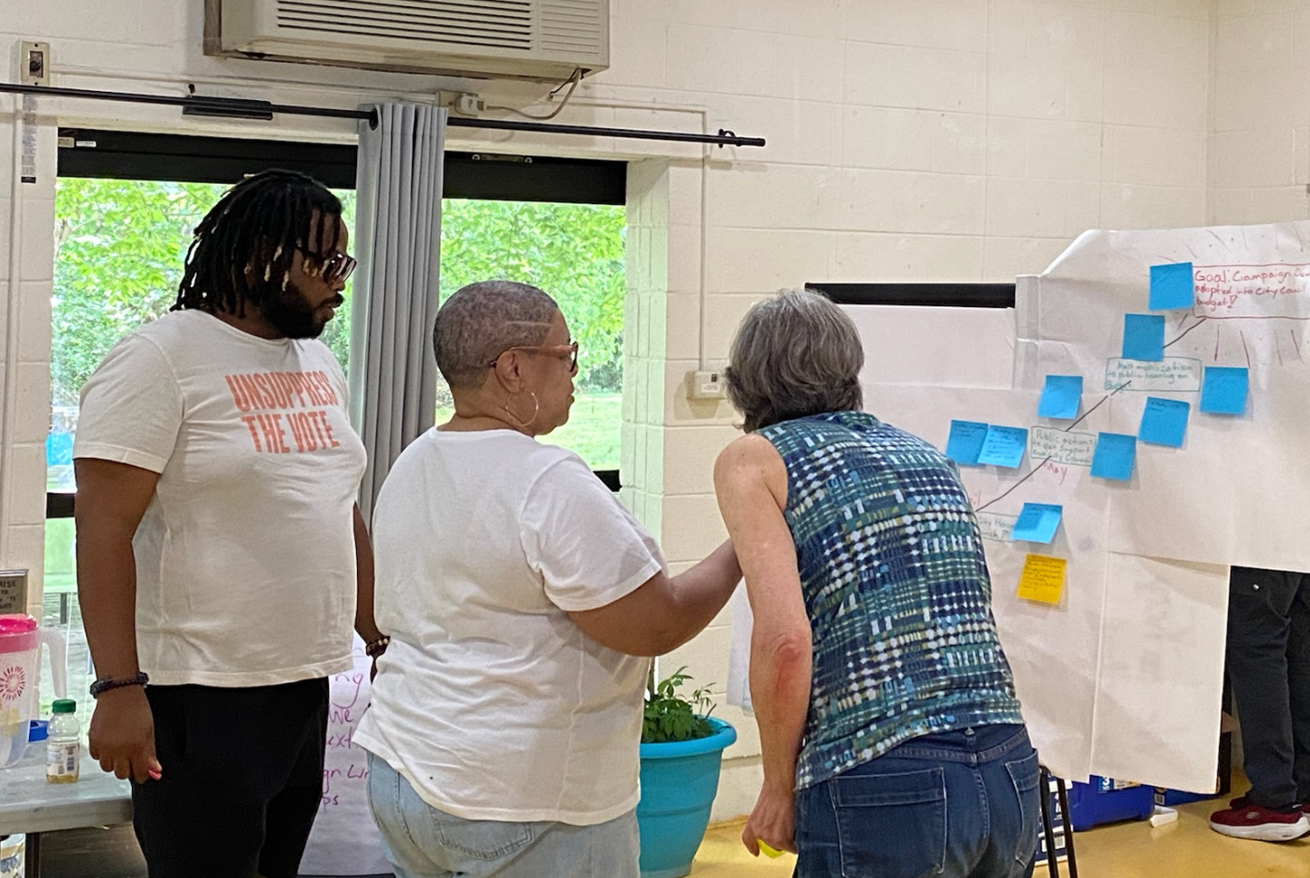
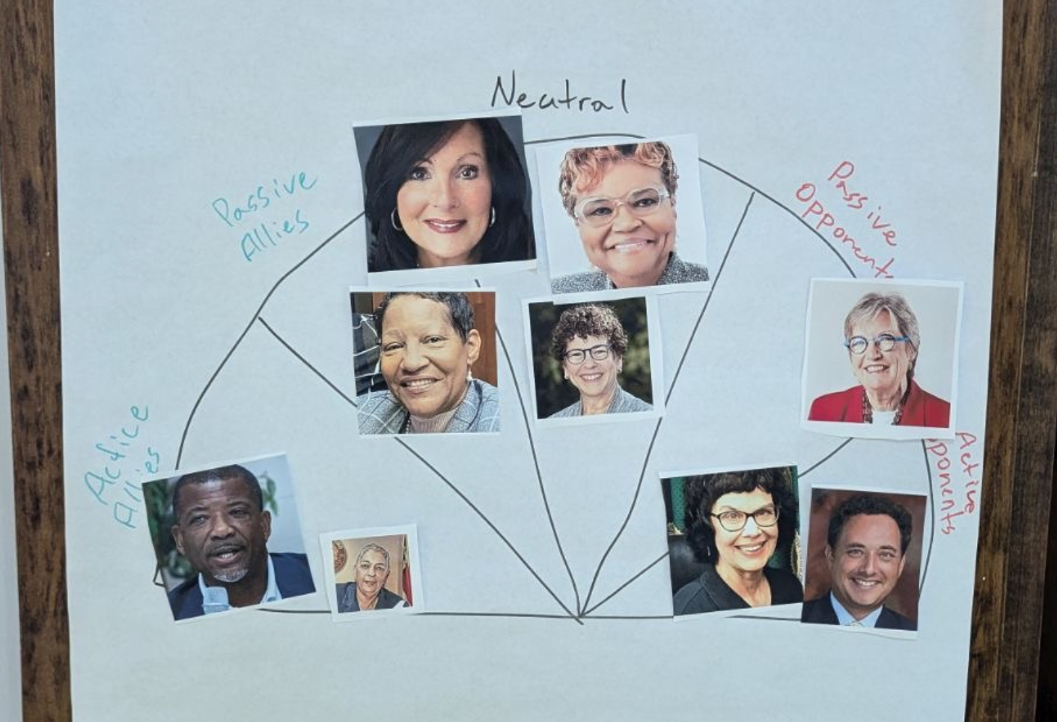
Planning

Slide 23
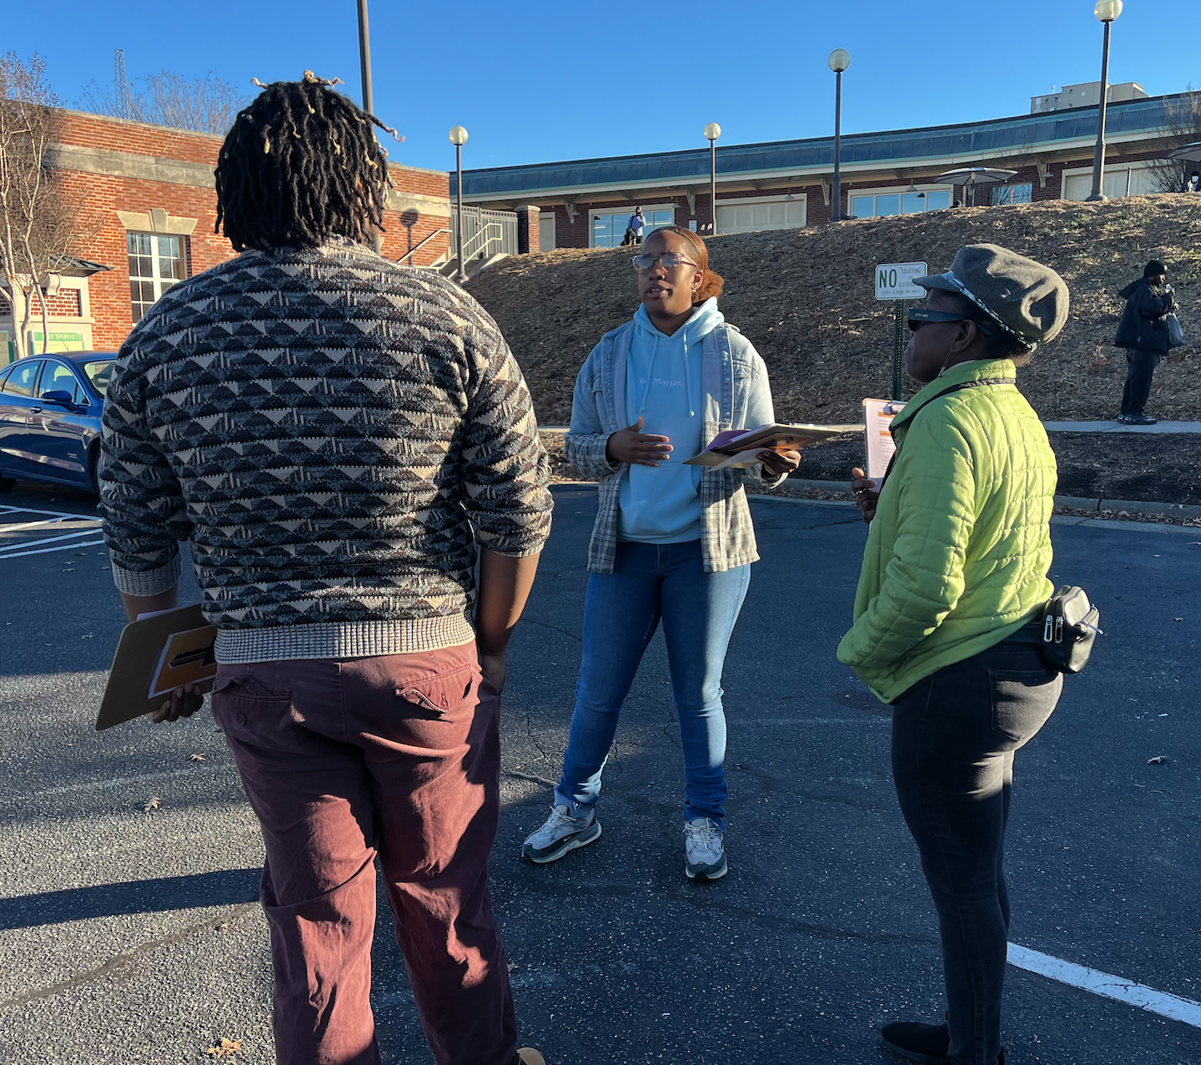
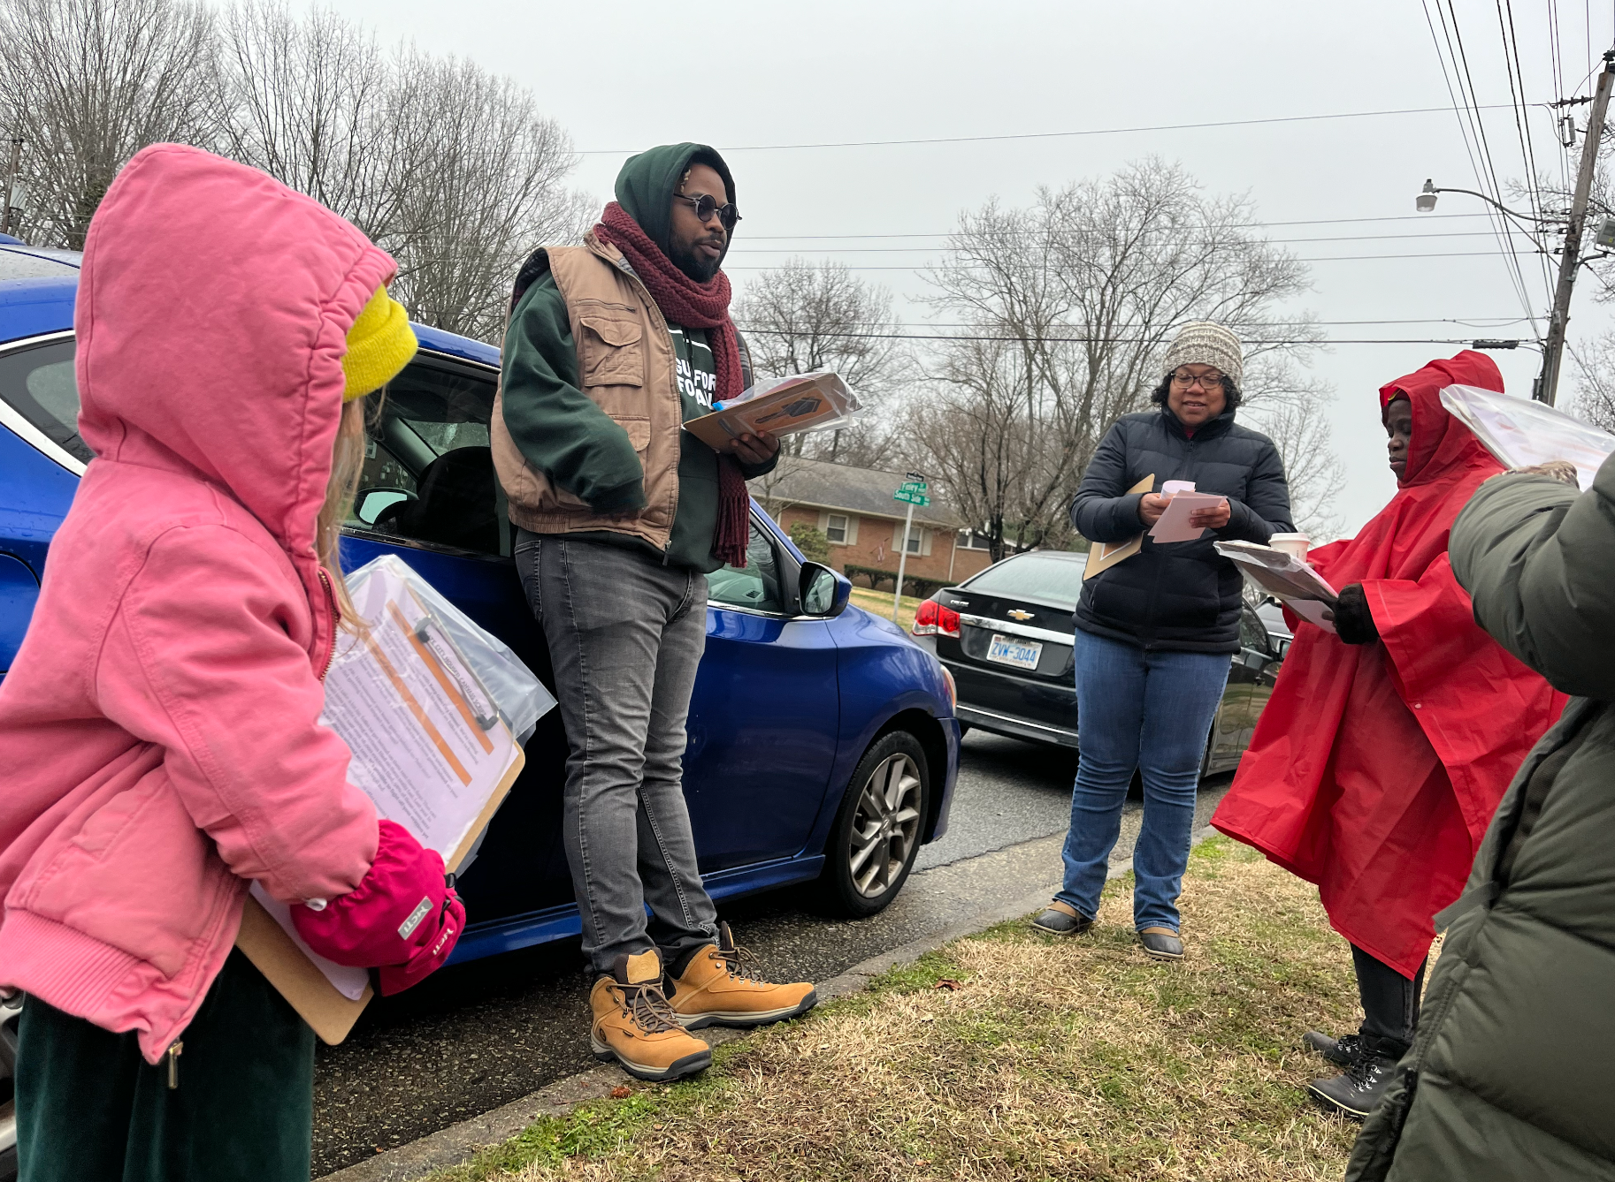
Outreach & Recruitment

Slide 24

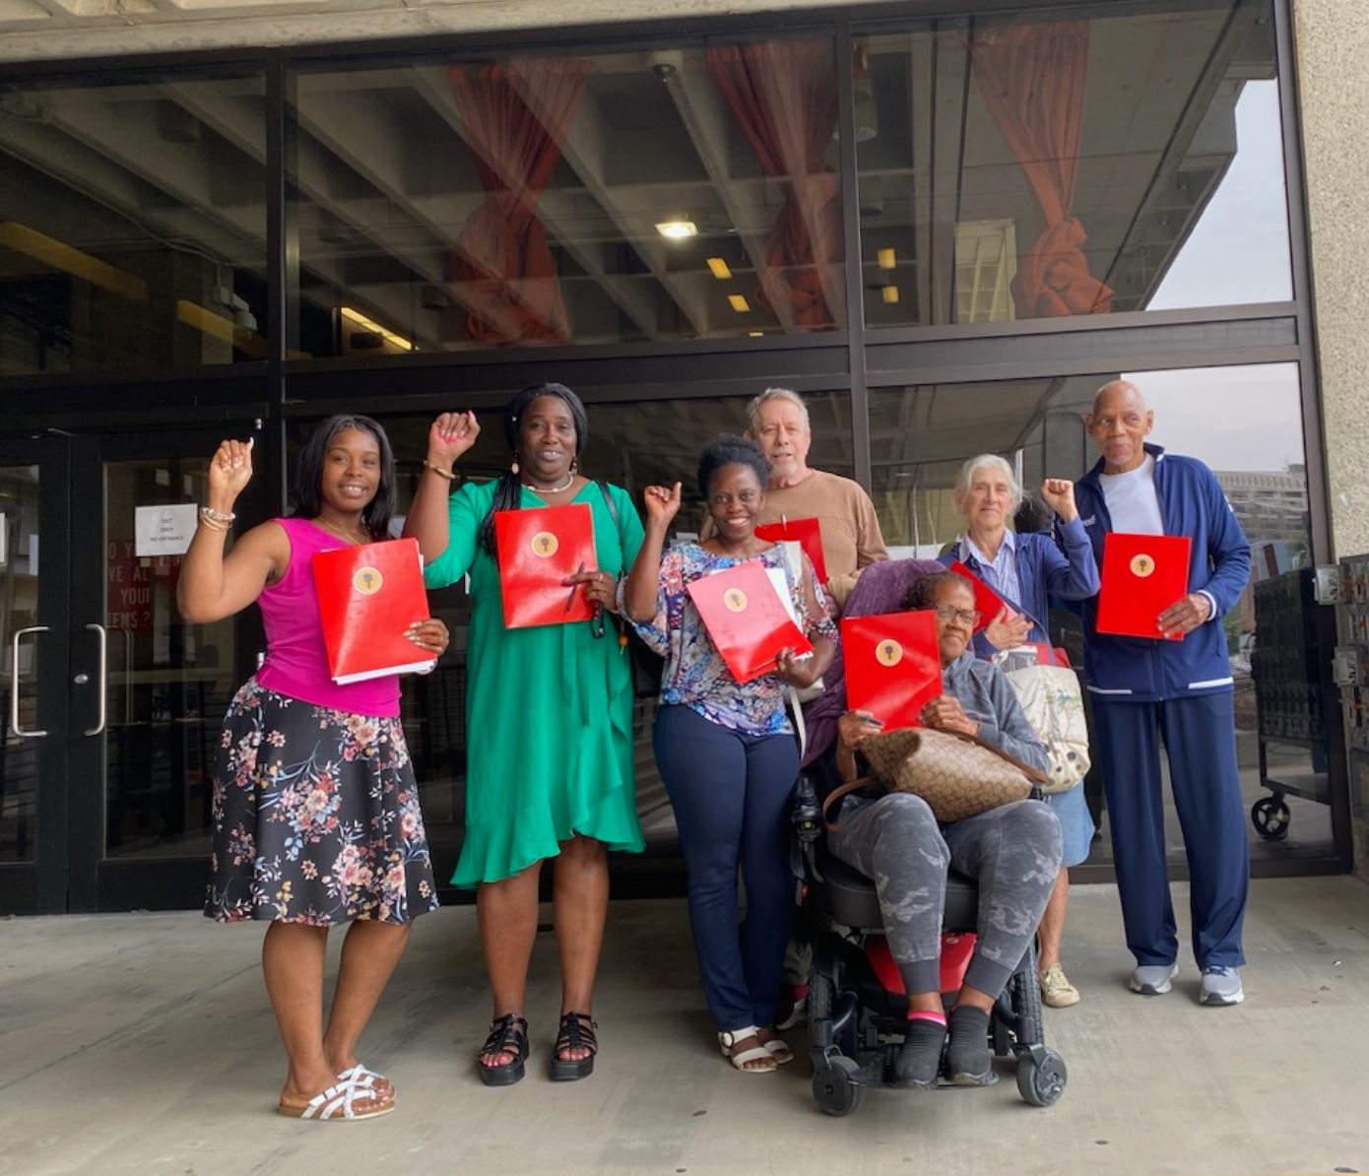
Court Watch

Slide 25
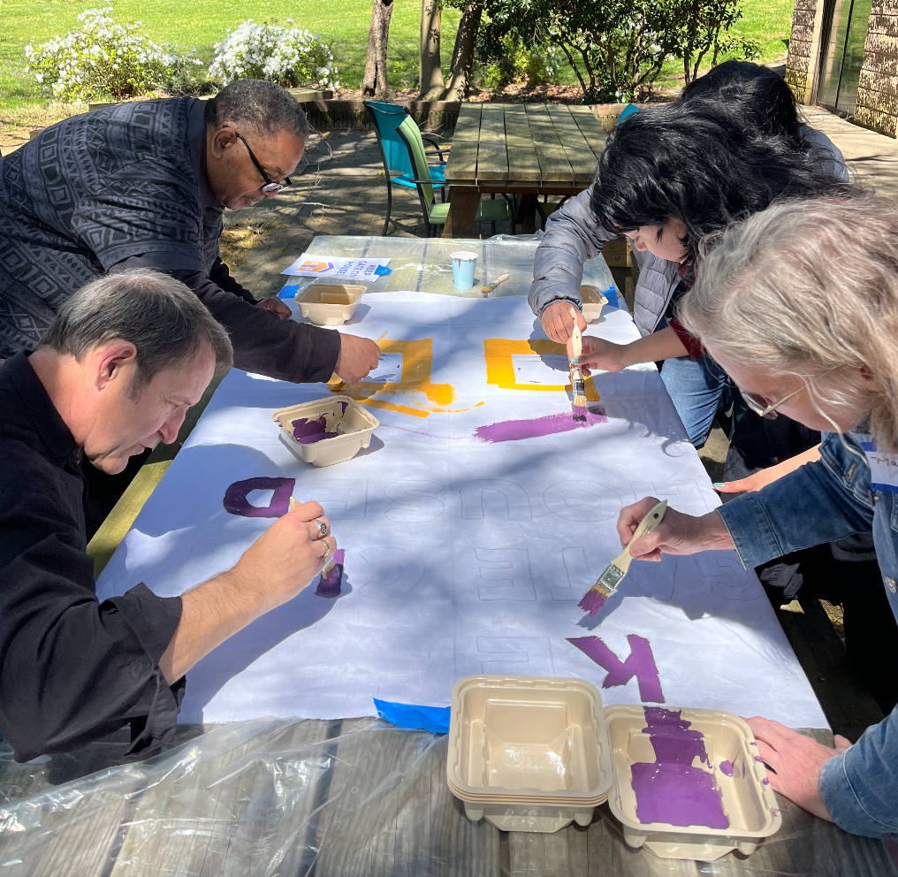
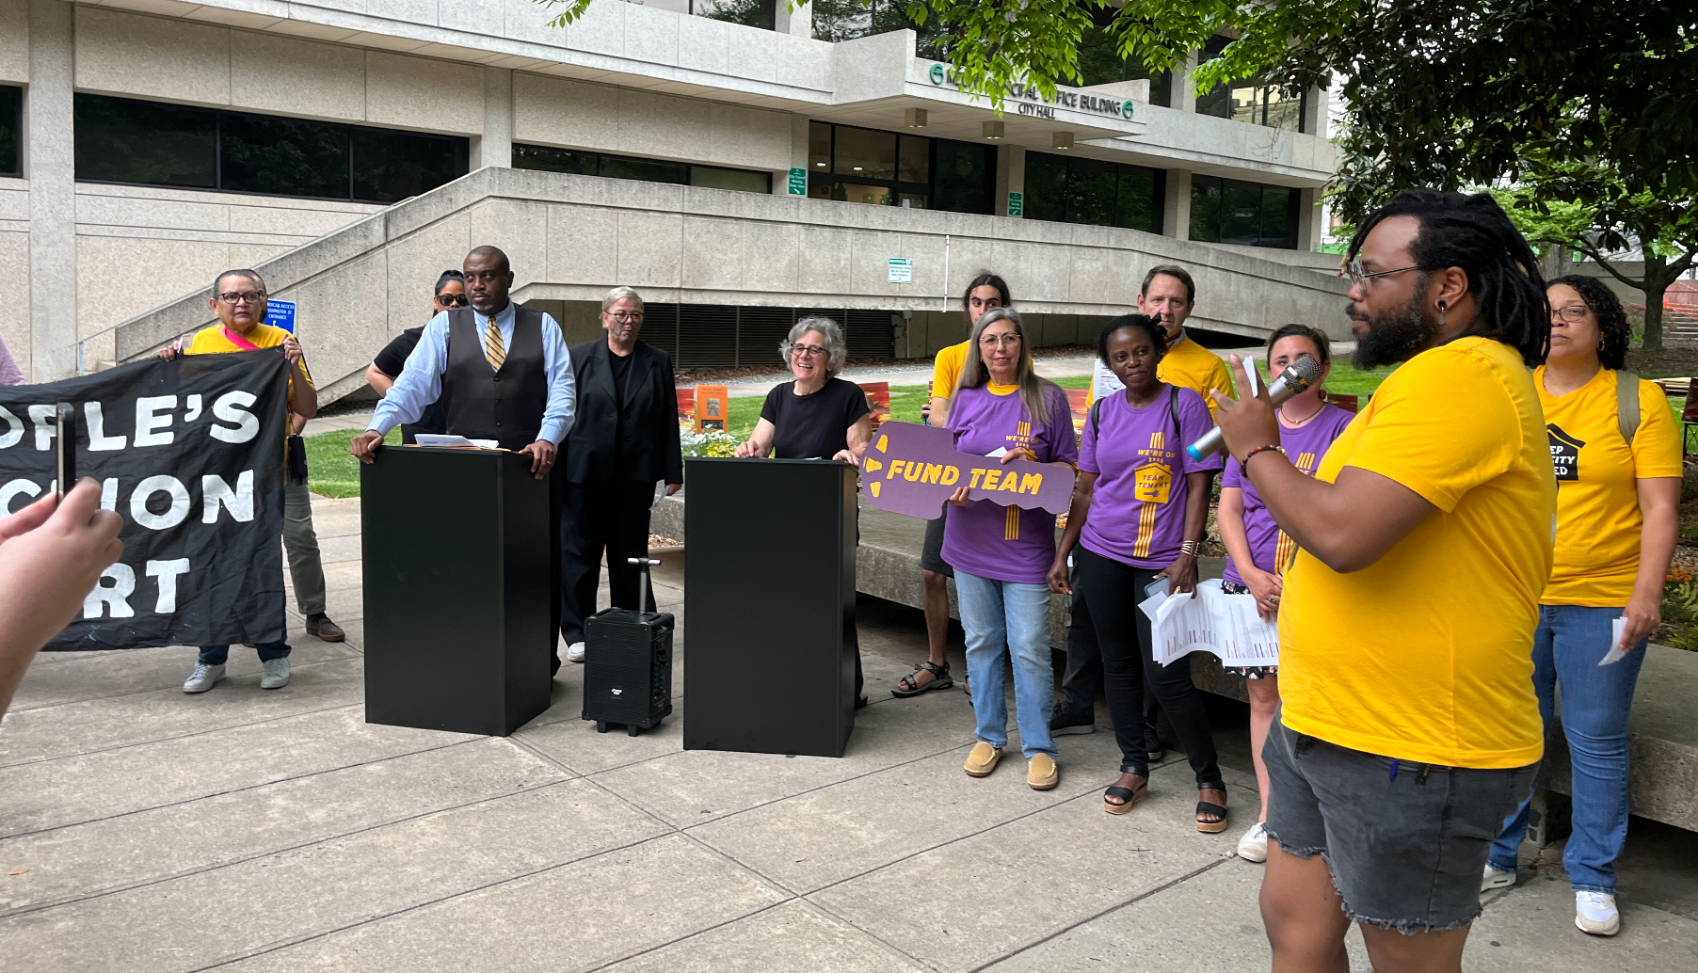
First Public Action

Slide 26

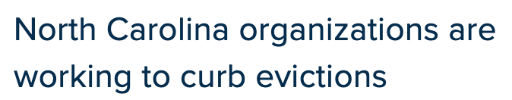

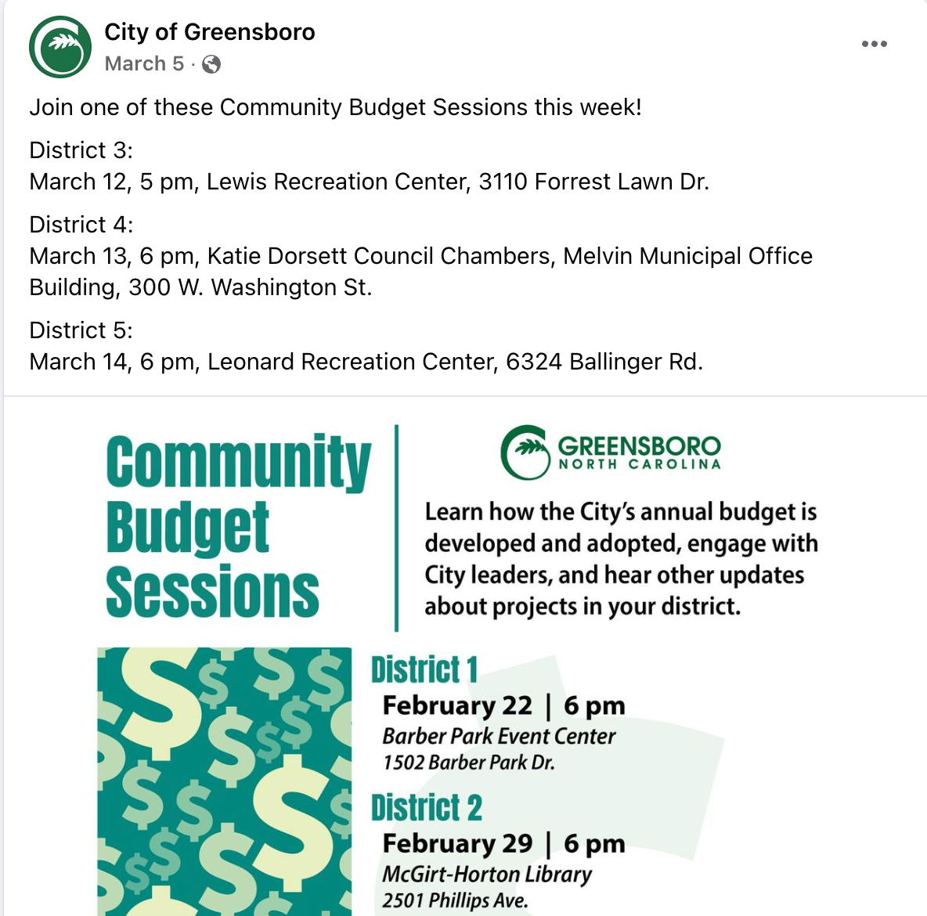

Momentum

Slide 27
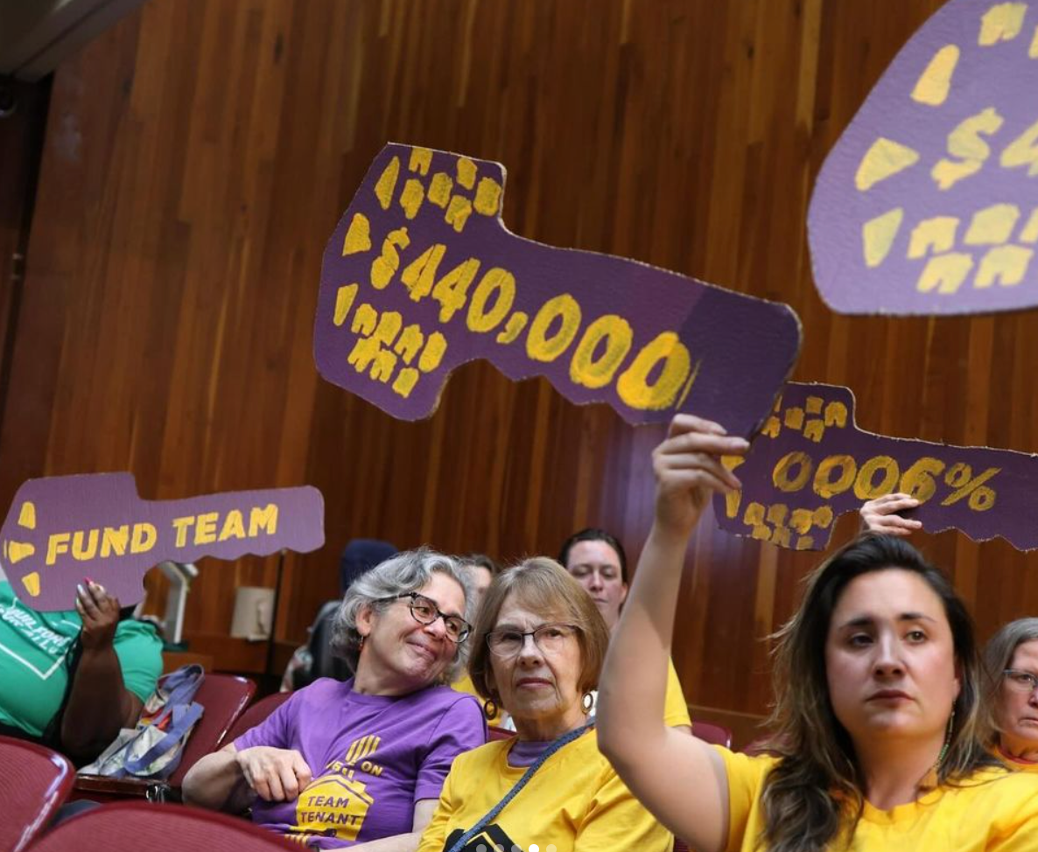
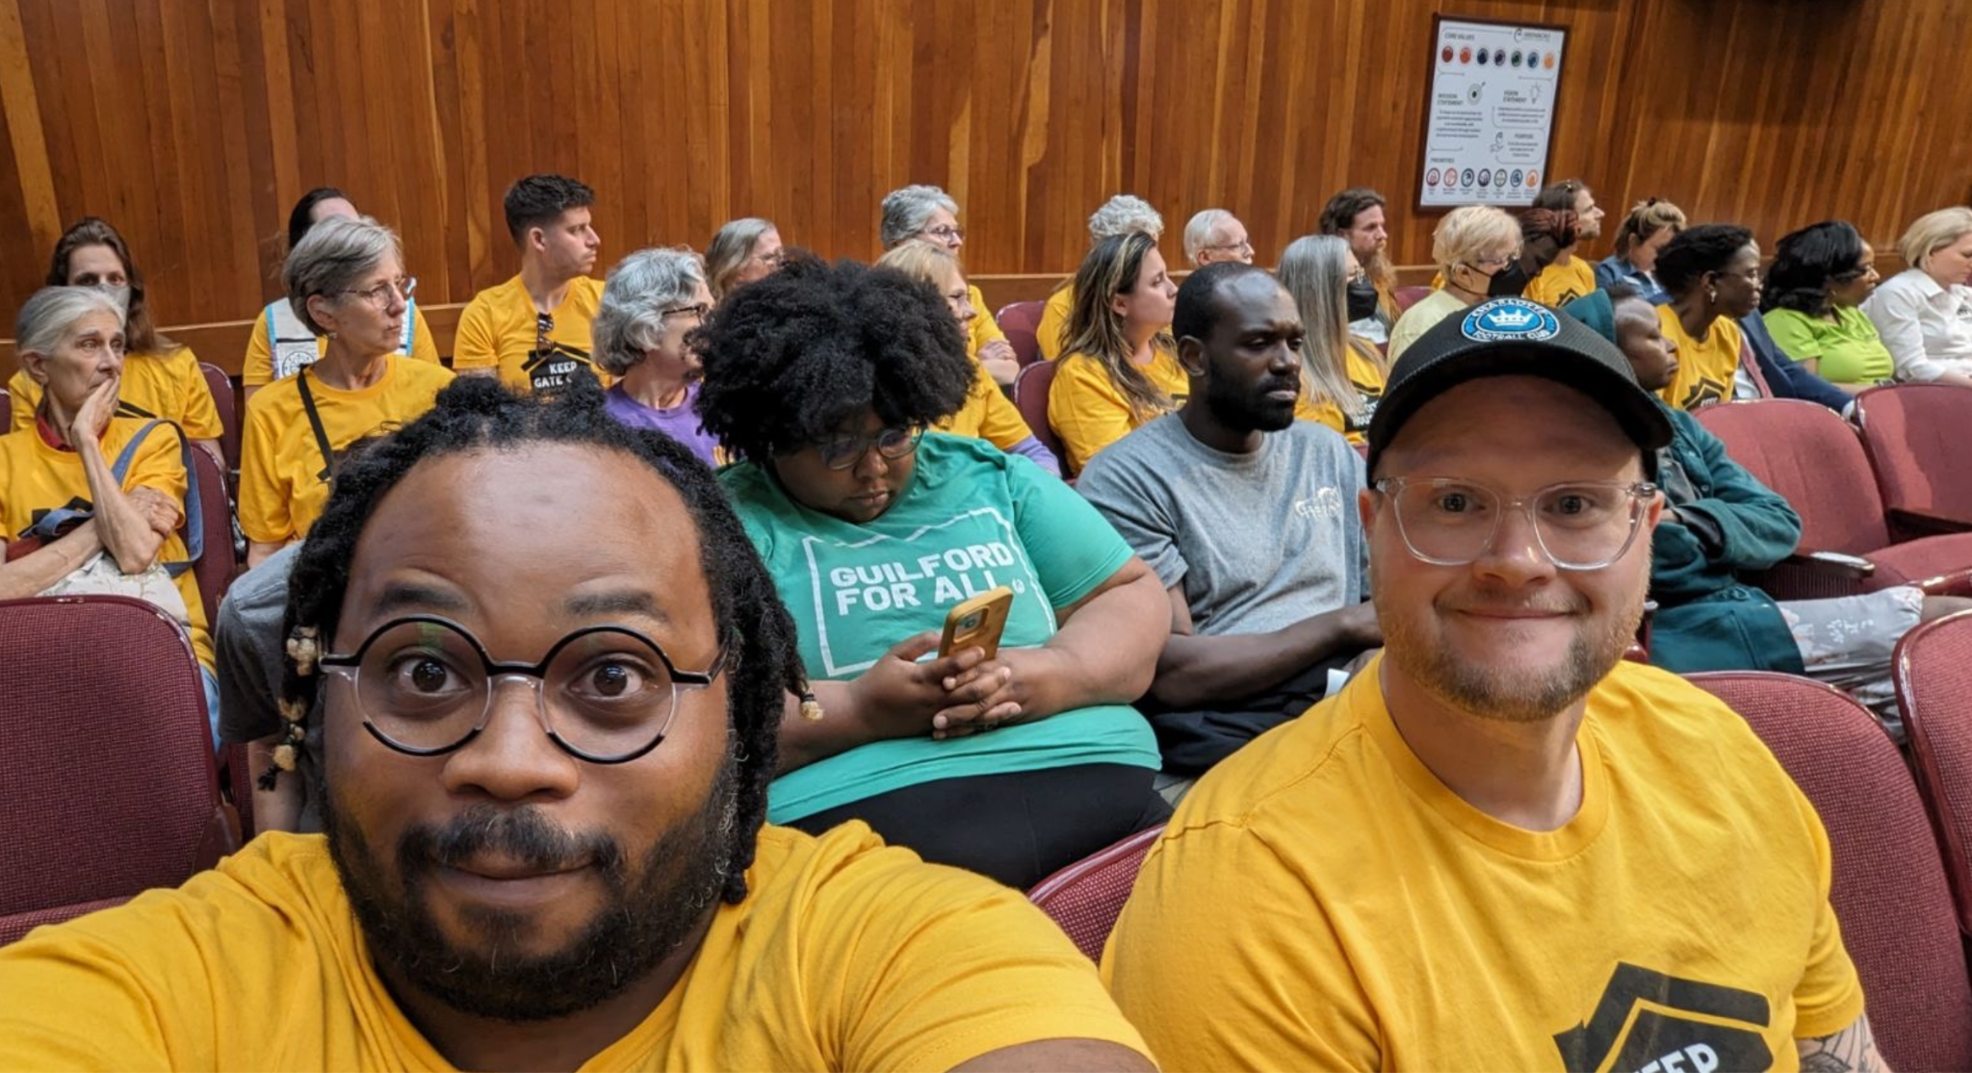
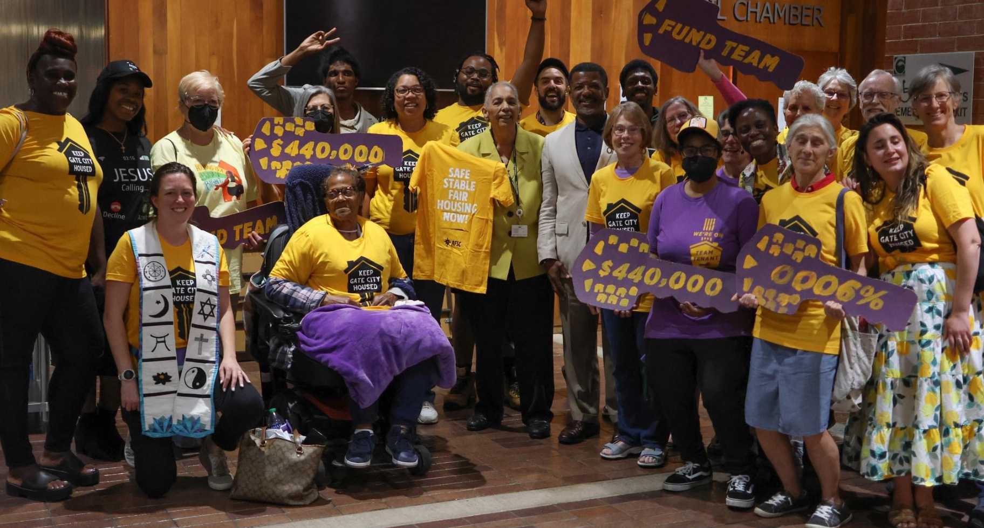
Final City Council Vote

Slide 28
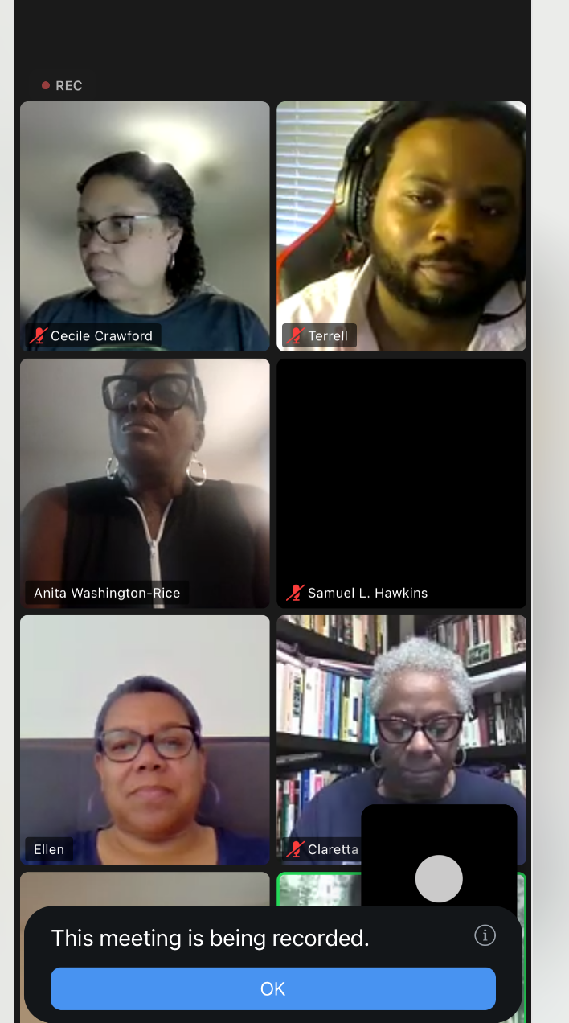
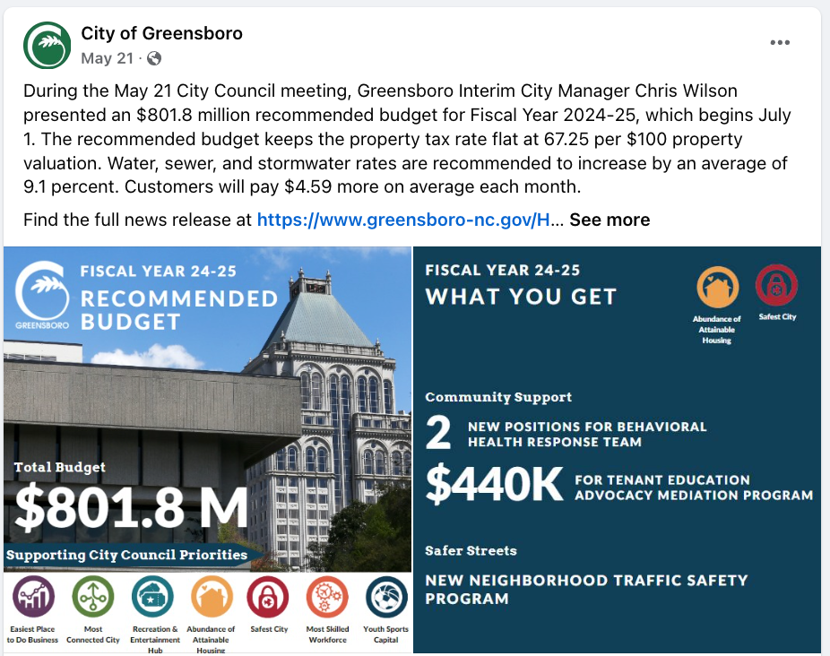
Win $440K + $1.5M for tenant defense

Slide 29
Reflect
What challenges unique to designing, launching and sustaining campaigns did you hear in the story?

Slide 30
Obstacles to launching and sustaining campaigns
Competing priorities
Lack of a deadline or sense of urgency
Ambivalence about campaigning
Lack of confidence
Lack of experience
Little sense of other “teams” waging campaigns

Slide 31
Coaching Responses to Campaigner Challenges
Connect to Stake
Keep a “Scoreboard”
Offer Structure
Inoculate

Slide 32
Break time!
Return by :44

Slide 33
Practice time!

Slide 34
Scenario: The situation
A group of 5 educators in an urban school district in South Carolina had spent two months planning a local issue campaign, as the NEA local’s designated campaign committee.
After using a survey and a set of informal listening sessions with other staff, they had identified the lack of reliable air conditioning at a third of the district’s buildings as an issue that resonated across members, potential members and parents.
Their campaign coach knew if the group was going to make A/C a defining issue of the coming County Commission and Board of Education primary elections in May, they would need to create a sense of crisis by sometime in February. But it was almost the end of November, and the group had put off completing their campaign plan. They still needed to decide on an initial tactic sequence, a public campaign launch, and invite parents and staff to an internal launch meeting. Their coach could sense this was a “do or die” moment – either the group would find a burst of motivation, or miss their window.

Slide 35
Scenario : The coach’s assessment
By the coach’s assessment, there were a few things getting in their way:
The group needed to make more time for a final, “putting-it-all-together” planning meeting, but hadn’t planned on that in advance,
An unverbalized, quiet consensus that “we can’t really win this demand” – none of them had been part of a winning issue campaign before,
There were so many things pulling on their attention, but no one was urging them to launch a campaign, and it was tough to spend so much time on something they didn’t hear about from colleagues or see reflected in their social media feeds.

Slide 36
Journal: What would you do?
Imagine you are the coach for this group. How might you prepare for your next coaching session with them? What coaching response might you go for and what tools would you prepare? What will you say, what you will ask, etc.
Use the previous slides to prepare. You have 5 minutes, and then we will share in breakouts.

Slide 37
Practice Partners
You’ll have 10 minutes in pairs to share how you prepared to be a coach in this scenario.
For example, what questions are you planning to ask? What tools will you use? What are your goals for the session?

Slide 38
Practice
Debrief
Notes:
Return to a large group and debrief.
“How was that? What came up in pairs? How are you feeling right now? How would it feel to walk into that next coaching session? What did you try? Say more about what you prepped? How did it go to try prepping that?...”
Unpack for options, use of tools, use of responses to challenges, toward mini successes or risks, and to surface the range of effective styles and approaches to coaching.
GENERALIZATION (12)
Invite in chat or out loud: “Given our discussion, what’s one lesson you’re learning about being an effective campaign coach?” and/or “What do you notice about the different ways people prepped? What meaning do you make of that?”
Elicit generalizations, a-ha moments, and lessons from the group
Affirm the range of styles and ways to approach coaching challenges.
Opportunity for trainer to name patterns or gaps in how participants prepped, and stick up for a style, option, or tool that’s on the margin.

Slide 39
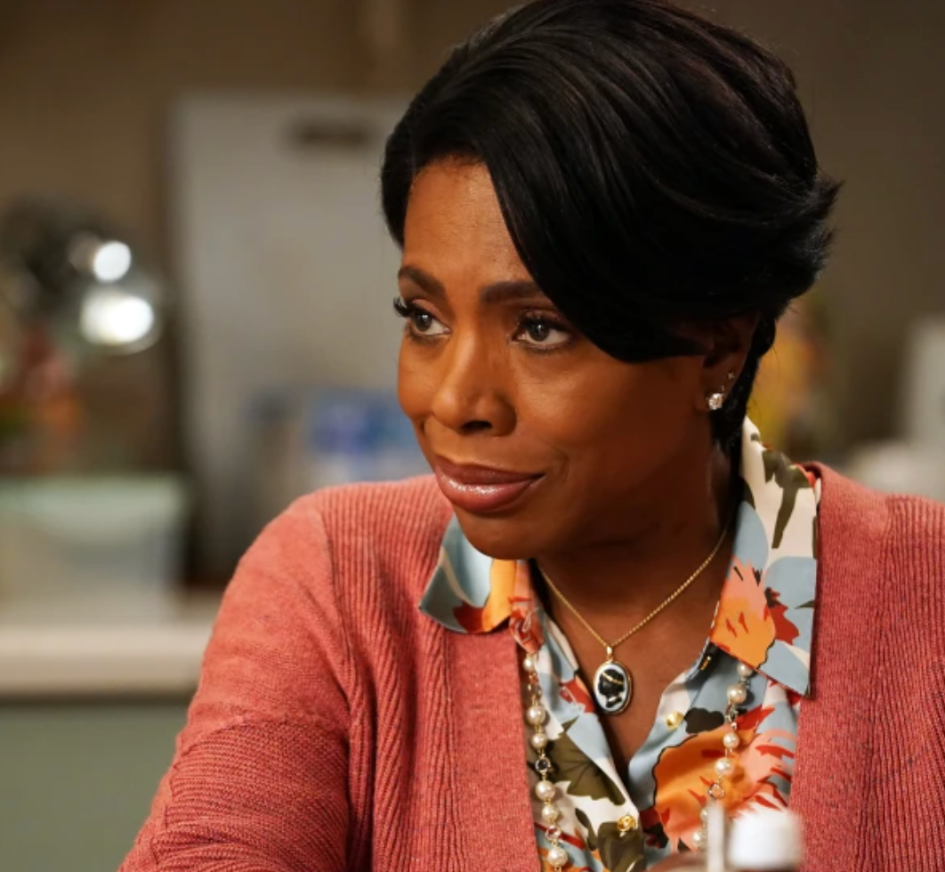
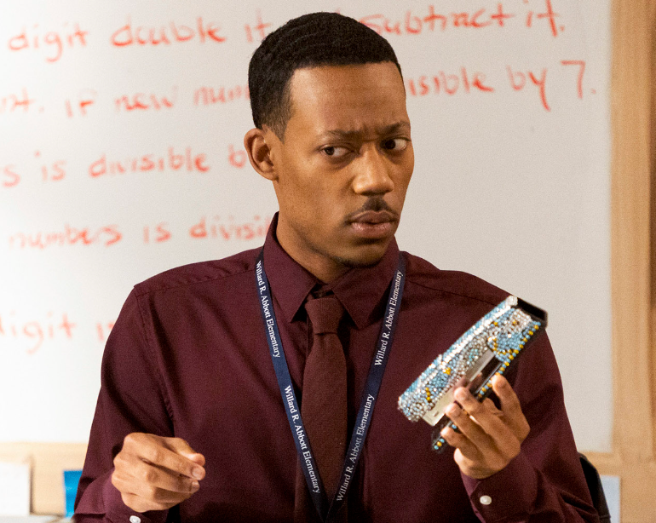


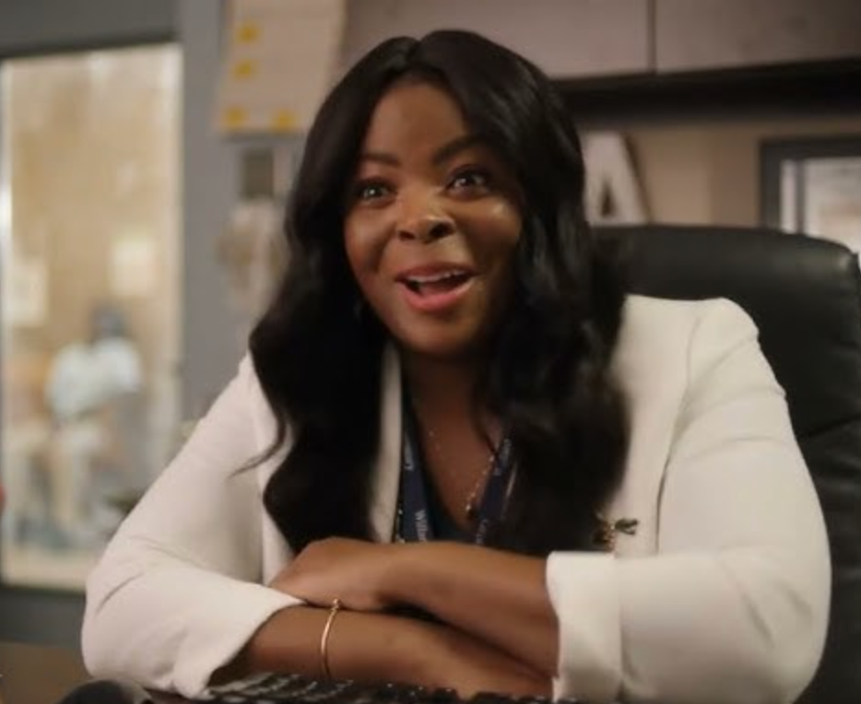
Coach styles
Expert Campaigner
Curious Co-Conspirator
Cheerleader
Supportive Peer
Head Coach

Slide 40
Setting the tone for coaching
Set of agreements between the coach and person
  Who I am & who I’m not → on how I will show up transparent, honest
  Relationship to being on-time
  Defining our relationship around the campaign
  Invitation to change agreements
Be direct in what you need from them in the coaching relationship
Being emotionally present
Being curious. Focus on 80/20....listening 80%, talking 20%
Set the stage for why we need thousands of campaigns, “I can’t believe we’re doing this…”
Sharing stories
Modeling listening more than talking
Set expectation that they can provide feedback on your coaching
Come in with expectations for ourselves & for the group
Acknowledge “this might be different… here’s what I’ll be trying to do…”
Ask them for advice: “What is an awesome coach, to you?”
Set goals for the relationship
Articulate the system I exist within: “there’s 50 of me…”
Notes:
“Soon, you’ll prep for your next real coaching session. For new coaching relationships, you get to ask, ‘how do I want to be received as a coach?’ This kind of coaching might be new for your coachees, who might be more used to other kinds of support roles like supervisors, or peer, or therapist”
Share brainstorm slide. “How can you ‘set the tone’ for coaching? What might establish your role, style, and goals as a campaign coach?”
Cofacilitator paste in chat:
=====
Add to the slide or share in chat: How can you ‘set the tone’ for coaching? What might establish your role, style, and goals as a campaign coach? [INSERT SLIDE LINK]
=======
Verbalize and start to generalize the range of ways to set the tone, as the slide fills up.
List to reference, in your back pocket:
Acknowledge “this might be different” – “Actually, I don’t spend a lot of time in ‘coaching mode’, here’s what else I’m doing week to week… Here’s how campaign coaching is a stretch for me, and might feel a little awkward… How might it be a stretch for you?”
Set expectations – “As your campaign coach, here’s what you can expect from me, and how I’m hoping to work with you in a way that’s a little different from a coworker, or a manager, or just a friend…”
Ask for advice – “Have you ever worked with a trainer or coach on developing a skill? What advice would you have for me about how to best support you to learn campaigning in the time we have together?”
Use questions – You can always “drop a level” and ask them to reflect on how this coaching relationship is going, or how you all might be “sliding out of coaching” and into a less skill-acquisition-based relationship
Use goals – Goals help establish “this is what we’re here to do” and allow you to reorient your conversations if you feel them “sliding out of coaching”
Use a workplan – Workplans don’t need to be overly ambitious or detailed to signal, “this is what we’re here to do together”
Introduce coach as dance partner or another similar metaphor
“Like organizing, coaching rests on the foundation of all strong relationships: feeling trusted, accepted and understood. And as with organizing, since we’ll be asking our coachees to go outside their comfort zones, to take risks while trying things they haven’t before, developing trust in the context of a timebound, working relationship requires showing up as an authentic “dance partner.”
Solo: “As we move toward wrap-up, take a look at this brainstorm. What’s one way you could set the tone that feels authentic to you?”
Cofacilitator paste in chat
=========
What’s one way you could set the tone that feels authentic to you? Let us know in the chat.
=========

Slide 41
What’s next?
We’ll be sending you:
The slides, recording, and chat transcript from today
Handouts
Please:
Give us feedback here

Slide 42


Check out:
Campaign Resources
PODCAST: Craft of Campaigns
WORKBOOK: Strategy Workbook
COACHING: Campaign Strategy Fellowship
More from Organizing Skills Institute
Other OSI workshops
Tools on organizing, action, and strategy

Slide 43
In Closing…

Slide 44
Tech Help Slides
Slides for explaining Zoom tools.
See speaker notes for more details.
Notes:
These slides were created by Training for Change (www.trainingforchange.org) for use in online trainings and meetings using Zoom software. We work to keep these slides up to date as Zoom is frequently changed. See also Zoom support.
HOW TO USE THESE SLIDES:
Some of these slides are designed to use proactively to train on tech tools during an online meeting. You can also include all these help slides at the end of your presentation to have in case you need them.
You can import or copy slides from this slideshow into your own slideshows. With your own slideshow open in another browser window or tab, select a slide in the left-hand menu of this slideshow then copy (Control-c or Command-C or Edit menu -> copy). In the slideshow you want to copy into, select a slide in the left-hand toolbar then paste (Control-v or Command-V or Edit menu -> paste).
You can copy these slides and edit them to create tech help slides for different software. Use the File menu to make a copy of the whole slideshow for yourself.
See slide 2 for how to adapt to your own style.
ACCESSIBILITY NOTES:
All images in this slideshow include alt text descriptions for those who will use screen readers to access the slides. For best usability, share the slide link directly. To edit the alt text on your own copy of these slides, right click on an image and select the alt text option.
We use and recommend a 4:3 slides ratio (rather than widescreen) to make the text and images on slides more clearly visible for users on smaller devices like tablets or mobile phones.
We used a contrast checker to ensure that there is a recommended contrast of at least 4.5:1 on our slides. To test your own visuals, try https://webaim.org/resources/contrastchecker/ or http://colorsafe.co.

Slide 45
Breakouts
Breakout Room 1
In breakouts you meet with a small group.
Only those in your breakout room can see/hear you or read your chats.
Your breakout is not in the recording.
Breakout Room 2
MAIN ROOM
Breakout Room 3
Breakout Room 4
Notes:
Template by Training for Change • www.trainingforchange.org
For more on using Breakouts in Zoom, see Tips for Zoom Breakout Rooms and VIDEO: How to Run Powerful Breakouts Online.

Slide 46
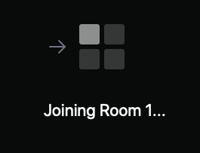
Joining breakouts
When we start the rooms you will automatically be added.
You may see something like this on screen:
Notes:
Template by Training for Change • www.trainingforchange.org
There are 3 different join breakout room help slides. This one is for if you choose the setting that moves people automatically into their rooms when you start the rooms.
For more on using Breakouts in Zoom, see Tips for Zoom Breakout Rooms and VIDEO: How to Run Powerful Breakouts Online.

Slide 47
Getting help in breakout
Click the Ask for help button in your toolbar and a trainer will come into your room.
Notes:
Template by Training for Change • www.trainingforchange.org
For more on using Breakouts in Zoom, see Tips for Zoom Breakout Rooms and VIDEO: How to Run Powerful Breakouts Online.

Slide 48
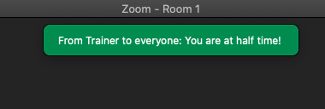
Messages
If you see a message pop up at the top of your breakout room screen, please read it to your group.
Notes:
Template by Training for Change • www.trainingforchange.org
For more on using Breakouts in Zoom, see Tips for Zoom Breakout Rooms and VIDEO: How to Run Powerful Breakouts Online.

Slide 49
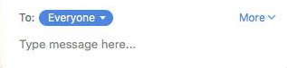
Private chat
Click to choose who to send your private chat to
Notes:
Template by Training for Change • www.trainingforchange.org

Slide 50
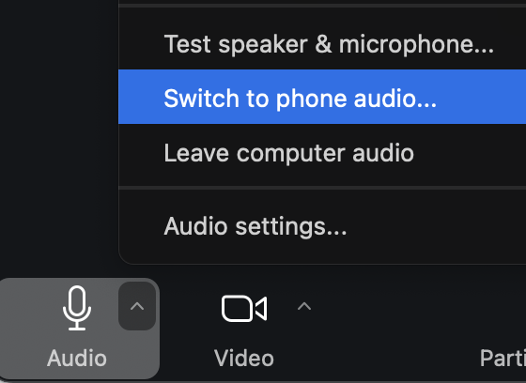
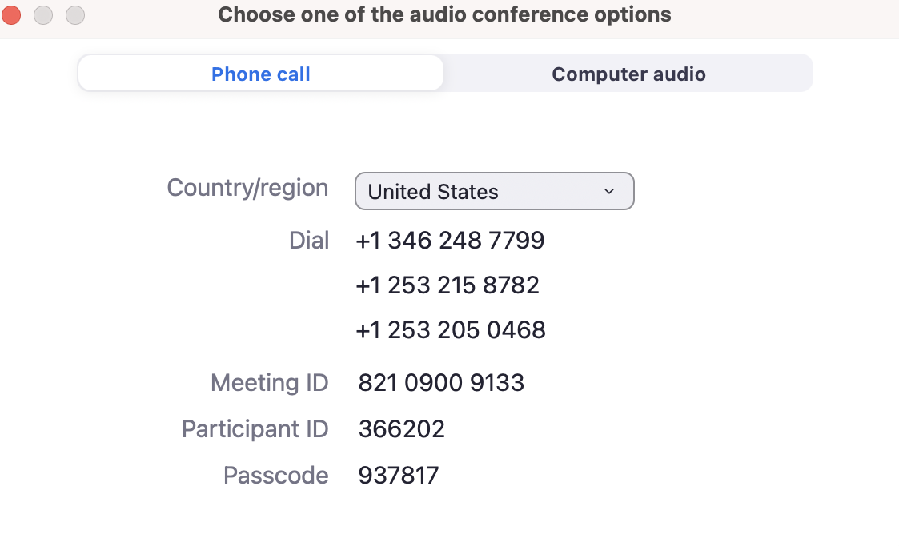
Switch to phone audio
Click the ^ arrow next to Audio in the toolbar.
Click Switch to phone audio…
Use the info on the screen to dial in on your phone or click the Country/region drop down to find local dial in.
Notes:
Template by Training for Change • www.trainingforchange.org

Slide 51
Phone shortcuts
*6 to mute/unmute
*9 to raise hand (can’t lower hand)
Notes:
Template by Training for Change • www.trainingforchange.org

Slide 52
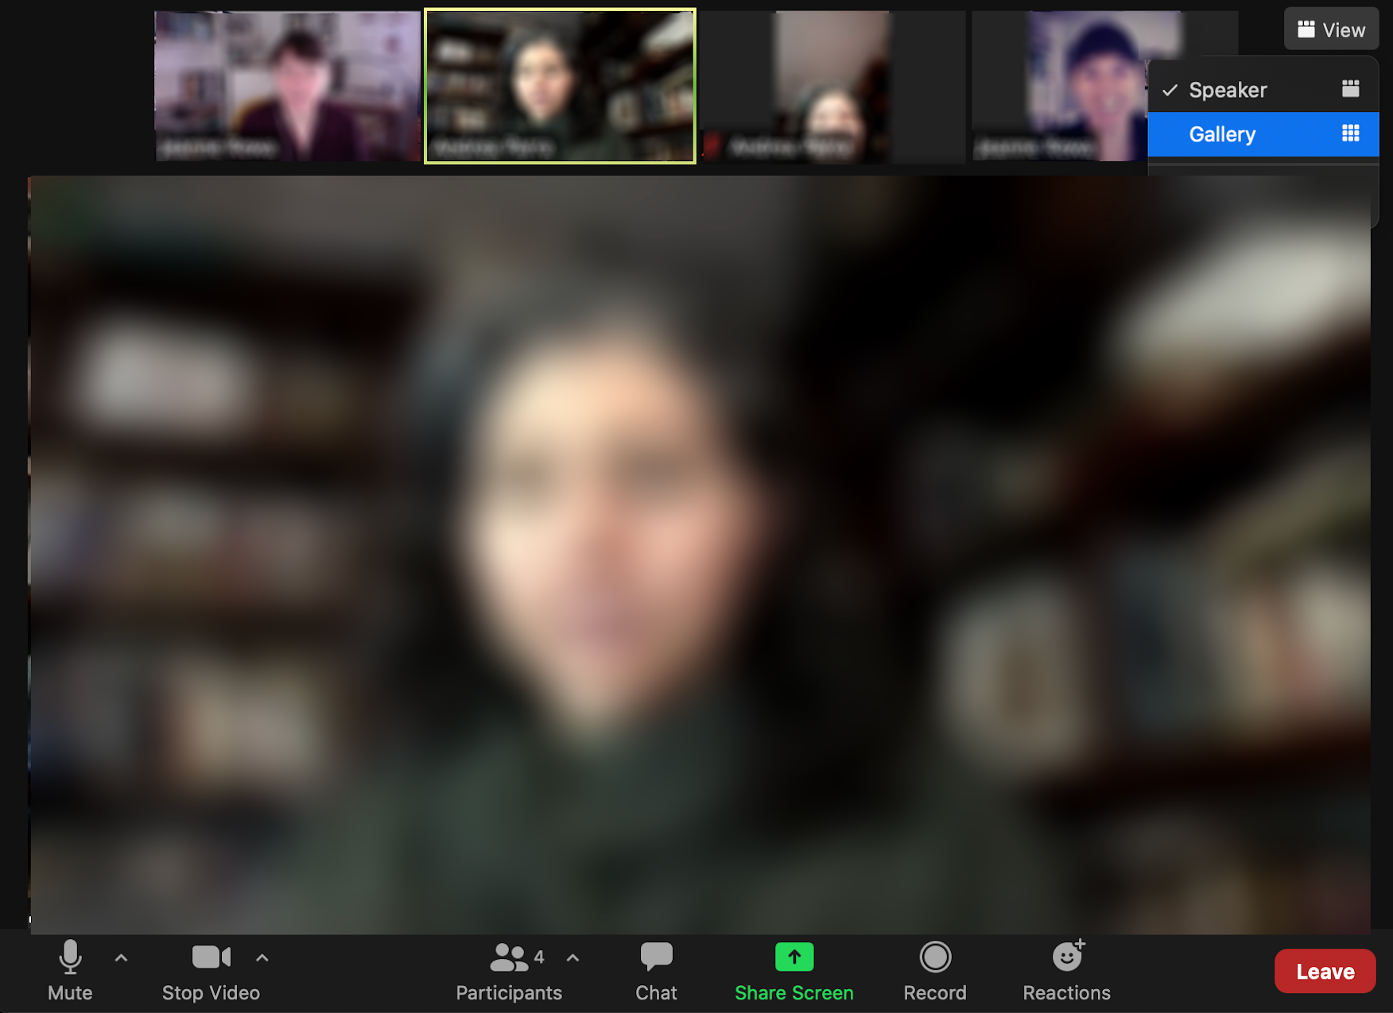
Change to Gallery View
Notes:
Template by Training for Change • www.trainingforchange.org

Slide 53
Closed Captioning
Click Show Captions in the toolbar
(if you don’t see it, look under More)
Notes:
Template by Training for Change • www.trainingforchange.org
Visual guide for how to turn on closed captioning is very important when you have a live captioner in your online meeting. It is recommended to also paste in chat:
==========
Live closed captioning available. Click “Closed Caption” in the toolbar and “Show Subtitle” to view the captions. Click “Subtitle Settings…” for more options.
==========

Slide 54
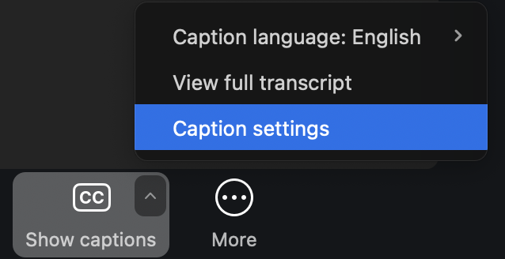
Resize Closed Captioning
Click arrow next to Show Captions and click Caption Settings...
Notes:
Template by Training for Change • www.trainingforchange.org

Slide 55
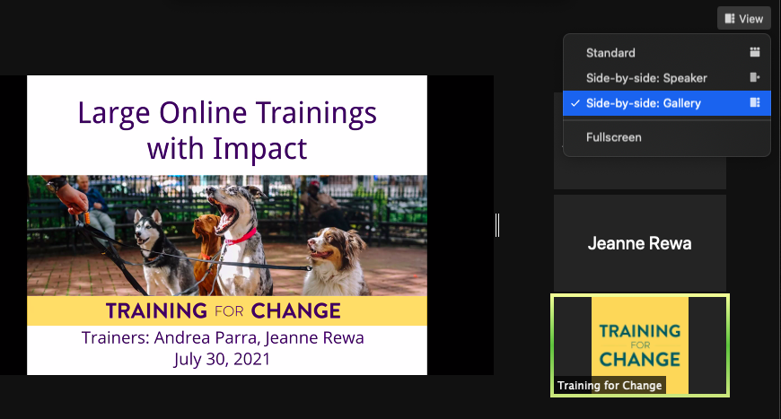
Change to Side by Side Mode
Click View at top right then choose Side-by-side: Gallery
Notes:
Template by Training for Change • www.trainingforchange.org

Slide 56
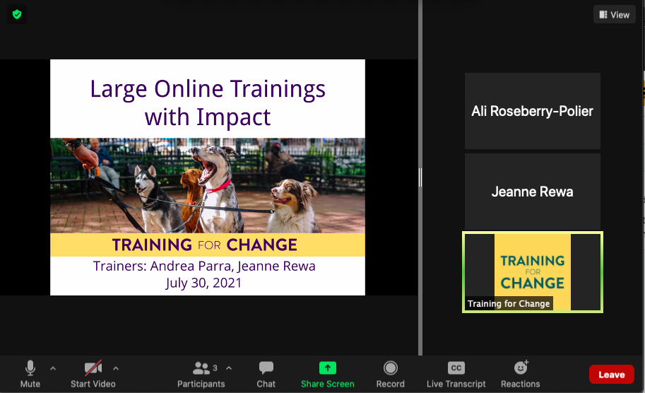
To Resize Side by Side Mode
Click and drag the handle in the middle.
Notes:
Template by Training for Change • www.trainingforchange.org

Slide 57
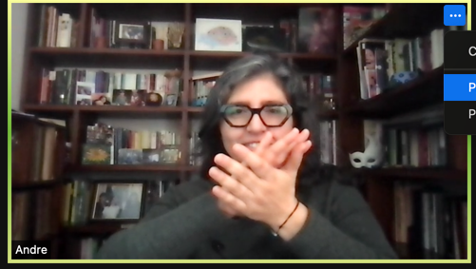
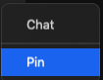
To pin a video
Click ... on their video then click Pin

