Slide 1
LGBTQ Leadership:
Caucus Campaigns
January, 2026

Slide 2

Overall Agenda
1:00-1:30 Intro for Ellen and Purpose
1:30-2:30 Challenges, Hopes, and Villians
2:30-2:45 Break
2:45-3:30 Current Situation and Power
3:30-4:30 Making Change
4:30-5:00 Next Steps

Slide 3

Shout Out Around the Room
Name
Pronouns
Work Location

Slide 4

Why are you here?

Slide 5

Picturing Our Purpose
Open a picture that represents why YOU choose to be part of the LGBTQ Caucus.
Quads– try to have a person from each region
1 Minute person
1 Minute to decide what you will summarize to share
Notes:
Participants will line up in order of nearest to farthest from Baton Rouge – They will then fold the line in half so that those on the nearest end of the line end up talking to the farthest end of the line

Slide 6

Discussion
How did you feel when you were presenting or listening ?
What are some common themes that you heard across the conversations?
Did you notice any patterns?

Slide 7
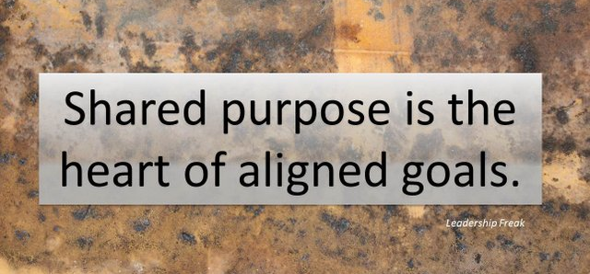

Slide 8
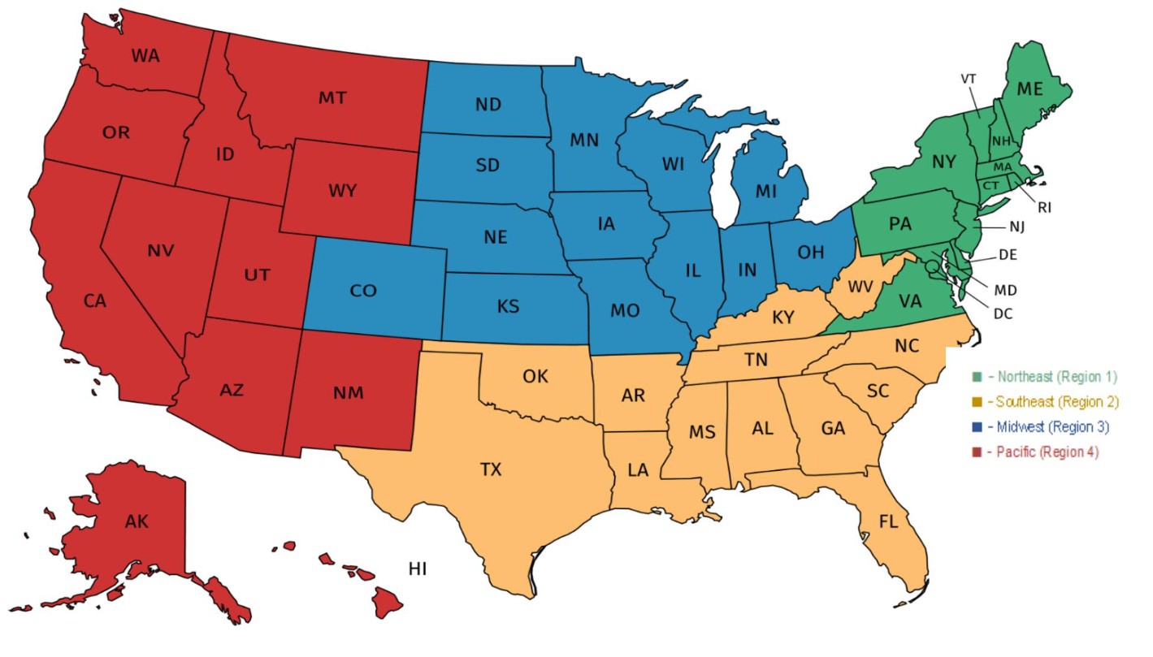
Strategies are Regional – Purpose is NOT

Slide 9
Challenges, Hope, and Villians

Slide 10

If you had all the power you could dream of, what is the biggest win you could hope for?

Slide 11

What are the challenges that diminish your hope?

Slide 12
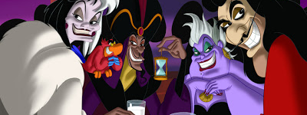
Who is the villain preventing you from achieving this win?
Notes:
Advocates, Mobilizers, Organizers Scenario

Slide 13

Why?
Who is benefiting from what's happening ?
What is the villain's vision for our public schools and higher education?
Notes:
12 min. Let's take a moment. How have the attacks impacted our schools and our communities? 6 min. Find someone to pair with to share. 6 min Group discussion
15 min. By small groups: Each table discusses one of these questions. (Facilitators can pop in for guidance as needed.)
Shared analysis -

Slide 14
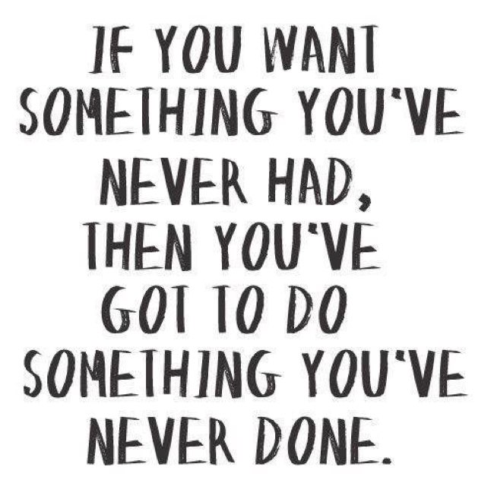
Will the way that this caucus operates get you the big dreams that you want?

Slide 15
Current Situation

Slide 16
Committee or Caucus
In our unions, a committee is an official, structured body for specific tasks like handling legislation or policy (e.g., Finance Committee), while a caucus is a more informal group of members with shared interests (e.g., Progressive Caucus) that lobbies for policy, builds coalitions, and influences the agenda, often acting as a voting block or research arm, whereas committees are formal arms of the governing body.
Committees focus on assigned duties, while caucuses build power and consensus around common goals.

Slide 17
Club or Union? Table Talk
Unorganized
Club
Union
Fighting Union
Which of these columns best describes the work of this Affiliate?
What indicators stand out to you?

Slide 18
Clubs require little risk and are about individuals. Clubs create programs which are events that individuals self-select and require little risk to attend. These are necessary, but not sufficient to build the power we need.
Fighting Unions build power by creating campaigns that are build with the core practices of organizing:
Interdependent Leadership
Collective Risk and Accountability
Shared Purpose

Slide 19
3 Prevalent Theories of Change
Advocacy
“Advocacy is the work of creating change through the actions of professionals or technical experts—lobbyists, pollsters, lawyers, communication specialists, researchers. Advocacy relies on the expertise, status, and know-how of these groups of people to make change. Advocacy usually happens in a closed-door room; ordinary people play a small to nonexistent role in its efficacy. Advocacy has become a dominant strategy for unions and liberals.”
Mobilizing
“Mobilizing, by contrast, activates an already-convinced membership. Mobilizing encourages those who already support a cause or a mission to take action to defend their belief—for example, by attending a protest, wearing a button, or signing a petition.”
Organizing
“To organize is to build mass support and strength among ordinary people. Organizing draws its power from working people’s biggest strength: our numbers. The work of organizing is systematic and rigorous: It requires connecting with every single worker in a shop, every educator in a building, every building in a district. At its core, it asks people to understand their own agency and to make choices about how they will exercise it.”

Slide 20

Time to Talk
Which of these theories do we mostly work in?
Which of these theories generates the power you need to win the changes you want ?

Slide 21
Advocacy is about using expertise of a few.
Mobilizing is about engaging the already committed.
These are necessary, but not sufficient to build the power we need.

Slide 22


Slide 23
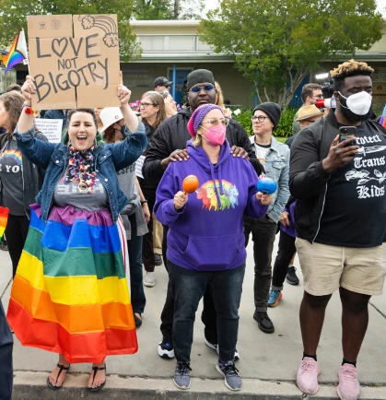

DEFINING POWER
Power is the ability to control, create, and prevent change.
Power is organized people and organized resources (money).
Power is not static, it is either waning or growing.

Slide 24

UNDERSTANDING POWER
Power is neutral
Our values affect the way we use power

Slide 25

TRUTHS ABOUT BUILDING POWER
Power has to be consistently built or it is waning
Not everyone wants us to have power and actively work to take our power away
Public actions through shared vision, shared purpose, shared resources, shared risk, and unity is how we build power
The bigger the win you want– the more power you need
Building power requires leadership

Slide 26
Campaigns are not Programs
An issue campaign is the process through which the people organize around leaders and structures to use their resources in accomplishing goals that achieve the change they need and want. It is public. It involves risk. It results in the story being about the workers.
From Marshall Ganz

Slide 27
How do we achieve our dreams?
Programs
Campaigns
Club
Union
Advocacy
Mobilizing
Fighting Union
Organizing

Slide 28

Key
Points
Intentional campaigns, not programs, not advocacy, build power.
The power to win is only built through people with a shared vision, making public commitments to act, to risk their collective resources, for the big meaningful changes they want.
The kind of power we need depends on what you do outside of this room and how accountable you are to each other for those actions.

Slide 29
Will the way that this caucus operates get you the big dreams that you want?

Slide 30
Making Change

Slide 31
Strategies for Making Change
Legal
Financial
Direct Action
Policy and Politics
The most effective groups often use a combination of these strategies, such as combining a lawsuit (legal) with a public march (protest), while funding the effort through community donations (financial) and pressuring legislators (political) simultaneously.
Which does this caucus use?

Slide 32
Let’s Look at History
Civil Rights Goal - Equality
Civil Rights Movement relies primarily on Legal Strategies
  While crucial, legal victories alone didn't end segregation in public life, and many felt a more direct approach was needed to challenge Jim Crow laws.
Montgomery Bus Boycott is the turning point where direct public action coupled with the withholding of financial resources
  They win legally, new leaders are identified, and mass public mobilization becomes a proven tactic
Direct Action Takes Over
  Sit ins, boycotts, marches

Slide 33
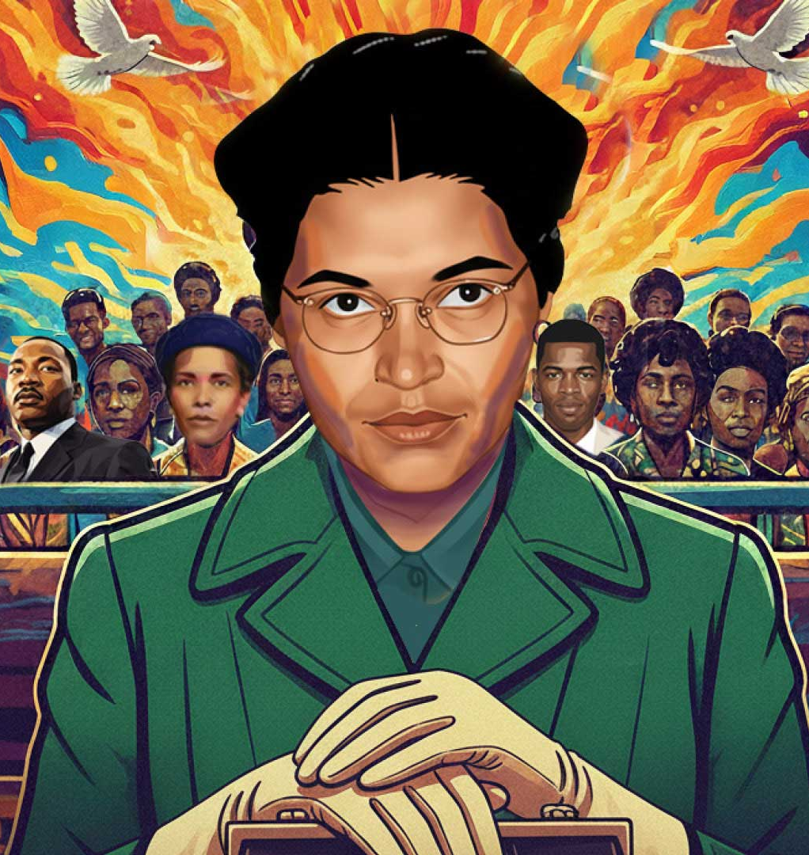
In essence, the Montgomery Bus Boycott showed that organized, nonviolent, direct action by ordinary citizens was a powerful tool, shifting the movement's momentum from courtrooms to the streets and transforming public perception.

Slide 34
Will the way that this caucus operates get you the big dreams that you want?

Slide 35
Measuring Power

Slide 36


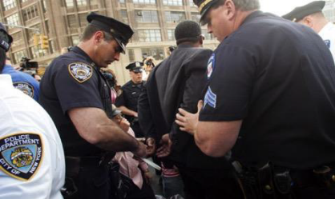
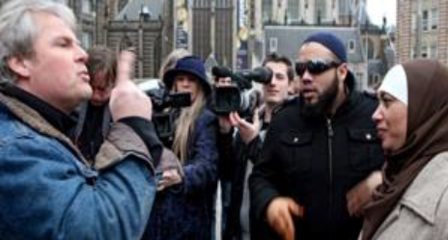
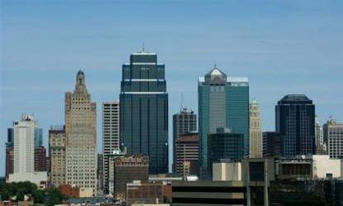
Expressions of Oppression
Individual
Internalized
Interpersonal
Systemic
Institutional
Structural
Notes:
INDIVIDUAL-LEVEL RACISM
INTERNALIZED RACISM lies within individuals. These are our private beliefs and biases about race and racism, influenced by our culture. Forms: racial prejudice toward other people of a different race; internalized oppression, the negative beliefs about oneself by people of color; or internalized privilege, beliefs about superiority or entitlement by white people.
INTERPERSONAL RACISM occurs between individuals. These are biases that occur when individuals interact with others and their private racial beliefs affect their public interactions.
SYSTEMIC-LEVEL RACISM
INSTITUTIONAL RACISM occurs within institutions and systems of power. It is the unfair policies and discriminatory practices of particular institutions (schools, workplaces, etc.) that routinely produce racially inequitable outcomes for people of color and advantages for white people. Individuals within institutions take on the power of the institution when they reinforce racial inequities.
STRUCTURAL RACISM is racial bias among institutions and across society. It involves the cumulative and compounding effects of the interactions of institutions and policies that systematically privilege white people and disadvantage people of color.

Slide 37
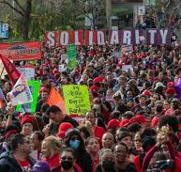
Strength and Growth to Win
Growth is a focus on building the base of members, leaders, structures, and partners.
Strength is the ability to use power to win.

Slide 38

Base Building Matters - Growth
We have to recruit new members to the caucus each a year just to maintain current levels. (Necessary)
BUT – this maintenance does not build. (Not Sufficient)

Slide 39
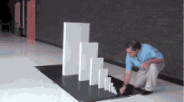
Exponential Base Building Matters More
With high member density, we can claim the wins we dream about AND control the outcomes of those wins across time.

Slide 40
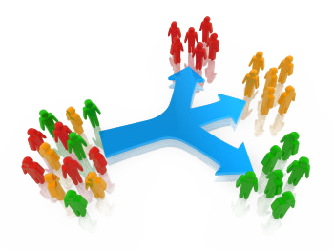
Exponential Base Building Practices
Public, direct-action campaigns
Interdependent leadership structures
Intentional coalitions along shared visions

Slide 41
Campaign Lab is an Different NEA Strategy
This is an intentionally created and networked leadership structure focused on building and using power within and across issue campaigns.

Slide 42

What makes Campaign Lab Unique?
Focus is on connecting:
Campaigns
Organizers
Leaders
Core Belief:
Those in the struggle have the best answers to solving the struggle.

Slide 43
Basic Structure of Campaign Lab
Team Lead
Team Lead
Coach
Coach
Coach
Tech
Logistics and Grants
Payments
Campaign Lab Coordinators
Team Lead
Team Lead
Mentor Coach
Team Lead
Team Lead
7
Notes:
The commitment for the local team lead is that they meet twice a month with a campaign coach to discuss their progress and receive just in time problem solving, advice, and coaching towards next steps. They also agree to attend an all call meeting once month to hear from others across the country that are also doing this work. Once a coach and a mentor coach agree that the Team Lead and local have a plan, have a team, and are ready to begin taking actions according to an actual escalating plan, they receive a seed grant of $2500.
Coaches, high capacity, campaign minded, leaders can serve as coaches and will receive training and support to do this. They agree to coach locals, up to two — and receive an annual stipend of up to $1800. They commit to meet with one to two teams, twice a month and attend the monthly all call meeting.
Mentor coaches are typically staff, who have a record of leading campaigns or growing locals through organizing. They do not receive a stipend. They have no more than 5 coaches that they meet with once a month and attend the all call meetings.
The Campaign Lab Coordinators, Amanda, Carrie, and Ellen, are managed by Kyle. Kyle is primarily focused on building the alignments with our outside partners and moves the Campaign Lab strategically into other aspects of the NEA enterprise. Amanda, Carrie, and Ellen work together they keep the system connected, convene the people in the system, build capacity across the system, manage and monitor applications of teams and coaches, and develop a strategic intent for the work across the campaign lab. They are supported by Dommie, Shola, and Karla. Dommie provides technology and data support, Shola coordinates the payment of coaches, Karla pulls team applications from the grant system and provides all travel logistics.

Slide 44
Mentor Coach
Mostly staff-based
Monthly meetings with assigned Campaign Coaches and whole network
Campaign Coach
Holds coaching calls, documents progress
Team Lead
Coordinates team operations, meetings, and roles
Support Campaign Coaches problem solving and thought partnership
Coaches 1–2 local teams
Engages in peer problem solving and coaching
Upholds team norms and shared commitments
Focus on output, capacity building, and leadership development
Clarifies team membership and purpose
Team Members
Implements the plan
Assists in developing added structures
Attends regular meetings
Critical in building the base, increasing engagement, and gathering information

Slide 45
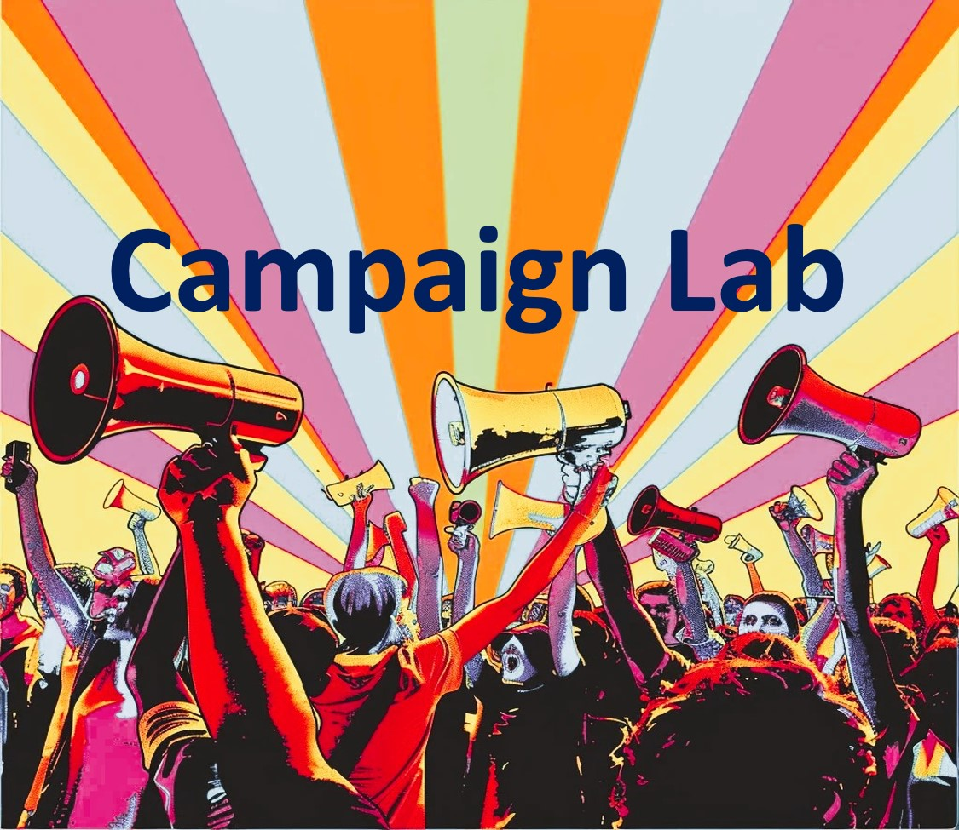

Information and Application
https://www.nea.org/resource-library/campaign-lab

Slide 46

Apply to be a Campaign Lab Coach
Possess an organizing and leadership mindset
Engages in peer problem solving and coaching
Campaign Coach
Holds coaching calls, with team 2 times a month
Coaches 1–2 local teams
Attends campaign coach training
Works with a mentor coach
https://forms.office.com/r/7yMBd7FLwM

Slide 47
Key
Points
The goal of the Campaign Lab is to be an intentional network to support organizing nationwide

Slide 48
Next Steps

Slide 49
Interdependent Structures
Allow for the distribution of power
Allow for responsibility
Prioritize leadership development
Organizing is a leadership practice that organizes the resources you have to build the power you want

Slide 50
Reflection at Tables
How do we create interdependent structures?
How do we shift from where we are to where we need to be to achieve the dreams we want?

Slide 51

Who are leaders?
Leaders are those who take responsibility for enabling others to achieve shared purpose in the face of uncertainty

Slide 52
Structures are groups of people who choose to use their agency to achieve a common goal.
Organizers identify, recruit, and develop leadership within and across structures.

Slide 53
Mapping by Region

Slide 54

Key Points
Campaigns allow for the identification of leaders who can share power, responsibility and authority.
Well planned campaigns intentionally build structures that distribute power, responsibility, and authority.

Slide 55
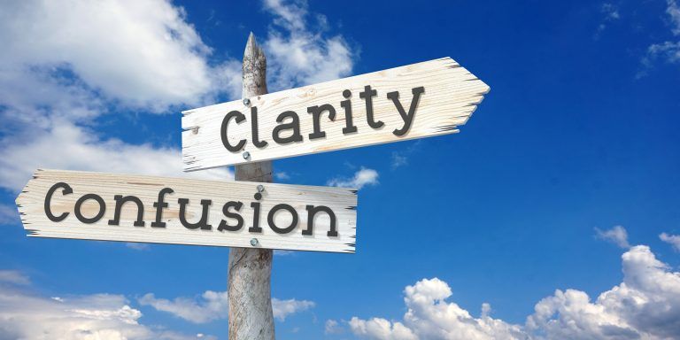
Closing the Day
What is becoming clearer?
What remains murky?
Housekeeping

