Slide 1
PLEASE -
Sit in at tables by regions – if your region needs more than one table, just make sure that your tables are in the same area.
Get your devices on and Log in to the Course
Use this wifi
  Hyatt Meeting
  PW: nea2025uniserv

Slide 2
Campaign Academy:
Leaders and Structures for Winning Campaigns
February, 2026

Slide 3

Campaign Academy
By attending this training, you confirm that you are either an NEA affiliate staff person or NEA member in good standing. The information you receive here is only for your use in your capacity as an NEA affiliate staff person or NEA member.
This presentation and its contents are confidential and may not be further distributed or passed on to any other person or published or reproduced, in whole or in part, by any medium or in any form, for any purpose unless written consent has been provided by Ellen Holmes. Audio/video recording, copying of slides, and the use of AI note-taking tools are prohibited without the written consent from Kyle Serrette. Violation of these terms may result in legal action.

Slide 4
NEA Standards of Conduct
NEA has adopted a Standard of Conduct Policy to ensure that all of our gatherings are welcoming to and free from discriminatory, harassing, or otherwise unacceptable behavior. Discrimination or harassment based on race, color, ethnicity, religion, sex, age, national origin, sexual orientation, disability, gender identity, or expression, or any other characteristic protected by law will not be tolerated. If you have experience any discriminatory or harassing behavior, please report the incident by emailing Ron "Duff" Martin (rmartin@nea.org) and Gladys Marquez (gmarquez@nea.org). Thank you for your commitment to ensuring a positive event for all.

Slide 5
Honoring This Space
We begin by acknowledging that through a history of colonization and brutality, we are currently on the traditional lands stewarded by generations of indigenous people.
We honor these indigenous people, all elders, past, present, and emerging. We are called to learn and share these learnings about this tribal history, culture, and contributions that have been suppressed in the telling of the story of what we now call the United States of America.

Slide 6

Key OUtcomes
Participants will: Understand a high-level overview of the purpose of the Campaign Lab Learn key concepts of power building through the development of Leaders and Structures Use lists of members and partners to begin mapping possible leaders Use an assessment tool to help understand the internal structure of their local Identify the internal and external parts of their campaign

Slide 7
Overall Agenda
Friday
  7:30-8:30 Breakfast
  10:15-10:30 Coffee and Tea
  8:30-Noon Meeting
  12:00-1:00 Lunch
  1:00-4:30 Meeting
  2:30-2:45 Break
  3:00-5:00 Beyond the Bell
Saturday
  7:30-8:30 Breakfast
  8:30-Noon Meeting
  10:15-10:30 Coffee and Tea
  12:00-1:00 Lunch
  1:00-4:30 Meeting
  2:30-2:45 Break
  4:30-5:00 Networking and Adjourn
Sunday
  7:30-8:30 Breakfast
  8:30-1:00 Meeting
  1:00 Adjourn, Lunch on your own

Slide 8

Documents you Will Need Today
Make sure you can access the Course
Make sure you have downloaded all files.
Pre Academy Assignments and the Participant Handout Module
Community Agreements
Make sure you can access the data about members you were asked to bring
Be able to access your personal self-assessment.

Slide 9
Logistics to Remember
Questions to Ask
Bathroom
Materials
PEPs Portal
Food
Room Temperature

Slide 10

Shout Out from Your Team and Around the Room
Name
Pronouns
Work Location

Slide 11

Caucus Social Contract
C. Scott

Slide 12

Why are you here?

Slide 13

Picturing Our Purpose
Open a picture that represents why you choose to be part of Campaign Lab.
Three 3 Minute Rounds
Triads – People you don’t typically talk to or are new to you.
Share your name, your picture, and your purpose.
Notes:
Participants will line up in order of nearest to farthest from Baton Rouge – They will then fold the line in half so that those on the nearest end of the line end up talking to the farthest end of the line

Slide 14

Discussion
How did you feel when you were presenting or listening ?
What are some common themes that you heard across the introductions?
Did you notice any patterns?

Slide 15
Dreams and Challenges
Ben

Slide 16

If you had all the power you could dream of, what is the biggest win your team could hope for?

Slide 17
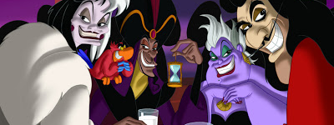
Who is the villain preventing you from achieving this win?
Notes:
Advocates, Mobilizers, Organizers Scenario

Slide 18

Why?
Who is benefiting from what's happening ?
What is the villain's vision for our public schools and higher education?
Notes:
12 min. Let's take a moment. How have the attacks impacted our schools and our communities? 6 min. Find someone to pair with to share. 6 min Group discussion
15 min. By small groups: Each table discusses one of these questions. (Facilitators can pop in for guidance as needed.)
Shared analysis -

Slide 19

6 Core Concepts We will Propose Here in Designing Winning Campaigns
1. Pick a Fight NOT Plan a win
2. Begin with Equity NOT Add Equity
3. Structure NOT Self-Selecting
4. Leaders vs. Activists
5. Majorities NOT Minorities
6. Organizing vs. Mobilizing/Activism

Slide 20
Shared Language
Ellen

Slide 21
Role Clarity
For this work to be equitable, we must have intentional structure, not guesswork
Misalignment leads to burnout, duplication, or dropped tasks
Clear roles help teams build power and leadership at every level

Slide 22
Basic Structure of Campaign Lab
Team Lead
Team Lead
Coach
Coach
Coach
Tech
Logistics and Grants
Payments
Campaign Lab Coordinators
Team Lead
Team Lead
Mentor Coach
Team Lead
Team Lead
7
Notes:
The commitment for the local team lead is that they meet twice a month with a campaign coach to discuss their progress and receive just in time problem solving, advice, and coaching towards next steps. They also agree to attend an all call meeting once month to hear from others across the country that are also doing this work. Once a coach and a mentor coach agree that the Team Lead and local have a plan, have a team, and are ready to begin taking actions according to an actual escalating plan, they receive a seed grant of $2500.
Coaches, high capacity, campaign minded, leaders can serve as coaches and will receive training and support to do this. They agree to coach locals, up to two — and receive an annual stipend of up to $1800. They commit to meet with one to two teams, twice a month and attend the monthly all call meeting.
Mentor coaches are typically staff, who have a record of leading campaigns or growing locals through organizing. They do not receive a stipend. They have no more than 5 coaches that they meet with once a month and attend the all call meetings.
The Campaign Lab Coordinators, Amanda, Carrie, and Ellen, are managed by Kyle. Kyle is primarily focused on building the alignments with our outside partners and moves the Campaign Lab strategically into other aspects of the NEA enterprise. Amanda, Carrie, and Ellen work together they keep the system connected, convene the people in the system, build capacity across the system, manage and monitor applications of teams and coaches, and develop a strategic intent for the work across the campaign lab. They are supported by Dommie, Shola, and Karla. Dommie provides technology and data support, Shola coordinates the payment of coaches, Karla pulls team applications from the grant system and provides all travel logistics.

Slide 23
Mentor Coach
Mostly staff-based
Monthly meetings with assigned Campaign Coaches and whole network
Campaign Coach
Holds coaching calls, documents progress
Team Lead
Coordinates team operations, meetings, and roles
Support Campaign Coaches problem solving and thought partnership
Coaches 1–2 local teams
Engages in peer problem solving and coaching
Upholds team norms and shared commitments
Focus on output, capacity building, and leadership development
Clarifies team membership and purpose
Team Members
Implements the plan
Assists in developing added structures
Attends regular meetings
Critical in building the base, increasing engagement, and gathering information

Slide 24
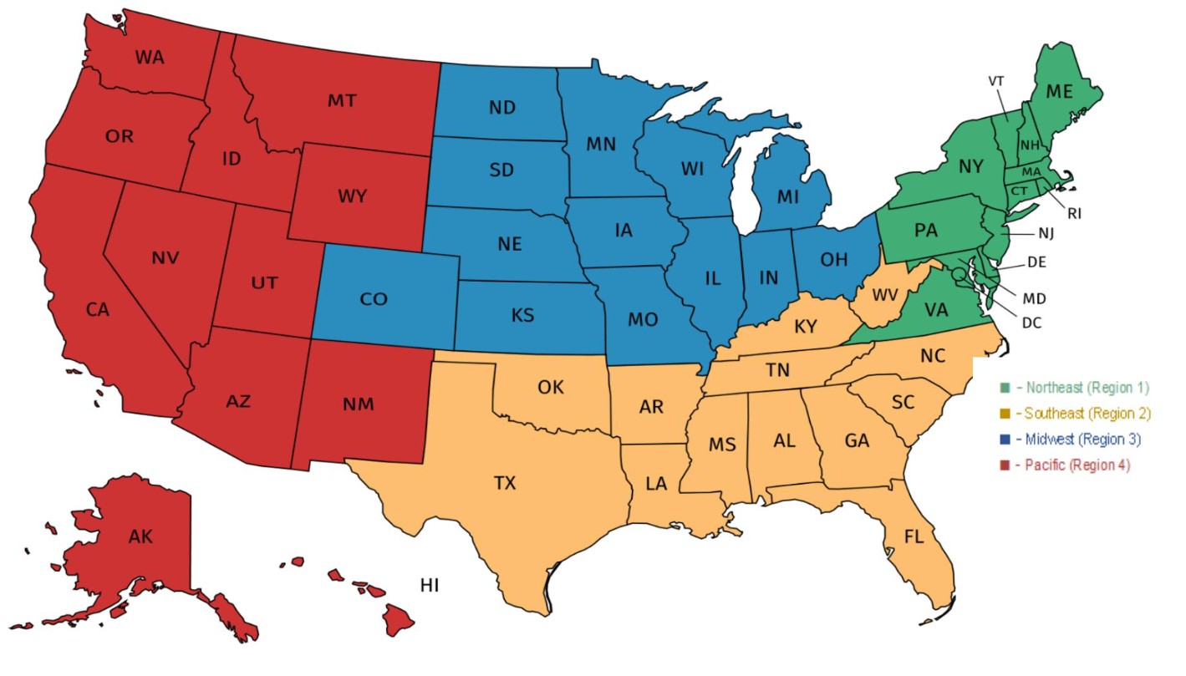
Strategies are Regional – Purpose is NOT

Slide 25
Committee or Caucus
In our unions, a committee is an official, structured body for specific tasks like handling legislation or policy (e.g., Finance Committee), while a caucus is a more informal group of members with shared interests (e.g., Progressive Caucus) that lobbies for policy, builds coalitions, and influences the agenda, often acting as a voting block or research arm, whereas committees are formal arms of the governing body.
Committees focus on assigned duties, while caucuses build power and consensus around common goals.

Slide 26
Club or Union
Unorganized
Club
Union
Fighting Union
Turn and Talk:
Which of these sounds like how you do your work?

Slide 27
Clubs require little risk and are about individuals. Clubs create programs which are events that individuals self-select and require little risk to attend. These are necessary, but not sufficient to build the power we need.
Fighting Unions build power by creating campaigns that are build with the core practices of organizing:
Interdependent Leadership
Collective Risk and Accountability
Shared Purpose

Slide 28

The change you are able to make is driven by how you collectively decide to act.
You need to make intentional decisions about roles and structures so that you can act in ways that will allow you to win.
Key Points

Slide 29
Network Building
Eric, C. Scott

Slide 30
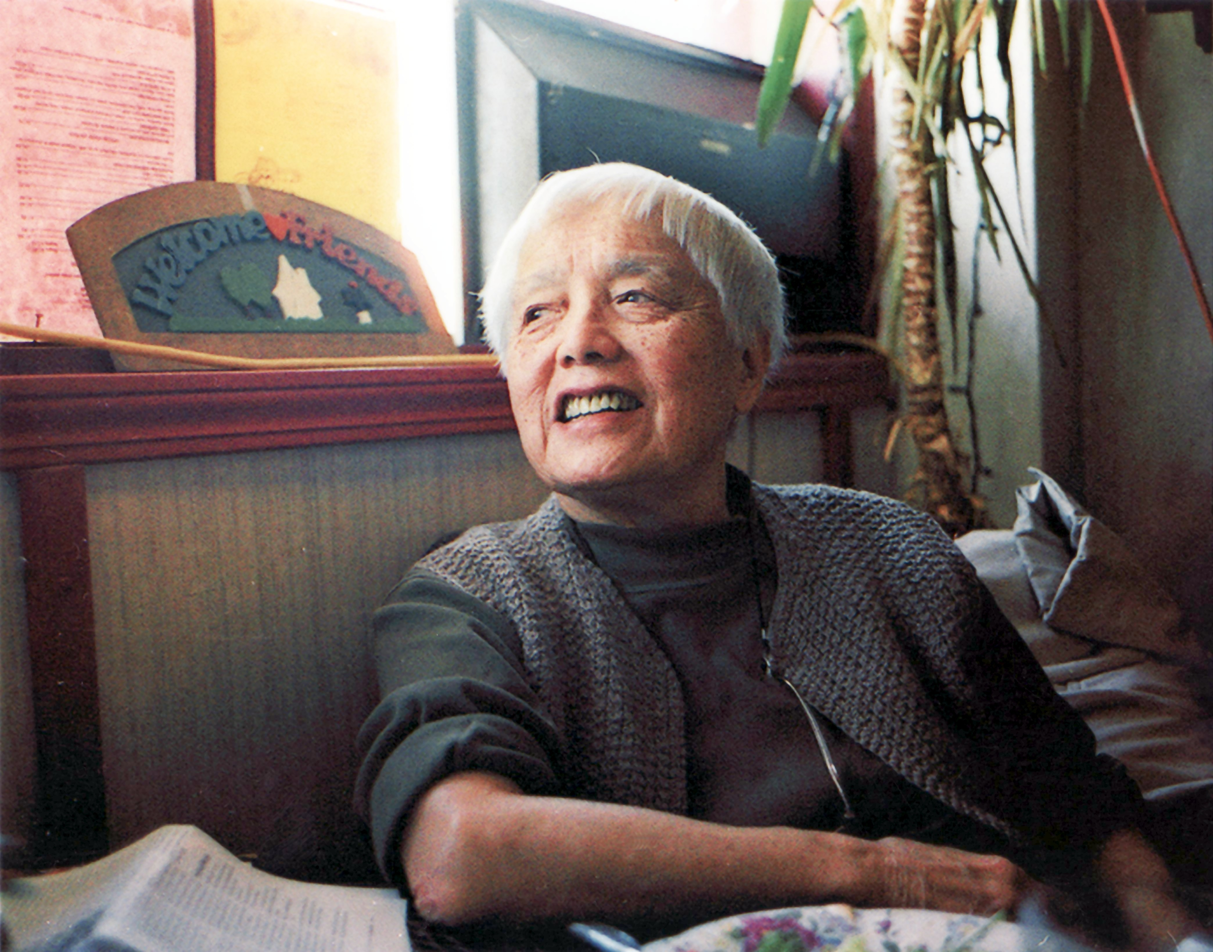
“Movements are born of critical conversations rather than critical mass.”
― Grace Lee Boggs

Slide 31

Who is in the Room?
My name is …
My region is …
I am here because …
I am concerned about …
As a member of the LGBTQIA+ Community, my connection to my union is stronger at ….
[local, state, or national level]

Slide 32

Critical Conversations Amongst the Caucus
Count off by 10's
Each Number Group will assemble together to share reflections.
The Person closest to the floor should lead the debrief.
Prior to returning to your seat, place your name on the association you feel the most connected to.

Slide 33
Whole Group Networking Reflections
What did you hear?
What did you see?
What did you feel?
What does the charts say about our connectedness to our associations?

Slide 34
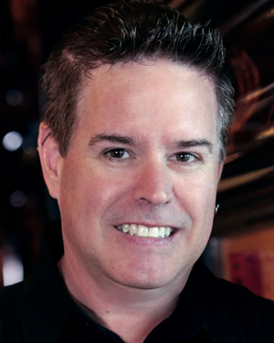
Welcome
Co-Chair
C. Scott Miller

Slide 35
BREAK

Slide 36
Centering Equity
Katie

Slide 37
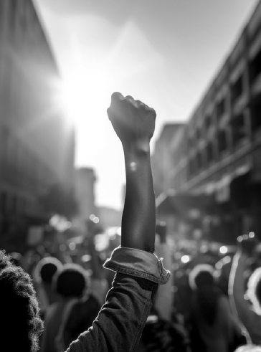
What will it take to achieve equity in the “Big Hope” you have for your campaigns, your schools, and your communities?

Slide 38
What type of union builds power?
Campaigns
Public Action and Demands
Strategic and Ongoing
Continues to Add
  Base – Mobilizers - Leaders
  Allies – Partners - Coalitions
  Requires Risk
  Supported by Staff
  Leaders Build and Use Power
Programs
Build Presence
Episodic
Member Recruitment
Committee/Program Leaders
Low Risk
Often Staff Led
Power in Policy

Slide 39
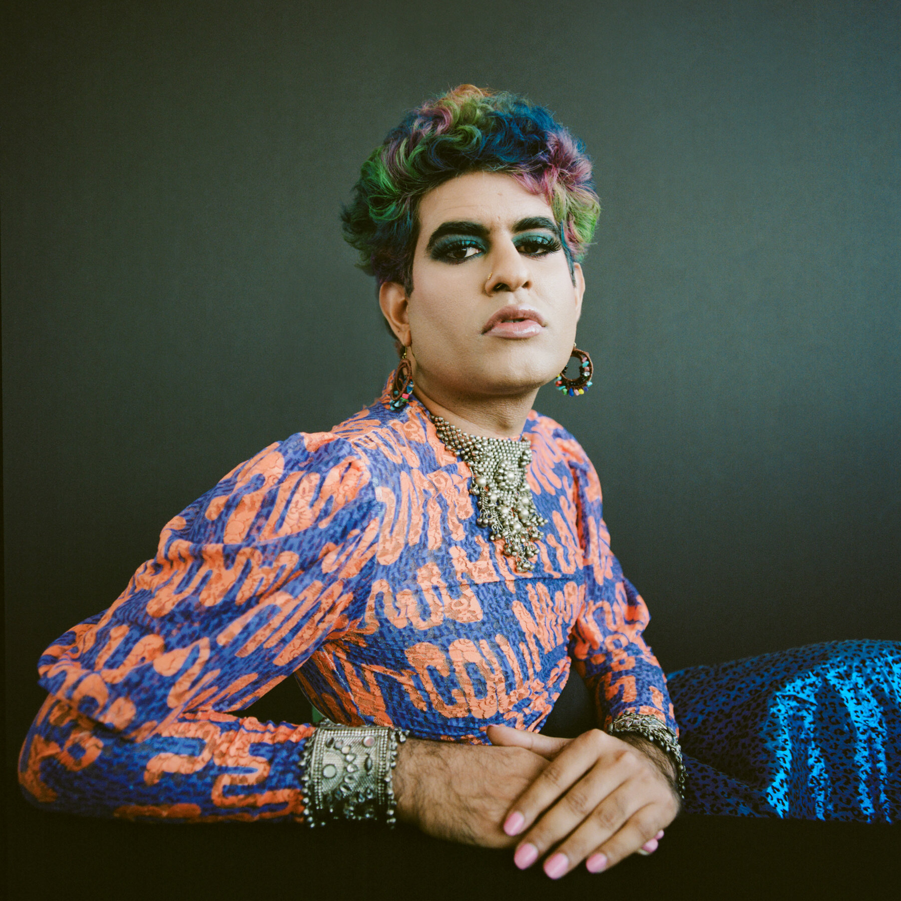
Alok Vaid-Menon
“The best way to eliminate a group is to demonize them, such that their disappearance is seen as an act of justice, not discrimination.”
― Alok Vaid-Menon, Beyond the Gender Binary

Slide 40
What about Race, Class, and Gender Justice?
Many of us value justice and equity, so we must apply a Race, Class, and Gender Justice lens to our work
This lens involves both personal and institutional commitment to advancing equity
It means proactively eliminating systemic barriers and setting clear, measurable equity goals
Use it to develop equity-focused campaigns and anticipate harm across race, class, and gender lines
It’s more than avoiding discrimination, it’s about creating systems that sustain equity

Slide 41
Team Time - Centering Equity Lens page 5
Causes: What institutions, policies, or practices are causing or contributing to the inequities? What social norms, popular myths, or cultural biases may be contributing?
History: How did things get this way and are things worsening or improving?
Strategies: What strategies and actions could be used to advance the solutions?
Problems: What inequities are you noticing or experiencing? What are the impacts on different racial groups? Who benefits most and who is hurt most?
Solutions: What solutions could address the root causes and eliminate the inequities? How would different racial groups be impacted by the proposed solutions?
Leadership: Who are the stakeholders most affected by the inequities? Are they involved in naming the issues and solutions? What kinds of active leadership roles could they take to advance the proposed solution?
Additional Equity Tools: Who is most directly impacted? Who has been left out? How can they be directly engaged? How do our demands center race, class, and gender justice?

Slide 42
Debrief
What did you learn about using this analysis tool?
What did your group struggle with?
How do you think you could use this in your own work?

Slide 43

Key
Points
Intentional campaigns, not programs, build power.
Centering race, class, and gender justice in our campaigns increases the number of people engaged, the number of leaders involved, and the amount of resources we have to win the change we want.
Power is only built through people with a shared vision, public actions, inclusion, and risking their collective resources, for the meaningful change they want.

Slide 44
Defining Leaders and Structures

Slide 45

Who are leaders?

Slide 46

Who are leaders?
Leaders are those who take responsibility for enabling others to achieve shared purpose in the face of uncertainty

Slide 47

If leadership is…
Taking responsibility for enabling others to achieve shared purpose in the face of uncertainty
Notes:
For the purpose of our working together today, let’s use this definition, “Leadership is taking responsibility for enabling others to achieve purpose, in the face of uncertainty”

Slide 48

Then leaders…
Have followers who trust and respect them.

Slide 49
Leaders...
Are TRUSTED and RESPECTED
Have followers

Slide 50
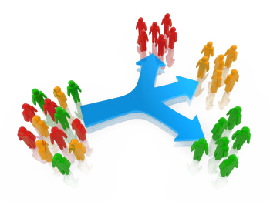
Structures
Structures are groups of people who choose to use their agency to achieve a common goal.
Organizers identify, recruit, and develop leadership within and across structures.

Slide 51
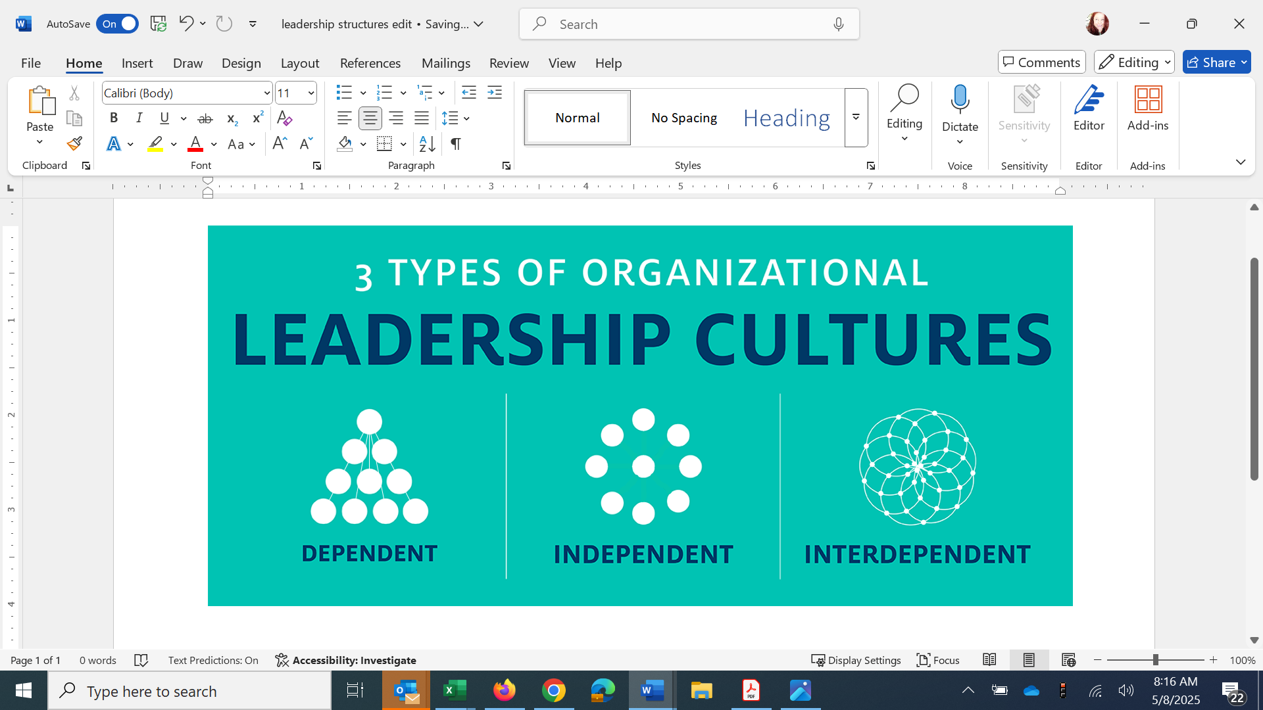
3 Types of Leadership Structures

Slide 52

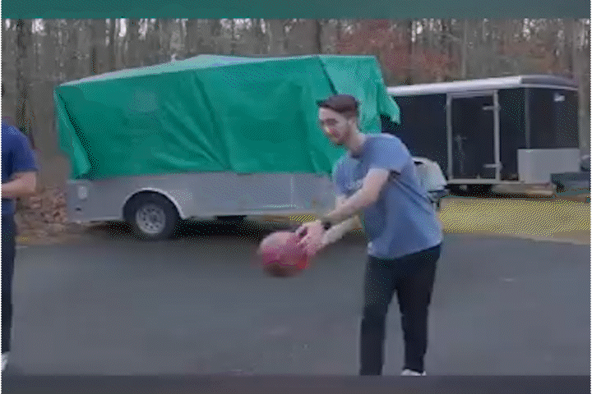
If you are the only leader…

Slide 53
Where is the power?
Is this a powerful or sustainable model?
Where are the resources? Who benfits?
What happens if the kingpin is knocked out?

Slide 54
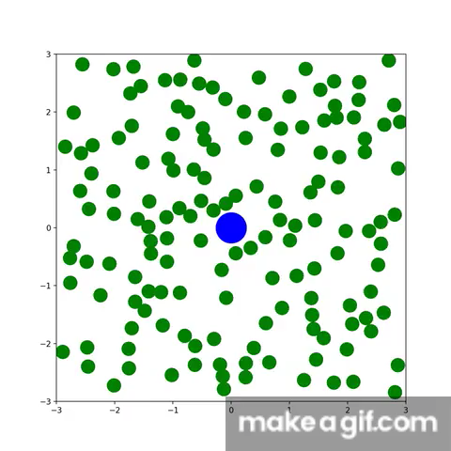
If we are all leaders…

Slide 55
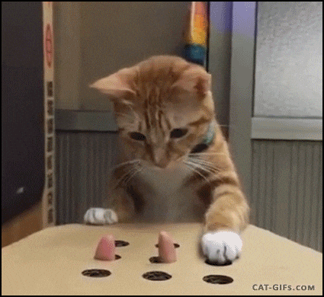
If we are all leaders…

Slide 56
Where is the power?
Is this a powerful or sustainable model?
Who benefits from the resources?
What happens to the resources?

Slide 57
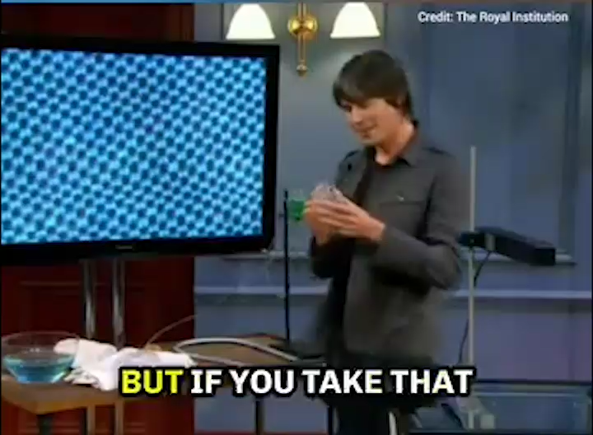

Slide 58
    In this model – where is the weight?
    Where is the power?
    Is this a powerful or sustainable model – Who benefits from the resources?

Slide 59
  How are they different from the dependent model?
  What are the qualities of a diamond that we get from this structure?

Slide 60
Interdependent Structures
Allow for the distribution of power
Allow for responsibility
Prioritize leadership development
Organizing is a leadership practice that organizes the resources you have to build the power you want

Slide 61
Table Talk
How close to or far away is your caucus (state, region of national) from interdependent leadership?
If you were truly an interdependent leadership structure - what indicators and evidence at the regional and national level of your caucus would we see?
How does your work shift across these leadership models?

Slide 62
Key Points
Campaigns allow for the identification of leaders who can share power, responsibility and authority.
Well planned campaigns intentionally build structures that distribute power, responsibility, and authority.

Slide 63
Building Power
Ben

Slide 64

Power of Post Its

Slide 65
Campaign Lab is a Structure to Build Power
It is an intentionally created and networked leadership structure focused on building and using power within and across issue campaigns.

Slide 66


Slide 67
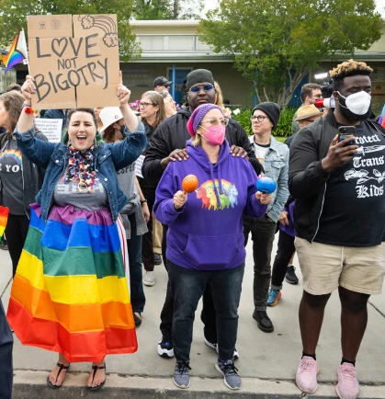

DEFINING POWER
Power is the ability to control, create, and prevent change.
Power is organized people and organized resources (money).
Power is not static, it is either waning or growing.

Slide 68

UNDERSTANDING POWER
Power is neutral
Our values affect the way we use power

Slide 69

TRUTHS ABOUT BUILDING POWER
Power has to be consistently built or it is waning
Not everyone wants us to have power and some actively work to take our power away
Public actions through shared vision, shared purpose, shared resources, shared risk, and unity is how we build power
The bigger the win you want– the more power you need
Building power requires leadership and interdependent structures

Slide 70

Discussion
Think about your Hopes and Villains chart
What kind of power will you need to achieve these hopes you have?
Think in terms of structures and leaders
    Structures and Teams of people

Slide 71
Key
Points
Intentional campaigns, not programs, build power.
The power to win is only built through people with a shared vision, making public commitments to act, to risk their collective resources, for the big meaningful changes they want.
The kind of power we needs depends a distributed and interdependent leadership structure.

Slide 72

LUNCH

Slide 73
Worksite Mapping: People in the Campaign
Zac
Notes:
Why Worksite Mapping Matters, Building Leader Capacity Through Mapping

Slide 74
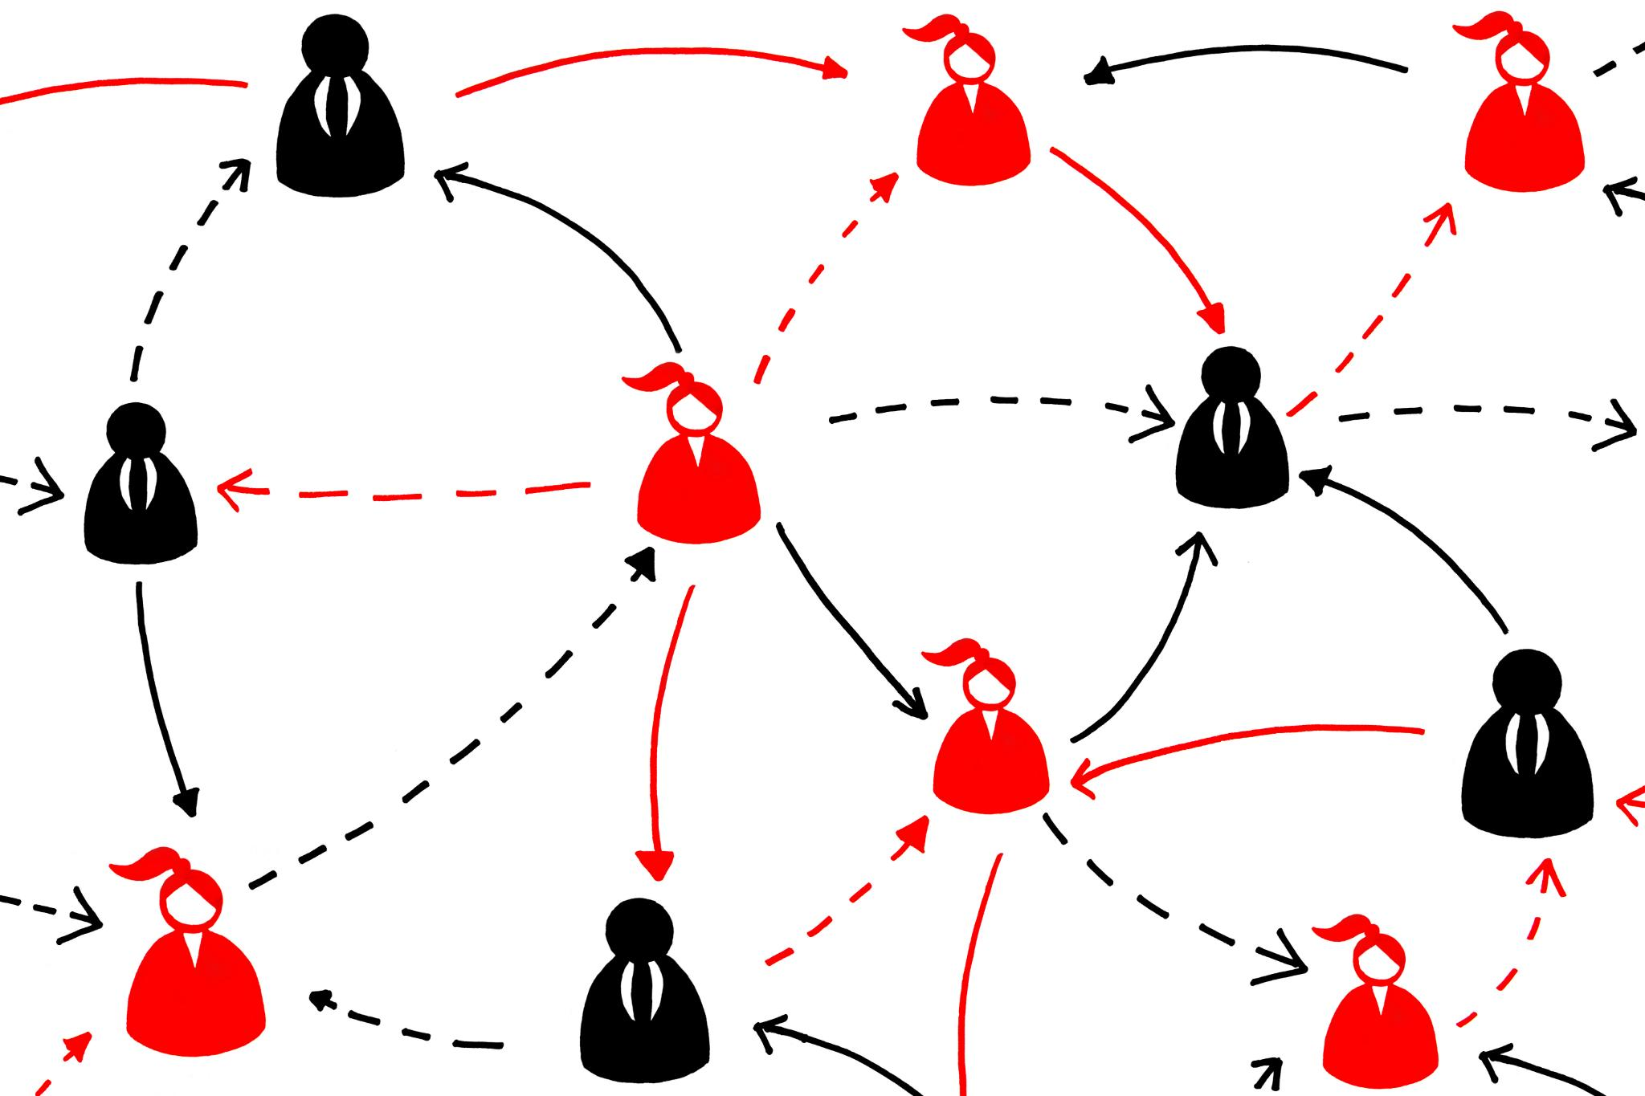
Why People Mapping Matters
Visualizing Structures
  People mapping helps leaders see who works where and when, revealing network structures and communication flow.
Identifying Influence and Opportunities
  Mapping uncovers key areas of influence and potential organizing opportunities within our communities.
Strategic Resource Allocation
  Mapping enables targeted outreach and efficient resource use, enhancing organizing effectiveness.
Turning Goals into Action
  Mapping transforms abstract goals into clear, actionable plans by depicting workplace dynamics visually.

Slide 75

How do we know who our people are?
How do we know where our people are?
How do we know who they are connected to?
Organizers Ask

Slide 76
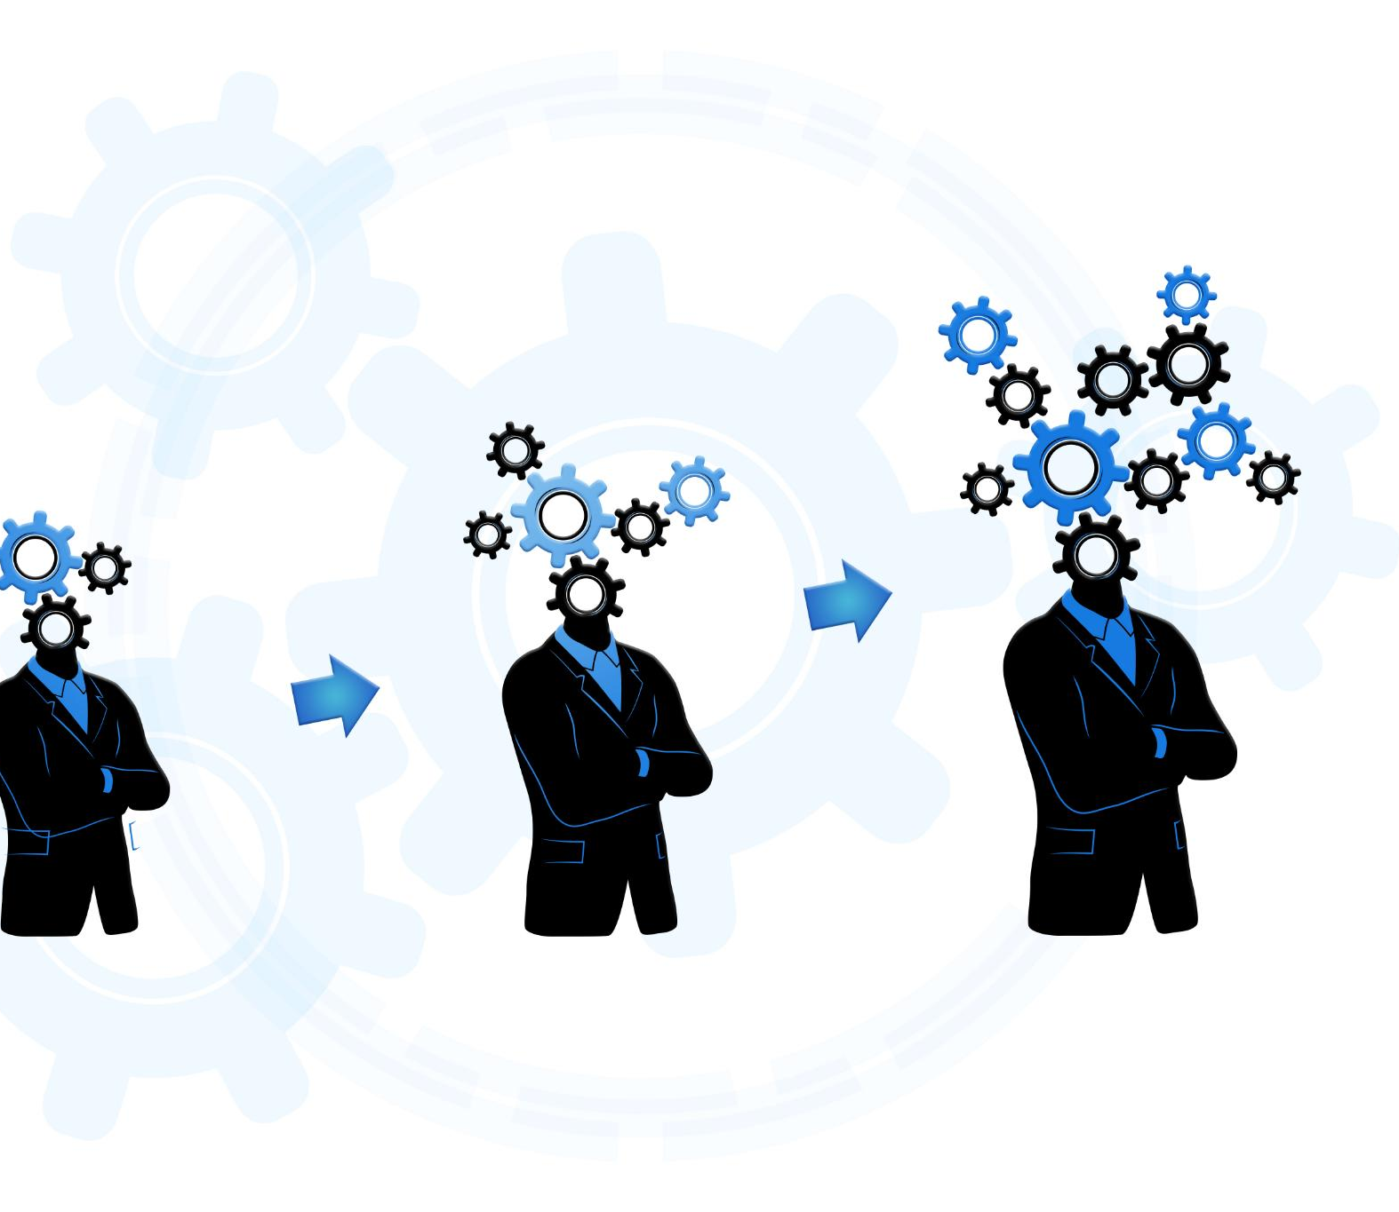
Building Leader Capacity Through Mapping
Mapping as Leadership Tool
  Mapping enables us to transform views, helping leaders identify influencers and relationship strengths clearly.
Identifying Key Leaders
  Mapping helps spot natural leaders and activists to play pivotal roles in campaigns.
Strategic Clarity and Mobilization
  Mapping provides clarity on where our people are, enabling leaders to strategize and mobilize effectively.
Fostering Engagement and Confidence
  Engaging in mapping encourages ownership, enhancing leader confidence and commitment.

Slide 77
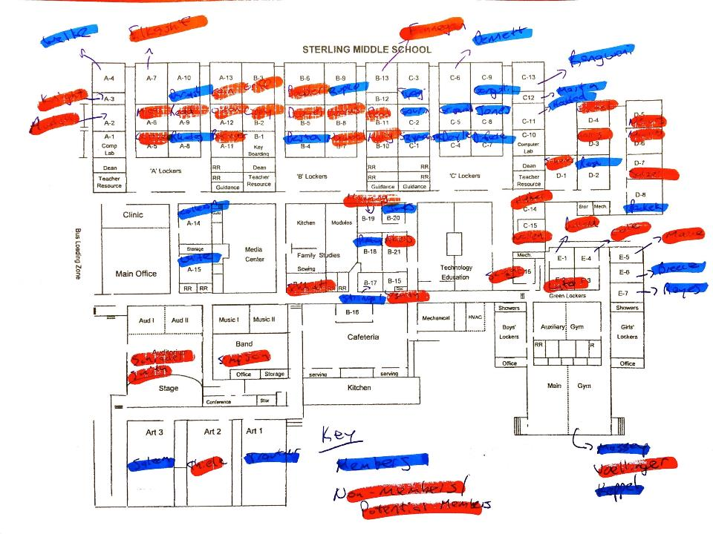
An Example You Might Know- Worksite Maps

Slide 78
An Example You Might Know- Spreadsheet
Name | Role | CEA Member? | ABC Member? | Works Well With | Union Support Rank | Attended Board Mtg | Joined Rally | Displayed Union Poster | Personal Contact Updated | Concerns
Alex Johnson | Math Teacher | Yes | Yes | Leo Martinez, Morgan Taylor | Leader | Yes | Yes | Yes | Yes | Class size concerns
Jamie Patel | School Nurse | Yes | No | Riley Brooks, Samira Ali | Supporter | No | Yes | No | Yes | Safety protocol clarity
Morgan Taylor | English Teacher | Yes | Yes | Alex Johnson, Taylor Green | Leader | Yes | Yes | Yes | Yes | Grievance process delays
Riley Brooks | Counselor | Yes | No | Jamie Patel, Samira Ali | Ally | No | No | No | No | Caseload limits
Samira Ali | SPED Teacher | Yes | No | Riley Brooks, Jamie Patel | Undecided | No | No | No | No | Planning time
Leo Martinez | Science Teacher | Yes | Yes | Alex Johnson, Drew Santiago | Leader | Yes | Yes | Yes | Yes | Lab safety resources
Taylor Green | Librarian | Yes | No | Morgan Taylor, Jordan Kim | Supporter | No | No | No | Yes | Access to materials
Jordan Kim | Art Teacher | No | No | Taylor Green | Undecided | No | No | No | No | Supply budget
Quinn Harper | Kindergarten Teacher | Yes | No | Drew Santiago, Samira Ali | Supporter | Yes | No | No | Yes | Evaluation support
Drew Santiago | PE Teacher | Yes | No | Leo Martinez, Quinn Harper | Leader | Yes | Yes | Yes | Yes | Assault protocol
Potential Building Chart

Slide 79
Who are we mapping?
Leaders – Trusted and respected by their colleagues in ways that cut across communities of workers- are connected by values and influential relationships with mobilizers, activists, and those not yet part of the work. Get people to move their thinking and take action.
Mobilizers – Are already convinced members, who are already willing to take action. They are connected to the other already convinced.
Activists – Supportive and willing to act if invited but not able to move others.

Slide 80




Roles of People Within Your Campaign
Leaders bring their followers.
Mobilizers bring their loyalty to leaders and their reputation with colleagues.
Activists bring their potential.
Not yet engaged – What is your plan?

Slide 81

Spectrum of Allies pg. 29-30

Slide 82

Spectrum of Allies
  Active allies: people who agree with you & are organizing alongside you
  Passive allies: people who agree but aren't doing anything about it (yet!)
  Neutrals: people who aren't sure, or are unengaged (they might just not know about you yet)
  Passive opponents: people who disagree, but aren't trying to stop you
  Active opponents: people who have done something to prevent you from reaching your goal

Slide 83
Key Points
Mapping is an analysis tool for members to use.
Helps organizers think about their people differently.
.

Slide 84
Things to Consider When Assessing Your Region
1. How many people have been identified as trusted and respected by a number of people in the region/local? (Leaders connect mobilizers into structures)
2. How many people are actively working in support of the union and have a group of folks that they influence? (Mobilizers get activists to show up and act)
3. How many people are ready to take pro-union action? (Activists see their relationship with the union as a participatory one)

Slide 85
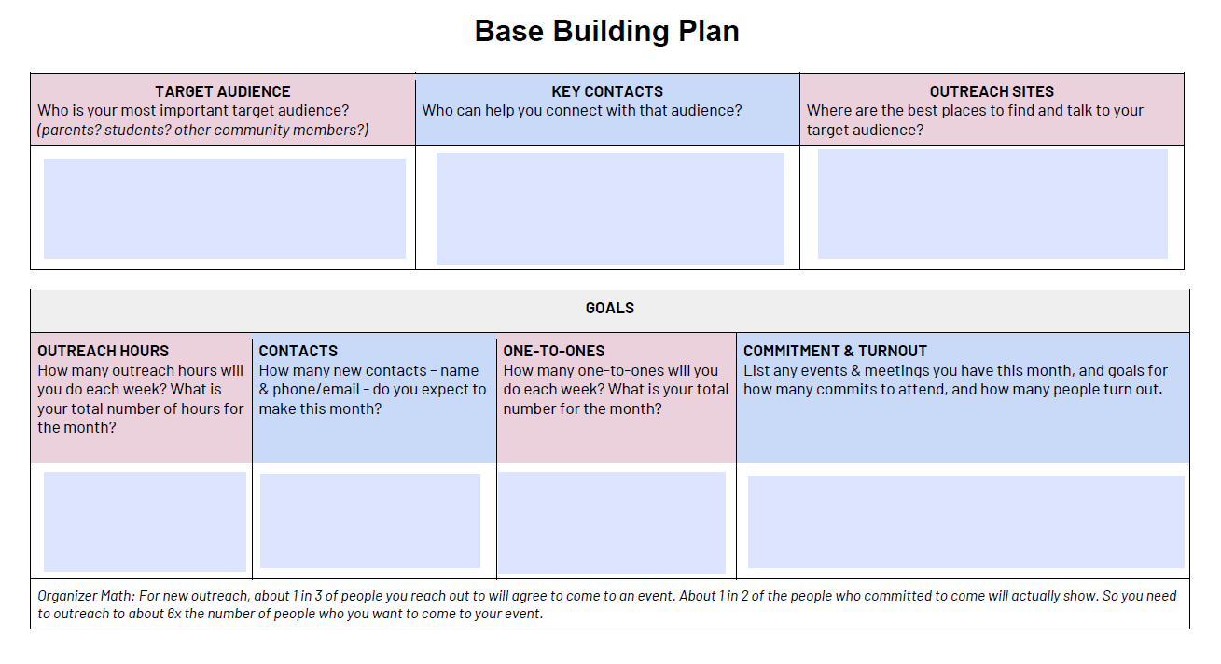
Page 23 Base Building Plan

Slide 86
Mix by NEA Region

Slide 87
Group Work
How do you Map your caucus (local, state, region, national) to find your leaders?
Who is missing from this room?
What tools, resources, supports do you need? What do you have access to at this moment?
Name, Role, Location, Etc
What roles do you need them to play in a particular campaign?
A list of what you do not yet have

Slide 88
Group Work (25 min)
Visualize structure(s)
ID Key leaders
List information/resources needed

Slide 89
Key Ideas
Mapping is an analysis tool for members to use.
Helps organizers think about their people differently and plan for effective use of power.

Slide 90
Self- Assessment
Dr. Taraja

Slide 91
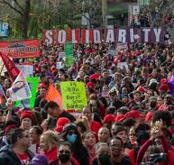
Strength and Growth Page 6
Strength is the ability to use power to win.
Growth is a focus on building the base of members, leaders, structures, and partners.
Think about the base building plan you just worked on.

Slide 92
Self-Assessment Cycle
Assess
Self assessment Tool
Prioritize
Which can we take on?
Plan
What ACTION can we put in place, by when
Review
What are the outcomes
Current Status
Which might build into other categories?
Who is responsible
What is our schedule for revisiting

Slide 93
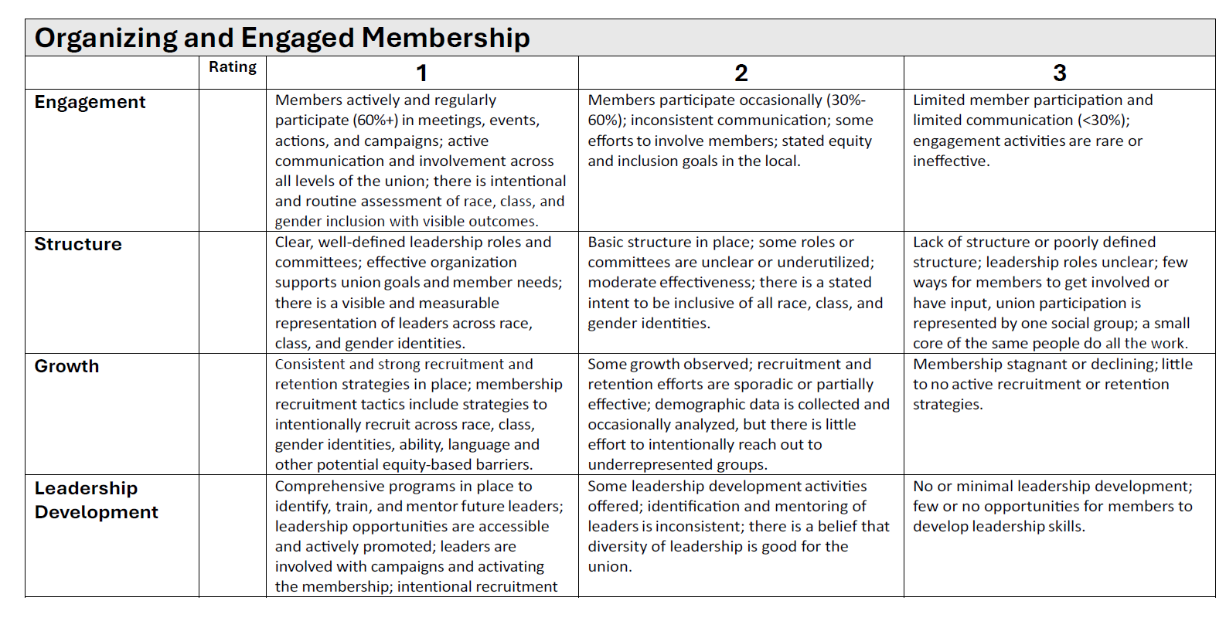
Tool Tour Page 6
Five broad categories with rows of descriptors
Rate each row then record a total for each category
Low Score is strength; High Score is growth focus

Slide 94

Report Out and Discuss
What did you notice?
Are these “internal” issues?
How can external campaigns help address your internal issues?

Slide 95

If there was a crisis, how prepared is your local?

Slide 96
Five Questions for Consideration- page 11
Has your local set goals for membership growth and participation? If yes, what are they?
2. What do you think are your organization’s main strengths that will allow you to build a strong union and effective campaign?
3. Overall, which of the areas above do you think are the largest challenges for your local?
4. In the areas that you’ve identified as your biggest challenges, what are the main barriers your local faces?
5. Which of the above areas do you think should be the top three priorities for your local to address?

Slide 97
Self-Assessment Cycle
Assess
Self assessment Tool
Prioritize
Which can we take on?
Plan
What ACTION can we put in place, by when
Review
What are the outcomes
Current Status
Which might build into other categories?
Who is responsible
What is our schedule for revisiting

Slide 98
Key
Points
Weaker locals are fixed, are leader sparse, are not focused on winning fights, are limited in capacity beyond single issues, and do not have enough resources to achieve the wins they want. Focus is on Growth.
Stronger locals are nimble, leader dense, have the ability to focus on a number of campaigns, are a series of interconnected structures, with the resources to achieve the wins they want. Focus is on Strength.

Slide 99
Beyond the Bell Tour
Eric

Slide 100

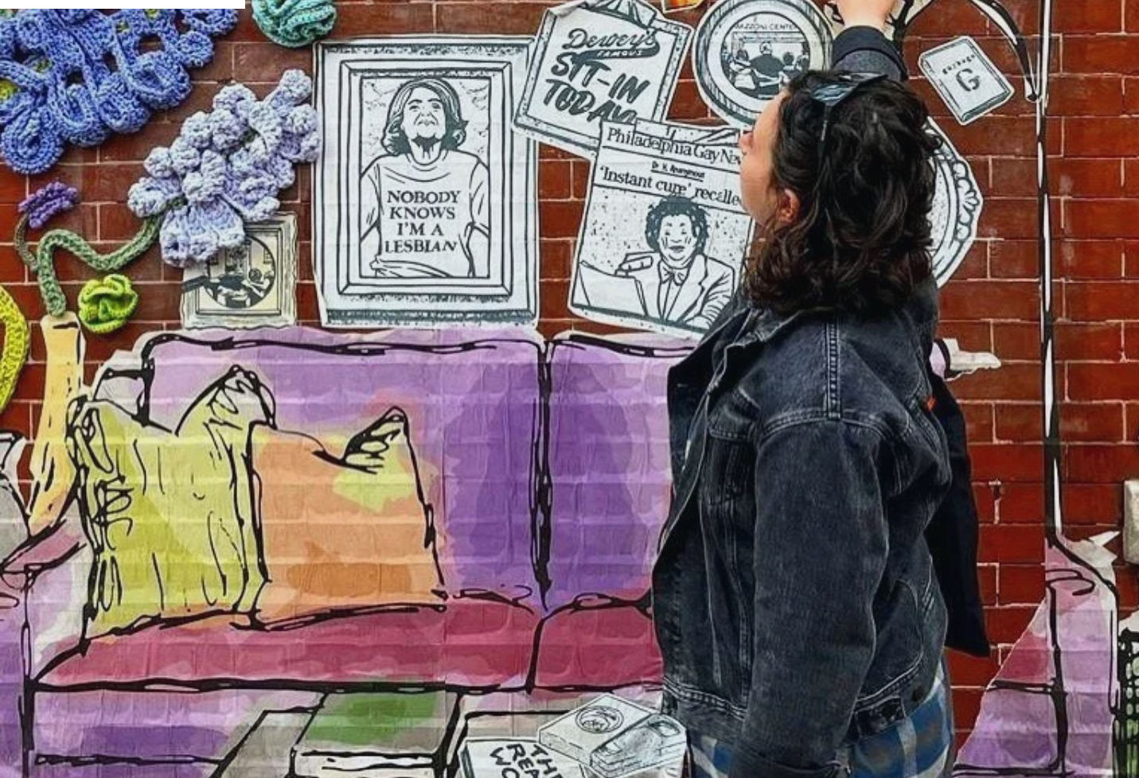
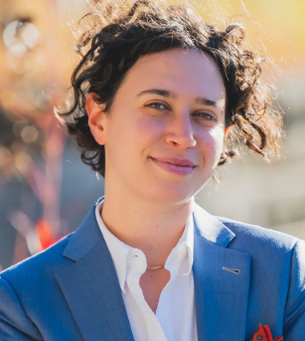

Slide 101

Rebecca Fisher (she/her)
Co-Founders

Slide 102


Slide 103


Slide 104
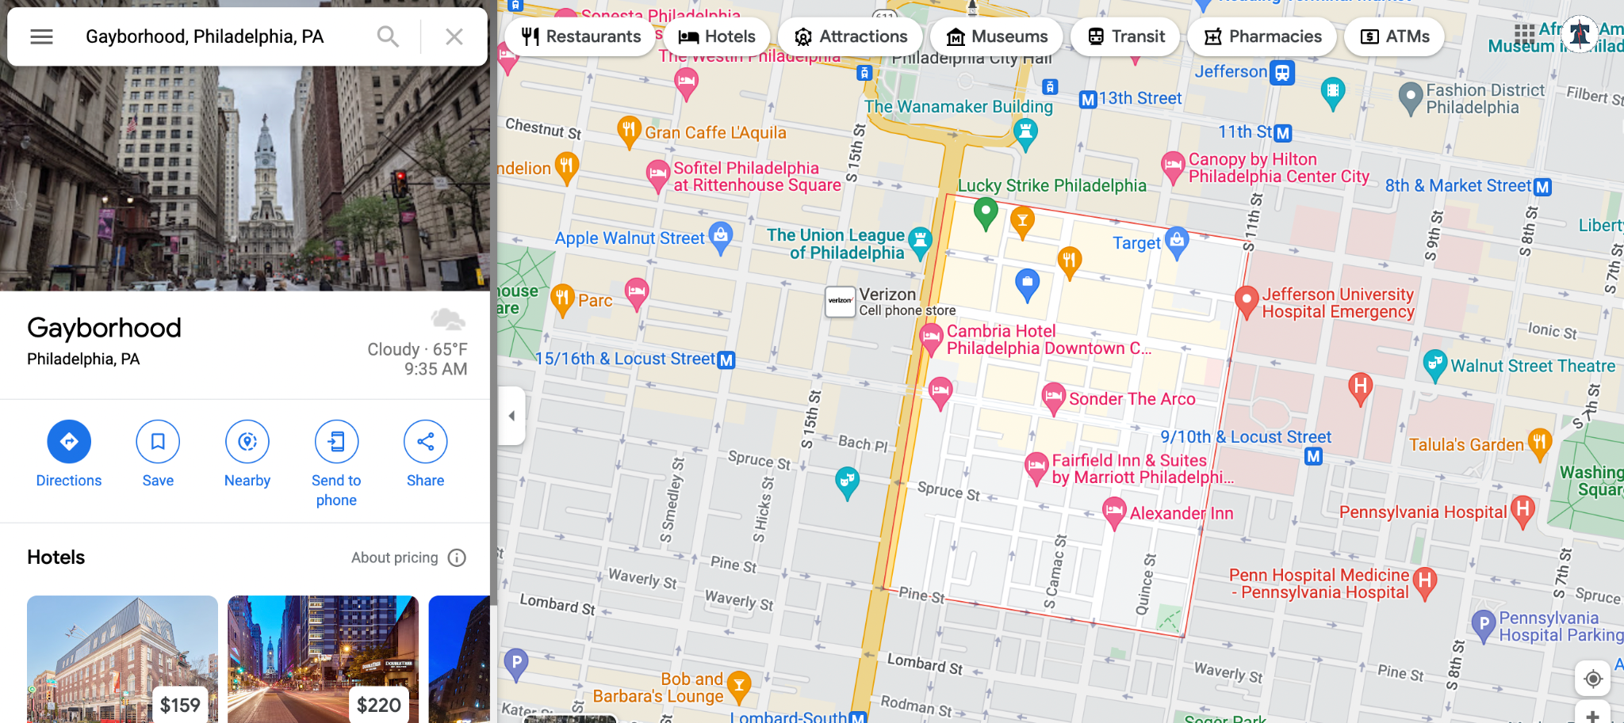

Slide 105
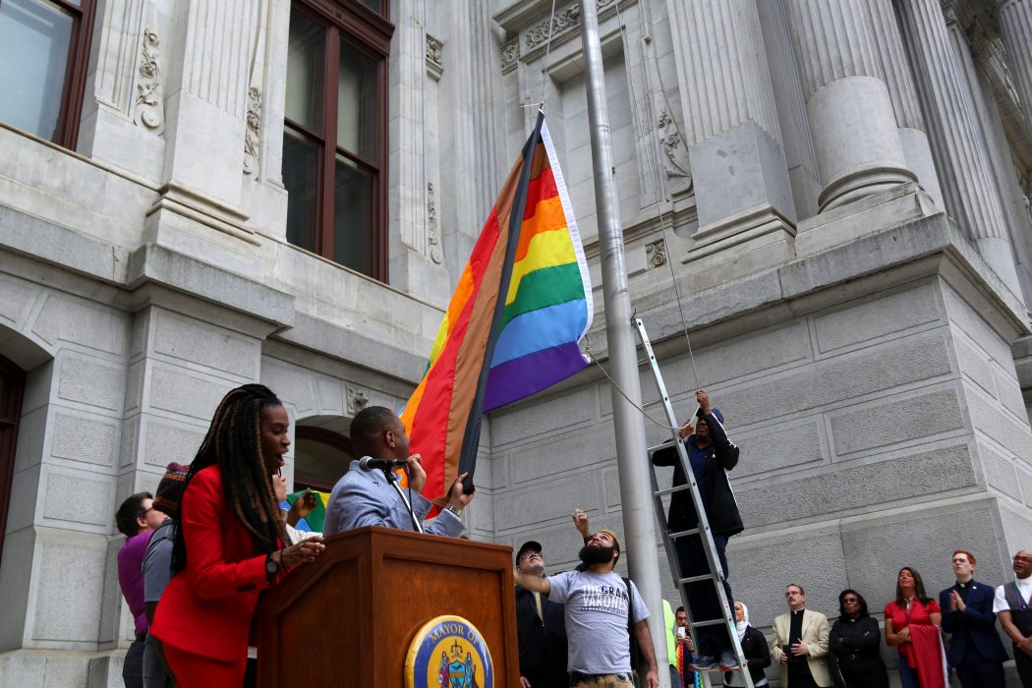


Slide 106
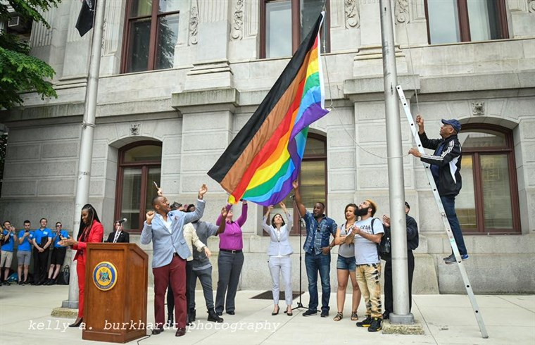

Slide 107
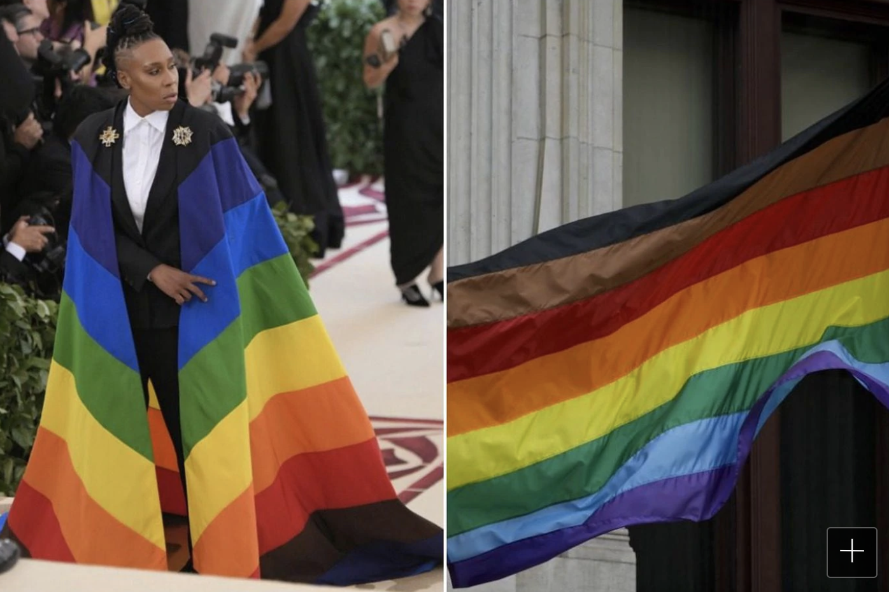

Slide 108
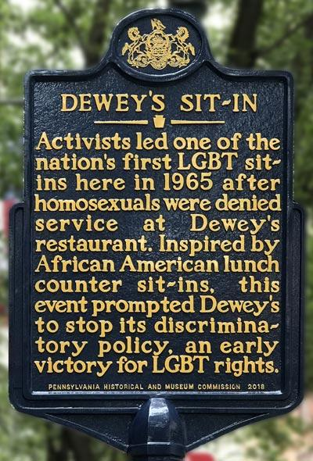
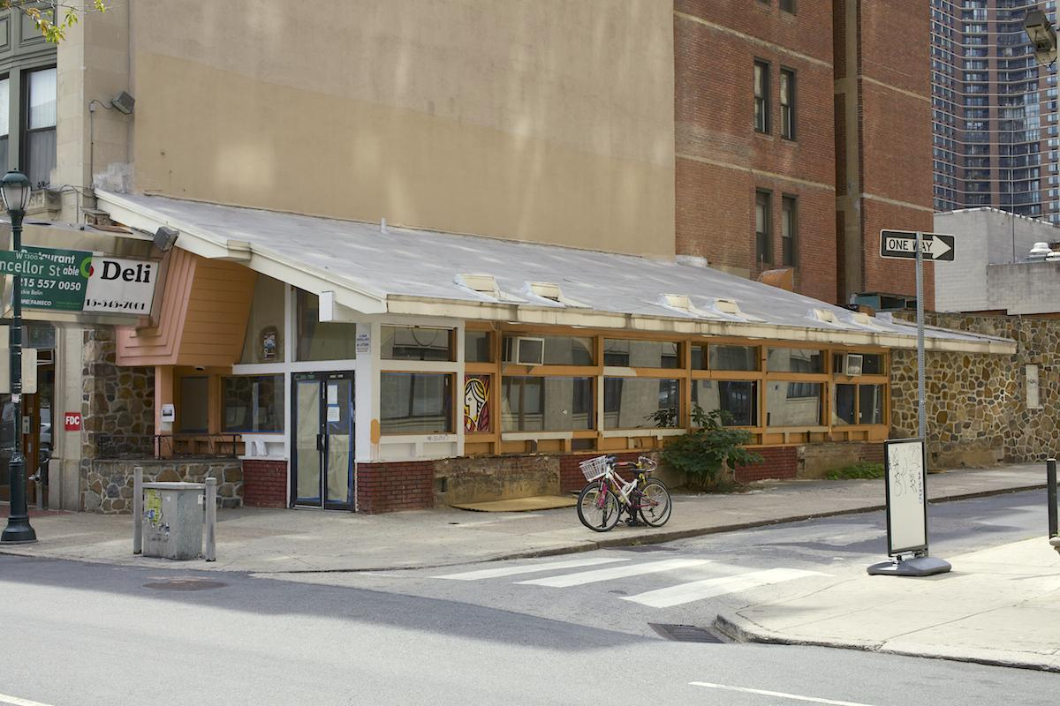

Slide 109
Dewey’s

Slide 110
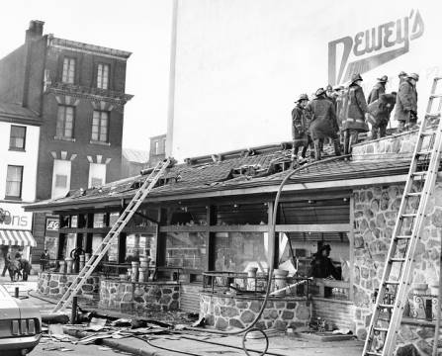

Slide 111


Slide 112
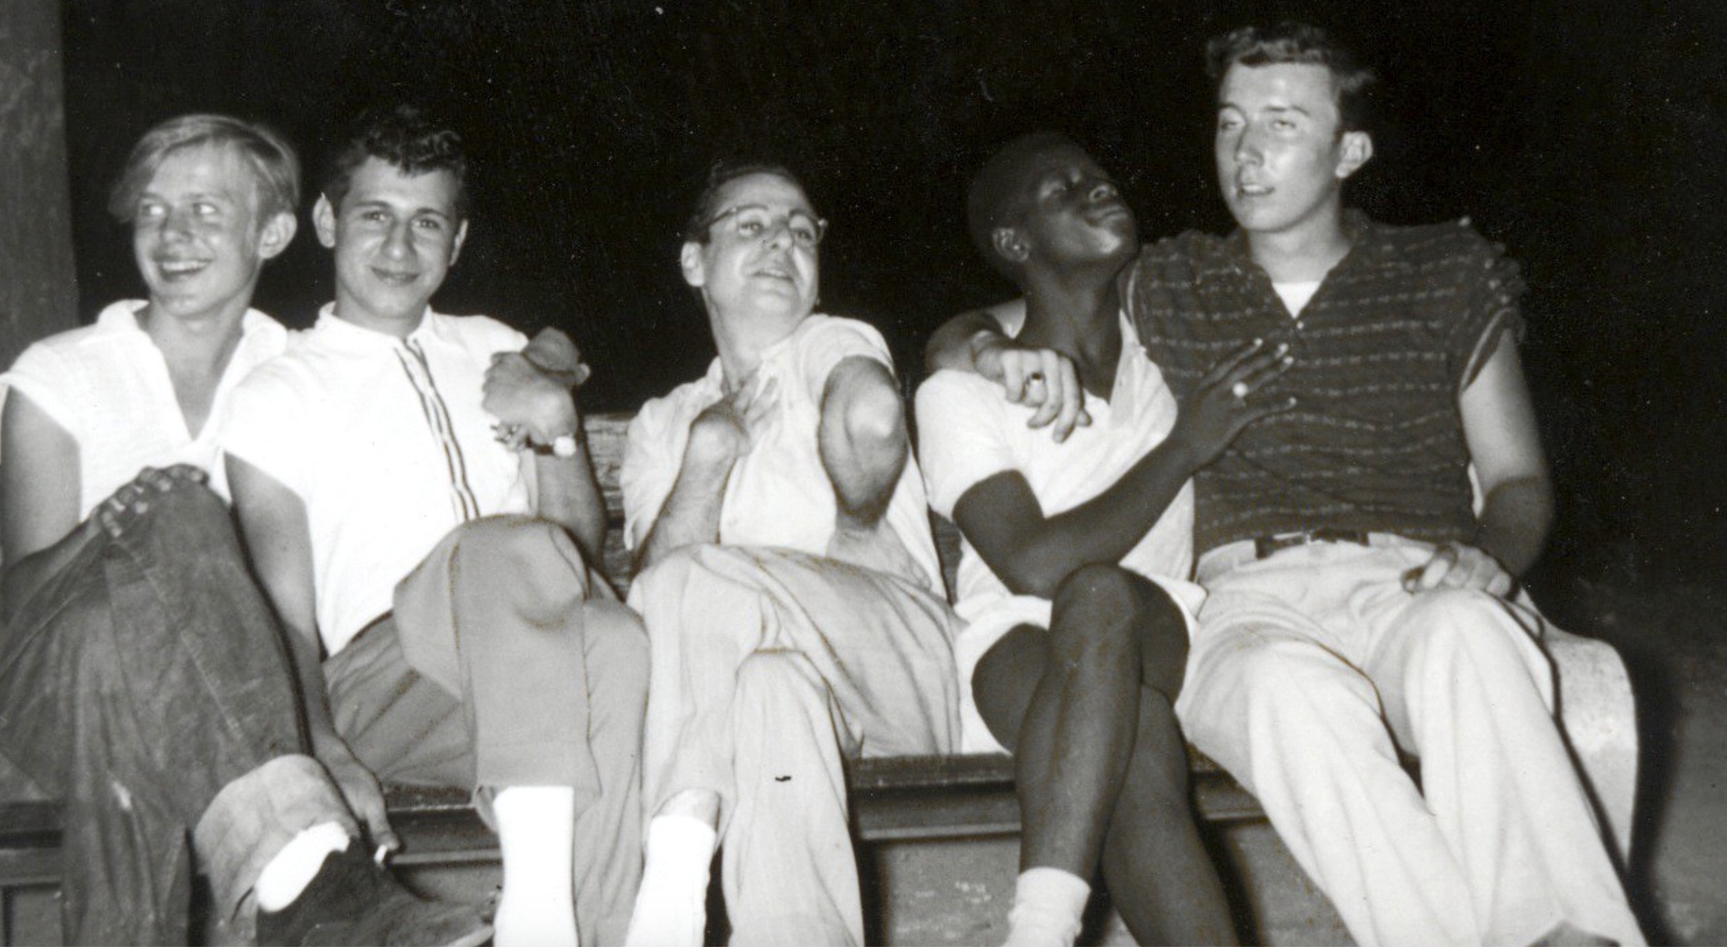

Slide 113
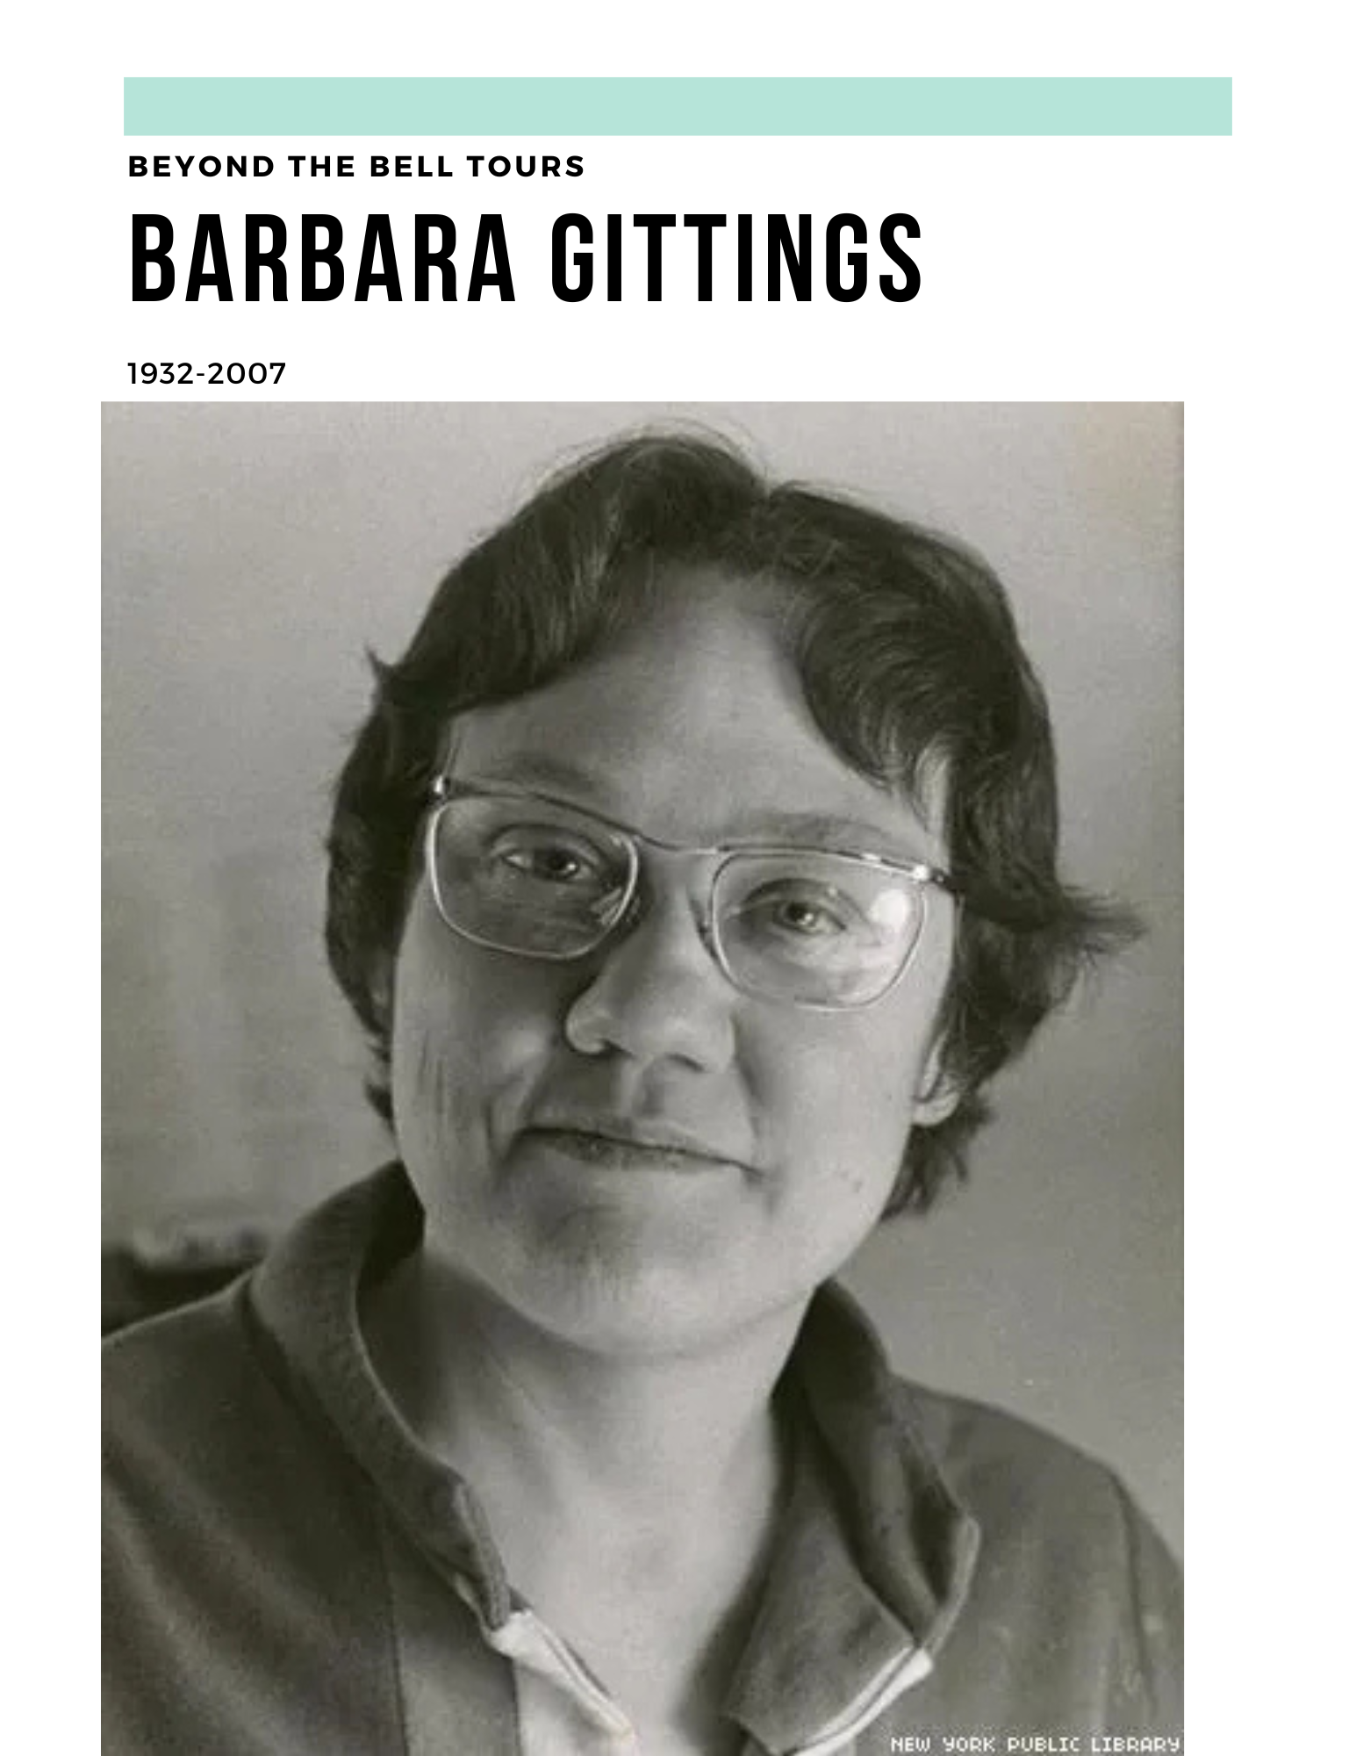

Slide 114
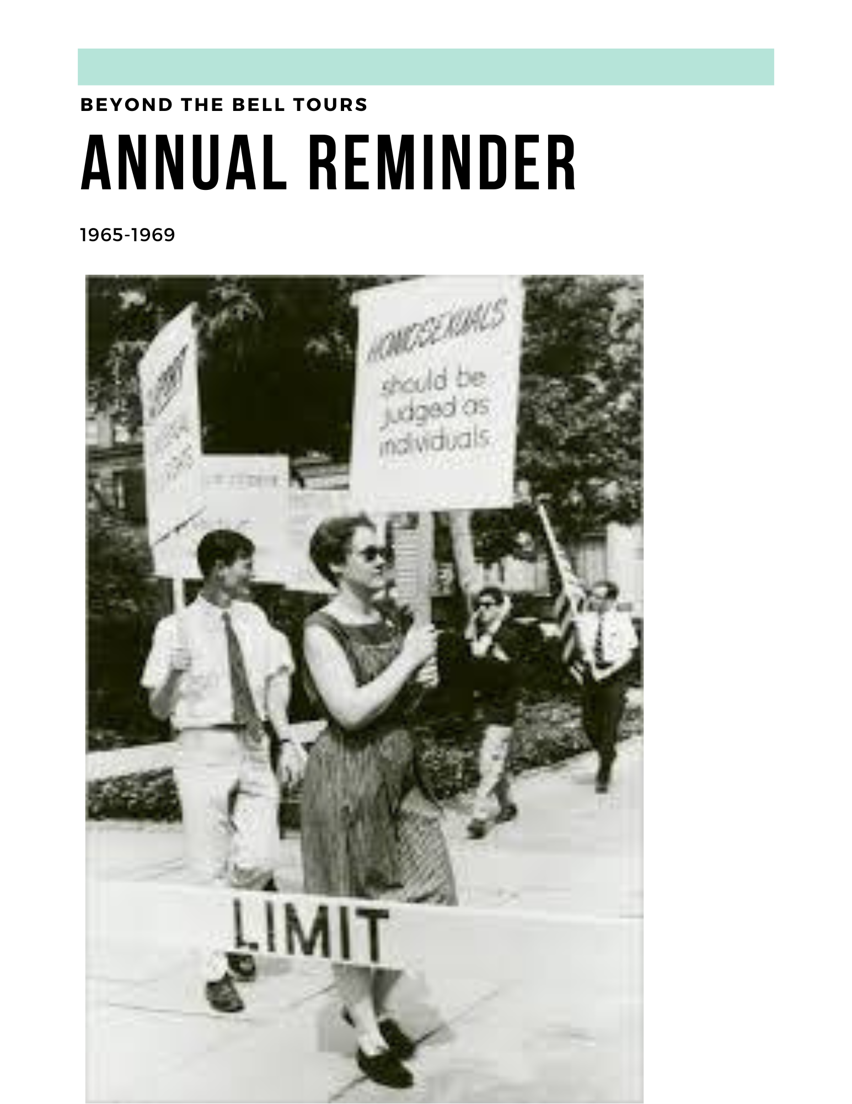
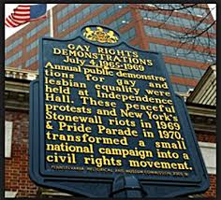

Slide 115
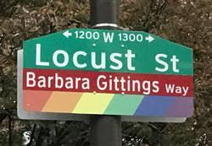


Slide 116
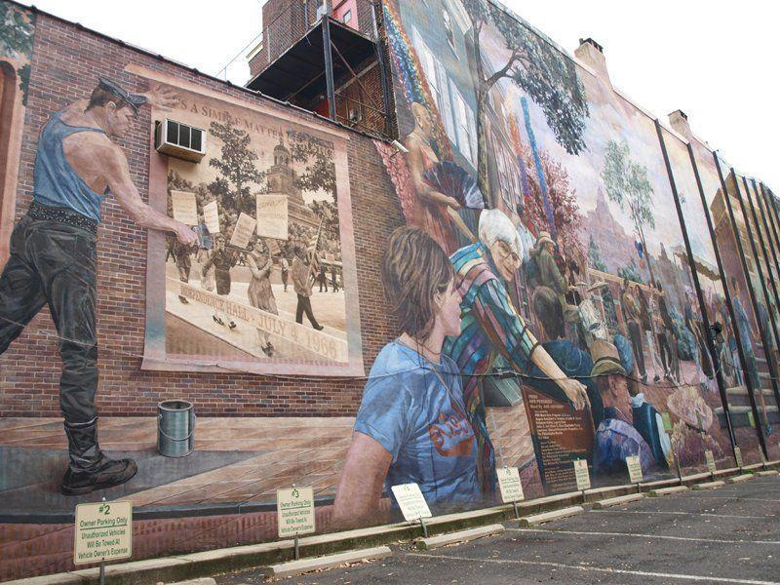

Slide 117
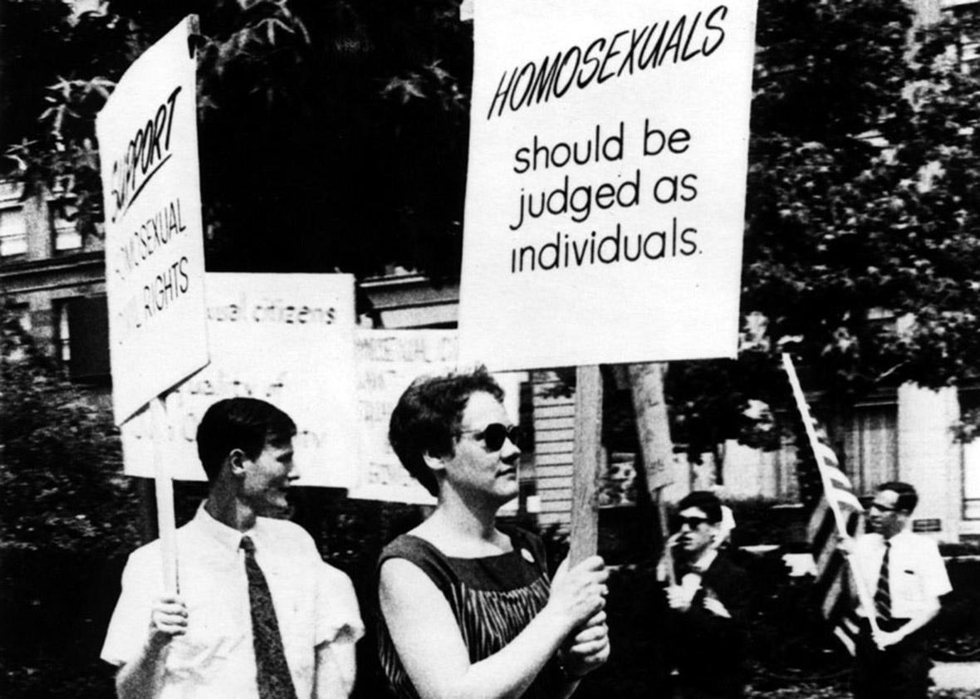

Slide 118
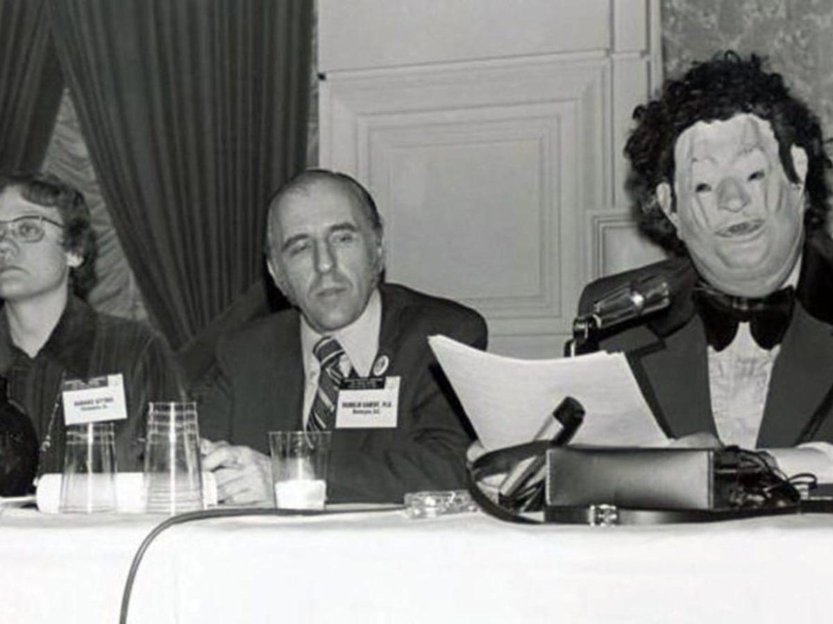

Slide 120
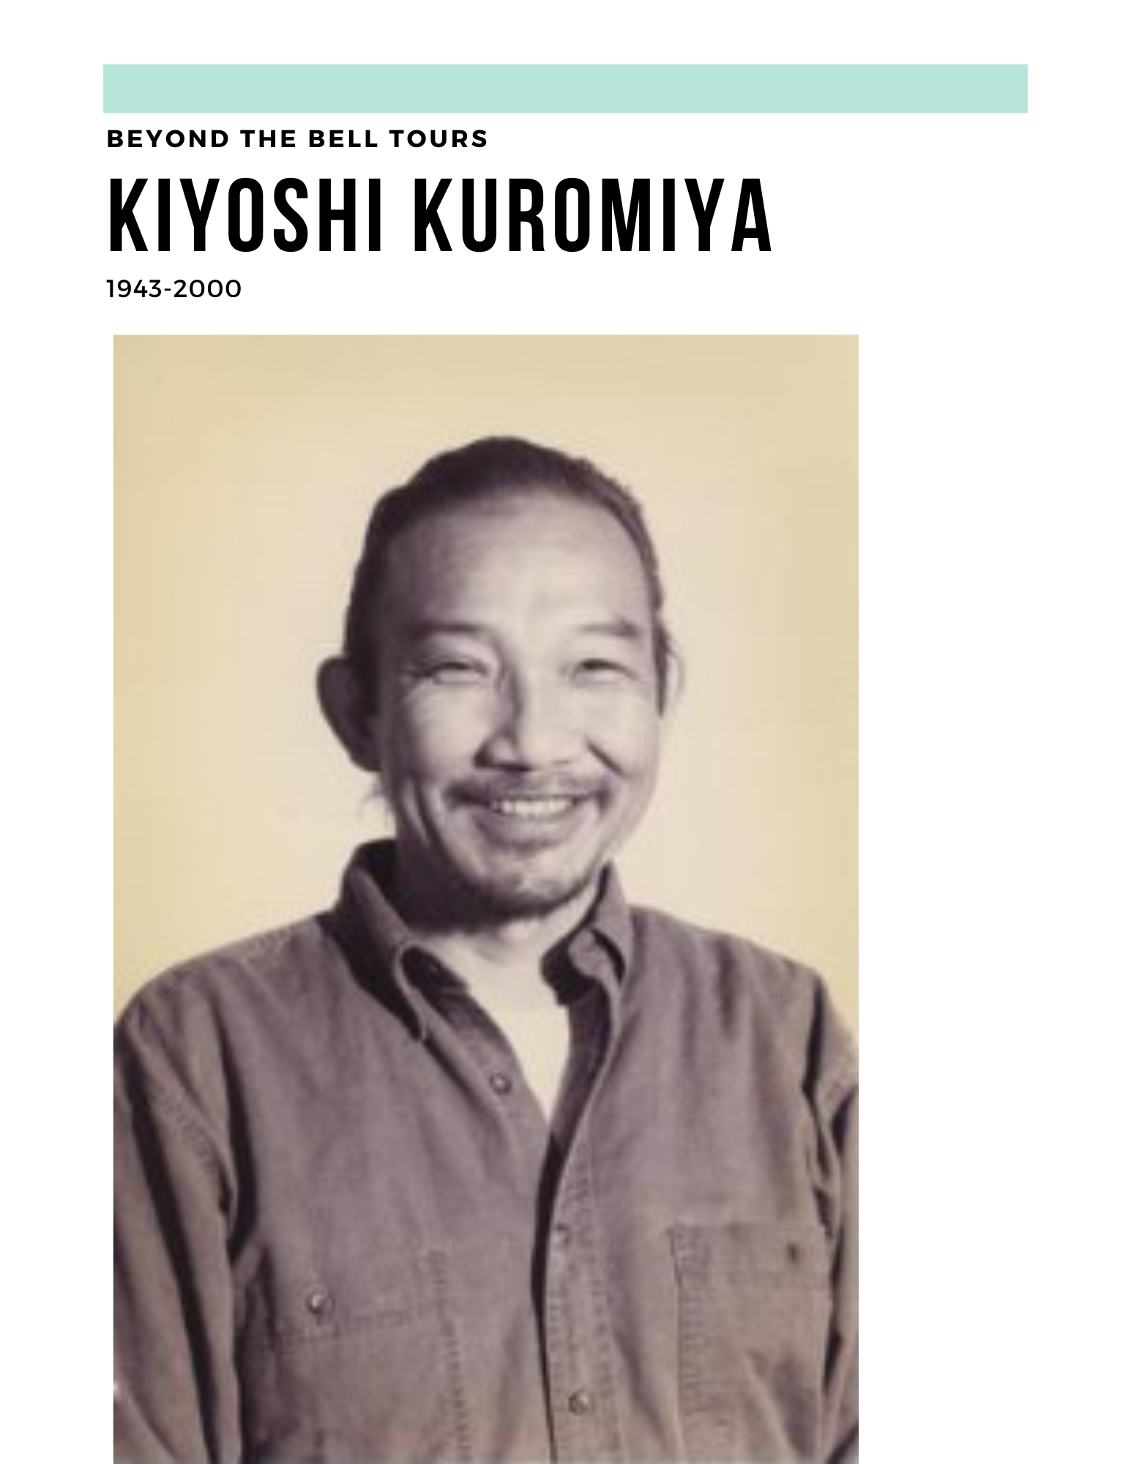

Slide 121
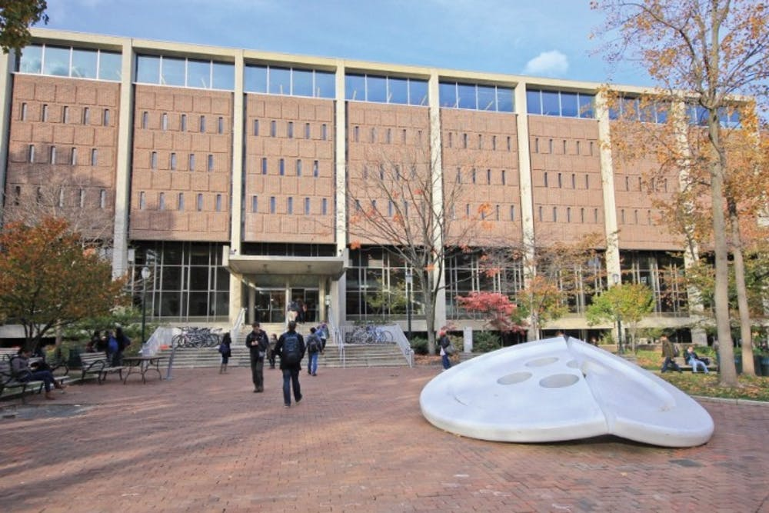
Van Pelt Library

Slide 122
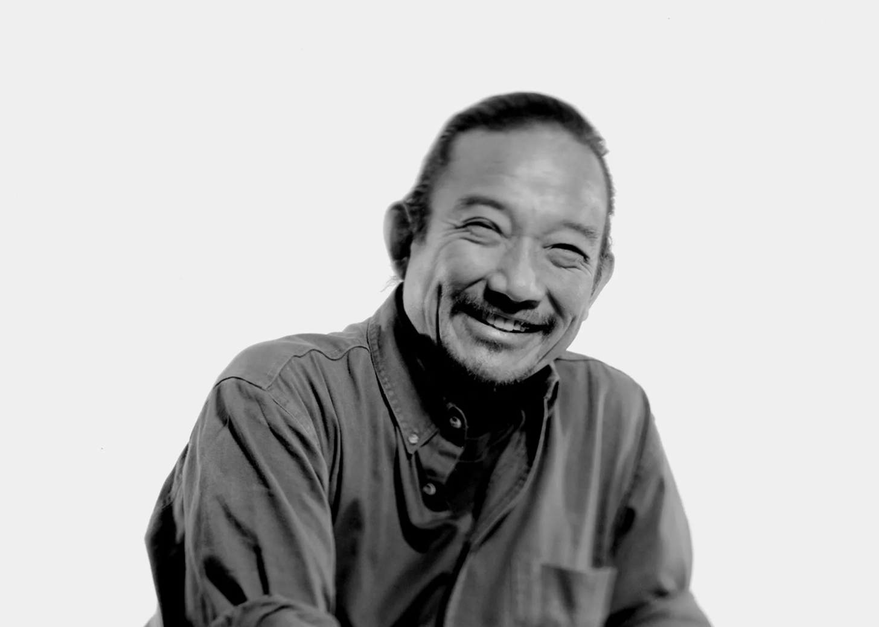

Slide 123


Slide 124
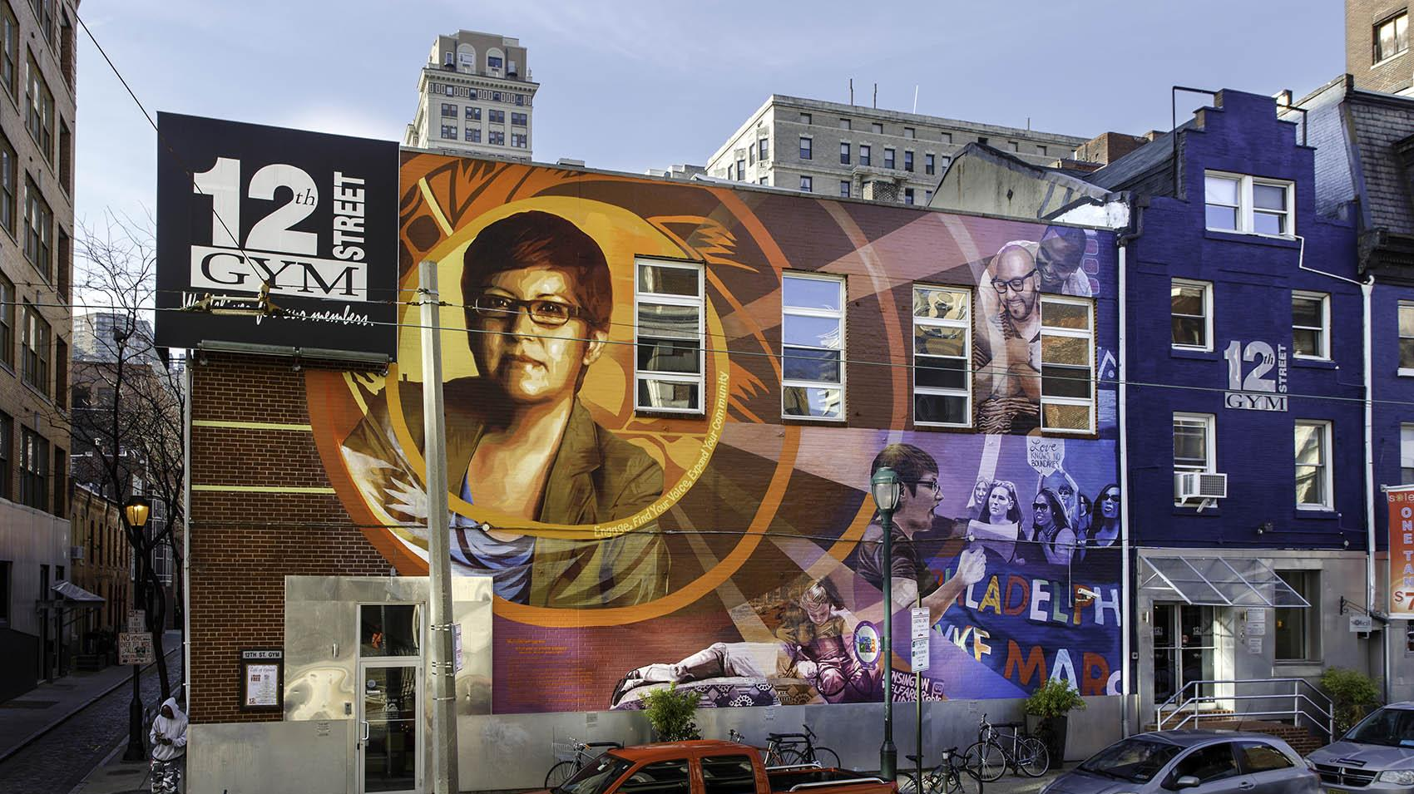
Notes:
I want you to think back to those three women and think about how you might monumentalize them, would you make a statue? A mural? Put a portrait in a museum?

Slide 125
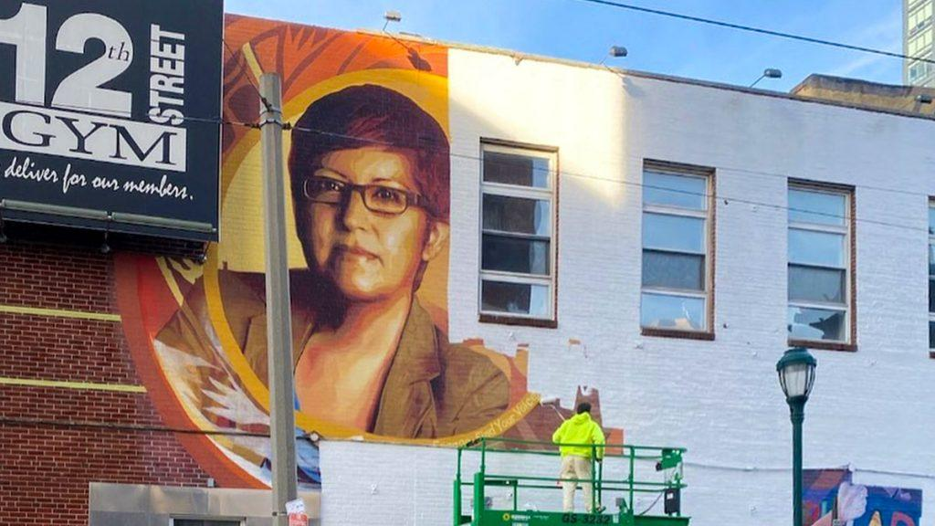

Slide 126
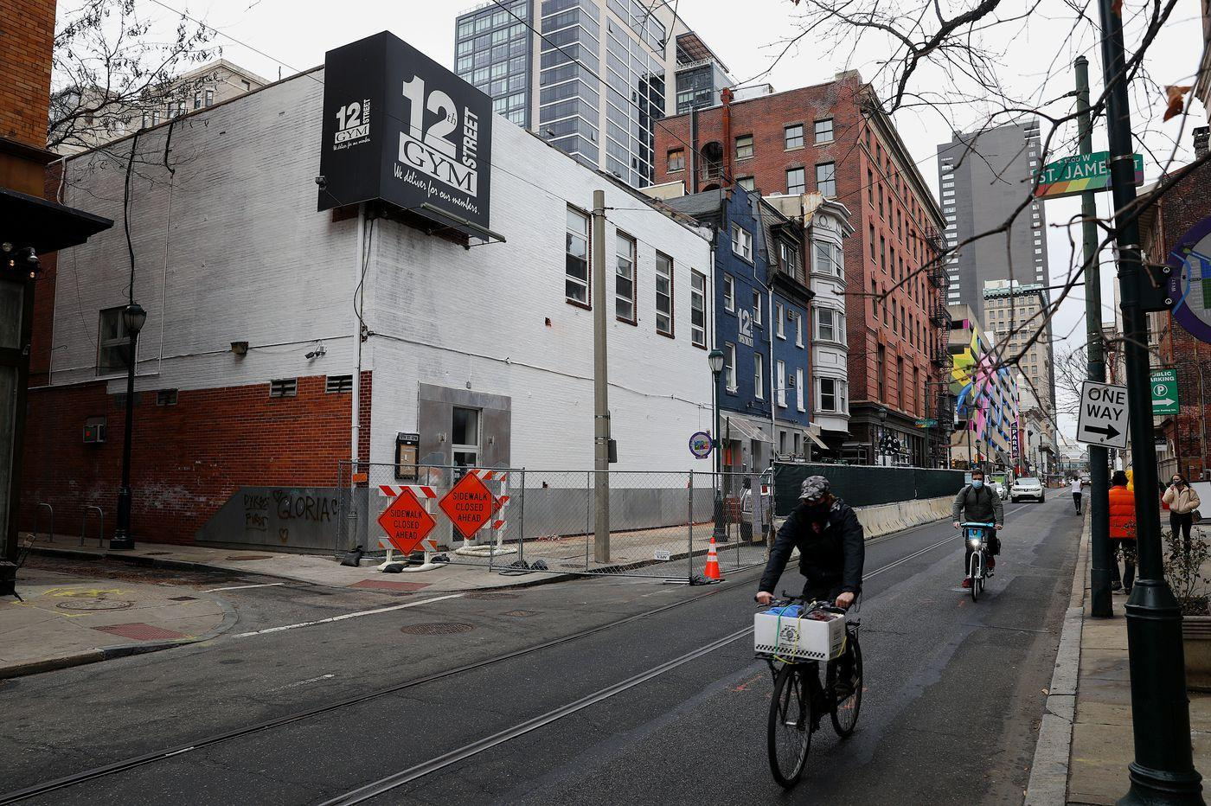

Slide 127
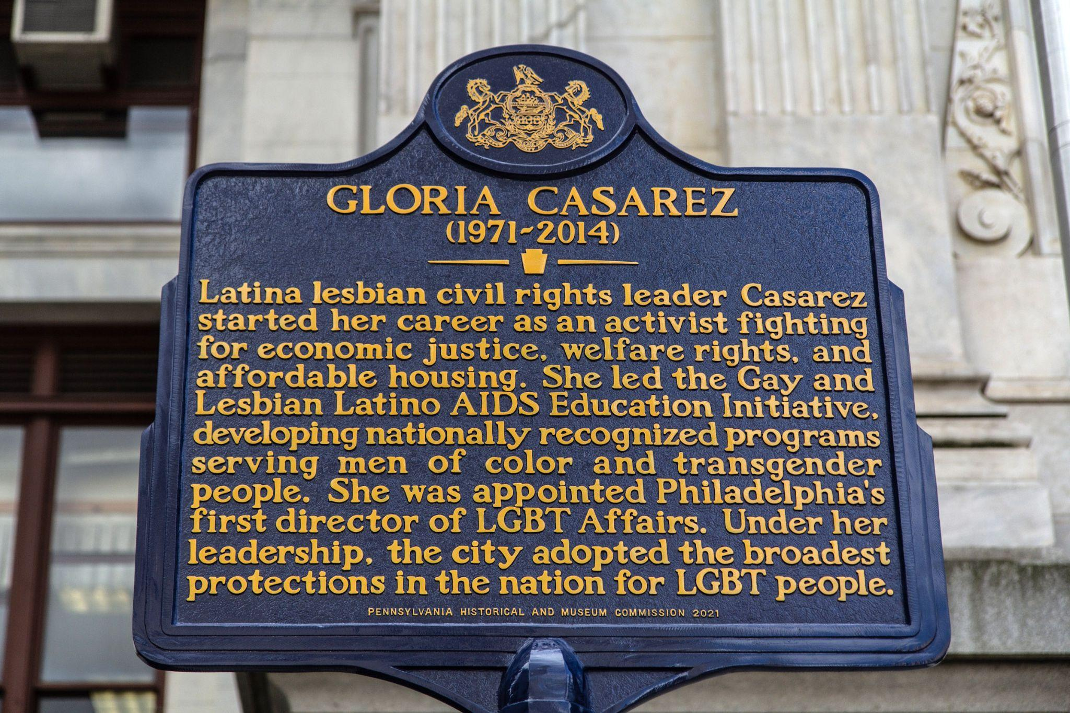

Slide 128
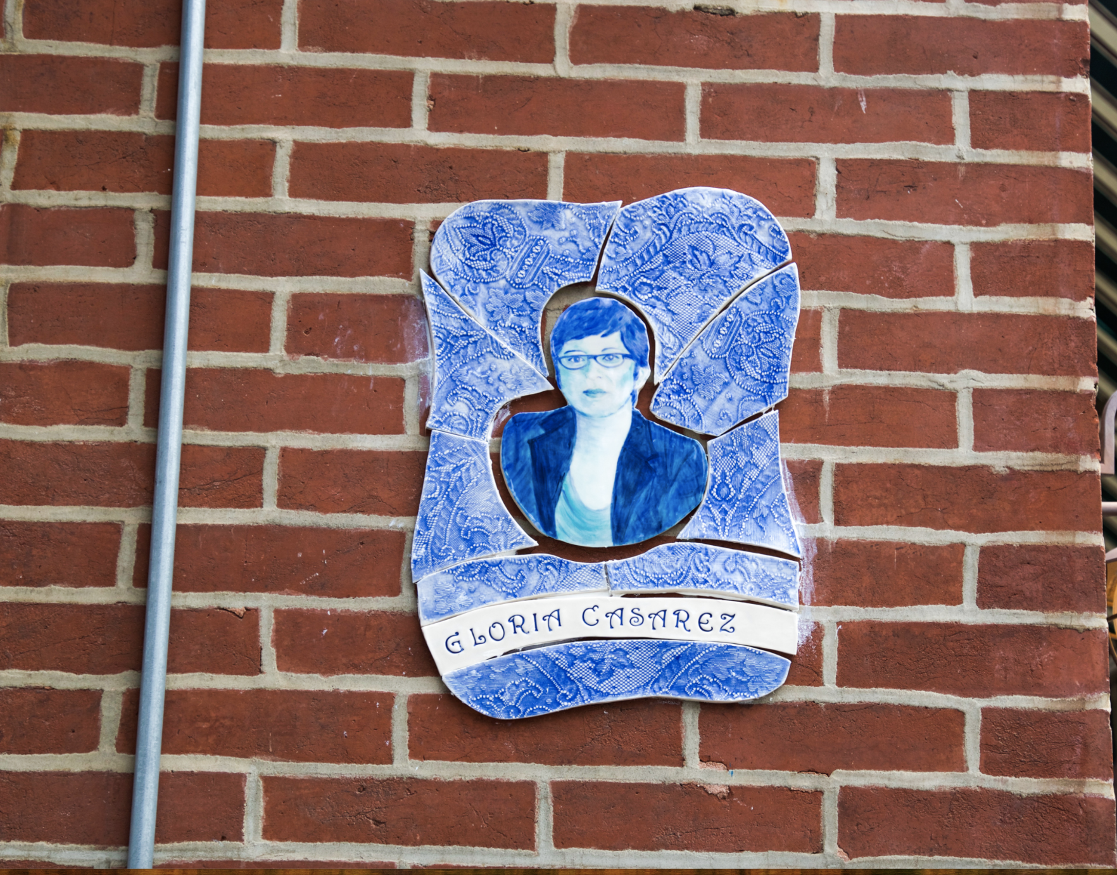

Slide 129
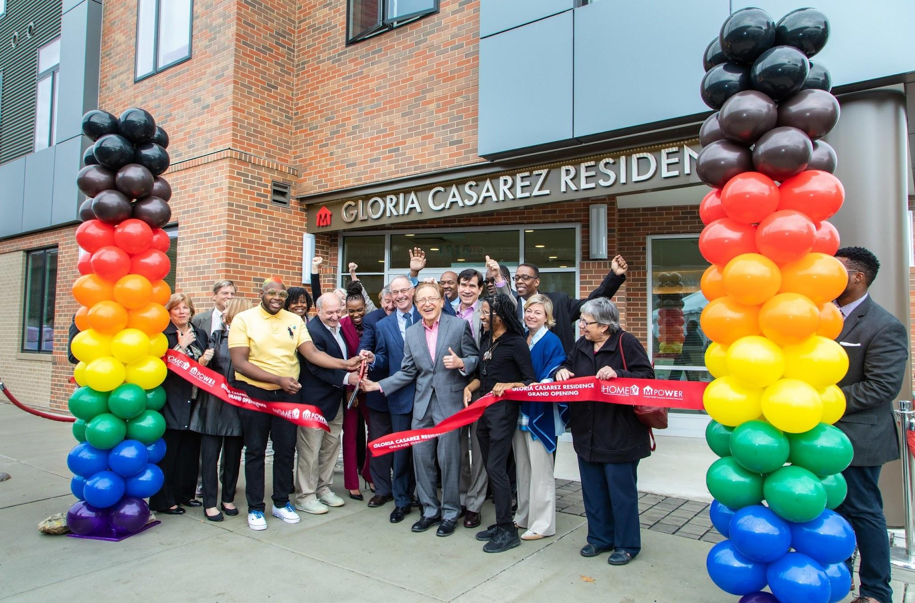
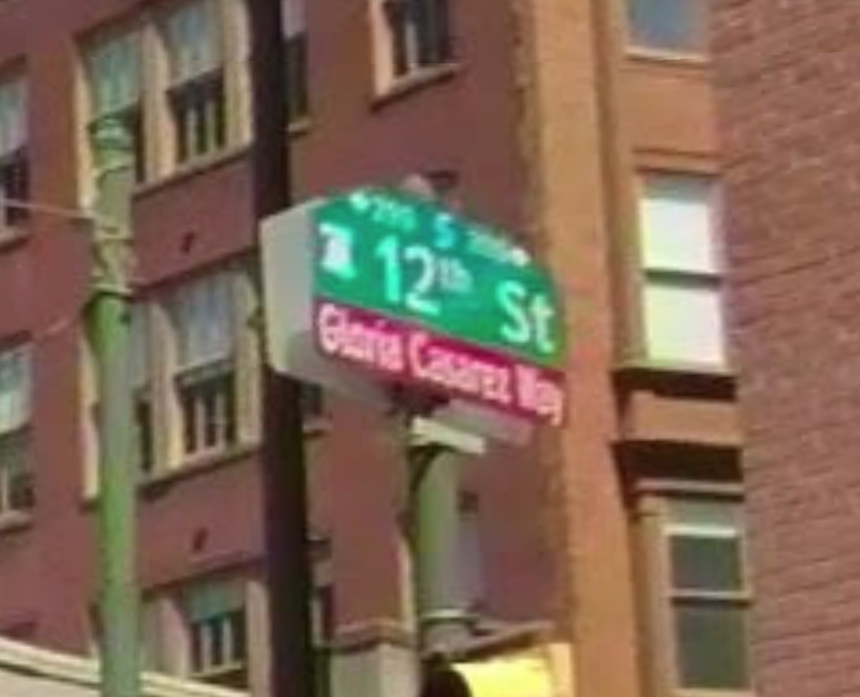

Slide 130
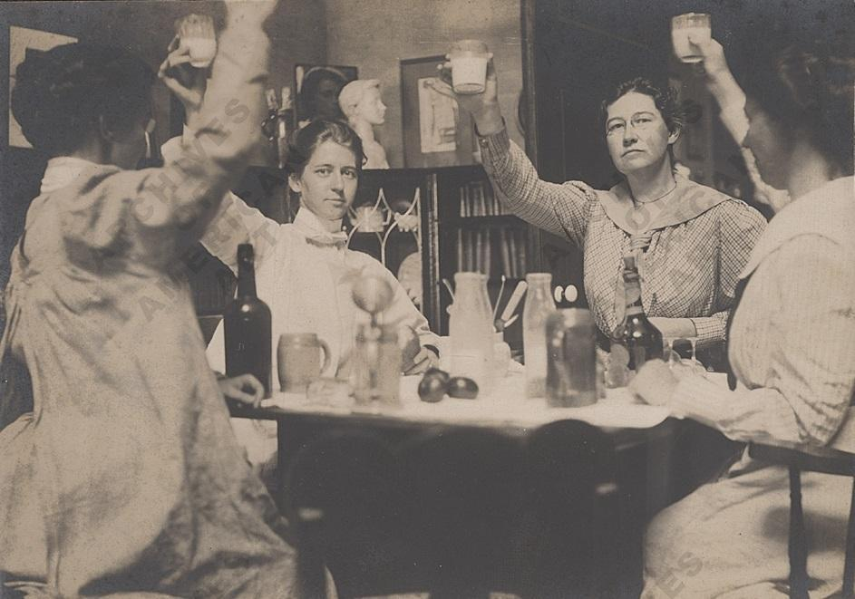

Slide 131
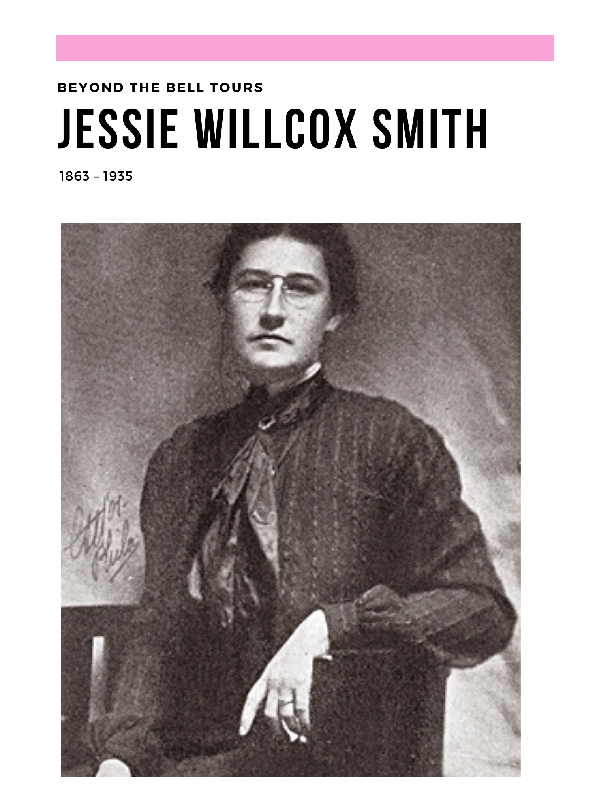


Slide 132



Slide 133
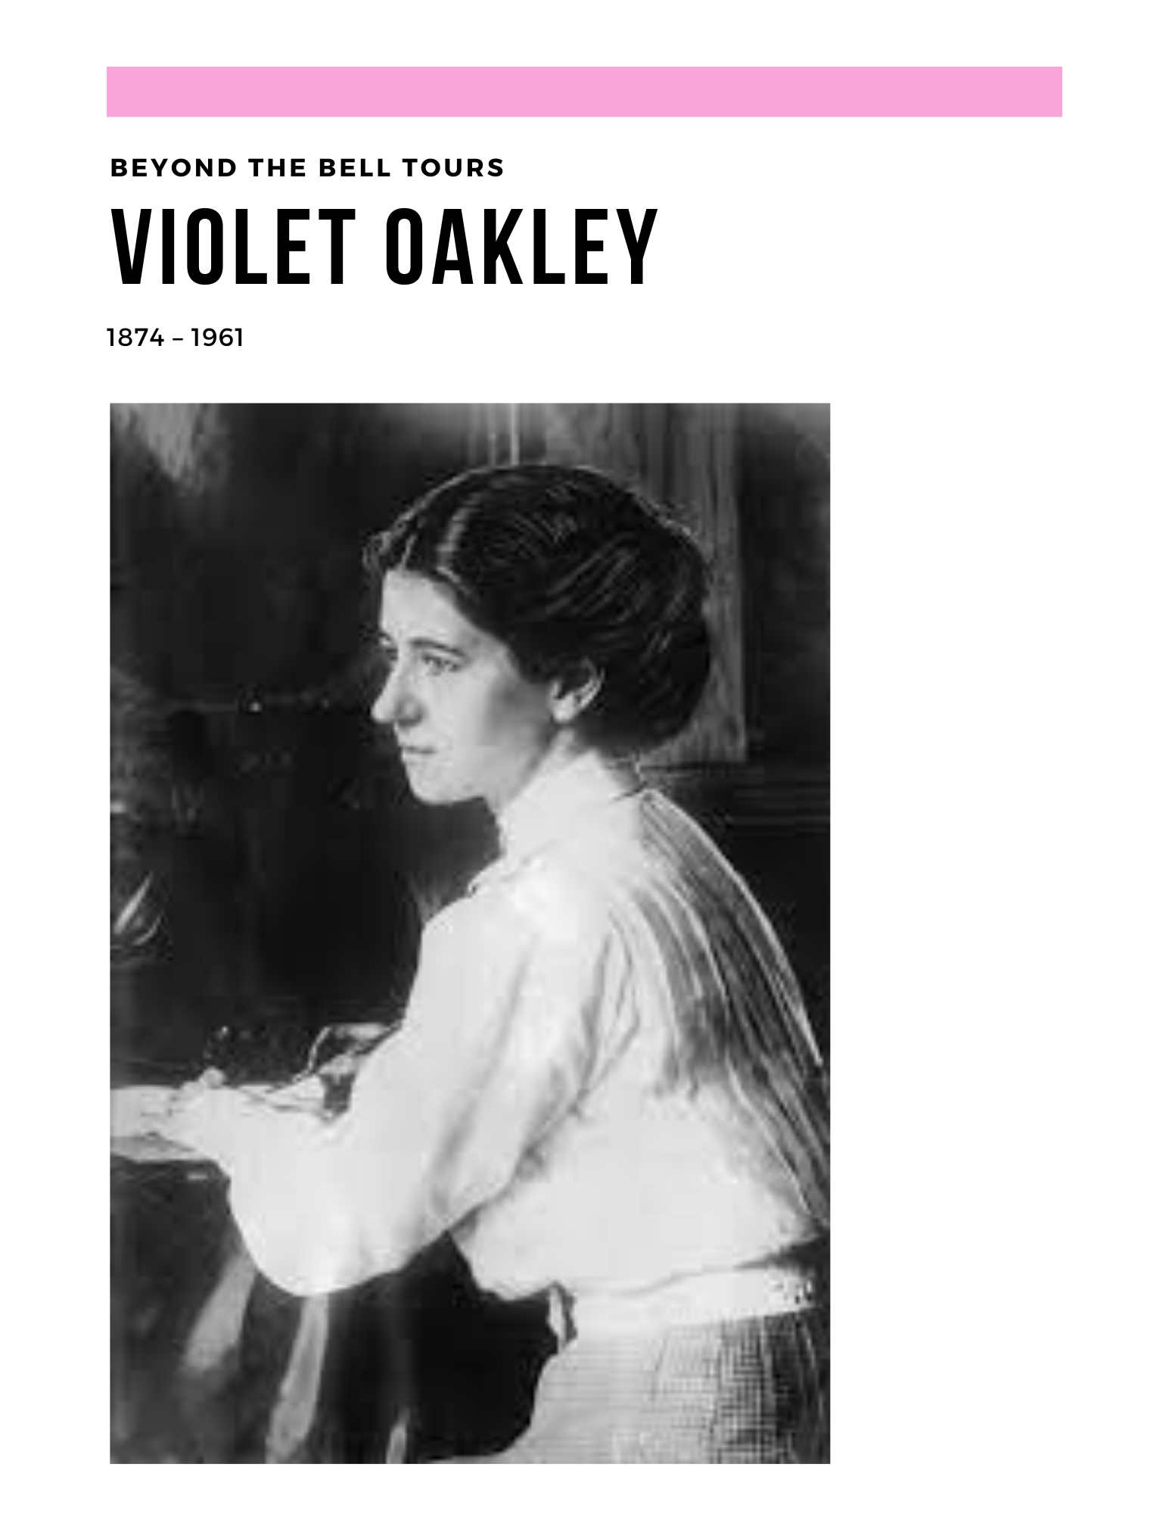


Slide 135
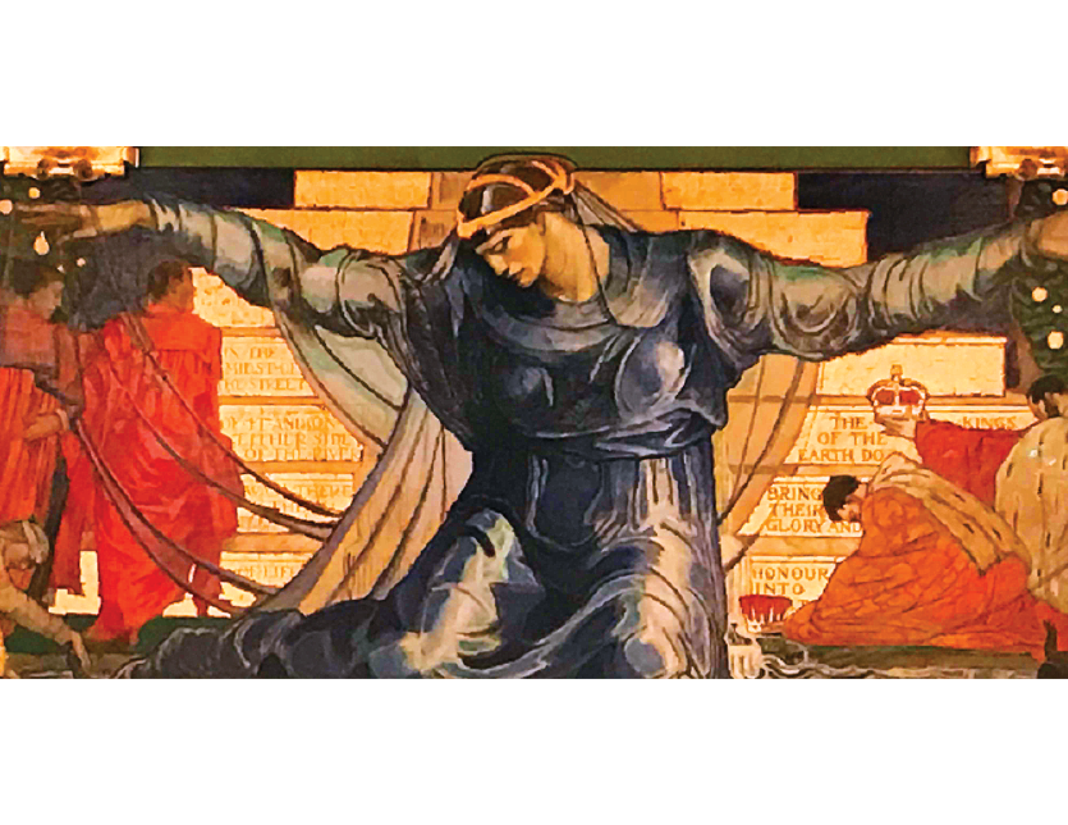

Slide 136


Slide 137


Slide 138


Slide 139



Slide 140



Slide 141



Slide 142


Slide 143



Slide 144



Slide 145


Slide 146


Slide 147


Slide 148

Rebecca L. Fisher info@beyondthebelltours.com www.beyondthebelltours.com
(484) 416-0140
?

Slide 149


Feedback time
Goal – 100% Participation
6 Short Questions
We use what you give us

Slide 150

Closing the Day
Ellen
What is becoming clearer?
What remains murky?
Housekeeping

