Slide 1
Campaign Academy:
Leaders and Structures for Winning Campaigns
February 28, 2026

Slide 2

Campaign Academy
By attending this training, you confirm that you are either an NEA affiliate staff person or NEA member in good standing. The information you receive here is only for your use in your capacity as an NEA affiliate staff person or NEA member.
This presentation and its contents are confidential and may not be further distributed or passed on to any other person or published or reproduced, in whole or in part, by any medium or in any form, for any purpose unless written consent has been provided by Ellen Holmes. Audio/video recording, copying of slides, and the use of AI note-taking tools are prohibited without the written consent from Kyle Serrette. Violation of these terms may result in legal action.

Slide 3
NEA Standards of Conduct
NEA has adopted a Standard of Conduct Policy to ensure that all of our gatherings are welcoming to and free from discriminatory, harassing, or otherwise unacceptable behavior. Discrimination or harassment based on race, color, ethnicity, religion, sex, age, national origin, sexual orientation, disability, gender identity, or expression, or any other characteristic protected by law will not be tolerated. If you have experience any discriminatory or harassing behavior, please report the incident by emailing Ron "Duff" Martin (rmartin@nea.org) and Gladys Marquez (gmarquez@nea.org). Thank you for your commitment to ensuring a positive event for all.

Slide 4

Caucus Social Contract
Make sure you signed it.
Are we living up to it?
Do we need to add anything?

Slide 5
Feedback on Feedback
45 out of 53 Respondents
Range of 4.85-4.75 out of 5
Highest for the team, next for the materials, then the flow of the day
Themes
Time to talk, Moving the tables,
Rebecca, Meaningful Program, Training Team

Slide 6
Your Words
There was time to work and process but it often felt interrupted and made it challenging to take what is in our hearts and minds and apply it. There were a few work times where we were discovering great things and lost the momentum. I recognize that time was not intended to get it all down but I really feel some additional time to work would leverage the focus and inspiration that we are getting at that time.
This training is a huge asset to helping grow and continue fighting for equity and humanity for our LGBTQ educators and students. This has allowed me to prioritize and generate very useful strategies for our state caucus.
This truly is one of the most valuable and important training I have attended in all of my 30 years of teaching. I will use this in so many ways. One thing I want to do is to bring this back to my local and use it to help create more leaders in our organization and to “disrupt the status quo to help us grow.

Slide 7

ToDay’s Agenda
  7:30-8:30 Breakfast
  8:30-Noon
  10:15-10:30 Break
  12:00-1:00 Lunch
  1:00-4:30
  2:30-2:45 Break
  4:30-5:00 Networking and Adjourn
.

Slide 8
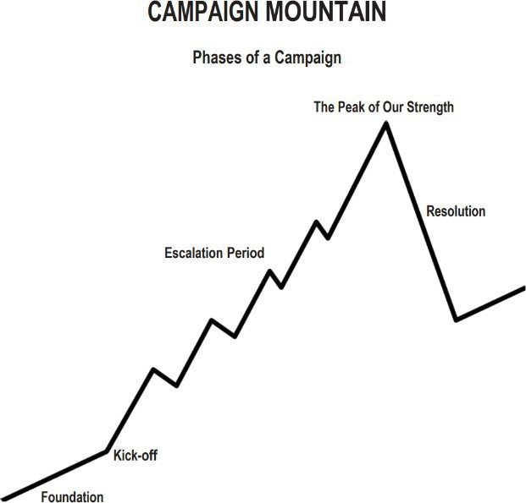
Structures and Leaders
  Centering Equity
  Leadership Team
  Problem and Issue Identification
  Target and Demand
  Power Analysis
  Allies
  Communication
  Strategy
  Tactics
  Metrics
Timeline
Tactics (in order) of escalation
Benchmarks for each tactic
Timeline
Tactics (in order) of escalation
Benchmarks for each tactic

Slide 9

Apply to be a Campaign Lab Coach
Possess an organizing and leadership mindset
Engages in peer problem solving and coaching
Campaign Coach
Holds coaching calls, with team 2 times a month
Coaches 1–2 local teams
Attends campaign coach training
Works with a mentor coach

Slide 10
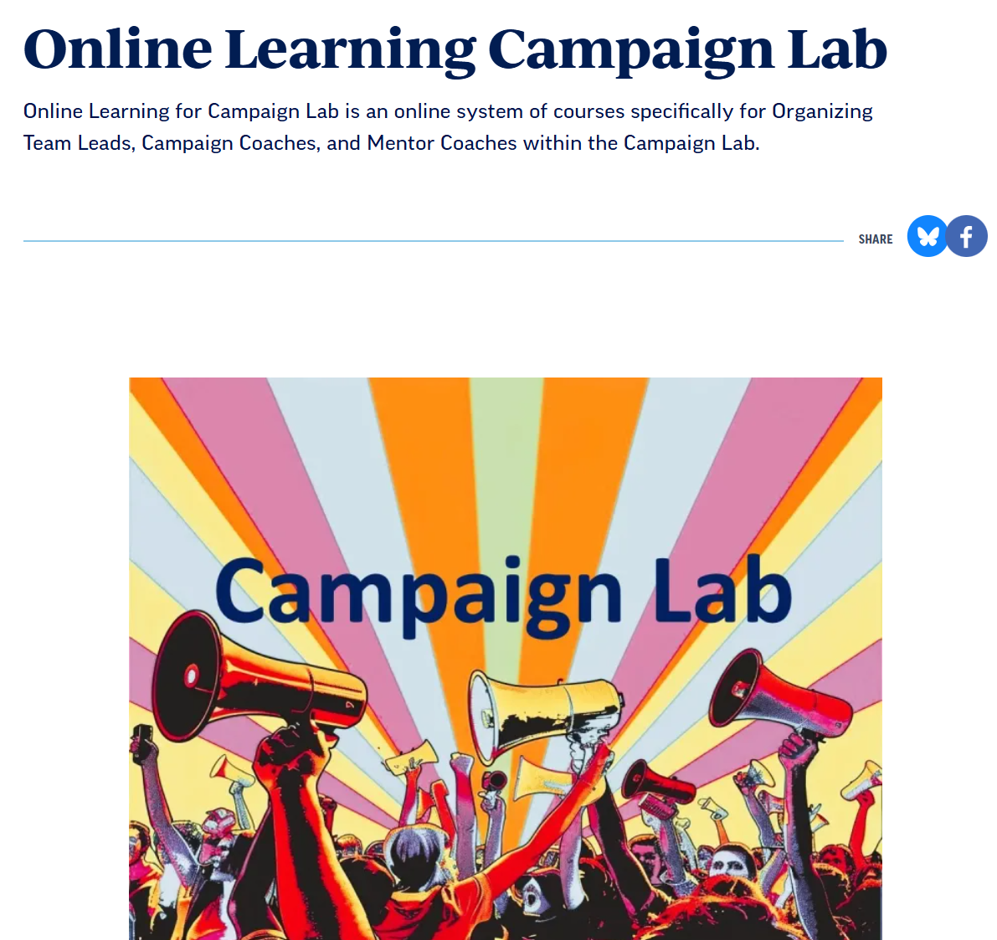
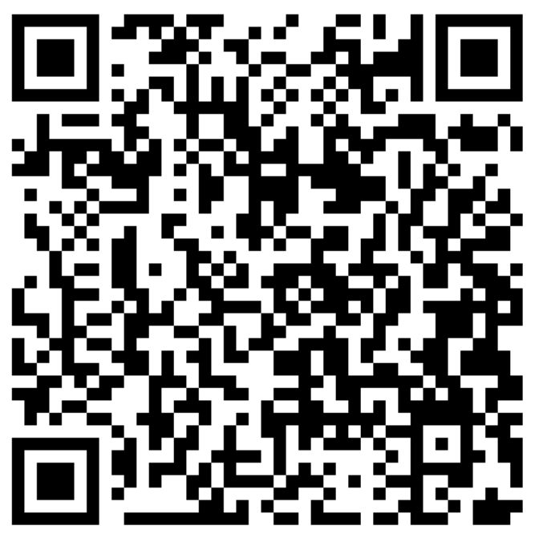
Online Learning Opportunities

Slide 11
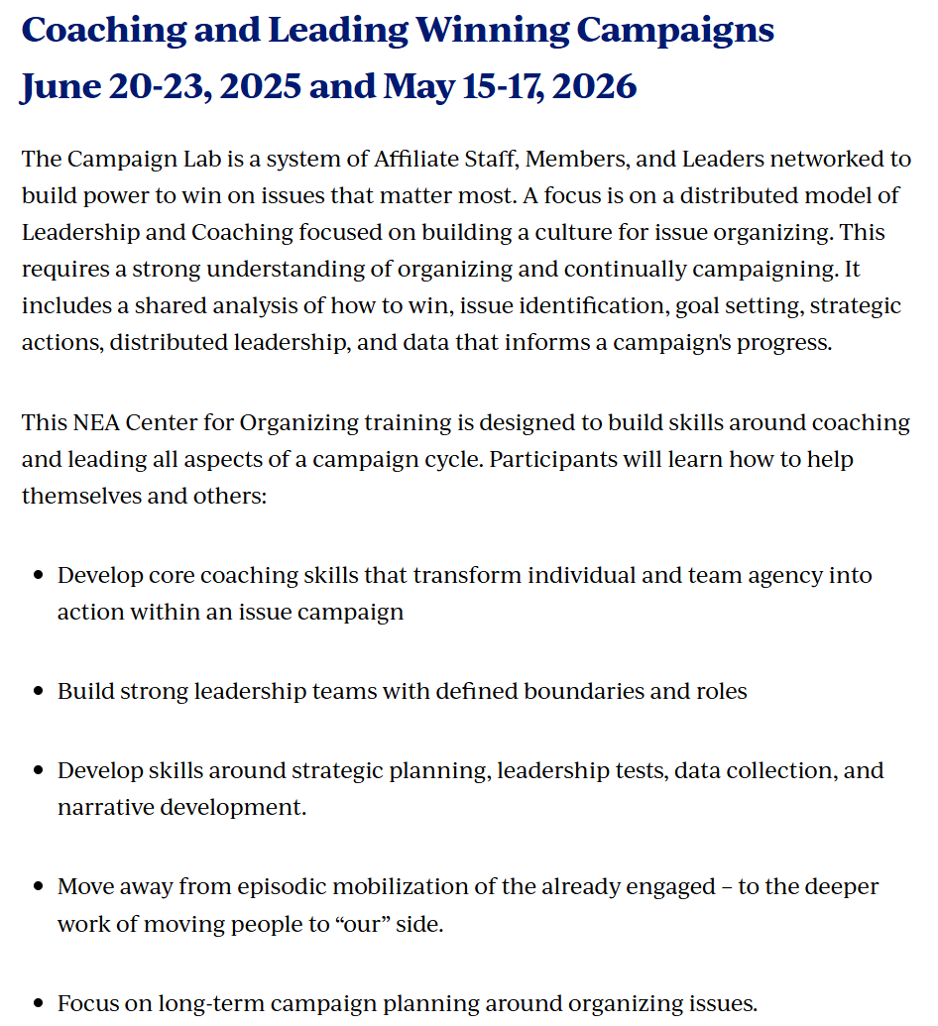
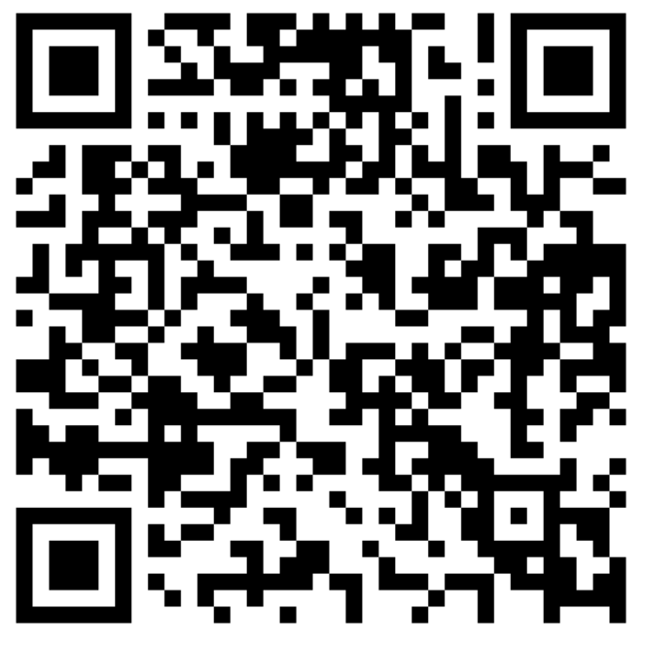


In Person Opportunities

Slide 12
Dreaming of 2030
Eric

Slide 13


Dreaming about 2030

Slide 14

On Your Own First
What do you see, hear, and feel in this future?
What’s one win you’re most proud of?
What did it take to get here?
Then – Share with your Team

Slide 15

Team TIME
Making the Dream Real
2030 is not a fantasy — it’s a destination. Every organizing conversation, every contract fight, every rally gets us closer.
Finish this statement
We joined the campaign lab so that we can win _____________ by 2030.

Slide 16

Key Points
Shared dreams can be achieved with intentional and strategic actions.
Strong Leadership teams Inspire hope, deepen commitment, and align their people around a shared vision

Slide 17
Problem and Issue
Zac

Slide 18
You will be working with your states.
Sit accordingly

Slide 19

PROBLEMS & ISSUE
Campaigns start with issues that people have value-based solidarity around.
An issue is a slice of a workplace problem.
  Often a problem can have different issues depending on the people's perspective
It is KEY to get enough input on what the issues are that make up the problem so that YOU do not drive the solution.
Investigating the issue is necessary but not sufficient – we also need to identify workers’ SHARED values
  WHY is this an issue?
  WHY do you want to fix this?
Notes:
What are some “red flags” to look out for when identifying the issue?

Slide 20

PROBLEM vs. ISSUE
A problem is the whole pie. Problems are vast, complex, and entrenched.
When we try to tackle a problem, we reinforce the hopelessness of the situation. We are trying to take on the full pie all at once.
Issues are the pieces of the pie. It’s a small chunk of the larger problem that we can make progress on, and in turn we are slowly taking on the full problem over time.
Notes:
What are some “red flags” to look out for when identifying the issue?

Slide 21
Issue
An issue is a slice of the larger problem that is manageable and solvable.

Slide 22

PROBLEM vs. ISSUE

Slide 23
Values
Values are fundamental beliefs that dictate behavior
Ideally, Unions advance the welfare of all members.
They are based on the universal ideal of human rights, the idea of justice, progress, and betterment of self and of society.
Through shared values, members build solidarity and commit to active participation in the labor movement.
Shared values transform individual members into part of something larger than themselves.

Slide 24
Some Union Values
Fairness, honesty/integrity, responsibility, compassion/empathy, safety, health, generosity, hard work/responsibility, community, freedom, democracy, binding contracts, equality, opportunity, respect, stability/security, unity, quality work, justice, collective action, dignity/respect, charity/community service, and due process.

Slide 25
How to Link Issues and Values
Investigating member issues is necessary but not sufficient – we also need to identify workers’ SHARED values –
WHY is this an issue?
WHY do you want to fix this?

Slide 26
EXAMPLES- Problems to Issues + Values
VALUES – Public Schools should be safe, equitable, and inclusive learning and working environments for all people.
PROBLEM -Our school is hostile to LGBTQ+ staff and students
  ◦ Issue Cut – There are no gender inclusive bathrooms and/or transgender students and staff are forced to use the wrong restroom.
PROBLEM - Our school reinforces racism by silencing protestors
  ◦ Issue Cut– We need to stop law enforcement from arresting students and staff for exercising their Constitutional rights.

Slide 27
TEAM WORK – The Problems
Look back at your Villains list. List the problems that your team wants to improve – these are BIG
For each of the problems you identify – try to think what the values are that are behind WHY you see this as a problem.
Example Problem – We want quality health care for everyone
Values behind wanting to fix this – equity, fairness, dignity
List your problems and values on your charts.

Slide 28
We listen for the values as talk about these problems.
This is how we build solidarity.
Key Points

Slide 29
TEAM WORK – Problems into Issues
Example Problem – We want quality health care for everyone
Values behind wanting to fix this – equity, fairness, dignity
Possible Issues –
Not enough providers in our rural system
Values – access and equity
Drugs are not affordable
Values – fairness and access
No coverage for home health options
Values – equity and dignity
Pick ONE problem and cut into issues on your charts.

Slide 30
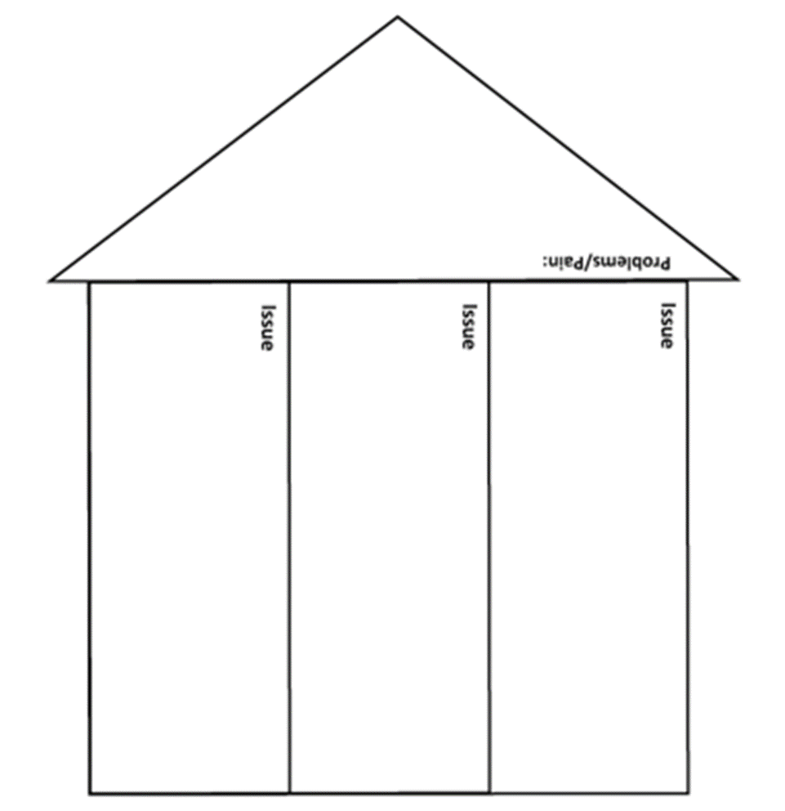
Issues are the small(er) actionable pieces that contribute to the larger problem. By asking why is this an issue you can uncover values.
(Page 19)

Slide 31
Assessing Our Issues
Widely felt and/or deeply felt.
  The pain can be felt by just one, but the injustice of that pain is shared by many.
  The pain AND the injustice of that pain is felt by many.
Winnable.
Builds the union and builds leaders.
Has a connection to students and the public.
Secrets of a Successful Organizer “A Good Organizing Issue” handout

Slide 32

Issue Criteria Checklist

Slide 33
Problems are big conditions of injustice
Issues are the smaller member identified components that makeup the problem
Issues indicate a path to action
Values build a relatable why across people experiencing the pain of the problem
We intentionally work to connect members around issues and values to build solidarity
Key Points

Slide 34

BREAK

Slide 35
Internal or External
Katie

Slide 36
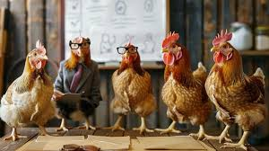
What is the difference between and internal and external campaign?

Slide 37

Internal Campaign - Growth
Goal: To increase member engagement, leadership development, structural capacity, and activist participation.
Focus: Member-to-member communication, empowering members to address issues together, and breaking down the perception of the union as a distant service provider.
Activities: Training existing members to become leaders and activists, conducting member education, and building strong committees to ensure member involvement in union activities.

Slide 38

External Campaigns - Strength
Goal: To win specific demands for members and partners.
Focus: Active participation of rank and file members and partners, building towards broader and bigger coalitions
Activities: Issue identification, escalating and public actions, strategic pressuring

Slide 39

Internal or External?

Slide 40

How do we actually get eggs in your basket?
Email blast, or?
Survey blast, or?
Social Media, or ?
Hustle, or ?
Stuff a mailbox, or ?
That is why 1:10

Slide 41

If there was a crisis, how prepared is your state caucus?

Slide 42

Guided Group activity
Write one metric that would indicate you are winning the goal of your issue.

Slide 43

Guided Group activity
2. Given your current home state's caucus structure, do you think you would be able to get more than 50% of your state's caucus members to take a small action such as signing an online petition or showing up to a rally? If yes, you are ready for an external campaign.

Slide 44

Guided Group activity
3. For the rest of us, how do we get there? Where do you even start? Make a list of home state's caucus members or other people.
Start with your most committed and end with your “best worst” (people that at least have some sign of being active.)

Slide 45

Guided Group activity p.13-16
4. Take some time to brainstorm how you might build this structure; refer to page 15 to help you with ideas. Put your ideas on your chart paper, and add questions you need to answer to put your plan in place.

Slide 46
Has you answer to this changed?
If there was a crisis, how prepared is your state caucus?

Slide 47

Key Points
Internal campaigns build the power to win external campaigns.
External campaigns engage your constituents and bring in potential members and community support.
Internal and external organizing feed each other and are how locals build power.
Strategic campaigns combine multiple cycles of internal and external organizing to win on multiple issues towards long term strategic goals, such as achieving your vision for public schools.

Slide 48
Demand, Win, Target
Ben

Slide 49

A Target is...
The person with the power to give you what you are demanding.
This person
Has a name
Has a face
Has an address

Slide 50
TEAMWORK
Return to Your Problem and Issue Charts
Who are the Potential Targets for the PROBLEM and your Issues?
Remember our Definition of Target

Slide 51
Demand
“Hey TARGET,
we demand ACTION
because HARM or IMPACT!”

Slide 52
Demand:
Hey Dean Sam: We demand gender affirming bathrooms in every building because all students and faculty need to feel safe and included in our schools. ”

Slide 53
Demands Should Be...
Measurable – did the Target do the thing
Achievable – It is possible for the Target to do the thing

Slide 54
TEAM WORK – Demand
Use your Issue and Target.
Draft at least one demand of your Target that resolves your issue and is linked to YOUR VALUES

Slide 55
Key Points
A powerful demand makes clear who has the power to make the change that’s needed
We can only build a powerful demand when we have taken the steps to accurately identify the issue and determine who has the power to create change

Slide 56
LUNCH

Slide 57
Dossier of Target
Zac

Slide 58
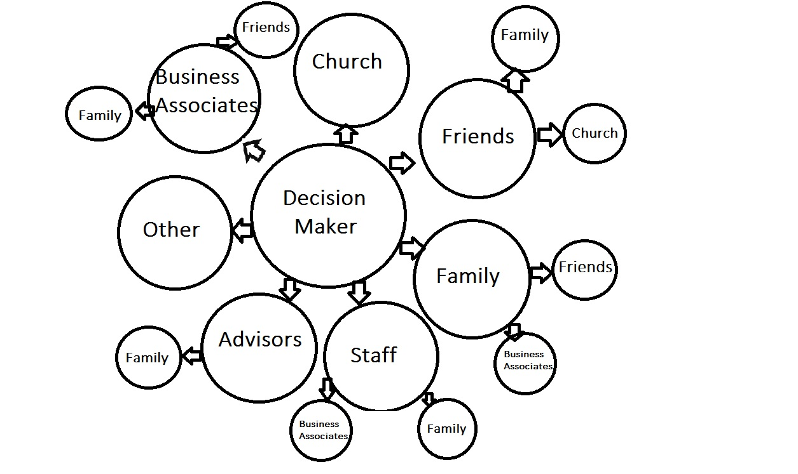
Questions to ask when building a Power Map
Who make decisions?
Who has formal authority?
Who has informal influence?
How are they all connected?
This helps us identify the pathways to influence the decision-maker.

Slide 59

Research – it's a powerful tool
It should be strategic, targeted, and relentless.
We need to know who holds the power and how they use it.
It's about finding leverage, and understanding what makes our target tick and how we can make them move

Slide 60
Where should we look? p.31
Institutional Power and Influence
Funding and Financial Ties
Policy History and Public Statements
Community Impact and Demographics
Local Institutions and Networks
Personal Background and affiliations
Local Intel and Relationships

Slide 61
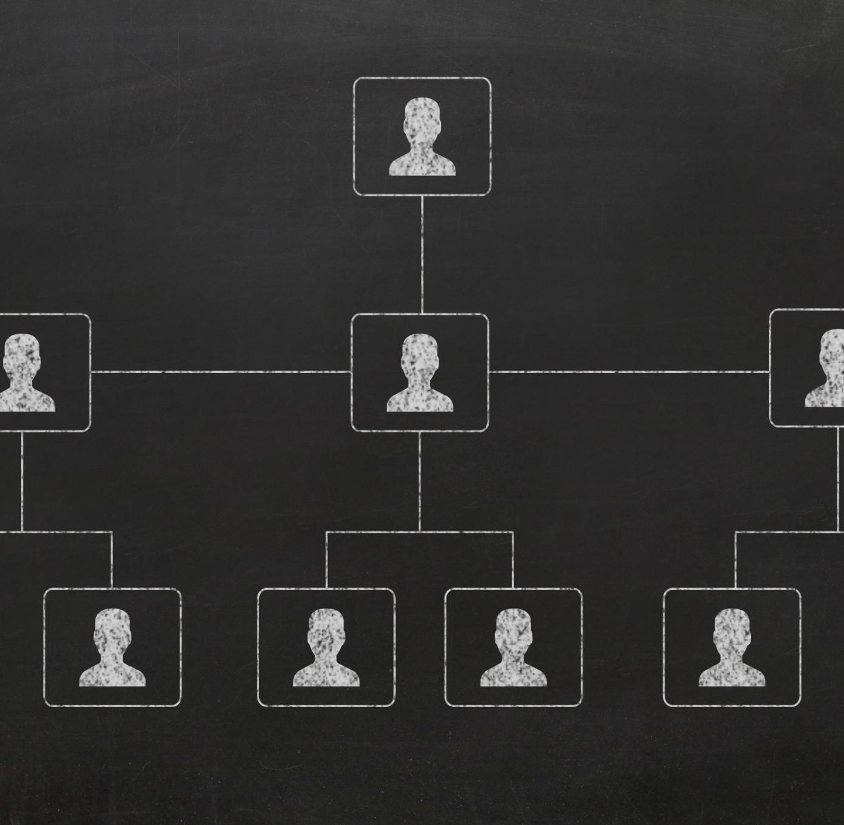
Institutional Power & Influence
Mapping Power Structures
  Identify who holds decision-making authority over staffing, budgets, curriculum, and safety within the institution.
Formal vs Informal Influence
  Recognize the difference between official authority and informal influence to locate real decision-makers effectively.
Targeting Campaign Strategies
  Use insights about power dynamics to focus campaigns on the right targets and tailor strategies accordingly.

Slide 62
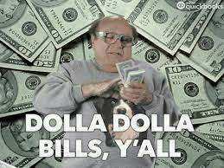
Funding & Financial Ties
Identifying Funding Sources
  Understanding who funds programs reveals priorities and potential conflicts of interest in decision-making.
Analyzing Financial Relationships
  Financial ties highlight loyalty, pressure points, and reveal hidden agendas impacting leadership.
Leveraging Financial Insights
  Organizers use funding analysis to uncover leverage points and build effective narratives for influence.

Slide 63

Policy History & Public Statements
Tracking Policy Decisions
  Analyzing policies pushed helps understand impact on educators and students and anticipate future moves.
Monitoring Public Statements
  Reviewing statements from forums and interviews reveals decision-makers’ positions and accountability.
Crafting Targeted Messaging
  Understanding history and statements enables tailored campaigns that anticipate resistance and build credibility.
Highlighting Inconsistencies
  Pointing out contradictions and failures strengthens campaign urgency and public trust.

Slide 64

Community Impact & Demographics
Affected Communities
  Understanding which communities are served or underserved guides inclusive and effective decision-making.
Demographic Factors
  Analyzing race, income, language, housing, and education levels reveals social and economic context.
Mobilizing and Outreach
  Demographic insights help identify allies and design outreach strategies to mobilize communities effectively.

Slide 65
Local Institutions & Networks
Institutions as Power Centers
Institutions like churches and schools hold significant influence and shape local power dynamics.
Identifying Allies and Opponents
Mapping which groups support or oppose decision-makers reveals strategic allies and opposition.
Strategic Coalition-Building
Understanding networks uncovers pressure points and opportunities to build coalitions for greater impact.

Slide 66
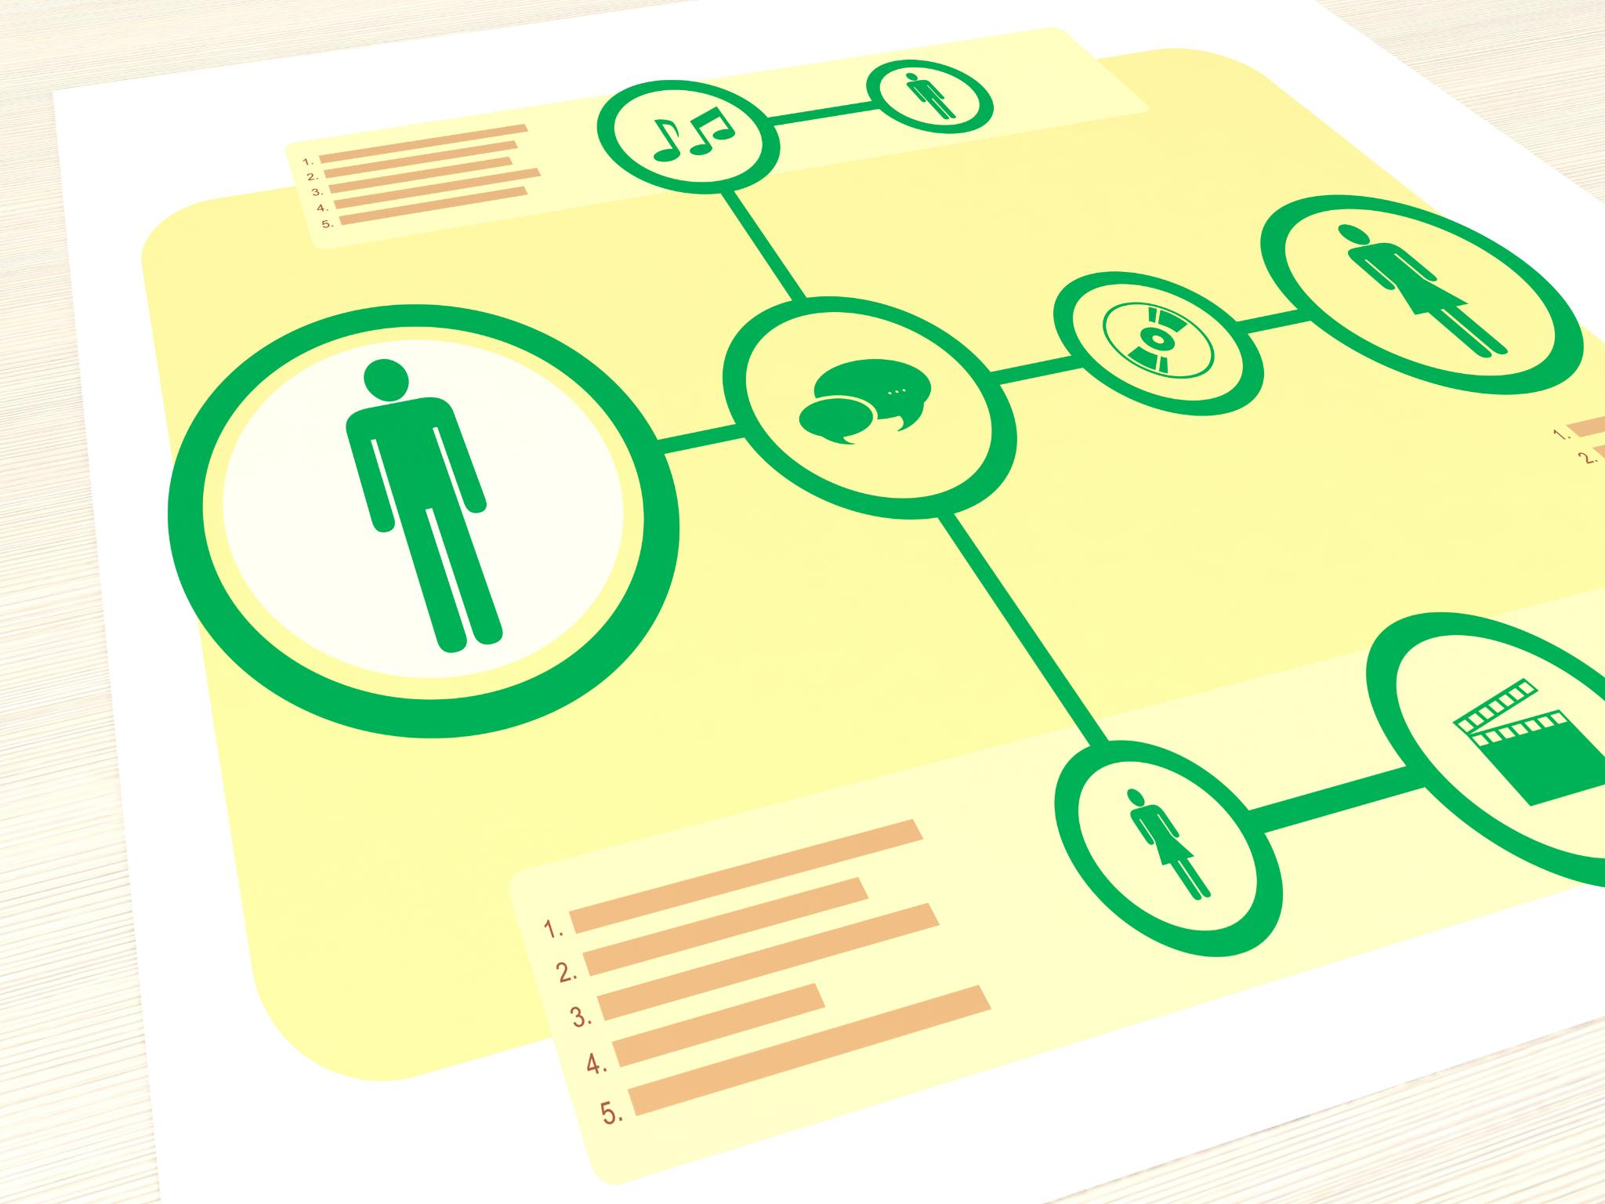
Personal Background & Affiliations
Understanding Personal Background
  Researching a person’s history reveals motivations and key factors beyond their professional role.
Exploring Affiliations
  Identifying boards and organizations linked to the person highlights their networks and influence.
Humanizing Through Research
  Personal research uncovers hidden motivations and aids storytelling to engage public opinion effectively.

Slide 67

Local Intel & Relationships
Continuous Communication
  Always talk to a variety of people to gather real stories and understand dynamics deeply.
Informal Intelligence Gathering
  Informal intel fills gaps left by formal research, providing context and actionable insights.
Building Trust
  Sustaining long-term efforts depends on building trust and maintaining relationships.

Slide 68
Getting the scoop
What research actions can we take?
Filing information requests
Work with staff to analyze budgets
Comb social media (“facebook stalking”)
Review public websites
Review candidate questionnaires

Slide 69
Gallery Walk – pages 31 & 32
With your group, identify the research actions that would need to be done in this category.
Be ready to discuss the following:
What surprised you most about the information you will need to research?
Which section of the handout felt most useful or revealing?
Did you discover any gaps in your current understanding of local power structures?

Slide 70
Key Points
When we know our target, we know how to organize.

Slide 71
Spectrum of Allies
Katie

Slide 72
Keep it in mind…
If campaigns put people at the center of solving the problems they are experiencing...
Then understanding the relationship people have with the win you seek is essential

Slide 73

Spectrum of Allies- page 29-30

Slide 74

Spectrum of Allies
  Active allies: people who agree with you & are organizing alongside you
  Passive allies: people who agree but aren't doing anything about it (yet!)
  Neutrals: people who aren't sure, or are unengaged (they might just not know about you yet)
  Passive opponents: people who disagree, but aren't trying to stop you
  Active opponents: people who have done something to prevent you from reaching your goal

Slide 75

An example from history – PFLAG

Slide 76
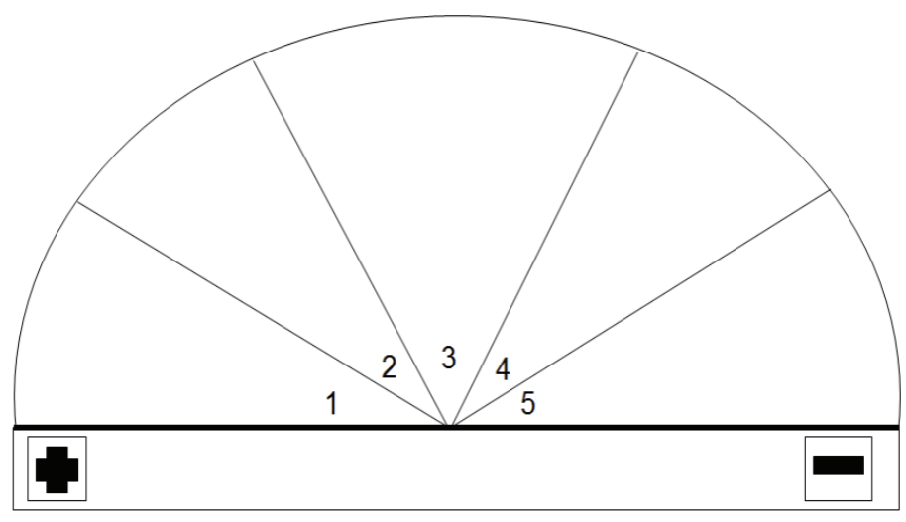
Spectrum of Allies Example
Neutrals
-Other Parents
-Union Members
Passive opponents
Passive Allies
-Parents and Friends and Family members
-Some Christian
Churches
Active Allies
Active Opponents
-Parents & Allies
LGBTQ Community Members
-White Supremacy culture
-Conservative lawmakers

Slide 77
It is only necessary to move some or all of the pie wedges one step in your direction.
If we shift each wedge one step, we are likely to win, even if the hardliners on the opponent’s side don’t budge.
Key Points

Slide 78

Messaging is Movement-Building
Messaging isn’t about arguing—it's about inviting.
Focus determines who gets included and who is left out.
Equity-centered messaging helps build power with, not for.

Slide 79
Who Are You Talking To?
Spectrum | Needs Messaging That...
Active Allies | Deepens commitment
Passive Allies | Invites low-risk engagement
Neutrals | Frames values alignment
Passive Opponents | De-escalates with dignity
Active Opponents | Not the focus but you gotta say something and it needs to make sense

Slide 80
Campaign Team Practice: Spectrum of Allies- p. 30

Slide 81

Elevator pitch time

Slide 82
Key Points
Equity means naming nuance - be specific, be inclusive
Don’t center your opponent - build around your base
Good messaging connects and activates people

Slide 83
Organizer Math: Building Exponential Power
Ben

Slide 84

How can I make a difference?

Slide 85
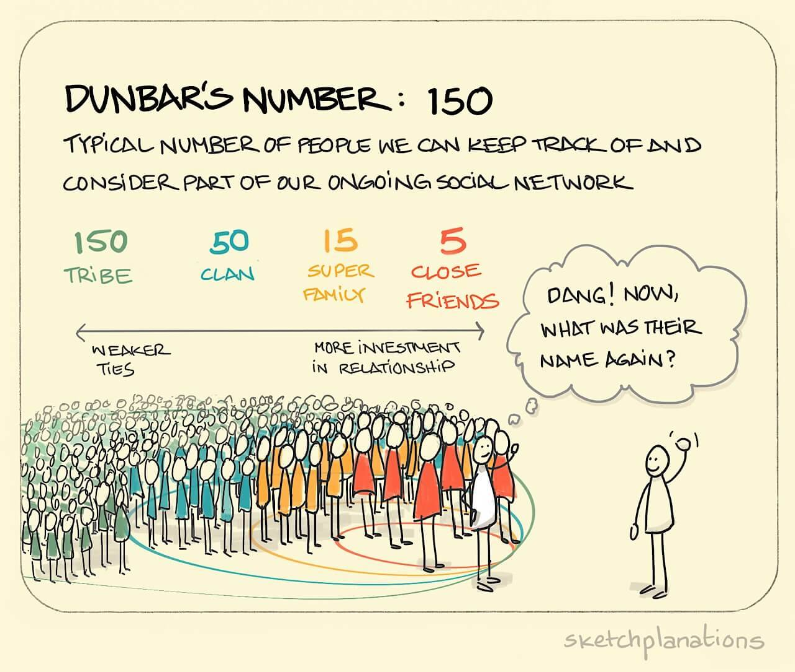

Slide 86
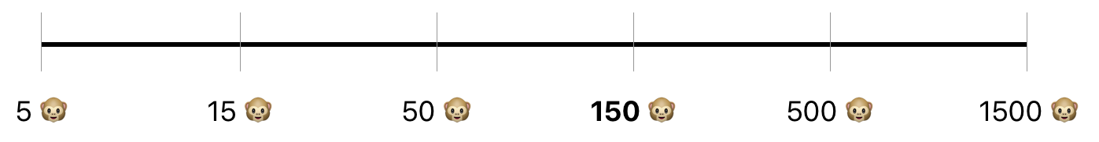
Why do we care about Dunbar’s Numbers? Pages 33-36
Stable - Relationship
Connections
Developing Leaders
Engaged Members
Aware Members
Disengaged Members - Supporters
“Driver” Leaders
Natural Leaders

Slide 87

The Schools Everyone Deserves Campaign
Page 37
Crisis: Board announced cuts (15 social workers, class size increase, salary freeze).
Union’s Shift: From service model → organizing model using Bargaining for the Common Good (BCG).
Victory Metric: 5,000 public pledges.
Notes:
Explain the strategic pivot: HPSEU reframed demands as Common Good issues, enabling coalition building and political leverage.

Slide 88
Team Work Time
At your table, answer the Debrief Questions in the Case Study (p. 46-47)
  How did framing demands as Common Good issues change the campaign's reach & impact?
  What were the key turning points in the campaign that shifted power toward the union?
  Why was achieving 92% internal unity before going public critical for success?
  How did the coalition with parents, students, and community groups amplify the union’s leverage?
Use all of the information included in pages 37-46 to answer the questions
Be ready to report out.

Slide 89
Phase 1 – Internal Unity (The Spark)- p. 40
Leadership Team 10
Organizer
Organizer
Organizer
Organizer
Organizer
Organizer
Organizer
Organizer
Organizer
Organizer
10 Core Leaders → 150 organizers (10% of union).
Internal test: 92% participation in 'Green for Harmony Day'.
Internal Unity
Victory
External Coalition
Notes:
Stress importance of structure tests and supermajority commitment before going public. This phase builds internal strength.

Slide 90
Phase 2 – External Coalition (The Multiplier)- p. 41
Internal
External
200
50 external organizers recruited (parents, students, clergy).
Rally: 1,250 attendees (60% non-union).
Internal Unity
Victory
External Coalition
Notes:
Show how Common Good framing multiplies power and builds political pressure through external allies.

Slide 91
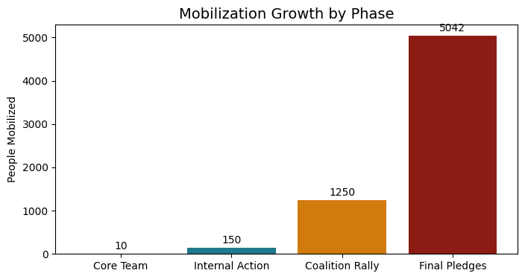
Final Phase – The Confrontation (Victory) - p.41-42
5,042 pledges + 94% strike vote.
Board rescinded cuts.
Internal Unity
Victory
External Coalition
Notes:
Emphasize measurable commitment as ultimate power metric. Translate numbers into political cost for decision-makers.

Slide 92
Action Checklist for Organizers- page 47
Identify
Identify 10% organizers.
Test
Test structure with measurable asks.
Frame
Frame demands as Common Good.
Build
Build coalition.
Track
Track power metrics.
Notes:
Provide practical steps for replication. Encourage organizers to apply these immediately in their campaigns.

Slide 93
Team Work Time
As a Team, complete the Planning Checklist for your own campaign (p. 47)
Be ready to report out

Slide 94
Key Points:
Power is not what you have, but what you can mobilize because you have working structures.
Organizing success depends on measurable commitment, not just membership size.

Slide 95
Ladder of Engagement
Dr. Taraja

Slide 96
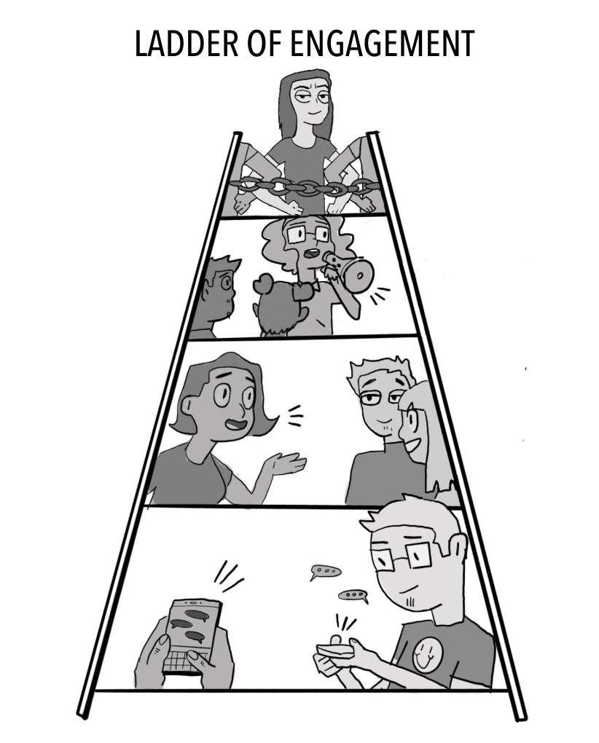
A Strategic Ladder for Union Campaigns

Slide 97
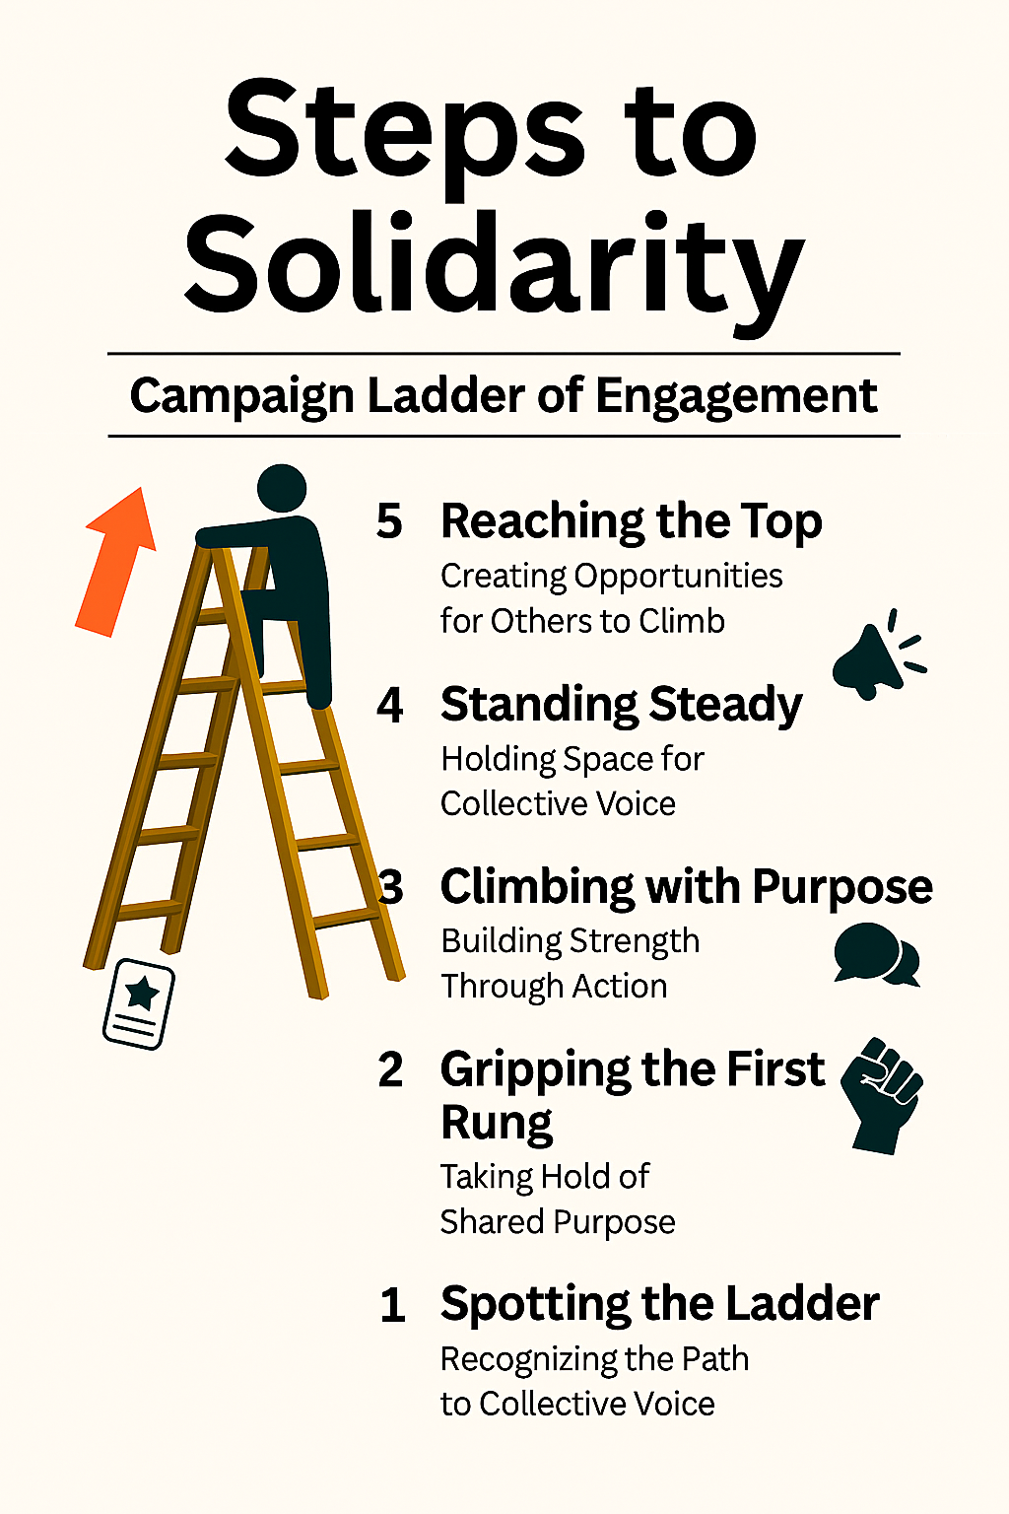
What is the Ladder of Engagement?
A framework to help union leaders activate and elevate member participation through a series of intentional steps.
Each step builds trust, capacity, and ownership—turning passive members into powerful advocates and leaders.

Slide 98

Step 1: Spotting the Ladder – Recognizing the Path to Collective Power
Objective: Introduce the campaign and spark initial interest.
Tactics:
  Send targeted emails or texts with campaign goals and relevance to educators.
  Share compelling stories or visuals on social media.
  Host informal info sessions or coffee chats at school sites.
Leadership Focus:
Equip building reps and site leaders with talking points and flyers.
Use warm, inclusive language that affirms educators’ values and concerns.

Slide 99
Step 2: Gripping the First Rung – Taking Hold of Shared Purpose
Objective: Encourage members to express curiosity and take a first step.
Tactics:
  Invite members to sign a petition or pledge of support.
  Conduct short surveys to gather input and build buy-in.
  Offer low-barrier opportunities to attend virtual briefings or town halls.
Leadership Focus:
  Track engagement and follow up personally.
  Celebrate participation publicly to build momentum.

Slide 100
Step 3: Climbing with Purpose – Building Strength Through Action
Objective: Move members from passive support to active involvement.
Tactics:
  Recruit volunteers for canvassing, phone banking, or event support.
  Form working groups around specific campaign issues (e.g., class size, funding).
  Host action nights or community forums.
Leadership Focus:
  Provide clear roles, training, and support.
  Recognize contributions and foster team spirit.

Slide 101
Step 4: Standing Steady – Holding Space for Collective Voice
Objective: Cultivate consistent, reliable contributors.
Tactics:
  Invite members to take on formal roles (e.g., site coordinator, committee lead).
  Offer leadership development workshops.
  Engage committed members in strategic planning or negotiations.
Leadership Focus:
  Build trust through transparency and shared decision-making.
  Create pathways for growth and mentorship.

Slide 102
Step 5: Reaching the Top – Creating Opportunities for Others to Climb
Objective: Empower members to lead, organize, and inspire others.
Tactics:
  Support members in organizing their own events or initiatives.
  Encourage representation at regional or statewide union gatherings.
  Develop a leadership pipeline with coaching and peer support.
Leadership Focus:
  Shift from directing to empowering.
  Celebrate leadership as a collective legacy.

Slide 103
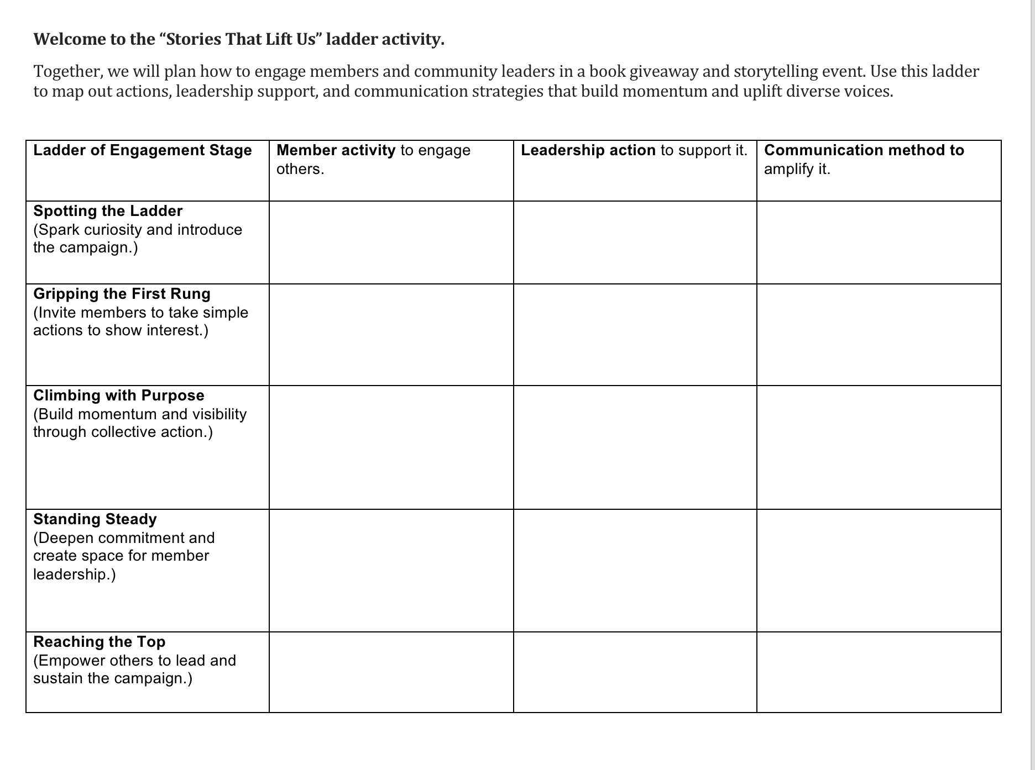
ScenarioTime! Page 22

Slide 104

Share Out!

Slide 105
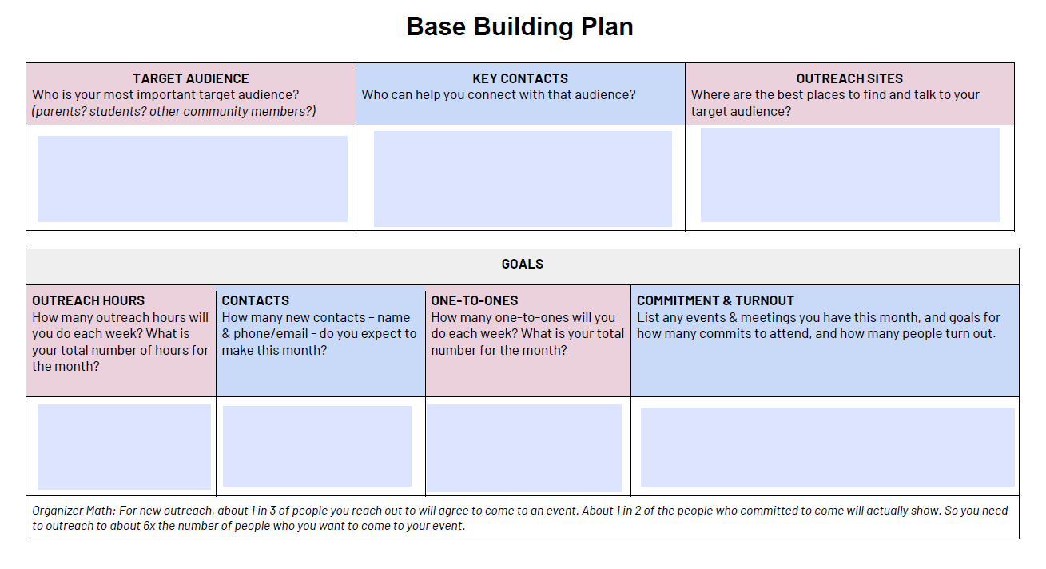
Future Application: Applying the Ladder to Your Base Building Plan

Slide 106

Journal: Open a Document and Reflect
What ideas or perspectives shifted as your group built the ladder?
Which step did you see a strong potential for big impact?
What strategies felt most effective for supporting and amplifying member voices?

Slide 107
Key Points:
Using the Ladder Strategically
Map your members: Identify where individuals currently sit on the ladder.
Design your campaign: Align tactics with each stage to meet members where they are.
Track progress: Use engagement metrics to assess movement and adjust strategy.
Build culture: Reinforce that union work is shared, valued, and visionary.

Slide 108
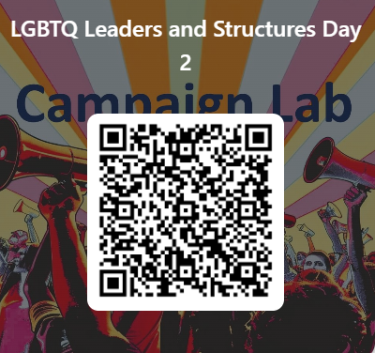
Feedback time
Goal – 100%Participation​
6 Short Questions​
We use what you give us

Slide 109

Closing the Day
What is becoming clearer?
What remains murky?
Housekeeping

