Slide 1

Entry Thinking and Chart
What do you need answered before you leave today?

Slide 2
Campaign Academy:
Leaders and Structures for Winning Campaigns
March 1st, 2026

Slide 3

Campaign Academy
By attending this training, you confirm that you are either an NEA affiliate staff person or NEA member in good standing. The information you receive here is only for your use in your capacity as an NEA affiliate staff person or NEA member.
This presentation and its contents are confidential and may not be further distributed or passed on to any other person or published or reproduced, in whole or in part, by any medium or in any form, for any purpose unless written consent has been provided by Ellen Holmes. Audio/video recording, copying of slides, and the use of AI note-taking tools are prohibited without the written consent from Kyle Serrette. Violation of these terms may result in legal action.

Slide 4
NEA Standards of Conduct
NEA has adopted a Standard of Conduct Policy to ensure that all of our gatherings are welcoming to and free from discriminatory, harassing, or otherwise unacceptable behavior. Discrimination or harassment based on race, color, ethnicity, religion, sex, age, national origin, sexual orientation, disability, gender identity, or expression, or any other characteristic protected by law will not be tolerated. If you have experience any discriminatory or harassing behavior, please report the incident by emailing Ron "Duff" Martin (rmartin@nea.org) and Gladys Marquez (gmarquez@nea.org). Thank you for your commitment to ensuring a positive event for all.

Slide 5

Caucus Social Contract
Be aware of how you are showing up in the room – side conversations, and same folks talking
Facilitators will try to give a one-minute warning before cutting off a conversation to move back to content

Slide 6

ToDay’s Agenda and Outcomes
  7:30-8:30 Breakfast
  8:30-11:00 Theory of Change, Escalation
  11:00-12:00 Campaign Planning
  12:00-12:30 Team Sharing
  12:30-1:00 Ending it Right
  1:00 Lunch on Your Own and Adjourn
Participants will understand the Basics of the Campaign Lab, the Structures for Support, and the stages of a Campaign Cycle

Slide 7
Feedback on Feedback
52 Responses!!!
Range 4.9 to 4.87 Highest to lowest – Facilitators, Materials, Content, Pacing.
Themes -
Remaining a cohort that is connected and continuing to learn
Too fast, not enough time to talk and work
Structure and content are great
Side bars and rotation of speakers

Slide 8
Your words
I really like the way this training is organized and put together. I have learned so much from this training to put into action
I am so excited to apply these ideas to our campaign! Getting into the details has made me realize that breaking this whole process down makes it a whole lot easier. Thank you!
More movement breaks, particularly after lunch. I've really enjoyed the training and have learned a great deal. I have also discovered how much I've already been doing without realizing the importance of the work. I have some great ideas to take home and share with my organizing team. Thank you!
I have an ACTUAL LIST of actionable items to push our campaign forward. I forgot to take a break this afternoon because I was so locked into our issue campaign strategy session. THANK YOU!

Slide 9
Theory of Change
Zac

Slide 10

What do you think a Theory of Change is?

Slide 11
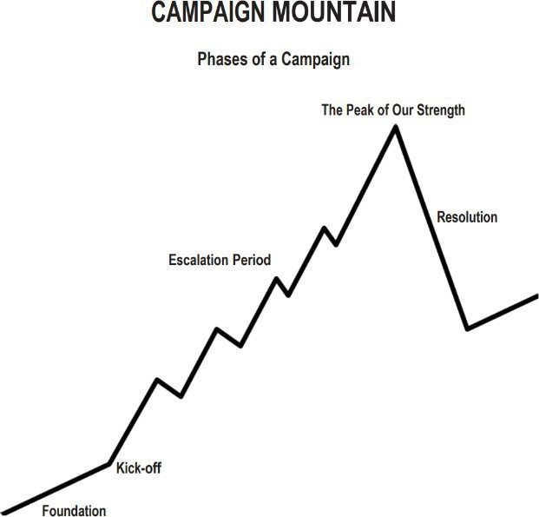
How Teams Climb the Mountain
Theory of Change -A clear theory of change is essential to developing a shared strategy. It helps organizers identify the power they have, the change they seek, and the path to get there.
Strategy Drives Tactics – Long-term strategic goals inform short-term actionable tactics for campaign success.
Creative Tactics Build Power –Joyful and creative tactics increase participation and strengthen collective power in campaigns.
Strategic Pivots – Plan for strategic adaptability to swiftly respond to critical redline actions or emerging challenges.
Escalating Campaigns – Craft and measure campaign tactics that escalate effectively to build momentum and impact over time.
Timeline
Tactics (in order) of escalation
Benchmarks for each tactic
Notes:
The learning goals of this training session are to help participants understand the difference between strategy and tactics, learn how joyful and creative tactics build power and participation, prepare for strategic pivots in response to redline actions, and practice designing campaign tactics that escalate effectively. These goals are aligned with the broader objective of empowering organizers to build resilient and impactful campaigns.

Slide 12
Developing a Theory of Change
Theory of Change helps define how your campaign will achieve its goals.
Key Components:
  Define the problem your community faces
  Identify the strategic goal (solution to the problem)
  Understand power dynamics: who has resources, who needs them
  Map your constituency's resources and influence
  Use If-Then planning to test assumptions
Organizing Sentence:
We are organizing [WHO] to achieve [WHAT] by [HOW] to achieve [CHANGE].

Slide 13
Example of If Then Statement
"Our district's new policy will raise our health insurance premiums by 30%. If we don't act now and organize our union, then our families will be forced to choose between groceries and a doctor's visit. But if we come together, sign these union cards, and demand fair health coverage, we can win the benefits we deserve".

Slide 14
If –Then Thinking
The "if" (the urgent challenge): This section identifies the immediate problem, threat, or opportunity facing the community. It creates a sense of urgency that demands a response. In the example, the immediate threat is the company's new policy raising health insurance premiums.
The "then" (the contrasting futures): This part presents two possible outcomes based on the community's choice. It starkly contrasts the negative consequences of inaction with the positive, hopeful vision of success through collective action. In the example:
Inaction leads to a negative future: Families forced to choose between health and groceries.
Collective action leads to a hopeful future: Winning the benefits the workers and their families need.

Slide 15
Why do we do this?
Practicing "if-then" thinking helps a team:
Build a robust strategy by improving preparedness
Fosters collaboration and
Maintains momentum during a campaign.
By anticipating potential obstacles and proactively planning a response, organizers can reduce decision fatigue and react more effectively when faced with employer resistance or unexpected setbacks.

Slide 16
The Organizing Sentence
We are organizing our community members to win affordable housing by lobbying city council and building a coalition with local tenants through door-to-door canvassing by the end of the year.
This sentence follows the structure of identifying the people being organized, the strategic goal, the tactics used, and the timeline for completion.
Who
To Do What
Win by When

Slide 17
Why do we do this?
Creating an organizing sentence helps a team:
Align their work
Summarizes the core elements
  Who
  Doing What
  Winning by When
A single, clear statement provides focus and clarity, ensuring the entire team is working toward the same purpose.

Slide 18

Team Time
Practice if then thinking
Create a single organizing sentence
Consider the POSSIBLE STRUCTURES you will need in this strategy
Be ready to share

Slide 19

Key Points
A clear theory of change is essential to developing a shared strategy.
It helps organizers identify the power they have, the change they seek, and the path to get there.
Strategy then guides the escalation timeline and necessary pivots in tactics.
Tactics must be joyful, creative, and aligned with strategic goals to build lasting power.

Slide 20
Strategy and Tactics
Ben

Slide 21
What do you think is the difference between a strategy and tactic?

Slide 22

Strategy vs. Tactics
Definition of Strategy
  Strategy is the comprehensive plan guiding a campaign towards its ultimate goals over time. It is the combination of your If then thinking and your organizing sentence
Definition of Tactics
  Tactics are specific actions or steps taken to execute the broader strategy effectively.
Importance of Analysis
  Effective tactics require analyzing problems, setting goals, understanding targets, and leveraging power forms.
Strategic Warning
  Without a clear strategy, one risks becoming part of another’s plan, highlighting strategy’s critical role.
Notes:
Strategy is the overarching plan that guides a campaign toward its goals, while tactics are the specific actions taken to implement that strategy. A critical distinction for effective campaigning is understanding that organizing a rally or petition is not a strategy but a tactic. Before selecting tactics, organizers must analyze the problem, identify their goals, understand their target, and determine the forms of power they can leverage. As Alvin Toffler famously said, 'If you don’t have a strategy, you’re part of someone else’s strategy.'

Slide 23

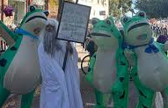
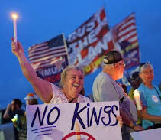
Joyful Escalation
Creative Participation Tactics
  Joyful escalation uses creative methods like coordinated color days and art builds to boost engagement and morale.
Community Rallies and Songs
  Song creation and community rallies energize supporters and create a positive atmosphere around campaigns.
Media and Public Influence
  Joyful tactics attract media attention and help sway undecided stakeholders with a positive message.
Notes:
Joyful escalation involves using creative and engaging tactics to build participation, morale, and public support. Examples include coordinated color days, art builds, song creation, and community rallies. These actions not only energize the base but also attract media attention and sway undecided stakeholders. Joyful tactics are strategic tools that demonstrate solidarity and amplify the campaign’s message in a positive and inclusive manner.

Slide 24
Joyful Escalation

Slide 25
What makes good tactics?

Slide 26
Tactics Must:
Put pressure on your Target
(puts them out of their comfort zone)
Build your Power
(develops leaders, brings more people in, etc.)
Build Solidarity and Persistence
  (joyful, creative tactics build hope and togetherness.)
Be Strategic
(apply campaign resources to bring the most pressure possible at the key moment of the escalation)

Slide 27
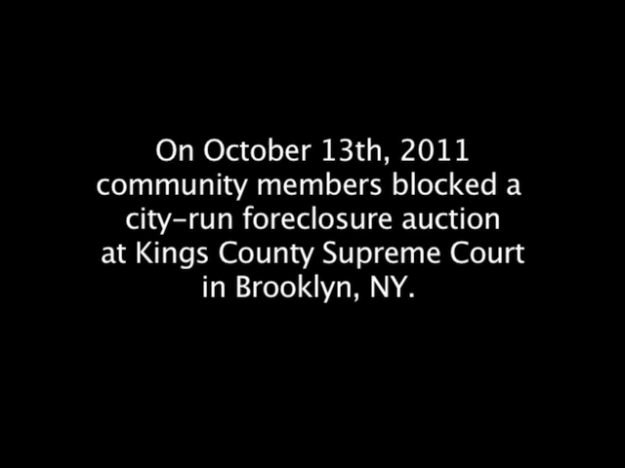
Was this an effective tactic?

Slide 28
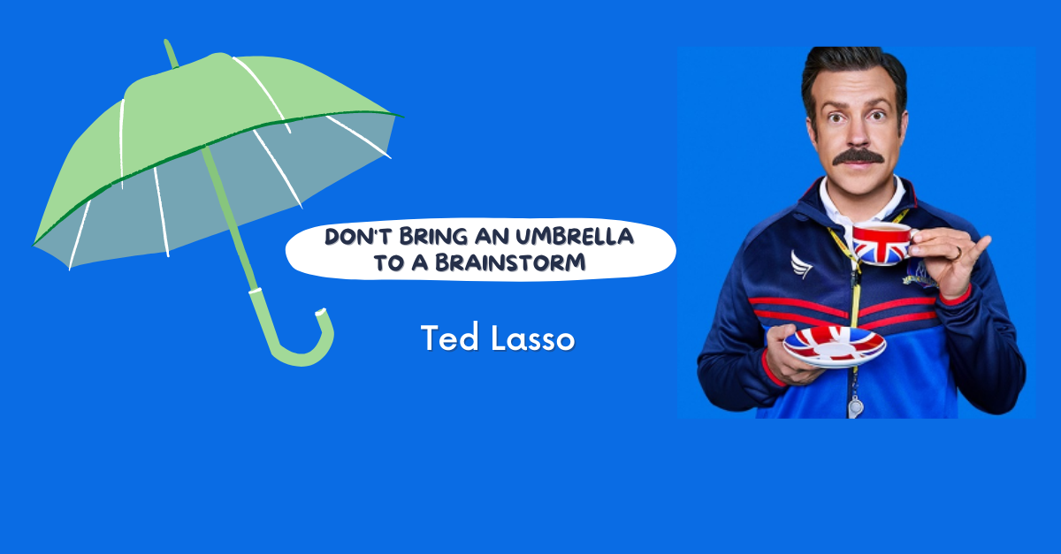
TEAM WORK – 5 Minute Tactic Brainstorm
+YOU HAVE 5 MINUTES!+
Brainstorm AS MANY joyful and creative tactics as you can on 1 chart.
You are NOT evaluating right now! Everything goes on the chart!

Slide 29
Team Work – 10 Minutes of Evaluation
TIME: 10 Minutes
Evaluate your tactics
Decide which tactics that you came up with are strategic based on the evaluation criteria
CIRCLE the tactics you decide are strategic
CROSS OUT the tactics you decide are not strategic

Slide 30
Evaluating Tactics
Put pressure on your Target.
Build your Power.
Build Solidarity and Persistence.
Be Strategic.

Slide 31
Option for Evaluating Tactics More Deeply
Does the action relate to your issue?
Does it align with your values?
Will it increase the pressure on the decision-maker?
Is it visible?
Is it timed for effect?
Is it new and different—or tried and true?
Are enough people ready to do it?
Will it unify people?
How will management react?
Does it violate the law? (If so, are we prepared for the consequences?)
Will it be fun?

Slide 32
Team Work – 15 Minutes Make a Plan for Each Tactic
AND Identify the Structure Needed to Accomplish the Tactic
Tactic | Objective | Target | Power Leveraged | Success Metric
Walk-in Rally | Demonstrate unity and visibility | School Board | Reputational | Media coverage and attendance
Petition Drive | Mobilize community support | Superintendent | Political | Number of signatures
Art Build | Engage members creatively | Public Audience | Relational | Social media engagement
Notes:
---
This slide references information from the following file: https://neahq-my.sharepoint.com/personal/eholmes_nea_org/_layouts/15/Doc.aspx?sourcedoc=%7B03152F2B-D5B9-4D15-B557-274772442337%7D&file=3.3%20Plan%20Out%20Your%20Tactics.docx&action=default&mobileredirect=true,https://neahq-my.sharepoint.com/personal/eholmes_nea_org/Documents/Microsoft%20Copilot%20Chat%20Files/2.20%20Tactics%20Examples.pdf
Teams will use a tactic planning table to organize their ideas. The table includes fields for the tactic name, objective, target, power leveraged, and success metric. This structured approach ensures that each tactic is aligned with the campaign’s strategy and goals. It also helps teams evaluate the feasibility and impact of their actions, ensuring that resources are used effectively and that each tactic contributes to building momentum.

Slide 33
Key Points
Tactics allow workers to:
Share Resources, Values, and Commitment
Take risks together and achieve shared wins
Build trust in their own agency and the collective effectiveness of their union.
Are BEST when joyful, creative, and strategic

Slide 34
Redline Tactics
Katie

Slide 35
What will your target do as you implement tactics?

Slide 36
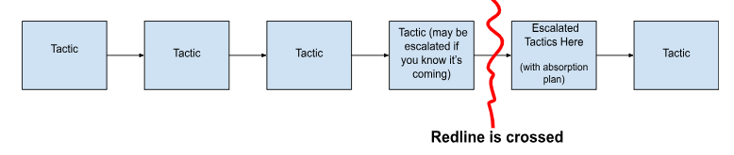
Escalation of Pressure
As you implement tactics that apply pressure, your target will will either:
Do nothing
Capitulate
React back

Slide 37
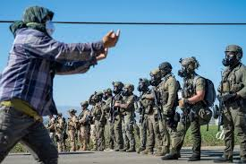
Danger – Red Line!
A “Red Line” tactic is the discriminatory practice of withholding resources, opportunities, or access from a specific group or geographic area. This is done to maintain existing power structures and undermine the community's organizing efforts.

Slide 38

Redline Pivots
Strategic Campaign Pivots
  Campaigns respond by shifting to public exposure and worker protection through higher visibility tactics, legal, and media actions.
Tactics to Increase Pressure
  Filing charges, media campaigns, rallies, and community alliances help galvanize support and pressure targets.
Notes:
A redline event occurs when an employer crosses a legal or ethical boundary, such as firing organizers, surveillance, or threats. In response, campaigns must pivot from internal organizing to public exposure and worker protection. Strategic pivots include filing Unfair Labor Practice charges, launching media campaigns, staging rallies, and building community alliances. These actions shift the narrative and leverage the employer’s overreach to galvanize support and increase pressure.

Slide 39

Redline Pivots
Establish clear boundaries for what actions your campaign is willing to accept before there are escalated consequences
Provide a deterrent for further actions against your campaign
Force an outcome from the target
Notes:
A redline event occurs when an employer crosses a legal or ethical boundary, such as firing organizers, surveillance, or threats. In response, campaigns must pivot from internal organizing to public exposure and worker protection. Strategic pivots include filing Unfair Labor Practice charges, launching media campaigns, staging rallies, and building community alliances. These actions shift the narrative and leverage the employer’s overreach to galvanize support and increase pressure.

Slide 40
Planning Your Pivots
1. REVEAL — Expose the Injustice - Powerholders prefer to act in the shadows. If we want a redline to resonate, we must bring the facts into the light — using images, stories, and trusted voices
2. REDEEM — Validate your Position and People - Redlines often come with smear campaigns. Those affected are devalued, criminalized, or painted as disposable. Our job is to re-humanize them.
3. RE-FRAME — Interpret the Event as Injustice - The system will try to spin it — calling it a misunderstanding, an isolated event, or your fault. We need to name it clearly as wrong, and make it part of a larger story.
4. REDIRECT — Mobilize Outside the System - Redlines CAN be pushed into courts, reviews, or commissions — slow processes that demobilize people. Instead, we can channel public anger into direct action and visible resistance.
5. RESIST — Build Strength and Withstand Pushback - After redlines are revealed, the backlash begins — intimidation, bribes, threats. We can protect each other, expose these attacks, and build long-term strength.
Notes:
A redline event occurs when an employer crosses a legal or ethical boundary, such as firing organizers, surveillance, or threats. In response, campaigns must pivot from internal organizing to public exposure and worker protection. Strategic pivots include filing Unfair Labor Practice charges, launching media campaigns, staging rallies, and building community alliances. These actions shift the narrative and leverage the employer’s overreach to galvanize support and increase pressure.

Slide 41
Team Time – 20 Minutes
Using the Handout – Redline Tactics
Your team will identify at least one possible red line tactic you think your target is likely to employ
Follow the 5 steps identified in the handout to develop a plan.
Consider any structures you might need to consider in the event of Redline Tactics.

Slide 42
Key Points
Your response to the redline tactic should:
Establish clear boundaries for what actions your campaign is willing to accept before there are escalated consequences
Provide a deterrent for further actions against your campaign
Force an outcome from the target

Slide 43
Timeline, Compression Points, and Escalation
Eric

Slide 44

Timeline
How long can you wait for the demand to be met?
Are you creating a deadline?
Is there and event creating the deadline?
How long will it take to identify the problem, identify the issues, build a leadership team, build a presence, etc. etc. etc.
When do you make the starting point?

Slide 45
Compression Points
Points on the calendar where you celebrate short term wins or escalate your tactics.
◦Naturally occurring deadlines- Breaks, Board Meetings
◦Artificial deadlines-target has till day X to act
◦Help us build urgency and crisis

Slide 46

Why do you think tactics escalate gradually?

Slide 47
Less escalated actions prepare our people for more escalated actions
Give the target a point to do the right thing before things escalate to the next tactic
Use the threat of escalation
Allows more people to join our base

Slide 48
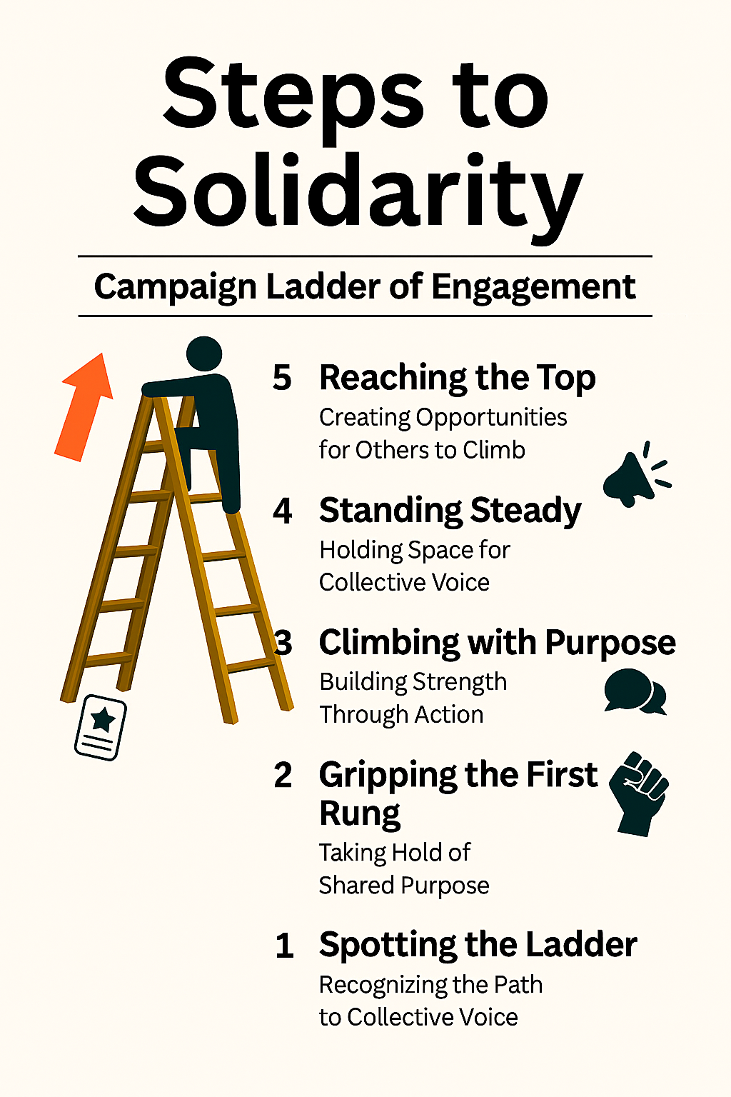
Remember:
The Ladder of Engagement
It is a framework to help union leaders activate and elevate member participation through a series of intentional steps.
Each step builds trust, capacity, and ownership—turning passive members into powerful advocates and leaders.

Slide 49
Incorporating the Ladder into
Your Campaign Mountain
Map your members: Identify where individuals currently sit on the ladder.
Design your campaign: Align tactics with each stage to meet members where they are.
Track progress: Use engagement metrics to assess movement and adjust strategy.
Build culture: Reinforce that union work is shared, valued, and visionary.

Slide 50
Key Points
An escalating campaign is driven by the overall strategy
An escalating campaign is held together by a set of values and shared commitment to a demand.
Escalating tactics are how we develop leaders, identify new leaders, move more people into our base.
Escalations should be planned – but should also be adaptable (ex. redline tactics)

Slide 51
Team Time and Presentation
Everyone

Slide 52
Team Work
Develop Escalation Timeline
  Create an escalation timeline of your tactics, the objectives, the success metrics and the structure for each.
Prepare Pivot Plan
  Prepare a pivot plan to address potential redline events and adapt tactics as needed.
Finalize and Present Tactics
  Finalize your strategic escalation plan and be ready to present a joyful,creative escalation of tactics, and possible pivots to the group.
Notes:
---
This slide references information from the following file: https://neahq-my.sharepoint.com/personal/eholmes_nea_org/_layouts/15/Doc.aspx?sourcedoc=%7B03152F2B-D5B9-4D15-B557-274772442337%7D&file=3.3%20Plan%20Out%20Your%20Tactics.docx&action=default&mobileredirect=true,https://neahq-my.sharepoint.com/personal/eholmes_nea_org/Documents/Microsoft%20Copilot%20Chat%20Files/2.20%20Tactics%20Examples.pdf
During the breakout activity, teams will follow a structured process to design campaign tactics. Step 1: Define the campaign’s core using the organizing sentence framework. Step 2: Develop an escalation timeline using the Tactical Timeline Guide and Tactics Examples. Step 3: Prepare a pivot plan for potential redline events. Step 4: Use the Plan Out Your Tactics worksheet to finalize details. Step 5: Present back to the group with one joyful tactic, one escalation tactic, and one pivot plan.

Slide 53

Joyful and Powerful Tactics
  Reflect on what characteristics make a tactic both joyful to execute and powerful in impact.
Linking Strategy to Escalation
  Consider how your team connected strategy decisions to escalation processes during the activity.
Surprises in Redline Pivots
  Identify unexpected insights or surprises experienced regarding redline pivots in the exercise.
Notes:
Participants will reflect on their experience and insights using the following prompts: What makes a tactic joyful and powerful? How did your team link strategy to escalation? What surprised you about redline pivots? These questions encourage deeper thinking about the strategic choices made during the activity and help solidify learning outcomes.

Slide 54
Key Points
Strategy Guides Tactics
  Every tactic should be directed by a clear and thoughtful strategy for maximum effectiveness.
Creative Tactics Engage
  Joyful, creative tactics increase participation and improve visibility in campaigns.
Adapt to Redline Events
  Strategic pivots are necessary during critical moments, avoiding panic to maintain campaign strength.
Build Leaders and Structures
  Acting together builds leaders and develops structural power.

Slide 55
Sharing

Slide 56
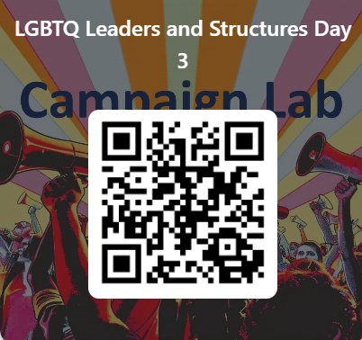
Feedback time
Goal – 100%Participation​
6 Short Questions​
We use what you give us

Slide 57
Closing the Day
What is becoming clearer?
What remains murky?
Housekeeping

