Slide 1
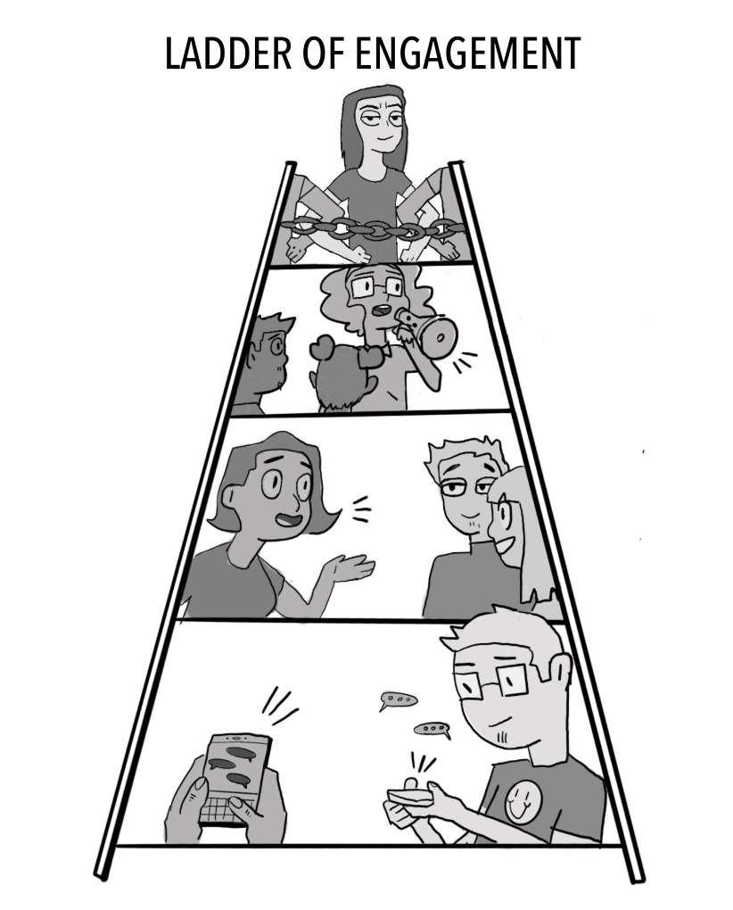
A Strategic Ladder for Union Campaigns

Slide 2
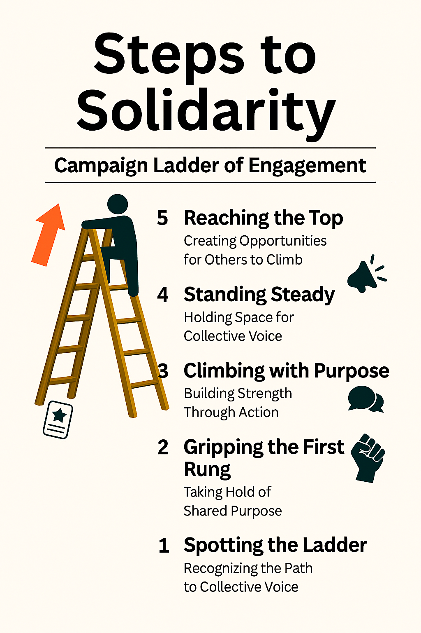
What is the Ladder of Engagement?
A framework to help union leaders activate and elevate member participation through a series of intentional steps.
Each stage builds trust, capacity, and ownership—turning passive members into powerful advocates and leaders.

Slide 3
Step 1: Spotting the Ladder – Recognizing the Path to Collective Power
Objective: Introduce the campaign and spark initial interest.
Tactics:
  Send targeted emails or texts with campaign goals and relevance to educators.
  Share compelling stories or visuals on social media.
  Host informal info sessions or coffee chats at school sites.
Leadership Focus:
Equip building reps and site leaders with talking points and flyers.
Use warm, inclusive language that affirms educators’ values and concerns.

Slide 4
Step 2: Gripping the First Rung – Taking Hold of Shared Purpose
Objective: Encourage members to express curiosity and take a first step.
Tactics:
  Invite members to sign a petition or pledge of support.
  Conduct short surveys to gather input and build buy-in.
  Offer low-barrier opportunities to attend virtual briefings or town halls.
Leadership Focus:
  Track engagement and follow up personally.
  Celebrate participation publicly to build momentum.

Slide 5
Step 3: Climbing with Purpose – Building Strength Through Action
Objective: Move members from passive support to active involvement.
Tactics:
  Recruit volunteers for canvassing, phone banking, or event support.
  Form working groups around specific campaign issues (e.g., class size, funding).
  Host action nights or community forums.
Leadership Focus:
  Provide clear roles, training, and support.
  Recognize contributions and foster team spirit.

Slide 6
Step 4: Standing Steady – Holding Space for Collective Voice
Objective: Cultivate consistent, reliable contributors.
Tactics:
  Invite members to take on formal roles (e.g., site coordinator, committee lead).
  Offer leadership development workshops.
  Engage committed members in strategic planning or negotiations.
Leadership Focus:
  Build trust through transparency and shared decision-making.
  Create pathways for growth and mentorship.

Slide 7
Step 5: Reaching the Top – Creating Opportunities for Others to Climb
Objective: Empower members to lead, organize, and inspire others.
Tactics:
  Support members in organizing their own events or initiatives.
  Encourage representation at regional or statewide union gatherings.
  Develop a leadership pipeline with coaching and peer support.
Leadership Focus:
  Shift from directing to empowering.
  Celebrate leadership as a collective legacy.

Slide 8
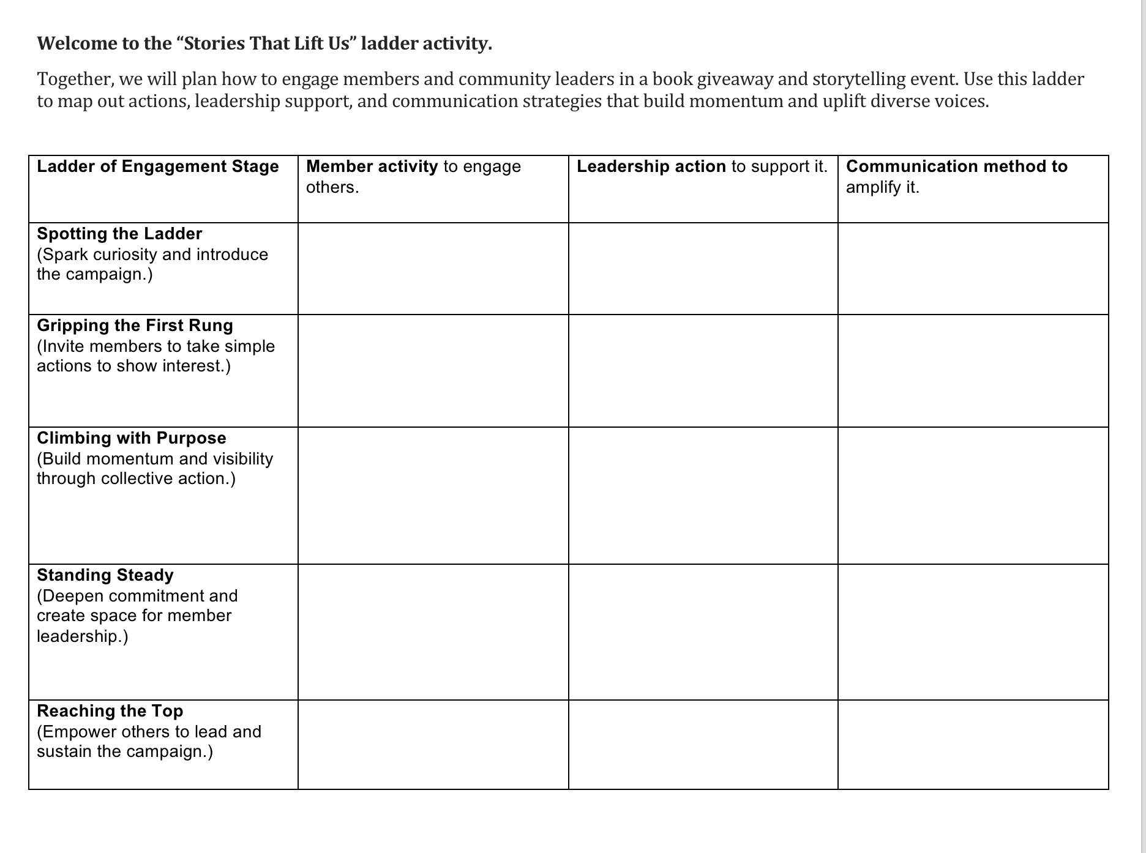
Let’s Practice!

Slide 9

Share Out!

Slide 10

Debrief
What ideas or perspectives shifted as your group built the ladder?
Which stage did you see a strong potential for impact?
What strategies felt most effective for supporting and amplifying member voices?
What’s one action you feel ready to take after this session?
How can you help others climb the ladder with you?

Slide 11
Key Points:
Using the Ladder Strategically
Map your members: Identify where individuals currently sit on the ladder.
Design your campaign: Align tactics with each stage to meet members where they are.
Track progress: Use engagement metrics to assess movement and adjust strategy.
Build culture: Reinforce that union work is shared, valued, and visionary.

