Slide 1
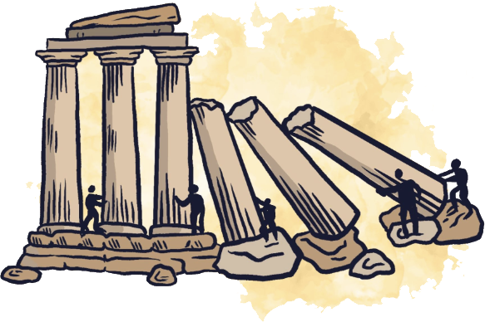
Module 2
PILLARS OF SUPPORT
This covers “why noncooperation beats authoritarianism” — it assumes people have a sense of authoritarianism and are ready to get an assessment of these times and how our approach has to shift.

Slide 2

Why noncooperation beats authoritarianism

Slide 3
“The most common way people
give up their power is by thinking
they don’t have any.”
-Alice Walker, author of The Color Purple

Slide 4
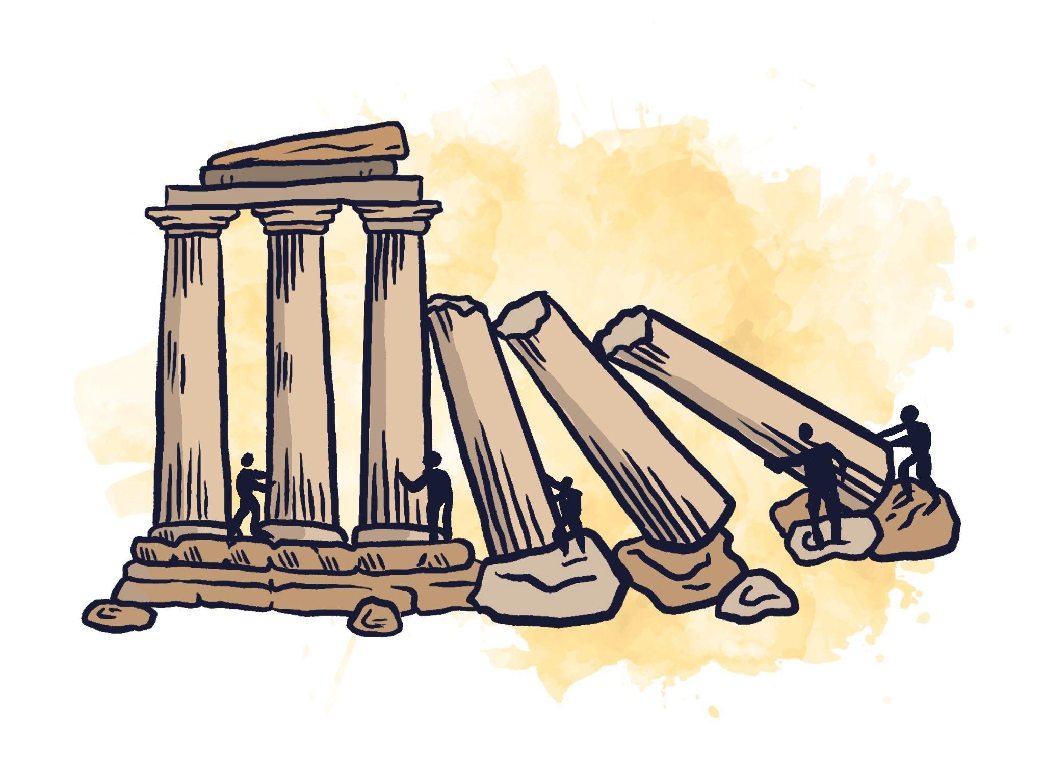
PILLARS
OF SUPPORT

Slide 5
Noncooperation is the act of refusing to cooperate or comply with requests, demands, or orders.
Enough noncooperation will cause a pillar to completely defect — or at least be unreliable in the autocrat’s aims.

Slide 6
Pillars of Support
Government/ Regime
Police / Military
Faith Communities
Business
Civil service
Media
Labor
Notes:
If we look at the cross section of a pillar, what do we see?
Is everybody in a pillar the same?
→ Not all pillars have same power/ position in upholding system nor same disruption potential!!!
Business:CEO- Managers- Workers- Consumers
EDucation: National Department or Agency– State Level Board of ED- local Boards- Superintendents/Administrators- Teachers - Students - PTAs!!

Slide 7

Cross Section of a Pillar
Government/ Regime
CEOs
Middle Management
Police / Military
Faith Communities
Business
Civil service
Workers
Media
Labor
Consumers
Notes:
If we look at the cross section of a pillar, what do we see?
Is everybody in a pillar the same?
→ Not all pillars have same power/ position in upholding system nor same disruption potential!!!
Business:CEO- Managers- Workers- Consumers
EDucation: National Department or Agency– State Level Board of ED- local Boards- Superintendents/Administrators- Teachers - Students - PTAs!!

Slide 8
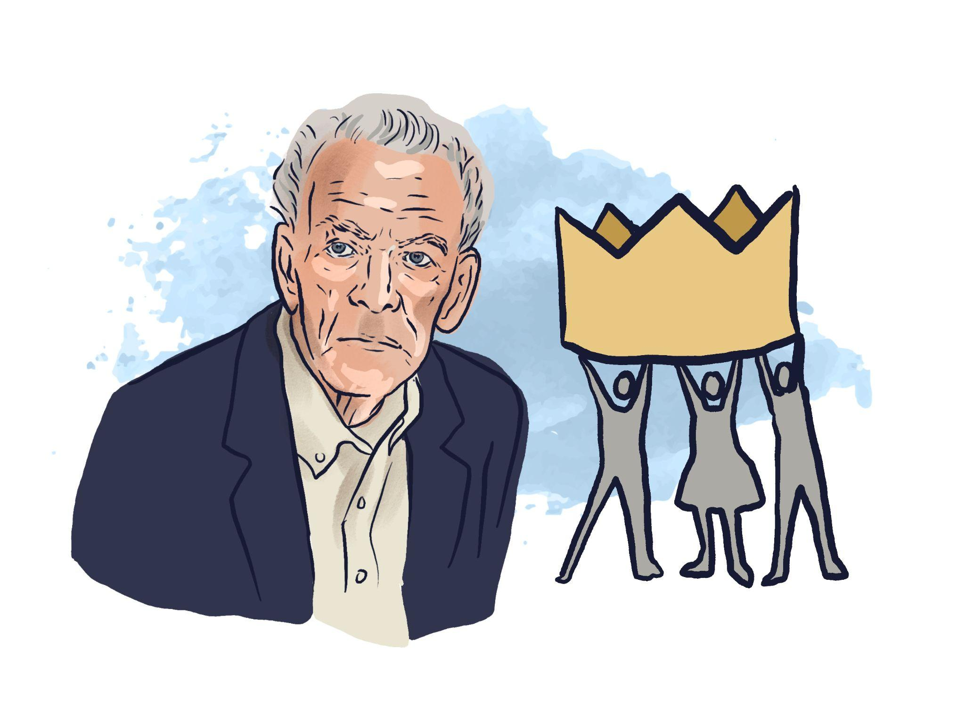
“By themselves, rulers cannot collect taxes, enforce repressive laws and regulations,
keep trains running on time,
prepare national budgets, direct traffic,
manage ports, print money, repair roads,
keep markets supplied with food, make steel, build rockets, train the police and army,
issue postage stamps or even milk a cow.
People provide these services to the ruler through a variety of organizations and institutions. If people would stop providing these skills, the ruler could not rule.”
— Gene Sharp

Slide 9
Spectrum of Allies
MOVEMENT
OPPONENTS
Notes:
Step 1. Explain the concept
In most social-change situations there is a struggle between those who want the change and those who don’t. On the one hand, there are people who are active supporters of the change—not just people who believe in the change but people who are taking actions to make it a reality. On the other hand, there are people who are active opposers, people who actively take actions to prevent the change.
In activist work, we often are focussed on those two groups — yet most people are somewhere between. Societies (towns, provinces, etc.) include a range of groups that can be put on a spectrum from closest to the point of view of your group to farthest away. This spectrum of allies illustrates this point.
The goal of the spectrum of allies is to identify different people—or specific groups of people—in each category, then design actions and tactics to move them one wedge to the left.

Slide 10
Spectrum of Allies
neutrals
passive allies
passive
opponents
MOVEMENT
active allies
active opponents
OPPONENTS
Notes:
Step 2. Explain benefits of this tool
Good news: in most social-change campaigns it is not necessary to win over the opponent to your point of view. It is only necessary to move the central pie wedges one step in your direction.
This is important. If we shift each wedge one step, we are likely to win, even if the hardliners on the other side never move. That means our goal is not to convince the fossil fuel industry to end themselves. Instead, it is moving the rest of the society to shut them down.
Often activists have the mistaken idea that they need to win everyone to their side (which invites despair), or that we need to change the fossil fuel industry or other people actively fighting against the campaign (again inviting despair). When organisers bring an optimistic attitude, instead of one of despair, to the task of mobilisation, it is a lot easier to get people on board.
The Spectrum of Allies also reminds us there is a need for many roles. Different actions will reach folks at different places in the spectrum, so there are many ways to support a campaign, from lobbying politicians to marching in the streets.
This tool also evaluates our work. Can we show that we are measurably moving some segment of people over to our side? If not, we need to rethink our strategy.

Slide 11


Fill out the Chart
neutrals
passive allies
passive
opponents
MOVEMENT
active allies
active opponents
OPPONENTS
Notes:
Step 3. Fill out the chart
This tool is even useful for small groups. Take some time to fill out the chart with specific people and groups. Note that you need to be specific to make this tool work. “The public,” for example, is far too broad to reach, and your strategy will suffer as a result. Instead, identify specific groups—groups that have a phone number, or an address –– a group you could attend a meeting of, or meet with a leader. Think of specific individuals, both politically influential, but also socially influential, like elders and community leaders. (Read more about power-mapping.)

Slide 12

Levels of Noncooperation
Individual & Small Group Noncooperation
Collective Noncooperation
Mass Noncooperation
Notes:
Federal workers have been at some of the front here.
They’ve done so much.
Tesla takedown / DOGE emails

Slide 13

Notes:
Reiterate the point that when repression increases, so does resistance. This lesson has been shown by many struggles in many places.

Slide 14
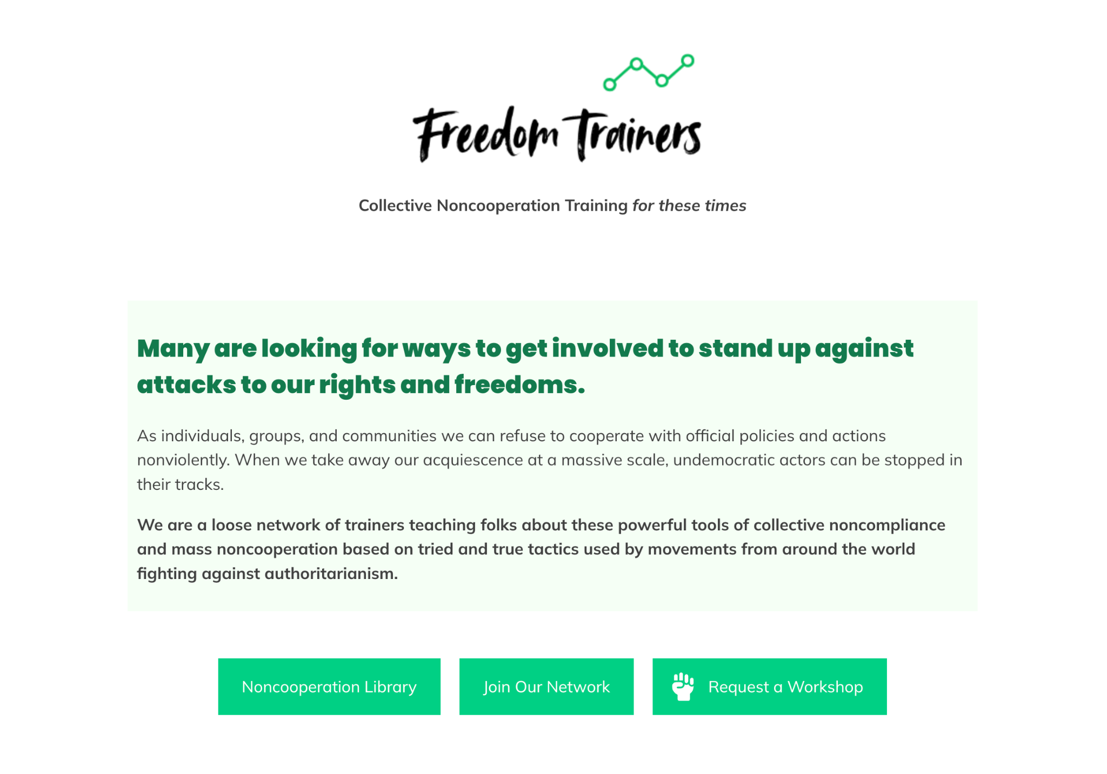
Thank you for joining us!
Get more resources and further training from Freedom Trainers — a network of noncooperation trainers.
freedomtrainers.net
Notes:
Thank people for showing up and for their willingness to explore what can help us to be effective in these times. Remind them that many successful movements have used tools like singing to manage their fear while also inviting in more people and putting their opponents in a bad light. Public prayer can do the same thing. They used humor in Serbia. We can likewise find ways to express our humanity while defending it. Let’s take a final deep breath together with gratitude for the movement we’re building.

