Slide 1
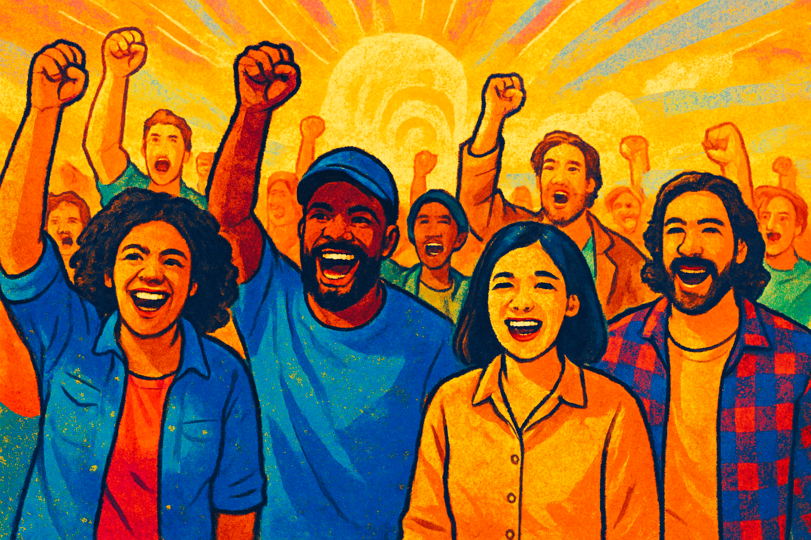
DSEA Board of Directors
From Purpose to Plan Day 1
Ellen Holmes

Slide 2

Honoring This Space
We begin by acknowledging that through a history of colonization and brutality, we are currently on the traditional lands stewarded by generations of the Lenape, also called the Lenni Lenape and the Delaware.
We honor these indigenous people, all elders, past, present, and emerging. We are called to learn and share these learnings about their tribal history, culture, and contributions that have been suppressed in the telling of the story of what we now call the United States of America.

Slide 3

Agenda Review – Today
Getting Started and Building Our Community
Shared Analysis of Power Building
Revisiting and Practicing The Skill of Dialogue

Slide 4

Community Agreements
Using Self-Awareness and Self-Knowledge
Listening for Understanding
Being Gracious
Staying Engaged
Being Open and Suspend Judgment
Saying “I”- tell your truth
Seeking Discomfort
Reaching Empathy
Expecting Non-Resolution and Non-Closure
*Adapted from “Embracing equity and inclusion”, Annie E. Casey Foundation
Notes:
Community Agreements for Our Time
Awareness and Self-Knowledge
This requires self-knowledge and self-awareness. Self-knowledge allows you to see what causes you pain and conflict and enables you to embrace your contradictions and inconsistencies. It allows the space to work on things about yourself that you are not happy with. In turn, self-knowledge helps to prevent you from projecting your negative aspects onto other people. Bringing your best self also requires that you have a positive attitude, are willing to deeply explore your perspectives and remain open to the perspectives and experiences of others.
Listening for Understanding
Be an active listener. Active listening involves paying full and careful attention to the other person, looking him or her in the eye, avoiding interruptions, reflecting your understanding, clarifying information, summarizing the other person’s perspectives and sharing your own. Remember that most people need time to open up and might not be willing to immediately share their personal stories, hopes, fears and/or concerns.
Being Gracious
Being kind is a vital way of bringing meaning to our own lives, as well as the lives of others. Kindness is about caring genuinely for others around you, wanting the best for them and recognizing in them the same wants, needs, aspirations and even fears that you may have. Being kind and generous allows us to communicate better with others, to be more self-compassionate and to be a positive force in other people’s lives. This includes following the COVID protocols that are in place to protect the health of this learning community.
Stay Engaged
Staying engaged requires you to be morally, emotionally, intellectually and socially involved in the conversation. Staying engaged means that you are listening with curiosity and willing to deepen your understanding. Staying engaged might also require you to sustain the conversation even when it gets uncomfortable or diverted. This also means a commitment to keeping your electronic communications to a minimum with folks not present in this learning community.
Be Open and Suspend Judgment
Listening with an open mind includes being receptive to the influence of others. You can suspend judgment by becoming aware of preconceived notions and listening to everything someone has to say before jumping to conclusions. Most importantly, suspending judgment also means listening to what the speaker has to say for understanding, not just to determine whether the speaker is right or wrong.
Say “I”- tell your truth
Speaking your truth in authentic and courageous conversations about race requires a willingness to take risks. It means that you will be absolutely honest and candid about your own thoughts, feelings, experiences and opinions and not just saying what you perceive others want to hear. Speaking your truth will require you to speak from the “first person” and use “I” statements.
Seek Discomfort
Leaning in to discomfort will require you to let go of racial understandings and stereotypes that you may be holding onto in order to move forward. Leaning in means that you will avoid judgment, assume positive intent and be open to the kernel of wisdom in each individual’s experiences. Leaning in to discomfort will require you to sit through moments of embarrassment, confusion, anxiety and/or fear.
Reaching Empathy
Empathy and compassion allow you to understand the other person’s point of view. When you are empathetic, you are more understanding, patient and kind. Expanding your capacity to feel empathy will also allow others to enter your circle of human concern.
Resolution and Closure
Expect and accept that there may not be closure. It is not likely that you will resolve your personal understanding about race or another person’s racial experience in a single conversation. The more you talk about race with another person, the more you learn and the more they will learn. Authentic and productive conversations about race are continuous and always evolving.
*Adapted from “Embracing equity and inclusion”, Annie E. Casey Foundation

Slide 5

Key Points
Agreements on how we will work together for our time allow both learners and facilitator a structure to manage learning and mediate challenges.
They support good communication.

Slide 6
Introduction Time

Slide 7
Your Core Values
Core values are the fundamental beliefs of a person. These guiding principles dictate behavior and can help people understand the difference between right and wrong. These can often be expressed in one or two words.

Slide 8
Ellen
She, her
“Protect Home”
Organizational Specialist
Use your handout to record yours. a

Slide 9

Name Pronouns
Role
Core Value
Introductions

Slide 10

Did you notice any patterns?
Surprises?

Slide 11
Key Point
Our work/life are prioritized by our core values.
Values are at the core of relationships, community and solidarity.
Stated values don’t always match actions

Slide 12
A Little Purpose

Slide 13

Your 'why'" refers to the core reason or driving force behind what you do, essentially your personal purpose or motivation
Sharing your "why"allows others to connect with your values, understand your passion, and build deeper relationships

Slide 14

Ellen

Slide 15

Cell Phone Mixer
Open a picture that represents your purpose for being on this board.
Three 5 Minute Rounds
Triads – People you don’t typically talk to or are new to you.
Share your name, your picture, and your purpose.
Notes:
Participants will line up in order of nearest to farthest from Baton Rouge – They will then fold the line in half so that those on the nearest end of the line end up talking to the farthest end of the line

Slide 16

Discussion
How did you feel when you were presenting or listening ?
What are some common themes that you heard across the introductions?

Slide 17
Did you notice any patterns?
Surprises?

Slide 18
Key Point
Our commitments in work and life are best when we understand why we do them.
Sharing your "why“ with others allows them to connect with your values, understand your passion, and build deeper relationships

Slide 19
Dreams and Challenges

Slide 20
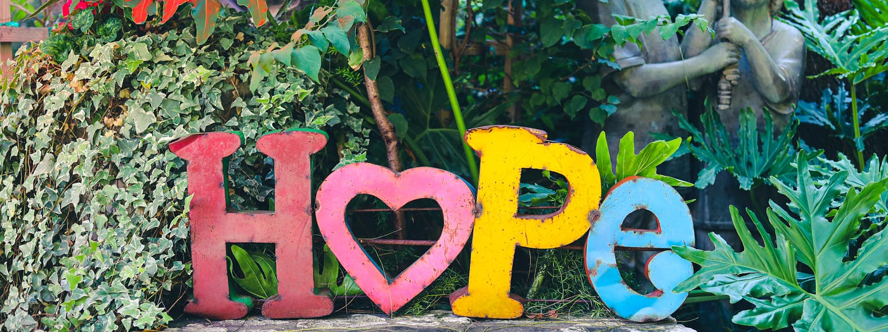
What does a Loving Community or School look like?

Slide 21
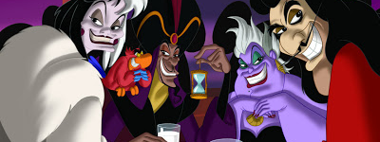
What or Who is preventing you from achieving this dream?
Notes:
Advocates, Mobilizers, Organizers Scenario

Slide 22

Why?
Why is this happening? What is the root cause?
Who is benefiting from what's happening ?
What is their vision for our public schools and higher education?
Notes:
12 min. Let's take a moment. How have the attacks impacted our schools and our communities? 6 min. Find someone to pair with to share. 6 min Group discussion
15 min. By small groups: Each table discusses one of these questions. (Facilitators can pop in for guidance as needed.)
Shared analysis -

Slide 23

What are the impacts on your
coworkers?
students?
community?

Slide 24
What's at stake and how do we currently talk about it?
    Public education?
    Public school workers?
    Public school students?
    Families and communities that public schools serve?
    DSEA and this board?

Slide 25

What do we want to do about this?

Slide 26
Key Point
Business as usual will keep us in the current status
Disrupting the current status will require a change in how we do business.

Slide 27
Current Strategic Plan

Slide 28
Delaware State Education Association
Strategic Plan
2015
Notes:
Welcome to the FY 2016 and FY2017 Proposed Budget Presentation. It is great to see so many new faces as well as those delegates who have participated in the budget process before.

Slide 29
Strategic PLAN focus areas
Communications
Organizing
Leading the Profession
Political Engagement
Social Justice
Notes:
And from what we heard, the governance in concert with the Executive Board and staff developed our strategic focus areas.

Slide 30
Communications Goals
Promote public education
Increase awareness/understanding of issues impacting teaching and learning among DSEA leaders, members and staff
Develop and promote brand for DSEA focusing on “why”
Promote and to respond to member feedback (“ownership”)
Notes:
These goals were derived specifically for the communications focus area. The first two goals are similar to the communications goals in previous strategic plans. An expanded goal is that we are going to promote DSEA in a way that focuses on the “why” why do we care about excessive testing—why do we care about the socio economic base that our students come from—why do we continue to engage new members and encourage them to participate in union business. Another addition is the goal to promote and to respond to member feedback. This gives the membership ownership of the communications processes.

Slide 31
Communications Activities
DSEA.org
ACTION!
Read Across America
New Media opportunities-TV commercials, online town halls
Great Public Schools
Digital Engagement –Facebook, Twitter, Flickr, List Servs, Podcasts
Video infomercials on education topics
Faces of DSEA
Notes:
Here are some activities that were funded through the Communications budget request.

Slide 32
Organizing goals
1 on 1 relationship building conversations
Recruit & engage new hires and non-members
Identify & build relationships with community partners
Events for members to meet and greet each other
Identify & build relationships with labor partners
Notes:
The goals for organizing focus on the recruitment and engagement of members, identification and training of leaders and strengthening our connection with members, labor partners and the community.

Slide 33
Organizing Activities
Countywide meetings for local members to share and learn new and best practices
Training for local leaders for new hire orientations and 1 on 1 conversations
Mentoring program for new members
Expanded student membership engagement
Member Benefit events (new format) and trainings
Building visits with members
Develop community partners
Quarterly member mixers
More member events – Labor day Picnic after parade, Family events
1 on 1 conversations with new hires, non-members and members
Notes:
Here are some of the activities that were funded as a result of the program requests.

Slide 34
Leading the profession Goals
Student centered, member led
Promote & support the professional growth of all members
Identify, train, and support leaders
Promote and protect rights of all members
Notes:
The goals of leading the profession focus on student based, educator led public education, promoting professional growth for all members, leadership development, and promoting and protecting the rights of all members.

Slide 35
Leading the Profession Activities
Increase the professional development opportunities for all member categories
Develop our own evaluation system
Focus on identifying and cultivating leaders representative of all categories of membership
Online professional development
Increase public awareness around ESP groups
Leadership Development Program
Develop seminar/round table series on different policy issues
Notes:
Here are some of the activities that were funded through the program requests.

Slide 36
Political Engagement goals
Increase member understanding & awareness of why we are involved in politics
Increase member interaction with elected & appointed officials (“relationships”)
Sustain & increase PAC contributions
Identify & support candidates who support public education regardless of party affiliation
Notes:
You may have heard the statement “If you are in education you are in politics” while very true not all of our members understand why we are involved in politics. Increasing that awareness will help us to meet the other goals of political engagement focus to increase member interaction with elected and appointed officials, sustain and increase PAC contributions, and identify and support candidates who support public education regardless of party affiliation.

Slide 37
Political Engagement
Ongoing education regarding how DSEA is involved in politics
Increase member awareness of what is happening in other places and could happen in Delaware
Have members visit legislators during session
Regular Town Halls – locally, countywide and statewide
Train members around modes of participation in process
Returns party after elections sponsored by DSEA
PAC Contests – locals, county, building
Legislators to visit rep meetings
Notes:
These are the activities funded through the political engagement budget request.

Slide 38
Social Justice Goals
Partnering with/or supporting efforts to promote equity of opportunity & fair treatment for all
Promoting cultural competency & diversity among our members
Protecting rights of educators & students to discuss & promote social justice efforts
Notes:
Social justice goals promote equity for all and respect for the cultural diversity of our membership and community base.

Slide 39
Social Justice Activities
Educate members on what social justice is through broad communication efforts
Monthly articles to members on social justice issues
Develop professional development training on cultural competencies
Build relationships with existing social justice organizations and develop an action plan on building level to address social justice
Create opportunities to participate in community based cultural events
Realign and legitimize the EMAC and HCR
Social Justice Day
Committee to organize groups for food banks, habitat for humanity, etc.
Notes:
Here are some of the activities funded through the program requests.

Slide 40
Club to Fighting Union

Slide 41
Club or Union? Table Talk
Unorganized
Club
Union
Fighting Union
Which of these columns best describes the work of this Affiliate?
What indicators stand out to you?

Slide 42
Clubs require little risk and are about individuals.
These are necessary, but not sufficient to build the power we need.
Fighting Unions build power through the core practices of organizing:
Interdependent Leadership
Collective Risk and Accountability
Shared Purpose

Slide 43
3 Prevalent Theories of Change
Advocacy
“Advocacy is the work of creating change through the actions of professionals or technical experts—lobbyists, pollsters, lawyers, communication specialists, researchers. Advocacy relies on the expertise, status, and know-how of these groups of people to make change. Advocacy usually happens in a closed-door room; ordinary people play a small to nonexistent role in its efficacy. Advocacy has become a dominant strategy for unions and liberals.”
Mobilizing
“Mobilizing, by contrast, activates an already-convinced membership. Mobilizing encourages those who already support a cause or a mission to take action to defend their belief—for example, by attending a protest, wearing a button, or signing a petition.”
Organizing
“To organize is to build mass support and strength among ordinary people. Organizing draws its power from working people’s biggest strength: our numbers. The work of organizing is systematic and rigorous: It requires connecting with every single worker in a shop, every educator in a building, every building in a district. At its core, it asks people to understand their own agency and to make choices about how they will exercise it.”

Slide 44

Time to Talk
Which of these theories do we mostly work in?
Which of these theories generates the power you need to win the changes you want ?

Slide 45
Advocacy is about using expertise of a few.
Mobilizing is about engaging the already committed.
These are necessary, but not sufficient to build the power we need.

Slide 46


Slide 47
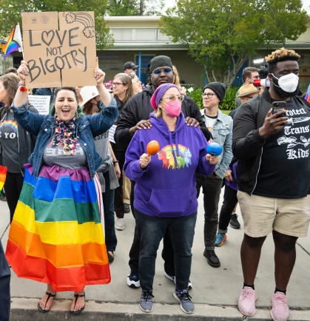

DEFINING POWER
Power is the ability to control, create, and prevent change.
Power is organized people and organized resources (money).
Power is not static, it is either waning or growing.

Slide 48

UNDERSTANDING POWER
Power is neutral
Our values affect the way we use power

Slide 49

TRUTHS ABOUT BUILDING POWER
Power has to be consistently built or it is waning
Not everyone wants us to have power and actively work to take our power away
Public actions through shared vision, shared purpose, shared resources, shared risk, and unity is how we build power
The bigger the win you want– the more power you need
Building power requires leadership

Slide 50
Power Building Scenarios
Social Justice Event
DSEA Face Book Page
Pac Donations
Testifying before Legislature
Winning Grievance
Doing 1:1’s
Weekend Rally
How is power being built?
Who’s doing the work of this?
Who is the story about?
What does this gain for all members?

Slide 51
Campaigns are not Programs
An issue campaign is the process through which the people organize around leaders and structures to use their resources in accomplishing goals that achieve the change they need and want. It is public. It involves risk. It results in the story being about the workers.
From Marshall Ganz

Slide 52
How do we achieve our dreams?
Programs
Campaigns
Club
Union
Advocacy
Mobilizing
Fighting Union
Organizing

Slide 53

Key
Points
Intentional campaigns, not programs, not advocacy, build power.
The power to win is only built through people with a shared vision, making public commitments to act, to risk their collective resources, for the big meaningful changes they want.
The kind of power we need depends on what you do outside of this room and how accountable you are to each other for those actions.

Slide 54
Communication Styles

Slide 55
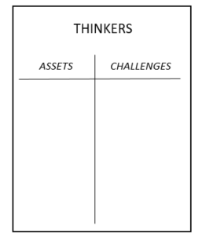
DISC STYLES
Step 1: Go to the chart where your dominant style is posted
Step 2: Colleagues create a T-Chart with one side listing what makes this style an asset in the work of Affiliate Staff, and on the other side the challenges this style creates for Board Members.
Steadiness
Dominant
Influence
Conscientious
Steadiness

Slide 56
DISC Styles
What makes this work style a great asset as a member of this board?
What sorts of challenges does this style create as a member of this board?
Dominant
Influence
Conscientious
Steadiness

Slide 57
Communication Styles Report Out
Dominant
Influence
Conscientious
Steadiness
Report out from the Styles
Which style is most challenging for your group to work with?

Slide 58
Key Points
Effective communication is vital for a healthy work culture and improved morale.
How we communicate, how people perceive us and how we listen are all factors in our effectiveness.
Recognizing our patterns is what is most important as it allows you to respond more effectively.

Slide 59
Communication Styles Under Stress

Slide 60
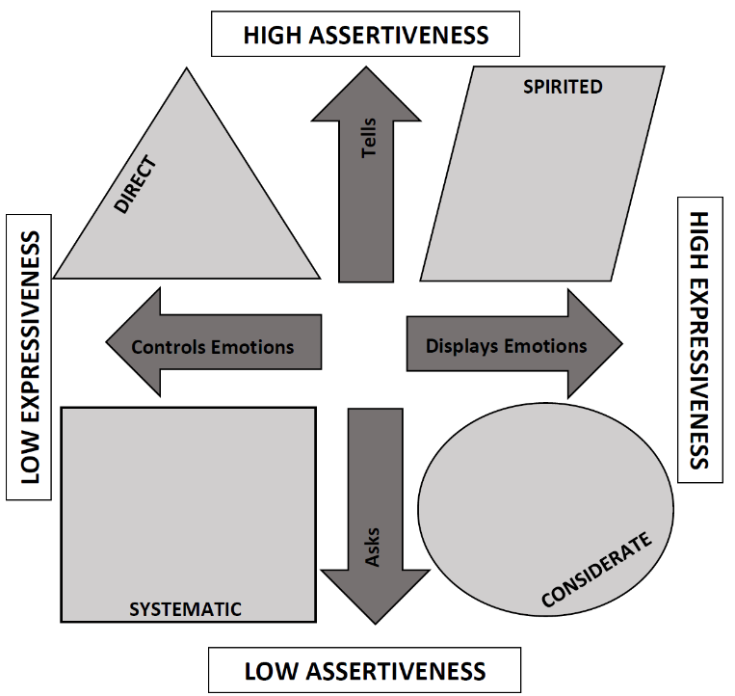
How Styles Handle Resistance
Dominant
Influence
Conscientious
Steadiness
Expect resistance and try to prepare for it
Avoid resistance and skirt around it

Slide 61

Style Under Stress
Violence
Controlling
Labeling
Attacking
Silence
Masking
Avoiding
Withdrawing

Slide 62
How Our Style Can Affect the Pool of Meaning
Dominant and Conscientious | Influence and Steadiness
Violence Patterns Violence patterns consist of any verbal strategy that attempts to convince, control, or compel others to your point of view. It violates safety by trying to force meaning into the pool. | Silence Patterns Silence patterns consist of any act to purposefully withhold information from the pool of meaning. It’s almost always done as a means of avoiding potential problems, and it always restricts the flow of meaning.

Slide 63
Use our Handouts
Style / Pattern | Checks
Masking | Rather than tell people exactly what you think, do you sometimes rely on jokes, sarcasm, or snide remarks to let them know you’re frustrated? When you have something tough to bring up, do you sometimes offer weak or insincere compliments to soften the blow?
Avoiding | Sometimes when people bring up a touchy or awkward issue, do you try to change the subject? When it comes to dealing with awkward or stressful subjects, do you sometimes hold back rather than give your full and candid opinion?
Withdrawing | At times, do you avoid situations that might bring you into contact with people you are having problems with? Have you put off returning phone calls or emails because you simply don’t want to deal with the person who sent them?
Controlling | In order to get your point across, do you sometimes exaggerate your side of the argument? If you seem to be losing control of a conversation, do you cut people off or change the subject in order to bring it back to where you think it should be?
Labeling | When others make points that seem stupid to you, do you sometimes let them know it without holding back at all? When you’re stunned by a comment, do you sometimes say things that others might take as forceful or attacking – comments such as “Give me a break!” or “That’s ridiculous!” ?
Attacking | Sometimes when things get heated, do you move from arguing against other’s points to saying things that might hurt them personally? If you get into a heated discussion, are you known to be tough on the other person. In fact, does the person feel a bit insulted or hurt?

Slide 64
Key Points
Effective communication is vital for a healthy work culture and improved morale.
How we communicate, how people perceive us and how we listen are all factors in our effectiveness.
Recognizing our patterns is what is most important as it allows you to respond more effectively.

Slide 65
Crucial Conversations

Slide 66
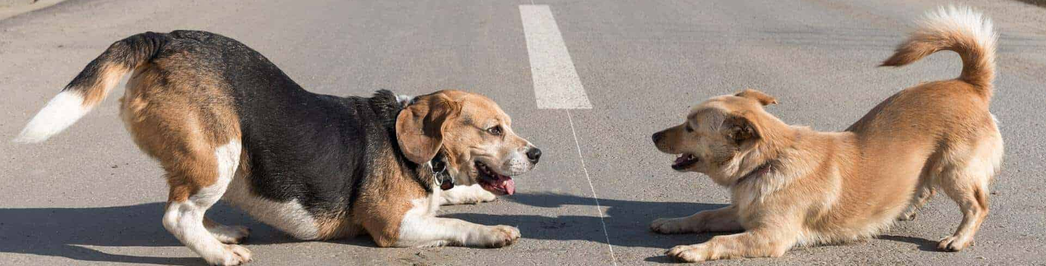
Crucial Conversations
Stakes are High
Opinions Differ
Emotions Run Strong

Slide 67
Why would a board of directors need to be able to have crucial conversations?

Slide 68

Can your Board discuss these?
Safety
  When someone violates a procedure or otherwise acts in an unsafe way, the first person to see the problem, regardless of his or her position, steps up and holds a crucial conversation.
Productivity
  If a member of the underperforms, fails to live up to a promise, doesn't carry his or her fair share, or simply isn't productive enough, the affected parties address the problem immediately.
Diversity
  When someone feels offended, threatened, insulted, or harassed, he or she skillfully and comfortably, discusses the issue with the offending party.
Quality
  When quality standards are not met, people discuss problems face-to-face when they first come up.

Slide 69

How do you react when conversations become tense or awkward?
Masking
Avoiding
Withdrawing
Controlling
Labeling
Attacking

Slide 70
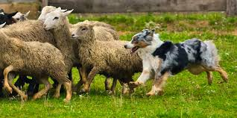



Why do we act this way?

Slide 71
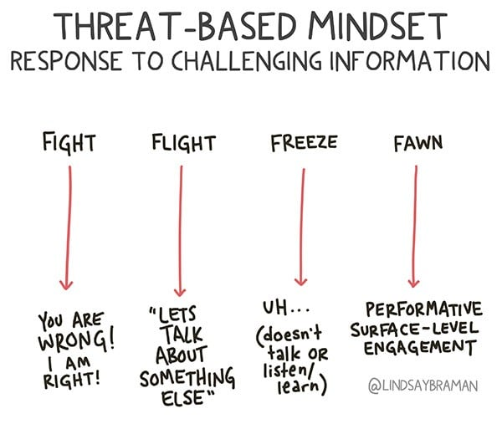
Masking
Avoiding
Withdrawing
Controlling
Labeling
Attacking

Slide 72

What is Needed…
Dialogue
  A two-way communication between persons who hold significantly differing views on a subject, with purpose of learning more truth about the subject from one another. Both are committed to speaking and listening.
  Building a pool of shared meaning.

Slide 73
Pool of Shared Meaning
All the shared knowledge in a conversation.
A measure of a group’s shared maturity.
More information in the pool makes for better decisions.
Remember
  The totality of information in the pool is what matters most
  One dominant person shouldn’t control it
  Other people’s contributions are just as valuable
  People are also more likely to follow through if they have contributed.
  Morale and trust grown when people feel they’re working towards a common goal.

Slide 74
How Our Style Can Affect the Pool of Meaning
Dominant and Conscientious | Influence and Steadiness
Violence Patterns Violence patterns consist of any verbal strategy that attempts to convince, control, or compel others to your point of view. It violates safety by trying to force meaning into the pool. | Silence Patterns Silence patterns consist of any act to purposefully withhold information from the pool of meaning. It’s almost always done as a means of avoiding potential problems, and it always restricts the flow of meaning.

Slide 75
Key Points
Effective communication is vital for a healthy work culture and improved morale.
Dialogue is necessary to build trust and become a better organization.
Decisions that matter must include dialogue.

Slide 76
Ending It Right

Slide 77
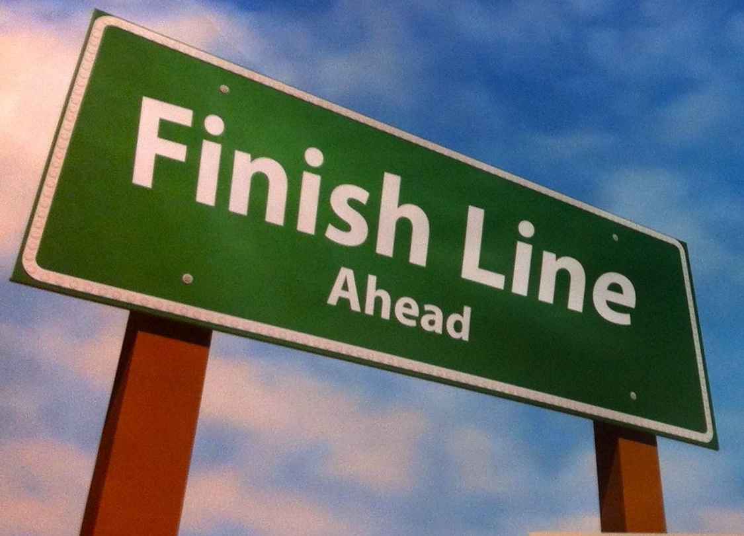
Ending it Right
Final Q & A
Plus, Delta, Key Learning

Slide 78
DSEA Board of Directors
From Purpose to Plan Day 2
Ellen Holmes

Slide 79
Community Agreements
Using Self-Awareness and Self-Knowledge
Listening for Understanding
Being Gracious
Staying Engaged
Being Open and Suspend Judgment
Saying “I”- tell your truth
Seeking Discomfort
Reaching Empathy
Expecting Non-Resolution and Non-Closure
*Adapted from “Embracing equity and inclusion”, Annie E. Casey Foundation
Notes:
Community Agreements for Our Time
Awareness and Self-Knowledge
This requires self-knowledge and self-awareness. Self-knowledge allows you to see what causes you pain and conflict and enables you to embrace your contradictions and inconsistencies. It allows the space to work on things about yourself that you are not happy with. In turn, self-knowledge helps to prevent you from projecting your negative aspects onto other people. Bringing your best self also requires that you have a positive attitude, are willing to deeply explore your perspectives and remain open to the perspectives and experiences of others.
Listening for Understanding
Be an active listener. Active listening involves paying full and careful attention to the other person, looking him or her in the eye, avoiding interruptions, reflecting your understanding, clarifying information, summarizing the other person’s perspectives and sharing your own. Remember that most people need time to open up and might not be willing to immediately share their personal stories, hopes, fears and/or concerns.
Being Gracious
Being kind is a vital way of bringing meaning to our own lives, as well as the lives of others. Kindness is about caring genuinely for others around you, wanting the best for them and recognizing in them the same wants, needs, aspirations and even fears that you may have. Being kind and generous allows us to communicate better with others, to be more self-compassionate and to be a positive force in other people’s lives. This includes following the COVID protocols that are in place to protect the health of this learning community.
Stay Engaged
Staying engaged requires you to be morally, emotionally, intellectually and socially involved in the conversation. Staying engaged means that you are listening with curiosity and willing to deepen your understanding. Staying engaged might also require you to sustain the conversation even when it gets uncomfortable or diverted. This also means a commitment to keeping your electronic communications to a minimum with folks not present in this learning community.
Be Open and Suspend Judgment
Listening with an open mind includes being receptive to the influence of others. You can suspend judgment by becoming aware of preconceived notions and listening to everything someone has to say before jumping to conclusions. Most importantly, suspending judgment also means listening to what the speaker has to say for understanding, not just to determine whether the speaker is right or wrong.
Say “I”- tell your truth
Speaking your truth in authentic and courageous conversations about race requires a willingness to take risks. It means that you will be absolutely honest and candid about your own thoughts, feelings, experiences and opinions and not just saying what you perceive others want to hear. Speaking your truth will require you to speak from the “first person” and use “I” statements.
Seek Discomfort
Leaning in to discomfort will require you to let go of racial understandings and stereotypes that you may be holding onto in order to move forward. Leaning in means that you will avoid judgment, assume positive intent and be open to the kernel of wisdom in each individual’s experiences. Leaning in to discomfort will require you to sit through moments of embarrassment, confusion, anxiety and/or fear.
Reaching Empathy
Empathy and compassion allow you to understand the other person’s point of view. When you are empathetic, you are more understanding, patient and kind. Expanding your capacity to feel empathy will also allow others to enter your circle of human concern.
Resolution and Closure
Expect and accept that there may not be closure. It is not likely that you will resolve your personal understanding about race or another person’s racial experience in a single conversation. The more you talk about race with another person, the more you learn and the more they will learn. Authentic and productive conversations about race are continuous and always evolving.
*Adapted from “Embracing equity and inclusion”, Annie E. Casey Foundation

Slide 80
Agenda Review – Today
Reentry
Shared Purpose and Values
Shared Commitments and Accountability
Agreements
Plan Outline

Slide 81
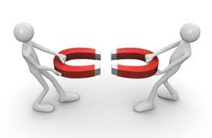
Magnetic Ideas
What is an idea, conversation, or action from yesterday that pushed on you? Or pulled on you?

Slide 82

What is hard about the following:
We trust that everyone here is an adult.
We trust the positive intent of everyone in the room.
We trust that we will have an equal voice.
We trust that everyone does what they say they will.

Slide 83
How Do get to Trust?
Predictability Can we predict what they will do in similar situations? | Reliability Do they do what they say they will do?
Accountability Do they take responsibility for what they do? | Honesty Do they have the same values about trust that we do?
Whether between or among individuals or organizations TRUST is a dependent variable.
The level of trust depends on four aspects of the relationships between and among individuals.

Slide 84
Ladder of Inference

Slide 85
What are you reading into this?
The message at the top of the screen is yours.
Scenario 1: You sent it to someone who you don’t trust very well. The response on the bottom is from them.
How do you feel?
How would you respond, or want to respond?

Slide 86
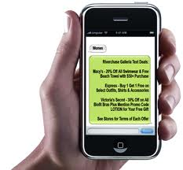
Thank you for your feedback on my meeting. I am sorry you did not get to see the whole thing. Let’s talk more about this.
Sure. I saw enough.

Slide 87
What are you reading into this?
The message at the top of the screen is yours.
Scenario 2: You sent the same message to someone you know well and trust. The response on the bottom of the screen is from them.
How do you feel?
How would you respond, or want to respond?

Slide 88
Thank you for your feedback on my meeting. I am sorry you did not get to see the whole thing. Let’s talk more about this.
Sure. I saw enough.

Slide 89

What made the difference in how you felt about the message?

Slide 90
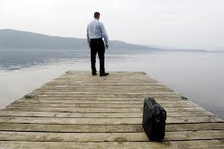
What’s the story… Page 19

Slide 91
Small Group Telling The Story
In your groups, decide what is the story of this picture.
Indicate the cues from the picture that allowed you to tell the story
Explain the story in detail
  What happened [or is happening]?
  When did [or does] it happen?
  Who is involved?
  How does it affect us?
  How does it make us feel?
  Describe, don’t characterize or blame.
Notes:
Carol

Slide 92
Debrief Your Group Stories
What are the actual cues in the picture?
How much of your story IS ONLY based on the cues?
We have beautiful minds that naturally build stories by filling in enormous gaps between the actual information we take in. We infer.
  This allows us to speed read
  This allows us to make snap decisions
  This allows to survive
  This is not conducive to building trust with others
  This is not conducive to building shared understanding
  This in not conducive to resolving conflicts

Slide 93
Ladder of Inference
The automatic and unconscious process of forming beliefs
 | Take action |  | We make decisions and take actions based on the rapid, unconscious reasoning process that just occurred. Our actions are visible to others — our reasoning behind them is not.
 | Adopt or support beliefs |  | We adopt beliefs based on our generalizations. These beliefs influence influence the data we select. We tend to select data to support our beliefs and ignore other data.
 | Make generalizations |  | We make generalizations about things we have not directly observed based on our conclusions about the person or event.
 | Draw conclusions |  | We reach conclusions based on the meanings we have added.
 | Add meaning |  | We attach meaning to the data we have selected based on our cultural and personal history.
 | Select data |  | We selectively acknowledge only certain data. This selection is influenced by our belief systems.
 | Observe event |  | The actual event — visible to any observer.
Based on original work by Chris Argyris, Robert Putnam and Peter Senge

Slide 94
Three Tools for the Ladder
Reflecting – Slow it down
Asking - Listen
Telling - Share

Slide 95
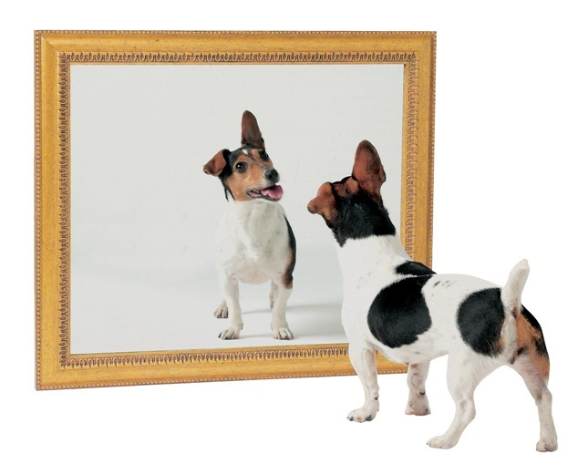
Reflecting
Aware of the limitations of our own thinking and reasoning
Our knowledge is always incomplete and, therefore, tentative
Surface our mental models and test them
Be open to new information
Be open to new ways of looking at experience
Seek to expand both our knowledge (data) and understanding (analysis)
Be curious and continuous learners

Slide 96
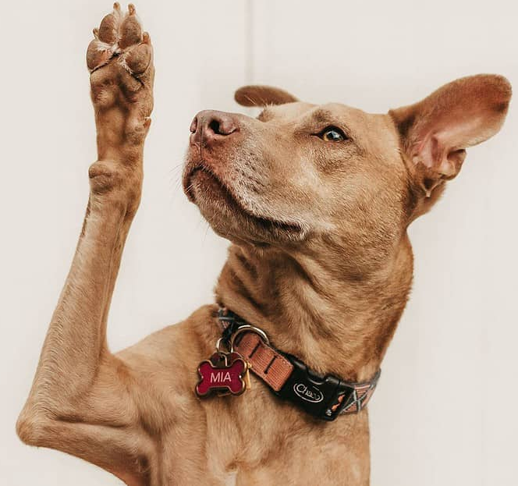
Asking
The purpose of inquiry or asking is to
  understand other people’s experience and perspectives
  make the others’ thinking visible
  open our minds to other ways to interpret our own experience
  question our mental models

Slide 97
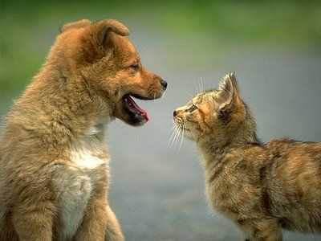
Telling
We walk others UP our own ladder of inference
We make our own thinking visible with the willingness to change our minds
We cannot impose our conclusions on each other if we are authentically engaged in dialogue.

Slide 98
Key Point
When in dialogue, we are only in control of how we add to the pool of knowledge, how we invite others to add, and how we listen.
Our primary tasks are to slow our thinking and focus on listening.

Slide 99
Shared Expectations

Slide 100
Community Agreements
What we agree to do
How we will behave
How we make decisions
What happens when we don’t do it

Slide 101
Why do we need shared agreements
Boards with explicit community agreements are more likely to achieve their goals, have internal trust, can hold difficult conversations, and make hard decisions.
Boards need operational agreements
  How often will we meet?
  How do we share, store, and use information?
  What do we do between meetings?
Boards need behavioral agreements
  How do we talk to each other?
  How do we engage in the work with each other?
  How do we operate outside of board meeting?
Boards need agreements about accountability
  What happens when someone does not do their part?

Slide 102
Shared Purpose

Slide 103
Why worry about our purpose?
Sharing purpose with others is important because it fosters trust, builds strong relationships, facilitates collaboration, and provides a common foundation for decision-making, allowing individuals to work towards a shared goal with greater alignment and motivation, especially in teams or organizations.

Slide 104
You Co-Constructed the Following

Slide 105
DSEA’s Core Purpose (Handout)
Advocate for the rights and interests of members and outstanding public education for all students. (From Webpage)
To increase the capacity of the local affiliates and members to effectively ADVOCATE for their needs
To ADVOCATE and build public support necessary for a quality public education for all students
To increase MEMBERSHIP, member commitment and involvement in activities of the union and its affiliates, and
To maximize member involvement in the POLITICAL ACTION process in order to impact policy and laws for the benefit of our members
To increase the capacity of our human resource, fiscal and communication SYSTEMS
To utilize the best TECHNOLOGY available to collect and share information that will enable effective decision-making.

Slide 106
What are the alignments you see?
What are gaps you notice?
Communications
Organizing
Leading the Profession
Political Engagement
Social Justice

Slide 107
Key Points
Stronger bonds and connection:
When people share similar values, they tend to feel more connected and comfortable with each other, which strengthens relationships and fosters trust.
Improved communication and collaboration:
A shared understanding purpose can lead to more effective communication and collaboration, as everyone is on the same page about priorities and goals.
Increased motivation and engagement:
Knowing that you are working towards a shared purpose can be highly motivating and lead to greater commitment and engagement in the work.
Resilience in challenging situations:
During difficult times, a shared sense of purpose can help a group stay focused and united, overcoming obstacles more effectively.

Slide 108
Shared Values

Slide 109
Core Values
Core values are the fundamental beliefs of a person or an organization. These guiding principles dictate behavior and can help people understand the difference between right and wrong. These can often be expressed in one or two words. We are taking a moment to consider our core values because they can provide a basis for solidarity in the midst of struggles.

Slide 110
Why worry about Shared Values?
Identifying shared values allows groups to communicate more effectively about what matters most and collaborate more deeply. A shared understanding of values allows diverse groups to be more aligned about priorities and goals. When facing challenges and dilemmas, shared values can help focus a group on making tough decisions that allow their actions to align with an overall purpose. Shared values are key to a strong culture where individuals feel comfortable expressing their opinions, supporting each other, and holding each other accountable.

Slide 111
DSEA Values (Beliefs)
That public education is the best way to provide opportunities for all in a democratic society;
That our members in public education and public health are our most valuable resources. It is through their empowerment and involvement that we will achieve our mission and goals;
That advocacy on behalf of our members and public education is the primary focus of our organization; and
That we build relationships based on fairness, dignity and respect.

Slide 112
What are the alignments you see?
What are gaps you notice?
Communications
Organizing
Leading the Profession
Political Engagement
Social Justice

Slide 113
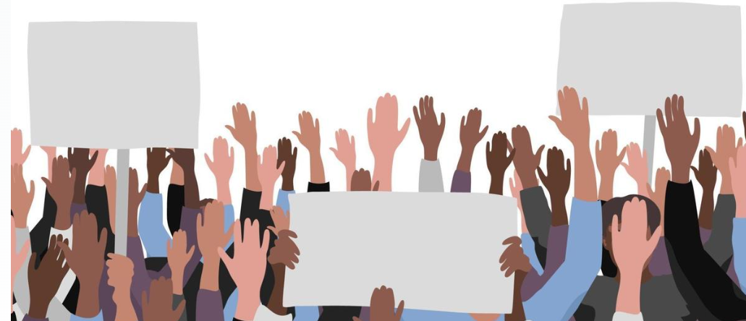
Union Values
Fairness, honesty/integrity, responsibility, compassion/empathy, safety, health, generosity, hard work/responsibility, community, freedom, democracy, binding contracts, equality, opportunity, respect, stability/security, unity, quality work, justice, collective action, dignity/respect, charity/community service, and due process.

Slide 114
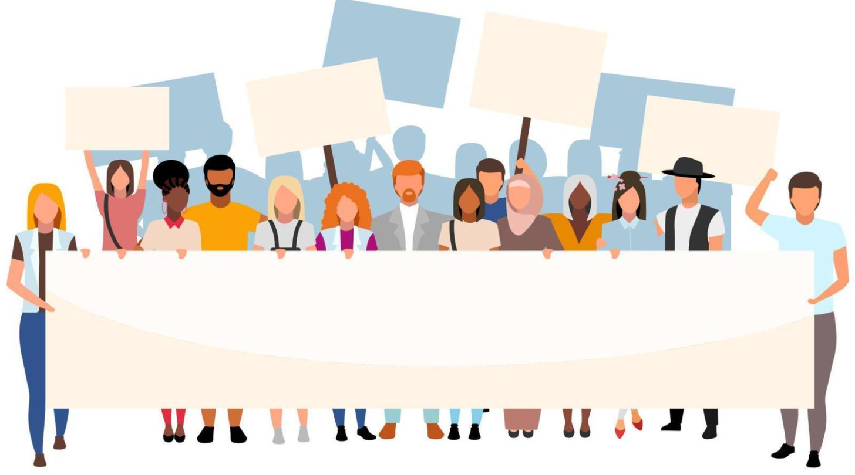
What do you think are the 5 most important values from this list that are exemplified by this Board?
What are specific examples of that?

Slide 115
Report Out
Each table shares list of values.
Listen as tables share out specific actions and only add new ones.
What do you notice?

Slide 116
Key Points
Improved communication and collaboration:
A shared understanding of values can lead to more effective communication and collaboration, as everyone is on the same page about priorities and goals.
Better decision-making:
When faced with challenges or dilemmas, shared values can act as a guiding principle to make decisions that align with the group's overall purpose.
Positive team dynamics:
Shared values contribute to a more positive and supportive team environment, where individuals feel comfortable expressing their opinions and supporting each other.

Slide 117
Key Points
Ideally – The purpose of Unions is to advance the welfare of all workers. They are based on the idea of justice, progress, and betterment of self and of society. They embody the universal ideal of human rights and the need to aspire to become more complete human beings. By becoming an active participant in the labor movement, members become part of something larger than themselves.
However, without INTENTIONAL APPLICATION of our stated values to dismantling systems of oppression we make no forward movement movement.

Slide 118
Walking Our Values: Focus on Social Justice

Slide 119
NEA’s Definition of Social Justice

Slide 120
Values that Social Justice Boards Hold
Calling People in Not Out
Accountability through Collective Action
Take risks, Make mistakes, Learn, and Persevere
Mutual Interest
Enough for All
Growing is Good

Slide 121
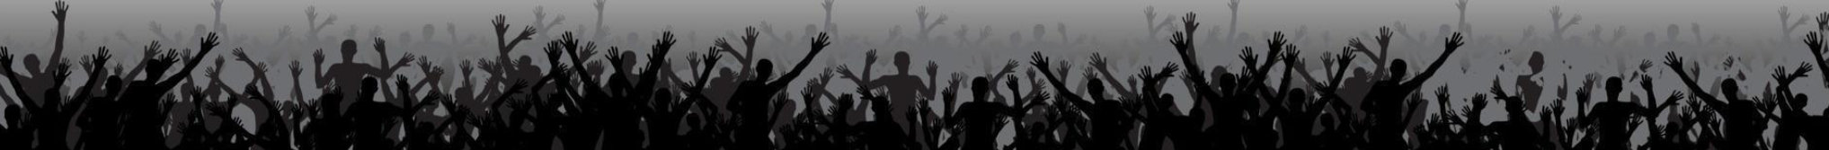
Walk the Line Activity
There will be six rounds
Listen to the union value statement, a description, and a short statement.
Based on how you have seen your board live into this stated value, you will move on the line toward “Strongly Agree” or Strongly Disagree”
Keep in mind, this is a reflection activity. People may feel very differently about the values and how they see our work. The variety of perspectives is important.

Slide 122
Walk the Line Activity – Round 1
Calling People In Not Out
Calling people in means trying to create a culture and community that people actually want to be a part of. Calling people in means we don’t shame or blame. It requires direct, specific and compassionate communication with one another. We all have space to grow, and calling people in is how we support one another through growth.
STATEMENT: Our board calls one another in when we need to communicate within our affiliate and with other white people.

Slide 123
Walk the Line Activity – Round 2
Accountability through Collective Action
Collective actions means that we look to build a movement of people. Individual transformation is not enough. This is done through building accountability relationships with groups of people who experience race, class, and gender oppression, groups who are doing social justice work and who are accountable to a group of people. We don’t wait to be asked to take action to organize people who hold greater privilege in social justice actions.
STATEMENT: Our affiliate is taking accountable collective action on a regular basis.

Slide 124
Walk the Line Activity – Round 3
Taking risks, making mistakes, learn, and keep going.
Making mistakes is part of life, and we know we have to be outside of our comfort zones in order to make change. Even when we take on real risk, we know that the risk is always greater for people with gender, race, and class oppression. When we make mistakes, we want to reflect and stay in motion. We cannot let making mistakes prevent us from continuing our work. When others make mistakes, we do not shame, blame or exile.
STATEMENT: Our affiliate stays in the process of taking action, receiving feedback and staying in motion. We support one another through our mistakes.

Slide 125
Walk the Line Activity – Round 4
Mutual Interest
Social justice isn’t something we help only people who experience race, class, and gender oppression with. The system of white supremacy harms all of us—including white people, though in very different ways than people of color. We need to get clear with ourselves about what we have to gain through this fight.
STATEMENT: Our affiliate and members are clear on our mutual interest. We’ve spent time getting clear on what’s at stake for us as individuals and as a group

Slide 126
Walk the Line Activity – Round 5
Enough for All
There are enough resources in the world for everyone's basic needs to be met— for folks to have decent housing, enough food, safety, etc. The problem isn’t that we don’t have enough stuff—it’s that it’s distributed unfairly. White supremacy tells us we need to compete with everyone, even other people doing this work.
STATEMENT: We organize from a place of abundance and cooperation.

Slide 127
Walk the Line Activity – Round 6
Growing is good
We need millions of white people to join the movement for social justice, and in order for this to happen our group needs to keep growing. We need to constantly bring in new voices and leaders. This means more than inviting people to come to meetings. It means finding new and exciting ways to bring people into the work based on their skills.
STATEMENT: Our group is open to growth. We bring in new members and engage with them as leaders.

Slide 128
Debrief the Line
What are you taking away from that activity that relates to how your Board operates?
Is there anything that surprised you?
Where are we doing really well?
Where do we need to grow?

Slide 129
Key Points
Organizations that adopt social justice values must ensure that they also invest in sustained forms of leadership, staff, and member development to create a shared understanding of race, class, and gender oppression.

Slide 130
How will we achieve our dreams?

Slide 134
Ending It Right

Slide 135

I used to think…
Now I know…

Slide 136
Ending it Right
Final Q & A
Plus and Delta

