Slide 1

Delaware State Education Association
Strategic Plan
2015
Notes:
Welcome to the FY 2016 and FY2017 Proposed Budget Presentation. It is great to see so many new faces as well as those delegates who have participated in the budget process before.

Slide 2
Strategic PLAN focus areas
Communications
Organizing
Leading the Profession
Political Engagement
Social Justice
Notes:
And from what we heard, the governance in concert with the Executive Board and staff developed our strategic focus areas.

Slide 3

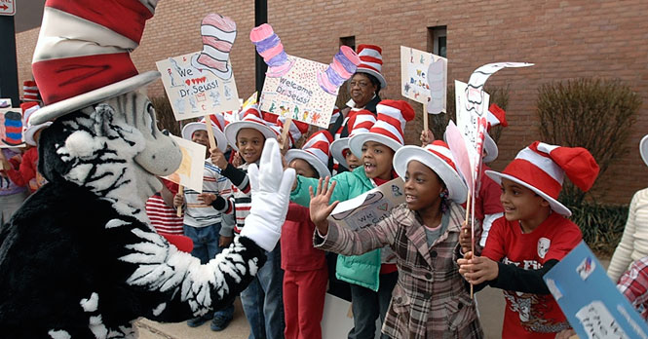
communications

Slide 4
Communications Goals
Promote public education
Increase awareness/understanding of issues impacting teaching and learning among DSEA leaders, members and staff
Develop and promote brand for DSEA focusing on “why”
Promote and to respond to member feedback (“ownership”)
Notes:
These goals were derived specifically for the communications focus area. The first two goals are similar to the communications goals in previous strategic plans. An expanded goal is that we are going to promote DSEA in a way that focuses on the “why” why do we care about excessive testing—why do we care about the socio economic base that our students come from—why do we continue to engage new members and encourage them to participate in union business. Another addition is the goal to promote and to respond to member feedback. This gives the membership ownership of the communications processes.

Slide 5
Communications Activities
DSEA.org
ACTION!
Read Across America
New Media opportunities-TV commercials, online town halls
Great Public Schools
Digital Engagement –Facebook, Twitter, Flickr, List Servs, Podcasts
Video infomercials on education topics
Faces of DSEA
Notes:
Here are some activities that were funded through the Communications budget request.

Slide 6


organizing

Slide 7
Organizing goals
1 on 1 relationship building conversations
Recruit & engage new hires and non-members
Identify & build relationships with community partners
Events for members to meet and greet each other
Identify & build relationships with labor partners
Notes:
The goals for organizing focus on the recruitment and engagement of members, identification and training of leaders and strengthening our connection with members, labor partners and the community.

Slide 8
Organizing Activities
Countywide meetings for local members to share and learn new and best practices
Training for local leaders for new hire orientations and 1 on 1 conversations
Mentoring program for new members
Expanded student membership engagement
Member Benefit events (new format) and trainings
Building visits with members
Develop community partners
Quarterly member mixers
More member events – Labor day Picnic after parade, Family events
1 on 1 conversations with new hires, non-members and members
Notes:
Here are some of the activities that were funded as a result of the program requests.

Slide 9
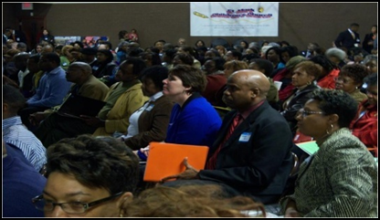
Leading the profession

Slide 10
Leading the profession Goals
Student centered, member led
Promote & support the professional growth of all members
Identify, train, and support leaders
Promote and protect rights of all members
Notes:
The goals of leading the profession focus on student based, educator led public education, promoting professional growth for all members, leadership development, and promoting and protecting the rights of all members.

Slide 11
Leading the Profession Activities
Increase the professional development opportunities for all member categories
Develop our own evaluation system
Focus on identifying and cultivating leaders representative of all categories of membership
Online professional development
Increase public awareness around ESP groups
Leadership Development Program
Develop seminar/round table series on different policy issues
Notes:
Here are some of the activities that were funded through the program requests.

Slide 12
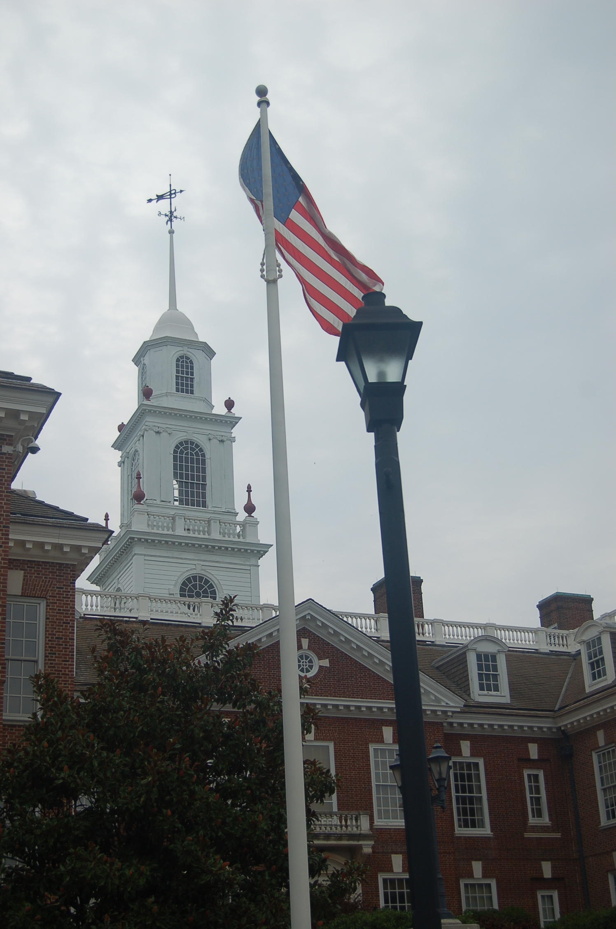
Political Engagement

Slide 13
Political Engagement goals
Increase member understanding & awareness of why we are involved in politics
Increase member interaction with elected & appointed officials (“relationships”)
Sustain & increase PAC contributions
Identify & support candidates who support public education regardless of party affiliation
Notes:
You may have heard the statement “If you are in education you are in politics” while very true not all of our members understand why we are involved in politics. Increasing that awareness will help us to meet the other goals of political engagement focus to increase member interaction with elected and appointed officials, sustain and increase PAC contributions, and identify and support candidates who support public education regardless of party affiliation.

Slide 14
Political Engagement
Ongoing education regarding how DSEA is involved in politics
Increase member awareness of what is happening in other places and could happen in Delaware
Have members visit legislators during session
Regular Town Halls – locally, countywide and statewide
Train members around modes of participation in process
Returns party after elections sponsored by DSEA
PAC Contests – locals, county, building
Legislators to visit rep meetings
Notes:
These are the activities funded through the political engagement budget request.

Slide 15
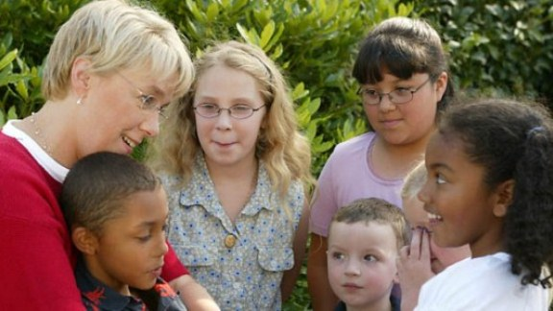
Social Justice

Slide 16
Social Justice Goals
Partnering with/or supporting efforts to promote equity of opportunity & fair treatment for all
Promoting cultural competency & diversity among our members
Protecting rights of educators & students to discuss & promote social justice efforts
Notes:
Social justice goals promote equity for all and respect for the cultural diversity of our membership and community base.

Slide 17
Social Justice Activities
Educate members on what social justice is through broad communication efforts
Monthly articles to members on social justice issues
Develop professional development training on cultural competencies
Build relationships with existing social justice organizations and develop an action plan on building level to address social justice
Create opportunities to participate in community based cultural events
Realign and legitimize the EMAC and HCR
Social Justice Day
Committee to organize groups for food banks, habitat for humanity, etc.
Notes:
Here are some of the activities funded through the program requests.

