Slide 2
Advancing LGBTQ+ Justice and Gender Advocacy
Salina Joiner, CA
Sara Fitouri, CO
Michelle Couture, NY
Barb Whitman, UT
Anthony Brisson, NEA

Slide 3
Land Acknowledgement
We begin by acknowledging that we meet on the traditional lands served by the Miccosukee, Seminole, and Mascogo Peoples. We honor America’s First Peoples and all elders—past, present, and emerging—, and we are called on to learn and share what we learn about the tribal history, culture and contributions that have been suppressed in telling the story of America.
Please visit this website https://native-land.ca/ to find your native land.
Please visit this mobile device application https://native-land.ca/mobile-app/ to find your native land.

Slide 4
NEA Standards of Conduct
NEA has adopted a Standards of Conduct policy to ensure that all of our gatherings are welcoming to all and free from discriminatory, harassing or otherwise unacceptable behavior. Discrimination or harassment based on race, color, ethnicity, religion, sex, age, national origin, sexual orientation, disability, gender identity or expression, or any other characteristic protected by law will not be tolerated. If you experience any discriminatory, harassing or otherwise unacceptable behavior please contact Christine Sampson-Clark (CClark@nea.org) to report the incident.
Thank you for your commitment to ensuring a positive event for all.

Slide 5
The Conference on Racial and Social Justice is presented by NEA’s Center for Racial and Social Justice. The purpose of the conference is to provide a unique space for educators, students, parents and families, organizers, community members and leaders to unite for the advancement of Justice in Education.

Slide 6
Engage with us and share your
CRSJ 2023 experience by using
#NEACRSJ2023
@NEAToday

Slide 7

Our Time Together
90 Minute Dash
  Starting the conversation outside the umbrella
  Issues
  Framework for Determining Actions
  A Little Law Talk
  Lessons Learned and Actions to Apply

Slide 8
Community Agreements
Awareness and Self-Knowledge
Listen for Understanding
Be Gracious
Stay Engaged
Be Open and Suspend Judgment
Say “I”- tell your truth
Seek Discomfort
Reach for Empathy
Expect non- Resolution and non-Closure

Slide 9
Why we are here!
LGBTQ youth are more than four times as likely to attempt suicide than their peers.
A majority of LGBTQ+ people say that they or an LGBTQ+ friend or family member have been threatened or non-sexually harassed (57 percent), been sexually harassed (51 percent), or experienced violence (51 percent) because of their sexuality or gender identity. [2]
NEA RA Support and Part of NEA Mission and Vision
[1] Human Rights Campaign Foundation. (2017, July). Mental health and the LGBTQ community. https://suicidepreventionlifeline.org/wp-content/uploads/2017/07/LGBTQ_MentalHealth_OnePager.pdf
[2] National Public Radio, the Robert Wood Johnson Foundation, & The Harvard T.H. Chan School of Public Health. (2017, November). Discrimination in America: Experiences and views of LGBTQ Americans. Retrieved June 24, 2020 from https://www.rwjf.org/en/library/research/2017/10/discrimination-in-america--experiences-and-views.html

Slide 10
The Words of Our Members
“Know that even if you do not personally know of any LGBTQ+ staff person in your district, they are there. Be an ally even if you do not know them. Speak up when you hear, see, or perceive bias and/or discrimination. Advocate for inclusive policies for both students and staff.”
10
Notes:
Throughout today’s training, we will be sharing the words of NEA members who are a part of the LGBTQ+ community. We shared an anonymous survey and think it’s important to hear the words of our colleagues—whether they are out or not—about their experiences as LGBTQ+ educators.

Slide 11
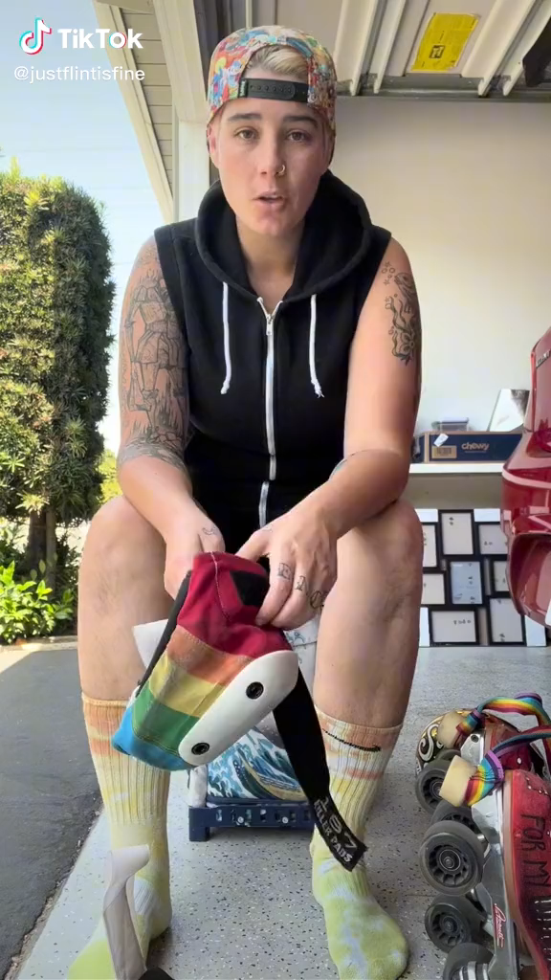

Slide 12
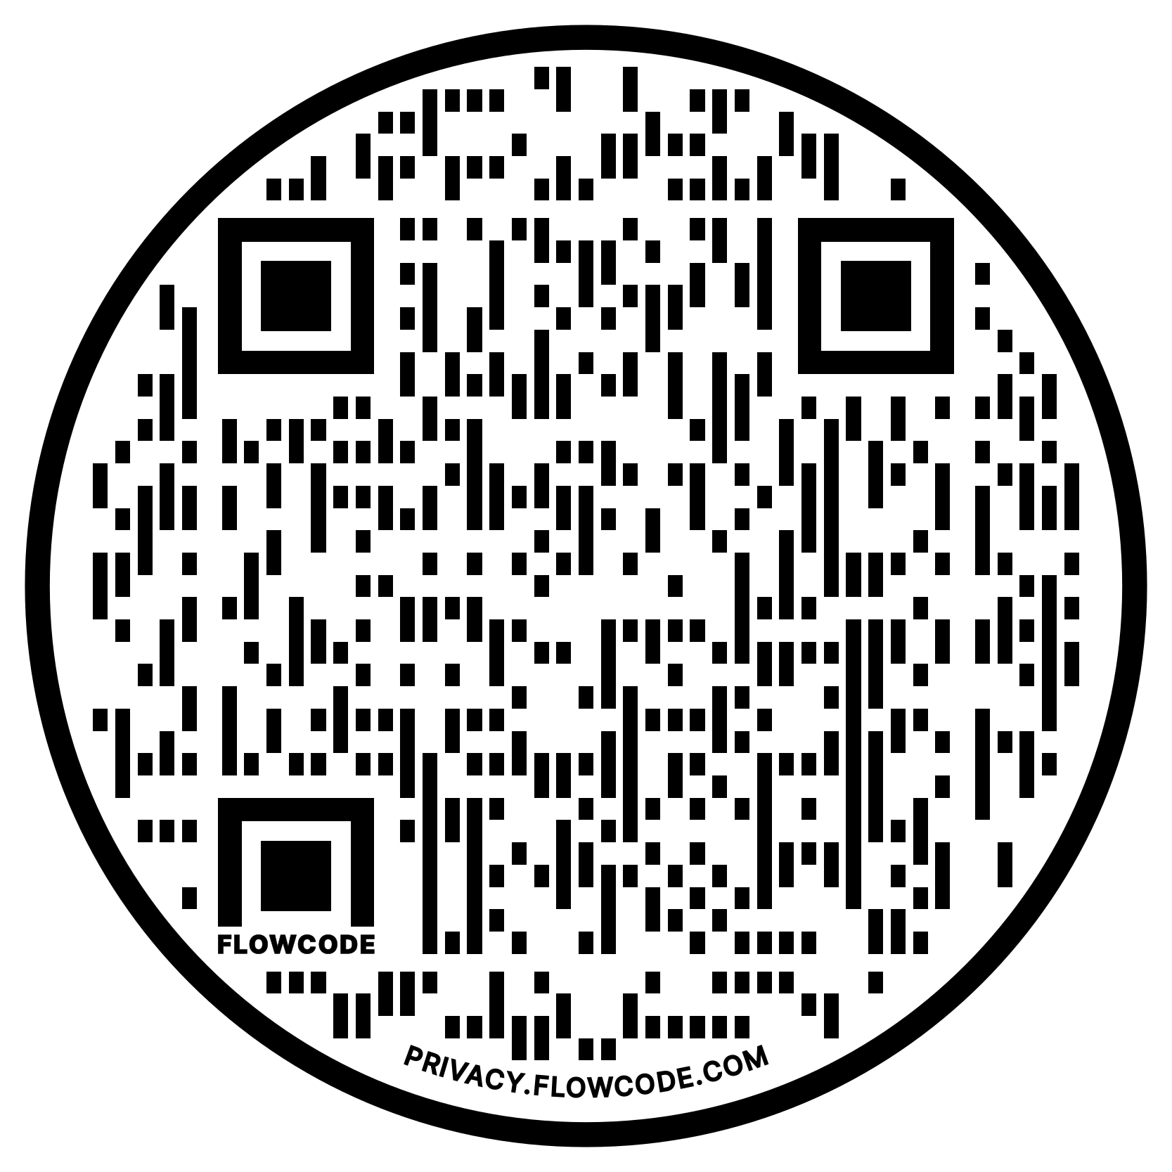
NEA Vision, Actions, Resources
Safe, Just, and Equitable Schools
Adopted by the 2022 NEA Representative Assembly
NBI 32
Training on Trans Gender Advocacy Issues for Affiliate Staff
NEA Online Toolkit – LGBTQ Resources

Slide 13
Facilitator

Slide 14

Building Beyond the Umbrella
How do you begin the work with your colleagues of seeking justice with those who don’t share the experiences, identities, and issues that you do?

Slide 15

Building Beyond the Umbrella
Solidarity
sol / i / dar / i / ty
Noun
  1. Unity or agreement of feeling or action especially among individuals with a common interest, mutual support; mutual support within a group.

Slide 16

The Gender Unicorn
16
Notes:
The Gender Unicorn is a popular way to help explain gender that was developed by Trans Student Educational Resources. You may be familiar with the “Genderbread Person,” but we choose not to use it. It was created by a Black trans woman, but someone else popularized it, and continues to get credit, pay and notoriety for it.
As you see, the Gender Unicorn highlights gender identity, expression, sex assigned at birth, and physical and emotional attraction.
Children learn that there are two groups—boys and girls—and that they fit into one or the other based on how their bodies are made. They are then socialized to accept specific gender norms and stereotypes, which are ways of behaving, based on this gender assigned at birth.
There’s increasing understanding that gender is more than a binary division. The spectrum of gender identity is becoming more widely accepted and gender expression is more expansive.
However, there are challenges to looking at gender beyond male and female. Across states, many laws and policies are being passed that affirm or harm individuals outside of the gender binary.

Slide 17
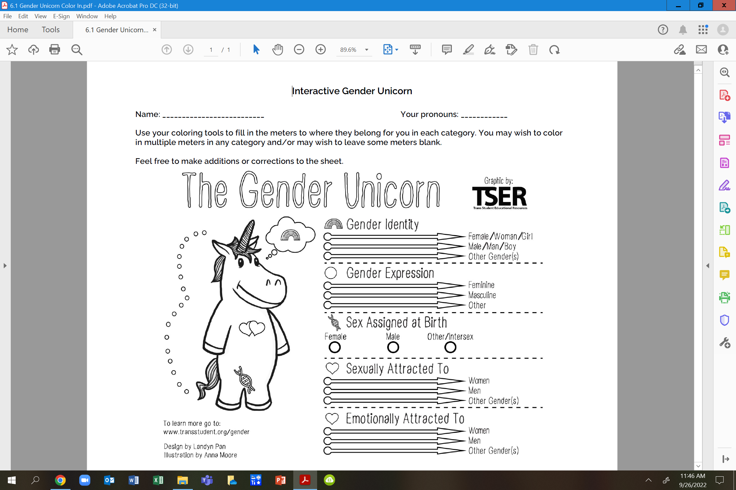
Using this page with others to build solidarity.

Slide 18
Questions to Ask
What is clearer to you?
Do you feel you can find yourself here?
Do you feel there is any nuance that may be missing?
How do our current union practices support the nuances we found?

Slide 19
Key Ideas
Our society and our unions reinforce the gender and sex binary – this is a construct.
People under the umbrella AND people not under the umbrella suffer from the binary construct.
Building shared understanding and shared values IS the best way to begin.

Slide 20
Faciliatator

Slide 21

What are all the issues that LGBTQ+ people face in their work and union lives?
Notes:
11:00-11:30

Slide 22
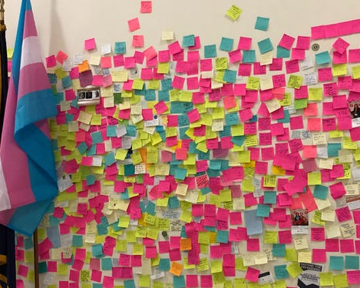
What are the issues?
At Your Tables –
Take a stack of post-it notes.
3 Minutes- On your own, brainstorm possible issues that LGBTQ+ members face in their work or union life. Write one issue per post-it
5 Minutes – On the wall poster, as a table, sort the issues into categories/themes.
5 Minutes – Share out

Slide 23

What are the issues?
What did you see that was common?
What was new to you?

Slide 24
PROBLEM vs. ISSUE
Campaigns start with issues that workers have value-based solidarity around.
An issue is a slice of a workplace problem.
Often a problem can have different issues depending on the perspective of the people we are working with.
It is KEY to get enough input on what the issues are that make up the problem so that YOU do not drive the solution.
Investigating the issue is necessary but not sufficient – we also need to identify workers’ SHARED values – WHY is this an issue? WHY do you want to fix this?

Slide 25

PROBLEM vs. ISSUE
Values that build a relatable “why”
Deserve safe and reliable transportation
Access to quality parts

Slide 26
EXAMPLE- Problem and Issue
PROBLEM -Our school is hostile to LGBTQ+ staff and students
◦ Issue – There are no gender inclusive bathrooms and/or transgender students are forced to use the wrong restroom
Values – Equity, Safety, Personal Choice, Student Choice
◦ Issue – Our healthcare and leave benefits do not cover non-“traditional” family structures or are not fully accessible to people with same-gender partners.
Values – Equitable Access, Fair Pay, Family
◦ Issue – Our administration forces us to “out” trans and queer students to their families.
Values- Professional Judgement, Safety, Student Choice

Slide 27

Issues Lead to Collective Action
• It is widely felt
• It is deeply felt
• It is winnable
• It builds the union and builds leaders
• It has a connection to students and the public
Notes:
Slide Time Allotment: 10 minutes
Share out issues from around the room.

Slide 28
Key Ideas
Problems are disabling.
Issues build solidarity.
We don’t choose the issues, the people who want the change choose the issue AND work to build a bigger base.

Slide 29
Facilitator

Slide 30

Using Intersectionality to Build Solidarity
Intersectionality is a framework for understanding a person, group of people, or social problem as affected by a number of discriminations and disadvantages. It takes into account people's overlapping identities and experiences in order to understand the complexity of prejudices they face.​

Slide 31
Levels of Expression of Oppression
I n d i v i d u a l | Internalized Oppression lies within individuals. These are our private beliefs and biases about others, influenced by our culture, that reside inside our minds. | S y s t e m i c | Institutional Oppression occurs within institutions and systems of power. It is the norms, policies and practices that are structured into political, societal and economic institutions that have the net effect of imposing oppressive conditions and denying rights, opportunity, and equality to identifiable groups.
 | Interpersonal Oppression occurs between individuals. Once we bring our private beliefs into our interactions with others, we are now in the interpersonal realm. |  | Structural Oppression is bias across institutions and society. It’s the cumulative and compounded effects of an array of factors that systematically privilege some and disadvantage others.
Notes:
10:45-11:30 Ben

Slide 32
Key Points
1. There are no hard and fast lines between the levels – and changing one can affect another. ​
​While we believe that the individual is ​responsible for exploring personal bias
​2. The way to effect change is by addressing institutionalized and structural oppression – this is where injustice lives.

Slide 33
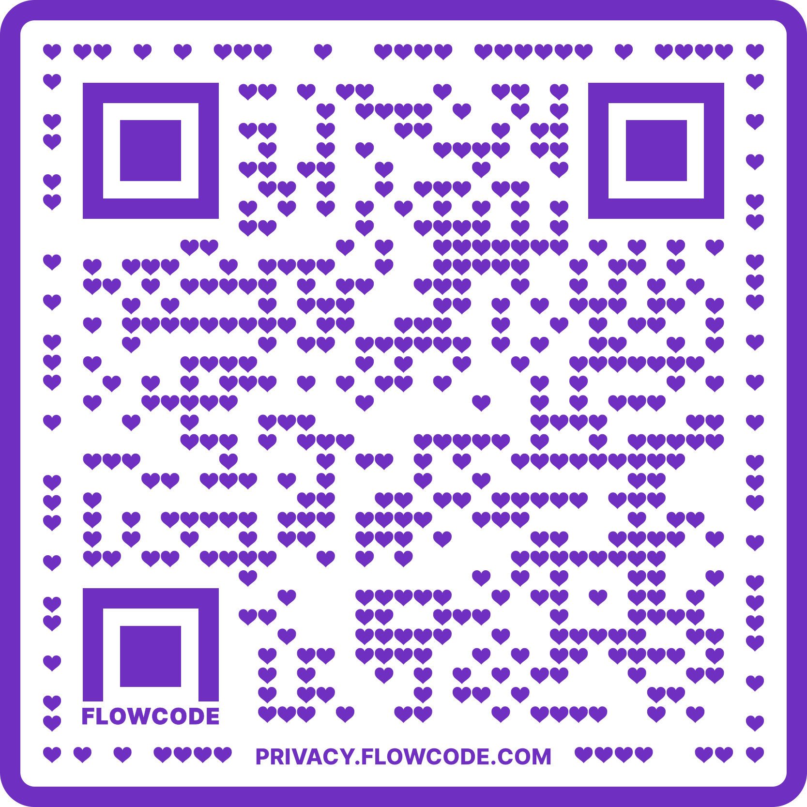
Materials
LGBTQ+ Justice and Trans Advocacy materials
PPTS
Trainer Agendas
Handout Files

Slide 34
Levels of Expressions of Oppression
Drawing on your knowledge base and experiences: ​
Independently analyze the scenarios and determine the expression of oppression. ​
Discuss at your tables and reach consensus about the expression of oppression in each scenario.​
TOTAL Report Out – 3 Minutes be prepared to report a 2 Sentence Summary of your scenario and the Consensus Decision about what level of oppression is being expressing and why.
Notes:
Count off by 8
Three Minute Report Outs ​
Summary​
What Level​
Why​
Then for all groups…​
What did you struggle with? ​
What was Clear to You?

Slide 35
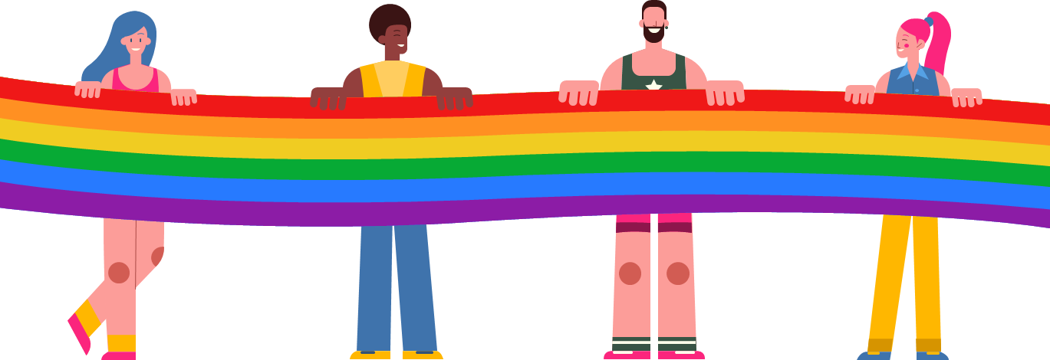
What did you struggle with?
What was clear to you?

Slide 36
Key Ideas
There are not hard and fast lines between the levels – and changing one can affect another.
This framework helps us think about the size of the solution we need to fight the injustice at a particular level.

Slide 37
Facilitator

Slide 38
8.1 Million
WHAT’S THE SIGNIFICANCE?
38
Notes:
In 2019, there were 157 million employees in the US. What do you think this number represents?
According to Catalyst.org, there are an estimated 8.1 million LGBTQ+ employees in the United States who are age 16 or older. 50% of these employees are not out at work because of fears of discrimination or ostracization. And 1 in 5 LGBTQ+ employees have experienced discrimination.
Reference: https://www.catalyst.org/research/lesbian-gay-bisexual-and-transgender-workplace-issues/

Slide 39
TRUE OR FALSE
In my state, an employee can be fired for being transgender.

Slide 40
TRUE OR FALSE
In my state, an employee can be fired for being a lesbian.

Slide 41
FALSE!
There are federal laws that protect LGBTQ+ workers from workplace discrimination in ALL states (yes, even yours).

Slide 42

A LANDMARK RULING
Bostock v. Clayton County
Prior to June 15, 2020
It was legal to fire an employee for being gay, bisexual or transgender, in more than half of the 50 states.
June 15, 2020
The Supreme Court rules it is illegal to discriminate against
or fire an employee based on their sexual orientation or gender identity.
42
Notes:
The Civil Rights Act of 1964 prohibits discrimination based on race, color, religion, sex, or national origin. The courts and the federal government have long refused to recognize LGBTQ+ discrimination as a form of sex discrimination. Over the past 20 years, however, federal courts and the government have at times recognized LGBTQ+ discrimination as sex discrimination.
It was not until June 15, 2020 that the Supreme Court finally recognized that LGBTQ+ employment discrimination is prohibited sex discrimination under Title VII of the Civil Rights Act of 1964.
This ruling recognized that it is illegal to discriminate against or fire an employee based on their sexual orientation or gender identity. Now lower federal courts and the Biden Administration are applying that ruling to education, health care, housing, credit discrimination, and more.

Slide 43
BOSTOCK V. CLAYTON COUNTY
Employment Discrimination is Illegal
Title VII of the 1964 Civil Rights Act prohibits employment discrimination based on race, color, religion, sex and national origin. Bostock interprets “sex” to include gender identity and sexual orientation.
43
Notes:
The Bostock ruling specifically states that employment discrimination on the basis of gender identity and sexual orientation is illegal.
Title VII of the Civil Rights Act covers the full spectrum of employment decisions, including recruitment, selections, terminations, and other actions concerning terms and conditions of employment. This is significant for the LGBTQ+ community because, as we saw, in many states it was legal to be denied an interview or a promotion, and even to be fired because of one’s gender identity or sexual orientation.

Slide 44
Title IX
Discrimination in Educational
Programs is Illegal
Title IX of the Education Amendments Act of 1972 states: "No person in the United States shall, on the basis of sex, be excluded from participation in, be denied the benefits of, or be subjected to discrimination under any education program or activity receiving Federal financial assistance."
44
Notes:
On March 26, 2021, the Department of Justice concluded that, as a result of the Bostock ruling, Title IX of the Education Amendments Act of 1972 also prohibits sexual-orientation and gender-identity discrimination in educational institutions that receive federal funding. This means all public schools. This means that students cannot be discriminated against in schools based on their LGBTQ+ identity.
There have been some significant wins recently for LGBTQ+ rights in the US But while progress is being made, attacks on LGBTQ+ rights in certain states have accelerated.
Reference: Department of Justice, “Application of Bostock v. Clayton County to Title IX of the Education Amendments of 1972,” March 26, 2021, https://www.justice.gov/crt/page/file/1383026/download

Slide 45
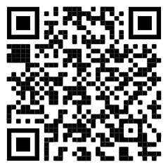
Review Laws in Your State
1. Go to www.lgbtmap.org and Click Equality Maps or use the QR Code.
2. Select “Choose a State” in the drop down menu.
3. Select a state and review the data.
How might this data impact members who are transitioning or transgender in your selected state?
Notes:
Look at Your State’s Equality Profile.
How might this impact members who are transitioning or transgender?
Instructions:
Go to www.lgbtqmap.org
Click Equality Maps
Select “Choose a State” in the drop down menu.
Select a state and review the data. How might this data impact members who are transitioning or transgender in your selected state?

Slide 46
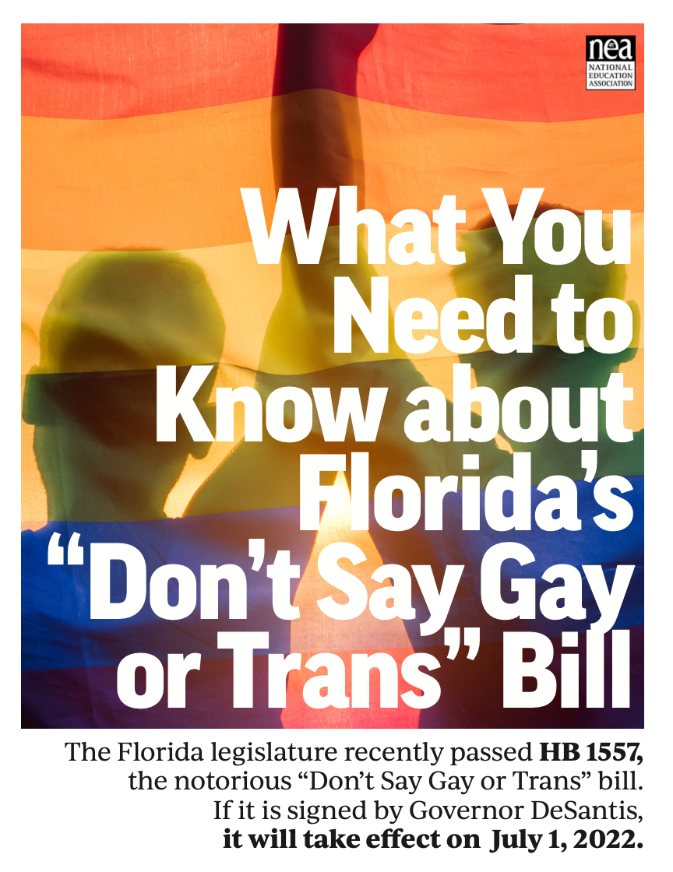



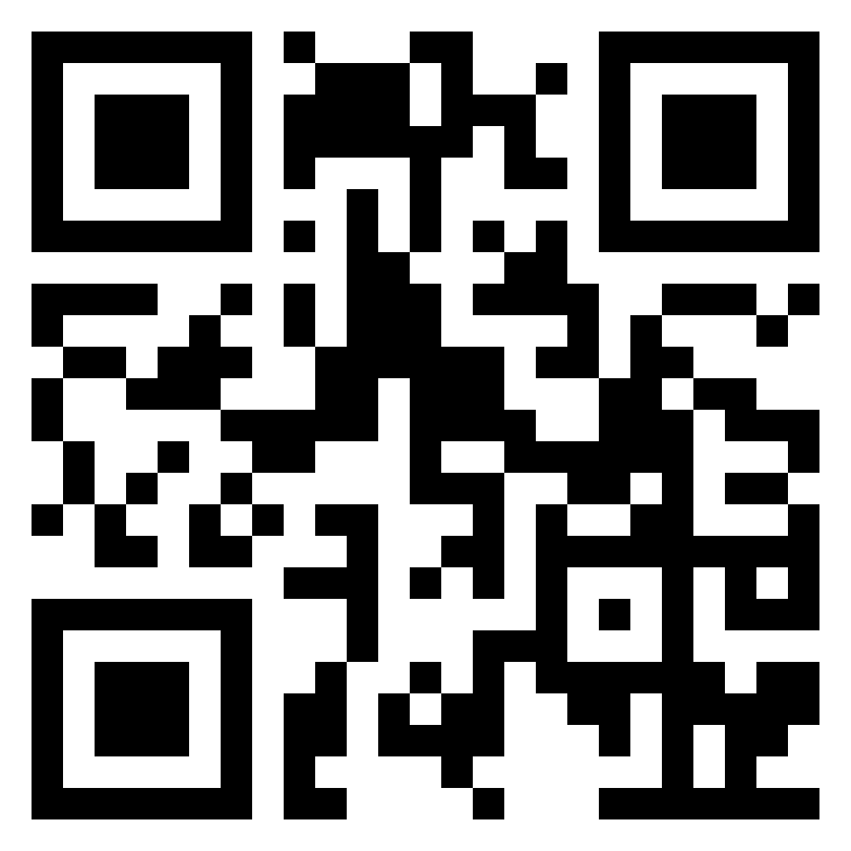

Legislative Trackers
Notes:
The NEA has several resources and recommendations for legislative trackers. (See handout for full list and website links.)
https://www.icnl.org/usprotestlawtracker/
https://www.aclu.org/legislation-affecting-lgbtq-rights-across-country

Slide 47
Key Ideas
At least for now, ALL LGBTQ+ workers are protected under Bostock - BUT Bostock is limited to Employment.
Title IX has applications to the protection of LGBTQ+ workers in publically funded educational programs.

Slide 48
Facilitator

Slide 49
SCENARIO: Supporting a Trans Educator
You are a Leader in a medium-sized conservative school district. A member reaches out to you and asks for your help. They explain to you that they are a returning employee who is transgender and began transitioning over the summer break. They are nervous about coming back in the fall and are asking for your help in navigating their return.
•What additional information would you need? How would you go about finding that information? What resources would you use or seek out?
•What would be your first steps?
•Knowing what we know now about transitioning and gender, what would you avoid doing?
15 minutes to answer the questions at your table.
One person from each group will report out on the questions.
49

Slide 50
DEBRIEF
What additional information would you need? How would you go about finding that information? What resources would you use or seek out?
What would be your first steps?
Knowing what we know now about transitioning and gender, what would you avoid doing?

Slide 51
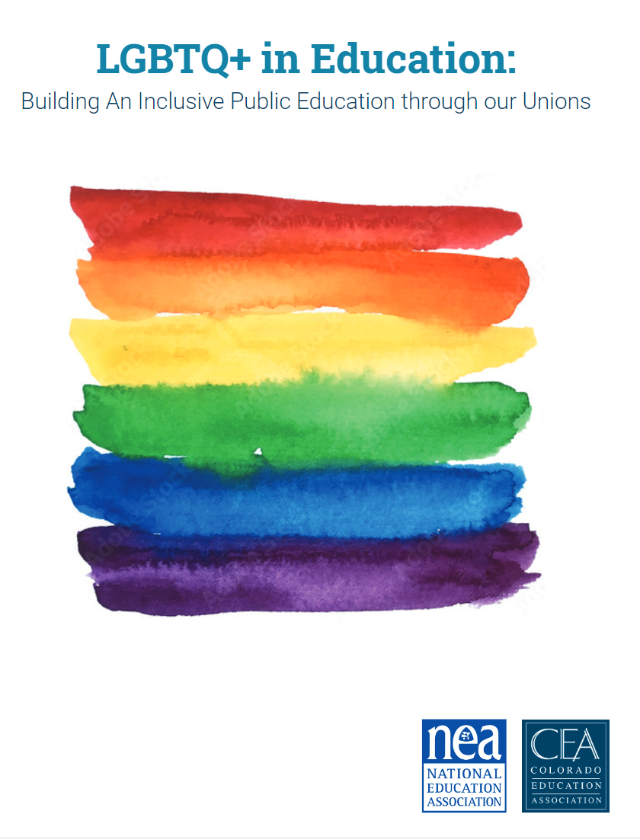
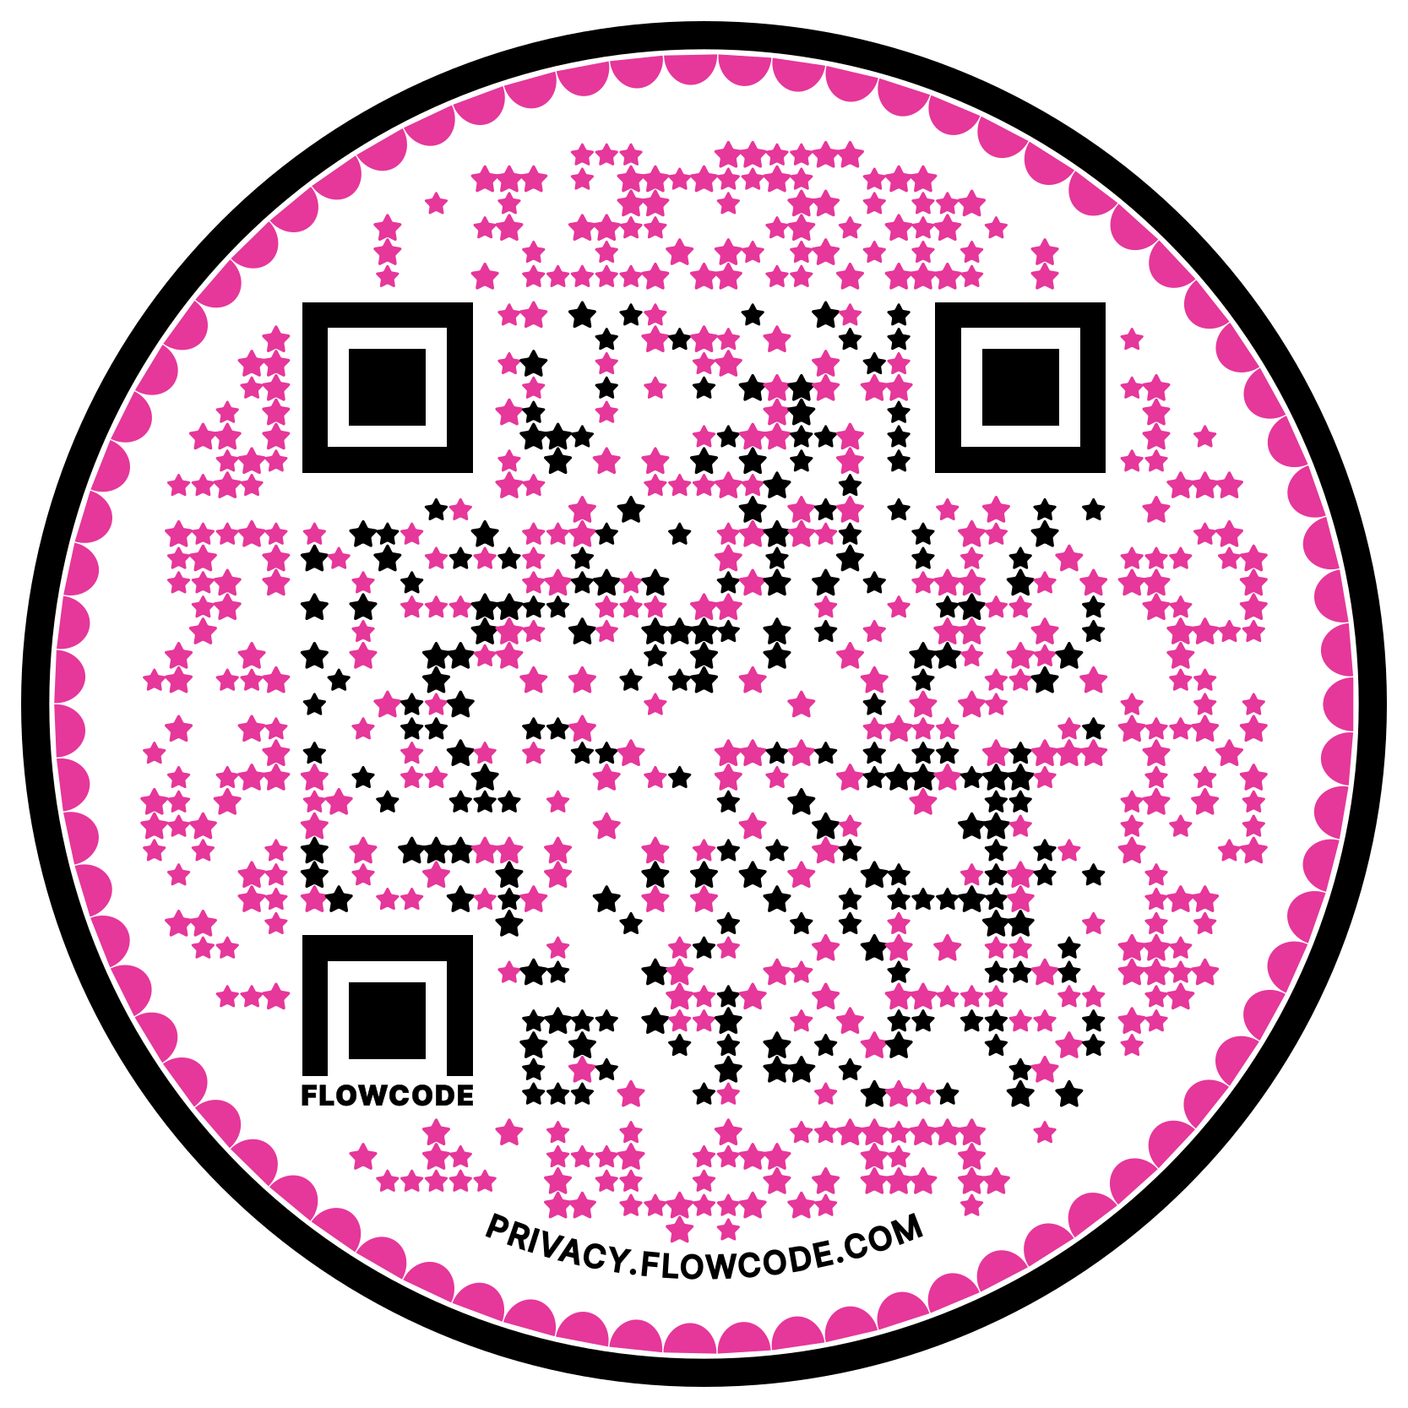
CEA Report and Wins

Slide 52

Ending It Right
What did you learn about today that:
You’re going to immediately tell your union bestie?
You’re going to use in the near future as part of your union work?
You’re going to work to learn more about?

Slide 53
Thank you for joining our meeting!
This summer, continue to:
expand your knowledge of social justice;
engage in conversations about racial justice;
build connections with a community of activists
#NEACRSJ2023
@NEAToday

Slide 54

Please complete the evaluation for this session by using the Conference app.

