Slide 1
Advancing LGBTQ+ Justice

Slide 2

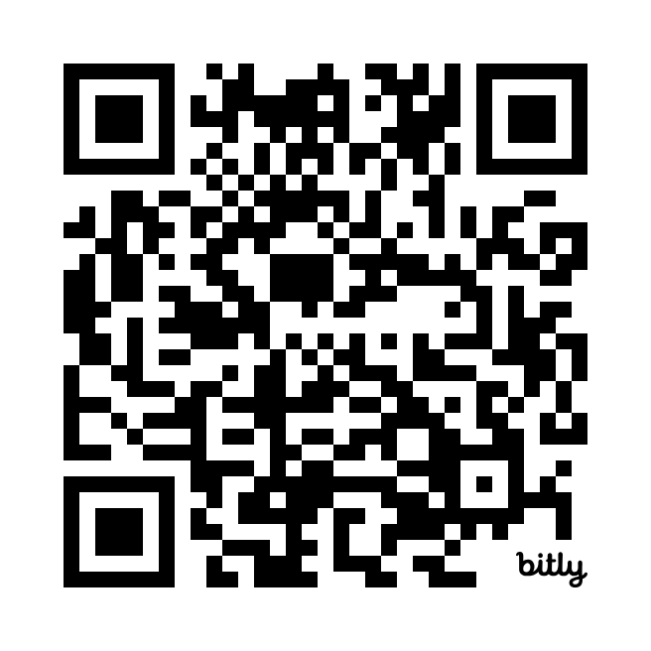
Morning Entry
This morning, continue thinking about our earlier conversation about intersectionality.
Check out the Human Rights Campaigns report “Black and African American LGBTQ+ Youth Report 2024” for more information about the challenges experienced by youth navigating multiple identities.
www.hrc.org/resources/lgbtq-youth-report#blackyouthreport

Slide 3

Ellen

Slide 4

NEA Standards of Conduct
NEA has adopted a Standard of Conduct Policy to ensure that all of our gatherings are welcoming to and free from discriminatory, harassing, or otherwise unacceptable behavior. Discrimination or harassment based on race, color, ethnicity, religion, sex, age, national origin, sexual orientation, disability, gender identity, or expression, or any other characteristic protected by law will not be tolerated. If you experience any discriminatory or harassing behavior, please report the incident to NEA EC Members: Gladys Marquez (gmarquez@nea.org) and Ronald "Duff" Martin (rmartin@nea.org). Thank you for your commitment to ensuring a positive event for all.

Slide 5
NEA Standards of Conduct
NEA has adopted a Standard of Conduct Policy to ensure that all of our gatherings are welcoming to and free from discriminatory, harassing, or otherwise unacceptable behavior. Discrimination or harassment based on race, color, ethnicity, religion, sex, age, national origin, sexual orientation, disability, gender identity, or expression, or any other characteristic protected by law will not be tolerated. If you have experience any discriminatory or harassing behavior, please report the incident. Thank you for your commitment to ensuring a positive event for all.

Slide 6
NEA MEMBERS AND SUPPORTERS
By attending this training, you confirm that you are a NEA affiliate staff member. The information you receive here is only for your use in your capacity as an NEA affiliate staff member.
This presentation and its contents are confidential and may not be further distributed or passed on to any other person or published or reproduced, in whole or in part, by any medium or in any form, for any purpose. Audio/video recording, copying of slides, and the use of AI note-taking tools are prohibited without the written consent from Ellen Holmes. Violation of these terms may result in legal action.

Slide 7
Feedback
22% Response Rate with a range of 4.5 to 5.0
Low for second half of day and high for the morning and transition plans.
Your Words -
I am grateful that material is presented and we are then allowed to digest with discussion or an activity. If I could add another layer that would also be helpful, it would be interpretive dance. I know that myself and my comrades would find it not only enlightening but delightful if the content could be also delivered with interpretive dance. Thank you for your consideration!
I genuinely found the work we did today to be incredibly informative and it was filled with things that can be taken back and directly applied in my local.

Slide 8

COMMUNITY AGREEMENTS
Awareness and Self-Knowledge
Listen for Understanding
Be Gracious
Stay Engaged
Be Open and Suspend Judgment
Say “I”- tell your truth
Seek Discomfort
Reach for Empathy
Expect non- Resolution and non-Closure

Slide 9

TODAY’S AGENDA
8:30 – 8:40 Morning Routine
8:40- 10:40 -- Content
10:40-11:00 - Break
11:00-11:40pm – Group Work Time
11:40 -12:40 -- Presentation
12:40-1:00 – Goodbyes
1:00 -- Lunch - grab and go

Slide 10
Sara

Slide 11
STEP 2:
Demand

Slide 12
Demand:
A demand is the outcome that addresses the issue that you are making of a target.
Measurable
Achievable
“We demand gender affirming bathrooms in every school because all students need to feel safe and included in our schools. ”
Notes:
Page 5 in POPS

Slide 13
STEP 3:
Target

Slide 14
Target:
Is the person with the power to give you what you are demanding.
A single person:
a name, face, & address
“ Hey Superintendent Sam - We demand gender affirming bathrooms in every school because all our students need to feel safe and included in our schools ”
Notes:
Page 5 in POPS

Slide 15
SCENARIO WORK!
In your group, decide the following:
Issue
Revisit to make sure it's the one you want
Demand
What do you want to win (and why)
to solve your issue?
Target
Who has the power to give you your demand?
(feel free to make up names and titles if your scenario doesn’t have one!)

Slide 16
Writing Your Own RCGN Messaging
Now that you have identified the issue impacting LGBTQ+ educators and students, create your vision statement.
Values: Lead with shared values that name race & class & gender
Villian: Name racial and gender identity scapegoating as a weapon that harms us all.
Vision: Emphasize unity and collective action to solve the problems

Slide 17
STEP 4:
Tactics

Slide 18
Tactics
Tactic: Actions you to take as a part of an escalation plan that increases pressure on your target to try to win your demand.

Slide 19

A Tactic Should
Put pressure on your Target
(puts them out of their comfort zone)
Build your Power
(develops leaders, brings more people in, etc.)
Be Strategic

Slide 20
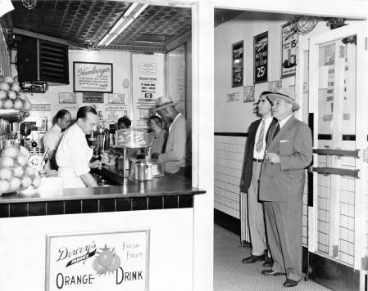
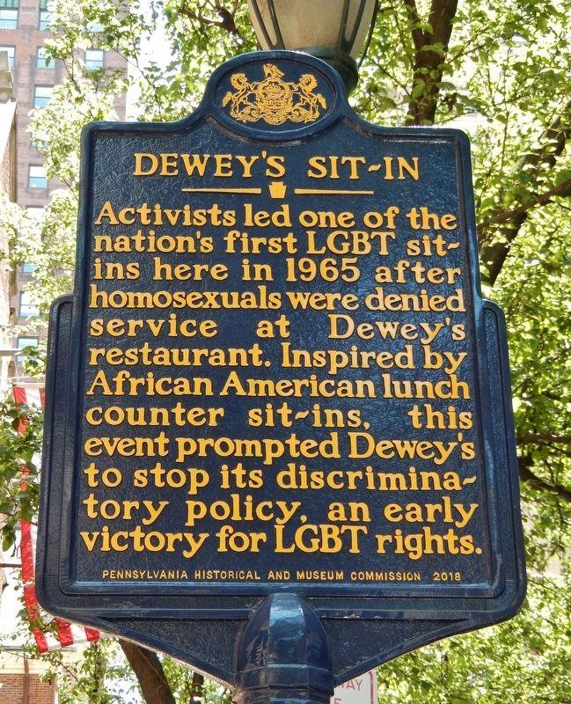
Historic LGBTQ+ Tactics

Slide 21
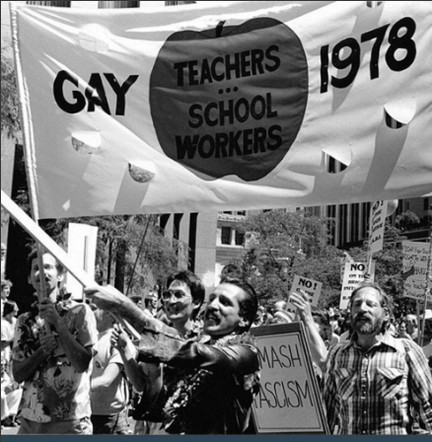
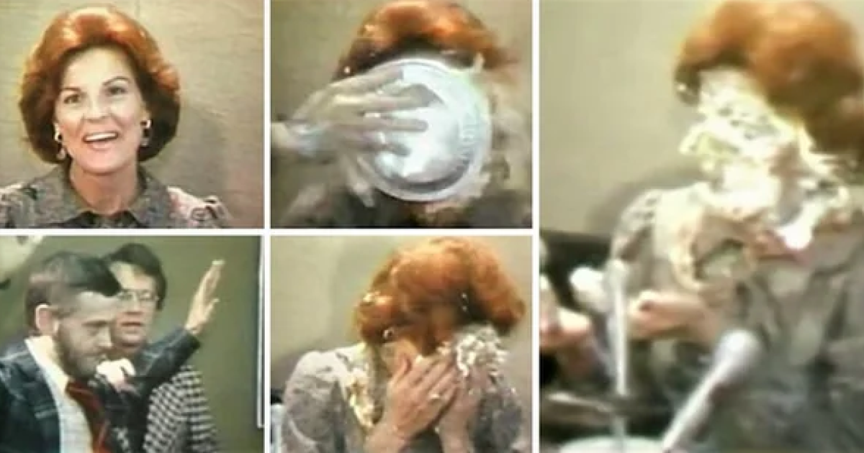
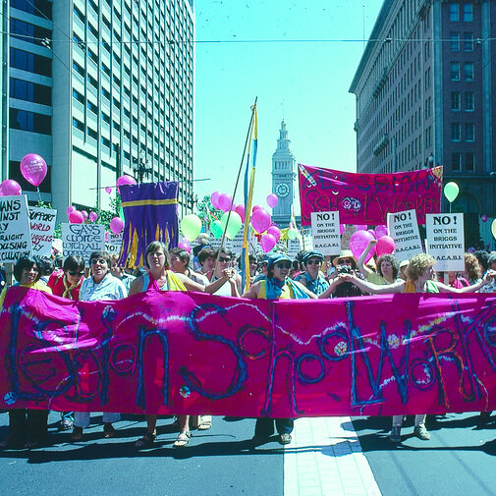
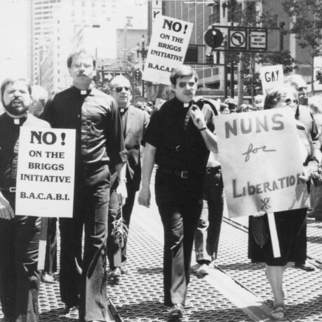
Historic LGBTQ+ Tactics

Slide 22
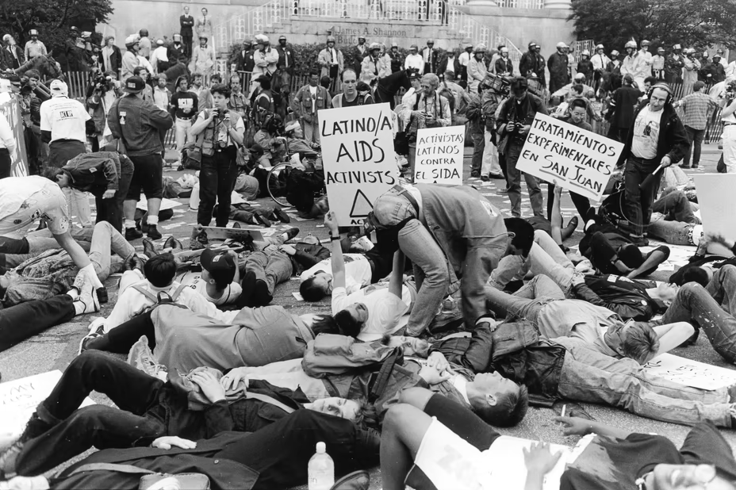

Historic LGBTQ+ Tactics
ACT UP!

Slide 23
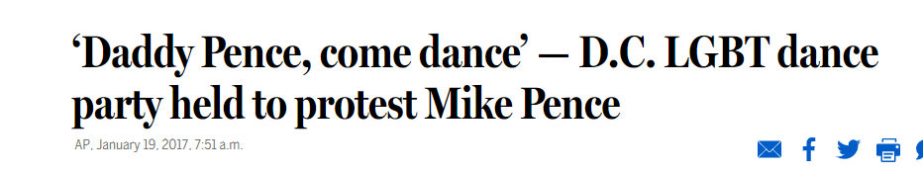
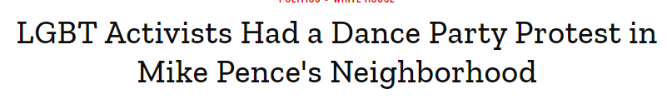
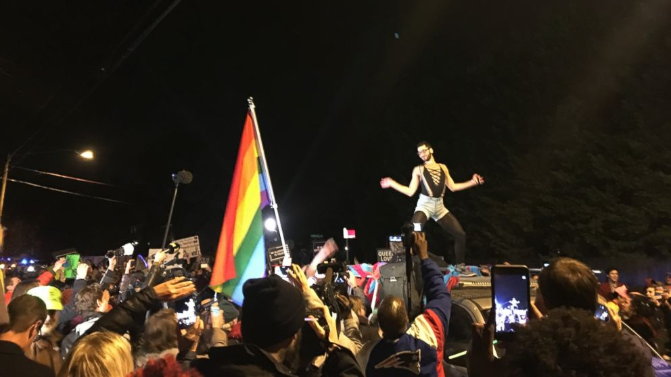
Historic LGBTQ+ Tactics

Slide 24
SCENARIO WORK!
TIME: 5 Minutes
TACTICS BRAINSTORM!
+++YOU HAVE 5 MINUTES!+++
Brainstorm AS MANY tactics as you can on 1 chart.
•Be creative!
•You are NOT evaluating right now!
Everything goes on the board!

Slide 25
Evaluating Tactics
Does the action relate to your issue?
Will it increase the pressure on the decision-maker?
Is it visible?
Is it timed for effect?
Is it new and different—or tried and true?
Are enough people ready to do it?​
Will it unify people?​
How will management react?​
Does it violate the law? (If so, are we prepared for the consequences?)​
Will it be fun?
Notes:
Page 6 in POPS

Slide 26
STEP 5:
Compression Points and
Escalation

Slide 27
Compression Points
Points on the calendar where you celebrate short term wins or escalate your tactics.
◦Naturally occurring deadlines - Breaks, Board Meetings
◦Artificial deadlines - Target has till day X to act
◦Help us build urgency and crisis

Slide 28

Why do you think tactics escalate gradually?

Slide 29
Less escalated actions prepare our people for more escalated actions
Give the target the chance to do the right thing before things escalate
Use the threat of escalation

Slide 30
Bekah & Beth

Slide 31
Definition of power
  Application or power to each element of an organizing campaign
Notes:
Introduce work for third day:
Power analysis
Coalition building

Slide 32

POWER
This module was modified from Jobs with Justice’s Organizing Training.
Notes:
From Foundations – day 1 (MN 2024- 2pm)

Slide 33
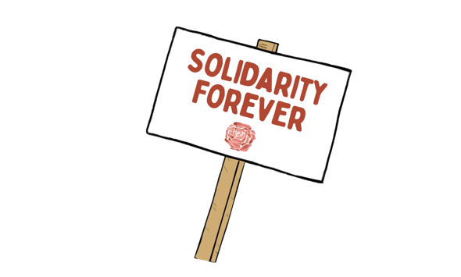
BRAINSTORM
Who are people in our society that we see as powerful?
Notes:
Count off by 8
Three Minute Report Outs ​
Summary​
What Level​
Why​
Then for all groups…​
What did you struggle with? ​
What was Clear to You?

Slide 34

What makes these people powerful?

Slide 35
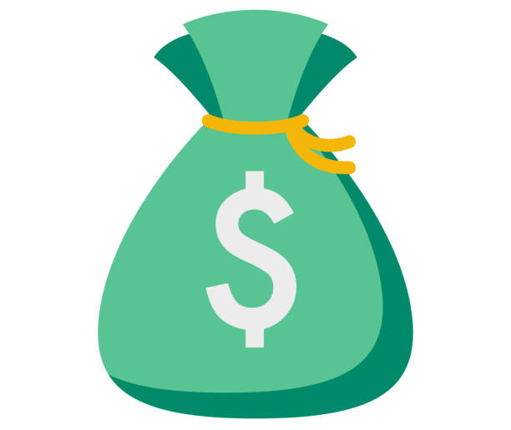

POWER
The ability to create, control, and prevent change.
ORGANIZED PEOPLE + ORGANIZED MONEY

Slide 36
Values Triangle
Consider questions on pg. 15 of Campaign Planning Document in Participant Handouts
Self-Interest
Power
alues
Relationships
Notes:
Zac J
First, we need to understand our own power. There is a helpful tool for power analysis that we call the Values Triangle. The triangle works from the bottom up and the inside out. At the bottom of the triangle, we have relationships. Everything starts with relationships because everything we do happens in, through, with and because of who we know and how we trust them. Inside the triangle is where we have values. Do you remember how we defined values this morning? Values are deeply-held beliefs that shape who you are. We are our best possible selves when we have clarity on our values. The world we want to see and how we define ourselves are based on our values. A person who is clear on their values knows who they are and what they believe in.
On the left of the triangle, we have self-interest. Self-interest is what our values look like in the world, the tangible manifestation of our values. When you understand your values you can discover your self-interest. Your self-interest is what you’re willing to fight for. For example, if one of your values is people over profits, one of your self-interests could include stronger unions, living wage policies, hazard pay for essential workers, and more. On the right side of the triangle is Power. Who remembers our definition of Power? Power is the ability to create, control, and prevent change. Power is made up of organized people and organized resources. Bringing it all together, we build relationships, so that we can agitate people to live up to their values and get clear on their self-interest so that we can build the power we need to make the world reflect our values. Understanding this triangle is key to your work and to making change. Every person and organization has one of these.

Slide 37
Values Triangle
Worker Voice
Collective Bargaining
Self-Interest
Power
Democracy
People over profit
Member organizing
Living Wages
Democracy
Dues
Strong Public Schools
alues
Relationships
Members
CWA
IAF
Ed Advocacy Org
America Votes
Housing Org
Endorsed elected Official
Notes:
Zac J
One helpful tool for completing a power analysis of our own context is called the Values Triangle. The triangle works from the bottom up and the inside out. At the bottom of the triangle, we have relationships. Everything starts with relationships because everything we do happens in, through, with and because of who we know and how we trust them. Inside the triangle is where we have values. Do you remember how we defined values this morning? Values are deeply-held beliefs that shape who you are. We are our best possible selves when we have clarity on our values. The world we want to see and how we define ourselves are based on our values. A person who is clear on their values knows who they are and what they believe in.
On the left of the triangle, we have self-interest. Self-interest is what our values look like in the world, the tangible manifestation of our values. When you understand your values you can discover your self-interest. Your self-interest is what you’re willing to fight for. For example, if one of your values is people over profits, one of your self-interests could include stronger unions, living wage policies, hazard pay for essential workers, and more. On the right side of the triangle is Power. Who remembers our definition of Power? Power is the ability to create, control, and prevent change. Power is made up of organized people and organized resources. Bringing it all together, we build relationships, so that we can agitate people to live up to their values and get clear on their self-interest so that we can build the power we need to make the world reflect our values. Understanding this triangle is key to your work and to making change. Every person and organization has one of these.

Slide 38
Sara and Salina

Slide 39
WHO ARE OUR PEOPLE?
Notes:
We discussed that power is organized people. So who are the people that amalgamate to form our power?

Slide 40
BASE:
This is "our" people
People who share our values and are included in our triangle.
In a union, our base is our membership.
.
We are responsible to, responsive to, and guided by our base.

Slide 41
ALLIES:
People who share our specific demand or self-interest but possibly not our values and cannot be part of
our base.
We are transparent and honest with our allies. We do not get our direction from our allies.

Slide 42
Turn and Talk!
Why do you think we differentiate between Base and Allies?
How is our relationship different with our base vs with our allies?

Slide 43
GENERAL RULE-
We TASK our ALLIES based on an overlap of shared interest
(Ex. Working on an event together, splitting up resource creation)
We BUILD our BASE.
(Ex. Craft our plans, Develop our leaders, build our membership, train our activists)

Slide 44
"NOTHING ABOUT US, WITHOUT US...._____________

Slide 45
"NOTHING ABOUT US, WITHOUT US, IS FOR US."
So, then who are the stakeholders who should be in the room?

Slide 46
COALITIONS:
A coalition is a temporary or long-term partnership we create with a group of our allies who unite to pursue a common goal.
Coalitions allow us to unite power to win things we don't have the power to win on our own.

Slide 47
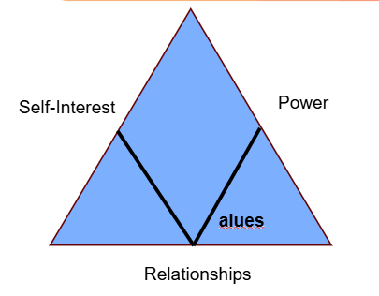
COALITIONS:
We can think of coalitions as a bunch of values triangles coming together!

Slide 48
Turn and Talk!
Why would we build coalitions? What are the advantages? What are the hurtles?

Slide 49
Advantages of Coalitions
• Increases resources
• Results in more creative ideas
• Allows more risk taking
• Spreads out the workload
• Raises community awareness

Slide 50
Hurdles of Coalitions
• Coordination requires time and skill
• Results can be slow
• Group decision making can be cumbersome and time consuming
• Motivation and enthusiasm may be difficult to maintain

Slide 51
COALITION BEST PRACTICES:
Coalition Purpose/Goals + Principles
  Does the coalition have a clear statement of purpose and a list of key principles that guide your work together?
  Do you have the right groups at the table? Are the people most impacted by your issue represented in the coalition? (ex: are youth-led groups invited in a campaign based in the schools? )
  Is the self-interest of each coalition partner known?
  Do you have a shared vision of what your success would like? If not, how will you go about creating these?
  How will you go about making sure everyone is on board with your principles?
Clear Expectations
  Does the coalition have clear expectations for coalition members?
  How were the expectations developed?
  Are expectations or agreements periodically revisited?
  Are there roles and expectations for supporters and endorsers?
  Is there clarity about the role and expectations of the staff who coordinates the coalition?

Slide 52
Coalition Structure + Decision Making ​
  What is the coalition’s process for decision-making?​
  Whose voice(s) are included? Whose voices are centered?​
  Is there a leadership body? Committees?​
Meetings​
  Is there a clear meeting schedule and structure? Examples include​
Group agreements ​
Regular orientations ​
Progressive stack ​
Ice breakers and music ​
Diversity and rotation of facilitators ​
Lots of different ways for folks to engage: small groups, pairs, working groups. ​
Make sure meetings are not report backs/updates/debates but working meetings. ​
Importance of documentation:
  Note taking, shared documentsclear access to campaign materials and decision-making processes and decisions ​

Slide 53
Strong Campaigns
  Does the coalition have a shared theory of change?
  Does the coalition utilize a common tool for planning its strategic campaigns? (ex: Midwest Academy Strategy Chart)
  Do you develop a living campaign plan with clear benchmarks and roles/responsibilities?
  Does the coalition engage in regular direct actions that not only move targets but build, expand and help develop the skills ofyour members?
  Is there clarity and discipline around a shared message for the campaign?
Effective Coordination
  Relationship Building
    What are things you do to build trust and solidarity?
    How often will you have 1 on 1s to better understand your coalition partners’ self-interest?
    How are you creating opportunities for members to build relationships with each other?
    How are you building in celebration: celebrating wins, creating space for folks to have fun, etc.
Internal communication
  What does communication look like and who manages it?
  Who is talking with member groups in between meetings?
  Who is tracking attendance, checking in on folks who haven’t come in a while, doing 1-1s with folks who are new, who areregularly coming and could take more leadership?
  How are you bringing in new members?
  Do you regularly have 1-1’s,orientations or materials/guides that orient folks to the work?

Slide 54
Leadership Development:
  How are you developing the leadership and capacity of coalition member organizations (and their membership)?
  Do you organize in-house training?
  Do you send folks to training?
  How are you rotating roles in the coalition and tracking it?
  Are members taking collective ownership of the coalition and its success? How can you help foster this?
  How will you build-in political education?
Accountability
  Is there a process/format for holding member organizations accountable to the shared expectations?
  Is there a process/format for holding the coalition “staff” to their expectations?
  Is there a process for navigating conflict within the coalition?
  How can everyone contribute? Are there ways for groups to contribute at different levels of engagement?
  What accessibility needs exist and how can you meet them?
  Does the coalition build in time for reflection and evaluation after actions and events and on a regular timeline?

Slide 55
Natasha and Rachel

Slide 56
Group Work
TIME: 30 minutes
Build your campaign!
You have 30 minutes to build your campaign and be ready to present out! Make sure that you include at least…
Issue
Demand
Target
Potential Coalition Partners
Tactics + Compression points in a campaign mountain!
Refine your race/class narrative - messaging, graphics, hashtags, etc.
Notes:
Rewrite this slide

Slide 57

Campaign Presentations!
Each group will have ____ to present their solution to their scenario.

Slide 58
Ellen

Slide 59
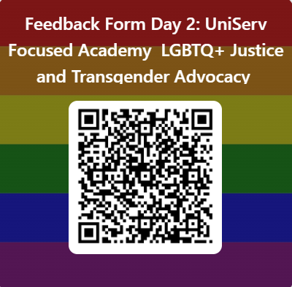
Feedback Form in Your Email
FINAL Feedback Form Day 3: UniServ Focused Academy Advancing LGBTQ+ Justice – Fill out form

Slide 60

LINGERING QUESTIONS
Anything you NEED to ask before leaving?
What feels VERY unsettled or confusing?

