Slide 1
Advancing LGBTQ+ Justice

Slide 2
Land Acknowledgement
We begin by acknowledging that we meet on the traditional lands served by the Southern Paiute, Las Vegas Paiute, and the Naevi. We honor these People, all elders, past, present and emerging and we are called on to learn and share what we learn about the tribal history, culture, and contributions that have been suppressed in telling the story of what we now call the United States America. We invite you to think about the spaces you are inhabiting and the Indigenous people who came before them and were stewards of the land.

Slide 3
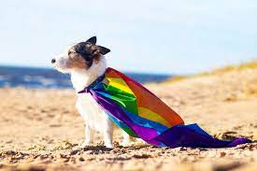
Who are we?
Anthony
Barb
Jeny
Grat
Ellen

Slide 4

Introduction Whip -Who are you?
Name
Pronouns
Your title
15 Seconds Each

Slide 5

Our Time Together
90 Minute Dash
  Starting the conversation outside the umbrella
  Issues
  Framework for Determining Actions
  A Little Law Talk
  Lessons Learned and Actions to Apply

Slide 6

Community Agreements Pg 2
Awareness and Self-Knowledge
Listen for Understanding
Be Gracious
Stay Engaged
Be Open and Suspend Judgment
Say “I”- tell your truth
Seek Discomfort
Reach for Empathy
Expect non- Resolution and non-Closure

Slide 7
Disclaimer
Reminder about sensitive topics
The content we are going to explore may bring up strong feelings. Throughout our time together, we will explore examples of racism, ableism, heterosexism, and sexism.
These oppressive ideas and assumptions are offensive, problematic and false. Yet, over time, they have become as pervasive and invisible as the air we breathe. We need to examine them so that we can understand and ultimately challenge them. Modified ADL

Slide 8
Why we are here!
LGBTQ+ youth are more than four times as likely to attempt suicide than their peers
A majority of LGBTQ+ people say that they or an LGBTQ+ friend or family member have been threatened or non-sexually harassed (57 percent), been sexually harassed (51 percent), or experienced violence (51 percent) because of their sexuality or gender identity. [2]
NEA RA Support and Part of NEA Mission and Vision Pg 5
[1] Human Rights Campaign Foundation. (2017, July). Mental health and the LGBTQ community. https://suicidepreventionlifeline.org/wp-content/uploads/2017/07/LGBTQ_MentalHealth_OnePager.pdf
[2] National Public Radio, the Robert Wood Johnson Foundation, & The Harvard T.H. Chan School of Public Health. (2017, November). Discrimination in America: Experiences and views of LGBTQ Americans. Retrieved June 24, 2020 from https://www.rwjf.org/en/library/research/2017/10/discrimination-in-america--experiences-and-views.html

Slide 9
The Words of Our Members
“Know that even if you do not personally know of any LGBTQ+ staff person in your district, they are there. Be an ally even if you do not know them. Speak up when you hear, see, or perceive bias and/or discrimination. Advocate for inclusive policies for both students and staff.”
9
Notes:
Throughout today’s training, we will be sharing the words of NEA members who are a part of the LGBTQ+ community. We shared an anonymous survey and think it’s important to hear the words of our colleagues—whether they are out or not—about their experiences as LGBTQ+ educators.

Slide 10
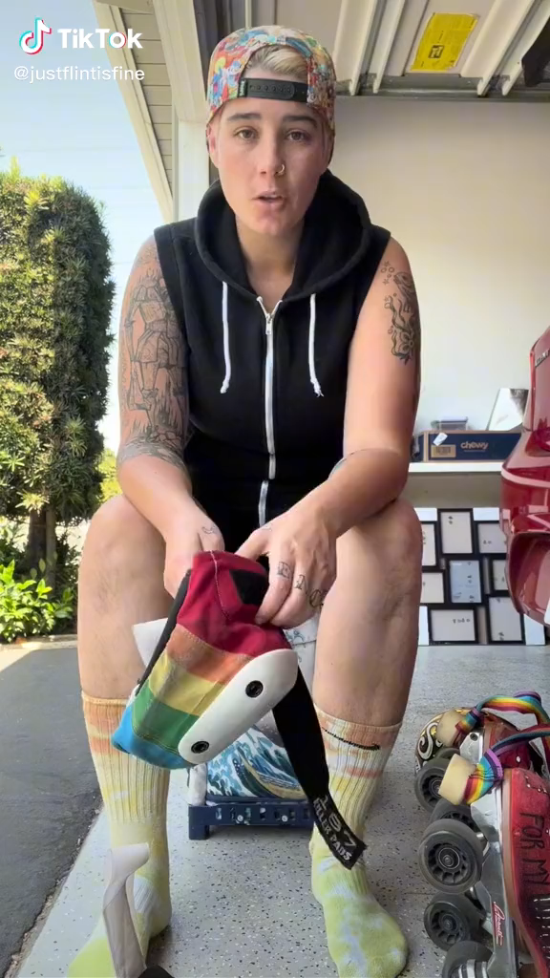

Slide 11

Identity

Slide 12

Building Beyond the Umbrella
How do you begin the work with your colleagues of seeking justice with those who don’t share the experiences, identities, and issues that you do?

Slide 13
Sharing Values for Solidarity
Core Values
1. Name
2. Core Value – One or two words that describes a fundamental belief held by you
**15 Seconds Each**
Core values are the fundamental beliefs of a person. These guiding principles dictate behavior and can help people understand the difference between right and wrong – These can often be expressed using one or two words.

Slide 14

Building Beyond the Umbrella
Solidarity
sol / i / dar / i / ty
Noun
  1. Unity or agreement of feeling or action especially among individuals with a common interest, mutual support; mutual support within a group.

Slide 15


The Gender Unicorn
15
Notes:
The Gender Unicorn is a popular way to help explain gender that was developed by Trans Student Educational Resources. You may be familiar with the “Genderbread Person,” but we choose not to use it. It was created by a Black trans woman, but someone else popularized it, and continues to get credit, pay and notoriety for it.
As you see, the Gender Unicorn highlights gender identity, expression, sex assigned at birth, and physical and emotional attraction.
Children learn that there are two groups—boys and girls—and that they fit into one or the other based on how their bodies are made. They are then socialized to accept specific gender norms and stereotypes, which are ways of behaving, based on this gender assigned at birth.
There’s increasing understanding that gender is more than a binary division. The spectrum of gender identity is becoming more widely accepted and gender expression is more expansive.
However, there are challenges to looking at gender beyond male and female. Across states, many laws and policies are being passed that affirm or harm individuals outside of the gender binary.

Slide 16
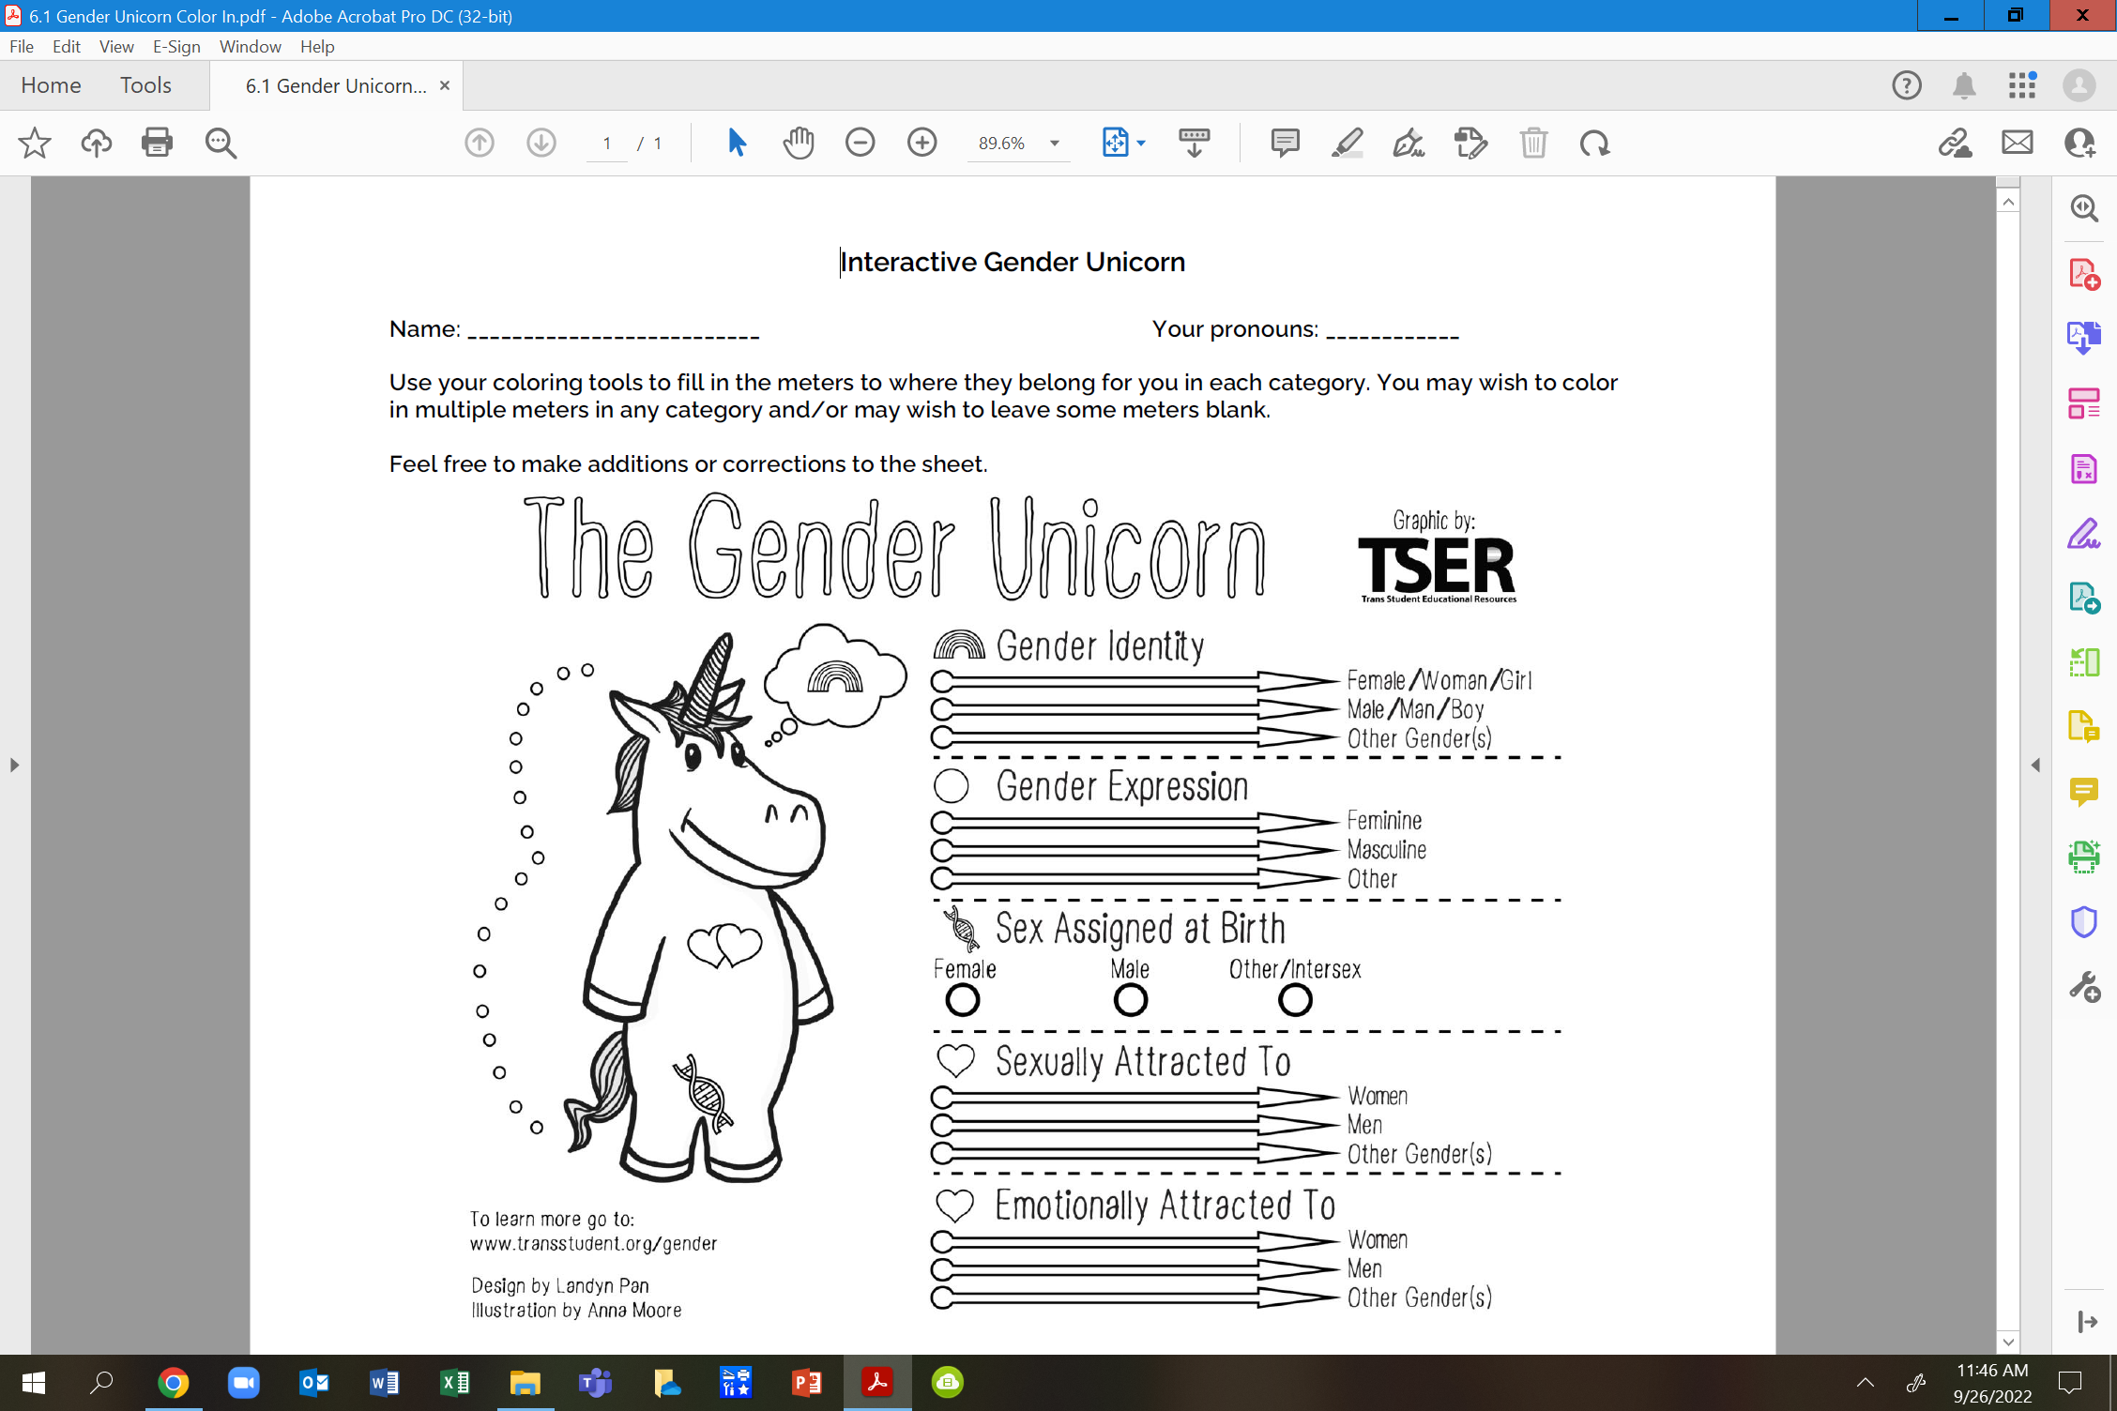
Using this page with others to build solidarity.

Slide 17
Questions to Ask
What is clearer to you?
Do you feel you can find yourself here?
Do you feel there is any nuance that may be missing?
How do our current union practices support the nuances we found?

Slide 18
Key Ideas
Our society and our unions reinforce the gender and sex binary – this is a construct
People under the umbrella AND people not under the umbrella suffer from the binary construct.
Building shared understanding and shared values IS the best way to begin.

Slide 19
Terminology

Slide 20
LGBTQ+ Terminology
Terminology Four Corners
On the slide will be the definition of LGBTQ+ terminology along with 4 possible options for words.
Get up and move to the corner that matches the word you think correctly matches the definition.
Notes:
Terminology Handout

Slide 21
LGBTQ+ Terminology
Terminology Four Corners-
How to find the answer?
You already know.
Use context clues.
Ask someone in the room that you trust.
(Yes, conversation is allowed and encouraged).
Notes:
Terminology Handout

Slide 22
LGBTQ+ Terminology
An internal, deeply felt sense of being female, male, a blend of both, or neither. Refers to how individuals perceive themselves and what they call themselves. Can be the same as or different from their sex assigned at birth.
A- Gender Identity
B- Gender Fluid
C- Gender Expression
D- Gender Queer
Notes:
Terminology Handout

Slide 23
LGBTQ+ Terminology
An internal, deeply felt sense of being female, male, a blend of both, or neither. Refers to how individuals perceive themselves and what they call themselves. Can be the same as or different from their sex assigned at birth.
A- Gender Identity
Notes:
Terminology Handout

Slide 24
LGBTQ+ Terminology
A teaching methodology focused on identity, diversity, justice, and action. ABAR pedagogy helps students develop a strong sense of self-worth, empathize with others, learn the impact of unfairness, and take action when they observe, or experience injustice.
A- Non-Binary
B- LGBTQ+
C- Transgender/Trans
D- Anti-Bias Anti-Racist (ABAR)
Notes:
Terminology Handout

Slide 25
LGBTQ+ Terminology
A teaching methodology focused on identity, diversity, justice, and action. ABAR pedagogy helps students develop a strong sense of self-worth, empathize with others, learn the impact of unfairness, and take action when they observe, or experience injustice.
D- Anti-Bias Anti-Racist (ABAR)
Notes:
Terminology Handout

Slide 26
LGBTQ+ Terminology
An adjective describing a person who does not identify exclusively as a woman or a man. They may identify as both, somewhere in between, or outside the categories of a woman and a man.
A- Intersex
B- Transgender/Trans
C- Gender Expression
D- Non-Binary
Notes:
Terminology Handout

Slide 27
LGBTQ+ Terminology
An adjective describing a person who does not identify exclusively as a woman or a man. They may identify as both, somewhere in between, or outside the categories of a woman and a man.
D- Non-Binary
Notes:
Terminology Handout

Slide 28
LGBTQ+ Terminology
A broad term referring to people who do not behave in a way that conforms to the traditional expectations of their gender or whose gender expression does not fit neatly into a category.
A- Gender Fluid
B- Gender Expression
C- Transgender/Trans
D- Gender Non-Conforming
Notes:
Terminology Handout

Slide 29
LGBTQ+ Terminology
A broad term referring to people who do not behave in a way that conforms to the traditional expectations of their gender or whose gender expression does not fit neatly into a category.
D- Gender Non-Conforming
Notes:
Terminology Handout

Slide 30
LGBTQ+ Terminology
A modern umbrella term used across the U.S. Native American and Canadian First Nations communities to describe Native people who fulfill a traditional third-gender or gender-variant ceremonial and social role in their cultures. Because being Two-Spirit also denotes one’s spirituality, not all transgender or non-binary Indigenous people consider themselves to be Two-Spirit. It is not a term appropriate for a non-Native person to use for their own identity. It’s an Indigenous term, thereby open solely to Indigenous community members.
Notes:
Terminology Handout

Slide 31
LGBTQ+ Terminology
A- Bisexual/Bi+
B- Two-Spirit
C- Intersex
D- Lesbian
Notes:
Terminology Handout

Slide 32
LGBTQ+ Terminology
B- Two-Spirit
Notes:
Terminology Handout

Slide 33
LGBTQ+ Terminology
Terminology Four Corners
Continuing from here you no longer need to move to the correct answer.
Stay at your table and discuss the options.
When you come to an agreement hold up the letter that correctly matches the word to the definition.
Notes:
Terminology Handout

Slide 34
LGBTQ+ Terminology
A term that describes a person whose gender identity aligns with the sex assigned to them at birth.
A- Agender
B- Cisgender
C- Gender Fluid
D- Transgender/Trans
Notes:
Terminology Handout

Slide 35
LGBTQ+ Terminology
A term that describes a person whose gender identity aligns with the sex assigned to them at birth.
B- Cisgender
Notes:
Terminology Handout

Slide 36
LGBTQ+ Terminology
A term used to describe someone who is actively supportive of LGBTQ+ people. It encompasses straight and cisgender allies and those within the LGBTQ+ community who support each other (e.g., a lesbian who is an ally to the bisexual community).
A- Queer
B- Genderqueer
C- Ally
D- Gender Expression
Notes:
Terminology Handout

Slide 37
LGBTQ+ Terminology
A term used to describe someone who is actively supportive of LGBTQ+ people. It encompasses straight and cisgender allies and those within the LGBTQ+ community who support each other (e.g., a lesbian who is an ally to the bisexual community).
C- Ally
Notes:
Terminology Handout

Slide 38
LGBTQ+ Terminology
A term that describes a person who is emotionally, romantically, or sexually attracted to people of more than one gender, sex, or gender identity.
A- Bisexual/Bi+
B- Intersex
C- Gay
D- Two-Spirit
Notes:
Terminology Handout

Slide 39
LGBTQ+ Terminology
A term that describes a person who is emotionally, romantically, or sexually attracted to people of more than one gender, sex, or gender identity.
A- Bisexual/Bi+
Notes:
Terminology Handout

Slide 40
LGBTQ+ Terminology
A term that describes a person who is emotionally, romantically, or sexually attracted to some members of the same gender.
A- Sexual Orientation
B- Transgender/Trans
C- Gay
D- Intersex
Notes:
Terminology Handout

Slide 41
LGBTQ+ Terminology
A term that describes a person who is emotionally, romantically, or sexually attracted to some members of the same gender.
C- Gay
Notes:
Terminology Handout

Slide 42
LGBTQ+ Terminology
A term that describes the clinically significant distress a person experiences when their assigned birth gender does not match their gender identity. According to the American Psychiatric Association’s Diagnostic and Statistical Manual of Mental Disorders (DSM), the term—which replaces Gender Identity Disorder—“is intended to better characterize the experiences of affected children, adolescents, and adults.”
A- Intersex C- Transgender/Trans
B- Gender Queer D- Gender Dysphoria
Notes:
Terminology Handout

Slide 43
LGBTQ+ Terminology
A term that describes the clinically significant distress a person experiences when their assigned birth gender does not match their gender identity. According to the American Psychiatric Association’s Diagnostic and Statistical Manual of Mental Disorders (DSM), the term—which replaces Gender Identity Disorder—“is intended to better characterize the experiences of affected children, adolescents, and adults.”
D- Gender Dysphoria
Notes:
Terminology Handout

Slide 44
LGBTQ+ Terminology
The external appearance of one’s gender identity, usually expressed through behavior, clothing, haircut, or voice, that may or may not conform to socially defined behaviors and characteristics typically associated with being either feminine or masculine.
A- Gender Expression
B- Intersex
C- Gender Non-Conforming
D- Queer
Notes:
Terminology Handout

Slide 45
LGBTQ+ Terminology
The external appearance of one’s gender identity, usually expressed through behavior, clothing, haircut, or voice, that may or may not conform to socially defined behaviors and characteristics typically associated with being either feminine or masculine.
A- Gender Expression
Notes:
Terminology Handout

Slide 46
LGBTQ+ Terminology
An acronym for “lesbian, gay, bisexual, transgender, and queer.” The “+” represents additional gender identities and sexual orientations that include intersex, agender, and asexual, among many others.
A- Gender Expression
B- Queer
C- LGBTQ+
D- Non-Binary
Notes:
Terminology Handout

Slide 47
LGBTQ+ Terminology
An acronym for “lesbian, gay, bisexual, transgender, and queer.” The “+” represents additional gender identities and sexual orientations that include intersex, agender, and asexual, among many others.
C- LGBTQ+
Notes:
Terminology Handout

Slide 48
LGBTQ+ Terminology
A woman who is emotionally, romantically, and/or sexually attracted to women. This includes cis, trans, and other people who are women.
A- Lesbian
B- Sexual Orientation
C- Gender Non-Conforming
D- Cisgender
Notes:
Terminology Handout

Slide 49
LGBTQ+ Terminology
A woman who is emotionally, romantically, and/or sexually attracted to women. This includes cis, trans, and other people who are women.
A- Lesbian
Notes:
Terminology Handout

Slide 50
LGBTQ+ Terminology
An inherent or immutable enduring emotional, romantic, or sexual attraction to other people.
A- Gay
B- Gender Expression
C- Sexual Orientation
D- Agender
Notes:
Terminology Handout

Slide 51
LGBTQ+ Terminology
An inherent or immutable enduring emotional, romantic, or sexual attraction to other people.
C- Sexual Orientation
Notes:
Terminology Handout

Slide 52
LGBTQ+ Terminology
An umbrella term for people whose gender identity and/or expression is different from cultural expectations based on the sex they were assigned at birth. Being transgender does not imply any specific sexual orientation.
A- Gender Queer
B- Transgender/Trans
C- Gender Fluid
D- Two-Spirit
Notes:
Terminology Handout

Slide 53
LGBTQ+ Terminology
An umbrella term for people whose gender identity and/or expression is different from cultural expectations based on the sex they were assigned at birth. Being transgender does not imply any specific sexual orientation.
B- Transgender/Trans
Notes:
Terminology Handout

Slide 54
LGBTQ+ Terminology
Describes someone who has the potential for emotional, romantic or sexual attraction to people of any gender though not necessarily simultaneously, in the same way or to the same degree. Sometimes used interchangeably with bisexual.
A- Gender fluid
B- Intersex
C- Pansexual
D- Gender Non-Conforming
Notes:
Terminology Handout

Slide 55
LGBTQ+ Terminology
Describes someone who has the potential for emotional, romantic or sexual attraction to people of any gender though not necessarily simultaneously, in the same way or to the same degree. Sometimes used interchangeably with bisexual.
C- Pansexual
Notes:
Terminology Handout

Slide 56
LGBTQ+ Terminology
A term people often use to express fluid identities and orientations. This term is often used interchangeably with “LGBTQ+.”
A- Intersex
B- Pansexual
C- Non-Binary
D- Queer
Notes:
Terminology Handout

Slide 57
LGBTQ+ Terminology
A term people often use to express fluid identities and orientations. This term is often used interchangeably with “LGBTQ+.”
D- Queer
Notes:
Terminology Handout

Slide 58
LGBTQ+ Terminology
Describes a person who does not have a gender.
A- Gender Fluid
B- Agender
C- Intersex
D- Pansexual
Notes:
Terminology Handout

Slide 59
LGBTQ+ Terminology
Describes a person who does not have a gender.
B- Agender
Notes:
Terminology Handout

Slide 60
LGBTQ+ Terminology
A person who does not identify with a single fixed gender or has a fluid or unfixed gender identity.
A- Intersex
B- Pansexual
C- Gay
D- Gender fluid
Notes:
Terminology Handout

Slide 61
LGBTQ+ Terminology
A person who does not identify with a single fixed gender or has a fluid or unfixed gender identity.
D- Gender fluid
Notes:
Terminology Handout

Slide 62
LGBTQ+ Terminology
…..... people typically reject notions of static categories of gender and embrace a fluidity of gender identity and often, though not always, sexual orientation. People who identify as this may see themselves as being both male and female, neither male nor female or as falling completely outside these categories.
A- Intersex C- Gender Identity
B- Gender Queer D- Gender Fluid
Notes:
Terminology Handout

Slide 63
LGBTQ+ Terminology
…..... people typically reject notions of static categories of gender and embrace a fluidity of gender identity and often, though not always, sexual orientation. People who identify as "genderqueer" may see themselves as being both male and female, neither male nor female or as falling completely outside these categories.
B- Gender Queer
Notes:
Terminology Handout

Slide 64
LGBTQ+ Terminology
…. people are born with a variety of differences in their sex traits and reproductive anatomy. There is a wide variety of difference among variations, including differences in genitalia, chromosomes, gonads, internal sex organs, hormone production, hormone response, and/or secondary sex traits.
A- Intersex C- Non-Binary
B- Gender Queer D- Transgender/Trans
Notes:
Terminology Handout

Slide 65
LGBTQ+ Terminology
…. people are born with a variety of differences in their sex traits and reproductive anatomy. There is a wide variety of difference among intersex variations, including differences in genitalia, chromosomes, gonads, internal sex organs, hormone production, hormone response, and/or secondary sex traits.
A- Intersex
Notes:
Terminology Handout

Slide 66
Terminology Debrief
Let’s Ask the Room Debrief
What surprised you?
What is your biggest opportunity for growth?
Who has a helpful “hint”?
What else may you need?
Tomorrow we are going to talk about the Q in the LGBTQ+
Notes:
2:00-2:30

Slide 67
Language Changes
Terminology around race and ethnicity changes every 10 years.
Terminology around gender, identity, and sexual orientation changes every 2 years.

Slide 68
Questions and Topics to Avoid
    Questions about genitalia or anatomy
It’s not your business!
    Questions about sexual experiences
Also, not your business
    Any questions that imply someone should delay or stop transitioning
Are you sure you want to switch your pronouns this school year?
    Any comments on someone’s transition
“I never would have known! You pass so well! You don’t look trans!”
    Questions or comments about, or using a person’s dead name
A dead name is the birth name of a transgender person who has changed their name
    Anything that assumes they are the expert on everything LGBTQ+
It's not their job to teach you or to speak for an entire, diverse community
Notes:
Added some from here- https://freedomforallamericans.org/messaging-terms-avoid/ (Sara)

Slide 69
TERMINOLOGY TO AVOID:
Best Practice: People first terminology AND Ask (respectfully)
Don’t use… | Because… | Use…
a Transgendered | Trans is not a noun! Trans is an adjective that helps describe someone’s gender identity. | “Person who is Transgender” or the identity the person chooses for themselves!
Homosexual/ Homosexuality (unless someone chooses it for themselves) | This term comes across clinical and dog whistle-y | The identity someone chooses! LGBTQ+ as an umbrella.
“Sexual preference”, “homosexual lifestyle” | These words have been co-opted as dog whistles to suggest gayness is a choice. | “Sexual Orientation”
“Sex Change”, “Pre-op/Post-op” | These are antiquated and centralize surgeries and anatomy as a determining factor in gender identity. | “Transition” or “gender confirmation surgery”
“Biologically male/female” | It is rarely relevant what sex someone was assigned at birth and this suggests that trans women/men are not “real” women/men | IF NECESSARY… Assigned Female/Male at Birth (AFAB/AMAB)
"Hermaphrodite" | This is a super stigmatized word! | Intersex
Notes:
Added some from here- https://freedomforallamericans.org/messaging-terms-avoid/ (Sara)

Slide 70
Key Ideas
There is a long history of language being weaponized to harm members of the LGBTQ+ community.
We must be intentional with our language and how we show up.
Again, a lot of this language is constantly changing, it is our responsibility to adjust and learn.

Slide 71
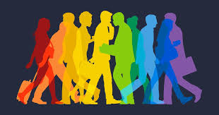
What are all the issues that LGBTQ+ people face in their work and union lives?
Notes:
11:00-11:30

Slide 72
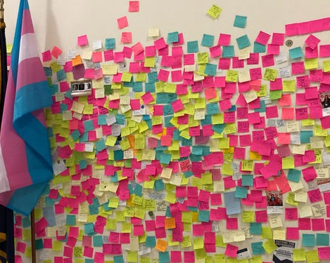
What are the issues?
At Your Tables –
Get a stack of post-it notes
1 FULL Minute, list one issue that LGBTQ+ members face in their work or union life
5 Minutes – as a table sort the issues into categories – name the categories, and write those names EACH ON THEIR OWN Post-it
Possible POWER BUILDING Bring these those to the wall and cluster those that are alike

Slide 73
What are the issues?
What did you see that was common?
What was new to you?

Slide 74
PROBLEM vs. ISSUE
Campaigns start with issues that workers have value-based solidarity around.
An issue is a slice of a workplace problem.
Often a problem can have different issues depending on the perspective of the people we are working with.
It is KEY to get enough input on what the issues are that make up the problem so that YOU do not drive the solution.
Investigating the issue is necessary but not sufficient – we also need to identify workers’ SHARED values – WHY is this an issue? WHY do you want to fix this?

Slide 75

PROBLEM vs. ISSUE
Values that build a relatable “why”
Deserve safe and reliable transportation
Access to quality parts

Slide 76
EXAMPLE- Problem and Issue
PROBLEM -Our school is hostile to LGBTQ+ staff and students
◦ Issue – There are no gender inclusive bathrooms and/or transgender students are forced to use the wrong restroom
Values – Equity, Safety, Personal Choice, Student Choice
◦ Issue – Our healthcare and leave benefits do not cover non-“traditional” family structures or are not fully accessible to people with same-gender partners.
Values – Equitable Access, Fair Pay, Family
◦ Issue – Our administration forces us to “out” trans and queer students to their families.
Values- Professional Judgement, Safety, Student Choice

Slide 77

Issues Lead to Collective Action
• It is widely felt
• It is deeply felt
• It is winnable
• It builds the union and builds leaders
• It has a connection to students and the public
Notes:
Slide Time Allotment: 10 minutes
Share out issues from around the room.

Slide 78
Key Ideas
Problems are disabling.
Issues build solidarity.
We don’t choose the issues, the people who want the change choose the issue AND work to build a bigger base.

Slide 79

Intersectionality

Slide 80
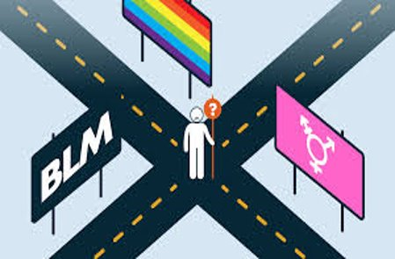
Using Intersectionality to Build Solidarity
Intersectionality is a framework for understanding a person, group of people, or social problem as affected by a number of discriminations and disadvantages. It takes into account people's overlapping identities and experiences in order to understand the complexity of prejudices they face.​

Slide 81
Levels of Expression of Oppression
I n d i v i d u a l | Internalized Oppression lies within individuals. These are our private beliefs and biases about others, influenced by our culture, that reside inside our minds. | S y s t e m i c | Institutional Oppression occurs within institutions and systems of power. It is the norms, policies and practices that are structured into political, societal and economic institutions that have the net effect of imposing oppressive conditions and denying rights, opportunity, and equality to identifiable groups.
 | Interpersonal Oppression occurs between individuals. Once we bring our private beliefs into our interactions with others, we are now in the interpersonal realm. |  | Structural Oppression is bias across institutions and society. It’s the cumulative and compounded effects of an array of factors that systematically privilege some and disadvantage others.
Notes:
10:45-11:30 Ben

Slide 82
KEY POINTS
1. There are no hard and fast lines between the levels – and changing one can affect another. ​
​
While we believe that the individual is ​
responsible for exploring personal bias
​2. The way to effect change is by addressing institutionalized and structural oppression – this is where injustice lives.

Slide 83
Key Ideas
There are not hard and fast lines between the levels – and changing one can affect another.
This framework helps us think about the size of the solution we need to fight the injustice at a particular level.

Slide 84
The law

Slide 85
TRUE OR FALSE
In my state, an employee can be fired for being transgender.

Slide 86
TRUE OR FALSE
In my state, an employee can be fired for being a lesbian.

Slide 87
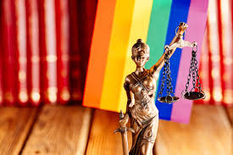
FALSE!
There are federal laws that protect LGBTQ+ workers from workplace discrimination in ALL states (yes, even yours).

Slide 88

A LANDMARK RULING
Bostock v. Clayton County
Prior to June 15, 2020
It was legal to fire an employee for being gay, bisexual or transgender, in more than half of the 50 states.
June 15, 2020
The Supreme Court rules it is illegal to discriminate against
or fire an employee based on their sexual orientation or gender identity.
88
Notes:
The Civil Rights Act of 1964 prohibits discrimination based on race, color, religion, sex, or national origin. The courts and the federal government have long refused to recognize LGBTQ+ discrimination as a form of sex discrimination. Over the past 20 years, however, federal courts and the government have at times recognized LGBTQ+ discrimination as sex discrimination.
It was not until June 15, 2020 that the Supreme Court finally recognized that LGBTQ+ employment discrimination is prohibited sex discrimination under Title VII of the Civil Rights Act of 1964.
This ruling recognized that it is illegal to discriminate against or fire an employee based on their sexual orientation or gender identity. Now lower federal courts and the Biden Administration are applying that ruling to education, health care, housing, credit discrimination, and more.

Slide 89
BOSTOCK V. CLAYTON COUNTY
Employment Discrimination is Illegal
Title VII of the 1964 Civil Rights Act prohibits employment discrimination based on race, color, religion, sex and national origin. Bostock interprets “sex” to include gender identity and sexual orientation.
89
Notes:
The Bostock ruling specifically states that employment discrimination on the basis of gender identity and sexual orientation is illegal.
Title VII of the Civil Rights Act covers the full spectrum of employment decisions, including recruitment, selections, terminations, and other actions concerning terms and conditions of employment. This is significant for the LGBTQ+ community because, as we saw, in many states it was legal to be denied an interview or a promotion, and even to be fired because of one’s gender identity or sexual orientation.

Slide 90
Title IX
Discrimination in Educational
Programs is Illegal
Title IX of the Education Amendments Act of 1972 states: "No person in the United States shall, on the basis of sex, be excluded from participation in, be denied the benefits of, or be subjected to discrimination under any education program or activity receiving Federal financial assistance."
90
Notes:
On March 26, 2021, the Department of Justice concluded that, as a result of the Bostock ruling, Title IX of the Education Amendments Act of 1972 also prohibits sexual-orientation and gender-identity discrimination in educational institutions that receive federal funding. This means all public schools. This means that students cannot be discriminated against in schools based on their LGBTQ+ identity.
There have been some significant wins recently for LGBTQ+ rights in the US But while progress is being made, attacks on LGBTQ+ rights in certain states have accelerated.
Reference: Department of Justice, “Application of Bostock v. Clayton County to Title IX of the Education Amendments of 1972,” March 26, 2021, https://www.justice.gov/crt/page/file/1383026/download

Slide 91
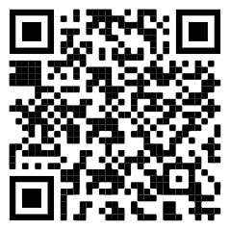
Review the Laws in Your State
1. Go to www.lgbtmap.org and Click Equality Maps or use the QR Code
2. Select “Choose a State” in the drop down menu.
3. Select a state and review the data.
How might this data impact members who are transitioning or transgender in your selected state?
Notes:
Look at Your State’s Equality Profile.
How might this impact members who are transitioning or transgender?
Instructions:
Go to www.lgbtqmap.org
Click Equality Maps
Select “Choose a State” in the drop down menu.
Select a state and review the data. How might this data impact members who are transitioning or transgender in your selected state?

Slide 92
Key Ideas
At least for now, ALL LGBTQ+ workers are protected under Bostock - BUT Bostock is limited to Employment
Title IX has applications to the protection of LGBTQ+ workers in public funded educational programs.

Slide 93
Microagressions

Slide 94

Ending It Right
What did you learn about today that:
You’re going to immediately tell your union bestie?
You’re going to use in the near future as part of your union work?
You’re going to work to learn more about?

Slide 95
Thank you!
Notes:
11:00-11:30

