Slide 1
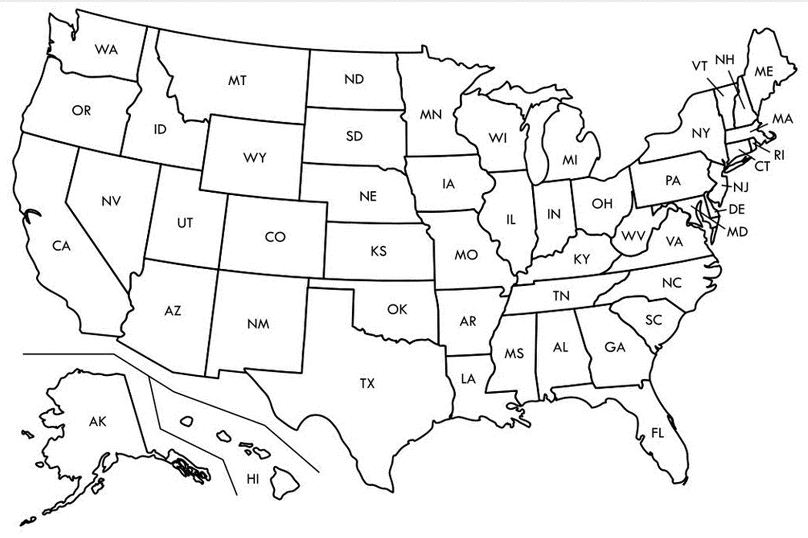

Entry Activity-Mapping
Place a dot on the map showing where you are from
Notes:
Populate from pre-survey
Zach will move dots

Slide 2
Advancing LGBTQ+ Justice

Slide 3

Ellen

Slide 4

NEA Standards of Conduct
NEA has adopted a Standard of Conduct Policy to ensure that all of our gatherings are welcoming to and free from discriminatory, harassing, or otherwise unacceptable behavior. Discrimination or harassment based on race, color, ethnicity, religion, sex, age, national origin, sexual orientation, disability, gender identity, or expression, or any other characteristic protected by law will not be tolerated. If you experience any discriminatory or harassing behavior, please report the incident to NEA EC Members: Gladys Marquez (gmarquez@nea.org) and Ronald "Duff" Martin (rmartin@nea.org). Thank you for your commitment to ensuring a positive event for all.

Slide 5
NEA MEMBERS AND SUPPORTERS
By attending this training, you confirm that you are a NEA affiliate staff member. The information you receive here is only for your use in your capacity as an NEA affiliate staff member.
This presentation and its contents are confidential and may not be further distributed or passed on to any other person or published or reproduced, in whole or in part, by any medium or in any form, for any purpose. Audio/video recording, copying of slides, and the use of AI note-taking tools are prohibited without the written consent from Ellen Holmes. Violation of these terms may result in legal action.

Slide 6
Land Acknowledgement
We begin by acknowledging that we meet on the traditional lands served by the Lenape people. We honor America’s First People and all elders, past, present and emerging and we are called on to learn and share what we learn about the tribal history, culture, and contributions that have been suppressed in telling the story of what we now call the United States America. We invite you to think about the spaces you are inhabiting and the Indigenous people who came before them and were stewards of the land.

Slide 7
Training Safety
Wear name badges at ALL times in training room
No Cell Phones in training room
Do not talk to anyone asking about the training
Do not share materials or trainers' personal information

Slide 8

Our Time Together
Days 1 & 2: 8:30 am- 5:00 pm
◦15 Minute AM + PM Break
◦Lunch 12:00 – 1:00pm
◦4:30 - 5:00 pm “Adult Choice Networking”
Day 3: 8:30 am -2:00 pm
◦15 Minute AM + PM Break
◦Lunch 1:00 pm
◦1:00 - 2:00 pm “Adult Choice Networking”

Slide 9

Today’s Agenda
8:30 – 10:15 -- Getting Started and Building Our Community
10:15-10:30 -- Break
10:30 -12:00 -- Who am I in the work
12:00 -1:00 -- Lunch
1:00 – 2:30 -- LGBTQ History & Terminology
2:30 – 2:45 -- Break
2:45 - 4:15 -- Gender Identity
4:15 – 4:30 -- Wrap Up and Reflect
4:30 – 5:00 -- Adult Choice Networking

Slide 10
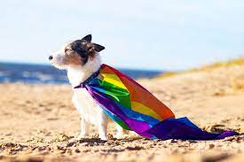
Logistics to Remember
Parking lot
Bathroom
Materials
Food
Room Temperature
Karla as Resource
Questions
Room Cleaning

Slide 11
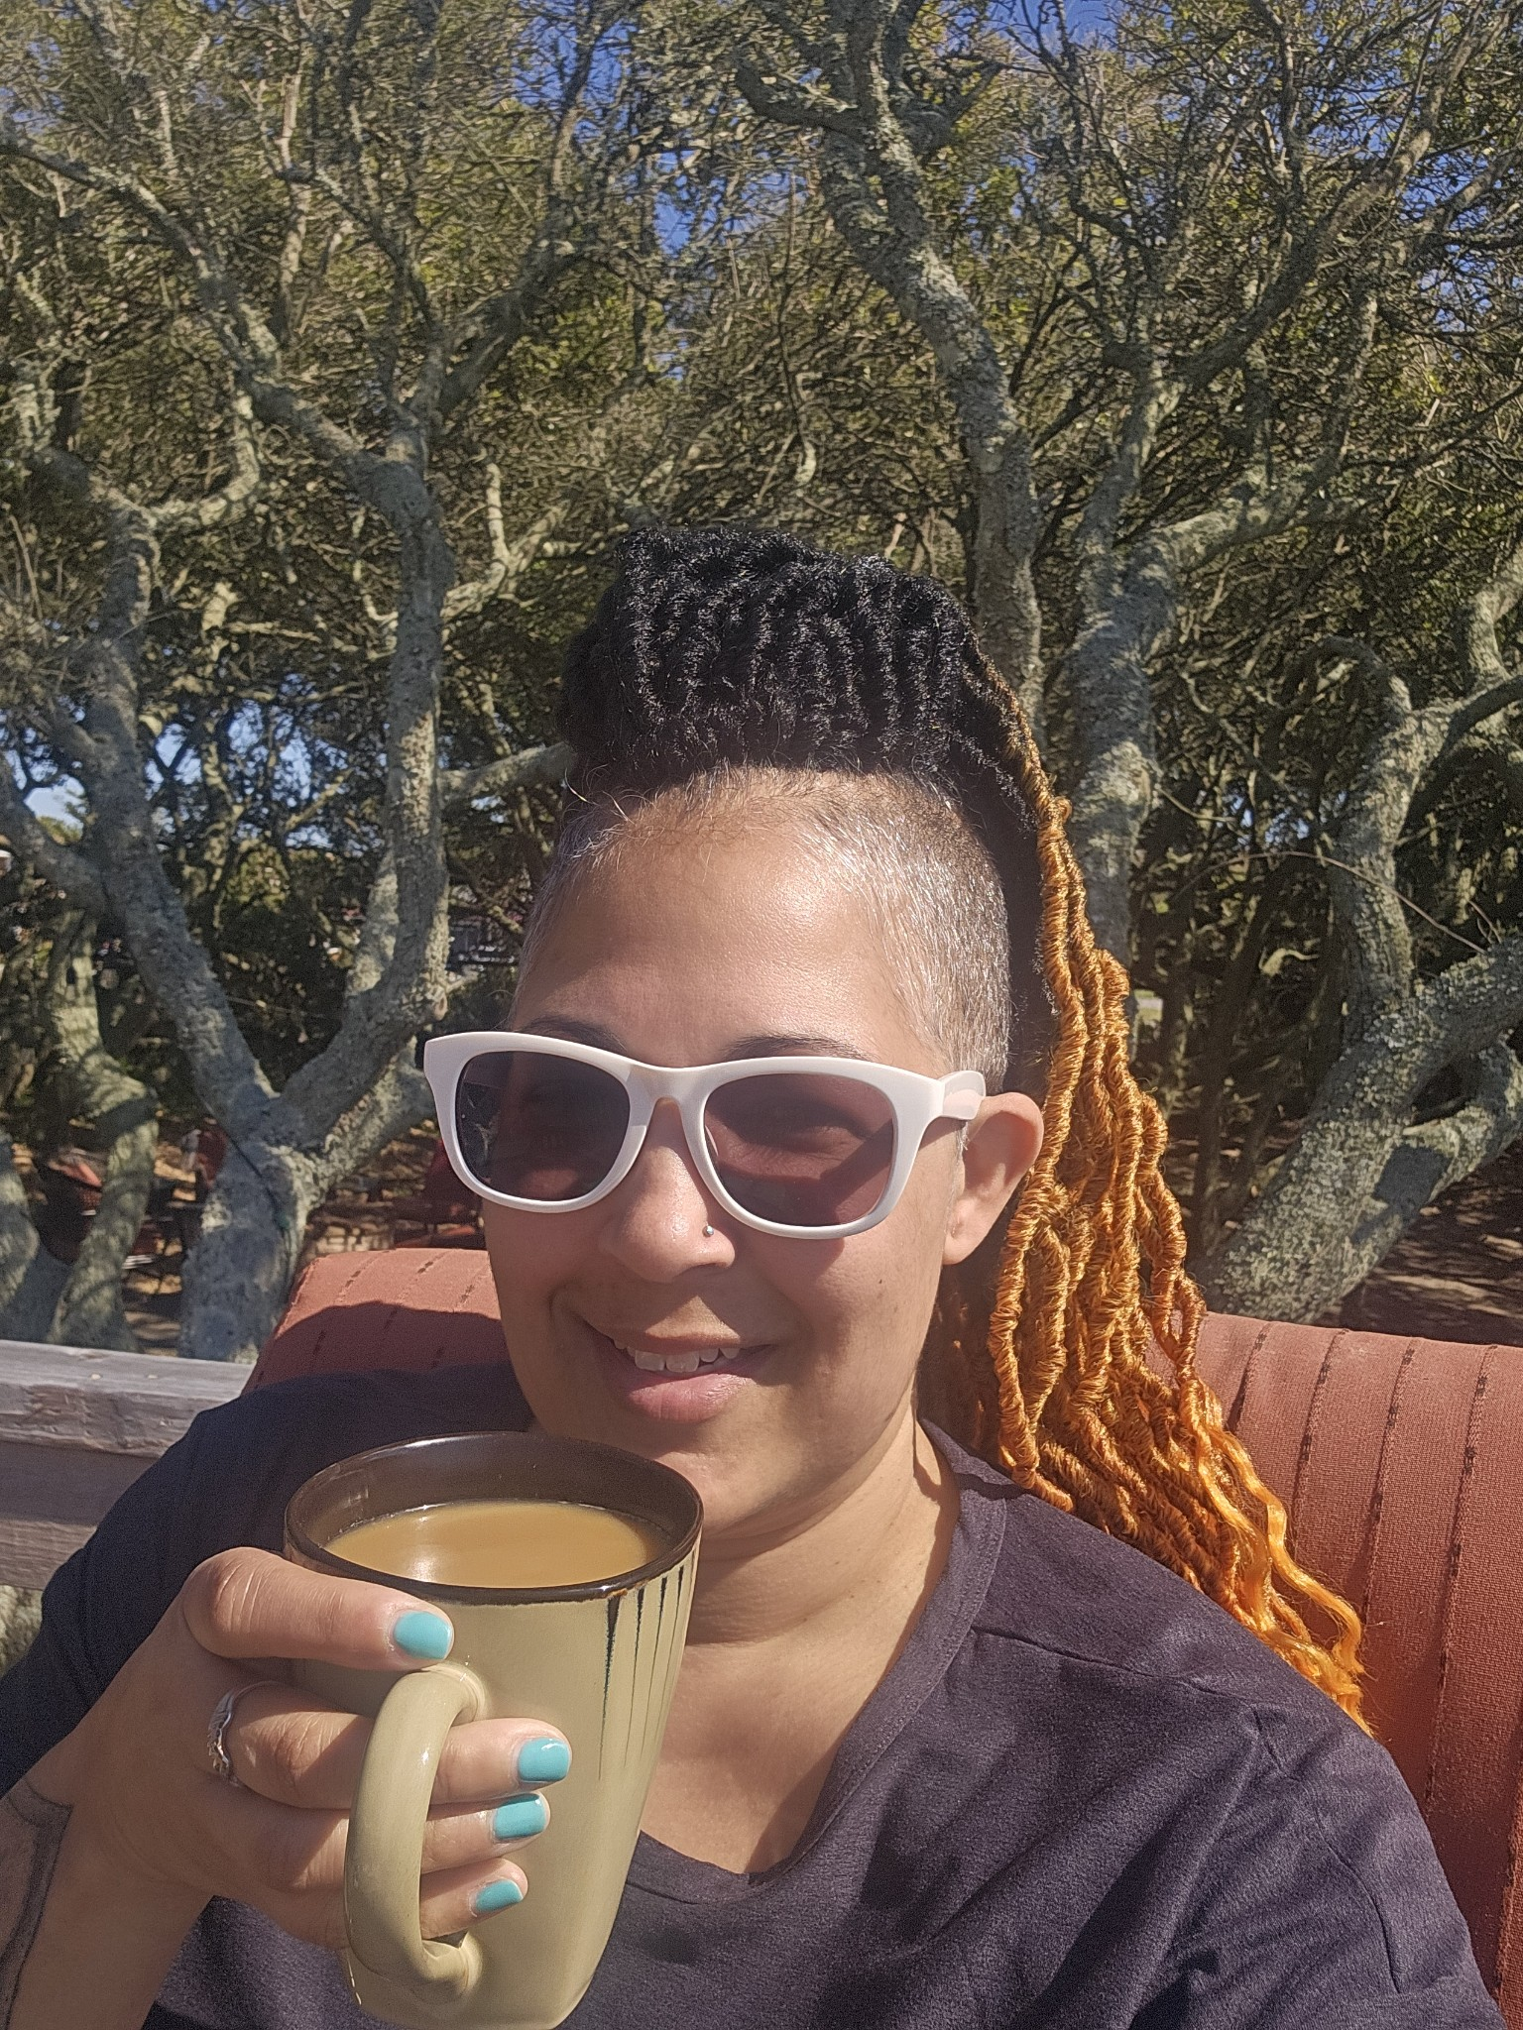
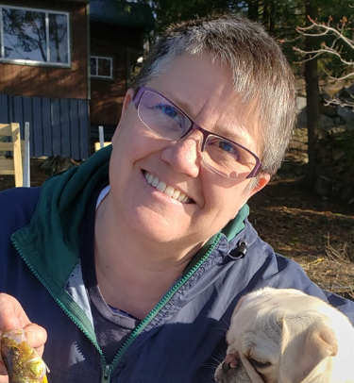
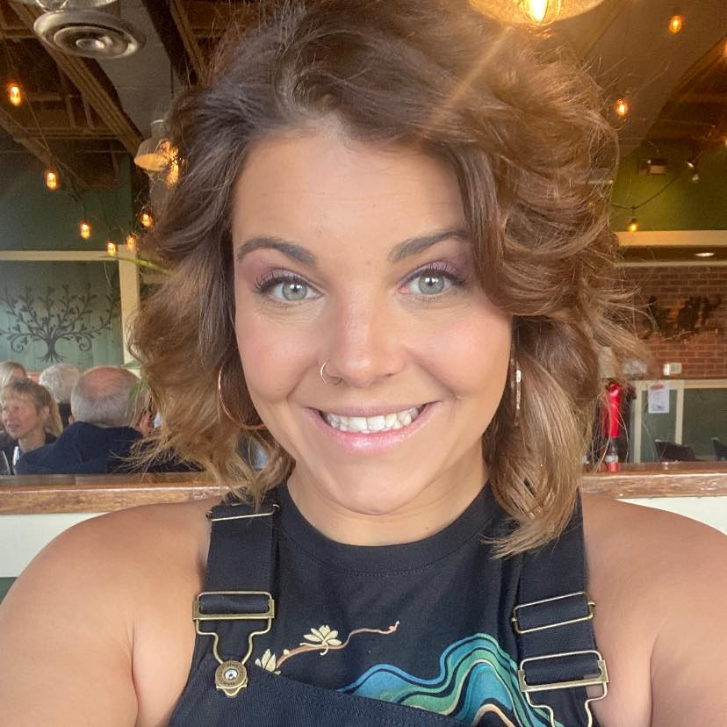
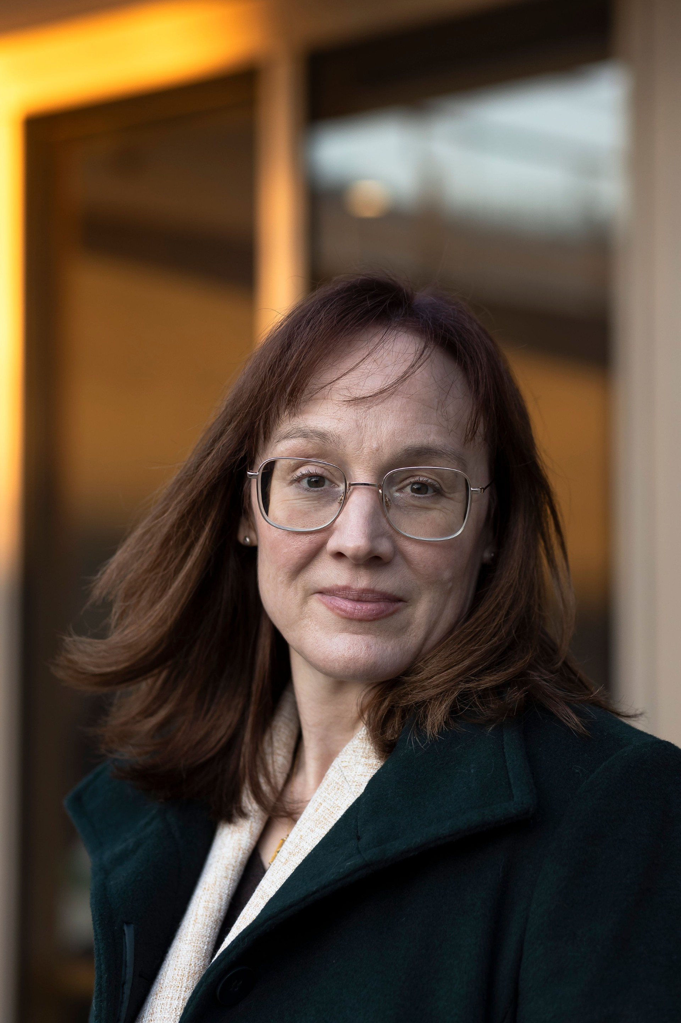
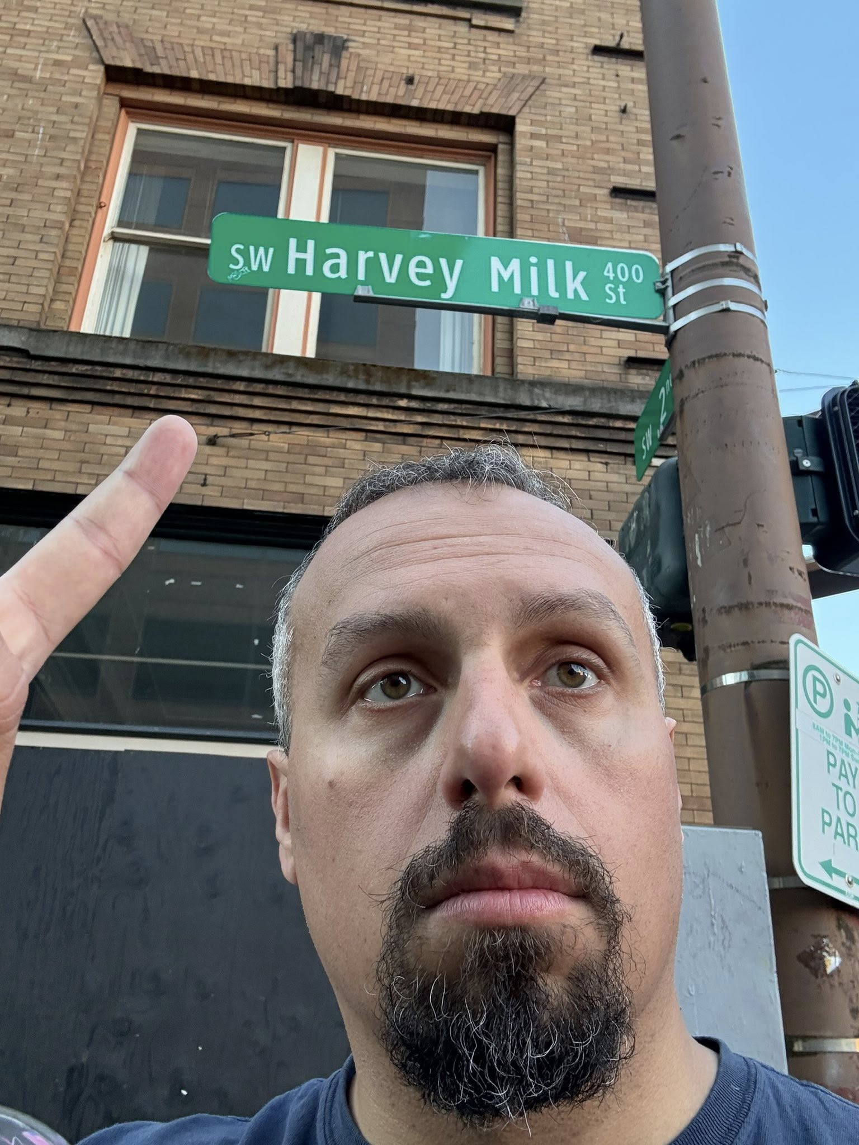
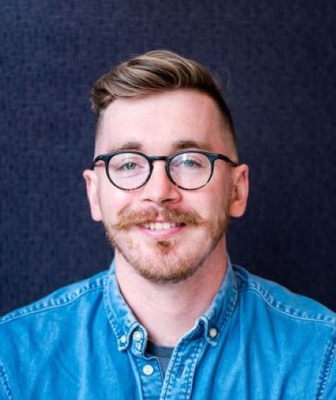
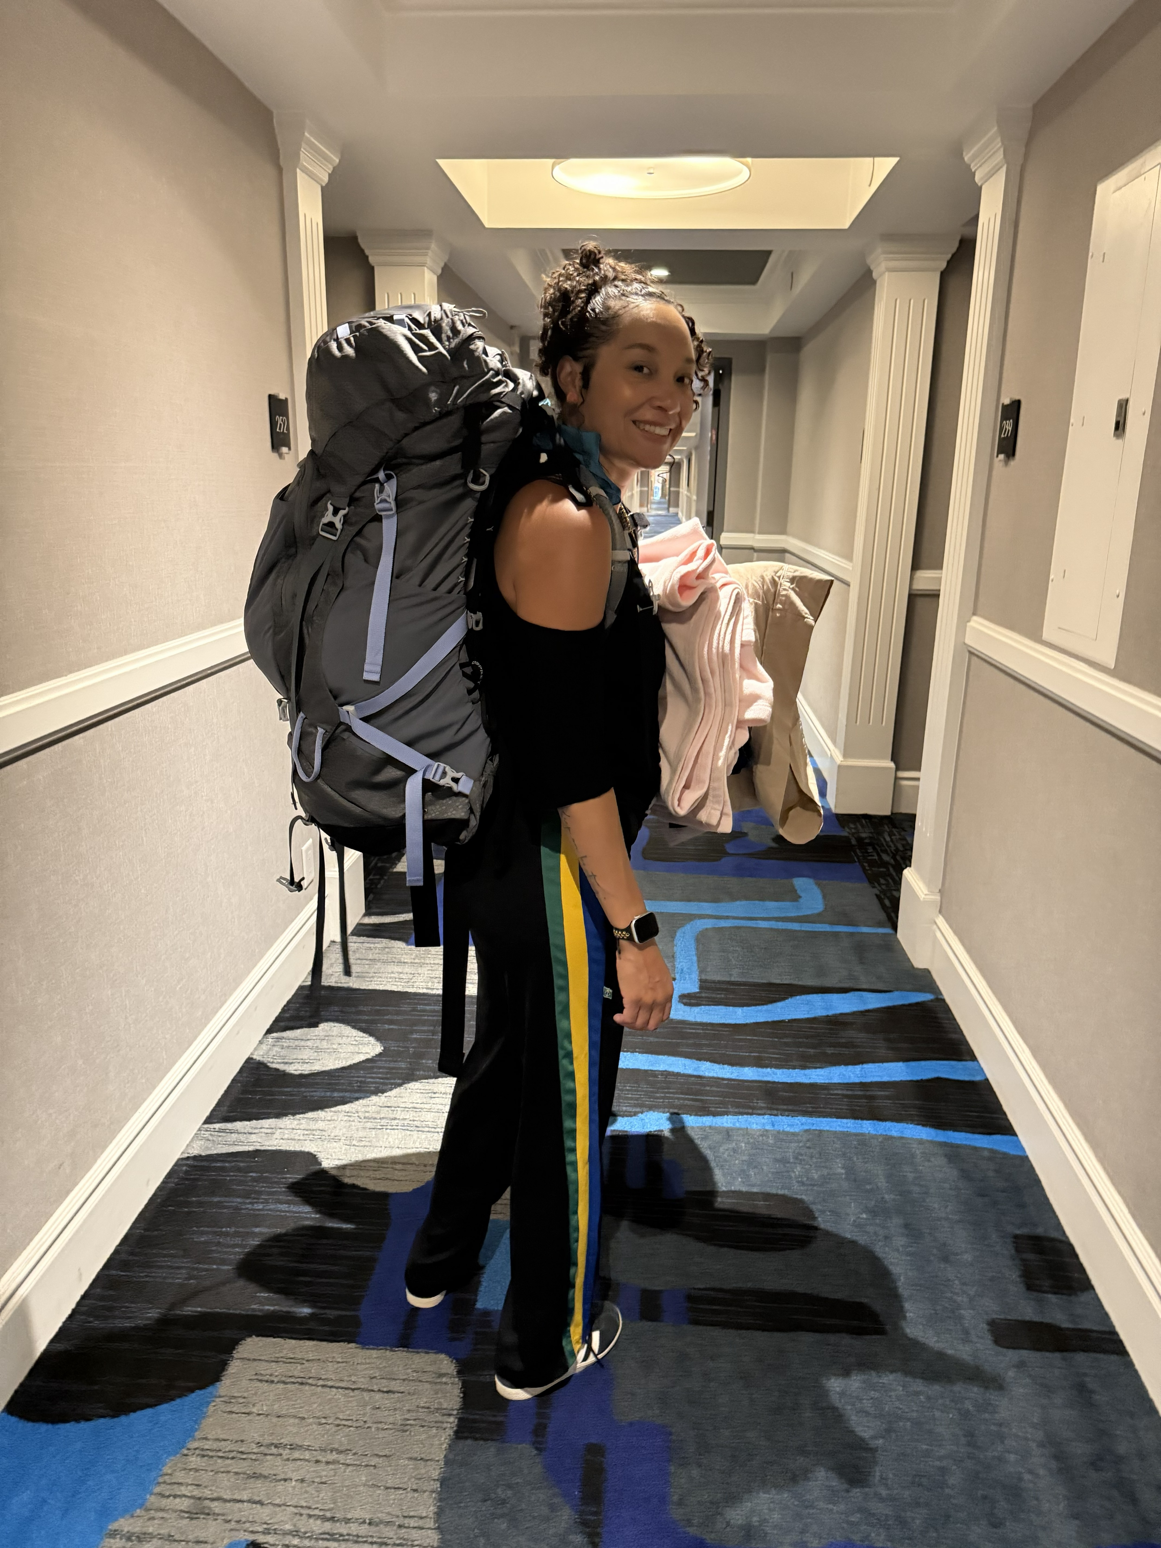
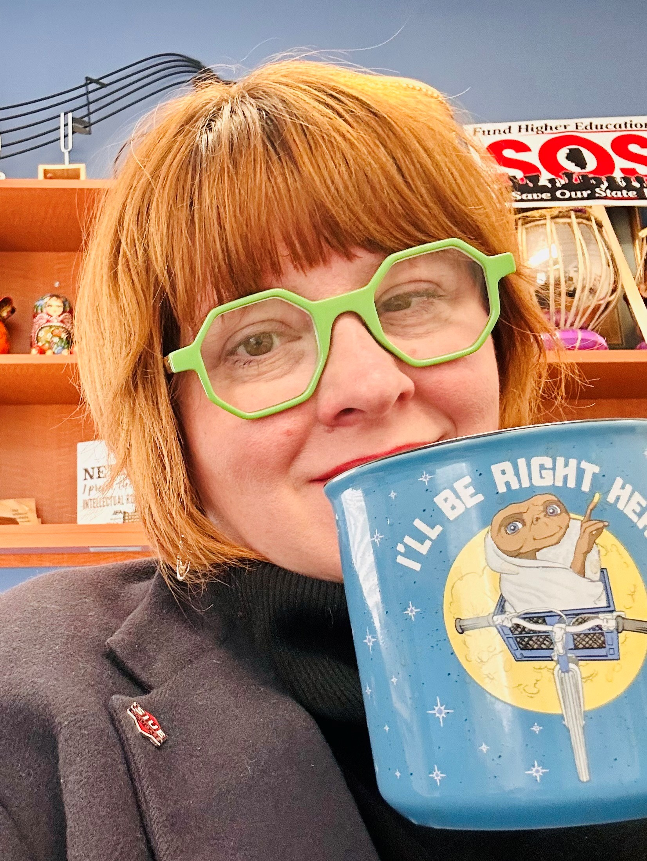
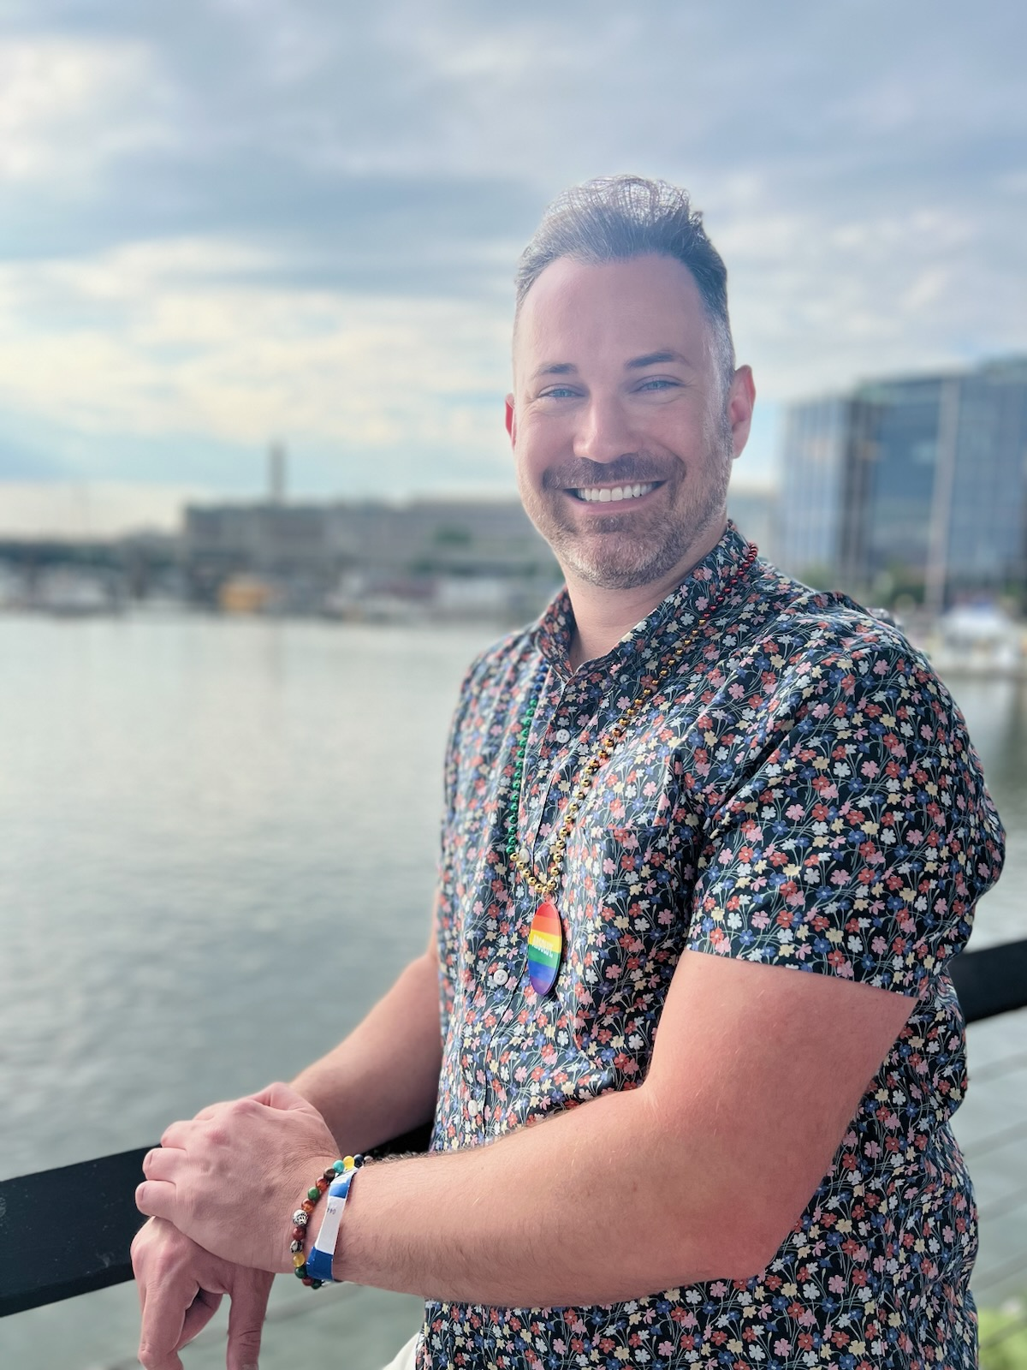
Introductions- Training Team
Natasha Eckart
She/They
Vermont
Ellen Holmes
She/Hers
NEA
Sara Fitouri
She/Her
Colorado
Keira McNett
She/Her
Washington, D.C.
Alex Lucini
He/Him
Rhode Island
Zac Johnson
He/Him
Colorado
Salina Serricchio-Joiner
She/Her
California
Rachel Tollett
She/Her
Illinois
Anthony Brisson
He/Him
Washington, D.C.

Slide 12

Community Agreements pg. 2 (Pre-Attendance)
Awareness and Self-Knowledge
Listen for Understanding
Be Gracious
Stay Engaged
Be Open and Suspend Judgment
Say “I”- tell your truth
Seek Discomfort
Reach for Empathy
Expect non- Resolution and non-Closure

Slide 13
Acknowledgement
Adapted from Transatlantic Notes
The content we are going to explore may bring up strong feelings. Throughout our time together, we will explore examples of racism, ableism, heterosexism, and sexism. By exploring these together, we can begin the process of unlearning our own internal oppression.
The purpose of unlearning isn’t about forgetting what we know or about being wrong; it’s a conscious act which requires critically examining the ideas and assumptions that influence our expectations, behaviors and beliefs about ourselves and other people. By doing this, we can challenge the cultural and structural norms that perpetuate racism and oppression.
Unlearning is something we can all be committed to because we all have a part to play in dismantling everything that helps maintain racism within society.

Slide 14
Anthony

Slide 15
Why we are here!
47% of LGBTQ young people seriously considered attempting suicide in the past year. [1]
A majority of LGBTQ+ people say that they or an LGBTQ+ friend or family member have been threatened or non-sexually harassed (57 percent), been sexually harassed (51 percent), or experienced violence (51 percent) because of their sexuality or gender identity. [2]
NEA RA Support and Part of NEA Mission and Vision (in "Additional Resources" on POPS
[1] The Trevor Project, Project SPARK Interim Report: A Longitudinal Study of Risk and Protective Factors in LGBTQ+ Youth Mental Health.
[2] National Public Radio, the Robert Wood Johnson Foundation, & The Harvard T.H. Chan School of Public Health. (2017, November). Discrimination in America: Experiences and views of LGBTQ Americans. Retrieved June 24, 2020 from https://www.rwjf.org/en/library/research/2017/10/discrimination-in-america--experiences-and-views.html
Notes:
Interim SPARK Report brings rate of suicide attempts up to 47% from 41% in 2023
Bring in historical grounding/establish current framework
Kiera's slide: inversion of political landscape
Maybe a slide with headlines

Slide 16

Why we are here!

Slide 17
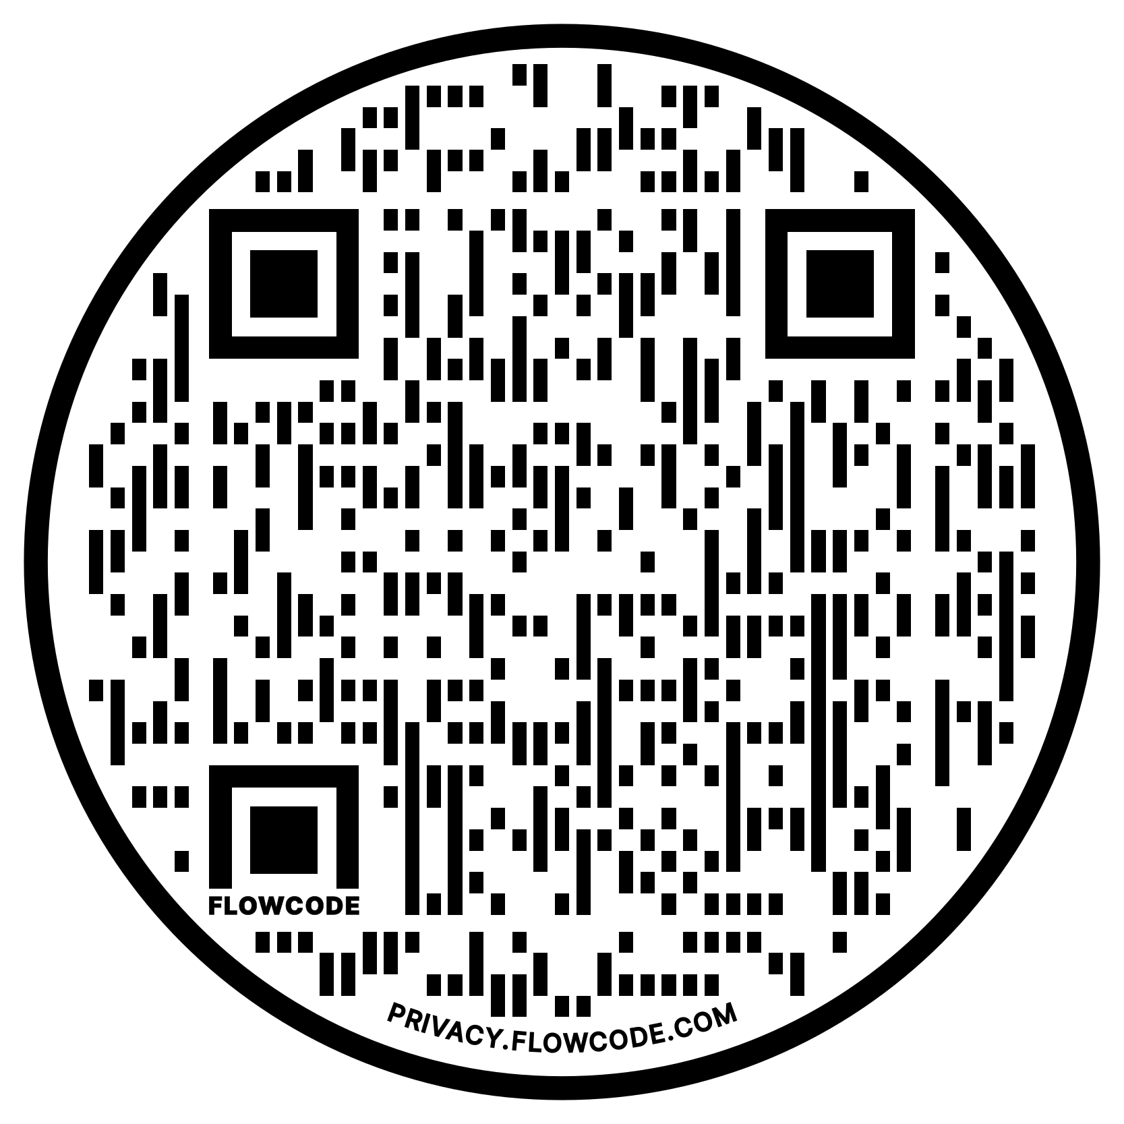
NEA Vision, Actions, Resources
Safe, Just, and Equitable Schools
Resolution adopted by the 2022 NEA Representative Assembly
2021 NBI 32
Training on Transgender Advocacy Issues for Affiliate Staff
NEA LGBTQ+ Caucus Resources
www.nea-lgbtqc.org/imhere.html
Notes:
The National Education Association's (NEA) Policy Statement on Safe, Just, and Equitable Schools aims to create safe and welcoming learning environments for all students
Campaign lab – teams can receive coaching

Slide 18
The Words of Our Members
“Know that even if you do not personally know of any LGBTQ+ staff person in your district, they are there. Be an ally even if you do not know them. Speak up when you hear, see, or perceive bias and/or discrimination. Advocate for inclusive policies for both students and staff.”
18
Notes:
Add quote from pre-survey

Slide 19
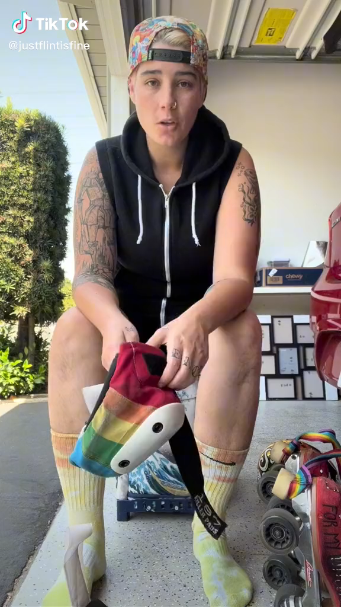
Notes:
Connect to current political landscape

Slide 20
Natasha

Slide 21
Ice Breaker
Find a partner that is not from your state
Be prepared to share a fun fact about your state or city with the group

Slide 22
Core Values
Core values are the fundamental beliefs of a person. These guiding principles dictate behavior and can help people understand the difference between right and wrong – These can often be expressed using one or two words. We are taking a moment to consider our core values because they can provide a basis for solidarity in the midst of struggles.

Slide 23
Sharing Values for Solidarity
Core Values
1. Name
2. Core Value – One or two words that describes a fundamental belief held by you
**15 Seconds Each**
Core values are the fundamental beliefs of a person. These guiding principles dictate behavior and can help people understand the difference between right and wrong – These are expressed using one or two words.

Slide 24

Key Ideas
Solidarity
sol / i / dar / i / ty
Noun
  1. Unity or agreement of feeling or action especially among individuals with a common interest, mutual support; mutual support within a group.
Shared Core Values are critical for building solidarity in our work.

Slide 25
Sara

Slide 26
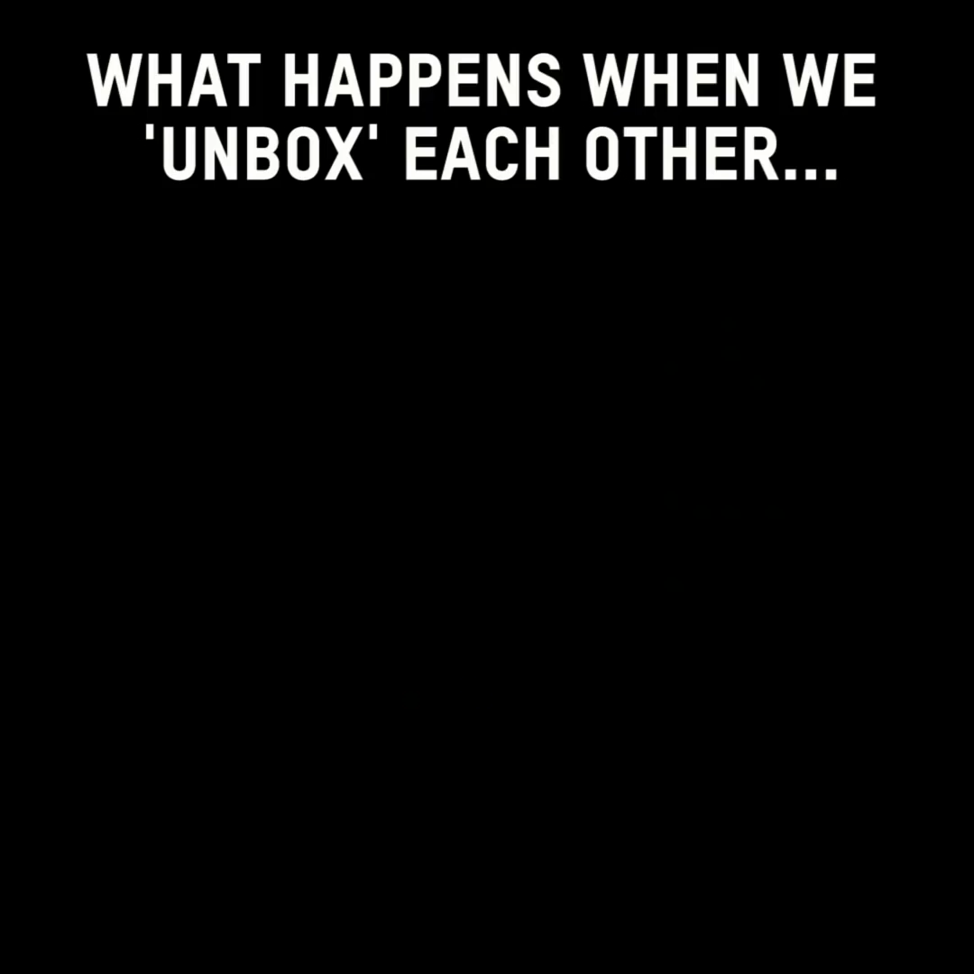

Slide 27

Shared Identity
Gather around an identity of your choosing
Answer the following discussion questions:
Why did you select this piece of your identity?
What are some challenges you face with this identity?
Notes:
10:00-10:15
Around the room: musician, traveler, foodie, planner, nature lover, pet owner
Beliefs are different than identity

Slide 28

Shared Identity
Debrief:
What was something you learned about someone else?
What was easy/hard about this activity?
How safe did you feel sharing in this activity?
What is similar about each of these identities?

Slide 29
Key Ideas
Discreet identities bind us
We all have pre-conceptions that might not match an actual identity of another
We don't get to assign a person's identity for them

Slide 30

15 Minute Break!
Please go to Kahoot.it and enter code:
Additional codes are on chart paper to the side of this screen.
Notes:
Update the influencers

Slide 31
Salina

Slide 32
Centering Race, Class, and Gender

Slide 33

TEAMWORK
Make a list of LBGTQ+ problems workers face in our schools.
What will it take to achieve equity for the people who work and learn in our schools?

Slide 34
How does a union build and transform their power?
Programs (club culture)
Build Presence
Episodic
Member Recruitment
Committee/Program Leaders
Low Risk
Often Staff Led
Power in Policy
Campaigns (fighting unions)
Public Action and Demands
Strategic and Ongoing
Continues to Add
  Base – Mobilizers – Leaders
  Allies – Partners – Coalitions
Requires Risk
Supported by Staff
Leaders Build and Use Power
Notes:
How does a union build and transform their power?
Programs tend to be exclusive and exclusionary. They only allow a certain number and/or type of person. Campaigns seek to include as many people as possible.
Programs, such as professional learning, staff led advocacy, social focused events, even policy advocacy do little to build power. Why is that? Well all of these programs are self-selected with little risk to join or leave them. I want to improve my classroom management, so I come to the Union led training on that. I might even lead one – but I have done little to build power with others. Also in a program, I am choosing to solve a “me” Problem and it does not require any other collective commitment.
Campaigns put people at the center of solving the problems they are experiencing. They name the issue, they decide the solution, they decide who they follow, and they determine what they are willing to risk. When we center people in a campaign – staff move to a coaching role. When people are at the center they use their agency and decide how to act, who they will act with, and what they are willing to risk to win. This is when members and leaders feel powerful in their union.
To begin a campaign you have to ask what the people want to solve, ask what they are willing to risk to solve that, and form demands that they think will provided the solution to their problem.

Slide 35
Centering Race, Class, and Gender Justice
Bargaining for the Common Good – RJE Guide pg. 40
Race, class, and gender justice is the systematic fair treatment of people resulting in equitable opportunities and outcomes for all.
It is not just the absence of discrimination and inequities, but also the presence of deliberate systems and supports to achieve and sustain race, class, and gender equity through proactive and preventative measures.
Notes:
What does it mean to center racial, class and gender justice? P. 40 in PH
Race, class and gender dynamics, disparities, and divisions permeate our society, communities, schools, and classrooms. Systemic oppression is so deeply rooted in our history, culture, and institutions that there is no escaping it. Visible or not, the impacts are ever-present. Race, class, and gender justice is the systematic fair treatment of people of all races, resulting in equitable opportunities and outcomes for all. It is not just the absence of discrimination and inequities, but also the presence of deliberate systems and supports to achieve and sustain race, class, and gender equity through proactive and preventative measures.

Slide 36

Race, Class, Gender Equity Tools
Links on pg. 40 of Bargaining for the Common Good - RJE Guide
What they do:
Proactively seek to both eliminate systemic barriers and advance equity
Identify clear goals, objectives and measurable outcomes
Develop mechanisms for successful implementation
What they are:
A set of questions used to anticipate, assess, and prevent potential adverse consequences of proposed actions on different race, class, or gender groups.
Notes:
To continually and systematically keep equity in your work you have to use a Race, Class, and Gender Equity tool (p. 40 & p.41-43), or lens. This is a person and institutional commitment to
Proactively seek to both eliminate systemic barriers and advance equity
Identify clear goals, objectives and measurable equity outcomes
Develop mechanisms for successful implementation of equity focused programs
A set of questions used to anticipate, assess, and prevent potential adverse consequences of proposed actions on different race, class, or gender groups.

Slide 37
Key Points about Equity Tool Success
Buy in from the organization and its leaders
Routine and ongoing use of the RET
Data- driven assessment
A commitment to making changes
Tenacity – A commitment to overcoming obstacles to making changes
WE HAVE TO DECIDE TO DO THINGS DIFFERENTLY AND STICK WITH IT

Slide 38
For each of the answers in step 1, ask these 4 questions.
For each problem ask these questions:
​Who is most directly impacted?
Who has been left out?
How can they be directly engaged?
How do our demands advance race, class, or gender justice?
Notes:
Step 1
Looking at your PROBLEM CHARTS – consider the c4 Organizing Questions for at least one of your problems - Who are my people? What are their issues?What do they Demand? What are they willing to risk to achieve that demand?
Step 2- Apply the following Equity Tool:
Who is most directly impacted?
Who has been left out?
How can they be directly engaged?

Slide 39
Key Ideas
Intentional campaigns, not programs build power.
Centering race, class, and gender justice in our campaigns increases the people engaged, the number of leaders involved, and the amount of resources we have to win the change we want.
Power is only built through people with a shared vision, making public commitments to act, to risk their collective resources, for the meaningful change they want.
If your campaign is not designed from the beginning to include those with the least amount of power, the least amount of privilege, the least amount of resources – there is no way to retool a campaign to include them.
Notes:
Intentional campaigns, not programs build power.
Centering race, class, and gender justice in our campaigns increases the people engaged, the number of leaders involved, and the amount of resources we have to win the change we want.
Power is only built through people with a shared vision, making public commitments to act, to risk their collective resources, for the meaningful change they want.
If your campaign is not designed from the beginning to include those with the least amount of power, the least amount of privilege, the least amount of resources – there is no way to retool a campaign to include them.

Slide 40
Alex

Slide 41

LGBTQ+ Terminology Review
Notes:
Replace with kahoot vocab review
Put after 1st shared identity activity

Slide 42
LGBTQ+ Terminology
Turn and Talk (5 minutes):
What terms did you mark as unclear or confusing?
What terms were new to you?
Were there any definitions that differed from your prior understanding?
Notes:
Replace with kahoot vocab review
Put after 1st shared identity activity

Slide 43
LGBTQ+ Terminology
Report out-Large Group :
What terms still have unresolved questions?

Slide 44
Language Changes
Terminology around race and ethnicity changes every 10 years.
Terminology around gender, identity, and sexual orientation changes every 2 years.
Notes:
QUILT BAG

Slide 45
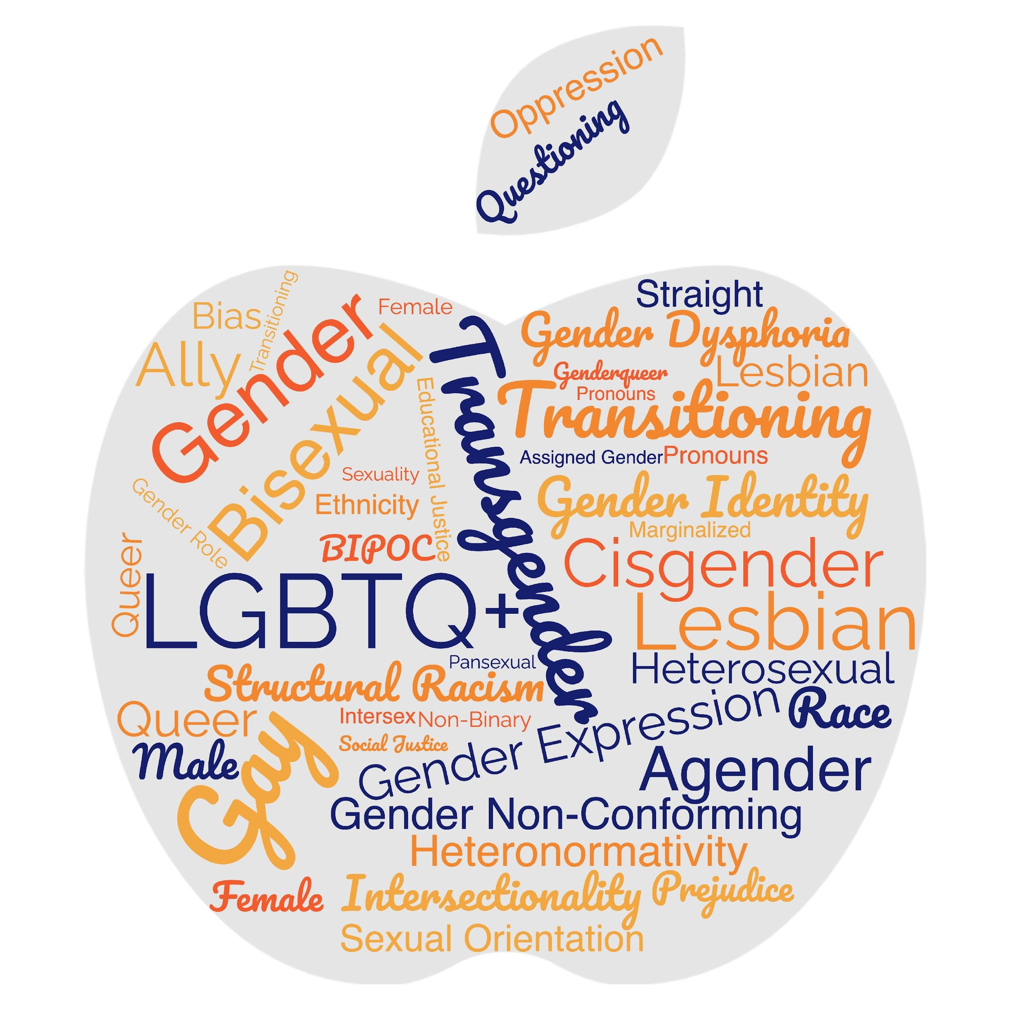
Turn and Talk
What makes a word a slur?
(or)
Who decides
what makes a
word offensive?

Slide 46
Turn and Talk
Words you might hear on the tour...be prepared.
Oppressed communities are not monoliths. Ask don't assume.

Slide 47
Terminology Debrief
Let’s Ask the Room Debrief
What surprised you?
What is your biggest opportunity for growth?
Who has a helpful “hint”?
What else may you need?
Notes:
2:00-2:30

Slide 48
Key Ideas
Terminology matters in making sure that people feel seen and included in spaces.
The lived experience of someone is more important than what you think you know.
These terms change rapidly.
We can never assume we have mastered these concepts.
We need to continue to be humble and learn!

Slide 49
Natasha

Slide 50

On Your Own First...
First Impressions Activity
Notes:
11:00-11:30

Slide 51
Reflect on Your Own – Create a Word Doc pg. 4 Participant Handouts
1. When’s the first time you can remember learning that some people are lesbian, gay, bisexual, or queer?
2. Where did most of the influence of your initial impressions/understanding of lesbian, gay, bisexual, and queer people come from? (e.g., family, friends, television, books, news, church)
3. When’s the first time you can remember learning that some people are transgender?
4. Where did most of the influence of your initial impressions/understanding of transgender people come from? (e.g., family, friends, television, books, news, church)
5. How have your impressions/understanding of LGBTQ+ (lesbian, gay, bisexual, transgender, and queer/questioning) people changed or evolved throughout your life?

Slide 52
Debrief - First Impressions Activity
What was it like to do that activity?
Does anyone have something that came up for them while they were answering the questions that they would like to share? Does anyone have an experience that was significantly different that they’d be interested in sharing?
What about question 5, would anyone share how their understanding of these issues have changed over time?

Slide 53
Key Ideas
Our perceptions, beliefs, and biases are shaped passively, intentionally and reside in our unconscious.
These can be reshaped.

Slide 54
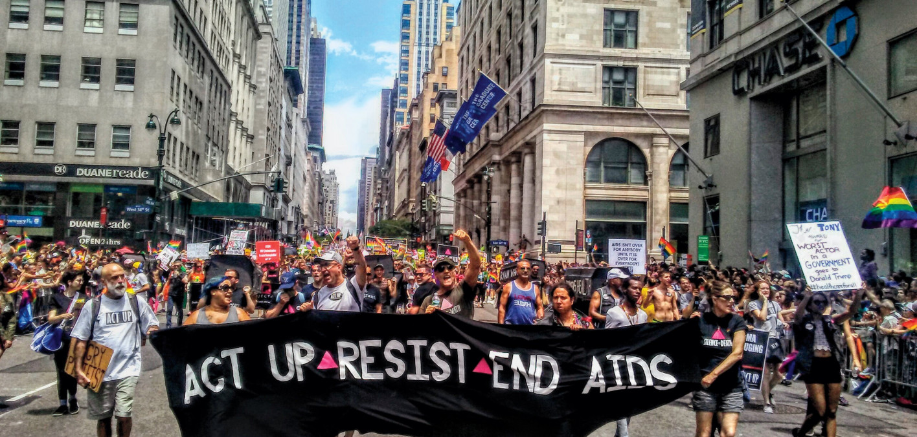
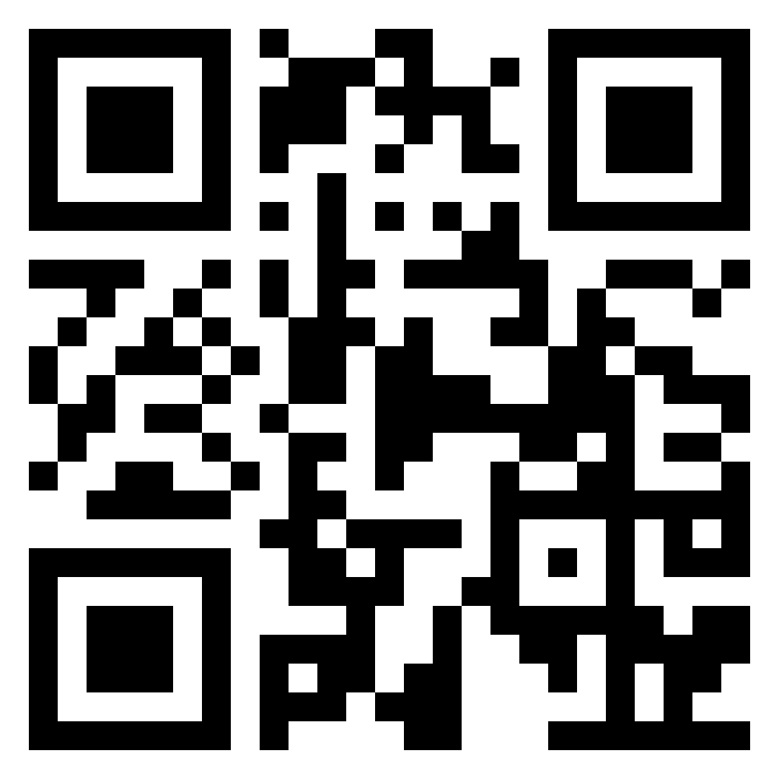
Lunch
1 hour for Lunch!
Over lunch, learn more about ACT UP! Add the documentary “United In Anger” to your cue! (available on Prime and Youtube!)
www.justwatch.com/us/movie/united-in-anger-a-history-of-act-up

Slide 55
Zach
Notes:
Put in day 2 of shared identity activity here

Slide 56
Shared Identity
Gather around an identity of your choosing
Answer the following discussion questions:
Why did you select this piece of your identity?
What are some challenges of this identity?
Notes:
Replace with Day 3 identity

Slide 57
Shared Identity
Debrief:
What was something you learned about someone else?
What was easy/hard about this activity?
How safe did you feel sharing in this activity?
How do your reactions to today's prompts compare to yesterday?
Notes:
Ben 10:00-10:15

Slide 58
Key Ideas
Discreet identities bind us
We all have pre-conceptions that might not match an actual identity of another
We don't get to assign a person's identity for them

Slide 59
Rachel
Notes:
Put in day 2 of shared identity activity here

Slide 60
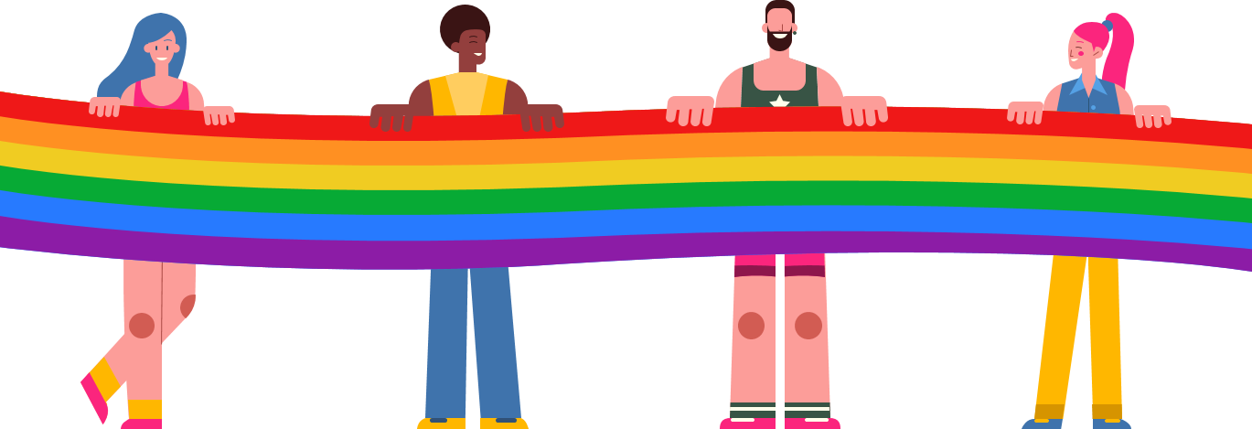
Timeline Activity
Look and read your Arc of LGBTQ+ Oppression and Justice Over Time Card.
Notes:
Be very strategic about curating cards and rethink activity process

Slide 61
Timeline Debrief
What were new events that you learned about?
Why do you think this was new to you?
What other communities of people in the United States have had their history erased?
What impact do you think this has on people who hold these identities?
What impact do you think this has on people who don’t hold these identities?
Notes:
Rethink these debrief questions, make them connect to the goals of the training: coalition building, power analysis, etc
Create some new updated timeline cards to show correlation between history and Trump's 2 terms
ACLU has updated timeline
LGBTQ under fascism around the world

Slide 62
Key Ideas
Oppressed people’s stories are deliberately kept out of the telling of the story of what we know as the United States of America.
What we now call the United States of America is still an uncomfortable, awkward, and sometimes unsafe place to be a member of the LGBTQ+ community.

Slide 63
Sara
Notes:
Put in day 2 of shared identity activity here

Slide 64
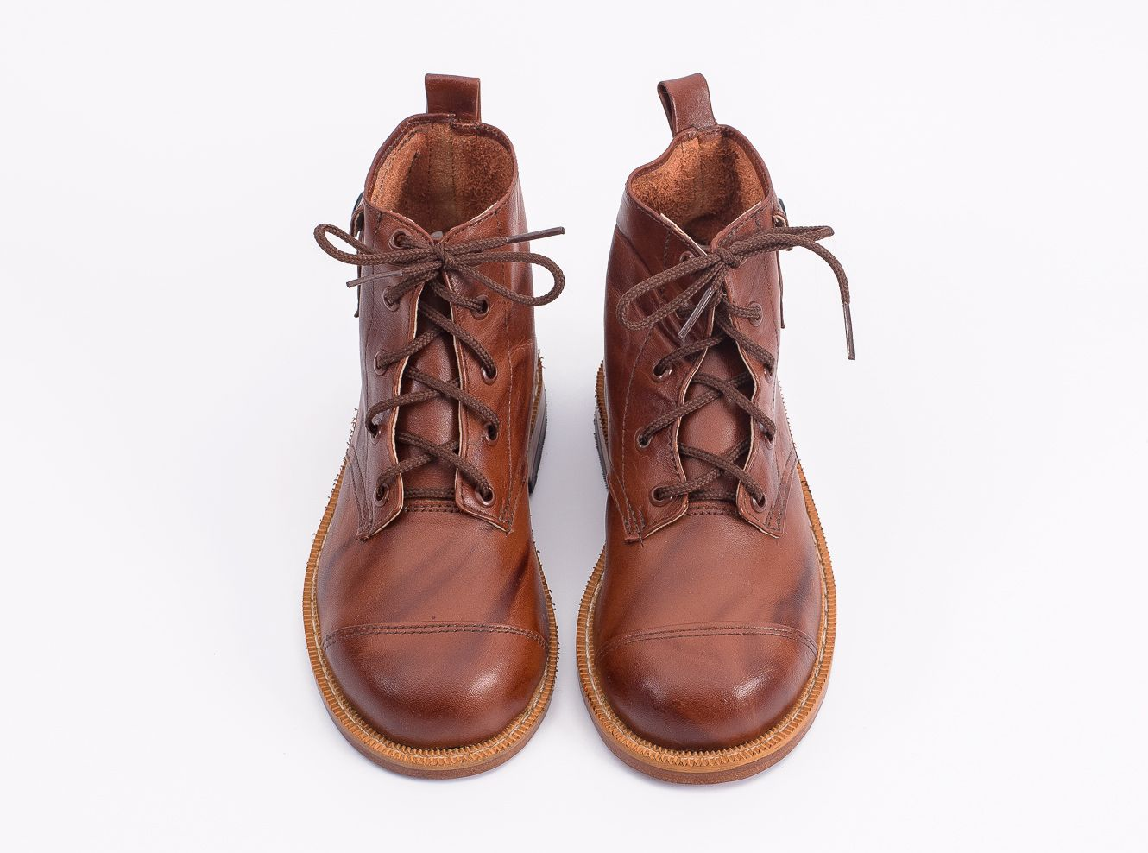
Movement and Change
64
Notes:
1:00-
Presenter Note:
Ask each participant to switch their left and right shoes (left shoe on the right foot, right shoe on the left foot). Say it’s part of the training, and then move on. DO NOT mention their shoes further. (The objective is that participants will experience a familiar but uncomfortable sensation that their shoes are on the opposite foot. This will help them experience, in a non-threatening way, the uncomfortable, awkward feelings or fear that transgender or gender non-conforming people may experience while they are in public.)

Slide 65

Transgender Terminology
Transgender
Binary
Trans man
Trans woman
Non-Binary
Genderqueer
Genderfluid
Bigender
Demiboy
Demigirl
Agender
Neutrois
…and more!
65
Notes:
Language in the LGBTQ+ communities changes very quickly. Language in ethnic communities changes about every ten years while language in the LGBTQ+ communities changes about every two years.
Transgender/Trans: This is an umbrella term for people whose gender identity and/or expression is different from cultural expectations based on the sex they were assigned at birth. Being transgender does not imply any specific sexual orientation. Both binary and non-binary genders and gender expressions fall under the umbrella.
Often, we hear transphobic comments when the appearance of Black and Brown bodies are compared to white/Eurocentric views of femininity. For example, internet conspiracy theories have long criticized the natural muscular frame of tennis superstar Serena Williams, and even former First Lady Michelle Obama. Obviously, these comparisons are harmful, and are just one example of how hate, prejudice and fear show up.

Slide 66
Binary & Non-binary
Gender Identities
BINARY
NON-BINARY
MAN WOMAN
A person who does not identify exclusively as a woman or man. They may be both, somewhere in between, or outside the categories of woman and man.
66
Notes:
Binary and non-binary are two types of gender identities.
Gender is a social construct. What it means to be male and what it means to be female are concepts created by humans, and over time, those definitions and views became generally accepted by society at large. Most of us align with these long-standing definitions of male and female and feel comfortable saying so.
A non-binary person is someone who does not adhere to these gender expectations or stereotypes. The binary—being male or female—will feel very foreign to them.

Slide 67


Binary & Non-binary
NON-BINARY
“It’s not that I don’t fit into being a man or woman.
I don’t see a difference.”
67
Notes:
For a non-binary person, their gender identity does not fit within the binary of male and female.
While we might see two separate colors, yellow and blue, a non-binary person may only see green. Someone who is agender (or who has no gender identity) might only see gray.
This is why non-binary is a gender identity and not a gender expression. Non-binary people are not attached to gender.

Slide 68
Key Ideas
Gender identities are constructed as binary, however, people's identities are much more fluid.
People who identify as non-binary express their gender identity in many ways
People's gender identity and sexual orientation can shift at different times.

Slide 69
"But science says..."

Slide 70
Intersex
Intersex is a general term used for a variety of people born with a reproductive or sexual anatomy that doesn’t fit the typical definitions of female or male.
Intersex
XO
XXX
XXY
XYY
Male
XY
Female
XX
70
Notes:
Intersex conditions comprise more than 30 natural genetic variations. Historically, these variations have not been socially acceptable.
Proposed laws focused on the rights of transgender people regarding restroom usage, participation in sports, and even access to specific health care coverage, and have centered on genitals or proposed chromosome tests. These laws also affect the intersex community, who are often entirely ignored or left out of those conversations.
More people are intersex than we realize. In the past, this was often discovered in testing for the Olympic games, because some women were subjected to gender testing if they were thought to have a perceived physical advantage.
Scientists say there is no clear definition of male & female – that one’s sex includes more than just physical anatomy. It also includes hormone levels, chromosomes, and more.
The LGBTQ+ movement is now often referred to as LGBTQIA+ to include intersex people because of the similar issues facing each group around body autonomy and identity. (The “I” is for Intersex and the “A” for Asexual, which is a lack of sexual attraction.)

Slide 71
Trans identities
Trans woman
Trans girl
Someone assigned a male sex at birth who knows themselves to be a woman (or girl).
Trans man
Trans boy
Someone assigned a female sex at birth who knows themselves to be as a man (or boy).
Trans-feminine
Trans-masculine
Descriptive terms that transgender people use to explain where their gender expression lies.
71
Notes:
Please note that “transgender” or “trans” are adjectives. They are terms that describe. A person is transgender, not “a transgender.”
A trans woman (or trans girl) is assigned a male sex at birth but knows themself to be a woman. Alternately, a trans man is assigned a female sex at birth but knows themself to be a man.
Someone who is transmasculine, identifies on the masculine side of the gender spectrum, but may not identify as a man. The same is true for transfeminine people. They may identify as more female, but not see themselves as a woman.

Slide 72
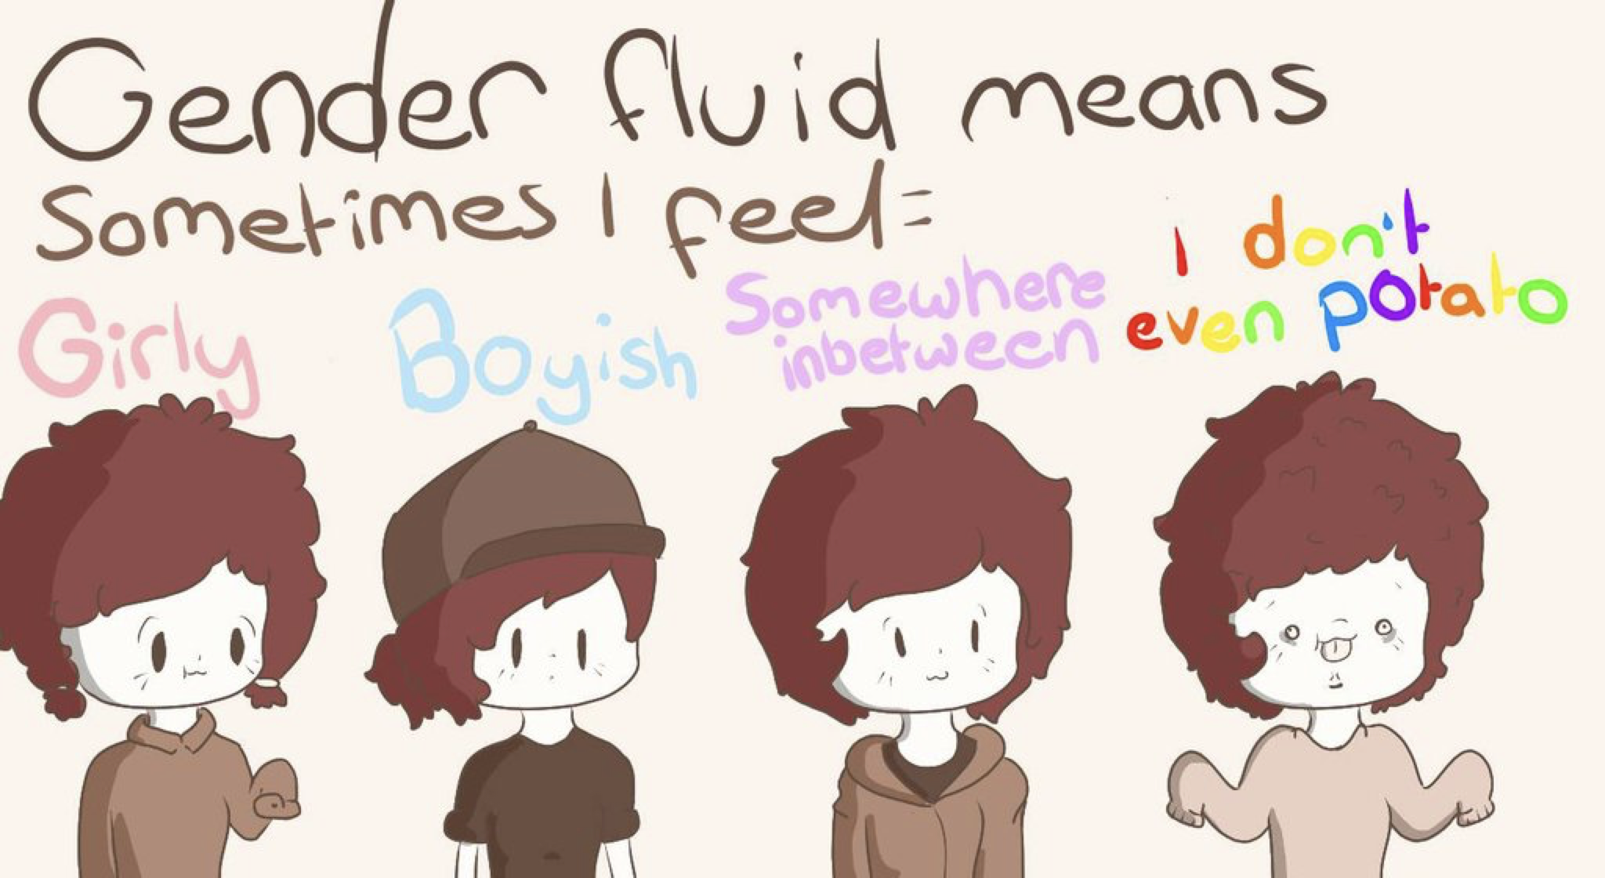
Other Gender Identities
Gender Fluid Genderqueer Agender
72
Notes:
Gender fluid is exactly what it sounds like. Gender flows in a more masculine way at times and in a more feminine way at others, with no internal struggle between the two. That fluidity could happen over many years, or it may fluctuate during a week.
Genderqueer people are fluid in their gender and often their sexuality. People who consider themselves genderqueer will often say that no rules apply. They like what they like, who they like, and feel the best living outside of any boxes.
Older generations often regard the word “queer” as a derogatory term. It causes LGBTQ+ people of a certain age to feel pain and relive some tough times when they hear it. But younger generations have reclaimed the word and are using “queer” for themselves. They don’t want to be narrowly defined as gay, lesbian, bi, or trans. Because there is respect for the spectrums of gender and sexuality, “queer” feels more all encompassing for who they are.
Agender is the last term on this slide, and it describes someone who does not have a gender. Agender people can feel no connection to the concept of gender at all. They may feel genderless or gender neutral.

Slide 73
TERMINOLOGY TO AVOID:
Best Practice: People first thinking—ask the individual what they would like to be called!
Don’t use… | Because… | Use…
a Transgendered | Trans is not a noun! Trans is an adjective that helps describe someone’s gender identity. | “Person who is Transgender” or the identity the person chooses for themselves!
Homosexual/ Homosexuality (unless someone chooses it for themselves) | This term comes across clinical and dog whistle-y | The identity someone chooses! LGBTQ+ as an umbrella.
“Sexual preference”, “homosexual lifestyle” | These words have been co-opted as dog whistles to suggest gayness is a choice. | “Sexual Orientation”
“Sex Change”, “Pre-op/Post-op” | These are antiquated and centralize surgeries and anatomy as a determining factor in gender identity. | “Transition” or “gender confirmation surgery”
“Biologically male/female” | It is rarely relevant what sex someone was assigned at birth and this suggests that trans women/men are not “real” women/men | IF NECESSARY… Assigned Female/Male at Birth (AFAB/AMAB)
"Hermaphrodite" | This is a super stigmatized word! | Intersex
Notes:
Added some from here- https://freedomforallamericans.org/messaging-terms-avoid/ (Sara)

Slide 74
Key Ideas
There is a long history of language being weaponized to harm members of the LGBTQ+ community.
We must be intentional with our language and how we show up.
Again, a lot of this language is constantly changing, it is our responsibility to adjust and learn.

Slide 75

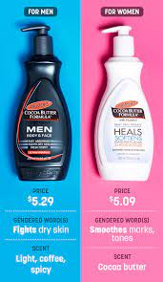



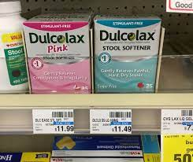
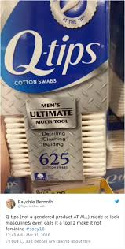
Turn and Share
Notes:
How do we see the gender binary popping up now

Slide 76
Gender binary on national scale
Gender binary within school house/district
Notes:
Add movement here- post-it notes onto chart paper

Slide 77
Gender binary in context of contract language and policy

Slide 78
Debrief
    What surprised you?
    What didn’t surprise you?
    How are you benefiting from our gender binary?
    How are you harmed by gender binary?
Notes:
Rewrite these questions, make it more agitational

Slide 79
Shoe Debrief
How did it feel to have your shoes on the wrong feet?
What connections can we make between the uncomfortable, awkward feelings of having your shoes on the wrong feet to what transgender or gender non-conforming people may experience while in public?
79
Notes:
1:00-
Presenter Note:
Ask each participant to switch their left and right shoes (left shoe on the right foot, right shoe on the left foot). Say it’s part of the training, and then move on. DO NOT mention their shoes further. (The objective is that participants will experience a familiar but uncomfortable sensation that their shoes are on the opposite foot. This will help them experience, in a non-threatening way, the uncomfortable, awkward feelings or fear that transgender or gender non-conforming people may experience while they are in public.)

Slide 80
Key Ideas
We have a rigidly enforced gender binary that we experience in our day to day lives.
Everyone deviates from gendered expectations in some ways.
Folks under the transgender umbrella face oppression from these rigid social expectations.

Slide 81
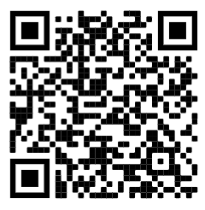
15 Minute Break!
Break time!
In the pre-attendance work, there were a lot of terms we never learned in sex ed! Check out this website of best practices for talking with kids about sex. (You might learn something new, too!)
https://sexpositivefamilies.com/10-best-sex-ed-resources-for-families/
Notes:
101 gender binary information

Slide 82
Zac and Sara
Notes:
Put in day 2 of shared identity activity here

Slide 83
ACTIVITY | GENDER-NEUTRAL WORLD
Topics related to sexual orientation and gender come up in society more often than we may realize.
Stereotypes about gender and sexual orientation often inform policies, practices, and traditions.
Reflect on the customs and norms within your learning community and answer the following questions in table groups.
Notes:
Modify last bullet to reflect contract activity

Slide 84
Contract and Policy Language (pp. 5-7)
Count off by 5
Once grouped, review your language (15 min)
  Identify who is left out by the language presented
  Rewrite the language to be more inclusive
  Identify what barriers may exist to making the changes.
  If you finish—look at another issue of your choice
Select a person to provide a 3 min report
Notes:
Beef up these examples
Bring in VT transgender athletes policy

Slide 85
Model Language
Model language:
Additional Participant Resources >
  "Bargaining to Protect LGBTQ Rights"
  "LGBTQ+ in Education" (Colorado)
  Sample Transition Support Plan

Slide 86
Key Ideas
Using language that is inclusive in our contracts and policies is one small way of moving towards LGBTQ+ equity
When we know better we do better
Barriers may include our members—we need to be willing to introduce the conversation

Slide 87
Alex
Notes:
Put in day 2 of shared identity activity here

Slide 88
Gender
Gender
Identity
How you feel. Female, male, both, or neither.
Gender
Expression
The ways you show your gender identity.
Gender
Role
A social role based on a person’s sex.
88
Notes:
Gender, or gender identity, is that internal sense of self we just mentioned—the feeling of being male, female, both, neither, or somewhere in between.
Gender expression includes all the ways you show your gender to the world. For example, your hair and clothes, how you cross your legs, how you walk, and even your voice inflections. Some of these are innate, and some are learned from our cultural norms.
Gender roles are social constructs based on one’s sex or biological attributes. They can be very different from one culture to another. These roles can become so internalized that they create stereotypes or an implicit bias within us (e.g., assuming nurses are women, or mechanics are men).
Gender non-conforming simply means the person is breaking cultural or social rules about gender roles and/or expression.
There is a huge difference between not conforming to certain societal norms and expectations for one’s gender and having an internal identity that is not in alignment with one’s biological sex.
A Note About Phobias:
A phobia is a persistent, irrational and exaggerated fear of an object, person, activity, animal or situation. Homophobia is a fear of people who are gay and lesbian. Transphobia is a fear of people who are transgender. When someone’s identity challenges a person’s expectations or preconceived notions of male and female, they may go into a panic. The incongruence of what someone sees, and what they think creates fear and misunderstanding.
We say “i-dentity” because it’s about the individual and how they personally identify, not “you-dentity” because of how you want to determine someone else’s existence.

Slide 89
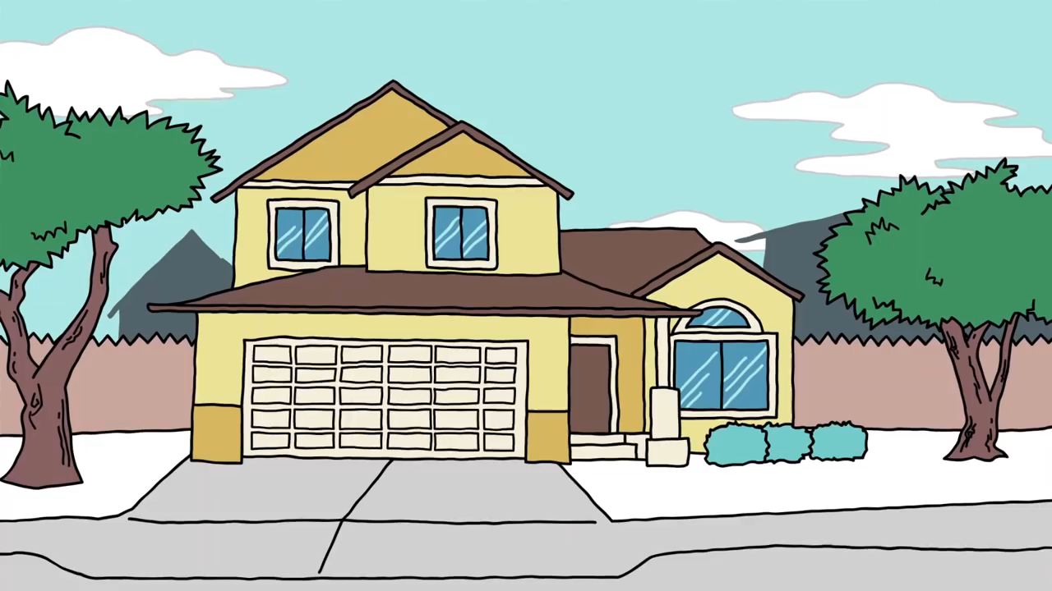
Explaining Gender Identity
Range of Gender Identities
89
Notes:
Video: https://youtu.be/i83VQIaDlQw
(3 minute)
This video offers a simple way of looking at various gender identities (~3 mins).
Debrief the video with these three questions:
What is the gender binary? How many of you grew up thinking the only gender options were male or female?
What does it mean to be non-binary?
What is the difference between transgender and non-binary?

Slide 90
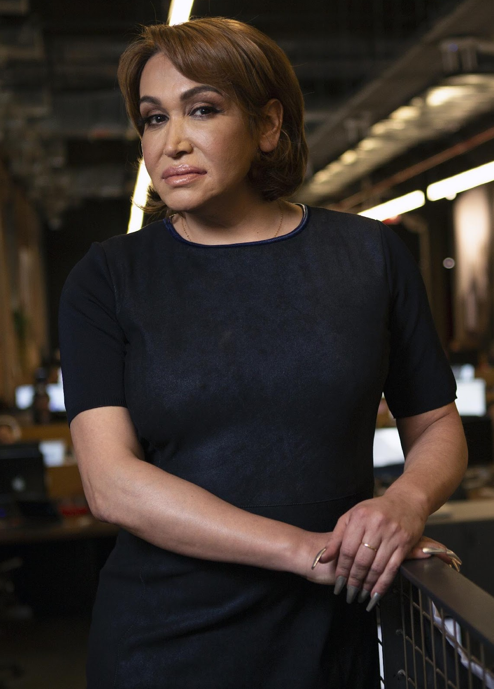
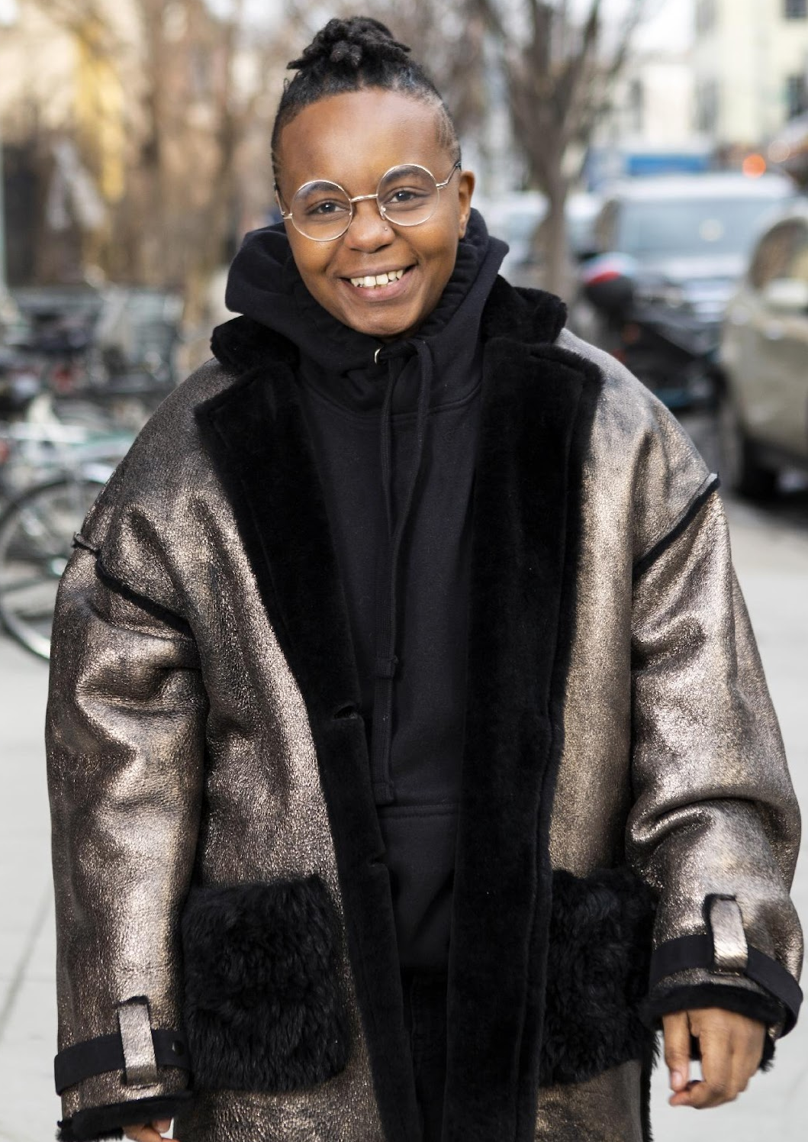
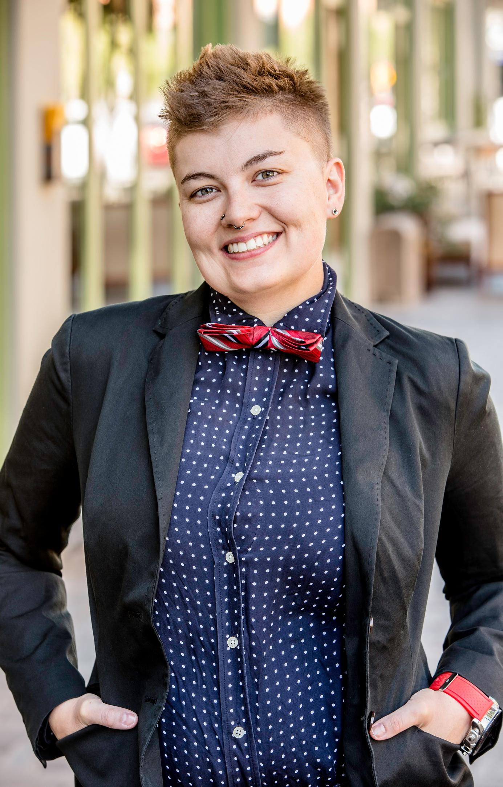
Gender Expression
A transgender woman
in an office.
A transmasculine person in a winter coat.
A gender-fluid woman on a city sidewalk.
Photos courtesy of the Gender Spectrum Collection.
90
Notes:
Transgender, non-binary, and gender non-conforming individuals show their gender to the world in many ways. Just as cisgender people have different hairstyles, clothing choices, mannerisms, and more, the same is true for trans, non-binary, and gender-non-conforming people. There is no “one way” to look to be any gender.
These images are from the Gender Spectrum Collection – a group that works with trans and non-binary models. In the first image we see a transgender woman in an office. The second is a transmasculine person in a winter coat. Transmasculine is a term generally used for people who were born female at birth, but who identify with masculinity. As we can see in both of these two photos, they present within the gender binary of male and female.
In the last image, we see a gender-fluid woman. Gender fluid refers to a person who does not feel they have a fixed gender.

Slide 91
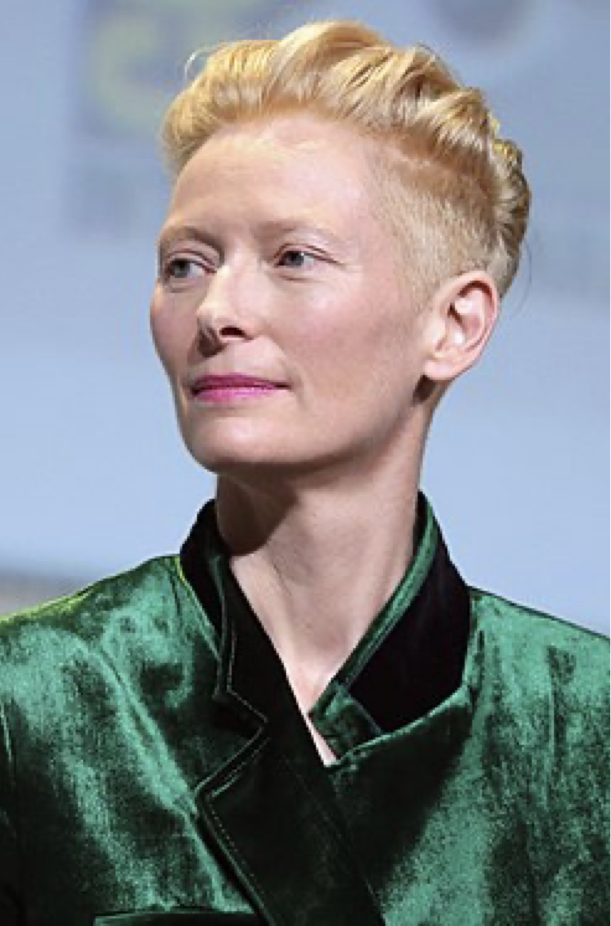
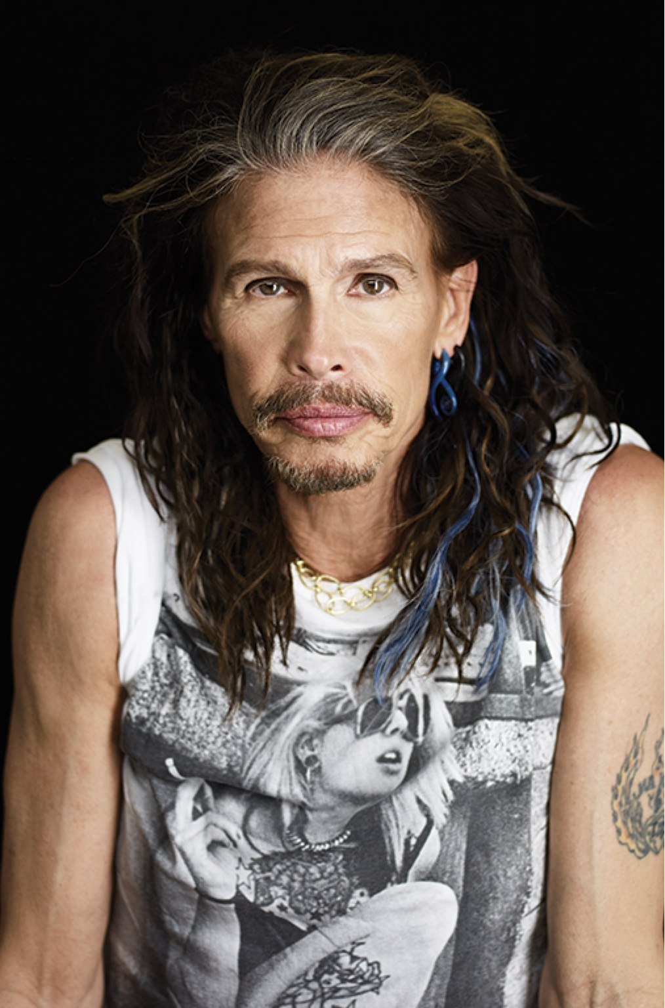
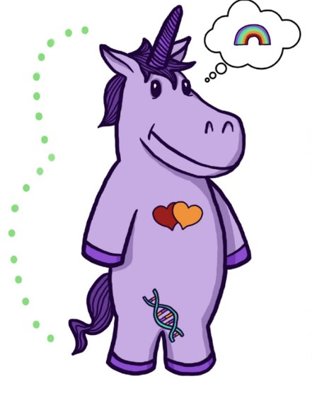
Non-binary Voices
“I don't know if I could ever really say that I was a girl—I was kind of a boy for a long time. I don't know, who knows? It changes.”
“I’ve been misquoted as saying I’m more female than male. Let me set the record straight—it’s more half and half.”
Tilda Swinton
Academy Award Winning Actress
Steven Tyler
Lead singer of Aerosmith
91
Notes:
For a lot of cisgender people, those whose sex and gender align really well, the concept of non-binary identities is really hard to understand. But we have some famous people who have described it really well.
Tilda Swinton and Steven Tyler have never indicated that they identify as transgender, but they describe a blending or fluidity of gender. For a lot of non-binary folks, that’s the only label they apply to themselves. Others can refine things a bit more.
(Read the slide.)

Slide 92
Salina
Notes:
Put in day 2 of shared identity activity here

Slide 93
What Does It Mean To Transition?
Notes:
Given all that a transgender person may be experiencing, one option is to transition. This means they align their inner identity with their external one. We’re going to talk about this process and how it affects trans adults.

Slide 94



Individuals May Go Through Various Transitions
Social Transition
Legal Transition
Physical Transition
94
Notes:
Transitioning is not a simple, one-time event, and there is no “one-size-fits-all” process, checklist, or approach. Transitioning is a complex issue, and it involves a wide variety of options for an individual.
Many factors influence a person’s decision to transition, and because of these factors, their transition may not be linear. Transitioning is a personal decision specific to the individual, so how a person goes about transitioning can change over time and vary from person to person.
There are 3 main types of transitions someone could go through: social, legal, and physical.

Slide 95
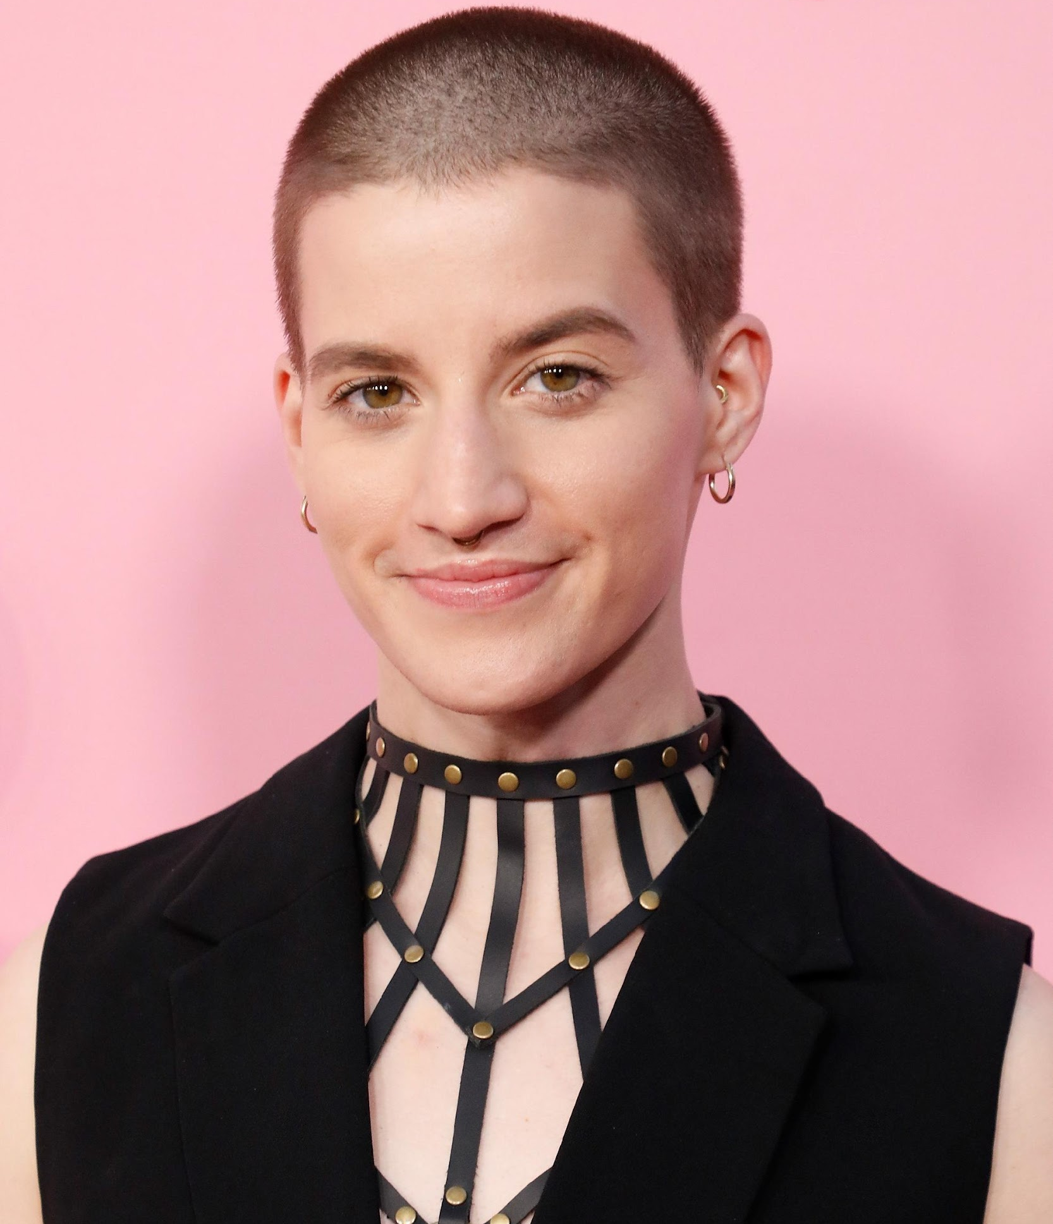
SOCIAL TRANSITION
Social transition is when a transgender person makes others aware of their gender identity.
Theo Germaine, actor in
Netflix’s The Politician
They/Them and He/His
95
Notes:
Social transition is just what it sounds like—changing how you present yourself and how others see you socially. A social transition can happen at any age. A person may start their transition, pause it, move back, and move forward again. It often includes changing clothing or hairstyles. Usually, it entails changing a name and switching pronouns—sometimes more than once.
A person may try on names for a while and switch from one gendered pronoun to another, only to decide that a non-binary pronoun fits better. Again, no rules.

Slide 96

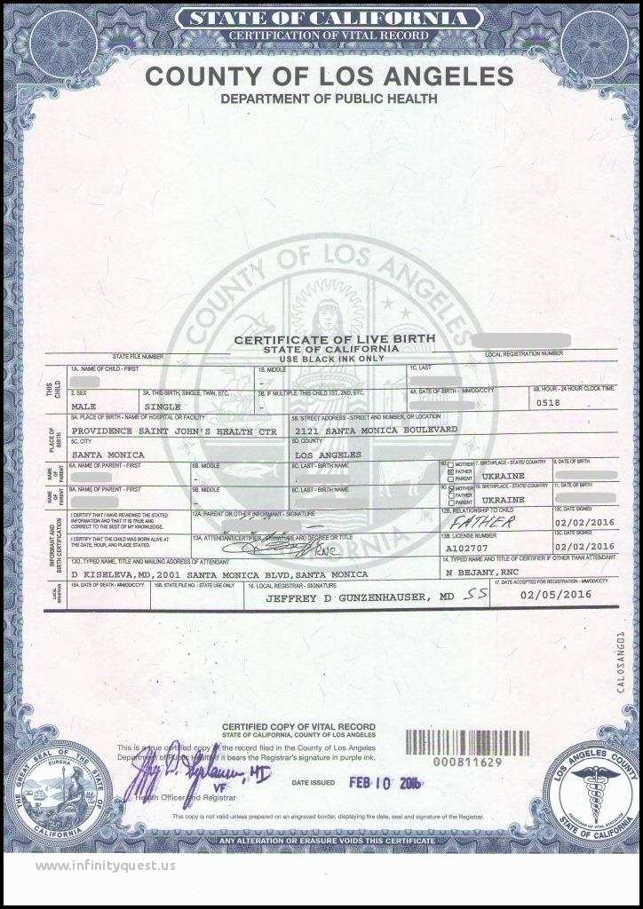
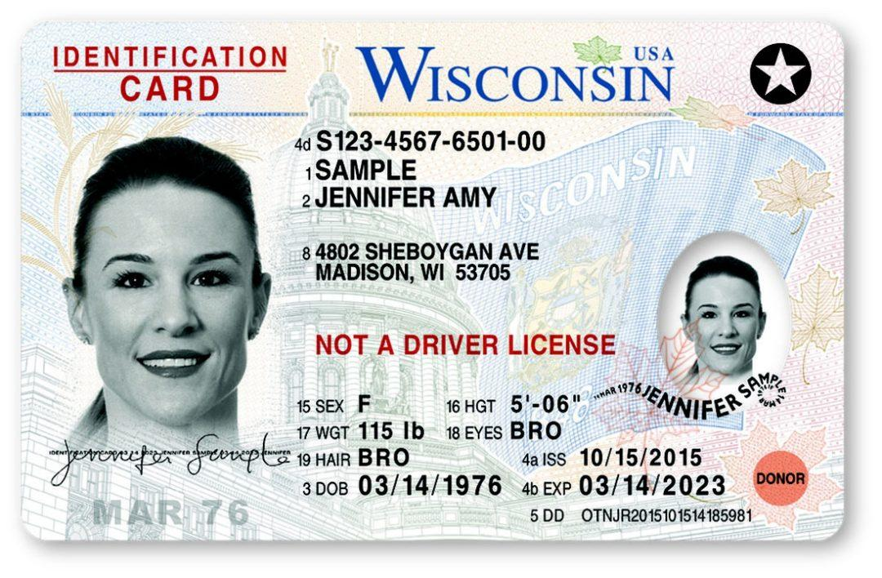
LEGAL TRANSITION
Legal transition is when a transgender person legally changes their existing documentation to match their gender identity.
These can be done by
court order or state law.
96
Notes:
A legal transition means updating documents through the legal process.
Some parts of the legal transition can include changing gender markers on birth certificates, changing names on social security cards, driver’s licenses, or passports. Legal transitions can also have other identification components, such as school documents. Passports are the easiest documents to change.
People cannot always experience a legal transition because of several barriers. Those barriers do not make their gender identity or their distress at being misgendered any less real.

Slide 97

PHYSICAL TRANSITION
Physical transition is when a transgender person undergoes medical treatments so that their sex characteristics better match their gender identity. Before puberty, there are no medical interventions. Ever.
Janet Mock (She/Her), Writer, Director & Transgender Activist
97
Notes:
Transgender health is a specialized area of medicine. There is no one way to have a physical transition.
Given the specialized nature of transgender health care, we can see how problematic it is for a trans person to be told they can only access gender-segregated spaces once they have “had a surgery.” It puts a burden on them that is impossible to overcome, denies their full identity, and creates equal-access issues. Additionally, not all trans people want to have surgery. It’s wrong to demand that another person undergo serious, invasive medical procedures to make other people comfortable.
Keep in mind that just like you would not want to be asked about your medical procedures, we don’t ask others about theirs.
Do not question what they are doing, question how can I support

Slide 98
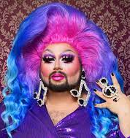
So, what about Drag?
Transgender refers to a personal gender identity and an authentic, lasting sense of self. In contrast, “drag” is a temporary and deliberate performance of gender.
Notes:
“Transgender” refers to a personal gender identity and an authentic, lasting sense of self. In contrast, “drag” is a temporary and deliberate performance of gender.
Drag is most commonly associated with gay men dressing up and embodying a “larger-than-life” female persona. Drag queens are flamboyant and this form of drag often involves sequins and feathers but it can also be sleek and edgy.
For drag queens, their drag persona can be an important part of their own identity as a gay man (this does not mean they are transgender). Similarly, women also perform drag as drag kings. Drag kings dress as men and take on male personas, often wearing facial hair, adopting masculine mannerisms and a deep voice.

Slide 99
Key Ideas
When someone calls you and tells you they are transitioning, do not question them about what they are doing.
Ask how you can support them and find out the answers to their questions.
Put the person in the driver seat; do not be the driver.
NEVER try to talk someone out of transitioning or question their decisions around their identity.

Slide 100
Ellen

Slide 101
Ending It Right
How does YOUR learning from today inform your work with members?
How might we inadvertently cause well-intentioned harm?
How can we prevent that?

Slide 102
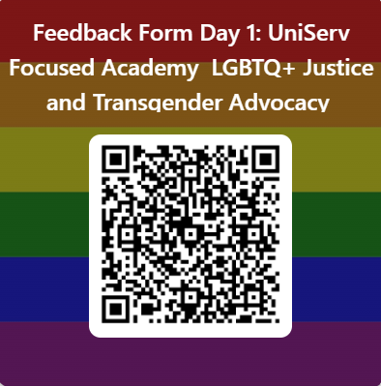
Feedback Form in Your Email
Feedback Form Day 1: UniServ Focused Academy LGBTQ+ Justice and Transgender Advocacy – Fill out form

Slide 103
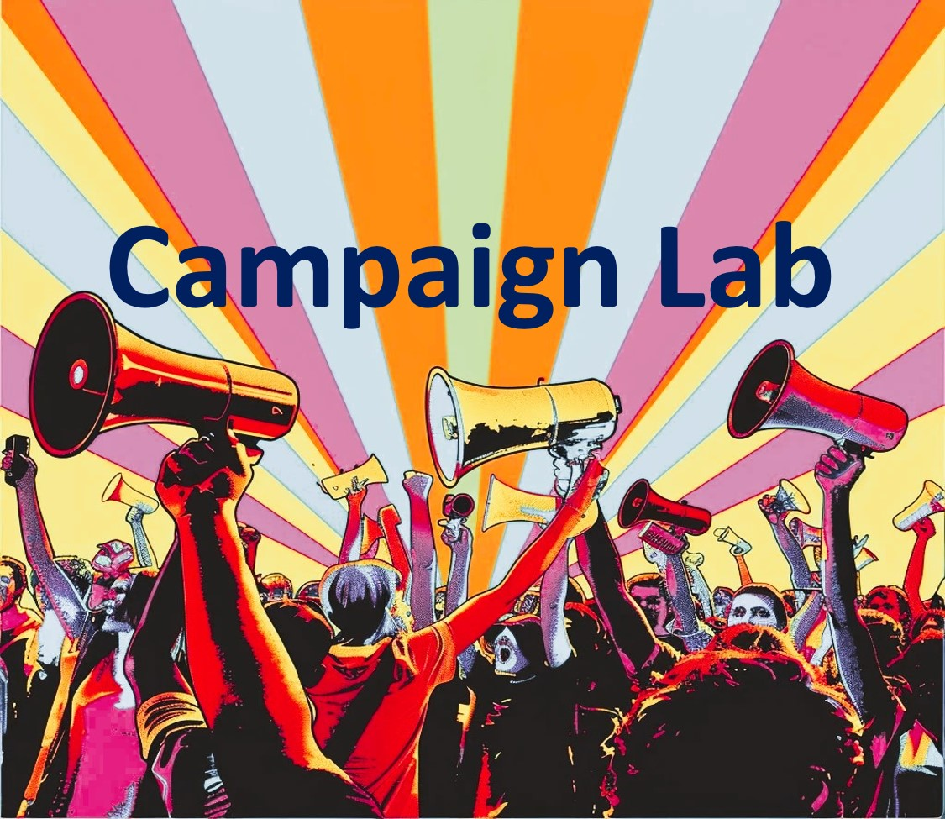

Information and Application
https://www.nea.org/resource-library/campaign-lab

Slide 104

Apply to be a Campaign Lab Coach
Possess an organizing and leadership mindset
Engages in peer problem solving and coaching
Campaign Coach
Holds coaching calls, with team 2 times a month
Coaches 1–2 local teams
Attends campaign coach training
Works with a mentor coach
https://forms.office.com/r/7yMBd7FLwM

Slide 105

Choice Networking Time

