Slide 1
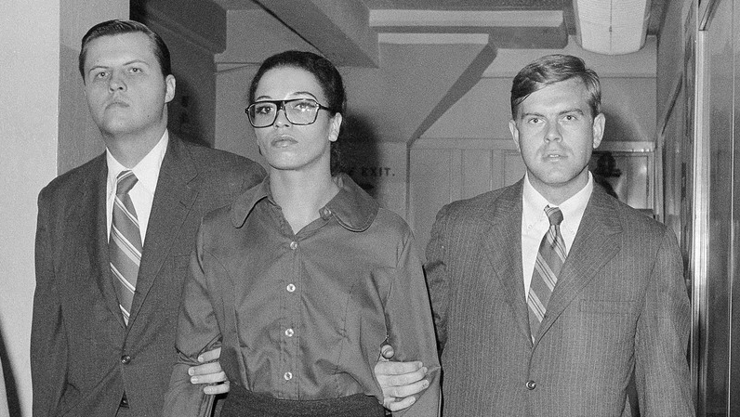
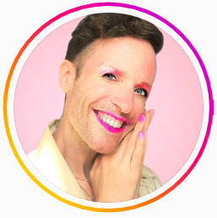
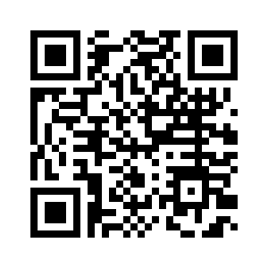
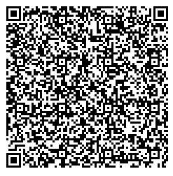
As you enter …
Scan this QR Code to view Jeffry Marsh’s Blog and Video on Pronouns
Scan this QR Code to listen to NPR’s, “This Forgotten Women’s Prison Helped Cement Greenwich Village’s Queer Identity”
https://tinyurl.com/marshpronouns
https://tinyurl.com/NPRPrison
Notes:
Sara will check all QR codes

Slide 2

Ellen

Slide 3

NEA Standards of Conduct
NEA has adopted a Standard of Conduct Policy to ensure that all of our gatherings are welcoming to and free from discriminatory, harassing, or otherwise unacceptable behavior. Discrimination or harassment based on race, color, ethnicity, religion, sex, age, national origin, sexual orientation, disability, gender identity, or expression, or any other characteristic protected by law will not be tolerated. If you experience any discriminatory or harassing behavior, please report the incident to NEA EC Members: Gladys Marquez (gmarquez@nea.org) and Ronald "Duff" Martin (rmartin@nea.org). Thank you for your commitment to ensuring a positive event for all.

Slide 4
NEA MEMBERS AND SUPPORTERS
By attending this training, you confirm that you are a NEA affiliate staff member. The information you receive here is only for your use in your capacity as an NEA affiliate staff member.
This presentation and its contents are confidential and may not be further distributed or passed on to any other person or published or reproduced, in whole or in part, by any medium or in any form, for any purpose. Audio/video recording, copying of slides, and the use of AI note-taking tools are prohibited without the written consent from Ellen Holmes. Violation of these terms may result in legal action.

Slide 5
Acknowledgement
Adapted from Transatlantic Notes
The content we are going to explore may bring up strong feelings. Throughout our time together, we will explore examples of racism, ableism, heterosexism, and sexism. By exploring these together, we can begin the process of unlearning our own internal oppression.
The purpose of unlearning isn’t about forgetting what we know or about being wrong; it’s a conscious act which requires critically examining the ideas and assumptions that influence our expectations, behaviors and beliefs about ourselves and other people. By doing this, we can challenge the cultural and structural norms that perpetuate racism and oppression.
Unlearning is something we can all be committed to because we all have a part to play in dismantling everything that helps maintain racism within society.

Slide 6
Advancing LGBTQ+ Justice

Slide 7
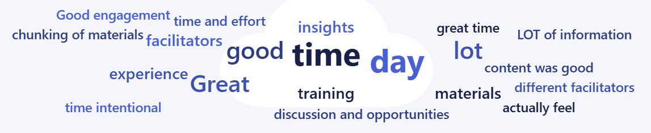
Feedback on Your Feedback
75% response rate with a range of 4.9 to 4.5
High for Facilitators, Low for Afternoon
Second place of 4.88 for the course and materials
Themes: great time, good facilitators, safe space, meaningful content

Slide 8
Your Words
I really enjoyed having the short pieces presented by different facilitators. The chunking of materials and our time is very effective!
The course materials are rich. I wish that other NEA events were built like this or even the trainings in our state. There is so much to use before, during, and after. I feel like the directions and focus for what to use in the materials has really matched what is being taught. The facilitators are the absolute bomb!!
This was a pretty magical experience. It feels good to be in a room with other with similar goals, and a space where I actually feel like I have insights to offer. I am so grateful for this opportunity. *insert sappy emoji here*
... there is A LOT of information in the course. The segments for each facilitator are pretty quick, and some relied on those materials quite a bit. If materials could go live in the course as needed, rather than being all placed there at once, it would have allowed me at least to focus more on the content and not searching for the right supporting documents. The content was good, and I appreciate that the time and effort that goes into planning these trainings.

Slide 9

Community Agreements
Awareness and Self-Knowledge
Listen for Understanding
Be Gracious
Stay Engaged
Be Open and Suspend Judgment
Say “I”- tell your truth
Seek Discomfort
Reach for Empathy
Expect non- Resolution and non-Closure

Slide 10

Today’s Agenda
8:30 - 10:10 -- Review and expand on key concepts
10:10 - 10:25 -- Break
10:25 - 12:00 -- Systems of Oppression and Legal
12:00 - 1:00 -- Lunch
1:00 - 2:00 -- Legal Q and A
2:00 - 2:15 -- Break
2:15 - 4:00 -- Collective Strength and Building Campaigns
4:00 - -- Leave for Walking Tour

Slide 11
Alex

Slide 12

Shared Identity
Gather around an identity of your choosing
Answer the following discussion questions:
Why did you select this piece of your identity?
What are some challenges of this identity?
Notes:
Post the following identities around the room:
Highest risk (day 3) – religious, spiritual, agnostic, survivor, immigrant, LGBTQ+, middle class
Participants will get up and gather around an identity of their choosing (2 min instructions), then they will answer the following discussion questions (8 min):
Why did you select this piece of your identity?
What are some challenges you face with this identity?
Share out/debrief (5 min)
What was something you learned about someone else
What was easy/hard about this activity?

Slide 13

More from our members!

Slide 14

Shared Identity
Debrief-
What was something you learned about someone else?
What was easy/hard about this activity?
How safe did you feel sharing in this activity?
How do your reactions to today's prompts compare to yesterday?
Notes:
Ben 10:00-10:15

Slide 15

Key Ideas
Discreet identities bind us
We all have pre-conceptions that might not match an actual identity of another
We don't get to assign a person's identity for them

Slide 16
Salina and Natasha

Slide 17
Turn and Talk
Recall a time when something in your life changed in a major way and you needed others to show up for you. What did they do that felt supportive? Was there anything they did that did not feel supportive?
Take three minutes to turn and talk with your neighbor
Notes:
Turn to someone near you. You will have three minutes to reflect on a time you experienced a major change in life and what support helped you through it.
After 3 minutes ask, “Based on our experiences, what are some universal needs people have during big changes in life? How might these needs apply to a colleague navigating a gender transition? (5mins)

Slide 18
What is a Transition Plan?
A Transition Plan is a collaborative agreement between a transitioning unit member and management that outlines how the workplace will support the unit member's transition process. The goal is to ensure the member’s rights, dignity, and safety are fully protected throughout their transition.
Notes:
What is a transition Plan? (2mins) ( Salina)
How do we support our members in their workplace that are transitioning? One way we can support them is through developing a transition plan.
A Transition Plan is a collaborative agreement between a transitioning unit member and management. It outlines the support systems, communication plans, and workplace accommodations that will help ensure the member’s transition is respected and protected.
The purpose is simple but powerful to make sure the members’ rights, dignity, and safety are upheld at every stage.
As a union, our responsibility is to make sure this isn’t just a promise, but a protected right through policy and contract language.
A reminder- EVERY EDUCATOR HAS THE LEGAL RIGHT TO TRANSITION AT WORK UNDER BOSTOCK. Your job is to make a plan to help this educator exercise their legal right!

Slide 19
BARRIERS TO TRANSITIONING
Not all trans people can transition as they would like to because of any number of factors, including:
Financial cost
Legislative rules/roadblocks (i.e.. Passports, state IDs)
Lack of access to competent healthcare
Health problems
Physical Safety
Unhappy with options available
Unsupportive family/family instability
Homelessness/domestic violence
Other personal reasons
19
Notes:
Here are a few examples of barriers a transgender educator might face:
Legislative rules/roadblocks — In most states, a person’s gender marker can only be changed on their birth certificate after permanent medical procedures have occurred. This is often stipulated as surgery.
Lack of access to competent healthcare — Trans health is still not taught in most medical schools. Often there is one class (class period…not entire course) devoted to it, if at all. Many providers are afraid to treat trans patients, and some patients travel to other states just to get competent care. GAC being limited because of age and/or denied.
Health problems — Underlying health conditions can complicate a physical transition just as they would complicate any number of other medical treatments or procedures.
Unhappy with options available — This could be surgical options, but could also affect a non-binary person who does not want to proceed with hormones that would make them look too feminine or too masculine.
And, other personal reasons.

Slide 20
Transition Plans
The unit member should have the autonomy whether or not to create a transition plan, choose what information to share (and with whom), and be fully involved in every decision that affects them.
There is no one-size-fits all approach to transitioning. Each person has unique needs, preferences, and experiences. Contract language should be flexible enough to accommodate these differences.
Notes:
Transition Plans ( 2mins) Natasha
One of the most important principles is autonomy.
The unit member should have complete choice about whether or not to create a plan, what details to share, and who to share them with.
There’s no one-size-fits-all path, every person’s transition journey is different. Some members may want broad communication and visibility; others may want to keep it very private. Both are valid.
As unions and leaders, we need to ensure our contract language and workplace practices are flexible enough to support this range of experiences and always centering the member’s comfort, timing, and consent.
So, what does all this look like when we put it into practice? Let’s look at the key components of a strong Transition Plan

Slide 21
Core Components of a Transition Plan
Anti-Harassment Protections – Statement of Rights and Nondiscrimination Policies
Leaves and Accommodations – Medical leave, coverage for gender-affirming care.
Workplace Logistics – Names/pronouns in records, email, ID cards, rosters.
Communication Plan – Who notifies colleagues, students, parents, etc.

Slide 22
Core Components of a Transition Plan
Confidentiality & Consent -Member decides what to share, with whom, and when.
Facilities Access – Restrooms, locker rooms, changing areas.
Union advocacy-union representation during discussions with management, ensuring compliance with contract language, and addressing discrimination or harassment if it arises.

Slide 23
Sample Contract Language
1.0 Statement of Rights and Non-Discrimination
1.1 No unit member shall be discriminated against, harassed, or retaliated against on the basis of actual or perceived gender identity, gender expression, or transition status.
2.0 Transition Planning
2.1 Any unit member who intends to begin gender transition, is currently in the process of gender transition, or has already completed gender transition, regardless of whether the unit member has received any therapy or medical care, may request a Transition Support Plan

Slide 24
Sample Contract Language
3.0 Leave and Accommodations
3.1 Unit members shall be entitled to use accrued sick leave, personal leave, or other applicable leave for transition-related medical appointments, procedures, or recovery, consistent with state and federal law.
4.0 Names, Pronouns, and Records
4.1 Upon request of the unit member, the Employer shall update the employee’s records, communications, and systems to reflect the member’s affirmed name and pronouns, regardless of whether a legal name change has been completed.

Slide 25
Questions and Topics to Avoid
    Questions about genitalia or anatomy
It’s not your business!
    Questions about sexual experiences
Also, not your business
    Any questions that imply someone should delay or stop transitioning
Are you sure you want to switch your pronouns this school year?
    Any comments on someone’s transition
“I never would have known! You pass so well! You don’t look trans!”
    Questions or comments about, or using a person’s dead name
A dead name is the birth name of a transgender person who has changed their name
    Anything that assumes they are the expert on everything LGBTQ+
It's not their job to teach you or to speak for an entire, diverse community
Notes:
Added some from here- https://freedomforallamericans.org/messaging-terms-avoid/ (Sara)

Slide 26
SCENARIO: Supporting a Trans Educator
You are a UniServ Director in a medium-sized conservative school district. A member reaches out to you and asks for your help. She explains to you that she is a returning employee who is transgender and began transitioning over the summer break. She is nervous about coming back in the fall and is asking for your help in navigating her return.
What would be your first steps?
What additional information would you need?
How would you go about finding that information? What resources would you use or seek out
Knowing what we know now about transitioning and gender, what would you avoid doing?
Refer to the Participant Handouts page 21.
26

Slide 27
Transition Plan Gallery Walk
Post plans around the room
Use sticky notes to leave feedback for each group.
  Highlight something you thought was strong
  Ask a question
  Make a suggestion for another layer of protection

Slide 28
Debrief
What parts of the transition planning process felt most important to center the member’s voice?
What obstacles or tensions might arise, and how can the union proactively address them?
How can the union strengthen contract language to ensure protections and supports are guaranteed?

Slide 29
Key Ideas
When someone calls you and tells you they are transitioning, do not question them about what they are doing.
NEVER try to talk someone out of transitioning or question their decisions around their identity.
The member decides whether to create a plan, what to share, and with whom. Put the person in the driver seat; do not be the driver.
There’s no one-size-fits-all approach. Each person’s experience, comfort level, and timing are different. Contract language should be flexible enough to meet those individual needs

Slide 30

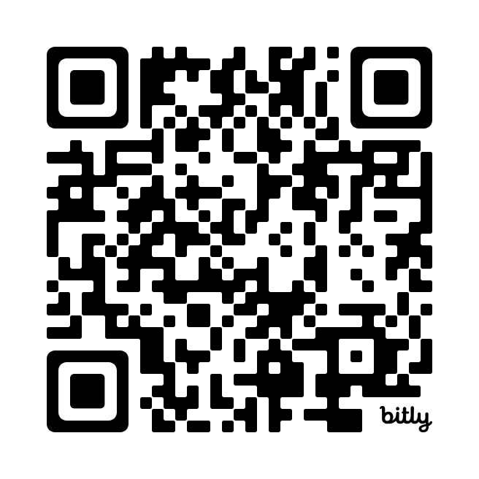
15 Minute Break!
Check out this site! It includes accurate and up to date maps that track LGBTQ+ policies across the nation. (We will revisit this map later)
https://www.lgbtmap.org/equality-maps

Slide 31
Rachel

Slide 32
Reminder: Definition of Privilege
Four Corners Activity
A special right, advantage, or immunity granted by our unique relationship to a system of power.

Slide 33
Power Shield
Four Corners Activity
Four Corners:
As we read off a question, go stand by the identity that most represents your answer.
Gender/ Presentation
Sexual Orientation
Race
Ethnicity
Religion
Nation/Language of Origin
Class
Physical/Mental Ability
Age
Work Category
Notes:
We are going to take a minute to look intentionally at our identities, and how they relate to power.
Stations around room for activity: Gender/Presentation, Race, Sexual Orientation, Ethnicity, Religion, Class, Nation/Language of Origin, Physical/Mental Ability, Age, Work Category
Challenge by choice; not meant to out someone.
Which identity do you think about the most?
…the least?
Which identity are people most surprised to learn about it?
Which identify brings you the most discomfort or confusion?

Slide 34

INTERSECTIONALITY

Slide 35

INTERSECTIONALITY
Intersectionality is a framework for understanding a person, group of people, or social problem as affected by a number of discriminations and disadvantages. It takes into account people's overlapping identities and experiences in order to understand the complexity of prejudices they face.​

Slide 36
LEVELS OF EXPRESSION OF OPPRESSION
I n d i v i d u a l | Internalized Oppression lies within individuals. These are our private beliefs and biases about others, influenced by our culture, that reside inside our minds. | S y s t e m i c | Institutional Oppression occurs within institutions and systems of power. It is the norms, policies and practices that are structured into political, societal and economic institutions that have the net effect of imposing oppressive conditions and denying rights, opportunity, and equality to identifiable groups.
 | Interpersonal Oppression occurs between individuals. Once we bring our private beliefs into our interactions with others, we are now in the interpersonal realm. |  | Structural Oppression is bias across institutions and society. It’s the cumulative and compounded effects of an array of factors that systematically privilege some and disadvantage others.

Slide 37
ACTIVITY: UNDERSTANDING EXPRESSIONS OF OPPRESSION pp. 23-30
Drawing on your knowledge base and experiences: ​
Independently analyze the scenarios and determine the expression of oppression. ​
  Scenarios can be found in POPs in "Participant Handouts", p. 24 - Expressions of Oppression Scenarios
Discuss at your tables and reach consensus about the expression of oppression in each scenario.​
TOTAL Report Out – 3 Minutes – be prepared to report a 2 Sentence Summary of your scenario and the Consensus Decision about what level of oppression is being expressed and why.
Notes:
Count off by 8
Three Minute Report Outs ​
Summary​
What Level​
Why​
Then for all groups…​
What did you struggle with? ​
What was Clear to You?

Slide 38

What did you struggle with?
What was clear to you?

Slide 39
KEY POINTS
1. There are no hard and fast lines between the levels – and changing one can affect another. ​
​
While we believe that the individual is ​
responsible for exploring personal bias …​
​2. The way to effect change is by addressing institutionalized and structural oppression – this is where injustice lives.

Slide 40
Keira and Anthony

Slide 41

Understanding the Legal Landscape on LGBTQ+ Rights
Advancing LGBTQ+ Justice Training
Keira McNett (she/her)
NEA Staff Counsel
December 3, 2025

Slide 42
CLOSED PRESENTATION
By attending this presentation, you confirm that you are an NEA member. The information you receive here is only for your use in your capacity as an NEA member.
This presentation and its contents are confidential and may not be further distributed or passed on to any other person or published or reproduced, in whole or in part, by any medium or in any form, for any purpose. Audio/video recording, copying of slides, and the use of AI note-taking tools are prohibited without the written consent from Keira McNett (kmcnett@nea.org). Violation of these terms may result in legal action.
Notes:
Legal information, not legal advice. For advice on specific situations, consult local or state legal counsel
Still, some confidentiality in this space – closed, not to be shared without express permission

Slide 43
Legal Update Agenda
LGBTQ+ Rights Under Federal Law
  Educators’ Rights under Bostock
  Students’ Rights and Title IX Regulations
Current Legal Landscape
  Executive Orders & Agency Actions
  Impacts on Educator and Student Rights
  Supreme Court Cases

Slide 44

Educators' Rights under Bostock
Employment Discrimination is Illegal
Title VII of the 1964 Civil Rights Act prohibits employment discrimination based on race, color, religion, sex and national origin. Bostock interprets “sex” to include gender identity and sexual orientation.
Bostock v. Clayton County (2020): “…it is impossible to discriminate against a person for being homosexual or transgender without discriminating against that individual based on sex”
Notes:
The Bostock ruling specifically states that employment discrimination on the basis of gender identity and sexual orientation is illegal.
Title VII of the Civil Rights Act covers the full spectrum of employment decisions, including recruitment, selections, terminations, and other actions concerning terms and conditions of employment. This is significant for the LGBTQ+ community because, as we saw, in many states it was legal to be denied an interview or a promotion, and even to be fired because of one’s gender identity or sexual orientation.

Slide 45

Students' Rights Under Title IX
Discrimination in Educational
Programs is Illegal
Title IX of the Education Amendments Act of 1972 states: "No person in the United States shall, on the basis of sex, be excluded from participation in, be denied the benefits of, or be subjected to discrimination under any education program or activity receiving Federal financial assistance."
Notes:
* Summarize back and forth of T9 regs
Reference: Department of Justice, “Application of Bostock v. Clayton County to Title IX of the Education Amendments of 1972,” March 26, 2021, https://www.justice.gov/crt/page/file/1383026/download

Slide 46
Title IX Regulations:
Anti-harassment protections
  Title IX Regulations - 2020 sexual harassment rule is currently in effect:
    These final regulations focus on prohibited conduct, irrespective of a person’s sexual orientation or gender identity. . . . These final regulations include sexual harassment as unwelcome conduct on the basis of sex that a reasonable person would determine is so severe, pervasive, and objectively offensive that it denies a person equal educational access; this includes but is not limited to unwelcome conduct of a sexual nature and may consist of unwelcome conduct based on sex or sex stereotyping. The Department will not tolerate sexual harassment as defined in [the regulation] against any student, including LGBTQ students.
    85 FR 30026, 30179 (2020).
Notes:
Currently the Trump 2020 regulations are in effect
Dept of Education OCR no help, but at school district and institution level, this is what schools are held to – schools have liability under Title IX if parent/student brings private lawsuit

Slide 47

LGBTQ+ Civil Rights Under Trump

Slide 48
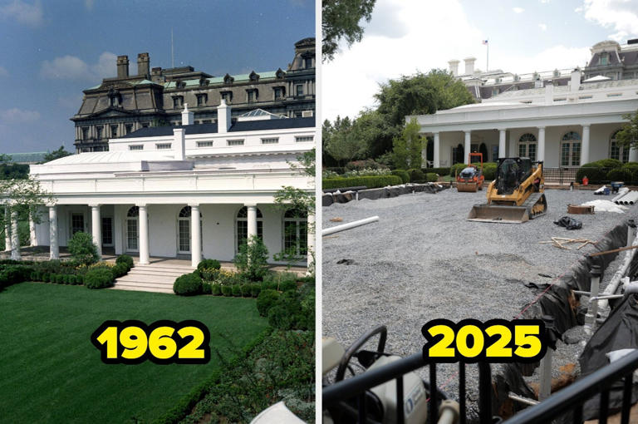
Executive Branch Actions
Trump issued 5 executive orders explicitly targeting transgender people
    Seeking to roll-back civil rights, deny accurate gender markers on passports, restrict gender affirming care, ban trans athletes, ban trans military service, and threaten inclusive curriculum and school policies
    Lawsuits ongoing across the country
DOJ/ED have threatening K-12 schools, colleges and universities that have trans-inclusive policies
EEOC – rolling back protections against gender identity discrimination
Notes:
K-12 schooling EO Attacking “gender ideology”; threatening prosecution for affirming trans, intersex and nonbinary students
The President cannot change existing federal civil rights laws.
The President cannot direct states and school districts how they will enforce their laws.
State non-discrimination, anti-harassment and bullying prevention laws, school district policies, and educator ethics codes often require that educators respect, affirm and include students of all genders.
In addition, state laws, school policies or professional ethics may require that staff respect the confidentiality of students who seek support.

Slide 49
Advocating for Educators
State Civil Rights Offices
Know Your Rights Training and Materials
School District Policies
Collective Bargaining Agreements
Notes:
KYR – employment law rights (federal and state and under district policies/CBAs) and rights as advocates (limitations of 1st amendment rights, esp K-12, but advocating on matters of public concern in private capacity)
Policies and CBA – can speak to incidents (like microaggressions) that can be addressed before something rises to the level of harassment
CBAs – NEA has guidance on bargaining for protections

Slide 50
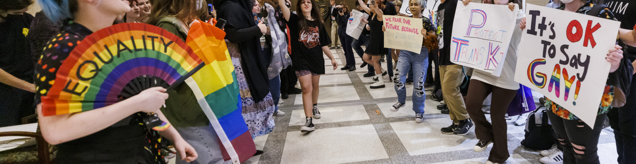
Advocating for Students

Slide 51
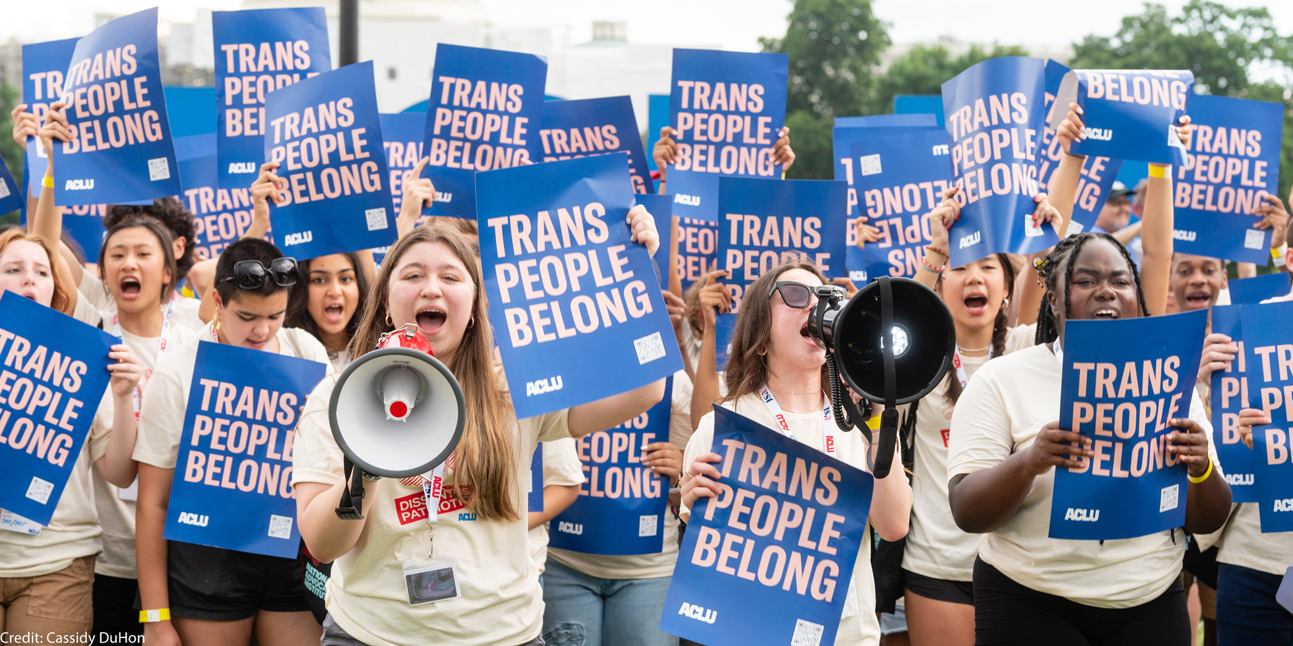
States and School Districts Pushed Back
  States reiterate inclusive policies and state law protections for ALL students, explicit protections against gender identity discrimination
  Individual school districts issuing statements
    Montgomery County, MD school district issued a letter to the community stating their commitment to high-quality education for all students regardless of race, ethnicity, sexual orientation, gender identity, immigration status, disability, religion, or any other identifying characteristic, and saying that that they “will fiercely support our teachers and staff as they implement our curriculum and policies.”
Notes:
CA AG Bonta; CA State Superintendent: “In California, all still means all.”
NJ, MA, others reiterating state law protections

Slide 52

Weaponization of Title IX
    Department of Education and DOJ launching Title IX “investigations” and withholding funds to schools districts and universities with trans-inclusive policies
    States and school districts are fighting back
      Minnesota
      Chicago
      Northern Virginia
      Denver Public High School
      New York City
    What you can do:
      If become aware of threat, such as a Title IX investigation letter sent to a district, alert local union and state GC’s office
      Organize and encourage districts to fight back

Slide 53
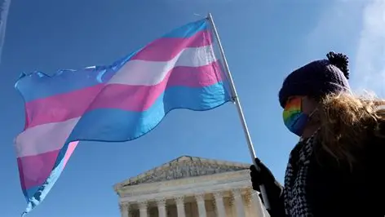
Supreme Court Cases
U.S. v. Skrmetti (2025): state law ban on gender-affirming care for minors does not violate the Equal Protection Clause of the Fourteenth Amendment
Mahmoud v. Taylor (2025): MD school district’s policy disallowing opt-outs from LGBTQ+ inclusive story books burdened parents’ free exercise of religion under the First Amendment
BPJ/Hecox (Pending): This term, the Supreme Court will decide whether state laws banning transgender girls and women from participating on girls’ and women’s sports teams violates Title IX and Equal Protection

Slide 54
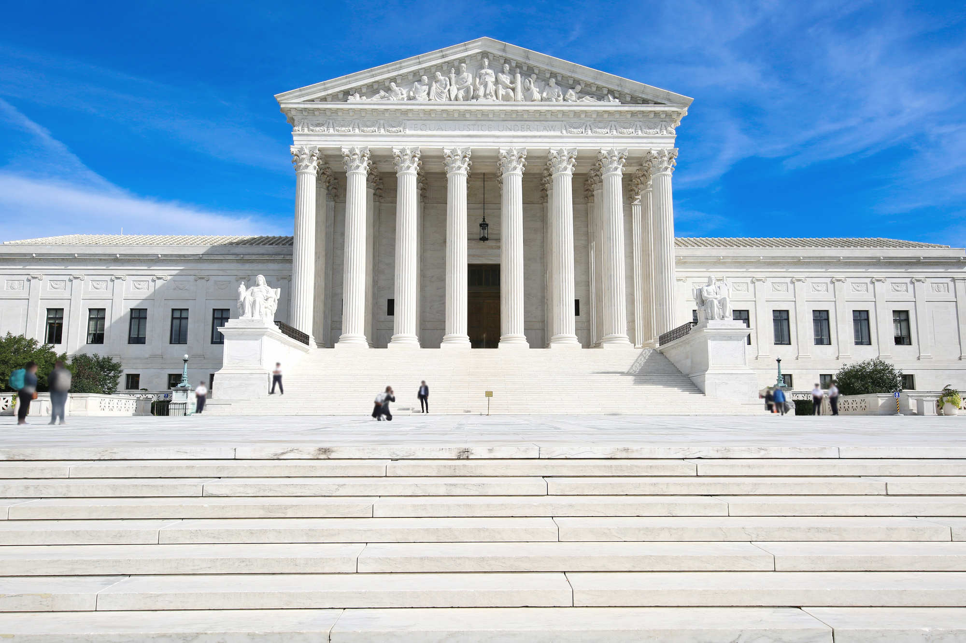
Mahmoud v. Taylor
Schools must allow parents to opt their child out of instruction that substantially interferes with their child’s religious development or “undermin[es] the religious beliefs and practices the parent wishes to instill in the child.”
This opt-out right is limited to religious objections, and does not include political, ideological, or moral objections.
This is not a book ban.
The decision does not prohibit teachers from acknowledging LGBTQ+ identities or answering student questions.
It does not allow “opt outs” from interacting with LGBTQ+ students, staff, or families. Nondiscrimination protections remain in place, and schools should continue to foster an inclusive environment where everyone is acknowledged and treated with respect.
This decision does not impact any student’s rights to be themselves, to talk about LGBTQ+ issues, and to have GSAs.
State laws and individual school district policies concerning religious opt-outs vary greatly from state to state.
It is the responsibility of the parent or guardian to assert a religious belief they want the school to accommodate.
The decision emphasized the young age of the students in this case (elementary school students).
Notes:
Schools do not have to remove any books from classrooms or school libraries; nor do they have to censor the curriculum in any way. LGBTQ+ inclusive books and curriculum are not presumptively objectionable.
4. Most districts already have opt-out policies in place that should be evaluated to determine if they are sufficient to provide parents with the required notice and opportunity to have their child excused from instruction that substantially interferes with their religion.
5. Educators and school administrators do not have an obligation to make guesses about what religious beliefs anyone holds or what may be objectionable based on those beliefs.
6. While the Court didn’t create a bright-line rule, it strongly implied that religious objections to exposure to LGBTQ+ topics (and presumably other topics about which a parent may have a religious objection) are particularly forceful when focused on younger students.

Slide 55
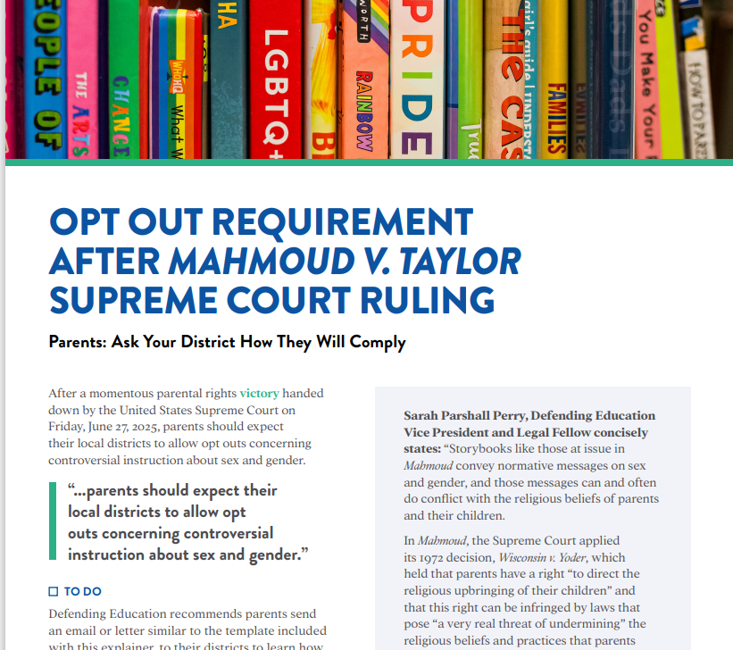
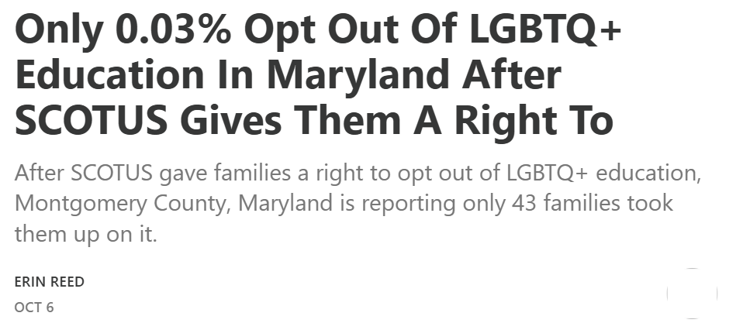
Notes:
Parents Defending Education
Erin in the Morning – substack
Very specific to state law/opt-out policies, district policies

Slide 56
8.1 Million
WHAT’S THE SIGNIFICANCE?
56
Notes:
In 2019, there were 157 million employees in the US. What do you think this number represents?
According to Catalyst.org, there are an estimated 8.1 million LGBTQ+ employees in the United States who are age 16 or older. 50% of these employees are not out at work because of fears of discrimination or ostracization. And 1 in 5 LGBTQ+ employees have experienced discrimination.
Reference: https://www.catalyst.org/research/lesbian-gay-bisexual-and-transgender-workplace-issues/

Slide 57
TRUE OR FALSE
In my state, an employee can be fired for being transgender

Slide 58
TRUE OR FALSE
In my state, an employee can be fired for being a lesbian.

Slide 59
FALSE!
There are federal laws that protect LGBTQ+ workers from workplace discrimination in ALL states (yes, even yours).

Slide 60
Federal Law
Notes:
Let’s first look at federal laws.

Slide 61
A NATION OF LAWS
1600s
Founding of Jamestown, VA
Mass. Bay General Court determined “sex crimes” and punishments.
1700s
Colonial sodomy laws passed and remained in place until 1925.
US Constitution passed and counts African-Americans as 3/5 a person.
1800s
14th Amendment passed that declares “equal protection of the laws.”
Plessy v. Ferguson declares racial segregation legal.
1900s
President Dwight Eisenhower bans gay people from working in the federal gov’t.
Famous celebrities, athletes & politicians start publicly coming out.
2000s
President Obama repealed “Don’t Ask Don’t Tell” so LGBTQ+ people could serve openly in the military.
Same-sex couples granted the right to marry across the US.
Notes:
The US has called itself a “Nation of Laws,” but what are the laws for? And, who do they help or harm? This timeline shows only a glimpse of how discrimination, exclusion, and beliefs in white supremacy have been a part of US laws since the earliest of colonial times. For a more comprehensive list of laws that impact LGBTQ+ people throughout US history, please see your handout.
Highlights for further discussion:
1607 – Founding of Jamestown, VA, the first permanent English settlement in the “New World.”
1607 – Massachusetts Bay Colony was established believing they made a “covenant with God to build an ideal Christian community.”
1619 – The first enslaved Africans arrive to Jamestown, VA
1631 – The Massachusetts Bay General Court, in accordance with Puritan religious and moral beliefs, declared that the following were considered sex crimes and punishable by whipping, banishment or execution: fornication, adultery, rape and sodomy.
1705 – The Colony of Virginia adopted the first Blood Quantum Law. A person’s blood quantum is defined as the fraction of their ancestors, out of their total ancestors, who are documented as full-blood Native Americans. These laws were applied across the thirteen colonies and later the entire United States. They limited the civil rights of Native Americans and regulated who could be classified as Native American.
1714 – Sodomy laws were passed in the early colonies and in the colonial militia. They stayed in place until challenged in 1925.
1775 – Population of enslaved people in the colonies is nearly 500,000.
1776 – Declaration of Independence signed.
1778 – Lieutenant Gotthold Frederick Enslin of the Continental Army becomes the first documented service member to be dismissed from the U.S. military for homosexuality. Read more at U.S. History Naval Institute Blog / Timeline of Military Gay History.
1779 – Thomas Jefferson proposes Virginia law to make sodomy punishable by mutilation rather than death. It was rejected by the Virginia legislature.
1788 – U.S. Constitution adopted. Includes a three-fifths clause that counted each enslaved person as three-fifths of a person for the purposes of congressional representation and tax apportionment.
1852 – Scottish writer J.D. Bothwick reports his attendance at a “miner’s ball” – a men’s only dance held in Angels’ Camp in California.
1857-1861 – James Buchanan elected president. A lifelong bachelor, Buchanan had a long-term relationship with William Rufus King, who served as vice president under Franklin Pierce. The two men lived together from 1840-1853 until King’s death. Some historians suggest Buchanan, by today’s terms, was gay.
1868 – Fourteenth Amendment Ratified. This is the most cited amendment in Supreme Court civil rights cases and has been the basis for landmark civil rights cases such as Brown v. Board of Education, Roe v. Wade and Obergefell v. Hodges. Gay rights advocates cite this amendment in support of equality for future court cases.
“All persons born or naturalized in the United States and subject to the jurisdiction thereof, are citizens of the United States and of the State wherein they reside. No State shall make or enforce any law, which shall abridge the privileges or immunities of citizens of the United States; nor shall any State deprive any person of life, liberty, or property, without due process of law; nor deny to any person within its jurisdiction the equal protection of the laws.”
1868 – Two-Spirit, We’wha, a Zuni Native American, meets with President Grover Cleveland.
Source: https://www.lgbtqhistory.org/lgbt-rights-timeline-in-american-history/
Source: https://en.wikipedia.org/wiki/Blood_quantum_laws

Slide 62
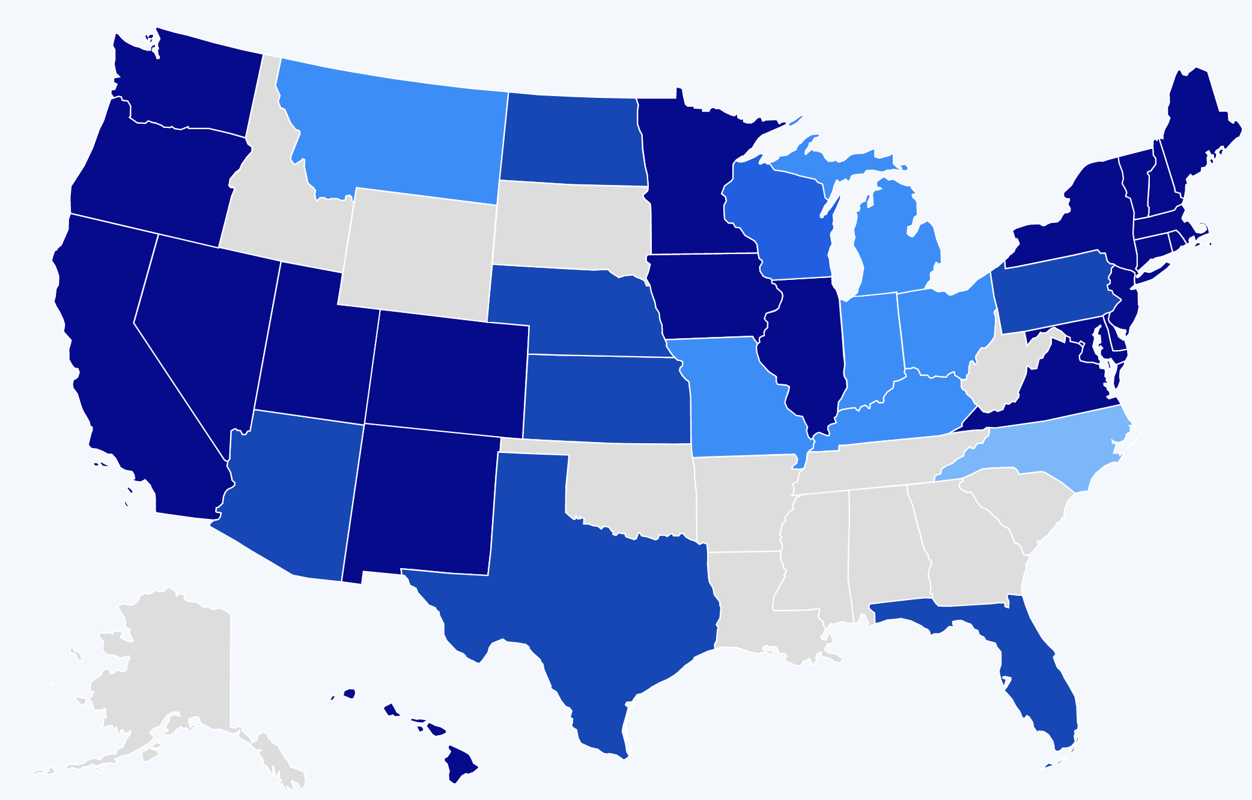
A HISTORY OF BARRIERS
In 2019, Just 22 States + DC Prohibited Workplace Discrimination Based On Sexual Orientation And Gender Identity.
Source: Human Rights Campaign
62
Notes:
US history is full of barriers for BIPOC and LGBTQ+ people. Discrimination because of one’s race and LGBTQ+ identity means lost wages, jobs, promotions, unfair treatment and even harassment at work. This discrimination compels many to hide their LGBTQ+ status for fear of retribution, losing one’s livelihood, support system, and more.
Before 2019, only a handful of states (in dark blue above) provided LGBTQ+ people some protection against employment discrimination, as well as in housing and public accommodations. This meant that in all the other states (those in tan and lighter shades of blue), LGBTQ+ people could be denied jobs, health care, housing, hotels, and more. This discrimination – across the majority of the US, and nearly all of the South— was perfectly legal.

Slide 63
A LANDMARK RULING
Bostock v. Clayton County
Prior to June 15, 2020
It was legal to fire an employee for being gay, bisexual or transgender, in more than half of the 50 states.
June 15, 2020
The Supreme Court rules it is illegal to discriminate against
or fire an employee based on their sexual orientation or gender identity.
63
Notes:
The Civil Rights Act of 1964 prohibits discrimination based on race, color, religion, sex, or national origin. The courts and the federal government have long refused to recognize LGBTQ+ discrimination as a form of sex discrimination. Over the past 20 years, however, federal courts and the government have at times recognized LGBTQ+ discrimination as sex discrimination.
It was not until June 15, 2020 that the Supreme Court finally recognized that LGBTQ+ employment discrimination is prohibited sex discrimination under Title VII of the Civil Rights Act of 1964.
This ruling recognized that it is illegal to discriminate against or fire an employee based on their sexual orientation or gender identity. Now lower federal courts and the Biden Administration are applying that ruling to education, health care, housing, credit discrimination, and more.

Slide 64
BOSTOCK V. CLAYTON COUNTY
Employment Discrimination is Illegal
Title VII of the 1964 Civil Rights Act prohibits employment discrimination based on race, color, religion, sex and national origin. Bostock interprets “sex” to include gender identity and sexual orientation.
64
Notes:
The Bostock ruling specifically states that employment discrimination on the basis of gender identity and sexual orientation is illegal.
Title VII of the Civil Rights Act covers the full spectrum of employment decisions, including recruitment, selections, terminations, and other actions concerning terms and conditions of employment. This is significant for the LGBTQ+ community because, as we saw, in many states it was legal to be denied an interview or a promotion, and even to be fired because of one’s gender identity or sexual orientation.

Slide 65
Title IX
Discrimination in Educational
Programs is Illegal
Title IX of the Education Amendments Act of 1972 states: "No person in the United States shall, on the basis of sex, be excluded from participation in, be denied the benefits of, or be subjected to discrimination under any education program or activity receiving Federal financial assistance."
65
Notes:
On March 26, 2021, the Department of Justice concluded that, as a result of the Bostock ruling, Title IX of the Education Amendments Act of 1972 also prohibits sexual-orientation and gender-identity discrimination in educational institutions that receive federal funding. This means all public schools. This means that students cannot be discriminated against in schools based on their LGBTQ+ identity.
There have been some significant wins recently for LGBTQ+ rights in the US But while progress is being made, attacks on LGBTQ+ rights in certain states have accelerated.
Reference: Department of Justice, “Application of Bostock v. Clayton County to Title IX of the Education Amendments of 1972,” March 26, 2021, https://www.justice.gov/crt/page/file/1383026/download

Slide 66
Title IX—Update May 2024
Some schools and districts are implementing gender-affirming policies and practices
Dozens of states are trying to license LGBTQ+ discrimination under the guise of “protecting children” or by claiming it is a right because of religious freedom.
More than two dozen states have now passed variations of legislation that limits, further marginalizes, and in some cases criminalizes efforts to support LGBTQ+ youth and adults.
Many of these attacks on LGBTQ+ people are being challenged in court with hope they will be struck down under the reasoning of Bostock.
With the current make-up of the Supreme Court and their record of overturning precedent-setting cases, nothing is guaranteed.
Notes:
Complete update

Slide 67
Several states have now passed legislation to restrict LGBTQ+ rights, including:
ANTI-LGBTQ+ LEGISLATION
Prohibiting or criminalizing healthcare for transgender youth
Mandating single-sex facility restrictions
Excluding transgender youth from athletics
Enacting restrictions on identification documents
Bans on books, curricula, and discussion of LGBTQ+ issues in classrooms
Exemptions to anti-discrimination laws for “religious or moral” beliefs
Source: ACLU.org
67
Notes:
While some schools and districts are implementing gender-affirming policies and practices, like recognizing proper names and pronouns for children, in the background, dozens of states are trying to license LGBTQ+ discrimination under the guise of “protecting children” or by claiming it is a right because of religious freedom. More than two dozen states have now passed variations of legislation that limits, further marginalizse, and in some cases criminalizes efforts to support LGBTQ+ youth and adults.
Many of these attacks on LGBTQ+ people, especially young people, are being challenged in court and we can hope they will be struck down under the reasoning of Bostock. But those lawsuits are just getting started and with the current make-up of the Supreme Court and their record of overturning precedent-setting cases, nothing is guaranteed.

Slide 68
WHAT WE KNOW TODAY
The Bostock ruling only applies to employment discrimination.
Discrimination in other areas (e.g., housing) is still legal in many states.
The Equality Act – a federal law currently stalled in Congress - would end discrimination across all areas for LGBTQ+ people.
68
Notes:
Key Notes
Bostock only applies to employers with more than 15 employees. Employers with fewer than 15 total employees are not covered by Title VII.
Bostock applies nationwide and protects employees from sexual orientation or gender identity discrimination regardless of state or local laws.
An employer covered by Title VII is not allowed to fire, refuse to hire, or take assignments away from someone (or discriminate in any other way) because customers or clients would prefer to work with people who have a different sexual orientation or gender identity. (For example, keeping LGBTQ+ employees out of public-facing positions.)
Although accidental misuse of a transgender employee’s preferred name and pronouns does not violate Title VII, intentionally and repeatedly using the wrong name and pronouns to refer to a transgender employee could contribute to an unlawful hostile work environment.

Slide 69

TURN & TALK
How have past and recent federal laws impacted LGBTQ+ individuals?
2. How does the Bostock ruling impact LGBTQ+ members? How does it impact the work of UniServ directors?
69
Notes:
Turn & Talk: Suggested Discussion Questions
How have past and recent federal laws impacted LGBTQ+ individuals?
How does the Bostock ruling support LGBTQ+ members? How does it impact the work of UniServ directors?

Slide 70
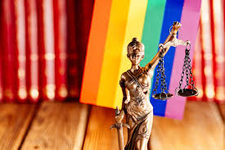
STATE & LOCAL LAWS ON THE RISE
In the absence of federal law that protects LGBTQ+ individuals, states are rushing to pass legislation.
State laws range from being affirming to harmful of LGBTQ+ individuals & their families.
Local School Boards have joined in passing policies that affirm or further marginalize/erase the history and lived experiences of LGBTQ+ and BIPOC students.
Notes:
Well funded political groups have launched a coordinated and strategic approach to overwhelm and see what legislation sticks regarding harmful legislation.
Local School boards & the public education system have become a focus for advancing anti-LGBTQ+ policies
While children of color make up the majority of U.S. public school students, policies that affirm their histories and lived experiences are not centered in local and state legislation.
Find some stats on this

Slide 71
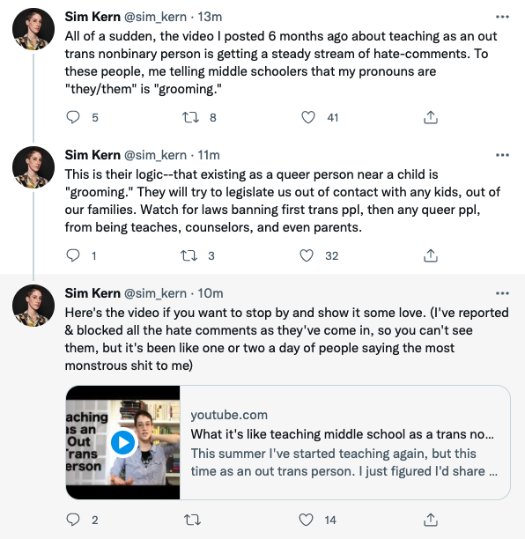
IMPACT ON EDUCATORS
Notes:
The coordinated attacks on LGBTQ+ individuals include providing people scripts that denounce teaching topics such as transgender rights, banning books from well known authors, and labeling inclusive and culturally responsive instruction as “critical race theory.” Unfortunately, these efforts have been effective.
As we see in this Twitter thread, a post from an out trans person, who six months ago shared their experience of teaching in middle school, is now accused of “grooming” students by sharing their pronouns.

Slide 72
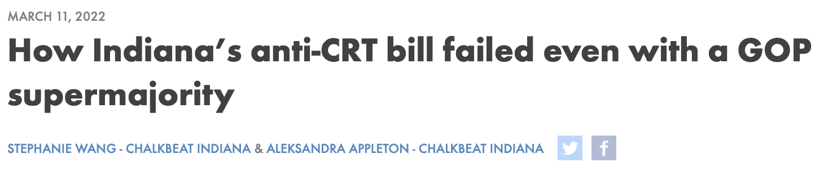
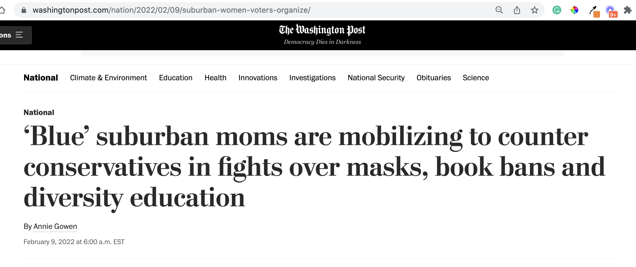


FIGHTING BACK
Notes:
While many states and lawmakers are working to advance anti-LGBTQ+ and other laws that discourage teaching an honest history of the US, not every effort is successful. While many of these efforts are specific to students, it worth noting that not all attempts have been successful.
In March 2022, a “CRT” bill in Indiana failed despite having a GOP supermajority.
Parents are mobilizing to counter the loud voices that dominate local school board meetings:
Red Wine & Blue is a a national network of more than 300,000 like-minded, mostly Democratic suburban women who believe the only way to fight back is to present a calm face to counter the angry groups that have dominated and disrupted board meetings and in some cases threatened officials. The group recently broadened its focus to fight the rising number of book bans across the country, and is running training sessions to help women testify and manage highly charged government meetings.
One WillCo is a community organization in Williamson County Tennessee that was organized by two mothers to address racial disparities in the community in 2021.
Invite discussion: Ask participants if they have heard of anti-LGBTQ+ or anti “CRT” laws that have failed to pass. Why do they think this is?
Sources:
https://www.wfyi.org/news/articles/indiana-anti-crt-bill-failed-republican-supermajority
https://onewillco.org/

Slide 73





Legislative Trackers
Notes:
The NEA has several resources and recommendations for legislative trackers. (See handout for full list and website links.)
https://www.icnl.org/usprotestlawtracker/
https://www.aclu.org/legislation-affecting-lgbtq-rights-across-country
https://translegislation.com/
https://www.equalityfederation.org/state-legislation-tracker

Slide 74
Key Ideas
At least for now, ALL LGBTQ+ workers are protected under Bostock.
BUT Bostock is limited to Employment.
Affirming and destructive policies are popping up everywhere- The map resource is a good way to stay up to date.
With the current Supreme Court, we don't know how long Bostock will survive.

Slide 75
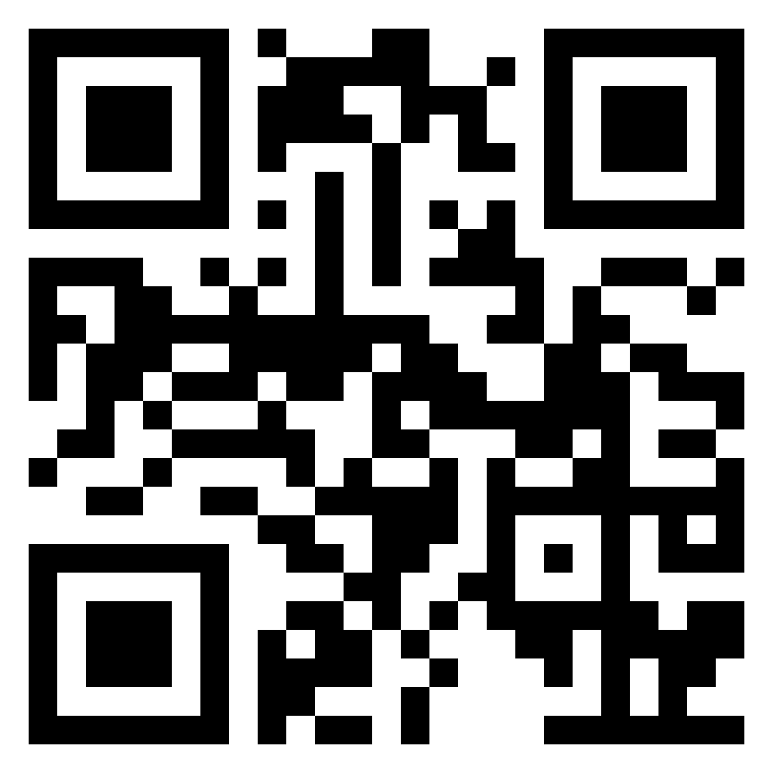
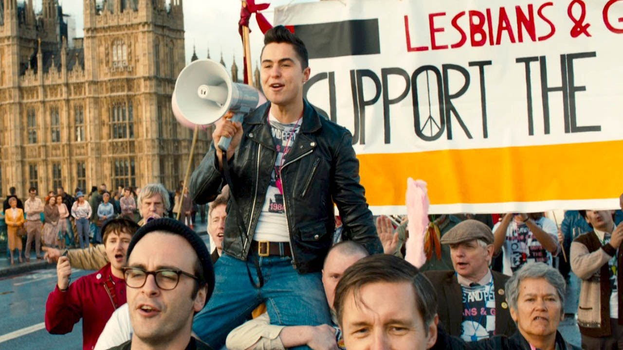
Lunch
1 hour for Lunch!
www.justwatch.com/us/movie/pride-2014
CUE IT UP!
Add the movie “Pride” to your to watch list. It is based on a true story about an LGBTQ+ group’s solidarity with striking miners. A feel good union story, but make sure to have tissues handy!

Slide 76
Anthony & Keira

Slide 77
2025 State Legislative Sessions – the Good
Over 200 pro-LGBTQ bills were introduced across the country, including in some red states; dozens became law.
Examples:
  Prohibit discrimination in educational settings, including requiring inclusive bathrooms
  Establish LGBTQ-inclusive curricular standards
  Anti-Bullying
  Require equal athletic opportunities for students
  Protect gender affirming care access and health insurance coverage
  Strengthen discrimination prohibitions in employment, housing, and public accommodations
  Prohibit discrimination in healthcare services
  Ban (or extend existing ban) on conversion therapy
  Ease restrictions on changing name and gender identifier
  Enshrine marriage equality at the state level
  Require anti-bias training
Notes:
ANTHONY – These 3 slides are possibilities for starting the discussion after lunch, prior to having folks look at MAP for their state. What do you think?

Slide 78
2025 State Legislative Sessions – the Bad
In 2025, state legislatures introduced 588 anti-LGBTQ bills. Of these, 65 were enacted into law, while 121 bills were defeated and 9 were vetoed
Examples:
  Redefine “sex” in an attempt to exclude trans and nonbinary people from protection under the law (37 bills across 19 states)
  School bathroom/locker room bans (63 bills across 31 states)
  Transgender sports bans (90 bills across 29 states)
  Forced outing requirements (37 bills across 20 states)
  Censoring curricula and banning books featuring LGBTQ+ people and issues (47 bills across 18 states)
  Ban or restrict gender-affirming care for trans youth (66 bills across 30 states)
  Allow for religious exemptions from anti-discrimination laws (60 bills across 31 states)
  Limit the ability to update gender information on IDs and records (36 bills across 16 states)
Notes:
Themese and trends

Slide 79
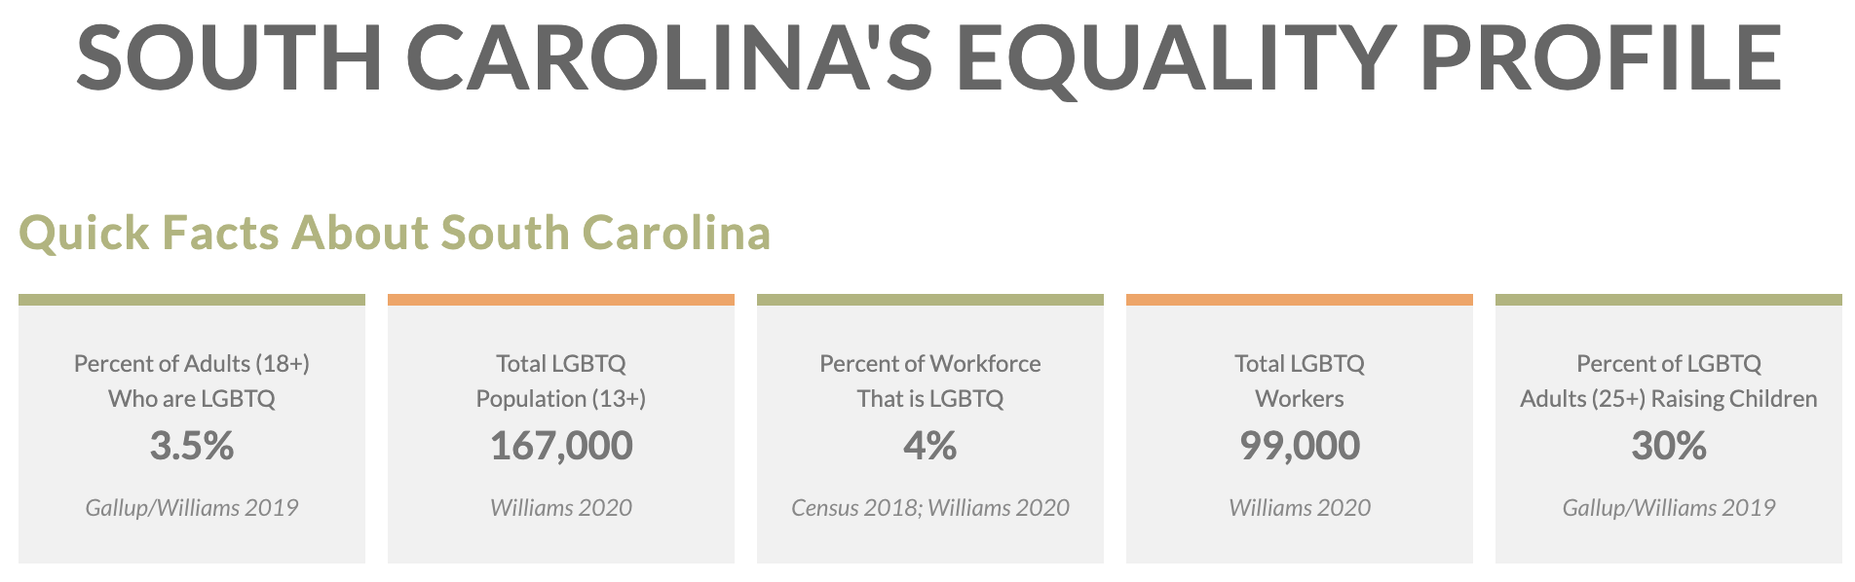
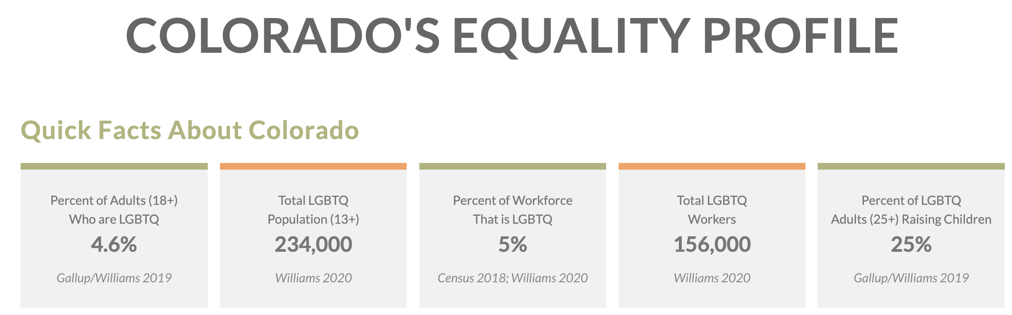
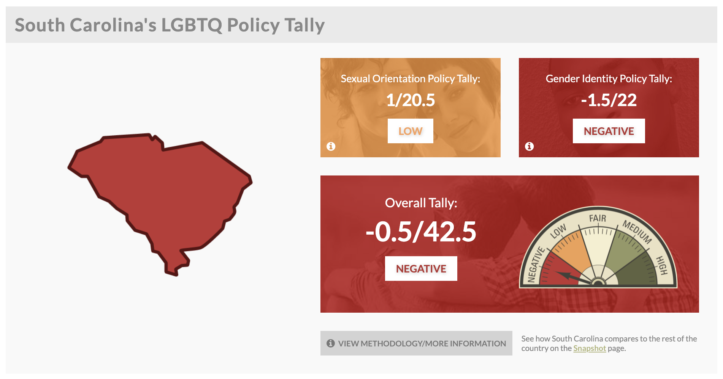
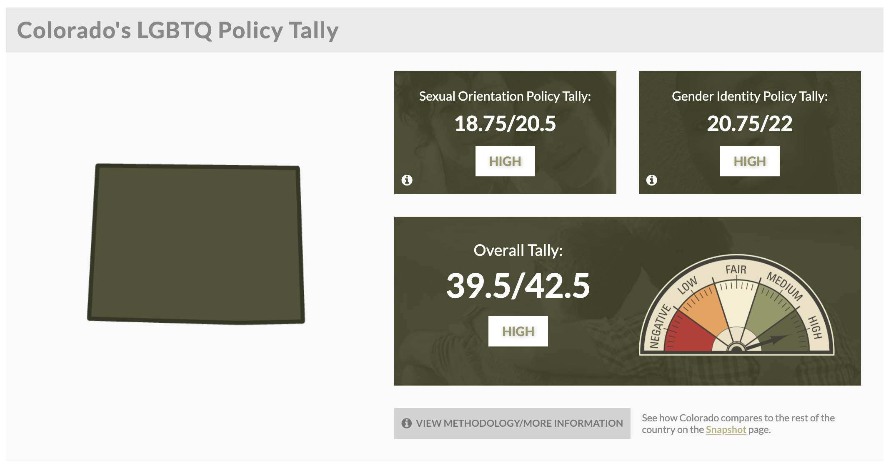
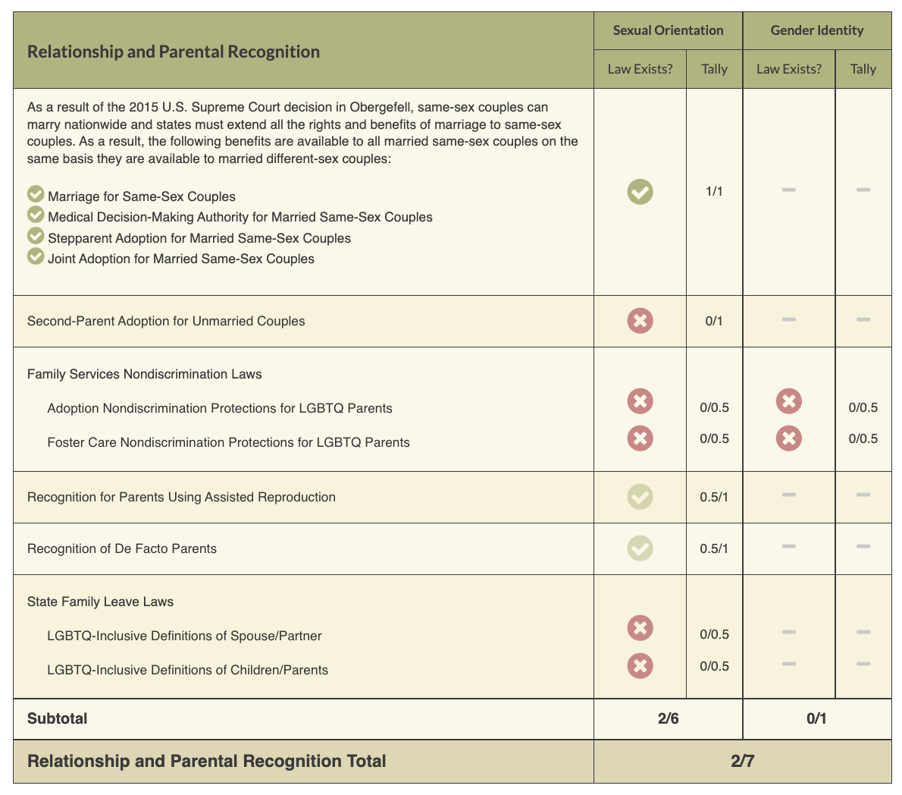
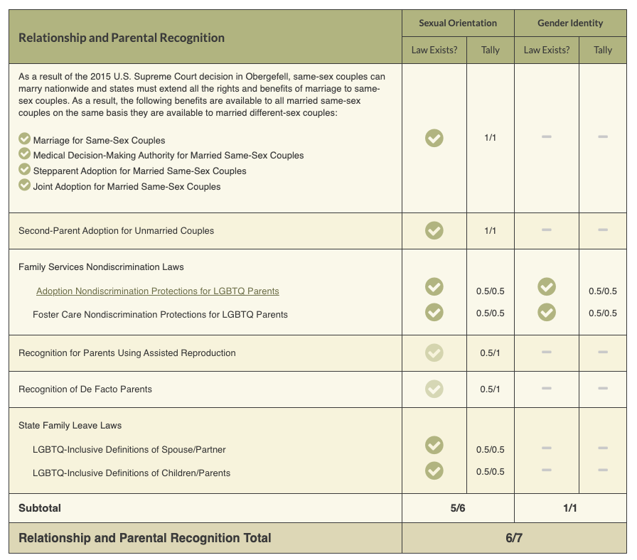
ACTIVITY
Review the Laws in Your State
Notes:
Look at Your State’s Equality Profile.
How might this impact members who are transitioning or transgender?
Instructions:
Go to www.lgbtqmap.org
Click Equality Maps
Select “Choose a State” in the drop down menu.
Select a state and review the data. How might this data impact members who are transitioning or transgender in your selected state?

Slide 80
NEA Legal Q&A
Look at your state profile from Movement Advancement Project: https://www.lgbtmap.org/
Those of you from states with PRO LGBTQ+ Laws will sit together
Those of you from states with ANTI LGBTQ+ Laws will sit together
How do these laws impact local issues? What issues are you experiencing (good or bad)? What are you/will you do at the local level?

Slide 81
What You Can Do
NEA Legal Q&A​
Know Your Rights
  Educator rights; student rights; rights as advocates
  Look at state laws, local ordinances, school board policies
Advocate for school board resolutions and policies that protect
  LGBTQIA+ students (e.g., gender- neutral bathrooms, inclusive curricula.
Bargain for protective policies for LGBTQIA+ educators
Tell the stories of real impact
  In support of lawsuits challenging harmful laws and policies
  When challenging anti-LGBTQIA+ state laws

Slide 82
Review the Laws in Your State
1. Go to www.lgbtmap.org and Click Equality Maps or use the QR Code
2. Select “Choose a State” in the drop down menu.
3. Select a state and review the data.
How might this data impact members who are transitioning or transgender in your selected state?
Notes:
Look at Your State’s Equality Profile.
How might this impact members who are transitioning or transgender?
Instructions:
Go to www.lgbtqmap.org
Click Equality Maps
Select “Choose a State” in the drop down menu.
Select a state and review the data. How might this data impact members who are transitioning or transgender in your selected state?

Slide 83

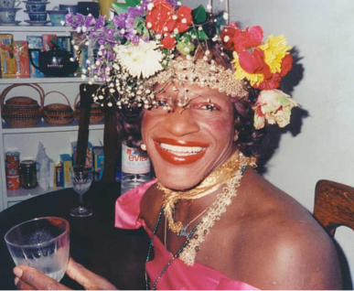
15 Minute Break!
www.womenshistory.org/education-resources/biographies/marsha-p-johnson

Slide 84
Sara and Zac

Slide 85

What is our Collective Strength?
How is collective strength shown in the video?
What is the collective strength we have in this room?

Slide 86
Good News and Wins
AZ Teacher: https://azmirror.com/2023/10/11/a-teachers-road-to-acceptance-and-fighting-back-against-hate/
Notes:
Overall Support:
A 2024 PRRI survey found 75% of Americans support policies protecting LGBTQ Americans from discrimination in housing, employment, and public accommodations, down from 80% in 2022.
GLAAD Study:
A 2024 GLAAD report also showed support for LGBTQ equal rights at 80%, a decline from 84% a year prior.

Slide 87
Zac

Slide 88

Freedom to Be Ourselves:
Telling our Story & Organizing for Change
Notes:
Today we are going to talk about Navigating and Narrating the Road to Education Justice and will share resources and tools to move our vision of education justice.
We are grateful to our partners who worked around the clock to get results ready for the research briefings we held in October. We have a recording of that presentation and the key findings documents for you in our Resources and Tools document that you will receive after this session.
In the next few weeks you will be receiving the message guidance that came from that research. This is not a research briefing.
Today, I want us to think about….
•Who’s talking about race?
•And how do we interrupt dog-whistle tactics to win the great public schools our students deserve?

Slide 89

Who is talking about race and gender and how is it impacting the terrain on which we teach and advocate?
What does research tell us about moving people to our vision of education justice?
What are ways we will join together to organize for change?
Notes:
Today we are going to talk about Navigating and Narrating the Road to Education Justice and will share resources and tools to move our vision of education justice.
We are grateful to our partners who worked around the clock to get results ready for the research briefings we held in October. We have a recording of that presentation and the key findings documents for you in our Resources and Tools document that you will receive after this session.
In the next few weeks you will be receiving the message guidance that came from that research. This is not a research briefing.
Today, I want us to think about….
•Who’s talking about race?
•And how do we interrupt dog-whistle tactics to win the great public schools our students deserve?

Slide 90
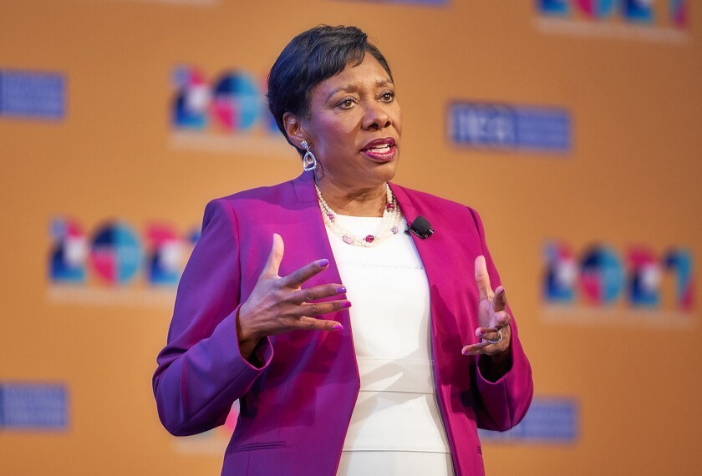
Being Intentional
“We, the NEA, will lead a movement that unites not just our members, but the entire nation to reclaim public education as a common good, and then transform it into something it was never designed to be—a racially and socially just and equitable system that prepares every student, every one, to succeed in a diverse and interdependent world.”
NEA President Becky Pringle, 2021 NEA RA
Notes:
But the NEA is clear on our collective vision and our responsibility to our students and educators… to win all that we need for all kids to thrive –whether Black, brown or white –

Slide 91

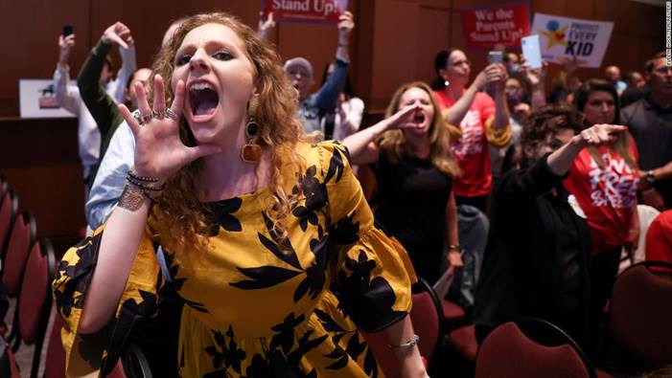
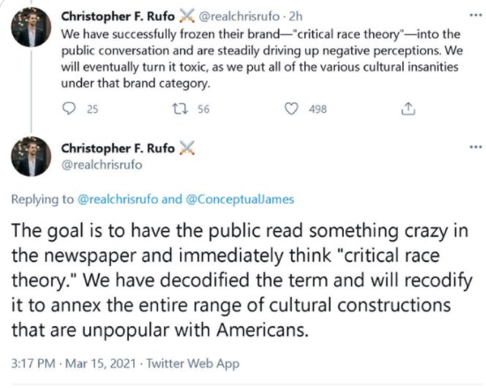
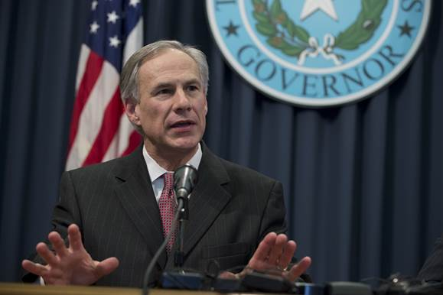
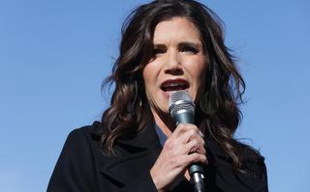
Notes:
PICTURES:
Tucker Carlson
Greg Abbott
Kristi Noem
Mike Pence
Parent at Virginia School Board meeting
==================
So, let’s look who’s talking about race
Christopher Rufo’s tweet is the most recent version of the age-old playbook – that has been used by so many –especially in public education.
And it caught on in the months that followed, we’ve seen governors, presidential hopefuls, TV personalities using this tactic to move a radical agenda.
Same coordinated & well funded actors: anti-vax, masks, LGBTQ and voting rights.
For months our opponents have channeled racial grievances into a race-baiting -debate challenging the progress we have made in teaching more honest and accurate history.
Based on lies and disinformation campaigns, they created a culture war issue meant to mobilize their base by spreading fear.
We’ve all seen the heightened attacks on educators, parents and students who speak out against these tactics.
But these tactics have also worked to move the conversation away from the learning and working conditions for students and educators and the very curriculum and care kids need to thrive.

Slide 92
What We’re Up Against
Erode trust
Reduce funding
Increase apathy & cynicism
Reduce Participation
Sow racial and gender division
Notes:
Read Pandemic message..

Slide 93

Uncontested, their narrative sets the frame
Notes:
Uncontested, we know that race baiting attacks and attempts at whitewashing history have direct impacts on achieving our vision for public education --fully funded and equitable for every student.
These tactics are directly linked to the rights agenda to:
--defund public schools
-privatize public schools and other public services and
--decrease professional respect for educators, union rights and collective bargaining power

Slide 94

Being Intentional
“There is a chilling effect on educators, in order to silence and marginalize and invisibilize support for LGBTQ-plus students,” Willingham-Jaggers said. “The real effect of this stuff is diminishing opportunities for LGBTQ young people.”
GLSEN Executive Director, Melanie Willingham-Jaggers
Notes:
These attacks impact every one of us who work in service of safe, affirming and just schools for our students.
The hateful rhetoric and policy language being spread seems designed to appeal to fringe partisans, it is part of a conservative effort to foster a moral panic that will help limit how and what educators teach — by restricting history lessons, banning books, and curbing discussions of systemic racism and LGBTQ issues. Inflicting pain on our students in service of creating division aimed at eroding trust in public education and public institutions writ large.

Slide 95

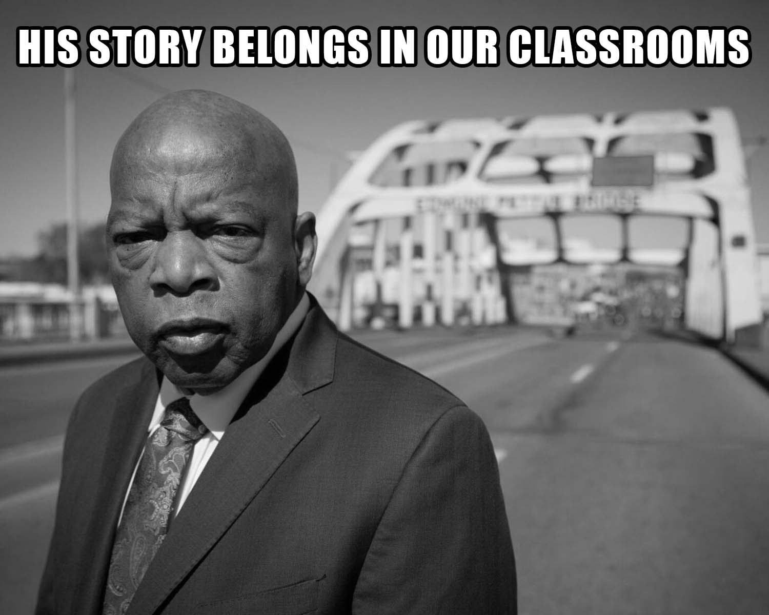
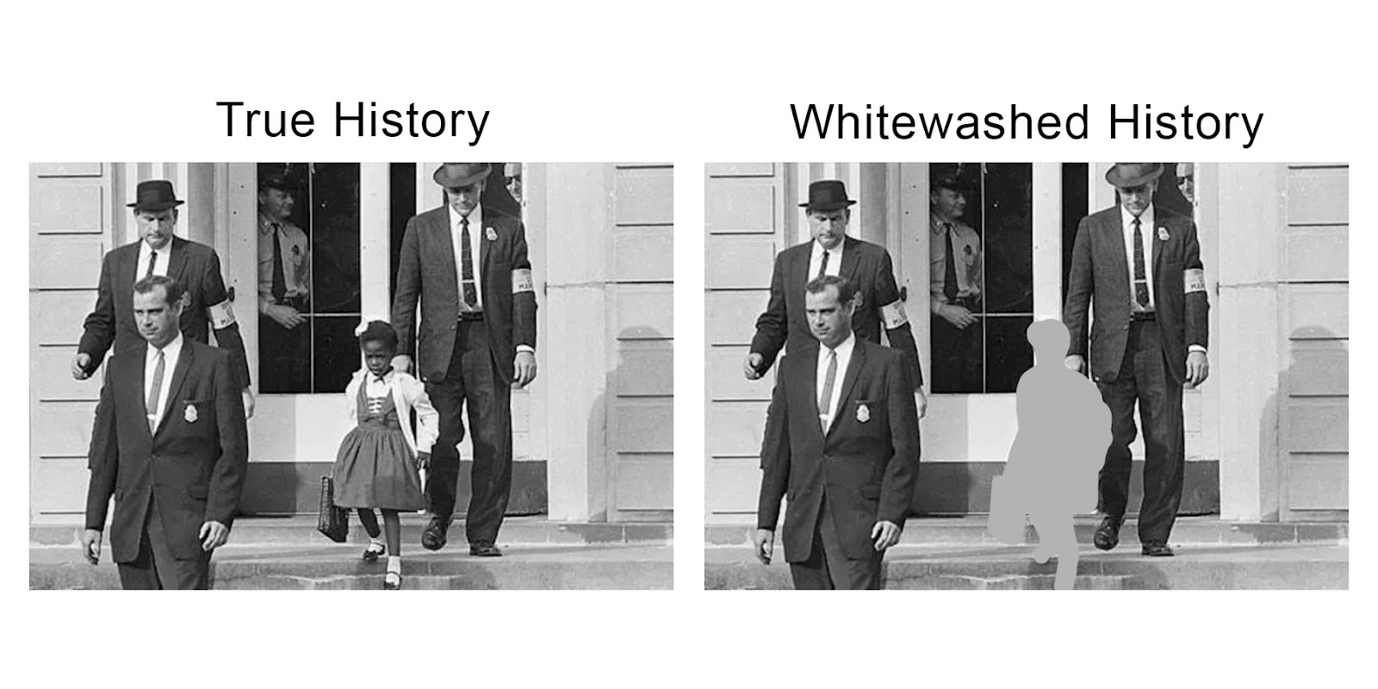
Building a Choir
We need to ensure that all our students are safe.
We must build true, authentic, intentional relationships.
This work is political. Everything in our lives is.

Slide 96


Talking about Race and Class: It’s Important
Notes:
Now that we have define dog whistles can you identify a few dog whistles used in education:
CRT
Private Schools
Government Schools
Indoctrination
Socialism
Title I Schools

Slide 97
Race Class Gender Narrative Key Elements
Lead with shared values that name race & class & gender
Name racial and gender identity scapegoating as
a weapon that harms us all.
Emphasize unity and collective action to solve the problems
Notes:
The key elements of RCN messages include:
1. Lead with a shared value that names race and class.
2. Naming the motive behind why our opponents are using racial scapegoating as a way to divide us...
3. Connect joining together to achieve desired outcomes. Give a call to action urging people to be an active participant in creating change.

Slide 98
School is a place where childhood happens. Most of us believe that every child, whatever their color, sexual orientation, background or zip code, has the right to learn in a supportive environment that respects their humanity, upholds their dignity, and responds fairly to mistakes and mis-steps.
Values
Notes:
*if time allows, read Education message.

Slide 99
But today, certain politicians fuel divisions so they can take resources away from our schools while they let the wealthiest few get away with not paying their fair share. They then blame parents, teachers and students to distract from these failures. They send police into schools to harm students who are Black, brown, LGBTQ+ or disabled for making mistakes that — for wealthy white kids — are deemed part of growing up and learning.
Villain (Actor)

Slide 100
Our schools must treat every child as equal, especially in situations of conflict. We make the future, and by joining together — parents and teachers, LGBTQ+, Black, white, and brown — we can make every neighborhood public school a place where all children can learn, grow, and thrive.
Collective Vision
Notes:
*if time allows, read Education message.

Slide 101

Values Based, Race Class Gender Forward Messages Mobilize!
Transgender Youth and the Freedom to Be Ourselves— We Make The Future
Notes:
The public is with us in supporting public schools. It is time to boldly, loudly, and repeatedly share our vision for public education. When we do, we win.

Slide 102

Key Findings
“freedom to be ourselves”
Notes:
New research by ASO Communications, Transgender Law Center, and Lake Research Partners finds that we can cultivate resistance to these attacks, build cross-racial solidarity, and advance a shared vision for the future by weaving together our shared values, experiences, and demands across races and genders. This new approach builds on the Race Class Narrative to tell a convincing story of how our opposition uses strategic racism and transphobia to harm us all; and how, by coming together, we can ensure we all have the freedom to be ourselves and support one another. Using a Race Class Gender Narrative, we can mobilize our base (particularly Black, AAPI, and Gen Z audiences), marginalize our opposition, and move persuadables across race.
TAKING THE WORD FREEDOM BACK. Across racial lines, evoking freedom as an aspirational value increases agreement with expressions of equity against opposition claims about parental freedom and choice. Talking about the “freedom for children to pursue their dreams” wins by big margins. Indeed, making children the protagonists in freedom-based framing is more effective than casting teachers in this role by discussing their freedom to determine what they teach.

Slide 103
Whether we are Black, white or brown, Native or newcomer, transgender or not, we want our kids to have the freedom to be themselves and pursue their dreams. But certain politicians try to get and hold onto power by putting us in boxes based on what we look like, where we’re from, or what our genders. They fuel divisions between parents, denying Black and brown kids opportunities in segregated schools, pushing laws to erase our history — from Selma to Stonewall — of coming together to push for better, and exploiting lack of familiarity with transgender people to exclude transgender kids from healthcare, school, and sports. By speaking out for welcoming, accurate, and fully funded education, we can make our schools places where children of all races and genders are free to learn all that they – and our country – have the potential to be.
Notes:
This is one example of how the race class gender narrative can be used to connect our issues… our fights.
PURPLE text is the VALUE
RED text describes the actors and their motivations
Green text is our COLLECTIVE Call to Action
**MAYBE CALL ON 3 AUDIENCE MEMBERS TO READ EACH COLOR?
That red part is important –We have to name the actors and their motivations. People are cynical that anything can change right now. If we don’t tell them who is making the decisions that impact their lives and what the motivations are, the people we want to mobilize to come to a school board meetings, or tur out to vote won’t –BECAUSE the problem will feel too overwhelming and the actions we are asking them to take won’t connect.

Slide 104
Race Class Gender Narrative Key Elements
Lead with shared values that name race & class & gender
Name racial and gender identity scapegoating as
a weapon that harms us all.
Emphasize unity and collective action to solve the problems
Notes:
The key elements of RCN messages include:
1. Lead with a shared value that names race and class.
2. Naming the motive behind why our opponents are using racial scapegoating as a way to divide us...
3. Connect joining together to achieve desired outcomes. Give a call to action urging people to be an active participant in creating change.

Slide 105

Gen Z Empowerment
Notes:
Thirdly, positioning bans as shortchanging children of the skills they need for the future proves effective. Our base and persuadables respond to the idea that “these bans shortchange [children] from developing critical thinking skills.”

Slide 106

Freedom to Learn & Be Ourselves
Notes:
Most of us believe all children should have the freedom to pursue their dreams, so we must equip every school with the resources to deliver quality education that prepares every child for the future, no matter their color, background or zip code. *** Point out when children can be their true authentic selves, then they can truly pursue their dreams***
While educators work to deliver our children accurate and honest education, some politicians are trying to turn us against schools so they can censor the lessons taught in our classrooms, deny certain children resources and write people who look like them out of our history books.

Slide 107

SEA Comes Together for Pride Flags
Notes:
Stonington Education Association Comes Together to Get Pride Flags Back in Classrooms
https://www.nea.org/nea-today/all-news-articles/pride-flag-flies-again
https://cea.org/stonington-education-association-comes-together-to-get-pride-flags-back-in-classrooms/

Slide 108


Slide 109
Alex

Slide 110
BUILDING AN ORGANIZING CAMPAIGN

Slide 111
Selecting a Scenario
p. 53-56
Move to a table that corresponds to that scenario
Take 2 minutes to read your scenario
Overview of what presentations and report out will look like
Notes:
Replace flag scenario with pronouns
Supplement book bans with curriculum
Do we add athletic teams to bathroom/locker room scenario

Slide 113
Consider...
For your scenario, imagine you are in a state that has recently banned conversations about LBGTQ+ topics. What would you do?

Slide 114
Consider...
Why do you think that it is important that we address concerns around LGBTQ+ equity through an organizing model?
(as opposed to relying solely on lawsuits and grievances?)

Slide 115
Organizing
What is organizing??
"If you don't know what jazz is, you'll never know." - Miles Davis
Organizing is
  An attitude that action can lead to a better outcome
  Based in equity
  Requires collective action
  Organizing is how individuals turn common challenges into common strength—transforming spaces through equity, action, and unity.

Slide 116
Why an Organizing Approach
Well-organized worksites and locals have a positive, visible presences
Members feel that they have the collective power to solve their problems and see themselves as responsible for the win – not a third party (UD, Lawyer, Lobbyist).
Builds power by continually increasing the amount of member leadership and ownership for the actions.
We cannot assume that the law/policy will always be on the side of LGBTQ+ equity!!!

Slide 117
What is an Organizing Campaign?
An action plan with a beginning, middle, and end, working towards a specific demand
•Involves a series of escalating actions (or tactics)
•Increases pressure on decision-makers
•Builds power by increasing engagement, developing leaders, and building capacity.
•Throughout the campaign we identify milestones that indicate we have enough power to try something more and something bigger and win!

Slide 118

Structure of a Campaign

Slide 119
Key Parts of an Organizing Campaign
• Issue
•Demand
•Target
•Tactics
•Escalation
Notes:
Possible trivia activity
Organizing terminology cheat sheet in resources

Slide 120
Key Ideas
Grievances are typically singular and don’t build people power
Campaigns involve lots of people, are member led, and increase power and visibility of the union

Slide 121
STEP 1:
Issue
P. 11 – Campaign Planning Document

Slide 122
PROBLEM vs. ISSUE
Campaigns start with issues members care about.
An issue is a slice of a workplace problem.
Often a problem can have different issues depending on the perspective of the people we are working with.
It is KEY to get enough input on what the issues are that make up the problem so that YOU do not drive the solution.

Slide 123

PROBLEM vs. ISSUE
Issues are the small(er) actionable pieces that contribute to the larger problem

Slide 124
EXAMPLE- Problem and Issue
PROBLEM -Our school is hostile to LGBTQ+ staff and students
◦ Issue – There are no gender inclusive bathrooms and/or transgender students are forced to use the wrong restroom.
◦ Issue – Our healthcare and leave benefits do not cover non-“traditional” family structures or are not fully accessible to people with same-gender partners.
◦ Issue – Our administration forces us to “out” trans and queer students to their families.

Slide 125
Assessing our Issues
What makes a good issue:
It is widely felt and/or deeply felt.
It is winnable.
It builds the union and builds leaders.
It has a connection to students and the public.

Slide 126
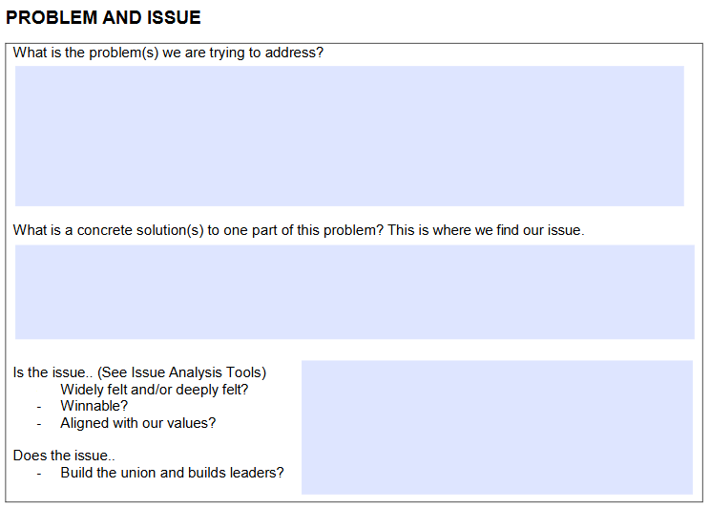
Assessing our Issues – p. 11
Sample chart that can be used to assess our issues (pg. 11 - Campaign Planning Document)

Slide 127
SCENARIO WORK!
In your group, spend time evaluating your issue using the chart in the handouts.

Slide 128
Ellen

Slide 129

Ending It Right
How does YOUR learning from today inform your work with members?
How might we inadvertently cause well-intentioned harm?
How can we prevent that?

Slide 130
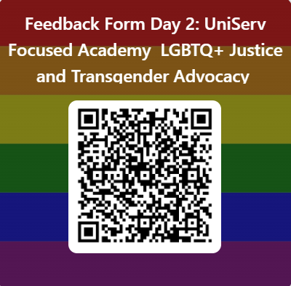
Feedback Form in Your Email
Feedback Form Day 2: UniServ Focused Academy LGBTQ+ Justice and Transgender Advocacy – Fill out form

Slide 131
Advancing LGBTQ+ Justice

