Slide 1



Advancing LGBTQ+ Inclusion & Belonging
NEA Retired Conference
Anthony Brisson, NEA HCR

Slide 2
NEA Members and External Audiences
By attending this session, you confirm that you are a NEA member, staff person, or invited guest. The information you receive here is only for your use in your capacity as a NEA member or supporter.
This presentation and its contents are confidential and closed to the press and may not be further distributed or passed on to any other person or published or reproduced, in whole or in part, by any medium or in any form for any purpose. Audio/video recording, copying of slides, and the use of AI note-taking tools are prohibited without the written consent. Violation of these terms may result in legal action.

Slide 3
Agenda
Knowing Your Why
LGBTQ+ State of the State
Problems vs. Issues
RCGN Messaging

Slide 4
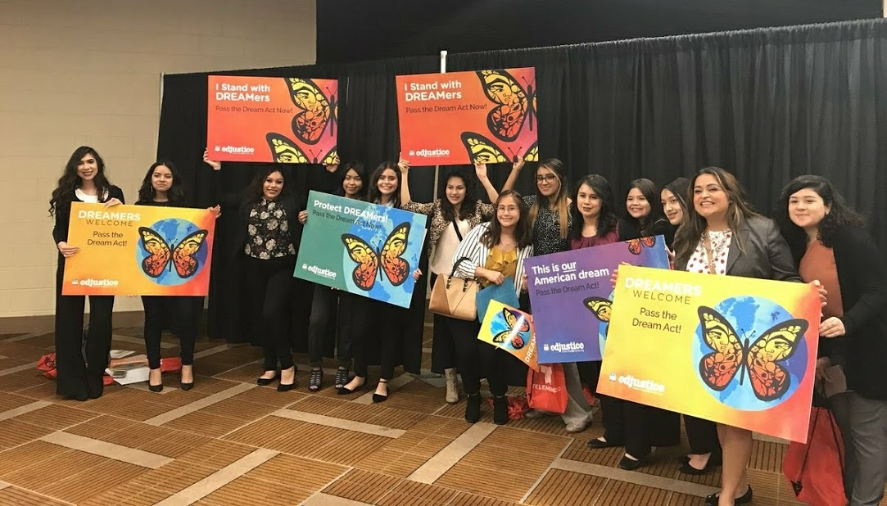
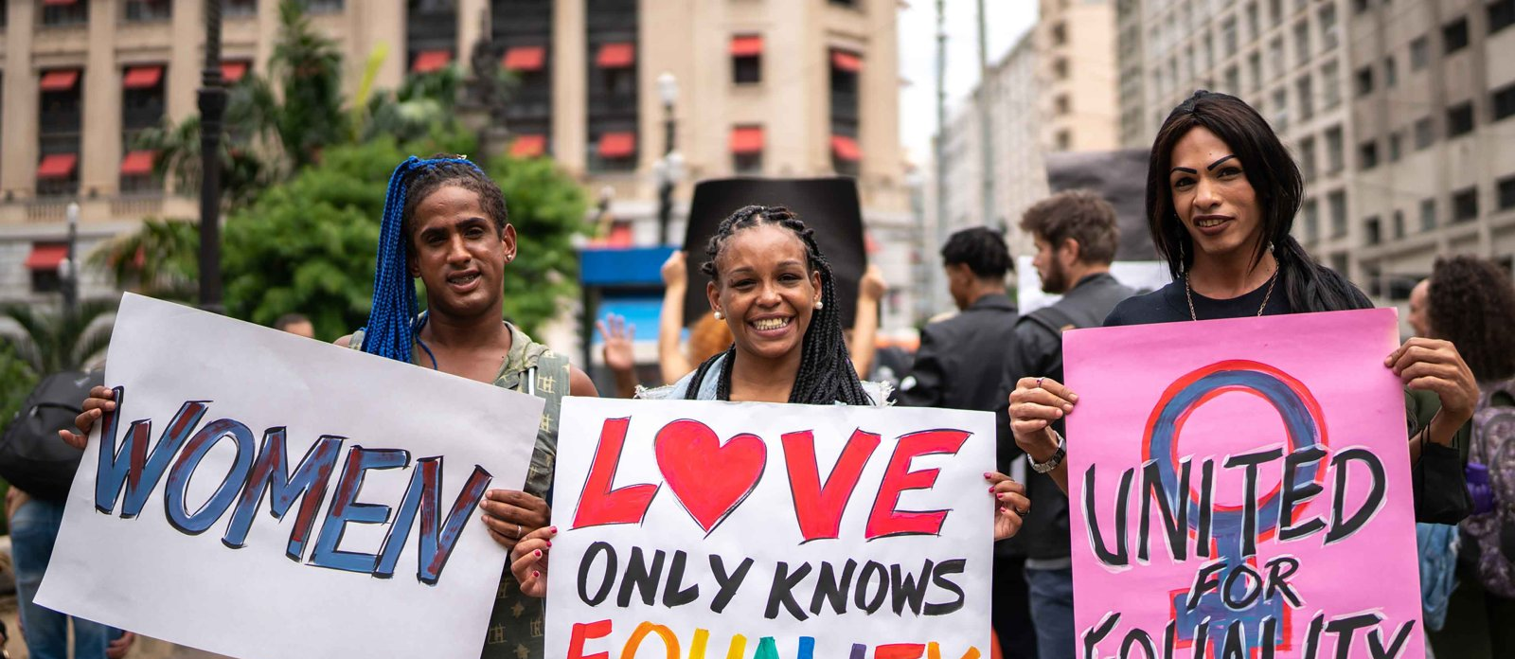
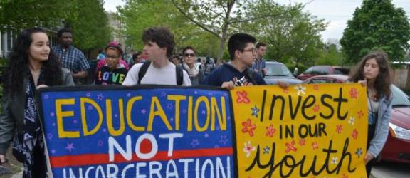
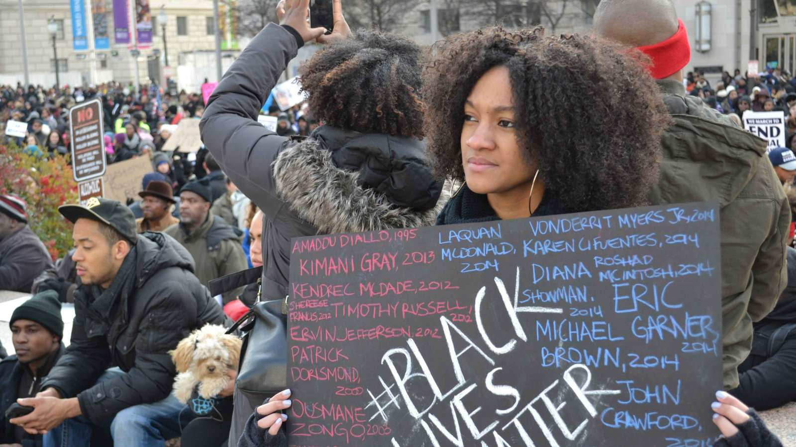
Promote, Protect, and Strengthen Public Education

Slide 5

Know Your Why
Know Your Why
https://www.youtube.com/watch?v=1ytFB8TrkTo

Slide 6
Shared Cored Values
First, read the different core values on the handout.
Then, circle your top 5 values.
Now, compare those values with a table partner.

Slide 7
Shared Cored Values
Now, pick your #1 value and compare with your table partner.
Whole group: What did you notice?

Slide 8
4 Prong Approach
Legal
Government Relations/Legislation
Policy and Practice
Member Engagement
Notes:
Legal
Amicus Briefs, Lawsuits, Letters to Districts, Know Your Rights Guides
Government Relations
Sign-on letters, member testimonies, member stories
Policy and Practice
School Board Resolutions, Professional Learning
Member Engagement
Rallies, marches, petitions, issue based organizing

Slide 9

Inversion of the Legal Landscape
From strong federal protections as a backstop to anti-LGBTQ state laws
To attacks by the federal government
→ Look to state laws, local policies, individual enforcement of rights
Notes:
Our current reality – 4 years!

Slide 10
Anti-LGBTQ+ Executive Order(s)
Placing restrictions on federal gender markers, such as passports, that require a person to use their sex assigned at birth
Military ban on transgender servicemembers
Block funding for reproductive health care organizations worldwide
Directing agencies to take action to prevent gender-affirming care from being provided to people under the age of 19
Attempting to dictate to students, their parents, and educators what they can read, learn, say, and who they can be
Prohibiting transgender girls from participating in school sports teams (Bill died in the Senate)
HRC 2025
Notes:
Because an EO cannot change federal civil rights laws or overrule court decisions interpreting those laws, this EO sets up a conflict between the Executive Branch’s enforcement of the civil rights laws and court decisions, which lays the foundation for further court or legislative action. Indeed, the EO itself calls for proposed legislation to be drafted within 30 days’ time to attempt to codify the definitions in the EO.

Slide 11
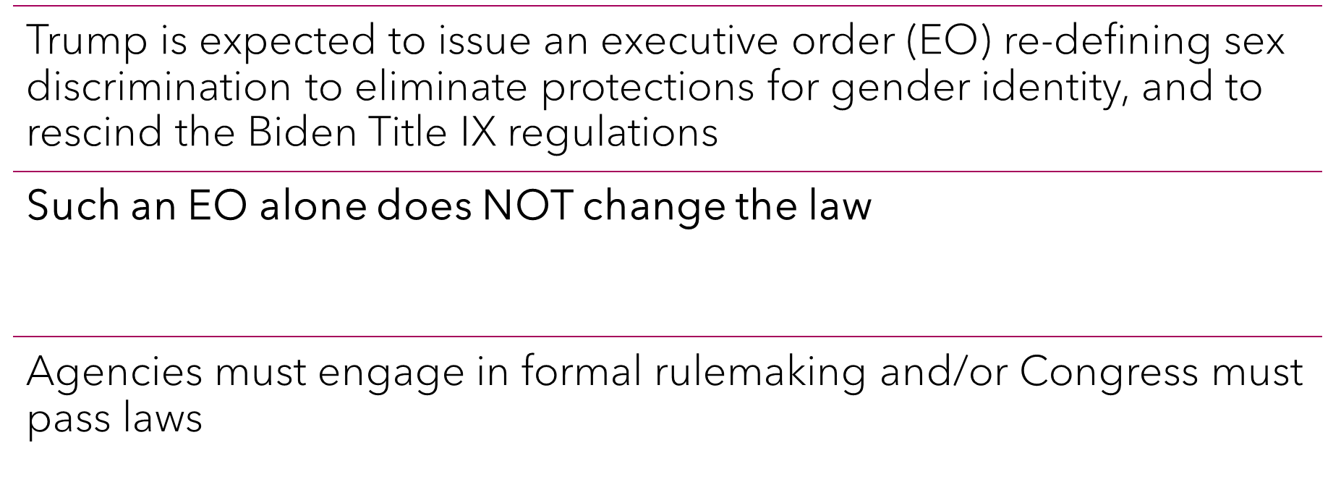
Executive Order(s)
Notes:
Because an EO cannot change federal civil rights laws or overrule court decisions interpreting those laws, this EO sets up a conflict between the Executive Branch’s enforcement of the civil rights laws and court decisions, which lays the foundation for further court or legislative action. Indeed, the EO itself calls for proposed legislation to be drafted within 30 days’ time to attempt to codify the definitions in the EO.

Slide 12
Protections at State & Local Levels
State/municipal laws prohibiting SO/GI discrimination in employment and education
Anti-harassment/bullying laws to protect students
Requirements for LGBTQ+ curriculum
Prohibitions on book bans
Other laws:
  protecting access to gender affirming healthcare
  banning conversion therapy
  guaranteeing processes for changing gender markers on identification and government records
  state law specifying that gender is self-reported with no requirement of medical documentation

Slide 13
Protections at the District Level
School board resolutions
District policies
Collective bargaining agreements (or tenure rights under state law)

Slide 14
Federal Protections
Title VII/Bostock - prohibits discrimination in employment
Title IX – prohibits sex-based discrimination in schools
14th Amendment Equal Protection
First Amendment protections for free expression and association
Equal Access Act – GSAs
FERPA - student rights to privacy and to change inaccurate records

Slide 15
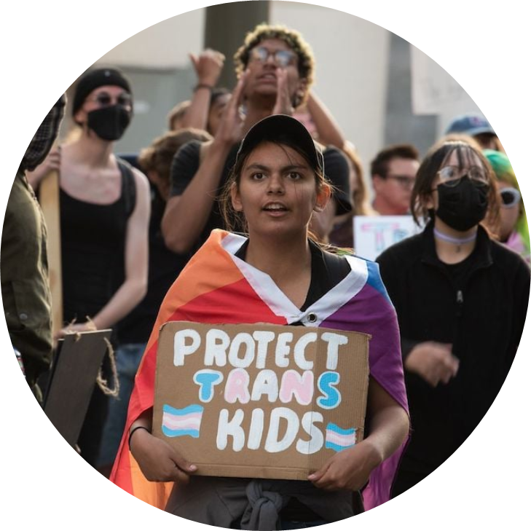
What Can You Do:
Lobby for good state or local laws
Advocate for school board resolutions and inclusive school policies
Help educate fellow members about LGBTQ+ rights and NEA resources
If you see discrimination or harassment, document and report it
Document adverse effects of school policies that exclude or marginalize LGBTQ+ students
Notes:
After Keira covers Legal, share some actions they can do right now.

Slide 16
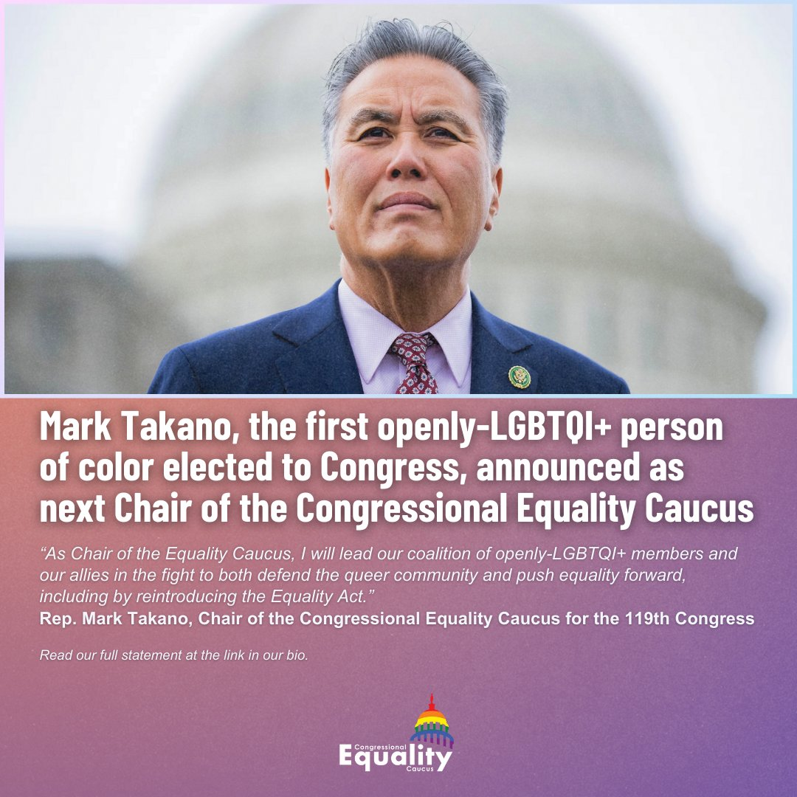
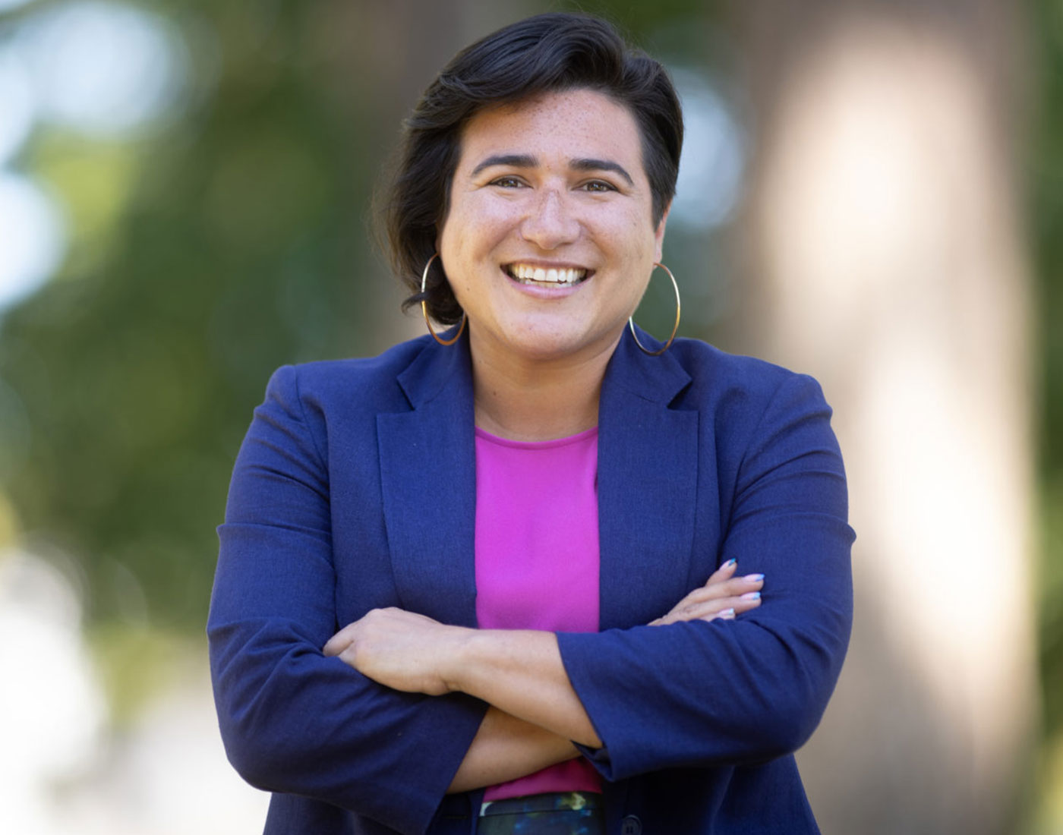
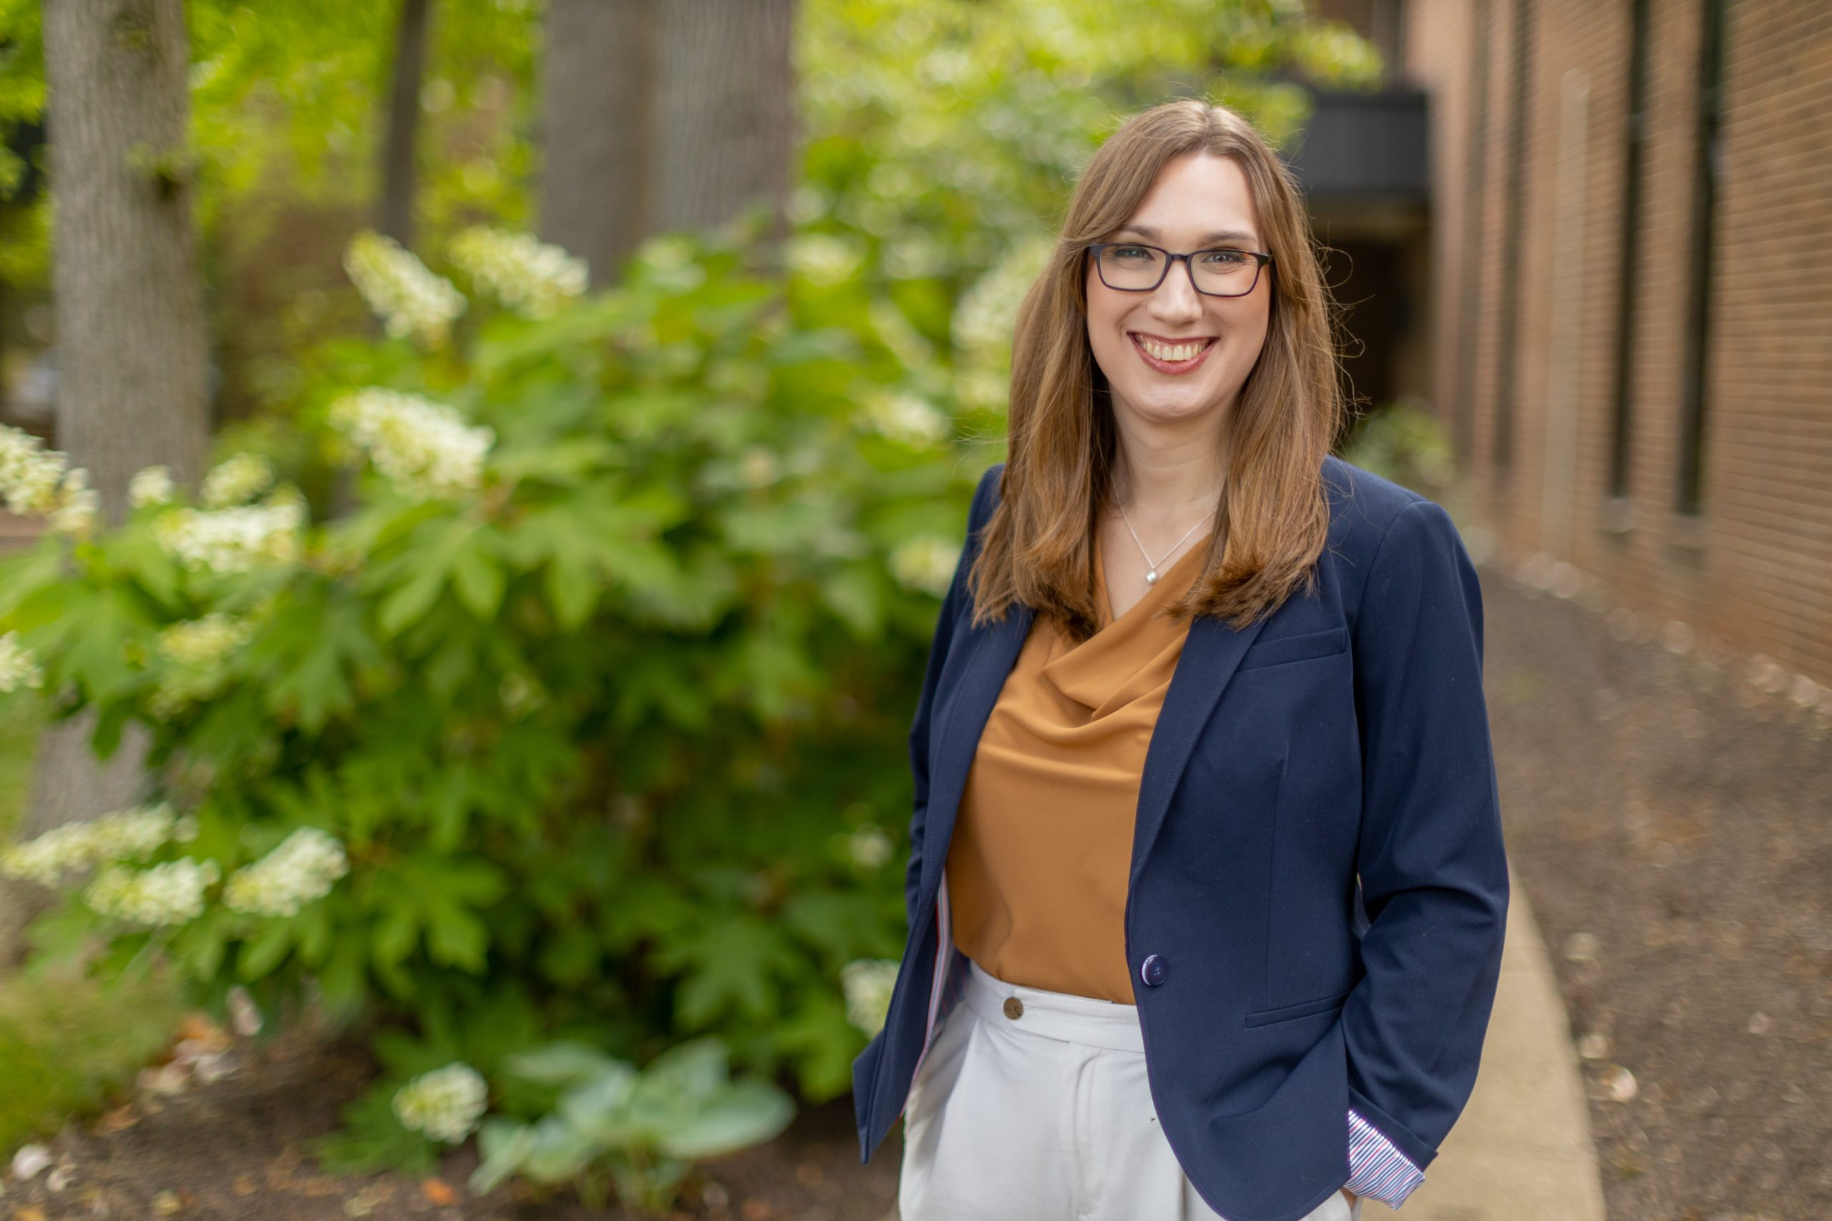
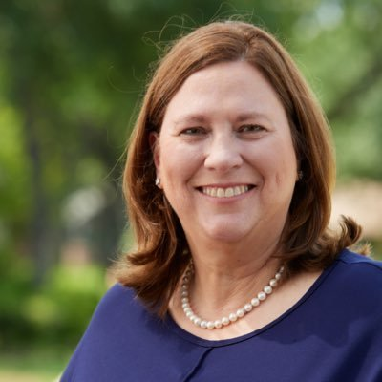
Government Relations
Good News!
  Expanded Congressional Equality Caucus
  New Congressional Equality Caucus Chair
  Lots of New Members
Notes:
Sarah McBride – Rep. for Delaware first openly transgender member of Congress.
Emily Randall is the first LGBTQ Latina in Congress after serving as a Washington state senator since 2018.
Julie Johnson, is the first LGBTQ+ member of Congress from the South, had served in the Texas state legislature since 2018.

Slide 17
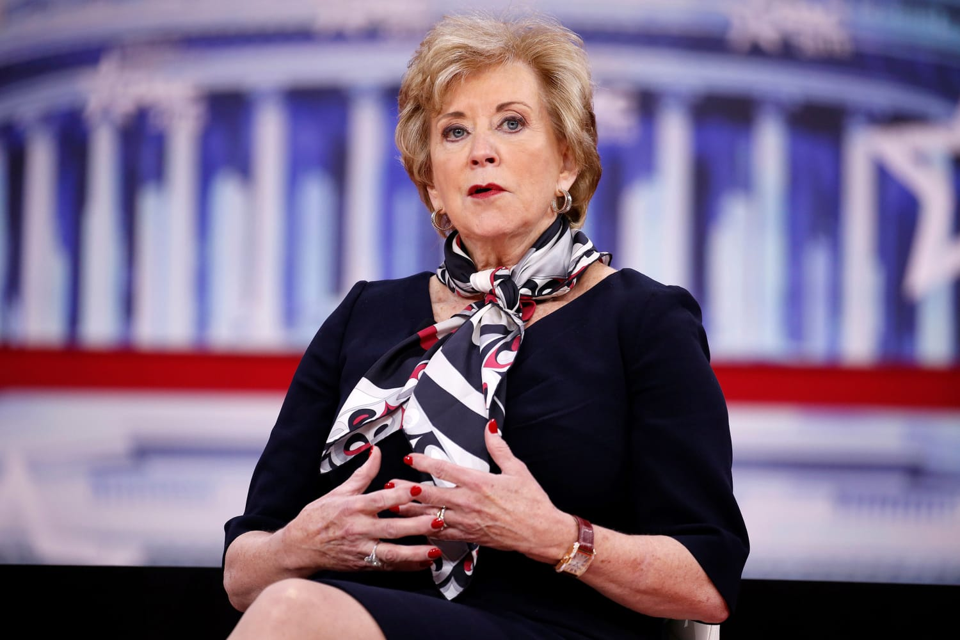
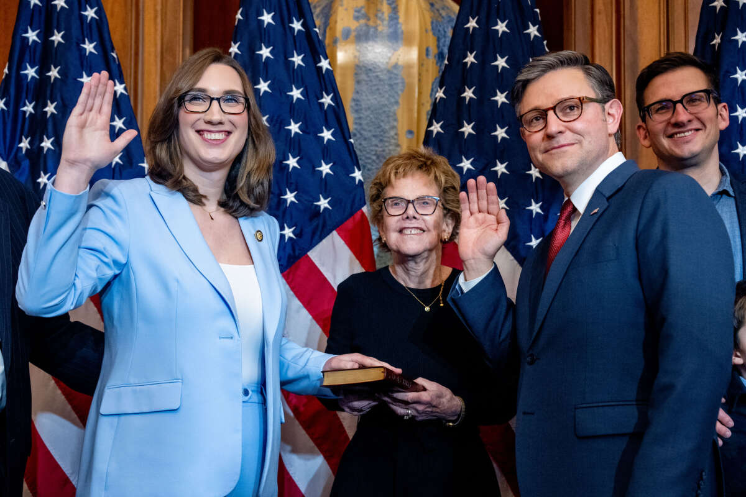
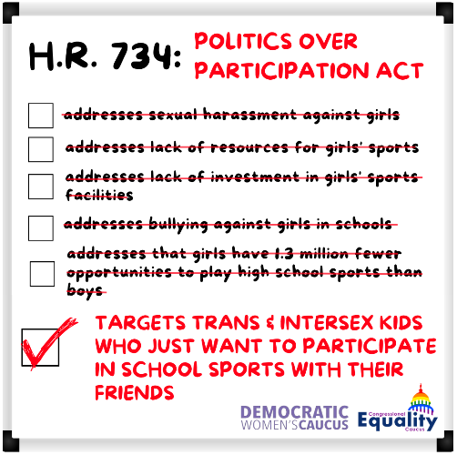
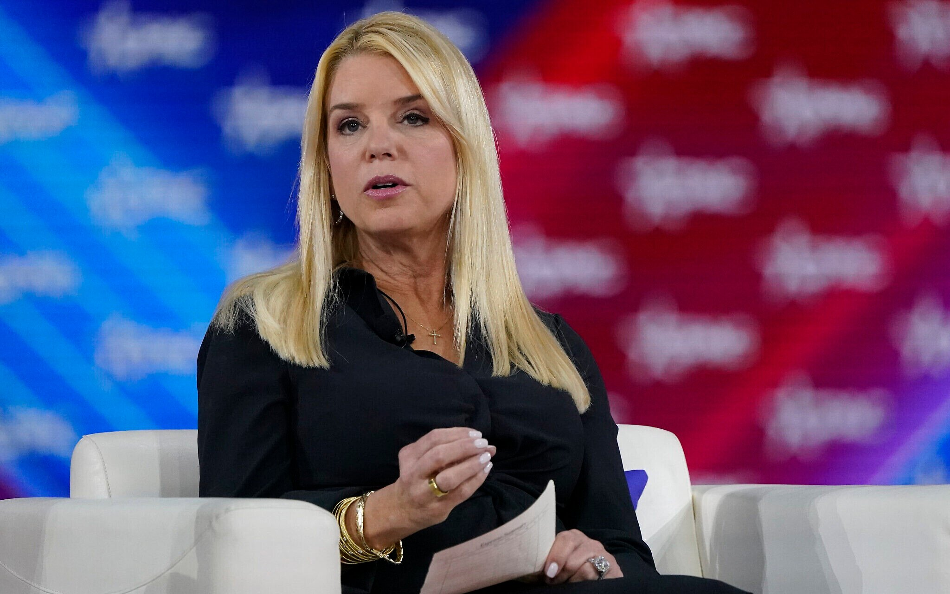
Government Relations
Bad News!
  Speaker Mike Johnson and Majority Leader John Thune
  House Priority Bill – Sports Ban but died in Senate
  Confirmation of Nominees

Slide 18

What Can You Do RIGHT NOW?
Join the NEA Action Center
  https://www.nea.org/advocating-for-change/action-center
Sign Up for Our Weekly Newsletter
Learn About Bills
Contact Your Members of Congress
  Local, State and Federal
Notes:
After Juan covers GR, share some actions they can do right now.

Slide 19
Member Engagement
Rallies
Marches
Petitions
Letters
Sharing a post
But, is this enough?
Notes:
We hear the word ally, the word ally is typically viewed as a verb. One needs to act as an ally and cannot bestow this title to themselves.
An ally is someone who supports a cause.
What risk is being taken? Although it may be low level action, we must be careful not to turn them away. Do not say “this is not enough”, rather identify where people are comfortable and let them engage. However, we know we need more than just showing up and supporting a cause. That’s when….

Slide 20
We Need Action
Issue Based Organizing
Build Campaigns & Partnerships
Educators need to run for office
Challenge Biases & Interrupt Microaggressions
Design & Teach anti-racist curriculum
Recognize your own stake in eradicating White Supremacy
Notes:
We need to be co-conspirators. Ask yourself: What are you willing to risk?
An ally is someone who supports a cause, while a co-conspirator is someone who takes action to advance that cause. Co-conspirators are change agents who are willing to take risks and make big commitments.
And being a white co-conspirator means you need to be in constant and consistent action.
Non LGBTQ+ - Build and join coalitions in partnership with the LGBTQ+ community
Ask what you can do, and how you can get involved. Just do not assume you know how to help because you could actually cause more harm.
Attend trainings to expand your learning. It is up to you to do some learning…..not just rely on the LGBTQ+ community.

Slide 21
Examples from other states
LGBTQ+ Caucuses
LGBTQ+ Training Cadres (for staff/officers and schools/members)
Gender neutral language in its contract
Sexual and Gender Affinity Groups
Mentoring programs/onboarding for LGBTQ+ educators and/or other affinity groups
LGBTQ+ Professional Development
Standing Agenda Items for Executive Committee Group addressing caucus/affinity group issues
School board resolutions create safe and inclusive spaces for LGBTQ+ students and educators

Slide 22
Moving Forward
Determine Where Districts & Schools Stand
LGBTQ+ Inclusivity Self-Assessment
Instructional and Institutional Entry Points
Continued Professional Learning
Educate, Affirm, Include and Interrupt
Controlling the narrative
Notes:
Republicans score political points by going after the LGBTQ+ community – particular our trans populations
Spreading of falsities which creates fear
Develop plans that outline what can and can not be said or taught according to the current law
Direct communication with school administrators to better understand what state laws and policies really mean for educators
CDC has a self assessment tool as well as Gender Spectrum has a Gender Inclusive Assessment
Need to Educate all staff, parents and community members
We need to affirm students identities
Include all perspectives
Interrupt students and adults any time hurtful language is used whether intentional or unintentional

Slide 23
In your state/local….
What are you hearing? What is happening?
Notes:
Write everything down that is impacting the LGBTQ+ community? Good/bad/indifferent

Slide 24
Problem vs. Issue
What is a problem?
What is an issue?
Notes:
There are adverse factors that affect the LGBTQ+ community including our members and students in our schools. In order to engage and address these adversities, we must first be able to identify and separate problems from issues. Discuss at your tables what you believe is the difference between a problem and an issue.

Slide 25
Problem vs. Issue
A problem is something that you don’t like about the world or your society, but it is too big or vague to grapple with in any coherent way.
Examples: “discrimination” and “homophobia”
We don’t like them, but it’s hard to know what to do about them in general.
An issue is a more specific challenge that is separated out from the larger “problem.” An issue, rightly framed, provides us with options to engage the challenge.
Example: A campaign to implement a school board resolution to allow pride flags to be displayed in classrooms.
Notes:
As we consider the difference between problems and issues for potential organizing campaigns, we must always as an organization – a union remember to build in pathways for organizational development and capacity building.

Slide 26
We Need Messaging!
We need to talk about the LGBTQ+ attacks
No matter the attack or vehicle, our shared values include:
  Protecting Individual Freedom
  Protecting Parental Freedom
  Opposing Government Overreach / Interference
We want to protect the rights and freedoms of:
  All people
  Parents and Families
  Doctors and Medical Professionals
Notes:
Trump & his allies spent hundreds of millions of dollars last cycle attacking VP Harris and scores of Democratic House and Senate candidates for their support of transgender people.
While TFA’s polling with Change Research shows these ads did not impact the outcome of the election, they did have an emotional impact on voters.
Share examples from:
NEA Messaging Guidance
Race Class Gender Narrative
Story of Self

Slide 27

Freedom to Be Ourselves:
Telling our Story & Organizing for Change
Notes:
Today we are going to talk about Navigating and Narrating the Road to Education Justice and will share resources and tools to move our vision of education justice.
We are grateful to our partners who worked around the clock to get results ready for the research briefings we held in October. We have a recording of that presentation and the key findings documents for you in our Resources and Tools document that you will receive after this session.
In the next few weeks you will be receiving the message guidance that came from that research. This is not a research briefing.
Today, I want us to think about….
•Who’s talking about race?
•And how do we interrupt dog-whistle tactics to win the great public schools our students deserve?

Slide 28

Who is talking about race and gender and how is it impacting the terrain on which we teach and advocate?
What does research tell us about moving people to our vision of education justice?
What are ways we will join together to organize for change?
Notes:
Today we are going to talk about Navigating and Narrating the Road to Education Justice and will share resources and tools to move our vision of education justice.
We are grateful to our partners who worked around the clock to get results ready for the research briefings we held in October. We have a recording of that presentation and the key findings documents for you in our Resources and Tools document that you will receive after this session.
In the next few weeks you will be receiving the message guidance that came from that research. This is not a research briefing.
Today, I want us to think about….
•Who’s talking about race?
•And how do we interrupt dog-whistle tactics to win the great public schools our students deserve?

Slide 29
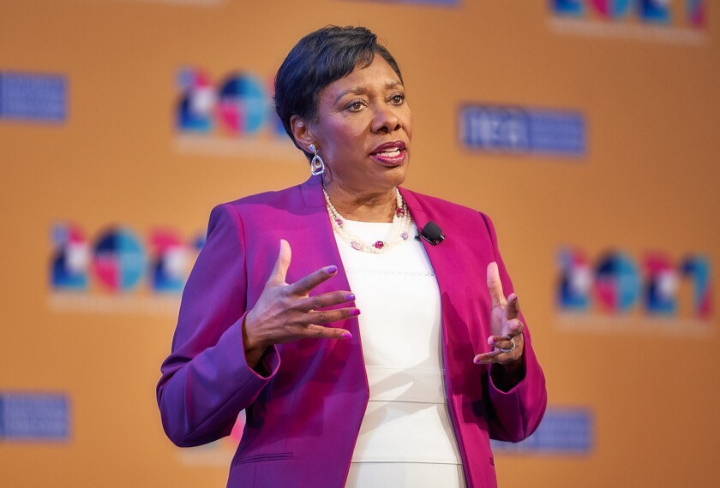
Being Intentional
“We, the NEA, will lead a movement that unites not just our members, but the entire nation to reclaim public education as a common good, and then transform it into something it was never designed to be—a racially and socially just and equitable system that prepares every student, every one, to succeed in a diverse and interdependent world.”
NEA President Becky Pringle, 2021 NEA RA
Notes:
But the NEA is clear on our collective vision and our responsibility to our students and educators… to win all that we need for all kids to thrive –whether Black, brown or white –

Slide 30
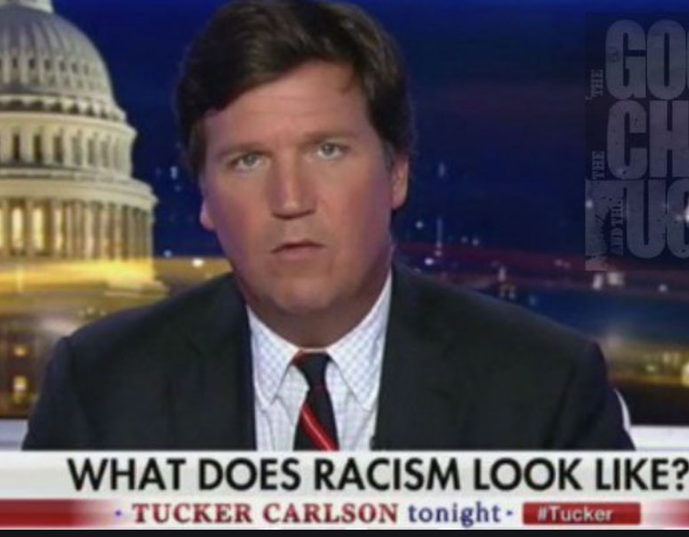
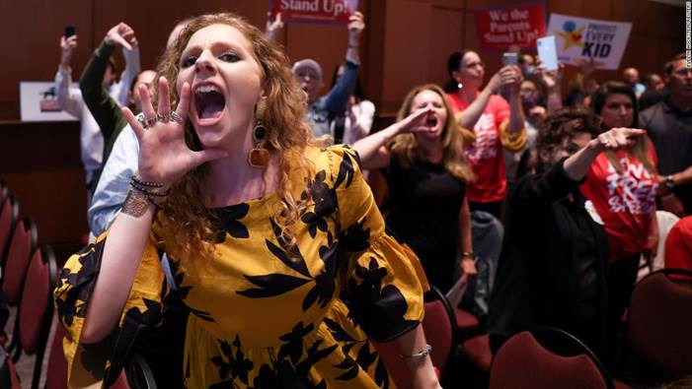
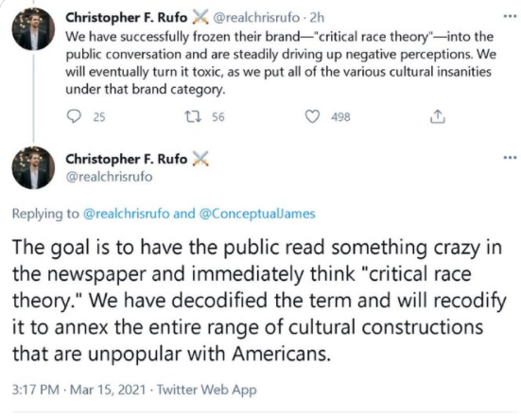
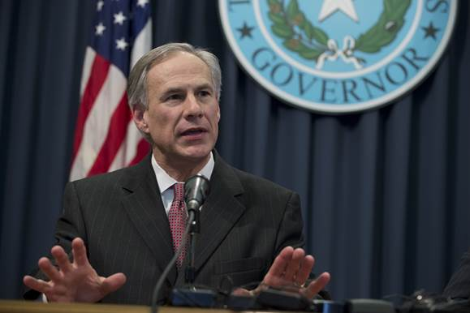
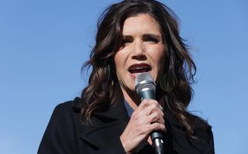
Notes:
PICTURES:
Tucker Carlson
Greg Abbott
Kristi Noem
Mike Pence
Parent at Virginia School Board meeting
==================
So, let’s look who’s talking about race
Christopher Rufo’s tweet is the most recent version of the age-old playbook – that has been used by so many –especially in public education.
And it caught on in the months that followed, we’ve seen governors, presidential hopefuls, TV personalities using this tactic to move a radical agenda.
Same coordinated & well funded actors: anti-vax, masks, LGBTQ and voting rights.
For months our opponents have channeled racial grievances into a race-baiting -debate challenging the progress we have made in teaching more honest and accurate history.
Based on lies and disinformation campaigns, they created a culture war issue meant to mobilize their base by spreading fear.
We’ve all seen the heightened attacks on educators, parents and students who speak out against these tactics.
But these tactics have also worked to move the conversation away from the learning and working conditions for students and educators and the very curriculum and care kids need to thrive.

Slide 31
What We’re Up Against
Erode trust
Reduce funding
Increase apathy & cynicism
Reduce Participation
Sow racial and gender division
Notes:
Read Pandemic message..

Slide 32

Uncontested, their narrative sets the frame
Notes:
Uncontested, we know that race baiting attacks and attempts at whitewashing history have direct impacts on achieving our vision for public education --fully funded and equitable for every student.
These tactics are directly linked to the rights agenda to:
--defund public schools
-privatize public schools and other public services and
--decrease professional respect for educators, union rights and collective bargaining power

Slide 33
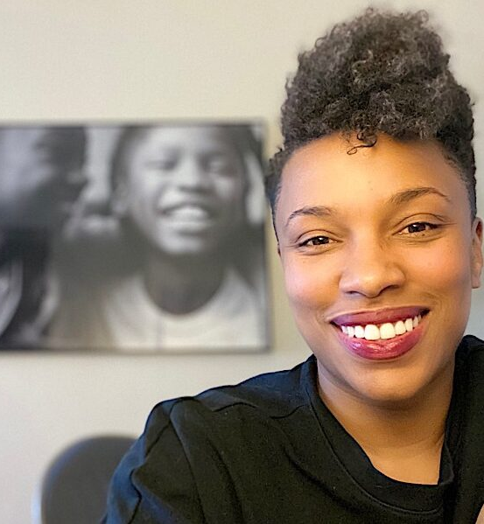
Being Intentional
“There is a chilling effect on educators, in order to silence and marginalize and invisibilize support for LGBTQ-plus students,” Willingham-Jaggers said. “The real effect of this stuff is diminishing opportunities for LGBTQ young people.”
GLSEN Executive Director, Melanie Willingham-Jaggers
Notes:
These attacks impact every one of us who work in service of safe, affirming and just schools for our students.
The hateful rhetoric and policy language being spread seems designed to appeal to fringe partisans, it is part of a conservative effort to foster a moral panic that will help limit how and what educators teach — by restricting history lessons, banning books, and curbing discussions of systemic racism and LGBTQ issues. Inflicting pain on our students in service of creating division aimed at eroding trust in public education and public institutions writ large.

Slide 34

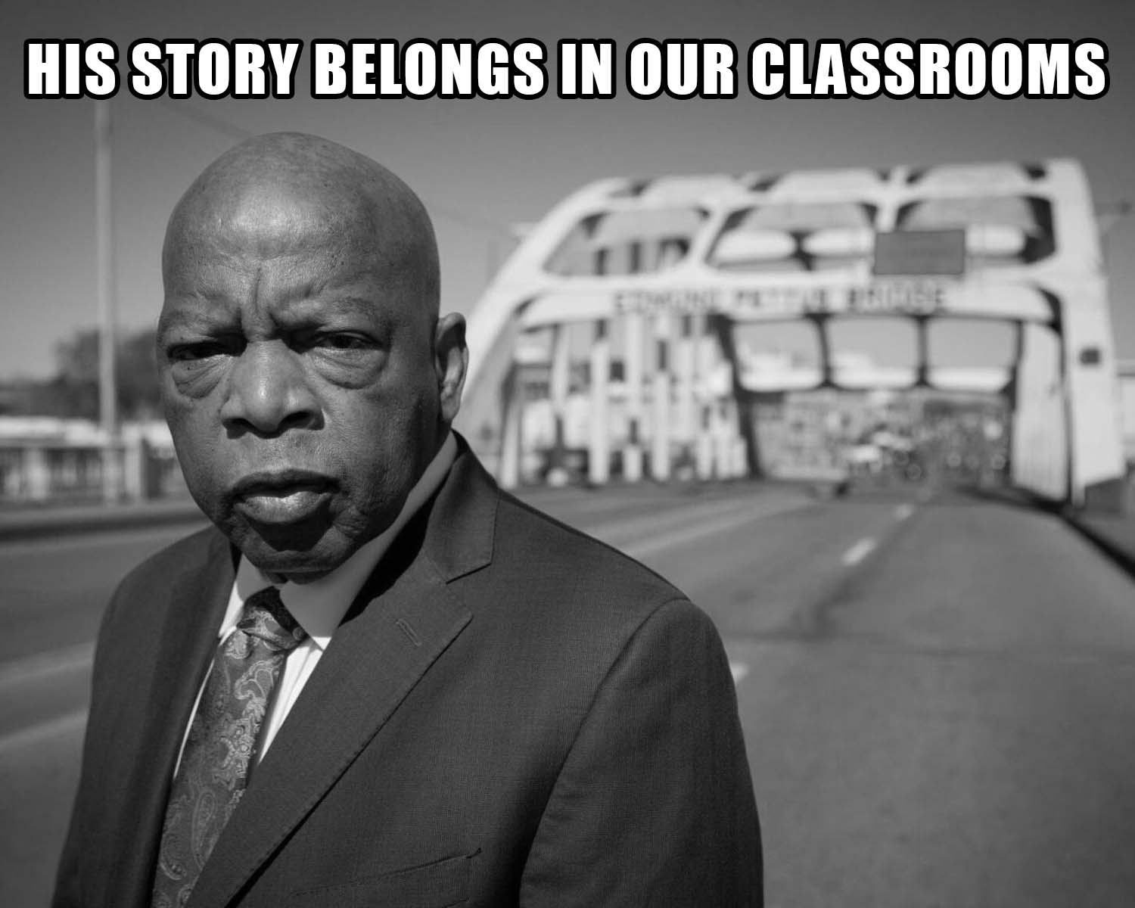
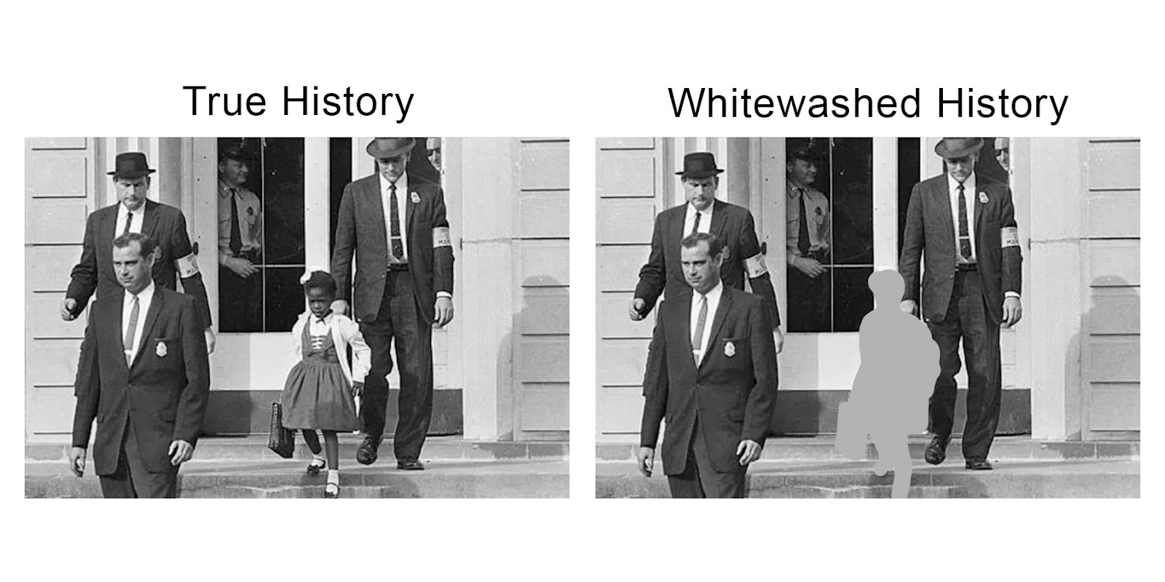
Building a Choir
We need to ensure that all our students are safe.
We must build true, authentic, intentional relationships.
This work is political. Everything in our lives is.

Slide 35
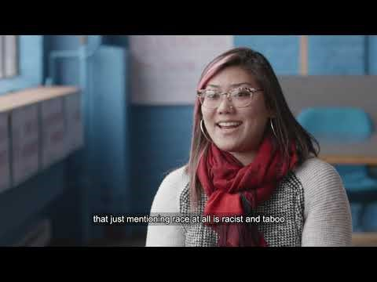

Talking about Race and Class: It’s Important
Notes:
Now that we have define dog whistles can you identify a few dog whistles used in education:
CRT
Private Schools
Government Schools
Indoctrination
Socialism
Title I Schools

Slide 36
Race Class Gender Narrative Key Elements
Lead with shared values that name race & class & gender
Name racial and gender identity scapegoating as
a weapon that harms us all.
Emphasize unity and collective action to solve the problems
Notes:
The key elements of RCN messages include:
1. Lead with a shared value that names race and class.
2. Naming the motive behind why our opponents are using racial scapegoating as a way to divide us...
3. Connect joining together to achieve desired outcomes. Give a call to action urging people to be an active participant in creating change.

Slide 37
School is a place where childhood happens. Most of us believe that every child, whatever their color, sexual orientation, background or zip code, has the right to learn in a supportive environment that respects their humanity, upholds their dignity, and responds fairly to mistakes and mis-steps.
Values
Notes:
*if time allows, read Education message.

Slide 38
But today, certain politicians fuel divisions so they can take resources away from our schools while they let the wealthiest few get away with not paying their fair share. They then blame parents, teachers and students to distract from these failures. They send police into schools to harm students who are Black, brown, LGBTQ+ or disabled for making mistakes that — for wealthy white kids — are deemed part of growing up and learning.
Villain (Actor)

Slide 39
Our schools must treat every child as equal, especially in situations of conflict. We make the future, and by joining together — parents and teachers, LGBTQ+, Black, white, and brown — we can make every neighborhood public school a place where all children can learn, grow, and thrive.
Collective Vision
Notes:
*if time allows, read Education message.

Slide 40
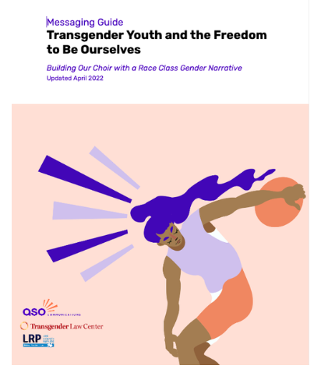
Values Based, Race Class Gender Forward Messages Mobilize!
Transgender Youth and the Freedom to Be Ourselves— We Make The Future
Notes:
The public is with us in supporting public schools. It is time to boldly, loudly, and repeatedly share our vision for public education. When we do, we win.

Slide 41

Key Findings
“freedom to be ourselves”
Notes:
New research by ASO Communications, Transgender Law Center, and Lake Research Partners finds that we can cultivate resistance to these attacks, build cross-racial solidarity, and advance a shared vision for the future by weaving together our shared values, experiences, and demands across races and genders. This new approach builds on the Race Class Narrative to tell a convincing story of how our opposition uses strategic racism and transphobia to harm us all; and how, by coming together, we can ensure we all have the freedom to be ourselves and support one another. Using a Race Class Gender Narrative, we can mobilize our base (particularly Black, AAPI, and Gen Z audiences), marginalize our opposition, and move persuadables across race.
TAKING THE WORD FREEDOM BACK. Across racial lines, evoking freedom as an aspirational value increases agreement with expressions of equity against opposition claims about parental freedom and choice. Talking about the “freedom for children to pursue their dreams” wins by big margins. Indeed, making children the protagonists in freedom-based framing is more effective than casting teachers in this role by discussing their freedom to determine what they teach.

Slide 42
Whether we are Black, white or brown, Native or newcomer, transgender or not, we want our kids to have the freedom to be themselves and pursue their dreams. But certain politicians try to get and hold onto power by putting us in boxes based on what we look like, where we’re from, or what our genders. They fuel divisions between parents, denying Black and brown kids opportunities in segregated schools, pushing laws to erase our history — from Selma to Stonewall — of coming together to push for better, and exploiting lack of familiarity with transgender people to exclude transgender kids from healthcare, school, and sports. By speaking out for welcoming, accurate, and fully funded education, we can make our schools places where children of all races and genders are free to learn all that they – and our country – have the potential to be.
Notes:
This is one example of how the race class gender narrative can be used to connect our issues… our fights.
PURPLE text is the VALUE
RED text describes the actors and their motivations
Green text is our COLLECTIVE Call to Action
**MAYBE CALL ON 3 AUDIENCE MEMBERS TO READ EACH COLOR?
That red part is important –We have to name the actors and their motivations. People are cynical that anything can change right now. If we don’t tell them who is making the decisions that impact their lives and what the motivations are, the people we want to mobilize to come to a school board meetings, or tur out to vote won’t –BECAUSE the problem will feel too overwhelming and the actions we are asking them to take won’t connect.

Slide 43
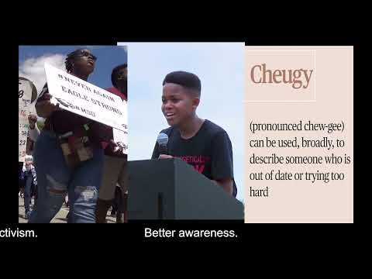
Gen Z Empowerment
Notes:
Thirdly, positioning bans as shortchanging children of the skills they need for the future proves effective. Our base and persuadables respond to the idea that “these bans shortchange [children] from developing critical thinking skills.”

Slide 44

Freedom to Learn & Be Ourselves
Notes:
Most of us believe all children should have the freedom to pursue their dreams, so we must equip every school with the resources to deliver quality education that prepares every child for the future, no matter their color, background or zip code. *** Point out when children can be their true authentic selves, then they can truly pursue their dreams***
While educators work to deliver our children accurate and honest education, some politicians are trying to turn us against schools so they can censor the lessons taught in our classrooms, deny certain children resources and write people who look like them out of our history books.

Slide 45
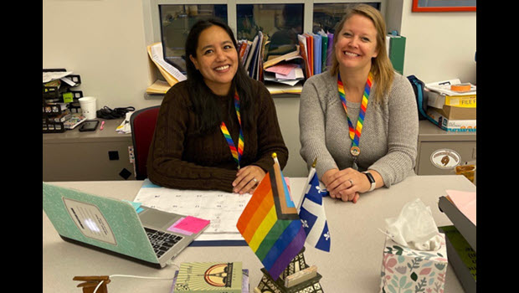
SEA Comes Together for Pride Flags
Notes:
Stonington Education Association Comes Together to Get Pride Flags Back in Classrooms
https://www.nea.org/nea-today/all-news-articles/pride-flag-flies-again
https://cea.org/stonington-education-association-comes-together-to-get-pride-flags-back-in-classrooms/

Slide 46


Slide 47
Now, identify your issue
Identify 1-2 issues impacting LGBTQ+ educators and students in your community that you would like to elevate through messaging.
Notes:
Pick one issue and produce a gender/LGBTQ+ explicit values based statement in response. (10-15 minutes). Individually then share with a partner and then we will ask for volunteers to share.
Resist the urge to bring your policy to an outcomes fight.

Slide 48
Now, let’s hear from you…
Share-out whole group!
Notes:
Ask for people to share out

Slide 49

NEA LGBTQ+ Resources
Notes:
Scan this code to access: LGBTQ+ resources such as trainings, Know Your Rights guides, Messaging Guidance, anti-LGBTQ+ bill trackers and more.

Slide 50

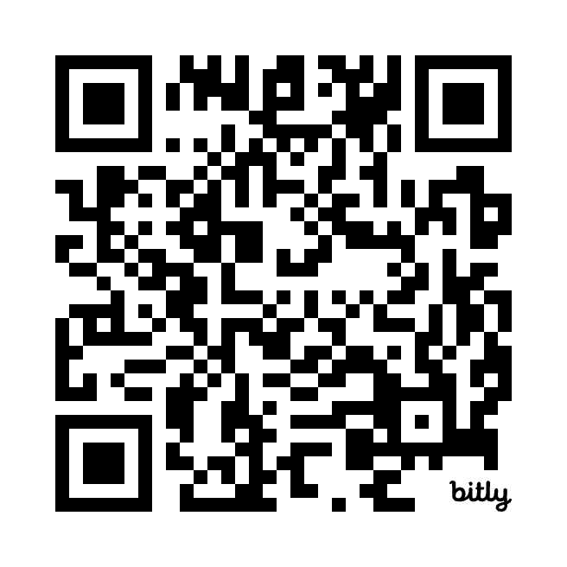
Making Gay History
Notes:
Soon to be released will be the lesson plans and interview of the educators who created the lesson plans through the teacher fellowship with MGH. Here, they can access the lesson plans and watch the interviews of the educators who developed and taught the lessons. They discuss the impact it had on them, as well as their students. Scan this QR code to learn more about Making Gay History, listen to the podcasts and access resources for educators.
Making Gay History (MGH) is a 501(c)(3) nonprofit organization that addresses the absence of substantive, in-depth LGBTQ+-inclusive American history from the public discourse and the classroom.
By sharing the stories of those who helped a despised minority take its rightful place in society as full and equal citizens, MGH aims to encourage connection, pride, and solidarity within the LGBTQ+ community—and to provide an entry point for both allies and the general public to its largely hidden history.

Slide 51
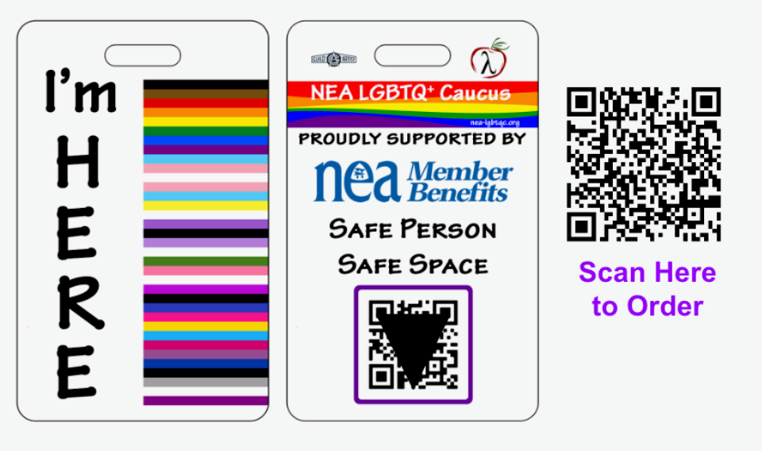
I’m HERE Badge
Notes:
By wearing the I’m HERE badge, you tell everyone that you are a safe person to discuss LGBTQ+ issues. Affirming LGBTQ+ youth couldn’t be easier than by identifying yourself as a safe and supportive person.
Use the QR code on the back of the badge to access the I'm HERE Educator Resource Toolkit with links to a variety of LGBTQ+ issues, organizations, and resources. The links are provided as a starting point to help you become aware and expand your knowledge of a variety of issues.

Slide 52
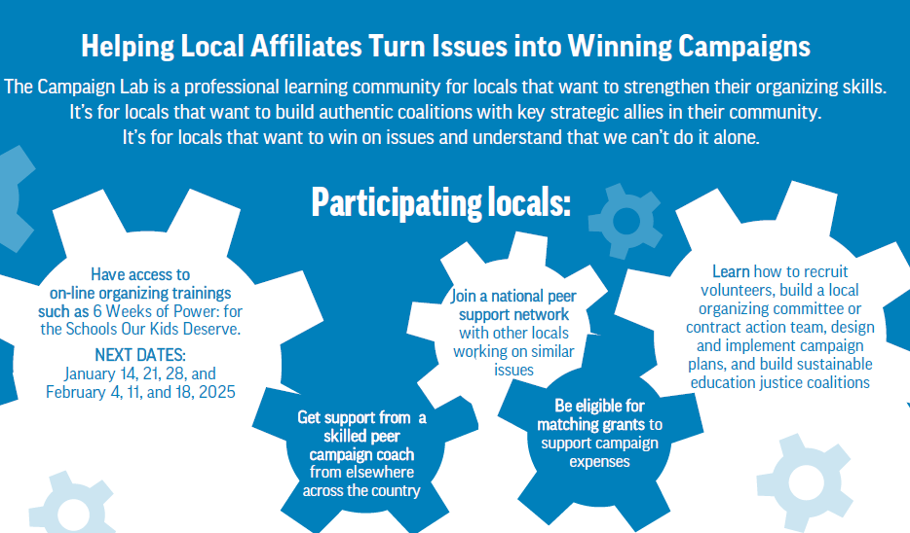
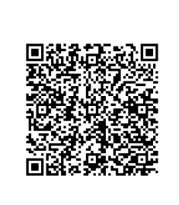
The NEA Campaign Lab

Slide 53

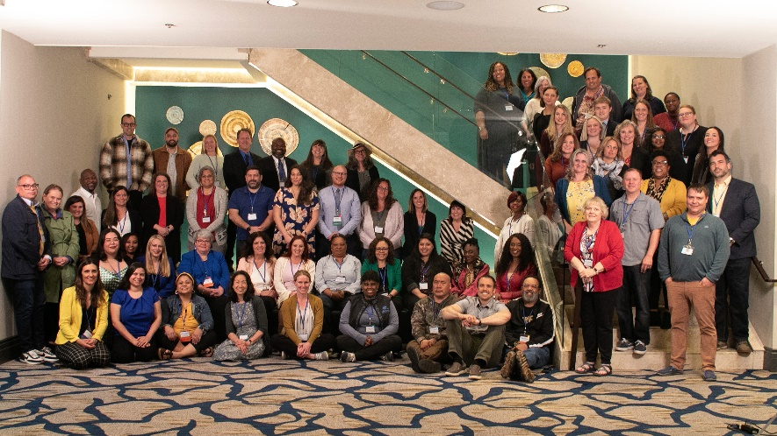
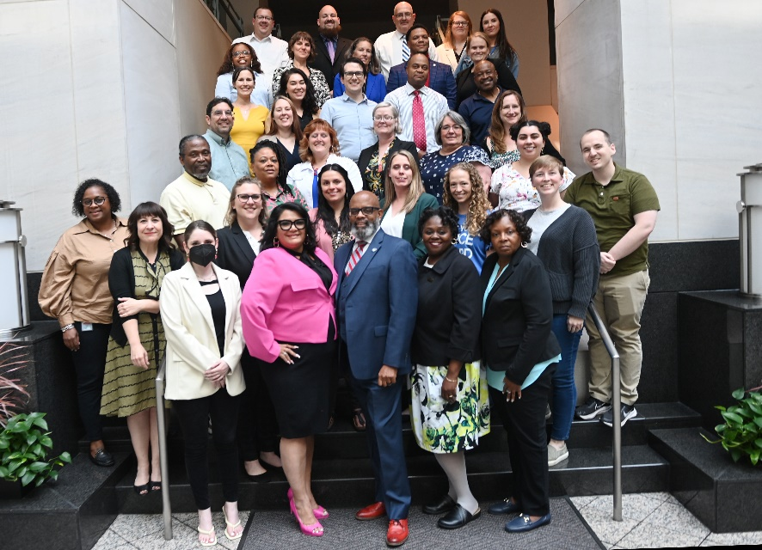
NEA’s See Educators Run program trains educators to create and promote a pro–public education platform and connect with voters who share our passion for strong public schools. Participants learn from NEA experts and top political consultants to help develop the confidence and skills needed to run a successful campaign.
Members learn:
How to prepare to become a candidate for office
How to communicate effectively with voters
Policy talking points to use on the campaign trail
Fundraising basics
Tips for recruiting volunteers and running a field operation
The nuts and bolts of running a campaign
Notes:
Nationally 81% of the school board candidates NEA endorses win their election.

Slide 54

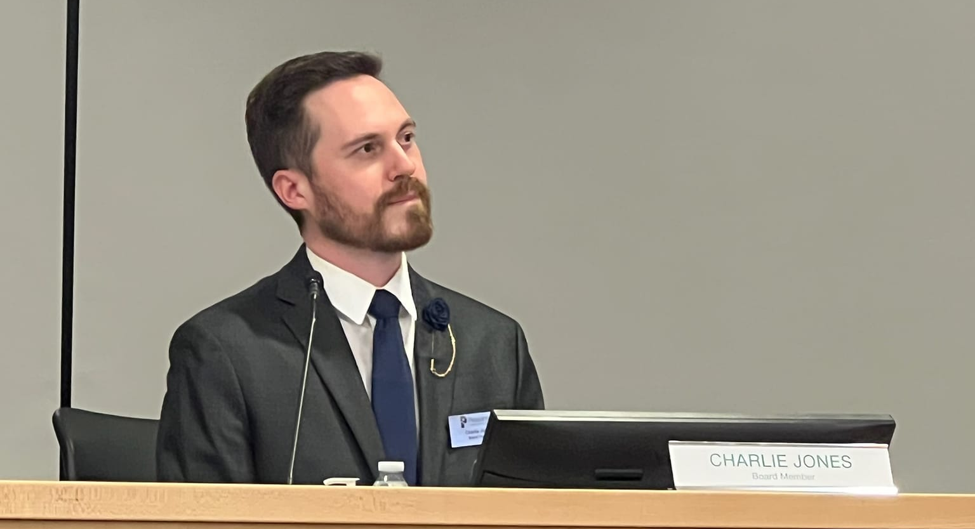
SCHOOL BOARD VICTORY
See Educators Run Alumni 2024
Charlie Jones is the first LGBTQ+ person elected in Pleasanton, CA history

Slide 55


Slide 56
And Remember….
YOUR WHY!

Slide 57
NEA Members and External Audiences
This presentation and its contents are confidential and may not be further distributed or passed on to any other person or published or reproduced, in whole or in part, by any medium or in any form for any purpose. Audio/video recording, copying of slides, and the use of AI note-taking tools are prohibited without the written consent. Violation of these terms may result in legal action.

Slide 58
LGBTQ+ Resources
Model School Board Resolutions and Policies
NEA LGBTQ+ Trainings (virtual and in-person)
NEA LGBTQ+ Caucus – you can be a member.
NEA Action Center
NEA Edjustice
Notes:
Here are some LGBTQ+ resources you can access right now. Bookmark these pages NOW!
(Just highlight a few and tell them we will have a complete list of resources and tools that will be emailed out after the call)

