Slide 1
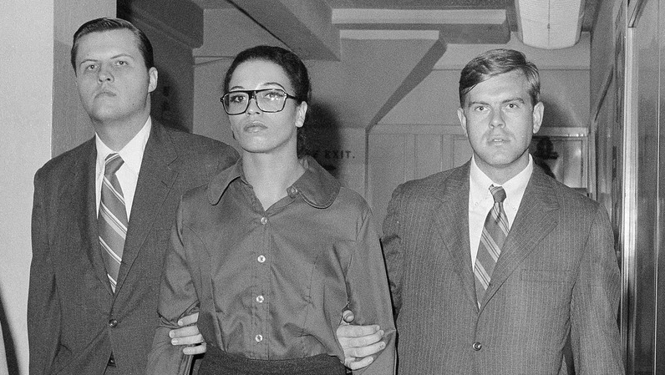
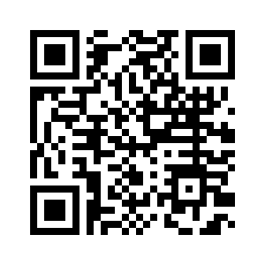
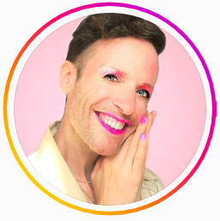
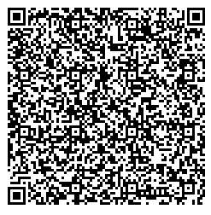
As you enter …
Scan this QR Code to view Jeffry Marsh’s Blog and Video on Pronouns
Scan this QR Code to listen to NPR’s, “This Forgotten Women’s Prison Helped Cement Greenwich Village’s Queer Identity”
Notes:
Sara will check all QR codes

Slide 2
Advancing LGBTQ+ Justice

Slide 3
Feedback on Your Feedback

Slide 4
Your Words

Slide 5

Community Agreements
Awareness and Self-Knowledge
Listen for Understanding
Be Gracious
Stay Engaged
Be Open and Suspend Judgment
Say “I”- tell your truth
Seek Discomfort
Reach for Empathy
Expect non- Resolution and non-Closure

Slide 6

Today’s Agenda
8:30 – 10:15 -- Review and expand on key concepts
10:15-10:30 -- Break
10:30 -12:00 -- Content
12:00 -1:00 -- Lunch
1:00 – 2:00 -- Content
2:00 – 3:30 -- Panel
3:30 - 4:15 -- Break and Conversations
4:15 – 4:30 -- Wrap Up and Reflect
4:30 – 5:00 -- Adult Choice Networking

Slide 7

Beth

Slide 8
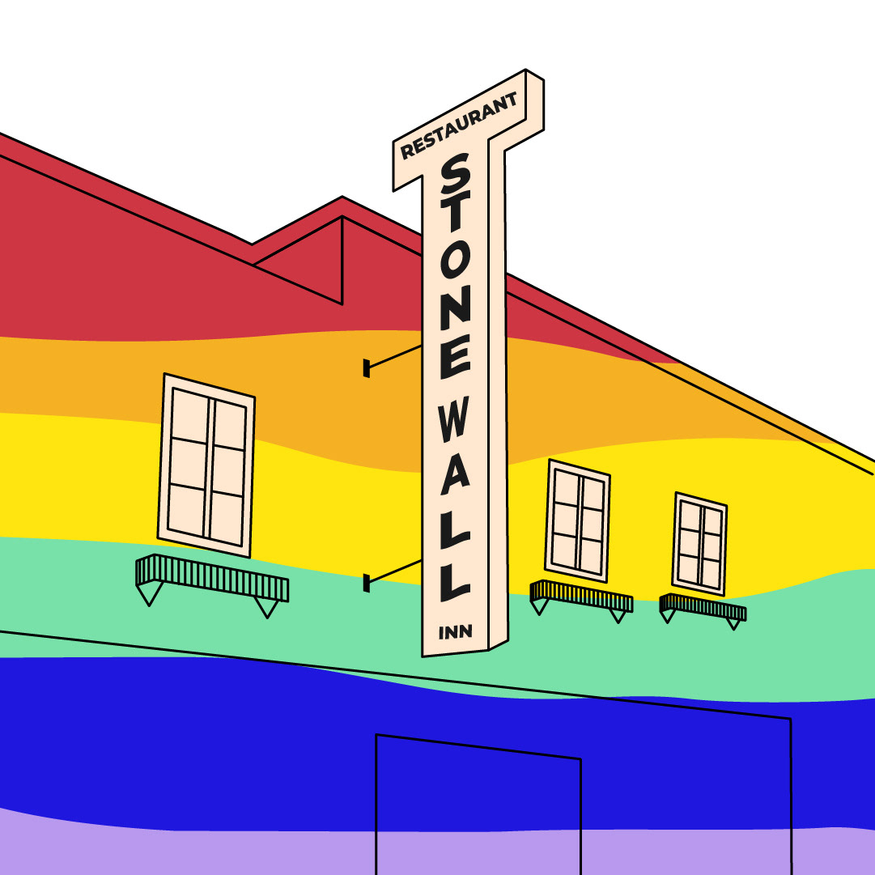
Shared Identity
Gather around an identity of your choosing
Answer the following discussion questions:
Why did you select this piece of your identity?
What are some challenges of this identity?
Notes:
Replace with Day 3 identity

Slide 9

Shared Identity
Debrief-
What was something you learned about someone else?
What was easy/hard about this activity?
How safe did you feel sharing in this activity?
How do your reactions to today's prompts compare to yesterday?
Notes:
Ben 10:00-10:15

Slide 10

Key Ideas
Discreet identities bind us
We all have pre-conceptions that might not match an actual identity of another
We don't get to assign a person's identity for them

Slide 11
Pete and Anthony

Slide 12
Digging into Key Terminology
102

Slide 13
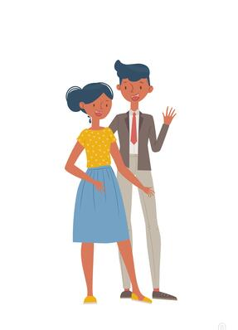
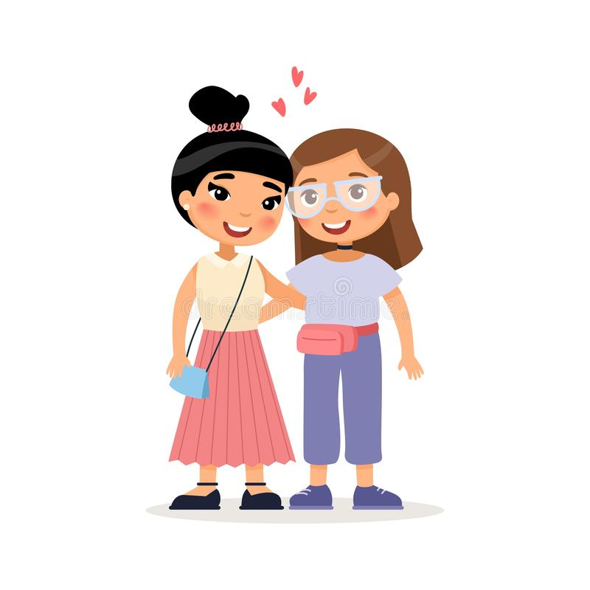

What is Sexual Orientation?
Sexual orientation is who you are emotionally,
romantically, and/or physically attracted to.
Sexual orientation is not dependent on your gender.
13
Notes:
Sexual orientation is an important part of a person’s identity. It is not a decision that one makes, rather it is an awakening.
There are a variety of sexual orientations:
Heterosexual
Bisexual
Homosexual
Pansexual
Asexual
Even though sexual orientation is a private identity, it can be a source of public scorn and a basis for exclusionary practices and discrimination.

Slide 14
Sex vs. Gender
SEX
Biological attributes that include physical features, chromosomes, internal and external reproductive organs, hormones, and anatomy.
GENDER
A person’s innermost, deeply held reality of self as male, female, both, in between or neither.
VS.
14
Notes:
Sex and Gender do NOT mean the same thing.
Our sex is determined by biological attributes such as chromosomes, hormones, reproductive organs, and other parts of our anatomy.
Gender is a person’s innermost, deeply held reality of self. It’s almost like being right-handed or left-handed. We don’t know why each person favors one hand over the other, but we all know that one just feels more correct for us. And, some people feel comfortable using either hand.
A person can have an inner reality of being male, female, both, neither, or somewhere in between.

Slide 15
Gender
Gender
Identity
How you feel. Female, male, both, or neither.
Gender
Expression
The ways you show your gender identity.
Gender
Role
A social role based on a person’s sex.
15
Notes:
Gender, or gender identity, is that internal sense of self we just mentioned—the feeling of being male, female, both, neither, or somewhere in between.
Gender expression includes all the ways you show your gender to the world. For example, your hair and clothes, how you cross your legs, how you walk, and even your voice inflections. Some of these are innate, and some are learned from our cultural norms.
Gender roles are social constructs based on one’s sex or biological attributes. They can be very different from one culture to another. These roles can become so internalized that they create stereotypes or an implicit bias within us (e.g., assuming nurses are women, or mechanics are men).
Gender non-conforming simply means the person is breaking cultural or social rules about gender roles and/or expression.
There is a huge difference between not conforming to certain societal norms and expectations for one’s gender and having an internal identity that is not in alignment with one’s biological sex.
A Note About Phobias:
A phobia is a persistent, irrational and exaggerated fear of an object, person, activity, animal or situation. Homophobia is a fear of people who are gay and lesbian. Transphobia is a fear of people who are transgender. When someone’s identity challenges a person’s expectations or preconceived notions of male and female, they may go into a panic. The incongruence of what someone sees, and what they think creates fear and misunderstanding.
We say “i-dentity” because it’s about the individual and how they personally identify, not “you-dentity” because of how you want to determine someone else’s existence.

Slide 16
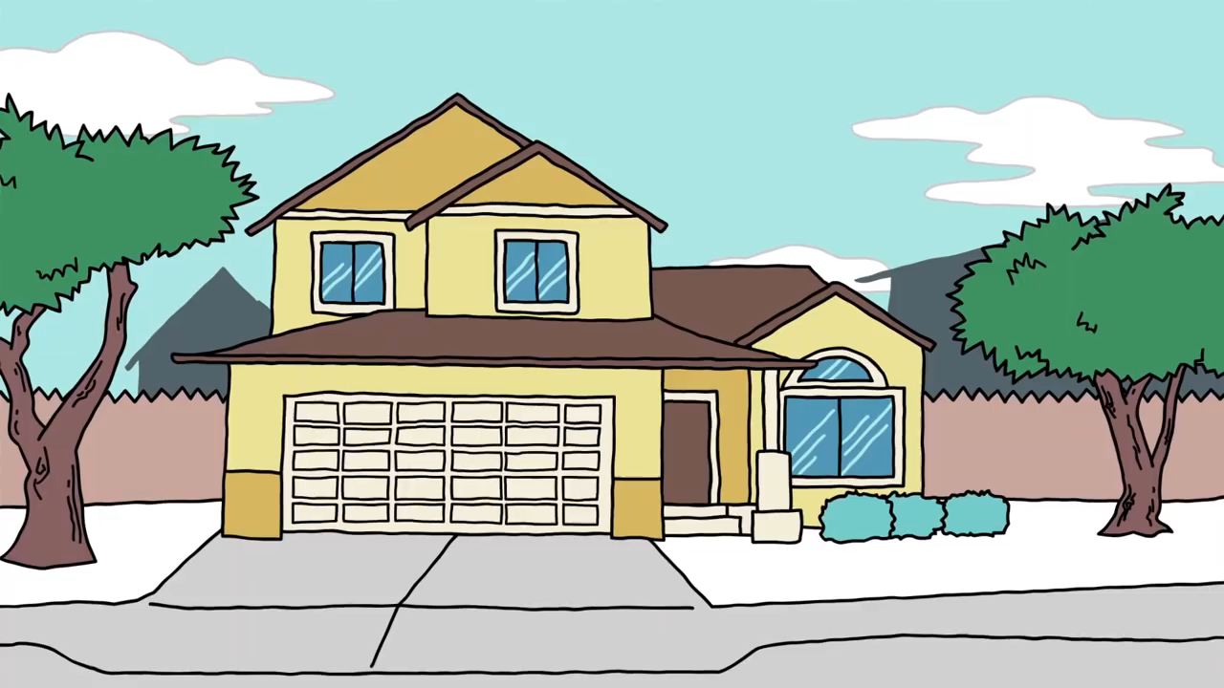
Explaining Gender Identity
Range of Gender Identities
16
Notes:
Video: https://youtu.be/i83VQIaDlQw
(3 minute)
This video offers a simple way of looking at various gender identities (~3 mins).
Debrief the video with these three questions:
What is the gender binary? How many of you grew up thinking the only gender options were male or female?
What does it mean to be non-binary?
What is the difference between transgender and non-binary?

Slide 17

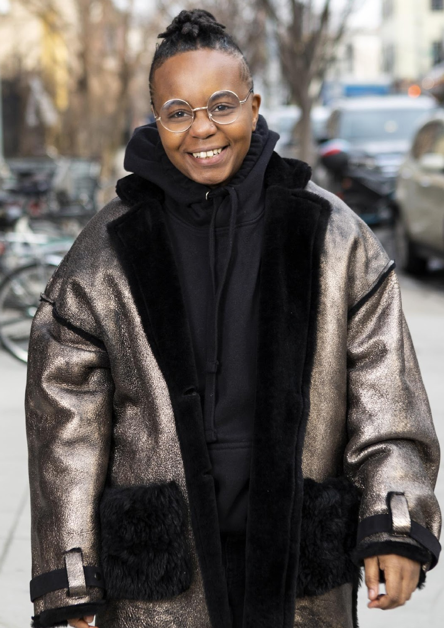

Gender Expression
A transgender woman
in an office.
A transmasculine person in a winter coat.
A gender-fluid woman on a city sidewalk.
Photos courtesy of the Gender Spectrum Collection.
17
Notes:
Transgender, non-binary, and gender non-conforming individuals show their gender to the world in many ways. Just as cisgender people have different hairstyles, clothing choices, mannerisms, and more, the same is true for trans, non-binary, and gender-non-conforming people. There is no “one way” to look to be any gender.
These images are from the Gender Spectrum Collection – a group that works with trans and non-binary models. In the first image we see a transgender woman in an office. The second is a transmasculine person in a winter coat. Transmasculine is a term generally used for people who were born female at birth, but who identify with masculinity. As we can see in both of these two photos, they present within the gender binary of male and female.
In the last image, we see a gender-fluid woman. Gender fluid refers to a person who does not feel they have a fixed gender.

Slide 18
ACTIVITY | GENDER-NEUTRAL WORLD
Topics related to sexual orientation and gender come up in society more often than we may realize.
Stereotypes about gender and sexual orientation often inform policies, practices, and traditions.
Reflect on the customs and norms within your learning community and answer the following questions in table groups.
Notes:
Modify last bullet to reflect contract activity

Slide 19
ACTIVITY | GENDER-NEUTRAL WORLD
How/When do people have to disclose their gender at your school? work? community?
Make a T-Chart labeled at the top with the word assumptions on the left and the word corrections on the right.
On the left, list examples of times when you make assumptions about someone's gender.

Slide 20
ACTIVITY | GENDER-NEUTRAL WORLD
Assumptions | Corrections
Giving all the women in the office a flower for Mother’s Day
Notes:
Left Side is the Assumption and Corrections (10 minute Activity)
Make a t chart with a heading that has assumptions on the left and corrections on the right. On the left list examples of times when you make assumptions about someones gender.
Possible Examples of assumptions:
Giving all the women in the office a flower for Mother’s Day
In small groups create at t chart on your piece of paper and list assumptions that your group comes up with

Slide 21
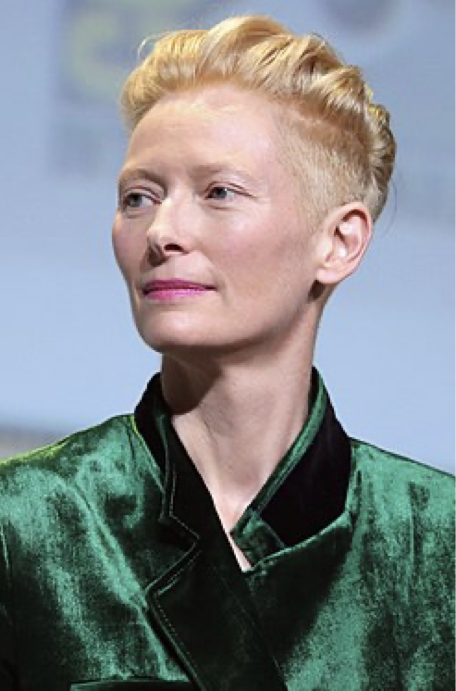
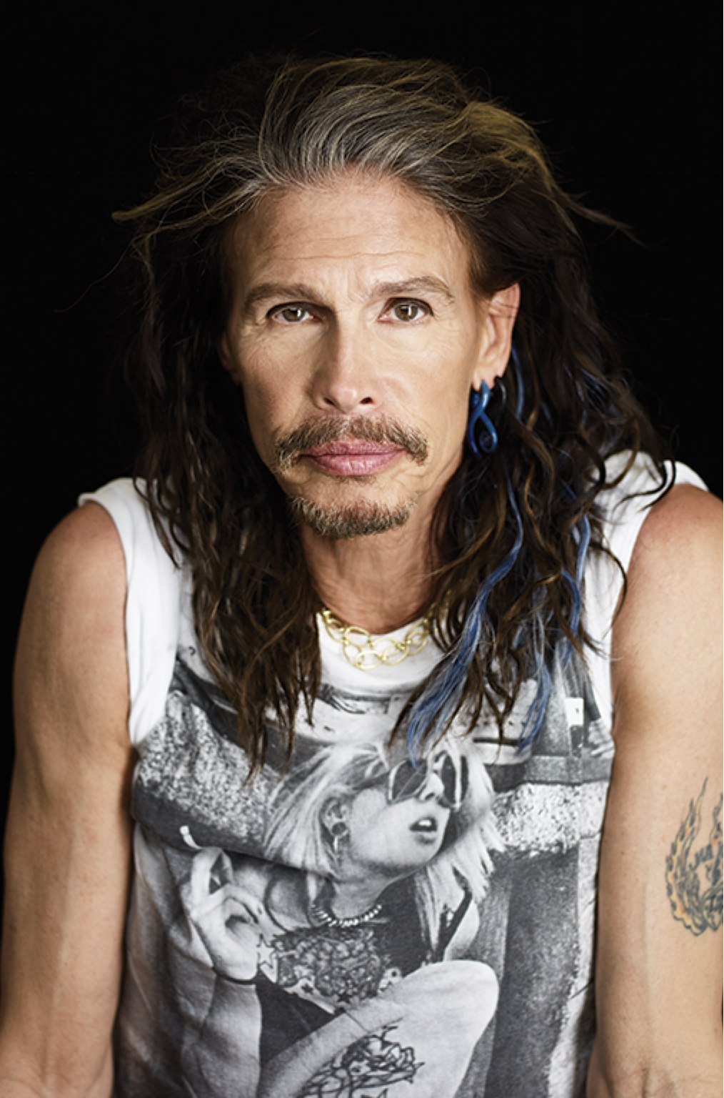
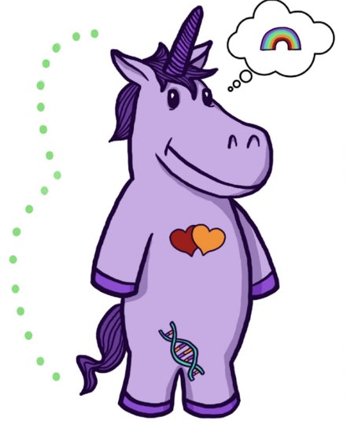
Non-binary Voices
“I don't know if I could ever really say that I was a girl—I was kind of a boy for a long time. I don't know, who knows? It changes.”
“I’ve been misquoted as saying I’m more female than male. Let me set the record straight—it’s more half and half.”
Tilda Swinton
Academy Award Winning Actress
Steven Tyler
Lead singer of Aerosmith
21
Notes:
For a lot of cisgender people, those whose sex and gender align really well, the concept of non-binary identities is really hard to understand. But we have some famous people who have described it really well.
Tilda Swinton and Steven Tyler have never indicated that they identify as transgender, but they describe a blending or fluidity of gender. For a lot of non-binary folks, that’s the only label they apply to themselves. Others can refine things a bit more.
(Read the slide.)

Slide 22
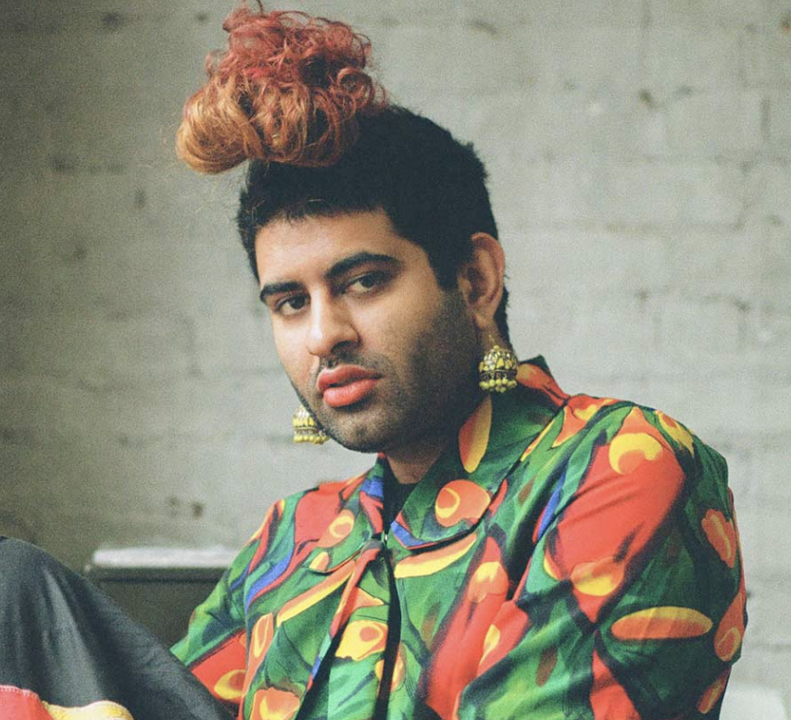
Non-binary voices
“Being non-binary isn’t just about being defined by my absence (I am not a man or a woman), but also by my abundance (I am far too expansive to be encapsulated by the gender binary). Being non-binary is about embracing my fluidity, my becoming, my journey without a fixed destination.”
Alok Vaid-Menon
(they/them)
22
Notes:
Here we see the words of Alok Vaid-Menon who uses the gender pronouns they/them. They are an internationally acclaimed gender non-conforming writer, performer, and public speaker. As a mixed-media artist, Alok’s work explores themes of trauma, belonging, and the human condition.
(Read the slide.)
Possibly replace with video clip (Getting Curious With Jonathan Van Ness | Can We Say Bye-bye To The Binary? | Netflix?)

Slide 23
What Does It Mean To Transition?
Notes:
Given all that a transgender person may be experiencing, one option is to transition. This means they align their inner identity with their external one. We’re going to talk about this process and how it affects trans adults.

Slide 24



Individuals May Go Through Various Transitions
Social Transition
Legal Transition
Physical Transition
24
Notes:
Transitioning is not a simple, one-time event, and there is no “one-size-fits-all” process, checklist, or approach. Transitioning is a complex issue, and it involves a wide variety of options for an individual.
Many factors influence a person’s decision to transition, and because of these factors, their transition may not be linear. Transitioning is a personal decision specific to the individual, so how a person goes about transitioning can change over time and vary from person to person.
There are 3 main types of transitions someone could go through: social, legal, and physical.

Slide 25

SOCIAL TRANSITION
Social transition is when a transgender person makes others aware of their gender identity.
Theo Germaine, actor in
Netflix’s The Politician
They/Them and He/His
25
Notes:
Social transition is just what it sounds like—changing how you present yourself and how others see you socially. A social transition can happen at any age. A person may start their transition, pause it, move back, and move forward again. It often includes changing clothing or hairstyles. Usually, it entails changing a name and switching pronouns—sometimes more than once.
A person may try on names for a while and switch from one gendered pronoun to another, only to decide that a non-binary pronoun fits better. Again, no rules.

Slide 26

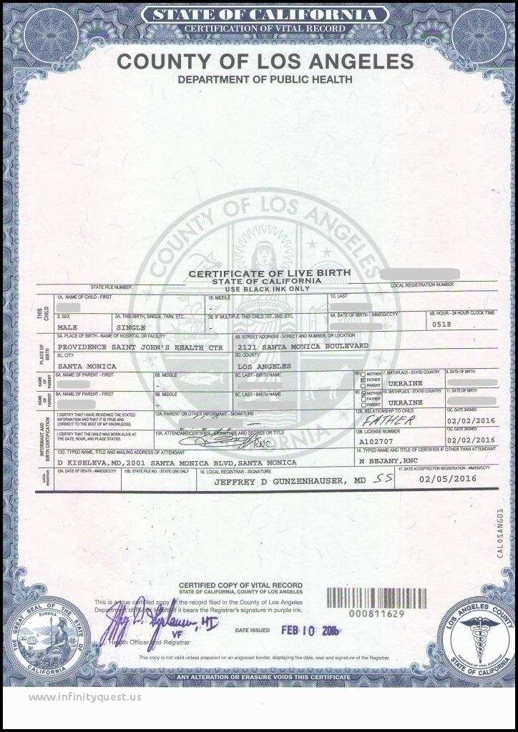
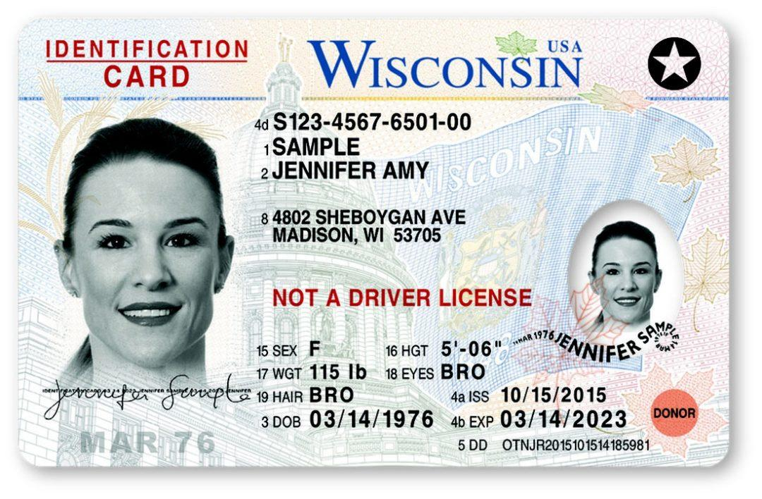
LEGAL TRANSITION
Legal transition is when a transgender person legally changes their existing documentation to match their gender identity.
These can be done by
court order or state law.
26
Notes:
A legal transition means updating documents through the legal process.
Some parts of the legal transition can include changing gender markers on birth certificates, changing names on social security cards, driver’s licenses, or passports. Legal transitions can also have other identification components, such as school documents. Passports are the easiest documents to change.
People cannot always experience a legal transition because of several barriers. Those barriers do not make their gender identity or their distress at being misgendered any less real.

Slide 27

PHYSICAL TRANSITION
Physical transition is when a transgender person undergoes medical treatments so that their sex characteristics better match their gender identity. Before puberty, there are no medical interventions. Ever.
Janet Mock (She/Her), Writer, Director & Transgender Activist
27
Notes:
Transgender health is a specialized area of medicine. There is no one way to have a physical transition.
Given the specialized nature of transgender health care, we can see how problematic it is for a trans person to be told they can only access gender-segregated spaces once they have “had a surgery.” It puts a burden on them that is impossible to overcome, denies their full identity, and creates equal-access issues. Additionally, not all trans people want to have surgery. It’s wrong to demand that another person undergo serious, invasive medical procedures to make other people comfortable.
Keep in mind that just like you would not want to be asked about your medical procedures, we don’t ask others about theirs.
Do not question what they are doing, question how can I support

Slide 28
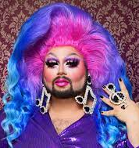
So, what about Drag?
Transgender refers to a personal gender identity and an authentic, lasting sense of self. In contrast, “drag” is a temporary and deliberate performance of gender.
Notes:
“Transgender” refers to a personal gender identity and an authentic, lasting sense of self. In contrast, “drag” is a temporary and deliberate performance of gender.
Drag is most commonly associated with gay men dressing up and embodying a “larger-than-life” female persona. Drag queens are flamboyant and this form of drag often involves sequins and feathers but it can also be sleek and edgy.
For drag queens, their drag persona can be an important part of their own identity as a gay man (this does not mean they are transgender). Similarly, women also perform drag as drag kings. Drag kings dress as men and take on male personas, often wearing facial hair, adopting masculine mannerisms and a deep voice.

Slide 29

Turn & Talk
Based on what you know, what are some of the barriers
members can face when transitioning?
2. How can you best support them?
29
Notes:
Turn & Talk: Suggested Discussion Questions:
Describe a time when you had to transition (e.g. moving to a new city, starting a new job, getting married, having or adopting a child, becoming a pet parent, etc.). Why did you want to make this change and did you have support?
Based on what you know, what are some of the barriers members can face when transitioning?

Slide 30
BARRIERS TO TRANSITIONING
Not all trans people can transition as they would like to because of any number of factors, including:
Financial cost
Legislative rules/roadblocks
Lack of access to competent healthcare
Health problems
Unhappy with options available
Unsupportive family/family instability
Homelessness/domestic violence
Other personal reasons
30
Notes:
Here are a few examples of barriers a transgender educator might face:
Legislative rules/roadblocks — In most states, a person’s gender marker can only be changed on their birth certificate after permanent medical procedures have occurred. This is often stipulated as surgery.
Lack of access to competent healthcare — Trans health is still not taught in most medical schools. Often there is one class (class period…not entire course) devoted to it, if at all. Many providers are afraid to treat trans patients, and some patients travel to other states just to get competent care.
Health problems — Underlying health conditions can complicate a physical transition just as they would complicate any number of other medical treatments or procedures.
Unhappy with options available — This could be surgical options, but could also affect a non-binary person who does not want to proceed with hormones that would make them look too feminine or too masculine.
And, other personal reasons.

Slide 31
Turn & Talk
1. How can you best support them?
2. What power do you need to
31
Notes:
Turn & Talk: Suggested Discussion Questions:
Describe a time when you had to transition (e.g. moving to a new city, starting a new job, getting married, having or adopting a child, becoming a pet parent, etc.). Why did you want to make this change and did you have support?
Based on what you know, what are some of the barriers members can face when transitioning?

Slide 32
Key Ideas
When someone calls you and tells you they are transitioning, do not question them about what they are doing.
Ask how you can support them and find out the answers to their questions.
Put the person in the driver seat; do not be the driver.
NEVER try to talk someone out of transitioning or question their decisions around their identity.

Slide 33

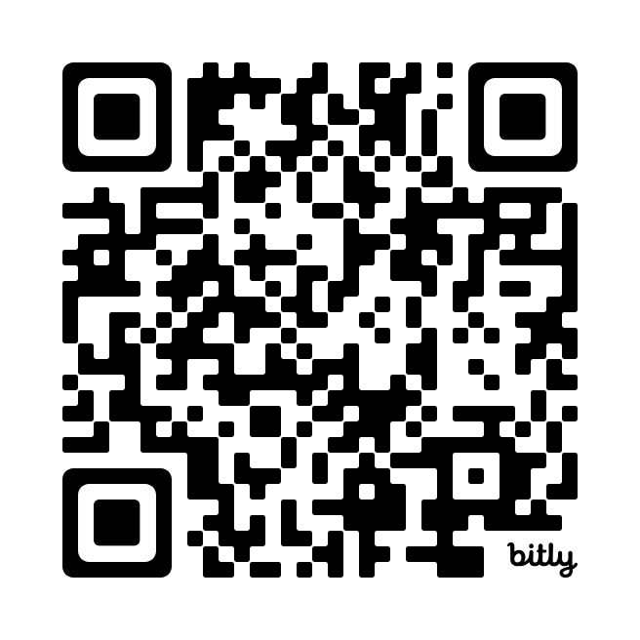
15 Minute Break!
Check out this site! It includes accurate and up to date maps that track LGBTQ+ policies across the nation. (We will revisit this map later)
https://www.lgbtmap.org/equality-maps

Slide 34
8.1 Million
WHAT’S THE SIGNIFICANCE?
34
Notes:
In 2019, there were 157 million employees in the US. What do you think this number represents?
According to Catalyst.org, there are an estimated 8.1 million LGBTQ+ employees in the United States who are age 16 or older. 50% of these employees are not out at work because of fears of discrimination or ostracization. And 1 in 5 LGBTQ+ employees have experienced discrimination.
Reference: https://www.catalyst.org/research/lesbian-gay-bisexual-and-transgender-workplace-issues/

Slide 35
TRUE OR FALSE
In my state, an employee can be fired for being transgender

Slide 36
TRUE OR FALSE
In my state, an employee can be fired for being a lesbian.

Slide 37
FALSE!
There are federal laws that protect LGBTQ+ workers from workplace discrimination in ALL states (yes, even yours).

Slide 38
Federal Law
Notes:
Let’s first look at federal laws.

Slide 39
A NATION OF LAWS
1600s
Founding of Jamestown, VA
Mass. Bay General Court determined “sex crimes” and punishments.
1700s
Colonial sodomy laws passed and remained in place until 1925.
US Constitution passed and counts African-Americans as 3/5 a person.
1800s
14th Amendment passed that declares “equal protection of the laws.”
Plessy v. Ferguson declares racial segregation legal.
1900s
President Dwight Eisenhower bans gay people from working in the federal gov’t.
Famous celebrities, athletes & politicians start publicly coming out.
2000s
President Obama repealed “Don’t Ask Don’t Tell” so LGBTQ+ people could serve openly in the military.
Same-sex couples granted the right to marry across the US.
Notes:
The US has called itself a “Nation of Laws,” but what are the laws for? And, who do they help or harm? This timeline shows only a glimpse of how discrimination, exclusion, and beliefs in white supremacy have been a part of US laws since the earliest of colonial times. For a more comprehensive list of laws that impact LGBTQ+ people throughout US history, please see your handout.
Highlights for further discussion:
1607 – Founding of Jamestown, VA, the first permanent English settlement in the “New World.”
1607 – Massachusetts Bay Colony was established believing they made a “covenant with God to build an ideal Christian community.”
1619 – The first enslaved Africans arrive to Jamestown, VA
1631 – The Massachusetts Bay General Court, in accordance with Puritan religious and moral beliefs, declared that the following were considered sex crimes and punishable by whipping, banishment or execution: fornication, adultery, rape and sodomy.
1705 – The Colony of Virginia adopted the first Blood Quantum Law. A person’s blood quantum is defined as the fraction of their ancestors, out of their total ancestors, who are documented as full-blood Native Americans. These laws were applied across the thirteen colonies and later the entire United States. They limited the civil rights of Native Americans and regulated who could be classified as Native American.
1714 – Sodomy laws were passed in the early colonies and in the colonial militia. They stayed in place until challenged in 1925.
1775 – Population of enslaved people in the colonies is nearly 500,000.
1776 – Declaration of Independence signed.
1778 – Lieutenant Gotthold Frederick Enslin of the Continental Army becomes the first documented service member to be dismissed from the U.S. military for homosexuality. Read more at U.S. History Naval Institute Blog / Timeline of Military Gay History.
1779 – Thomas Jefferson proposes Virginia law to make sodomy punishable by mutilation rather than death. It was rejected by the Virginia legislature.
1788 – U.S. Constitution adopted. Includes a three-fifths clause that counted each enslaved person as three-fifths of a person for the purposes of congressional representation and tax apportionment.
1852 – Scottish writer J.D. Bothwick reports his attendance at a “miner’s ball” – a men’s only dance held in Angels’ Camp in California.
1857-1861 – James Buchanan elected president. A lifelong bachelor, Buchanan had a long-term relationship with William Rufus King, who served as vice president under Franklin Pierce. The two men lived together from 1840-1853 until King’s death. Some historians suggest Buchanan, by today’s terms, was gay.
1868 – Fourteenth Amendment Ratified. This is the most cited amendment in Supreme Court civil rights cases and has been the basis for landmark civil rights cases such as Brown v. Board of Education, Roe v. Wade and Obergefell v. Hodges. Gay rights advocates cite this amendment in support of equality for future court cases.
“All persons born or naturalized in the United States and subject to the jurisdiction thereof, are citizens of the United States and of the State wherein they reside. No State shall make or enforce any law, which shall abridge the privileges or immunities of citizens of the United States; nor shall any State deprive any person of life, liberty, or property, without due process of law; nor deny to any person within its jurisdiction the equal protection of the laws.”
1868 – Two-Spirit, We’wha, a Zuni Native American, meets with President Grover Cleveland.
Source: https://www.lgbtqhistory.org/lgbt-rights-timeline-in-american-history/
Source: https://en.wikipedia.org/wiki/Blood_quantum_laws

Slide 40
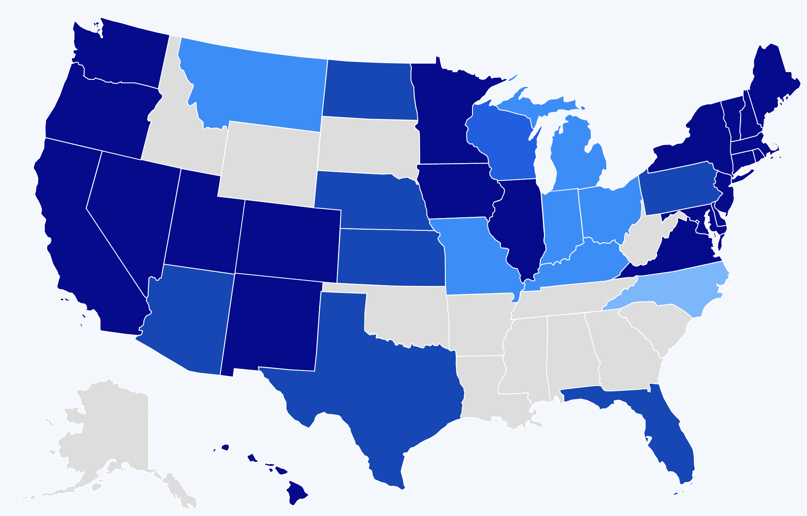
A HISTORY OF BARRIERS
In 2019, Just 22 States + DC Prohibited Workplace Discrimination Based On Sexual Orientation And Gender Identity.
Source: Human Rights Campaign
40
Notes:
US history is full of barriers for BIPOC and LGBTQ+ people. Discrimination because of one’s race and LGBTQ+ identity means lost wages, jobs, promotions, unfair treatment and even harassment at work. This discrimination compels many to hide their LGBTQ+ status for fear of retribution, losing one’s livelihood, support system, and more.
Before 2019, only a handful of states (in dark blue above) provided LGBTQ+ people some protection against employment discrimination, as well as in housing and public accommodations. This meant that in all the other states (those in tan and lighter shades of blue), LGBTQ+ people could be denied jobs, health care, housing, hotels, and more. This discrimination – across the majority of the US, and nearly all of the South— was perfectly legal.

Slide 41
A LANDMARK RULING
Bostock v. Clayton County
Prior to June 15, 2020
It was legal to fire an employee for being gay, bisexual or transgender, in more than half of the 50 states.
June 15, 2020
The Supreme Court rules it is illegal to discriminate against
or fire an employee based on their sexual orientation or gender identity.
41
Notes:
The Civil Rights Act of 1964 prohibits discrimination based on race, color, religion, sex, or national origin. The courts and the federal government have long refused to recognize LGBTQ+ discrimination as a form of sex discrimination. Over the past 20 years, however, federal courts and the government have at times recognized LGBTQ+ discrimination as sex discrimination.
It was not until June 15, 2020 that the Supreme Court finally recognized that LGBTQ+ employment discrimination is prohibited sex discrimination under Title VII of the Civil Rights Act of 1964.
This ruling recognized that it is illegal to discriminate against or fire an employee based on their sexual orientation or gender identity. Now lower federal courts and the Biden Administration are applying that ruling to education, health care, housing, credit discrimination, and more.

Slide 42
BOSTOCK V. CLAYTON COUNTY
Employment Discrimination is Illegal
Title VII of the 1964 Civil Rights Act prohibits employment discrimination based on race, color, religion, sex and national origin. Bostock interprets “sex” to include gender identity and sexual orientation.
42
Notes:
The Bostock ruling specifically states that employment discrimination on the basis of gender identity and sexual orientation is illegal.
Title VII of the Civil Rights Act covers the full spectrum of employment decisions, including recruitment, selections, terminations, and other actions concerning terms and conditions of employment. This is significant for the LGBTQ+ community because, as we saw, in many states it was legal to be denied an interview or a promotion, and even to be fired because of one’s gender identity or sexual orientation.

Slide 43
Title IX
Discrimination in Educational
Programs is Illegal
Title IX of the Education Amendments Act of 1972 states: "No person in the United States shall, on the basis of sex, be excluded from participation in, be denied the benefits of, or be subjected to discrimination under any education program or activity receiving Federal financial assistance."
43
Notes:
On March 26, 2021, the Department of Justice concluded that, as a result of the Bostock ruling, Title IX of the Education Amendments Act of 1972 also prohibits sexual-orientation and gender-identity discrimination in educational institutions that receive federal funding. This means all public schools. This means that students cannot be discriminated against in schools based on their LGBTQ+ identity.
There have been some significant wins recently for LGBTQ+ rights in the US But while progress is being made, attacks on LGBTQ+ rights in certain states have accelerated.
Reference: Department of Justice, “Application of Bostock v. Clayton County to Title IX of the Education Amendments of 1972,” March 26, 2021, https://www.justice.gov/crt/page/file/1383026/download

Slide 44
Title IX—Update May 2024
Some schools and districts are implementing gender-affirming policies and practices
Dozens of states are trying to license LGBTQ+ discrimination under the guise of “protecting children” or by claiming it is a right because of religious freedom.
More than two dozen states have now passed variations of legislation that limits, further marginalizes, and in some cases criminalizes efforts to support LGBTQ+ youth and adults.
Many of these attacks on LGBTQ+ people are being challenged in court with hope they will be struck down under the reasoning of Bostock.
With the current make-up of the Supreme Court and their record of overturning precedent-setting cases, nothing is guaranteed.

Slide 45
Several states have now passed legislation to restrict LGBTQ+ rights, including:
ANTI-LGBTQ+ LEGISLATION
Prohibiting or criminalizing healthcare for transgender youth
Mandating single-sex facility restrictions
Excluding transgender youth from athletics
Enacting restrictions on identification documents
Bans on books, curricula, and discussion of LGBTQ+ issues in classrooms
Exemptions to anti-discrimination laws for “religious or moral” beliefs
Source: ACLU.org
45
Notes:
While some schools and districts are implementing gender-affirming policies and practices, like recognizing proper names and pronouns for children, in the background, dozens of states are trying to license LGBTQ+ discrimination under the guise of “protecting children” or by claiming it is a right because of religious freedom. More than two dozen states have now passed variations of legislation that limits, further marginalizse, and in some cases criminalizes efforts to support LGBTQ+ youth and adults.
Many of these attacks on LGBTQ+ people, especially young people, are being challenged in court and we can hope they will be struck down under the reasoning of Bostock. But those lawsuits are just getting started and with the current make-up of the Supreme Court and their record of overturning precedent-setting cases, nothing is guaranteed.

Slide 46
WHAT WE KNOW TODAY
The Bostock ruling only applies to employment discrimination.
Discrimination in other areas (e.g., housing) is still legal in many states.
The Equality Act – a federal law currently stalled in Congress - would end discrimination across all areas for LGBTQ+ people.
46
Notes:
Key Notes
Bostock only applies to employers with more than 15 employees. Employers with fewer than 15 total employees are not covered by Title VII.
Bostock applies nationwide and protects employees from sexual orientation or gender identity discrimination regardless of state or local laws.
An employer covered by Title VII is not allowed to fire, refuse to hire, or take assignments away from someone (or discriminate in any other way) because customers or clients would prefer to work with people who have a different sexual orientation or gender identity. (For example, keeping LGBTQ+ employees out of public-facing positions.)
Although accidental misuse of a transgender employee’s preferred name and pronouns does not violate Title VII, intentionally and repeatedly using the wrong name and pronouns to refer to a transgender employee could contribute to an unlawful hostile work environment.

Slide 47
TURN & TALK
How have past and recent federal laws impacted LGBTQ+ individuals?
2. How does the Bostock ruling impact LGBTQ+ members? How does it impact the work of UniServ directors?
47
Notes:
Turn & Talk: Suggested Discussion Questions
How have past and recent federal laws impacted LGBTQ+ individuals?
How does the Bostock ruling support LGBTQ+ members? How does it impact the work of UniServ directors?

Slide 48
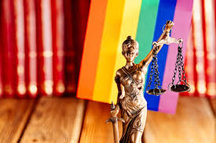
STATE & LOCAL LAWS ON THE RISE
In the absence of federal law that protects LGBTQ+ individuals, states are rushing to pass legislation.
State laws range from being affirming to harmful of LGBTQ+ individuals & their families.
Local School Boards have joined in passing policies that affirm or further marginalize/erase the history and lived experiences of LGBTQ+ and BIPOC students.
Notes:
Well funded political groups have launched a coordinated and strategic approach to overwhelm and see what legislation sticks regarding harmful legislation.
Local School boards & the public education system have become a focus for advancing anti-LGBTQ+ policies
While children of color make up the majority of U.S. public school students, policies that affirm their histories and lived experiences are not centered in local and state legislation.

Slide 49
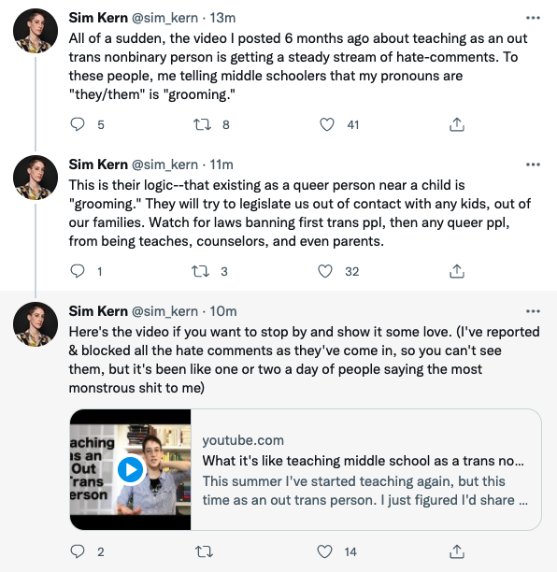
IMPACT ON EDUCATORS
Notes:
The coordinated attacks on LGBTQ+ individuals include providing people scripts that denounce teaching topics such as transgender rights, banning books from well known authors, and labeling inclusive and culturally responsive instruction as “critical race theory.” Unfortunately, these efforts have been effective.
As we see in this Twitter thread, a post from an out trans person, who six months ago shared their experience of teaching in middle school, is now accused of “grooming” students by sharing their pronouns.

Slide 50
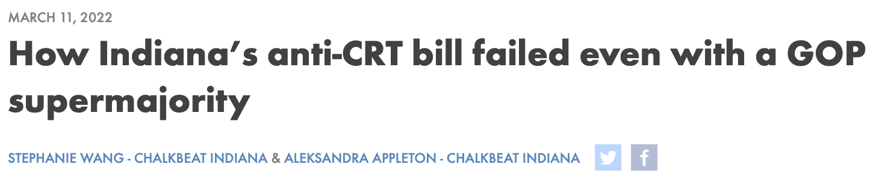
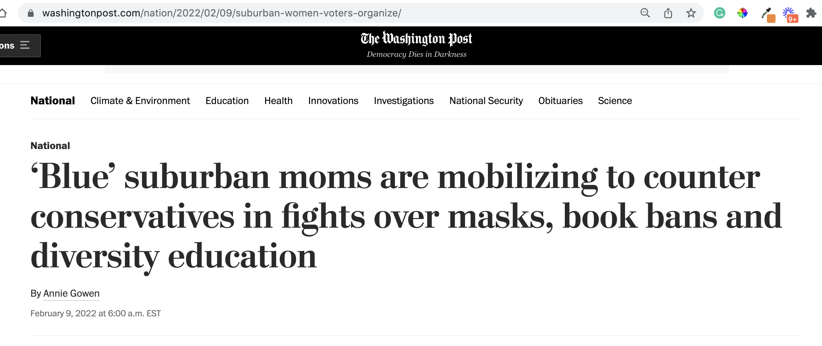


FIGHTING BACK
Notes:
While many states and lawmakers are working to advance anti-LGBTQ+ and other laws that discourage teaching an honest history of the US, not every effort is successful. While many of these efforts are specific to students, it worth noting that not all attempts have been successful.
In March 2022, a “CRT” bill in Indiana failed despite having a GOP supermajority.
Parents are mobilizing to counter the loud voices that dominate local school board meetings:
Red Wine & Blue is a a national network of more than 300,000 like-minded, mostly Democratic suburban women who believe the only way to fight back is to present a calm face to counter the angry groups that have dominated and disrupted board meetings and in some cases threatened officials. The group recently broadened its focus to fight the rising number of book bans across the country, and is running training sessions to help women testify and manage highly charged government meetings.
One WillCo is a community organization in Williamson County Tennessee that was organized by two mothers to address racial disparities in the community in 2021.
Invite discussion: Ask participants if they have heard of anti-LGBTQ+ or anti “CRT” laws that have failed to pass. Why do they think this is?
Sources:
https://www.wfyi.org/news/articles/indiana-anti-crt-bill-failed-republican-supermajority
https://onewillco.org/

Slide 51
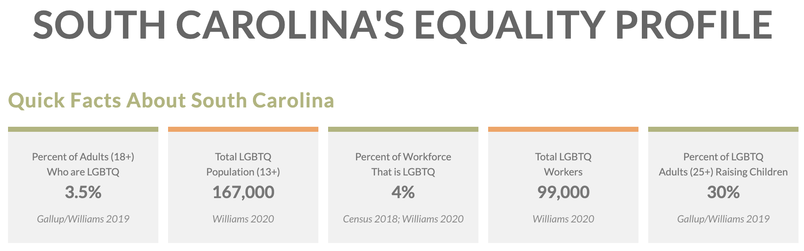
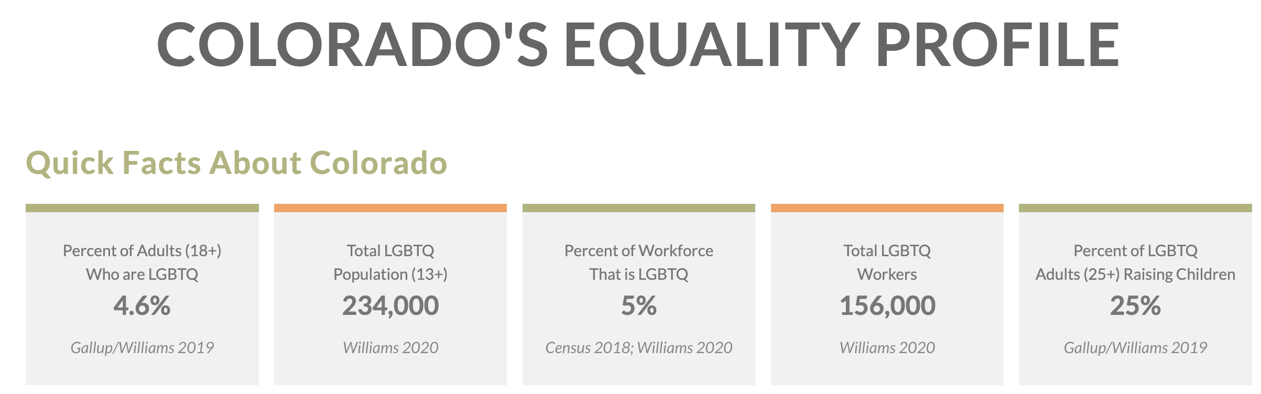
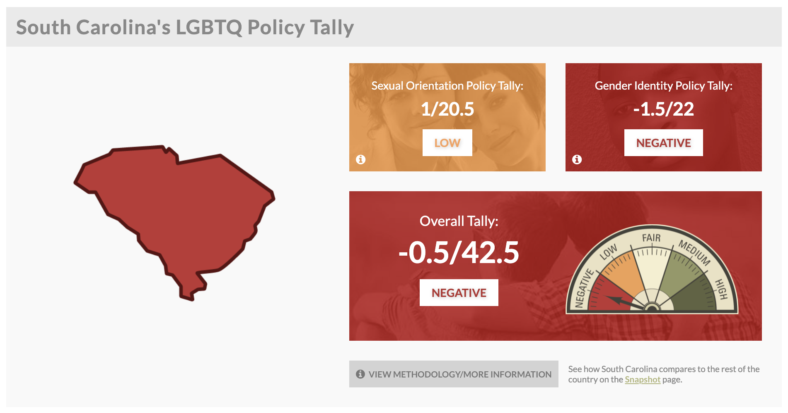
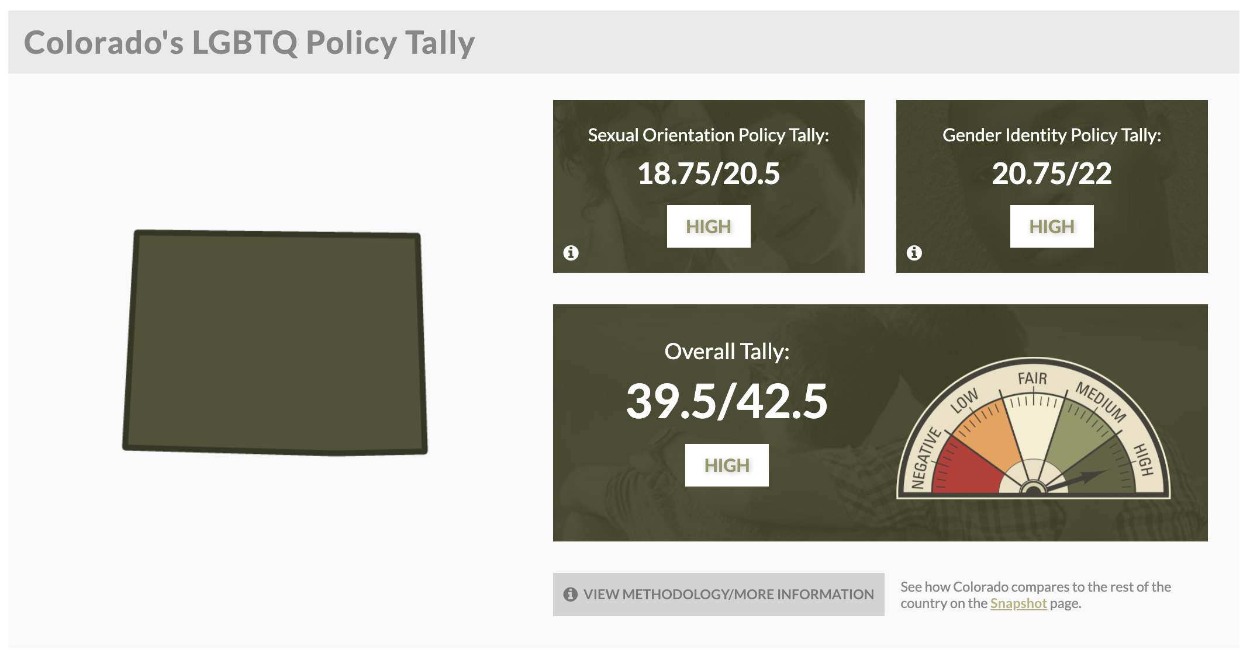
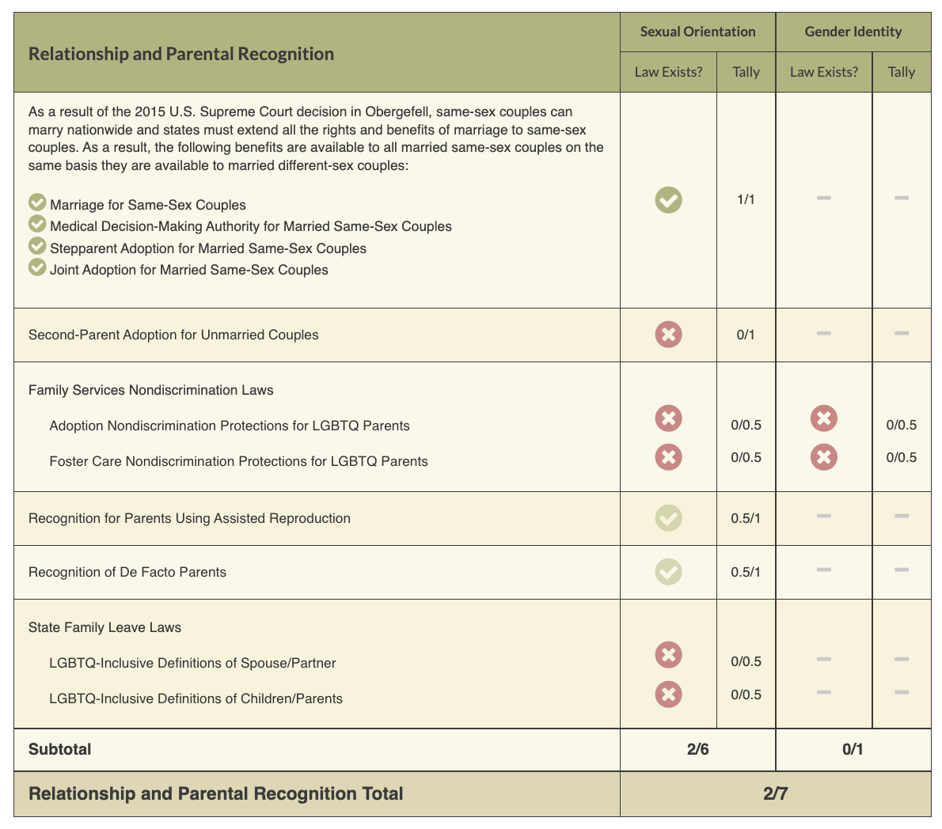
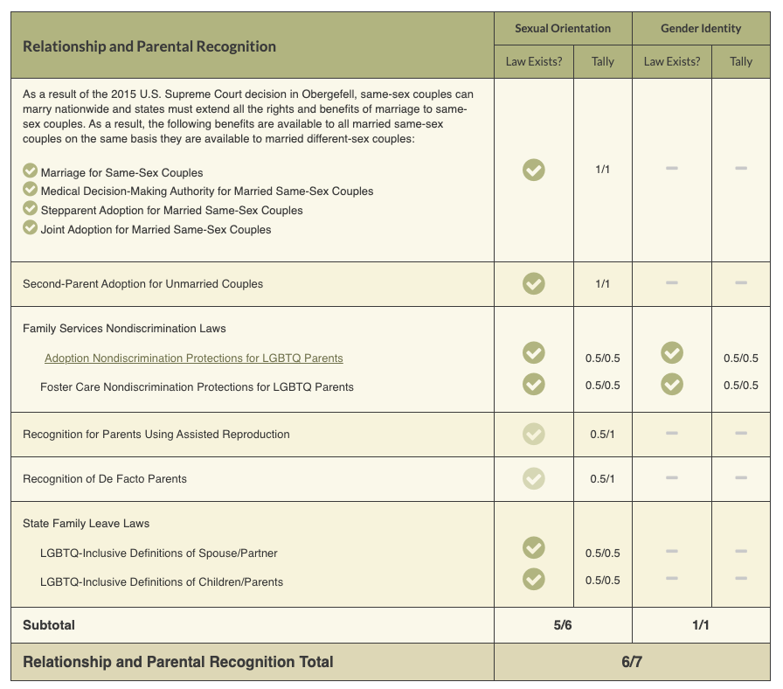
ACTIVITY #2
Review the Laws in Your State
Notes:
Look at Your State’s Equality Profile.
How might this impact members who are transitioning or transgender?
Instructions:
Go to www.lgbtqmap.org
Click Equality Maps
Select “Choose a State” in the drop down menu.
Select a state and review the data. How might this data impact members who are transitioning or transgender in your selected state?

Slide 52
Review the Laws in Your State
1. Go to www.lgbtmap.org and Click Equality Maps or use the QR Code
2. Select “Choose a State” in the drop down menu.
3. Select a state and review the data.
How might this data impact members who are transitioning or transgender in your selected state?
Notes:
Look at Your State’s Equality Profile.
How might this impact members who are transitioning or transgender?
Instructions:
Go to www.lgbtqmap.org
Click Equality Maps
Select “Choose a State” in the drop down menu.
Select a state and review the data. How might this data impact members who are transitioning or transgender in your selected state?

Slide 53
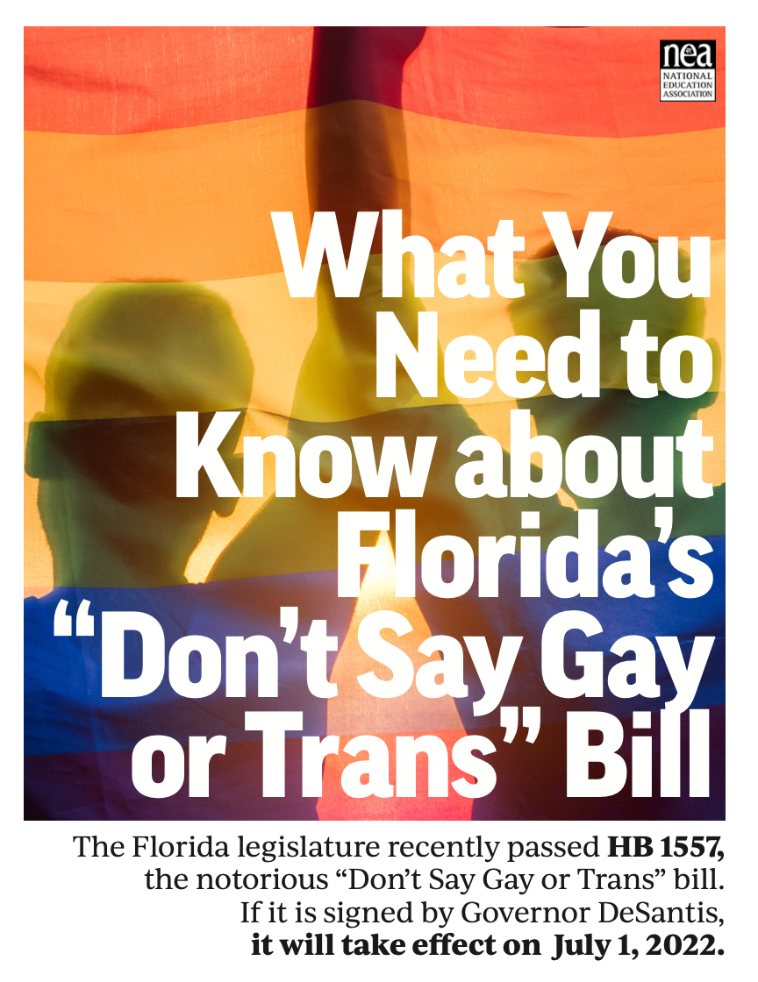




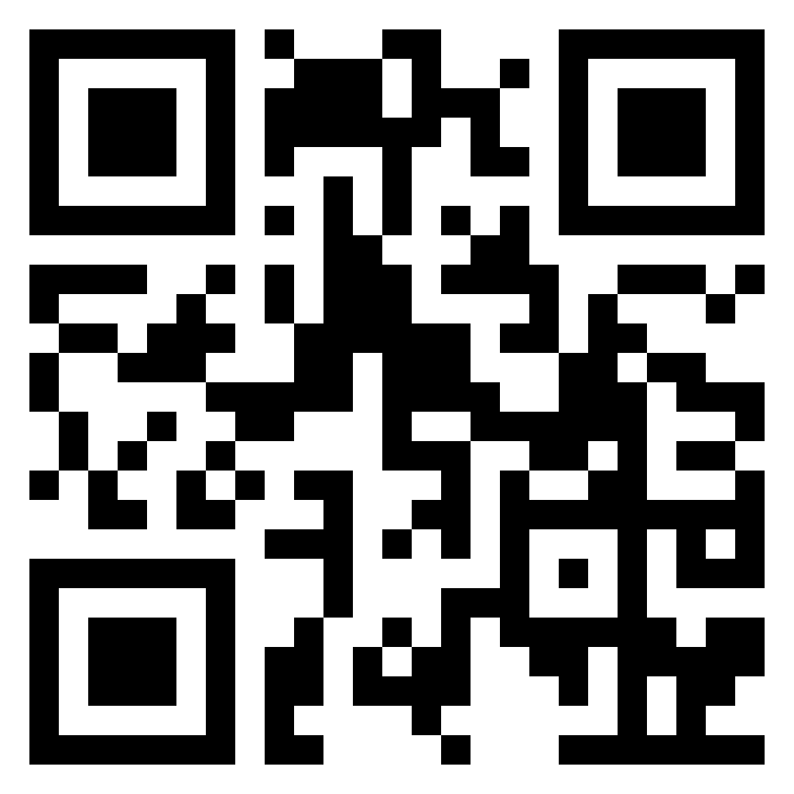
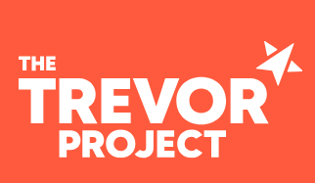
NEA Partners
Legislative Trackers
Notes:
The NEA has several resources and recommendations for legislative trackers. (See handout for full list and website links.)
https://www.icnl.org/usprotestlawtracker/
https://www.aclu.org/legislation-affecting-lgbtq-rights-across-country

Slide 54
Key Ideas
At least for now, ALL LGBTQ+ workers are protected under Bostock.
BUT Bostock is limited to Employment.
Affirming and destructive policies are popping up everywhere- The map resource is a good way to stay up to date.
With the current Supreme Court, we don't know how long Bostock will survive.

Slide 55
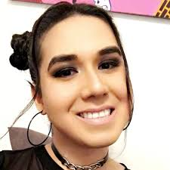

Non-binary voices
“Throughout my life, I have made so many stops all along the gender and sexuality spectrums. Each one felt like home until it didn’t. I’d stumble across a new shell and try it on. If it fit, I’d keep it, and leave my old one behind.
So I’ve been gay. I’ve been gender non-conforming. I’ve been queer. I’ve been genderqueer. And now I’m non-binary. And sometimes a demiwoman.”
Karari Olvera Orozco (they/she)
Activist, writer, co-founder and former editor-in-chief of xQsí Magazine, an online LGBTQ Latin@ Multimedia Publication.
55
Notes:
As we’ve said, gender can be fluid. Here, writer and activist Karari Olvera Orozco shares a bit of their story. (Read the slide.)
A demiwoman is someone who was assigned female at birth but does not fully identify with being a woman, socially or mentally.
If someone has two types of pronouns, like we see here with Karari, they may feel more comfortable with one over the other. So be sure to ask which one they are most comfortable with.

Slide 56
ACTIVITY | GENDER-NEUTRAL WORLD CONT.
Refer to the T-Chart you created earlier.
Thinking about why the assumptions on the left are problematic, use the right side of the chart to develop a way to correct that assumption.

Slide 57
ACTIVITY | GENDER-NEUTRAL WORLD
Assumptions | Corrections
Giving all the women in the office a flower for Mother’s Day | Give all people in the office flowers on Mother''s Day. For example, while I can't get Hallmark to stop celebrating Mother's Day, I can get my workplace to acknowledge the complexity of parenting and gender by not focusing any celebration on the day.
Notes:
Complete the T Chart activity (10 Minutes)
Thinking about the assumptions and why they are problematic, as a group, on the right side of the t chart – come up with a way to correct that assumption.
Return to your t chart on right side your group is now going to
For example – Giving all women a flower for Mother’s Day - Correction is give everyone flowers on May Day instead of on Mother’s Day

Slide 58
KEY IDEAS
We can intentionally create more gender inclusive spaces.
Focus on what is within our control.

Slide 59
Rachel

Slide 60
Reminder: Definition of Privilege
A special right, advantage, or immunity granted by our unique relationship to a system of power.

Slide 61
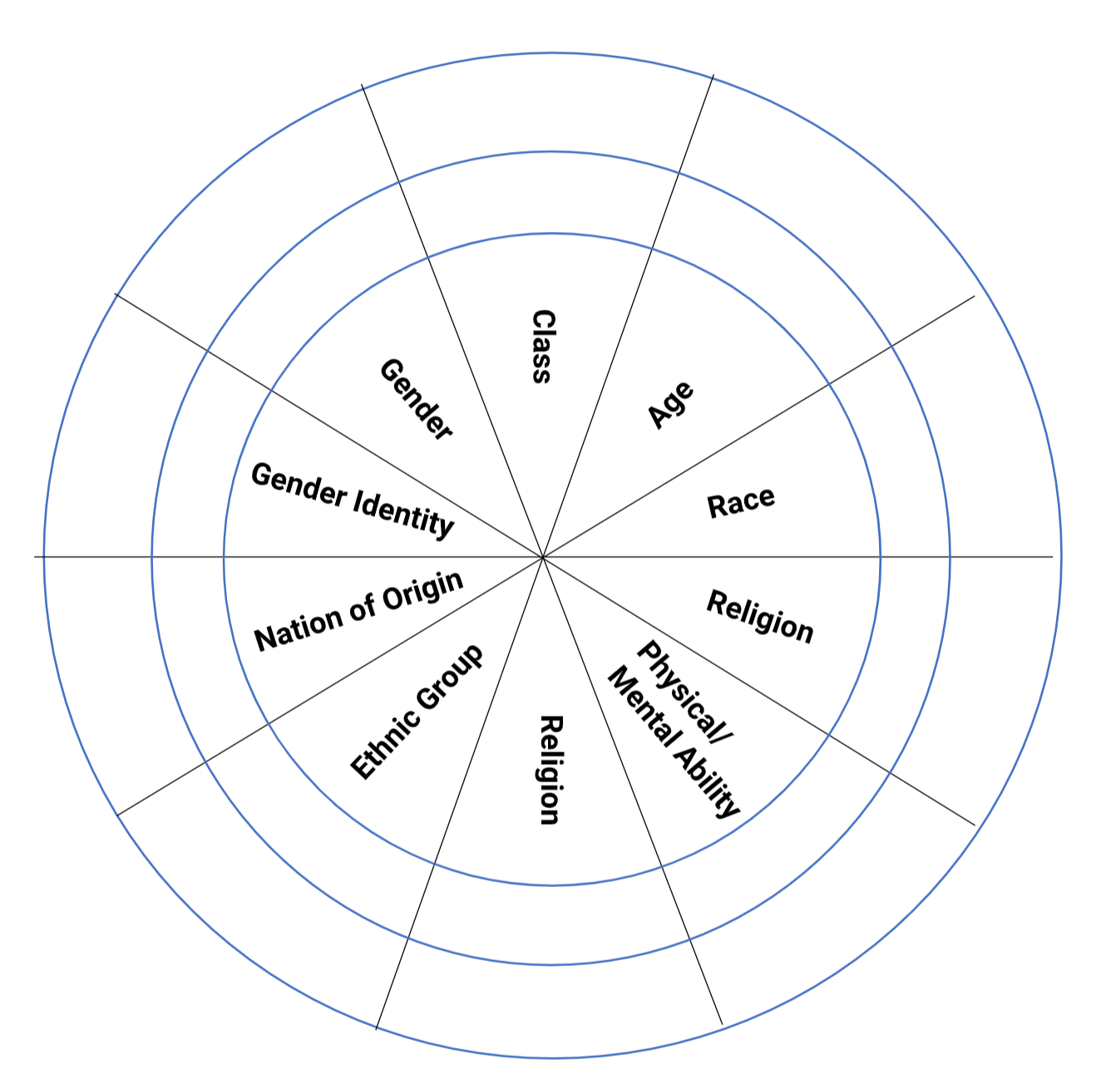
Power Shield
Power
Shield
P. 4
With one
Correction on the handouts
Sex
Sexual Orientation
Notes:
Reformat this slide- create a four corner activity
May need hand out for this as well
We are going to take a minute to look intentionally at our identities, and how they relate to power.
Stations around room for activity: Gender/Presentation, Race, Sexual Orientation, Ethnicity, Religion, Class, Nation/Language of Origin, Physical/Mental Ability, Age, Work Category
Challenge by choice; not meant to out someone.
Which identity do you think about the most?
…the least?
Which identity are people most surprised to learn about it?
Which identify brings you the most discomfort or confusion?

Slide 62
Power Shield Activity
Analysis of Power and Privilege as Individuals
Inner Ring – Dominant Identities
Outer Ring – Oppressed Identities
First on your own, then discuss as a group
Sex
Sexual Orientation

Slide 63
Power Shield Activity
On your own --
Mark the inner or outer ring of each trait to describe your identity.
Consider as a table group:
How many of your segments are not dominant, meaning you do not share those areas of power conferred by society?
What insight does this provide on how you have been treated as a person of privilege or a marginalized person?
Which Identity brings you the most discomfort or confusion?
Sex
Sexual Orientation

Slide 64
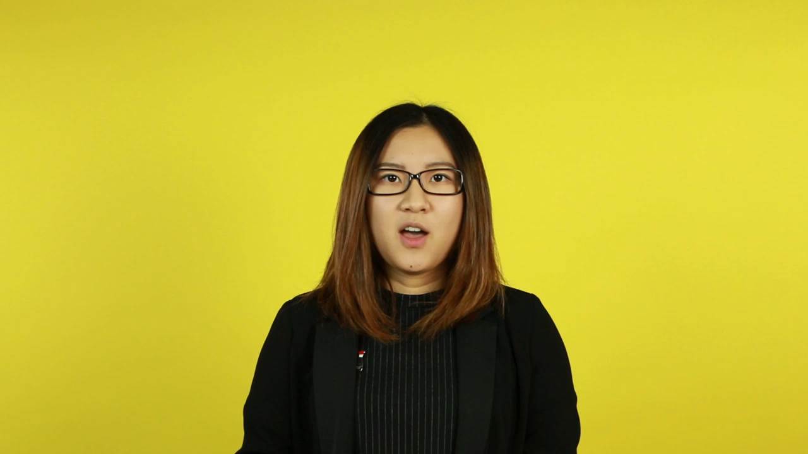
INTERSECTIONALITY

Slide 65
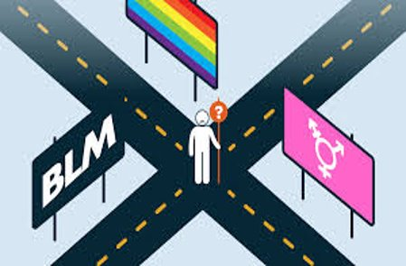
INTERSECTIONALITY
Intersectionality is a framework for understanding a person, group of people, or social problem as affected by a number of discriminations and disadvantages. It takes into account people's overlapping identities and experiences in order to understand the complexity of prejudices they face.​

Slide 66
LEVELS OF EXPRESSION OF OPPRESSION
I n d i v i d u a l | Internalized Oppression lies within individuals. These are our private beliefs and biases about others, influenced by our culture, that reside inside our minds. | S y s t e m i c | Institutional Oppression occurs within institutions and systems of power. It is the norms, policies and practices that are structured into political, societal and economic institutions that have the net effect of imposing oppressive conditions and denying rights, opportunity, and equality to identifiable groups.
 | Interpersonal Oppression occurs between individuals. Once we bring our private beliefs into our interactions with others, we are now in the interpersonal realm. |  | Structural Oppression is bias across institutions and society. It’s the cumulative and compounded effects of an array of factors that systematically privilege some and disadvantage others.
Notes:
10:45-11:30 Ben

Slide 67
ACTIVITY: UNDERSTANDING EXPRESSIONS OF OPPRESSION
Drawing on your knowledge base and experiences: ​
Independently analyze the scenarios and determine the expression of oppression. ​
  Scenarios can be found in POPs in "Additional Participant Handouts", the last resource at the bottom- Levels of Expression of Aggression
Discuss at your tables and reach consensus about the expression of oppression in each scenario.​
TOTAL Report Out – 3 Minutes be prepared to report a 2 Sentence Summary of your scenario and the Consensus Decision about what level of oppression is being expressed and why.
Notes:
Count off by 8
Three Minute Report Outs ​
Summary​
What Level​
Why​
Then for all groups…​
What did you struggle with? ​
What was Clear to You?

Slide 68
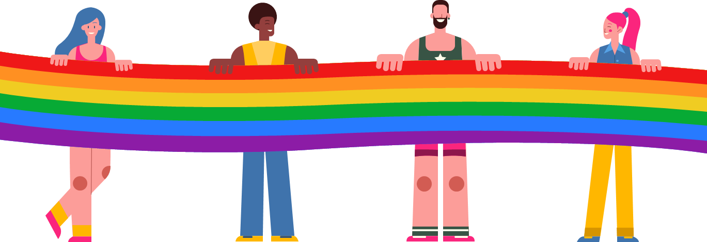
What did you struggle with?
What was clear to you?

Slide 69
KEY POINTS
1. There are no hard and fast lines between the levels – and changing one can affect another. ​
​
While we believe that the individual is ​
responsible for exploring personal bias …​
​2. The way to effect change is by addressing institutionalized and structural oppression – this is where injustice lives.

Slide 70
Grat and Bekah

Slide 71
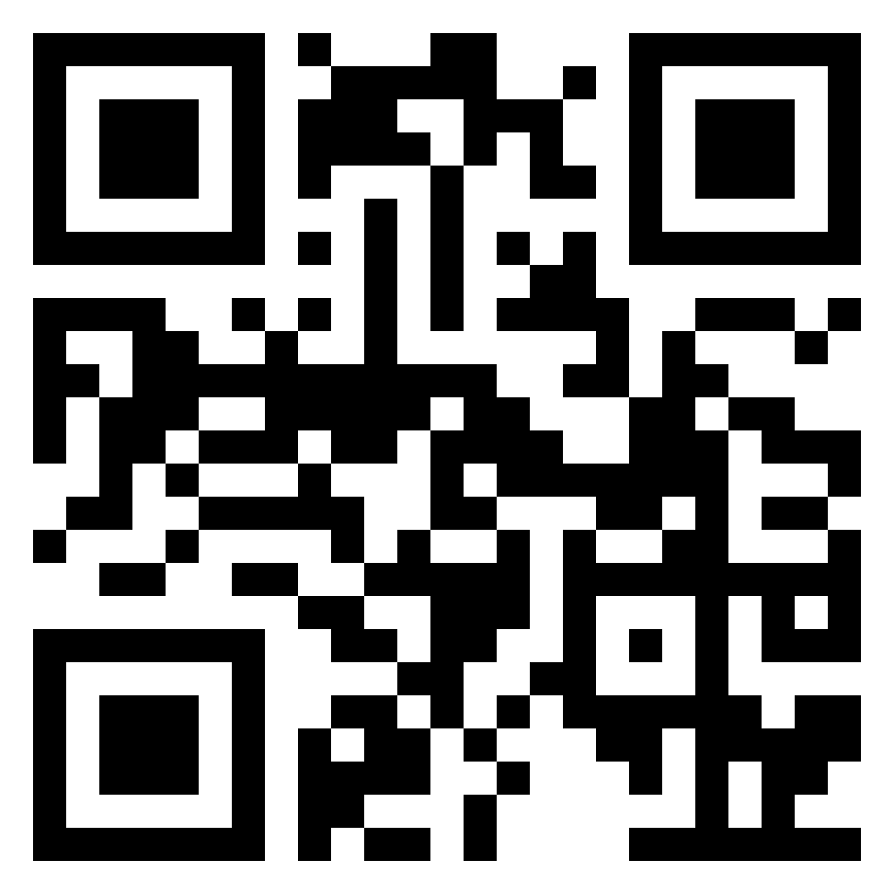
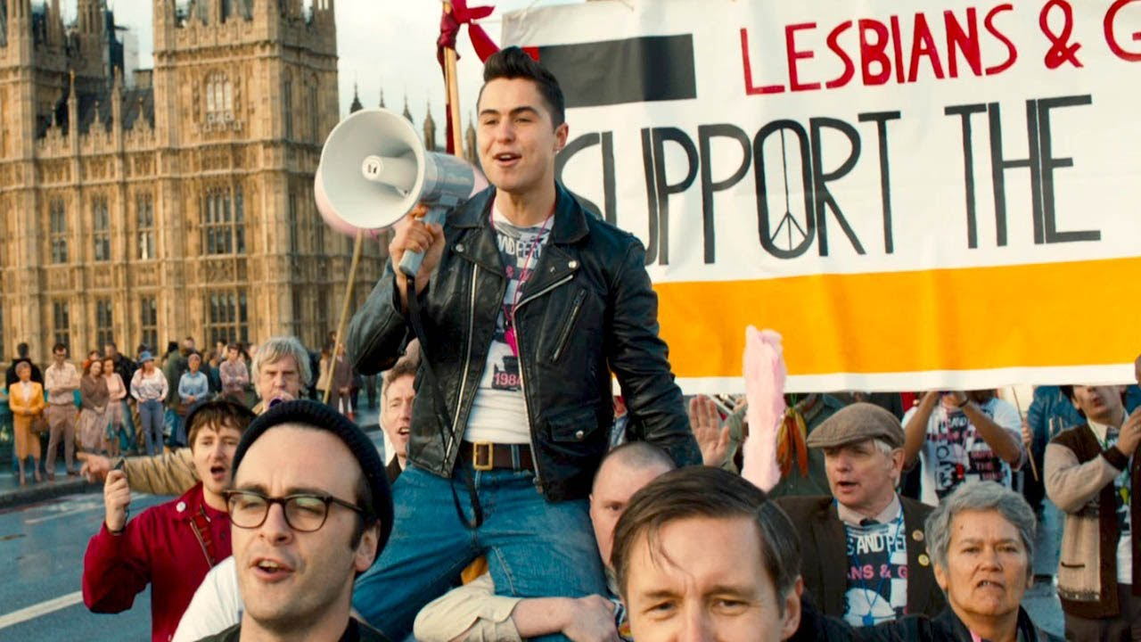
Lunch
1 hour for Lunch!
CUE IT UP!
Add the movie “Pride” to your to watch list. It is based on a true story about an LGBTQ+ group’s solidarity with striking miners. A feel good union story, but make sure to have tissues handy!

Slide 72
Anthony

Slide 73
15 Minute Break!

Slide 74
Beth and Grat

Slide 75
Panel

Slide 76
Pete and Dawn

Slide 77
SCENARIO: Supporting a Trans Educator
You are a Uniserv Director in a medium-sized conservative school district. A member reaches out to you and asks for your help. She explains to you that she is a returning employee who is transgender and began transitioning over the summer break. She is nervous about coming back in the fall and is asking for your help in navigating her return.
•What additional information would you need? How would you go about finding that information? What resources would you use or seek out?
•What would be your first steps?
•Knowing what we know now about transitioning and gender, what would you avoid doing?
15 minutes to answer the questions at your table.
One person from each group will report out on the questions.
77

Slide 78
DEBRIEF
What additional information would you need? How would you go about finding that information? What resources would you use or seek out?
What would be your first steps?
Knowing what we know now about transitioning and gender, what would you avoid doing?
For additional support see the document in Additional Resources section of POPS called, "Gender Diversity in the Workplace."

Slide 79
Questions and Topics to Avoid
    Questions about genitalia or anatomy
It’s not your business!
    Questions about sexual experiences
Also, not your business
    Any questions that imply someone should delay or stop transitioning
Are you sure you want to switch your pronouns this school year?
    Any comments on someone’s transition
“I never would have known! You pass so well! You don’t look trans!”
    Questions or comments about, or using a person’s dead name
A dead name is the birth name of a transgender person who has changed their name
    Anything that assumes they are the expert on everything LGBTQ+
It's not their job to teach you or to speak for an entire, diverse community
Notes:
Added some from here- https://freedomforallamericans.org/messaging-terms-avoid/ (Sara)

Slide 80
Key Ideas
When someone calls you and tells you they are transitioning, do not question them about what they are doing.
Ask how you can support them and find out the answers to their questions.
Put the person in the driver seat; do not be the driver.
NEVER try to talk someone out of transitioning or question their decisions around their identity.

Slide 81
Natasha

Slide 82
BUILDING AN ORGANIZING CAMPAIGN

Slide 83
Consider...
For your scenario, imagine you are in a state that has recently banned conversations about LBGTQ+ topics. What would you do?

Slide 84
Consider...
Why do you think that it is important that we address concerns around LGBTQ+ equity through an organizing model?
(as opposed to relying solely on lawsuits and grievances?)

Slide 85
Organizing Definition

Slide 86
Why an Organizing Approach
Well-organized worksites and locals have a positive, visible presences
Members feel that they have the collective power to solve their problems and see themselves as responsible for the win – not a third party (UD, Lawyer, Lobbyist).
Builds power by continually increasing the amount of member leadership and ownership for the actions.
We cannot assume that the law/policy will always be on the side of LGBTQ+ equity!!!

Slide 87
What is an Organizing Campaign?
An action plan with a beginning, middle, and end, working towards a specific demand
•Involves a series of escalating actions (or tactics)
•Increases pressure on decision-makers
•Builds power by increasing engagement, developing leaders, and building capacity.
•Throughout the campaign we identify milestones that indicate we have enough power to try something more and something bigger and win!

Slide 88

Structure of a Campaign

Slide 89
Key Parts of an Organizing Campaign
• Issue
•Demand
•Target
•Tactics
•Escalation
Notes:
Possible trivia activity
Organizing terminology cheat sheet in resources

Slide 90
Key Idea
Grievances are typically singular and don’t build people power
Campaigns involve lots of people, are member led, and increase power and visibility of the union

Slide 91
Definition of power
  Application or power to each element of an organizing campaign

Slide 92
Introduce work for third day:
Power analysis
Coalition bldg

Slide 93
Selecting a Scenario
Count off by 6 to find your group
(groups 1 / 4-scenario 1, groups 2 / 5-scenario 2, groups 3 / 6-scenario 3)
Move to a table that corresponds to that scenario
Take 2 minutes to read your scenario
Overview of what presentations and report out will look like
Notes:
Replace flag scenario with pronouns
Supplement book bans with curriculum
Do we add athletic teams to bathroom/locker room scenario

Slide 94
Advancing LGBTQ+ Justice

