Slide 1
Advancing LGBTQ+ Justice

Slide 2

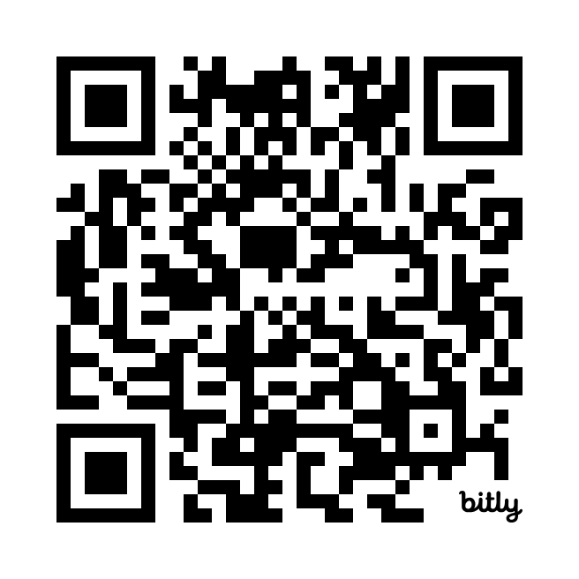
Morning Entry
This morning, continue thinking about our earlier conversation about intersectionality.
Check out the Human Rights Campaigns report “Black and African American LGBTQ+ Youth Report 2024” for more information about the challenges experienced by youth navigating multiple identities.

Slide 3
Feedback

Slide 4

COMMUNITY AGREEMENTS
Awareness and Self-Knowledge
Listen for Understanding
Be Gracious
Stay Engaged
Be Open and Suspend Judgment
Say “I”- tell your truth
Seek Discomfort
Reach for Empathy
Expect non- Resolution and non-Closure

Slide 5

TODAY’S AGENDA
8:30 – 8:40 Morning Routine
8:40- 10:40 -- content
10:40-11:00 - Break
11:00-11:40pm – Group Work Time
11:40 -12:40 -- Presentation
12:40-1:00 – Goodbyes
1:00 -- Lunch - grab and go

Slide 6

Beth

Slide 7

Ice Breaker
Gather around an identity of your choosing
Answer the following discussion questions:
Why did you select this piece of your identity?
What are some challenges of this identity?
Notes:
Ben 10:00-10:15
Post the following identities around the room:
High risk (day 3) – caregiver, speaker language other than English, environmental/political/social activist, neurodivergent, organizer, experienced heartbreak
Participants will get up and gather around an identity of their choosing (2 min instructions), then they will answer the following discussion questions (8 min):
Why did you select this piece of your identity?
What are some challenges you face with this identity?
Share out/debrief (5 min)
What was something you learned about someone else
What was easy/hard about this activity?

Slide 8
Anthony

Slide 9
Definition of power
  Application or power to each element of an organizing campaign

Slide 10
Introduce work for third day:
Power analysis
Coalition bldg

Slide 11
Group Work
TIME: 30 minutes
Build your campaign!
You have 30 minutes to build your campaign and be ready to present out! Make sure that you include at least…
Issue
Demand
Target
Tactics + Compression points in a campaign mountain!
Extra points if you include some messaging, graphics, hashtags, etc.
Notes:
Rewrite this slide

Slide 12
Anthony

Slide 13

Campaign Presentations!
Each group will have ____ to present their solution to their scenario.

Slide 14
Ellen

Slide 15

LINGERING QUESTIONS
Anything you NEED to ask before leaving?
What feels VERY unsettled or confusing?

