Slide 1
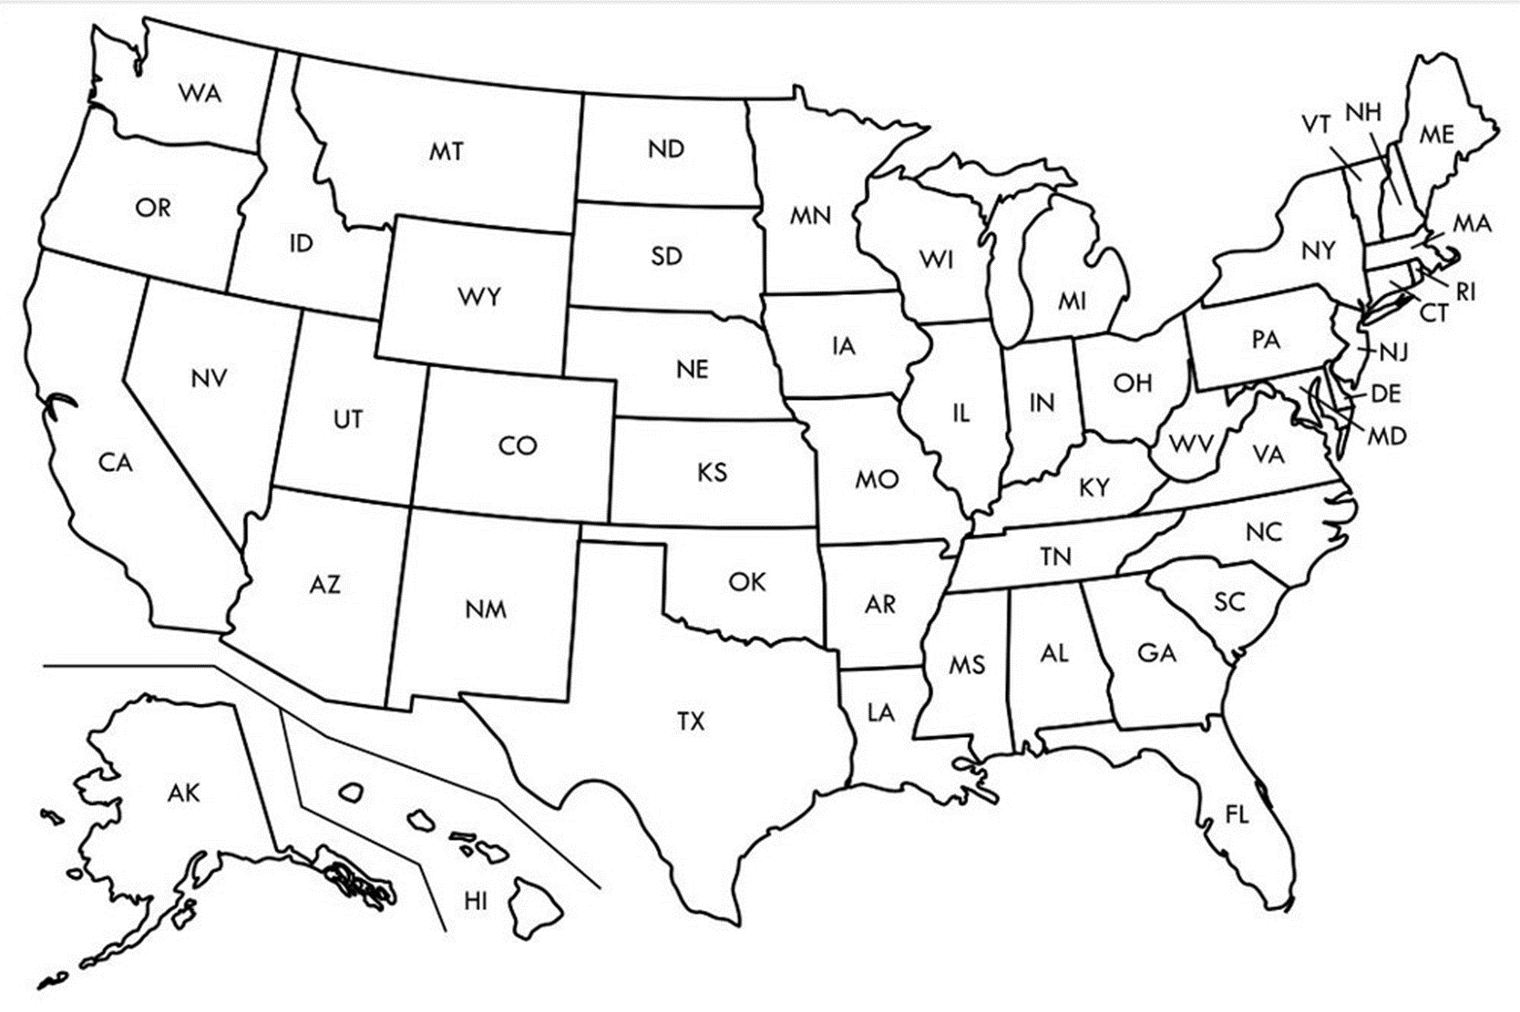

Entry Activity-Mapping
Place a dot on the map showing where you are from
Notes:
Populate from pre-survey

Slide 2
Advancing LGBTQ+ Justice

Slide 3
Land Acknowledgement
We begin by acknowledging that we meet on the traditional lands served by the Lenape people. We honor America’s First People and all elders, past, present and emerging and we are called on to learn and share what we learn about the tribal history, culture, and contributions that have been suppressed in telling the story of what we now call the United States America. We invite you to think about the spaces you are inhabiting and the Indigenous people who came before them and were stewards of the land.

Slide 4
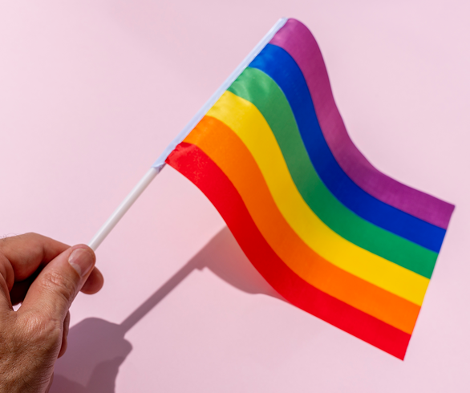
Our Time Together
Days 1 & 2: 8:30 am- 5:00 pm
◦15 Minute AM + PM Break
◦Lunch 12:00 – 1:00pm
◦4:30 - 5:00 pm “Adult Choice Networking”
Day 3: 8:30 am -2:00 pm
◦15 Minute AM + PM Break
◦Lunch 1:00 pm
◦1:00 - 2:00 pm “Adult Choice Networking”

Slide 5

Today’s Agenda
8:30 – 10:15 -- Getting Started and Building Our Community
10:15-10:30 -- Break
10:30 -12:00 -- Who am I in the work
12:00 -1:00 -- Lunch
1:00 – 2:30 -- LGBTQ History & Terminology
2:30 – 2:45 -- Break
2:45 - 4:15 -- Gender Identity
4:15 – 4:30 -- Wrap Up and Reflect
4:30 – 5:00 -- Adult Choice Networking
Beyond the Bell Walking Tour

Slide 6
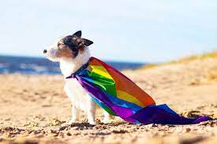
Logistics to Remember
Parking lot
Bathroom
Materials
Food
Room Temperature
Karla as Resource
Questions
Room Cleaning

Slide 7
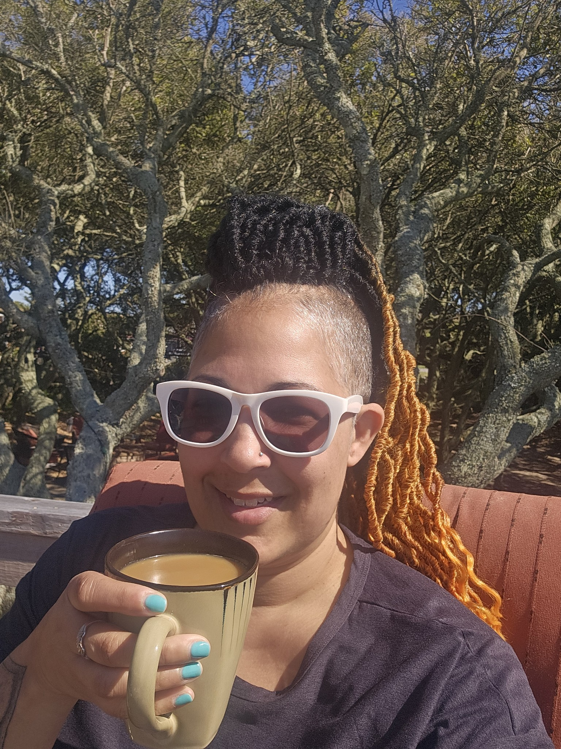
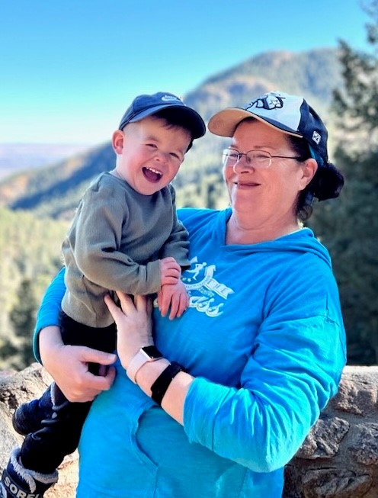
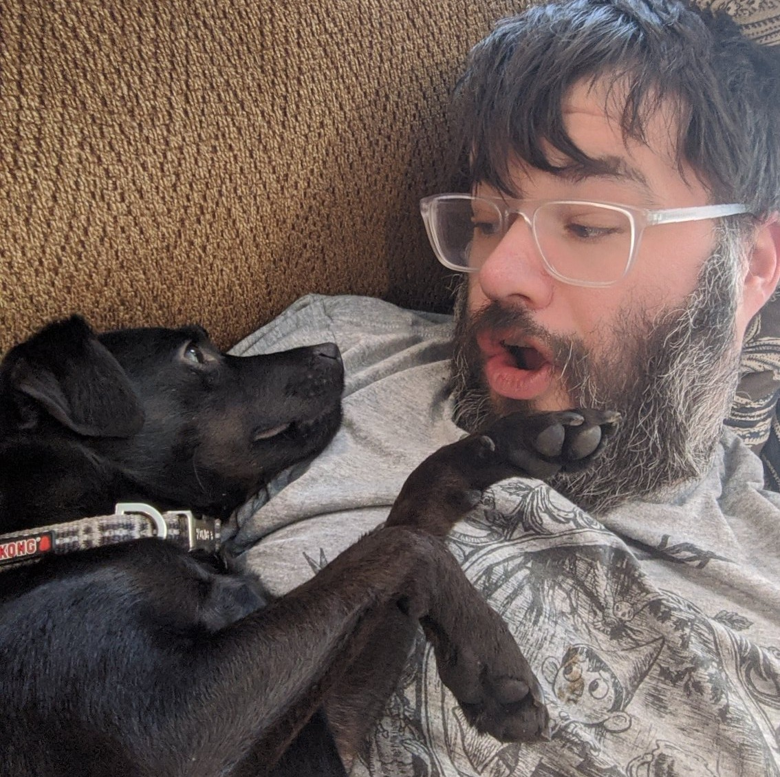
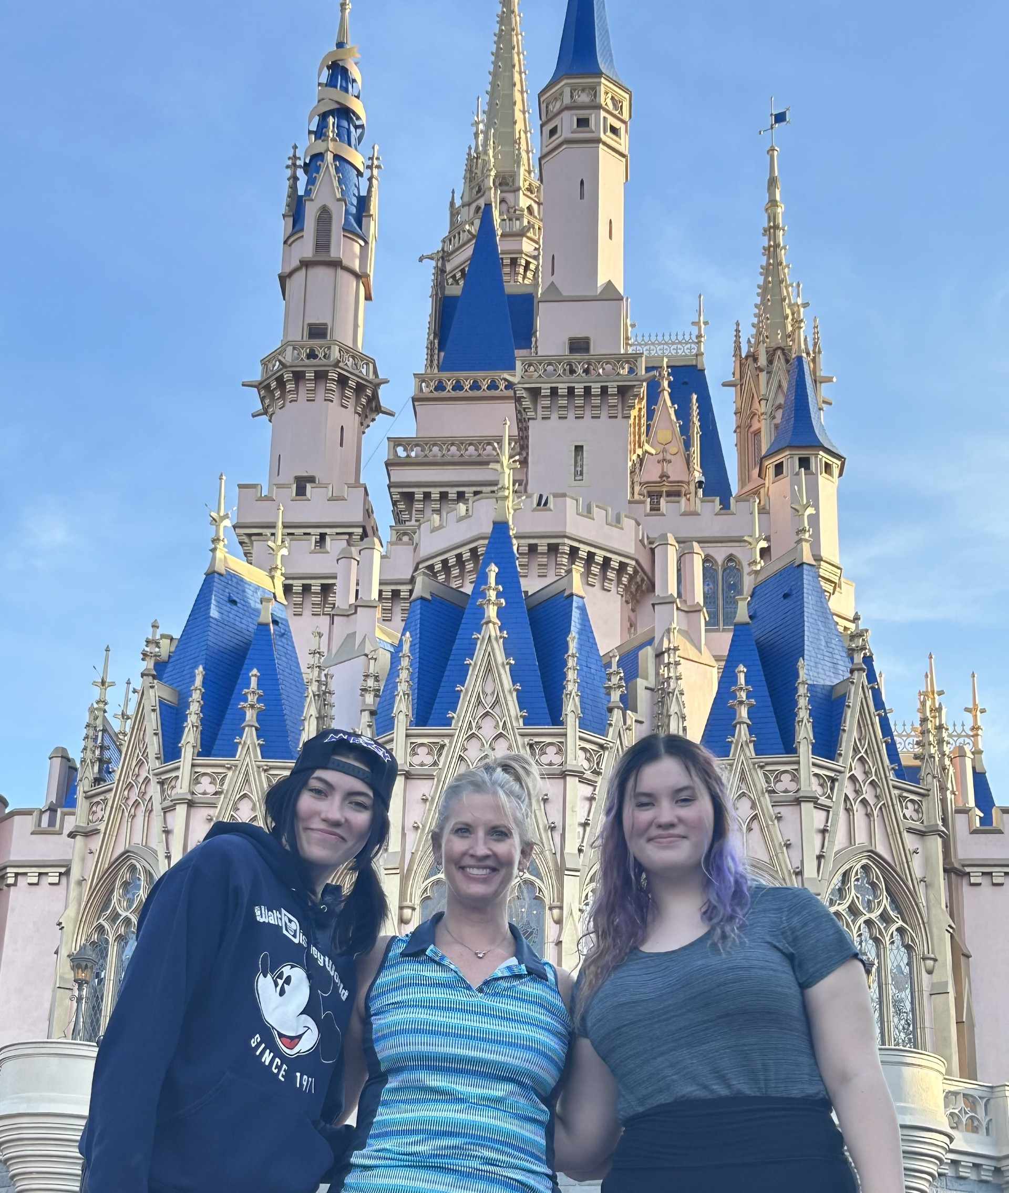
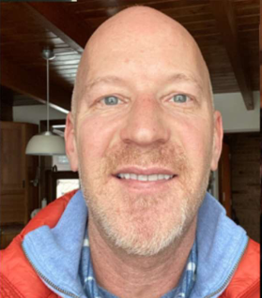
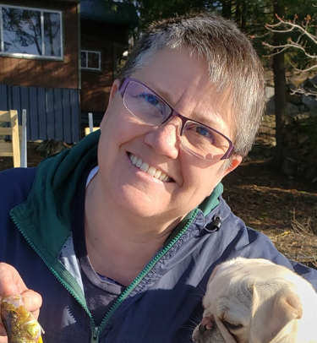
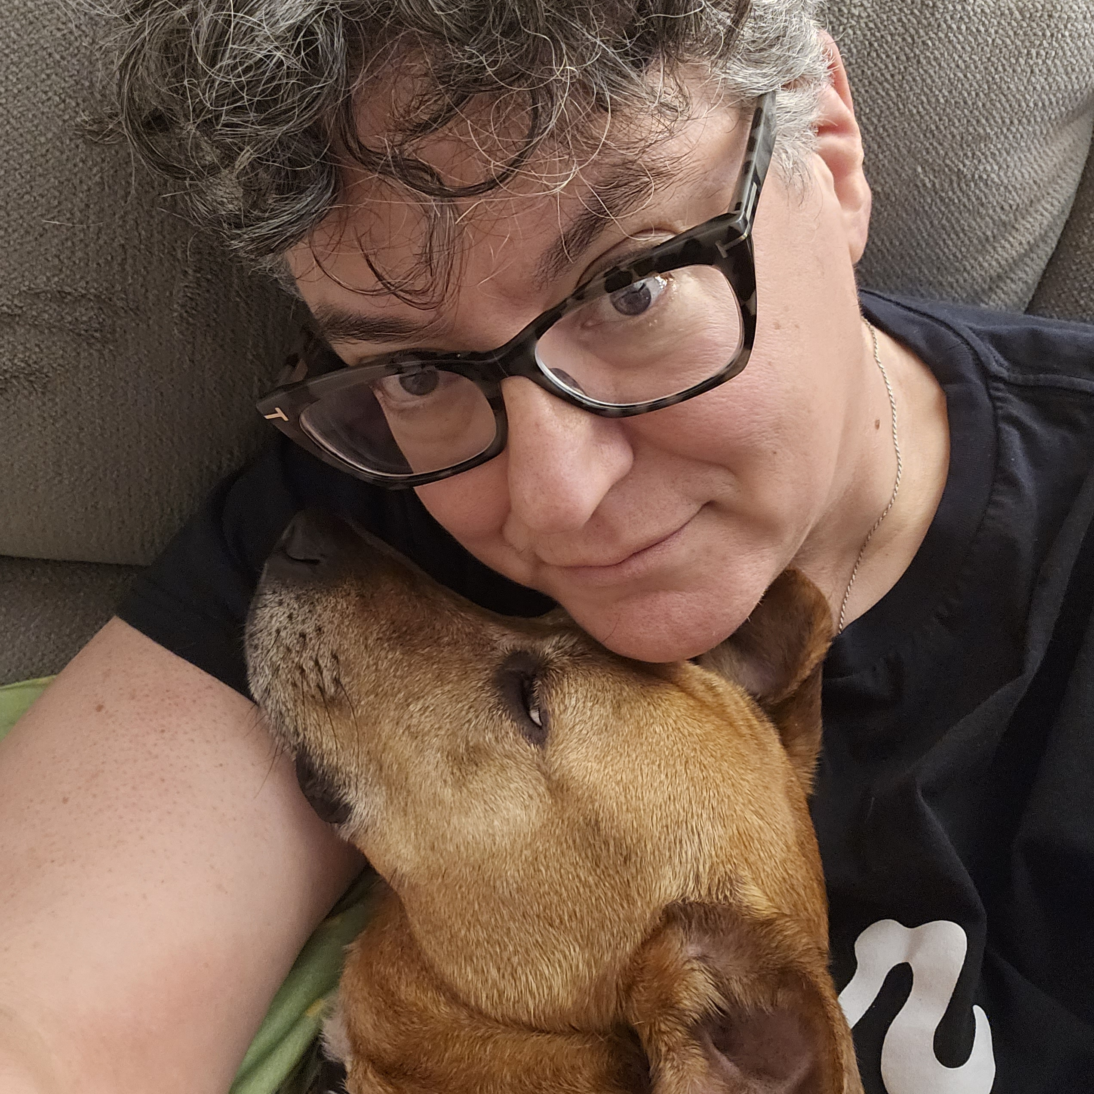
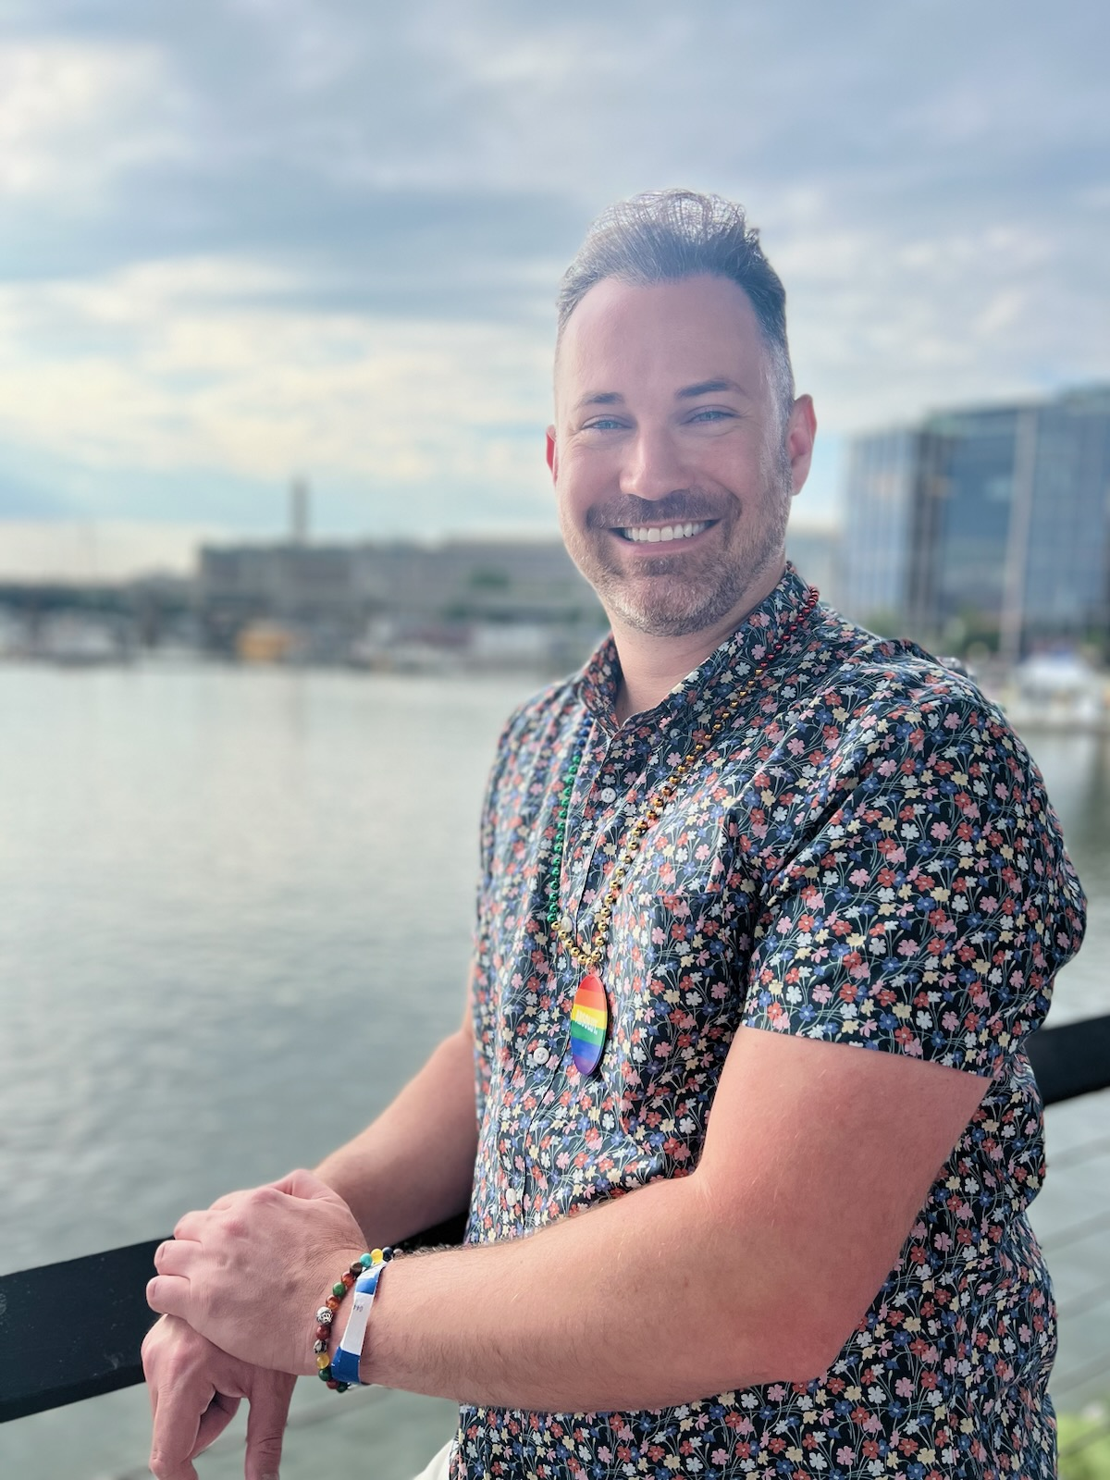
Introductions- Training Team
Natasha Eckart
She/They
Vermont
Dawn Moretz
She/Her
Montgomery County, MD
Pete Clancy
He/Him
Iowa
Beth Anderson
She/Hers
Minnesota
Grat Dalton
He/Him
Michigan
Ellen Holmes
She/Hers
NEA
Bekah Saxon
She/Hers
Connecticut
Anthony Brisson
He/Him
Washington, D.C.

Slide 8

Community Agreements pg 2 (Pre-Attendance)
Awareness and Self-Knowledge
Listen for Understanding
Be Gracious
Stay Engaged
Be Open and Suspend Judgment
Say “I”- tell your truth
Seek Discomfort
Reach for Empathy
Expect non- Resolution and non-Closure

Slide 9
Disclaimer
Reminder about sensitive topics
The content we are going to explore may bring up strong feelings. Throughout our time together, we will explore examples of racism, ableism, heterosexism, and sexism.
These oppressive ideas and assumptions are offensive, problematic and false. Yet, over time, they have become as pervasive and invisible as the air we breathe. We need to examine them so that we can understand and ultimately challenge them. Modified ADL

Slide 10

Circling Up -Who are you and how are you feeling?
30 Minute Circle
Name
Pronouns
Your title
How are you feeling
in this moment?
Notes:
Move it someplace else?

Slide 11

Anthony

Slide 12
Why we are here!
41% of LGBTQ young people seriously considered attempting suicide in the past year. [1]
A majority of LGBTQ+ people say that they or an LGBTQ+ friend or family member have been threatened or non-sexually harassed (57 percent), been sexually harassed (51 percent), or experienced violence (51 percent) because of their sexuality or gender identity. [2]
NEA RA Support and Part of NEA Mission and Vision (in "Additional Resources" on POPS
[1] The Trevor Project, "2023 U.S. National Survey on the Mental Health of LGBTQ Young People
[2] National Public Radio, the Robert Wood Johnson Foundation, & The Harvard T.H. Chan School of Public Health. (2017, November). Discrimination in America: Experiences and views of LGBTQ Americans. Retrieved June 24, 2020 from https://www.rwjf.org/en/library/research/2017/10/discrimination-in-america--experiences-and-views.html
Notes:
Update data
Bring in historical grounding/establish current framework
Kiera's slide: inversion of political landscape
Maybe a slide with headlines

Slide 13
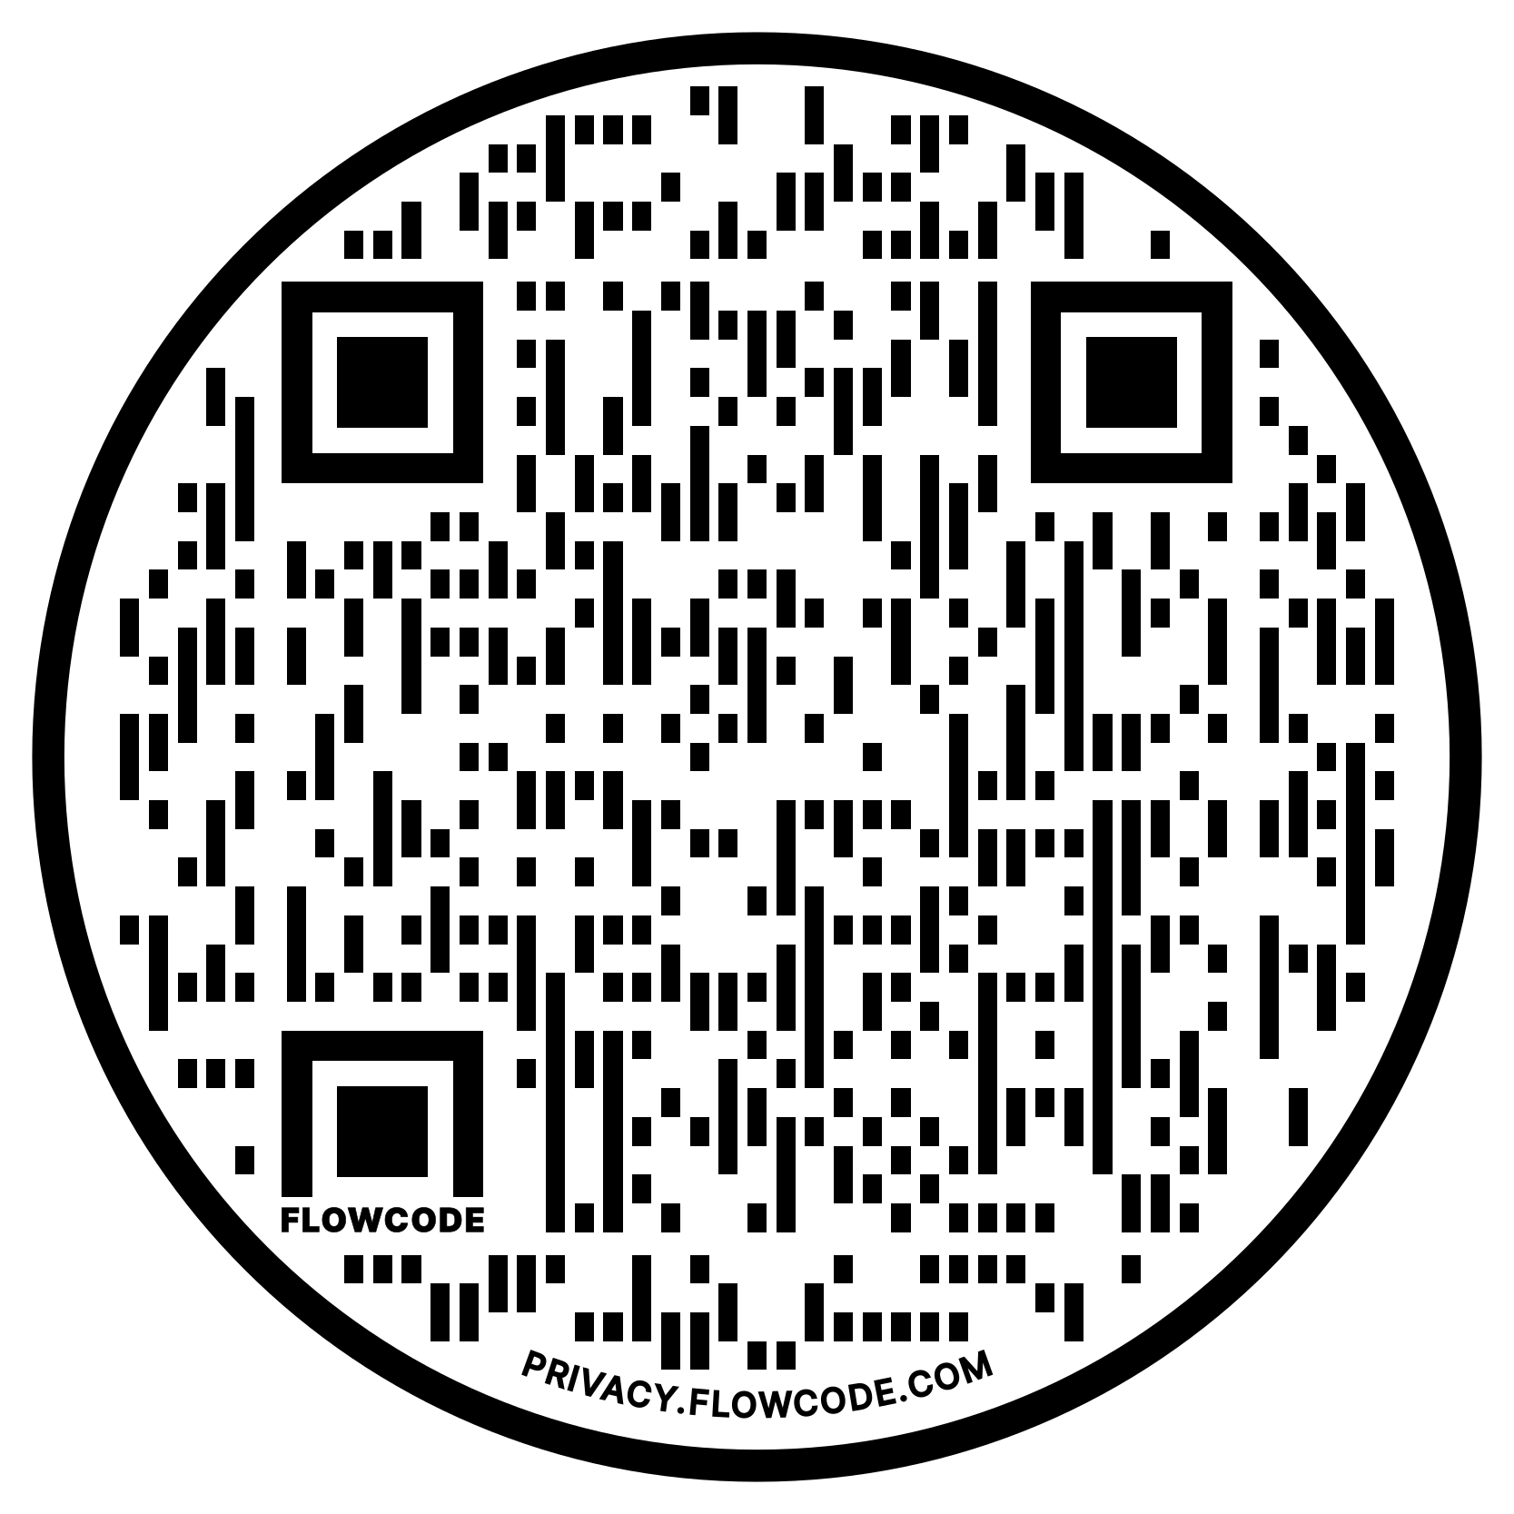
NEA Vision, Actions, Resources
Safe, Just, and Equitable Schools
Resolution adopted by the 2022 NEA Representative Assembly
2021 NBI 32
Training on Transgender Advocacy Issues for Affiliate Staff
NEA LGBTQ+ Caucus Resources
Notes:
The National Education Association's (NEA) Policy Statement on Safe, Just, and Equitable Schools aims to create safe and welcoming learning environments for all students
Campaign lab – teams can receive coaching

Slide 14
The Words of Our Members
“Know that even if you do not personally know of any LGBTQ+ staff person in your district, they are there. Be an ally even if you do not know them. Speak up when you hear, see, or perceive bias and/or discrimination. Advocate for inclusive policies for both students and staff.”
14
Notes:
Add quote from pre-survey

Slide 15
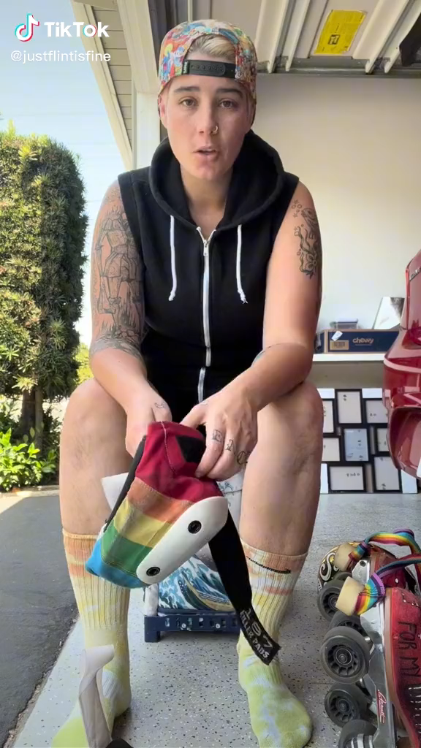
Notes:
Connect to current political landscape

Slide 16
LGBTQ+ Terminology
Turn and Talk (5 minutes):
What terms did you mark as unclear or confusing?
What terms were new to you?
Were there any definitions that differed from your prior understanding?
Notes:
Replace with kahoot vocab review
Put after 1st shared identity activity

Slide 17
LGBTQ+ Terminology
Report out-Large Group :
What terms still have unresolved questions?

Slide 18
Language Changes
Terminology around race and ethnicity changes every 10 years.
Terminology around gender, identity, and sexual orientation changes every 2 years.
Notes:
QUILT BAG

Slide 19
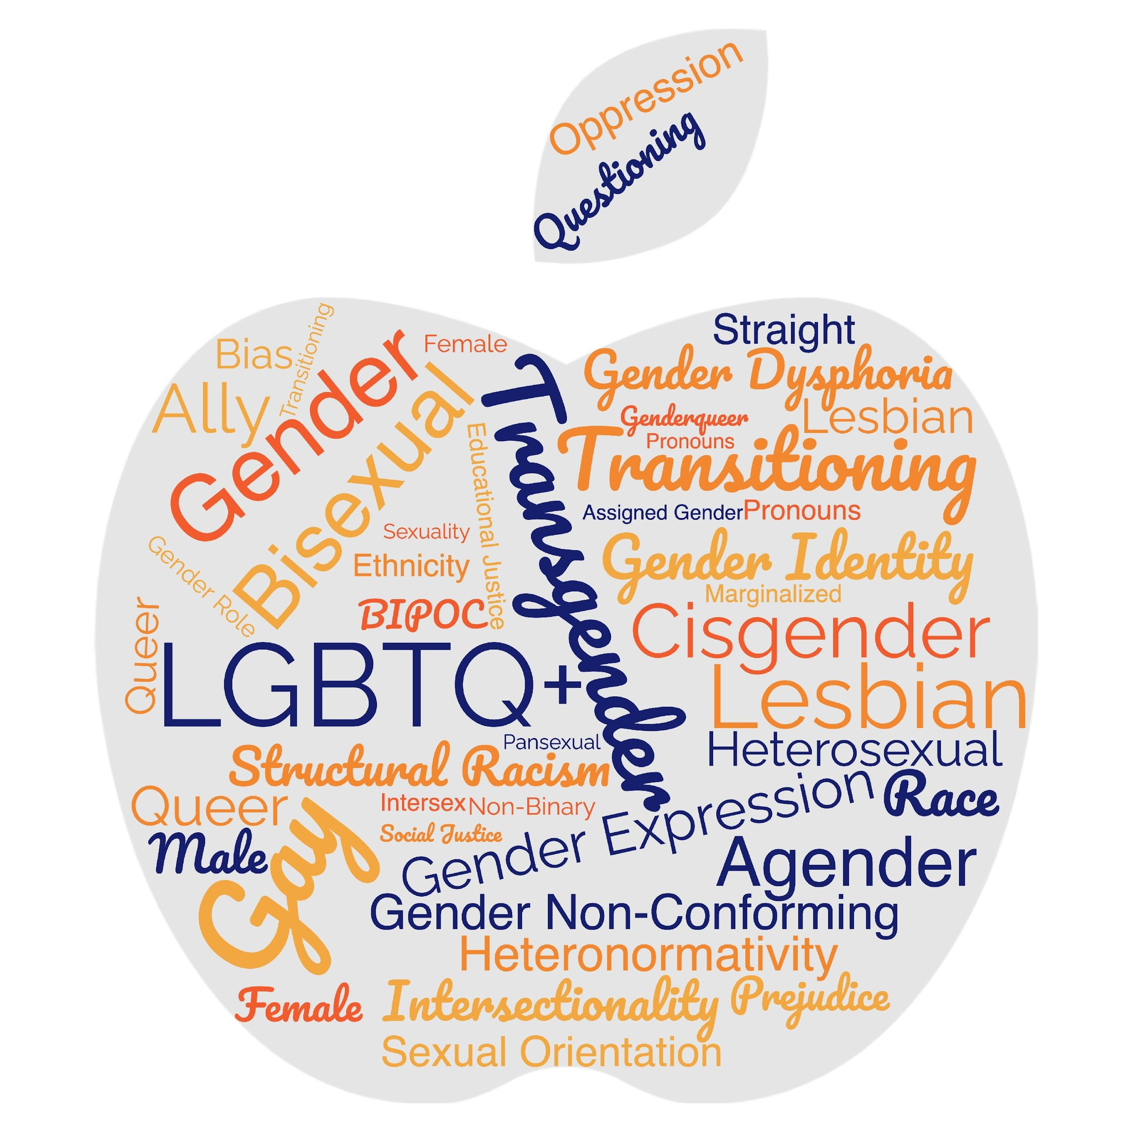
Turn and Talk
What makes a word a slur?
(or)
Who decides
what makes a
word offensive?

Slide 20
Turn and Talk
Words you might hear on the tour...be prepared.
Oppressed communities are not monoliths. Ask don't assume.

Slide 21
Terminology Debrief
Let’s Ask the Room Debrief
What surprised you?
What is your biggest opportunity for growth?
Who has a helpful “hint”?
What else may you need?
Notes:
2:00-2:30

Slide 22

Key Ideas
Terminology matters in making sure that people feel seen and included in spaces.
The lived experience of someone is more important than what you think you know.
These terms change rapidly.
We can never assume we have mastered these concepts.
We need to continue to be humble and learn!

Slide 23
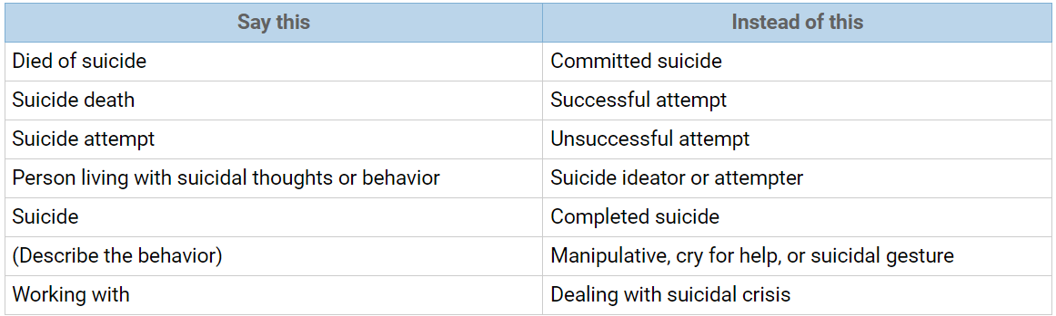
Language Around Suicide
Language matters when discussing issues of suicide. Language reflects our attitudes and influences our attitudes and the attitudes of others. Words have power; words matter. The language we choose is an indicator of social injustice and has the power to shape our ideas and feelings in very insidious ways.
Language Matters: Why We Don't Say "Committed Suicide"
IRMI: International Risk Management Institute
https://www.irmi.com/articles/expert-commentary/language-matters-why-we-dont-say-committed-suicide

Slide 24
Grat

Slide 25
Ice Breaker
Find a partner that is not from your state
Be prepared to share a fun fact about your state or city with the group

Slide 26
Dawn

Slide 27
Core Values
Core values are the fundamental beliefs of a person. These guiding principles dictate behavior and can help people understand the difference between right and wrong – These can often be expressed using one or two words. We are taking a moment to consider our core values because they can provide a basis for solidarity in the midst of struggles.

Slide 28
Sharing Values for Solidarity
Core Values
1. Name
2. Core Value – One or two words that describes a fundamental belief held by you
**15 Seconds Each**
Core values are the fundamental beliefs of a person. These guiding principles dictate behavior and can help people understand the difference between right and wrong – These are expressed using one or two words.

Slide 29
Key Ideas
Solidarity
sol / i / dar / i / ty
Noun
  1. Unity or agreement of feeling or action especially among individuals with a common interest, mutual support; mutual support within a group.
Shared Core Values are critical for building solidarity in our work.

Slide 30

15 Minute Break!
During the break, follow these LGBTQ+ Member Educator Influencers on social media to continue our learning each time we scroll!
@justflintisfine @sabocat
@thegayschoolcounselor @keithkmusic
Notes:
Update the influencers

Slide 31
Beth

Slide 32
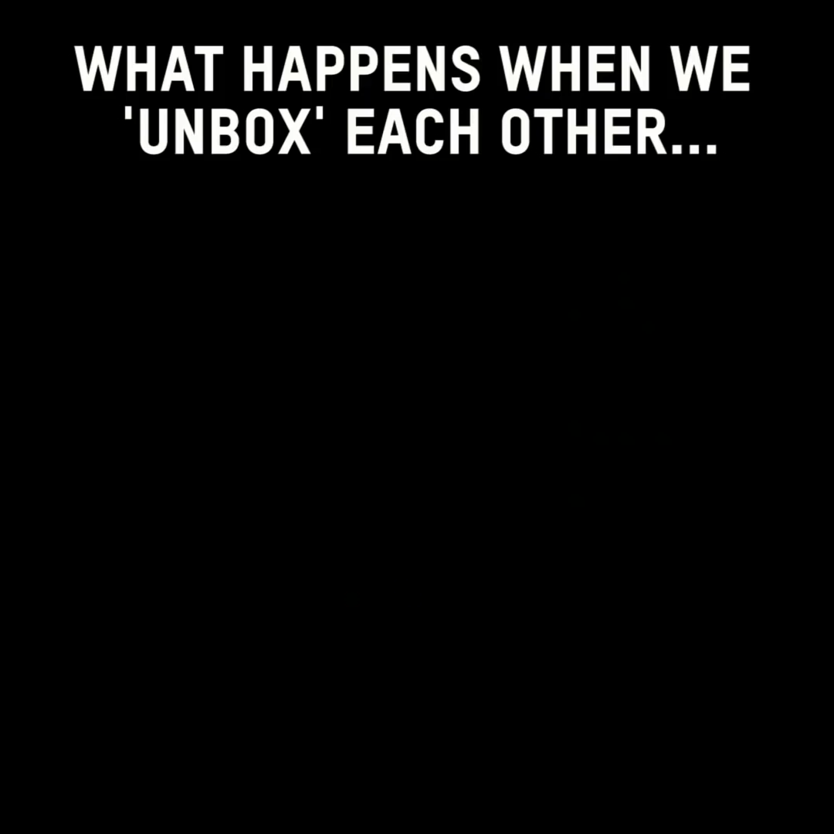

Slide 33

Shared Identity
Gather around an identity of your choosing
Answer the following discussion questions:
Why did you select this piece of your identity?
What are some challenges you face with this identity?
Notes:
10:00-10:15
Around the room: musician, traveler, foodie, planner, nature lover, pet owner
Beliefs are different than identity

Slide 34

Shared Identity
Debrief:
What was something you learned about someone else?
What was easy/hard about this activity?
How safe did you feel sharing in this activity?
What is similar about each of these identities?

Slide 35
Key Ideas
Discreet identities bind us
We all have pre-conceptions that might not match an actual identity of another
We don't get to assign a person's identity for them

Slide 36
Pete

Slide 37
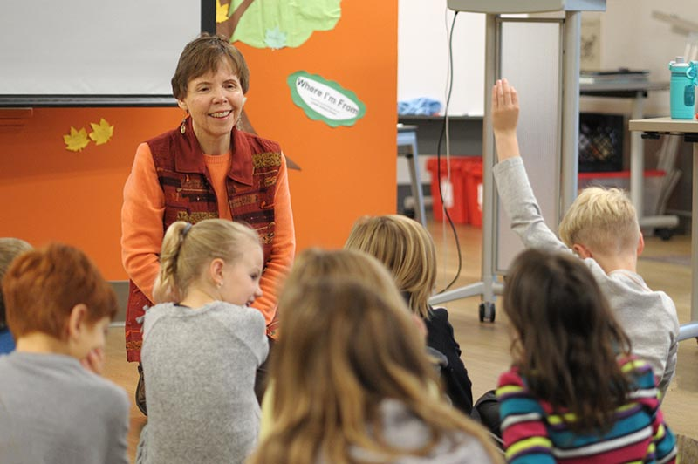
Where I am From
George Ella Lyons Poet Laureate, Author, Teacher from Kentucky.
Widely used as a way to get people to think about where they are from as more than a place.
It is in the sharing that we see how we are remarkably different and yet we have overlapping similarities.

Slide 38

Kenneth is from…

Slide 39
I am From by George Ella Lyons
I am from clothespins,
from Clorox and carbon-tetrachloride
I am from the dirt under the back porch
(Black, glistening it tasted like beets)
I am from the forsythia bush,
the Dutch elm whose long gone limbs I remember as if they were my own.
I’m from the fudge and eyeglasses,
from Imogene and Alafair.
I’m from the know-it-alls and the pass-it-ons, from perk up and pipe down.
I’m from He restoreth my soul with a cottonball lamb and ten verses I can say myself.
I’m from Artemus and Billie’s Branch,
fried corn and strong coffee.
from the finger my grandfather lost
to the auger
the eye my father shut to keep his sight.
Under my bed was a dress box
spilling old pictures, a sift of lost faces
to drift beneath my dreams.
I am from those moments–
snapped before I budded–
leaf-fall from the family tree
----George Ella Lyons

Slide 40
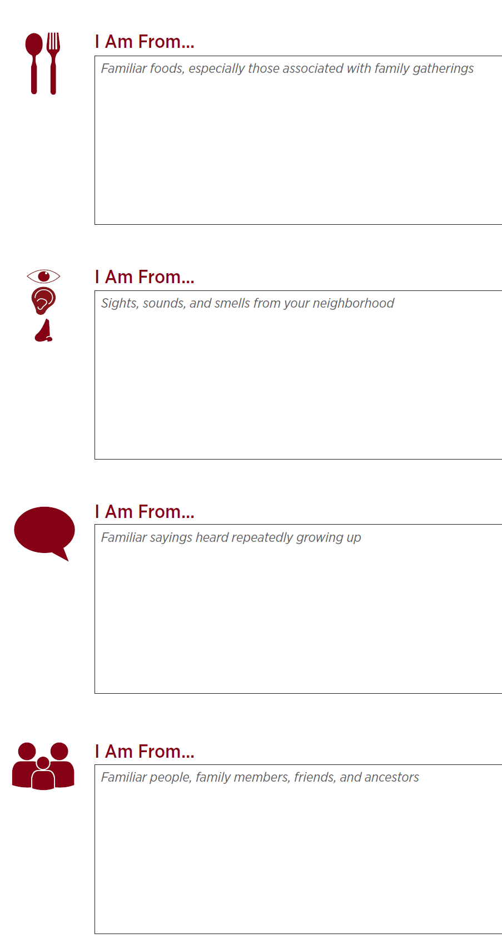
I Am From Poem
Activity:
I Am From POEM
Notes:
10:30-11:00

Slide 41
Key Ideas
We are all individuals with unique sets of experiences and yet...
There are many points of common ground

Slide 42
Natasha

Slide 43

On Your Own First...
First Impressions Activity
Notes:
11:00-11:30

Slide 44
Reflect on Your Own – Create a Word Doc
1. When’s the first time you can remember learning that some people are lesbian, gay, bisexual, or queer?
2. Where did most of the influence of your initial impressions/understanding of lesbian, gay, bisexual, and queer people come from? (e.g., family, friends, television, books, news, church)
3. When’s the first time you can remember learning that some people are transgender?
4. Where did most of the influence of your initial impressions/understanding of transgender people come from? (e.g., family, friends, television, books, news, church)
5. How have your impressions/understanding of LGBTQ (lesbian, gay, bisexual, transgender, and queer/questioning) people changed or evolved throughout your life?

Slide 45
Debrief- First Impressions Activity
What was it like to do that activity?
Does anyone have something that came up for them while they were answering the questions that they would like to share? Does anyone have an experience that was significantly different that they’d be interested in sharing?
What about question 5, would anyone share how their understanding of these issues have changed over time?

Slide 46
Key Ideas
Our perceptions, beliefs, and biases are shaped passively, intentionally and reside in our unconscious.
These can be reshaped.

Slide 47
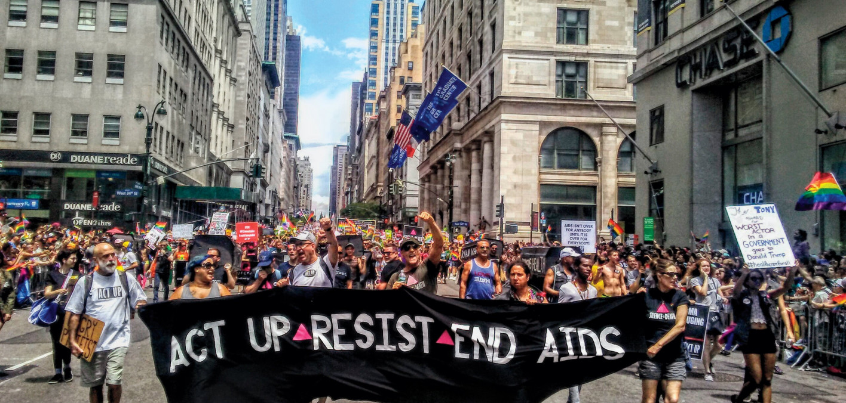
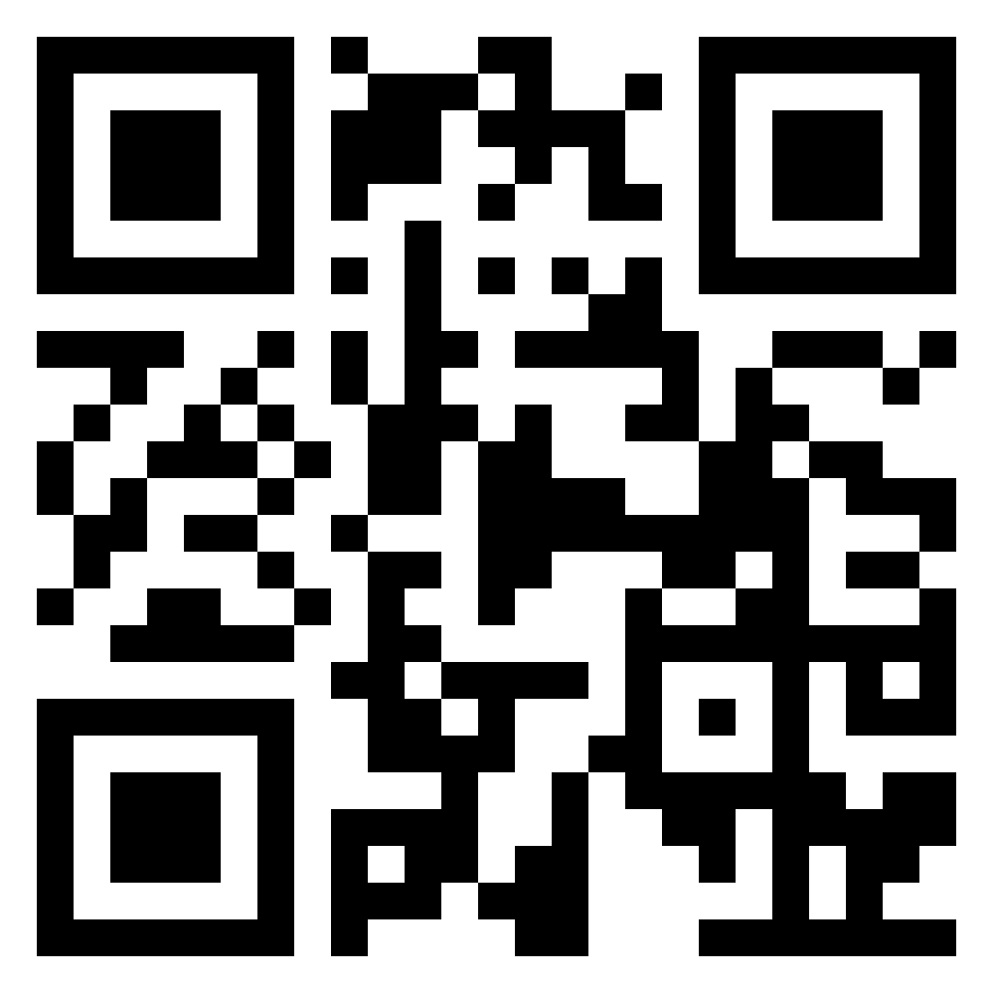
Lunch
1 hour for Lunch!
Over lunch, learn more about ACT UP!
Add the documentary “United In Anger” to your cue!
(available on Prime and Youtube!)

Slide 48
Bekah & Beth
Notes:
Put in day 2 of shared identity activity here

Slide 49
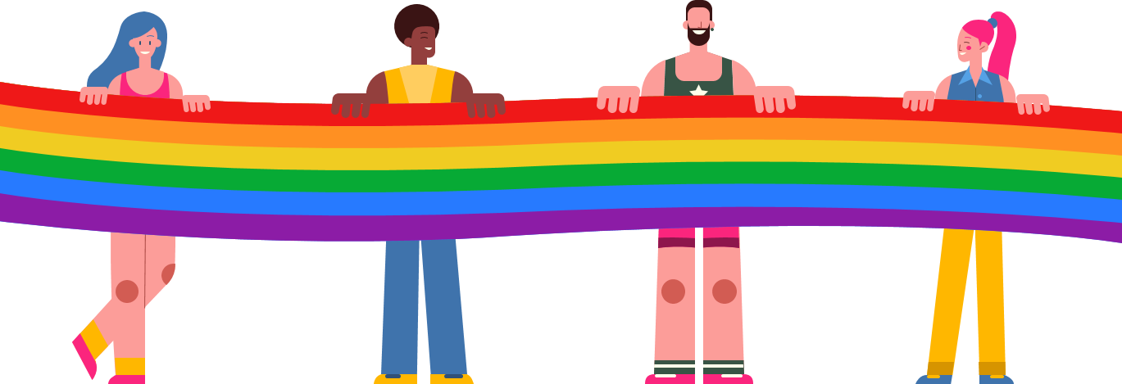
Timeline Activity
Look and read your Arc of LGBTQ+ Oppression and Justice Over Time card.
Notes:
Be very strategic about curating cards and rethink activity process

Slide 50
Timeline Debrief
What were new events that you learned about?
Why do you think this was new to you?
What other communities of people in the United States have had their history erased?
What impact do you think this has on people who hold these identities?
What impact do you think this has on people who don’t hold these identities?
Notes:
Rethink these debrief questions, make them connect to the goals of the training: coalition building, power analysis, etc
Create some new updated timeline cards to show correlation between history and Trump's 2 terms
ACLU has updated timeline
LGBTQ under fascism around the world

Slide 51
Key Ideas
Oppressed people’s stories are deliberately kept out of the telling of the story of what we know as the United States of America.

Slide 52
Key Ideas
What we now call the United States of America is still an uncomfortable, awkward, and sometimes unsafe place to be a member of the LGBTQ+ community.

Slide 53
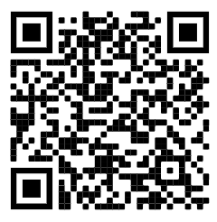
15 Minute Break!
Break time!
In the pre-attendance work, there were a lot of terms we never learned in sex ed! Check out this website of best practices for talking with kids about sex. (You might learn something new, too!)
https://sexpositivefamilies.com/10-best-sex-ed-resources-for-families/
Notes:
101 gender binary information

Slide 54
Grat & Dawn

Slide 55
Anthony
Notes:
Move shoe activity here

Slide 56
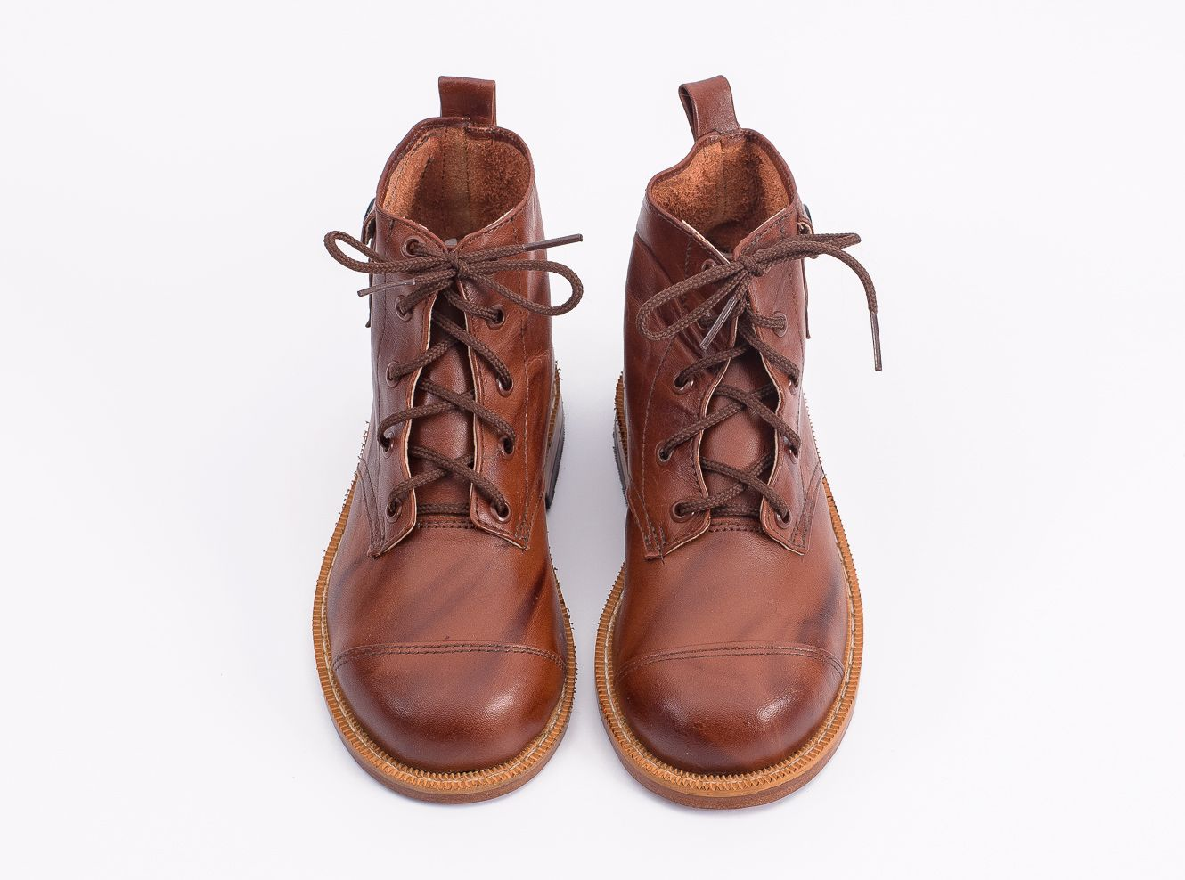
Movement and Change
56
Notes:
Move to transgender content area

Slide 57
Movement and Change
57
Notes:
1:00-
Presenter Note:
Ask each participant to switch their left and right shoes (left shoe on the right foot, right shoe on the left foot). Say it’s part of the training, and then move on. DO NOT mention their shoes further. (The objective is that participants will experience a familiar but uncomfortable sensation that their shoes are on the opposite foot. This will help them experience, in a non-threatening way, the uncomfortable, awkward feelings or fear that transgender or gender non-conforming people may experience while they are in public.)

Slide 58

Transgender Terminology
Transgender
Binary
Trans man
Trans woman
Non-Binary
Genderqueer
Genderfluid
Bigender
Demiboy
Demigirl
Agender
Neutrois
…and more!
58
Notes:
Language in the LGBTQ+ communities changes very quickly. Language in ethnic communities changes about every ten years while language in the LGBTQ+ communities changes about every two years.
Transgender/Trans: This is an umbrella term for people whose gender identity and/or expression is different from cultural expectations based on the sex they were assigned at birth. Being transgender does not imply any specific sexual orientation. Both binary and non-binary genders and gender expressions fall under the umbrella.
Often, we hear transphobic comments when the appearance of Black and Brown bodies are compared to white/Eurocentric views of femininity. For example, internet conspiracy theories have long criticized the natural muscular frame of tennis superstar Serena Williams, and even former First Lady Michelle Obama. Obviously, these comparisons are harmful, and are just one example of how hate, prejudice and fear show up.

Slide 59
Binary & Non-binary
Gender Identities
BINARY
NON-BINARY
MAN WOMAN
A person who does not identify exclusively as a woman or man. They may be both, somewhere in between, or outside the categories of woman and man.
59
Notes:
Binary and non-binary are two types of gender identities.
Gender is a social construct. What it means to be male and what it means to be female are concepts created by humans, and over time, those definitions and views became generally accepted by society at large. Most of us align with these long-standing definitions of male and female and feel comfortable saying so.
A non-binary person is someone who does not adhere to these gender expectations or stereotypes. The binary—being male or female—will feel very foreign to them.

Slide 60


Binary & Non-binary
NON-BINARY
“It’s not that I don’t fit into being a man or woman.
I don’t see a difference.”
60
Notes:
For a non-binary person, their gender identity does not fit within the binary of male and female.
While we might see two separate colors, yellow and blue, a non-binary person may only see green. Someone who is agender (or who has no gender identity) might only see gray.
This is why non-binary is a gender identity and not a gender expression. Non-binary people are not attached to gender.

Slide 61
Key Ideas
Gender identities are constructed as binary, however, people's identities are much more fluid.
People who identify as non-binary express their gender identity in many ways
People's gender identity and sexual orientation can shift at different times.

Slide 62
"But science says..."

Slide 63
Intersex
Intersex is a general term used for a variety of people born with a reproductive or sexual anatomy that doesn’t fit the typical definitions of female or male.
Intersex
XO
XXX
XXY
XYY
Male
XY
Female
XX
63
Notes:
Intersex conditions comprise more than 30 natural genetic variations. Historically, these variations have not been socially acceptable.
Proposed laws focused on the rights of transgender people regarding restroom usage, participation in sports, and even access to specific health care coverage, and have centered on genitals or proposed chromosome tests. These laws also affect the intersex community, who are often entirely ignored or left out of those conversations.
More people are intersex than we realize. In the past, this was often discovered in testing for the Olympic games, because some women were subjected to gender testing if they were thought to have a perceived physical advantage.
Scientists say there is no clear definition of male & female – that one’s sex includes more than just physical anatomy. It also includes hormone levels, chromosomes, and more.
The LGBTQ+ movement is now often referred to as LGBTQIA+ to include intersex people because of the similar issues facing each group around body autonomy and identity. (The “I” is for Intersex and the “A” for Asexual, which is a lack of sexual attraction.)

Slide 64
Trans identities
Trans woman
Trans girl
Someone assigned a male sex at birth who knows themselves to be a woman (or girl).
Trans man
Trans boy
Someone assigned a female sex at birth who knows themselves to be as a man (or boy).
Trans-feminine
Trans-masculine
Descriptive terms that transgender people use to explain where their gender expression lies.
64
Notes:
Please note that “transgender” or “trans” are adjectives. They are terms that describe. A person is transgender, not “a transgender.”
A trans woman (or trans girl) is assigned a male sex at birth but knows themself to be a woman. Alternately, a trans man is assigned a female sex at birth but knows themself to be a man.
Someone who is transmasculine, identifies on the masculine side of the gender spectrum, but may not identify as a man. The same is true for transfeminine people. They may identify as more female, but not see themselves as a woman.

Slide 65
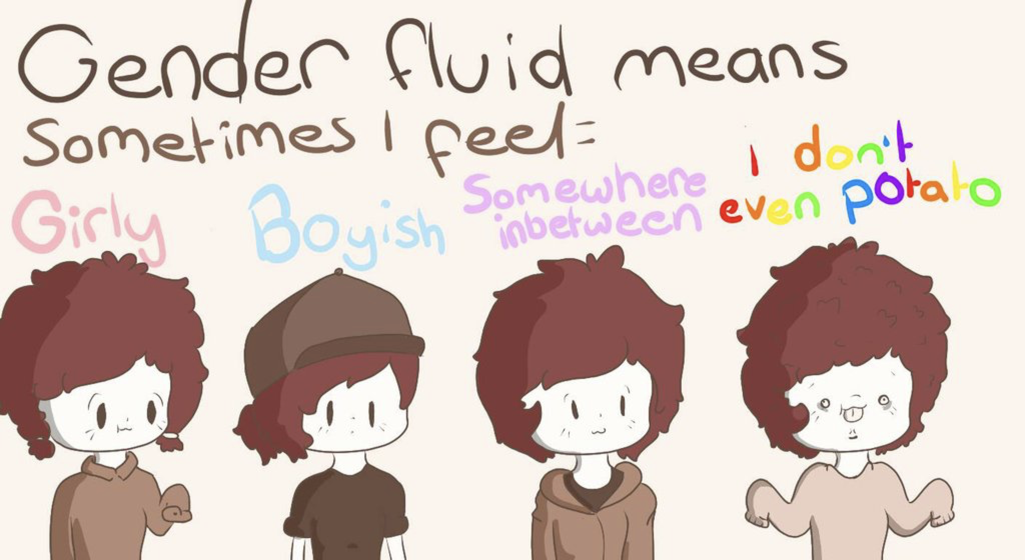
Other Gender Identities
Gender Fluid Genderqueer Agender
65
Notes:
Gender fluid is exactly what it sounds like. Gender flows in a more masculine way at times and in a more feminine way at others, with no internal struggle between the two. That fluidity could happen over many years, or it may fluctuate during a week.
Genderqueer people are fluid in their gender and often their sexuality. People who consider themselves genderqueer will often say that no rules apply. They like what they like, who they like, and feel the best living outside of any boxes.
Older generations often regard the word “queer” as a derogatory term. It causes LGBTQ+ people of a certain age to feel pain and relive some tough times when they hear it. But younger generations have reclaimed the word and are using “queer” for themselves. They don’t want to be narrowly defined as gay, lesbian, bi, or trans. Because there is respect for the spectrums of gender and sexuality, “queer” feels more all encompassing for who they are.
Agender is the last term on this slide, and it describes someone who does not have a gender. Agender people can feel no connection to the concept of gender at all. They may feel genderless or gender neutral.

Slide 66
TERMINOLOGY TO AVOID:
Best Practice: People first thinking—ask the individual what they would like to be called!
Don’t use… | Because… | Use…
a Transgendered | Trans is not a noun! Trans is an adjective that helps describe someone’s gender identity. | “Person who is Transgender” or the identity the person chooses for themselves!
Homosexual/ Homosexuality (unless someone chooses it for themselves) | This term comes across clinical and dog whistle-y | The identity someone chooses! LGBTQ+ as an umbrella.
“Sexual preference”, “homosexual lifestyle” | These words have been co-opted as dog whistles to suggest gayness is a choice. | “Sexual Orientation”
“Sex Change”, “Pre-op/Post-op” | These are antiquated and centralize surgeries and anatomy as a determining factor in gender identity. | “Transition” or “gender confirmation surgery”
“Biologically male/female” | It is rarely relevant what sex someone was assigned at birth and this suggests that trans women/men are not “real” women/men | IF NECESSARY… Assigned Female/Male at Birth (AFAB/AMAB)
"Hermaphrodite" | This is a super stigmatized word! | Intersex
Notes:
Added some from here- https://freedomforallamericans.org/messaging-terms-avoid/ (Sara)

Slide 67
Key Ideas
There is a long history of language being weaponized to harm members of the LGBTQ+ community.
We must be intentional with our language and how we show up.
Again, a lot of this language is constantly changing, it is our responsibility to adjust and learn.

Slide 68

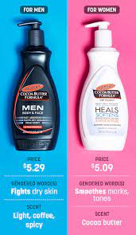
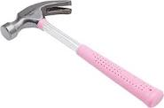


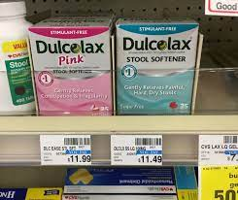
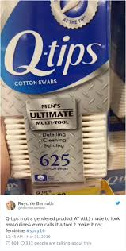
Turn and Share
Notes:
How do we see the gender binary popping up now

Slide 69
Gender binary on national scale
Gender binary within school house/district
Notes:
Add movement here- post-it notes onto chart paper

Slide 70
Gender binary in context of contract language and policy

Slide 71
Debrief
    What surprised you?
    What didn’t surprise you?
    How are you benefiting from our gender binary?
    How are you harmed by gender binary?
Notes:
Rewrite these questions, make it more agitational

Slide 72
Shoe Debrief
How did it feel to have your shoes on the wrong feet?
What connections can we make between the uncomfortable, awkward feelings of having your shoes on the wrong feet to what transgender or gender non-conforming people may experience while in public?
72
Notes:
1:00-
Presenter Note:
Ask each participant to switch their left and right shoes (left shoe on the right foot, right shoe on the left foot). Say it’s part of the training, and then move on. DO NOT mention their shoes further. (The objective is that participants will experience a familiar but uncomfortable sensation that their shoes are on the opposite foot. This will help them experience, in a non-threatening way, the uncomfortable, awkward feelings or fear that transgender or gender non-conforming people may experience while they are in public.)

Slide 73
Key Ideas
We have a rigidly enforced gender binary that we experience in our day to day lives.
Everyone deviates from gendered expectations in some ways.
Folks under the transgender umbrella face oppression from these rigid social expectations.

Slide 74
Pete

Slide 75

The Gender Unicorn pg. 5 & 6
Notes:
The Gender Unicorn is a popular way to help explain gender that was developed by Trans Student Educational Resources. You may be familiar with the “Genderbread Person,” but we choose not to use it. It was created by a Black trans woman, but someone else popularized it, and continues to get credit, pay and notoriety for it.
As you see, the Gender Unicorn highlights gender identity, expression, sex assigned at birth, and physical and emotional attraction.
Children learn that there are two groups—boys and girls—and that they fit into one or the other based on how their bodies are made. They are then socialized to accept specific gender norms and stereotypes, which are ways of behaving, based on this gender assigned at birth.
There’s increasing understanding that gender is more than a binary division. The spectrum of gender identity is becoming more widely accepted and gender expression is more expansive.
However, there are challenges to looking at gender beyond male and female. Across states, many laws and policies are being passed that affirm or harm individuals outside of the gender binary.

Slide 76
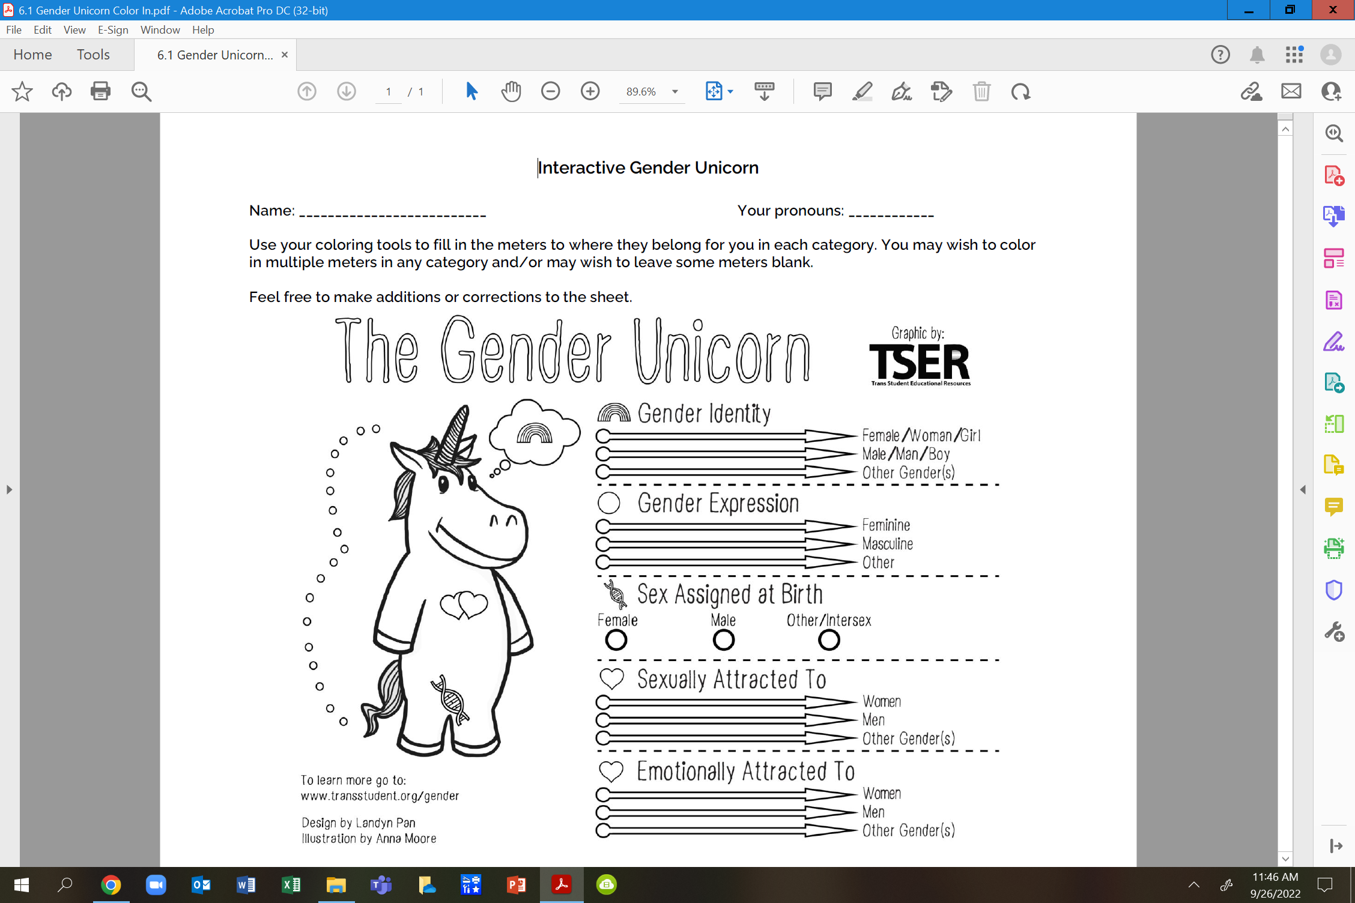
Your Turn... pg. 6

Slide 77
Debrief
What has been made clearer to you after using this tool?
Knowing we will be continuing to discuss gender, what is still unclear that you will be looking forward to learning more about?

Slide 78
Key Ideas
Our society reinforces the gender and sex binary – this is a construct
These are spectrums
These are separate categories and the way YOU present/identify in one is not an automatic indication of how you present/identify in another

Slide 79
Beth

Slide 80
Pronoun Practice Exercise
Partner up
Share a story of a friend
Replace binary pronouns with they/them
Listener should correct every pronoun error
(Pronoun Guide is on pgs. 2-3)
Notes:
10:30-10:45 Ben

Slide 81
Key Ideas
Using someone's correct pronouns is an important way to show respect.
It is on us to get good at this.
Using someone's name or neutral pronouns is the most respectful approach if you don't know.
Notes:
Put this as a a place holder if needed
Also have as pre-work

Slide 82
Natasha

Slide 83
ACTIVITY | GENDER-NEUTRAL WORLD
Topics related to sexual orientation and gender come up in society more often than we may realize.
Stereotypes about gender and sexual orientation often inform policies, practices, and traditions.
Reflect on the customs and norms within your learning community and answer the following questions in table groups.
Notes:
Modify last bullet to reflect contract activity

Slide 84
Contract and Policy Language (pg. 11-13)
Count off by 5
Once grouped, review your language (15 min)
  Identify who is left out by the language presented
  Rewrite the language to be more inclusive
  Identify what barriers may exist to making the changes.
  If you finish—look at another issue of your choice
Select a person to provide a 3 min report
Notes:
Beef up these examples
Bring in VT transgender athletes policy

Slide 85
Key Ideas
Using language that is inclusive in our contracts and policies is one small way of moving towards LGBTQ+ equity
When we know better we do better
Barriers may include our members—we need to be willing to introduce the conversation

Slide 86
Ellen

Slide 87

Ending It Right
How does YOUR learning from today inform your work with members?
How might we inadvertently cause well-intentioned harm?
How can we prevent that?

Slide 88
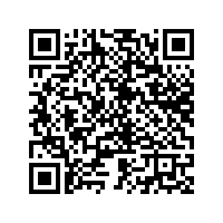
Ending It Right
Tomorrow- panel discussion

Slide 89

Choice Networking Time

Slide 90
Entry Activity-Mapping
Place a dot on the map showing where you are from
Notes:
Grat - 9:30-10:00

Slide 91
Language Around Suicide
Language matters when discussing issues of suicide. Language reflects our attitudes and influences our attitudes and the attitudes of others. Words have power; words matter. The language we choose is an indicator of social injustice and has the power to shape our ideas and feelings in very insidious ways.
Language Matters: Why We Don't Say "Committed Suicide"
IRMI: International Risk Management Institute
https://www.irmi.com/articles/expert-commentary/language-matters-why-we-dont-say-committed-suicide

Slide 92
Sex vs. Gender
SEX
Biological attributes that include physical features, chromosomes, internal and external reproductive organs, hormones, and anatomy.
GENDER
A person’s innermost, deeply held reality of self as male, female, both, in between or neither.
VS.
92
Notes:
Sex and Gender do NOT mean the same thing.
Our sex is determined by biological attributes such as chromosomes, hormones, reproductive organs, and other parts of our anatomy.
Gender is a person’s innermost, deeply held reality of self. It’s almost like being right-handed or left-handed. We don’t know why each person favors one hand over the other, but we all know that one just feels more correct for us. And, some people feel comfortable using either hand.
A person can have an inner reality of being male, female, both, neither, or somewhere in between.

