Slide 1
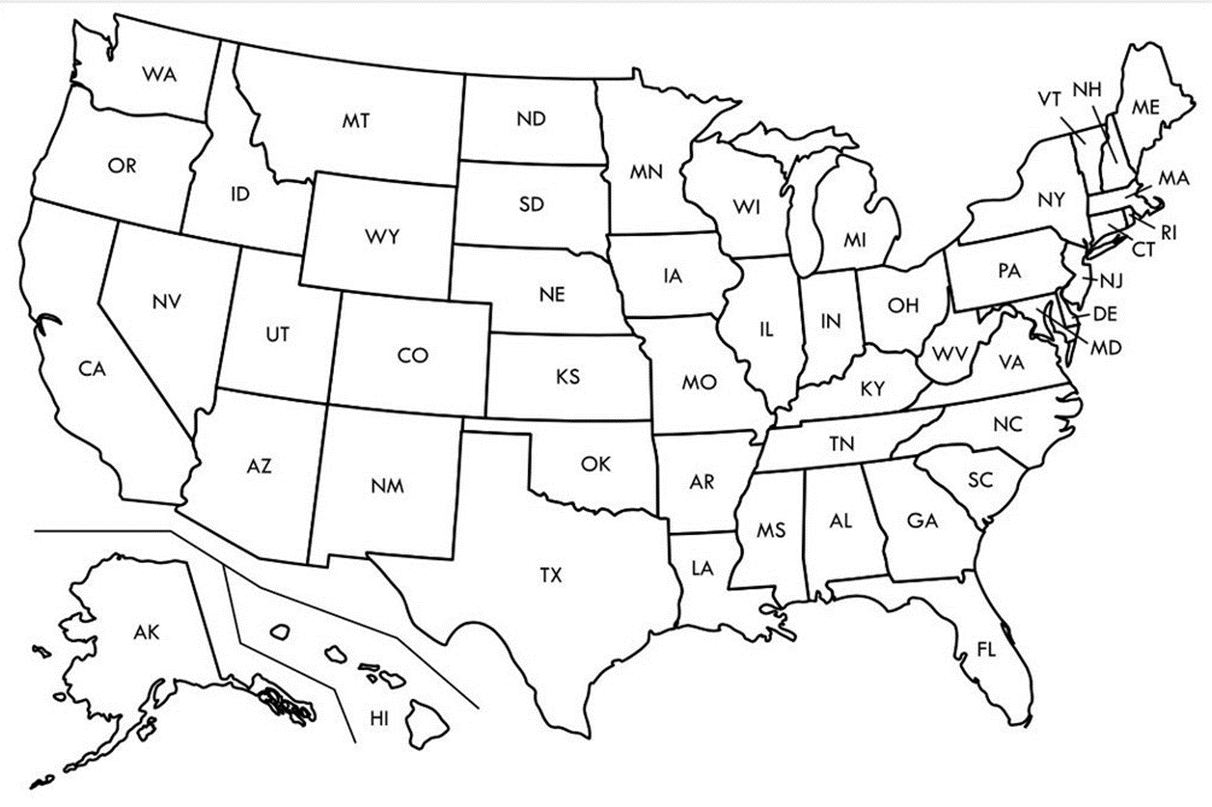

Entry Activity-Mapping
Place a dot on the map showing where you are from
Notes:
Grat - 9:30-10:00

Slide 2
Advancing LGBTQ+ Justice

Slide 3
Land Acknowledgement
We begin by acknowledging that we meet on the traditional lands served by the Lenape people. We honor America’s First People and all elders, past, present and emerging and we are called on to learn and share what we learn about the tribal history, culture, and contributions that have been suppressed in telling the story of what we now call the United States America. We invite you to think about the spaces you are inhabiting and the Indigenous people who came before them and were stewards of the land.

Slide 4

Our Time Together
Days 1 & 2: 8:30 am- 5:00 pm
◦15 Minute AM + PM Break
◦Lunch 12:00 – 1:00pm
◦4:30 - 5:00 pm “Adult Choice Networking”
Day 3: 8:30 am -2:00 pm
◦15 Minute AM + PM Break
◦Lunch 1:00 pm
◦1:00 - 2:00 pm “Adult Choice Networking”

Slide 5

Today’s Agenda
8:30 – 10:15 -- Getting Started and Building Our Community
10:15-10:30 -- Break
10:30 -12:00 -- Who am I in the work
12:00 -1:00 -- Lunch
1:00 – 2:30 -- LGBTQ History & Terminology
2:30 – 2:45 -- Break
2:45 - 4:15 -- Gender Identity
4:15 – 4:30 -- Wrap Up and Reflect
4:30 – 5:00 -- Adult Choice Networking
Beyond the Bell Walking Tour

Slide 6
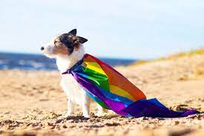
Logistics to Remember
Parking lot
Bathroom
Materials
Food
Room Temperature
Karla as Resource
Questions
Room Cleaning

Slide 7
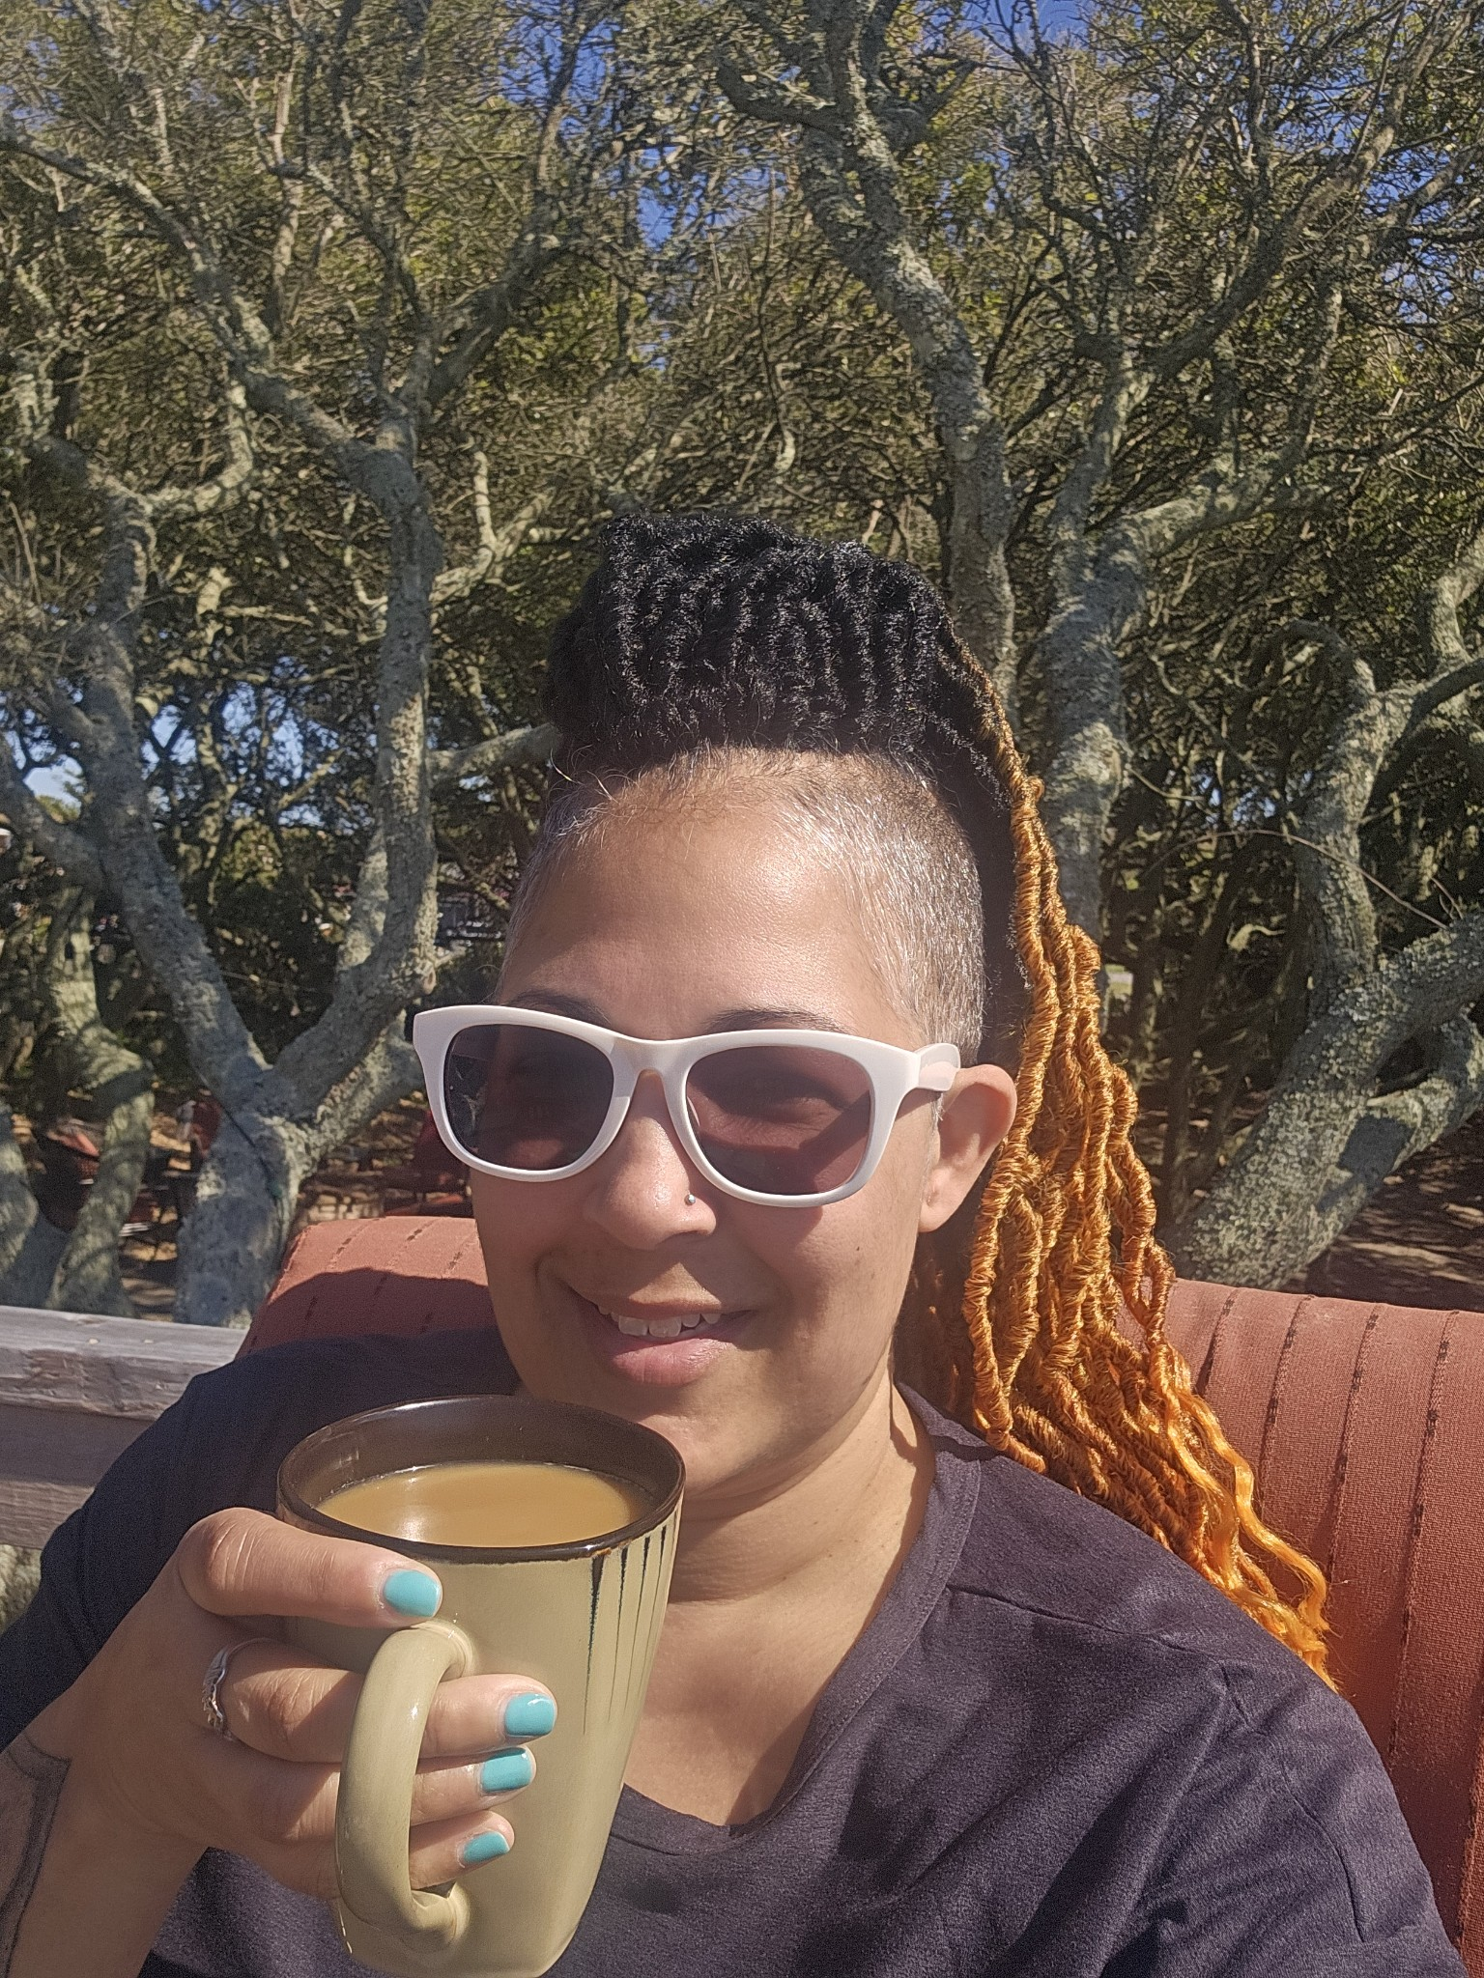
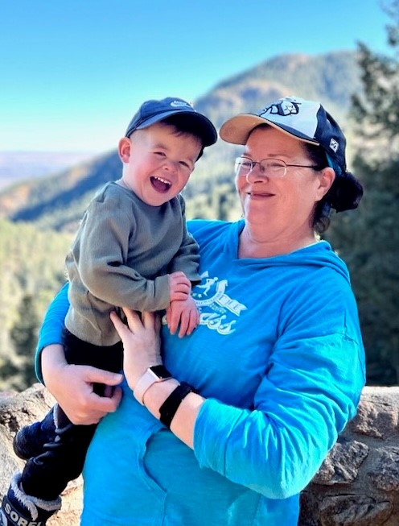
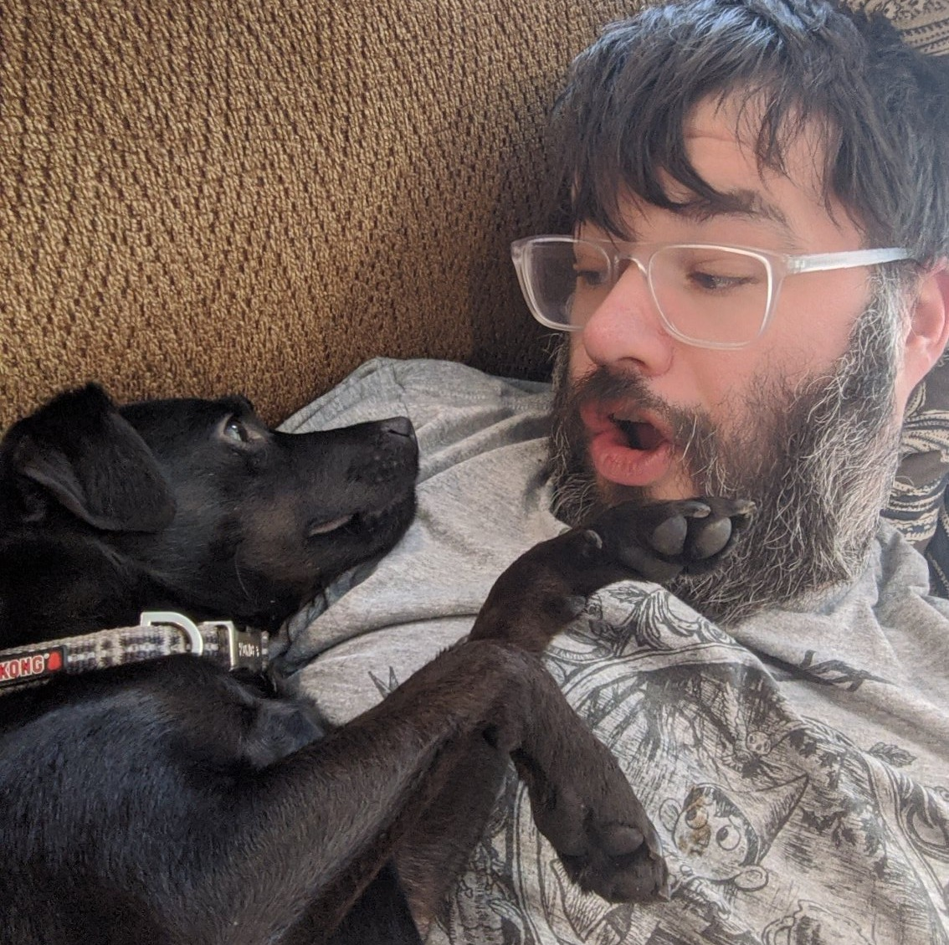
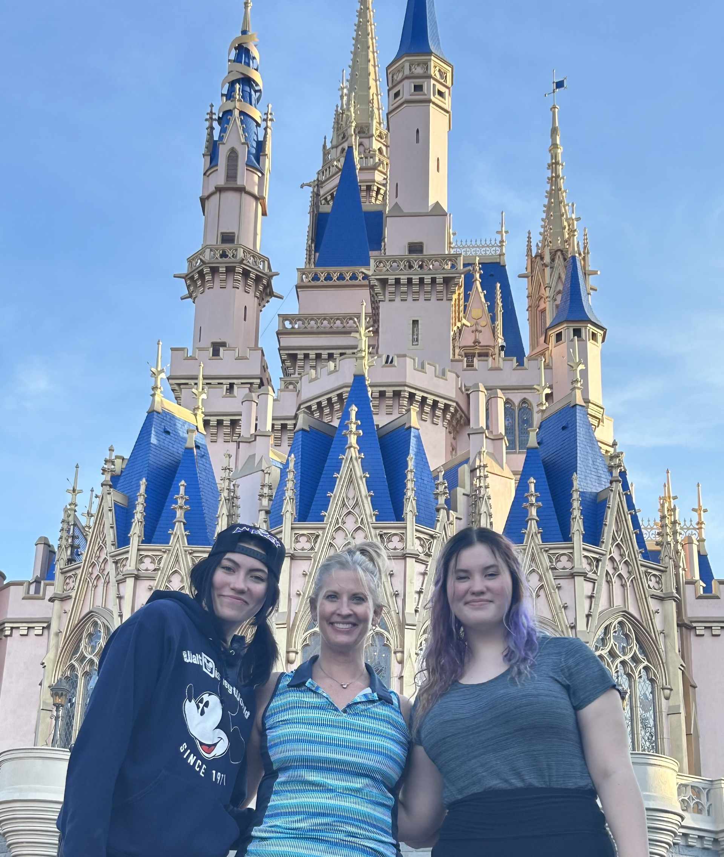
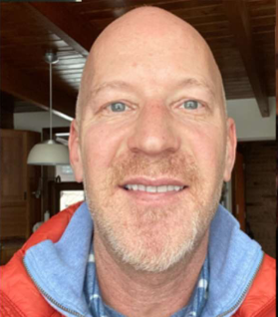
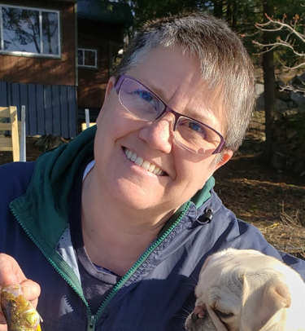
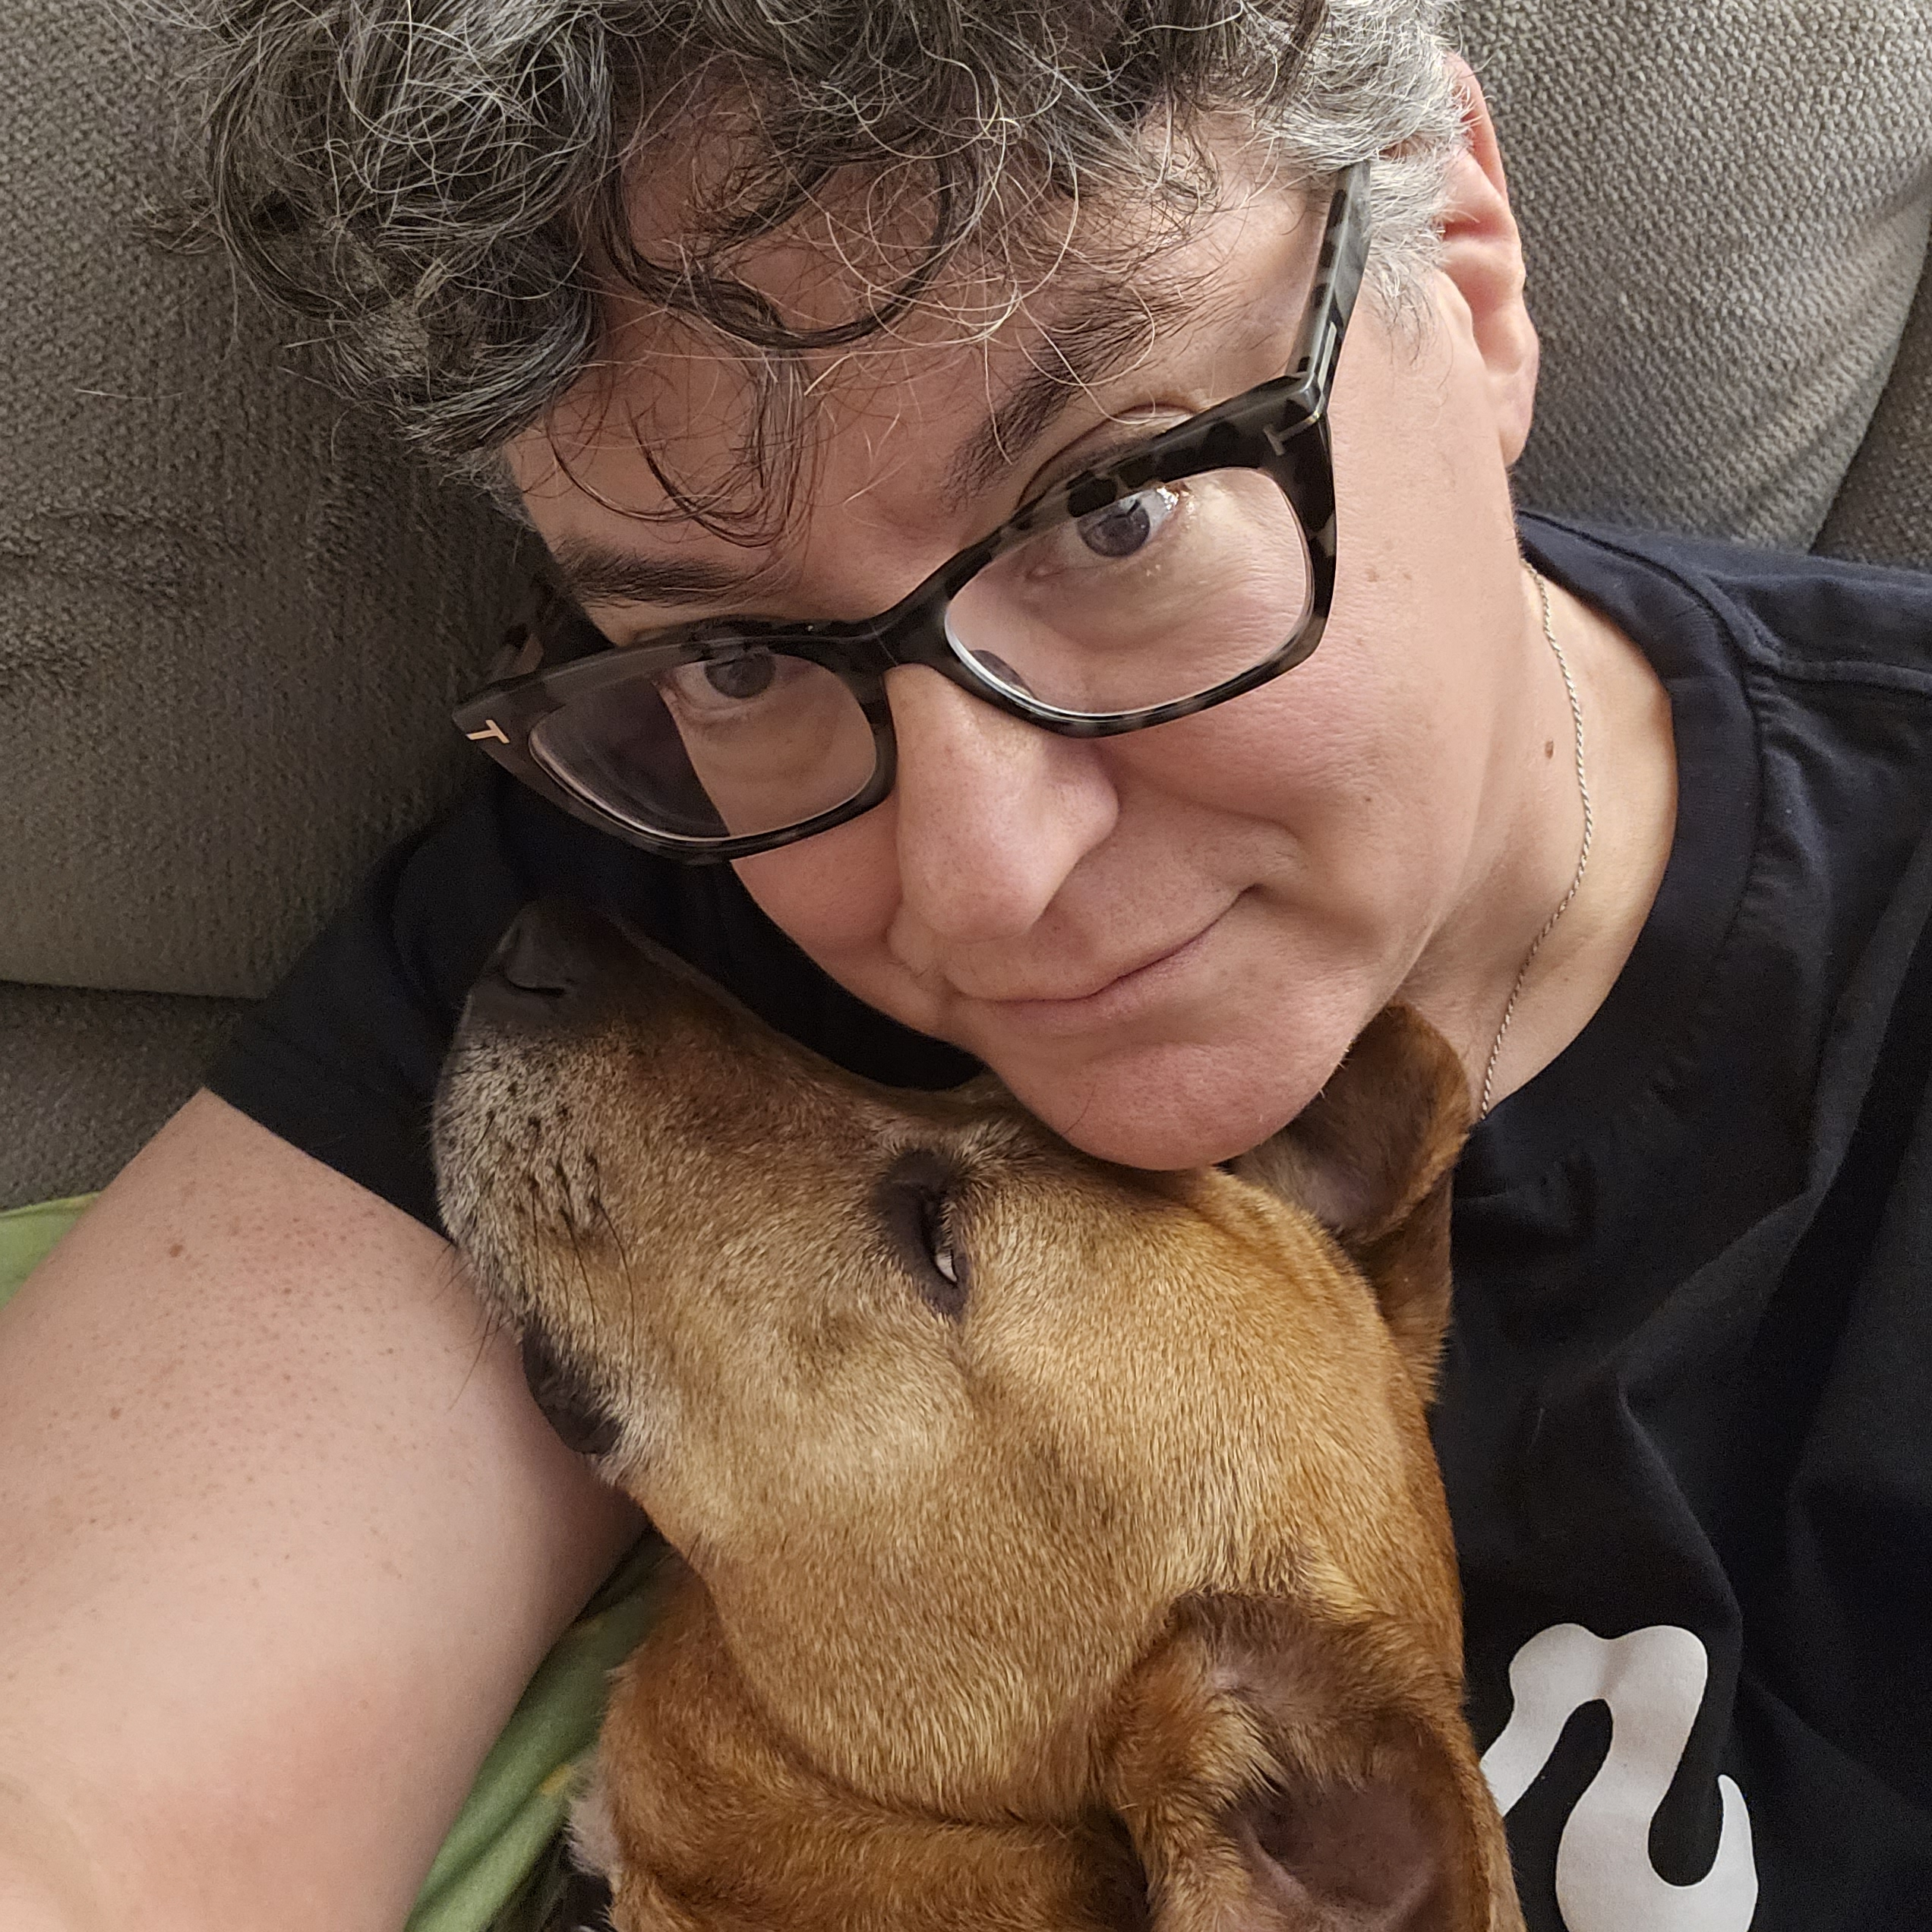
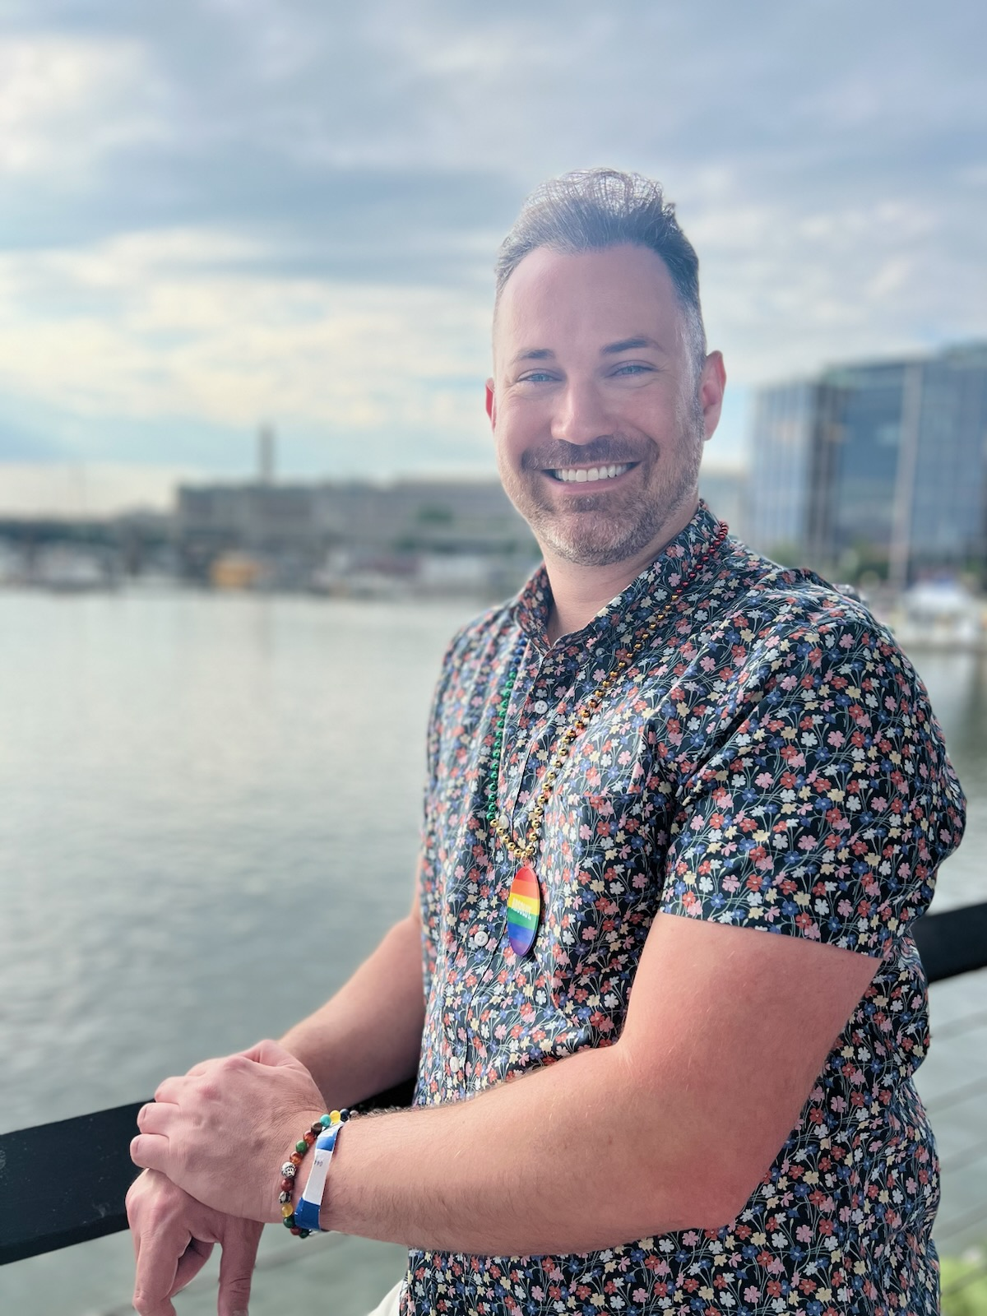
Introductions- Training Team
Natasha Eckart
She/They
Vermont
Dawn Moretz
She/Her
Montgomery County, MD
Pete Clancy
He/Him
Iowa
Beth Anderson
She/Hers
Minnesota
Grat Dalton
He/Him
Michigan
Ellen Holmes
She/Hers
NEA
Bekah Saxon
She/Hers
Connecticut
Anthony Brisson
He/Him
Washington, D.C.

Slide 8

Community Agreements pg 2 (Pre-Attendance)
Awareness and Self-Knowledge
Listen for Understanding
Be Gracious
Stay Engaged
Be Open and Suspend Judgment
Say “I”- tell your truth
Seek Discomfort
Reach for Empathy
Expect non- Resolution and non-Closure

Slide 9
Disclaimer
Reminder about sensitive topics
The content we are going to explore may bring up strong feelings. Throughout our time together, we will explore examples of racism, ableism, heterosexism, and sexism.
These oppressive ideas and assumptions are offensive, problematic and false. Yet, over time, they have become as pervasive and invisible as the air we breathe. We need to examine them so that we can understand and ultimately challenge them. Modified ADL

Slide 10

Circling Up -Who are you and how are you feeling?
30 Minute Circle
Name
Pronouns
Your title
How are you feeling
in this moment?

Slide 11

Anthony

Slide 12
Why we are here!
41% of LGBTQ young people seriously considered attempting suicide in the past year. [1]
A majority of LGBTQ+ people say that they or an LGBTQ+ friend or family member have been threatened or non-sexually harassed (57 percent), been sexually harassed (51 percent), or experienced violence (51 percent) because of their sexuality or gender identity. [2]
NEA RA Support and Part of NEA Mission and Vision (in "Additional Resources" on POPS
[1] The Trevor Project, "2023 U.S. National Survey on the Mental Health of LGBTQ Young People
[2] National Public Radio, the Robert Wood Johnson Foundation, & The Harvard T.H. Chan School of Public Health. (2017, November). Discrimination in America: Experiences and views of LGBTQ Americans. Retrieved June 24, 2020 from https://www.rwjf.org/en/library/research/2017/10/discrimination-in-america--experiences-and-views.html
Notes:
Why are we here – the system of oppression’s outcomes on the LGBTQ+ community are something that justice seeking people can not tolerate.

Slide 13
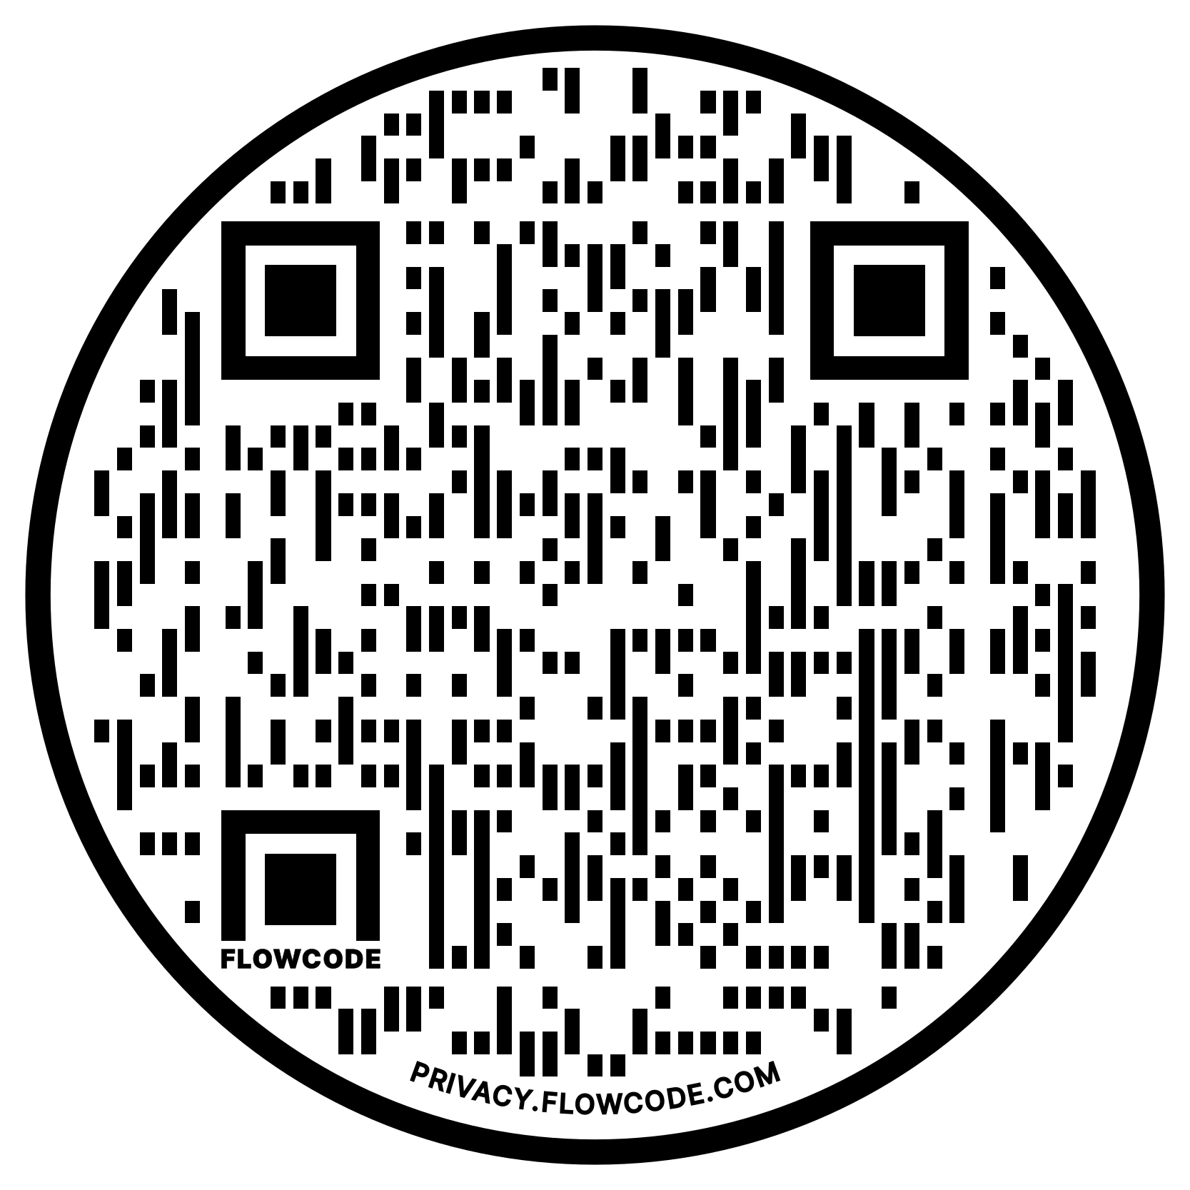
NEA Vision, Actions, Resources
Safe, Just, and Equitable Schools
Resolution adopted by the 2022 NEA Representative Assembly
2021 NBI 32
Training on Transgender Advocacy Issues for Affiliate Staff
NEA Online Toolkit – LGBTQ+ Caucus Resources
Notes:
The National Education Association's (NEA) Policy Statement on Safe, Just, and Equitable Schools aims to create safe and welcoming learning environments for all students
Campaign lab – teams can receive coaching

Slide 14
The Words of Our Members
“Know that even if you do not personally know of any LGBTQ+ staff person in your district, they are there. Be an ally even if you do not know them. Speak up when you hear, see, or perceive bias and/or discrimination. Advocate for inclusive policies for both students and staff.”
14
Notes:
Throughout today’s training, we will be sharing the words of NEA members who are a part of the LGBTQ+ community. We shared an anonymous survey and think it’s important to hear the words of our colleagues—whether they are out or not—about their experiences as LGBTQ+ educators.

Slide 15
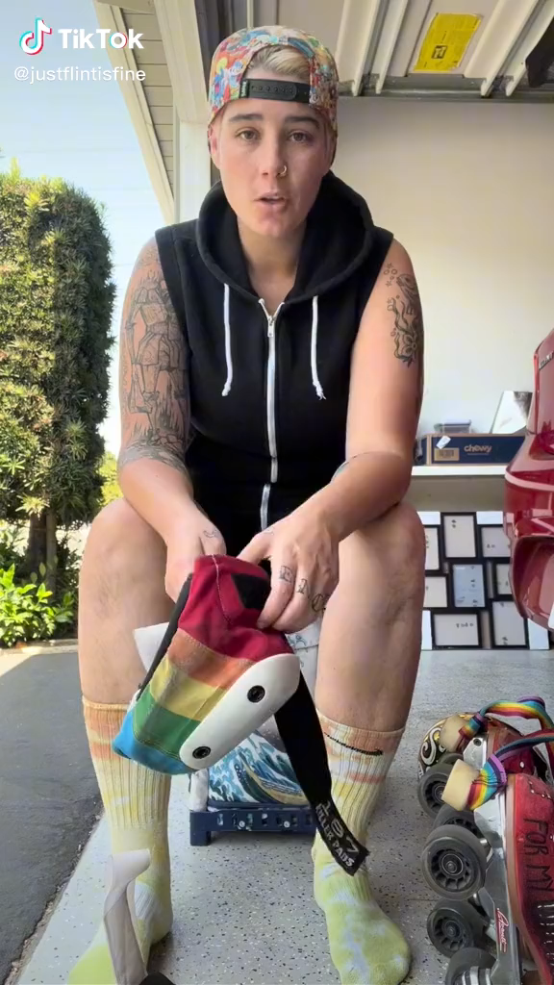
Notes:
As staff supporting members we need to check ourselves before we wreck ourselves, we want to provide guidance and not be patronizing.
When a member says this is the thing I want to say, want to do, our job is not to cut them off – but advise them of what the consequences are. We are not here to protect them from all harm – our role is to advise them of the choices they make. We want them to know they are valuable and we support them in the choices they make. This is actually how leaders and power are realized.

Slide 16
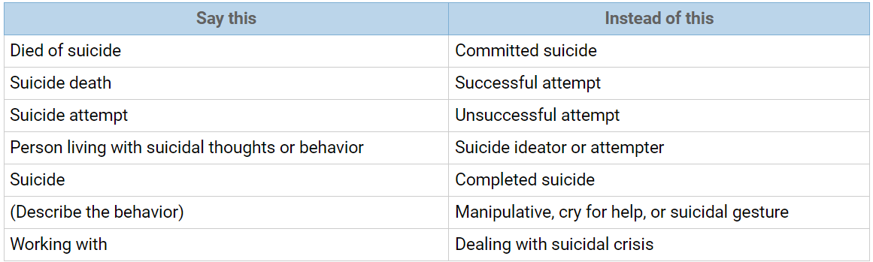
Language Around Suicide
Language matters when discussing issues of suicide. Language reflects our attitudes and influences our attitudes and the attitudes of others. Words have power; words matter. The language we choose is an indicator of social injustice and has the power to shape our ideas and feelings in very insidious ways.
Language Matters: Why We Don't Say "Committed Suicide"
IRMI: International Risk Management Institute
https://www.irmi.com/articles/expert-commentary/language-matters-why-we-dont-say-committed-suicide

Slide 17
Grat

Slide 18
Ice Breaker
Find a partner that is not from your state
Be prepared to share a fun fact about your state or city with the group

Slide 19
Dawn

Slide 20
Core Values
Core values are the fundamental beliefs of a person. These guiding principles dictate behavior and can help people understand the difference between right and wrong – These can often be expressed using one or two words. We are taking a moment to consider our core values because they can provide a basis for solidarity in the midst of struggles.

Slide 21
Sharing Values for Solidarity
Core Values
1. Name
2. Core Value – One or two words that describes a fundamental belief held by you
**15 Seconds Each**
Core values are the fundamental beliefs of a person. These guiding principles dictate behavior and can help people understand the difference between right and wrong – These are expressed using one or two words.

Slide 22

Key Ideas
Solidarity
sol / i / dar / i / ty
Noun
  1. Unity or agreement of feeling or action especially among individuals with a common interest, mutual support; mutual support within a group.
Shared Core Values are critical for building solidarity in our work.

Slide 23

15 Minute Break!
During the break, follow these LGBTQ+ Member Educator Influencers on social media to continue our learning each time we scroll!
@justflintisfine @sabocat
@thegayschoolcounselor @keithkmusic

Slide 24
Beth

Slide 25
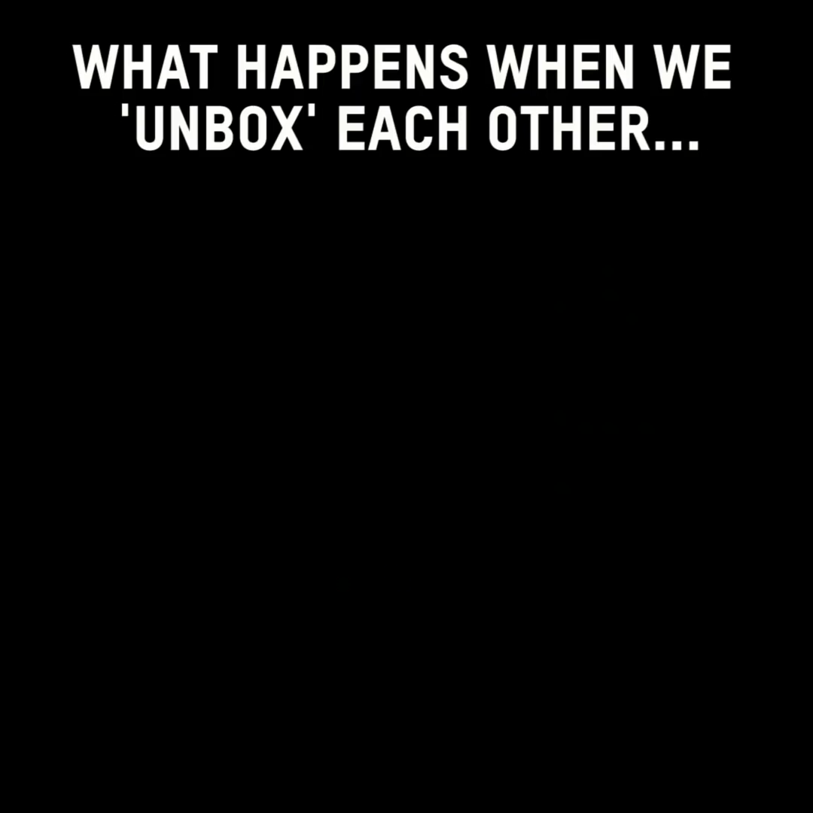

Slide 26

Shared Identity
Gather around an identity of your choosing
Answer the following discussion questions:
Why did you select this piece of your identity?
What are some challenges you face with this identity?
Notes:
10:00-10:15
musician, traveler, foodie, planner, nature lover, pet owner
Beliefs are different than identity

Slide 27

Shared Identity
Debrief:
What was something you learned about someone else?
What was easy/hard about this activity?
How safe did you feel sharing in this activity?
What is similar about each of these identities?

Slide 28
Key Ideas
Discreet identities bind us
We all have pre-conceptions that might not match an actual identity of another
We don't get to assign a person's identity for them

Slide 29
Pete

Slide 30
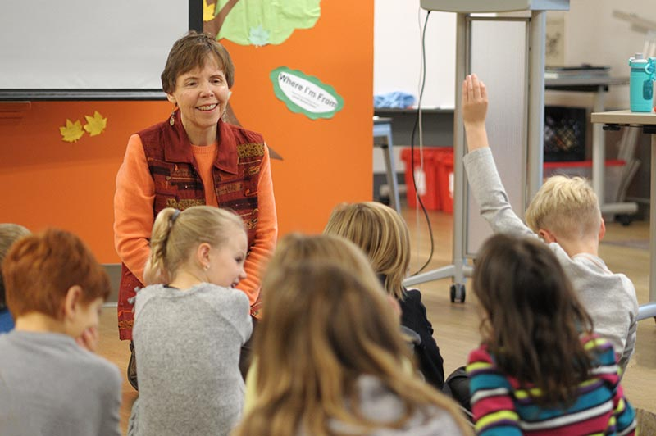
Where I am From
George Ella Lyons Poet Laureate, Author, Teacher from Kentucky.
Widely used as a way to get people to think about where they are from as more than a place.
It is in the sharing that we see how we are remarkably different and yet we have overlapping similarities.

Slide 31

Kenneth is from…

Slide 32
I am From by George Ella Lyons
I am from clothespins,
from Clorox and carbon-tetrachloride
I am from the dirt under the back porch
(Black, glistening it tasted like beets)
I am from the forsythia bush,
the Dutch elm whose long gone limbs I remember as if they were my own.
I’m from the fudge and eyeglasses,
from Imogene and Alafair.
I’m from the know-it-alls and the pass-it-ons, from perk up and pipe down.
I’m from He restoreth my soul with a cottonball lamb and ten verses I can say myself.
I’m from Artemus and Billie’s Branch,
fried corn and strong coffee.
from the finger my grandfather lost
to the auger
the eye my father shut to keep his sight.
Under my bed was a dress box
spilling old pictures, a sift of lost faces
to drift beneath my dreams.
I am from those moments–
snapped before I budded–
leaf-fall from the family tree
----George Ella Lyons

Slide 33
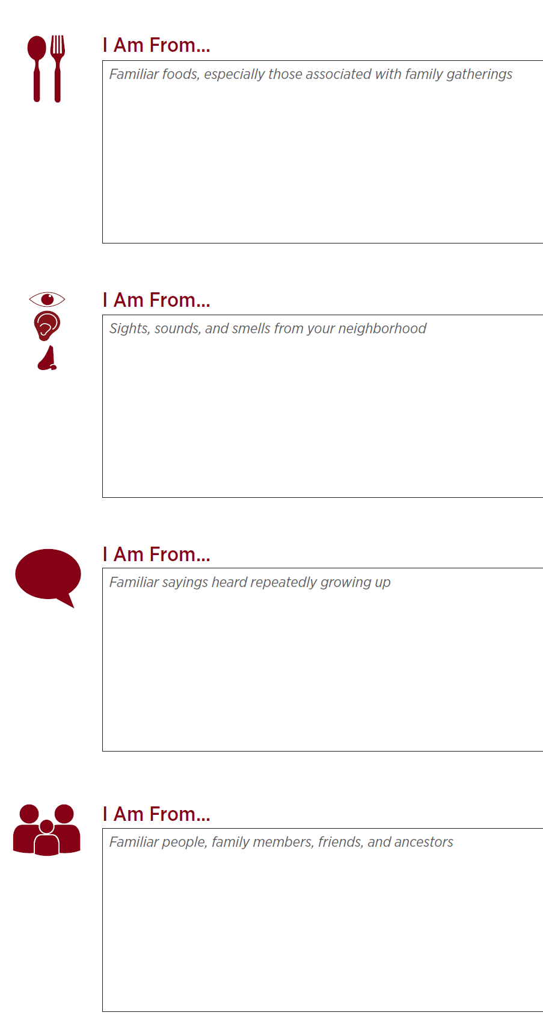
I Am From Poem
Activity:
I Am From POEM
Notes:
10:30-11:00

Slide 34
Key Ideas
We are all individuals with unique sets of experiences and yet...
There are many points of common ground

Slide 35
Natasha

Slide 36

On Your Own First...
First Impressions Activity
Notes:
11:00-11:30

Slide 37
Reflect on Your Own – Create a Word Doc
1. When’s the first time you can remember learning that some people are lesbian, gay, bisexual, or queer?
2. Where did most of the influence of your initial impressions/understanding of lesbian, gay, bisexual, and queer people come from? (e.g., family, friends, television, books, news, church)
3. When’s the first time you can remember learning that some people are transgender?
4. Where did most of the influence of your initial impressions/understanding of transgender people come from? (e.g., family, friends, television, books, news, church)
5. How have your impressions/understanding of LGBTQ (lesbian, gay, bisexual, transgender, and queer/questioning) people changed or evolved throughout your life?

Slide 38
Debrief- First Impressions Activity
What was it like to do that activity?
Does anyone have something that came up for them while they were answering the questions that they would like to share? Does anyone have an experience that was significantly different that they’d be interested in sharing?
What about question 5, would anyone share how their understanding of these issues have changed over time?

Slide 39
Key Ideas
Our perceptions, beliefs, and biases are shaped passively, intentionally and reside in our unconscious.
These can be reshaped.

Slide 40
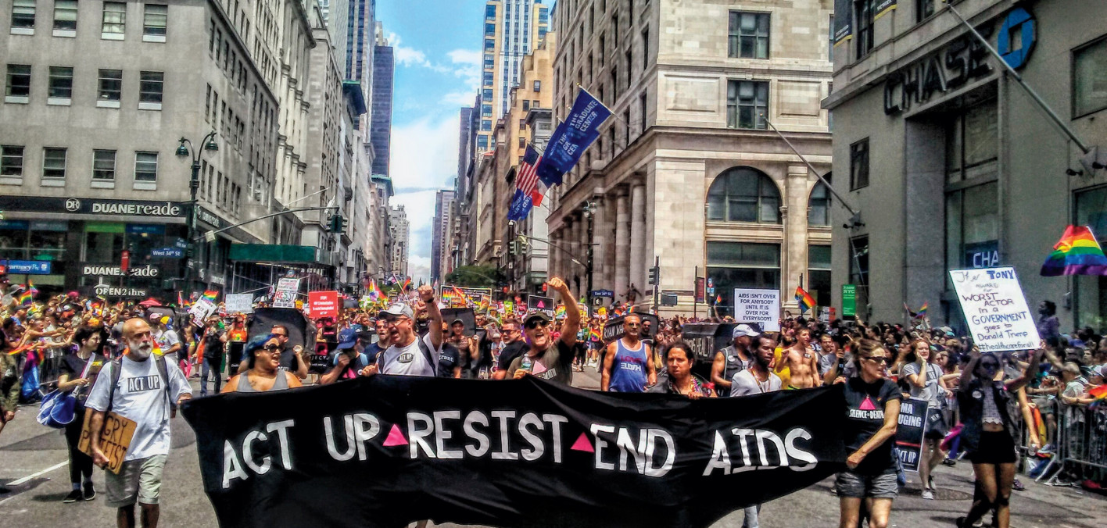
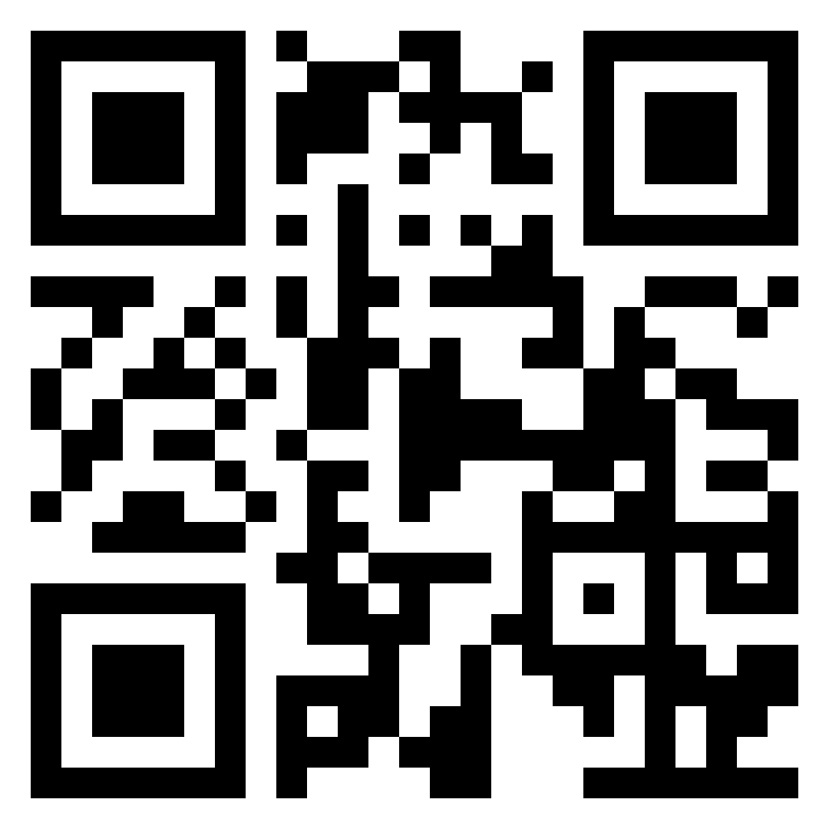
Lunch
1 hour for Lunch!
Over lunch, learn more about ACT UP!
Add the documentary “United In Anger” to your cue!
(available on Prime and Youtube!)

Slide 41
Bekah & Beth

Slide 42
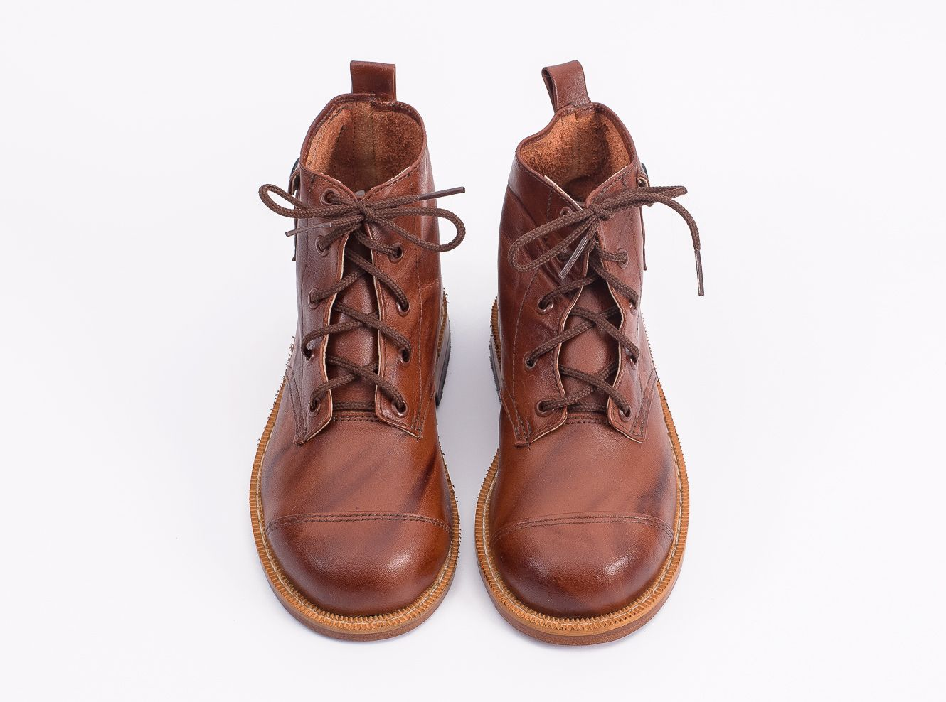
Movement and Change
42
Notes:
1:00-
Presenter Note:
Ask each participant to switch their left and right shoes (left shoe on the right foot, right shoe on the left foot). Say it’s part of the training, and then move on. DO NOT mention their shoes further. (The objective is that participants will experience a familiar but uncomfortable sensation that their shoes are on the opposite foot. This will help them experience, in a non-threatening way, the uncomfortable, awkward feelings or fear that transgender or gender non-conforming people may experience while they are in public.)

Slide 43
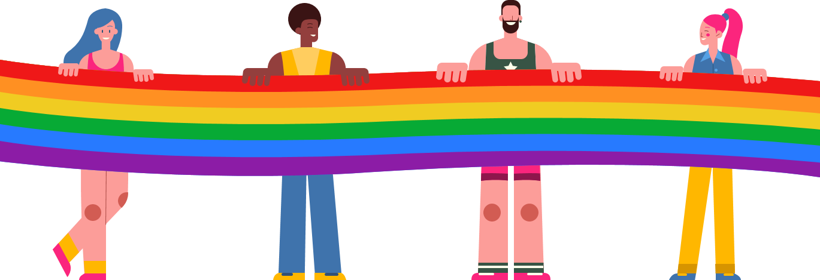
Timeline Activity
Look and read your Arc of LGBTQ+ Oppression and Justice Over Time card.
Notes:
11:30-12:00

Slide 44
Movement and Change
44
Notes:
1:00-
Presenter Note:
Ask each participant to switch their left and right shoes (left shoe on the right foot, right shoe on the left foot). Say it’s part of the training, and then move on. DO NOT mention their shoes further. (The objective is that participants will experience a familiar but uncomfortable sensation that their shoes are on the opposite foot. This will help them experience, in a non-threatening way, the uncomfortable, awkward feelings or fear that transgender or gender non-conforming people may experience while they are in public.)

Slide 45
Timeline Debrief
What were new events that you learned about?
Why do you think this was new to you?
What other communities of people in the United States have had their history erased?
What impact do you think this has on people who hold these identities?
What impact do you think this has on people who don’t hold these identities?
Notes:
1:00-1:30

Slide 46
Key Ideas
Oppressed people’s stories are deliberately kept out of the telling of the story of what we know as the United States of America.

Slide 47
Shoe Debrief
How did it feel to have your shoes on the wrong feet?
What connections can we make between the uncomfortable, awkward feelings of having your shoes on the wrong feet to what transgender or gender non-conforming people may experience while in public?
47
Notes:
1:00-
Presenter Note:
Ask each participant to switch their left and right shoes (left shoe on the right foot, right shoe on the left foot). Say it’s part of the training, and then move on. DO NOT mention their shoes further. (The objective is that participants will experience a familiar but uncomfortable sensation that their shoes are on the opposite foot. This will help them experience, in a non-threatening way, the uncomfortable, awkward feelings or fear that transgender or gender non-conforming people may experience while they are in public.)

Slide 48
Key Ideas
What we now call the United States of America is still an uncomfortable, awkward, and sometimes unsafe place to be a member of the LGBTQ+ community.

Slide 49
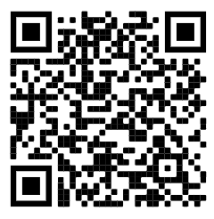
15 Minute Break!
Break time!
In the pre-attendance work, there were a lot of terms we never learned in sex ed! Check out this website of best practices for talking with kids about sex. (You might learn something new, too!)
https://sexpositivefamilies.com/10-best-sex-ed-resources-for-families/

Slide 50
Grat & Dawn

Slide 51
LGBTQ+ Terminology
Turn and Talk (5 minutes):
What terms did you mark as unclear or confusing?
What terms were new to you?
Were there any definitions that differed from your prior understanding?

Slide 52
LGBTQ+ Terminology
Report out-Large Group :
What terms still have unresolved questions?

Slide 53
Language Changes
Terminology around race and ethnicity changes every 10 years.
Terminology around gender, identity, and sexual orientation changes every 2 years.
Notes:
QUILT BAG

Slide 54
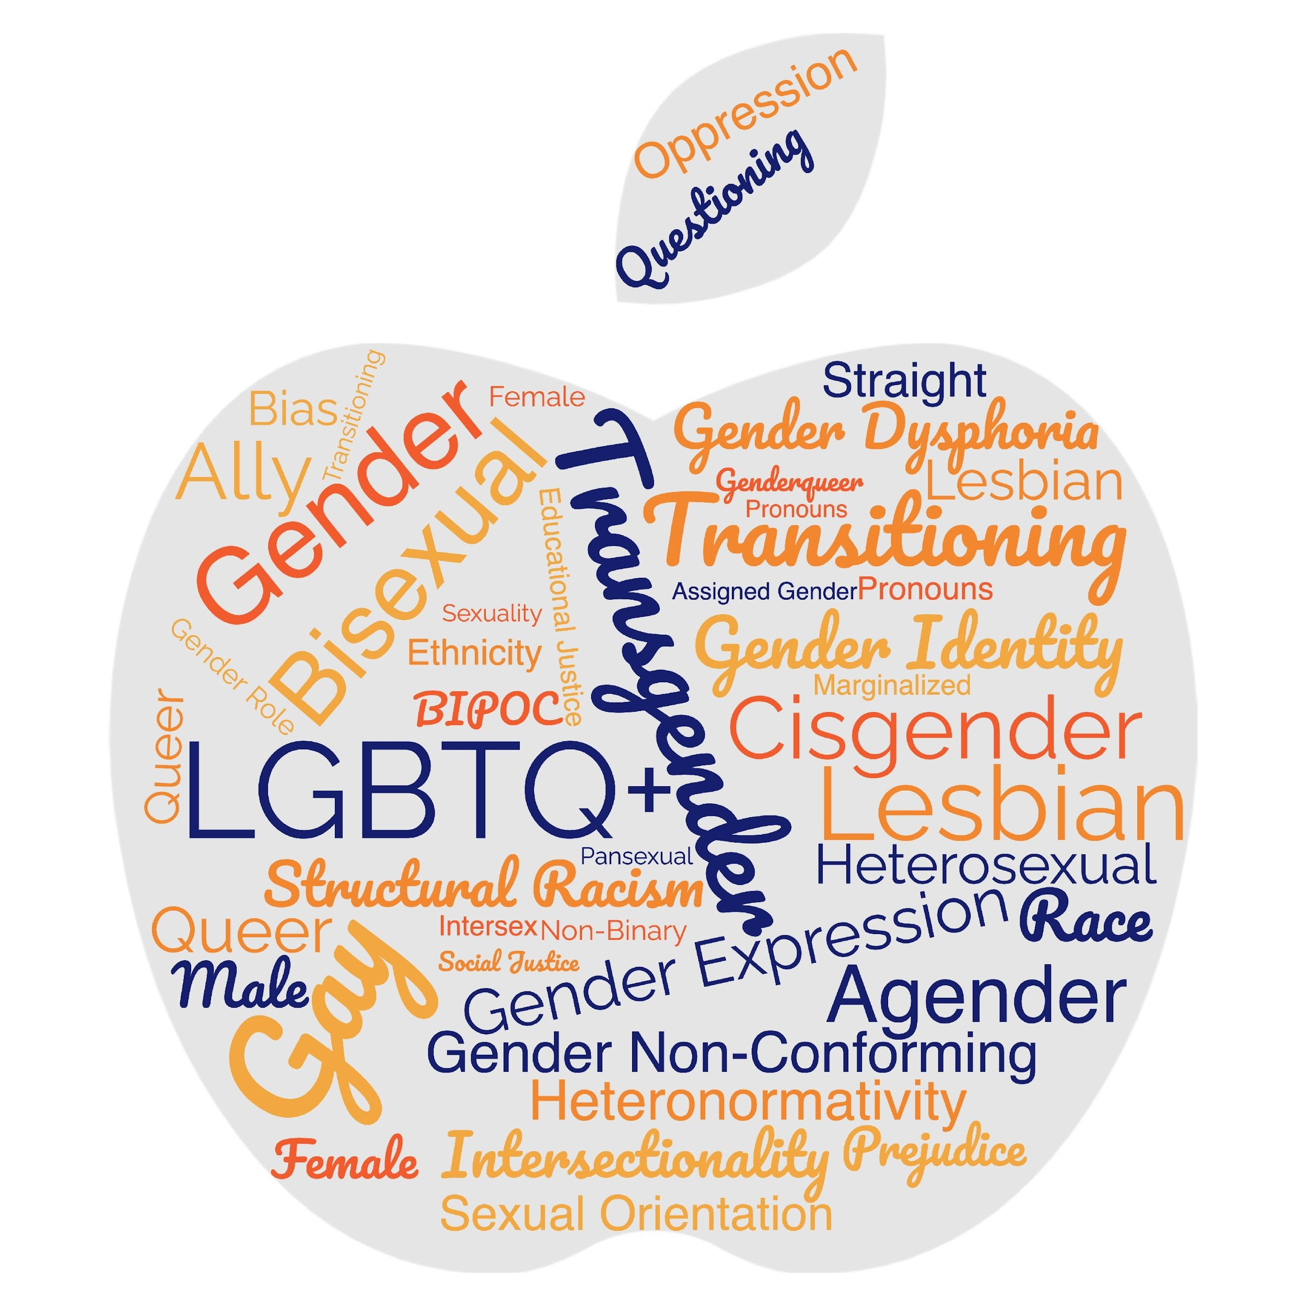
Turn and Talk
What makes a word a slur?
(or)
Who decides
what makes a
word offensive?

Slide 55
Turn and Talk
Words you might hear on the tour...be prepared.
Oppressed communities are not monoliths. Ask don't assume.

Slide 56
Terminology Debrief
Let’s Ask the Room Debrief
What surprised you?
What is your biggest opportunity for growth?
Who has a helpful “hint”?
What else may you need?
Notes:
2:00-2:30

Slide 57
Key Ideas
Terminology matters in making sure that people feel seen and included in spaces.
The lived experience of someone is more important than what you think you know.
These terms change rapidly.
We can never assume we have mastered these concepts.
We need to continue to be humble and learn!

Slide 58
Anthony

Slide 59

Transgender Terminology
Transgender
Binary
Trans man
Trans woman
Non-Binary
Genderqueer
Genderfluid
Bigender
Demiboy
Demigirl
Agender
Neutrois
…and more!
59
Notes:
Language in the LGBTQ+ communities changes very quickly. Language in ethnic communities changes about every ten years while language in the LGBTQ+ communities changes about every two years.
Transgender/Trans: This is an umbrella term for people whose gender identity and/or expression is different from cultural expectations based on the sex they were assigned at birth. Being transgender does not imply any specific sexual orientation. Both binary and non-binary genders and gender expressions fall under the umbrella.
Often, we hear transphobic comments when the appearance of Black and Brown bodies are compared to white/Eurocentric views of femininity. For example, internet conspiracy theories have long criticized the natural muscular frame of tennis superstar Serena Williams, and even former First Lady Michelle Obama. Obviously, these comparisons are harmful, and are just one example of how hate, prejudice and fear show up.

Slide 60

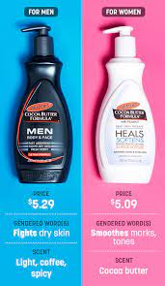



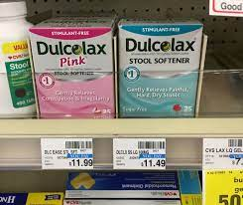
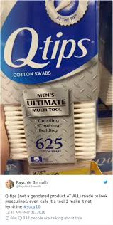
Turn and Share
Notes:
Turn and share gendered items (drinks, clothing, appearance) How embedded is binary in society?- ideas from media: Magazine, advertising, stores

Slide 61
Debrief
    What surprised you?
    What didn’t surprise you?
    How are you benefiting from our gender binary?
    How are you harmed by gender binary?
Notes:
Have we thought about the cost difference as well?

Slide 62
Key Ideas
We have a rigidly enforced gender binary that we experience in our day to day lives.
Everyone deviates from gendered expectations in some ways.
Folks under the transgender umbrella face oppression from these rigid social expectations.

Slide 63
Pete

Slide 64

The Gender Unicorn pg. 5 & 6
Notes:
The Gender Unicorn is a popular way to help explain gender that was developed by Trans Student Educational Resources. You may be familiar with the “Genderbread Person,” but we choose not to use it. It was created by a Black trans woman, but someone else popularized it, and continues to get credit, pay and notoriety for it.
As you see, the Gender Unicorn highlights gender identity, expression, sex assigned at birth, and physical and emotional attraction.
Children learn that there are two groups—boys and girls—and that they fit into one or the other based on how their bodies are made. They are then socialized to accept specific gender norms and stereotypes, which are ways of behaving, based on this gender assigned at birth.
There’s increasing understanding that gender is more than a binary division. The spectrum of gender identity is becoming more widely accepted and gender expression is more expansive.
However, there are challenges to looking at gender beyond male and female. Across states, many laws and policies are being passed that affirm or harm individuals outside of the gender binary.

Slide 65
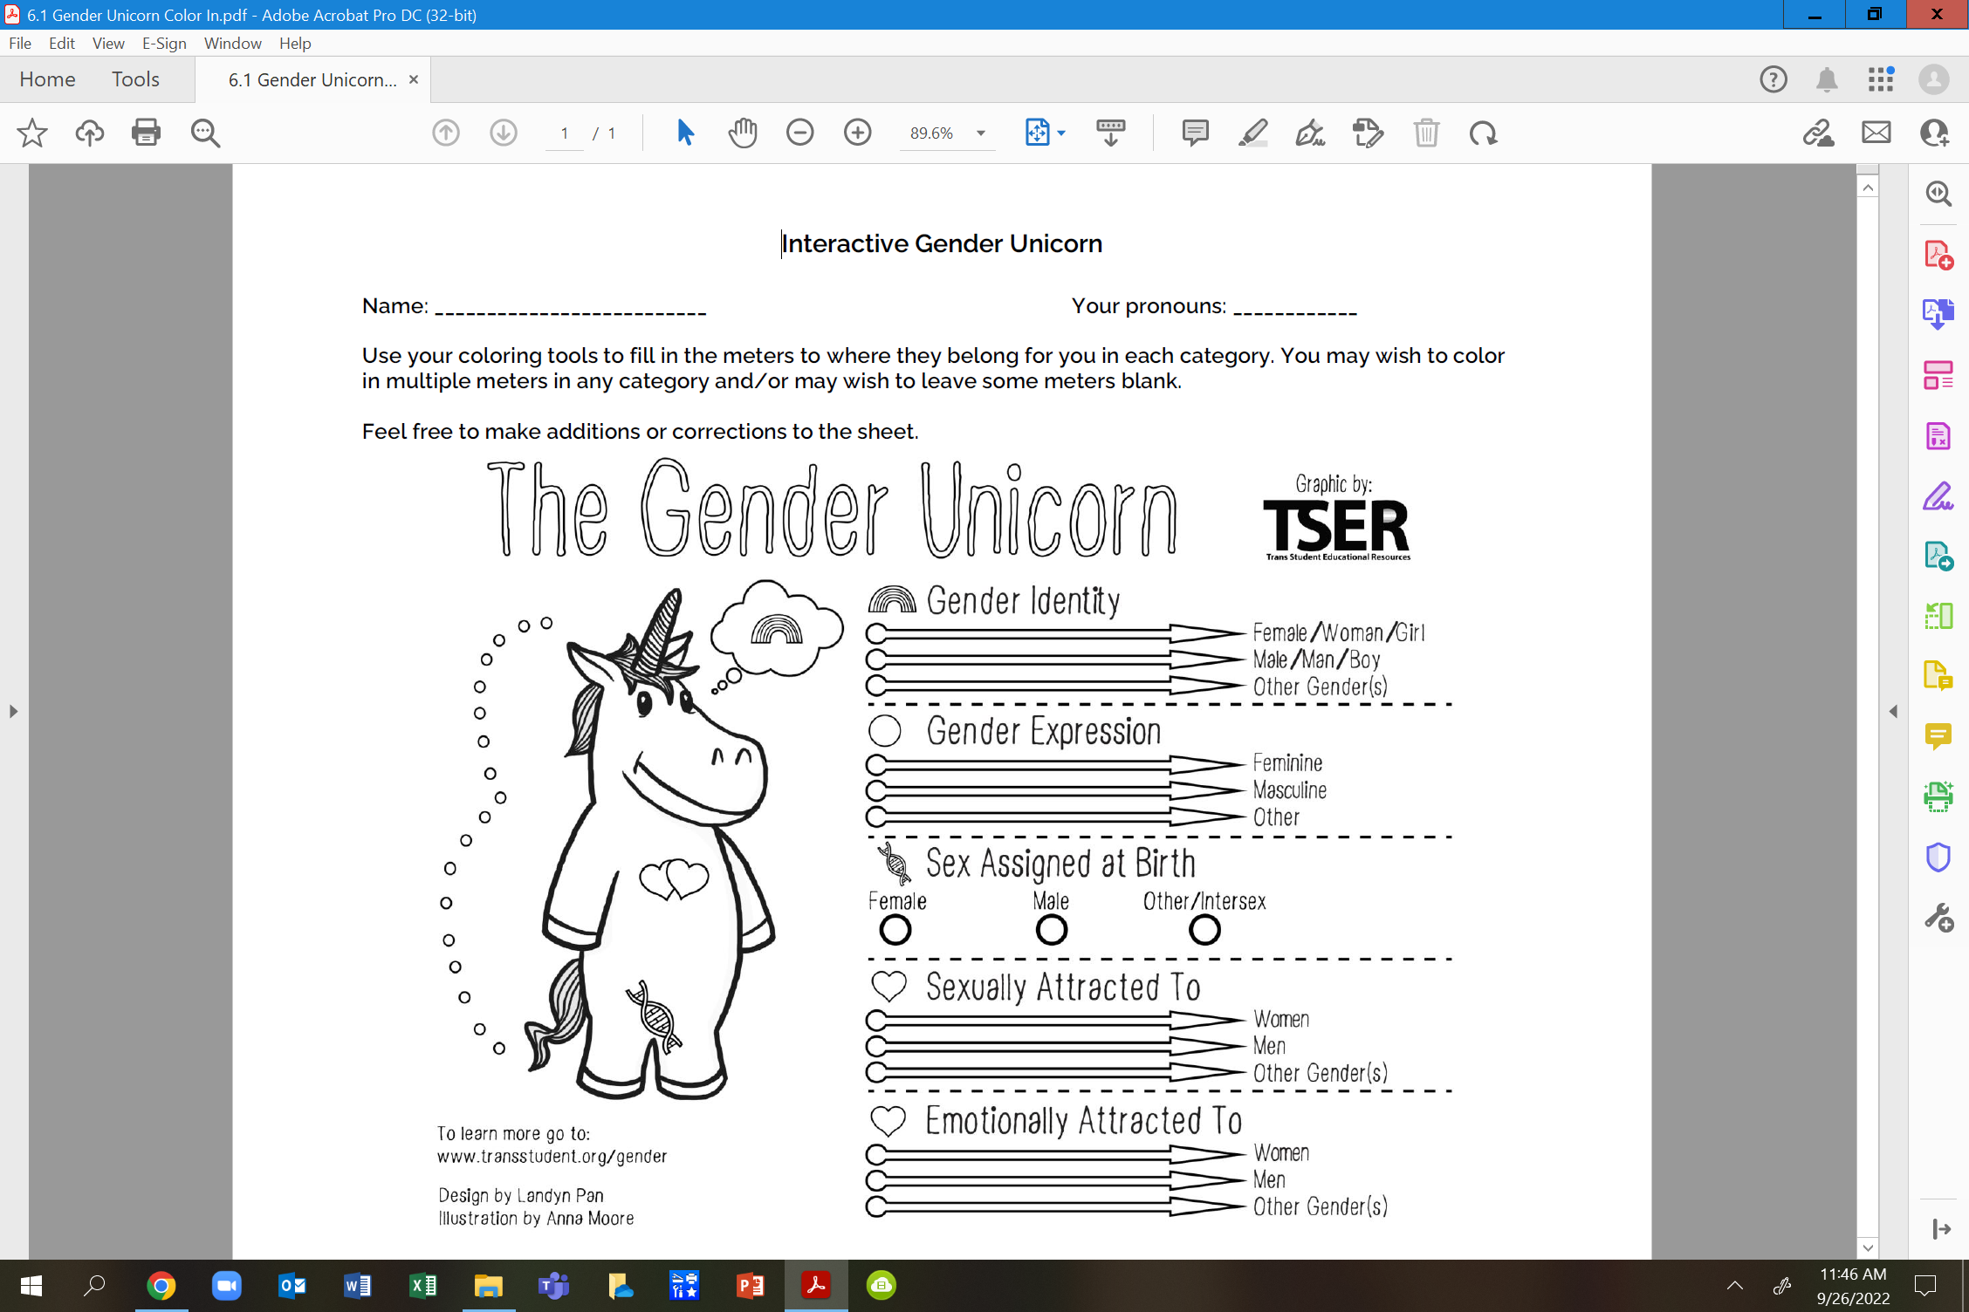
Your Turn... pg. 6

Slide 66
Debrief
What has been made clearer to you after using this tool?
Knowing we will be continuing to discuss gender, what is still unclear that you will be looking forward to learning more about?

Slide 67
Key Ideas
Our society reinforces the gender and sex binary – this is a construct
These are spectrums
These are separate categories and the way YOU present/identify in one is not an automatic indication of how you present/identify in another

Slide 68
Beth

Slide 69
Pronoun Practice Exercise
Partner up
Share a story of a friend
Replace binary pronouns with they/them
Listener should correct every pronoun error
(Pronoun Guide is on pgs. 2-3)
Notes:
10:30-10:45 Ben

Slide 70
Key Ideas
Using someone's correct pronouns is an important way to show respect.
It is on us to get good at this.
Using someone's name or neutral pronouns is the most respectful approach if you don't know.

Slide 71
Natasha

Slide 72
Contract and Policy Language (pg. 11-13)
Count off by 5
Once grouped, review your language (15 min)
  Identify who is left out by the language presented
  Rewrite the language to be more inclusive
  Identify what barriers may exist to making the changes.
  If you finish—look at another issue of your choice
Select a person to provide a 3 min report

Slide 73
Key Ideas
Using language that is inclusive in our contracts and policies is one small way of moving towards LGBTQ+ equity
When we know better we do better
Barriers may include our members—we need to be willing to introduce the conversation

Slide 74
Ellen

Slide 75

Ending It Right
How does YOUR learning from today inform your work with members?
How might we inadvertently cause well-intentioned harm?
How can we prevent that?

Slide 76
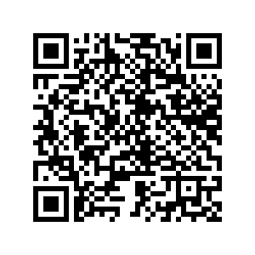
Ending It Right
Tomorrow- panel discussion

Slide 77

Choice Networking Time

Slide 78
Entry Activity-Mapping
Place a dot on the map showing where you are from
Notes:
Grat - 9:30-10:00

Slide 79
Language Around Suicide
Language matters when discussing issues of suicide. Language reflects our attitudes and influences our attitudes and the attitudes of others. Words have power; words matter. The language we choose is an indicator of social injustice and has the power to shape our ideas and feelings in very insidious ways.
Language Matters: Why We Don't Say "Committed Suicide"
IRMI: International Risk Management Institute
https://www.irmi.com/articles/expert-commentary/language-matters-why-we-dont-say-committed-suicide

