Slide 1
Advancing LGBTQ+ Justice

Slide 2

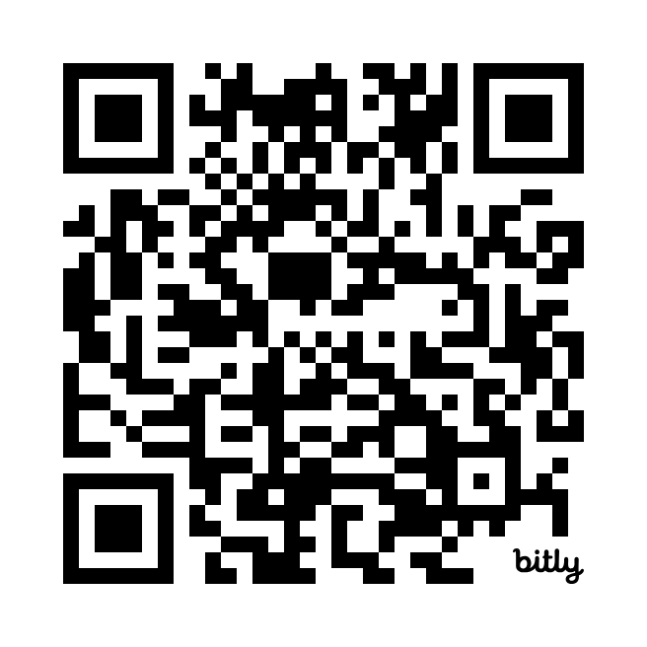
Morning Entry
This morning, continue thinking about our earlier conversation about intersectionality.
Check out the Human Rights Campaigns report “Black and African American LGBTQ+ Youth Report 2024” for more information about the challenges experienced by youth navigating multiple identities.

Slide 3
Feedback

Slide 4

COMMUNITY AGREEMENTS
Awareness and Self-Knowledge
Listen for Understanding
Be Gracious
Stay Engaged
Be Open and Suspend Judgment
Say “I”- tell your truth
Seek Discomfort
Reach for Empathy
Expect non- Resolution and non-Closure

Slide 5

TODAY’S AGENDA
8:30 – 8:40 Morning Routine
8:40- 8:55 -- Shared Identity
8:55-9:35 – Workplace Issues
9:35- 10:00- Building Campaigns
10:00-10:40 -- Problems and Issues
10:40-10:55 - Break
10:55-11:30- Targets and Tactics
11:30-12:10pm – Group Work Time
12:10 -12:40 -- Presentation
12:40-1:00 – Goodbyes
1:00 -- Lunch - grab and go

Slide 6

Beth

Slide 7

SHARED IDENTITY
Gather around an identity of your choosing
Answer the following discussion questions:
Why did you select this piece of your identity?
What are some challenges of this identity?
Notes:
Ben 10:00-10:15
Post the following identities around the room:
High risk (day 3) – religious, spiritual, agnostic, survivor, immigrant, LGBTQ+, middle class
Participants will get up and gather around an identity of their choosing (2 min instructions), then they will answer the following discussion questions (8 min):
Why did you select this piece of your identity?
What are some challenges you face with this identity?
Share out/debrief (5 min)
What was something you learned about someone else
What was easy/hard about this activity?

Slide 8

More from our members!

Slide 9

SHARED IDENTITY
Debrief-
What was something you learned about someone else?
What was easy/hard about this activity?
How safe did you feel sharing in this activity?
Which of these identities are internal vs external?
Notes:
Ben 10:00-10:15

Slide 10
Natasha

Slide 11
BUILDING AN ORGANIZING CAMPAIGN: Brief Review

Slide 12
Consider...
For your scenario, imagine you are in a state that has recently banned conversations about LBGTQ+ topics. What would you do?
How do you address it with an organizing campaign?

Slide 13
Key Parts of an Organizing Campaign
•Issue
•Demand
•Target
•Tactics
•Escalation

Slide 14
Bekah

Slide 15
STEP 1:
Issue

Slide 16
PROBLEM vs. ISSUE
Campaigns start with issues members care about.
An issue is a slice of a workplace problem.
Often a problem can have different issues depending on the perspective of the people we are working with.
It is KEY to get enough input on what the issues are that make up the problem so that YOU do not drive the solution.

Slide 17

PROBLEM vs. ISSUE

Slide 18
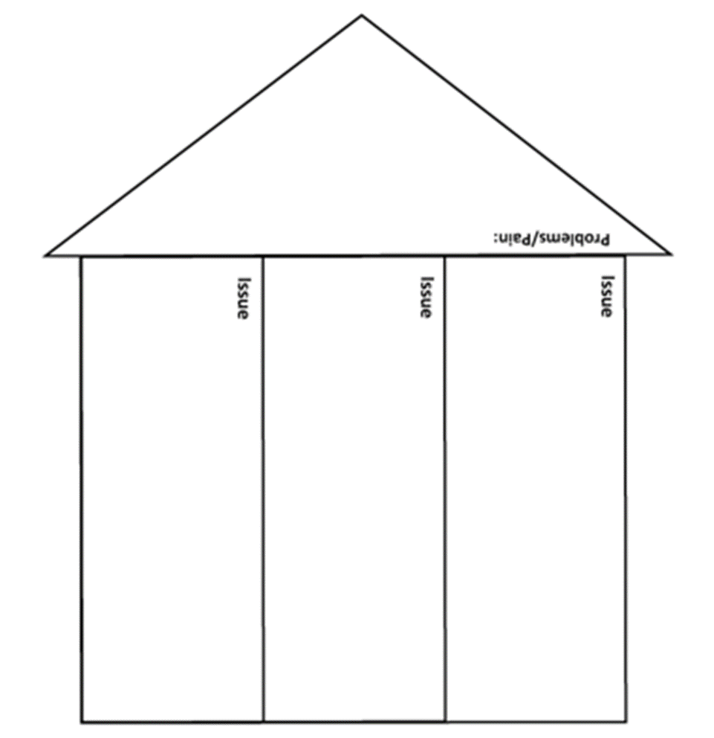
Issues are the small(er) actionable pieces that contribute to the larger problem
(POPs in the Participant Handouts Pg. 3)

Slide 19
EXAMPLE- Problem and Issue
PROBLEM -Our school is hostile to LGBTQ+ staff and students
◦ Issue – There are no gender inclusive bathrooms and/or transgender students are forced to use the wrong restroom.
◦ Issue – Our healthcare and leave benefits do not cover non-“traditional” family structures or are not fully accessible to people with same-gender partners.
◦ Issue – Our administration forces us to “out” trans and queer students to their families.

Slide 20
SCENARIO WORK!
In your group, spend time identifying the potential “Issues” in your scenario.

Slide 21
Assessing our Issues pg. POPs Participant Handout 4
What makes a good issue:
It is widely felt and/or deeply felt.
It is winnable.
It builds the union and builds leaders.
It has a connection to students and the public.

Slide 22

Assessing our Issues
Sample chart that can be used to assess our issues (pg. 4)

Slide 23
SCENARIO WORK!
In your group, spend time evaluating your issue using the chart in the handouts.

Slide 24
Dawn and Pete

Slide 25
STEP 2:
Demand

Slide 26
Demand:
A demand is the outcome that addresses the issue that you are making of a target.
Measurable
Achievable
“We demand gender affirming bathrooms in every school because all students need to feel safe and included in our schools. ”
Notes:
Page 5 in POPS

Slide 27
STEP 3:
Target

Slide 28
Target:
Is the person with the power to give you what you are demanding.
A single person:
a name, face, & address
“ Hey Superintendent Sam - We demand gender affirming bathrooms in every school because all our students need to feel safe and included in our schools ”
Notes:
Page 5 in POPS

Slide 29
SCENARIO WORK!
In your group, decide the following:
Issue
Revisit to make sure it's the one you want
Demand
What do you want to win (and why) to solve your issue?
Target
Who has the power to give you your demand?
(feel free to make up names and titles if your scenario doesn’t have one!)

Slide 30
STEP 4:
Tactics

Slide 31
Tactics
Tactic: Actions you to take as a part of an escalation plan that increases pressure on your target to try to win your demand.

Slide 32

A Tactic Should
Put pressure on your Target
(puts them out of their comfort zone)
Build your Power
(develops leaders, brings more people in, etc.)
Be Strategic

Slide 33
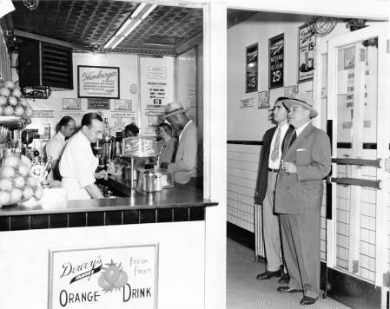
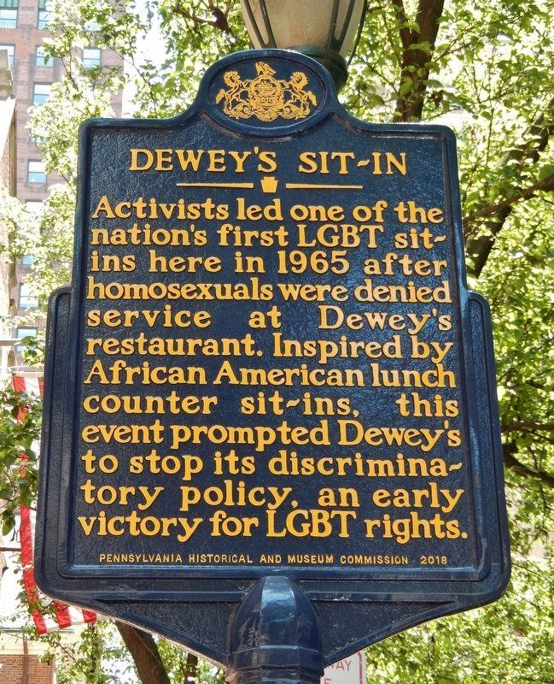
Historic LGBTQ+ Tactics

Slide 34


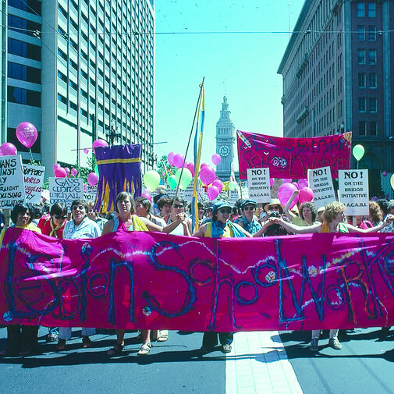
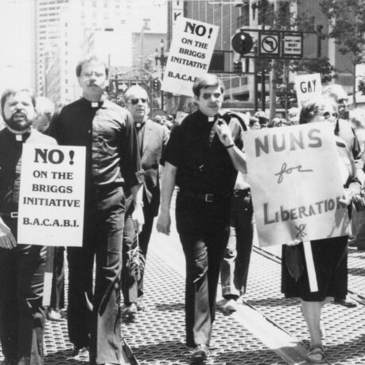
Historic LGBTQ+ Tactics

Slide 35
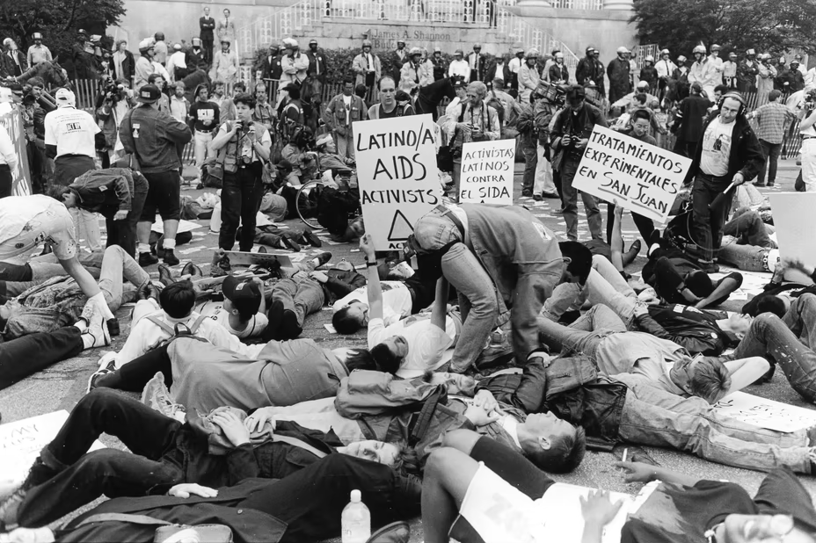

Historic LGBTQ+ Tactics
ACT UP!

Slide 36
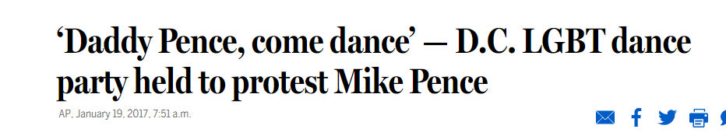

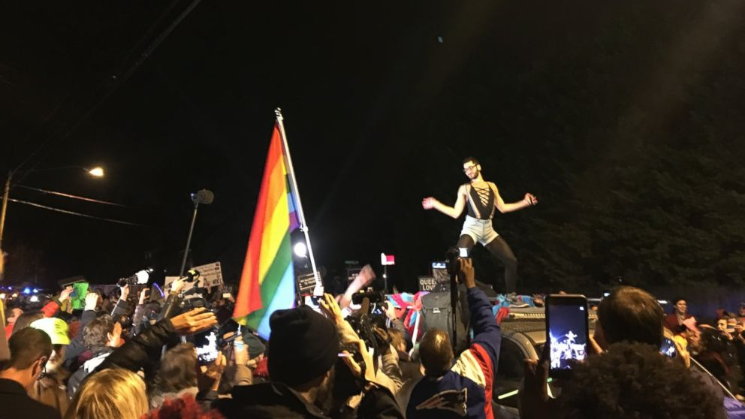
Historic LGBTQ+ Tactics

Slide 37
SCENARIO WORK!
TIME: 5 Minutes
TACTICS BRAINSTORM!
+++YOU HAVE 5 MINUTES!+++
Brainstorm AS MANY tactics as you can on 1 chart.
•Be creative!
•You are NOT evaluating right now!
Everything goes on the board!

Slide 38
Evaluating Tactics
Does the action relate to your issue?
Will it increase the pressure on the decision-maker?
Is it visible?
Is it timed for effect?
Is it new and different—or tried and true?
Are enough people ready to do it?​
Will it unify people?​
How will management react?​
Does it violate the law? (If so, are we prepared for the consequences?)​
Will it be fun?
Notes:
Page 6 in POPS

Slide 39
STEP 5:
Compression Points and
Escalation

Slide 40
Compression Points
Points on the calendar where you celebrate short term wins or escalate your tactics.
◦Naturally occurring deadlines - Breaks, Board Meetings
◦Artificial deadlines - Target has till day X to act
◦Help us build urgency and crisis

Slide 41

Why do you think tactics escalate gradually?

Slide 42
Less escalated actions prepare our people for more escalated actions
Give the target the chance to do the right thing before things escalate
Use the threat of escalation

Slide 43
Anthony

Slide 44
Group Work
TIME: 30 minutes
Build your campaign!
You have 30 minutes to build your campaign and be ready to present out! Make sure that you include at least…
Issue
Demand
Target
Tactics + Compression points in a campaign mountain!
Extra points if you include some messaging, graphics, hashtags, etc.
Notes:
Groups 1-3 present to each other
Groups 4-6 present to each other

Slide 45
Anthony

Slide 46

Campaign Presentations!
Each group will have ____ to present their solution to their scenario.

Slide 47
Ellen

Slide 48

LINGERING QUESTIONS
Anything you NEED to ask before leaving?
What feels VERY unsettled or confusing?

