Slide 1
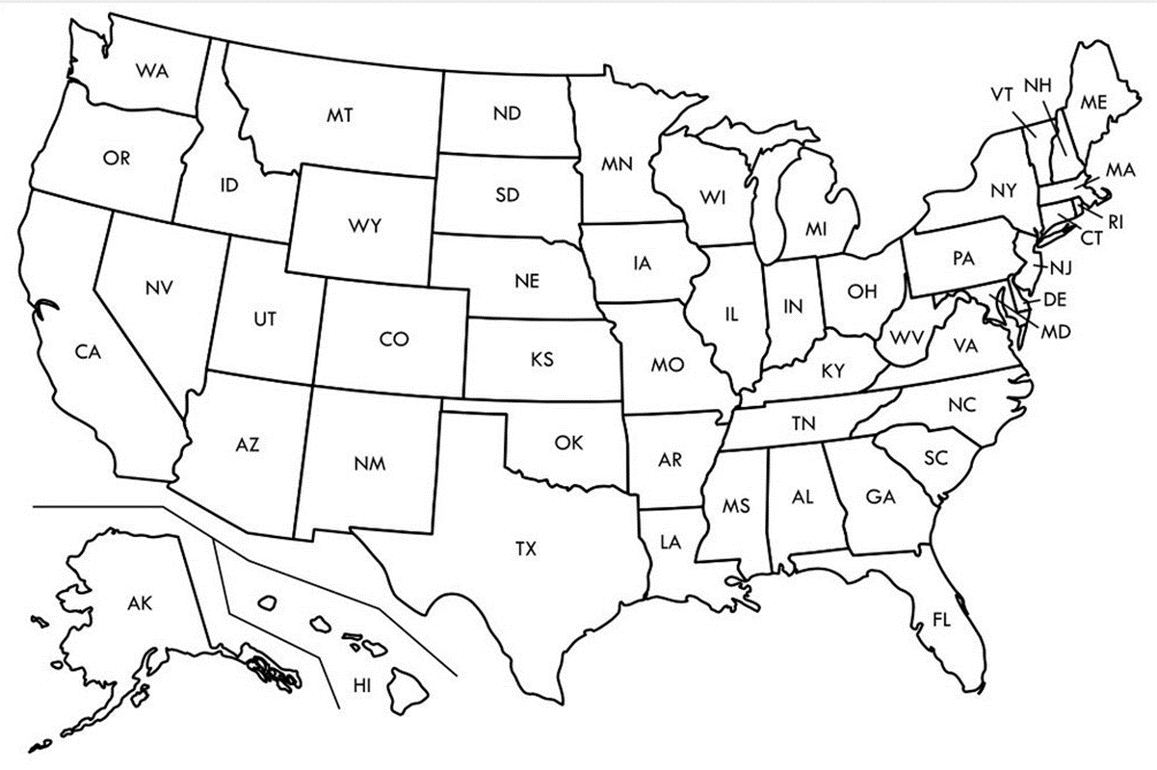

Entry Activity-Mapping
Place a dot on the map showing where you are from
Notes:
Grat - 9:30-10:00

Slide 2
Advancing LGBTQ+ Justice

Slide 3
Land Acknowledgement
We begin by acknowledging that we meet on the traditional lands served by the Lenape people. We honor America’s First People and all elders, past, present and emerging and we are called on to learn and share what we learn about the tribal history, culture, and contributions that have been suppressed in telling the story of what we now call the United States America. We invite you to think about the spaces you are inhabiting and the Indigenous people who came before them and were stewards of the land.

Slide 4

Our Time Together
Days 1 & 2: 8:30 am- 5:00 pm
◦15 Minute AM + PM Break
◦Lunch 12:00 – 1:00pm
◦4:30 - 5:00 pm “Adult Choice Networking”
Day 3: 8:30 am -2:00 pm
◦15 Minute AM + PM Break
◦Lunch 1:00 pm
◦1:00 - 2:00 pm “Adult Choice Networking”

Slide 5

Today’s Agenda
8:30 – 10:15 -- Getting Started and Building Our Community
10:15-10:30 -- Break
10:30 -12:00 -- Who am I in the work
12:00 -1:00 -- Lunch
1:00 – 2:30 -- LGBTQ History & Terminology
2:30 – 2:45 -- Break
2:45 - 4:15 -- Gender Identity
4:15 – 4:30 -- Wrap Up and Reflect
4:30 – 5:00 -- Adult Choice Networking

Slide 6
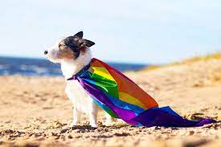
Logistics to Remember
Parking lot
Bathroom
Materials
Food
Room Temperature
Karla as Resource
Questions
AFSE Support
Room Cleaning

Slide 7
Disclaimer
Reminder about sensitive topics
The content we are going to explore may bring up strong feelings. Throughout our time together, we will explore examples of racism, ableism, heterosexism, and sexism.
These oppressive ideas and assumptions are offensive, problematic and false. Yet, over time, they have become as pervasive and invisible as the air we breathe. We need to examine them so that we can understand and ultimately challenge them. Modified ADL

Slide 8

But what if I want to say more....
Time at the End and
Start of the Day.
So...make note of what
You want to ask or
continue

Slide 9
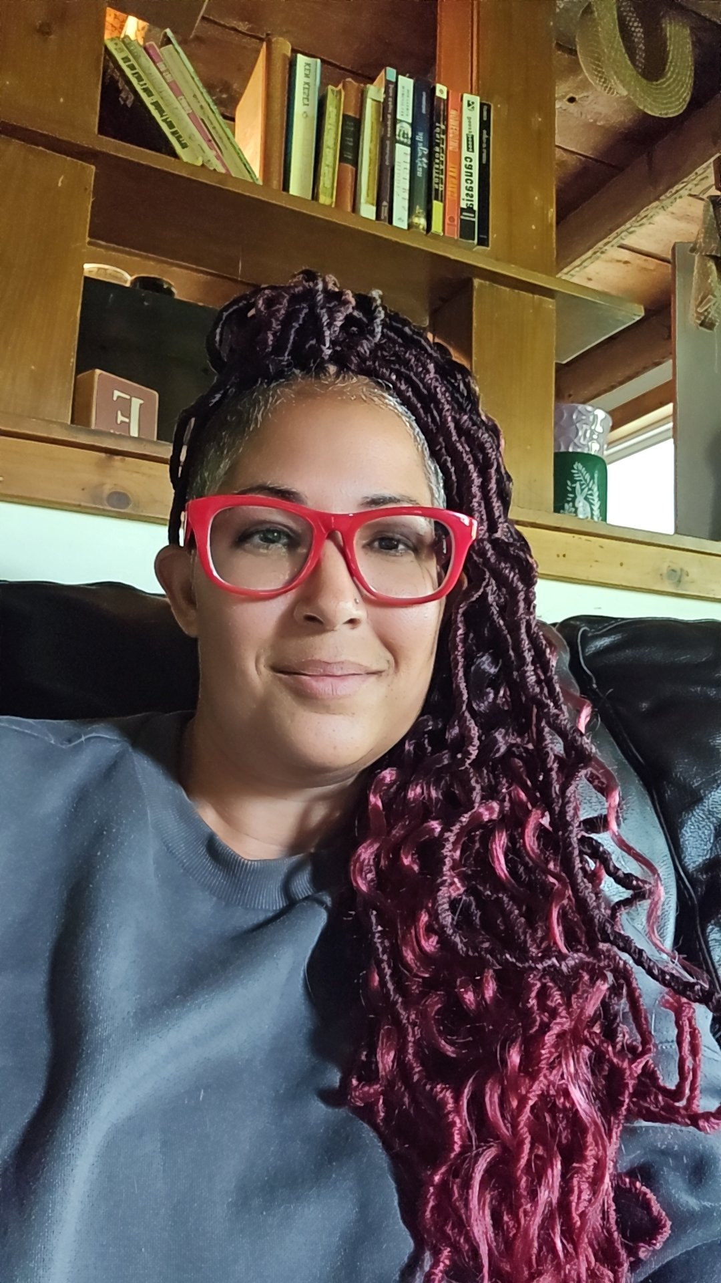
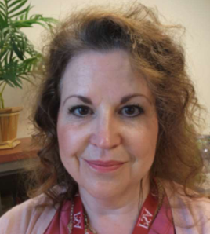
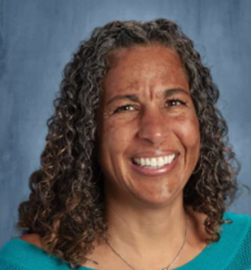
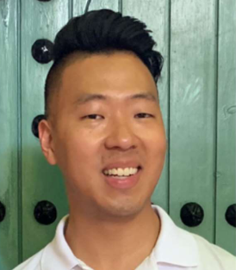
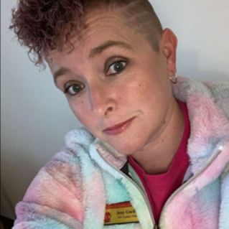
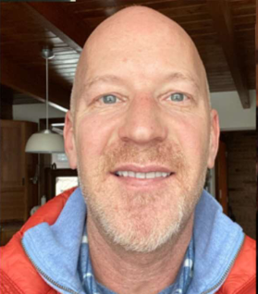

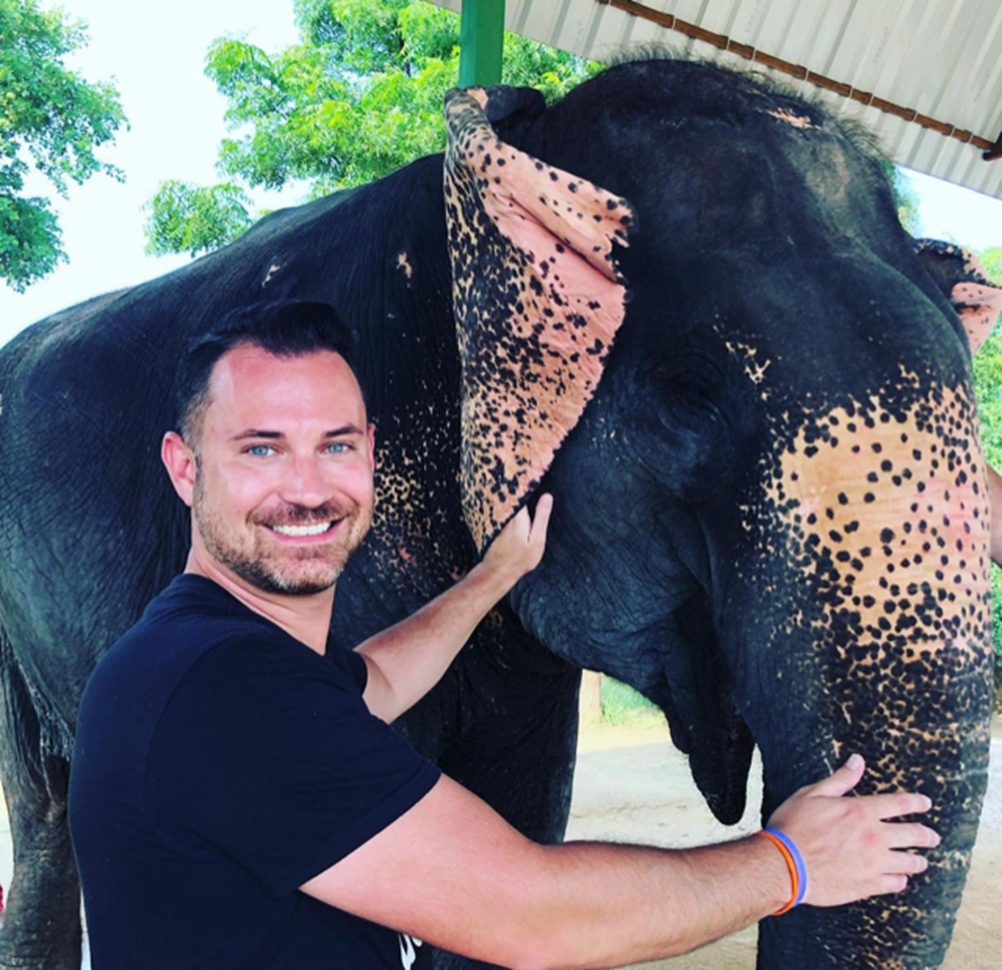
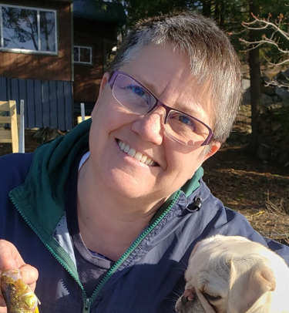
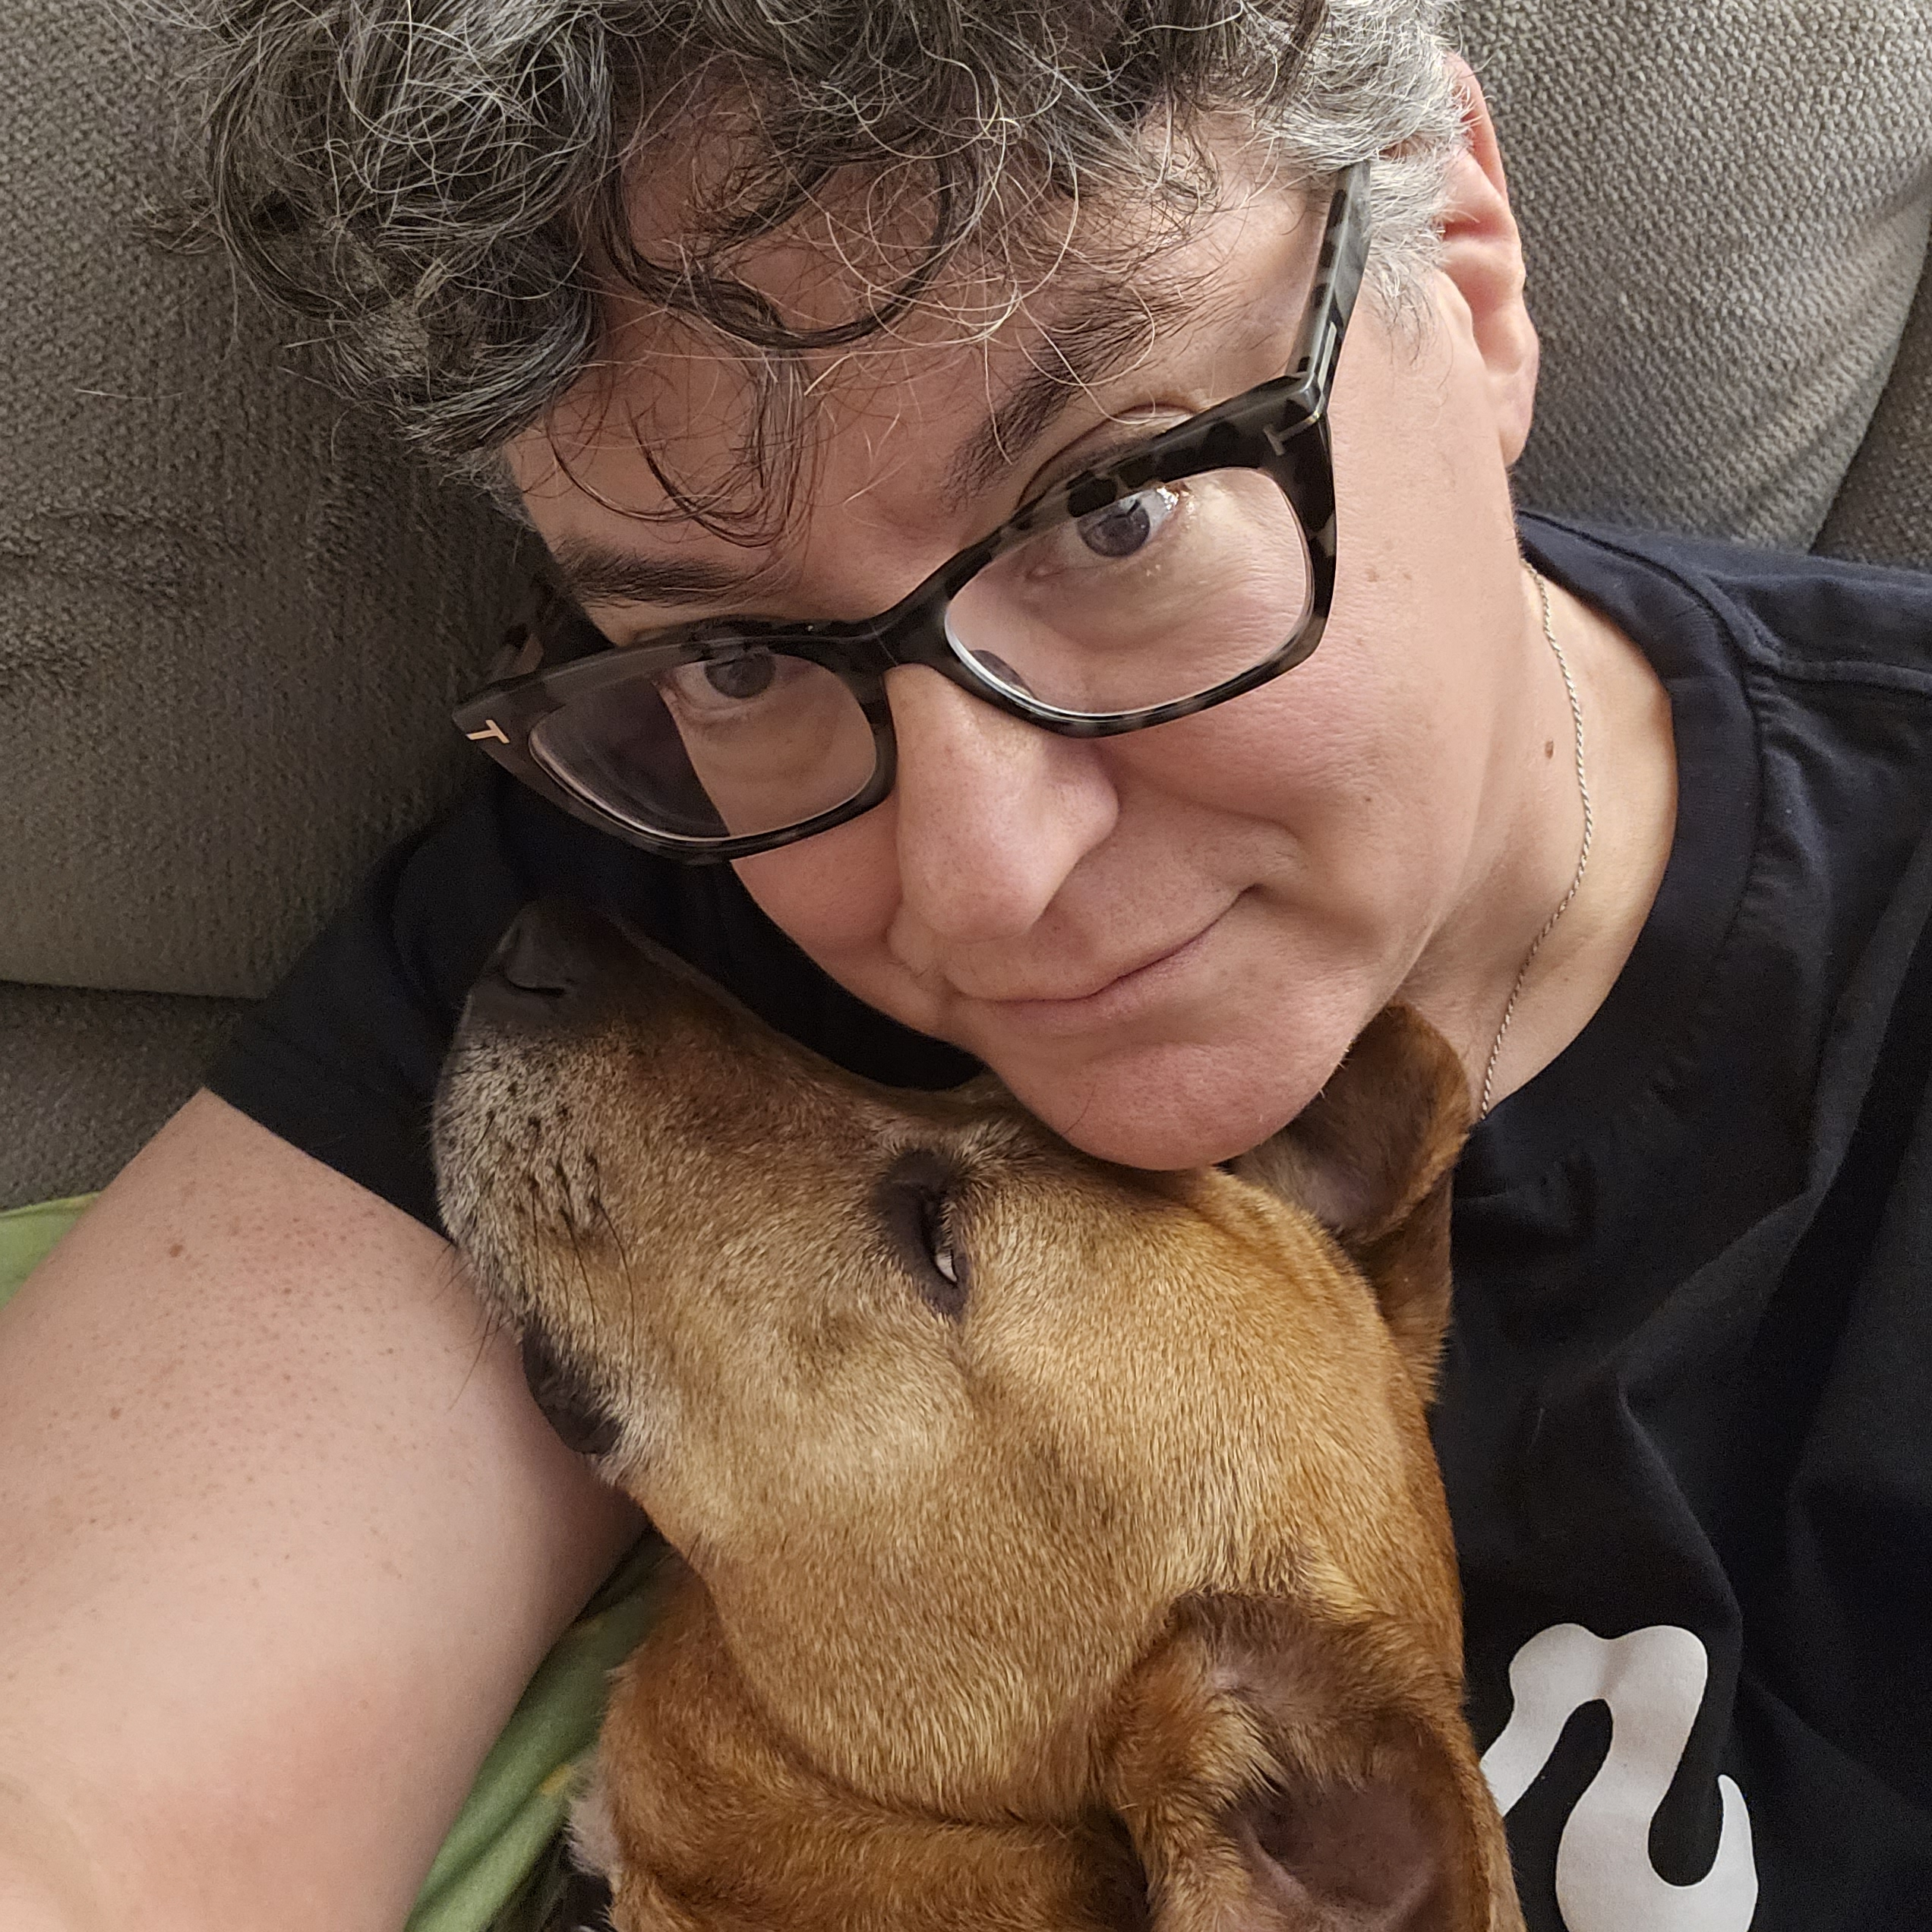
Introductions- Training Team
Natasha Eckart
She/Hers
Vermont
Michelle Couture She/Hers
New York
Barb Whitman She/Hers
Utah
Ben West
He/Him
California
Jeny Gardner
All Pronouns
Wyoming
Grat Dalton
He/Him
Michigan
Lucy Griswold
She/Hers
Washington, D.C.
Bekah Saxon
She/Hers
Connecticut
Anthony Brisson
He/Him
Washington, D.C.
Ellen Holmes
She/Hers
NEA

Slide 10

Community Agreements Pg 2
Awareness and Self-Knowledge
Listen for Understanding
Be Gracious
Stay Engaged
Be Open and Suspend Judgment
Say “I”- tell your truth
Seek Discomfort
Reach for Empathy
Expect non- Resolution and non-Closure

Slide 11
Introduction Whip -Who are you?
Name
Pronouns
Your title
15 Seconds Each

Slide 12

Anthony

Slide 13
Why we are here!
LGBTQ+ youth are more than four times as likely to attempt suicide than their peers
A majority of LGBTQ+ people say that they or an LGBTQ+ friend or family member have been threatened or non-sexually harassed (57 percent), been sexually harassed (51 percent), or experienced violence (51 percent) because of their sexuality or gender identity. [2]
NEA RA Support and Part of NEA Mission and Vision Pg 7
[1] Human Rights Campaign Foundation. (2017, July). Mental health and the LGBTQ community. https://suicidepreventionlifeline.org/wp-content/uploads/2017/07/LGBTQ_MentalHealth_OnePager.pdf
[2] National Public Radio, the Robert Wood Johnson Foundation, & The Harvard T.H. Chan School of Public Health. (2017, November). Discrimination in America: Experiences and views of LGBTQ Americans. Retrieved June 24, 2020 from https://www.rwjf.org/en/library/research/2017/10/discrimination-in-america--experiences-and-views.html

Slide 14
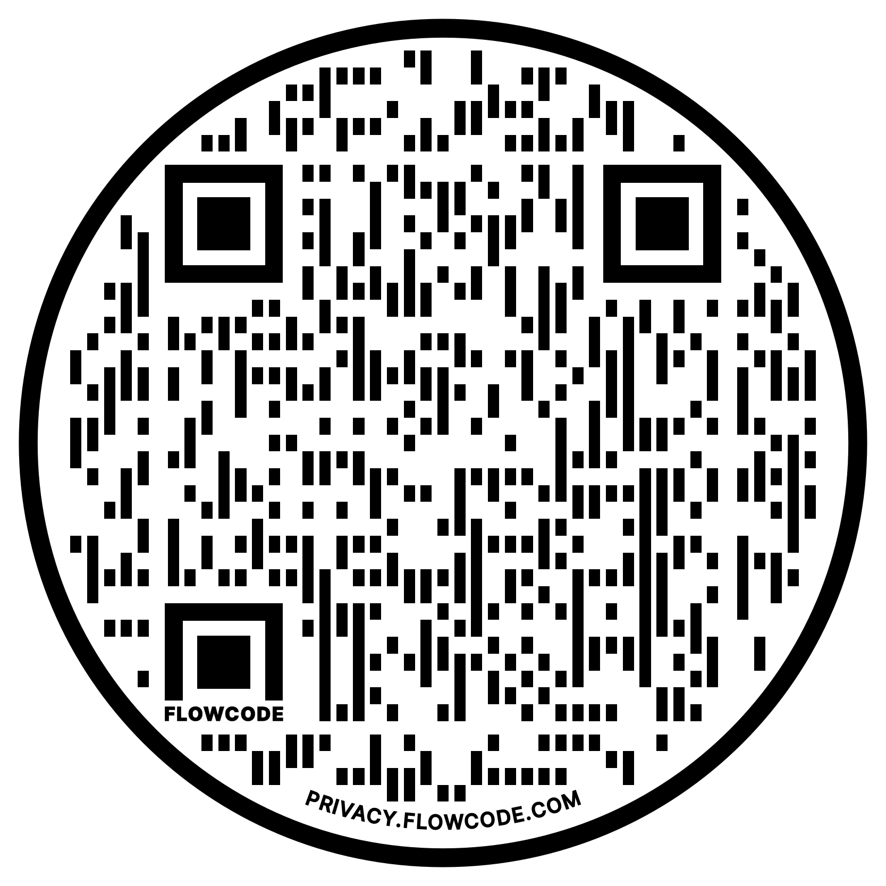
NEA Vision, Actions, Resources
Safe, Just, and Equitable Schools
Adopted by the 2022 NEA Representative Assembly
NBI 32
Training on Trans Gender Advocacy Issues for Affiliate Staff
NEA Online Toolkit – LGBTQ+ Resources

Slide 15
The Words of Our Members
“Know that even if you do not personally know of any LGBTQ+ staff person in your district, they are there. Be an ally even if you do not know them. Speak up when you hear, see, or perceive bias and/or discrimination. Advocate for inclusive policies for both students and staff.”
15
Notes:
Throughout today’s training, we will be sharing the words of NEA members who are a part of the LGBTQ+ community. We shared an anonymous survey and think it’s important to hear the words of our colleagues—whether they are out or not—about their experiences as LGBTQ+ educators.

Slide 16
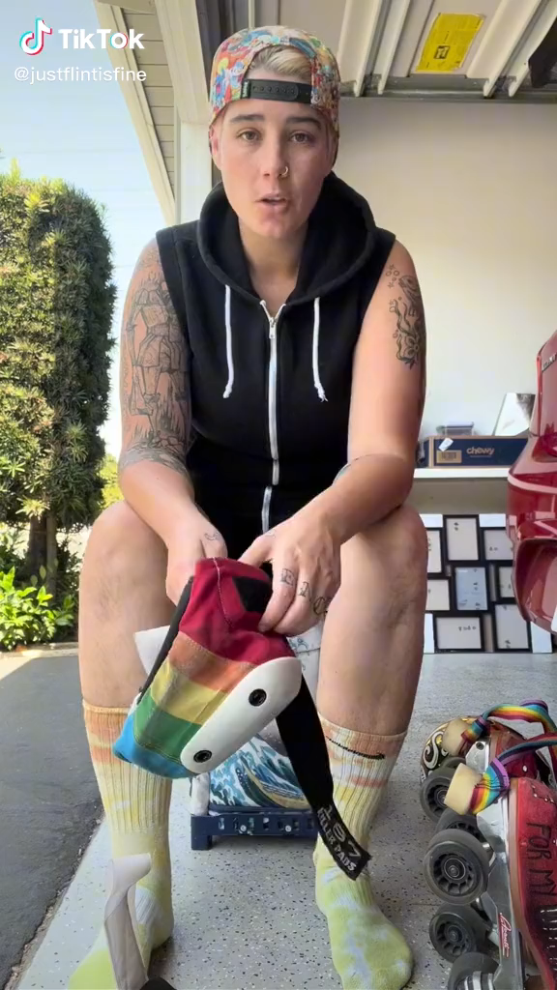

Slide 17
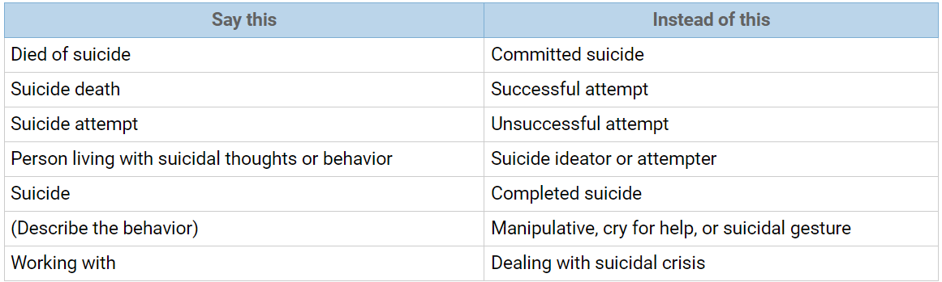
Language Around Suicide
Language matters when discussing issues of suicide. Language reflects our attitudes and influences our attitudes and the attitudes of others. Words have power; words matter. The language we choose is an indicator of social injustice and has the power to shape our ideas and feelings in very insidious ways.
Language Matters: Why We Don't Say "Committed Suicide"
IRMI: International Risk Management Institute
https://www.irmi.com/articles/expert-commentary/language-matters-why-we-dont-say-committed-suicide

Slide 18
Grat

Slide 19
Ice Breaker
Find a partner that is not from your state
Be prepared to share a fun fact about your state or city with the group

Slide 20
Bekah

Slide 21
Core Values pg 13
Core values are the fundamental beliefs of a person. These guiding principles dictate behavior and can help people understand the difference between right and wrong – These can often be expressed using one or two words. We are taking a moment to consider our core values because they can provide a basis for solidarity in the midst of struggles.

Slide 22
Sharing Values for Solidarity
Core Values
1. Name
2. Core Value – One or two words that describes a fundamental belief held by you
**15 Seconds Each**
Core values are the fundamental beliefs of a person. These guiding principles dictate behavior and can help people understand the difference between right and wrong – These can often be expressed using one or two words.

Slide 23

Key Ideas
Solidarity
sol / i / dar / i / ty
Noun
  1. Unity or agreement of feeling or action especially among individuals with a common interest, mutual support; mutual support within a group.
Shared Core Values are critical for building solidarity in our work.

Slide 24
Ben

Slide 25
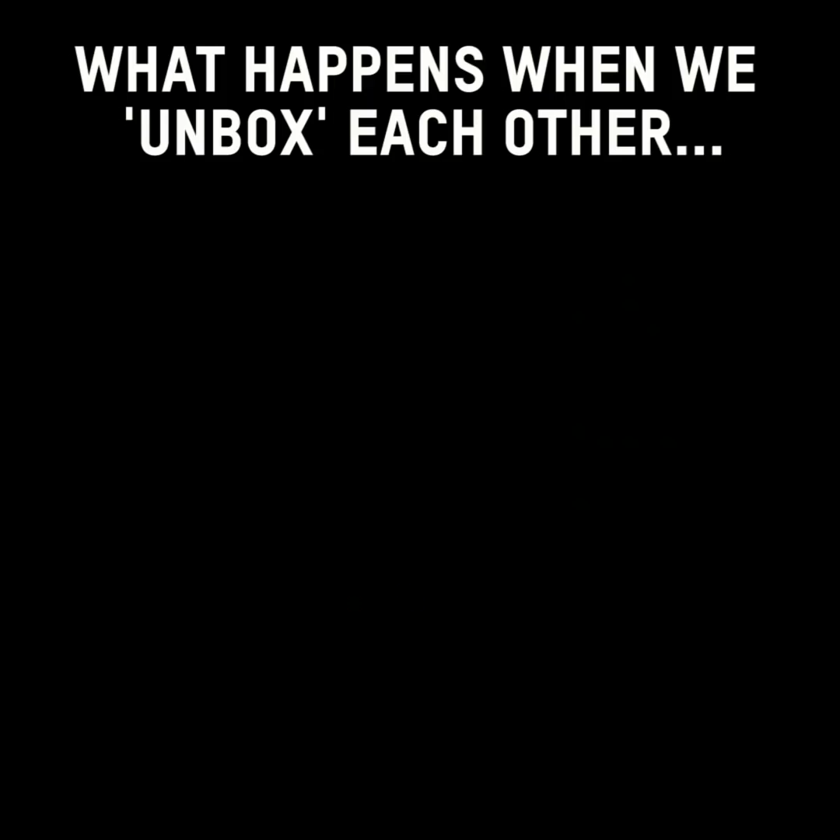

Slide 26

Shared Identity
Gather around an identity of your choosing
Answer the following discussion questions:
Why did you select this piece of your identity?
Notes:
Ben 10:00-10:15
musician, traveler, foodie, planner, nature lover, pet owner

Slide 27

Shared Identity
Debrief-
What was something you learned about someone else?
What was easy/hard about this activity?
How safe did you feel sharing in this activity?
Notes:
Ben 10:00-10:15

Slide 28
Key Ideas
Discreet identities bind us
We all have pre-conceptions that might not match an actual identity of another
We don't get to assign a person's identity for them

Slide 29

15 Minute Break!
During the break, follow these LGBTQ+ Member Educator Influencers on social media to continue our learning each time we scroll!
@justflintisfine @sabocat
@thegayschoolcounselor @keithkmusic

Slide 30
Michelle

Slide 31
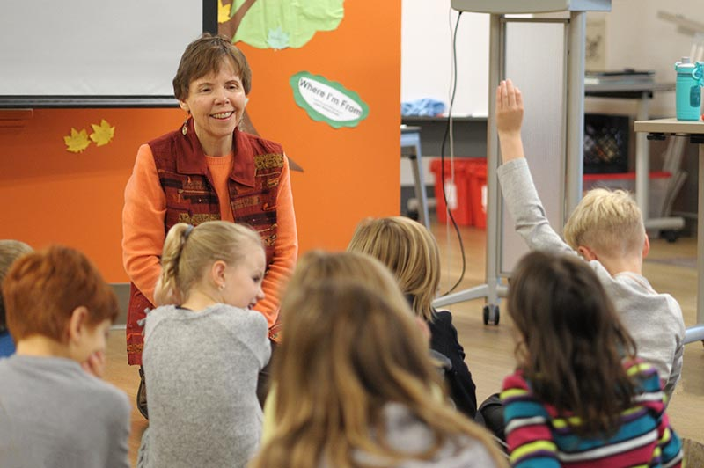
Where I am From
George Ella Lyons Poet Laureate, Author, Teacher from Kentucky.
Widely used as a way to get people to think about where they are from as more than a place.
It is in the sharing that we see how we are remarkably different and yet we have overlapping similarities.

Slide 32

Kenneth is from…

Slide 33
I am From by George Ella Lyons
I am from clothespins,
from Clorox and carbon-tetrachloride
I am from the dirt under the back porch
(Black, glistening it tasted like beets)
I am from the forsythia bush,
the Dutch elm whose long gone limbs I remember as if they were my own.
I’m from the fudge and eyeglasses,
from Imogene and Alafair.
I’m from the know-it-alls and the pass-it-ons, from perk up and pipe down.
I’m from He restoreth my soul with a cottonball lamb and ten verses I can say myself.
I’m from Artemus and Billie’s Branch,
fried corn and strong coffee.
from the finger my grandfather lost
to the auger
the eye my father shut to keep his sight.
Under my bed was a dress box
spilling old pictures, a sift of lost faces
to drift beneath my dreams.
I am from those moments–
snapped before I budded–
leaf-fall from the family tree
----George Ella Lyons

Slide 34
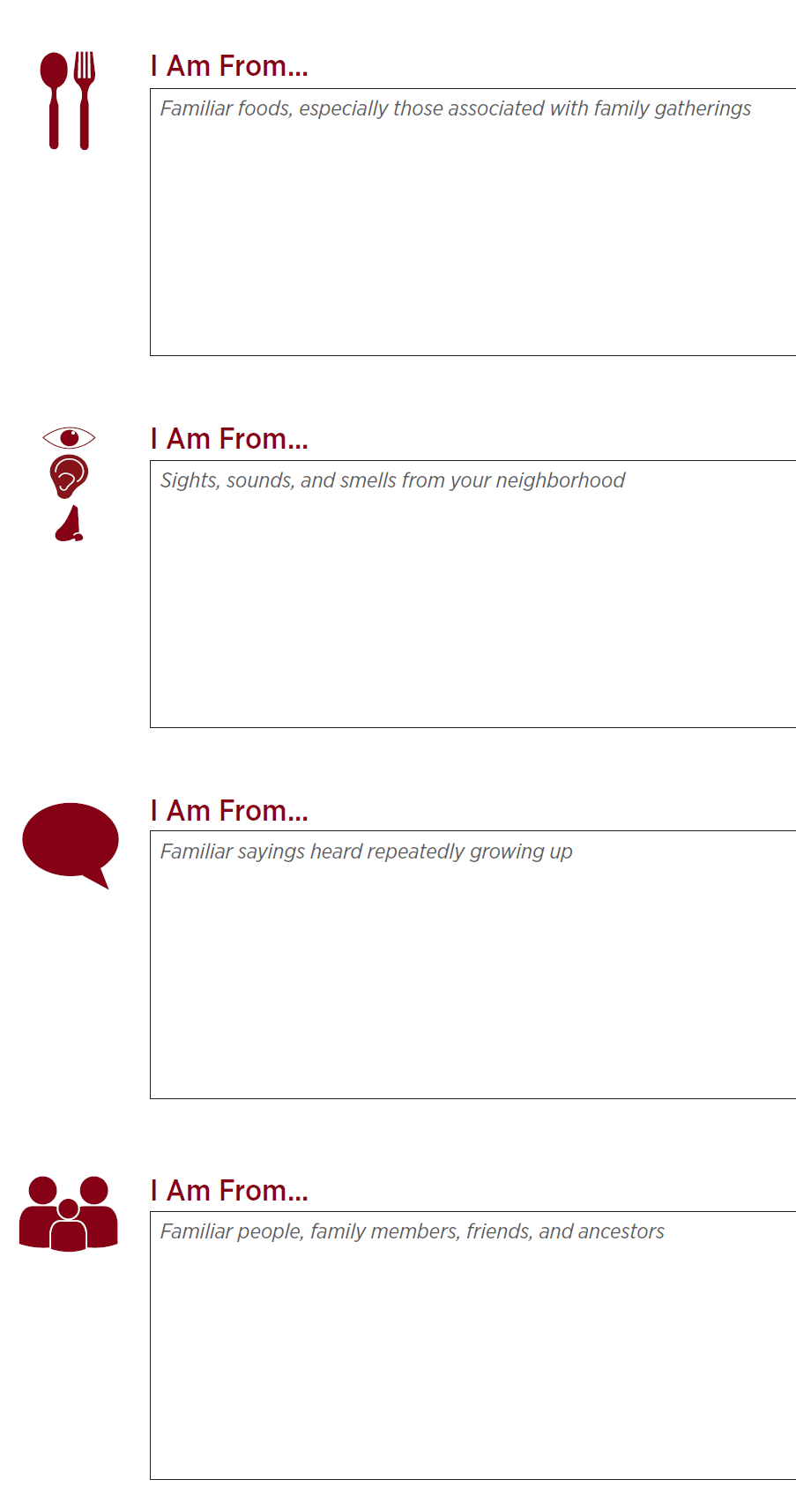
I Am From Poem Pg 14
Activity:
I Am From POEM
Notes:
10:30-11:00

Slide 35
Key Ideas
We are all individuals with unique sets of experiences and yet...
There are many points of common ground

Slide 36
Barb

Slide 37

First Impressions Activity pg 17
On your own first
Notes:
11:00-11:30

Slide 38
Debrief- First Impressions Activity
What was it like to do that activity?
Does anyone have something that came up for them while they were answering the questions that they would like to share? Does anyone have an experience that was significantly different that they’d be interested in sharing?
What about question 5, would anyone share how their understanding of these issues have changed over time?

Slide 39
Key Ideas
Our perceptions, beliefs, and biases are shaped passively, intentionally and reside in our unconscious.
These can be reshaped.

Slide 40
Natasha

Slide 41
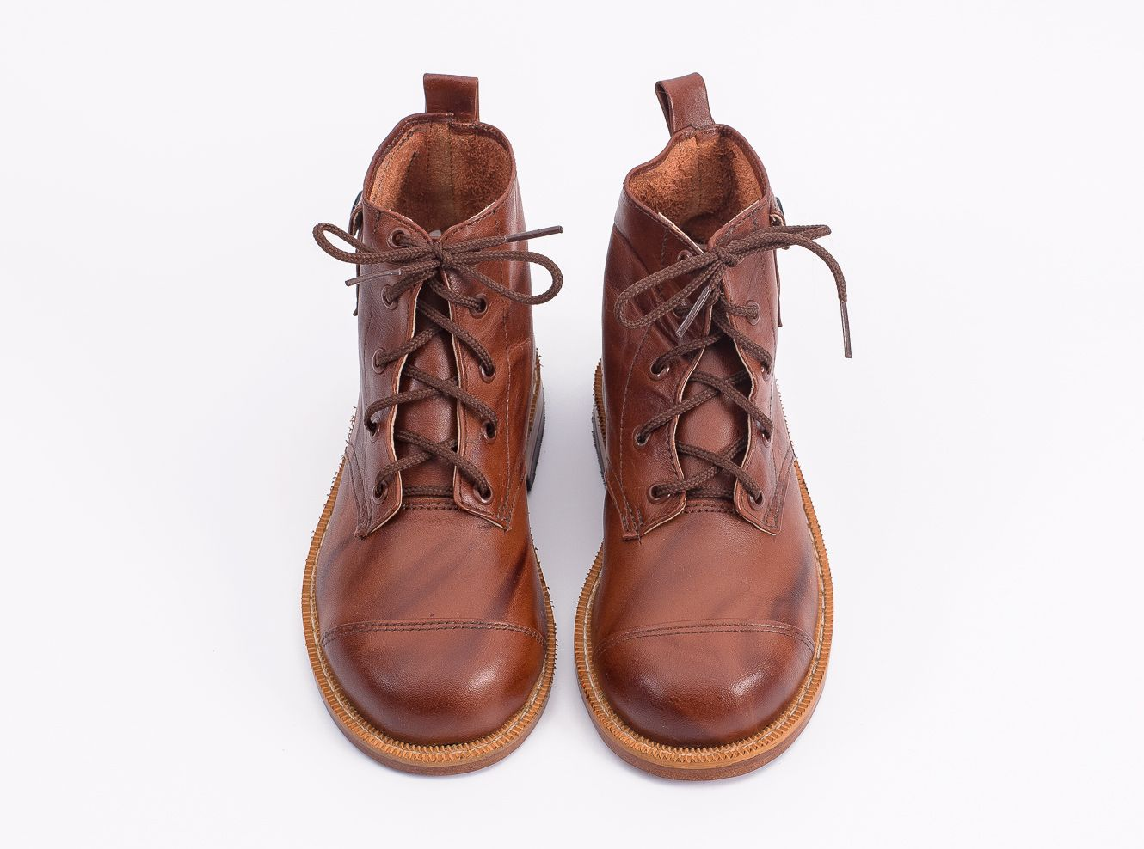
Movement and Change
41
Notes:
1:00-
Presenter Note:
Ask each participant to switch their left and right shoes (left shoe on the right foot, right shoe on the left foot). Say it’s part of the training, and then move on. DO NOT mention their shoes further. (The objective is that participants will experience a familiar but uncomfortable sensation that their shoes are on the opposite foot. This will help them experience, in a non-threatening way, the uncomfortable, awkward feelings or fear that transgender or gender non-conforming people may experience while they are in public.)

Slide 42
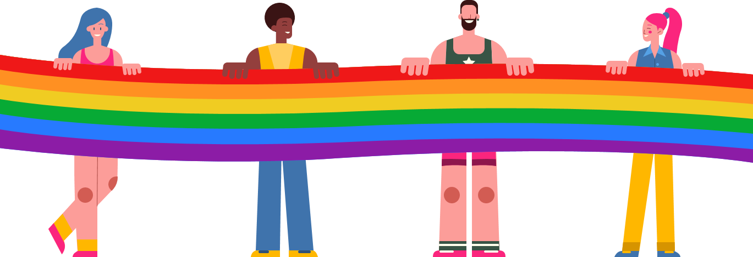
Timeline Activity
Look and read your Arc of LGBTQ+ Oppression and Justice Over Time card.
Notes:
11:30-12:00

Slide 43
Movement and Change
43
Notes:
1:00-
Presenter Note:
Ask each participant to switch their left and right shoes (left shoe on the right foot, right shoe on the left foot). Say it’s part of the training, and then move on. DO NOT mention their shoes further. (The objective is that participants will experience a familiar but uncomfortable sensation that their shoes are on the opposite foot. This will help them experience, in a non-threatening way, the uncomfortable, awkward feelings or fear that transgender or gender non-conforming people may experience while they are in public.)

Slide 44
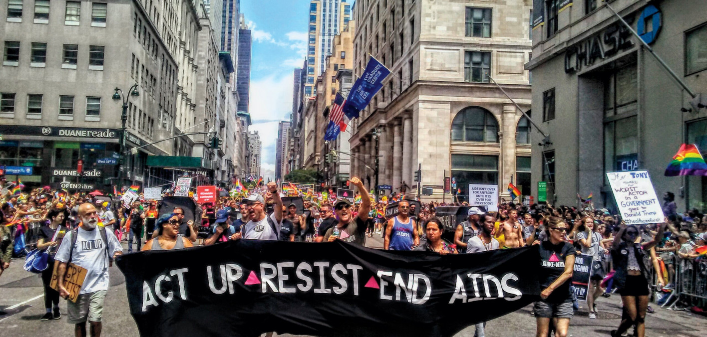
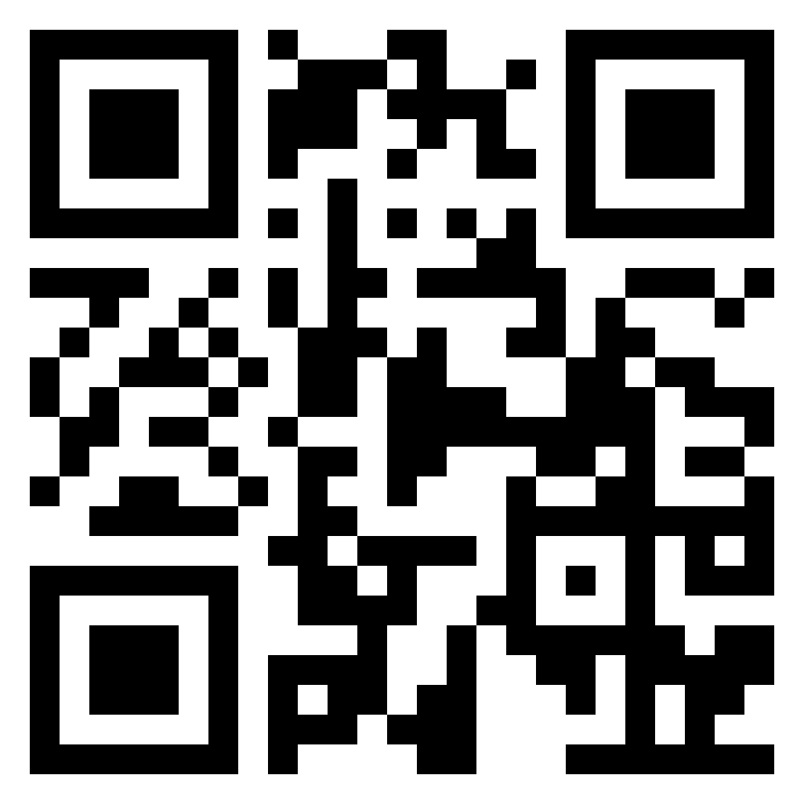
Lunch
1 hour for Lunch!
Over lunch, learn more about ACT UP!
Add the documentary “United In Anger” to your cue!
(available on Prime and Youtube!)

Slide 45
Natasha

Slide 46
Timeline Debrief
What were new events that you learned about?
Why do you think this was new to you?
What other communities of people in the United States have had their history erased?
What impact do you think this has on people who hold these identities?
What impact do you think this has on people who don’t hold these identities?
Notes:
1:00-1:30

Slide 47
Key Ideas
Oppressed people’s stories are deliberately kept out of the telling of the story of what we know as the United States of America.

Slide 48
Bekah

Slide 49
Shoe Debrief
How did it feel to have your shoes on the wrong feet?
What connections can we make between the uncomfortable, awkward feelings of having your shoes on the wrong feet to what transgender or gender non-conforming people may experience while in public?
49
Notes:
1:00-
Presenter Note:
Ask each participant to switch their left and right shoes (left shoe on the right foot, right shoe on the left foot). Say it’s part of the training, and then move on. DO NOT mention their shoes further. (The objective is that participants will experience a familiar but uncomfortable sensation that their shoes are on the opposite foot. This will help them experience, in a non-threatening way, the uncomfortable, awkward feelings or fear that transgender or gender non-conforming people may experience while they are in public.)

Slide 50
Key Ideas
What we now call the United States of America is still an uncomfortable, awkward, and sometimes unsafe place to be a member of the LGBTQ+ community.

Slide 51
Grat and Michelle

Slide 52
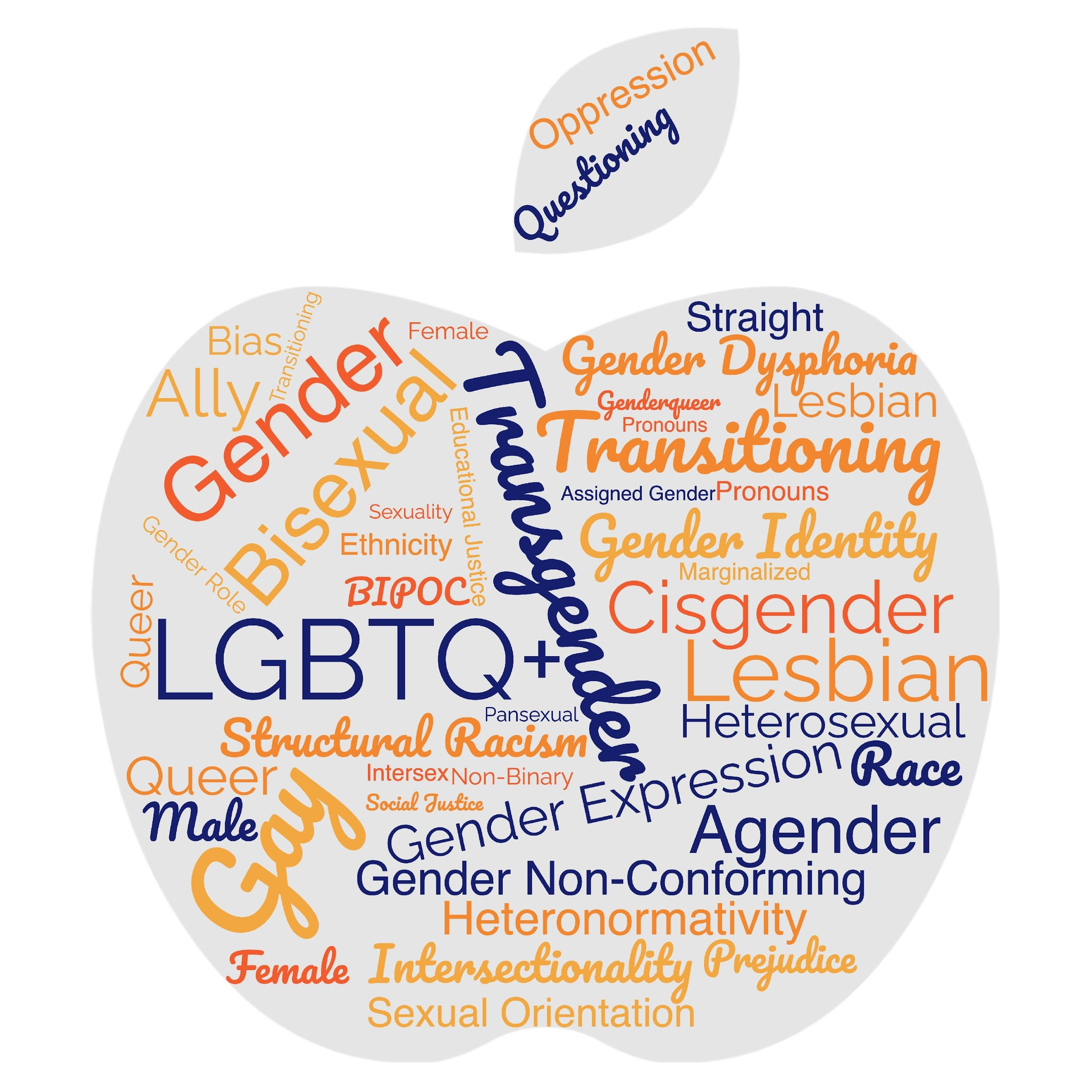
Turn and Talk
What makes a word a slur?

Slide 53
LGBTQ+ Terminology
Terminology Four Corners
On the slide will be the definition of LGBTQ+ terminology along with 4 possible options for words.
Get up and move to the corner that matches the word you think correctly matches the definition.
Notes:
Terminology Handout

Slide 54
LGBTQ+ Terminology
Terminology Four Corners-
How to find the answer?
You already know.
Use context clues.
Ask someone in the room that you trust.
(Yes, conversation is allowed and encouraged).
Notes:
Terminology Handout

Slide 55
LGBTQ+ Terminology
An internal, deeply felt sense of being female, male, a blend of both, or neither. Refers to how individuals perceive themselves and what they call themselves. Can be the same as or different from their sex assigned at birth.
A- Gender Identity
B- Gender Fluid
C- Gender Expression
D- Gender Queer
Notes:
Terminology Handout

Slide 56
LGBTQ+ Terminology
An internal, deeply felt sense of being female, male, a blend of both, or neither. Refers to how individuals perceive themselves and what they call themselves. Can be the same as or different from their sex assigned at birth.
A- Gender Identity
Notes:
Terminology Handout

Slide 57
LGBTQ+ Terminology
A teaching methodology focused on identity, diversity, justice, and action. ABAR pedagogy helps students develop a strong sense of self-worth, empathize with others, learn the impact of unfairness, and take action when they observe, or experience injustice.
A- Non-Binary
B- LGBTQ+
C- Transgender/Trans
D- Anti-Bias Anti-Racist (ABAR)
Notes:
Terminology Handout

Slide 58
LGBTQ+ Terminology
A teaching methodology focused on identity, diversity, justice, and action. ABAR pedagogy helps students develop a strong sense of self-worth, empathize with others, learn the impact of unfairness, and take action when they observe, or experience injustice.
D- Anti-Bias Anti-Racist (ABAR)
Notes:
Terminology Handout

Slide 59
LGBTQ+ Terminology
An adjective describing a person who does not identify exclusively as a woman or a man. They may identify as both, somewhere in between, or outside the categories of a woman and a man.
A- Intersex
B- Transgender/Trans
C- Gender Expression
D- Non-Binary
Notes:
Terminology Handout

Slide 60
LGBTQ+ Terminology
An adjective describing a person who does not identify exclusively as a woman or a man. They may identify as both, somewhere in between, or outside the categories of a woman and a man.
D- Non-Binary
Notes:
Terminology Handout

Slide 61
LGBTQ+ Terminology
A broad term referring to people who do not behave in a way that conforms to the traditional expectations of their gender or whose gender expression does not fit neatly into a category.
A- Gender Fluid
B- Gender Expression
C- Transgender/Trans
D- Gender Non-Conforming
Notes:
Terminology Handout

Slide 62
LGBTQ+ Terminology
A broad term referring to people who do not behave in a way that conforms to the traditional expectations of their gender or whose gender expression does not fit neatly into a category.
D- Gender Non-Conforming
Notes:
Terminology Handout

Slide 63
LGBTQ+ Terminology
A modern umbrella term used across the U.S. Native American and Canadian First Nations communities to describe Native people who fulfill a traditional third-gender or gender-variant ceremonial and social role in their cultures. Because being Two-Spirit also denotes one’s spirituality, not all transgender or non-binary Indigenous people consider themselves to be Two-Spirit. It is not a term appropriate for a non-Native person to use for their own identity. It’s an Indigenous term, thereby open solely to Indigenous community members.
Notes:
Terminology Handout

Slide 64
LGBTQ+ Terminology
A- Bisexual/Bi+
B- Two-Spirit
C- Intersex
D- Lesbian
Notes:
Terminology Handout

Slide 65
LGBTQ+ Terminology
B- Two-Spirit
Notes:
Terminology Handout

Slide 66
LGBTQ+ Terminology
Terminology Four Corners
Continuing from here you no longer need to move to the correct answer.
Stay at your table and discuss the options.
When you come to an agreement hold up the letter that correctly matches the word to the definition.
Notes:
Terminology Handout

Slide 67
LGBTQ+ Terminology
A term that describes a person whose gender identity aligns with the sex assigned to them at birth.
A- Agender
B- Cisgender
C- Gender Fluid
D- Transgender/Trans
Notes:
Terminology Handout

Slide 68
LGBTQ+ Terminology
A term that describes a person whose gender identity aligns with the sex assigned to them at birth.
B- Cisgender
Notes:
Terminology Handout

Slide 69
LGBTQ+ Terminology
A term used to describe someone who is actively supportive of LGBTQ+ people. It encompasses straight and cisgender allies and those within the LGBTQ+ community who support each other (e.g., a lesbian who is an ally to the bisexual community).
A- Queer
B- Genderqueer
C- Ally
D- Gender Expression
Notes:
Terminology Handout

Slide 70
LGBTQ+ Terminology
A term used to describe someone who is actively supportive of LGBTQ+ people. It encompasses straight and cisgender allies and those within the LGBTQ+ community who support each other (e.g., a lesbian who is an ally to the bisexual community).
C- Ally
Notes:
Terminology Handout

Slide 71
LGBTQ+ Terminology
A term that describes a person who is emotionally, romantically, or sexually attracted to people of more than one gender, sex, or gender identity.
A- Bisexual/Bi+
B- Intersex
C- Gay
D- Two-Spirit
Notes:
Terminology Handout

Slide 72
LGBTQ+ Terminology
A term that describes a person who is emotionally, romantically, or sexually attracted to people of more than one gender, sex, or gender identity.
A- Bisexual/Bi+
Notes:
Terminology Handout

Slide 73
LGBTQ+ Terminology
A term that describes a person who is emotionally, romantically, or sexually attracted to some members of the same gender.
A- Sexual Orientation
B- Transgender/Trans
C- Gay
D- Intersex
Notes:
Terminology Handout

Slide 74
LGBTQ+ Terminology
A term that describes a person who is emotionally, romantically, or sexually attracted to some members of the same gender.
C- Gay
Notes:
Terminology Handout

Slide 75
LGBTQ+ Terminology
A term that describes the clinically significant distress a person experiences when their assigned birth gender does not match their gender identity. According to the American Psychiatric Association’s Diagnostic and Statistical Manual of Mental Disorders (DSM), the term—which replaces Gender Identity Disorder—“is intended to better characterize the experiences of affected children, adolescents, and adults.”
A- Intersex C- Transgender/Trans
B- Gender Queer D- Gender Dysphoria
Notes:
Terminology Handout

Slide 76
LGBTQ+ Terminology
A term that describes the clinically significant distress a person experiences when their assigned birth gender does not match their gender identity. According to the American Psychiatric Association’s Diagnostic and Statistical Manual of Mental Disorders (DSM), the term—which replaces Gender Identity Disorder—“is intended to better characterize the experiences of affected children, adolescents, and adults.”
D- Gender Dysphoria
Notes:
Terminology Handout

Slide 77
LGBTQ+ Terminology
The external appearance of one’s gender identity, usually expressed through behavior, clothing, haircut, or voice, that may or may not conform to socially defined behaviors and characteristics typically associated with being either feminine or masculine.
A- Gender Expression
B- Intersex
C- Gender Non-Conforming
D- Queer
Notes:
Terminology Handout

Slide 78
LGBTQ+ Terminology
The external appearance of one’s gender identity, usually expressed through behavior, clothing, haircut, or voice, that may or may not conform to socially defined behaviors and characteristics typically associated with being either feminine or masculine.
A- Gender Expression
Notes:
Terminology Handout

Slide 79
LGBTQ+ Terminology
An acronym for “lesbian, gay, bisexual, transgender, and queer.” The “+” represents additional gender identities and sexual orientations that include intersex, agender, and asexual, among many others.
A- Gender Expression
B- Queer
C- LGBTQ+
D- Non-Binary
Notes:
Terminology Handout

Slide 80
LGBTQ+ Terminology
An acronym for “lesbian, gay, bisexual, transgender, and queer.” The “+” represents additional gender identities and sexual orientations that include intersex, agender, and asexual, among many others.
C- LGBTQ+
Notes:
Terminology Handout

Slide 81
LGBTQ+ Terminology
A woman who is emotionally, romantically, and/or sexually attracted to women. This includes cis, trans, and other people who are women.
A- Lesbian
B- Sexual Orientation
C- Gender Non-Conforming
D- Cisgender
Notes:
Terminology Handout

Slide 82
LGBTQ+ Terminology
A woman who is emotionally, romantically, and/or sexually attracted to women. This includes cis, trans, and other people who are women.
A- Lesbian
Notes:
Terminology Handout

Slide 83
LGBTQ+ Terminology
An inherent or immutable enduring emotional, romantic, or sexual attraction to other people.
A- Gay
B- Gender Expression
C- Sexual Orientation
D- Agender
Notes:
Terminology Handout

Slide 84
LGBTQ+ Terminology
An inherent or immutable enduring emotional, romantic, or sexual attraction to other people.
C- Sexual Orientation
Notes:
Terminology Handout

Slide 85
LGBTQ+ Terminology
An umbrella term for people whose gender identity and/or expression is different from cultural expectations based on the sex they were assigned at birth. Being transgender does not imply any specific sexual orientation.
A- Gender Queer
B- Transgender/Trans
C- Gender Fluid
D- Two-Spirit
Notes:
Terminology Handout

Slide 86
LGBTQ+ Terminology
An umbrella term for people whose gender identity and/or expression is different from cultural expectations based on the sex they were assigned at birth. Being transgender does not imply any specific sexual orientation.
B- Transgender/Trans
Notes:
Terminology Handout

Slide 87
LGBTQ+ Terminology
Describes someone who has the potential for emotional, romantic or sexual attraction to people of any gender though not necessarily simultaneously, in the same way or to the same degree. Sometimes used interchangeably with bisexual.
A- Gender fluid
B- Intersex
C- Pansexual
D- Gender Non-Conforming
Notes:
Terminology Handout

Slide 88
LGBTQ+ Terminology
Describes someone who has the potential for emotional, romantic or sexual attraction to people of any gender though not necessarily simultaneously, in the same way or to the same degree. Sometimes used interchangeably with bisexual.
C- Pansexual
Notes:
Terminology Handout

Slide 89
LGBTQ+ Terminology
A term people often use to express fluid identities and orientations. This term is often used interchangeably with “LGBTQ+.”
A- Intersex
B- Pansexual
C- Non-Binary
D- Queer
Notes:
Terminology Handout

Slide 90
LGBTQ+ Terminology
A term people often use to express fluid identities and orientations. This term is often used interchangeably with “LGBTQ+.”
D- Queer
Notes:
Terminology Handout

Slide 91
LGBTQ+ Terminology
Describes a person who does not have a gender.
A- Gender Fluid
B- Agender
C- Intersex
D- Pansexual
Notes:
Terminology Handout

Slide 92
LGBTQ+ Terminology
Describes a person who does not have a gender.
B- Agender
Notes:
Terminology Handout

Slide 93
LGBTQ+ Terminology
A person who does not identify with a single fixed gender or has a fluid or unfixed gender identity.
A- Intersex
B- Pansexual
C- Gay
D- Gender fluid
Notes:
Terminology Handout

Slide 94
LGBTQ+ Terminology
A person who does not identify with a single fixed gender or has a fluid or unfixed gender identity.
D- Gender fluid
Notes:
Terminology Handout

Slide 95
LGBTQ+ Terminology
…..... people typically reject notions of static categories of gender and embrace a fluidity of gender identity and often, though not always, sexual orientation. People who identify as this may see themselves as being both male and female, neither male nor female or as falling completely outside these categories.
A- Intersex C- Gender Identity
B- Gender Queer D- Gender Fluid
Notes:
Terminology Handout

Slide 96
LGBTQ+ Terminology
…..... people typically reject notions of static categories of gender and embrace a fluidity of gender identity and often, though not always, sexual orientation. People who identify as "genderqueer" may see themselves as being both male and female, neither male nor female or as falling completely outside these categories.
B- Gender Queer
Notes:
Terminology Handout

Slide 97
LGBTQ+ Terminology
…. people are born with a variety of differences in their sex traits and reproductive anatomy. There is a wide variety of difference among variations, including differences in genitalia, chromosomes, gonads, internal sex organs, hormone production, hormone response, and/or secondary sex traits.
A- Intersex C- Non-Binary
B- Gender Queer D- Transgender/Trans
Notes:
Terminology Handout

Slide 98
LGBTQ+ Terminology
…. people are born with a variety of differences in their sex traits and reproductive anatomy. There is a wide variety of difference among intersex variations, including differences in genitalia, chromosomes, gonads, internal sex organs, hormone production, hormone response, and/or secondary sex traits.
A- Intersex
Notes:
Terminology Handout

Slide 99
Terminology Debrief
Let’s Ask the Room Debrief
What surprised you?
What is your biggest opportunity for growth?
Who has a helpful “hint”?
What else may you need?
Tomorrow we are going to talk about the Q in the LGBTQ+
Notes:
2:00-2:30

Slide 100
Language Changes
Terminology around race and ethnicity changes every 10 years.
Terminology around gender, identity, and sexual orientation changes every 2 years.

Slide 101
Turn and Talk
Words you might hear on the tour...be prepared.
Oppressed communities are not monoliths. Ask don't assume.

Slide 102
Key Ideas
Terminology matters in making sure that people feel seen and included in spaces.
The lived experience of someone is more important than what you think you know.
These terms change rapidly.
We can never assume we have mastered these concepts.
We need to continue to be humble and learn!

Slide 103
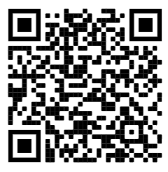
15 Minute Break!
Break time!
Ok… so all this means the sex ed we were taught is outdated and excludes a whole bunch of identities. Check out this website of best practices for talking with kids about sex.
(You might learn something new, too!)
https://sexpositivefamilies.com/10-best-sex-ed-resources-for-families/

Slide 104
Jeny

Slide 105


Transgender Terminology
Transgender
Binary
Trans man
Trans woman
Non-Binary
Genderqueer
Genderfluid
Bigender
Demiboy
Demigirl
Agender
Neutrois
…and more!
105
Notes:
Language in the LGBTQ+ communities changes very quickly. Language in ethnic communities changes about every ten years while language in the LGBTQ+ communities changes about every two years.
Transgender/Trans: This is an umbrella term for people whose gender identity and/or expression is different from cultural expectations based on the sex they were assigned at birth. Being transgender does not imply any specific sexual orientation. Both binary and non-binary genders and gender expressions fall under the umbrella.
Often, we hear transphobic comments when the appearance of Black and Brown bodies are compared to white/Eurocentric views of femininity. For example, internet conspiracy theories have long criticized the natural muscular frame of tennis superstar Serena Williams, and even former First Lady Michelle Obama. Obviously, these comparisons are harmful, and are just one example of how hate, prejudice and fear show up.

Slide 106

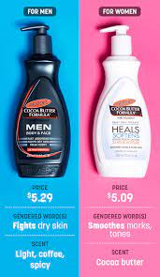
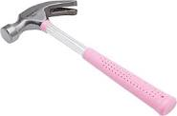

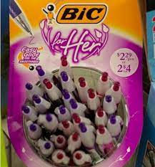
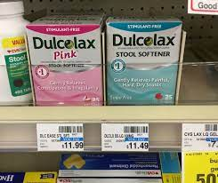
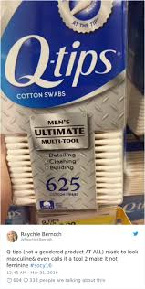
Turn and Share
Notes:
Turn and share gendered items (drinks, clothing, appearance) How embedded is binary in society?- ideas from media: Magazine, advertising, stores

Slide 107
Debrief
    What surprised you?
    What didn’t surprise you?
    How are you benefiting from our gender binary?
    How are you harmed by gender binary?
Notes:
Have we thought about the cost difference as well?

Slide 108
Key Ideas
We have a rigidly enforced gender binary that we experience in our day to day lives.
Everyone deviates from gendered expectations in some ways.
Folks under the transgender umbrella face oppression from these rigid social expectations.

Slide 109
Jeny & Barb

Slide 110

The Gender Unicorn pg. 25
110
Notes:
The Gender Unicorn is a popular way to help explain gender that was developed by Trans Student Educational Resources. You may be familiar with the “Genderbread Person,” but we choose not to use it. It was created by a Black trans woman, but someone else popularized it, and continues to get credit, pay and notoriety for it.
As you see, the Gender Unicorn highlights gender identity, expression, sex assigned at birth, and physical and emotional attraction.
Children learn that there are two groups—boys and girls—and that they fit into one or the other based on how their bodies are made. They are then socialized to accept specific gender norms and stereotypes, which are ways of behaving, based on this gender assigned at birth.
There’s increasing understanding that gender is more than a binary division. The spectrum of gender identity is becoming more widely accepted and gender expression is more expansive.
However, there are challenges to looking at gender beyond male and female. Across states, many laws and policies are being passed that affirm or harm individuals outside of the gender binary.

Slide 111
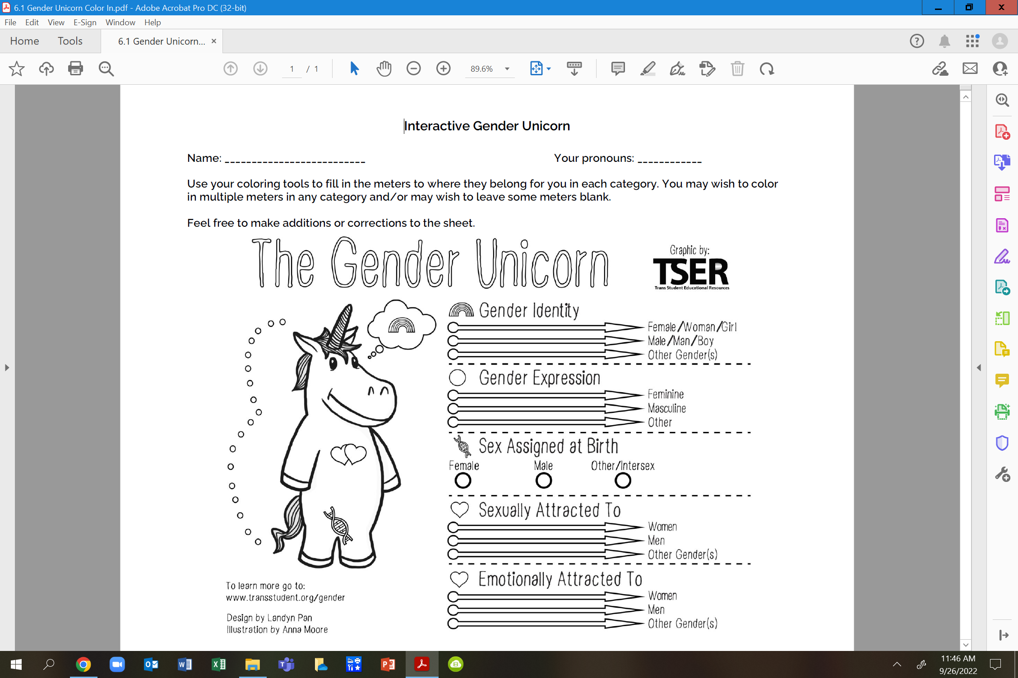
Your Turn... pg. 26

Slide 112
Debrief
What is clearer to you?
Do you feel you can find yourself here?
Do you feel there is any nuance that may be missing?

Slide 113
Key Ideas
Our society reinforces the gender and sex binary – this is a construct
These are spectrums
These are separate categories and the way YOU present/identify in one is not an automatic indication of how you present/identify in another

Slide 114
Ben

Slide 115
Pronoun Practice Exercise
Partner up
Share a story of a friend
Replace binary pronouns with they/them
Listener should correct every pronoun error
Pronouns Guide is on pg. 4-5
Notes:
10:30-10:45 Ben

Slide 116
Key Ideas
Using someone's correct pronouns is an important way to show respect.
It is on us to get good at this.
Using someone's name or neutral pronouns is the most respectful approach if you don't know.

Slide 117
Ellen

Slide 118

Ending It Right
How does YOUR learning from today inform your work with members?
How might we inadvertently cause well-intentioned harm?
How can we prevent that?

Slide 119
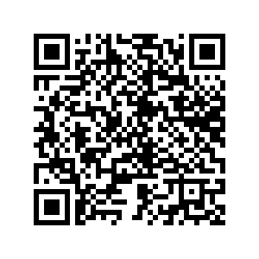
Ending It Right
Tomorrow- panel discussion

Slide 120

Choice Networking Time

Slide 121
Entry Activity-Mapping
Place a dot on the map showing where you are from
Notes:
Grat - 9:30-10:00

